Slide 1

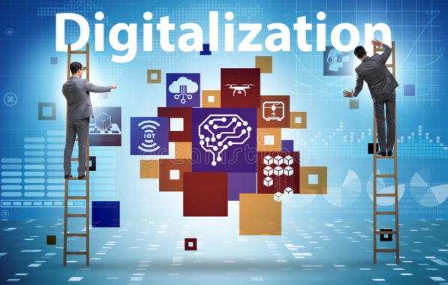



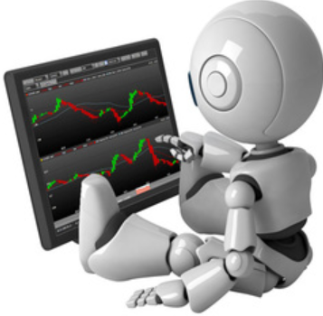


AI's role in digitalization of research:
from linked data to digital clones
Vagan Terziyan
“Collective Intelligence” research group,
Faculty of Information Technology, University of Jyväskylä
Science Council / Evening School / Development Workshop /
30th August, 2021; 1:30-4 pm

Slide 2
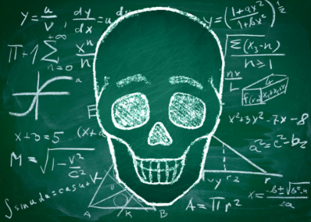
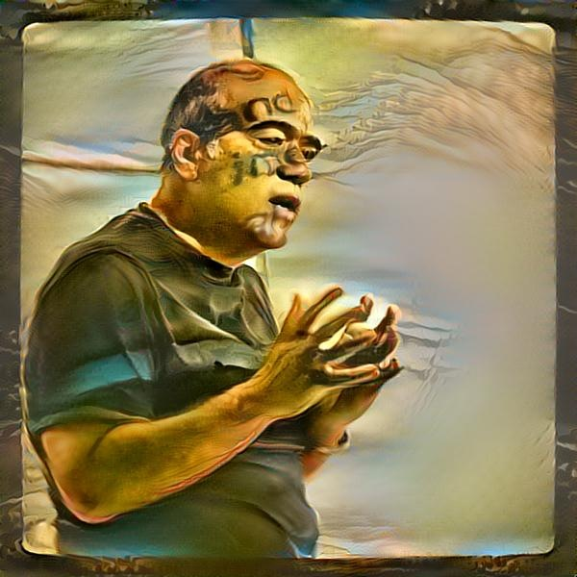


The lecturer today
AI+MATH
Vagan Terziyan
Professor: Distributed Systems (University of Jyväskylä, Finland)
40+ years of research and teaching experience in AI …
Head of: Collective Intelligence research group
Head of International Master Programs:
WISE: “Web Intelligence and Service Engineering”
COIN: “Cognitive Computing and Collective Intelligence”
Background: Applied Mathematics; Artificial Intelligence
Interests: AI: machine (deep) learning, linked data & ontology engineering & semantic technologies, agent technologies & multi-agent systems , cyber-physical systems, Industry 4.0, smart everything, cognitive computing, collective (collaborative) intelligence, cybersecurity & digital immunity & digital vaccination, digital “cloning” of humans and systems, …

Slide 3
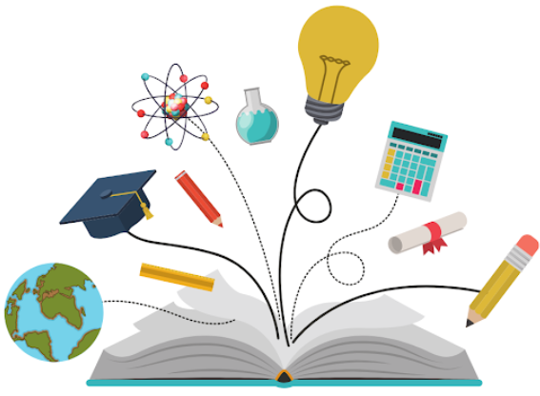

Artificial Intelligence (AI) Facets
AI-Driven Research Digitalization Schema
Top-Down AI (“symbolic”, human-driven, explicit, explainable …)
Bottom-up AI (“statistical”, Machine Learning-driven, com-putational, “black-box”)
Autonomous AI (self-managed, agent-driven, ubiquitous, collaborative, AGI …)
Layer of Smart and Secure Processes: Collective Intelligence Layer
Layer of Smart Artifacts: Self-Management Layer
Digitalization Layers
Layer of Linked Artifacts: Semantic Layer

Slide 4
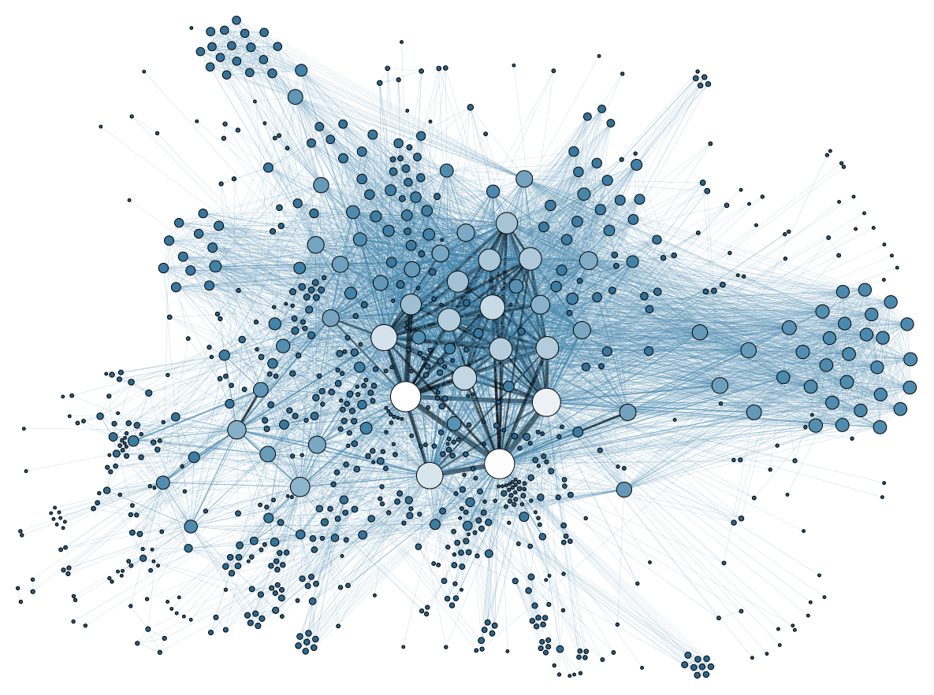

A Layer of Linked Artifacts: Semantic Layer …
… is the best known AI-driven way to structure and standardize the content from research and research digitalization processes for internal and external use …

Slide 5
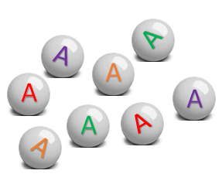
Semantic Layer (1): Collecting digital evidence on artifacts (research data)
Collected Evidence

Slide 6

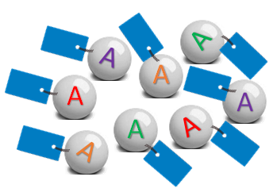
Semantic Layer (2): Labelling (tagging) digital evidence
Collected Evidence
Labelled Evidence

Slide 7

Semantic Layer (3): Formalization of (explicit & explainable) inference rules
Collected Evidence
Inference
XAI – Explainable Artificial Intelligence
Labelled Evidence

Slide 8
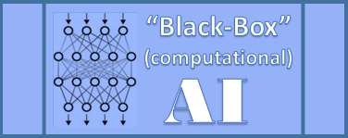
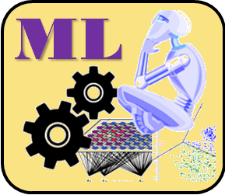
Semantic Layer (4): Automatic (“black-box”) inference model creation (Machine Learning)
Collected Evidence
Inference
Labelled Evidence

Slide 9
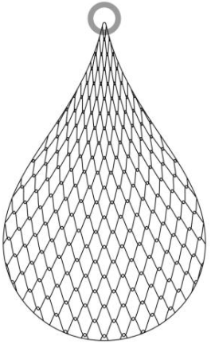

ML
1
Collecting evidence: Researcher has collected some evidence regarding various artifacts …
A
A
A
A
A
A
A
A

Slide 10

F
ML
Tagged evidence OR labelled data OR declarative knowledge
A
A
A
A
A
A
A
A
2
A
Tagging evidence: Researcher is using his or her hidden personal skill F to “tag” the evidence (declarative knowledge creation)…
A
A
A
A
A
A
A

Slide 11

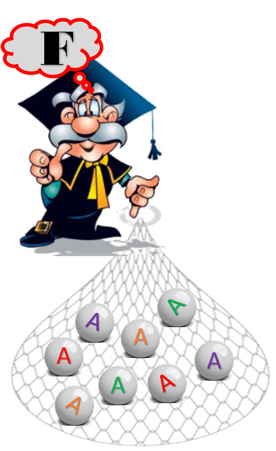


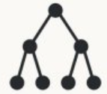


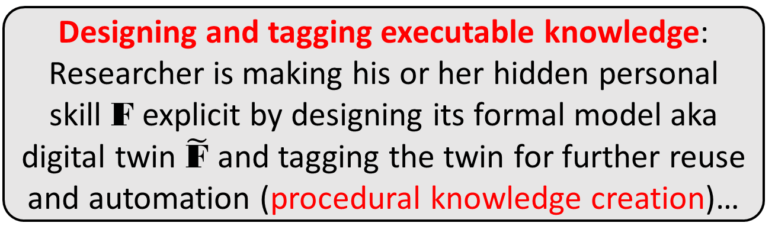


$$\tilde{\text{F}}≈\text{F}$$
ML
$$\tilde{\text{F}}$$
3
Designing and tagging executable knowledge: Researcher is making his or her hidden personal skill F explicit by designing its formal model aka digital twin $\tilde{\text{F}}$ and tagging the twin for further reuse and automation (procedural knowledge creation)…

Slide 12

$$\tilde{\text{F}}≈\text{F}$$
ML
$$\tilde{\text{F}}$$
$$\tilde{\text{F}}$$
4
Automatic work of executable knowledge: After being trained, the executable models are capable of automated tagging of new (previously unseen) artifacts …

Slide 13
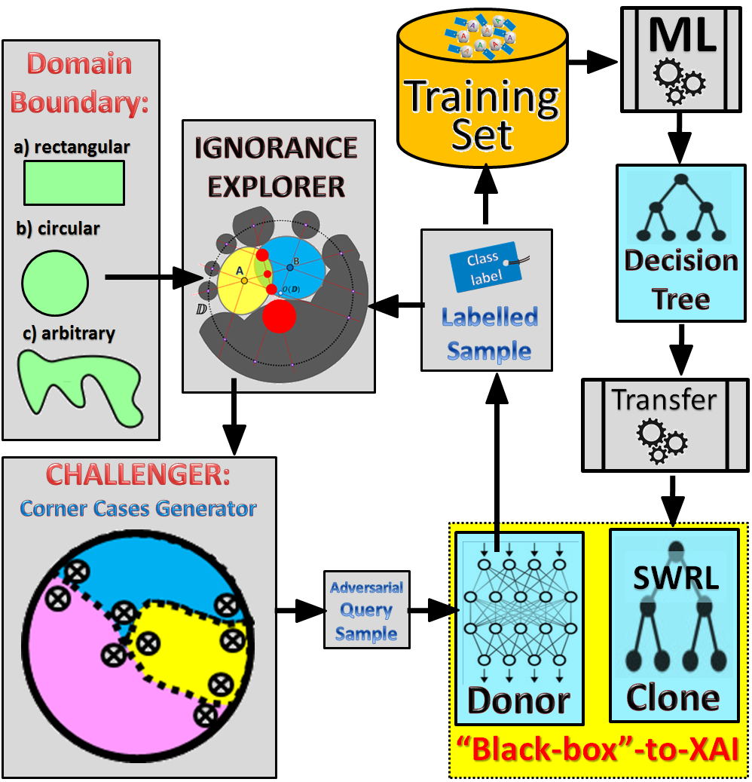
Semantic Layer (5): Automatic translation (CAI -> XAI) and integration of inference models
Collected Evidence
Inference
Labelled Evidence
“Black-Box” AI to XAI transformation

Slide 14
Semantic Layer (6): Automatic inference, reasoning and new knowledge creation
Collected Evidence
Inference
Inferred Evidence
Labelled Evidence

Slide 15

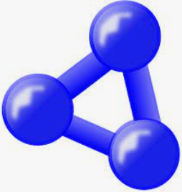
Semantic Layer (7): Designing ontology as a research domain knowledge model
Collected Evidence
Inference
Inferred Evidence
Ontology
Labelled Evidence

Slide 16
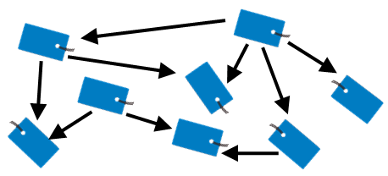
Semantic Layer (8): Linking data, knowledge and models using ontology
Collected Evidence
Inference
Inferred Evidence
Ontology
Linked Artifacts
Labelled Evidence

Slide 17
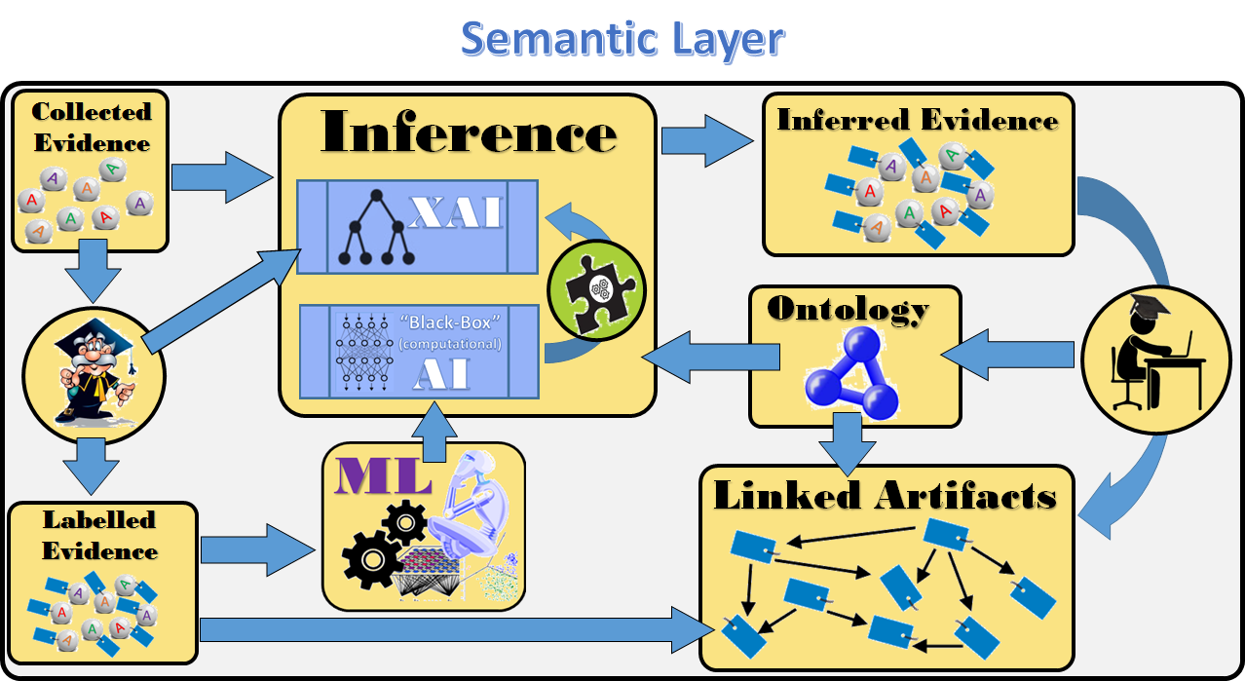
“Why” and “How” Semantic Layer (in research digitalization schema)?
HOW?
Top-Down AI
WHY?
If you want to learn fast how to use available tools to design ontologies within your domain, link data and knowledge, design and execute inference rules, etc., please join our course for all (no prerequisites, no special background):
Automation (users of content are not only humans but programs as well, which can automatically find, understand and process the content);
Integration (possibility to integrate heterogeneous research content into integrated and executable format);
Interoperability (possibility to link distributed research content internally and externally and enable external tools to jointly and seamlessly work on it);
Reuse (research discoveries, data, knowledge, models, etc. remain longer in use for the research community).
ITKS5440: Semantic Web and Linked Data (5 ECTS)
http://www.cs.jyu.fi/ai/vagan/AI_Courses_Vagan_Terziyan.htm

Slide 18

Self-management Layer (1): Artifacts are “smart” (agent-driven)
A
Each digitalized and semantically tagged research artifact (A) will be supplied with the autonomous manager (software robot / agent) who is aware of A, will “take care” of A and works as a smart interface of A:
  Knows how to use A (query, execute, etc.);
  Capable of advertising (promoting) A across the internal and external networks;
  Capable of linking A with other artifacts;
  Capable of maintaining and updating A;
  Responsible for security and privacy of A;
  Capable of communicating issues related to A with the users, other agents or external programs…
A
A
A

Slide 19
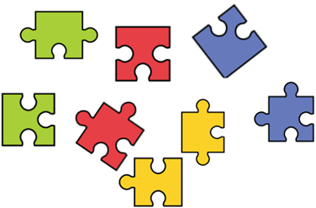



Self-management Layer (2): Benefits of smart artifacts
(self-management, internal and external
autonomous communication, networking
and collaboration)
A
Software
A
External agents
A
A
A
A
A
Users
A

Slide 20
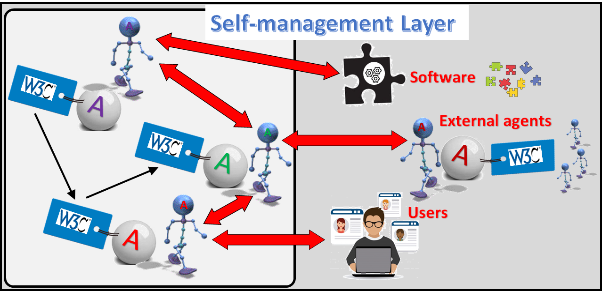
“Why” and “How” Self-Management Layer (in research digitalization schema)?
HOW?
Autonomous AI
WHY?
If you want to learn fast how to use available methods and tools to design autonomous agents (software robots) within your domain, please join our course for all (no prerequisites, no special background):
Self management (software robots or agents are self-aware and capable of self-configuration, self-optimization, self-protection and self-healing);
Ubiquity (the same agent can synchronously take part in several processes 24/7 without control from humans);
Efficiency (agents are very efficient in their use of computational and time resources);
Collaboration (agent tools and platforms support communication, networking and collaboration);
Smartness (agents are not preprogrammed to do things, they are capable of planning and reasoning).
TIES4530: Collective Intelligence and Agent Technology (5 ECTS)
http://www.cs.jyu.fi/ai/vagan/AI_Courses_Vagan_Terziyan.htm

Slide 21
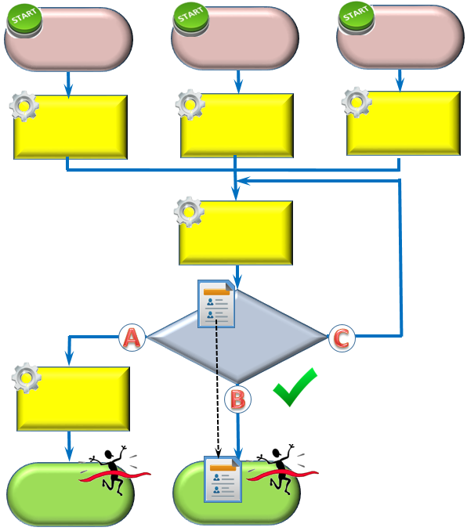


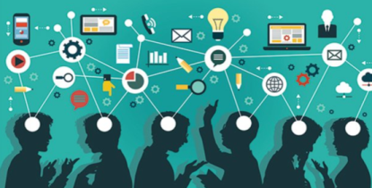

Collective Intelligence Layer (1): Layer of smart and secure processes
Collective Intelligence
(collaborative [human + AI])
Digitalized and smart research-related business processes driven by collaborative intelligence

Slide 22


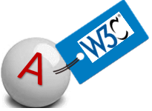
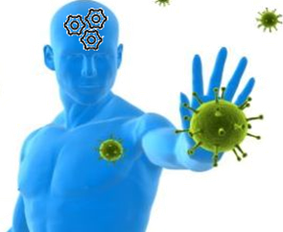
Collective Intelligence Layer (2): The main smart assets
Collective Intelligence
(collaborative [human + AI])
Software robots
Humans
Digital Clones of Humans
Digital Immunity
Heterogeneous, smart, autonomous and collaborating players

Slide 23

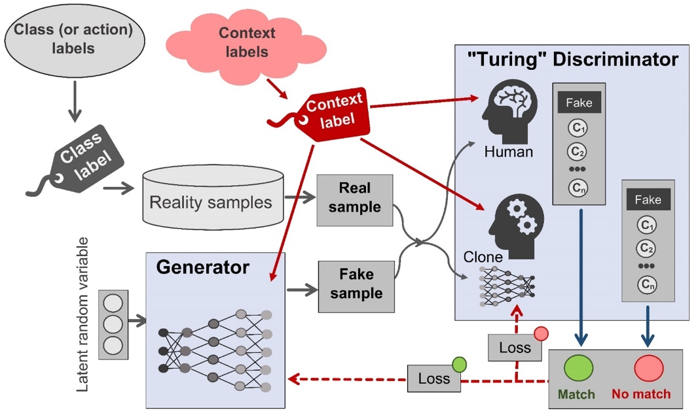
Collective Intelligence Layer (3): Digital clones of humans and digital immunity
Digital Cloning
Digital Immunity
Unique adversarial training techniques for digital cloning of humans and training digital immunity by digital vaccination

Slide 24
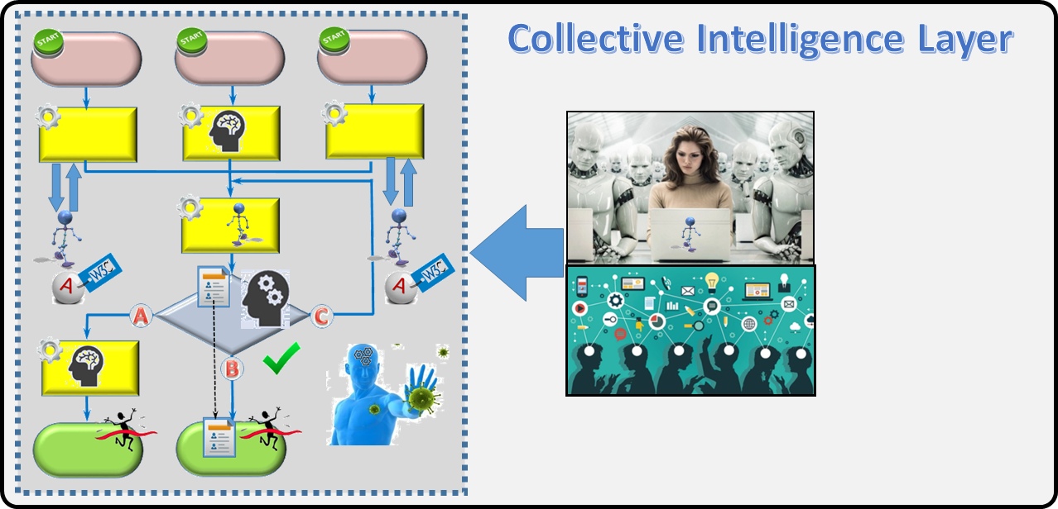


“Why” and “How” Collective Intelligence Layer (in research digitalization schema)?
HOW?
WHY?
Bottom-Up (Computational) AI
If you want to learn fast how to use available methods and tools to design and train collective intelligence for smart and secure processes within your domain based on Machine Learning, Neural Networks, Cognitive Computing and Adversarial Training, please join our course for all (no prerequisites, no special background):
Responsibility (cloning technology enables responsible behavior of designed clones of humans);
Ubiquity of humans (the same human can synchronously take part in several processes 24/7 due to own digital clones);
Transparency (processes run with highest level of transparency, awareness and involvement);
Security and resilience (processes can be digitally vaccinated against external intrusions, manipulations with data and knowledge, corruption, etc. …);
Effectiveness (smart artificial components combined with humans improve quality of the processes).
TIES4910: Deep Learning for Cognitive Computing. Theory (5 ECTS)
http://www.cs.jyu.fi/ai/vagan/AI_Courses_Vagan_Terziyan.htm

Slide 25





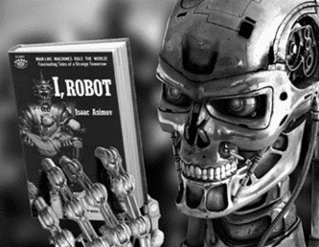

Collaboration
Digital cloning
Prof. Tuure Tuunanen
Value Creation for Cyber-Physical Systems and Services
Prof. Vagan Terziyan
Collective Intelligence Group
Cybersecurity
Prof. Timo Hamalainen
Software and Communications Engineering Division
Machine Learning
Agent-Based Systems
Department of AI (UKRAINE)
Kharkiv National University of Radioelectronics
Prof. Timo Tiihonen
Computational Science Division

Slide 26
Concluding remark
Such layered AI-Driven digitalization schema could be unique not only locally but also globally …
Semantic Layer
… This could be an opportunity, in which University of Jyväskylä could take a leadership role …

Slide 27
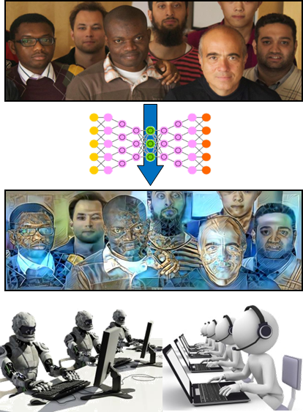

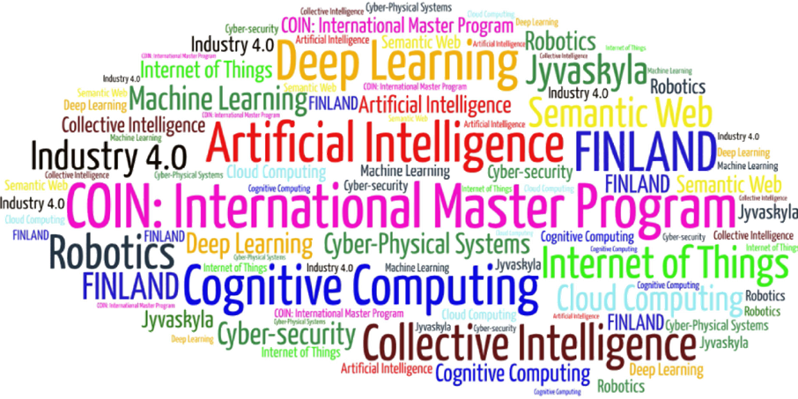
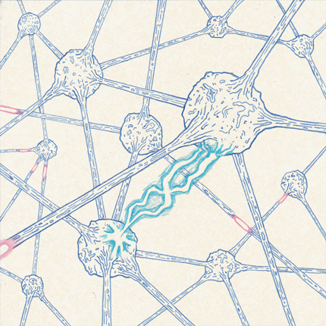
Come to study at our International Master Program
COIN: Cognitive Computing and Collective Intelligence …
… the first university program for collective intelligence, where humans learn together with their digital clones and autonomous digital assistants …
http://www.jyu.fi/coin
COIN

Slide 28


Link to the presentation: http://www.cs.jyu.fi/ai/AI_Digitalization.pptx
AI
Contact: vagan.terziyan@jyu.fi

