Slide 1
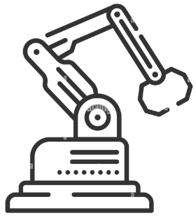
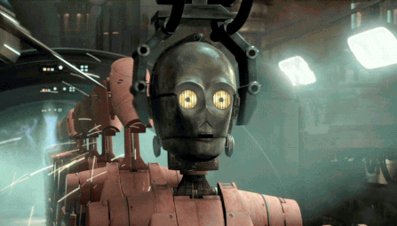
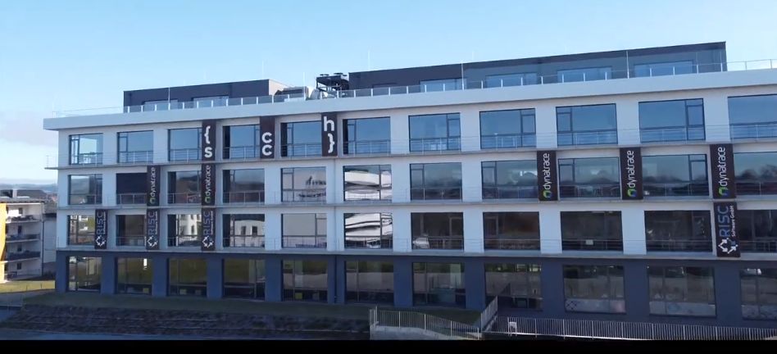
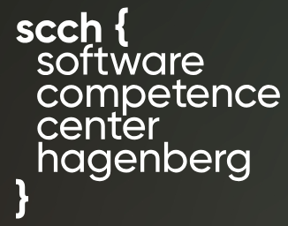
“Adversarial Analytics – Adversarial Maintenance – Adversarial AI:
A New Bermuda Triangle?”
Vagan Terziyan
Hagenberg Prescriptive Analytics Days 2024
(11:00 - 11:40, April 4, 2024)

Slide 2
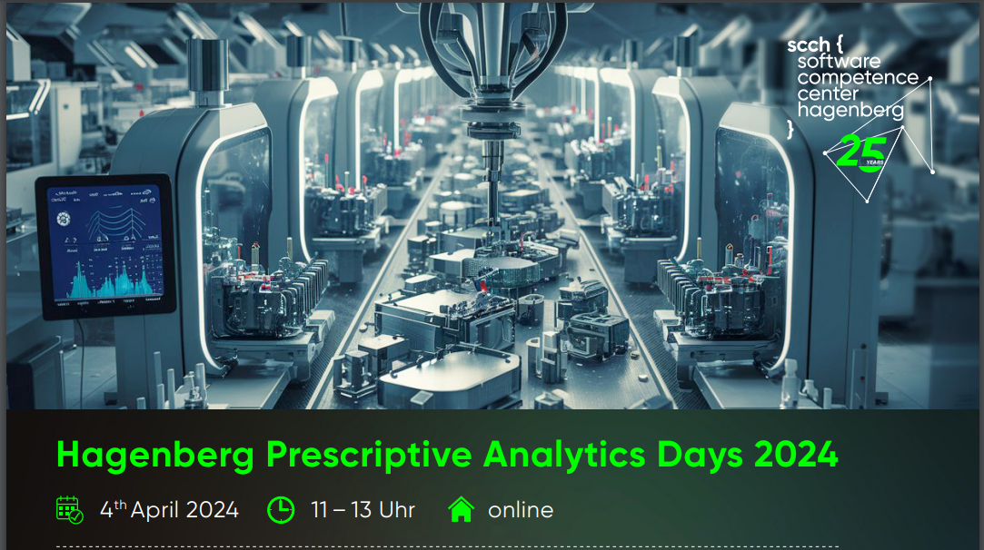
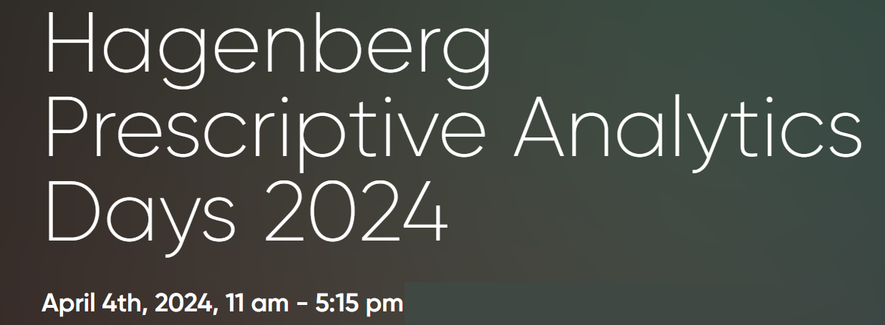
INTRODUCTION (Florian Sobieczky)
“… It has become a standard method in the production and service industries to use trained Machine Learning models for the prediction of anomalous events such as breakdowns or deviations from the regular process mode. Prescriptiveness has emerged as a generalization of this procedure: It means "Reporting of the patterns of the favorable instances" - and refers to deducing and providing not only the prediction of process anomalies - but also the capability of controlling the process parameters for maximizing advantageous effects - such as long production cycles, or a small number of cyber-attacks ...”

Slide 3
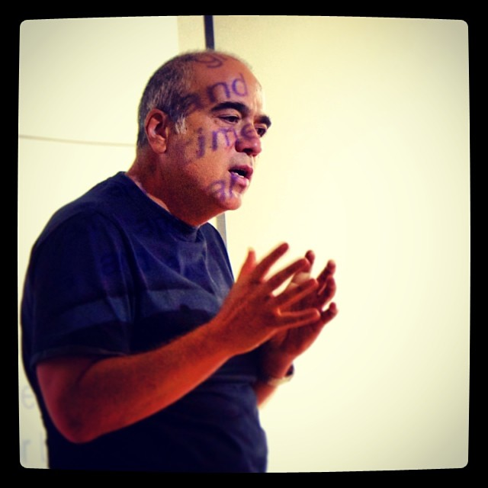
Adversarial Analytics – Adversarial Maintenance – Adversarial AI: A New Bermuda Triangle?
ABSTRACT:
This presentation invites you into the mysterious kingdom of adversarial technologies, including analytics, maintenance, and AI, where we explore the intricate interplay between security, reliability, robustness, resilience, and responsible autonomy. We briefly touch the challenges posed by adversaries in both the digital and physical worlds and discuss the hidden potential of proactive defense, risk awareness, and robustness in the era of AI. Going beyond traditional prescriptive maintenance principles, we navigate the uncharted waters of adversarial intelligence through the metaphorical “Bermuda Triangle” towards a safer and more resilient future.
Vagan Terziyan
Professor (Distributed Systems / AI)
Faculty of Information Technology,
University of Jyväskylä, FINLAND.
Head of Collective Intelligence research group.
Email: vagan.terziyan@jyu.fi
URL: https://ai.it.jyu.fi/vagan
Cite as:
Terziyan, V. (2024). Adversarial Analytics – Adversarial Maintenance – Adversarial AI: A New Bermuda Triangle? In: F. Sobieczky (ed.), Presentations of the Hagenberg Prescriptive Analytics Days 2024. Hagenberg, Austria, April 4, 2024. https://ai.it.jyu.fi/Adversarial_Analytics.pptx

Slide 4
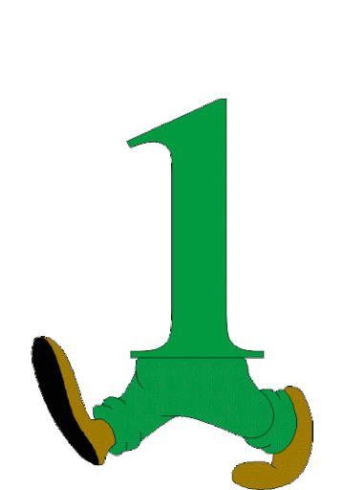
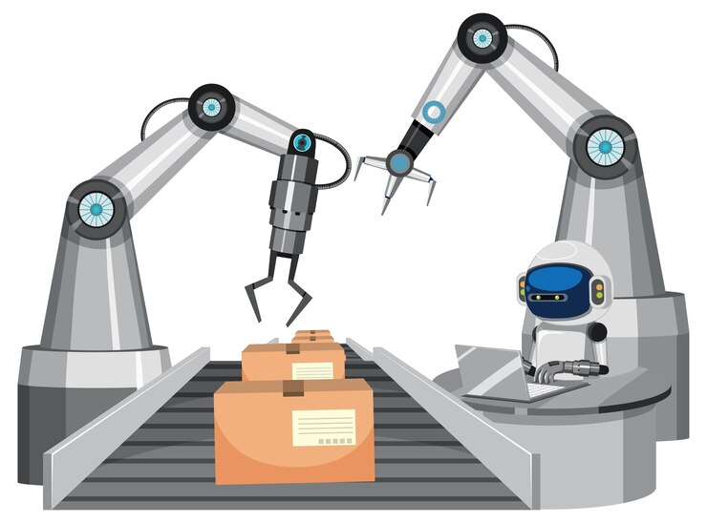
Contents
Artificial Intelligence: To be or not to be?
Industry 5.0: towards resilient collaborative (human + AI) intelligence.
Introducing Adversarial Maintenance
Humans’ vs AI’s security vulnerabilities: smart way to handle both.
“Digital cloning”: towards responsible AI, which enhances and secures (not replaces) humans.
“Digital immunity and vaccination”: adversarial training of resilience.
Knowledge-informed adversarial maintenance: collaborative immunity training.
Complementary Artificial Intelligence: Prepare to potential “disability” in advance.
Conclusions.
I am grateful to the anonymous photographers and artists, whose photos and pictures (available in the Internet) have been used in this presentation.

Slide 5
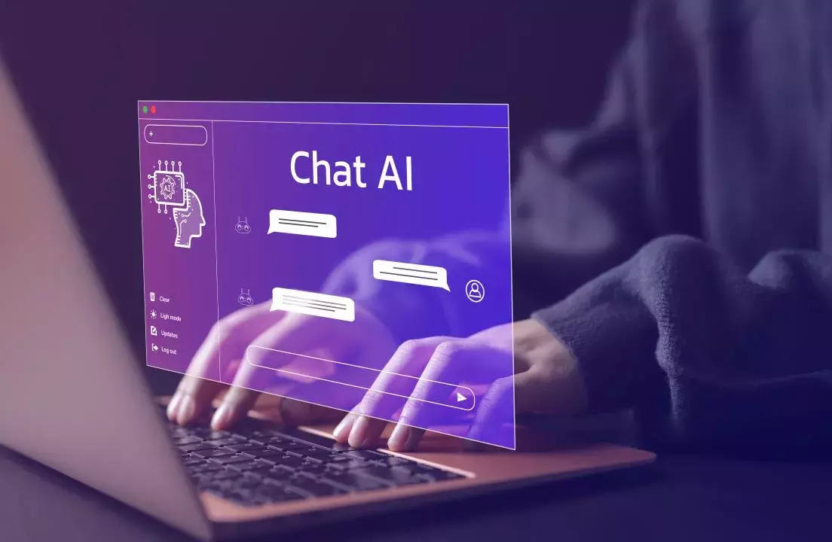
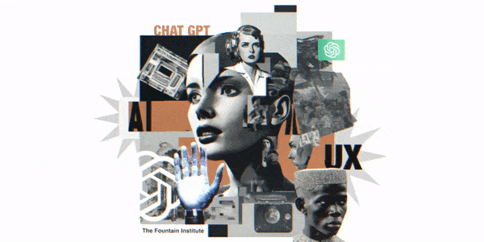
Instead Introduction:
Artificial Intelligence:
To be or not to be?

Slide 6
Responsible use of Artificial Intelligence … What is that?

Slide 7
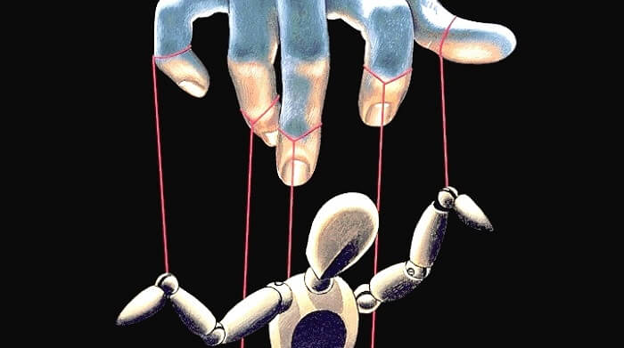
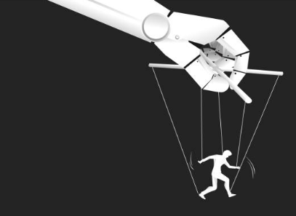
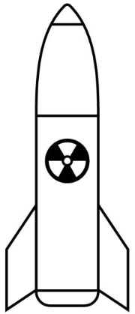
“We would rather be afraid of crazy people controlling smart AI than smart AI controlling crazy people.” [Vagan Terziyan, April 24, 2023]
$$≫$$

Slide 8
Check your logic … and see one of our research objectives
Person A is generally smarter than Person B.
See details in:
Terziyan, V. (2023). Digital Cloning: Towards Responsible Use of AI. In: P. Hartikainen (Ed.), Presentations of the KONE Cybersecurity Week. Espoo, Finland, October 23-28, 2023. https://ai.it.jyu.fi/KONE_AI_and_Cybersecurity.pptx
Person A is smarter than Person B as a user of AI.
Person A is smarter than Person B as a responsible user of AI.
Person C is a smartest one among all other humans.
See, when and if published:
Shukla, A.K., Terziyan, V., & Tiihonen, T. (2024, submitted). AI as a User of AI: Towards Responsible Autonomy. Heliyon. Cell Press.
Person C is a smartest one among all other humans as a responsible user of AI.
We can trust more to Person C among all other humans regarding the responsible use of AI.
IF TO ASSUME OR TO ADMIT: AI is smarter than any human, including Person C.
AI is smarter than any human as a responsible user of AI.
We can trust more to AI than to any other human regarding the responsible use of AI (i.e., AI-as-a-responsible user-of-itself).
RESPONSIBLE AUTONOMY
Self-Controlled Responsible Superintelligence with Human Face

Slide 9
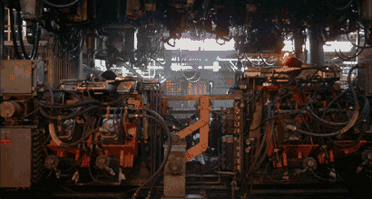
Industry 5.0:
towards resilient collaborative (human + AI) intelligence

Slide 10
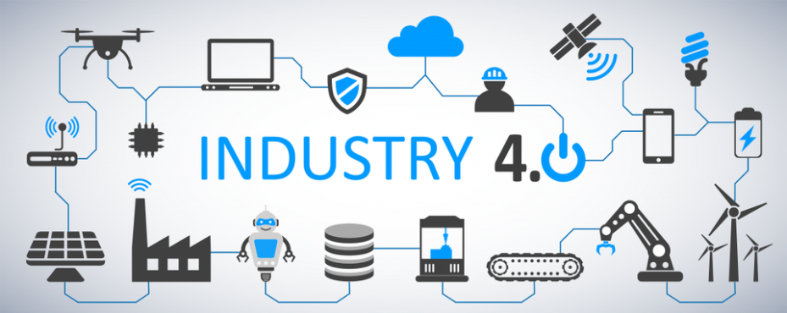
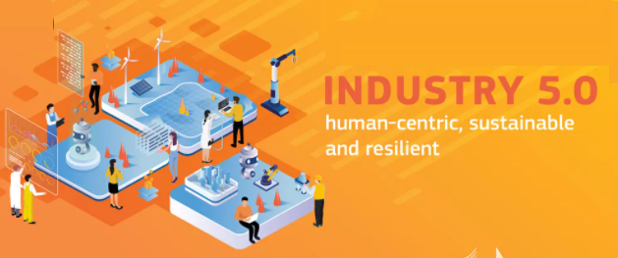
“Industry 4.0 vs. Industry 5.0” – is it all about human role?
vs.
New generation of AI drives Industry 4.0 from “Automatic” to “Automagic” one …
A popular view is that Industry 4.0 concept assumes a high share of automation in the decision-making processes and the Industry 5.0 concept assumes the recovery of the leading role of humans within the decision-making processes. Is these completely so? …

Slide 11
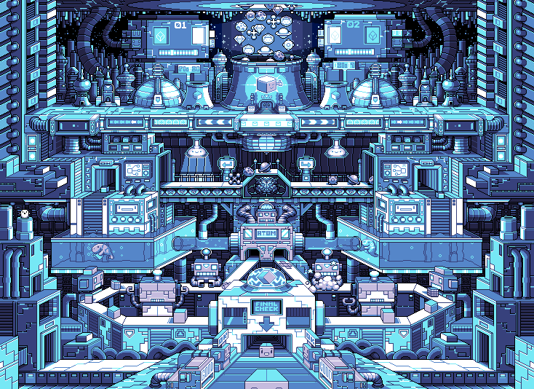
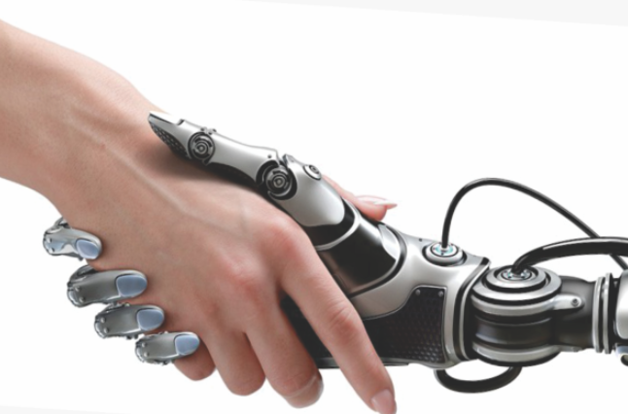
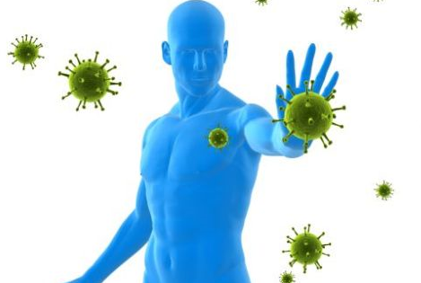
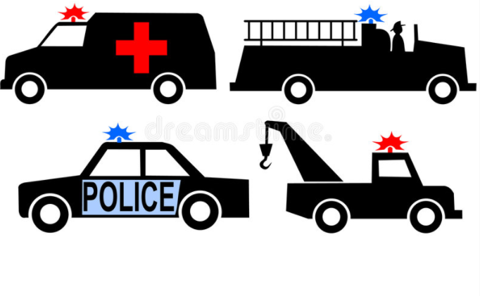
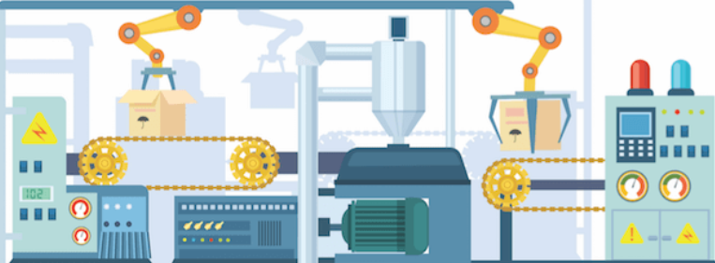
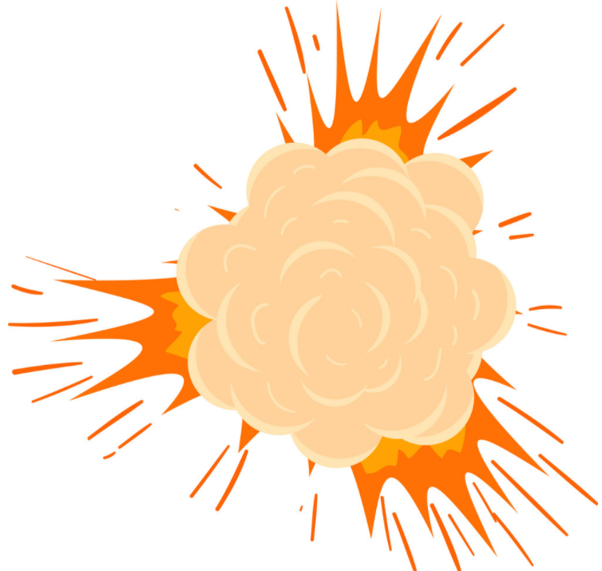
AI meets challenges …
Digital Overload
Pandemics
Hybrid Threats
Artificial Intelligence as a digital recovery, sustainability and resilience enabler
I D U S T R Y
Cyberattacks
AI
Emergencies
Crashes

Slide 12
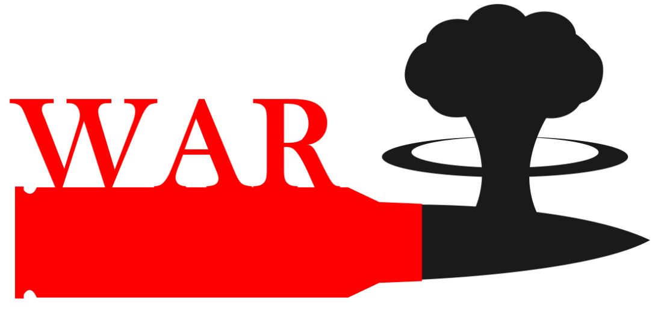
… these change Human + AI collaboration scenarios …
AI meets also the new challenges …
Artificial Intelligence as a digital recovery, sustainability and resilience enabler
I D U S T R Y
Refugee
AI
Crisis

Slide 13
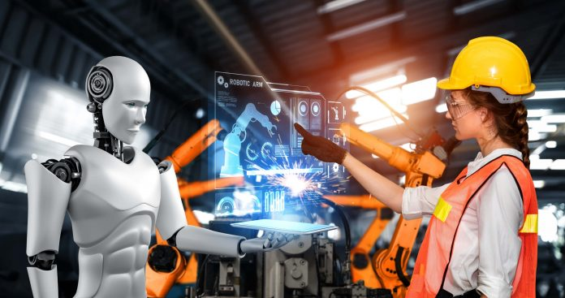
The need for resilience changes everything
AI vs. Human in Industry
Resilience
≈
AI strengths
Human vulnerabilities
Resilient Industry
≈
AI vulnerabilities
Human strengths

Slide 14
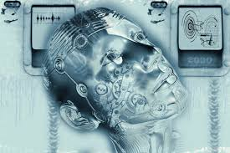
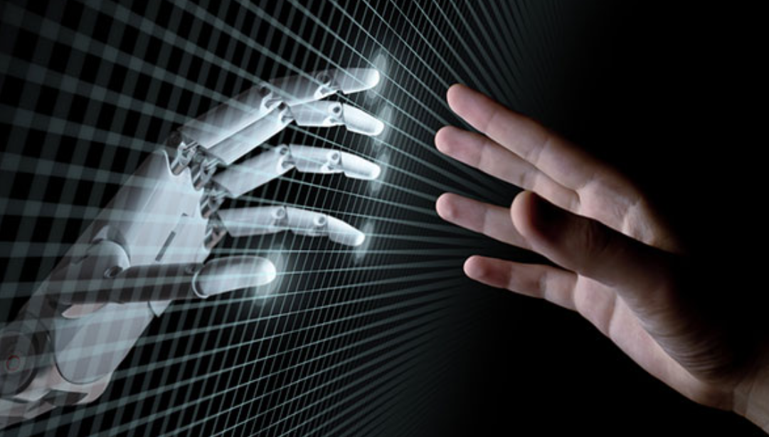
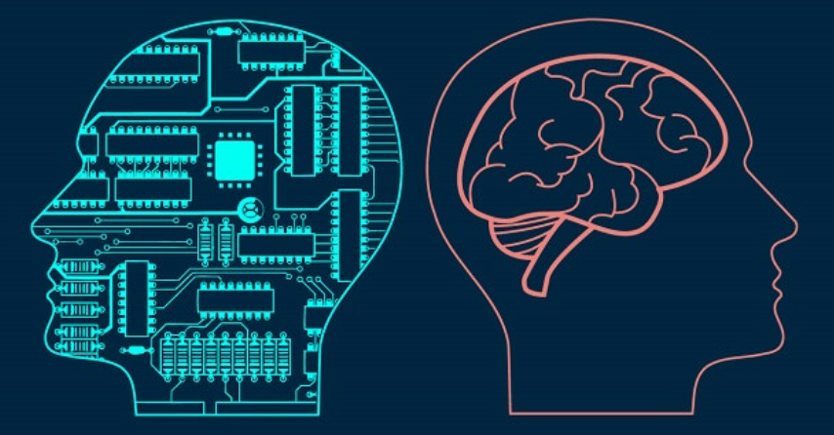
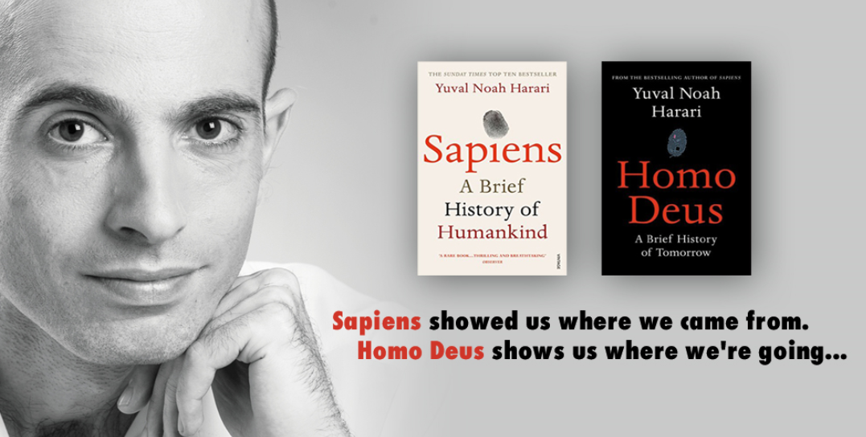
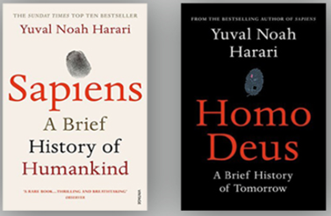
Resilient Industry
To enable resilient and efficient industry of the future we need a hybrid “Industry 4.0 + Industry 5.0” with:
humans enhanced by autonomous AI;
autonomous AI “with human face” …
… and which will inherit the most valuable features of both - efficiency of the Industry 4.0 processes and sustainability of the Industry 5.0 decisions. Digital cognitive clones (i.e., twinning human decision-making behavior) could be an enabling technology for the future hybrid and as an accelerator (as well as resilience enabler) of the convergence of the digital and human worlds ...
21 Lessons shows us where we are today …

Slide 15
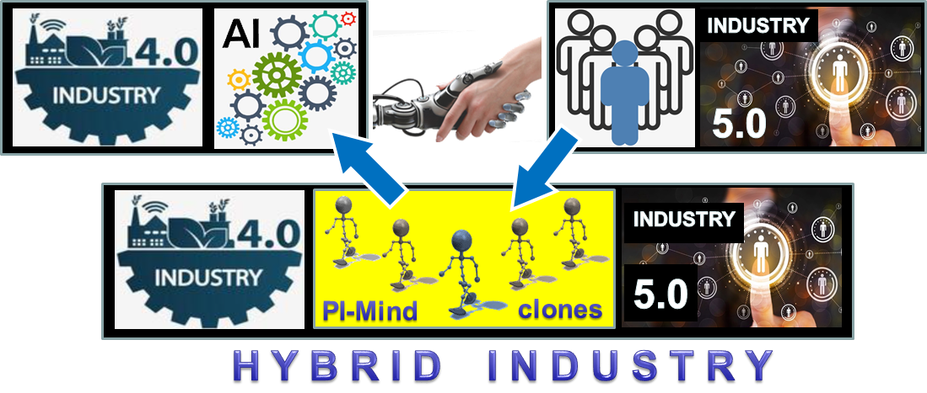
The concept of Industry 4.0 + Industry 5.0 hybrid (driven by digital cognitive clones of humans)
Cite as:
Golovianko, M., Terziyan, V., Branytskyi, V., & Malyk, D., (2023). Industry 4.0 vs. Industry 5.0: Co-existence, Transition, or a Hybrid. Procedia Computer Science, 217, 102-113. Elsevier. https://doi.org/10.1016/j.procs.2022.12.206. Presentation slides: https://ai.it.jyu.fi/ISM-2022-Industry_4_5.pptx

Slide 16
AI
Introducing Adversarial Maintenance

Slide 17
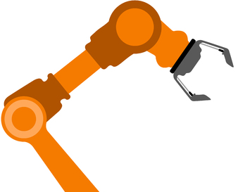
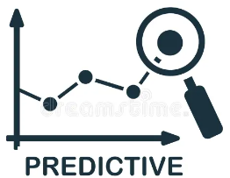
Maintenance
Modern maintenance frameworks:
Do we need anything else?
Predictive maintenance uses data and analytics to predict when equipment is likely to fail. It involves monitoring the real-time condition of equipment and performing maintenance when indicators suggest an impending failure.
Prescriptive maintenance takes a step further by not only predicting when maintenance is needed but also prescribing the optimal actions to take.
…
Industrial Asset
PRESCRIPTIVE

Slide 18
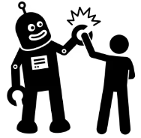
Maintenance
Collective (Hybrid) Intelligence as a user
Actually, we need to maintain the whole system, where our “asset-in-question” is used/managed by humans, by AI, or by hybrid collective intelligence
…
Industrial Asset
PRESCRIPTIVE

Slide 19
Maintenance
Assets as well as their “users” (control systems) are subject of adversarial attacks …
Collective (Hybrid) Intelligence as a user
…
… therefore, new maintenance frameworks are needed to address this challenge …
Industrial Asset
PRESCRIPTIVE

Slide 20
Adversarial Maintenance with its “worst-case scenario” adversarial pre-training mechanisms, is supposed to guard industrial assets with respect to the R3 (Reliability, Robustness, and Resilience) concept:
Reliability is the capability of an asset to provide expected and consistent behavior and performance in the typical “business-as-usual” scenarios.
Robustness is the capability of an asset to perform without failure under a wide range of possible off-nominal conditions and scenarios including adversarial attacks.
Resilience is the capability of an asset to recover from unanticipated changes in working conditions and scenarios, including consequences of adversarial attacks, by adapting its behavior to the new operational context.
By proactively approaching the R3 concept, Adversarial Maintenance (AM) goes beyond traditional practices to fortify industrial assets, making them more reliable, robust, and resilient in the dynamic and potentially adversarial environments of Industry 4.0, Industry 5.0, and Smart Manufacturing:
AM enhances reliability by proactively identifying and addressing potential threats before they impact system performance. Through continuous monitoring and pre-training, it minimizes the likelihood of unplanned disruptions, ensuring a more reliable operation of industrial assets.
AM strengthens robustness by preparing systems to withstand intentional adversarial attacks and hybrid threats. Unlike traditional approaches that may focus solely on known faults, AM broadens the scope to address unforeseen challenges, making systems more robust and adaptable in the face of evolving risks.
Adversarial Maintenance contributes to resilience by training the ability of systems to recover swiftly from adversarial events. Through pre-training mechanisms and dynamic response optimization, it ensures that even if an attack occurs, the system can bounce back resiliently, minimizing the impact on operations and maintaining continuity in the face of disruptions.
Therefore, the focus of AM will be on proactive defense against intentional attacks, incorporating adversarial pre-training and dynamic response mechanisms to fortify systems.
Find more details and cite as (when published):
Terziyan, V., & Kaikova, O. (2025, submitted). Guardians of Reliability, Robustness, and Resilience: Adversarial Maintenance in the Era of Industry 4.0 and 5.0. Procedia Computer Science, 12 pp. Elsevier.
Zissis, G. (2019). The R3 concept: Reliability, Robustness, and Resilience [President’s message]. IEEE Industry Applications Magazine, 25(4), 5–6. https://doi.org/10.1109/MIAS.2019.2909374

Slide 21
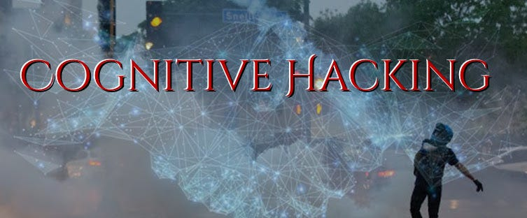
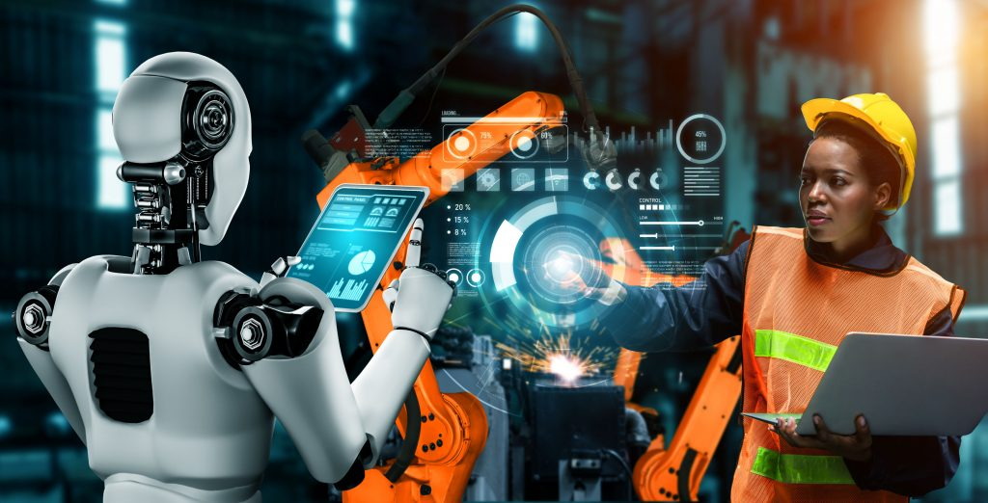
Human’s vs AI’s security vulnerabilities: Smart way to handle both

Slide 22
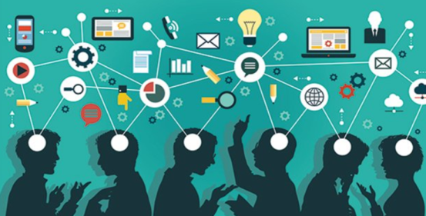
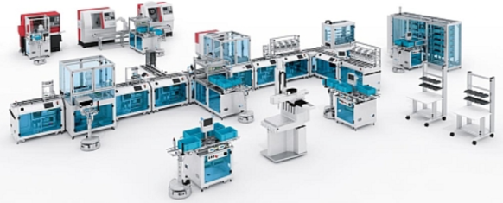
Cyber-Physical-Social Systems
Collective Intelligence
Factories of the Future, Smart Manufacturing, Smart Critical Infrastructure, Industry 4.0 (5.0) are all about emerging Cyber-Physical-Social Systems, which are populated and controlled by the Collective Intelligence and which are essential for the functioning of a society and economy …
Future Manufacturing Infrastructure
Humans and artificial decision makers
Flexible infrastructure of heterogeneous systems, facilities, assets, technologies, networks and processes
Artificial decision-makers are autonomous models specially trained (by Machine Learning on the basis of available data) to make decisions by addressing certain observations.
https://bt3gl.github.io/index.html

Slide 23
Cyber-Physical-Social Systems
Collective Intelligence
Which of these is more vulnerable for a hacking attack: infrastructure or intelligence?
Future Manufacturing Infrastructure
“Only amateurs attack machines…”
[B. Schneier (2000). Semantic Attacks…]
“… professionals target people”
[B. Schneier (2000). Semantic Attacks…]

Slide 24
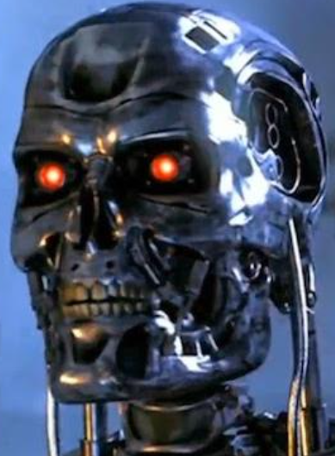
Artificial Intelligence (AI) and CyberThreats (CT):
- AI as a source of CT;
- AI as a target of CT;
- AI as an instrument of CT;
- AI as a defence from CT.
AI could be used and is used already to enhance cyberattacks and other hybrid threats, while AI is vulnerable itself …

Slide 25
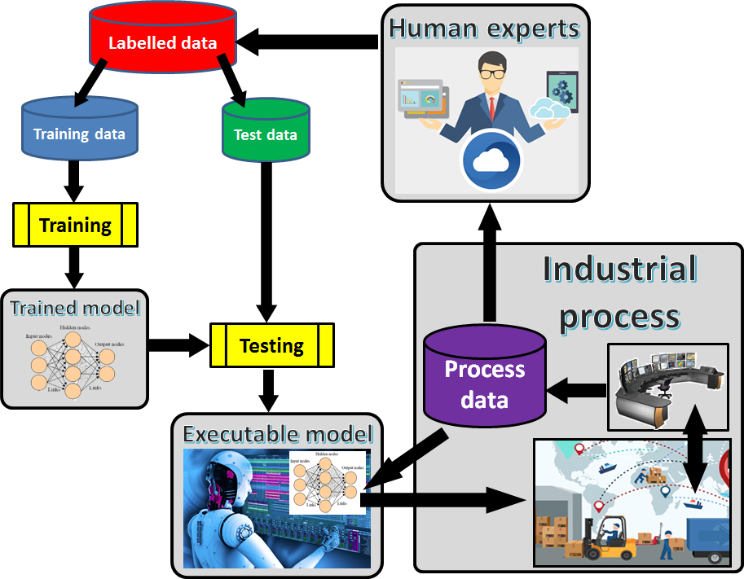
Machine Learning process in Industry 4.0 (5.0)

Slide 26
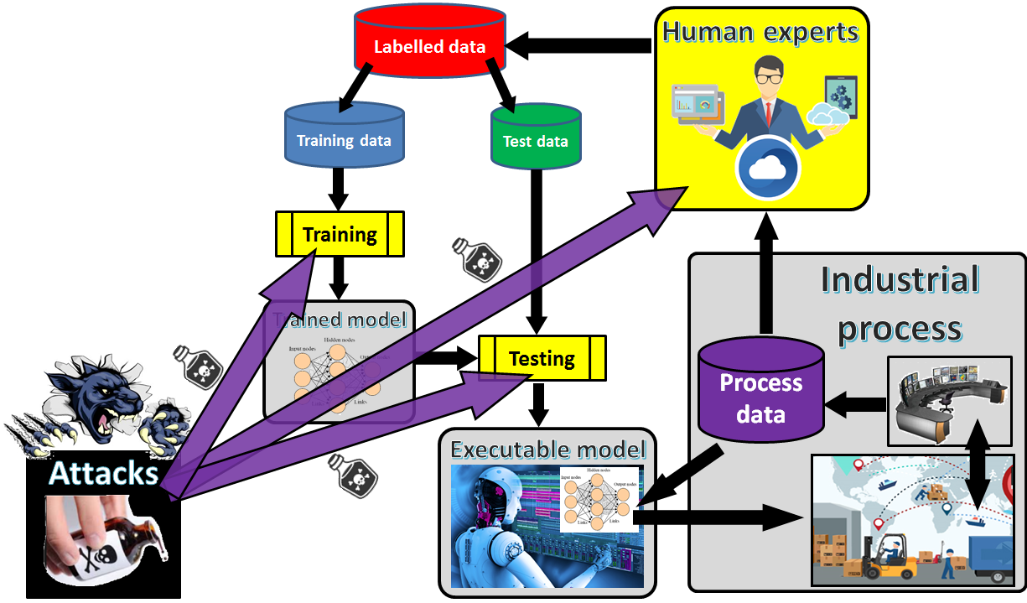
Both Human and AI (training & testing) components of Machine Learning process are the targets for adversarial attacks

Slide 27
AI under Attack (Adversarial Machine Learning)
See more in:
Terziyan, V., Golovianko, M., & Gryshko, S. (2018). Industry 4.0 Intelligence under Attack: From Cognitive Hack to Data Poisoning. In: K. Dimitrov (Ed.), Cyber Defence in Industry 4.0 Systems and Related Logistics and IT Infrastructure (NATO Science for Peace and Security Series D: Information and Communication Security, Vol. 51, pp. 110-125). IOS Press. https://doi.org/10.3233/978-1-61499-888-4-110. Presentation: https://ai.it.jyu.fi/nato/NATO.pptx

Slide 28
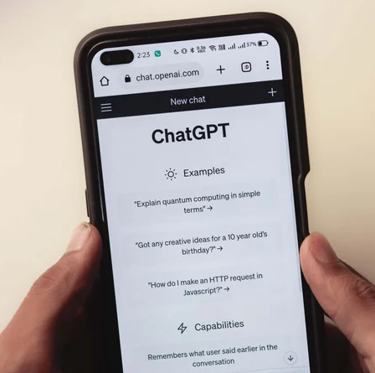
Emerging new attack: Prompt Injection (Adversarial Machine Learning)
- Targeted on large-language models (LLMs), which utilize prompt-based learning. Prompt injection is currently associated with the number 1 vulnerability of LLMs.
https://www.cobalt.io/blog/prompt-injection-attacks
A prompt is a piece of text or input that we provide to an AI language model to guide its responses. A prompt is crucial in shaping the output generated by the language model. It provides the initial context, specific instructions, or the desired format for the response. The quality and specificity of the prompt can influence the relevance and accuracy of the model’s output.
Prompt injection attack is defined as “using carefully crafted prompts that make the model ignore previous instructions or perform unintended actions.”
These attacks can also occur within an application built on top of ChatGPT or other emerging language models. By injecting a prompt that deceives the application into executing unauthorized code, attackers can exploit vulnerabilities, posing risks such as data breaches, unauthorized access, or compromising the entire application's security. Security researchers have demonstrated attacks using ChatGPT can be created by directing the tool to write malware, identify exploits in popular open-source code, or create phishing sites that look similar to well-known sites. To achieve any of these malicious examples, attackers have to creatively circumvent the existing content restrictions used by these models.

Slide 29
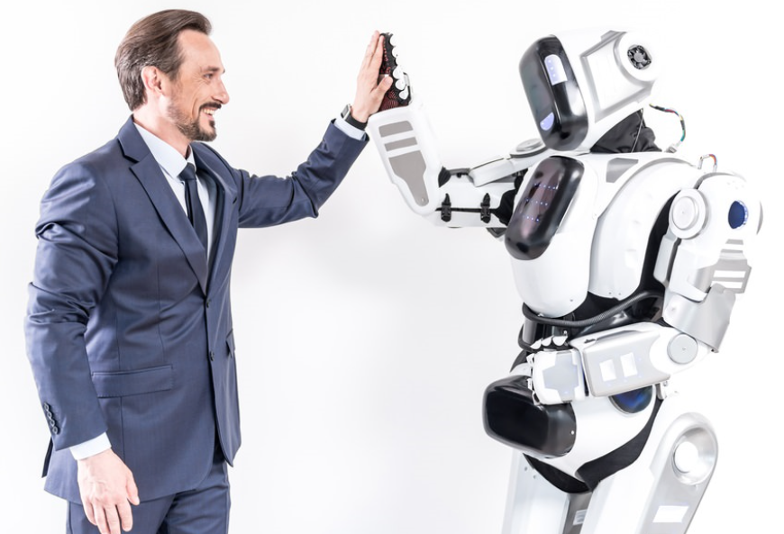
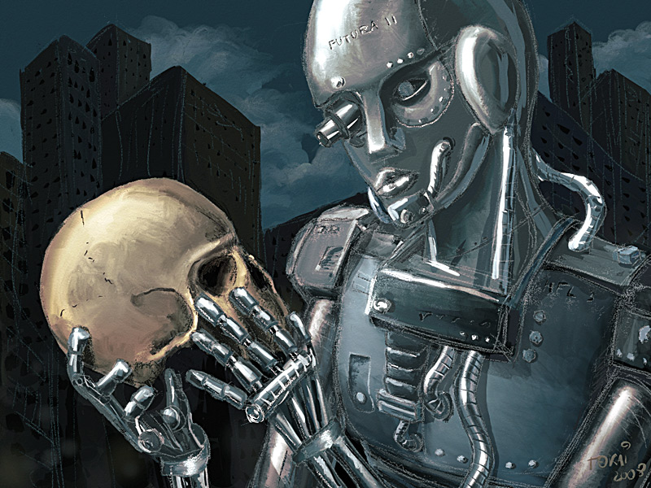
We are different but we have similar vulnerabilities
At certain level of abstraction we may assume that human vulnerabilities regarding Cognitive Hacking are similar to the vulnerabilities of Artificial Intelligence regarding Data Evasion, Data Poisoning, etc. attacks …

Slide 30
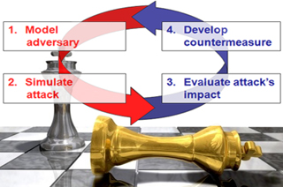
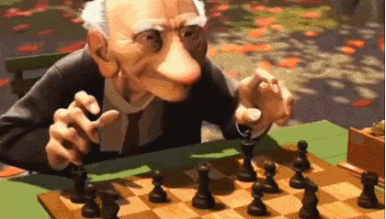
Adversarial Learning
Adversarial learning is a novel research field that lies at the intersection of machine learning and computer security. It addresses the following main open issues:
identifying potential vulnerabilities of machine learning algorithms during learning and classification;
devising the corresponding attacks and evaluating their impact on the attacked system;
proposing countermeasures to improve the security of machine learning algorithms against the considered attacks.
Adversarial learning usually focuses on attacks staged either at training (poisoning) or test time (evasion), together with the proposal of suitable countermeasures.
Reactive
Proactive

Slide 31
Artificial Intelligence has already
many real threats, and more new
ones are foreseen in near future
#G5511 “Cyber Defence for Intelligent Systems”
I M M U N E
http://recode.bg/natog5511/
AI
We cannot rely on a reactive approach towards the threats. We need an “Immunity” for AI !

Slide 32
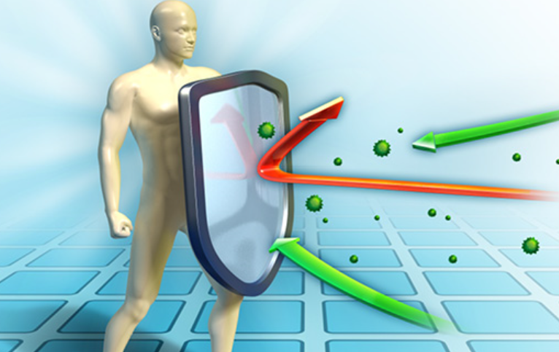
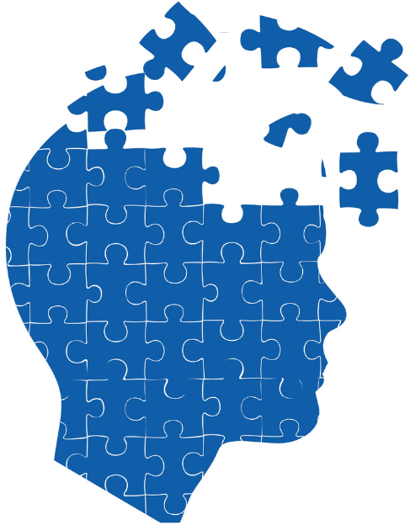
Humanity have already many
hybrid threats, and more new
ones are foreseen in near future
https://warn-erasmus.eu/
https://ai.it.jyu.fi/WARN.pptx
We cannot rely on a reactive approach towards the threats. We need to train an “Immunity” for our minds !
Read more about IMMUNE and WARN projects here:
Kaikova, O., Terziyan, V., Tiihonen, T., Golovianko, M., Gryshko, S., & Titova, L. (2022). Hybrid Threats against Industry 4.0: Adversarial Training of Resilience. E3S Web of Conferences, 353, 03004. https://doi.org/10.1051/e3sconf/202235303004
Presentation slides: https://ai.it.jyu.fi/EVF-2021.pptx

Slide 33
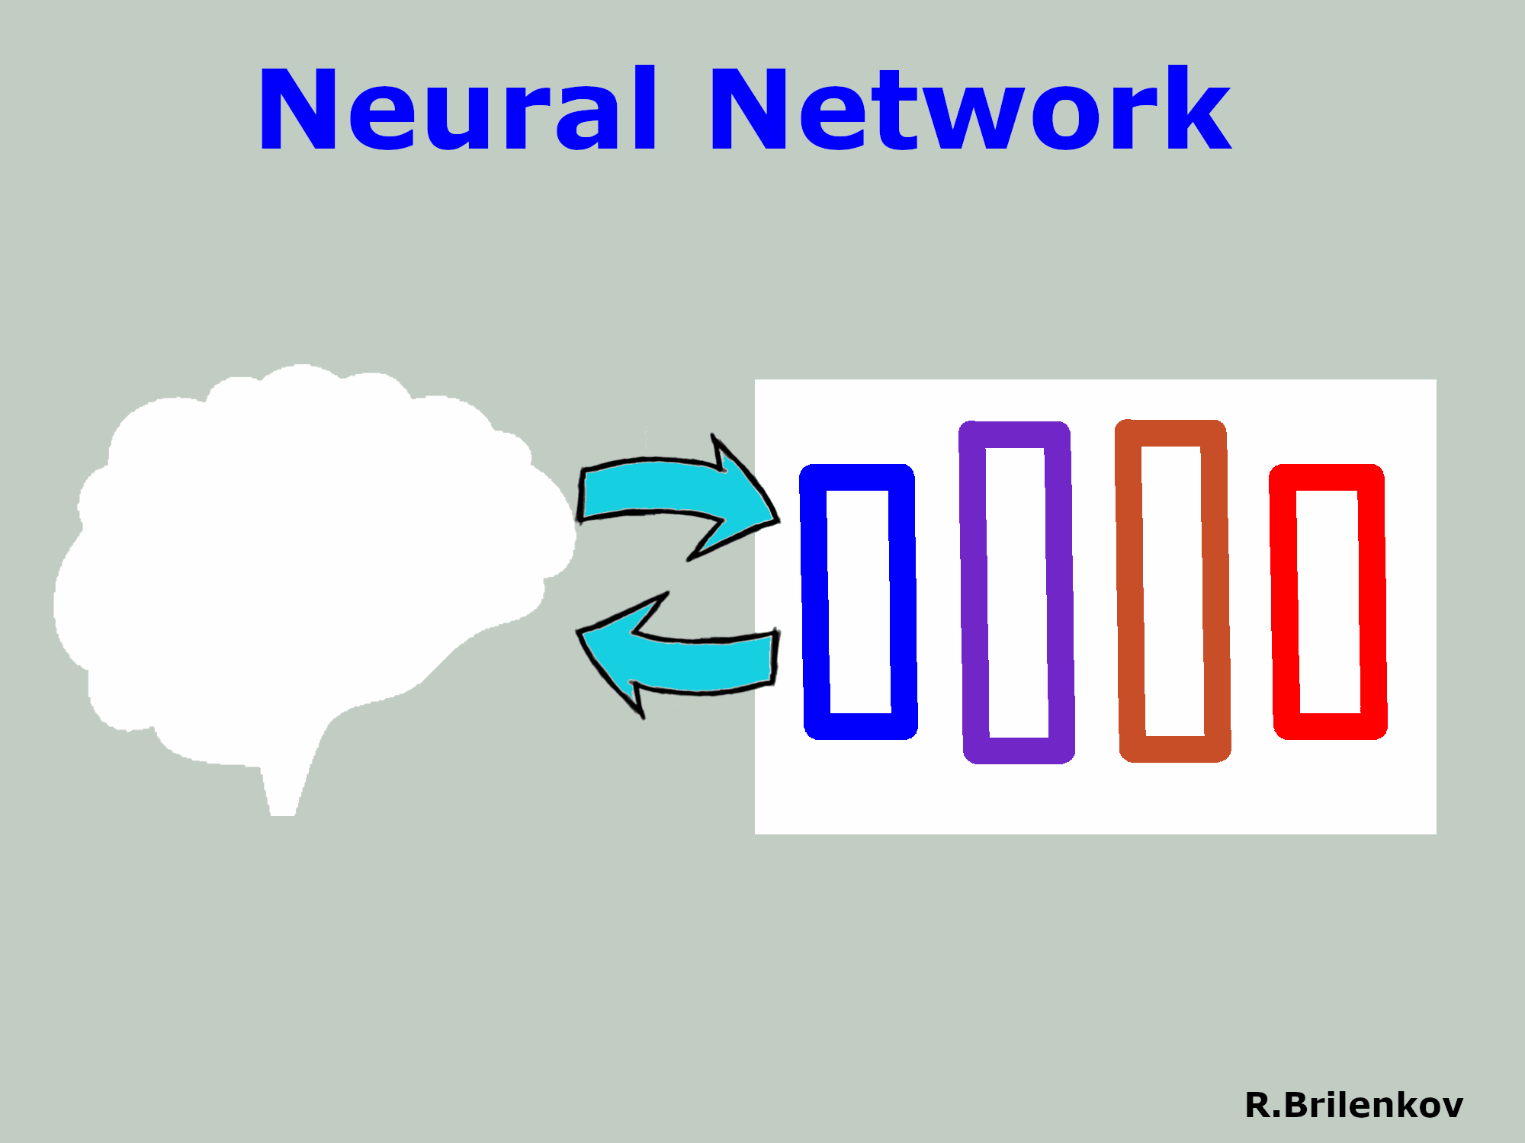
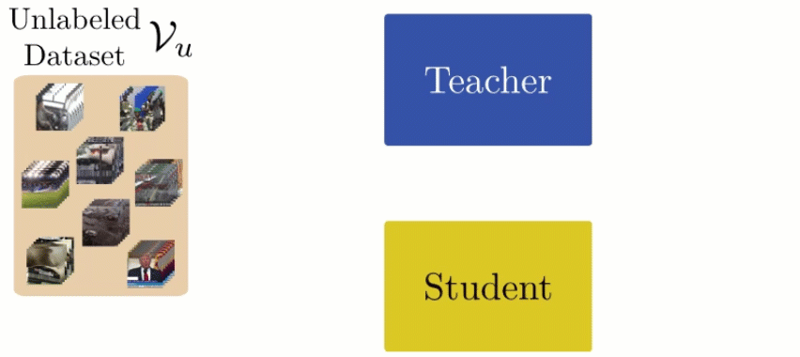
Knowledge transfer
C L O N I N G
Knowledge distillation
“Digital cloning”:
towards responsible AI, which enhances (not replaces), secures, and maintains humans and assets.

Slide 34
Triangle of important concepts
Human
Autonomous Agent
(aka “software robot”)
Cognitive cloning of humans involves at least cloning of their cognitive capabilities under the umbrella of autonomy
Capability

Slide 35
Autonomous AI (agents) as proxy to external capabilities
SaaS;
Other system;
Other agent;
Human, …
… not yet cloning but step ahead …
Enhancing a human or a system (process) with some external capabilities-as-such
SmartResource and UBIWARE as enablers:
https://ai.it.jyu.fi/SmartResource_UBIWARE.html
More about UBIWARE:
Katasonov, A., Kaykova, O., Khriyenko, O., Nikitin, S., & Terziyan, V. (2008). Smart Semantic Middleware for the Internet of Things. In: J. Filipe, J. A. Cetto & J.-L. Ferrier (Eds.), Proceedings of the 5-th International Conference on Informatics in Control, Automation and Robotics (Vol. 1, pp. 169-178). SciTePress. https://doi.org/10.5220/0001489001690178
More about SmartResource:
Terziyan, V. (2008). SmartResource – Proactive Self-Maintained Resources in Semantic Web: Lessons learned. International Journal of Smart Home, 2(2), 33-57. Global Vision Press. https://gvpress.com/journals/IJSH/vol2_no2/3.pdf

Slide 36
Agents as smart, autonomous,
personalized, trainable capabilities
… not yet cloning but closer …
“Cellular Collective Intelligence”
(“me” and “my” “pocket advisors”)
Enhancing a human, an asset, or a system (process) with personalized, trainable and evolving autonomous capabilities
Cite as:
Gavriushenko, M., Kaikova, O., & Terziyan, V. (2020). Bridging Human and Machine Learning for the Needs of Collective Intelligence Development. Procedia Manufacturing, 42, 302-306. Elsevier. https://doi.org/10.1016/j.promfg.2020.02.092

Slide 37
Agents as autonomous “clones” of human capabilities
Enhancing a human (or a system!) by making him/her ubiquitous and omniscient due to multiple autonomous clones capable to be present, self-develop and decide on human’s behalf synchronously within many processes.
A digital cognitive clone of a human decision-maker is an industrial compromise in the “robots vs. humans” dilemma, serving as a bridging concept to marry automation-centric Industry 4.0 and human-centric Industry 5.0. Cognitive clones, as smart bridging technological artifacts, keep particular humans (donors for the clones) within the loop of responsible decision-making processes and, at the same time, make such human involvement ubiquitous and, therefore, efficient.

Slide 38
Autonomous agent (software robot) as a “clone”
or digital copy (twin) of human intelligence
Patented Intelligence
(Pi-Mind)
Digital clone
Of a human
Process
human
$π$-Mind (Pi-Mind) – “Patented Intelligence” technology is capable to capture, formalize, license, share, reuse, and integrate personal cognitive models and corresponding personal value- and decision-driven behavior (of a human or other smart entity) within autonomous cyber-physical-social systems and various business processes.
Cite as:
Terziyan, V., Gryshko, S., & Golovianko, M. (2018). Patented Intelligence: Cloning Human Decision Models for Industry 4.0. Journal of Manufacturing Systems, 48 (Part C), 204-217. Elsevier. https://doi.org/10.1016/j.jmsy.2018.04.019

Slide 39
Digital Clones vs. Digital Twins

Slide 40
Cloning Process
(aka adversarial training)
- based on Conditional Generative Adversarial Network with special “Turing” Discriminator (T-GAN)
Golovianko, M., Gryshko, S., Terziyan, V., & Tuunanen, T. (2022). Responsible Cognitive Digital Clones as Decision Makers: A Design Science Research Study. European Journal of Information Systems, 32(5), 879–901, https://doi.org/10.1080/0960085X.2022.2073278
Golovianko, M., Gryshko, S., Terziyan, V., & Tuunanen, T. (2021). Towards Digital Cognitive Clones for the Decision-Makers: Adversarial Training Experiments. Procedia Computer Science, 180, 180-189. Elsevier. https://doi.org/10.1016/j.procs.2021.01.155. Presentation: https://ai.it.jyu.fi/ISM-2020-Pi-Mind.pptx

Slide 41
Cloning collective Intelligence
Using special GAN architecture with “Turing (group) Discriminator”
Cite as:
Terziyan, V., Gavriushenko, M., Girka, A., Gontarenko, A., & Kaikova, O. (2021). Cloning and Training Collective Intelligence with Generative Adversarial Networks. IET Collaborative Intelligent Manufacturing, 3(1), 64-74. John Wiley and Sons Ltd. https://doi.org/10.1049/cim2.12008
We provided an adversarial training framework for the collective intelligence. We show how cognitive capabilities can be copied (“cloned”) from humans and trained as a (responsible) collective intelligence. We made some modifications to the Generative Adversarial Networks architectures and adapted them for the cloning and training tasks. We modified the Discriminator component to a so‐called “Turing (group) Discriminator”, which includes one or several human and artificial discriminators working together.

Slide 42
Cloning-GAN (C-GAN) architecture
Advanced Cloning Architectures
Driven by handcrafted mathematical expert knowledge
Cite as:
Terziyan, V., & Tiihonen, T. (2024). Using Cloning-GAN Architecture to Unlock the Secrets of Smart Manufacturing: Replication of Cognitive Models. Procedia Computer Science, 232, 890-902. Elsevier. https://doi.org/10.1016/j.procs.2024.01.089
See presentation: https://ai.it.jyu.fi/ISM-2023-Cloning_GAN.pptx
Multi-Expert-Guided Cloning-GAN (MEG-C-GAN) architecture
Trained cognitive clones of sensitive assets could have life-long re-training in evolving adversarial environments refreshing their robustness and resilience.
Driven by trainable expert components
Cite as (when published):
Terziyan, V., & Tiihonen, T. (2025, submitted). Digital Cloning as a Self-Adaptive Multicriteria Optimization Process. Procedia Computer Science, 12 pp. Elsevier.

Slide 43
“Digital immunity” and “vaccination”:
Adversarial training of resilience
Branytskyi, V., Golovianko, M., Gryshko, S., Malyk, D., Terziyan, V., & Tuunanen, T. (2022). Digital Clones and Digital Immunity: Adversarial Training Handles Both. International Journal of Simulation and Process Modelling, 18(2), 124-139. Inderscience Publishers. https://doi.org/10.1504/IJSPM.2022.10048910
AI
Kaikova, O., Terziyan, V., Tiihonen, T., Golovianko, M., Gryshko, S., & Titova, L. (2022). Hybrid Threats against Industry 4.0: Adversarial Training of Resilience. E3S Web of Conferences, 353, 03004. https://doi.org/10.1051/e3sconf/202235303004. Presentation: http://www.cs.jyu.fi/ai/EVF-2021.pptx.

Slide 44
Similarity of two problems:
(a) digital cloning vs. (b) digital vaccination
… as both require vulnerability zones discovery and adversarial samples generation for further retraining …
Cite as:
Branytskyi, V., Golovianko, M., Gryshko, S., Malyk, D., Terziyan, V., & Tuunanen, T. (2022). Digital Clones and Digital Immunity: Adversarial Training Handles Both. International Journal of Simulation and Process Modelling, 18(2), 124-139. Inderscience Publishers. https://doi.org/10.1504/IJSPM.2022.10048910

Slide 45
Our approach: Digital Immunity for Artificial Intelligence or for the “cognitive clones” of human decision-makers trained by “Smart Vaccination” and driven by Generative Adversarial Networks (GANs)

Slide 46
Enhancing humans, systems, or assets by agent-driven, smart, autonomous cognitive immune system (aka personal security officer)
“poison”
Content from the environment
Terziyan, V., Golovianko, M., & Gryshko, S. (2018). Industry 4.0 Intelligence under Attack: From Cognitive Hack to Data Poisoning. In: K. Dimitrov (Ed.), Cyber Defence in Industry 4.0 Systems and Related Logistics and IT Infrastructure (NATO Science for Peace and Security Series D: Information and Communication Security, Vol. 51, pp. 110-125). IOS Press. https://doi.org/10.3233/978-1-61499-888-4-110
Enhancing a human or a system (process) by protecting it against inappropriate, adversarial, poisoned, etc., inputs and, therefore, protecting human’s or system’s knowledge, values and decision-making from “cognitive hacking”

Slide 47
Example of decision space

Slide 48
Example: Training set for supervised learning
Weight (kg) | Height (sm) | Decision
67 | 175 | skinny
77 | 182 | skinny
82 | 198 | skinny
76 | 164 | overweight
91 | 167 | overweight
98 | 180 | overweight

Slide 49
Training samples

Slide 50
Area of confident decisions

Slide 51
Area of confident decisions

Slide 52
Tricky area of uncertainty

Slide 53
Example of possible ML (NN-driven) solution

Slide 54
ML-learned vs hidden (correct) decision boundary

Slide 55
Vulnerability zone within decision space
Vulnerability zone: area of potentially incorrect decisions by the target model and, at the same time, this is the space (“window of opportunity”) for the attackers aiming further “poisoning” the target decision model and, therefore, making the situation with the decision-making correctness even worth …

Slide 56
Original training set for supervised learning
DATA POISONING ATTACK
Weight (kg) | Height (sm) | Decision
67 | 175 | skinny
77 | 182 | skinny
82 | 198 | skinny
76 | 164 | overweight
91 | 167 | overweight
98 | 180 | overweight
Additional “poisoned” samples
Weight (kg) | Height (sm) | Decision
96 | 199 | overweight
64 | 162 | skinny

Slide 57
Impact of poisoned samples
Result of poisoning: larger vulnerability zone, which also means more opportunities for the attackers in further poisoning …

Slide 58
Impact of further poisoning
Result of further poisoning: larger vulnerability zone, which means incorrect decision-making in larger areas and which also means more opportunities for the attackers in even-further poisoning …

Slide 59
Poisoning vs. Vaccination:
just one “small” difference

Slide 60
Poisoning vs. Vaccination

Slide 61
Remember? Poisoning example
The vulnerability zone within the decision space is discovered and adversarial samples within it are generated…
… then the adversarial samples within the vulnerability zone are deliberately converted into POISON by incorrect labelling.

Slide 62
Vaccine instead of poison …
The vulnerability zone within the decision space is discovered and adversarial samples within it are generated…
… then the adversarial samples are converted into VACCINE by assigning them the correct labels .

Slide 63
Generic model of humans’ adversarial training in classroom
(Attacker vs. Defender | Arbiter)

Slide 64
Generic model of adversarial training in the classroom

Slide 65
Knowledge-Informed Adversarial Maintenance:
Collaborative Immunity Training

Slide 66
IMPORTANT trend: from purely data-driven to knowledge-informed machine learning (KIML) models (to better fit industrial needs and address security)
(some kind of a hybrid of a black-box and eXplainable AI aiming quality, transparency, and security …)
There are clear indicators that the focus of innovations in AI in general and particularly in ML is shifting from purely data-driven models towards more robust and accurate knowledge-enhanced “Knowledge-Informed ML” (KIML) models, for example, from Computational Science …
Computational Science
AI & ML
Data Science
Knowledge-Informed GANs for cognitive cloning and immunity training could be an excellent option

Slide 67
Physics-Informed Neural Network (PINN)
– not only better accuracy but also better robustness against adversarial attacks
NN
We can see that the additional “Knowledge Loss” in the loss function tries to ensure that the solution learned by the network is consistent with the known physics.
PINN

Slide 68
Taxonomy-Informed Neural Networks (TINNs) for knowledge-informed and collaborative immunity training
Cite as:
Terziyan, V., & Vitko, O. (2024). Taxonomy-Informed Neural Networks for Smart Manufacturing. Procedia Computer Science, 232, 1388-1399. Elsevier. https://doi.org/10.1016/j.procs.2024.01.137
Terziyan, V., & Vitko, O. (2024, submitted). Collaborative Resilience: Taxonomy-Informed Neural Networks for Smart Assets’ Maintenance in Hostile Industry 4.0 Environments. International Journal of Mechatronics and Manufacturing Systems, 17, 16 pp. Inderscience Publishers.
Simple/basic scenarios of Taxonomy-Informed Neural Network training and related loss function computing:
(a) the generic case of combining data and knowledge loss for a single asset;
(b) combining data loss with knowledge on the class, to which the asset belongs to;
(c) simple multiple inheritance case with two “mother” classes for the target asset;
(d) simple hierarchy case when the loss computation for the target asset combines knowledge from “mother” and “grandmother” classes;
(e) combined (c) and (d) cases;
(f) scenario from (e), which is generalized to multiple “mother” classes.

Slide 69
Class- vs TINN-based personalized digital twins of industrial assets
Consider we have class of assets, each of which is exploited in different working environments and involved to different processes. Each of the assets collects own data and learns corresponding models out of it when necessary. The fact the assets belong to the same class means that all the assets share some basic knowledge, which is common for all the assets of the class but, in addition, they also have personal experience driven acquired knowledge. Let us assume that the knowledge on the class as whole is collected as a kind of digital twin for an abstract asset from the class. However, such an abstract digital twin can be personalized regarding each of the individual assets by combining such common knowledge with the personal data-driven knowledge. Therefore, we may get personalized digital twins specific for each individual assets, i.e., while training individual models we can use TINN analytics to benefit from known taxonomies.
Cite as:
Terziyan, V., & Vitko, O. (2024, submitted). Collaborative Resilience: Taxonomy-Informed Neural Networks for Smart Assets’ Maintenance in Hostile Industry 4.0 Environments. International Journal of Mechatronics and Manufacturing Systems, 17, 16 pp. Inderscience Publishers.

Slide 70
Collective (“Herd”) Immunity: Adversarial retraining and refining personalized digital twins and corresponding TINN models towards adversarial robustness by combining federated and informed ML
Federated ML is an approach in ML where a model is trained across decentralized assets (e.g., personalized digital twins) holding local data samples, without exchanging them. We aim to improve model for each personalized digital twin of a particular asset using personalized digital twin models from similar assets during informed ML process. We assume that personalized digital twin for each individual asset has been pretrained independently following TINN analytics. Now we can refine each of the pretrained models (i.e., corresponding personalized twins) using extra training and feedback from other models. Such scenario is useful when extra training is based on challenging or adversarial training samples aiming to add additional adversarial robustness to the individual models using crowdsourcing effect. Therefore, all the individual models are exposed to adversarial input from, e.g., adversarial samples’ generator.
Cite as:
Terziyan, V., & Vitko, O. (2024, submitted). Collaborative Resilience: Taxonomy-Informed Neural Networks for Smart Assets’ Maintenance in Hostile Industry 4.0 Environments. International Journal of Mechatronics and Manufacturing Systems, 17, 16 pp. Inderscience Publishers.

Slide 71
Complementary Artificial Intelligence:
Prepare to potential “disability” in advance

Slide 72
Complementary AI (CAI): Enhancing disabled humans (systems) by autonomous, agent-driven, trainable complementary capabilities
… driven by “coolability” assumption (acquiring enhanced capabilities to complement some other ones, which are temporarily disabled)…
Cite as:
Terziyan, V., & Kaikova, O. (2021). Neural Networks with Disabilities: An Introduction to Complementary Artificial Intelligence. Neural Computation, 34(1), 255-290. MIT Press Direct. https://doi.org/10.1162/neco_a_01449
Enhancing partially (temporarily) disabled human or a system (process) with specially trained, personalized, autonomous, smart complementary capabilities, which will compensate the lacking skills

Slide 73
Could we prepare our decision-making components for these in advance?
Smart cyber-physical-social system operating in (a) normal conditions (all healthy “sensors” and “actuators”) and (b)conditions with enforced sensory or functional disabilities (due to adversarial attack), or both.
Cite as:
Terziyan, V., & Kaikova, O. (2021). Neural Networks with Disabilities: An Introduction to Complementary Artificial Intelligence. Neural Computation, 34(1), 255-290. MIT Press Direct. https://doi.org/10.1162/neco_a_01449

Slide 74
Special Neural Network Driven Coolability Training
Shallow architecture of a sustainable coolability-enhanced multichannel neural network and its training:
The architecture with the “short” disability channels.
The stage of training the healthy-to-healthy channel, while other channels (i.e., corresponding weights) are locked for training.
The stage of training the $i$-th-disabled-to-$j$-th-disabled channel (such training stage is applied separately to all pairs of input and output channels), while other channels (i.e., corresponding weights) are locked for training.
Cite as:
Terziyan, V., & Kaikova, O. (2021). Neural Networks with Disabilities: An Introduction to Complementary Artificial Intelligence. Neural Computation, 34(1), 255-290. MIT Press Direct. https://doi.org/10.1162/neco_a_01449

Slide 75
Resilience pre-training with CAI-GAN
CAI-GAN has a unique and complex CAI Discriminator, which comprises three essential components:
The first component is the Managed Asset, which simulates the behavior of the monitored smart industrial asset or AI-driven system. Connected to the real asset, this component translates its physical input-output activity into digital form.
The second component is the Knowledge Clone, which houses the model of how the asset should behave based on specifications. The collaboration of the Managed Asset and Knowledge Clone allows for a comparison between the actual and intended outputs, revealing any deviations from the desired activity.
The final (third) component is the trainable CAI module, a neural network capable of learning to compensate for deviations in the asset’s activity. The CAI component generates outputs that, combined with the Managed Asset output, closely match the intended Knowledge Clone output.
Cite as (when published):
Terziyan, V., & Kaikova, O. (2025, submitted). Guardians of Reliability, Robustness, and Resilience: Adversarial Maintenance in the Era of Industry 4.0 and 5.0. Procedia Computer Science, 12 pp. Elsevier.

Slide 76
Robustness pre-training with COOL-GAN
COOL-GAN has a unique double Generator and Turing Discriminator. Applied to trainable digital smart decision-making assets (Managed Smart Asset component within the Turing Discriminator), this architecture aims to pre-train the robustness of the maintained asset.
Before any disruptions occur, a digital clone (copy), known as the Frozen Clone of the Asset component, is created and preserved within the Turing Discriminator. Both the asset and its clone normally address inputs similarly, as indicated by the matching component of the Turing Discriminator. The core idea is to challenge the intended activity of the asset using sophisticated (confusing and adversarial) inputs and even “physical” influence, forcing the asset to adapt the intended activity robustly under potential attacks.
Two generators are employed to pre-train the robustness of the maintained asset. The first, Adversarial Reality Generator, is trained to generate sophisticated adversarial inputs aiming to confuse the Managed Smart Asset, leading it to react differently than the intended reaction from the Frozen Clone of the Asset. The corresponding Loss function from the Turing Discriminator penalizes the neural network model accordingly.
The second, Disability Generator (Attacker), is trained to make structural changes (attacks) within the Managed Smart Asset’s neural network, enforcing sensory, functional, or memory disabilities. The Loss function from the Turing Discriminator penalizes the Disability Generator, encouraging it to generate the most “painful” disabilities for the maintained asset. Both the couple of Generators and the Managed Smart Asset, synchronously learn, pushed by opposite objectives and co-evolving towards perfection.
Pre-training such an internal compensation skill, aka “coolability”, as part of Adversarial Maintenance activity guarantees smart robustness capability for the Managed Asset in potentially sophisticated adversarial environments.
Cite as (when published):
Terziyan, V., & Kaikova, O. (2025, submitted). Guardians of Reliability, Robustness, and Resilience: Adversarial Maintenance in the Era of Industry 4.0 and 5.0. Procedia Computer Science, 12 pp. Elsevier.

Slide 77
Instead of Conclusions:
Adversarial Maintenance is not a piece of cake but something worth eating together …
Cite as (when published):
Terziyan, V., & Kaikova, O. (2025, submitted). Guardians of Reliability, Robustness, and Resilience: Adversarial Maintenance in the Era of Industry 4.0 and 5.0. Procedia Computer Science, 12 pp. Elsevier.

Slide 78
Come to study at our International Master Program
Artificial Intelligence
(former COIN: Cognitive Computing and Collective Intelligence)
… the first university program for collective intelligence, where humans learn together with their digital clones and autonomous AI-driven digital assistants …
http://www.jyu.fi/ai
AI

Slide 79
General conclusive point
Advanced AI and ML, in the context of emerging hybrid threats, bring additional (never seen before!) challenges to the industrial maintenance agenda.
Therefore, join us on this epic journey as we unravel the “Bermuda Triangle’s” $\left\{Adversarial×\left(AI+Analytics+Maintenance\right)\right\}$ mysteries and will write together a saga of confidence, resilience, and triumph in the face of adversity.
AI
Link to this presentation: https://ai.it.jyu.fi/Adversarial_Analytics.pptx
Contact for questions and proposals: vagan.terziyan@jyu.fi

