Slide 1
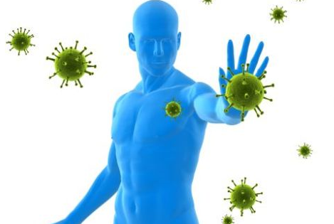
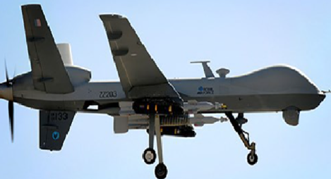
AI
HYBRID THREATS AGAINST INDUSTRY 4.0:
Adversarial Training of Resilience
Olena Kaikova, Vagan Terziyan, Timo Tiihonen,
Mariia Golovianko, Svitlana Gryshko, Liudmyla Titova
Collective Intelligence research group, Faculty of Information Technology, University of Jyväskylä (FINLAND)
Adversarial Intelligence research group, Department of Artificial Intelligence, Kharkiv National University of Radio Electronics (UKRAINE)

Slide 2
How to cite this paper:
Kaikova, O., Terziyan, V., Tiihonen, T., Golovianko, M., Gryshko, S., & Titova, L. (2022). Hybrid Threats against Industry 4.0: Adversarial Training of Resilience. E3S Web of Conferences, 353, 03004. https://doi.org/10.1051/e3sconf/202235303004

Slide 3
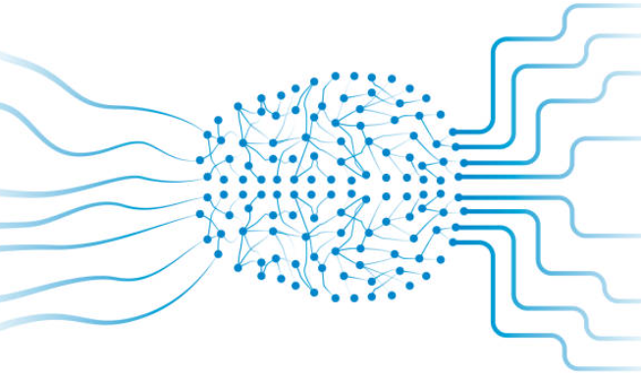
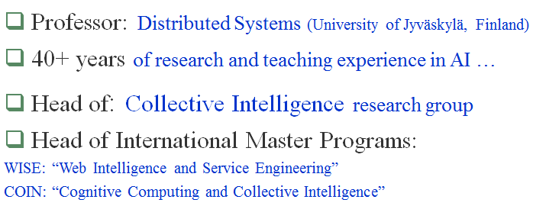
Authors
Olena Kaikova
Vagan Terziyan
Timo Tiihonen
Mariia Golovianko
Svitlana Gryshko
Liudmyla Titova
https://www.jyu.fi/en/
https://nure.ua/en/
Speaker
Vagan Terziyan
vagan.terziyan@jyu.fi

Slide 4
Moumen and our recent projects …
#G5511 “Cyber Defence for Intelligent Systems”
A.-Moumen DARCHERIF
https://www.ecam-epmi.fr/

Slide 5
CYBER-PHYSICAL-SOCIAL SYSYEMS; CRITICAL INFRASTRUCTURE; SMART MILITARY SYSTEMS; INDUSTRY 4.0; SMART MANUFACTURING; LOGISTICS
“IMMUNE” PROJECT
COLLABORATIVE INTELLIGENCE
(human + AI –driven decision-making)
AI
ADVERSARIAL MACHINE LEARNING
The “Three Whales” of the IMMUNE project
(“Cyber Defence for Intelligent Systems”)

Slide 6
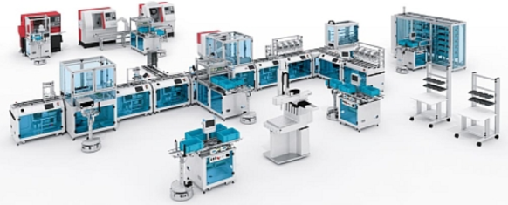
Cyber-Physical-Social Systems
Collective Intelligence
Factories of the Future, Smart Manufacturing, Smart Critical Infrastructure, Industry 4.0 are all about emerging Cyber-Physical-Social Systems, which are populated and controlled by the Collective Intelligence and which are essential for the functioning of a society and economy …
Future Manufacturing Infrastructure
Humans and artificial decision makers
Flexible infrastructure of heterogeneous systems, facilities, assets, technologies, networks and processes
Artificial decision-makers are autonomous models (e.g., Neural Networks) specially trained (Machine Learning process on the basis of available training data) to make decisions by addressing certain observations.
https://bt3gl.github.io/index.html

Slide 7
Cyber-Physical-Social Systems
Collective Intelligence
Which of these is more vulnerable for a hacking attack: infrastructure or intelligence?
Future Manufacturing Infrastructure
“Only amateurs attack machines…”
[B. Schneier (2000). Semantic Attacks…]
“… professionals target people”
[B. Schneier (2000). Semantic Attacks…]

Slide 8
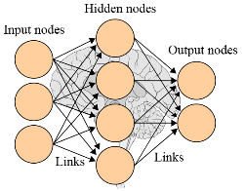
Machine Learning process in Industry 4.0
Labelled data
Human experts
Training data
Test data
Training
Industrial process
Trained model
Testing
Process data
Executable model

Slide 9
Both Human and AI (training & testing) components of Machine Learning process are the targets for adversarial attacks
Labelled data
Human experts
Training data
Test data
Training
Industrial process
Trained model
Testing
Process data
Executable model
Attacks

Slide 10
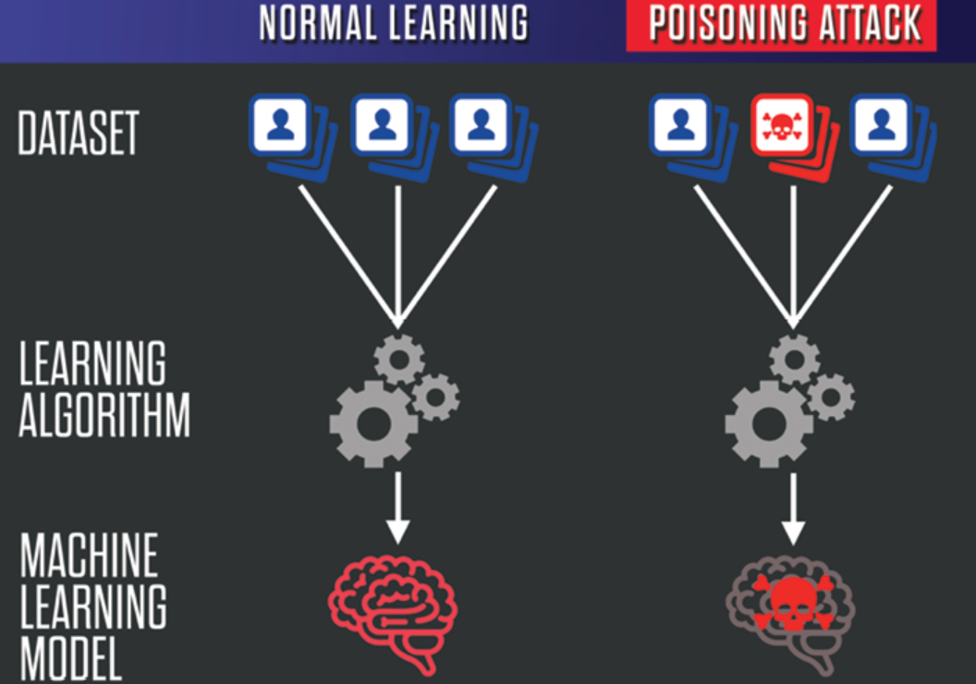
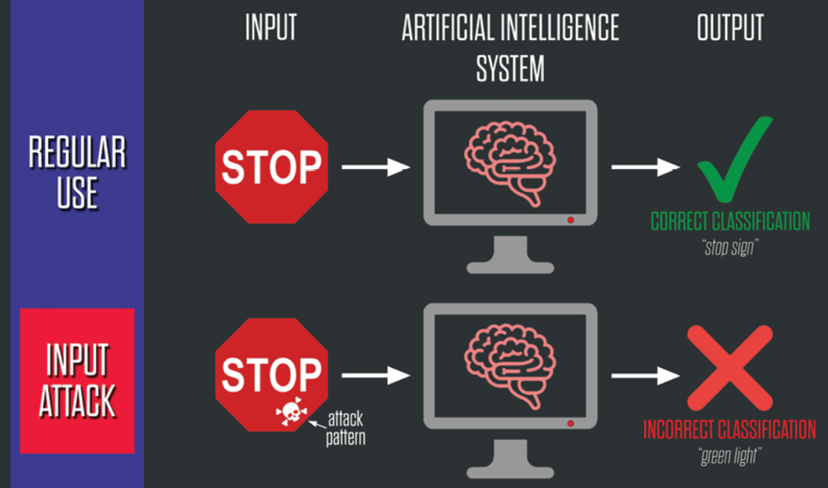
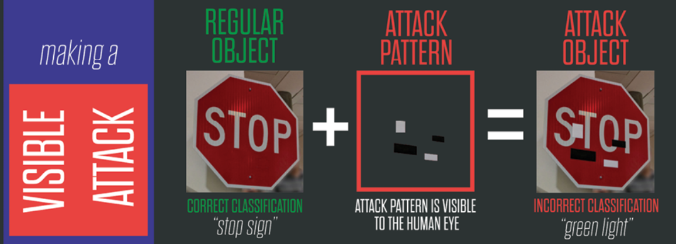
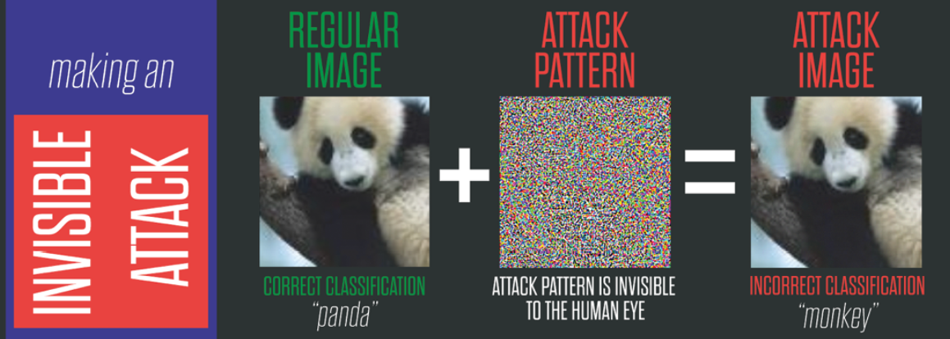
Artificial Intelligence under Attack
POISONING ATTACK
EVASION ATTACK
https://www.belfercenter.org/publication/AttackingAI

Slide 11
Example:
200
Height (sm)
Skinny
Hidden decision boundary (machine learning objective)
180
Overweight
160
60
80
Weight (kg)
100

Slide 12
Example: Training set for supervised learning
Weight (kg) | Height (sm) | Decision
67 | 175 | skinny
77 | 182 | skinny
82 | 198 | skinny
76 | 164 | overweight
91 | 167 | overweight
98 | 180 | overweight

Slide 13
Example:
200
“Training Samples” on top of the “Decision Space”
Height (sm)
“Training Samples” on top of the “Decision Space”
180
160
60
80
Weight (kg)
100

Slide 14
Example:
200
Skinny
Area of relative certainty: for any point (a new test person) within this area we could be more or less certain that the person is “Skinny”
Height (sm)
180
160
60
80
Weight (kg)
100

Slide 15
Example:
200
Height (sm)
Another area of relative certainty: for any point (a new test person) within this area we could be more or less certain that the person is “Overweight”
180
160
60
80
Weight (kg)
100

Slide 16
Example:
200
Skinny
Height (sm)
“GREY ZONE”: Somewhere within this area we have the hidden “decision boundary” between the two options, which we are going to learn
180
“GREY” (IGNORANCE or CONFUSION) ZONE
Overweight
160
60
80
Weight (kg)
100

Slide 17
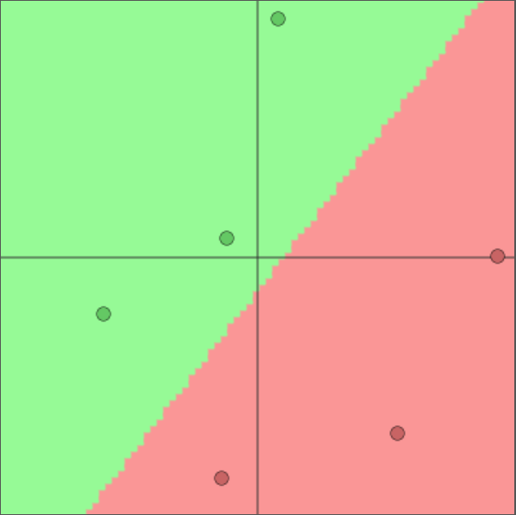
Example:
200
Skinny
Height (sm)
180
Learned decision boundary (from the training samples)
Machine Learning model
Overweight
160
60
80
Weight (kg)
100

Slide 18
Example:
200
Height (sm)
Hidden “correct” decision boundary (machine learning objective)
180
Actually learned decision boundary (machine learning outcome based on training samples)
160
60
80
Weight (kg)
100

Slide 19
Example:
200
Height (sm)
Hidden “correct” decision boundary (machine learning objective)
Vulnerability zone: area of potentially incorrect decisions by the target model and, at the same time, this is the space (“window of opportunity”) for the attackers aiming further “poisoning” the target decision model and, therefore, making the situation with the decision-making correctness even worth …
180
Actually learned decision boundary (machine learning outcome based on training samples)
Vulnerability zone
160
60
80
Weight (kg)
100

Slide 20
Example: Training set for supervised learning
DATA POISONING ATTACK
Weight (kg) | Height (sm) | Decision
67 | 175 | skinny
77 | 182 | skinny
82 | 198 | skinny
76 | 164 | overweight
91 | 167 | overweight
98 | 180 | overweight
Example: Poisoned samples
Weight (kg) | Height (sm) | Decision
96 | 199 | overweight
64 | 162 | skinny

Slide 21
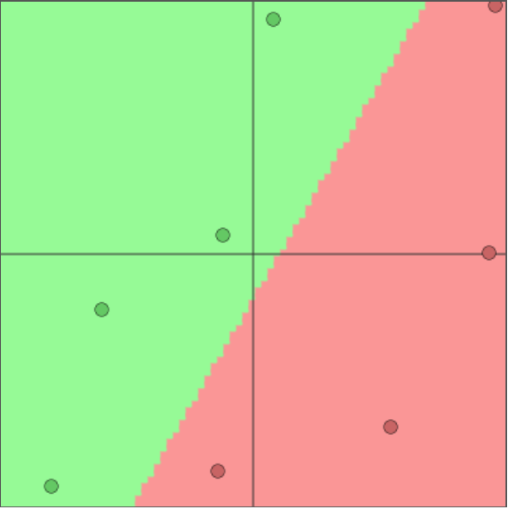
Example:
200
Poisoned sample
Height (sm)
Hidden “correct” decision boundary (machine learning objective)
180
Re-trained model: decision boundary (from training samples + new poisoned samples)
Vulnerability zone (expands)
Result of poisoning: larger vulnerability zone, which also means more opportunities for the attackers in further poisoning …
Poisoned sample
160
60
80
Weight (kg)
100

Slide 22
Example: impact of more poisoning
200
Poisoned sample
Poisoned samples
Height (sm)
Hidden “correct” decision boundary (machine learning objective)
Result of poisoning: larger vulnerability zone, which means incorrect decision-making in larger areas and which also means more opportunities for the attackers in further poisoning …
180
Re-trained model: decision boundary (from training samples + new poisoned samples)
Vulnerability zone (expands)
Poisoned samples
Poisoned samples
160
60
80
Weight (kg)
100

Slide 23
We are different but we have similar vulnerabilities
At certain level of abstraction we may assume that human vulnerabilities regarding Cognitive Hacking are similar to the vulnerabilities of Artificial Intelligence regarding Data Evasion, Data Poisoning, etc. attacks …

Slide 24
Artificial Intelligence (AI) threats and opportunities
AI, although being different from human intelligence, exposes similar vulnerabilities to adversarial attacks like:
poisoning data used for training AI (learning phase)
information manipulation (decision-making phase)
stealing data and knowledge (privacy violation, IPR)
deepfake (generation and extortion)
AI is the ONLY technology capable to detect, identify, attribute and counter above listed attacks
By learning how to protect AI cognitive capabilities we simultaneously learning to protect human decision-making processes. Main instrument for it is Adversarial Learning Technology

Slide 25
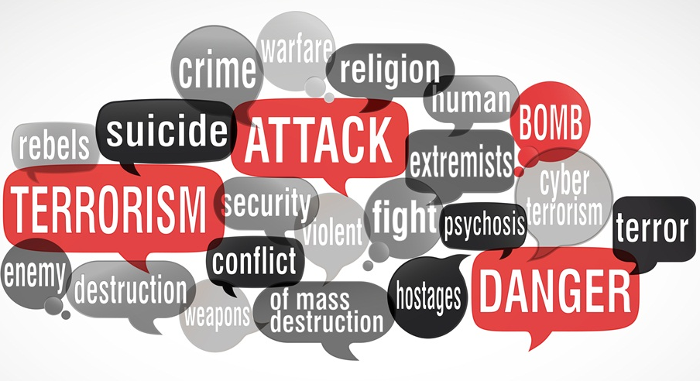
We will be also talking about Hybrid Threats (HT). What is the key aspect of HT and WARN team concern?
“Hybrid Threat is a coordinated activity, that … influences … decision making …”

Slide 26
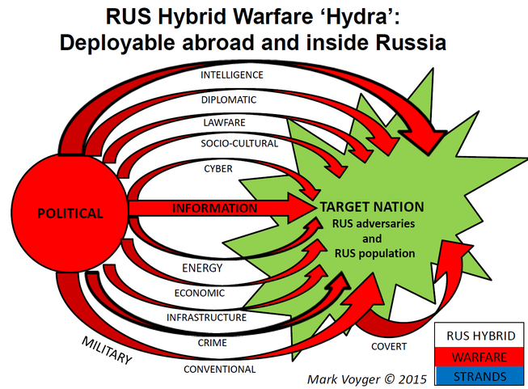
Key hybrid threat:
Provoking self-destruction by information
Information attacks aim to “awaken” hidden internal forces that may lead a nation to self-destruction
INFORMATION
COVERT

Slide 27
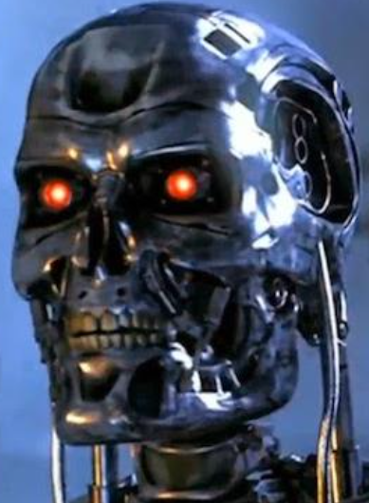
Artificial Intelligence (AI) and Hybrid Threats (HT):
- AI as source of HT;
- AI as target of HT;
- AI as instrument of HT;
- AI as defence from HT
Artificial Intelligence (AI) may be used and is used to enhance hybrid threats, while AI is vulnerable itself …

Slide 28
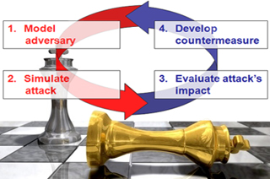
Adversarial Learning
Adversarial learning is a novel research field that lies at the intersection of machine learning and computer security. It addresses the following main open issues:
identifying potential vulnerabilities of machine learning algorithms during learning and classification;
devising the corresponding attacks and evaluating their impact on the attacked system;
proposing countermeasures to improve the security of machine learning algorithms against the considered attacks.
Adversarial learning usually focuses on attacks staged either at training (poisoning) or test time (evasion), together with the proposal of suitable countermeasures.
Reactive
Proactive

Slide 29
#G5511 “Cyber Defence for Intelligent Systems”
Artificial Intelligence has already
many real threats, and more new
ones are foreseen in near future
I M M U N E
AI
We cannot rely on a reactive approach towards the threats. We need an “Immunity” for AI !

Slide 30
Humanity have already many
hybrid threats, and more new
ones are foreseen in near future
We cannot rely on a reactive approach towards the threats. We need to train an “Immunity” for our minds !

Slide 31
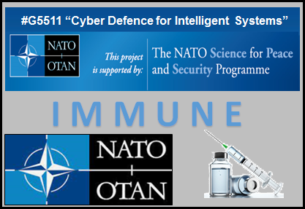
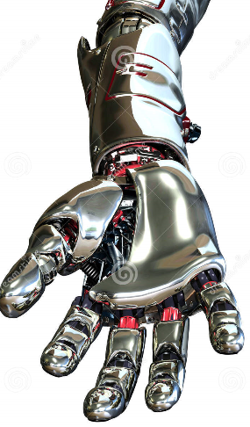
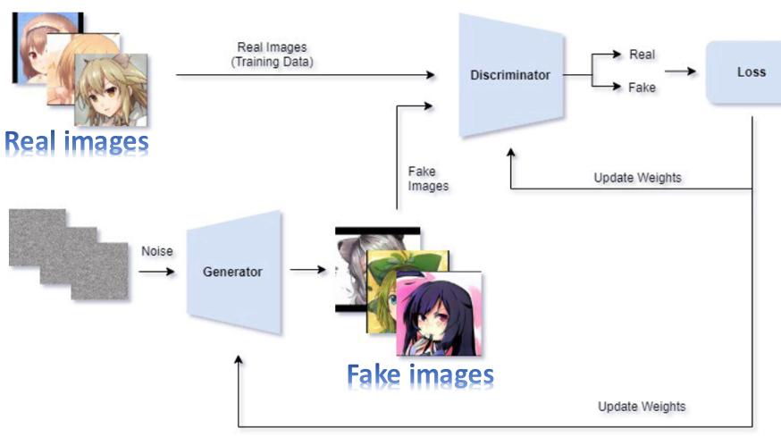
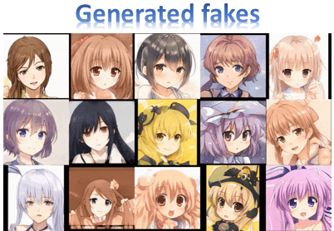
Our approach: Digital Immunity for Artificial Intelligence or for the “cognitive clones” of human decision-makers trained by “Smart Vaccination” and driven by Generative Adversarial Networks (GANs)
Artificial attacker
“Generator”
Artificial defender
“Discriminator”
VS
GAN
Artificial attacker “Generator” is trained to generate sophisticated, well-disguised and constantly improved attacks by creating fake data as an input to AI system
Artificial defender “Discriminator” is trained to distinguish between fake and real inputs coming to AI system and constantly improves the ability to repel the attacks

Slide 32
Poisoning vs. Vaccination:
just one “small” difference
Poisoning
Vaccination
In both cases we discover the vulnerability zone within the decision space and generate adversarial samples within it …
… then we either convert the adversarial samples into a POISON by assigning them the incorrect labels …
… or we convert the adversarial samples into a VACCINE by assigning them the correct labels .

Slide 33
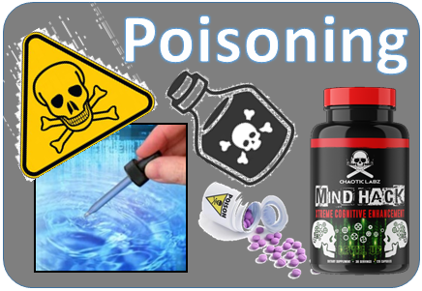
Poisoning vs. Vaccination
digital vaccine
“GREY” (IGNORANCE or CONFUSION) ZONE
digital poison

Slide 34
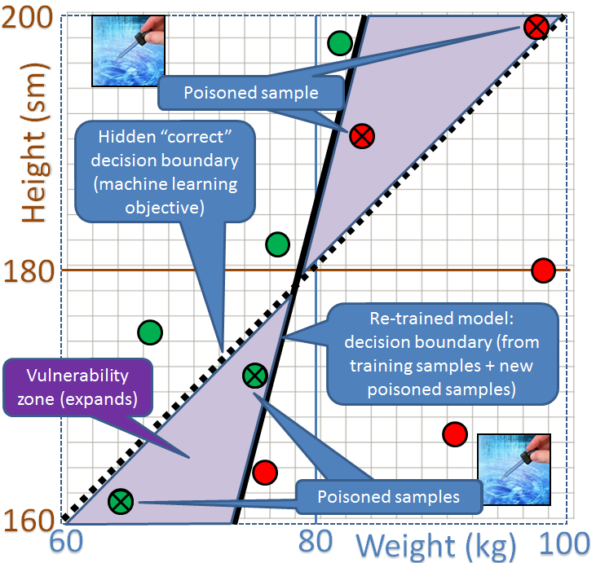
Remember? Poisoning example
The vulnerability zone within the decision space is discovered and adversarial samples within it are generated…
… then the adversarial samples within the vulnerability zone are deliberately converted into a POISON by incorrect labelling.

Slide 35
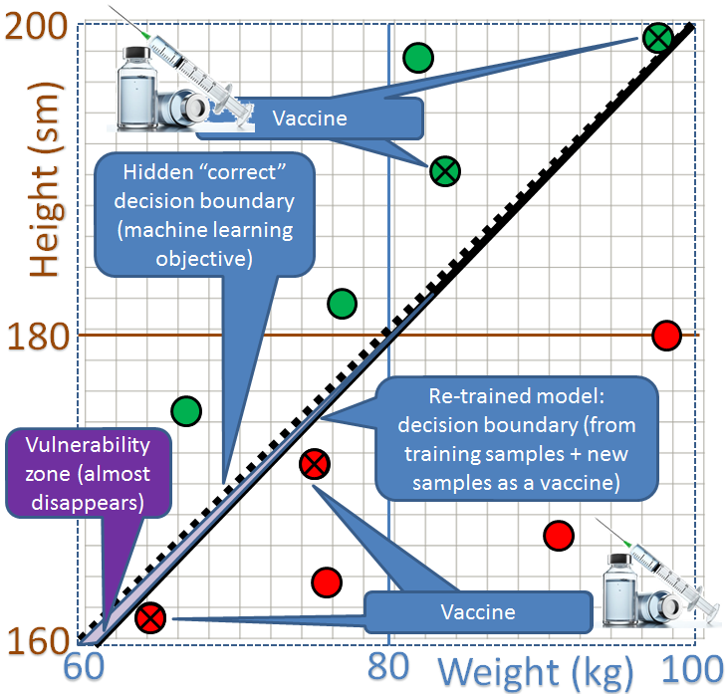
Vaccine instead of poison …
The vulnerability zone within the decision space is discovered and adversarial samples within it are generated…
… then the adversarial samples are converted into a VACCINE by assigning them the correct labels .

Slide 36
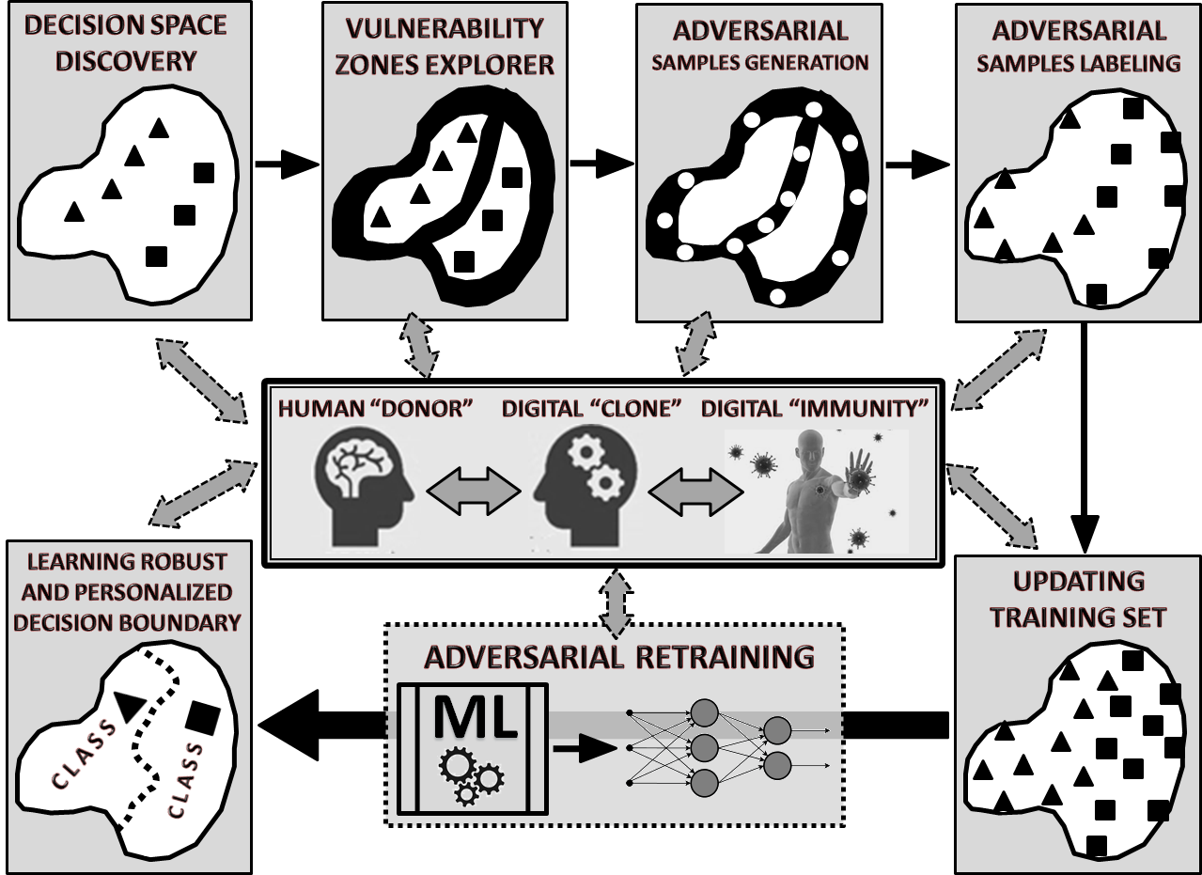
Similarity of two problems: (a) digital cloning and (b) digital vaccination
… as all three require vulnerability zones discovery and adversarial samples generation for further retraining …

Slide 37
Objective for WARN courses
The content of our courses essentially serves as a preventive vaccine that can strengthen the immunity of students against hybrid attacks (both internal and external) on their consciousness, conscience, responsibility, culture and value system.
“The learning objective and related intended learning outcomes of the new WARN-related courses or/and programs is not an update of personal knowledge, skills, beliefs or values (traditional outcomes) but the robustness and resilience of the already available ones (WARN project discovery and innovation) … “

Slide 38
… just as simple as …

Slide 39
Generic model of adversarial training in the classroom
(Attacker vs. Defender | Arbiter)
Attacker
Defender
VS
“Immune
System”
“Vaccine”
Arbiter
“Facilitator”

Slide 40
Generic model of adversarial training in the classroom

Slide 41
Simple conclusion “formula” (from IMMUNE to WARN)
- Artificial Intelligence is a double-edged weapon (for and against both: humans and autonomous systems);
- Machine-Learning-based systems are vulnerable as well and in similar way as human decision-making;
- Attackers are using Machine Learning to compromise Machine-Learning-based systems (and to design Hybrid Threats as well);
- Defenders must also use Machine Learning to prevent attackers to use Machine Learning against Machine-Learning-based systems (and to counter Hybrid Threats as well) ...;
- Within the “IMMUNE” project we provided the “fresh” view, some interesting solutions and implementations regarding the major problems of the Adversarial Machine Learning ..., which we also applied to counter Hybrid Threats (“WARN” project).

Slide 42
Puzzles of our
“From-IMMUNE-to-WARN” academic portfolio
(2018 - 2021)
Terziyan, V., Gryshko, S., & Golovianko, M. (2018). Patented Intelligence: Cloning Human Decision Models for Industry 4.0. Journal of Manufacturing Systems, 48 (Part C), 204-217. Elsevier. doi:10.1016/j.jmsy.2018.04.019
Terziyan, V., Golovianko, M., & Gryshko, S. (2018). Industry 4.0 Intelligence under Attack: From Cognitive Hack to Data Poisoning. In: K. Dimitrov (Ed.), Cyber Defence in Industry 4.0 Systems and Related Logistics and IT Infrastructure (NATO Science for Peace and Security Series D: Information and Communication Security, Vol. 51, pp. 110-125). IOS Press. https://doi.org/10.3233/978-1-61499-888-4-110
Terziyan, V., & Nikulin, A. (2019). Ignorance-Aware Approaches and Algorithms for Prototype Selection in Machine Learning. arXiv:1905.06054.
Terziyan, V., & Nikulin, A. (2021). Semantics of Voids within Data: Ignorance-Aware Machine Learning. ISPRS International Journal of Geo-Information, 10(4), 246. https://doi.org/10.3390/ijgi10040246
Gavriushenko, M., Kaikova, O., & Terziyan, V. (2020). Bridging Human and Machine Learning for the Needs of Collective Intelligence Development. Procedia Manufacturing, 42, 302-306. Elsevier. https://doi.org/10.1016/j.promfg.2020.02.092
Terziyan, V., Gavriushenko, M., Girka, A., Gontarenko, A., & Kaikova, O. (2021). Cloning and Training Collective Intelligence with Generative Adversarial Networks. IET Collaborative Intelligent Manufacturing, 3(1), 64-74. John Wiley and Sons Ltd. https://doi.org/10.1049/cim2.12008
Girka, A., Terziyan, V., Gavriushenko, M., & Gontarenko, A. (2021). Anonymization as Homeomorphic data Space Transformation for Privacy-Preserving Deep Learning. Procedia Computer Science, 180, 867-876. Elsevier. https://doi.org/10.1016/j.procs.2021.01.337
Terziyan, V., Gryshko, S., & Golovianko, M. (2021). Taxonomy of Generative Adversarial Networks for Digital Immunity of Industry 4.0 Systems. Procedia Computer Science, 180, 676-685. Elsevier. https://doi.org/10.1016/j.procs.2021.01.290
Golovianko, M., Gryshko, S., Terziyan, V., & Tuunanen, T. (2021). Towards Digital Cognitive Clones for the Decision-Makers: Adversarial Training Experiments. Procedia Computer Science, 180, 180-189. Elsevier. https://doi.org/10.1016/j.procs.2021.01.155
Semenets, V., Terziyan, V., Gryshko, S., & Golovianko, M. (2021). Assessment and Decision-Making in Universities: Analytics of the Administration-Staff Compromises. arXiv preprint arXiv:2105.10560.
Semenets, V., Gryshko, S., Golovianko, M., Shevchenko, O., Titova, L., Kaikova, O., Terziyan, V., & Tiihonen, T. (2021). How the University Portal Inspired Changes in the Academic Assessment Culture. arXiv preprint arXiv:2105.14154
Terziyan, V., & Kaikova, O. (2021). Neural Networks with Disabilities: An Introduction to Complementary Artificial Intelligence. Neural Computation, 33, 1-36. MIT Press. https://doi.org/10.1162/neco_a_01449
Terziyan, V., Golovianko, M., Branytskyi, V., Malyk, D., & Gryshko, S. (2021). Implementing and Training the Immune System (Attack Detector). Technical Report (Annex 3, Deliverable 3, pp. 1-19). NATO SPS G511 Project IMMUNE: “Cyber-Defence for Intelligent Systems”. http://recode.bg/natog5511/wp-content/uploads/2021/05/ANNEX-3-Deliverable-3_NURE-and-JYU-G5511.pdf .
Branytskyi, V., Golovianko, M., Gryshko, S., Malyk, D., Terziyan, V., & Tuunanen, T. (2021). Digital Clones and Digital Immunity: Adversarial Training Handles Both. International Journal of Simulation and Process Modelling. (To appear).
Kumpulainen, S., & Terziyan, V. (2022). Artificial General Intelligence vs. Industry 4.0: Do They Need Each Other? Procedia Computer Science. Elsevier. (To appear).
Terziyan, V., & Vitko, O. (2022). Explainable AI for Industry 4.0: Semantic Representation of Deep Learning Models. Procedia Computer Science. Elsevier. (To appear).
Branytskyi, V., Golovianko, M., Malyk, D., & Terziyan, V. (2022). Generative Adversarial Networks with Bio-Inspired Primary Visual Cortex for Industry 4.0. Procedia Computer Science. Elsevier. (To appear).
Golovianko, M., Gryshko, S., Terziyan, V., & Tuunanen, T. (2022). Responsible Cognitive Digital Clones as Decision Makers: A Design Science Research Study. European Journal of Information Systems. Submitted (under review).
IMMUNE
WARN

Slide 43
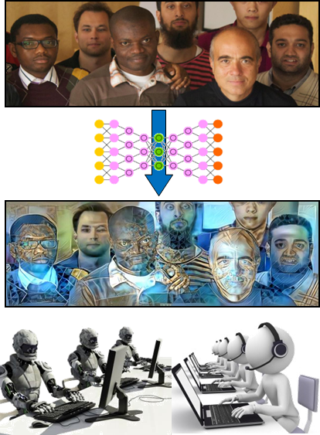
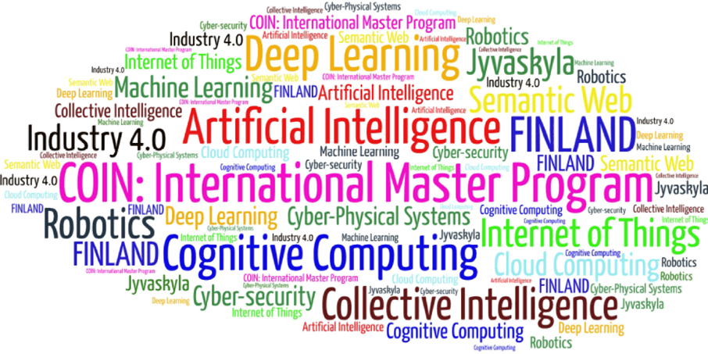
Project results within the courses of COIN Master Program
COIN: Cognitive Computing and Collective Intelligence …
… the first university program for collective intelligence, where humans learn together with their digital clones and autonomous and secure digital assistants …
http://www.jyu.fi/ai
COIN

Slide 44
Link to the presentation: https://ai.it.jyu.fi/EVF-2021.pptx
AI
Contact: vagan.terziyan@jyu.fi

Slide 45
Thank you, Moumen, thank you ECAM-EPMI, thank you, France, for being an excellent partner …

