Slide 1
“Resilience Training in Higher Education: AI-Assisted Collaborative Learning”
Svitlana Gryshko ª, Vagan Terziyan ^{b}, Mariia Golovianko ª
ª Department of Artificial Intelligence, Kharkiv National University of Radio Electronics, Kharkiv, Ukraine
^{b} Faculty of Information Technology, University of Jyväskylä, Jyväskylä, Finland
https://www.jyu.fi/en/
https://nure.ua/en/

Slide 2
“Resilience Training in Higher Education: AI-Assisted Collaborative Learning”
Paper # 1391
Svitlana Gryshko, Vagan Terziyan & Mariia Golovianko
Tallinn University of Technology
26 September, 2024, 08:15 - 08:30
Session: 4E
EEST — Eastern European Summer Time

Slide 3
Authors
“Resilience Training in Higher Education: AI-Assisted Collaborative Learning”
Svitlana Gryshko
Vagan Terziyan
vagan.terziyan@jyu.fi
Mariia Golovianko
https://nure.ua/en/
https://www.jyu.fi/en/
https://nure.ua/en/

Slide 4
Human
AI
BROADER CONTEXT OF OUR STUDY:
Education Meets New Challenges

Slide 5
Our confession:
Artificial Intelligence (AI), which is the intelligence shown by machines, has become so strongly embedded in our lives (including education) that picturing existence without its guiding hand is like imagining a world without electricity.
https://www.forbes.com/sites/naveenjoshi/2022/08/02/7-ways-ai-will-affect-humans-in-our-future/
Our focus today!

Slide 6
Education as a complex cyber-physical-social system
“Education 5.0”
Modern Education, with its interconnected learning environments, can be conceptualized as complex cyber-physical-social system, where digital platforms, physical classrooms, and social interactions converge to shape their effectiveness and functionality.
EDUCATION 4.0
EDUCATION 5.0
Industry 4.0
Industry 5.0
Much like the transition from Industry 4.0 to Industry 5.0 emphasizes the recovery of the human role and resilience in industrial processes, the transformation from Education 4.0 to Education 5.0 underscores empowering learners to improve adaptability and creativity, enhancing resilience against contemporary challenges, including hybrid threats.

Slide 7
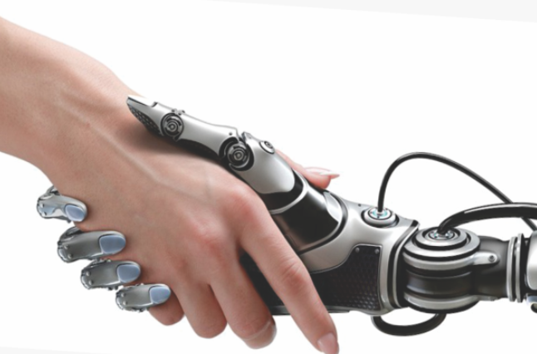
AI used in education meets challenges …
Digital Overload
Pandemics
Hybrid Threats
Artificial Intelligence as a digital recovery, sustainability and resilience enabler
EDUCATION
Cyberattacks
AI
Emergencies
Crashes

Slide 8
… these change Human + AI collaboration scenarios …
AI meets also the new challenges …
Artificial Intelligence as a digital recovery, sustainability and resilience enabler
EDUCATION
Refugee
AI
Crisis

Slide 9
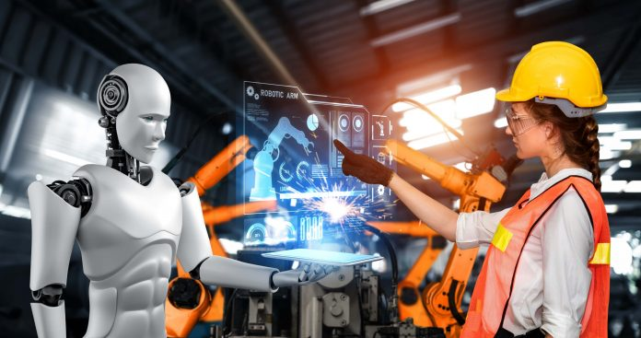
The need for resilience changes everything …
AI vs. Human in Industry
Resilience
≈
AI strengths
Human vulnerabilities
Resilient Industry
≈
AI vulnerabilities
Human strengths

Slide 10
The need for resilience changes everything …
Resilience
AI vs. Human in Education
≈
AI strengths
Human vulnerabilities
Resilient Education
≈
AI vulnerabilities
Human strengths

Slide 11
Potential solution for resilient education
To enable resilient and efficient (hybrid) Education of the future we need:
humans enhanced by autonomous AI;
autonomous AI “with human face” …
Resilient Education
… and which will inherit the most valuable features of both - efficiency of the processes and sustainability of the decisions.
Digital cognitive clones (i.e., twinning human decision-making behavior) could be an enabling technology for the future hybrid and as an accelerator (as well as resilience enabler) of the convergence of digital and human worlds ...
21 Lessons shows us where we are today …

Slide 12
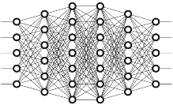
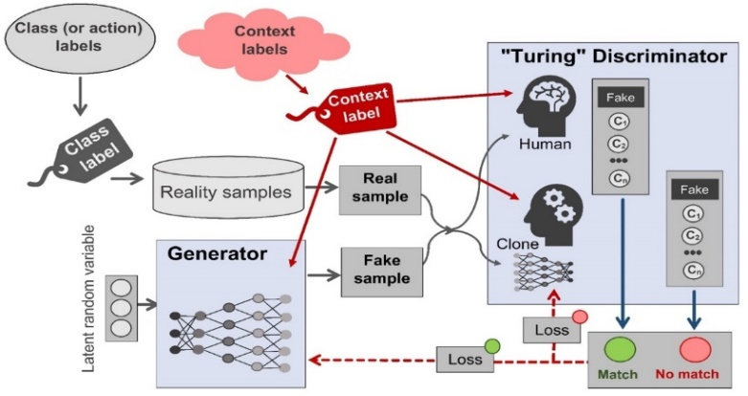
Broader context of our research:
Hybrid approaches towards future resilient Industry and Education using AI-Clones-of-Humans as mediators
Terziyan, V., Gryshko, S., & Golovianko, M. (2018). Patented Intelligence: Cloning Human Decision Models for Industry 4.0. Journal of Manufacturing Systems, 48 (Part C), 204-217. Elsevier. https://doi.org/10.1016/j.jmsy.2018.04.019
Golovianko, M., Gryshko, S., Terziyan, V., & Tuunanen, T. (2021). Towards Digital Cognitive Clones for the Decision-Makers: Adversarial Training Experiments. Procedia Computer Science, 180, 180-189. Elsevier. https://doi.org/10.1016/j.procs.2021.01.155. Presentation: https://ai.it.jyu.fi/ISM-2020-Pi-Mind.pptx
HUMAN
AI
Terziyan, V., Gavriushenko, M., Girka, A., Gontarenko, A., & Kaikova, O. (2021). Cloning and Training Collective Intelligence with Generative Adversarial Networks. IET Collaborative Intelligent Manufacturing, 3(1), 64-74. John Wiley and Sons Ltd. https://doi.org/10.1049/cim2.12008
clone
Agents as autonomous cognitive “clones” of humans
Golovianko, M., Gryshko, S., Terziyan, V., & Tuunanen, T. (2022). Responsible Cognitive Digital Clones as Decision Makers: A Design Science Research Study. European Journal of Information Systems, 32(5), 879–901, https://doi.org/10.1080/0960085X.2022.2073278
Golovianko, M., Terziyan, V., Branytskyi, V., & Malyk, D., (2023). Industry 4.0 vs. Industry 5.0: Co-existence, Transition, or a Hybrid. Procedia Computer Science, 217, 102-113. Elsevier. https://doi.org/10.1016/j.procs.2022.12.206.
Presentation: https://ai.it.jyu.fi/ISM-2022-Industry_4_5.pptx
Terziyan, V., & Tiihonen, T. (2024). Using Cloning-GAN Architecture to Unlock the Secrets of Smart Manufacturing: Replication of Cognitive Models. Procedia Computer Science, 232, 890-902. Elsevier. https://doi.org/10.1016/j.procs.2024.01.089
Presentation: https://ai.it.jyu.fi/ISM-2023-Cloning_GAN.pptx
Terziyan, V., & Kaikova, O. (2024). Hybrid Additive Manufacturing: A Convergence of Physical, Digital, and Social Realms Driven by Generative AI. Lecture Notes in Computer Science, 14748, 427–441. Springer. https://doi.org/10.1007/978-981-97-4677-4_35 Presentation: https://ai.it.jyu.fi/IEAAIE-2024-HAM.pptx

Slide 13
Collaborative Decision Making
(both intuitive-emotional vs. pragmatic-rational)
Individual reasoning
Coordinated reasoning

Slide 14
Sitting at the round table of collaborative decision-making:
Does it matter who?
vs

Slide 15
Two opposite (homogeneous) scenarios
I
decision makers are humans
decision makers are autonomous AI agents
II

Slide 16
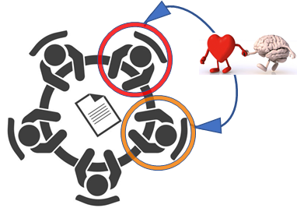
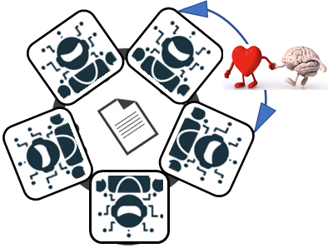
Humans vs. Autonomous AI Performance
Today and “Tomorrow”
2024
2029
Skills in adversarial games | Artificial Intelligence | Human
General awareness
Classified awareness
Inferred awareness
Intuitive awareness
Decision-making
Adversarial robustness
Collaboration
Skills in adversarial games | Artificial Intelligence | Human
General awareness
Classified awareness
Inferred awareness
Intuitive awareness
Decision-making
Adversarial robustness
Collaboration
Mark of better performance

Slide 17
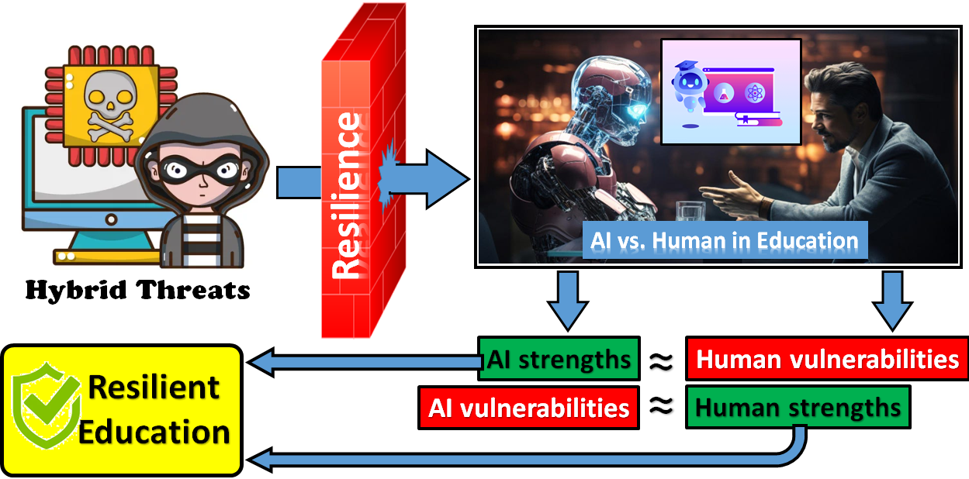
Sustainable effect of collective (“hybrid”) intelligence
Good so far …
… better soon …
… sustainably the best

Slide 18
Sustainable effect of collective (“hybrid”) intelligence
>
>
<
now
in 5 years
>
Human
AI

Slide 19
Hybrid Threats
NARROWING CONTEXT OF OUR STUDY:
Approaching Resilience through Education

Slide 20
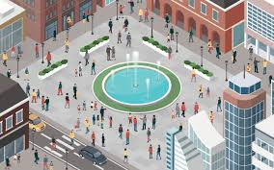
Cyber-Physical-Social Systems
Education of the Future is about emerging Cyber-Physical-Social Systems, which are populated and controlled by efficient, robust, and resilient Collective Intelligence essential for functioning, sustainability, and safety of educational institutions, learning environments, social interactions, and the broader knowledge economy.
Collective Intelligence
Future Education Infrastructure
Humans and artificial decision makers
Artificial decision-makers are autonomous models specially trained (by Machine Learning on the basis of available data) to make decisions by addressing certain observations.
Flexible infrastructure of heterogeneous systems, facilities, assets, technologies, networks and processes

Slide 21
Cyber-Physical-Social Systems
Which of these is more vulnerable for a hacking attack: infrastructure or intelligence?
Collective Intelligence
Future Education Infrastructure
“… professionals target people”
[B. Schneier (2000). Semantic Attacks…]
“Only amateurs attack machines…”
[B. Schneier (2000). Semantic Attacks…]

Slide 22
Cognitive Hack as an emergent CyberThreat
Cognitive Hack

Slide 23
We are different but we have similar vulnerabilities
At certain level of abstraction we may assume that human vulnerabilities regarding Cognitive Hacking are similar to the vulnerabilities of Artificial Intelligence regarding Data Evasion, Data Poisoning, etc. attacks …

Slide 24
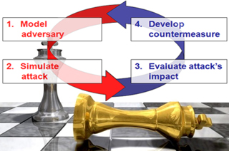
Adversarial Learning
Adversarial learning is a novel research field that lies at the intersection of machine learning and computer security. It addresses the following main open issues:
identifying potential vulnerabilities of machine learning algorithms during learning and classification;
devising the corresponding attacks and evaluating their impact on the attacked system;
proposing countermeasures to improve the security of machine learning algorithms against the considered attacks.
Adversarial learning usually focuses on attacks staged either at training (poisoning) or test time (evasion), together with the proposal of suitable countermeasures.
Reactive
Proactive

Slide 25
Artificial Intelligence has already
many real threats, and more new
ones are foreseen in near future
#G5511 “Cyber Defence for Intelligent Systems”
I M M U N E
http://recode.bg/natog5511/
AI
We cannot rely on a reactive approach towards the threats. We need an “Immunity” for AI !

Slide 26
Humanity have already many
hybrid threats, and more new
ones are foreseen in near future
https://warn-erasmus.eu/
https://ai.it.jyu.fi/WARN.pptx
We cannot rely on a reactive approach towards the threats. We need to train an “Immunity” for our minds !
Read more about IMMUNE and WARN projects here:
Kaikova, O., Terziyan, V., Tiihonen, T., Golovianko, M., Gryshko, S., & Titova, L. (2022). Hybrid Threats against Industry 4.0: Adversarial Training of Resilience. E3S Web of Conferences, 353, 03004. https://doi.org/10.1051/e3sconf/202235303004
Presentation slides: https://ai.it.jyu.fi/EVF-2021.pptx

Slide 27
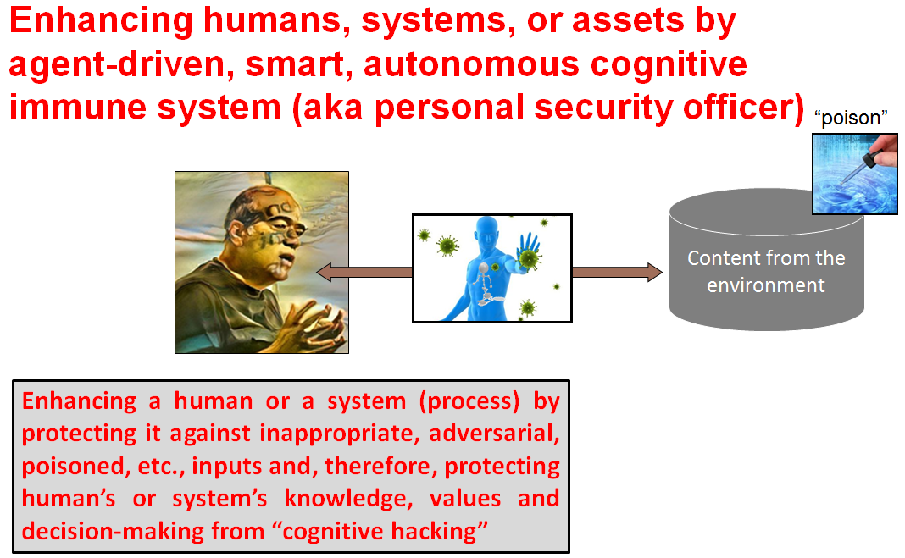
Poisoning vs. Vaccination:
just one “small” difference
Digital Immunity

Slide 28
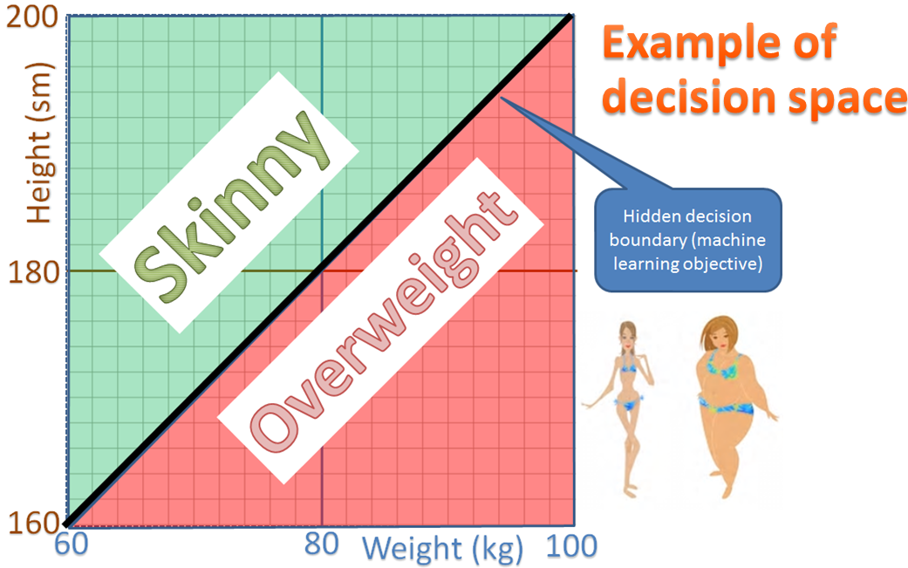
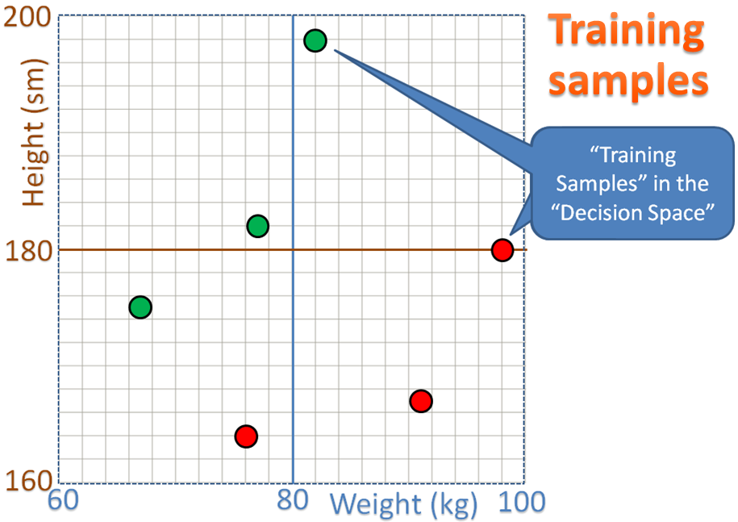
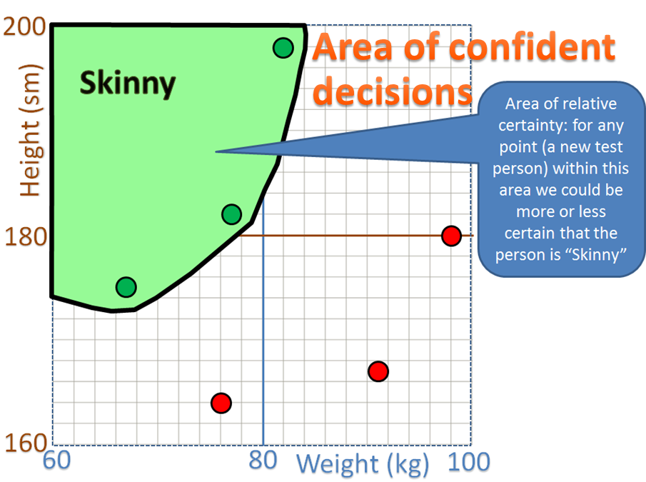
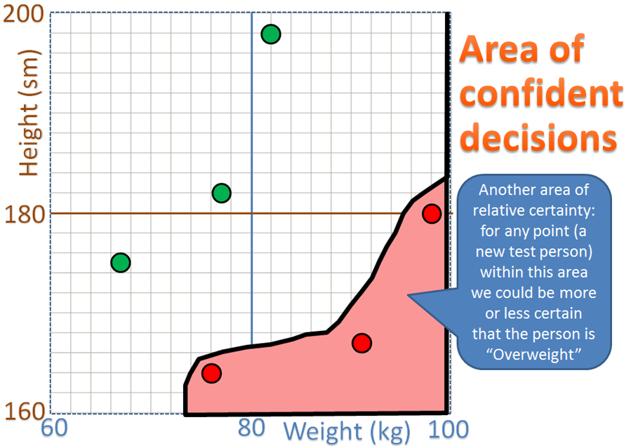
Poisoning vs. Vaccination:
more details on how these work
(click on small image to enlarge)
Find more in and cite as:
Terziyan, V., Golovianko, M., & Gryshko, S. (2018). Industry 4.0 Intelligence under Attack: From Cognitive Hack to Data Poisoning. In: K. Dimitrov (Ed.), Cyber Defence in Industry 4.0 Systems and Related Logistics and IT Infrastructure (NATO Science for Peace and Security Series D: Information and Communication Security, Vol. 51, pp. 110-125). IOS Press. https://doi.org/10.3233/978-1-61499-888-4-110
Related Presentations: https://ai.it.jyu.fi/nato/NATO.pptx ; https://ai.it.jyu.fi/WARN.pptx

Slide 29
Objective for WARN courses
“The learning objective and related intended learning outcomes of the new WARN-related courses or/and programs is not an update of personal knowledge, skills, beliefs or values (traditional outcomes) but the robustness and resilience of the already available ones (WARN project discovery and innovation) … “
The content of our courses essentially serves as a preventive vaccine that can strengthen the immunity of students against hybrid attacks (both internal and external) on their consciousness, conscience, responsibility, culture and value system.

Slide 30
… just as simple as …

Slide 31
Generic model of humans’ adversarial training in classroom
(Attacker vs. Defender | Arbiter)

Slide 32
Generic model of adversarial immunity training in classroom

Slide 33
EXPERIMENTAL STUDY:
Adversarial Learning of Resilience in Classroom

Slide 34
Our key hypotheses about AI (LLMs) impact:
S
W
Paradox of collective/hybrid intelligence
W
S
AI
AI
|StrongHuman − WeakHuman| > |(StrongHuman + LLM) − (WeakHuman + LLM)|
Hypothesis #1: The use of LLMs improves the level of argumentation of each player.
Hypothesis #2: Adversarial dialogue in the classroom improves the level of argumentation of each player.
Hypothesis #3: Competitive interaction among players with hybrid (human + LLM) collective intelligence accelerates human development.
Hypothesis #4: Competitive interaction among players with hybrid collective intelligence reduces the cognitive gap, pulling weak players up to the level of strong players.

Slide 35
Prepare for the experiments:
Split students by dilemma question
Round-I experiments’ dilemma:
“If you had a choice of only these two options, what would you choose:
Exercise but not follow a healthy diet;
Consume only healthy food but do not exercise at all?”
Consequently, 178 Round-I respondents were divided:
53% (94 students);
47% (84 students)
Round-II experiments’ dilemma:
“If you were faced with such a choice, what would you choose:
find yourself in an unfamiliar country with a high standard of living and almost no crime with $100 in your pocket
find yourself with $1,000,000, but in one of the poorest countries with high levels of crime and poverty?”
Consequently, 164 Round-II respondents were divided:
48% (79 students);
52% (85 students)
$$≈50\%$$
$$≈50\%$$

Slide 36
Grouping students to 4 types of groups
Dilemma choice A
Dilemma choice B
IT
EC
EN
$$≈\frac{1}{2}$$
$$≈\frac{1}{2}$$
Inf. Technology
Economics
Engineering
A L L S T U D E N T S
$$≈\frac{1}{2}$$
Weak
W
W
…
…
$$≈\frac{1}{2}$$
Strong
S
S
…
…

Slide 37
Multiple completion pairs at the different stages of the experiments
Weak vs. Weak
AI-Enhanced-Weak vs. AI-Enhanced-Weak
W
W
W
W
Weak vs. Strong
AI-Enhanced-Weak vs. AI-Enhanced-Strong
W
S
W
S
Each experiment consisted of a documented and assessed adversarial dialogue within each pair where opponents iteratively argued their initially opposite starting opinions regarding a particular issue or dilemma question.
S
W
S
W
Strong vs. Strong
AI-Enhanced-Strong vs. AI-Enhanced-Strong
S
S
S
S

Slide 38
Metric to assess argumentation
Each experiment consisted of a documented and assessed adversarial dialogue within each pair where opponents iteratively argued their initially opposite starting opinions regarding a particular issue or dilemma question. Each adversarial iteration within each stage of each experiment was assessed using four methods: (1) player self-assessment, (2) adversary assessment, (3) tutor assessment, and (4) integral Toulmin assessment. Personal assessments (self point, opponent’s point, and tutor’s point) were scored such that (+1) point was given to the winner, (-1) point to the loser, and 0 points if it was a draw.
The Toulmin model considers an argument as a system of components that interact and can be evaluated: Claim (C), Grounds (G), Warrant (W), Backing (B), Rebuttal (R) and Qualifier (Q). In this study, a ternary metric was developed to evaluate each of the six attributes in the Toulmin model: (+1) if the attribute is present, correctly expressed, adequate, and relevant; (-1) if the attribute is present but incorrectly expressed, inadequate, or irrelevant; (0) if the attribute is absent. Each presented argument was assessed using this scale as follows:
Toulmin points = [∑C] + [∑G] + [∑W] + [ ∑B] + [∑R] + [∑Q]
The final result of each player in each round, termed the mass of argumentation (A-Mass), is calculated as follows:
A-Mass = [Toulmin points] + [self points] + [adversary points] + [tutor points]

Slide 39
Results
Each of the 42 students received 9 initial assessments per round, which were consolidated into the final mass of argumentation. Since each of the 42 students participated in 8 rounds of intellectual sparring, the total number of measurements conducted is 3,024. These initial data were transformed into 336 resulting indicators (for each of the 42 players over 8 rounds), representing the calculated mass of argumentation. Throughout the experiment, the overall mass of argumentation increased by 12.68 times.
Visualization of the experimental results’. On the X-axis are the players (42 points) marked with their player number, level, and domain. The Y-axis represents the mass of argumentation for each player in a specific round. The lines connect the results of each round (color codes and round numbers are below the graph).

Slide 40
OBSERVATIONS AND CONCLUSIONS

Slide 41
Discussions and conclusions regarding results (Part - I)
Parameter | Group | Observation | Discussion
Adversarial Training Dynamics | “Strong” Pairs | Strong students maintained leadership through all rounds | Adversarial training among strong students showed consistent leadership, but the introduction of LLMs narrowed the gap, emphasizing the positive impact of AI tools on argumentation skills
 | “Mixed” Pairs | Strong students consistently outperformed weak ones, with some weakening in the weak students’ performance | The use of LLMs improved strong students’ performance, but some weak students struggled. Despite the overall gap, the weak participants significantly improved through competitive practice, showcasing the potential of adversarial training.
 | “Weak” Pairs | No clear leaders, low initial scores, improvement with LLMs, and increased competitiveness among weak students | LLMs had a limited impact on the weak students’ initial low scores. However, competitive practice allowed weak students to approach the level of strong students, highlighting the effectiveness of adversarial training in the absence of strong opponents
Influence of LLMs | All groups | LLMs contributed to narrowing the performance gap and improving overall scores in most groups | The application of LLMs positively influenced argumentation, evidenced by increased scores and closer competition. However, individual responses varied, indicating the need for tailored approaches based on participant characteristics.
Competitiveness and Performance Improvement | All groups | Competitive practice significantly improved weak students' performance | Search for counterarguments with the help of LLMs
Impact on Resilience | All groups | Resilience was evident in participants adapting and improving through the adversarial process | Formation of the final argumentation of one’s own position

Slide 42
Discussions and conclusions regarding results (Part - II)
Parameter | Group | Observation | Discussion
Adversarial Training Dynamics | “Strong” Pairs | Experience gained in Part I led to an increase in absolute scores in all rounds | Consistent leadership was maintained by strong students, indicating the impact of prior adversarial training. The application of LLMs further enhanced argumentation, showcasing continued positive dynamics
 | “Mixed” Pairs | Absolute scores increased in both teams, with a noticeable gap between strong and weak students | Strong students continued to outperform weak ones, and the use of LLMs improved performance overall. However, the gap persisted, indicating that competition with weak students presented different challenges for the strong group
 | “Weak” Pairs | Absolute scores significantly increased compared to Part I, showcasing improvement | LLMs contributed to performance improvement, but the gap persisted. Competitive practice allowed weak students to approach the level of strong students, highlighting the continued effectiveness of adversarial training
Influence of LLMs | All groups | LLMs continued to contribute to narrowing the performance gap and improving overall scores | The positive influence of LLMs on argumentation skills was evident. However, variations in individual responses emphasized the need for personalized approaches based on participant characteristics
Competitiveness and Performance Improvement | All groups | Competitive practice remained crucial for overall performance improvement | The competitive nature of the exercises continued to play a vital role in enhancing weak students’ performance. Adversarial training consistently fostered improvement, demonstrating its resilience-building effect
Impact on Resilience | All groups | Resilience was evident as participants adapted and improved through continued adversarial training | Part II of the experiments reaffirmed that adversarial training, coupled with AI tools, contributes to the development of resilient minds. Participants adapted strategies, showcased competitiveness, and leveraged technology for improved argumentation, reinforcing its potential in addressing hybrid threats

Slide 43
Result of experiments before and after “Prompt engineering” lectures
Mass of argumentation
“Do not expect too much from the Artificial Intelligence, if you cannot use it properly …”
[our team’s quota]

Slide 44
Hypotheses vs. Experimental Evidence:
Hypothesis #1
Experimental Evidence. Hypothesis #1 has been confirmed, but with certain caution. Indeed, argumentation with LLMs becomes better. In fact, everyone now has a chance to become a leader. The general use of LLMs improves self-esteem—the weak stop underestimating themselves. However, on its own, it is unable to elevate the “weak” to the level of the “strong” in just a few iterations.
Hypothesis #1: The use of LLMs improves the level of argumentation of each player.

Slide 45
Hypotheses vs. Experimental Evidence:
Hypothesis #2
Experimental Evidence. Hypothesis #2 has been confirmed, but with certain caution. It seems that it is important for the strong to compete with the strong in order to grow; while the weak grow, even if they compete with the weak. Competition itself leads to improved performance for all participants. However, the difference between the levels (weak - strong) not only remains but is also imprinted – the weak lose their incentive over time, and the strong “relax”, even in homogeneous groups.
Hypothesis #2: Adversarial dialogue in the classroom improves the level of argumentation of each player.

Slide 46
Hypotheses vs. Experimental Evidence:
Hypothesis #3
Experimental Evidence. Hypothesis #3 has been confirmed completely. Adversarial use of LLMs (especially after prompt engineering education!) absolutely leads to the transition of results to a new quantitative and qualitative level for all the participants.
Hypothesis #3: Competitive interaction among players with hybrid (human + LLM) collective intelligence accelerates human development.

Slide 47
Hypotheses vs. Experimental Evidence:
Hypothesis #4
Hypothesis #4: Competitive interaction among players with hybrid collective intelligence reduces the cognitive gap, pulling weak players up to the level of strong players.
Experimental Evidence. Hypothesis #4 has been confirmed, but under certain conditions. The use of LLMs indeed reduces the cognitive gap, but only if one learns to use it properly.

Slide 48
Additional Unforeseen Observations:
Observation #1
All rounds of experiments demonstrated that the use of LLMs increases the mass of argumentation, and accordingly, the robustness and resilience against the shifts-in-position-attempts, or cognitive-hack-adversarial-hybrid-attacks, as well as other manipulations.

Slide 49
Additional Unforeseen Observations:
Observation #2
LLMs have significantly greater potential for cognitive defense (if the truth is in the initial settings of the defender) than for cognitive attack (if manipulation is in the initial settings of the attacker). A person does not always realize the logic on which their initial stance is based, even if it is truthful. Thus, an attacker has a chance to shake their position with crafty manipulative argumentation. However, AI is a tool of logic, and in the pair Human+LLM, it enhances the logicality of conclusions, helping the defender structure reasoning to understand the truth of their position. Nevertheless, if the attacker strengthens their position with LLMs, they will find much less support because manipulation has distorted logic.
In the confrontation “Attacker vs. Defender”, the attacker has more chances of success than in the pair “Attacker + AI vs. Defender + AI”.

Slide 50
Additional Unforeseen Observations:
Observation #3
Using LLM tools requires more than just the ability to work with an application program. Observing the players showed that the sudden growth in effectiveness appeared with the emergence of some “chemistry” between Human and LLMs. The inspiration of a person in a task or question provoked LLMs to give extraordinary creative responses, and vice versa. We observed that the dynamic and mutual exchange of ideas between Human and LLMs leads to shared motivation and creativity among both participants of different natures (human and artificial), i.e., “human-AI co-inspiration”.

Slide 51
Summary of unforeseen: “AI is strong already, but it will perform much better if used wisely, professionally, and for the good purpose …”

Slide 52
Humans and ChatGPT:
“A monkey with a grenade”?
How quickly ChatGPT (and other GPT-based Large Language Models) has woven itself into the fabric of our daily lives in less than two years! But as we ponder its omnipresence, we are left to wonder: is this newfound reliance a blessing or a burden?

Slide 53
Our latest research:
AI-as-a-user-of-AI
(decision-making as a self-supervised, self-policy-driven chat with oneself)
Cite as:
Shukla, A.K., Terziyan, V., & Tiihonen, T. (2024). AI as a User of AI: Towards Responsible Autonomy. Heliyon. 10(11), e31397. Cell Press.

Slide 54
General conclusive point
Advanced generative AI, in the context of emerging hybrid threats, brings additional (never seen before!) challenges as well additional (never seen before!) opportunities for the education as whole, and particularly for special adversarial training of the collaborative (hybrid) decision-making, robustness, and resilience of own minds, knowledge, and skills against potential hybrid threats and all kinds of manipulations.
AI

Slide 55
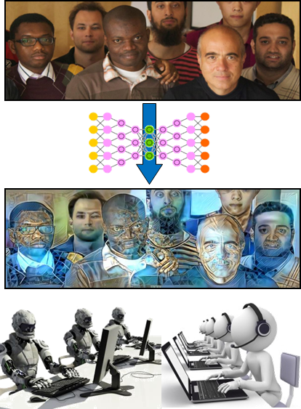
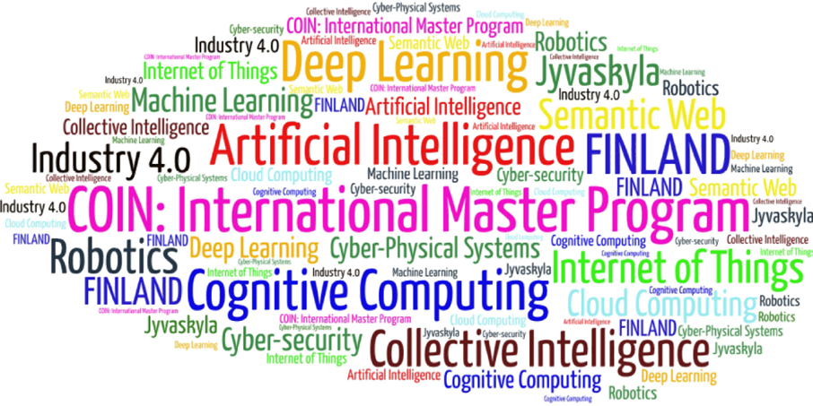
Come to study at our International Master Program
Artificial Intelligence
(former COIN: Cognitive Computing and Collective Intelligence)
… the first university program for collective intelligence, where humans learn together with their digital clones and autonomous AI-driven digital assistants …
http://www.jyu.fi/ai
AI

Slide 56
Link to the presentation: https://ai.it.jyu.fi/ICL-2024-RESILIENCE.pptx
Contact: vagan.terziyan@jyu.fi

