Slide 1
Exploring the Social Impact of Multidisciplinary, Multicultural Hybrid Collaborative Learning Across Diverse Domains
Dr. Mariia Golovianko¹, Dr. Svitlana Gryshko¹, Dr. Olena Kaikova²,
Dr. Oleksandr Shevchenko¹, Prof. Vagan Terziyan², and Dr. Rafik Absi³
¹ Kharkiv National University of Radio Electronics, Kharkiv, Ukraine
² University of Jyväskylä, Jyväskylä, Finland
³ ECAM EPMI - école d'ingénieurs généraliste à Paris Cergy, France
24–27 September 2024, TalTech, Tallinn, Estonia

Slide 2
ABOUT THE SPEAKER
Associate Professor, Department of Artificial Intelligence, NURE
Researcher.
An academic expert in Horizon 2020, COST, TEMPUS, NATO SPS, ERASMUS + Projects;
A member of the trans sectoral academic WARN environment and MetaIntelligence Lab.
Collaboration with ECAM-EPMI, University of Jyvaskyla, University of Jaen, University of Coimbra, University of Tartu and others...
Research interests: Collective Intelligence, AI Security, Adversarial Machine Learning, Industry 5.0, Hybrid Threats, Knowledge Informed Machine Learning, Ontologies, Semantic Technology, Information Retrieval, Collaborative Learning.
MARIIA GOLOVIANKO
PhD, Associate Professor
AI Department
Metaintelligence Lab
Kharkiv National University
of Radio Electronics
http://nure.ua/en/staff/mariia-golovianko
mariia.golovianko@nure.ua

Slide 3
RESEARCH OUTLINE
Hypothesis: Collaboration, encompassing international, multicultural, and multidisciplinary aspects, leads to positive outcomes in terms of personal development, cross-cultural understanding, innovation, societal change, and even national security.
Qualitative methods of research:
Analysis of 17 years of the international collaborative learning.
Interviews, case studies and participant observations, documents and communications produced by the program.
Tracking graduates over time to assess the long-term impact of the program on career progression, innovation output, or societal contributions
Analysis of correlations between program dynamics and global trends in digital and societal transformation.
Quantitative methods of research:
Data analytics provided by SciVal;
Social impact metrics: The UN`s Sustainable Development Goals (SDGs).
Participants:
More than 500 students from France (ECAM-EPMI, ITIN/ITESCIA) and Ukraine (NURE)
More than 30 members of universities` staff, industrial experts, members of chambers of commerce and business incubators’ representatives from FR and UA.

Slide 4
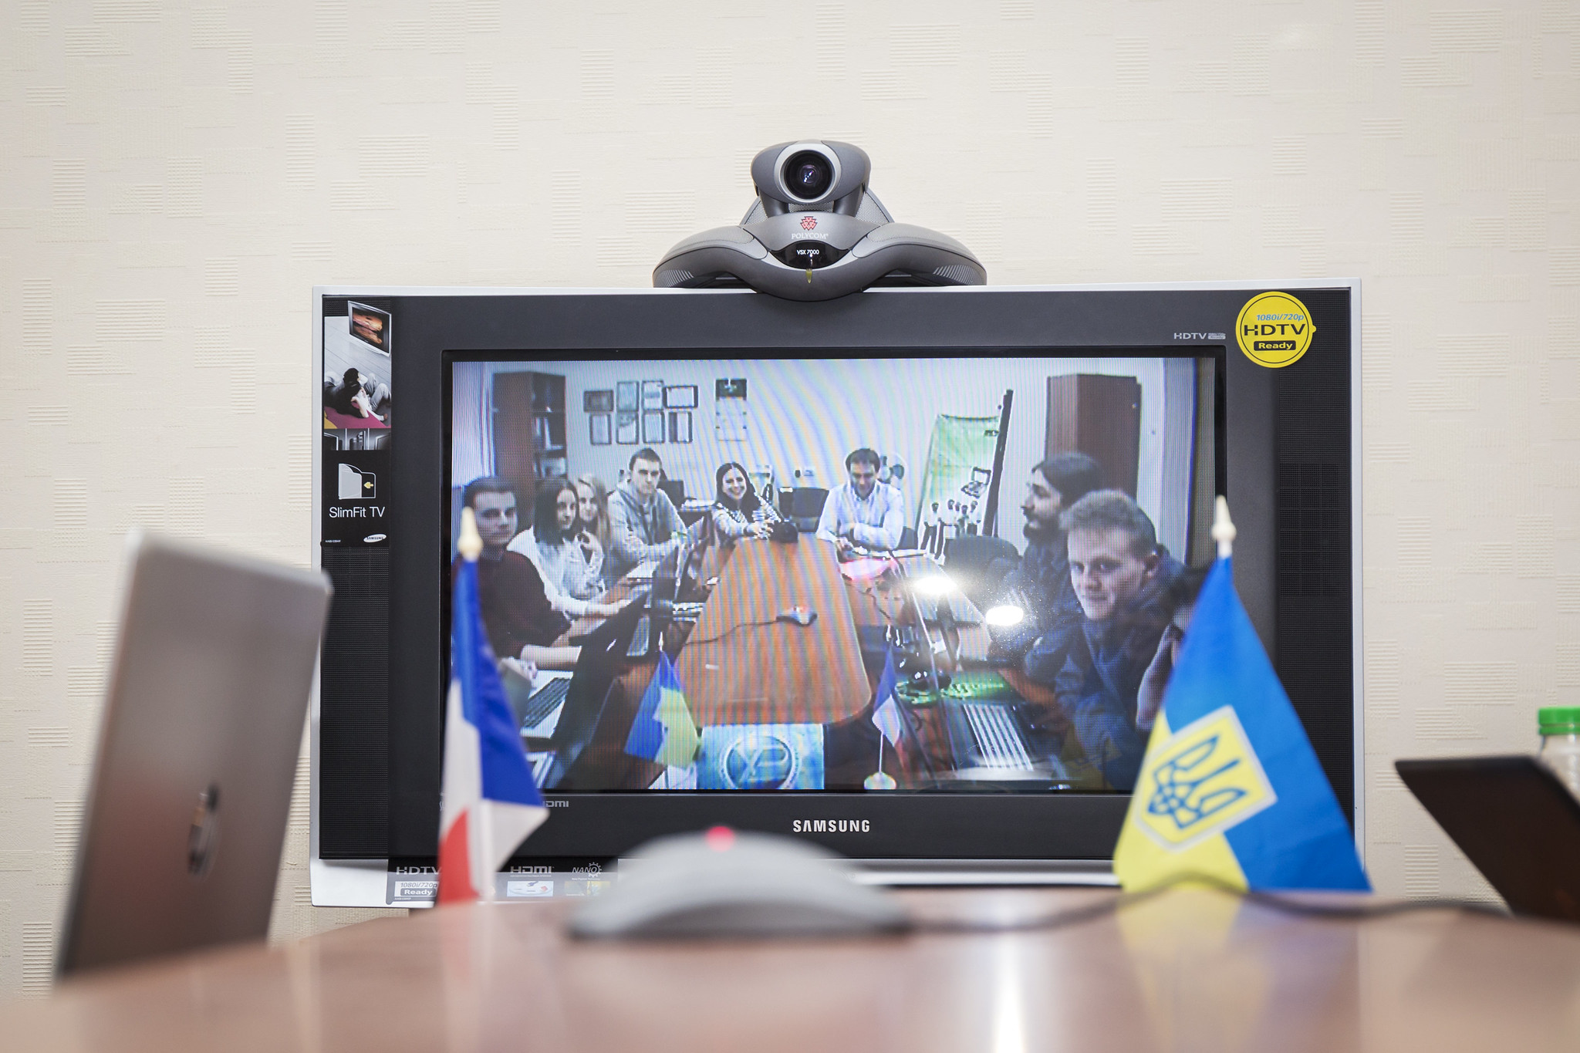
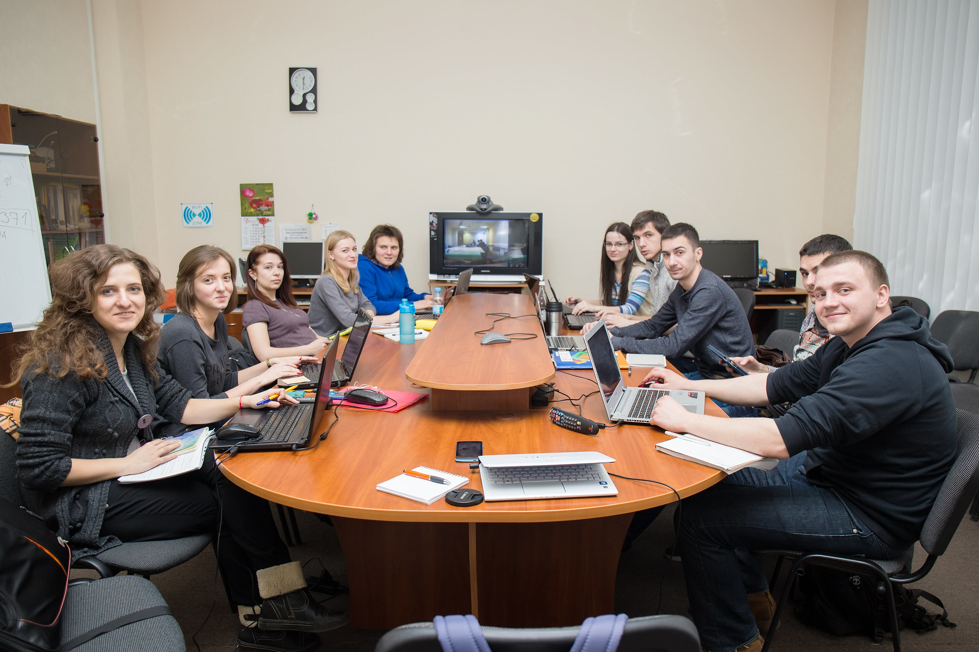
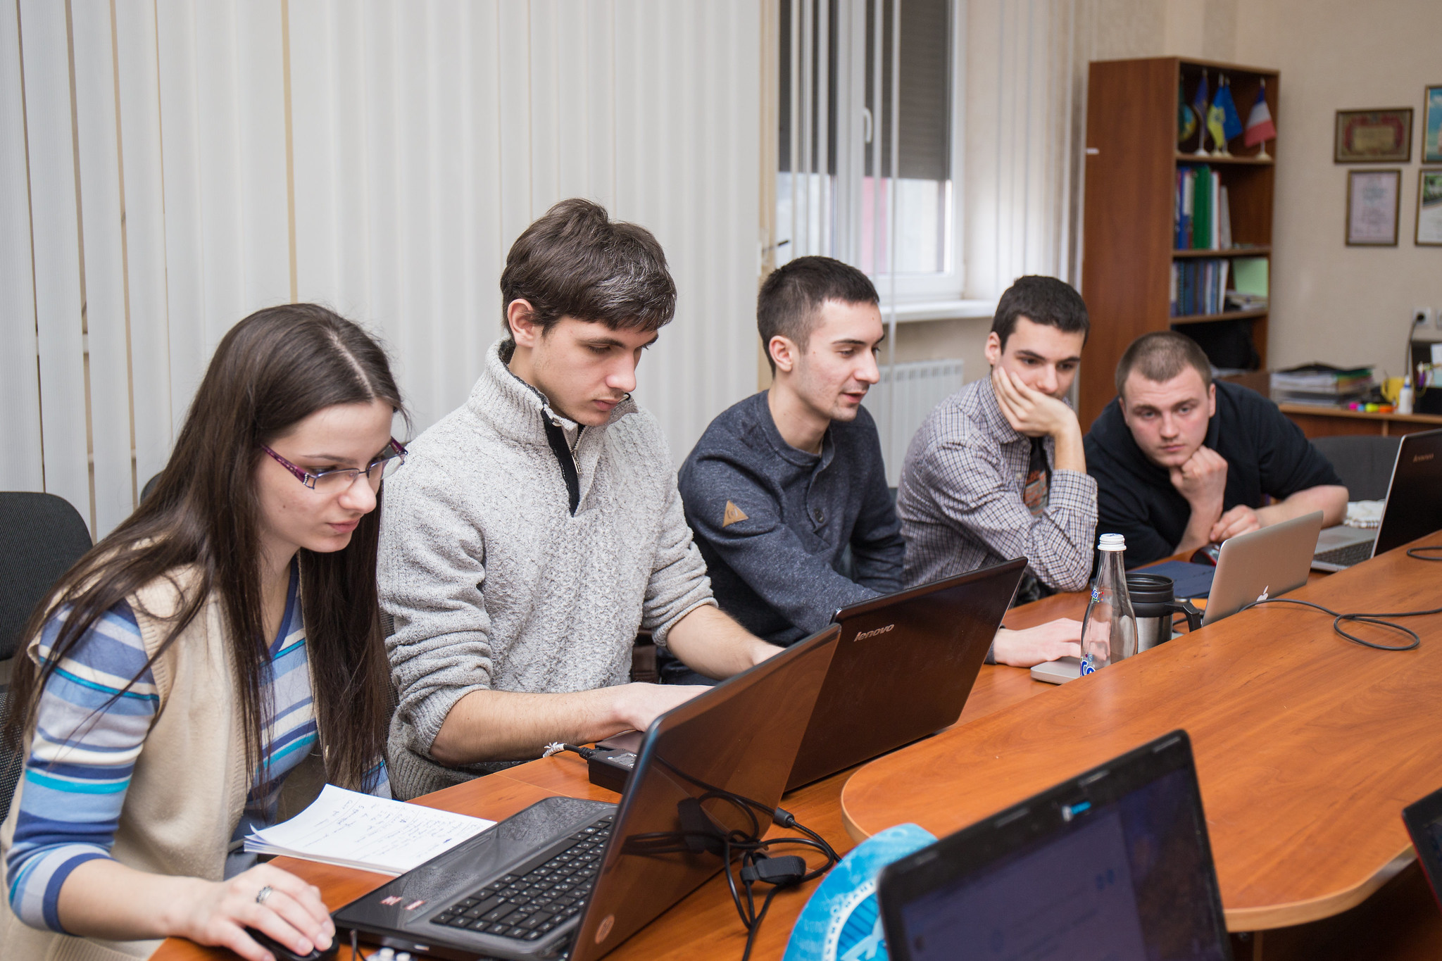
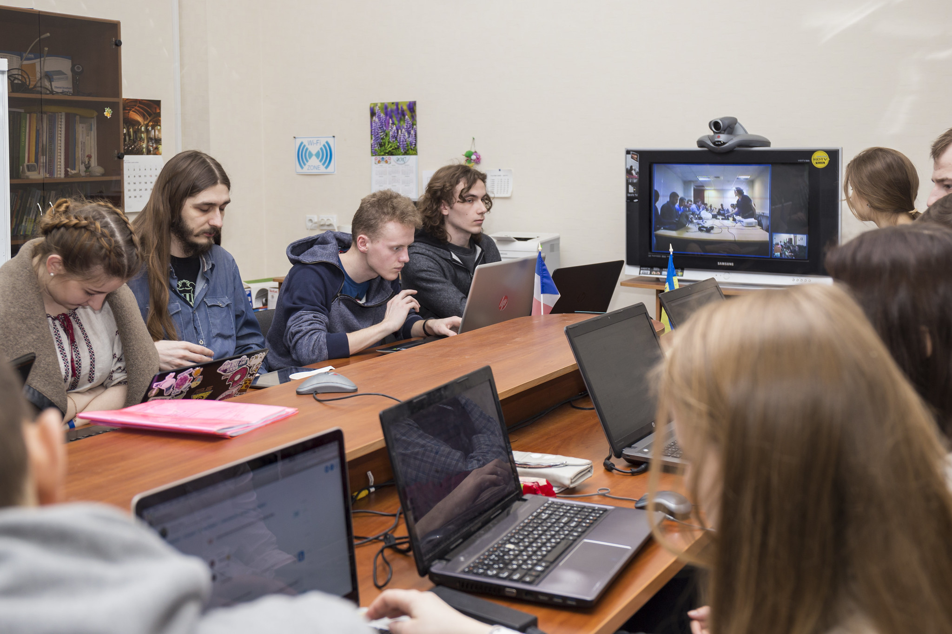
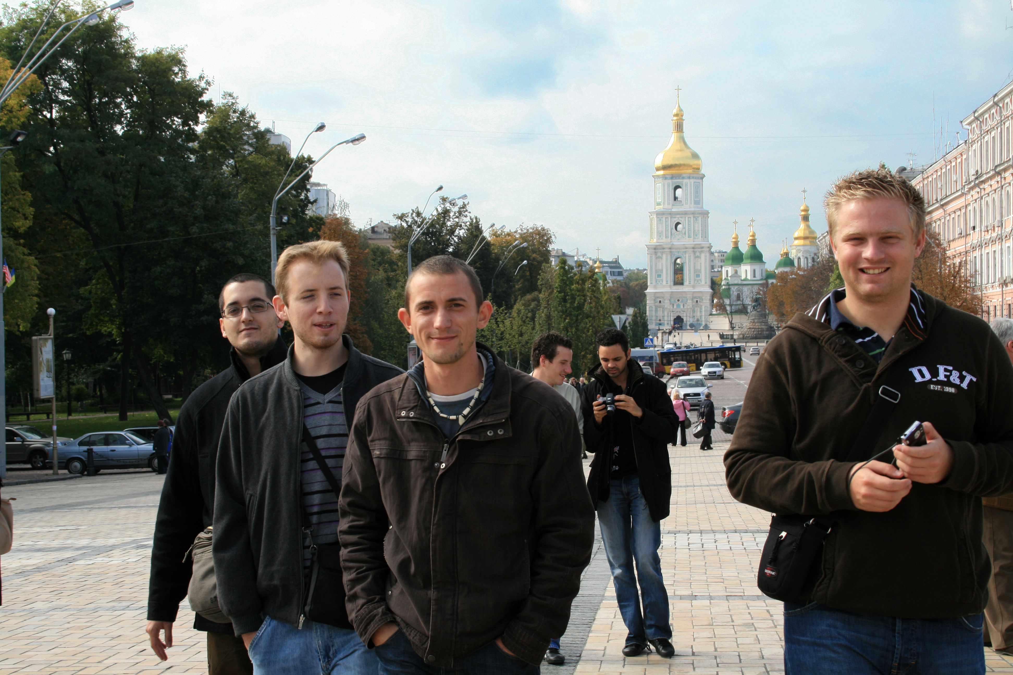
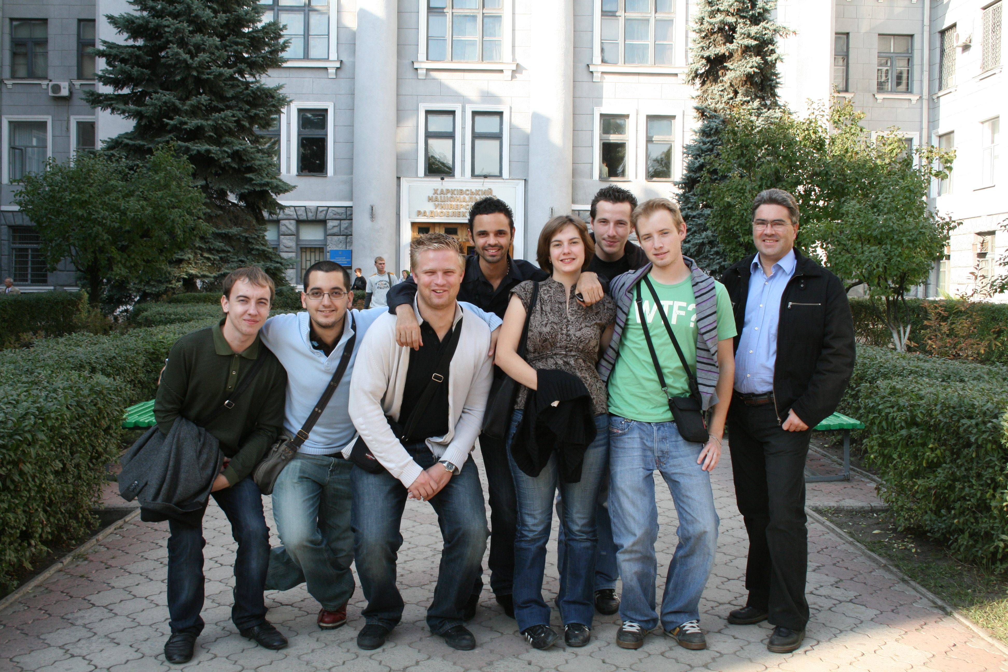
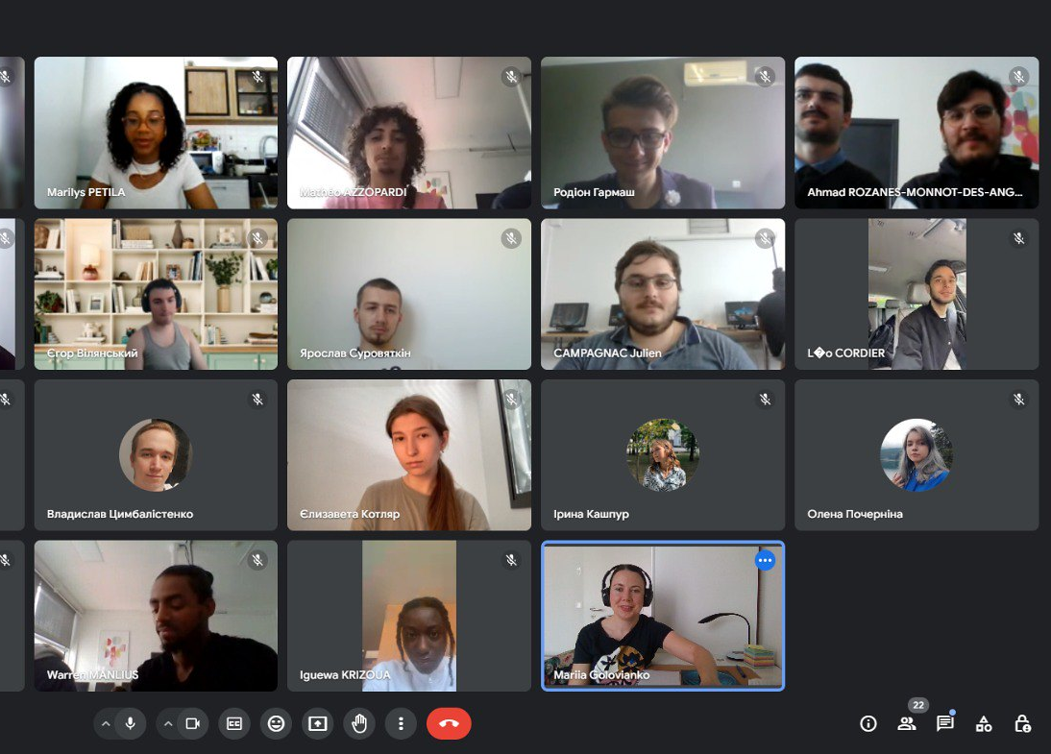
European Virtual Venture
A collaborative learning initiative launched in 2006 to equip future computer scientists and engineers in FR and UA with the entrepreneurial skills.
An international multidisciplinary, multicultural and hybrid training environment, where students learn how to transform innovative ideas into viable business projects.
Format: team project-based learning , mobility at home, telecommunication tools

Slide 5
COMMUNITIES OF PRACTICE (CoP)
Partnerships across private, public, and third sector:
To exchange benchmarking information
To utilize diverse resources, expertise, and perspectives
To improve output-oriented quality of research and education
To attract sponsors for research projects
To address complex (security, social) issues more effectively
To create sustainable solutions that benefit the entire society
Collaborative learning and research initiatives (Learning as a social system)
Domain: a shared professional domain of interest
Community: members who engage in joint activities and discussions, help each other, share information and learn from each other.
Practice: a shared repertoire of resources: experiences, stories, tools, ways of addressing recurring problems

Slide 6
EVV COMMUNITY OF PRACTICE (CoP)
Partnership across private, public, and third sector:
To exchange benchmarking information
To utilize diverse resources, expertise, and perspectives
To improve output-oriented quality of research and education
To attract sponsors for research projects
To address complex (security, social) issues more effectively
To create sustainable solutions that benefit the entire society
Collaborative learning and research initiatives (Learning as a social system)
Domain: innovative entrepreneurship
Community: students, university teachers, entrepreneurs, ICT-professionals and industry experts sharing passion for applied innovation
Practice: Designing innovative ventures:
Hybrid training sessions
Distributed team-work
Industrial visits.

Slide 7
PROGRAM TIMELINE AND TRENDS
Industry 3.0 automation
AI/Industry 5.0
Study visit of French students to Ukraine.
Covid-19, scale up, cross-regional development of a new training program JoInME
2006
2018
2024
63 business projects
34 business projects
First round of EVV with ITIN, France.
ECAM-EPMI joins the partnership, new topics, formats
2008
2020

Slide 8
HEI
MULTI-LAYER IMPACT
Participants
HEI
Academia
Business
Global Society
Comprehensive personal development: soft and hard skills.
Creativity, critical thinking, search of a bigger picture.
Global citizens prepared for intenational environments.
Higher resilience.
HEIs higher resilience and robustness;
Staff and student mobilities.
Joint conferences.
New research and capacity building projects.
New adaptive, collaborative, and personalized learning formats.
Additional funds.
Reforms in the Ukrainian higher educational system.
Impact-based quality culture based on transparency (TRUST project).
Workforce with valuable skills and sustainability practices.
Improved management skills.
Social capital, networks, higher job positions.
Progress towards global sustainable development goals (SDG).
An international system – that is better prepared to manage the challenges we face now and in the future.

Slide 9
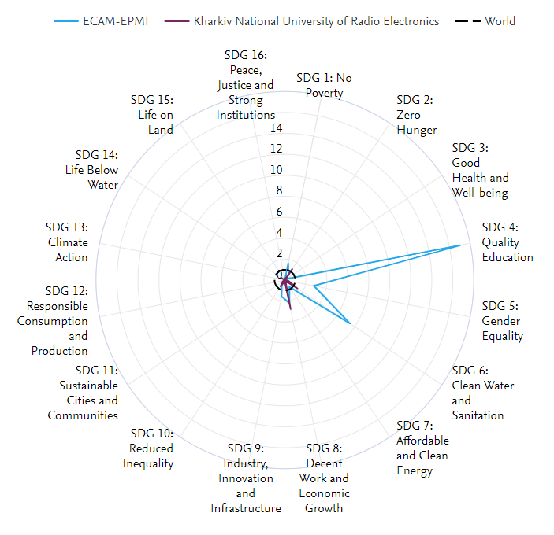
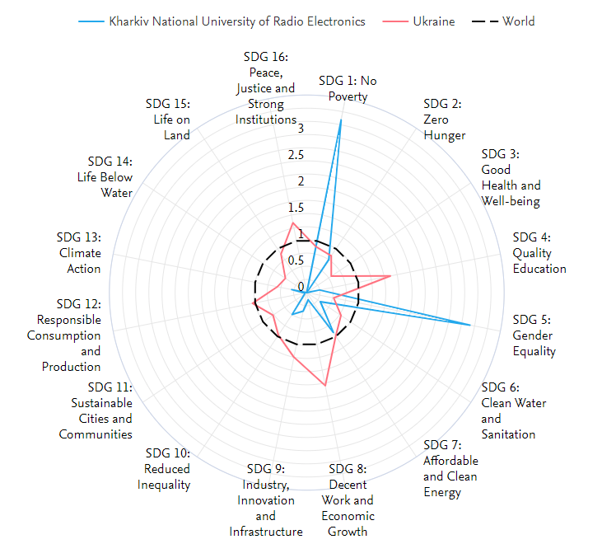
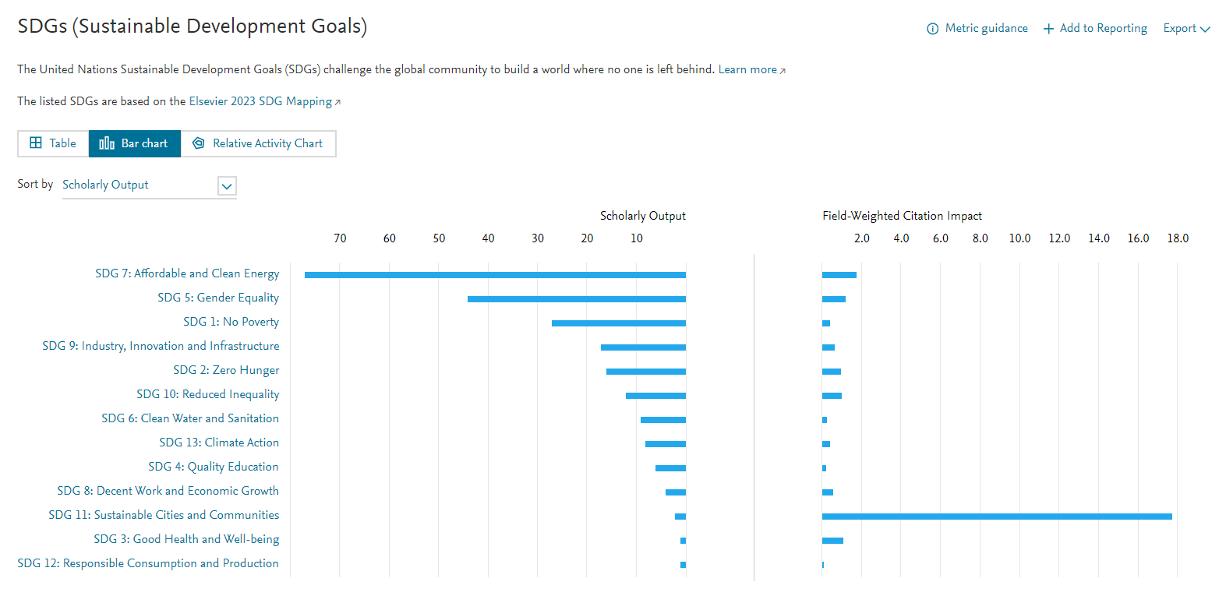
HEI
Scholarly Output in terms of SDGs
Innovative thinking and multidisciplinary approach trained by the program allow EVV-community contributing to the achievement of global sustainable development goals (SDG) [20-25] and promoting the culture of sustainable development at the institutional and national level
Innovative thinking and multidisciplinary approach trained by the program allow EVV-community:
contributing to the achievement of Global Sustainable Development Goals (SDG)
promoting the culture of sustainable development at the institutional and national level
Comprehensive personal development: soft and hard skills.
Creativity, critical thinking, search of a bigger picture.
Smoother entrance of new disciplines.
Preparedness for intenational environments.
Higher resilience.

Slide 10
Conclusions
To address the complexity and the scale of today’s societal challenges it is crucial to combine international, multicultural, and multidisciplinary aspects of the collaboration.
International, multicultural, and multidisciplinary collaborative learning (IMMCL) have high potential to raise the level of cross-cultural understanding, tolerance, and innovation, shaping a more interconnected and socially conscious global community.
The impact extends beyond its immediate participants, reaching into wider society.
IMMCL enriches the educational experience and leads to the societal sustainable development.
As graduates enter various industries and sectors, they bring there the innovative ideas and skills, serving as catalysts for positive change and progress in their respective fields.

Slide 11
THANK YOU
Contact person:
mariia.golovianko@nure.ua

