Slide 1
IEA/AIE 2024
The 37th International Conference on Industrial, Engineering & Other Applications of Applied Intelligent Systems
Hybrid Additive Manufacturing: A Convergence of Physical, Digital, and Social Realms Driven by Generative AI
Vagan Terziyan ª, Olena Kaikova ^{b}
^{a,b} Faculty of Information Technology, University of Jyväskylä, Jyväskylä, Finland
https://www.jyu.fi/en/

Slide 2
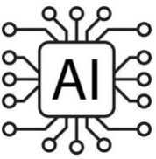
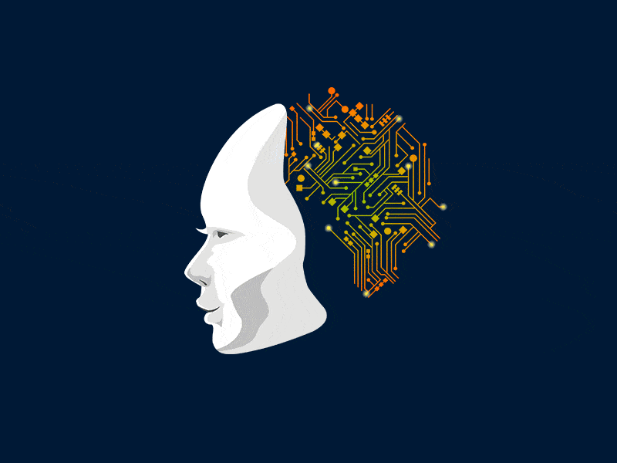
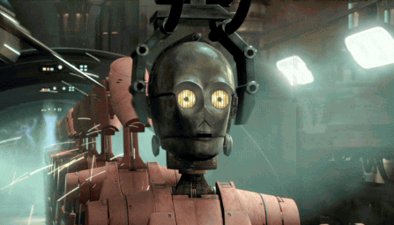
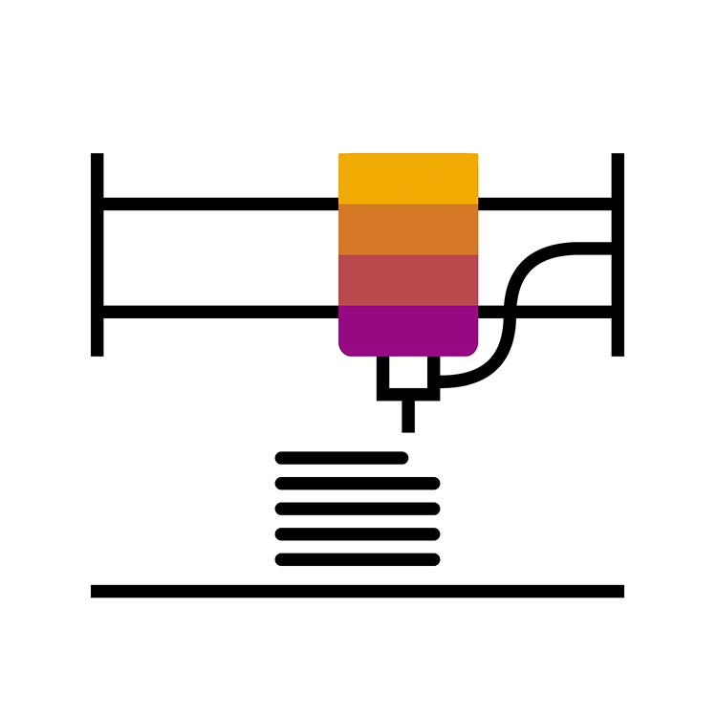
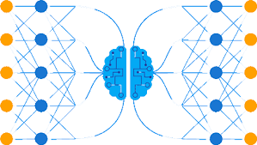
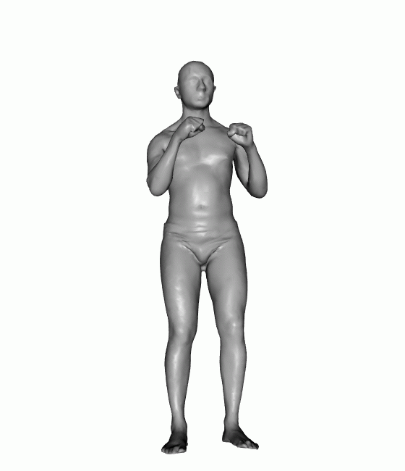
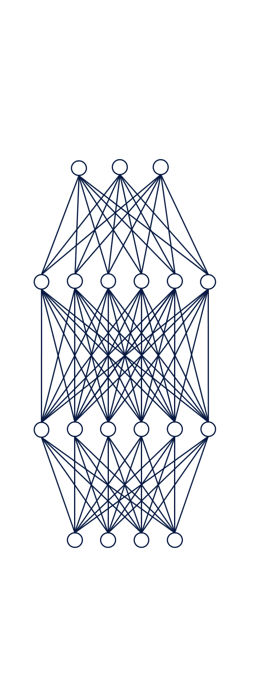
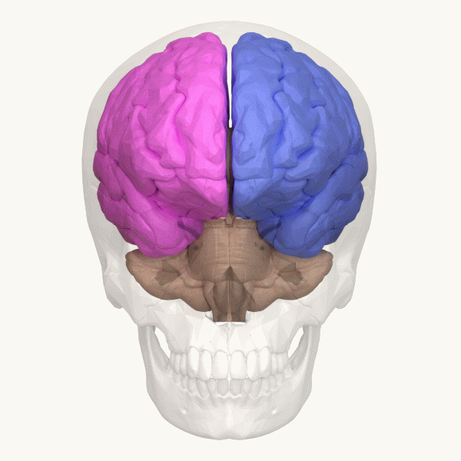
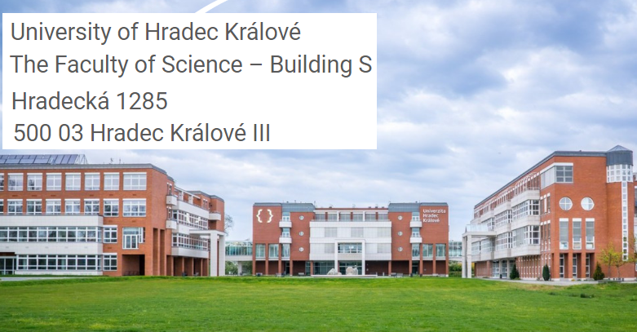
Hybrid Additive Manufacturing
“Hybrid Additive Manufacturing: A Convergence of Physical, Digital, and Social Realms Driven by Generative AI”
Paper # 18
Vagan Terziyan & Olena Kaikova
IEA/AIE 2024
Hradec Kralove, Czech Republic
July 10, 2024, 12:20 - 12:50
The 37th International Conference on Industrial, Engineering & Other Applications of Applied Intelligent Systems
Room C: “Various Applications”

Slide 3
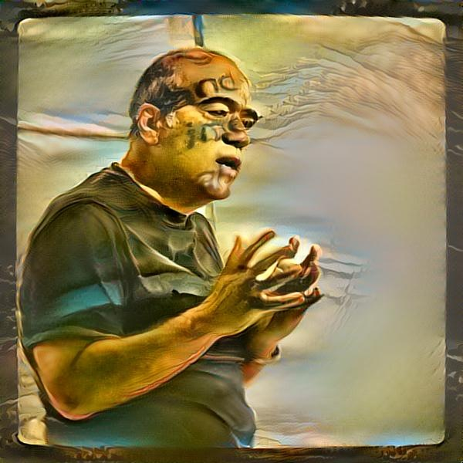
Authors
Olena Kaikova
“Hybrid Additive Manufacturing: A Convergence of Physical, Digital, and Social Realms Driven by Generative AI”
Vagan Terziyan
vagan.terziyan@jyu.fi
https://www.jyu.fi/en/

Slide 4
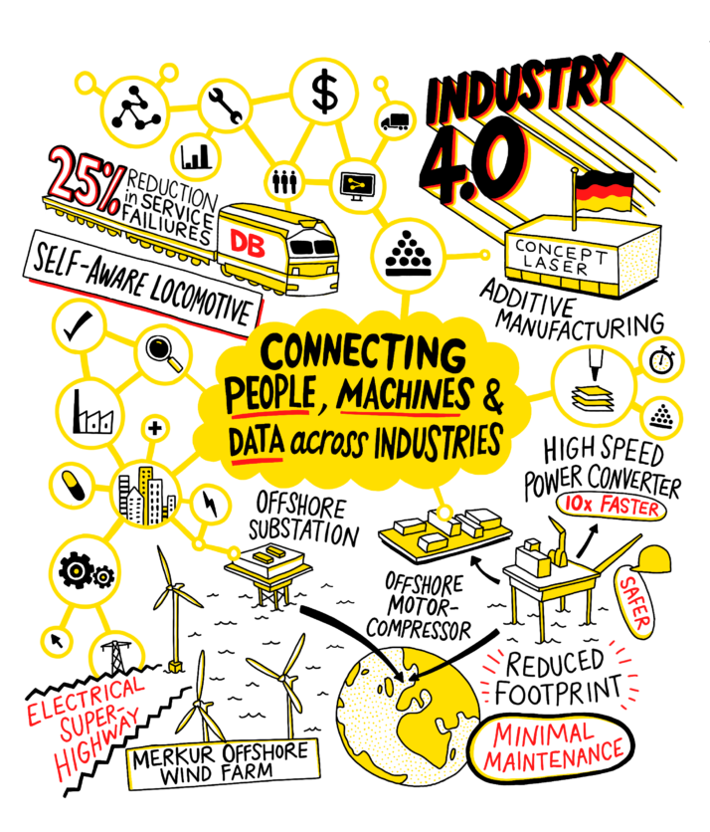
Industry 4.0 and Additive Manufacturing
https://www.politico.eu/sponsored-content/the-next-chapter-in-german-industry/
Industry 4.0 represents the fourth industrial revolution characterized by the integration of digital technologies into manufacturing processes.
Additive manufacturing, also known as 3D printing, revolutionizes production by building objects layer by layer from digital designs.
The link between additive manufacturing and Industry 4.0 is that 3D printing showcases how production methods are going digital. This means that with 3D printing, we can make things when we need them, in many different places, and tailor them exactly how we want – which are all important ideas in Industry 4.0.
Haertel: “Initially, Industry 4.0 was very much focused on the next phase of industry automation. ... That focus has been upgraded, and the goals refined to increasing industrial automation using big data collected from many different points.
Additive manufacturing is not necessarily connected to Industry 4.0. It has developed independently of it. But there is a point of connection in how additive manufacturing starts out from data, and then builds a component or device.
So if you are already dealing intensely with data and Industry 4.0, then adding additive manufacturing is relatively straightforward. They mesh naturally.”

Slide 5
Concepts and research questions of this study
A Cyber-Physical-Social System (CPSS) is a complex system that integrates digital, physical, and social elements, where digital technologies interact with physical components and human actors to achieve specific goals or functions. These systems are characteristic of Industry 4.0 (and Industry 5.0), where advancements in automation, data exchange, and artificial intelligence with human-in-the-loop enable seamless integration across cyber, physical, and social domains. CPSS operates in real-time environments and critical infrastructure, such as smart cities, smart grids, or online social networks, and they are characterized by their interconnectedness, where changes in one component can impact others.
In this study, we define the concept of “Hybrid Additive Manufacturing” (HAM) as a visionary approach aimed at “printing” intelligent hybrid entities of Cyber-Physical-Social Systems (CPSS) using Generative Artificial Intelligence (GAI) synchronized with Additive Manufacturing (AM) technologies, with respect to integration of physical processes, digital intelligence, and meaningful social interactions within entities.
Generative Artificial Intelligence (GAI) is an emerging subfield in AI, which is focused on creating realistically looking data instances for various purposes. It involves algorithms that learn patterns from available data and generates never seen before outputs, contributing to tasks such as image (text, sound, etc.) generation by nicely copying humans’ cognitive functions and even outperforming them in many cases.
Additive Manufacturing (AM), commonly known as 3D printing, is an advanced manufacturing process (often attributed to the Industry 4.0 horizon) that constructs objects layer-by-layer, adding source material gradually to create a three-dimensional product.
Research questions:
RQ1. What is the added value of GAI, which makes the difference between traditional AM and HAM?
RQ2. What would be the major technology enablers for HAM; are they available, and how far are they developed?

Slide 6
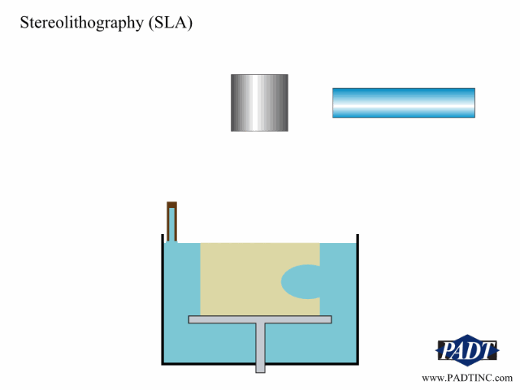
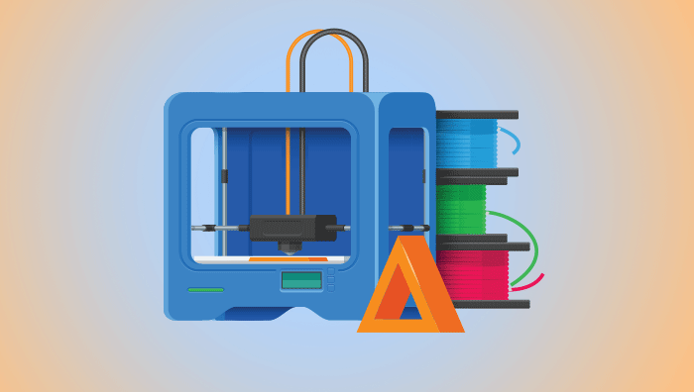
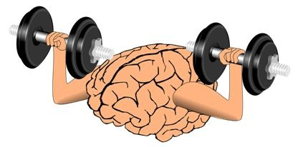
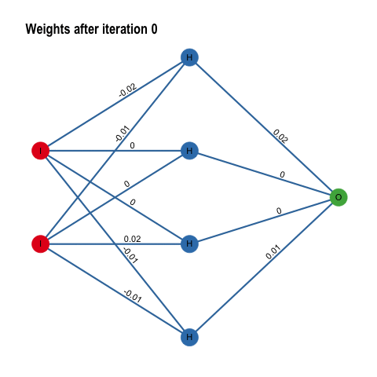
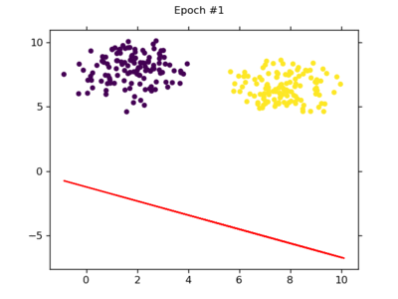
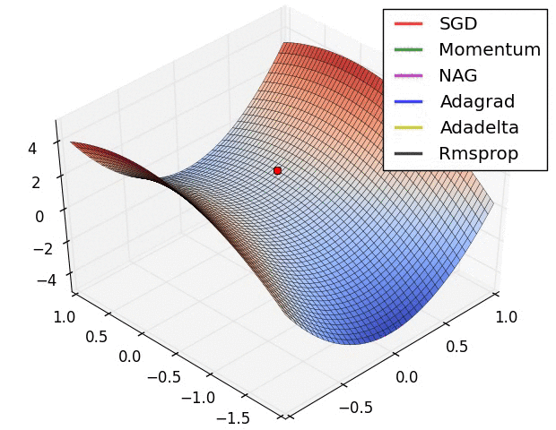
3D printing AND backpropagation: A COMMON BACKBONE
At a certain level of abstraction, layer-by-layer 3D printing in additive manufacturing and backpropagation learning of neural networks share a common backbone in their iterative refinement processes, which involve feedback loops, where each iteration contributes to the overall improvement of the final outcome.
Additive Manufacturing
In 3D printing, each layer contributes to the final physical object, with adjustments made based on feedback from previous layers.
Similarly, in backpropagation learning, adjustments to neural network weights are made based on feedback from the output layer, gradually refining the network’s predictive capabilities.
Learning Neural Networks
(by backpropagation)

Slide 7
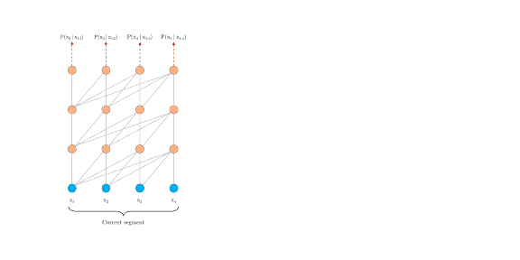
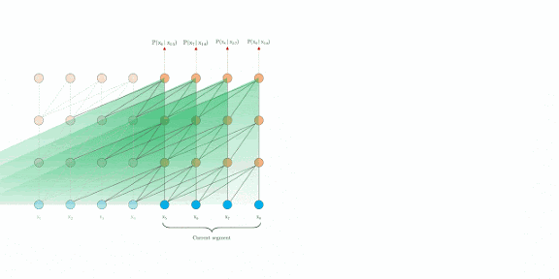
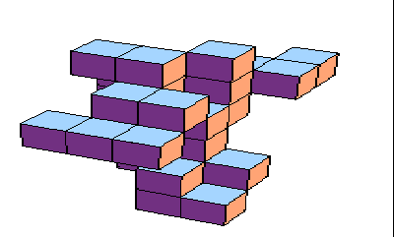
Additive Manufacturing AND GENERATIVE AI: A COMMON BACKBONE
At a fundamental level of abstraction, both layer-by-layer 3D printing in additive manufacturing and recurrence mechanisms in generative AI, particularly in transformers, share a common backbone in their approach to building complexity from simplicity. Both processes illustrate how starting with simple elements and systematically adding complexity leads to creation of sophisticated and functional systems.
Additive Manufacturing
In 3D printing, each layer adds to the overall structure, gradually building up the final object from basic components.
Similarly, in transformers, recurrence mechanisms allow for the iterative processing of information, where each step builds upon the previous one to create more sophisticated outputs.
Transformer
Generative AI
https://neptune.ai/blog/comprehensive-guide-to-transformers

Slide 8
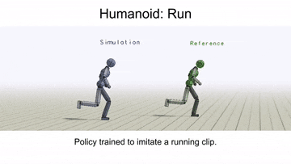
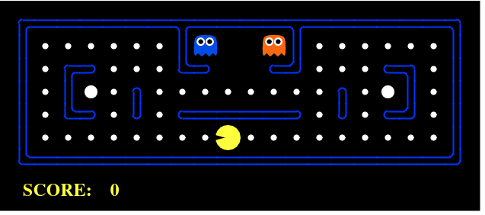
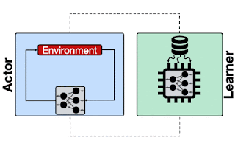
Additive Manufacturing AND Reinforcement learning: A COMMON BACKBONE
Just as additive manufacturing builds physical objects layer by layer using digital instructions, reinforcement learning constructs intelligent behaviors step by step through iterative learning from feedback. Both processes involve an iterative, trial-and-error approach where the system learns from its actions and adapts over time to achieve desired outcomes.
Additive Manufacturing
In 3D printing, each layer contributes to the final physical structure, and adjustments can be made based on real-time observations or modifications to the digital blueprint.
Similarly, in reinforcement learning, an agent learns by interacting with environment, receiving feedback (rewards or penalties) based on its actions, and adjusting its behavior accordingly to maximize long-term performance.
Reinforcement Learning

Slide 9
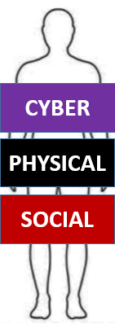
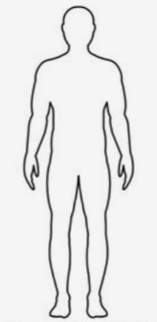
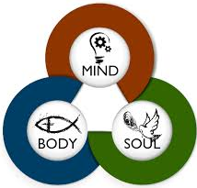
“Cyber-physical-social” vs “Mind-Body-soul” analogy
The analogy between a Cyber-Physical-Social (CPS) entity/system and a Mind-Body-Soul (MBS) entity/system lies in their holistic nature and the interconnectedness of their components:
Holistic Nature: Just as a MBS entity encompasses various aspects of human existence, including cognitive, physical, and spiritual dimensions, a CPS entity integrates digital, physical, and social elements into a unified whole. Both systems understand and interact with the world comprehensively.
Interconnectedness: In a MBS system, the mind influences the body, which in turn affects the soul, and vice versa. Similarly, in a CPS system, the digital (cyber) component interacts with the physical environment, which in turn impacts social dynamics, and vice versa.
Complexity and Emergence: Both CPS and MBS systems exhibit emergent properties arising from the interactions among their components. In a MBS system, consciousness emerges from the complex interactions of the mind, body, and soul. Similarly, in a CPS system, emergent behaviors and phenomena, such as collective intelligence or societal trends, arise from the interactions of digital, physical, and social elements.
Unity and Harmony: Both frameworks emphasize the importance of achieving unity and harmony among their components. In a MBS system, balance and alignment among the mind, body, and soul are essential for overall well-being and fulfillment. Similarly, in a CPS system, synergy and alignment among digital, physical, and social elements are crucial for optimal functioning and societal cohesion.

Slide 10
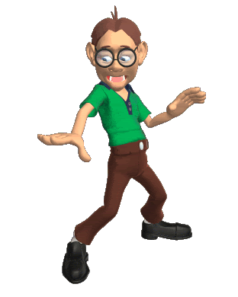
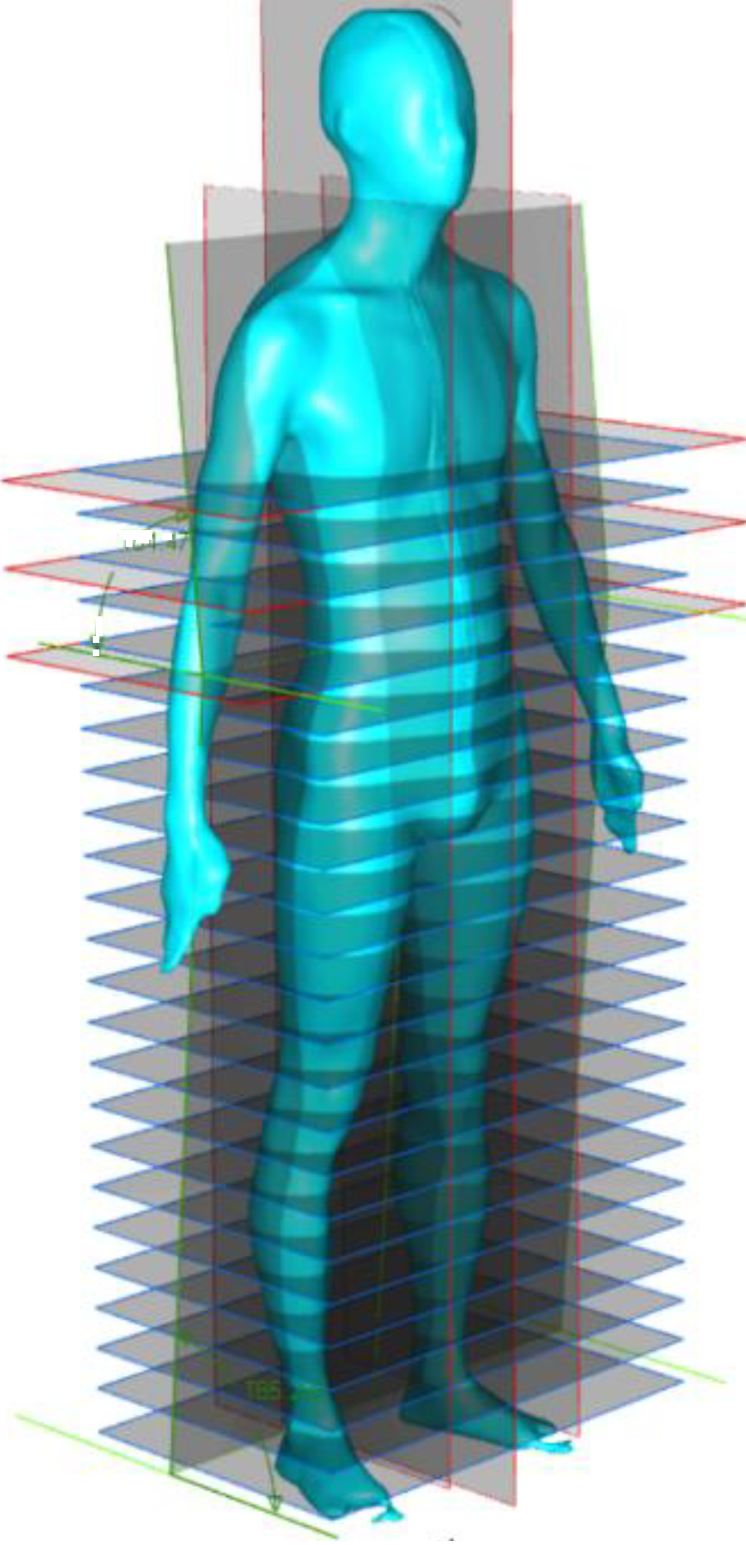
“Printing” humans:
a dream of optimists
or a fear of pessimists?
By following a hybrid additive manufacturing printing process, it is conceivable that one day we could achieve the capability to print humans. Just as with the robotic arm example, this process would involve synchronizing the printing of physical, cyber, and social components to create a fully functional human entity.
Physically, each part of the human body would be printed layer by layer, incorporating biological materials or their synthetic equivalents. These physical components would then be complemented by cyber components, comprising the sophisticated network of neural pathways, organs, and systems necessary for life. Additionally, social components would be integrated to enable communication, interaction, and adaptation within social contexts.
This ambitious vision aligns with the principles of agile development, where iterative progress and continuous refinement lead to the creation of complex and adaptive systems. While the idea may seem like science fiction today, advancements in additive manufacturing, artificial intelligence, and biotechnology are steadily pushing the boundaries of what is possible, making the concept of printing humans a provocative prospect for the future.
The time interval (“WHEN?”) between optimistic and pessimistic estimations could range from just a few decades to several centuries, reflecting the diverse range of perspectives and uncertainties surrounding transformative technological developments.

Slide 11
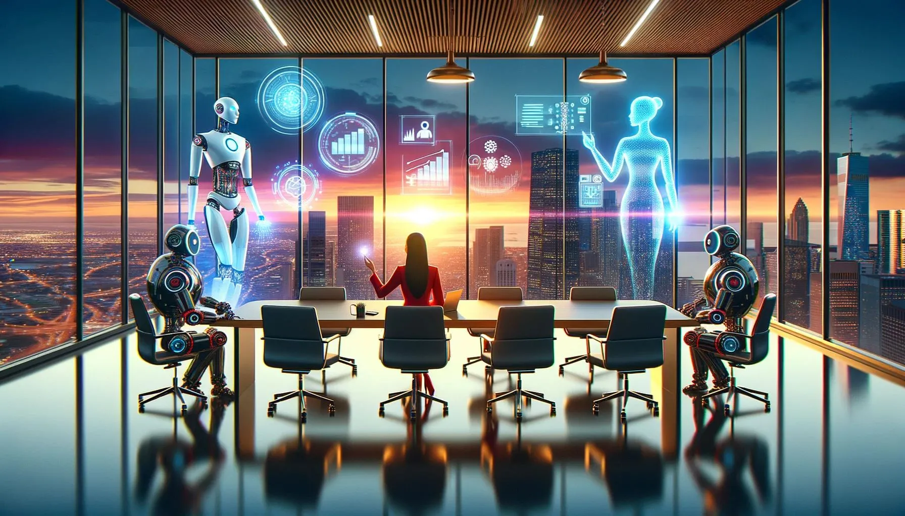
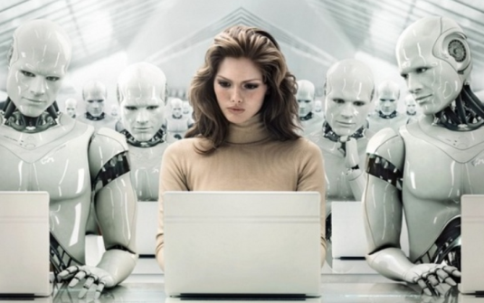
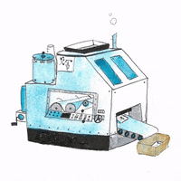
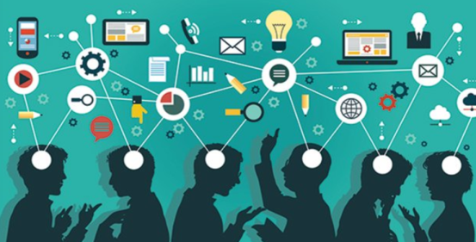
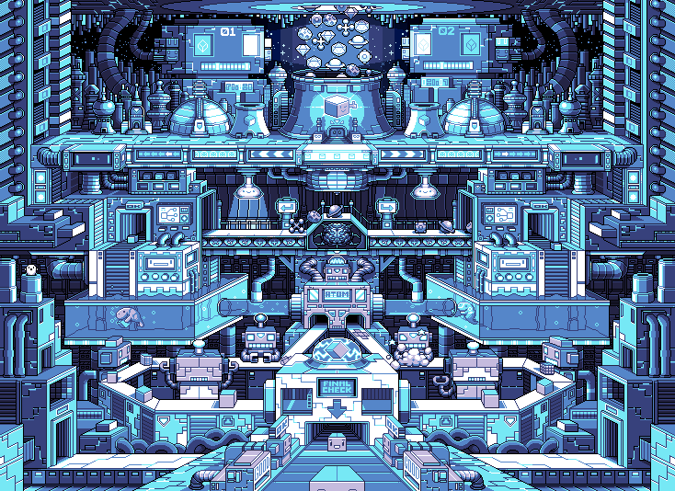
Hybrid additive manufacturing CHALLENGE
“Printing” objective
“Printing” “MIND”
CYBER
“MIND”
“MIND”
Cyber-Physical-Social System
PHYSICAL
Synchronization and integration
SOCIAL
“BODY”
“Printing” “BODY”
“Printed” …
Cyber-Physical-Social Entity

Slide 12
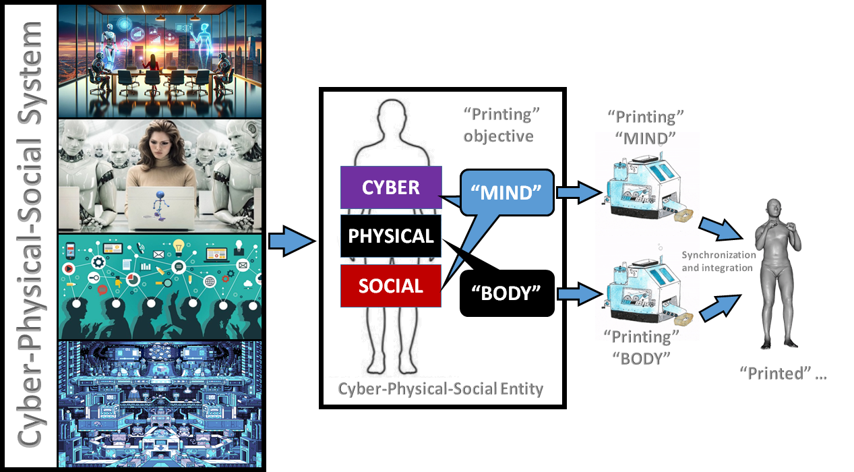
Hybrid additive manufacturing:
“Printing” “Body” and “mind”
Imagine the creation of a cyber-physical-social entity as a synchronized process, similarly to 3D printing physical components and employing Generative AI as a printer of cyber and social components.
“PRINTING BODY”: In this abstract process, the physical components are the tangible structure of the entity, analogous to the layers formed in additive manufacturing. Each layer represents a foundational aspect of the entity’s physical existence, such as its infrastructure or material composition.
“PRINTING MIND”: Concurrently, Generative AI functions as the printer of cyber and social components, mirroring the iterative generation and refinement of solutions. Here, the cyber components represent the digital framework or algorithms guiding the entity’s functions, while the social components embody its interactions and relationships within its environment.
Through synchronized operation, the 3D printing of physical components and the generation of cyber-social components converge, layer by layer and iteration by iteration, to construct a holistic cyber-physical-social entity. This abstract process underscores the interdisciplinary nature of entity creation, where physical, digital, and social elements intertwine to form a cohesive whole.

Slide 13
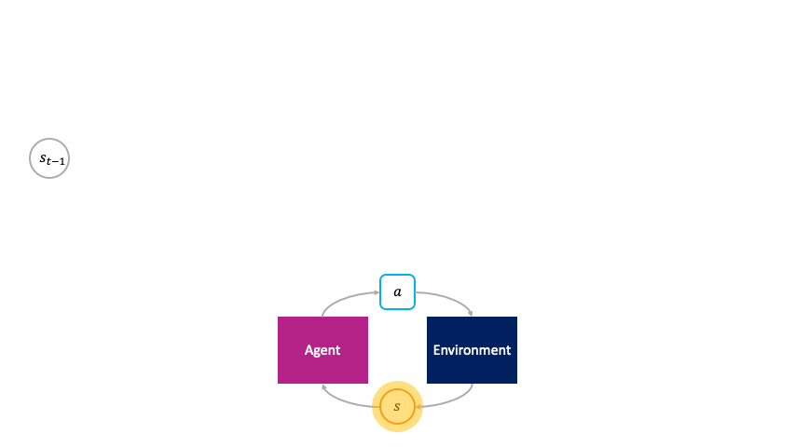
Reinforcement Learning as an Intelligent Controller FOR Hybrid Additive Manufacturing:
Reinforcement Learning
Controller
RL takes on the role of an intelligent controller that oversees the entire printing process, orchestrating the interaction between AM and GAI to optimize performance and outcomes so that printed-so-far-by-AM physical components will function (behave) following the printed-so-far-by-GAI models. RL continuously learns from feedback received during the printing process and adjusts the parameters and strategies of both printers to maximize efficiency, quality, and resource utilization.
RL as the intelligent controller governs the interaction between AM and GAI, ensuring the seamless synchronization and collaboration of these two essential components in the hybrid printing process.
Read also about research on “body”-morphology-aware Deep Evolutionary Reinforcement Learning, which aims at optimal embodied intelligence.
Additive Manufacturing
3D printing
GAI
HYBRID PRINTERS

Slide 14
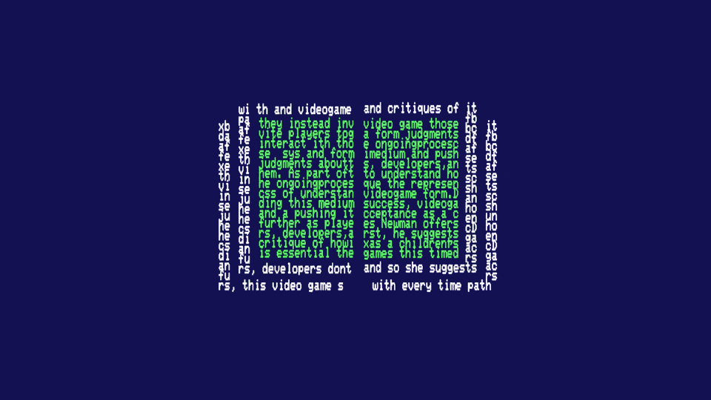
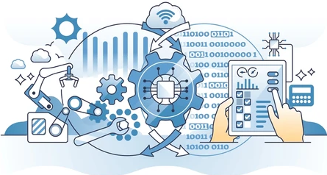
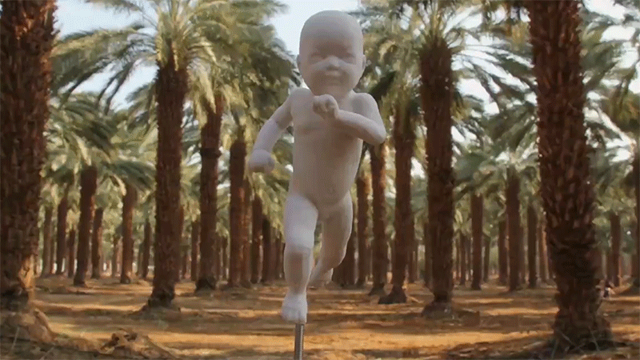
Reinforcement Learning
Controller
Hybrid additive manufacturing
GAI
HYBRID PRINTERS
CYBER
Cyber-Physical-Social Entity
Additive Manufacturing
3D printing
PHYSICAL
SOCIAL
GAI

Slide 15
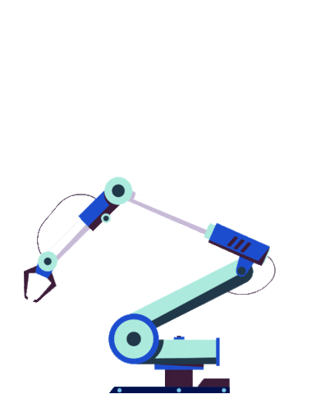
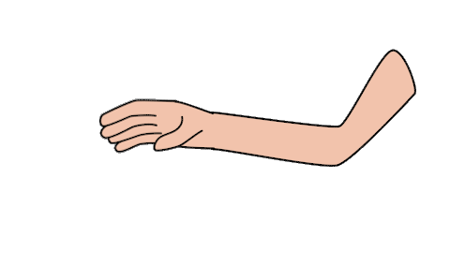
Hybrid Additive Manufacturing (3D printing) as an Agile process
The synchronized hybrid printing process can be likened to an agile methodology, where iterative development and continuous feedback drive progress. As each physical component is printed, it receives its cyber and social counterparts in a synchronized manner, reflecting the agile principle of delivering functional increments (“sprints”).
For example, consider a robotic arm, which physical component is being printed layer by layer. As each layer is completed, the arm receives its cyber component—a set of algorithms and control systems that enable its operation. These cyber components are dynamically adjusted and refined based on real-time data and feedback, aligning with the agile concept of responding to change over following a rigid plan.
Simultaneously, the arm also receives its social component, allowing it to communicate and coordinate with other components within the system. This social aspect enables collaboration and adaptation, akin to the agile emphasis on individuals and interactions over processes and tools.
This bottom-up hybrid printing approach ensures that even unfinished prints are operational to some extent, reflecting the agile principle of delivering working solutions incrementally. Each printed component contributes to the overall functionality of the system, allowing for continuous integration and testing throughout the printing process.
Therefore, it would be a reasonable idea to consider the synchronized hybrid printing process in Hybrid Additive Manufacturing as the one, which embodies the agile philosophy of iterative development, adaptability, and collaboration, ensuring that the evolving entity remains functional and responsive at every stage of its creation.

Slide 16
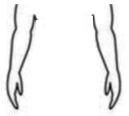
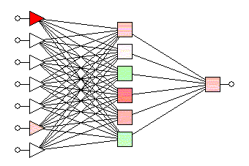
Stages in agile printing process
Hybrid additive manufacturing AS AN AGILE PROCESS
CONTROLLER
CYBER
PHYSICAL
HYBRID PRINTERS
REINFORCEMENT
SOCIAL
Sprint 1
Sprint 1

Slide 17
Stages in agile printing process
Hybrid additive manufacturing AS AN AGILE PROCESS
CONTROLLER
CYBER
PHYSICAL
HYBRID PRINTERS
REINFORCEMENT
Sprint 2
SOCIAL
Sprint 2
Sprint 1

Slide 18
Stages in agile printing process
Hybrid additive manufacturing AS AN AGILE PROCESS
CONTROLLER
Sprint 3
CYBER
PHYSICAL
HYBRID PRINTERS
REINFORCEMENT
Sprint 2
SOCIAL
Sprint 3
Sprint 1

Slide 19
Table 1. Availability and role of technological enablers for the Hybrid Additive Manufacturing
Brief Description of the Technology | Role in Hybrid Additive Manufacturing
Digital Twin or Clone Technology
Implement a digital twin (or clone) framework where a virtual replica of hybrid intelligent entity is created. The physical and digital aspects are tightly synchronized, allowing their real-time updates and interactions. | Enables continuous monitoring, processing, and adjustment of the physical entity based on its digital counterpart. Enables autonomous behavior of the physical entity.
Integrated (Embedded) AI and Machine Learning Systems
Embed AI and ML algorithms directly into the entity’s hardware. This involves hardware-accelerated AI processing units that can handle complex decision-making and learning tasks. | Facilitates autonomous decision-making, learning from interactions, and adaptive behavior based on changing conditions. Also optimizes resource consumption.
Embedded Sensors and IoT Connectivity
Integrate network of sensors into the entity to capture physical data. Utilize Internet of Things (IoT) connectivity for seamless communication between the entity and external systems. | Enables the entity to sense and respond to its environment, promoting adaptability and real-time interaction.
Blockchain for Secure and Transparent Transactions
Implement blockchain technology to secure and transparently record interactions and transactions between the entity and external systems. This ensures data integrity, traceability, and secure collaboration. | Enhances security, trust, and transparency in the interactions and transactions involving the hybrid intelligent entity.
Human-Machine Interface Technologies
Develop advanced human-machine interfaces that allow intuitive interactions between users and hybrid entity (natural language processing, voice and gesture control, extended, augmented, virtual and mixed realities, etc.) | Facilitates meaningful social interactions and user engagement, contributing to the social intelligence of the hybrid intelligent entity.

Slide 20
Table 1. Availability and role of technological enablers for the Hybrid Additive Manufacturing (contunue)
Brief Description of the Technology | Role in Hybrid Additive Manufacturing
Generative Design and Evolutionary Algorithms
Utilize generative design algorithms and evolutionary approaches to optimize the entity’s physical and AI components. This involves iterative design processes driven by AI to achieve optimal configurations. | Enhances efficiency and effectiveness of the hybrid intelligent entity’s design, ensuring a cohesive integration of physical and GAI elements.
Edge Computing for Decentralized Processing
Distribute computing power across the entity’s components through edge computing. This involves processing data locally rather than relying exclusively on centralized cloud services. | Enhances real-time processing with reduced latency contributing to the autonomy of the hybrid intelligent entity.
Ethical AI and Responsible Design Principles
Integrate ethical AI principles and responsible design considerations into the development process. This involves addressing bias, ensuring fairness, and promoting secure, responsible and ethical behavior in the entity’s interactions. | Safeguards against unintended consequences, promotes secure and responsible behavior, and aligns the hybrid intelligent entity’s actions with ethical standards.

Slide 21
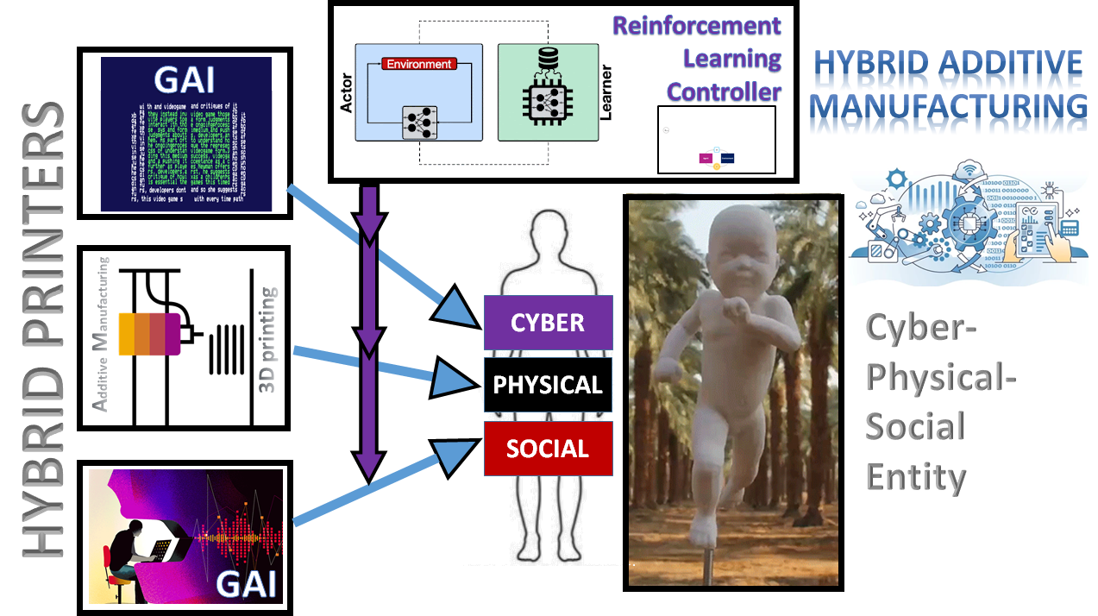
“Printing” vs. “Cloning”
While the concept of hybrid printing may still seem futuristic, recent advancements in various technologies have brought us closer to its realization than ever before.
One significant step in this direction is the digital cognitive cloning of humans, where advanced technologies aim to replicate human cognition and behavior in digital form.
By digitally cloning human cognitive processes, we are essentially laying the groundwork for the integration of cyber, physical, and social components – a fundamental aspect of hybrid printing.
See the following slides about why and how we approached digital cognitive cloning
Digital Cognitive Cloning

Slide 22
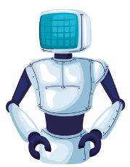
Critical infrastructure as complex cyber-physical-social system
Modern states, with their interconnected critical infrastructure, can be conceptualized as complex cyber-physical-social systems, where digital networks, physical assets, and social dynamics converge to shape their resilience and functionality.
“State 5.0”
STATE 4.0
STATE 5.0
Industry 4.0
Industry 5.0
Much like the transition from Industry 4.0 to Industry 5.0 emphasizes the recovery of the human role and resilience in industrial processes, the transformation from “State 4.0” to “State 5.0” underscores empowering individuals to strengthen resilience against contemporary challenges, including hybrid threats.

Slide 23
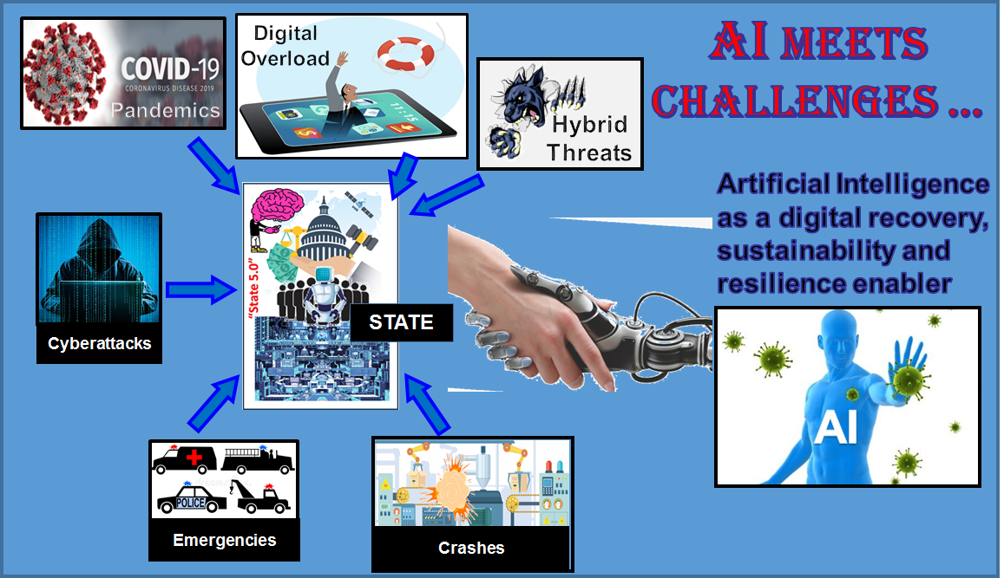
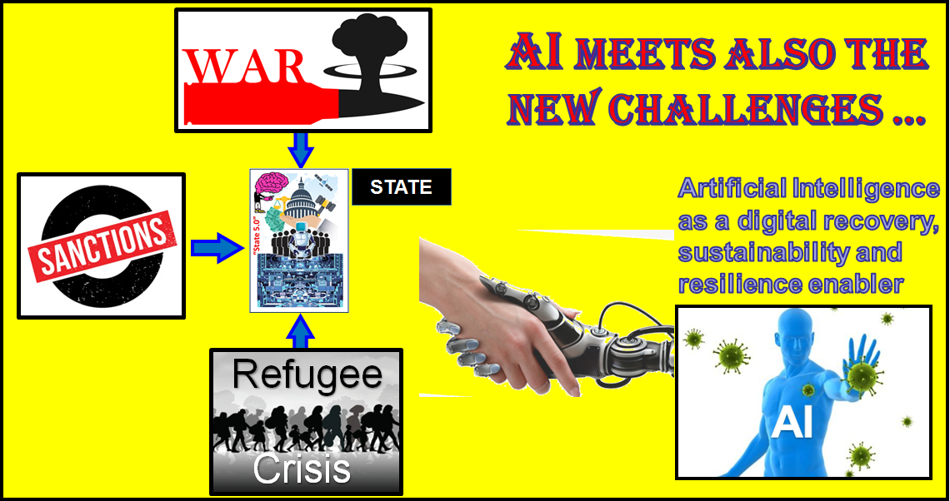
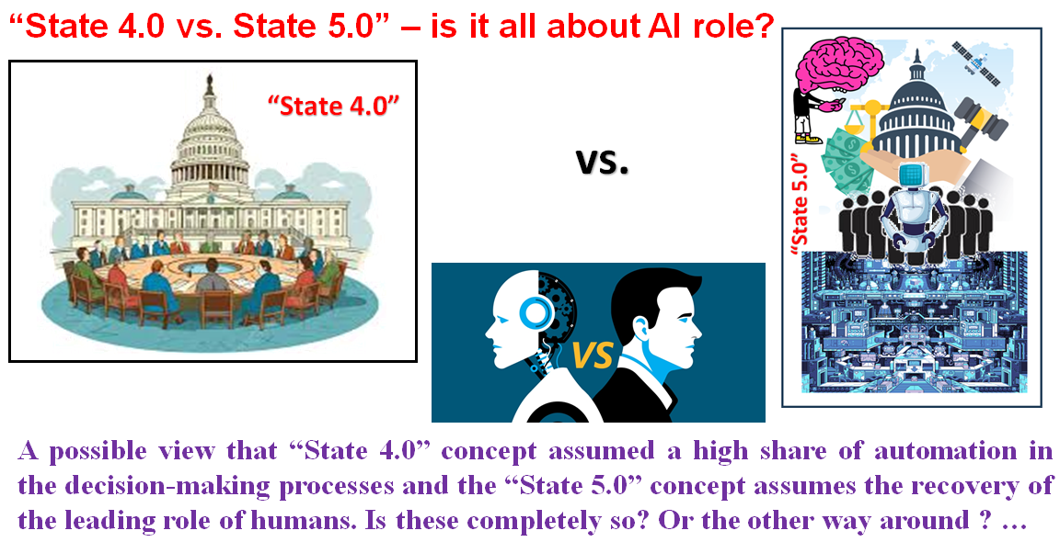
Human vs. AI in managing critical infrastructure

Slide 24
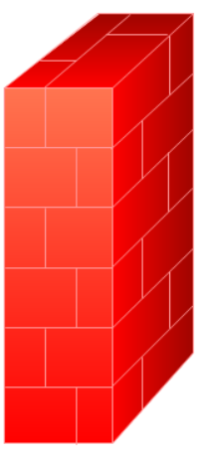
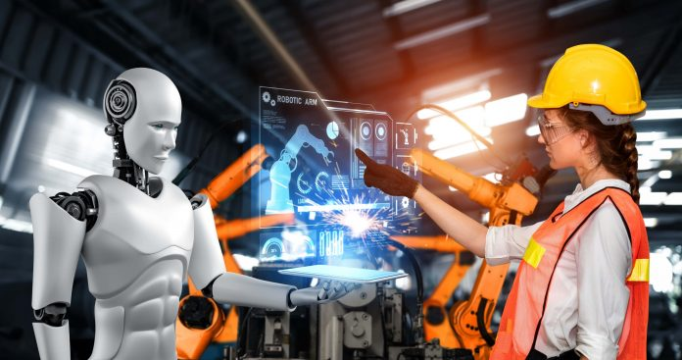
The need for resilience changes everything - I
AI vs. Human in Industry
Resilience
≈
AI strengths
Human vulnerabilities
Resilient Industry
≈
AI vulnerabilities
Human strengths

Slide 25
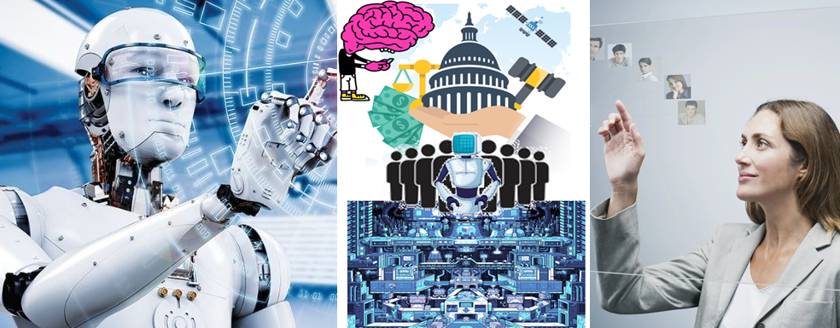
The need for resilience changes everything - II
AI vs. Human in State Management
Resilience
≈
AI strengths
Human vulnerabilities
Resilient State
≈
AI vulnerabilities
Human strengths

Slide 26
Two objectives – same solution
To enable resilient and efficient Industry of the future we need a hybrid “Industry 4.0 + Industry 5.0” with:
humans enhanced by autonomous AI;
autonomous AI “with human face” …
Resilient Industry
To enable resilient and efficient State of the future we need a hybrid “State 4.0 + State 5.0” with:
humans enhanced by autonomous AI;
autonomous AI “with human face” …
Resilient State
… and which will inherit the most valuable features of both - efficiency of the processes and sustainability of the decisions.
Digital cognitive clones (i.e., twinning human decision-making behavior) could be an enabling technology for the future hybrid and as an accelerator (as well as resilience enabler) of the convergence of the digital and human worlds ...
21 Lessons shows us where we are today …

Slide 27
Hybrid approaches towards future Industry and Future State using AI-Clones-of-Humans as mediators
Cite as:
Golovianko, M., Terziyan, V., Branytskyi, V., & Malyk, D., (2023). Industry 4.0 vs. Industry 5.0: Co-existence, Transition, or a Hybrid. Procedia Computer Science, 217, 102-113. Elsevier. https://doi.org/10.1016/j.procs.2022.12.206.
Presentation slides:
https://ai.it.jyu.fi/ISM-2022-Industry_4_5.pptx
“A unity of opposites”
HUMAN
AI
clone

Slide 28
Agents as autonomous “clones” of human capabilities
Not yet “hybrid printing” but step ahead
Enhancing a human (or a system or autonomous AI agent!) by making him/her ubiquitous and omniscient due to multiple autonomous clones capable to be present, self-develop and decide on human’s behalf synchronously within many processes.
A digital cognitive clone of a human decision-maker is an industrial compromise in the “robots vs. humans” dilemma, serving as a bridging concept to marry automation-centric Industry 4.0 and human-centric Industry 5.0 (as well as State 4.0 vs. State 5.0). Cognitive clones, as smart bridging technological artifacts, keep particular humans (donors for the clones) within the loop of responsible decision-making processes and, at the same time, make such human involvement ubiquitous and, therefore, efficient.

Slide 29
Autonomous agent (software robot) as a “clone”
or digital copy (twin) of human intelligence
Patented Intelligence
(Pi-Mind)
Digital clone
Of a human
Process
human
$π$-Mind (Pi-Mind) – “Patented Intelligence” technology is capable to capture, formalize, license, share, reuse, and integrate personal cognitive models and corresponding personal value- and decision-driven behavior (of a human or other smart entity) within autonomous cyber-physical-social systems and various business processes.
Cite as:
Terziyan, V., Gryshko, S., & Golovianko, M. (2018). Patented Intelligence: Cloning Human Decision Models for Industry 4.0. Journal of Manufacturing Systems, 48 (Part C), 204-217. Elsevier. https://doi.org/10.1016/j.jmsy.2018.04.019

Slide 30
Cloning …
Cloning
… and “cellular collective intelligence”

Slide 31
Cloning Process
(aka adversarial training)
- based on Conditional Generative Adversarial Network with special “Turing” Discriminator (T-GAN)
Golovianko, M., Gryshko, S., Terziyan, V., & Tuunanen, T. (2022). Responsible Cognitive Digital Clones as Decision Makers: A Design Science Research Study. European Journal of Information Systems, 32(5), 879–901, https://doi.org/10.1080/0960085X.2022.2073278
Golovianko, M., Gryshko, S., Terziyan, V., & Tuunanen, T. (2021). Towards Digital Cognitive Clones for the Decision-Makers: Adversarial Training Experiments. Procedia Computer Science, 180, 180-189. Elsevier. https://doi.org/10.1016/j.procs.2021.01.155. Presentation: https://ai.it.jyu.fi/ISM-2020-Pi-Mind.pptx
… contribution to “Cyber” component of hybrid Additive Manufacturing …

Slide 32
Cloning collective Intelligence
Using special GAN architecture with “Turing (group) Discriminator”
Cite as:
Terziyan, V., Gavriushenko, M., Girka, A., Gontarenko, A., & Kaikova, O. (2021). Cloning and Training Collective Intelligence with Generative Adversarial Networks. IET Collaborative Intelligent Manufacturing, 3(1), 64-74. John Wiley and Sons Ltd. https://doi.org/10.1049/cim2.12008
We provided an adversarial training framework for the collective intelligence. We show how cognitive capabilities can be copied (“cloned”) from humans and trained as a (responsible) collective intelligence. We made some modifications to the Generative Adversarial Networks architectures and adapted them for the cloning and training tasks. We modified the Discriminator component to a so‐called “Turing (group) Discriminator”, which includes one or several human and artificial discriminators working together.
… contribution to “social” component of hybrid Additive Manufacturing …

Slide 33
Cloning-GAN (C-GAN) architecture
Advanced Cloning Architectures
Driven by handcrafted mathematical expert knowledge
Cite as:
Terziyan, V., & Tiihonen, T. (2024). Using Cloning-GAN Architecture to Unlock the Secrets of Smart Manufacturing: Replication of Cognitive Models. Procedia Computer Science, 232, 890-902. Elsevier. https://doi.org/10.1016/j.procs.2024.01.089
See presentation: https://ai.it.jyu.fi/ISM-2023-Cloning_GAN.pptx
Multi-Expert-Guided Cloning-GAN (MEG-C-GAN) architecture
Trained cognitive clones of sensitive assets could have life-long re-training in evolving adversarial environments refreshing their robustness and resilience.
Driven by trainable artificial expert components
Cite as (when published):
Terziyan, V., & Tiihonen, T. (2025, submitted). Digital Cloning as a Self-Adaptive Multicriteria Optimization Process. Procedia Computer Science, 12 pp. Elsevier.

Slide 34
CONCLUSIONS
Hybrid Additive Manufacturing (HAM) is a vision, which assumes a unique synergy and integrated power of Additive Manufacturing, Generative AI, and Reinforcement Learning, which has certain potential to revolutionize the way we create and conceive complex hybrid entities, including humans. This vision blurs the boundaries between the physical, digital, and social domains, enabling us to shape and bring to life entities of unparalleled complexity and sophistication.
Visionary futuristic objective
(top-down view)
Hybrid Additive Manufacturing
Enabling technologies: The concept of HAM is feasible one. In this study, we show that all the necessary conceptual and technological components, methods, algorithms, and tools are available, and they are developed deeply enough to be used as HAM enablers. The combination of 3D printing with GAI under umbrella of HAM provides more opportunities to AM widening the range of new applications and products.
ML
AM
Edge
Enabling technologies
(ensure that top-down will meet bottom up)
AI
IoT
Bioprinting
Agile
GAI
GAN
Blockchain
Transformers
Digital cognitive cloning is a process capable of making digital replicas of complex cognitive assets with respect to their individual biases. The cloning process is supposed to be a kind of adversarial distillation driven by a generative adversarial network with a special configuration and objectives regarding the generator and discriminator networks. It facilitates supervised machine learning of the clone model due to a smart way to generate challenging inputs for the donor.
Realistic objective
(bottom-up view)

Slide 35
Come to study at our International Master Program
AI: Artificial Intelligence
(former Cognitive Computing and Collective Intelligence) …
… the first university program for collective intelligence, where humans learn together with their digital clones and autonomous digital assistants …
http://www.jyu.fi/ai
AI

Slide 36
Link to the presentation: https://ai.it.jyu.fi/IEAAIE-2024-HAM.pptx
Contact: vagan.terziyan@jyu.fi

