Slide 1
TB-Structure: Collective Intelligence for Exploratory Keyword Search
Vagan Terziyan, Mariia Golovianko & Michael Cochez
IKC-2016, Cluj-Napoca, Romania, 8-9 September 2016
Check updates here: http://www.mit.jyu.fi/ai/IKC-2016.pptx

Slide 3
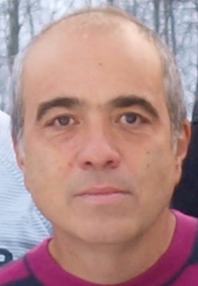
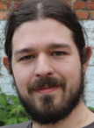
The Authors
Vagan Terziyan, Professor (Distributed Systems), Faculty of Information Technology, University of Jyväskylä (FINLAND),
e-mail:
vagan.terziyan@jyu.fi .
Mariia Golovianko, PhD, Department of Artificial Intelligence, Kharkiv National University of Radioelectronics (UKRAINE),
ACKNOWLEDGEMENT: this research has been supported by the STSM grant from KEYSTONE (COST ACTION IC1302)
e-mail:
mariia.golovianko@nure.ua ;
golovianko@gmail.com .‎
Michael Cochez, PhD, University of Jyväskylä (FINLAND), Currently: postdoctoral researcher at the Fraunhofer Institute for Applied Information Technology FIT / RWTH University in Aachen (GERMANY)
e-mail:
michael.cochez@jyu.fi ;
michael.cochez@fit.fraunhofer.de .

Slide 4
We are grateful to the anonymous photographers and artists, whose photos and pictures (or their fragments) posted on the Internet, we used in the presentation.
Beware on hidden slides!

Slide 5
“Exploratory searcher has a set of search criteria in mind, but does not know how many results will match those criteria — or if there even are any matching results to be found” (Tunkelang, 2013)
Exploratory
Search
Exploratory search covers a broader class of information exploration activities than typical information retrieval and these activities are usually carried out by searchers who are, according to White and Roth (2009):
unfamiliar with the domain of their search objective, i.e., unsure how to formulate their objective;
or unsure about the ways (technology or process) to approach their objective;
or unsure about their search objectives in the first place.
Typically, therefore, such searchers generally combine querying and browsing strategies to foster learning and investigation.
An example scenario, often used to motivate the research by mSpace (http://mspace.fm/), states: “if a user does not know much about classical music, how should they even begin to find a piece that they might like”.

Slide 6
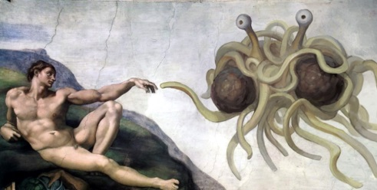
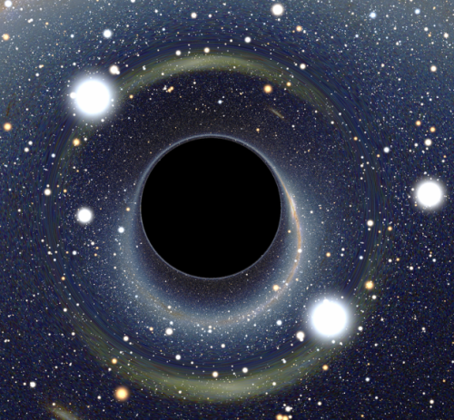
The Open World Assumption (Interpretations)
“Students need to be prepared for jobs that do not yet exist ... using technologies that have not yet been invented … in order to solve problems that we do not even know are problems yet”.
[Richard Riley, Secretary of Education under Clinton]
The Open World Assumption (OWA): a lack of information does not imply the missing information to be false.
Knowledge is never complete — gaining and using knowledge is a permanent evolutionary process, and is never complete. A completeness assumption around knowledge is by definition inappropriate;
Search algorithms need to be prepared for content instances that do not yet visible or exist ... which may have keywords that have not yet been invented or cannot yet be formulated … in order to get meaningful search outcome to be used for the problems that we do not even recognize to be our problems yet.

Slide 7
Closed World Information Retrieval vs. Exploratory Search based on the Open World Assumption
Search Query
Q_{i}
OWA-Driven Iterative Discovery Engine
Q_{i+1}
Discovered update on Search Query
Discovered Content
Data Mining and Query Refinement
OUT_{i}
Generated “query trail”:
{Q_{i} → Q_{i+1} → Q_{i+2} → … → Q_{i+n} }
With the OWA-Driven Search you may discover interesting content from the Web (as well as a promising business opportunity) having no idea in advance what you are searching for !

Slide 8
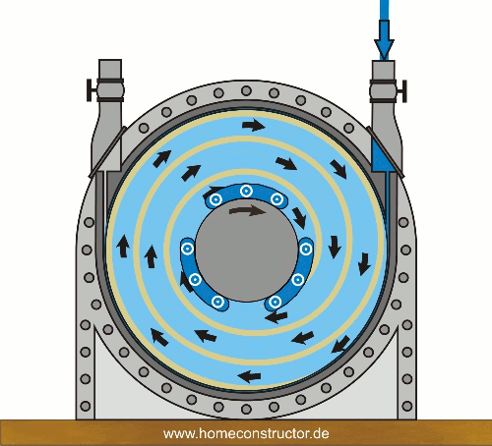
Information Retrieval (CWA) vs. Exploratory Search (OWA)
Query
CWA-Driven Engine
Answer
Query
OWA-Driven Engine
New Query
The “Perpetuum Mobile”

Slide 9
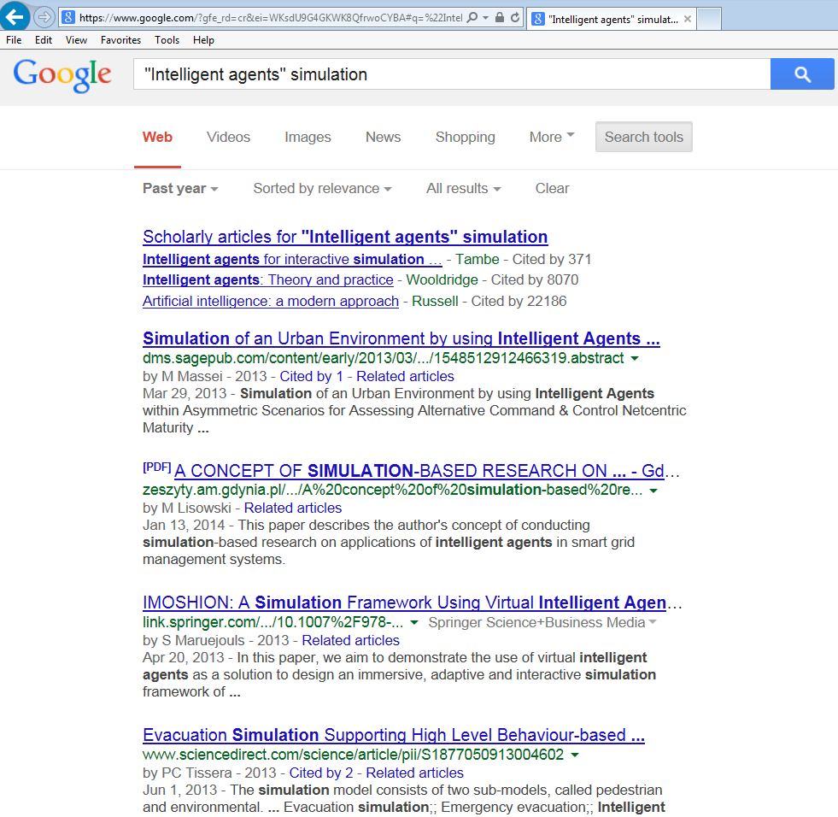
Exploratory Search Example (1)
Q₀: { intelligent-agents ; simulation }
Q₁: {simulation ; military-context }

Slide 10
Exploratory Search Example (2)
Q₁: {simulation ; military-context }
Q₂: { simulation ; cultural-awareness}

Slide 11
Exploratory Search Example (3)
Q₂: { simulation ; cultural-awareness}
Q₃: {semantic-social-sensing }

Slide 12
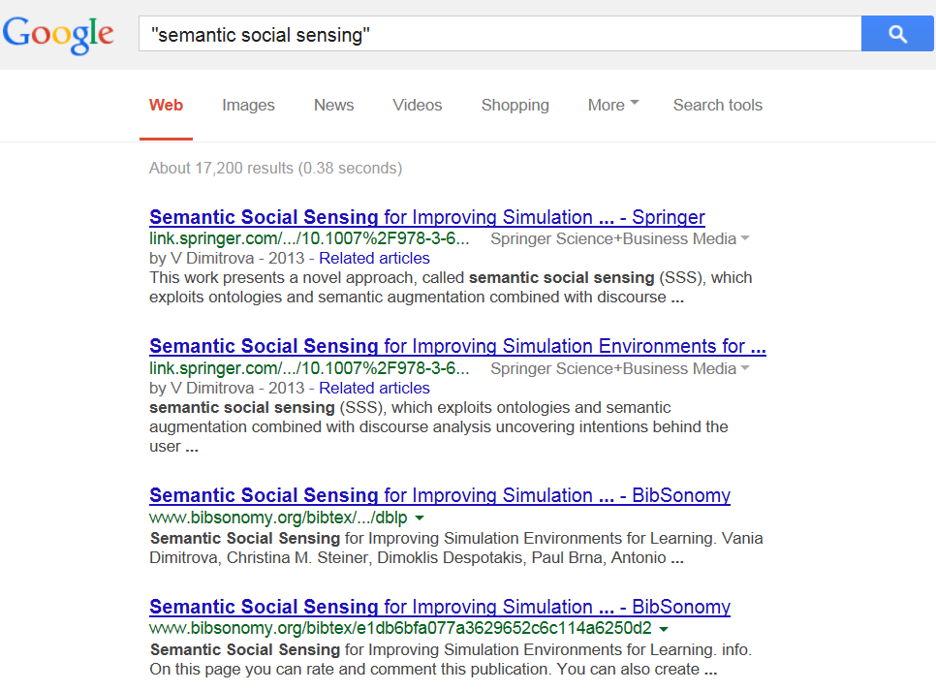
Exploratory Search Example (4)
Q₃: {semantic-social-sensing }
Q₀ (!)
Intelligent-agents
Q₄: {semantic-social-sensing ; simulation ; intelligent-agents}
Q₀ (?)

Slide 13
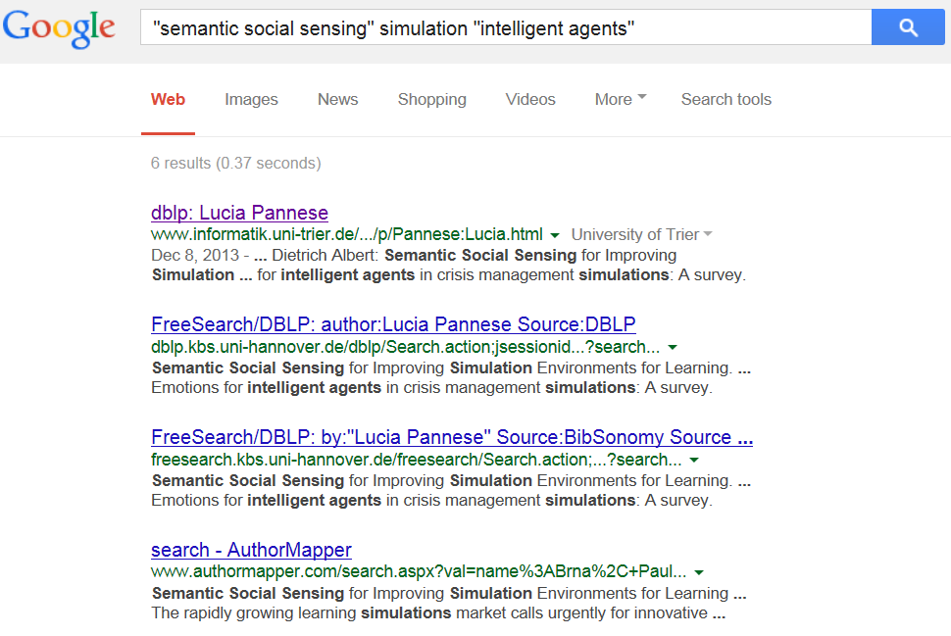
Exploratory Search Example (5)
Q₄: {semantic-social-sensing ; simulation ; intelligent-agents}
!!!
!!!
Q₅: { Lucia-Pannese }

Slide 14
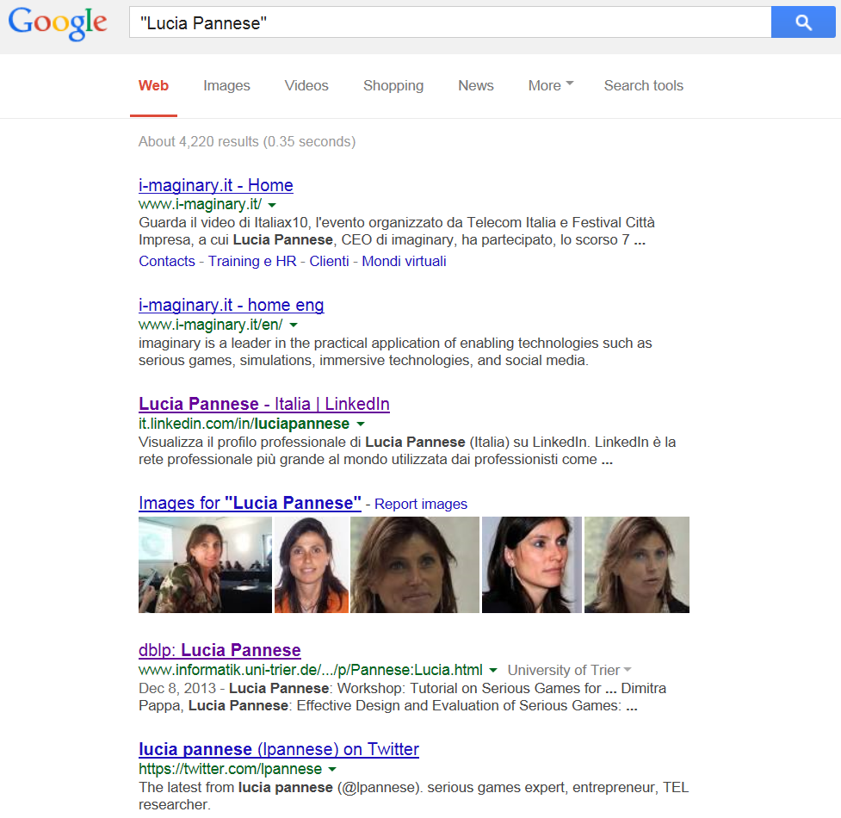
Exploratory Search Example (6)
Q₅: { Lucia-Pannese }
Original query: Q₀: { intelligent-agents ; simulation }
Discovered: new collaboration opportunity “Lucia Pannese” !
Query trail: {Q₀ → Q₁ → Q₂ → Q₃ → Q₄ → Q₅ }
Discovered: potentially interesting domain – “semantic social sensing” !

Slide 15
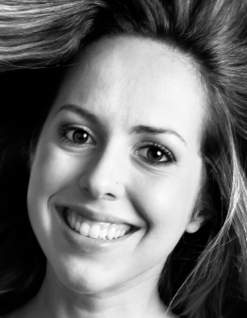
Query trails aka “collective intelligence”
Q₁
Collected query trails:
{Q₁, Q₂, Q₃, Q₄, Q₅}
Q₂
{Q₁₁, Q₃, Q₉}
Q₃
A Q u e r y t r a I l: { Q₁ , Q₂ , … , Q_{n} }
Collected query trails:
Q₄
{Q₁, Q₂, Q₆ , Q₇ , Q₈}
RQ: Can we make any sense from such collection?
…
{Q₁₂, Q₂, Q₃, Q₄, Q₅}
Q_{n-1}
Collected query trails:
Q_{n}
{Q₁, Q₂, Q₃, Q₉}
{Q₁₀, Q₂, Q₆, Q₇, Q₈}

Slide 16
Query (Prefix) Tree / Forest:
“collective confusion” – “individual satisfaction”
Q₁
Q₁₀
Q₁₂
Q₂
Collected query trails:
{Q₁, Q₂, Q₃, Q₄, Q₅}
Q₂
Q₂
{Q₁₁, Q₃, Q₉}
{Q₁, Q₂, Q₆ , Q₇ , Q₈}
Q₃
Q₆
{Q₁₂, Q₂, Q₃, Q₄, Q₅}
{Q₁, Q₂, Q₃, Q₉}
Q₁₁
Q₆
Q₃
{Q₁₀, Q₂, Q₆, Q₇, Q₈}
Q₄
Q₇
Q₃
Q₇
Q₄
Q₅
Q₉
Q₈
Q₉
Q₈
Q₅

Slide 17
Inverted Query (Suffix) Tree / Forest:
“collective satisfaction” – “individual confusion”
Q₅
Q₈
Q₉
Q₄
Inverted (!) query trails:
Q₇
Q₃
Q₃
{Q₅, Q₄, Q₃, Q₂, Q₁}
{Q₉, Q₃, Q₁₁}
{Q₈, Q₇, Q₆ , Q₂ , Q₁}
Q₆
{Q₅, Q₄, Q₃, Q₂, Q₁₂}
Q₂
Q₂
{Q₉, Q₃, Q₂, Q₁}
{Q₈, Q₇, Q₆, Q₂, Q₁₀}
Q₂
Q₁
Q₁₁
Q₁
Q₁₂
Q₁
Q₁₀

Slide 18
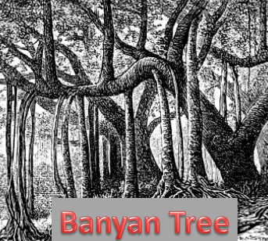
Merged Query Forest with Inversed Query Forest =
= There-and-Back-Structure (TB-Query-Structure)
Lovitskii, V. A., Terziyan, V. (1981). Words’ Coding in TB-Structure. Problemy Bioniki, 26, 60-68. (In Russian)

Slide 19
TB-Query has been originally invented for “intelligent” storage of words

Slide 20
TB-Structure (merged Prefix & Suffix forests):
“collective or individual confusion” – “COLLABORATIVE satisfaction”
Original (Collected) query trails:
{Q₁, Q₂, Q₃, Q₄, Q₅}
{Q₁₁, Q₃, Q₉}
Q₁₁
Q₁₂
Q₁
Q₁₀
{Q₁, Q₂, Q₆ , Q₇ , Q₈}
{Q₁₂, Q₂, Q₃, Q₄, Q₅}
{Q₁, Q₂, Q₃, Q₉}
{Q₁₀, Q₂, Q₆, Q₇, Q₈}
Q₂
Q₃
Q₆
New (inferred)
query trails:
{Q₁₁, Q₃, Q₄, Q₅}
Q₄
{Q₁₂, Q₂, Q₃, Q₉}
Q₇
{Q₁₂, Q₂, Q₆ , Q₇ , Q₈}
{Q₁₀, Q₂, Q₃, Q₄, Q₅}
{Q₁₀, Q₂, Q₃, Q₉}
Q₅
Q₉
Q₈

Slide 21
Batch preprocessing of trails before feeding TB-structure (because order matters):
using “prefix-suffix similarity” function
$${SIMPS}_{T_{x},T_{y}}=\frac{\left|T_{x}∩^{P}T_{y}\right|+\left|T_{x}∩^{S}T_{y}\right|}{\left|T_{x}\right|+\left|T_{y}\right|}$$
Original (Collected) query trails:
{Q₁, Q₂, Q₃, Q₄, Q₅}
{Q₁₁, Q₃, Q₉}
$\left|T_{x}∩^{P}T_{y}\right|$ - longest common prefix length
{Q₁, Q₂, Q₆ , Q₇ , Q₈}
{Q₁₂, Q₂, Q₃, Q₄, Q₅}
$\left|T_{x}∩^{S}T_{y}\right|$ - longest common suffix length
{Q₁, Q₂, Q₃, Q₉}
{Q₁₀, Q₂, Q₆, Q₇, Q₈}
T_{x}: { Q₁, Q₂, Q₃, Q₄, Q₅, Q₆ }
Ordered query trails:
{Q₁, Q₂, Q₃, Q₄, Q₅}
T_{y}: { Q₁, Q₂, Q₃, Q₇, Q₈, Q₅, Q₆ }
{Q₁₂, Q₂, Q₃, Q₄, Q₅}
{Q₁, Q₂, Q₃, Q₉}
{Q₁₁, Q₃, Q₉}
$${SIMPS}_{T_{x},T_{y}}=\frac{5}{13}≈0.3846$$
{Q₁, Q₂, Q₆ , Q₇ , Q₈}
{Q₁₀, Q₂, Q₆, Q₇, Q₈}

Slide 22
How we got this TB-Structure:
Step-by-Step structure feeding
Q₁₁
Q₁₂
Q₁
Q₁₀
Ordered query trails:
Q₂
{Q₁, Q₂, Q₃, Q₄, Q₅}
{Q₁₂, Q₂, Q₃, Q₄, Q₅}
Q₃
Q₆
{Q₁, Q₂, Q₃, Q₉}
{Q₁₁, Q₃, Q₉}
{Q₁, Q₂, Q₆ , Q₇ , Q₈}
Q₄
Q₇
{Q₁₀, Q₂, Q₆, Q₇, Q₈}
Q₅
Q₉
Q₈

Slide 23
How we got this TB-Structure:
Step 1
Q₁
Ordered query trails:
Q₂
{Q₁, Q₂, Q₃, Q₄, Q₅}
{Q₁₂, Q₂, Q₃, Q₄, Q₅}
Q₃
{Q₁, Q₂, Q₃, Q₉}
{Q₁₁, Q₃, Q₉}
{Q₁, Q₂, Q₆ , Q₇ , Q₈}
Q₄
{Q₁₀, Q₂, Q₆, Q₇, Q₈}
Q₅

Slide 24
How we got this TB-Structure:
Step 2
Q₁₂
Q₁
Ordered query trails:
Q₂
{Q₁, Q₂, Q₃, Q₄, Q₅}
{Q₁₂, Q₂, Q₃, Q₄, Q₅}
Q₃
{Q₁, Q₂, Q₃, Q₉}
{Q₁₁, Q₃, Q₉}
{Q₁, Q₂, Q₆ , Q₇ , Q₈}
Q₄
{Q₁₀, Q₂, Q₆, Q₇, Q₈}
Q₅

Slide 25
How we got this TB-Structure:
Step 3
Q₁₂
Q₁
Ordered query trails:
Q₂
{Q₁, Q₂, Q₃, Q₄, Q₅}
{Q₁₂, Q₂, Q₃, Q₄, Q₅}
Q₃
{Q₁, Q₂, Q₃, Q₉}
{Q₁₁, Q₃, Q₉}
{Q₁, Q₂, Q₆ , Q₇ , Q₈}
Q₄
{Q₁₀, Q₂, Q₆, Q₇, Q₈}
NOTICE NEW (INFERRED) TRAIL:
Q₅
Q₉
{Q₁₂, Q₂, Q₃, Q₉}
… which means that for the entry Q₁₂ we may offer also search outcomes of the implicit query Q₉ (as well as, of course, of the explicit one Q₅ )

Slide 26
How we got this TB-Structure:
Step 3* (“Collaborative Filtering” effect?)
NOTICE EFFECT aka “Collaborative Filtering” !!!
Q₁₂
Q₁
The underlying assumption of the collaborative filtering approach is that if a person A has the same “satisfaction” as a person B on an issue X (i.e., on the content returned by a search engine), then A is more likely to be satisfied on a different issue Y, which has already satisfied B, than to have the same satisfaction on Y as a person chosen randomly.
Q₂
Q₃
Q₄
NOTICE NEW (INFERRED) TRAIL:
Q₅
Q₉
{Q₁₂, Q₂, Q₃, Q₉}
… which means that for the entry Q₁₂ we may offer also search outcomes of the implicit query Q₉ (as well as, of course, of the explicit one Q₅ )

Slide 27
How we got this TB-Structure:
Step 4
Q₁₁
Q₁₂
Q₁
Ordered query trails:
Q₂
{Q₁, Q₂, Q₃, Q₄, Q₅}
{Q₁₂, Q₂, Q₃, Q₄, Q₅}
Q₃
{Q₁, Q₂, Q₃, Q₉}
{Q₁₁, Q₃, Q₉}
{Q₁, Q₂, Q₆ , Q₇ , Q₈}
Q₄
{Q₁₀, Q₂, Q₆, Q₇, Q₈}
NOTICE NEW (INFERRED) TRAIL:
Q₅
Q₉
{Q₁₁, Q₃, Q₄, Q₅}

Slide 28
How we got this TB-Structure:
Step 5
Q₁₁
Q₁₂
Q₁
Ordered query trails:
Q₂
{Q₁, Q₂, Q₃, Q₄, Q₅}
{Q₁₂, Q₂, Q₃, Q₄, Q₅}
Q₃
Q₆
{Q₁, Q₂, Q₃, Q₉}
{Q₁₁, Q₃, Q₉}
{Q₁, Q₂, Q₆ , Q₇ , Q₈}
Q₄
Q₇
{Q₁₀, Q₂, Q₆, Q₇, Q₈}
NOTICE NEW (INFERRED) TRAIL:
Q₅
Q₉
Q₈
{Q₁₂, Q₂, Q₆, Q₇, Q₈}

Slide 29
How we got this TB-Structure:
Step 6
Q₁₁
Q₁₂
Q₁
Q₁₀
Ordered query trails:
Q₂
{Q₁, Q₂, Q₃, Q₄, Q₅}
{Q₁₂, Q₂, Q₃, Q₄, Q₅}
Q₃
Q₆
{Q₁, Q₂, Q₃, Q₉}
{Q₁₁, Q₃, Q₉}
{Q₁, Q₂, Q₆ , Q₇ , Q₈}
Q₄
Q₇
{Q₁₀, Q₂, Q₆, Q₇, Q₈}
NOTICE 2 NEW (INFERRED) TRAILS:
Q₅
Q₉
Q₈
{Q₁₀, Q₂, Q₃, Q₄, Q₅}
{Q₁₀, Q₂, Q₃, Q₉}

Slide 30
How we got this TB-Structure:
(finally, notice collaborative satisfaction nodes due to inferred trails)
Ordered query trails:
{Q₁, Q₂, Q₃, Q₄, Q₅}
Q₁₁
Q₁₂
Q₁
Q₁₀
{Q₁₂, Q₂, Q₃, Q₄, Q₅}
{Q₁, Q₂, Q₃, Q₉}
{Q₁₁, Q₃, Q₉}
Q₂
{Q₁, Q₂, Q₆ , Q₇ , Q₈}
{Q₁₀, Q₂, Q₆, Q₇, Q₈}
Q₃
Q₆
5 INFERRED TRAILS:
{Q₁₂, Q₂, Q₃, Q₉}
Q₄
Q₇
{Q₁₁, Q₃, Q₄, Q₅}
{Q₁₂, Q₂, Q₆, Q₇, Q₈}
{Q₁₀, Q₂, Q₃, Q₄, Q₅}
Q₅
Q₉
Q₈
{Q₁₀, Q₂, Q₃, Q₉}

Slide 31
Trails merged simultaneously from prefix and suffix:
of course possible, no problem!
Q₁
{ Q₁, Q₂, Q₃, Q₄, Q₅, Q₆ }
Q₂
{ Q₁, Q₂, Q₃, Q₇, Q₈, Q₅, Q₆ }
Q₃
Q₇
Q₄
Q₈
Unordered loops
(alternative paths from origin to destination)
are possible in TB-Structure
Q₅
Q₆

Slide 32
Nested prefixes or/and suffixes:
of course possible, no problem!
Q₁
Q₂
{ Q₁, Q₂, Q₃, Q₄, Q₅, Q₆ }
{Q₁, Q₂, Q₃, Q₄, Q₅, Q₆}
{Q₂, Q₃, Q₄, Q₅, Q₆}
{ Q₂, Q₃, Q₄, Q₅, Q₆ }
Q₃
{ Q₁, Q₂, Q₃, Q₄, Q₅ }
{ Q₁, Q₂, Q₃, Q₄, Q₅ }
Q₃
Q₄
Maximal compactness
(and high inference potential)
Q₅
Q₆

Slide 33
Trails: Trees vs. Tries
Trees-based
TB-structure
Tries-based
TB-structure
Q₁
Q₂
Q₂
Q₁
Q₅
Q₅
Q₇
Q₇
Q₉
Q₁₀
Q₉
Q₁₀
Q₁₂
Q₁₃
Q₁₂
Q₁₃
Q₁₈
Q₁₉
Q₁₈
Q₁₉

Slide 34
Experiments with TB-Structure (Data Generation)
To test the properties of a TB-structures the first round of experiments has been run on an automatically generated artificial data set.
The automatic generation of trails was performed in two different ways:
With a uniform generator, which generated trails by choosing query symbols Q_{i} from the so called “alphabet” {Q} uniformly at random and constructing trails of the length chosen randomly between l_{min} and l_{max} ;
With a random traversal generator which created a graph of the query symbols by placing each symbol in a node and adding a directed edge from each node to a fixed number of randomly chosen other nodes. A trail was generated by the graph traversal from a randomly chosen starting node.

Slide 35
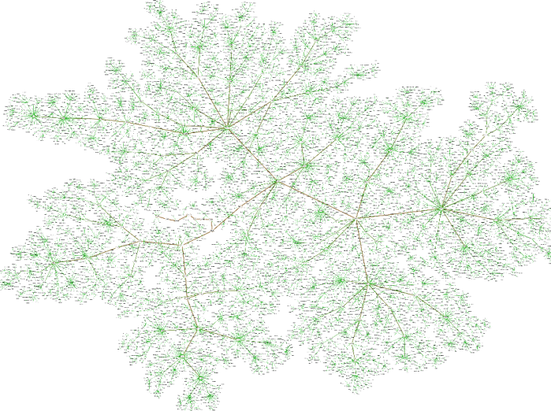
Experiments with TB-Structure (Data Settings)
We automatically generated 5391 restricted* TB-structures and 5391 fail-over** structures with different settings.
We varied the minimal trail length l_{min} from 5 to 55 nodes, the maximal length l_{max} varies from 5 to 60 nodes, the step of the length for each new set of generated structures was 5 nodes;
A number of symbols in the query alphabet varies from 20 minimum to 1280 maximum;
A number of initial trails varies from 100 to 51200.
* Trails in restricted structures does not contain the same symbol (query) several times in various places (natural assumption);
** Trails in fail-over structures does not have any limitations (may lead to so called “toxic” cases).
Math genealogy

Slide 36
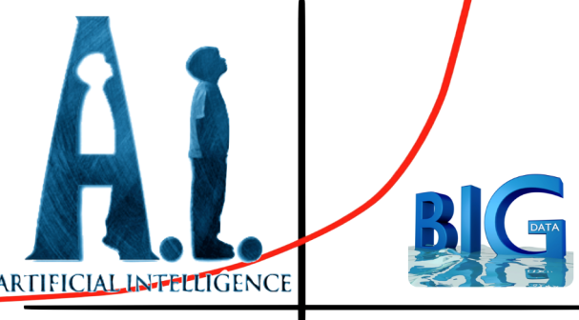
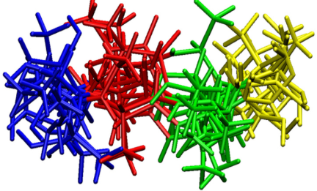
Experiments with TB-Structure
(verifying new-trails’ “generative power” (inference capacity),
which also means storage “compactness”)
An important property of the TB structure verified by experiments is its generative power – ability to infer new trails, implicit in the initial collection of trails. Such property shows both the inference power and the compactness of the structure.
The experiments shown a non-linear, exponential-like dependency between the number of initial trails and newly generated ones.
The maximum number of generated trails was achieved in case of the bigger difference between the minimal possible length of trails and their maximal possible length (l_{min} = 5 ; l_{max} = 60) and the smallest possible alphabet (= 20). The biggest explosion of new trails was observed in a fail-over structure. In many cases the number of generated trails was so large that we were unable to count it at in reasonable time*.
* The combinatorial explosion is not critical in our case because usually real search tasks imply shorter query trails than what we used in experiments, and a large alpha-bet. TB-structures constructed with these settings are more compact and suffer less from explosion of newly generated trails.

Slide 37
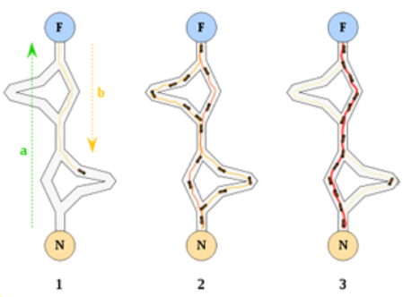
Next Stage: SWARM-TB-Query-Structure
Q₁
Q₂
Q₃
Q₄
Q₅
Q₆
Q₇
Q₈
Q₉
Q₁₀
Q₁₁
Q₁₂
Q₁₃
Q₁₄
Q₁₅
Q₁₆
Q₁₇
Q₁₈
Q₁₉
Q₂₀
Q₂₁
Q₂₂
Q₂₃

Slide 38
SWARM-TB-Query-Structure
How we may use pheromone?
Ant Colony Optimization scheme:
Initialize pheromone values
repeat
for ant k ∈ {1, . . .,m}
construct a solution
endfor
forall pheromone values do
decrease the value by a certain percentage {evaporation}
endfor
forall pheromone values corresponding to good solutions
do
increase the value {intensification}
endfor
until stopping criterion is met
[ D. Merkle & M. Middendorf ]

Slide 39
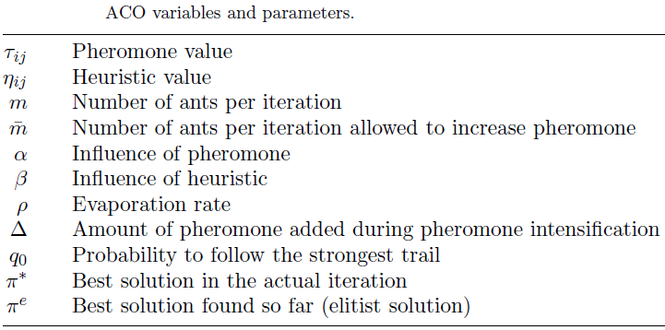
SWARM-TB-Query-Structure
Traveling Salesperson Problem ACO scheme:
Initialize pheromone values
repeat
for ant k ∈ {1, . . .,m}{solution construction}
S := {1, . . . , n} {set of selectable edges}
choose edge i with probability p_{0i}
repeat
choose edge j ∈ S with probability p_{ij}
S := S − {j}
i := j
until S = ∅
Endfor
forall i, j do
τ_{ij} := (1 − ρ) · τ_{ij} {evaporation}
endfor
forall i, j in iteration best solution do
τ_{i,j} := τ_{ij} +Δ {intensification}
endfor
until stopping criterion is met
[ D. Merkle & M. Middendorf ]

Slide 40
Summary and Conclusions
Exploratory search optimization benefits from capturing and processing collective search experience;
Collective behavior contains hidden patterns that can be uncovered and used;
TB-Structure contributes to the effective storage and operation over big data sequences, e.g., query trails of collective search experience;
TB-structure is a smart data model used for compact storage of explicit query trails and inference of implicit trails useful for new users’ intents prediction;
TB-structure can be applied for various tasks implying sequential processes, configurations and plans in biology, medicine, industry, logistics, etc.;
Experiments show that generative power of the proposed data structures is very high, in some cases we experience explosion of new implicit knowledge emergence;
The structure will benefit from applying a swarm intelligence on top of it.

Slide 41
If no time for explicit questions,
then explore:
http://www.cs.jyu.fi/ai/IKC-2016.pptx
for implicit answers …

Slide 42
Hidden slides

Slide 43
S₀
Q₁
Search Trail
R₁
The terminology
S₁
S₀
The initial state-of-mind (original believed search objective)
Q₂
Q_{i}
The keyword search query (depends on current state-of-mind)
A S e a r c h t r a I l
R₂
R_{i}
The return/response from the search engine (includes also its clickable neighborhood)
S₂
…
S_{i}
The refined state-of-mind (refined search objective)
S_{n-1}
S_{n}
The satisfaction state-of-mind (search mission accomplished)
Q_{n}
R_{n}
S_{n}

Slide 44
Mind Trail
S₀
R₁
Q₁
Query Trail
S₁
Q₂
R₂
Response Trail
S₂
Q₃
R₃
A M I N D t r a I l
A Q u e r y t r a I l
S₃
Q₄
A r e s p o n s e t r a I l
R₄
…
…
…
mind
S_{n-1}
Q_{n-1}
R_{n-1}
S_{n}
Q_{n}
R_{n}
Search
Engine
Query
Content

Slide 45
Query Tree
example
Query Tree
Trails of the tree:
Q₁
{Q₁}
{Q₁,Q₂,Q₃,Q₄,Q₅}
{Q₁,Q₂,Q₆,Q₇,Q₈,Q₉}
Q₂
{Q₁,Q₂,Q₆,Q₇,Q₁₀,Q₁₁}
{Q₁,Q₂,Q₆,Q₇,Q₁₀,Q₁₂,Q₁₃}
Q₃
Q₆
{Q₁,Q₂,Q₆,Q₁₄,Q₁₅,Q₁₆,Q₁₇}
{Q₁,Q₁₈}
Q₄
Q₇
Q₁₄
Q₈
Q₁₀
Q₁₅
Q₁₂
Q₁₆
Q₅
Q₉
Q₁₁
Q₁₃
Q₁₇
Q₁₈

Slide 46
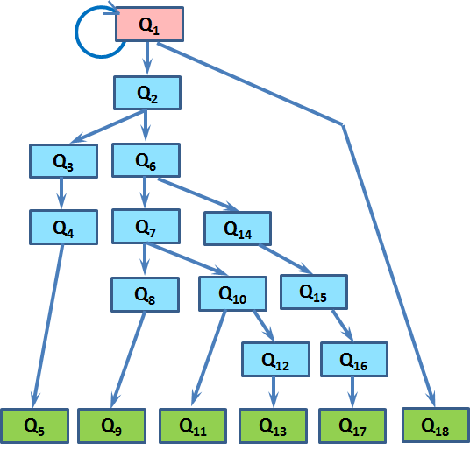
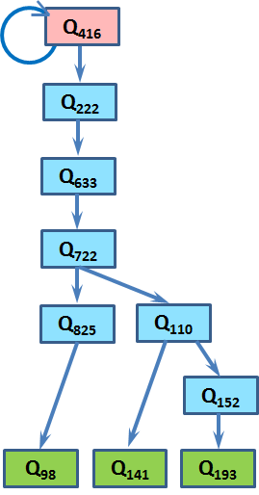
Query Forest
example
Query Forest

Slide 47
Inversed Query Tree
example
Inverse Query Tree
Trails of the tree:
Q₅
{Q₁}
{Q₁,Q₂,Q₃,Q₄,Q₅}
Q₄
{Q₆,Q₇,Q₈,Q₂,Q₃,Q₄,Q₅}
{Q₉,Q₈,Q₂,Q₃,Q₄,Q₅}
Q₃
{Q₁₀,Q₃,Q₄,Q₅}
Q₂
Q₈
Q₇
Q₁
Q₆
Q₉
Q₁₀

Slide 48
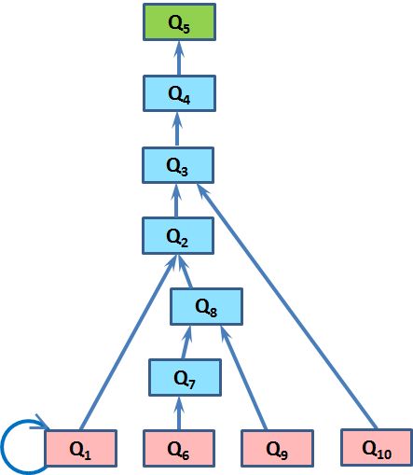
Inverse Query Forest
example
Inversed Query Forest

Slide 49
TB-Query-Structure
example
Q₁
Q₂
Q₃
Q₄
Q₅
Q₆
Q₇
Q₈
Q₉
Q₁₀
Q₁₁
Q₁₂
Q₁₃
Q₁₄
Q₁₅
Q₁₆
Q₁₇
Q₁₈
Q₁₉
Q₂₀
Q₂₁
Q₂₂
Q₂₃

Slide 50
There-and-Back-Structure (example from old paper)
Lovitskii, V. A., Terziyan, V. (1981). Words’ Coding in TB-Structure. Problemy Bioniki, 26, 60-68. (In Russian).
Words:
Inverted Words:
Ч-И-Т-А-Т-Ь
Ь-Т-А-Т-И-Ч
Ч-И-Т-А-Т-Е-Л-Ь
Ь-Л-Е-Т-А-Т-И-Ч
Ч-И-Т-А-Л
Л-А-Т-И-Ч
П-И-С-А-Т-Ь
Ь-Т-А-С-И-П

Slide 51
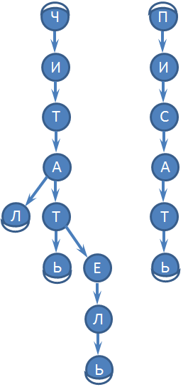
There-and-Back-Structure (example from old paper)
Prefix Forest:
Words:
Ч
П
Ч-И-Т-А-Т-Ь
Ч-И-Т-А-Т-Е-Л-Ь
И
И
Ч-И-Т-А-Л
П-И-С-А-Т-Ь
Т
С
А
А
Л
Т
Т
Ь
Е
Ь
Л
Ь

Slide 52
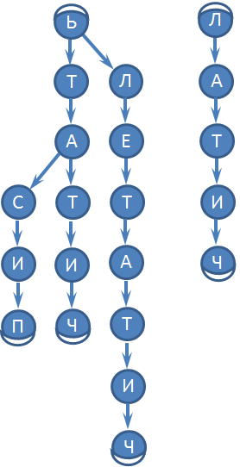
Inverted Words:
There-and-Back-Structure (example from old paper)
Ь-Т-А-Т-И-Ч
Ь-Л-Е-Т-А-Т-И-Ч
Suffix Forest:
Л-А-Т-И-Ч
Ь-Т-А-С-И-П
Ь
Л
Т
Л
А
А
Е
Т
С
Т
Т
И
И
И
А
Ч
П
Ч
Т
И
Ч

Slide 53
There-and-Back-Structure (example from old paper)
Prefix Forest:
Suffix Forest:
Ч
П
Ь
Л
И
И
Т
Л
А
Т
С
А
Е
Т
А
А
С
Т
Т
И
Л
Т
Т
И
И
А
Ч
Ь
Е
Ь
П
Ч
Т
Л
И
Ь
Ч

Slide 54
There-and-Back-Structure (example from old paper)
Prefix Forest:
Suffix Forest:
Ь
Л
Ч
П
Т
Л
А
И
И
А
Е
Т
Т
С
С
Т
Т
И
А
А
И
И
А
Ч
Л
Т
Т
П
Ч
Т
Ь
Е
Ь
И
Л
Ч
Ь

Slide 55
There-and-Back-Structure (example from old paper)
TB-Structure:
Ч
П
Original words:
И
И
Ч-И-Т-А-Т-Ь
Ч-И-Т-А-Т-Е-Л-Ь
Т
С
Ч-И-Т-А-Л
П-И-С-А-Т-Ь
А
New words appear:
Л
Т
П-И-С-А-Т-Е-Л-Ь
Е
П-И-С-А-Л
Л
Ь

Slide 56
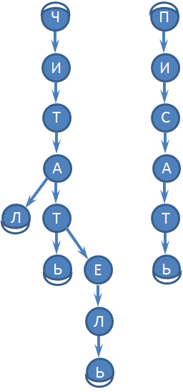
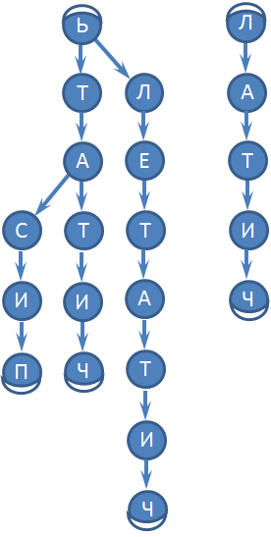
Words:
Inverted Words:
TB-Structure:
Merged Prefix & Suffix Forests
Ч-И-Т-А-Т-Ь
Ь-Т-А-Т-И-Ч
Ч-И-Т-А-Т-Е-Л-Ь
Ь-Л-Е-Т-А-Т-И-Ч
Ч-И-Т-А-Л
Л-А-Т-И-Ч
П-И-С-А-Т-Ь
Ь-Т-А-С-И-П
Prefix Forest:
Suffix Forest:
New words appeared (!):
П-И-С-А-Т-Е-Л-Ь
П-И-С-А-Л

Slide 57
Generating Effect of TB-Query-Structure
example
1
Q₁
{Q₁, Q₇, Q₉, Q₁₂, Q₁₈}
Q₇
Q₉
Q₁₂
Q₁₈

Slide 58
Generating Effect of TB-Query-Structure
example
2
Q₁
{Q₁, Q₇, Q₉, Q₁₂, Q₁₈}
{Q₁, Q₇, Q₁₀, Q₁₃, Q₁₉}
Q₇
Q₉
Q₁₀
Q₁₂
Q₁₃
Q₁₈
Q₁₉

Slide 59
Generating Effect of TB-Query-Structure
example
3
Q₁
Q₂
{Q₁, Q₇, Q₉, Q₁₂, Q₁₈}
{Q₁, Q₇, Q₁₀, Q₁₃, Q₁₉}
Q₅
{Q₂, Q₅, Q₇, Q₉, Q₁₂, Q₁₈}
Q₇
Q₉
Q₁₀
Q₁₂
Q₁₃
Q₁₈
Q₁₉

Slide 60
Generating Effect of TB-Query-Structure
example
4’’
Q₁
Q₂
{Q₁, Q₇, Q₉, Q₁₂, Q₁₈}
Q₅
{Q₁, Q₇, Q₁₀, Q₁₃, Q₁₉}
{Q₂, Q₅, Q₇, Q₉, Q₁₂, Q₁₈}
Q₇
Q₉
Q₁₀
{Q₂, Q₅, Q₇, Q₁₀, Q₁₃, Q₁₉}
Reminds a collaborative filtering effect !
Q₁₂
Q₁₃
New trail generated automatically !
Q₁₈
Q₁₉
10 nodes; 9 edges

Slide 61
Collaborative Filtering (just a reminder)
[Wikipedia]: Collaborative filtering (CF) is a technique used by some recommender systems. Applications of collaborative filtering typically involve very large data sets. Collaborative filtering is a method of making automatic predictions (“filtering”) about the interests of a user by collecting preferences or taste information from many users (“collaborating”).
The underlying assumption of the collaborative filtering approach is that if a person A has the same “satisfaction” as a person B on an issue X (i.e., on the content returned by a search engine), then A is more likely to be satisfied on a different issue Y, which has already satisfied B, than to have the same satisfaction on Y as a person chosen randomly.

Slide 62
Some relevant study on
Search + Collaborative_Filtering
The study by Deokule, Yu & Lea (2005) proposed a Collaborative Filtering algorithm that generates and recommends a list of alternate keywords based on the keywords originally set by a user when searching documents from an online search engine. The proposed algorithm incorporates the similarities among keywords associated with the documents and provides crucial recommendations that may not be considered by the user. The purpose of the algorithm is to reduce the efforts in identifying appropriate keywords set to allocate the desired documents more efficiently.
Deokule, S. S., Yu, W. B., & Lea, B. R. (2005). A conceptual framework of using collaborative filtering algorithms to enhance keyword search. University of Missouri--Rolla.

Slide 63
1
2
3
Q₁
Q₂
1
{Q₁, Q₇, Q₉, Q₁₂, Q₁₈}
2
{Q₁, Q₇, Q₁₀, Q₁₃, Q₁₉}
Q₅
3
{Q₂, Q₅, Q₇, Q₉, Q₁₂, Q₁₈}
Q₇
Q₉
Q₁₀
{Q₂, Q₅, Q₇, Q₁₀, Q₁₃, Q₁₉}
Q₁₂
Q₁₃
New trail generated automatically !
Q₁₈
Q₁₉
10 nodes; 9 edges

Slide 64
Generating Effect of TB-Query-Structure
example
5
Q₁
Q₂
{Q₁, Q₇, Q₉, Q₁₂, Q₁₈}
{Q₁, Q₇, Q₁₀, Q₁₃, Q₁₉}
Q₅
{Q₂, Q₅, Q₇, Q₉, Q₁₂, Q₁₈}
{Q₁, Q₇, Q₉, Q₁₂, Q₁₈}
Q₇
Q₇
Q₁₀
Q₉
{Q₂, Q₅, Q₇, Q₁₀, Q₁₃, Q₁₉}
Q₁₃
Q₁₂
No new trail generated ! And not optimally compressed tree !
Q₁₉
Q₁₈
Order matters !
11 nodes; 10 edges

Slide 65
“Prefix-Suffix” Similarity
$${SIMPS}_{T_{x},T_{y}}=\frac{\left|T_{x}∩^{P}T_{y}\right|+\left|T_{x}∩^{S}T_{y}\right|}{\left|T_{x}\right|+\left|T_{y}\right|}$$
$\left|T_{x}∩^{P}T_{y}\right|$ - longest common prefix length
$\left|T_{x}∩^{S}T_{y}\right|$ - longest common suffix length
T_{x}: { Q₁, Q₂, Q₃, Q₄, Q₅, Q₆ }
T_{y}: { Q₁, Q₂, Q₃, Q₇, Q₈, Q₅, Q₆ }
$${SIMPS}_{T_{x},T_{y}}=\frac{5}{13}≈0.3846$$

Slide 66
“Prefix-Suffix” Similarity (aka Ochiai coefficient)
$${SIMPS′}_{T_{x},T_{y}}=\sqrt{\frac{\left|T_{x}∩^{P}T_{y}\right|∙\left|T_{x}∩^{S}T_{y}\right|}{\left|T_{x}\right|∙\left|T_{y}\right|}}$$
T_{x}: { Q₁, Q₂, Q₃, Q₄, Q₅, Q₆ }
T_{y}: { Q₁, Q₂, Q₃, Q₇, Q₈, Q₅, Q₆ }
$${SIMPS′}_{T_{x},T_{y}}≈\frac{2.449}{6.48}≈0.378$$

Slide 67
“Prefix-Suffix” Similarity (Harmonic mean-based)
$${SIMPS′′}_{T_{x},T_{y}}=\frac{\left|T_{x}∩^{P}T_{y}\right|∙\left|T_{x}∩^{S}T_{y}\right|∙\left(\left|T_{x}\right|+\left|T_{y}\right|\right)}{\left|T_{x}\right|∙\left|T_{y}\right|∙\left(\left|T_{x}∩^{P}T_{y}\right|+\left|T_{x}∩^{S}T_{y}\right|\right)}$$
T_{x}: { Q₁, Q₂, Q₃, Q₄, Q₅, Q₆ }
T_{y}: { Q₁, Q₂, Q₃, Q₇, Q₈, Q₅, Q₆ }
$${SIMPS′′}_{T_{x},T_{y}}=\frac{78}{201}≈0.3714$$

Slide 68
$${SIMPS′′}_{T_{x},T_{y}}≤{SIMPS′}_{T_{x},T_{y}}≤{SIMPS}_{T_{x},T_{y}}$$

Slide 69
“Prefix-Suffix” Similarity
T_{x}: { Q₁, Q₂, Q₃, Q₄, Q₅, Q₆ }
T_{y}: { Q₁, Q₂, Q₃, Q₄, Q₃, Q₄, Q₅, Q₆ }
$${SIMPS}_{T_{x},T_{y}}={SIMPS′}_{T_{x},T_{y}}={SIMPS′′}_{T_{x},T_{y}}=\frac{8}{14}≈0.5714$$

Slide 70
“Prefix-Suffix” Similarity
T_{x}: { Q₁, Q₂, Q₃, Q₂ , Q₁}
T_{y}: { Q₁, Q₂ , Q₃ }
$${SIMPS}_{T_{x},T_{y}}={SIMPS′}_{T_{x},T_{y}}={SIMPS′′}_{T_{x},T_{y}}=\frac{6}{8}=0.75$$

Slide 71
Interesting case: what to do?
{Q₁, Q₂, Q₆, Q₂, Q₃}
{Q₁, Q₂, Q₄, Q₅}
Q₁
Q₇
{Q₁, Q₂, Q₆, Q₂, Q₄, Q₅}
?
Q₂
{Q₇, Q₂, Q₄, Q₅}
Q₆
Q₂
Q₃
Q₄
Q₅

Slide 72
Interesting case: what to do?
{Q₁, Q₂, Q₆, Q₂, Q₃}
Allow or not allow?
{Q₁, Q₂, Q₄, Q₅}
Q₁
{Q₁, Q₂, Q₆, Q₂, Q₄, Q₅}
Q₂
{Q₇, Q₂, Q₄, Q₅}
Q₆
Just not allow ties like this one!
Q₂
Q₂
Q₂
Q₃
Q₄
Q₅
Q₄
… but which one to delete?

Slide 73
Interesting case: delete always the newer one?
{Q₁, Q₂, Q₆, Q₂, Q₃}
{Q₁, Q₂, Q₄, Q₅}
Q₁
Q₇
{Q₁, Q₂, Q₆, Q₂, Q₄, Q₅}
Q₂
{Q₇, Q₂, Q₄, Q₅}
Q₆
Just not allow ties like this one!
Q₂
Q₂
Q₂
Q₃
Q₄
Q₅
Q₄
… but which one to delete?

Slide 74
Interesting case: delete always the newer one!
Q₁
Q₇
{Q₁, Q₂, Q₆, Q₂, Q₃}
{Q₁, Q₂, Q₆, Q₂, Q₄, Q₅}
Q₂
{Q₁, Q₂, Q₄, Q₅}
Q₆
{Q₇, Q₂, Q₄, Q₅}
Q₂
Just not allow ties like this one!
Q₃
Q₄
Q₂
Q₂
Q₅
Q₄
The structure must depend on
the order of feeding. Must it ???
… but which one to delete?

Slide 75
Interesting case: if so?
Q₁
Q₁
{Q₁, Q₂, Q₆, Q₂, Q₃}
Q₂
Q₆
Q₂
Q₆
Q₃
Q₃
Q₁
Q₂
Q₃

Slide 76
Interesting case: if so???
{Q₁, Q₄, Q₂, Q₆, Q₂, Q₆, Q₄, Q₃}
{Q₁, Q₄, Q₃}
{Q₁, Q₂, Q₆, Q₂, Q₆,Q₃}
{Q₁, Q₂, Q₆, Q₃}
{Q₁, Q₂, Q₅, Q₆, Q₂, Q₄, Q₆,Q₃}
{Q₁, Q₂, Q₄, Q₆, Q₃}
{Q₁, Q₂, Q₅, Q₆, Q₃}

Slide 77
Interesting case: what to do?
Step-by-step: step 1
{Q₁, Q₂, Q₆, Q₂, Q₃}
Q₁
Q₂
Q₆
Q₂
Q₃

Slide 78
Interesting case: what to do?
Step-by-step: step 2
{Q₁, Q₂, Q₆, Q₂, Q₃}
{Q₁, Q₂, Q₄, Q₅}
Q₁
Q₂
Q₆
Q₂
Q₃
Q₄
Q₅

Slide 79
Interesting case: what to do?
Step-by-step: step 3
{Q₁, Q₂, Q₆, Q₂, Q₃}
{Q₁, Q₂, Q₄, Q₅}
Q₁
{Q₁, Q₂, Q₆, Q₂, Q₄, Q₅}
Q₂
Q₆
Q₂
Q₃
Q₄
Q₅
assume we allow this tie …

Slide 80
Interesting case: what to do?
Step-by-step: step 4
{Q₁, Q₂, Q₆, Q₂, Q₃}
{Q₁, Q₂, Q₄, Q₅}
Q₁
Q₇
{Q₁, Q₂, Q₆, Q₂, Q₄, Q₅}
?
Q₂
{Q₇, Q₂, Q₄, Q₅}
Q₆
Q₂
Q₃
Q₄
Q₅
… then we will have another dilemma …

Slide 81
Interesting case: what to do?
Step-by-step: step 4’
{Q₁, Q₂, Q₆, Q₂, Q₃}
{Q₁, Q₂, Q₄, Q₅}
Q₁
Q₇
{Q₁, Q₂, Q₆, Q₂, Q₄, Q₅}
Q₂
Create both links ???
{Q₇, Q₂, Q₄, Q₅}
Create both links ???
Q₆
Q₂
Q₃
Q₄
Q₅

Slide 82
Interesting case: what to do?
Step-by-step: step 4’’
{Q₁, Q₂, Q₆, Q₂, Q₃}
{Q₁, Q₂, Q₄, Q₅}
Q₁
Q₇
{Q₁, Q₂, Q₆, Q₂, Q₄, Q₅}
Q₂
{Q₇, Q₂, Q₄, Q₅}
Choose one option aiming more new strings appear ???
Q₆
{Q₁, Q₂, Q₆, Q₈}
Q₂
Which means in case of a tie choose an option at a higher layer of the tree (?)
Q₈
Q₃
Q₄
Q₅

Slide 83
“Top” vs “Bottom”
Q₁
Q₂
{Q₁, Q₂, Q₃, Q₄, Q₅, Q₆}
{Q₁, Q₂, Q₃, Q₄, Q₇, Q₃, Q₄, Q₅, Q₆}
Q₃
?
Q₄
Q₇
?
Q₃
Q₄
Or allow like here? Which of two? Or both?
Q₅
Q₆

Slide 84
“Top” vs “Bottom” (order matters)
{Q₁, Q₂, Q₃, Q₄, Q₅, Q₆}
Q₁
{Q₁, Q₂, Q₃, Q₄, Q₇, Q₃, Q₄, Q₅, Q₆}
Q₂
Q₃
Q₄
Q₅
Q₆
Too radical? But clear! (?)

Slide 85
“Top” vs “Bottom” (order matters)
Q₁
Q₂
{Q₁, Q₂, Q₃, Q₄, Q₇, Q₃, Q₄, Q₅, Q₆}
Q₃
{Q₁, Q₂, Q₃, Q₄, Q₅, Q₆}
Q₄
Q₇
Q₃
Q₄
Too radical? But clear! (?)
Q₅
Q₆

Slide 86
Nested trees dilemma
{Q₁, Q₂, Q₃, Q₄, Q₅, Q₆}
Q₁
Q₃
Q₁
{Q₃, Q₄, Q₅, Q₆}
{Q₁, Q₂}
Q₂
Q₂
Q₃
OR
Q₃
Q₄
Q₄
Q₅
Q₅
Q₆
Q₆
Q₂
Which way is better?

Slide 87
Nested trees dilemma.
Case of tries…
No problem??!
Common “NEST” node
Q₁
Q₃
Q₂
{Q₁, Q₂, Q₃, Q₄, Q₅, Q₆}
{Q₃, Q₄, Q₅, Q₆}
Q₂
Q₃
{Q₁, Q₂}
Q₄
Q₅
Q_{k}
Q_{k}
Q_{k}
Q₆
Considered as different !
Considered as different !
Common “SATISFACTION” node
Considered as different !

Slide 88
What to do with one-node strings?
{Q₁}
OR
OR even
Q₁
Q₁
Q₁
Q₁
Q₁
Q₁
Which way is better?

Slide 89
What to do with one-node strings? Case of tries… No problem?!!
{Q₁}
Common “NEST” node
Q₁
Common “SATISFACTION” node

Slide 90
Trails pre-processing before feeding TB-Query-Structure
Self-Optimization:
Structure decomposition, trails’ set optimal reordering and structure re-composition

Slide 91
Future: TB-Everything
TB-Bayesian-networks
TB-Markov-chains
TB-Planning
E.g., TB-Taxonomy (ontology) (probably there anyway)
TB-Partonomy – interesting new inference opportunity!
Partonomy (meronomy)
looks already like a TB-structure !

Slide 92
Future: TB-Everything
TB-Taxonomy
Class₁
Class₂
{C₁, C₃, C₄}
Class₃
{C₁, C₃, C₅}
{C₂, C₃, C₅}
{C₂, C₃, C₄}
Class₄
Class₅
TB-Inheritance???

Slide 93
Future: TB-Everything
TB-Planning
Personal or collaborative planning history
A₁ : Take Bus
A₂ : Walk
{A₁, A₃, A₄}
A₃ : Enter Store
{A₁, A₃, A₅}
{A₂, A₃, A₅}
{A₂, A₃, A₄}
A₄ : Buy Bread
A₅ : Buy Beer
New valid plan !
Similar effect: TB-Markov-Chain; TB-Bayesian-Network, etc. (!!!)

Slide 94
Divergent Thinking?
Divergent thinking is an idea generation technique (such as brainstorming) in which an idea is followed in several directions to lead to one or more new ideas, which in turn lead to still more ideas. In contrast to convergent thinking, (which aims at solving a specific problem) divergent thinking is creative, open-ended thinking aimed at generating fresh views and novel solutions. (http://www.businessdictionary.com/definition/divergent-thinking.html);
Divergent thinking is a thought process or method used to generate creative ideas by exploring many possible solutions. It is often used in conjunction with its cognitive opposite, convergent thinking, which follows a particular set of logical steps to arrive at one solution, which in some cases is a ‘correct’ solution. By contrast, divergent thinking typically occurs in a spontaneous, free-flowing manner, such that many ideas are generated in an emergent cognitive fashion. Many possible solutions are explored in a short amount of time, and unexpected connections are drawn. After the process of divergent thinking has been completed, ideas and information are organized and structured using convergent thinking. (http://en.wikipedia.org/wiki/Divergent_thinking )

Slide 95
OWA-Driven Search terminology:
Open world (“Do not know what”) Search
Information discovery
Adaptive keyword Search
Incremental Search
Learning from search history
Query dialogue mining
Query Trails
Intelligent structure
Swarm Intelligence
Self-optimization
… more to come …

