Slide 1
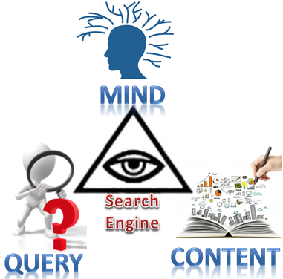
From Deep Learning to Deep University: Cognitive Development of Intelligent Systems
Mariia Golovianko, Svitlana Gryshko & Vagan Terziyan
IKC-2017, Gdańsk, Poland, 11-12 September 2017
Check updates here: http://www.mit.jyu.fi/ai/IKC-2017.pptx

Slide 2
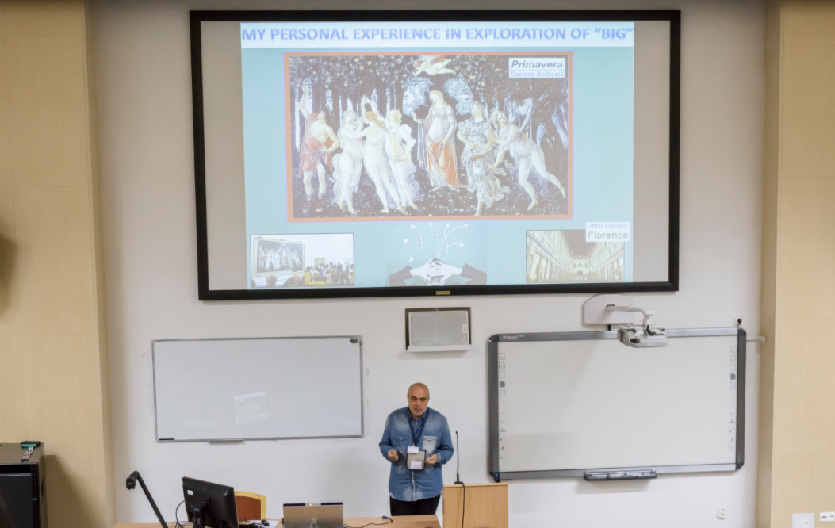

Slide 3
The Authors
Mariia Golovianko, PhD, Department of Artificial Intelligence, Kharkiv National University of Radioelectronics (UKRAINE),
e-mail:
mariia.golovianko@nure.ua ;
golovianko@gmail.com .‎
Svitlana Gryshko, PhD, Associate Professor of Department of Economic Cybernetics and Management of Economic Security, Kharkiv National University of Radioelectronics (UKRAINE),
e-mail:
svitlala.gryshko@nure.ua ;
hryshko.sv@gmail.com .‎
Vagan Terziyan, Professor (Distributed Systems), Faculty of Information Technology, University of Jyväskylä (FINLAND),
e-mail:
vagan.terziyan@jyu.fi .
I take my personal responsibility
for everything I say today

Slide 4
We are grateful to the anonymous photographers and artists, whose photos and pictures (or their fragments) posted on the Internet, we used in the presentation.
Beware on hidden slides!

Slide 5
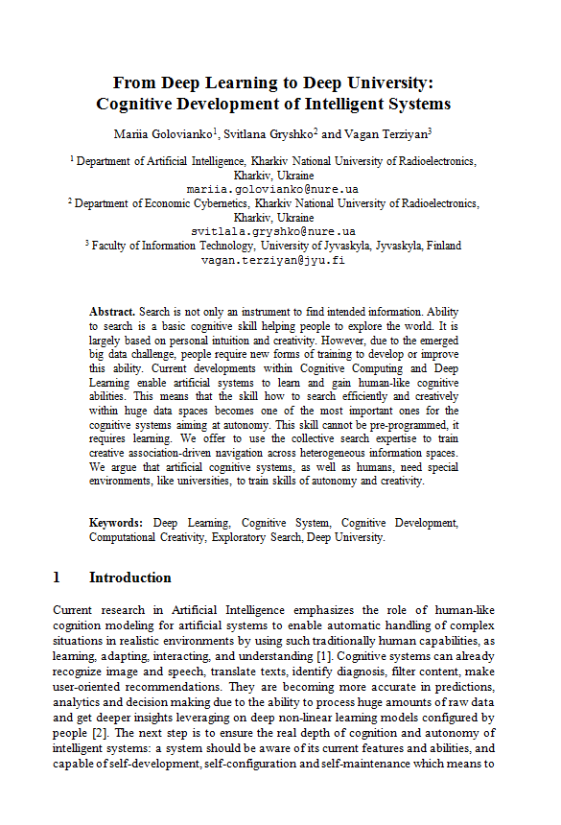
The goal of this presentation
“The paper is well-written and its presentation in IKC may initiate some interesting discussion ...
The main problem is that … the paper is completely out of the scope of the conference, since keyword-based search is not discussed at all …”
The reviewer
of our paper
With This presentation we want
to challenge the reviewer’s statement

Slide 6
Searching-as-usual is possible also today
but finding is not a piece-of-cake

Slide 7
We are almost lost in Big Data

Slide 8
There are many ways to explore big data,
But do we understand our way?

Slide 9
We are confused, naturally …

Slide 10
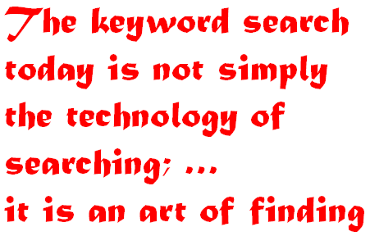
Our belief and our implicit message
to the reviewer and to Keystone
One can still make just a cosmetic improvement of available search engines, but the search process and the search skills, needed for human or artificial and autonomous users of the search engines, require a radical change due to the big data challenge …

Slide 11
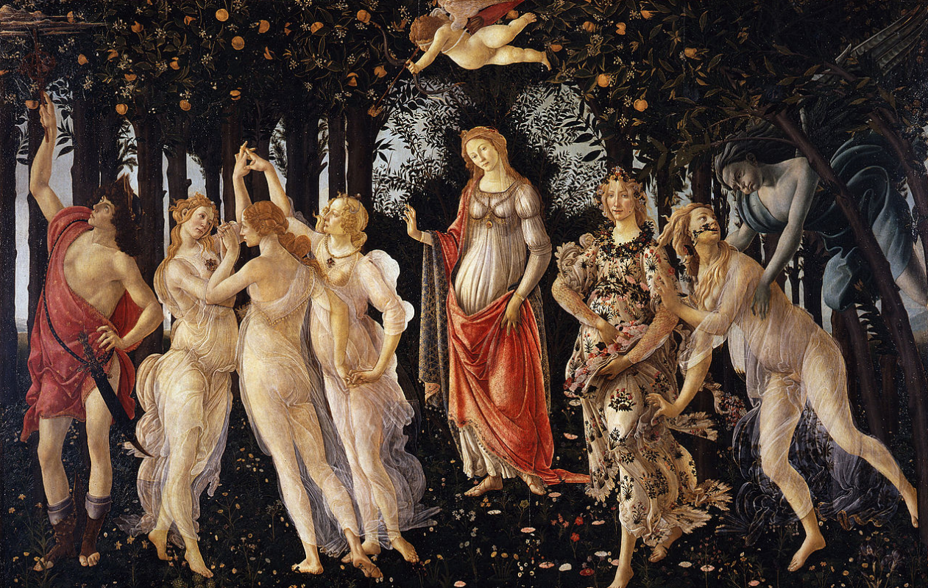
My personal experience in exploration of “Big”

Slide 12
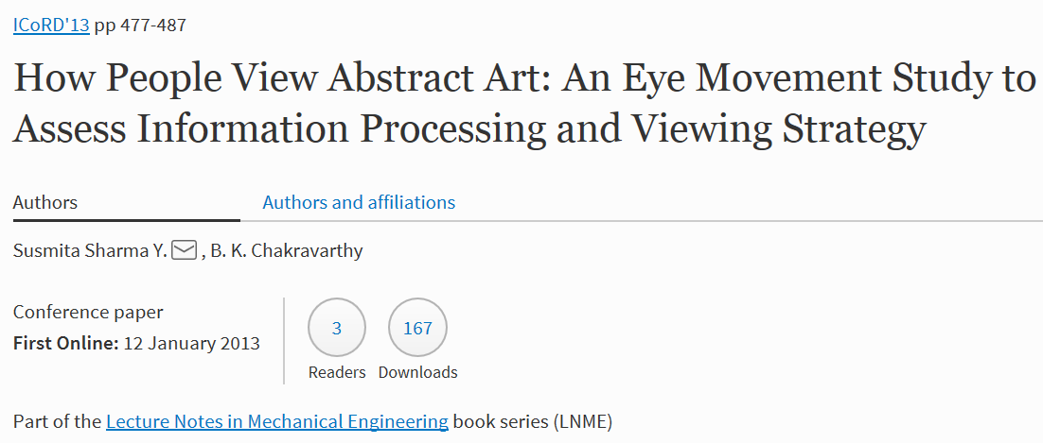
To find something useful within the big data,
one need to control own focus smartly
https://link.springer.com/chapter/10.1007/978-81-322-1050-4_38

Slide 13
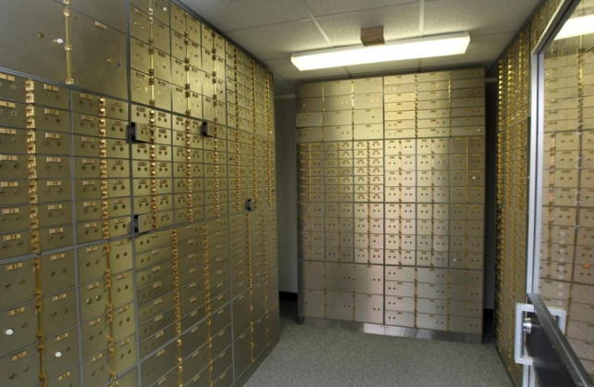
Smart focusing means computing iteratively the next target for the focus depending of what have been explored so far

Slide 14
We use keywords for focusing
in (exploratory) information retrieval

Slide 15
A search process starts from certain
Cognitive state of a user (human or agent)

Slide 16
the Cognitive state results to a potential
search focus (keyword query)

Slide 17
with that “key”, a Chosen search engine opens the “lock”
Of an appropriate “storage box” from the data “bank” …

Slide 18
… and now the content of that “storage box” is available
for the user for further exploration

Slide 19
The exploration may result to a new cognitive state
of a searcher …

Slide 20
… and this new cognitive state May result to a new focus
(a new “key”, a new keyword search query) …

Slide 21
… and this new key with the help of search engine unlocks
Another “storage box” from the data “bank” …

Slide 22
… where the searcher finally finds what he/she/it
believes it Needs.

Slide 23
implicit links on the discovery process graph:
One is the link between the (before and after) keys …

Slide 24
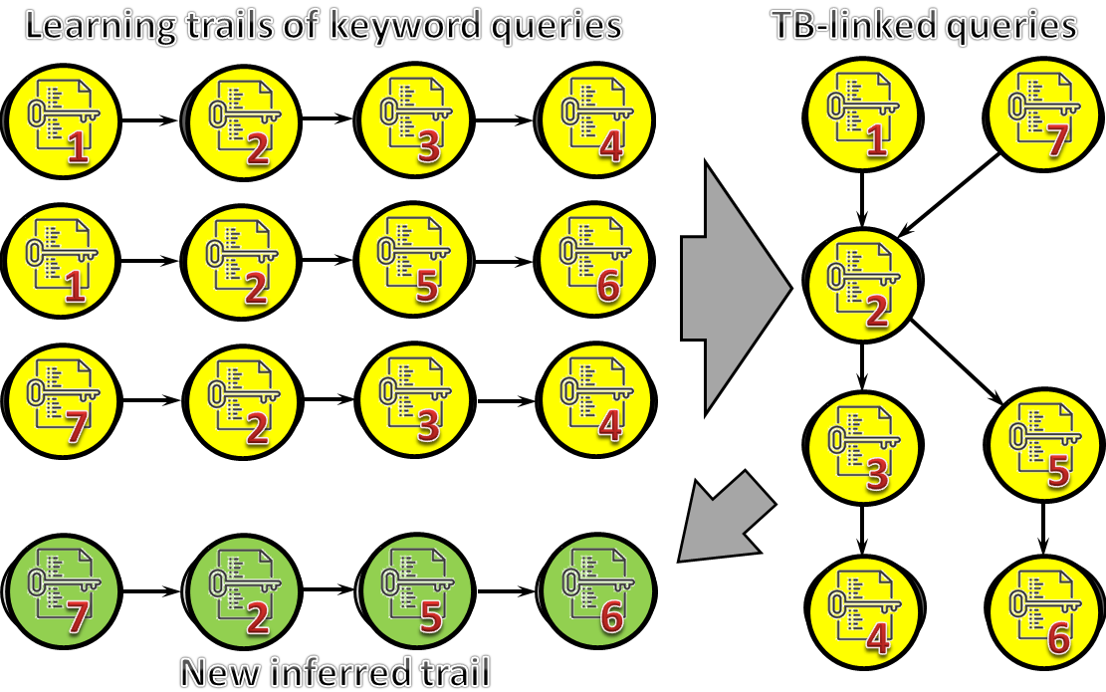
PAST (IKC-2016): TB-Linked Keywords
Terziyan V., Golovianko M., & Cochez M., TB-Structure: Collective Intelligence for Exploratory Keyword Search. In: A. Calì, D. Gorgan, & M. Ugarte (Eds.), Semantic Keyword-Based Search on Structured Data Sources. KEYSTONE 2016, LNCS 10151, 2017, Springer, pp. 171-178. (presentation slides are here).

Slide 25
implicit links on the discovery process graph:
another one is the link between the (before and after) Data

Slide 26
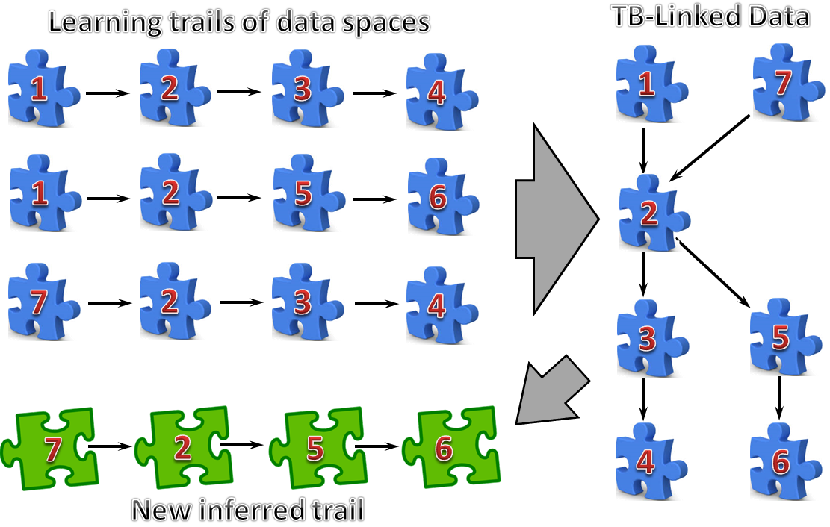
FUTURE (IKC-2018 ?): TB-Linked Data

Slide 27
FUTURE (IKC-2018 ?): TB-Linked Data

Slide 28
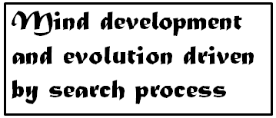
implicit links on the discovery process graph:
The last one is the link between the (before and after) Minds

Slide 29
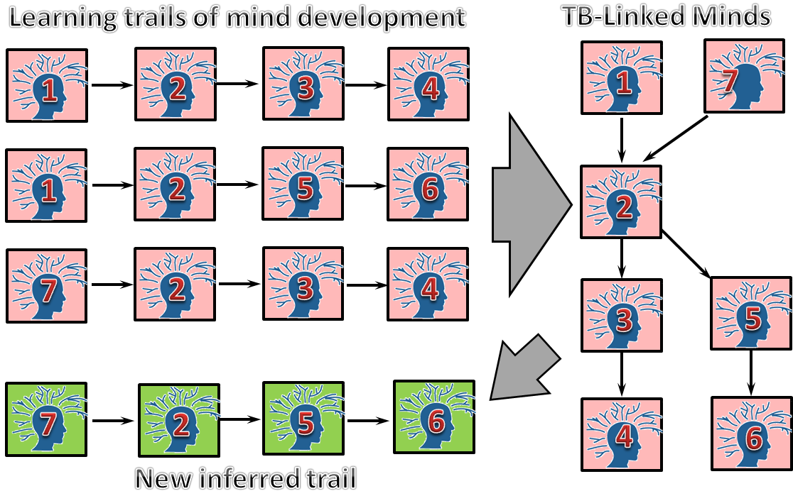
PRESENT (IKC-2017): TB-Linked Minds

Slide 30
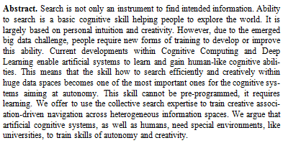
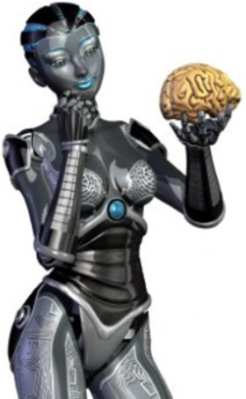
Ability of an Artificial system to search and find in current environment is a basic cognitive skill needed for survival.
It Cannot be pre-programmed, it requires training and life-long development.
Special “Universities” might be needed

Slide 31
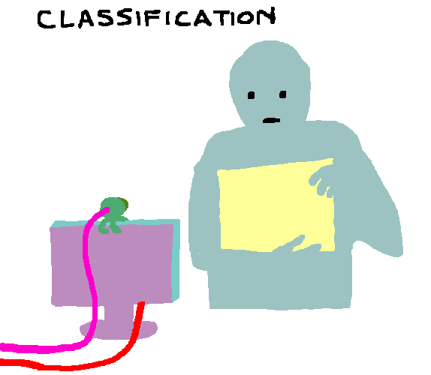
Just a reminder:
Do not even try to hardcode a fully skilled AI. It is known to be impossible. The only way is to program a “child” (basic intelligent instincts and capabilities to learn own skills) and then train it to the level it will be capable for further self-development.
But it is very important to teach your “child” smartly and carefully…

Slide 32
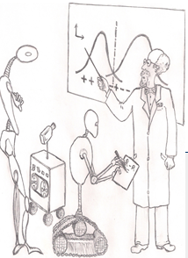
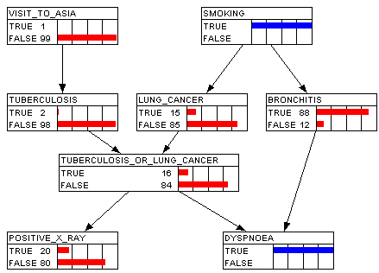
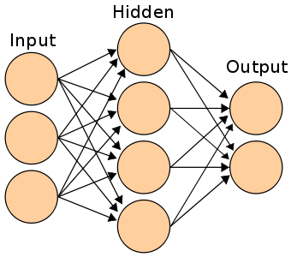
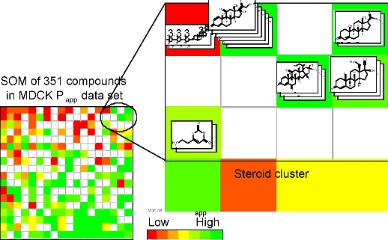
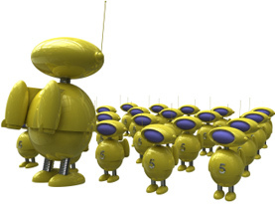
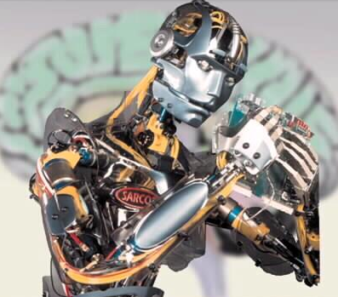
University for “Everything” !
Machine Learning?

Slide 33
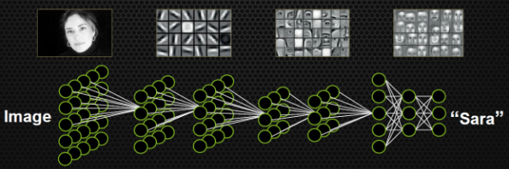
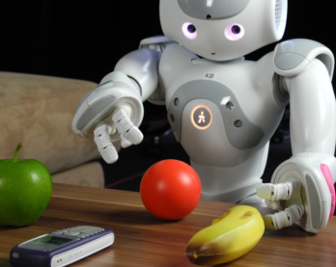
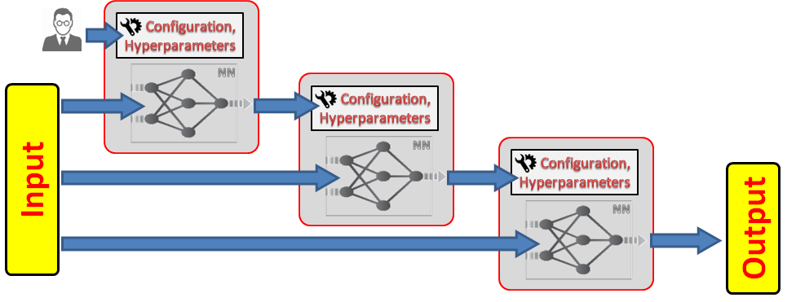
Another philosophy for the Deep Learning in our University
Traditional Deep Learning process
Self-Aware and Self-Configurable Deep Learning Process
In the “deep” University, an artificial system will consciously develop its cognitive skills to explore (search, sense and understand what to search, why and how) the external physical and abstract world together with itself smartly and creatively.

Slide 34
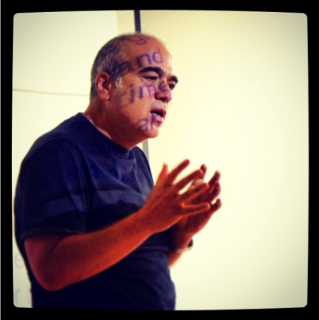
So why do robots especially make the best teachers?
by Doug Johnson
They always follow the mandated curriculum (and love the Common Core)
They give no special treatment to individual students
They have no special passions that take away time from teaching the basics
The do not tolerate ambiguity - only right and wrong
They never laugh, never get mad, never show excitement, never use sarcasm
They are easily programmed by politicians
They pay attention during meetings
They don't need staff development
Their grades and lesson plans are always in on time
They work well with robot students

Slide 35
Why robots make the best students?
by Doug Johnson
They don't challenge the teacher's authority or subject expertise.
They don't ask questions that might not have a right or wrong answer.
They all learn in the same way, at the same pace.
They stay in their seats with eyes straight ahead.
They don't go on vacations with their families during school time or skip school.
They don't need to learn to work in cooperative groups …
… or need social skills. Or need conflict resolution abilities.
They don't need sex education, multicultural education, or physical education. The arts and literature are wasted on them. No field trips, no fire drills, no hot lunch.
They never make the principal or teacher look bad (e.g. stupid or incompetent).
They follow the school dress code and never swear.
They have no strongly held opinions or passions for which to fight.
They always pass the state tests and they all read at grade level.
They are always willing to do the homework no matter how meaningless.
They don't complain when lectured or given worksheets. Endlessly.
They can all use the same textbook and they are all always on the same chapter.
They make good robot employees.

Slide 36
COIN Master Program –
A pilot for the “University-for-Everything”
New International Master Program: COIN: Cognitive Computing and Collective Intelligence
COIN
starts September 2018
On completion of the programme, the graduates will be able to use, design and train complex self-managed and continuously evolving public and private industrial systems, digital ecosystems, cyber-physical systems, systems-of-systems, platforms, services and applications; will be able to connect their designs with publicly available Deep Learning and Big Data analytics and Web-based Cognitive Computing capabilities as services; will be able to figure-out and approach various challenging aspects of wicked problems world-wide, which require collective intelligence and self-managing service-based architectures for their solutions; understand and professionally utilize for that purpose knowledge on enabling technologies and tools; … Students, who will graduate from the programme with a Master of Science in Natural Sciences from the Faculty of Information Technology, will think beyond the routine and will be able not just to adapt to a change but to help to create and control it. This means that our graduates will not be able only to “solve smart problems”, but in addition to it they will be able to “invent new and smart problems” and drive them by “designing artificial smart problem solvers”.

Slide 37
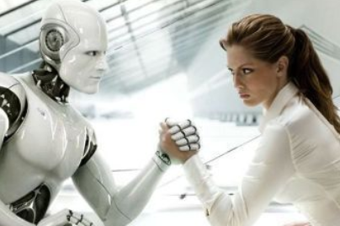
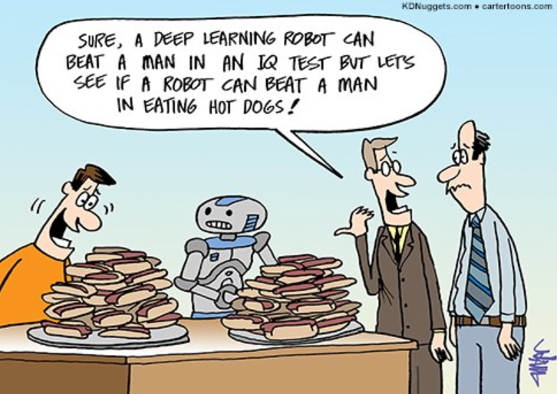
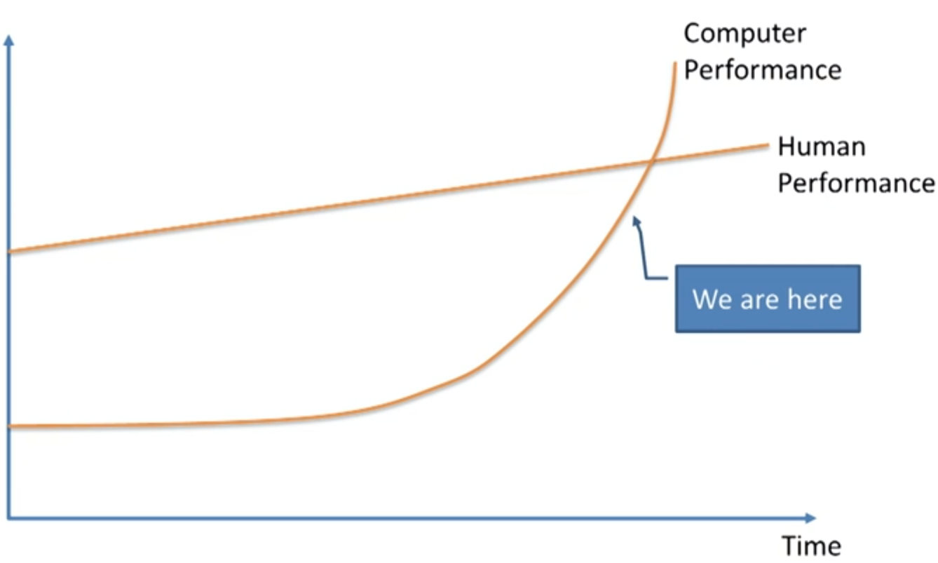
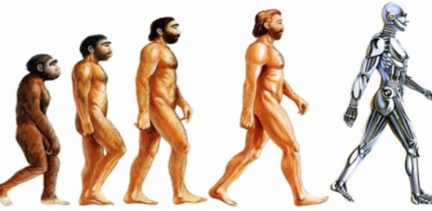
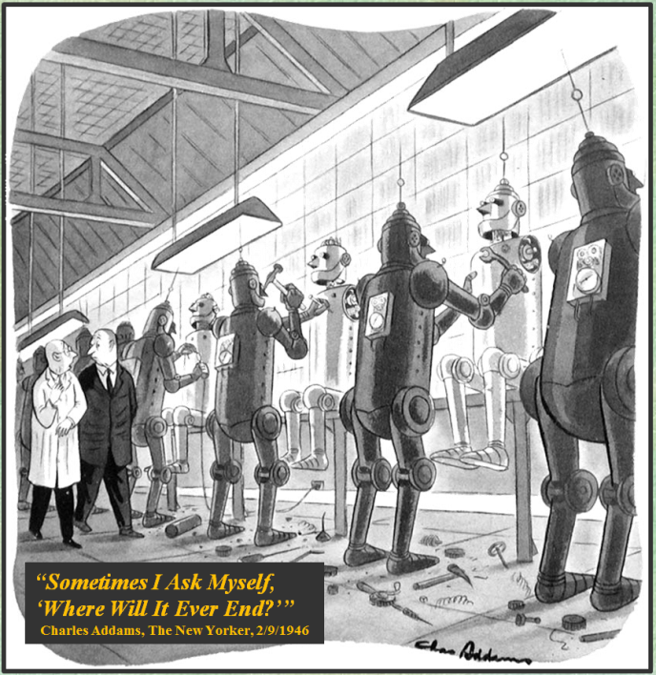
Why we must study “Cognitive Computing and Collective Intelligence” together with “them”?
- Otherwise it will be too late soon …
Welcome to study at COIN !
… you are also welcome !

Slide 38
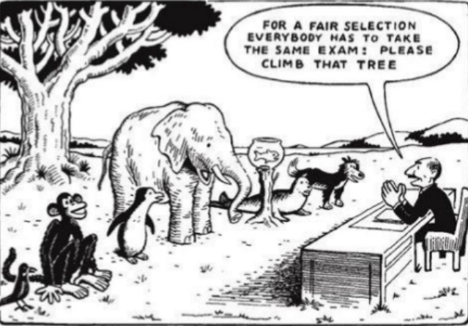
COIN: Learning Outcomes
COIN
On completion of the programme, the graduates will be able to use, design and train complex self-managed and continuously evolving public and private industrial systems, digital ecosystems, cyber-physical systems, systems-of-systems, platforms, services and applications; will be able to connect their designs with publicly available Deep Learning and Big Data analytics and Web-based Cognitive Computing capabilities as services; will be able to figure-out and approach various challenging aspects of wicked problems world-wide, which require collective intelligence and self-managing service-based architectures for their solutions; understand and professionally utilize for that purpose knowledge on enabling technologies and tools; … Students, who will graduate from the programme with a Master of Science in Natural Sciences from the Faculty of Information Technology, will think beyond the routine and will be able not just to adapt to a change but to help to create and control it. This means that our graduates will not be able only to “solve smart problems”, but in addition to it they will be able to “invent new and smart problems” and drive them by “designing artificial smart problem solvers”.

Slide 39
Cognitive Computing and
Collective Intelligence (COIN) as a profession
COIN
Emergent professions around the Cognitive Computing and Collective Intelligence domains (e.g., Cognitive Computing Engineer, or analyst or scientist) is the natural evolution of popular professions such as Software Engineer (as well as software analyst) and Data Engineer (as well as data scientist or analyst). The simplified formula is as follows:
A Software Engineer creates the systems that create the data.
A Data Engineer builds systems that create the value out of the data, which come from the various systems created by software engineers.
A Cognitive Computing Engineer builds and trains intelligent systems (models) that automatically create the systems, which create the data and pick the value out of it; i.e., it automates the essential part of the duties from software engineers and data engineers.

Slide 40
What kind of skills/profession is your learning objective(s) (i.e., why University?)

Slide 41
Good Engineers ...
… converting problems into products
Problems
Products

Slide 42
Good Engineers vs. Managers
… “talking” about products (buying, managing, selling)
Products

Slide 43
Good Engineers vs. Advanced Users
… installing (or API-based accessing as-a-service), administrating and using product as part of their professional activity or as a component in their applications or business processes … understanding WHAT the product is doing but without deep understanding HOW …
Products

Slide 44
Good Engineers vs. VIP Engineers
… inventing new problems
Problems
Products

Slide 45
VIP Engineers vs. WISE Engineers
… inventing new and SMART problems
AND
… designing and training (!) SMART problem solvers!
Agents
Problems
Products

Slide 46
Reason to study at COIN Program

Slide 47
Reason to study at COIN Program
HE GRADUATED FROM UNIVERSITY OF JYVÄSKYLÄ,
IT- FACULTY, COIN PROGRAM
OK, THEN YOU HAVE NO HOPE, SORRY…

Slide 48
If no time for explicit questions,
then explore:
http://www.cs.jyu.fi/ai/IKC-2017.pptx
for implicit answers …

