Slide 1
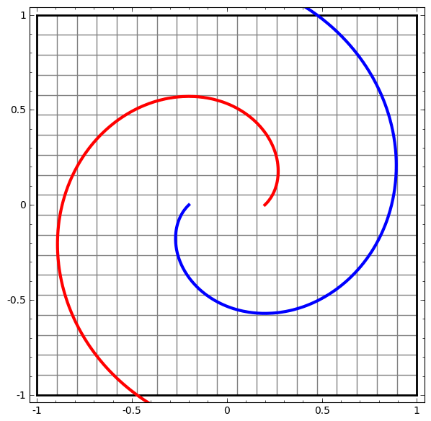
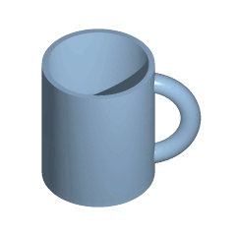
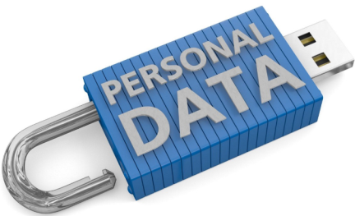
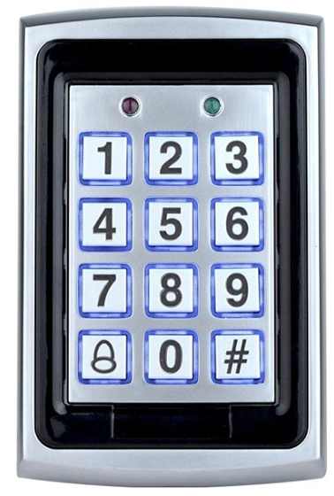
“ANONYMIZATION AS HOMEOMORPHIC DATA SPACE TRANSFORMATION FOR PRIVACY-PRESERVING DEEP LEARNING”
Paper # 105
Vagan Terziyan,
Anastasiia Girka, Mariia Gavriushenko & Andrii Gontarenko
University of Applied Science, Linz, Austria
24 November, 2020, 14:00 - 15:30
ISM 2020
International Conference on Industry 4.0
and Smart Manufacturing
Room 4: Security, Privacy and Intellectual Property Rights in Industry

Slide 2
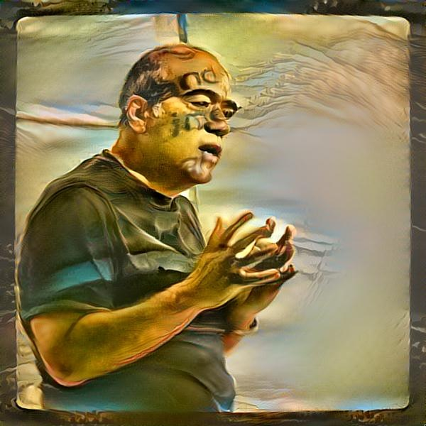
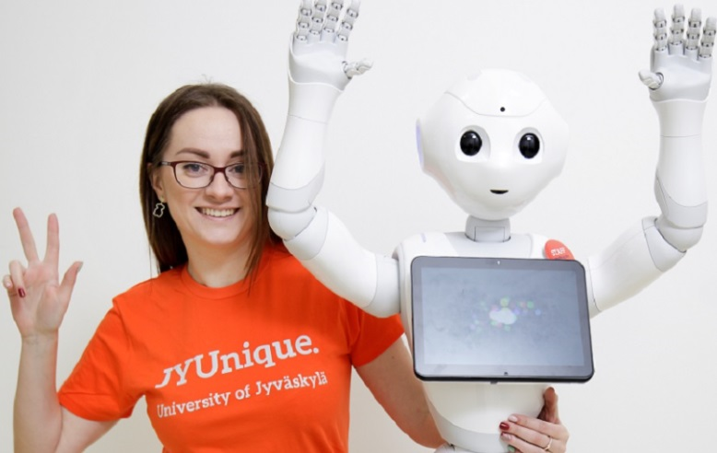
Vagan Terziyan
vagan.terziyan@jyu.fi
Authors
“ANONYMIZATION AS HOMEOMORPHIC DATA SPACE TRANSFORMATION FOR PRIVACY-PRESERVING DEEP LEARNING”
https://www.jyu.fi/en/
Mariia Gavriushenko
Anastasiia Girka
Andrii Gontarenko
https://qvantel.com/

Slide 3
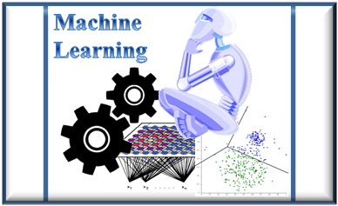
Data privacy challenge for Industry 4.0
Private (!)
DATA
Intelligence-as-a-Service
How to capture hidden value out of the data but (while doing it) preserve the data privacy?
The technical challenge would be enabling correct and efficient analysis of the large amounts of data produced by Industry 4.0 and its large sensor networks.
Machine Learning (ML) as a technology has progressed a lot during the last few years, however, the legal aspects of the collection and processing data (such as privacy concern regarding personal data) has been neglected. Nowadays the potential of the ML models is essentially limited by the strict privacy regulations.

Slide 4
The need
Assume that some company (Private Data Owner in the picture) has collected data from its processes. The data contains also sensitive information about the personnel, customers (patients, etc.).
Assume that this company wants to get some added value from the data but cannot afford expensive AI/ML analytics and appropriate Data Science / AI skills within own (Private) premises …
Private Data Owner
Data
Private

Slide 5
Machine-Learning-as-a-Service
… Popular option would be to use external clouds (provided by, e.g., Microsoft, IBM, Google, Amazon,…, etc.), which provide solid Intelligence-as-a-Service AI/ML analytics …
Intelligence-as-a-Service Provider
Private Data Owner
Data
Safe
Intelligence-as-a-Service
Unsafe

Slide 6
Machine-Learning-as-a-Service
… Ordinary practice is that the data has to be placed within this remote cloud before the actual processing starts …
Intelligence-as-a-Service Provider
Private Data Owner
Data
Unsafe
Data
Safe
Intelligence-as-a-Service

Slide 7
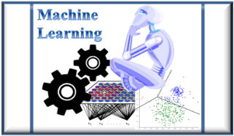
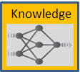
… Machine Learning tools of the cloud process the data, and the as a result there will be trained model(s) as function(s) for potential decision-making, anomaly detection, diagnostics, classification, prediction, forecasting, etc. Let us call this outcome as “Knowledge” …
Machine-Learning-as-a-Service
Intelligence-as-a-Service Provider
Private Data Owner
Data
Safe
Unsafe
Intelligence-as-a-Service

Slide 8
… Traditionally derived Knowledge is not returned back but remain available in the cloud for remote queries managed by the data owner. Now our Private Data Owner can arrange different business models and design “Applications”, which will send queries to both Data and Knowledge and get the corresponding outcomes …
Keeping Data and Knowledge in the cloud …
Intelligence-as-a-Service Provider
Private Data Owner
Applications
Data
Safe
Unsafe

Slide 9
… Traditionally derived Knowledge is not returned back but remain available in the cloud for remote queries managed by the data owner. Now our Private Data Owner can arrange different business models and design “Applications”, which will send queries to both Data and Knowledge and get the corresponding outcomes …
… is not safe
Intelligence-as-a-Service Provider
This traditional practice is not safe regarding the personal data privacy and derived knowledge ownership and does not fit current requirements, concerns and laws regarding personal data …
Private Data Owner
Applications
Data
Safe

Slide 10
… Our Private Data Owner may apply some traditional (lets call it “naive” or “weak”) anonymization technique while preparing sensitive data for the remote storage and processing …
Let’s try to “weakly” anonymize data
Intelligence-as-a-Service Provider
Private Data Owner
Data
Data
Safe
Intelligence-as-a-Service
Unsafe

Slide 11
… and move the anonymized data
to the cloud for processing …
… “weakly” anonymized data is placed into the remote cloud . This would be much safer, but is it really safe? …
Intelligence-as-a-Service Provider
Private Data Owner
Data
Unsafe
Data
Safe

Slide 12
… In some cases hackers may use publicly available data from elsewhere and also AI tools to uncover (re-identify) the sensitive information from “weakly anonymized” data …
… still the data may not
be safe there …
Intelligence-as-a-Service Provider
Private Data Owner
Data
Unsafe
Safe
Data
A
I
Public context

Slide 13
… can you get knowledge from
the anonymized data ?
… or, even if the anonymized data itself is safe within the remote cloud, can one be sure that the knowledge (models trained by ML tools) will make any sense for potential use ? …
Intelligence-as-a-Service Provider
Private Data Owner
Data
Safe
Unsafe
Intelligence-as-a-Service

Slide 14
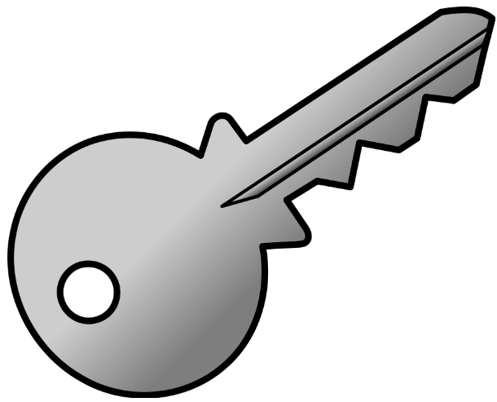
… would such knowledge be useful and safe ?
… Assume that we finally got the anonymized data and anonymized knowledge derived from it. Now we need our (Private Data Owner) applications to be capable of sending anonymized queries to both data and knowledge and get the anonymized responses, but such ones that (when “unlocked” in the safe place) they will make the sense for the applications as expected …
Intelligence-as-a-Service Provider
Private Data Owner
Applications
Data
Safe
Unsafe

Slide 15
… would such knowledge be useful and safe ?
… Assume that we finally got the anonymized data and anonymized knowledge derived from it. Now we need our (Private Data Owner) applications be capable to send anonymized queries to both data and knowledge and get the anonymized responses, but such ones that when “unlocked” in the safe place they will make the sense for the applications as expected …
Intelligence-as-a-Service Provider
“Week” or “naive” anonymization is insufficient for both: safety of the private data and for the applicability of the derived knowledge models from such data …
Private Data Owner
Applications
Data
Safe
Unsafe

Slide 16
… Therefore, we need a set of “Smart Anonymization” techniques (Smart Privacy Guardian) capable to not only protect privacy of personal data but also enable remote AI/ML tools (Intelligence-as-a-Service analytics) from unsafe/untrusted clouds to capture applicable and protected knowledge models out of it …
Key Objective:
“Smart Anonymization”
Intelligence-as-a-Service Provider
Smart Privacy Guardian
Private Data Owner
Applications
Data
Safe
Intelligence-as-a-Service
Unsafe

Slide 17
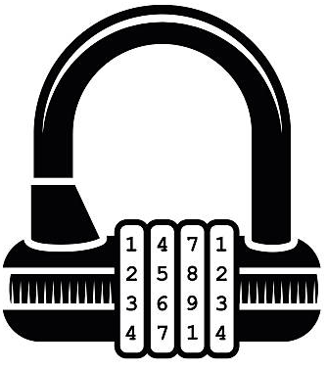
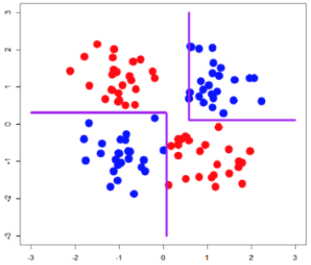
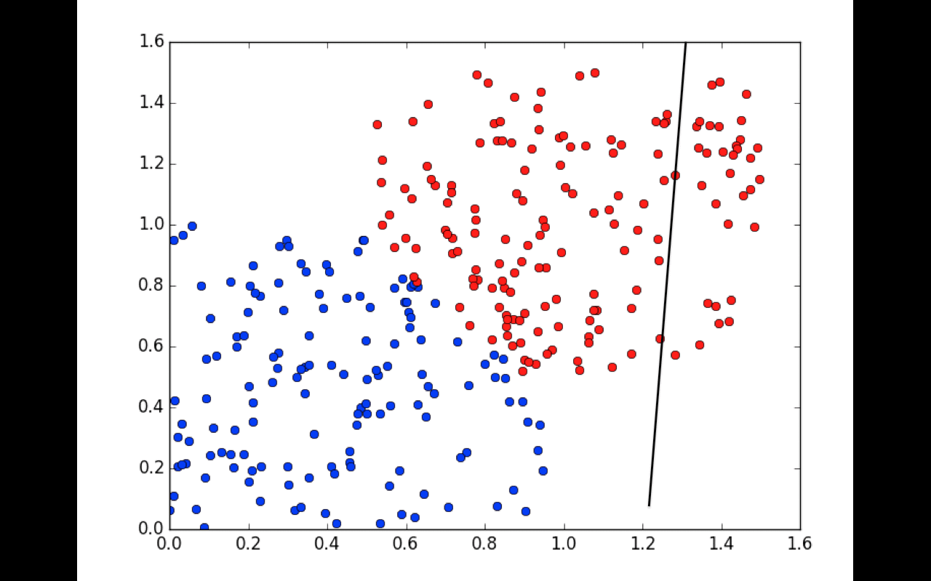
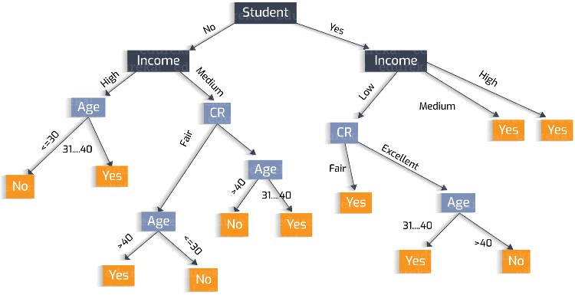
Additional Challenge 1: Smart Anonymization may require different approaches depending on the type of intended knowledge model(s) to be learned within the remote cloud …
Data
Data
Smart Privacy Guardian
Learning Decision Tree
Learning Neural Network
Data
Intelligence-as-a-Service

Slide 18
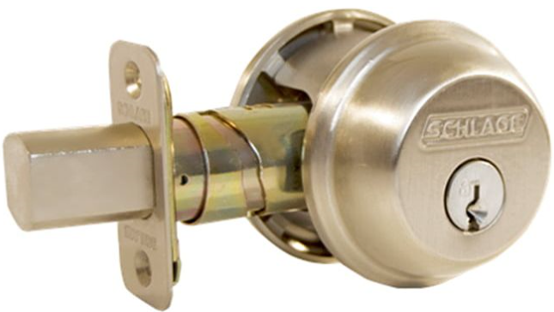
Additional Challenge 2: Smart Anonymization may require different approaches depending on the type of source data to be anonymized …
Smart Privacy Guardian
Numeric
Intelligence-as-a-Service
Data
Learning Neural Network
Texts
Data
Images
Data
Streams
Data
Videos
Data

Slide 19
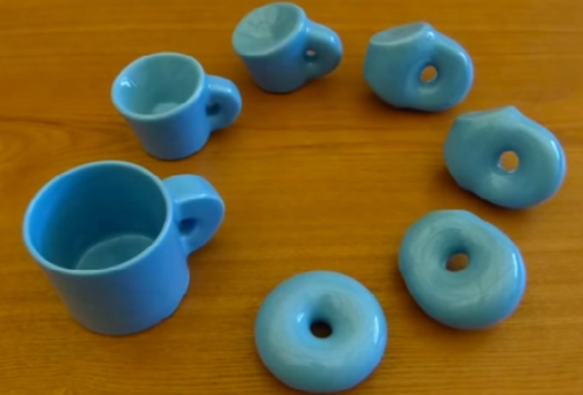
Smart Privacy Guardian
We based our solution “Smart Privacy Guardian” on the basis of the homeomorphic data space transformation
(we used Olah (2014) post and proven theorem from: http://colah.github.io/posts/2014-03-NN-Manifolds-Topology/ )
Topology is concerned with the properties of space that are preserved under continuous deformations, such as stretching, crumpling and bending, but not tearing or gluing.
https://en.wikipedia.org/wiki/Topology
In the mathematical field of topology, a homeomorphism or topological isomorphism is a continuous function between topological spaces that has a continuous inverse function. Homeomorphisms are the mappings that preserve all the topological properties of a given space. Two spaces with a homeomorphism between them are called homeomorphic, and from a topological viewpoint they are the same. [Wikipedia]

Slide 20
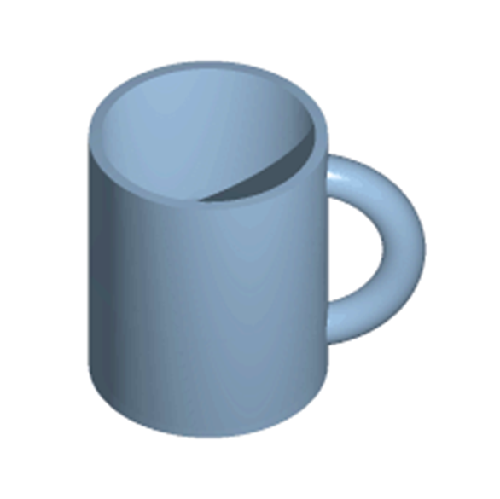
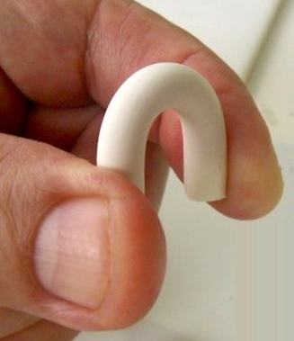
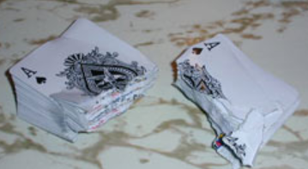
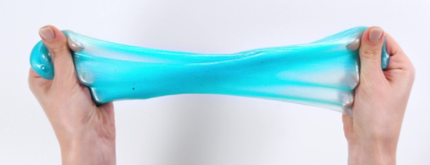
Bending
Homeomorphism and Deep Neural Nets
http://colah.github.io/posts/2014-03-NN-Manifolds-Topology/
Tearing
Stretching
Gluing
Crumpling
Topology of hidden layers in deep NN (according to Olah (2014)):
Each layer stretches and squishes space, but it never cuts, breaks, or folds it. We can see that it preserves topological properties. Transformations like this, which don’t affect topology, are called homeomorphisms. Formally, they are bijections that are continuous functions both ways.

Slide 21
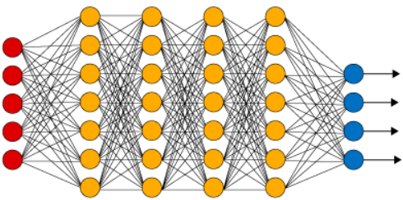
Bending
Homeomorphism and Deep Neural Nets
Tearing
Stretching
Gluing
Crumpling
Olah Theorem: Deep NN Layers with N inputs and N outputs are homeomorphisms, if the corresponding weight matrix W [N×N], is invertible (i.e., non-singular).
A square matrix that is not invertible is called singular or degenerate. A square matrix is singular if and only if its determinant is 0.
http://colah.github.io/posts/2014-03-NN-Manifolds-Topology/

Slide 22
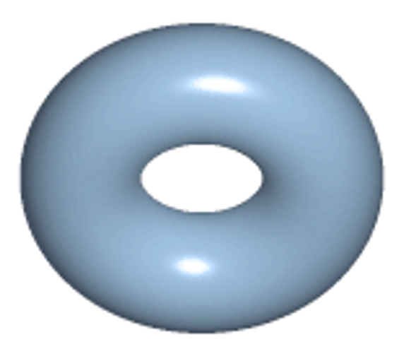
Bending
Homeomorphism and Deep Neural Nets
Tearing
Stretching
Gluing
Crumpling
Proof: Assume W has a non-zero determinant. Then it is a bijective linear function with a linear inverse. Linear functions are continuous. So, multiplying by W is a homeomorphism. Translations are homeomorphisms. Activation functions tanh and sigmoid (but not ReLU) are continuous functions with continuous inverses. Applying them pointwise is a homeomorphism. Thus, if W has a non-zero determinant, our layer is a homeomorphism. This result continues to hold if we compose arbitrarily many of these layers together.

Slide 23
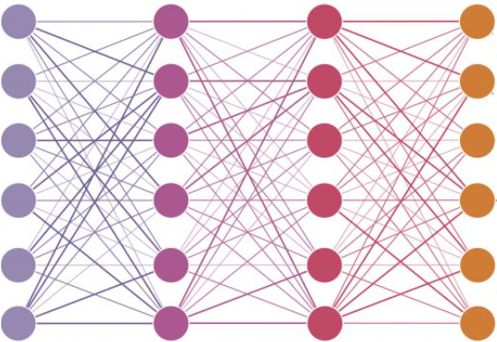
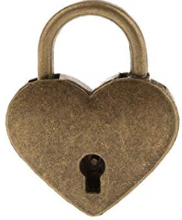
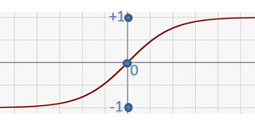
Anonymizer as a Deep Neural Network
with “frozen” secret parameters
Data
Data
Not safe for Machine Learning
Safe for Machine Learning
Several fully-connected anonymization layers aka deep neural
network with frozen secret weights-and-biases-as-keys
and non-linear invertible activation functions

Slide 24
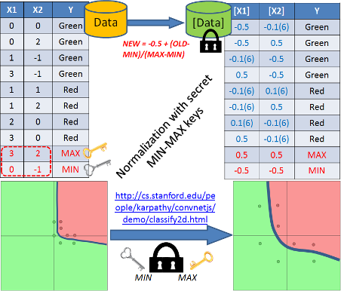
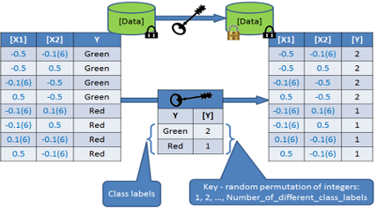
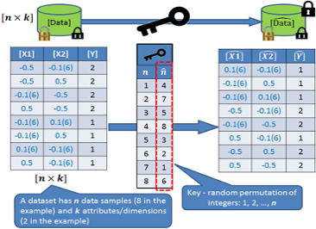
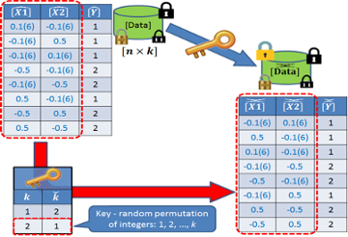
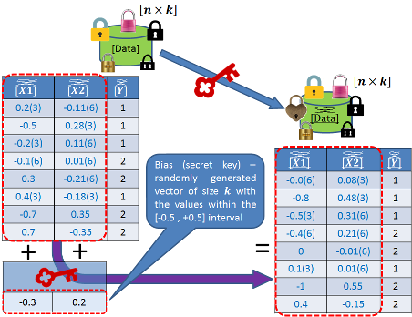
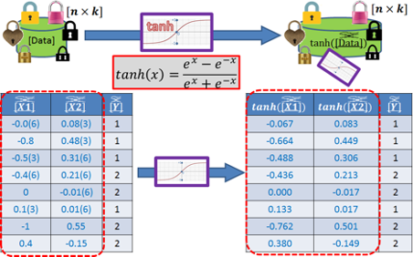
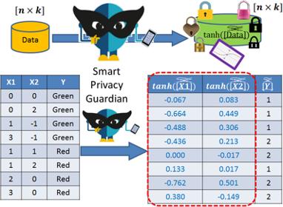
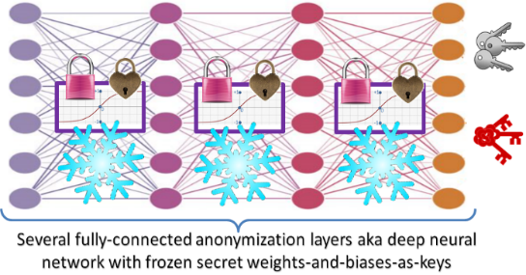
See details on the anonymization algorithm
with the step-by-step example in the paper
Smart Privacy Guardian concept offers a reliable and accessible solution to save privacy of data processed by MLaaS platforms. In this paper, we take the problem of supervised machine learning with deep feedforward neural nets and provide an anonymization algorithm (based on the homeomorphic data space transformation), which guarantees privacy of the data and allows neural networks to learn successfully.

Slide 25
How secure is this solution?
Assume the unlikely worth case scenario. Due to huge leak, a hacker knows (almost) everything about the original $\left[n×k\right]$ dataset ($n$ $k$-dimensional data samples) and also he got access to the anonymized data. Assume also (almost impossible) that he uncovered correct order of samples in the dataset ($n!$ complexity) as well as the correct order of attributes ($k!$ complexity). Now he wants to break the homeomorphic protection (i.e., uncover the transformation matrixes and biases by solving the set of complex non-linear equations). If he does this computationally huge task, then he can uncover the remaining part of the original data. Each additional layer of defense produces $k∙(k+1)$ unknown variables ($k^{2}$ - transformation matrix values and $k$ – bias vector values) to the hacker’s set of equations, however, if the number of data samples in the dataset $n≫k$ , then the hacker will have enough equations to succeed. Therefore, for complete protection (i.e., even with all the data leaked, the keys cannot be uncovered unambiguously), more anonymization layers are needed. Minimum amount of layers $l$ for complete protection can be computed as follows: $l=\left\lceil \frac{n}{k∙(k+1)}\right\rceil .$ For example, complete protection of the completely leaked 10-dimensional dataset with 10000 data samples will require 91 protection layers.

Slide 26
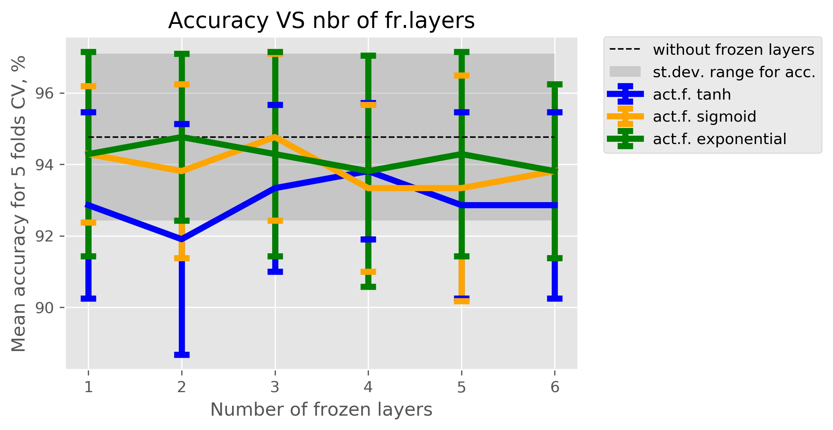
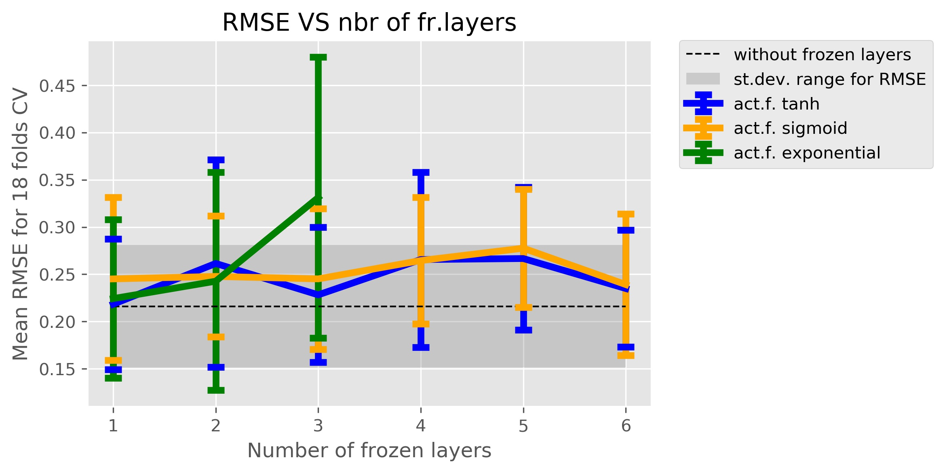
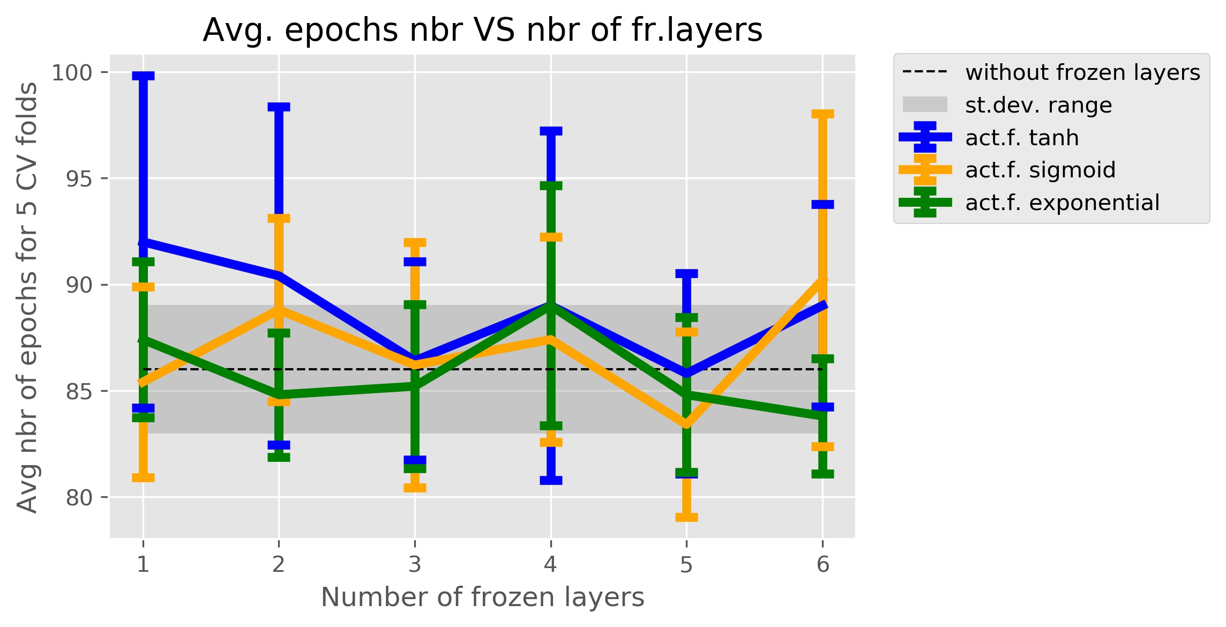
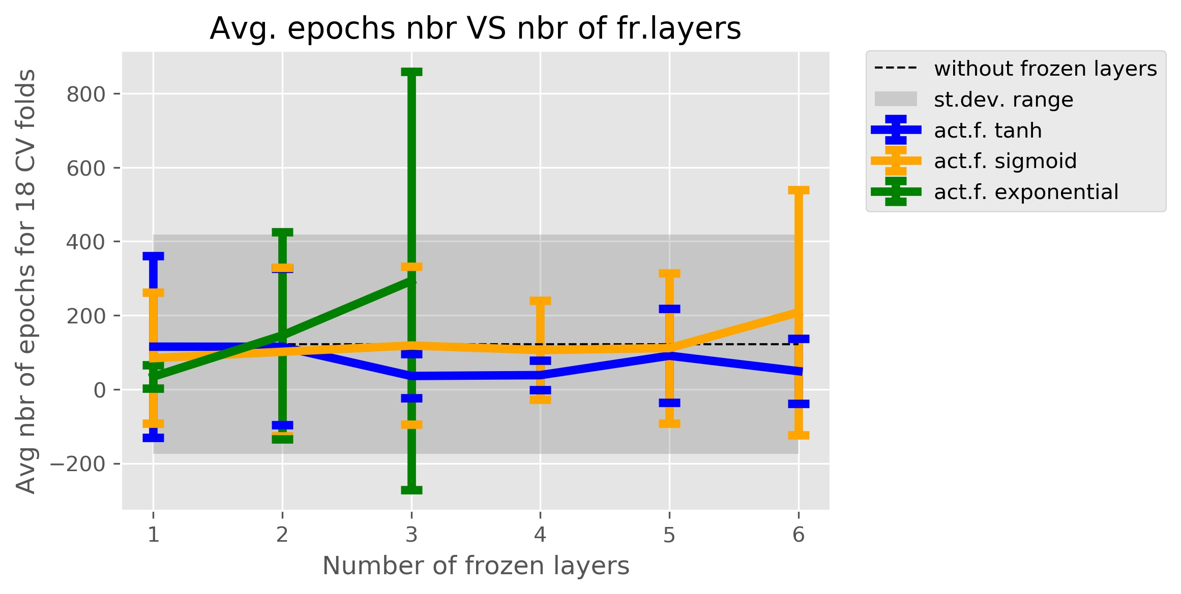
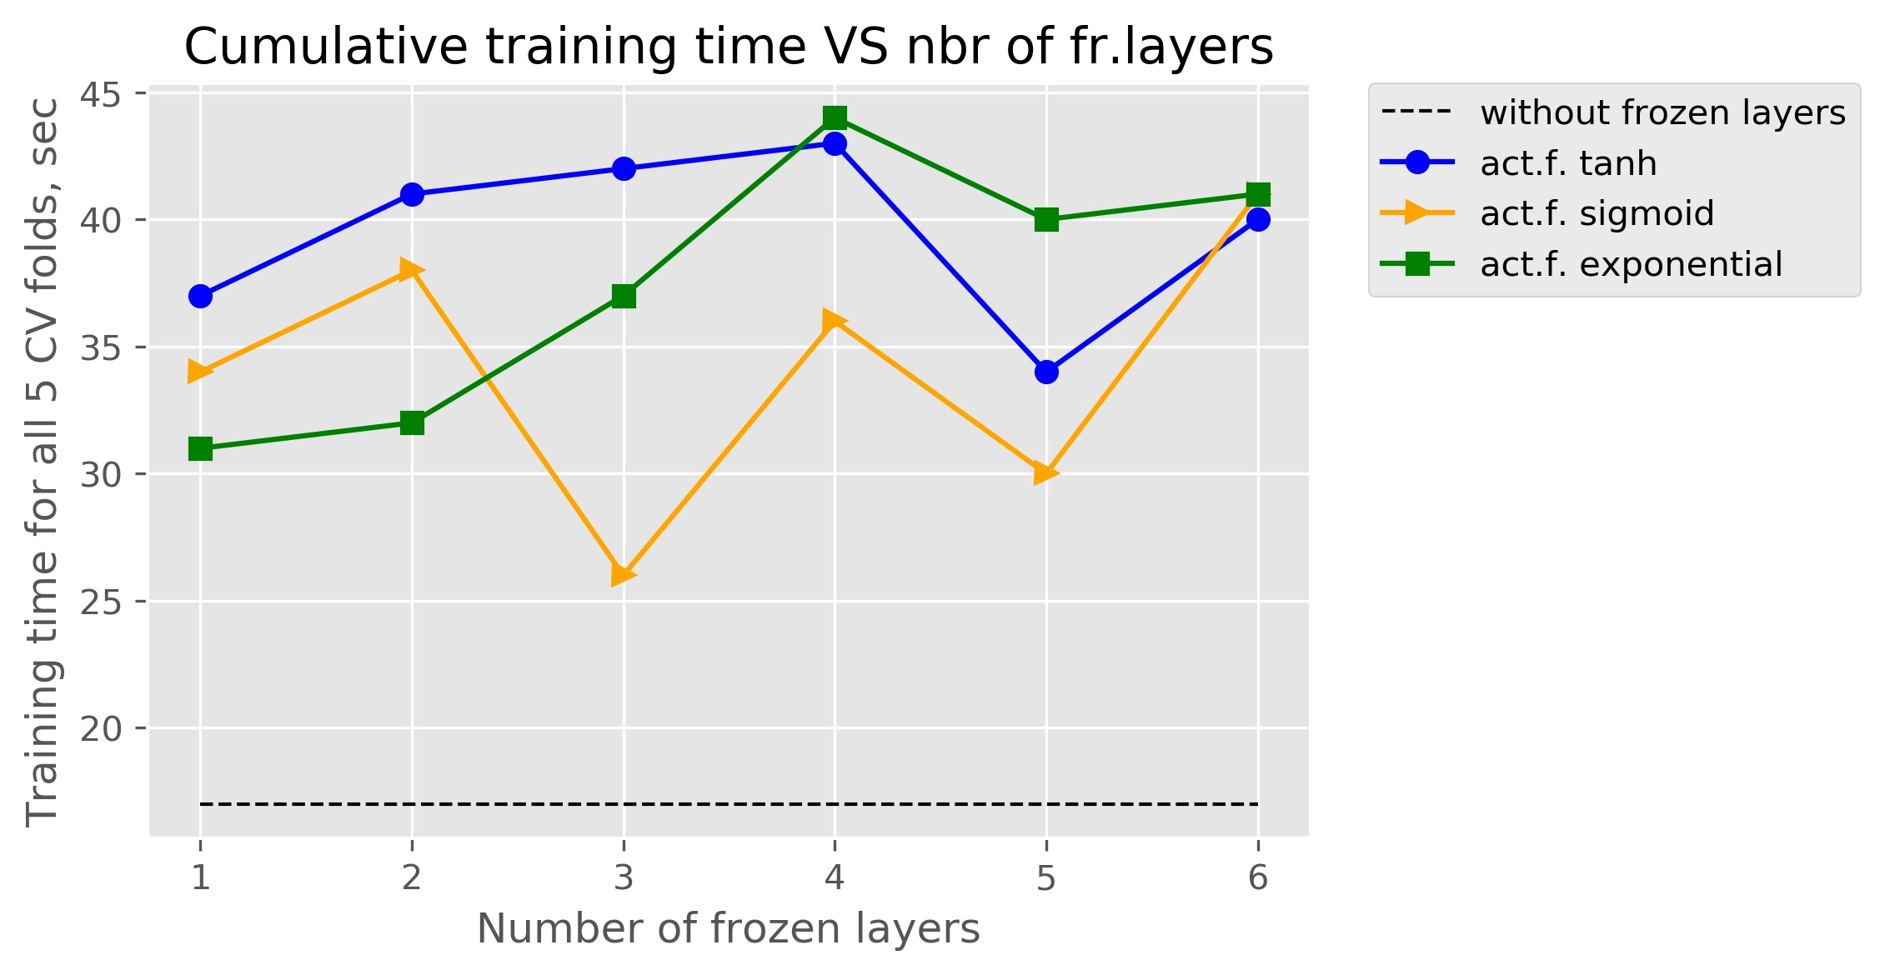
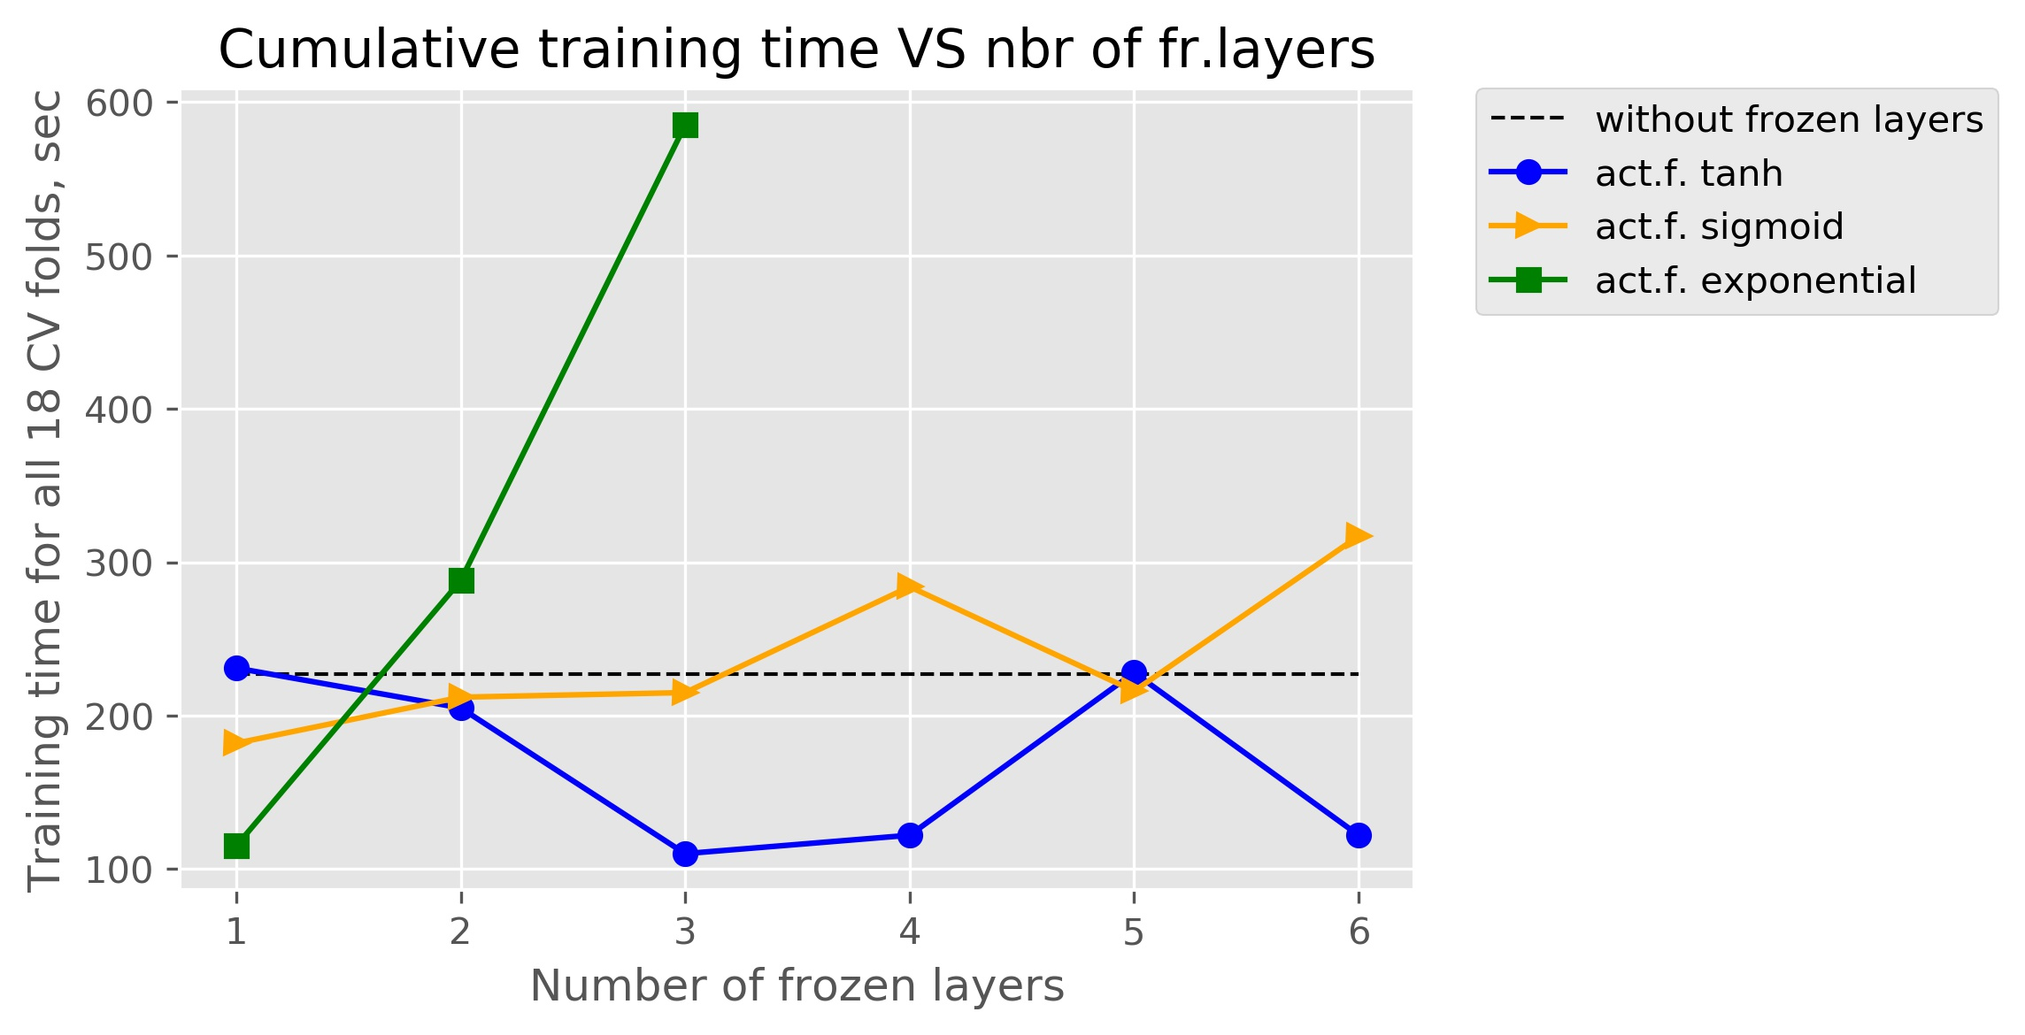
Experiments
Classification | Prediction
Checking the performance and the efficiency of the ML algorithms (Classification and Prediction) with the anonymizes datasets depending on the depth of anonymization.
Conclusion
We made several experiments to show how much the performance of the trained neural nets will suffer from the deepening of the anonymization power. The conducted experiments revealed no sufficiently decreasing performance with the introduced homeomorphic transformation and no dependency between number of frozen layers and the training time.

Slide 27
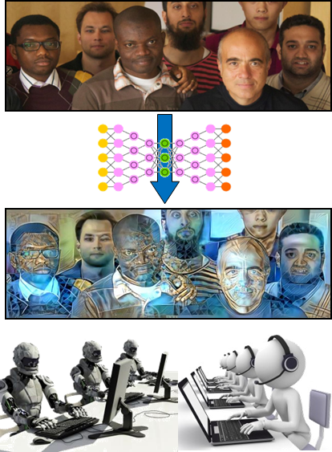
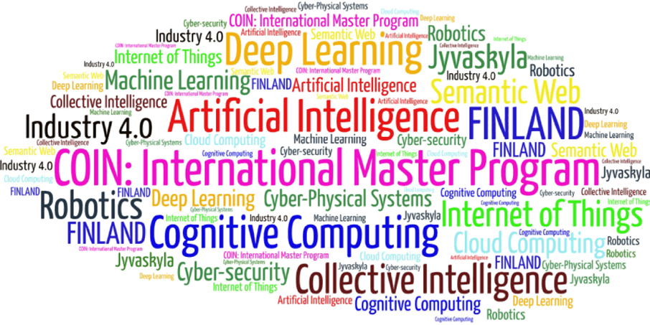
Come to study at our International Master Program
COIN: Cognitive Computing and Collective Intelligence …
… the first university program for collective intelligence, where humans learn together with their digital clones and autonomous digital assistants …
http://www.jyu.fi/ai
COIN

Slide 28
Link to the presentation: https://ai.it.jyu.fi/ISM-2020-Anonymization.pptx
Contact: vagan.terziyan@jyu.fi

