Slide 1

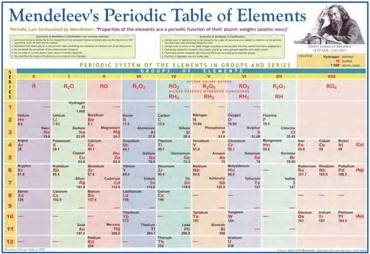
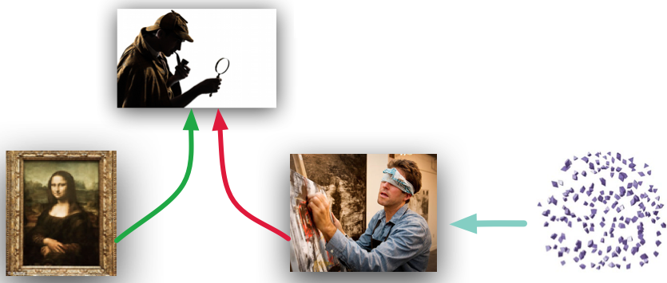

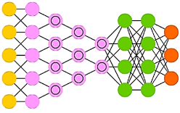
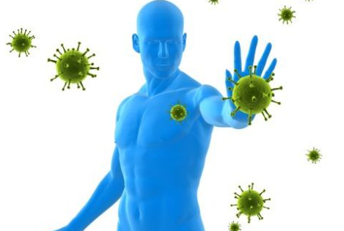
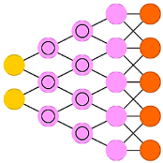
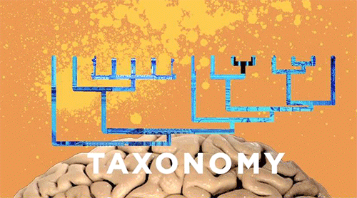
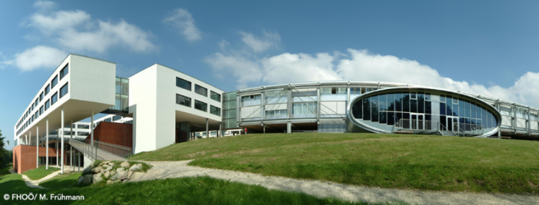

G A N s
AI
“Taxonomy of generative adversarial networks for digital immunity of Industry 4.0 systems”
Paper # 83
Vagan Terziyan,
Svitlana Gryshko & Mariia Golovianko
University of Applied Science, Linz, Austria
23 November, 2020, 14:00 - 15:30
ISM 2020
International Conference on Industry 4.0
and Smart Manufacturing
Room 3: Security and Privacy for the Smart Factory

Slide 2
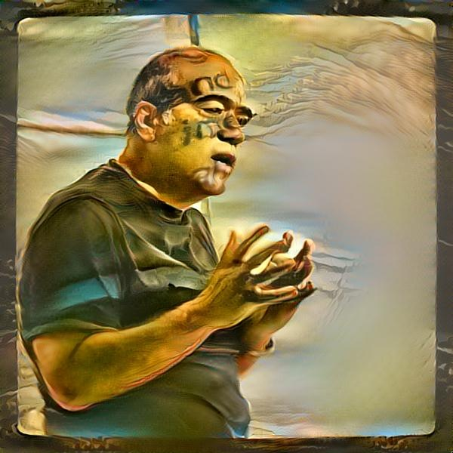




Authors
Vagan Terziyan
vagan.terziyan@jyu.fi
“Taxonomy of generative adversarial networks for digital immunity of Industry 4.0 systems”
https://www.jyu.fi/en/
Svitlana Gryshko
Mariia Golovianko
https://nure.ua/en/

Slide 3
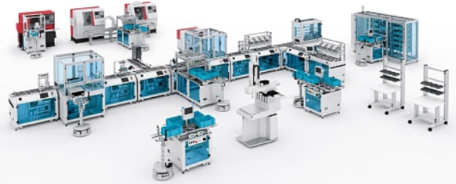
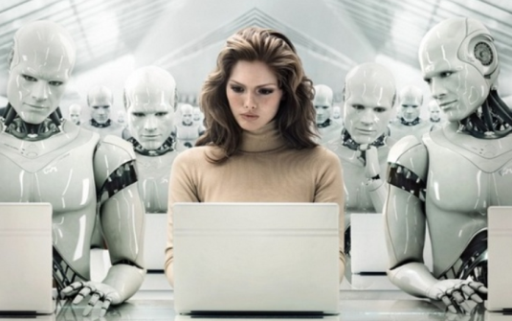
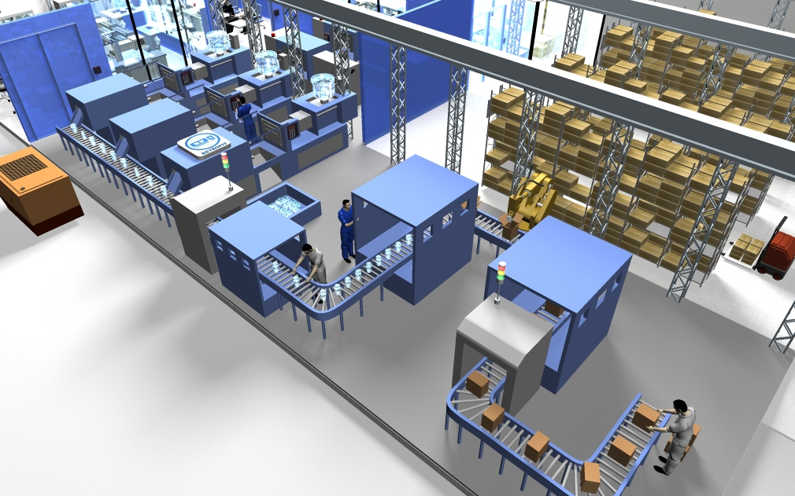
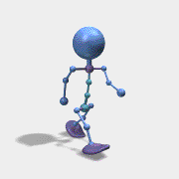


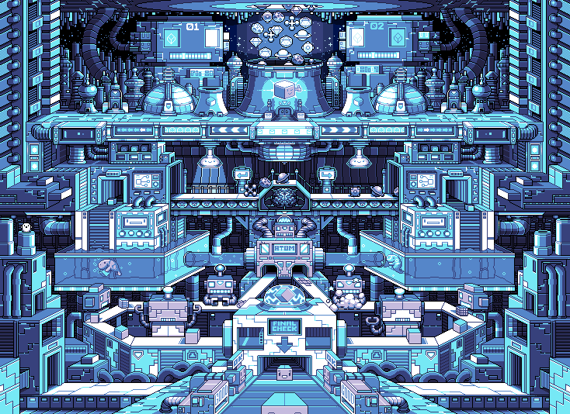
Cyber-Physical Systems
Where is the main vulnerability in Industry 4.0 ?
Collective Intelligence
Industry 4.0 is about Cyber-Physical Systems populated and controlled by the Collective Intelligence for the smart and autonomous manufacturing purposes
Industry 4.0
Flexible infrastructure
Humans and artificial decision makers (AI agents)
“Only amateurs attack machines…”
[B. Schneier (2000). Semantic Attacks…]
“… professionals target people”
[B. Schneier (2000). Semantic Attacks…]
https://bt3gl.github.io/index.html

Slide 4
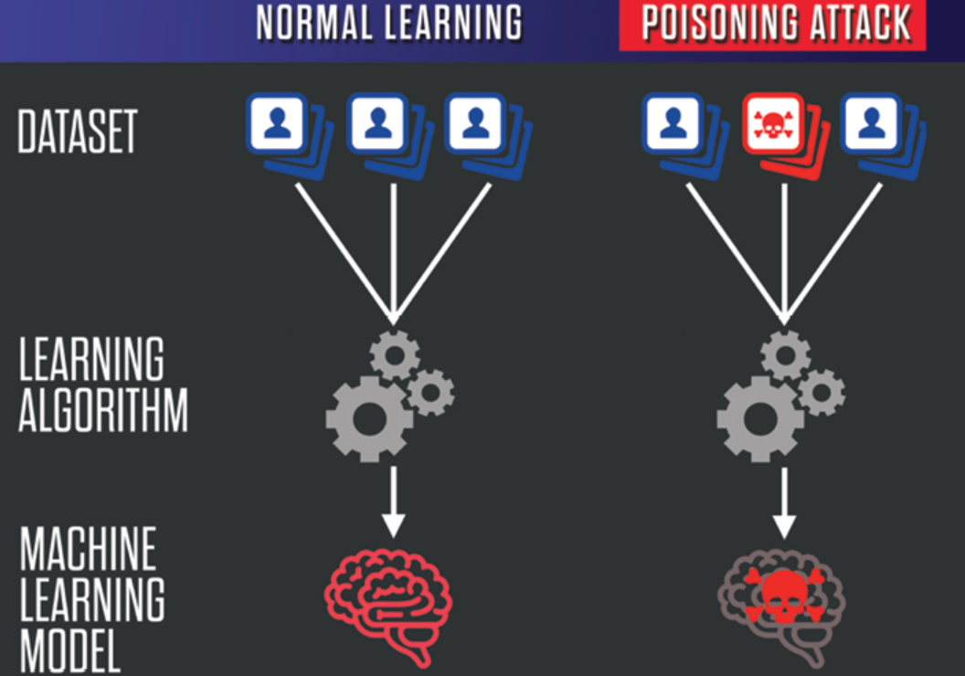
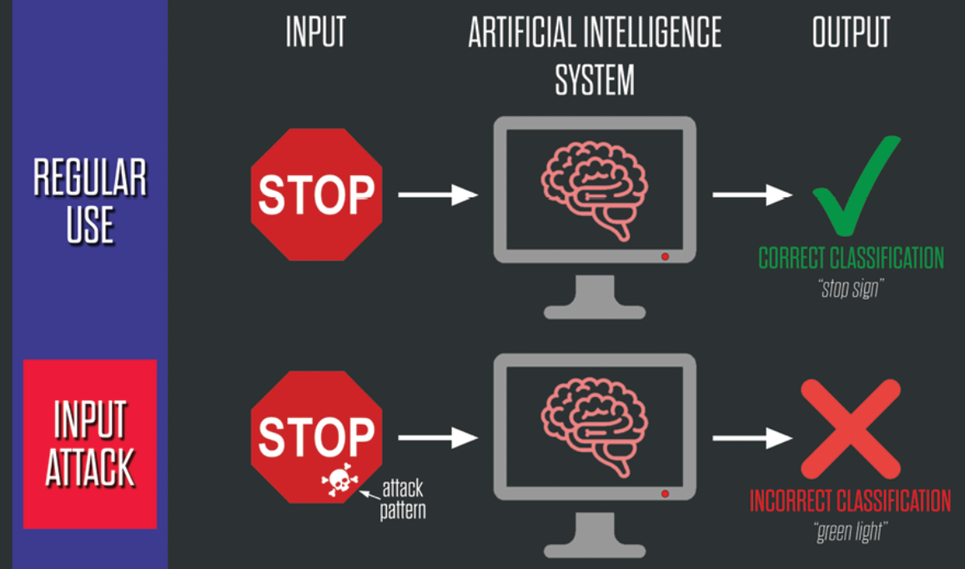
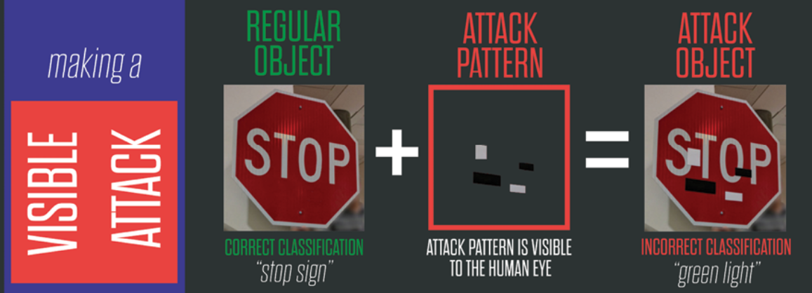
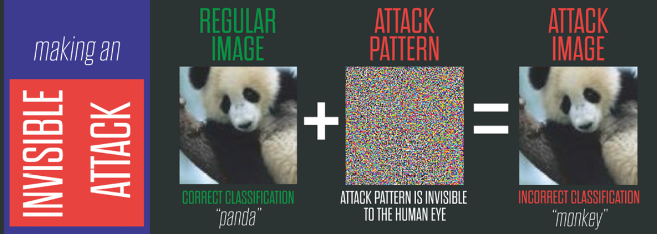
Artificial Intelligence under Attack:
Adversarial Machine Learning
EVASION ATTACK
https://www.belfercenter.org/publication/AttackingAI
https://www.belfercenter.org/publication/AttackingAI

Slide 5



The Cognitive Early Warning Predictive System (CEWPS) described in the book replicates the human immune system and creates “the digital immune system”;
CEWPS inoculates critical systems with the “Vaccination-as-a-service”;
This is achieved through its “Smart Vaccine” (autonomous AI robot), the holy grail of digital immunity. It uses self-trained AI reasoning engine that acquires knowledge from past attacks and predicts, probable incoming cyberattacks;
Such approach to digital immunity (of the generic critical system components) applies top-down (expert-driven) AI (ontological representation of knowledge and inference engine).
In our study, we suggest an opposite, bottom-up (computational intelligence) AI approach to digital immunity of the intelligent component of critical systems) and smart vaccination, which can be obtained as a result of adversarial GAN-driven learning.
GAN – Generative Adversarial Network

Slide 6

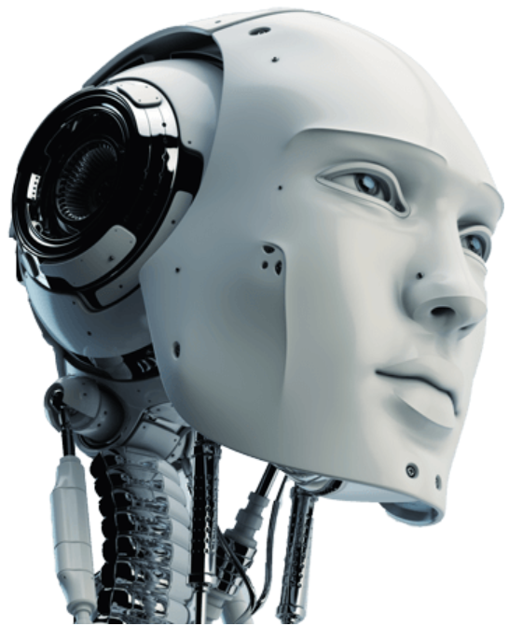

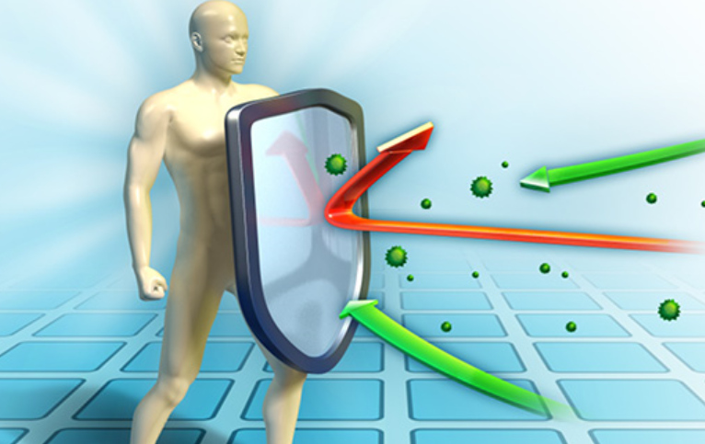
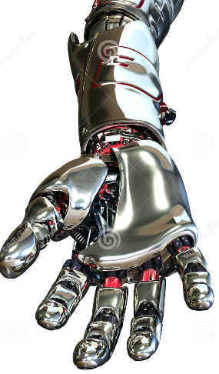
Our approach: Artificial Immune System for Artificial Intelligence trained by “Smart Vaccination” and driven by Generative Adversarial Networks (GANs)
Artificial attacker
“Generator”
Artificial defender
“Discriminator”
VS
Artificial attacker “Generator” is trained to generate sophisticated, well-disguised and constantly improved attacks by creating fake data as an input to AI system
Artificial defender “Discriminator” is trained to distinguish between fake and real inputs coming to AI system and constantly improves the ability to repel the attacks

Slide 7
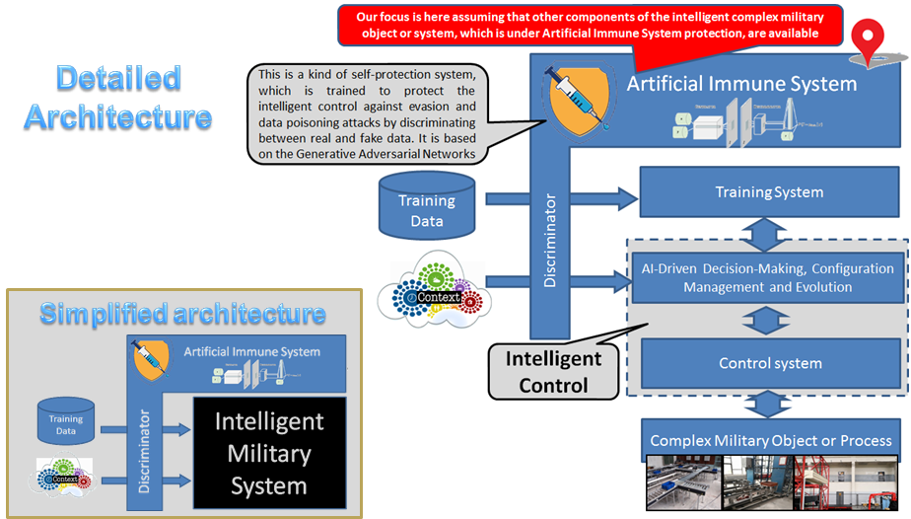

NATO SPS Project “Cyber-Defence of Intelligent Systems”
Resilient Cyber Defense of Intelligent Systems:
http://recode.bg/natog5511

Slide 8
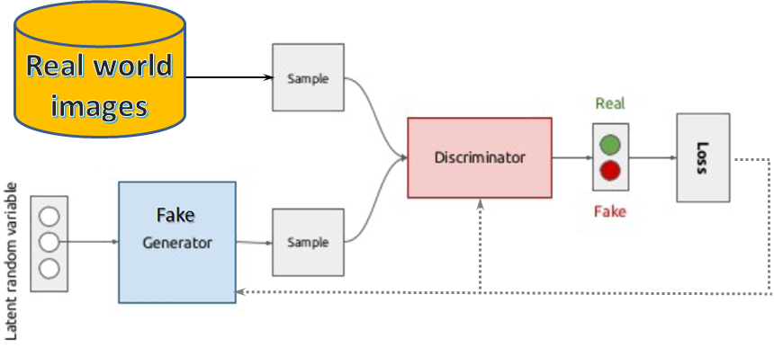
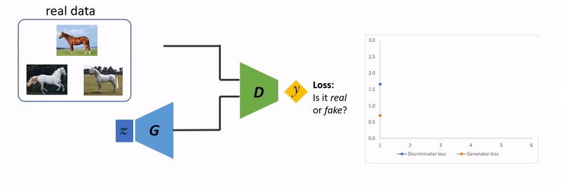

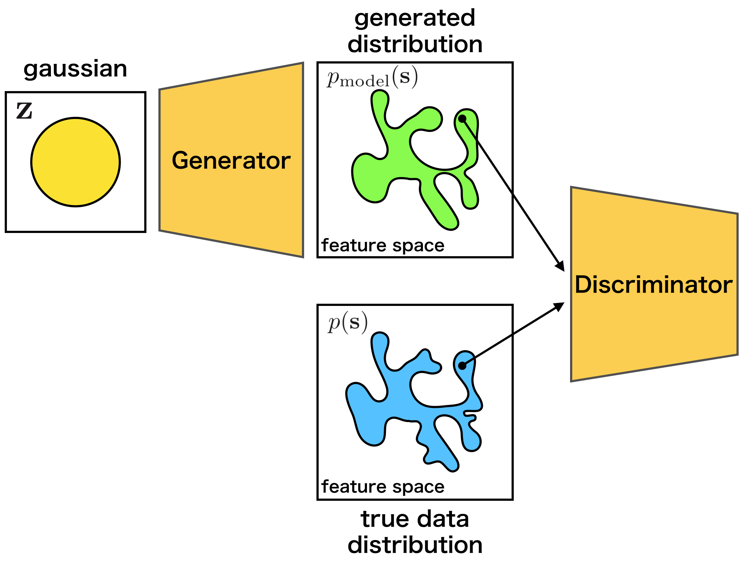
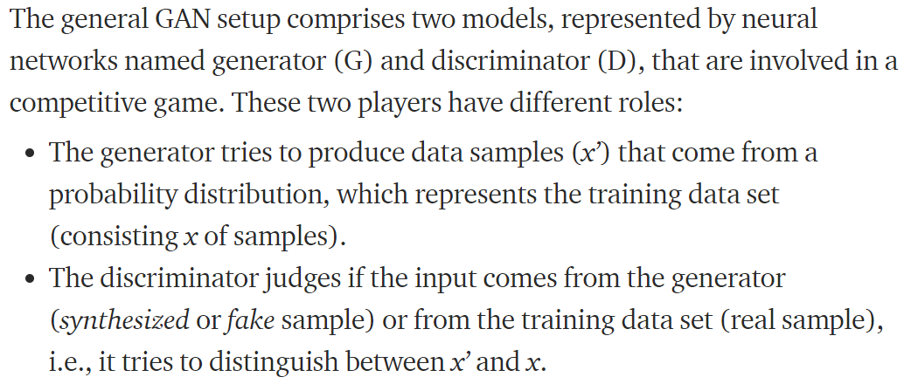
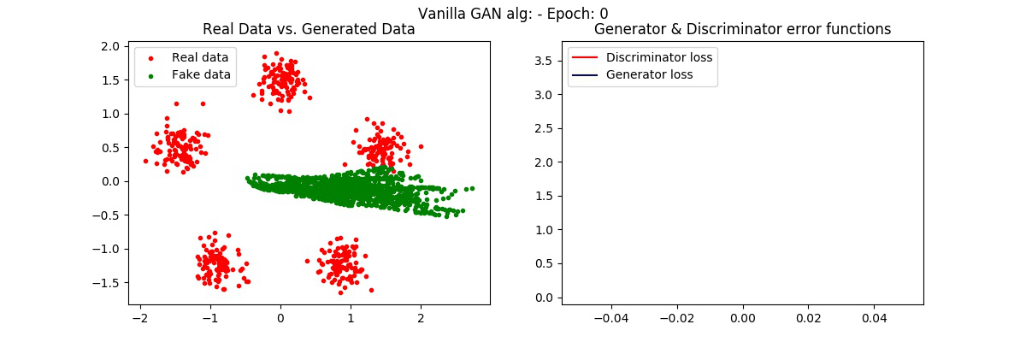
Generative Adversarial Networks (GANs)
https://medium.com/@jamaltoutouh/lipizzaner-a-framework-for-co-evolutionary-distributed-gan-training-7a725fb17e49
https://github.com/dhyaaalayed/gan-gaussian

Slide 9
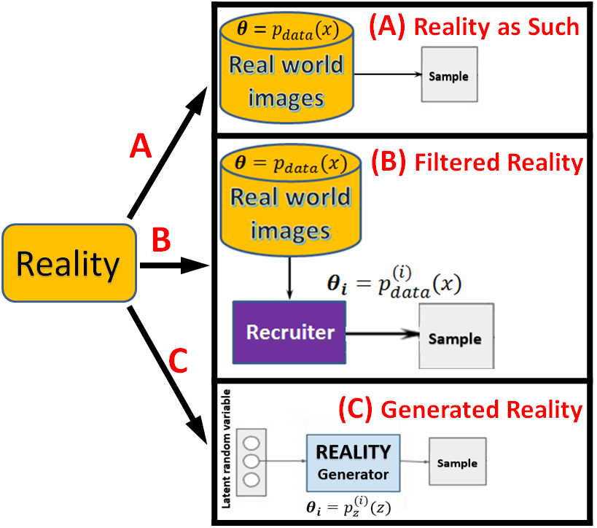
Different “players” for the “Reality” role in GANs
Reality

Slide 10
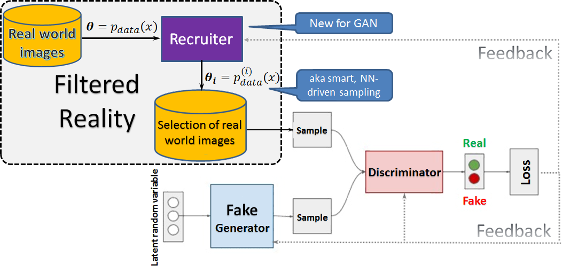
“Filtered Reality” adds the third Neural Network-driven player to the GAN game

Slide 11
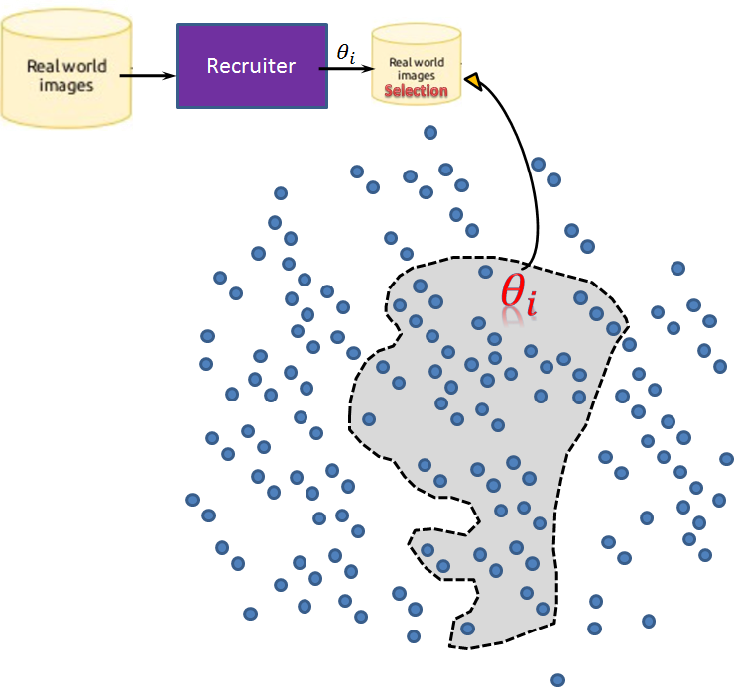
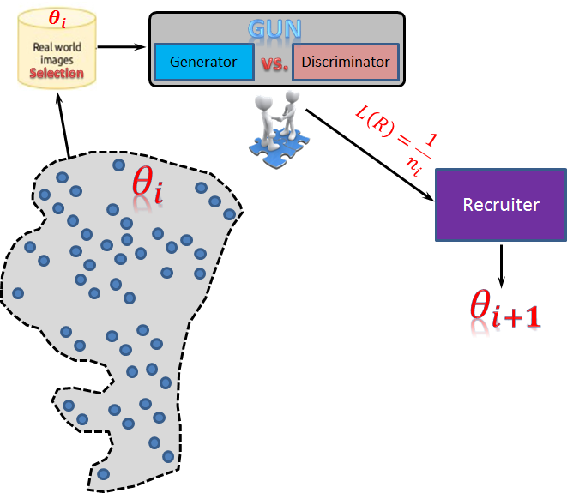
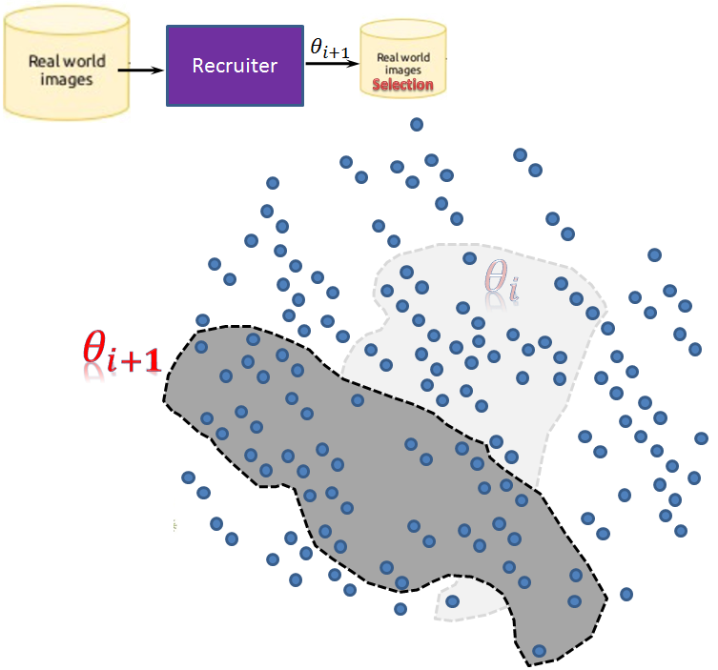
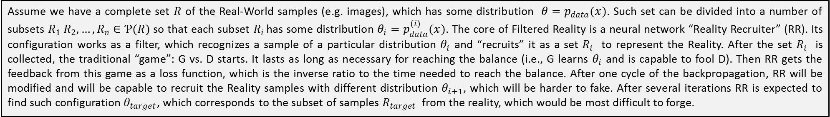
“Filtered Reality” as sustainable reality
Assume we have a complete set $R$ of the Real-World samples (e.g. images), which has some distribution $θ=p_{data}(x)$. Such set can be divided into a number of subsets $R_{1} R_{2},…, R_{n}∈Ƥ(R)$so that each subset $R_{i}$ has some distribution $θ_{i}=p_{data}^{(i)}(x)$. The core of Filtered Reality is a neural network “Reality Recruiter” (RR). Its configuration works as a filter, which recognizes a sample of a particular distribution $θ_{i}$ and “recruits” it as a set $R_{i}$ to represent the Reality. After the set $R_{i}$ is collected, the traditional “game”: G vs. D starts. It lasts as long as necessary for reaching the balance (i.e., G learns $θ_{i}$ and is capable to fool D). Then RR gets the feedback from this game as a loss function, which is the inverse ratio to the time needed to reach the balance. After one cycle of the backpropagation, RR will be modified and will be capable to recruit the Reality samples with different distribution $θ_{i+1}$, which will be harder to fake. After several iterations RR is expected to find such configuration $θ_{target}$, which corresponds to the subset of samples $R_{target}$ from the reality, which would be most difficult to forge.

Slide 12
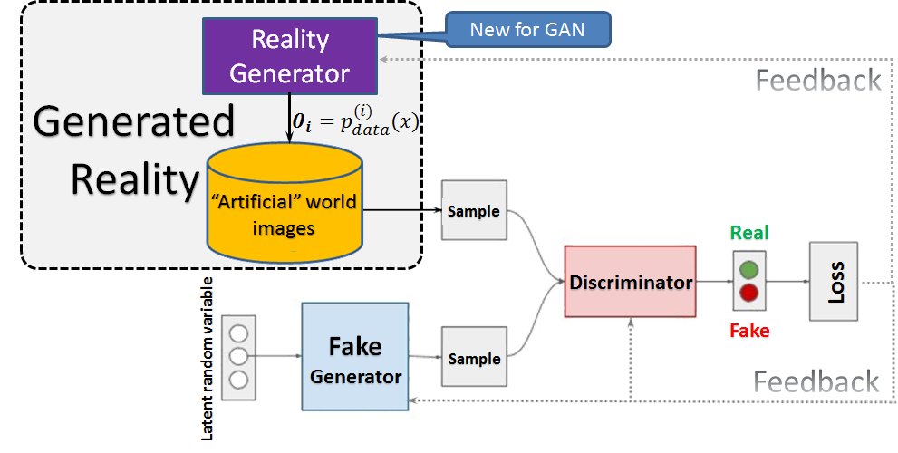
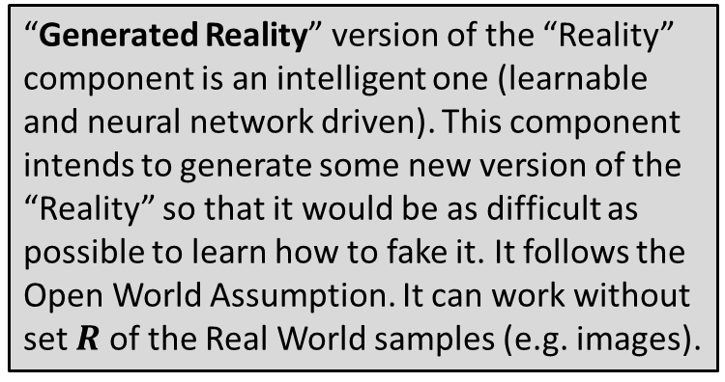
“Generated Reality” – the “game” with the “Open World Assumption”
Reality Generator (GR): “creates” an “artificial real world” and therefore updates the distribution of the artificial reality images (aiming to hide as long as possible this distribution from the Fake Generator)
“Generated Reality” version of the “Reality” component is an intelligent one (learnable and neural network driven). This component intends to generate some new version of the “Reality” so that it would be as difficult as possible to learn how to fake it. It follows the Open World Assumption. It can work without set $R$ of the Real World samples (e.g. images).

Slide 13
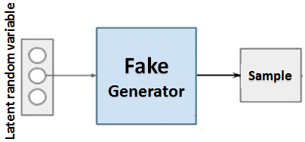
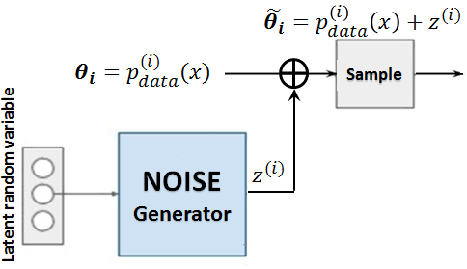
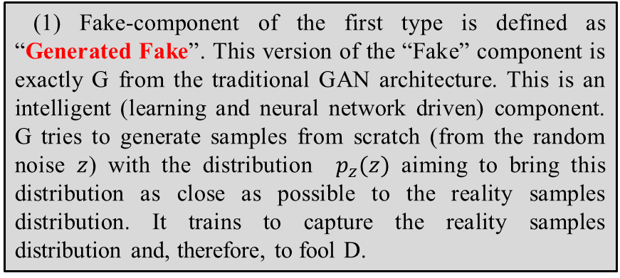
Different “players” for the “Fake-Maker” role in GANs
(1) Generated Fake
(1) Fake-component of the first type is defined as “Generated Fake”. This version of the “Fake” component is exactly G from the traditional GAN architecture. This is an intelligent (learning and neural network driven) component. G tries to generate samples from scratch (from the random noise $z$) with the distribution $p_{z}(z)$ aiming to bring this distribution as close as possible to the reality samples distribution. It trains to capture the reality samples distribution and, therefore, to fool D.
1
Fake
(2) Generated Noise
(2) Fake-component of the second type is defined as “Generated Noise”. Such component is not creating fakes as such, but it creates (generates) special signals (“noise”), which being mixed with the Reality samples, keep these samples to be naturally looking for humans and at the same time confusing for the artificial D (evasion attack). We consider two kinds of “noise”: the one, which is added as such to the reality samples; or the one, which is served as a “style”, i.e., set of features values, which are integrated to the deeper representation of the reality sample.
2

Slide 14
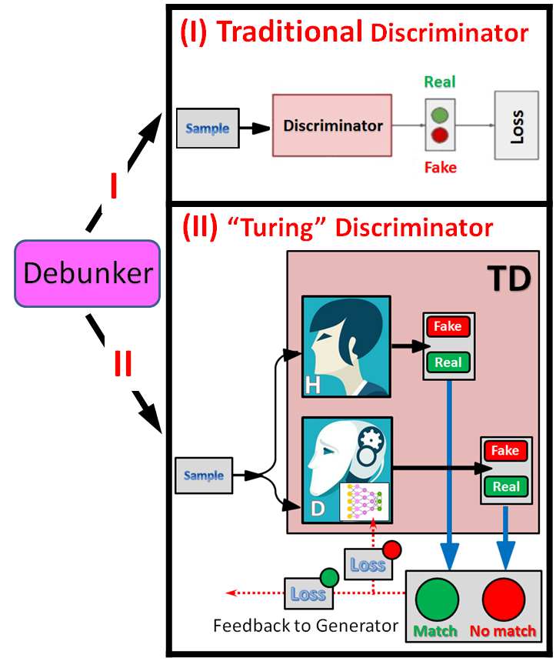
Different “players” for the “Debunker” (i.e., “Discriminator”) role in GANs
(I) The Traditional Discriminator version of the “Debunker” component is exactly the one, named D in the traditional GAN architecture. This is an intelligent (learning and neural network driven) component. D tries to distinguish between samples coming from the “Reality” channel from the ones coming from the “Fake” channel, i.e., it learns the decision boundary between real and fake samples. When trained, it can be used as a component, which “protects” the “organism” of an intelligent system from the dangerous alien instances.
(II) The “Turing” Discriminator version of the “Debunker” component is an innovative and potentially very useful and multi-purpose component. The “Turing Discriminator” (TD) behaves, on the one hand, as a “black box”, i.e., similar to the traditional D, it has the same structure of the loss function, however, on the other hand, it has different semantics. TD is a collective intelligence, which includes at least one human (H), and at least one traditional learning neural (D) discriminator. Both (H and D) are differentiating between input samples (“real” or “fake”). The TD outputs the probability distribution between “Match” and “No match” of the H and D opinions, which is used as the loss function to train D. The D player in TD tries to learn to synchronize its own opinions on the inputs with the H’s opinions. Such schema allows training D to be resistant against potential evasion attacks.

Slide 15
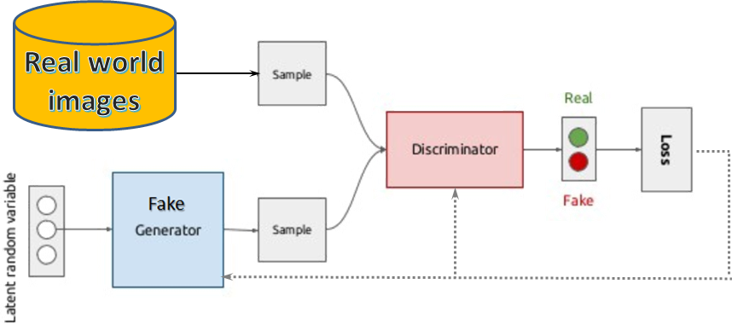
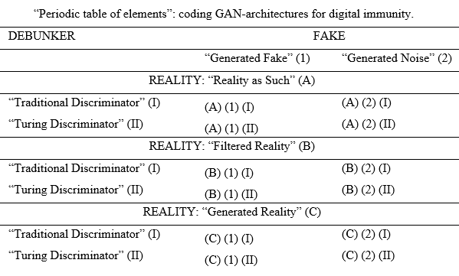
GAN Taxonomy
as a “Periodic table of elements” for GAN architectures
(A) (1) (I)
(A) (1) (I)

Slide 16
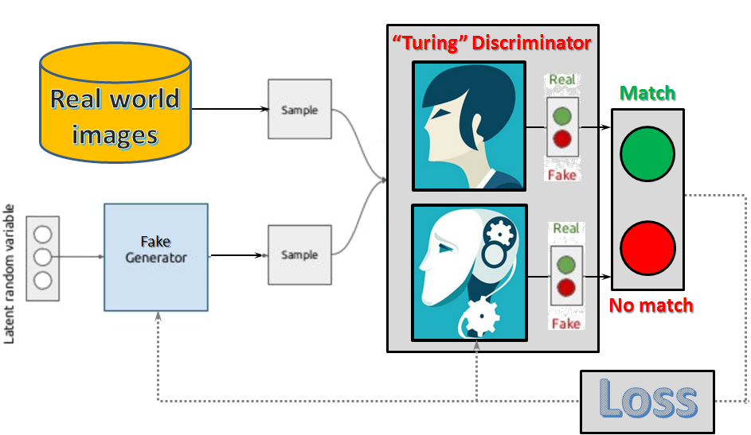
Just an example of one of 12 GAN architectures
(A) (1) (II)
Vaccination
(A) (1) (II)
TD
GAN architecture with TD encoded as (A) (1) (II) is an illustration of a “vaccination” aiming protection of the intelligent systems against evasion attacks. TD improves own performance in being at least as good as a human in handling pertrubated images. Such or similar architectures can be used also to train “cognitive clones” of particular human skills or other intelligent decision-makers.

Slide 17

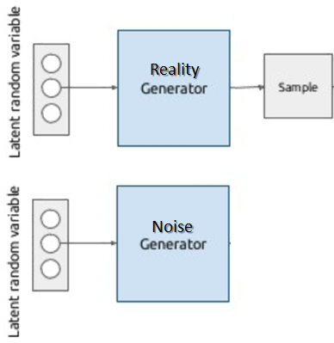
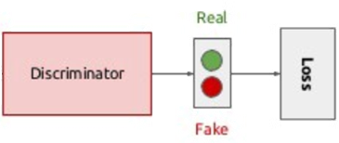
Just an example of one of 12 GAN architectures
(A) (2) (I)
Immunity against poisons
(A) (2) (I)
GAN architecture encoded as (A) (2) (I) is a good illustration of a training model (aka “immunity against poisons”) for an Intelligent System. GN generates well camouflaged and constantly evolving noise (or style) to compromise data, and D improves own performance in the discovery (“poisoned” or “clean”) for every input.
Real world
images
D
GN
Loss

Slide 18
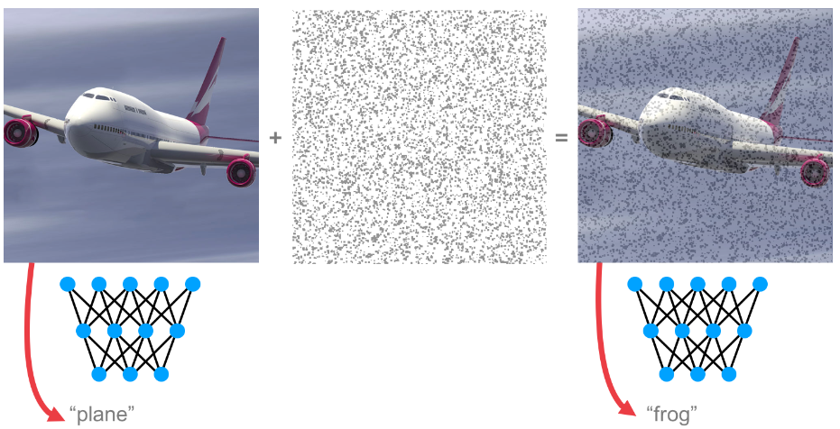
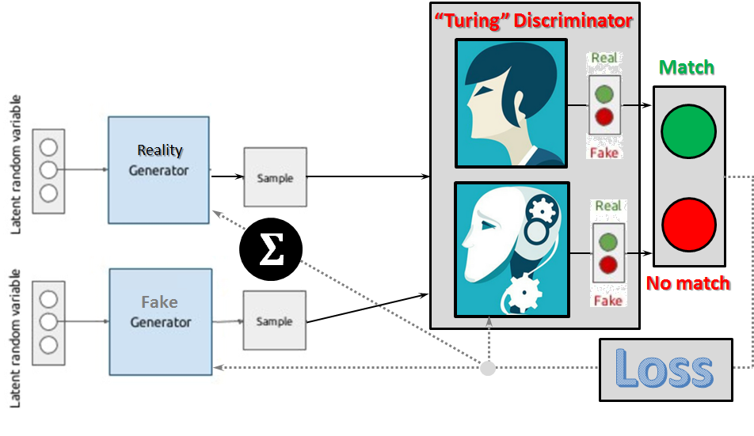
Just an example of one of 12 GAN architectures
Immunity against evasion attacks
TD
(C) (1) (II)
(C) (1) (II)
Architecture (C)(1)(II) naturally inherits the properties of (C)(1)(I), (A)(1)(II) and (B)(1)(II) architectures. This architecture is a challenge for both (human and AI components of the TD) because the GR may generate new reality samples never seen before. Anyway the target is still synchronous decision (human and AI) on inputs to be protected against the “Evasion” attacks on the test data. G is trained against smart (self-creative) reality, therefore, while competing with G, the TD improves own performance in a harder competition while learning to distinguish (“friend” or “alien”) for every input.
GR
G

Slide 19
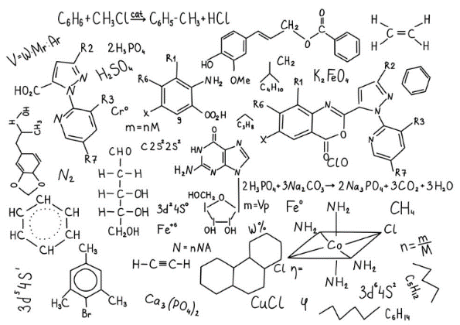
Conclusions and Future Work
Digital immunity as a basic trained self-protection mechanism is needed for Industry 4.0 systems.
GAN is a suitable paradigm to simulate training environment needed for the digital immunity.
We suggest a couple of modifications to the basic GAN schema (proactive smart Reality and Turing Discriminator).
By combining various players in the GAN configuration (three options for the Reality role; two options for the Discriminator role and two options for the Generator role), we present taxonomy of 12 GAN architectures.
Each of these 12 architectures has certain specifics if applied for the purpose of security of Industry 4.0 systems. Tasks related to the immunity training against various sophisticated attacks (data poisoning, evasion, etc.) could be addressed by thorough choice of the appropriate GAN architecture.
Smart and evolving adversarial components in the architectures essentially facilitate the immunity training.
Future research: basic GAN components can be multiplied (e.g., several Discriminators or Generators, or several humans within Turing Discriminator), which creates wide possibilities to create complex GANs for new challenging problems. Therefore, as the immediate goals for the future research would be constructing and testing GAN architectures with multiple human and AI components, i.e., with the embedded collective intelligence and checking the potential impact of such digitalized collaborative intelligence for a variety of industrial problems.

Slide 20
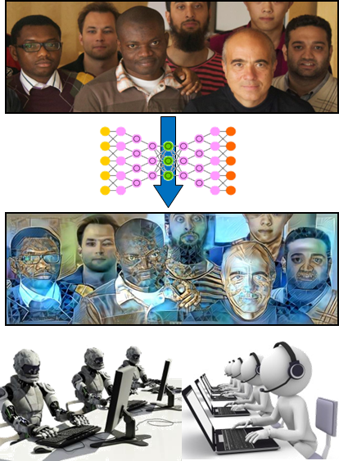

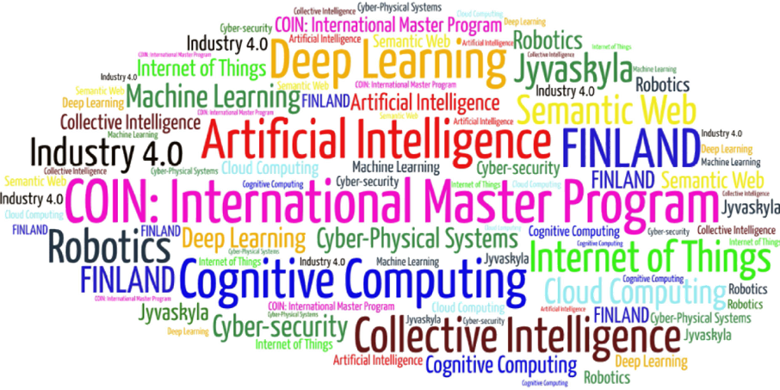
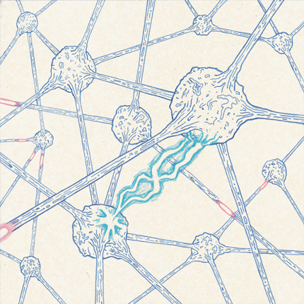
Come to study at our International Master Program
COIN: Cognitive Computing and Collective Intelligence …
… the first university program for collective intelligence, where humans learn together with their digital clones and autonomous digital assistants …
http://www.jyu.fi/ai
COIN

Slide 21


Link to the presentation: https://ai.it.jyu.fi/ISM-2020-GAN-Taxonomy.pptx
Contact: vagan.terziyan@jyu.fi

