Slide 1
“Artificial General Intelligence vs. Industry 4.0: Do They Need Each Other?”
Samu Kumpulainen ª , Vagan Terziyan ^{b}
^{a,b} Faculty of Information Technology, University of Jyväskylä, Jyväskylä, Finland
https://www.jyu.fi/en/

Slide 2
How to cite this paper:
Kumpulainen, S., & Terziyan, V. (2022). Artificial General Intelligence vs. Industry 4.0: Do They Need Each Other? Procedia Computer Science, 200, 140-150. Elsevier. https://doi.org/10.1016/j.procs.2022.01.213

Slide 3
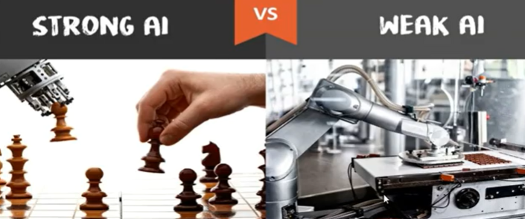
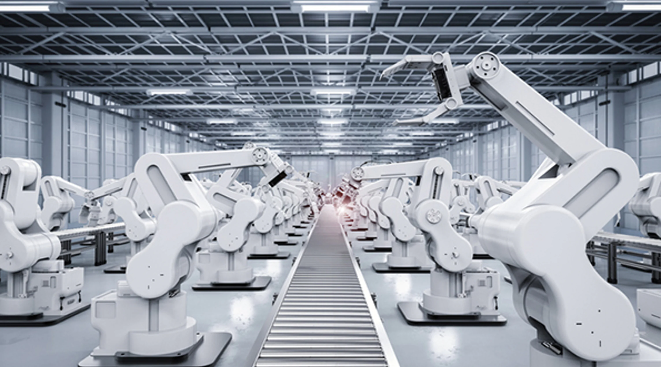
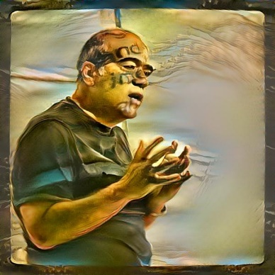
“Artificial General Intelligence vs. Industry 4.0: Do They Need Each Other?”
Paper # 17
Vagan Terziyan
Samu Kumpulainen
&
Vagan Terziyan
Samu Kumpulainen
vagan.terziyan@jyu.fi
samu.kumpulainen@gmail.com
18 November, 2021, 9:10 - 9:30
Session S1.1 - exAI : Explainable Artificial Intelligence

Slide 4
Beware on hidden slides!
Due to the time and video file size limits, I will report now only the key summary of our study with hidden details. You can find more detailed presentation in the Web …
Link to the complete presentation: https://ai.it.jyu.fi/ISM-2021-AGI.pptx
Original data and graphs regarding this mapping study:
https://zenodo.org/record/4765682#.YWk9FBpBw2w

Slide 5
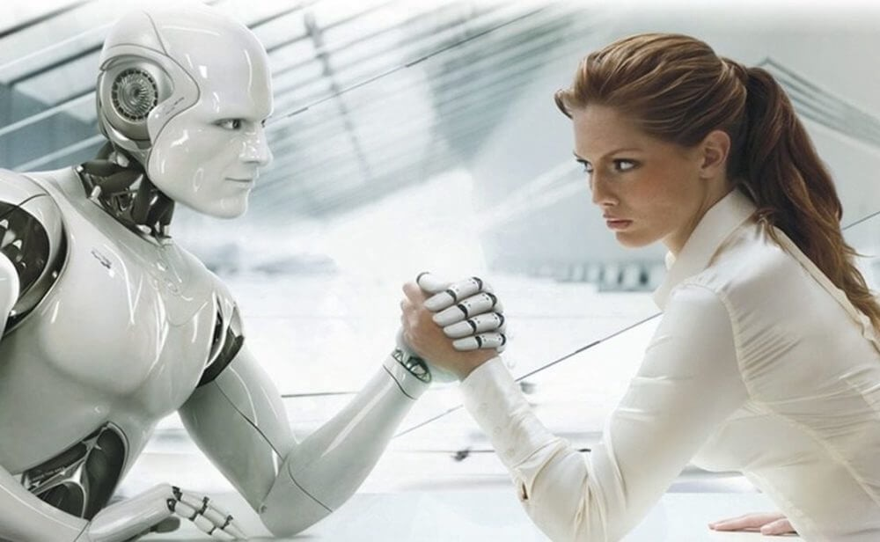
Artificial General Intelligence → ???
Artificial general intelligence (AGI) is the hypothetical ability of an intelligent agent to understand or learn any intellectual task that a human being can. It is a primary goal of some artificial intelligence research and a common topic in science fiction and futures studies. [Possible also as a Collective AGI …]
Superintelligence is a hypothetical agent that possesses intelligence far surpassing that of the brightest and most gifted human minds. A superintelligence may or may not be created by an intelligence explosion and associated with a technological singularity (or a hypothetical point in time at which technological growth becomes uncontrollable and irreversible, resulting in unforeseeable changes to human civilization).
Strong AI aims to create intelligent machines that are indistinguishable from the human mind. But just like a child, the AI machine would have to learn through input and experiences, constantly progressing and advancing its abilities over time. If researchers are able to develop Strong AI, the machine would require an intelligence [at least] equal to humans; it would have a consciousness (i.e. a hypothetical machine that possesses awareness of external objects and self-awareness) that has the ability to solve problems, learn, and plan for the future.
Self-Managed AI is such AI, which we (humans) may not understand what such AI is doing, why and how. Probably humans will not immediately benefit from such AI because its logic of thinking and doing will be very different. Should we start worry about it ? …

Slide 6
Artificial General Intelligence → ???
Artificial General Intelligence (AGI) understands, learns, plans and performs like a human.
Strong AI has intelligence [at least] equal to human’s; and consciousness (awareness of external objects and self-awareness).
Self-Managed AI is such AI, which we (humans) may not be capable to control and may not understand what such AI is doing, why and how.
Superintelligence or hypothetical AI that performs stronger than the most gifted human intelligence; it is associated with a technological singularity (or a hypothetical point in time at which technological growth becomes uncontrollable ...).
Should we start worry about all these ? …

Slide 7
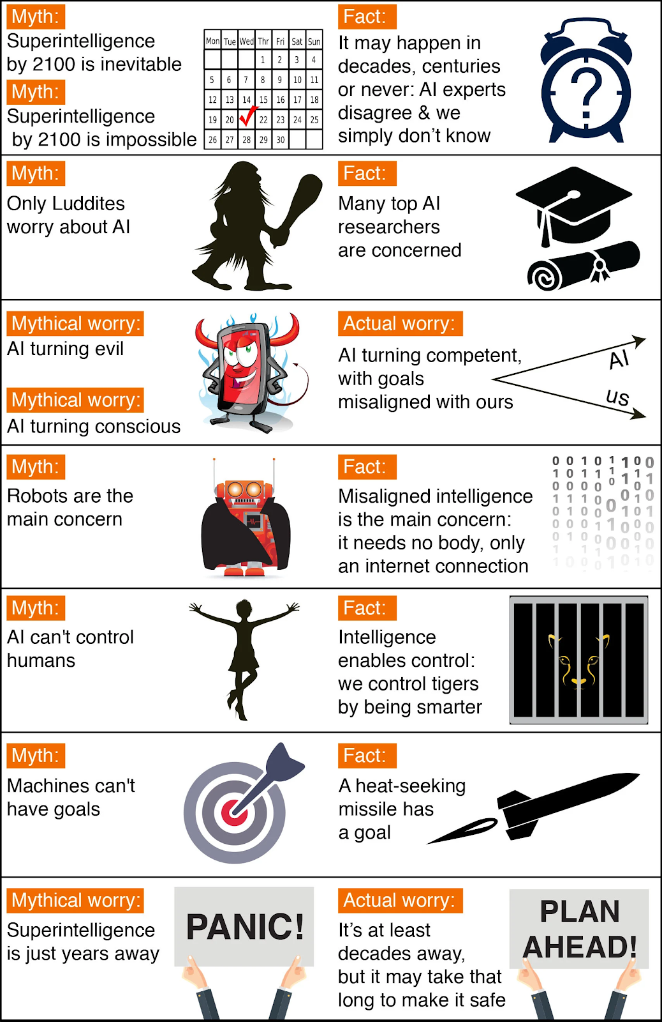
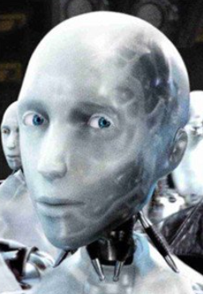
Artificial General Intelligence:
myths or reality, worries or hopes?
Are we capable of achieving AGI? Optimistic experts believe AGI is possible, but it’s hard to decide how far away we are from realizing it ...

Slide 8
Is the Artificial General Intelligence too far from the reality concept to be adopted by the industry (e.g., Industry 4.0 )?
I n d u s t r y 4.0
AGI
“To apply or not to apply ?”

Slide 9
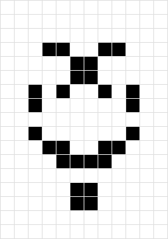
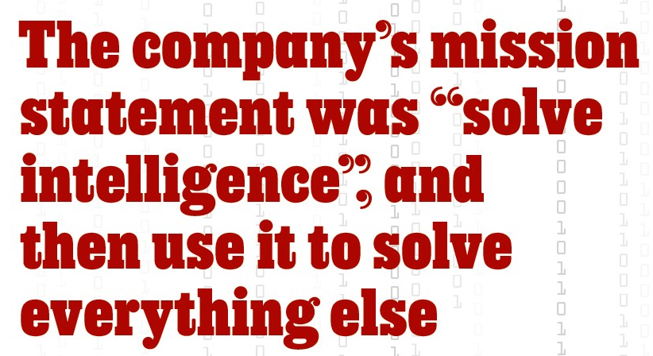
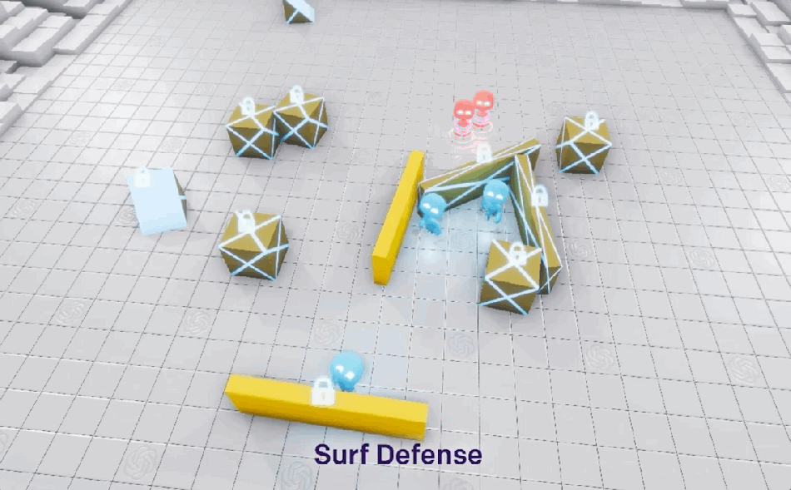
Is the Artificial General Intelligence too far from the reality concept to be adopted by the industry (who else cares)?
https://www.economist.com/1843/2019/03/01/deepmind-and-google-the-battle-to-control-artificial-intelligence

Slide 10
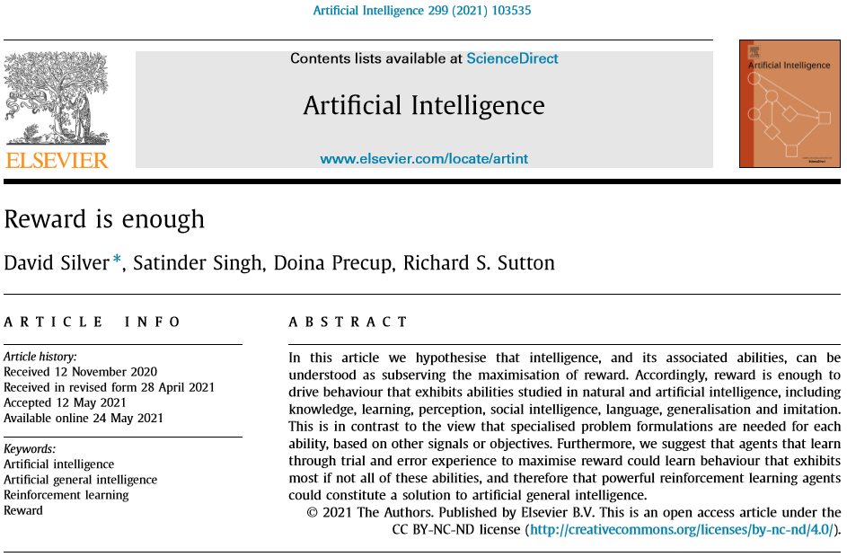
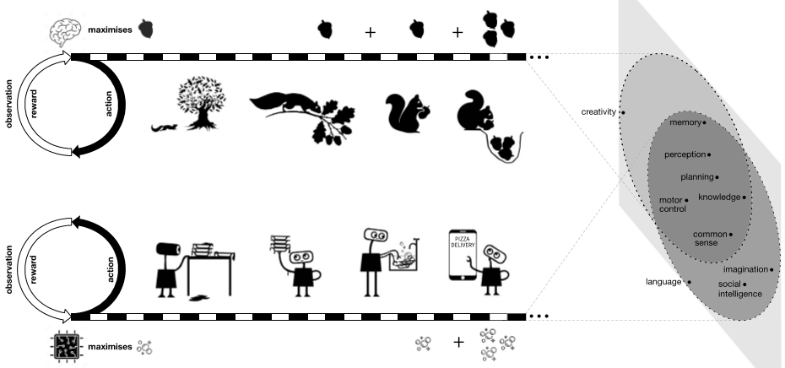
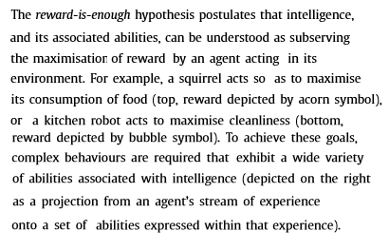
Recent bold claim in AGI:
“Reward is Enough”
https://www.youtube.com/watch?v=dmH1ZpcROMk

Slide 11
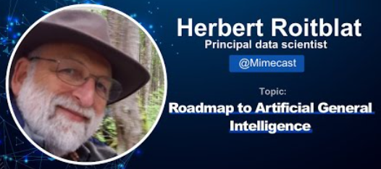
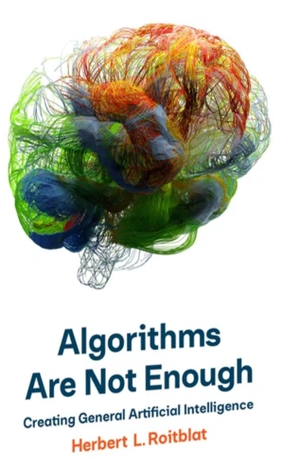
Critics of the bold claim:
“Reward is NOT Enough”
https://bdtechtalks.com/2021/07/07/ai-reward-is-not-enough-herbert-roitblat/
“The “general” in artificial general intelligence is not characterized by the number of different problems it can solve, but by the ability to solve many types of problems. A general intelligence agent must be able to autonomously formulate its own representations. It has to invent its own approach to solving problems, selecting its own goals, representations, methods, and so on. So far, that is all the purview of human designers who reduce problems to forms that a computer can solve through the adjustment of model parameters. We cannot achieve general intelligence until we can remove the dependency on humans to structure problems. Reinforcement learning, as a selective process, cannot do it. Rewards select among available alternatives but they cannot create those alternatives. Behaviorist rewards work so long as one does not look too closely at the phenomena and as long as one assumes that there must be some reward that reinforces some action. They are good after the fact to “explain” any observed actions, but they do not help outside the laboratory to predict which actions will be forthcoming. These phenomena are consistent with reward, but it would be a mistake to think that they are caused by reward. … Contrary to Silver et al.’s claims, reward is not enough.”

Slide 12
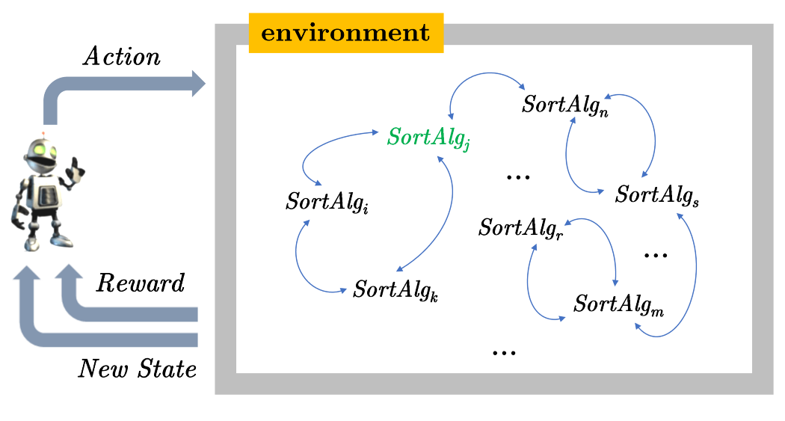
A ‘Reward’ is not always computable …
https://medium.com/ontologik/reward-is-not-enough-and-neither-is-machine-learning-6f9896274995
In typical reinforcement learning settings the computation of the reward is well defined — in fact, that’s what the agent uses to adjust their policy and take a new action that improves the situation. This works well for knowledge that we actually learn incrementally —which are mostly animal-like skills, like seeking food when hungry, or in more advanced settings like games where the goal is also well-defined, namely winning the game, etc. When the goal is well defined, a “reward” can be computed. In games like Go (or Chess), for example, one naïve way to compute the reward would be to apply some function on the current board that returns a numeric value of how “close” the current board is to winning. But how would we compute the reward in our problem above? The answer is we cannot. First, there are infinite number of semantically equivalent sorting algorithms — just think that we can always append an empty list to a list, or add 0 to some number without changing the semantics of a program. Worse yet, how do we score a certain algorithm that we reached to determine if the agent’s action improved its search for the optimal algorithm? The only way we can do this is by executing the program we are now at, but this immediately means we are face to face with the halting problem (what can we conclude if the program never terminated while we are evaluating the algorithm?)
A “Reward is Enough” casting of an agent that is trying to learn the optimal sorting algorithm.
The reward in this problem is not defined — and thus:
we cannot discover the best sorting algorithm within a reinforcement learning and “Reward is Enough” paradigm.
… In fact, the best sorting algorithm, like many important human knowledge, is not discovered by incremental learning, but by reasoning and deduction.

Slide 13
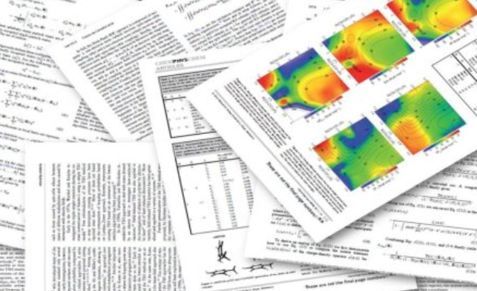
Objectives and methods of our study
Definitely, AGI is a popular subject within futurology and science fiction, however, our concerns are:
- Are there any indicators (within the recent academic publications) that current discoveries in AGI are being adopted already or going to be adopted soon within Industry 4.0?
- What is the gap (and trends regarding such gap) between the AGI research and modern industry needs?
We address our questions here (to the pool of academic publications) as the objectives for systematic mapping study and also we apply google distance-based measurements for the gap analysis …
A systematic mapping study is “the process of identifying, categorizing, analyzing existing literatures that are relevant to a certain research topic”. The aim of a systematic mapping study is to get a comprehensive overview on a particular research topic, present unbiased assessment of current literature, identify research gaps and collect evidence for future research directions. The outcome of a mapping study is a classified portfolio of publications on the research area; i.e., a high level map reporting the structure of existing literature related to the research field subject of interest, visualizing the status of that field with respect to pre-defined research questions, and giving a visual summary and mapping with respect to various classification categories.

Slide 14
Inspected sources for the mapping study
92 articles from 3 scientific journals and 2 conferences published within the period 2015 – 2019 were inspected as follows:
Artificial Intelligence (AIJ);
International Conference on Artificial General Intelligence (ICAGI);
International Joint Conference on Artificial Intelligence (IJCAI);
Journal of Artificial General Intelligence (JAGI);
Journal of Artificial Intelligence Research (JAIR).
Selected is based on relatedness to AGI, perceived popularity and quality.
The search phrase used in the automatic search was: ‘Artificial General Intelligence’ OR AGI OR ‘Human-Level AI’ OR HLAI OR Superintelligence

Slide 15
Distribution of inspected articles:
among publication forums;
yearly distribution

Slide 16
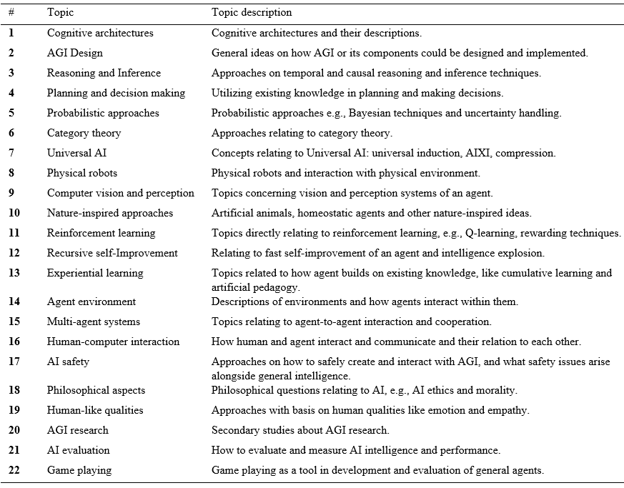
Discovered topic categories of inspected articles:

Slide 17
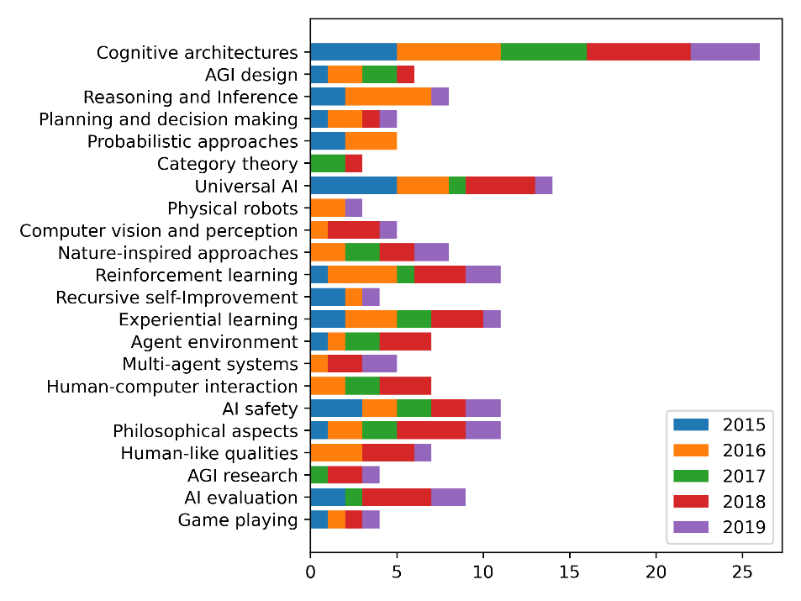
Topic frequencies by year:
The most frequent topic is Cognitive Architectures, which are the abstract models of cognition as well as its software implementation that aims to be a system showing intelligent behavior through AI.
The second largest topic category was Universal AI. The theory of universal AI was created by Marcus Hutter and it describes a complete mathematical model for general AI, named AIXI. Although incomputable, this theory is a target of vigorous research.
Reinforcement Learning (RL) was the third largest category. In 2016 Susumu Katayama presents a new RL algorithm idea with similarity to AIXI. RL is one of the main paradigms of ML, and widely used in narrow AI approaches, but it is also a very important part of many approaches to AGI.

Slide 18
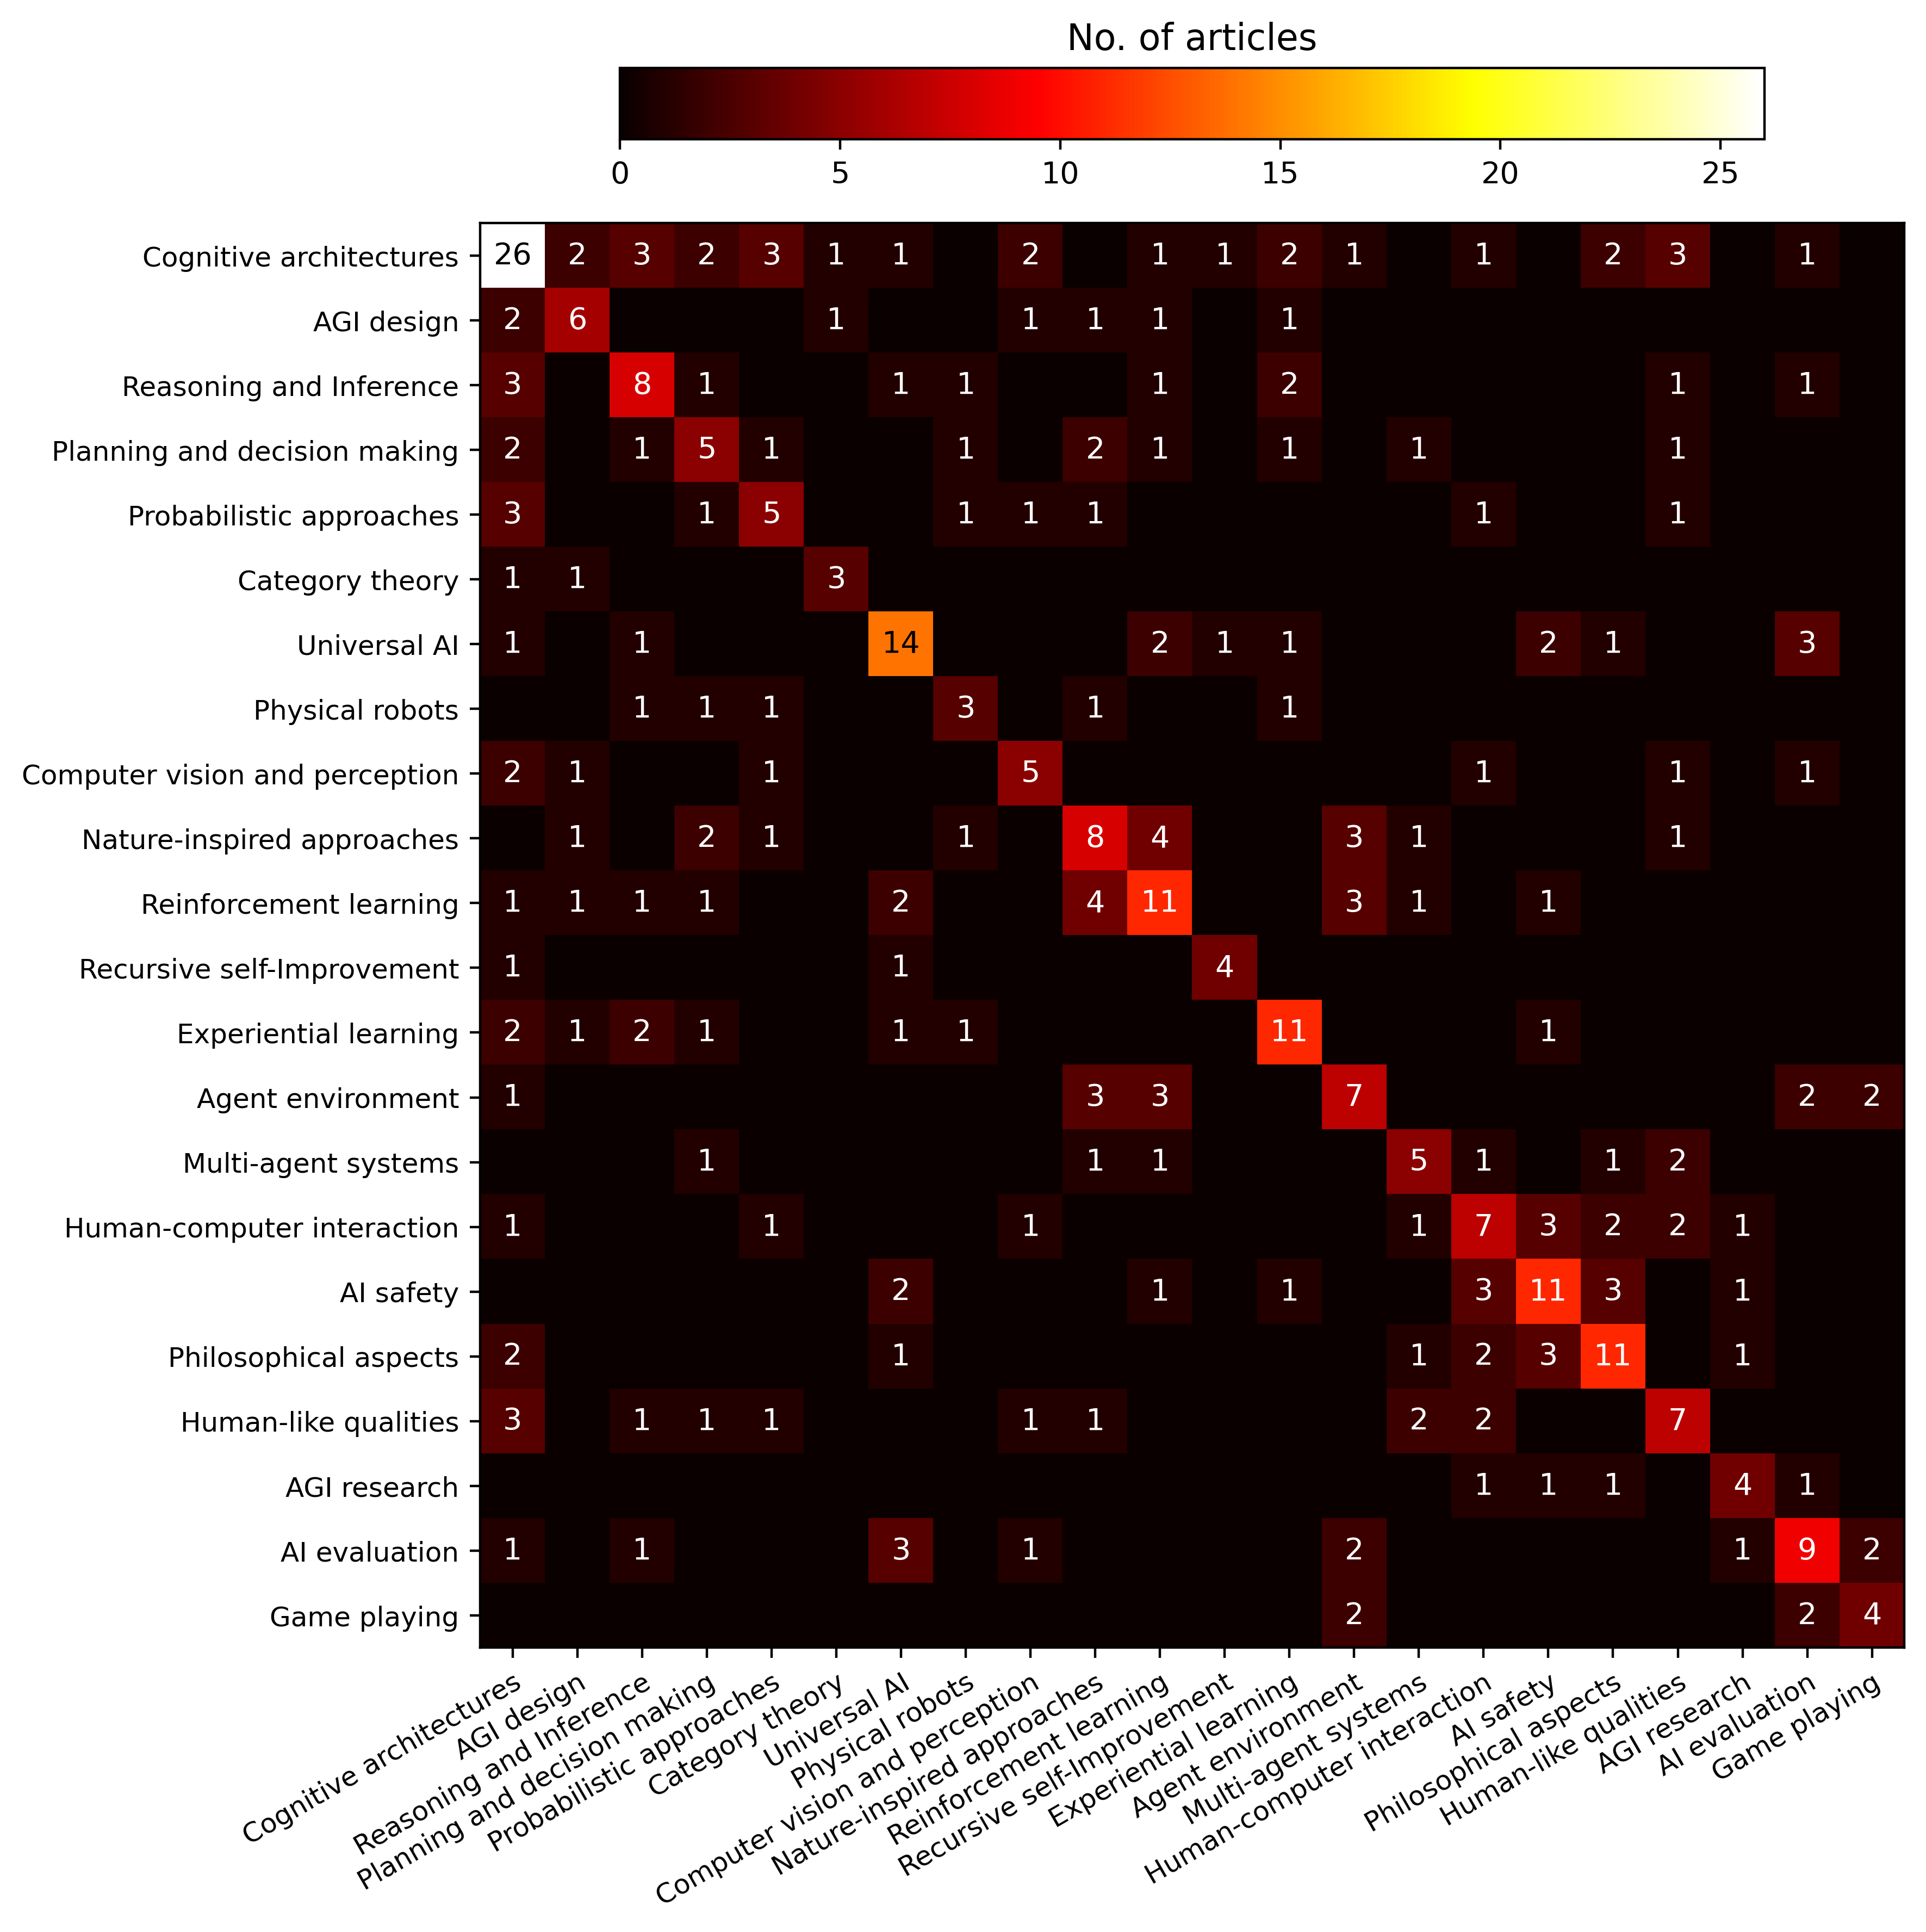
Discovered connections between topics:
Cognitive architectures can be associated with 15 other categories. As the aim of cognitive architecture is often to create a versatile general agent, it is reflected on the way the research is done. Nature-inspired approaches are often associated with agent environment and reinforcement learning. The relation between AI evaluation and universal AI can also be observed. A clearly visible focus area on the topic relations is the area with topics 15-20. The heatmap shows close connections between less technical topics such as human-computer interaction, AI safety, philosophical aspects, and human-like qualities, and also multi-agent systems and AGI research.

Slide 19
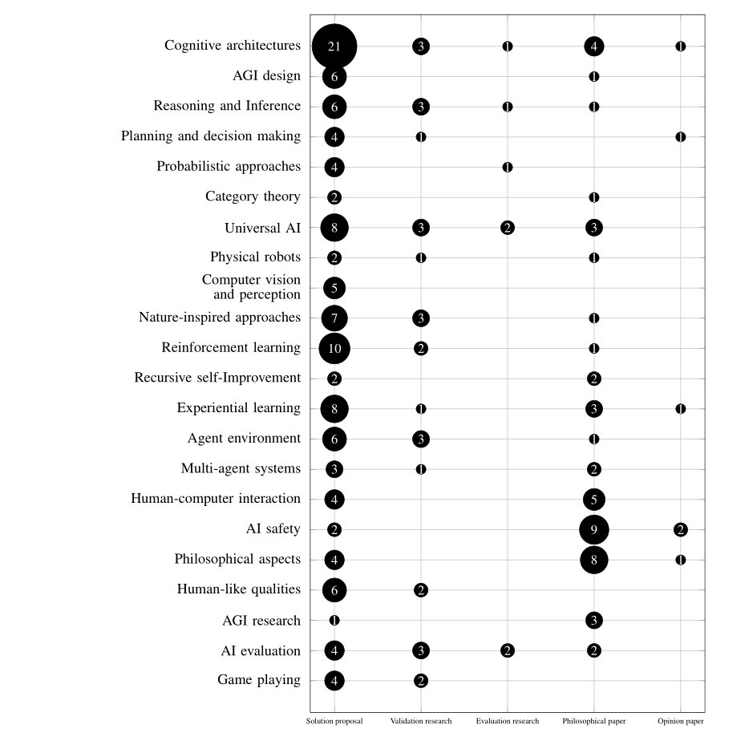
Types of AGI research:
It can be seen that most of the research in the field is solution proposals. This means that the research consists predominantly of new approaches to different problems. This focus on the new ideas combined with the almost complete lack of evaluation research shows that the field is still very young, as there are not much practical applications to investigate. It is also possible that often this kind of evaluation research could be very valuable and therefore kept private and unpublished, but as the sample articles are mostly from academia, that should not be the case here.
There is some validation research, which means investigation of not-yet-implemented solution proposals. Often solution proposal articles provided some proof in form of methodological analysis, prototype or experiments, which makes them also validation research papers.
Also common were philosophical papers, meaning papers that sketch a new way of looking at the subject, or that present a conceptual framework to be used in future research. Especially on these topics the lack of practical applications makes evaluation and validation research difficult, as there is currently no competent AGI.

Slide 20
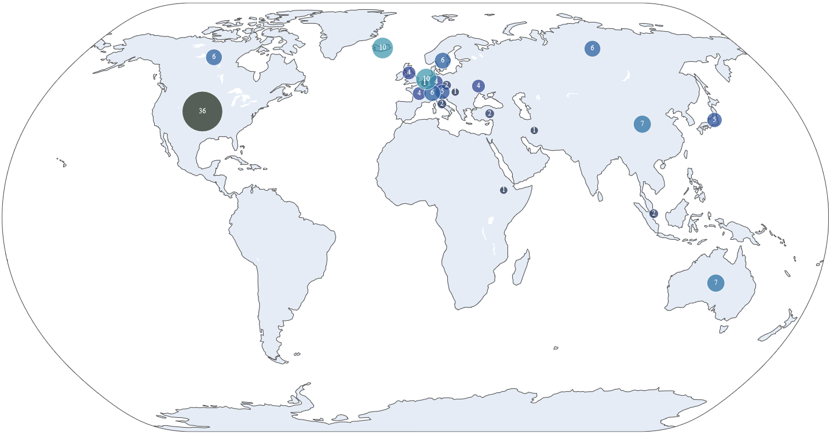
AGI research locations:
Leaders:
USA, Netherlands, Iceland, China, Australia, Russia, Canada, Japan …

Slide 21
Normalized Google Distance (NGD) is a semantic similarity measure derived from the number of hits returned by the Google search engine for a given set of keywords. Keywords (or search terms) with the same or similar meanings in a natural language sense tend to be "close" in units of Normalized Google Distance, while words with dissimilar meanings tend to be farther apart.
$$NGD\left(x,y\right)=\frac{\max\left\{\log{f\left(x\right)},\log{f\left(y\right)}\right\}−\log{f\left(x,y\right)}}{\log{N−}\min\left\{\log{f\left(x\right)},\log{f\left(y\right)}\right\}}$$
$f(x)$ is the number of Google hits regarding the search term $x$;
$f(y)$ is the number of Google hits regarding the search term $y$;
$f(x,y)$ is the number of Google hits regarding the search term ( $x$ AND $y$ );
$N$ is the total number of pages indexed by Google.

Slide 22
Narrowing the scope of NGD:
Google Scholar Distance (GSD)
$$GSD\left(x,y\right)=\frac{\max\left\{\log{F\left(x\right)},\log{F\left(y\right)}\right\}−\log{F\left(x,y\right)}}{\log{F\left(Domain\left(x,y\right)\right)−}\min\left\{\log{F\left(x\right)},\log{F\left(y\right)}\right\}}$$
$F(x)$ is the number of Google Scholar hits regarding the search term $x$;
$F(y)$ is the number of Google Scholar hits regarding the search term $y$;
$F(x,y)$ is the number of Google Scholar hits regarding the search term ( $x$ AND $y$ );
$F(Domain(x,y))$ is the number of Google Scholar hits regarding the search term ( $X$ OR $Y$ ), where $x⊂X$ and $y⊂Y$ . The maximal possible value here is the number of academic items indexed by Google Scholar (currently > 380 000 000 indexed items*).
Such function is definitely an approximate and heuristic measure for concept matching (or, to be precise, it is a mismatch or distance or the gap between the concepts measure) and it is usually applied when the concepts $x$ and $y$ are expected to have different definitions in different sources (articles) and the set of such sources is huge (big data) and it is not feasible to process it all manually. In many realistic domains like Industry 4.0, it is difficult to give precise concept definitions, and consequently any equivalence measure will be a fuzzy one.
*Gusenbauer (2019) has found that Google Scholar is the world’s largest academic search engine, containing over 380 000 000 records.
Gusenbauer, M. (2019). Google Scholar to overshadow them all? Comparing the sizes of 12 academic search engines and bibliographic databases. Scientometrics 118, 177–214 (2019). https://doi.org/10.1007/s11192-018-2958-5

Slide 23
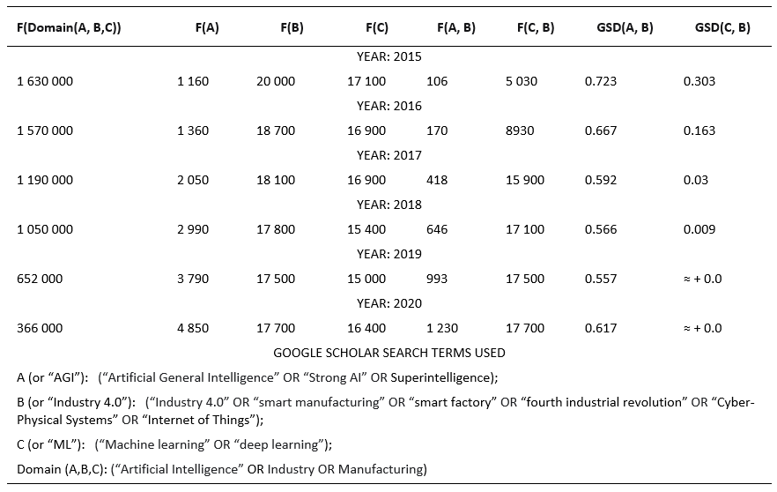
Gap analysis using Google Scholar Distance (dissimilarity measure)

Slide 24
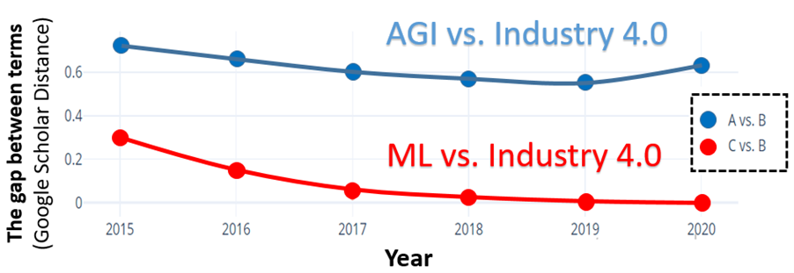
Gap trends visualized
Machine Learning (ML) is a “competitor” of AGI (regarding attention from Industry 4.0) and ML is usually associated with Narrow AI or application-specific cognitive abilities.
Bad news for AGI: One can see that (according to the academic publications during 2015-2020) Industry 4.0 is much closer related to ML than to AGI. Even more – from 2019 the gap (Industry 4.0 – AGI) began to widen, while the gap (Industry 4.0 – ML) has almost vanished. Therefore, now one may see that the published studies related to the ML-for-Industry-4.0 steadily displace from the academic agenda the studies related to the AGI-for-Industry-4.0.

Slide 25
AGI is still alive as Industry’s 4.0 potential driver (Good News for AGI):
Robot self-control, planning, re-planning;
Generalized cognitive architectures for generalized (industrial) diagnostics;
Manufacturing singularity driven by collective intelligence;
Digital cloning of human generic cognitive skills;
Cognitive self-protection, digital immunity and vaccination;
Bridging human and machine learning;
…

Slide 26
Conclusions:
The gaps observed through the mapping suggest that there is a need for more research on the practical applications of AGI.
In this mapping study, it was observed that while AGI research is definitely not the most popular subfield of AI at the moment, there is steady number of articles being published on the topics regularly in its main publication forums, with wide variety of different issues.
It is obvious that even though there have been major breakthroughs in AI in recent years, the ultimate goal of general intelligence is not yet close to realization.
We have also used the Google Scholar Distance to assess the dynamics of the AGI-Industry 4.0 gap using bigger set of articles (all indexed by Google Scholar). We admit that the gap is still big and even have tendency to grow, however we discovered some indicators of potential application areas of AGI suitable to the Industry 4.0 needs (e.g., adaptive planning, cumulative learning, general collective intelligence, digital cloning, etc.).

Slide 27
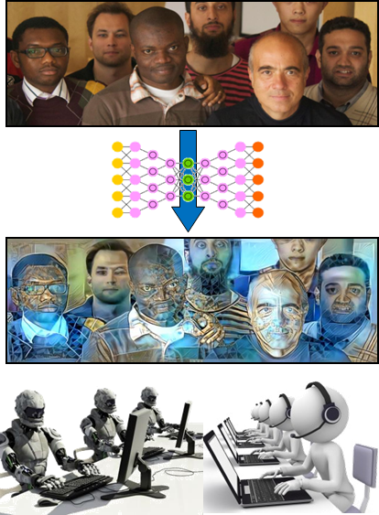
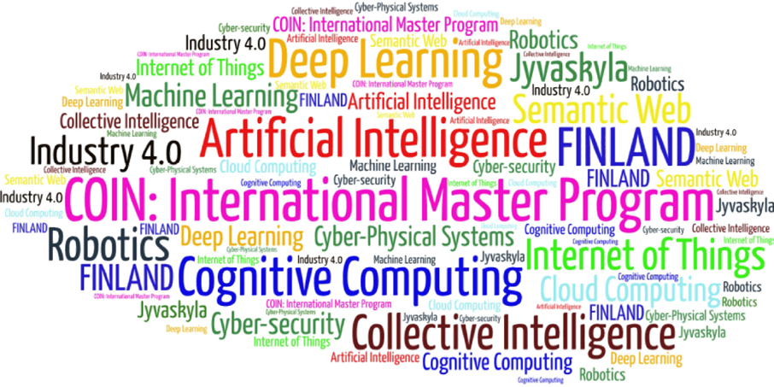
Come to study at our International Master Program
COIN: Cognitive Computing and Collective Intelligence …
… the first university program for collective intelligence, where humans learn together with their digital clones and autonomous digital assistants …
http://www.jyu.fi/ai
COIN

Slide 28
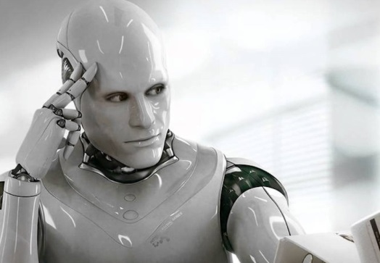
Link to the presentation: https://ai.it.jyu.fi/ISM-2021-AGI.pptx
Contact: vagan.terziyan@jyu.fi

Slide 29
Thank you!
“Artificial General Intelligence vs. Industry 4.0: Do They Need Each Other?”
Samu Kumpulainen ª , Vagan Terziyan ^{b}
^{a,b} Faculty of Information Technology, University of Jyväskylä, Jyväskylä, Finland
Contacts
ª samu.kumpulainen@gmail.com , ^{b} vagan.terziyan@jyu.fi
Link to complete slide-set:
https://ai.it.jyu.fi/ISM-2021-AGI.pptx
https://www.jyu.fi/en/

