Slide 1
“Generative Adversarial Networks with Bio-Inspired Primary Visual Cortex for Industry 4.0”
Vladyslav Branytskyi ª, Mariia Golovianko ^{b} , Diana Malyk ^{c} , Vagan Terziyan ^{d}
^{a,b,c} Department of Artificial Intelligence, Kharkiv National University of Radio Electronics, Kharkiv, Ukraine
^{d} Faculty of Information Technology, University of Jyväskylä, Jyväskylä, Finland
https://www.jyu.fi/en/
https://nure.ua/en/

Slide 2
How to cite this paper:
Branytskyi, V., Golovianko, M., Malyk, D., & Terziyan, V. (2022). Generative Adversarial Networks with Bio-Inspired Primary Visual Cortex for Industry 4.0. Procedia Computer Science, 200, 418-427. Elsevier. https://doi.org/10.1016/j.procs.2022.01.240

Slide 3
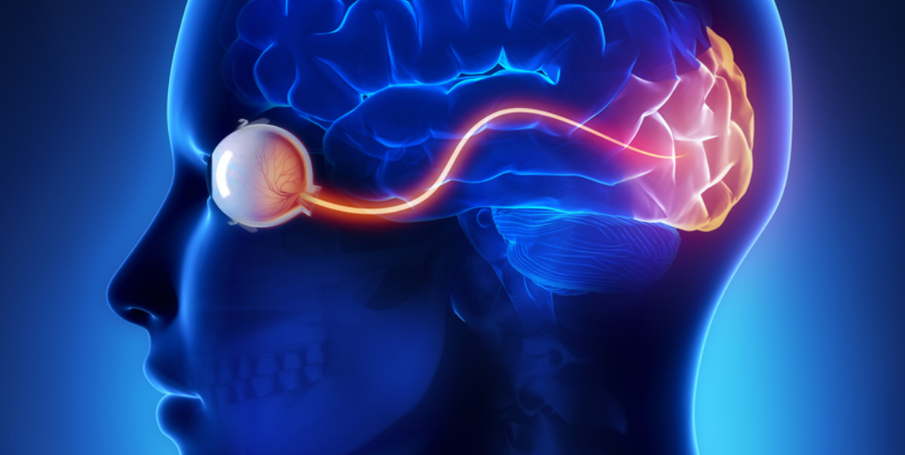
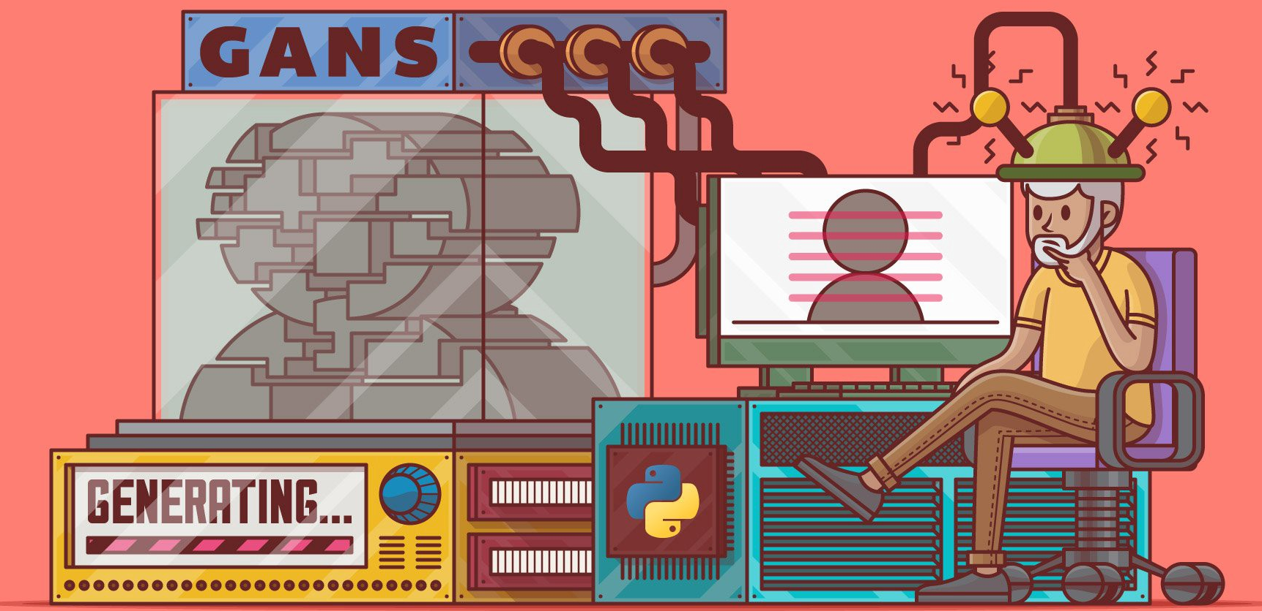
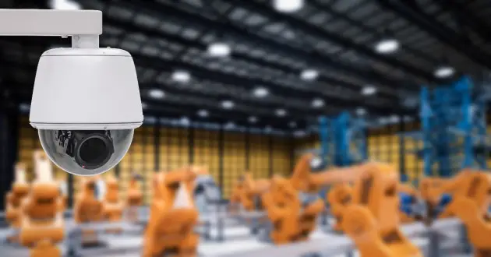
“Generative Adversarial Networks with Bio-Inspired Primary Visual Cortex for Industry 4.0”
Paper # 44
Vladyslav Branytskyi, Mariia Golovianko, Diana Malyk,
&
Vagan Terziyan
19 November, 2021, 14:35 - 14:55
Session S3.3 - BIO : Bio-Inspired Manufacturing & Ethical Aspects

Slide 4
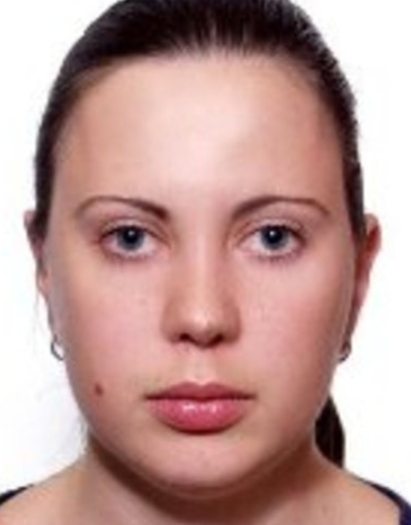
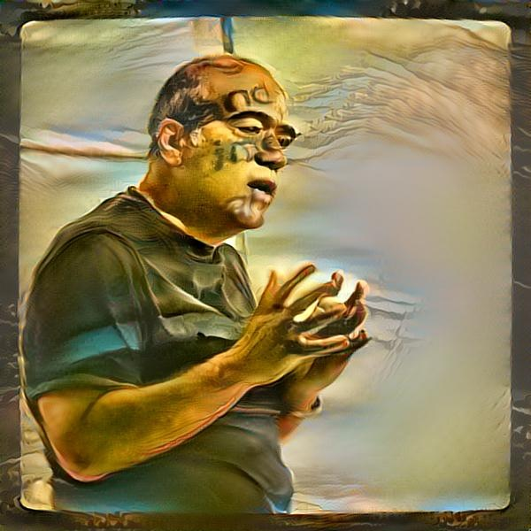
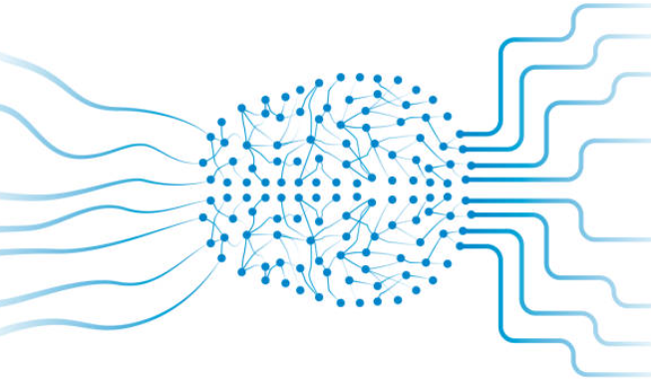
Authors
Vladyslav Branytskyi
Mariia Golovianko
Diana Malyk
“Generative Adversarial Networks with Bio-Inspired Primary Visual Cortex for Industry 4.0”
Vagan Terziyan
vagan.terziyan@jyu.fi
https://nure.ua/en/
https://www.jyu.fi/en/

Slide 6
Our inputs from ISM-2020 (a)
… Here we present a taxonomy of adversarial neural networks’ architectures, which can be used for different task of designing artificial digital immunity of intelligent systems and enable digital vaccination as a proactive protection strategy. We suggest several innovative components for the generative adversarial networks, which can be used in many other disciplines giving essential added value to the adversarial learning …
Terziyan, V., Gryshko, S., & Golovianko, M. (2021). Taxonomy of Generative Adversarial Networks for Digital Immunity of Industry 4.0 Systems. Procedia Computer Science, 180, 676-685. Elsevier. https://doi.org/10.1016/j.procs.2021.01.290

Slide 7
Our inputs from ISM-2020 (b)
… Here we reported the set of successful experiments done within the project laboratory of logistics and related to project objectives: (a) modelling adversarial attacks on intelligent system via corrupting camera images and (b) automatic generating digital vaccine (special images) for retraining and protection of the system. The analogy has been also reported between the tasks of the digital immunity design and the digital cloning of humans …
Golovianko, M., Gryshko, S., Terziyan, V., & Tuunanen, T. (2021). Towards Digital Cognitive Clones for the Decision-Makers: Adversarial Training Experiments. Procedia Computer Science, 180, 180-189. Elsevier. https://doi.org/10.1016/j.procs.2021.01.155

Slide 8
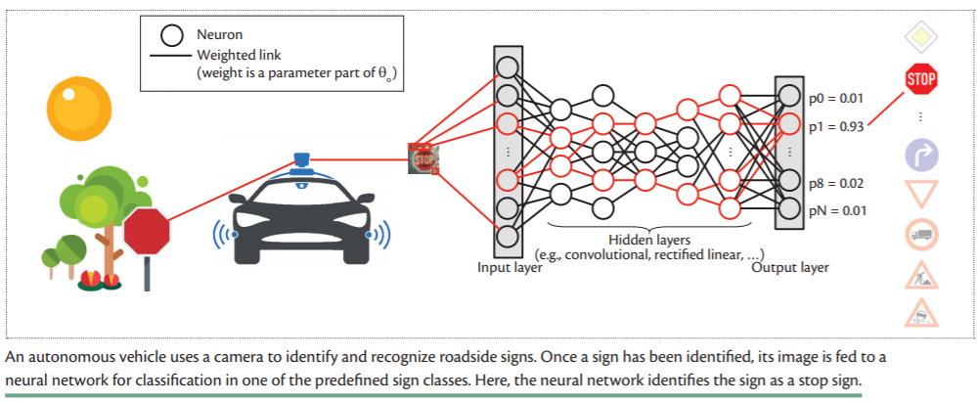
(Deep Convolutional) Neural Network is making decisions (can we trust them; could the network be attacked ?)

Slide 9
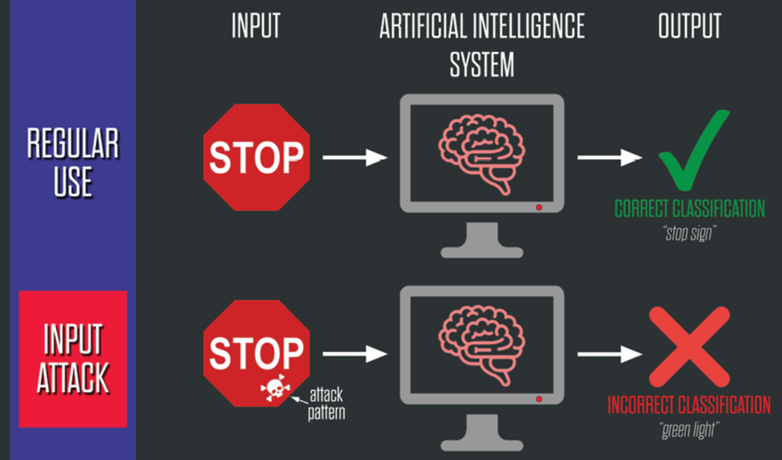
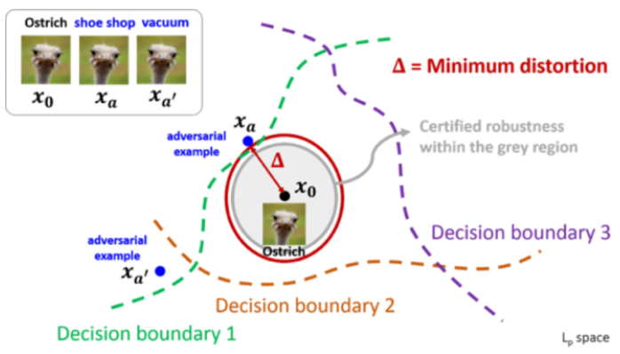
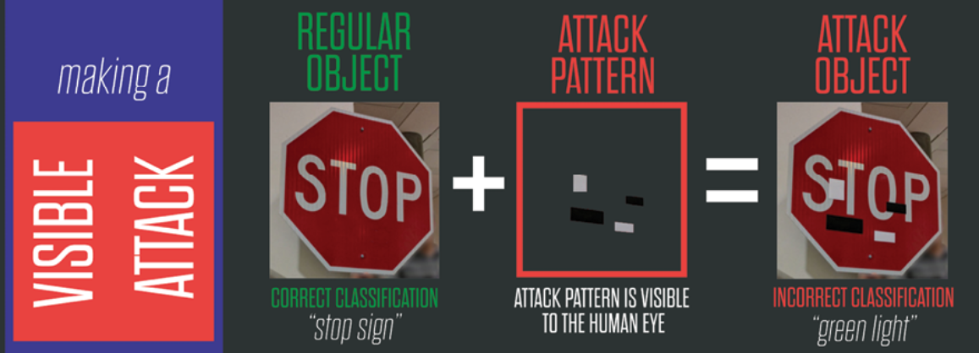
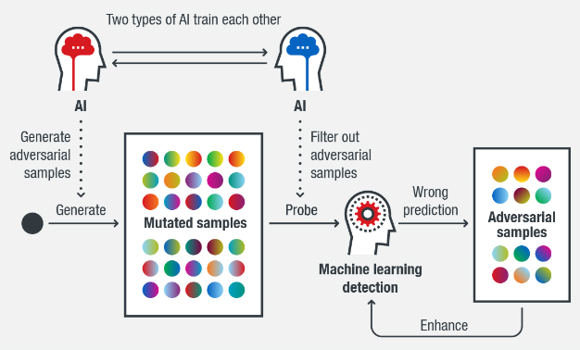
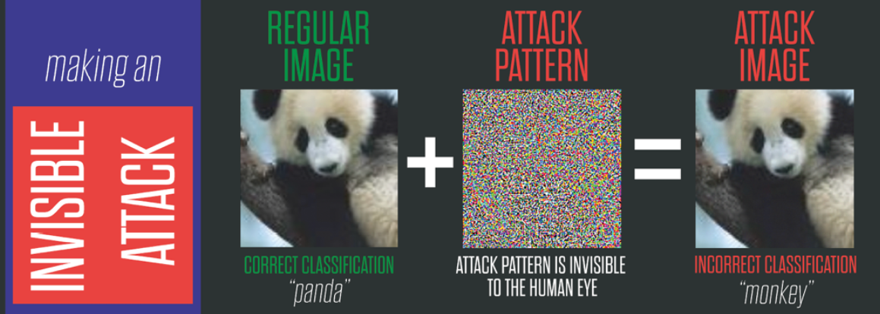
EVASION ATTACK
Evasion attack
https://www.belfercenter.org/publication/AttackingAI

Slide 10
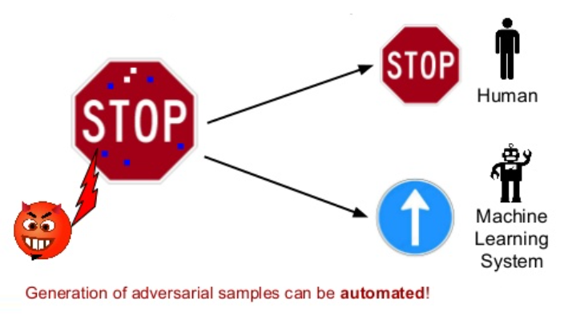
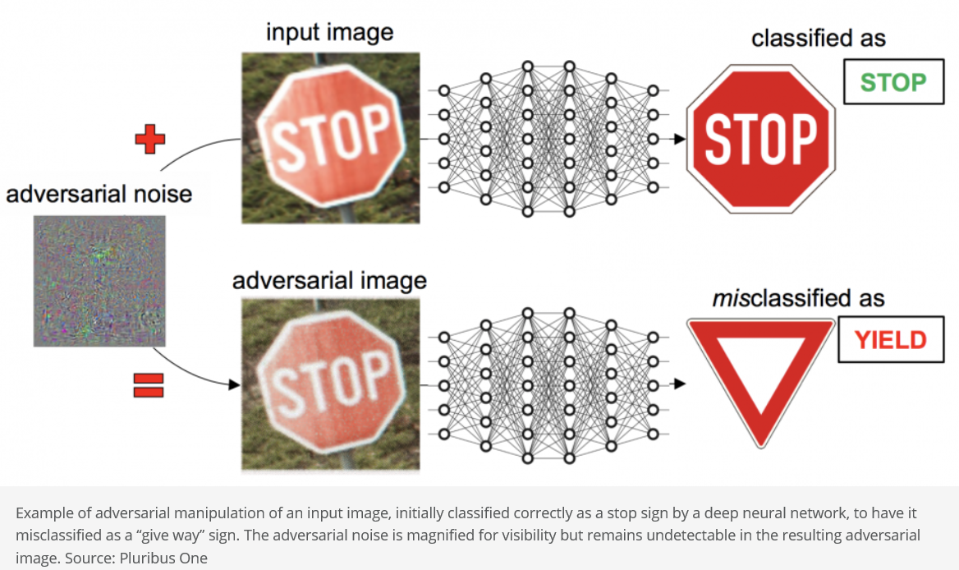
Evasion attacks with “adversarial samples” are able to fool Convolutional Neural Network based visual recognition models …
Visible attack
Invisible attack
adversarial pattern
patterns
Adversarial samples from an evasion attack are “toxic” for a Machine Learning system (e.g., Convolutional Neural Network) but not for a human, which means that human’s visual recognition systems is more resilient against evasion attacks …

Slide 11
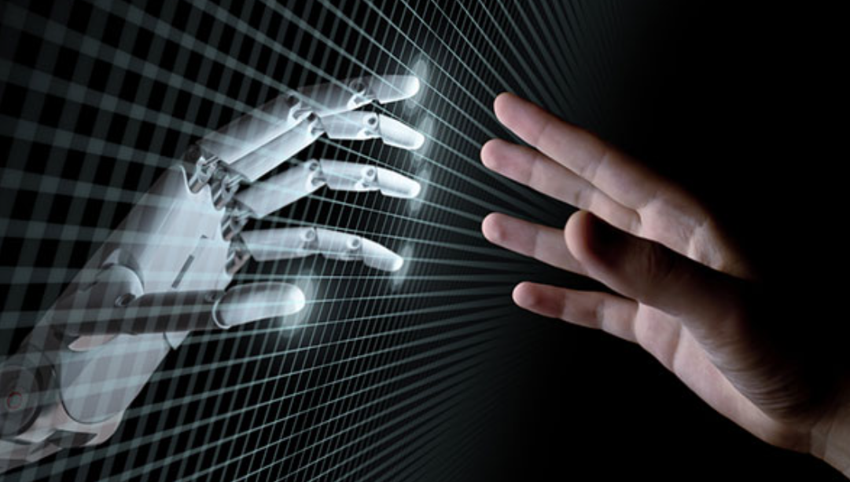
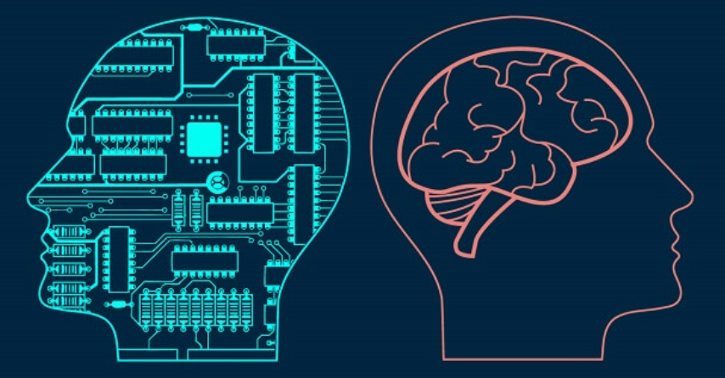
… AI + Human hybrid architecture is needed
Adversarial samples from an evasion attack are “toxic” for a Machine Learning system (e.g., Convolutional Neural Network) but not for a human, which means that human’s visual recognition systems is more resilient against evasion attacks …
… therefore, we can expect that adding some “human visual recognition features” to the traditional Convolutional Neural Network architecture may increase its resilience against evasion attacks …

Slide 12
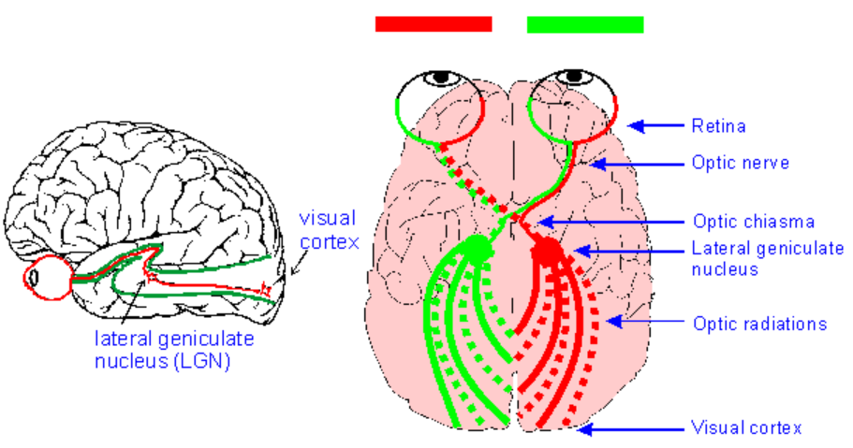
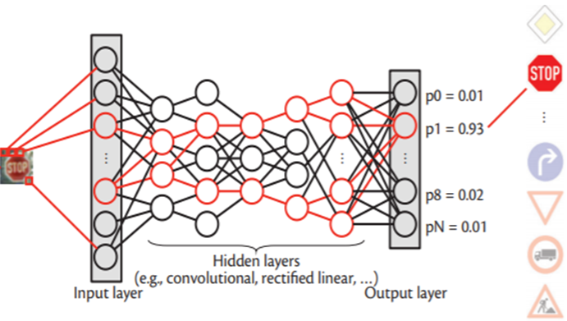
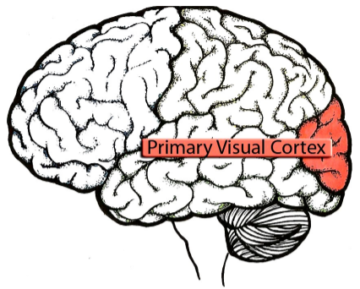
… AI + Human hybrid architecture is needed:
what about human’s primary visual cortex ?
Primary Visual Cortex:
Subdivision of the cortex located at the back of the brain, which analyses information from the retina in order to begin to reconstitute the image perceived by the eye …
+

Slide 13
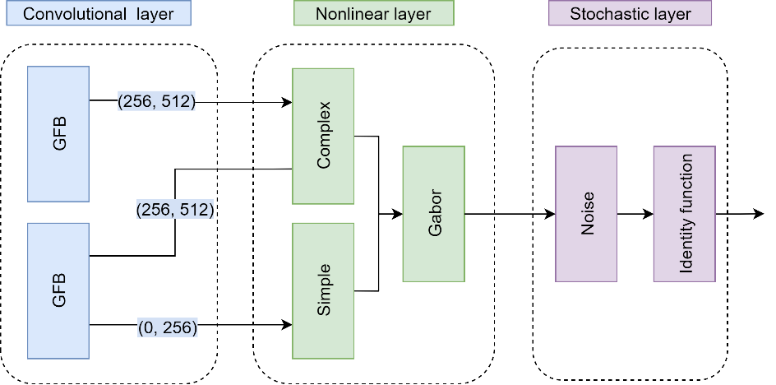
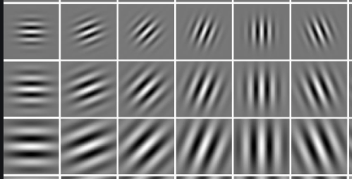
Primary visual cortex (V1) as a convolutional neural network
Recently, convolutional neural networks (CNNs) have been used as a powerful tool to solve many problems of machine learning and computer vision. V1 enhanced CNN model uses Gabor filters to improve the performance of traditional CNN architectures.
VOneNet (V1) consists of:
A convolutional layer – a Gabor Filter Bank (GFB) of Gabor filters with fixed weights constrained by empirical data. It convolves the RGB input images with Gabor filters considerably more heterogeneous than those found in standard CNNs.
A nonlinear layer (applying rectified linear transformation for simple cells, and spectral power of a quadrature phase-pair for complex cells).
A stochastic layer (a “stochasticity” generator with variance equal to mean).
Dapello, J., Marques, T., Schrimpf, M., Geiger, F., Cox, D. D., & DiCarlo, J. J. (2020). Simulating a primary visual cortex at the front of CNNs improves robustness to image perturbations. BioRxiv. https://www.biorxiv.org/content/biorxiv/early/2020/10/22/2020.06.16.154542.full.pdf
In image processing, a Gabor filter is used for texture analysis, which essentially means that it analyzes whether there is any specific frequency content in the image in specific directions in a localized region around the point of analysis. Image analysis with Gabor filters is thought by some to be similar to perception in the human visual system.
“… VOneNets improve robustness to all adversarial attacks tested and many common image corruptions, and they accomplish this with no additional training overhead …”

Slide 14
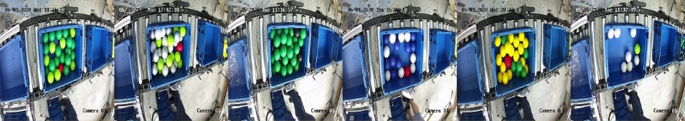
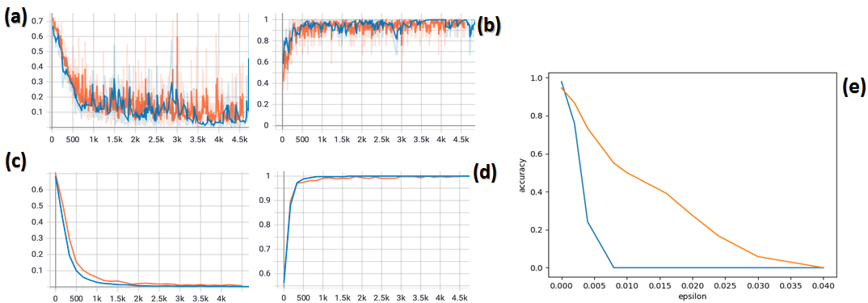
We have checked the quality and robustness of the hybrid (V1-enhanced CNN) within the industrial laboratory settings
ResNet-50 CNN
Performance evaluation of the hybrid CNN (ResNet-50 model combined with V1 network) recognizing objects in the industrial inter-roll conveyor system. Blue line – pure ResNet-50 model, orange line – V1+ResNet-50 model. (a) loss on training dataset; (b) top-1 accuracy on training dataset; (c) loss on validation set; (d) top-1 accuracy on validation dataset; (e) adversarial accuracy of the classifier under perturbation attack with different values of perturbation denoted as “epsilon”.

Slide 15
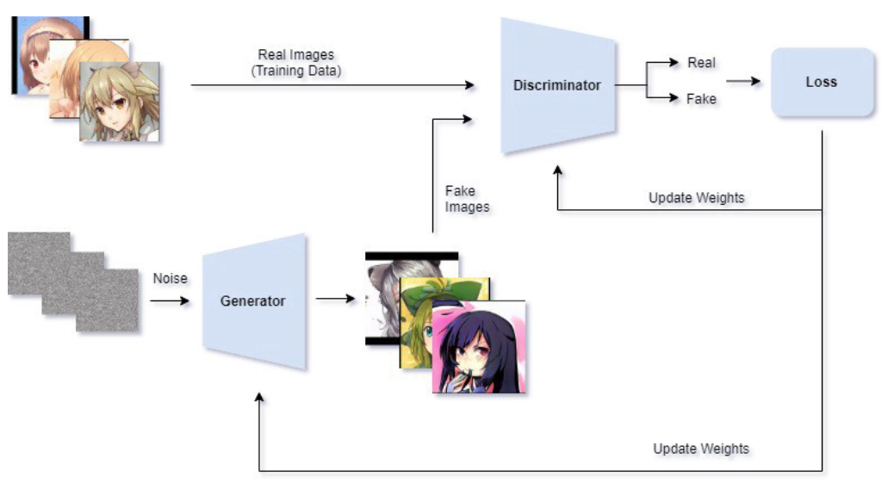
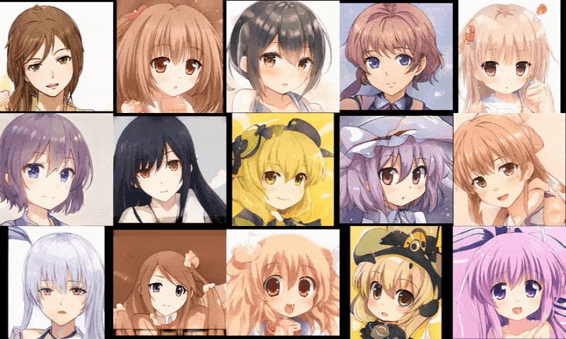
Generative Adversarial Networks (GANs) is a groundbreaking invention in Machine Learning, which can be used for realistically looking (“fake” or “adversarial”) images’ generation
Real images
Generated fakes
Fake images

Slide 16
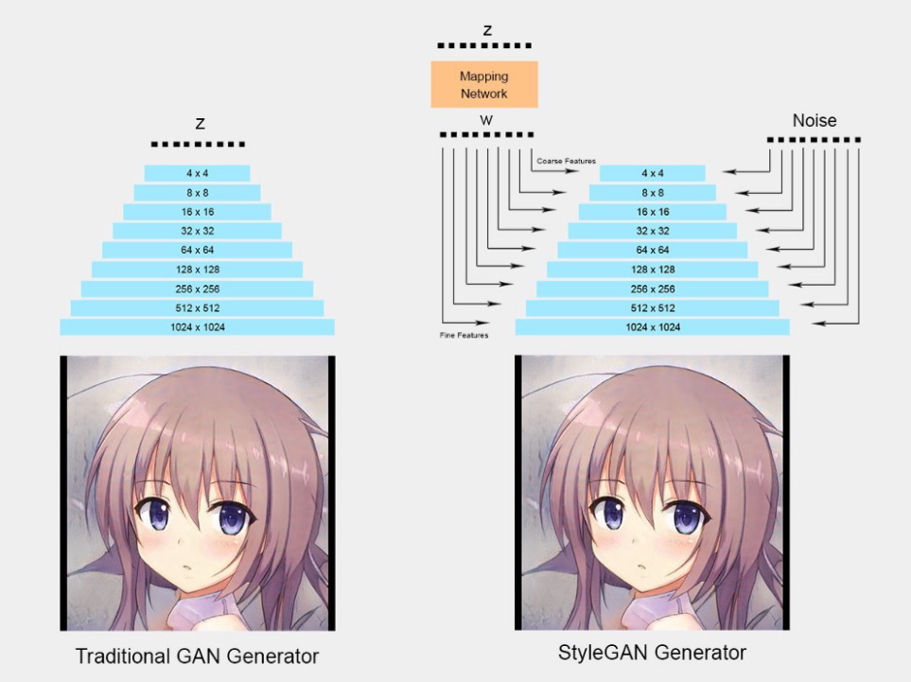
Advanced GAN architecture (StyleGAN) – enables very high quality fakes
In 2018, NVIDIA published a groundbreaking paper that manages to generate high-quality images (1024x1024) titled “A Style-Based Generator Architecture for Generative Adversarial Networks”. One of the novelty is that it disentangles the latent space which allows us to control the attributes at a different level. For example, the lower layer would be able to control the pose and head shape while the higher layer control high level features such as the lighting or texture.
The disentanglement is done by introducing an additional mapping network that maps the input z (noise/random vector sampled from a normal distribution) to separate vector w and feed it into different levels of the layers. Hence, each part of the z input control a different level of features

Slide 17
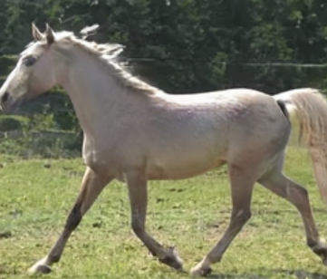
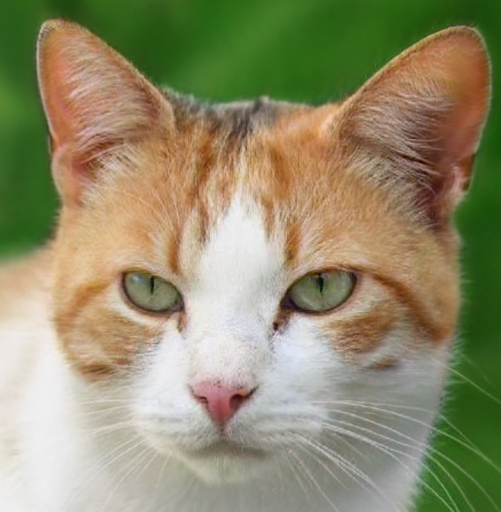
These people (and animals) do not exist; they are
just “invented” by Generative Adversarial Network (StyleGAN2)
https://thispersondoesnotexist.com/

Slide 18
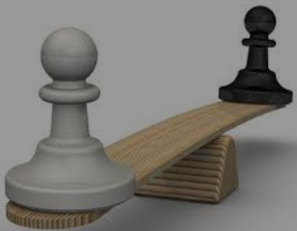
GAN is trained to reach the balance of “power” between Generator and Discriminator, therefore, by making one of them stronger we automatically get the other one stronger too …
Generator
Discriminator
VS

Slide 19
Therefore, our hypothesis, which motivated this study was as follows:
“If to enhance the architecture of the Discriminator (within some popular GAN architectures) with the Primary Visual Cortex (V1) (i.e., make CNN+V1 hybrid as the Discriminator), then we may expect that the Generator (while training to reach the balance with the stronger Discriminator) will also improve its performance in generating high quality images“.

Slide 20
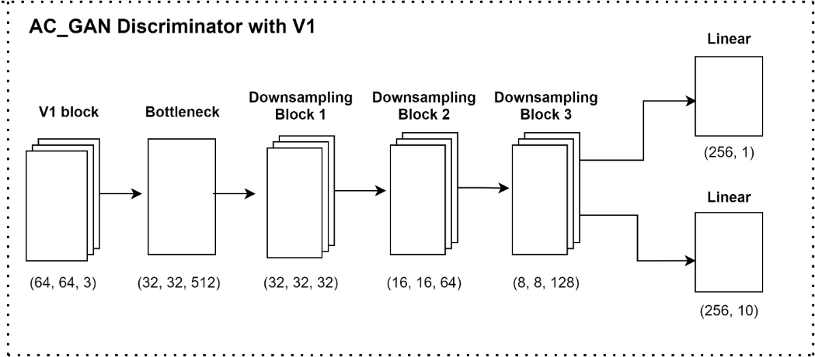
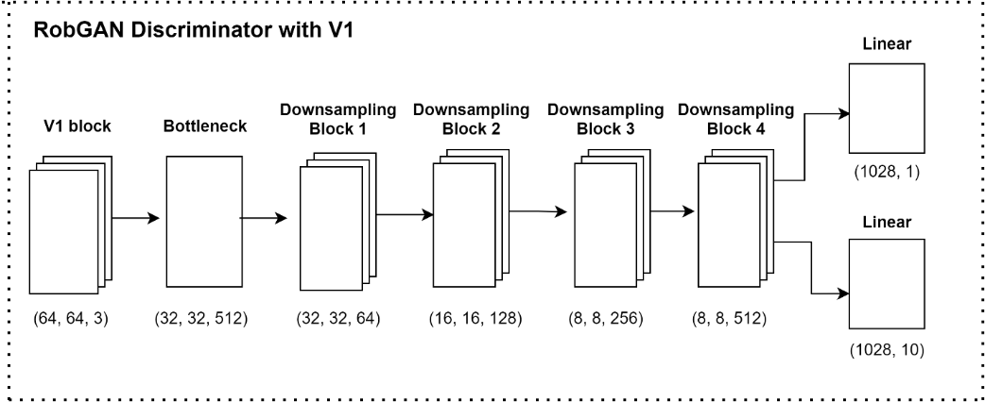
We have enhanced discriminators within two popular GAN architectures (AC_GAN and RobGAN)
AC_GAN:
Odena, A., Olah, C., & Shlens, J. (2017). Conditional Image Synthesis with Auxiliary Classifier GANs. In: Proceedings of the International Conference on Machine Learning (pp. 2642-2651). PMLR.
RobGAN:
Liu, X., & Hsieh, C. J. (2019). Rob-GAN: Generator, Discriminator, and Adversarial Attacker. In: Proceedings of the IEEE/CVF Conference on Computer Vision and Pattern Recognition (pp. 11234-11243).

Slide 21
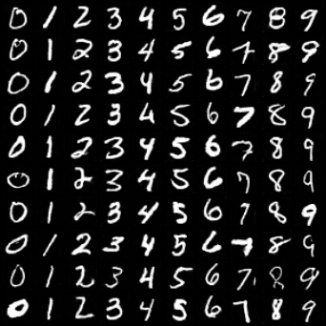
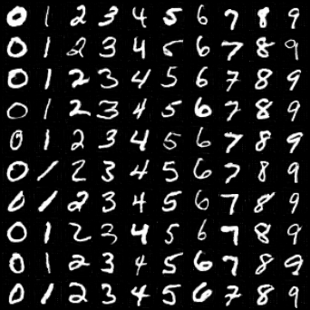
GAN vs. GAN+V1 experiments: image generation
Newly generated images by GAN trained with a 64 channels CNN in the discriminator during 220 epochs on CIFAR-10 dataset: (left) RobGAN vs. (right) V1+RobGAN.
The CIFAR-10 dataset consists of 60000 32x32 color images in 10 classes, with 6000 images per class.
Newly generated images by GAN trained with a 32 channels CNN in the discriminator during 220 epochs on MNIST dataset: (left) RobGAN vs. (right) V1+RobGAN.
The MNIST dataset consists of 60000 28x28 grayscale images of handwritten digits in 10 classes, with 6000 images per class.

Slide 22
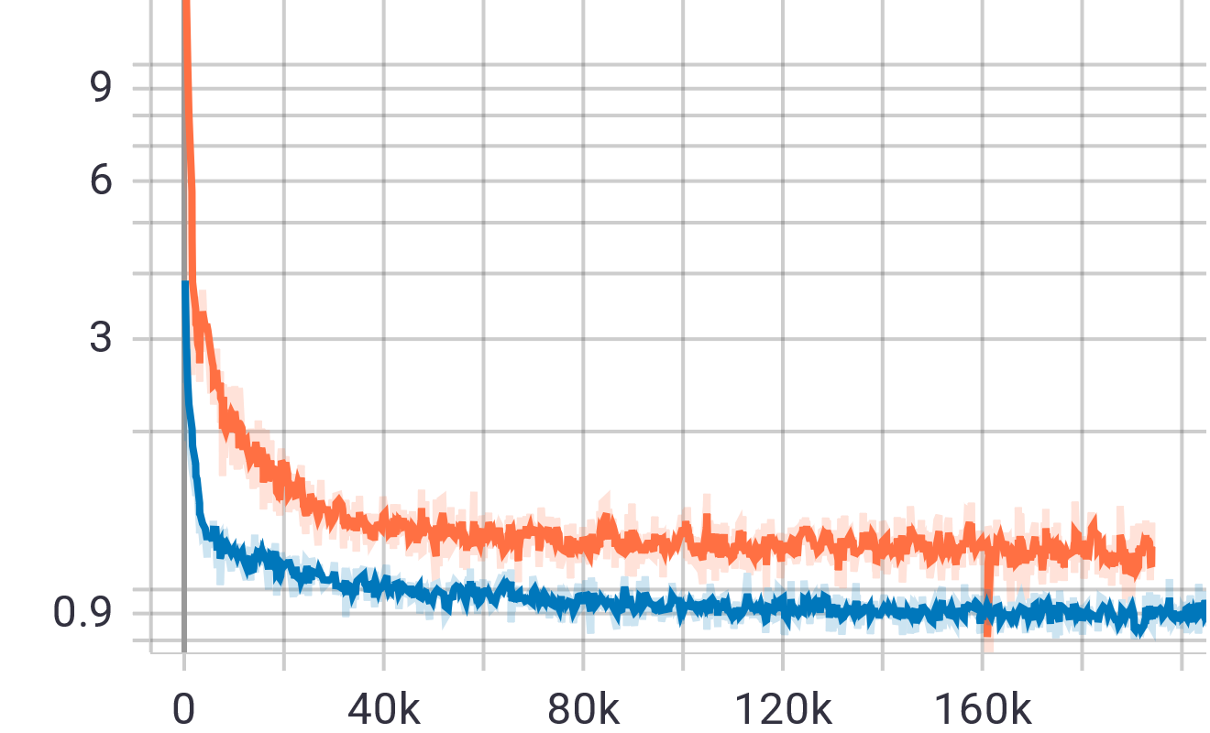
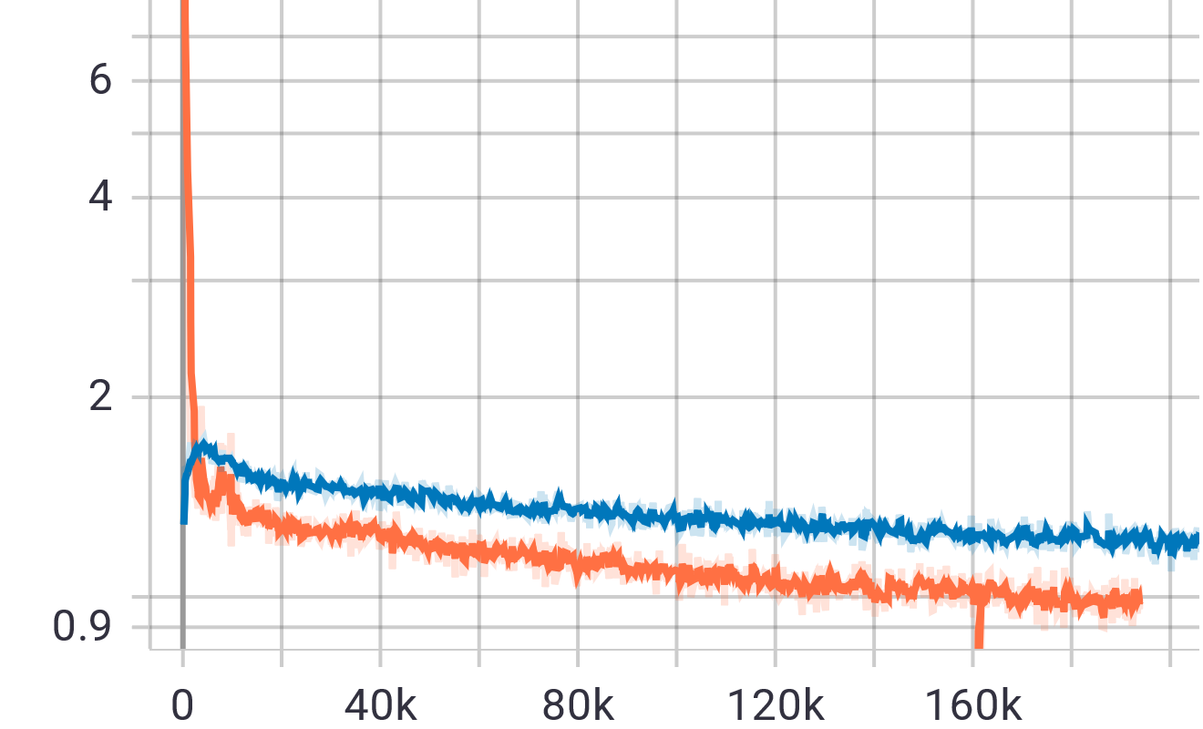
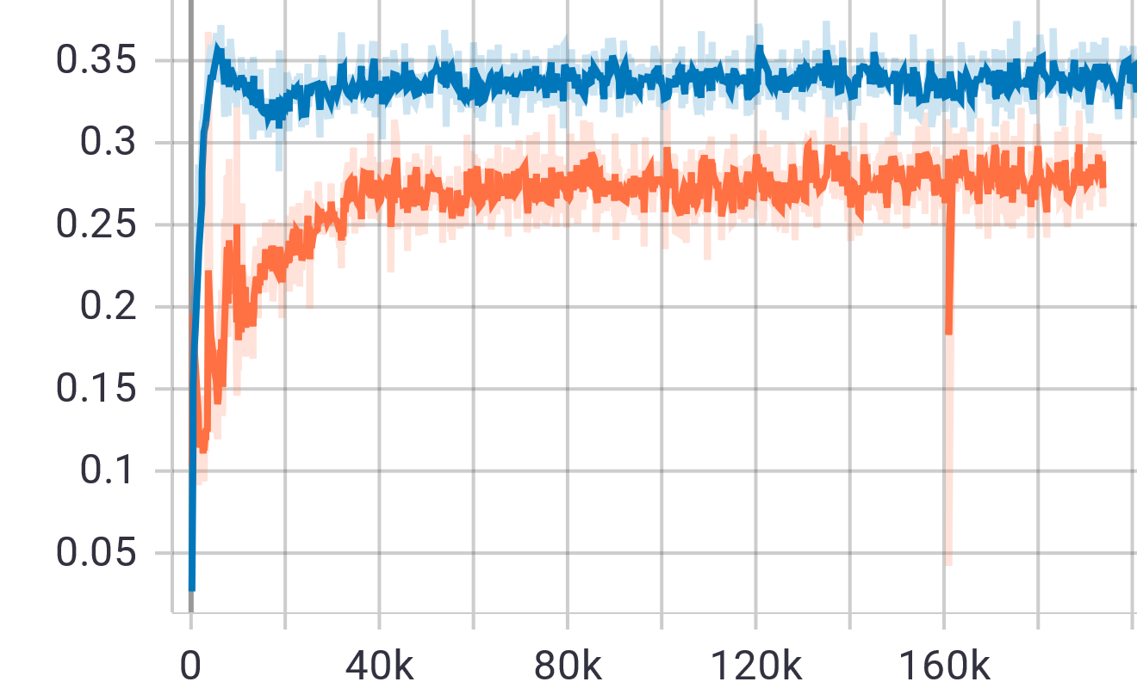
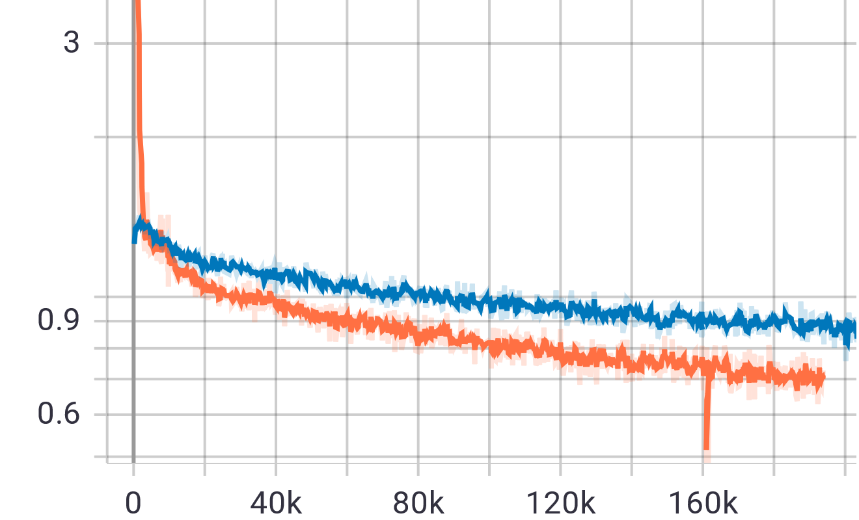
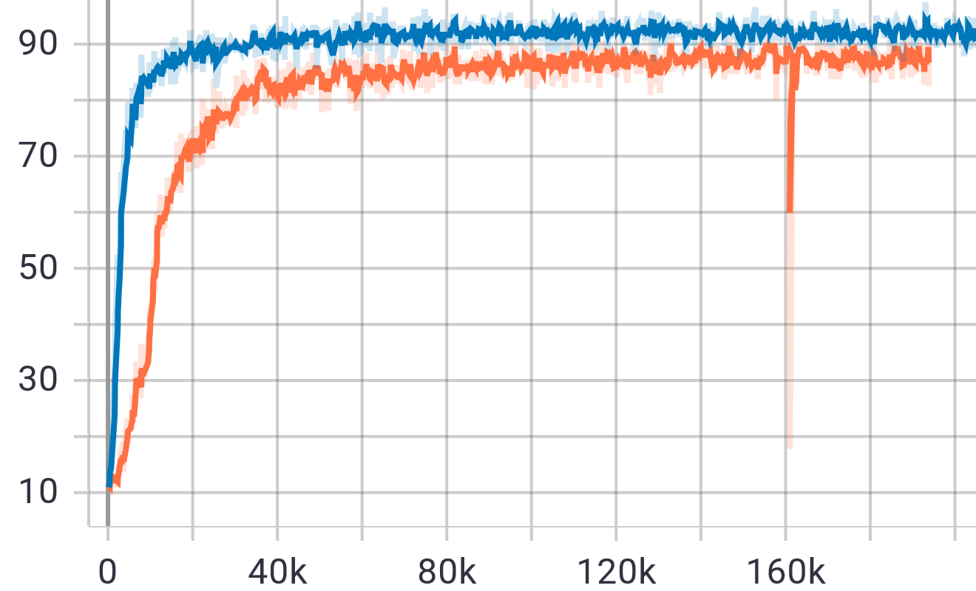
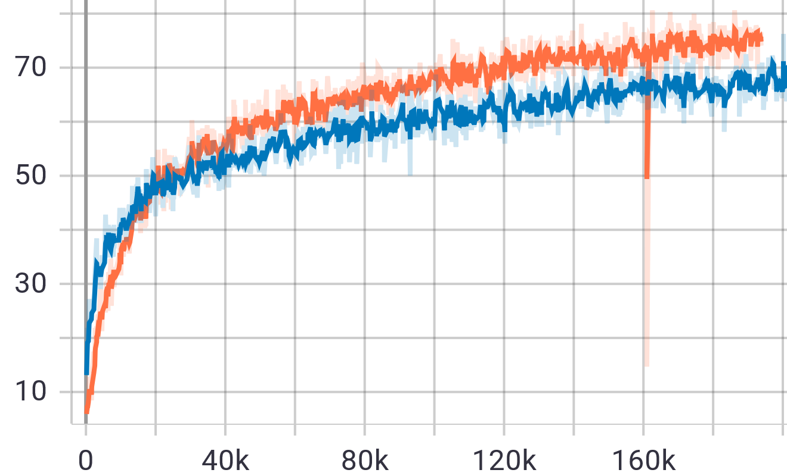
GAN vs. GAN+V1 experiments: comparing stability of the training processes according to the key training metrics
a
b
c
d
e
f
The key training metrics of pure RobGAN (blue line) and V1+RobGAN (orange line) on CIFAR10 dataset. V1+RobGAN demonstrates improved classification accuracy on the original data under attack, that indicates an increased robustness to the perturbation of Discriminator over a number of training iterations. There is a small gap in the classification accuracy on the generated data due to the stronger Generator. (a) Generator loss. (b) Discriminator loss. (c) Discriminator loss on generated images. (d) Discriminator loss on original images with adversarial perturbation. (e) Classification accuracy on generated examples. (f) Classification accuracy on original examples with adversarial perturbation.

Slide 23
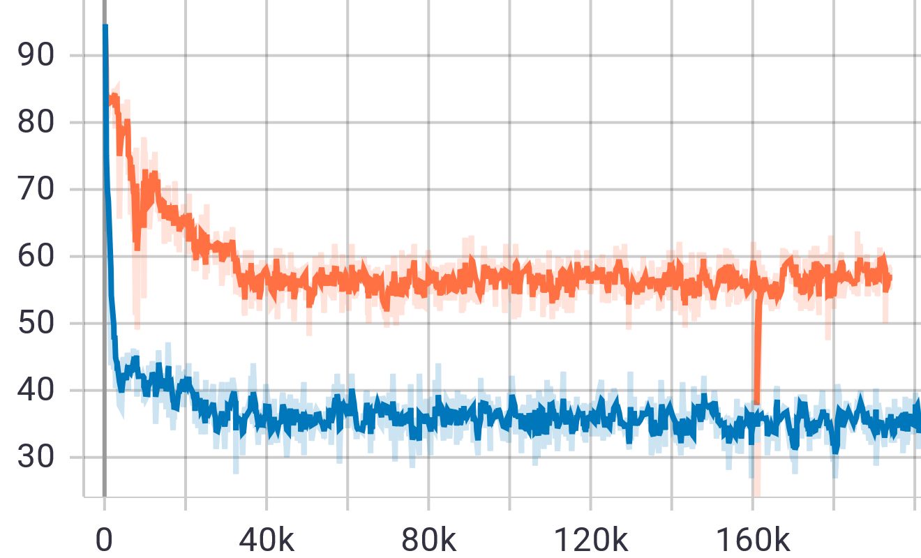
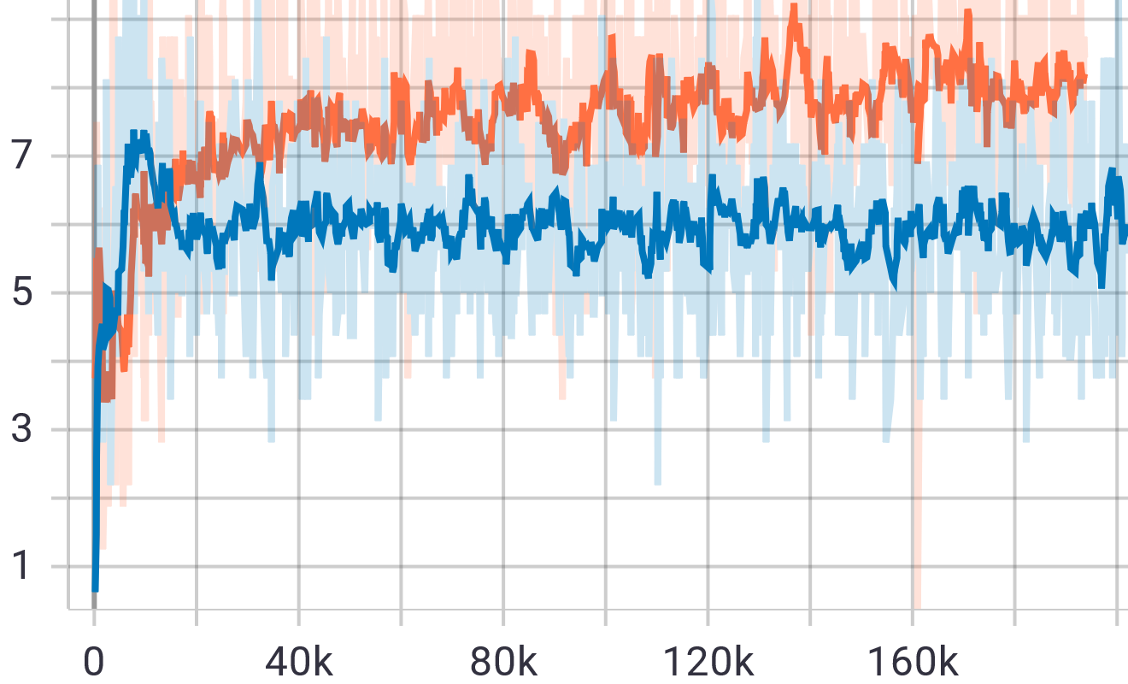
GAN vs. GAN+V1 experiments: comparing binary accuracy as a measure of skill to distinguish between pertrubated and generated images
The comparison of binary accuracy values confirm the improved ability of V1+RobGAN (orange line) on CIFAR10 dataset to distinguish between pertrubated original samples and generated samples over the pure RobGAN (blue line). Left: Binary accuracy on original but pertrubated images over a number of iterations. Right: Binary accuracy on generated images over a number of iterations.

Slide 24
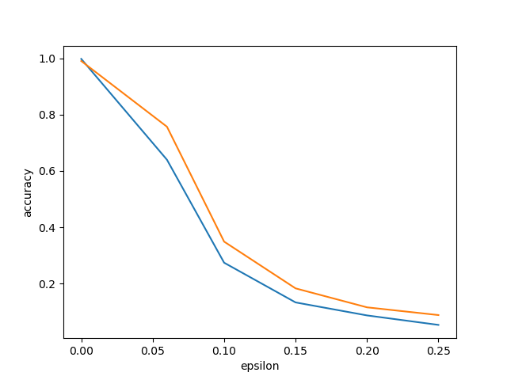
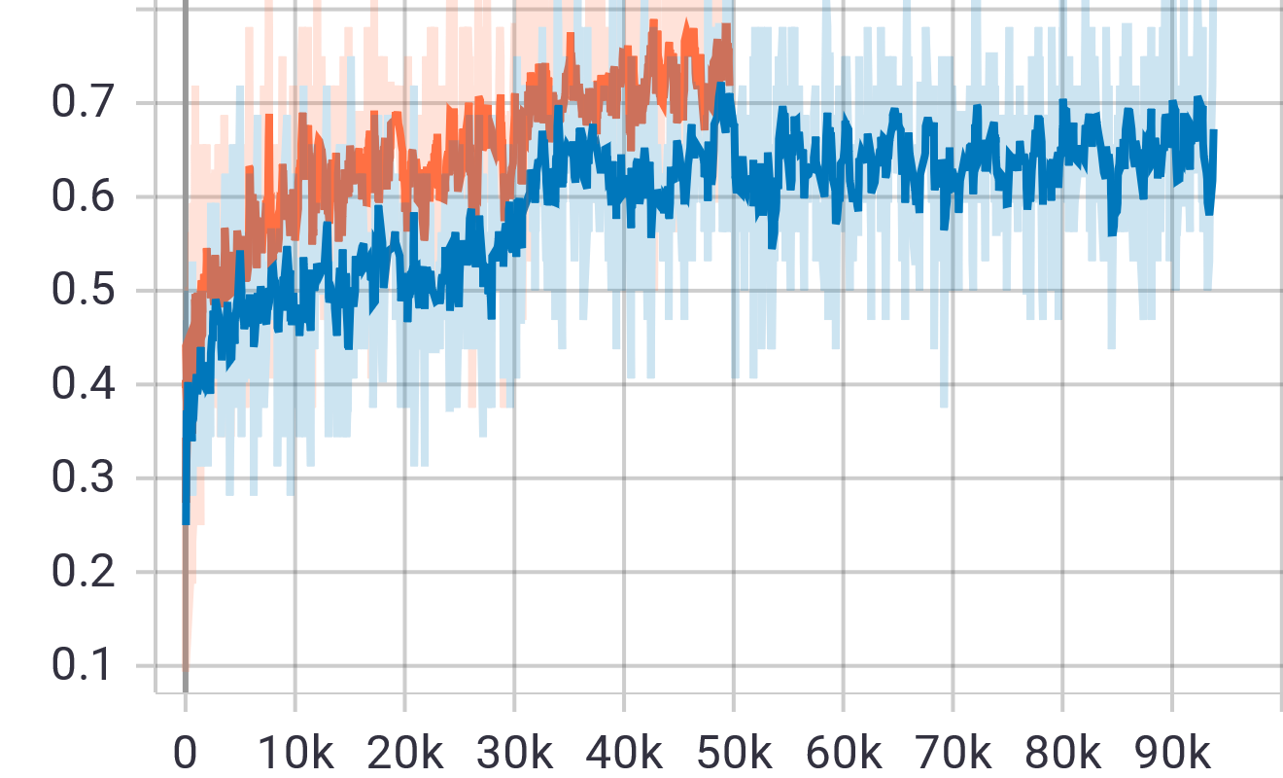
GAN vs. GAN+V1 experiments: comparing adversarial robustness
Adding the third component (Adversarial Attacker) to GAN, we train both Generator and Discriminator in the wider adversarial context: the Generator feeds generated images to the Discriminator; meanwhile real images sampled from training set are pertrubated by the Adversarial Attacker before sending to the Discriminator. Such adversarial training is used to improve the robustness of the Discriminator (also it increases the convergence speed and leads to better Generators). Consequently the robust auxiliary classifier can be extracted from the Discriminator to classify images independently from GAN.
Achieving better adversarial robustness of the V1+CNN Discriminator after fine-tuning on CIFAR10 dataset. Left: Evaluation of Classification accuracy during the fine-tuning of V1+RobGAN (orange line) over a number of iterations and retraining pure RobGAN (blue line). Right: Comparison of V1+RobGAN (orange line) and pure RobGAN (blue line) under adversarial perturbation attack with different values of perturbation denoted as “epsilon”.

Slide 25
Conclusions and future work:
Image classification (classification accuracy, performance, robustness and resilience against adversarial attacks) can be improved by enhancing traditional Convolutional Neural Network Models with some human visual recognition features (such as Primary Visual Cortex – V1);
Enhanced Discriminator component of our VOneGAN architecture (Generative Adversarial Network + V1) will have positive affect also on the performance of Generator component;
Stability of GANs’ training process can be improved by using V1-enhanced Discriminator (VOneGANs provide stability while training and robustness when trained);
Our previous results on cloning human cognitive skills (where GAN architecture is an important component) could be potentially improved by using bio-inspired GANs (VOneGANs);
Our previous results on generating “digital vaccine” to enable digital immunity of AI-driven systems could be potentially improved by using VOneGANs where the [“vaccine”] Generator will have better performance;
VOneGANs could improve other existing GAN-driven Industry 4.0 applications in comparison to existing pure GANs architectures.

Slide 26
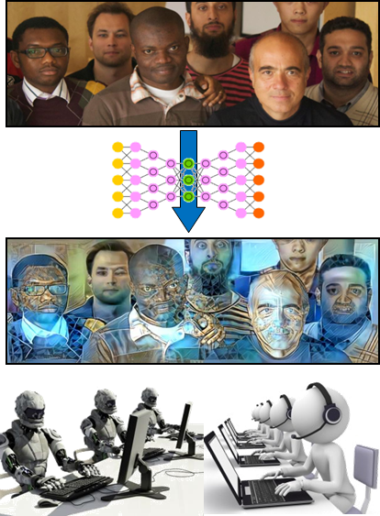
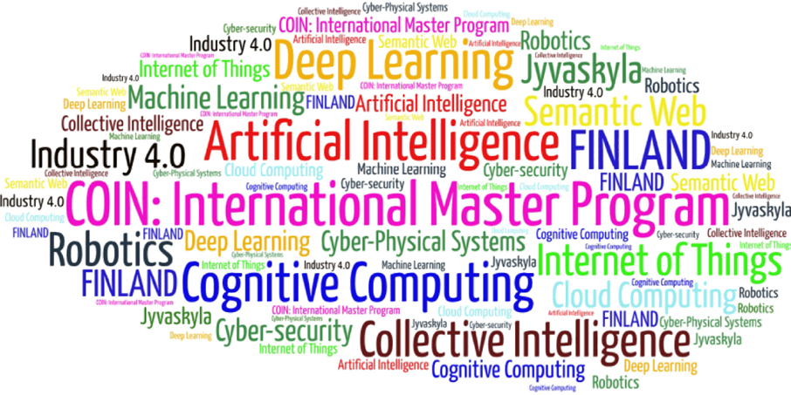
Come to study at our International Master Program
COIN: Cognitive Computing and Collective Intelligence …
… the first university program for collective intelligence, where humans learn together with their digital clones and autonomous digital assistants …
http://www.jyu.fi/ai
COIN

Slide 27
Link to the presentation: https://ai.it.jyu.fi/ISM-2021-V1-GAN.pptx
Contact: mariia.golovianko@nure.ua

Slide 28
Thank you!
“Generative Adversarial Networks with Bio-Inspired Primary Visual Cortex for Industry 4.0”
Vladyslav Branytskyi ª, Mariia Golovianko ^{b} , Diana Malyk ^{c} , Vagan Terziyan ^{d}
^{a,b,c} Department of Artificial Intelligence, Kharkiv National University of Radio Electronics, Kharkiv, Ukraine
^{d} Faculty of Information Technology, University of Jyväskylä, Jyväskylä, Finland
Contacts
ª vladyslav.branytskyi@nure.ua , ^{b} mariia.golovianko@nure.ua , ^{c} diana.malyk@nure.ua , ^{d} vagan.terziyan@jyu.fi
Link to complete slide-set:
https://ai.it.jyu.fi/ISM-2021-V1-GAN.pptx
https://www.jyu.fi/en/
https://nure.ua/en/

