Slide 1
“Explainable AI for Industry 4.0: Semantic Representation of Deep Learning Models”
Vagan Terziyan ª, Oleksandra Vitko ^{b}
ª Faculty of Information Technology, University of Jyväskylä, Jyväskylä, Finland
^{b} Department of Artificial Intelligence, Kharkiv National University of Radio Electronics, Kharkiv, Ukraine
https://www.jyu.fi/en/
https://nure.ua/en/

Slide 2
How to cite this paper:
Terziyan, V., & Vitko, O. (2022). Explainable AI for Industry 4.0: Semantic Representation of Deep Learning Models. Procedia Computer Science, 200, 216-226. Elsevier. https://doi.org/10.1016/j.procs.2022.01.220

Slide 3
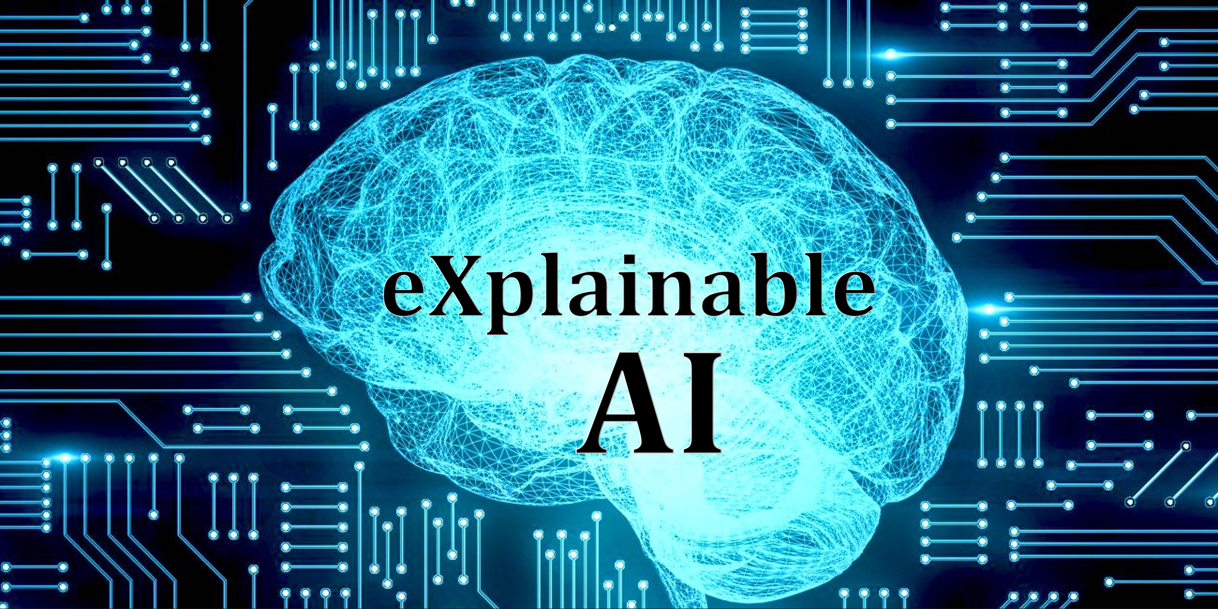
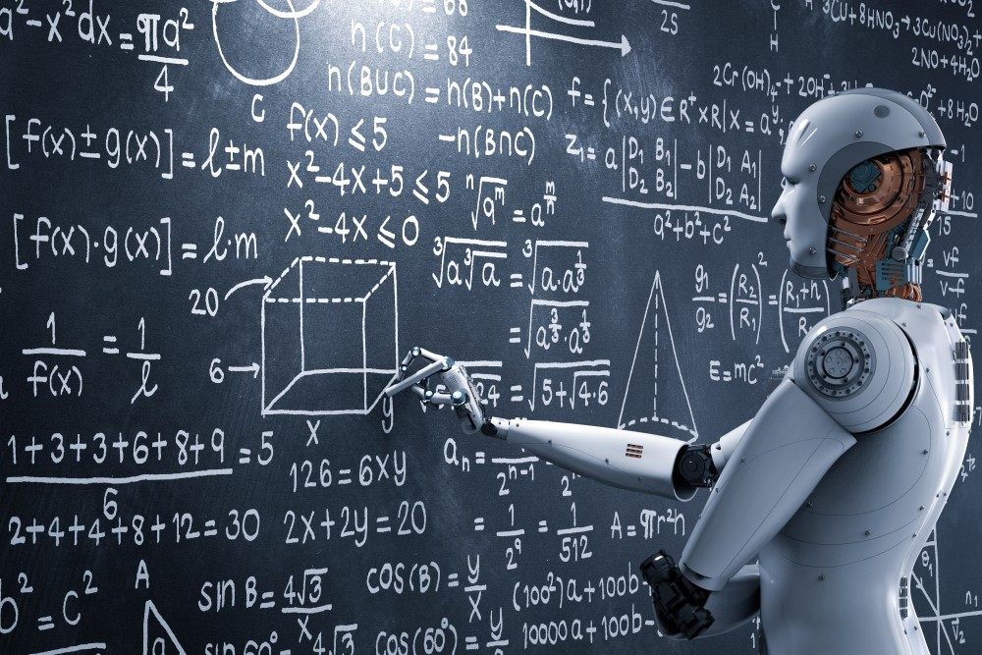
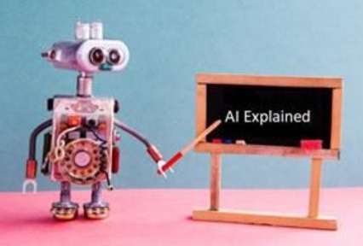
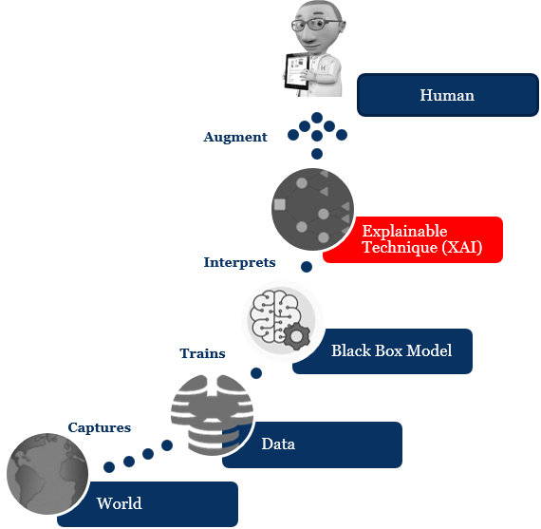
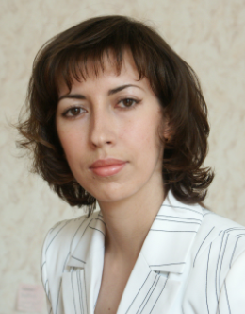
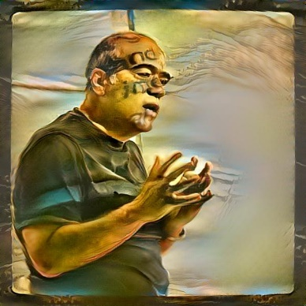
“Explainable AI for Industry 4.0: Semantic Representation of Deep Learning Models”
Paper # 24
Vagan Terziyan
Vagan Terziyan
&
Oleksandra Vitko
Oleksandra Vitko
vagan.terziyan@jyu.fi
18 November, 2021, 9:30 - 9:50
Session S1.1 - exAI : Explainable Artificial Intelligence

Slide 4
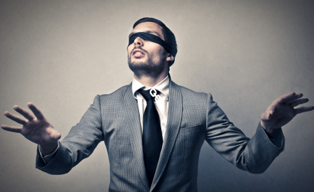
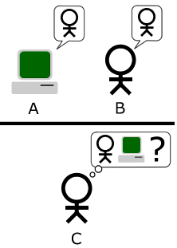
Problems with the Deep Learning (… or do not expect too much from the Neural Networks! …)
What for “Deep learning”:
AI ≠ NNs
Discovery and interpretation
vs.
Interpolation/approximation ?
“People do not memorize data and then look that data up when asked. AI, to me at least, is about modeling human intelligence, not effective data processing.” [Roger Schank]
Neural networks are too much of a black box. It makes them difficult to train: the training outcome can be nondeterministic and depend crucially on the choice of initial parameters. It makes them hard to determine how they are solving a problem. It makes them difficult to troubleshoot when they don't work as you expect. You will never really feel confident that they will generalize well to data not included in your training set because, fundamentally, you don't understand how your network is solving the problem. … Any automatically trained net with more than a few dozen neurons is virtually impossible to analyze and understand. One can't tell if a net has memorized inputs, or is 'cheating' in some other way. A promising use for neural nets these days is to predict the stock market. Even though initial results are extremely good, investors are leery of trusting their money to a system that nobody understands. [https://www.quora.com/What-are-the-pros-and-cons-of-neural-networks-from-a-practical-perspective ]

Slide 5
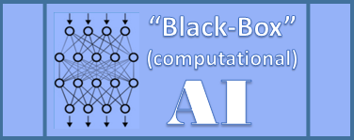
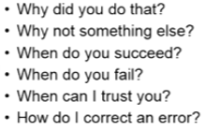
The Deep Learning -related problem:
… lack of explainability! …
Deep Neural Nets
Users and their concerns
PROS: Deep Learning models (i.e., deep Neural Networks) is a popular tool for Smart Manufacturing nowadays because they do their job (classification, diagnostics, forecasting) with high accuracy and generalization performance (better than any of the explainable models, such as, e.g., Decision Trees …).
CONS: However, neural networks cannot yet address important concerns of the users, if a user wants to understand: why the model has made a particular decision, diagnosis or prediction; could this decision be trusted; could just this decision be a failure, etc. …

Slide 6
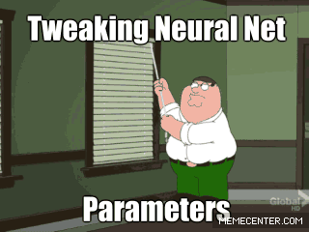
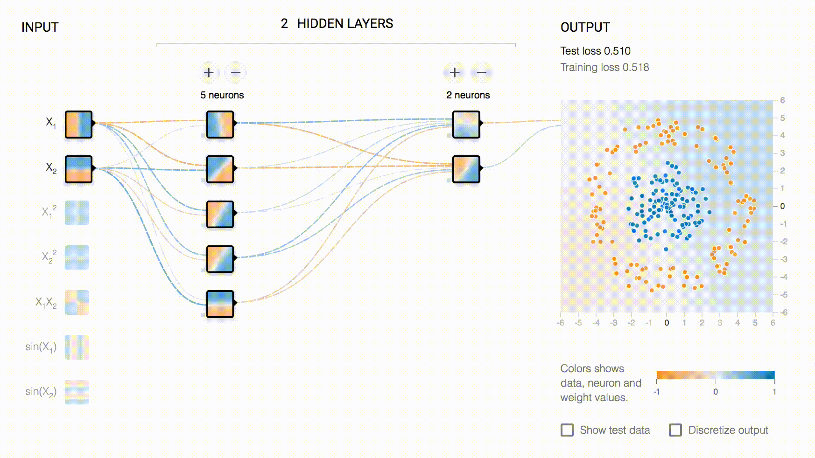
… even a data scientist often trains a neural network without understanding why a particular configuration would work …

Slide 7
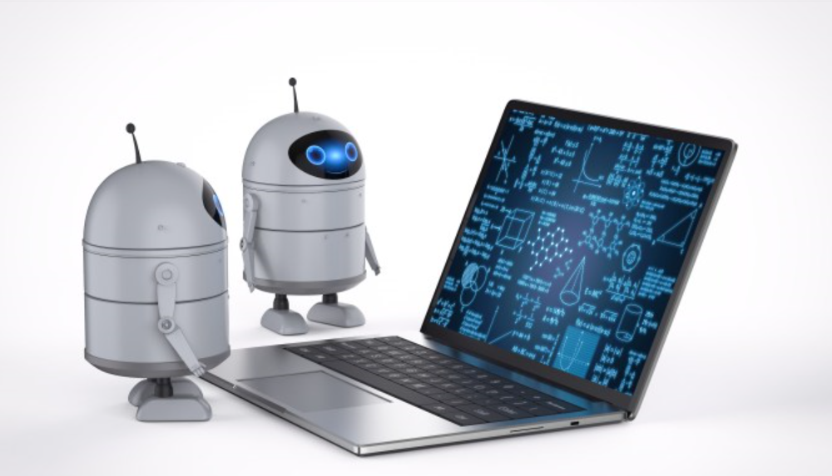
Need for Explainable Artificial Intelligence
Neural network models lack interpretability and, therefore, trust …
… However, trust is a critical factor if the models are used to manage processes, e.g., within critical infrastructure or sensitive healthcare processes or financial risk assessments and decision-making … etc.
XAI

Slide 8
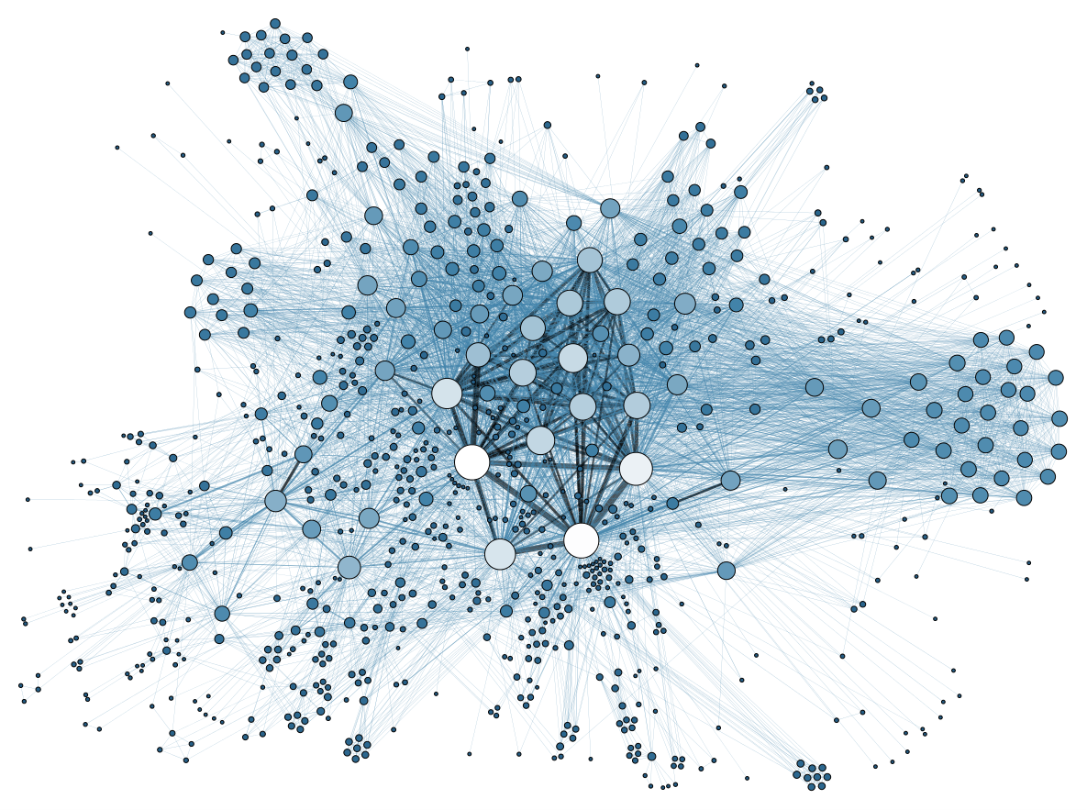
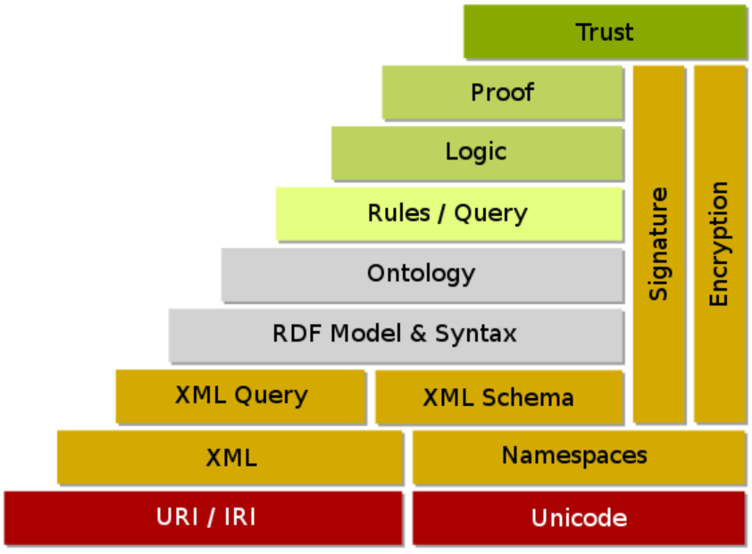
Linked Artifacts: Semantic Layer of XAI…
!
Semantic Web …
… is the best known AI-driven way to structure and standardize the content from industry (e.g., Industry 4.0) and manufacturing processes’ digitalization …
… Semantic Web is being developed towards enabling trust to knowledge models by making the content self-explainable and capable of self-proving its own validity …

Slide 9
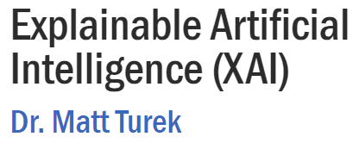
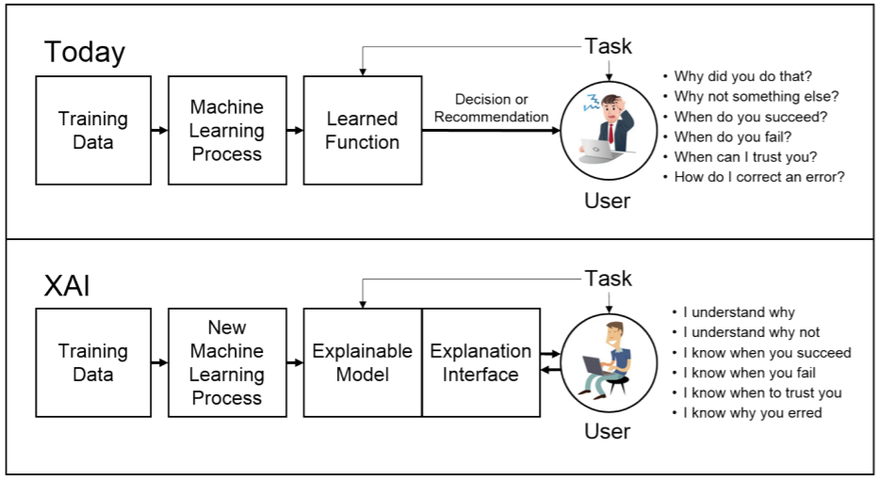
Explainable Artificial Intelligence (XAI) concept (according to DARPA)
DARPA believes that XAI is about changing Machine Learning process
∆

Slide 10
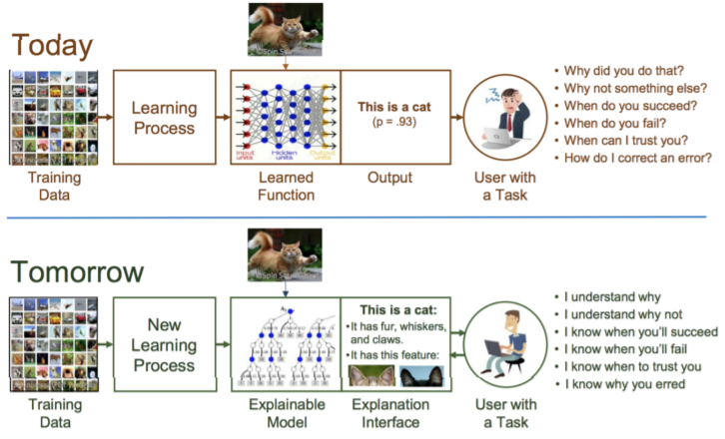
Explainable Artificial Intelligence (XAI) concept (according to DARPA)
DARPA believes that XAI is about changing Machine Learning process
∆

Slide 11
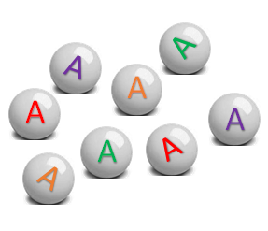
Semantic Layer (1): Collecting digital evidence on artifacts
Collected Evidence

Slide 12
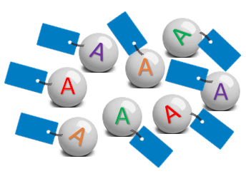
Semantic Layer (2): Labelling (tagging) digital evidence
Collected Evidence
Labelled Evidence

Slide 13
Semantic Layer (3): Formalization of (explicit & explainable) inference rules
Collected Evidence
Inference
XAI – Explainable Artificial Intelligence
Labelled Evidence

Slide 14
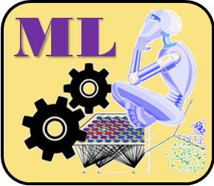
Semantic Layer (4): Automatic (“black-box”) inference model creation (Machine Learning)
Collected Evidence
Inference
Labelled Evidence

Slide 15
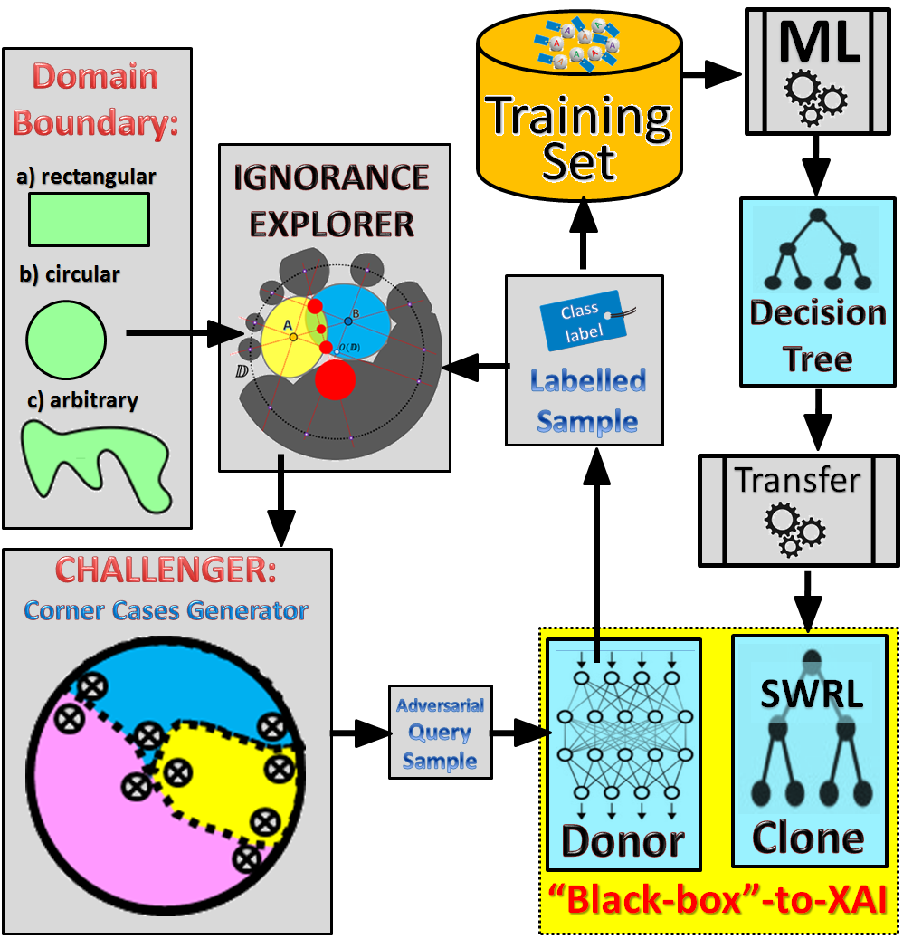
Semantic Layer (5): Automatic translation (CAI -> XAI) and integration of inference models
Collected Evidence
Inference
Labelled Evidence
“Black-Box” AI to XAI transformation

Slide 16
Semantic Layer (6): Automatic inference, reasoning and new knowledge creation
Collected Evidence
Inference
Inferred Evidence
Labelled Evidence

Slide 17
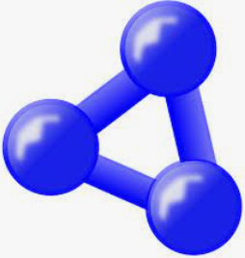
Semantic Layer (7): Designing ontology as a research domain knowledge model
Collected Evidence
Inference
Inferred Evidence
Ontology
Labelled Evidence

Slide 18
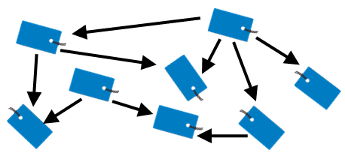
Semantic Layer (8): Linking data, knowledge and models using ontology
Collected Evidence
Inference
Inferred Evidence
Ontology
Linked Artifacts
Labelled Evidence

Slide 19
Our approach towards XAI
Traditional ways to approach XAI
Labelled Evidence
Special
Labelled Evidence
Our approach: Automatic Black-Box --> XAI transformation

Slide 20
Simple example (2D decision problem and available data for supervised ML)

Slide 21
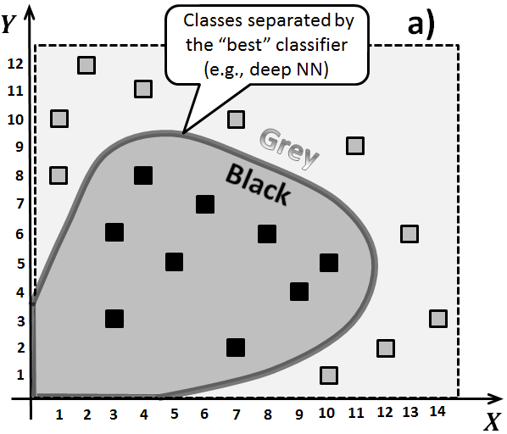
“Black-Box” Neural network (usually) performs (generalizes) better than “explainable” Decision Tree
b)
vs
for class “Black”

Slide 22
“Black-Box” Neural network (usually) performs (generalizes) better than “explainable” Decision Tree
d)
b)
vs
… for class “Grey”

Slide 23
$$Y$$
$$Y>8→Class=GREY$$
12
RULE 1
11
RULE_1: swrlb:greaterThan(?var_coord_Y, "8.0"^^xsd:double) ^ coord_Y(?instance, ?var_coord_Y) -> grey(?instance)
10
Decision Tree → SWRL Rules transformation by Protégé plugin (SWRL – Semantic Web Rules Language)
9
8
?
RULE 3
$$X>11 AND Y≤8$$
$$→Class=GREY$$
7
6
5
RULE_3: swrlb:lessThanOrEqual(?var_coord_Y, "8.0"^^xsd:double) ^ coord_Y(?instance, ?var_coord_Y) ^ coord_X(?instance, ?var_coord_X) ^ swrlb:greaterThan(?var_coord_X, "11.0"^^xsd:double) -> grey(?instance)
RULE 2
4
3
2
1
?
1
2
3
4
5
6
7
8
9
10
11
12
13
14
$$X$$
$$X≤11 AND Y≤8$$
$$→Class=BLACK$$
RULE_2: swrlb:lessThanOrEqual(?var_coord_Y, "8.0"^^xsd:double) ^ coord_Y(?instance, ?var_coord_Y) ^ coord_X(?instance, ?var_coord_X) ^ swrlb:lessThanOrEqual(?var_coord_X, "11.0"^^xsd:double) -> black(?instance)

Slide 24
“Black-Box” Neural network (usually) performs (generalizes) better than “explainable” Decision Tree
… for class “Black”
… for class “Grey”
e)

Slide 25
Re-training decision tree with improved training set

Slide 26
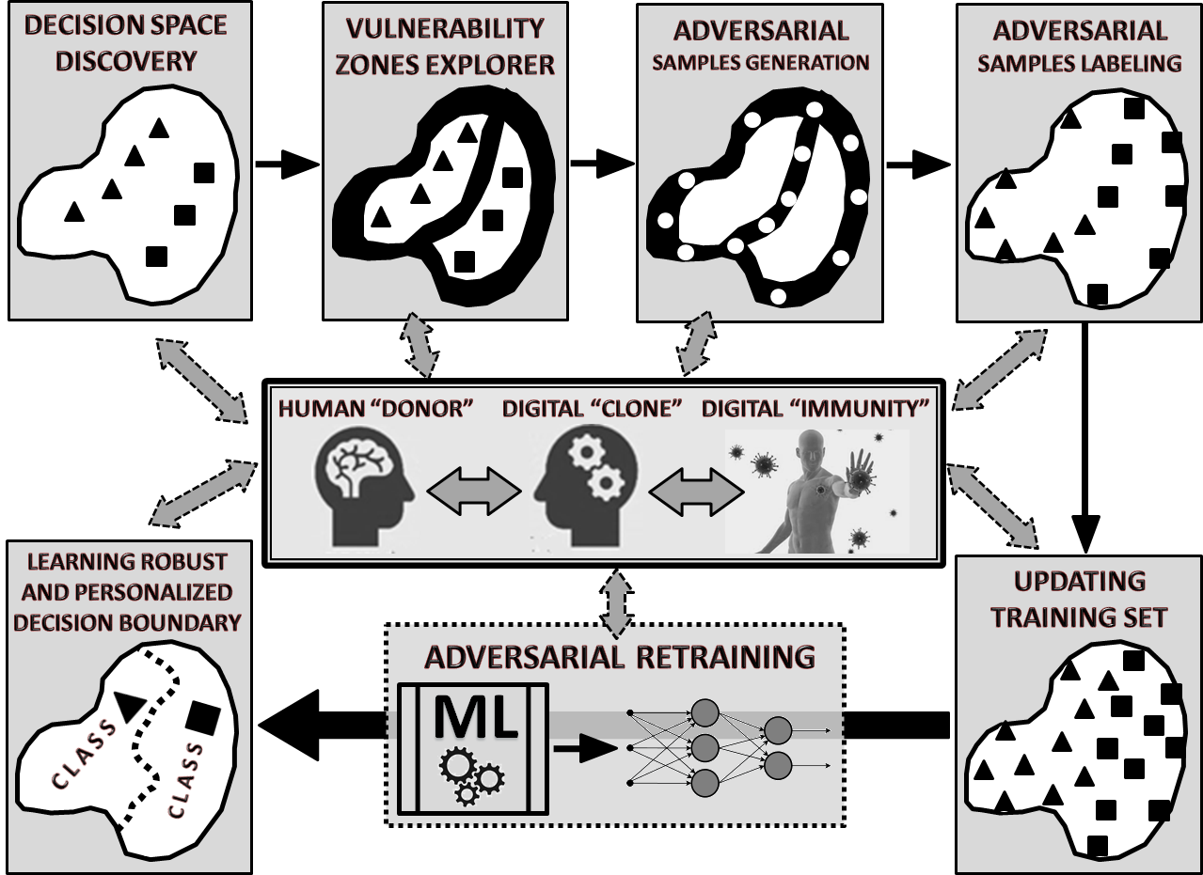
Similarity of three problems: (a) digital cloning, (b) digital vaccination and (c) Black-Box → XAI transformation, …
… as all three require vulnerability zones discovery and adversarial samples generation for further retraining …

Slide 27
“Ignorance Explorer” is a key component of the semantic transformation (Black-Box → XAI) process and we designed this component in accordance with our recent publication:
Terziyan, V., & Nikulin, A. (2021). Semantics of Voids within Data: Ignorance-Aware Machine Learning. ISPRS International Journal of Geo-Information, 10(4), 246. https://doi.org/10.3390/ijgi10040246

Slide 28
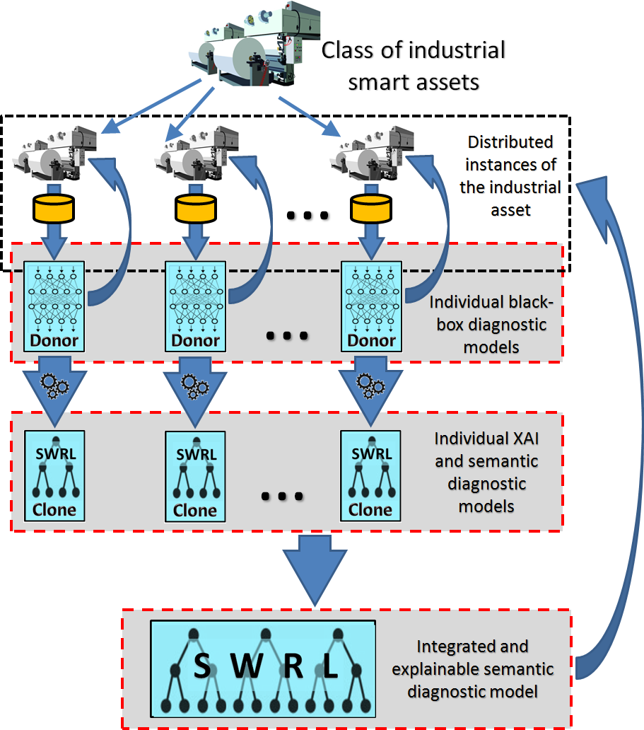
Use case scenario (diagnostics and predictive maintenance of smart industrial assets) for the black-box – XAI (SWRL) transformation and integration
We took the real industrial use-cases from our former projects SmartResource and UBIWARE (documentation and downloads can be found in: www.cs.jyu.fi/ai/SmartResource_UBIWARE.html ). During these projects’ times, we have collected huge datasets on industrial assets (paper machines, power networks, etc.). Due to the explainability requirement, originally, we have used either manually-fed expert rules for fault detection and classification or ML algorithms (Bayesian networks and decision tree learning). With such models, that time, we could get the overall classification accuracy of about 75-85%. In the current study we reuse the same datasets, however we were able to train the deep neural networks, which gave us much higher classification accuracy (85-97%). Then we used our XAI transformation technique and get the explainable version of these deep neural networks in terms of SWRL rules. By this way we were able to preserve required explainability but in the same time we were able to use the advantage of neural network (i.e., capability to generalize better and provide better classification accuracy).

Slide 29
Use case scenario (diagnostics and predictive maintenance of smart industrial assets) for the black-box – XAI (SWRL) transformation and integration
We took the real industrial use-cases from our former projects SmartResource and UBIWARE (documentation and downloads can be found in: www.cs.jyu.fi/ai/SmartResource_UBIWARE.html ). During these projects’ times, we have collected huge datasets on industrial assets (paper machines, power networks, etc.). Due to the explainability requirement, originally, we have used either manually-fed expert rules for fault detection and classification or ML algorithms (Bayesian networks and decision tree learning). With such models, that time, we could get the overall classification accuracy of about 75-85%. In the current study we reuse the same datasets, however we were able to train the deep neural networks, which gave us much higher classification accuracy (85-97%). Then we used our XAI transformation technique and get the explainable version of these deep neural networks in terms of SWRL rules. By this way we were able to preserve required explainability but in the same time we were able to use the advantage of neural network (i.e., capability to generalize better and provide better classification accuracy).
XAI Models Integration and Interoperability:
Important advantage of the explainable isolated diagnostic models (represented by SWRL rules) is that they could be integrated into more powerful models and applied to individual instances from the classes of similar industrial assets (our experiments with UBIWARE-related data
www.cs.jyu.fi/ai/SmartResource_UBIWARE.html)

Slide 30
Conclusions:
Outcomes of deep learning, which are accurate but not explainable AI models, can be automatically retrained as decision trees without access to the original training data and without essential loss of generalization accuracy.
Training data for strong XAI models (decision trees) must be recovered by “interviewing” these “black-boxes”. To make the process of training data recovery efficient, we applied special incremental ignorance discovery algorithms where the ignorance or confusion zones (specially defined “voids”) within the incrementally designed training dataset are discovered as a target area to generate new queries to the black-box at each iteration aiming to label most vulnerable places for potential decision tree classifier.
We have shown that, for better explainability and integration capacity, the retrained decision tree models could be represented as rules and more specifically as SWRL rules, which support the Open World Assumption, could be connected with the domain ontology and other previously defined rules, i.e., enabling semantic integration and interoperability of AI models and knowledge-based systems.
We have made the transformation algorithm: neural network – SWRL rules with the explicit mediator - a decision tree aiming to get XAI representation in both forms (decision tree and SWRL) each potentially useful in different applications.

Slide 31
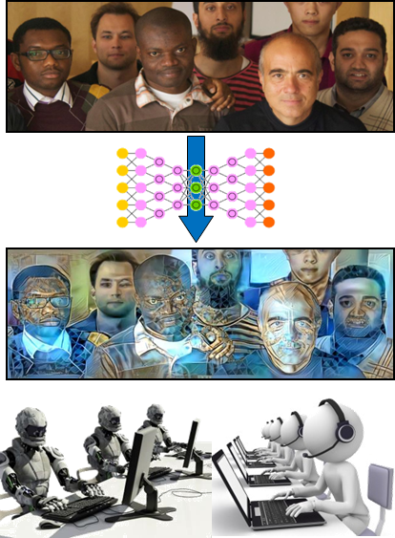
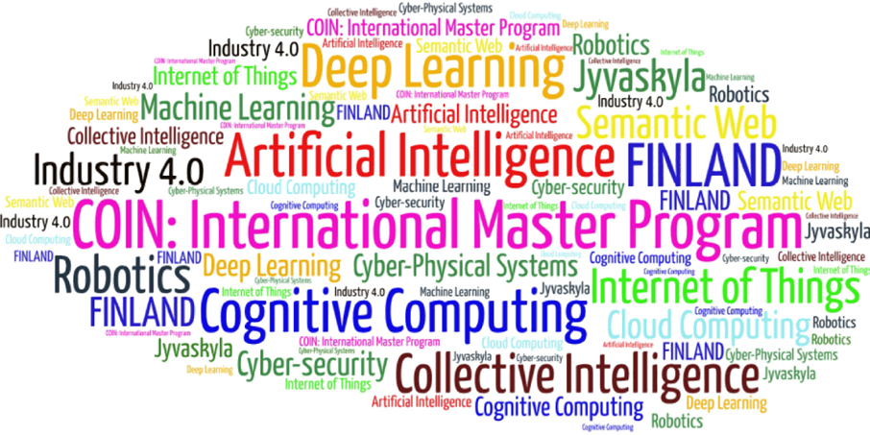
Come to study at our International Master Program
COIN: Cognitive Computing and Collective Intelligence …
… the first university program for collective intelligence, where humans learn together with their digital clones and autonomous digital assistants …
http://www.jyu.fi/ai
COIN

Slide 32
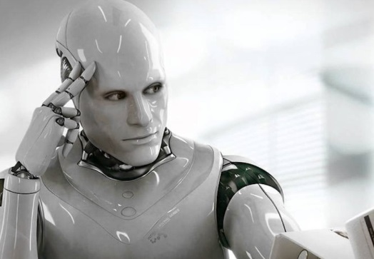
Link to the presentation: https://ai.it.jyu.fi/ISM-2021-XAI.pptx
Contact: vagan.terziyan@jyu.fi

Slide 33
Thank you!
“Explainable AI for Industry 4.0: Semantic Representation of Deep Learning Models”
Vagan Terziyan ª, Oleksandra Vitko ^{b}
ª Faculty of Information Technology, University of Jyväskylä, Jyväskylä, Finland
^{b} Department of Artificial Intelligence, Kharkiv National University of Radio Electronics, Kharkiv, Ukraine
Contacts
ª vagan.terziyan@jyu.fi, ^{b} oleksandra.vitko@nure.ua
Link to complete slide-set:
https://ai.it.jyu.fi/ISM-2021-XAI.pptx
https://www.jyu.fi/en/
https://nure.ua/en/

