Slide 1
4th International Conference on Industry 4.0 and Smart Manufacturing – ISM 2022
Upper Austria University of Applied Science – Hagenberg Campus – Linz, Austria
Blended Conference | 2-4 November 2022
“Causality-Aware Convolutional Neural Networks for Advanced Image Classification and Generation”
Vagan Terziyan ª, Oleksandra Vitko ^{b}
ª Faculty of Information Technology, University of Jyväskylä, Jyväskylä, Finland
^{b} Department of Artificial Intelligence, Kharkiv National University of Radio Electronics, Kharkiv, Ukraine
https://www.jyu.fi/en/
https://nure.ua/en/

Slide 2
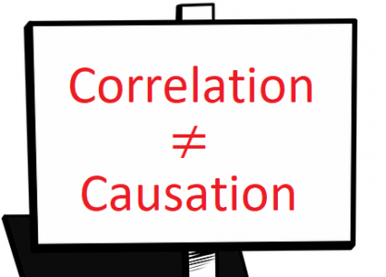
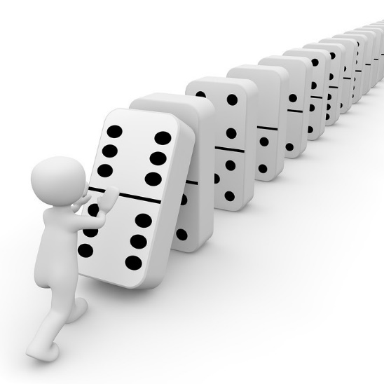
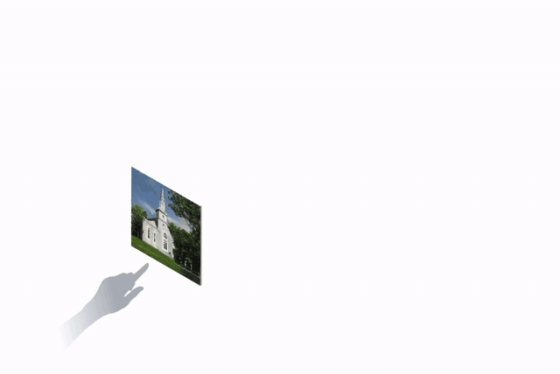
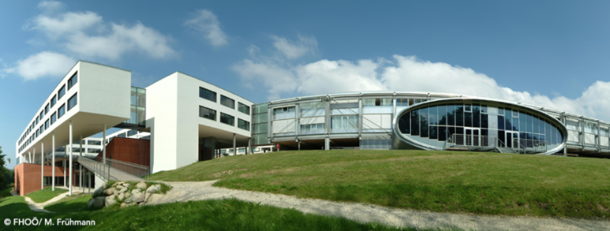
“Causality-Aware Convolutional Neural Networks for Advanced Image Classification and Generation”
Paper # 1646
Vagan Terziyan,
Oleksandra Vitko
University of Applied Science, Linz, Austria
4 November, 2022, 17:00 - 17:20
ISM 2022
International Conference on Industry 4.0
and Smart Manufacturing
Section/Room:
S 2.4 - IMAGE / Room: HS₃

Slide 3
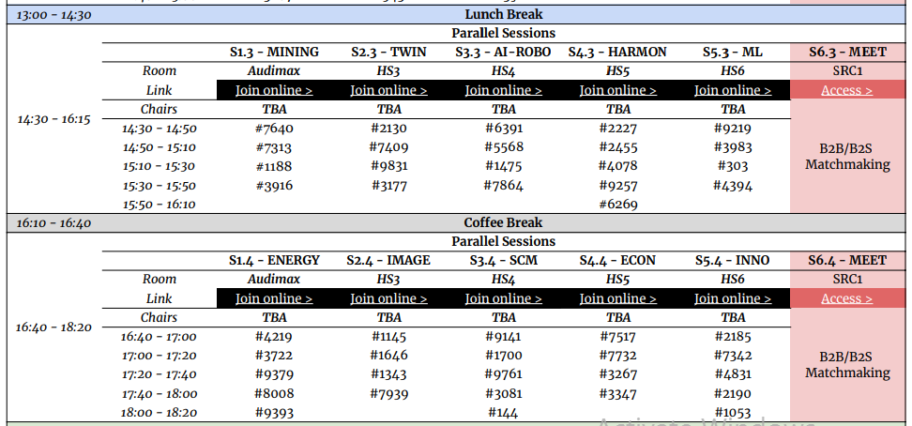
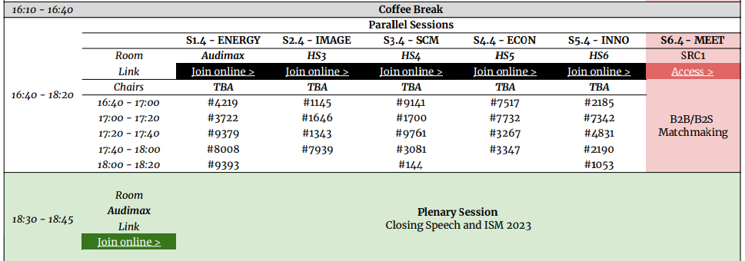
https://www.msc-les.org/conf/ism2022/ISM2022_ProgramAtAGlance.pdf
https://www.msc-les.org/ism2022/program-at-a-glance/
https://teams.microsoft.com/l/meetup-join/19%3a9b435349a7404e4998b14385638430bc%40thread.tacv2/1665006794870?context=%7b%22Tid%22%3a%227519d0cd-2106-47d9-adcb-320023abff57%22%2c%22Oid%22%3a%229f6efedb-1e10-4496-942f-92bdb2ba849d%22%7d
ISM-2022_1646_Causality
“Causality-Aware Convolutional Neural Networks for Advanced Image Classification and Generation”
https://teams.microsoft.com/dl/launcher/launcher.html?url=%2F_%23%2Fl%2Fmeetup-join%2F19%3A9b435349a7404e4998b14385638430bc%40thread.tacv2%2F1665006794870%3Fcontext%3D%257b%2522Tid%2522%253a%25227519d0cd-2106-47d9-adcb-320023abff57%2522%252c%2522Oid%2522%253a%25229f6efedb-1e10-4496-942f-92bdb2ba849d%2522%257d%26anon%3Dtrue&type=meetup-join&deeplinkId=99b66ce6-7980-4b35-8a42-8fba6d04abe0&directDl=true&msLaunch=true&enableMobilePage=true&suppressPrompt=true
https://teams.microsoft.com/dl/launcher/launcher.html?url=%2F_%23%2Fl%2Fmeetup-join%2F19%3A9b435349a7404e4998b14385638430bc%40thread.tacv2%2F1665006794870%3Fcontext%3D%257b%2522Tid%2522%253a%25227519d0cd-2106-47d9-adcb-320023abff57%2522%252c%2522Oid%2522%253a%25229f6efedb-1e10-4496-942f-92bdb2ba849d%2522%257d%26anon%3Dtrue&type=meetup-join&deeplinkId=ae1e14c0-5873-4fba-9600-88fab4c7ef66&directDl=true&msLaunch=true&enableMobilePage=true&suppressPrompt=true

Slide 4
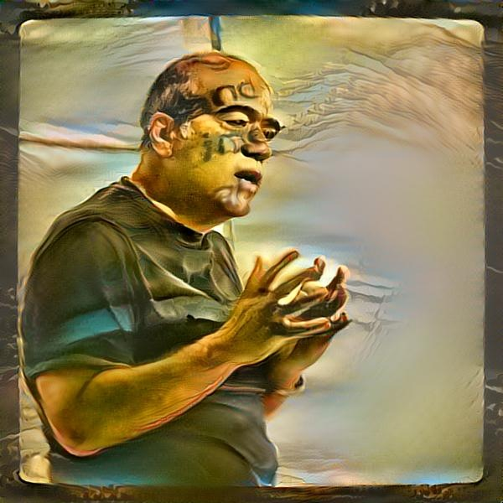
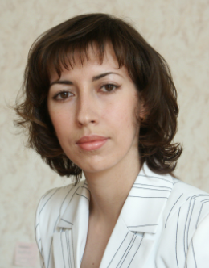
Authors
Vagan Terziyan
vagan.terziyan@jyu.fi
“Causality-Aware Convolutional Neural Networks for Advanced Image Classification and Generation”
Oleksandra Vitko
https://www.jyu.fi/en/
https://nure.ua/en/

Slide 5
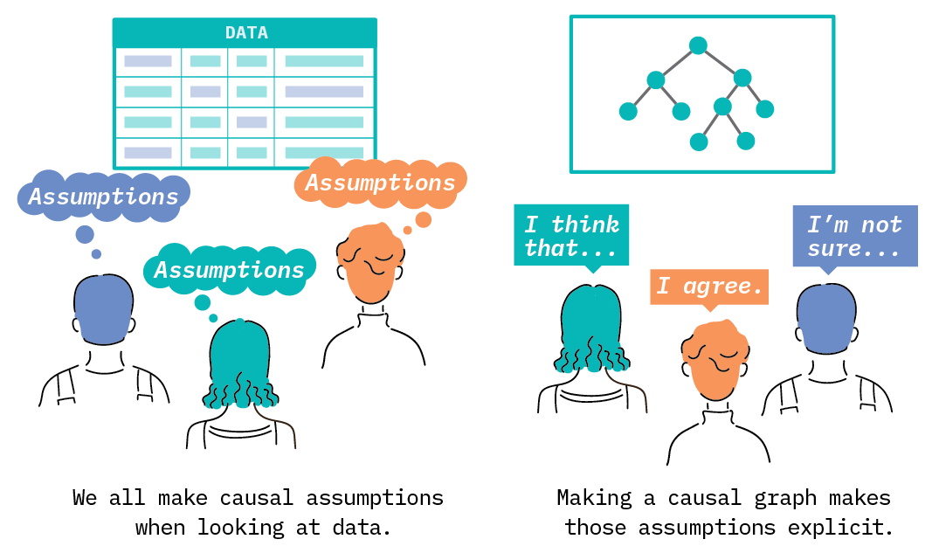
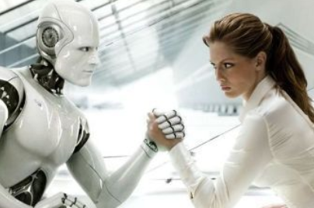
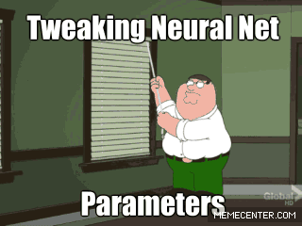
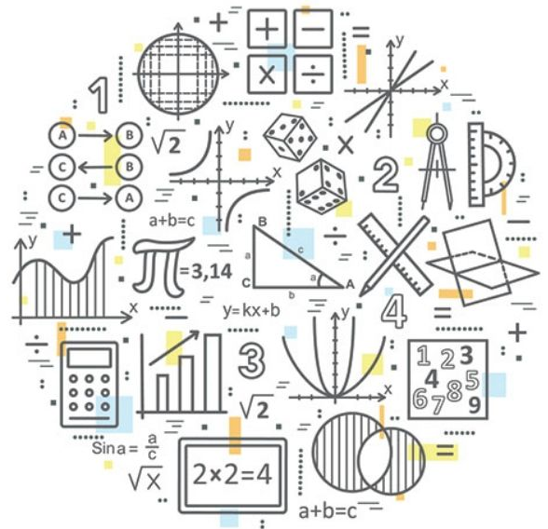
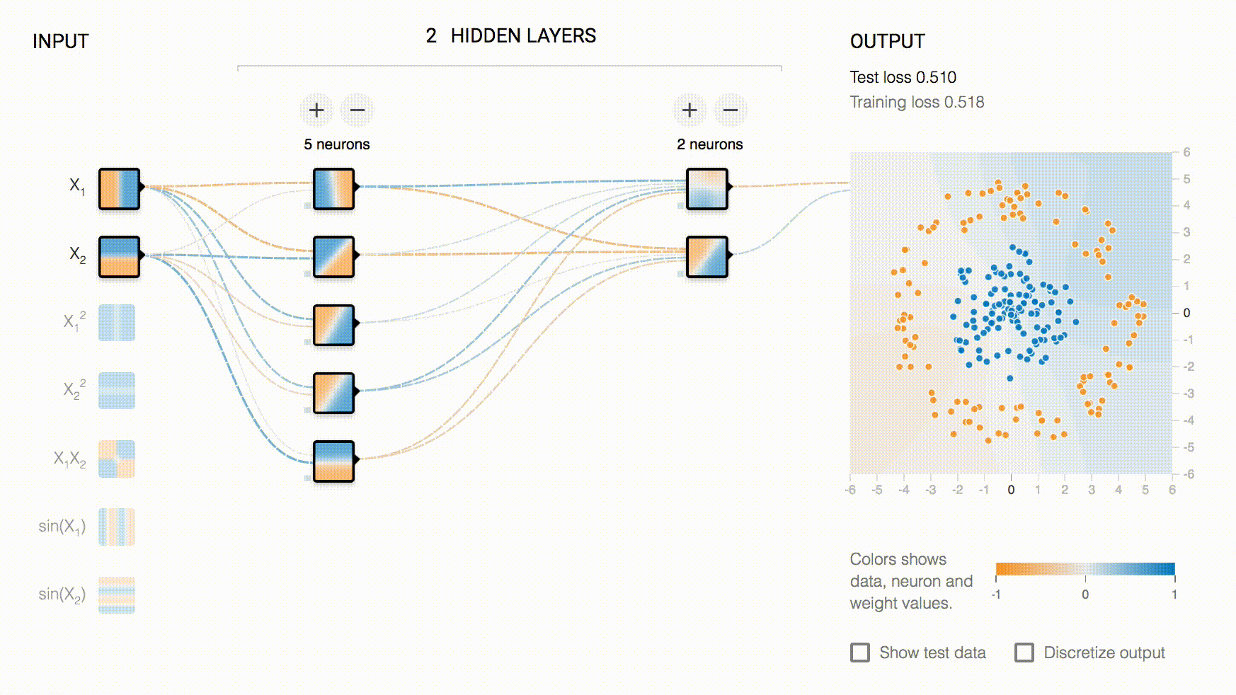
We approach problems differently
Understanding the phenomenon based on discovered causalities within it
[not much of data needed]
VS
Mathematical approximation of the phenomenon based on discovered correlations within it
[quite a lot of data needed]
Instead of looking for superficial statistical correlations, an AI system should be able to identify causal variables and separate their effects on the environment.

Slide 6
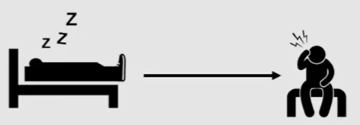
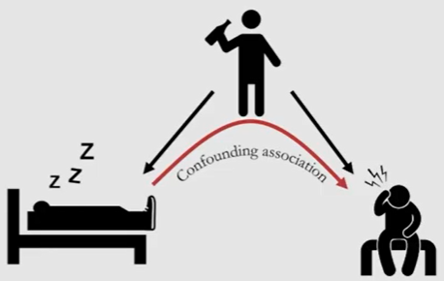
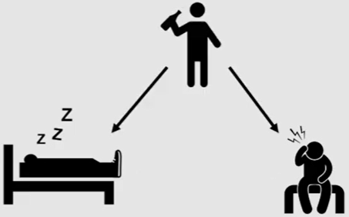
Correlation Does Not Imply Causation
Does not cause!
https://www.youtube.com/watch?v=DFPm_a-_uJM

Slide 7
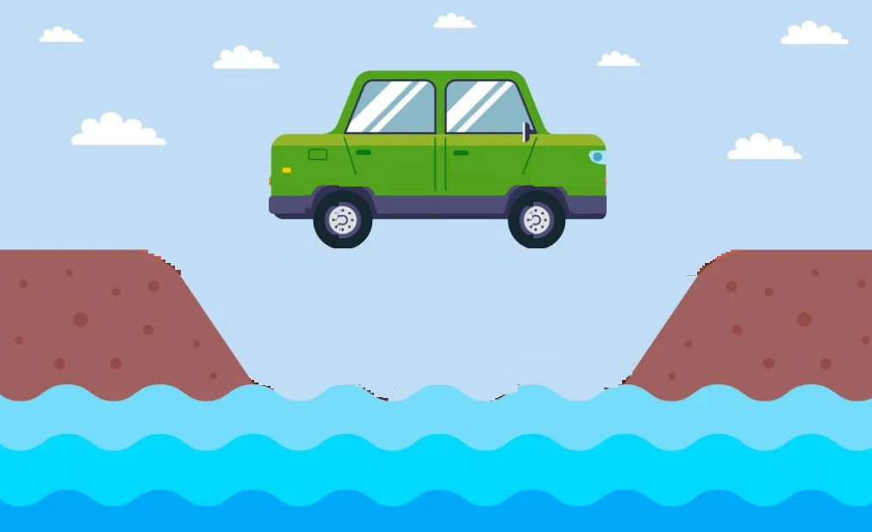
Causal effect in images
https://www.qualcomm.com/news/onq/2022/09/is-causality-the-missing-piece-of-the-ai-puzzle-
Consider the two counterfactual questions “What would the scene look like if we were to remove the car?” and “What would the scene look like if we were to remove the bridge?” On the one hand, the ﬁrst intervention seems rather benign. After removing the car, we could argue that the rest of the scene depicted in the image (the river, the bridge) would remain invariant. On the other hand, the second intervention seems more severe. If the bridge had been removed from the scene, it would, in general, make little sense to observe the car ﬂoating weightlessly above the river. Thus, we understand that the presence of the bridge has an effect on the presence of the car.
https://arxiv.org/abs/1605.08179

Slide 8
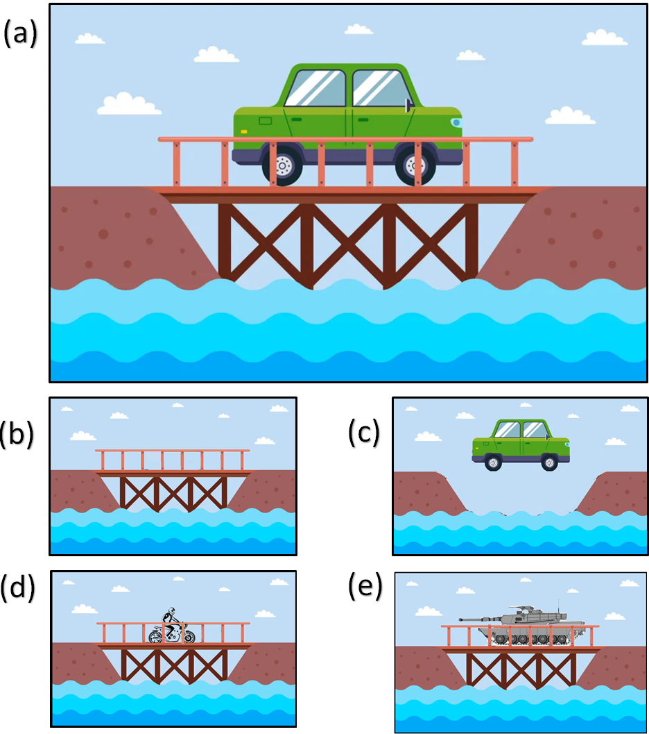
Causal disposition in images
Illustration of the “causal disposition” concept:
original image of a car on a wooden bridge;
removal of the car from the scene keeps the image realistically looking;
removal of the bridge makes the scene inconsistent;
replacing the car with a bike is still a valid intervention;
replacing the car with the tank makes the consistency of the image questionable (i.e., probably, too heavy vehicle for a wooden bridge).

Slide 9
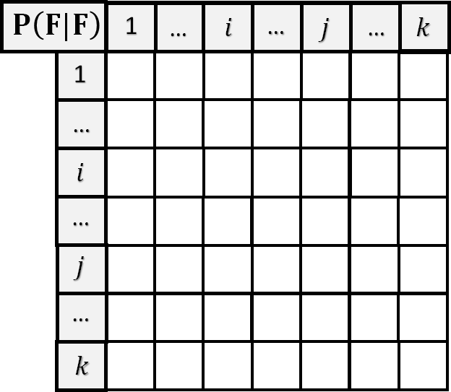
From features to causality map
$$F^{1}$$
Feature extractor
$$…$$
Image
$$F^{i}$$
$$…$$
Features
$$F^{j}$$
$$…$$
Conditional probability schema
$$F^{k}$$
Causality Map
$$P\left(F^{i}|F^{j}\right)=\frac{P\left(F^{i},F^{j}\right)}{P(F^{j})}$$
*

Slide 10
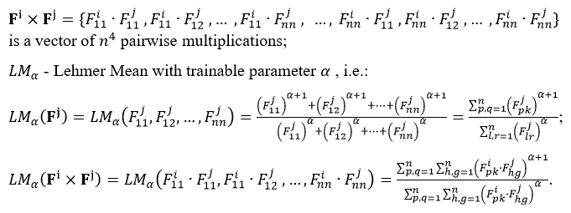
Convolutional Neural Network (CNN), features and causalities
In CNN, each i_{th} feature is represented by [$n×n$] matrix$F^{i}$(feature map) of normalized numbers $F_{l,r}^{i}$ indicating feature presence value (aka probability within each particular $(l,r)$ location within the image).
Computing the causality matrix aka conditional probability estimate:
Option 2:
$${P\left(F^{i}|F^{j}\right)}_{α}=\frac{\left.{LM}_{α} (F^{i}×F^{j}\right)}{\left.{LM}_{α}(F^{j}\right)}$$
Option 1:
$$P\left(F^{i}|F^{j}\right)=\frac{P\left(F^{i},F^{j}\right)}{P(F^{j})}$$
$$P\left(F^{i}|F^{j}\right)=\frac{\left(\max_{l,r=\overline{1,n}}{F_{l,r}^{i}}\right)∙\left(\max_{l,r=\overline{1,n}}{F_{l,r}^{j}}\right)}{\sum_{l,r=1}^{n}{F_{l,r}^{j}}}$$

Slide 11
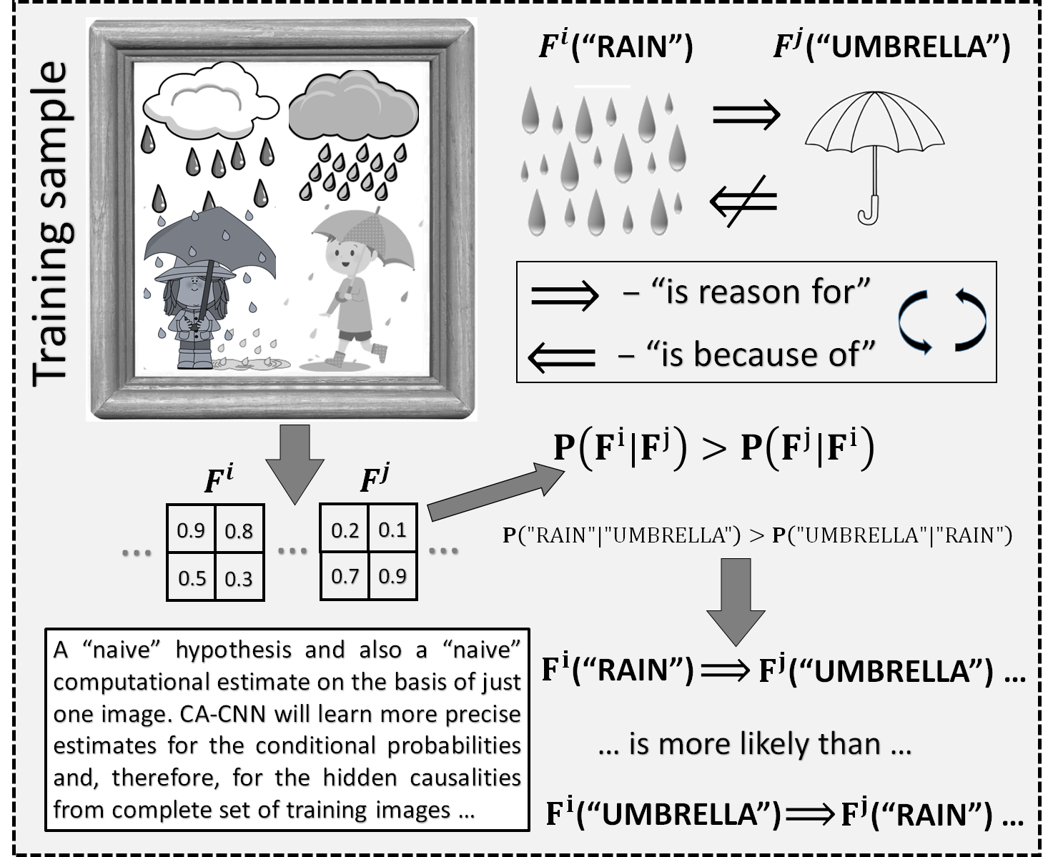
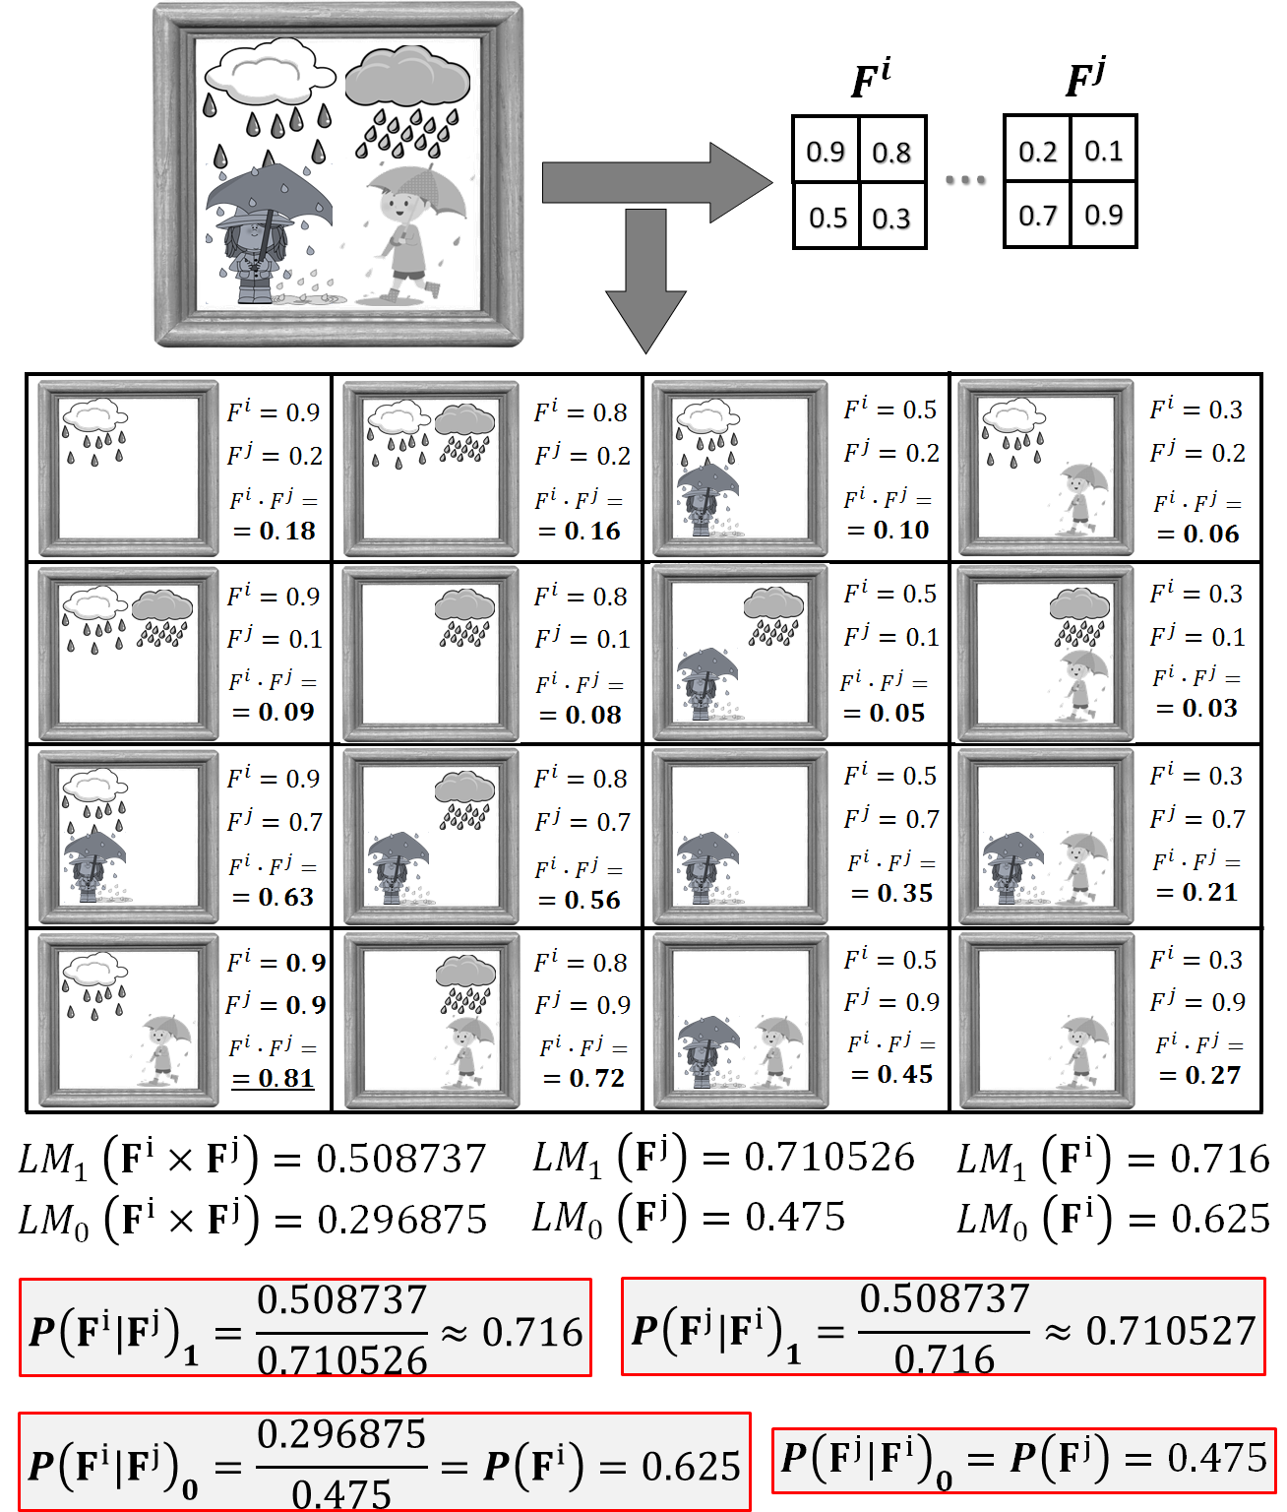
A naïve hypothesis on causality assessment
An intuitive hypothesis (as a driver for the causality relationships discovery within the images) is illustrated by simple example.

Slide 12
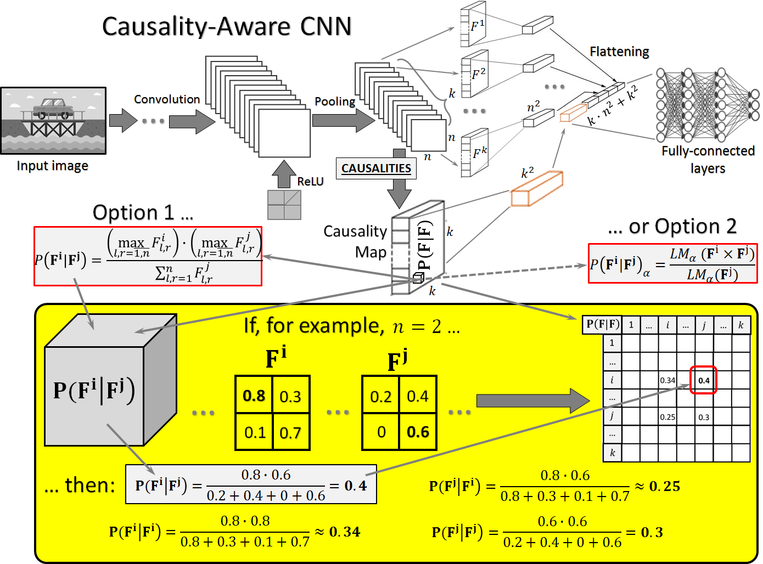
Causality-Aware CNN
The basic architecture of a “Causality-Aware” Convolutional Neural Network (CA-CNN).
In addition to the feature maps after the last pooling layer, it also has the causality map containing estimates for pairwise causal relationship between the features. This causality map is computed by one of the two options as shown in the figure. Together with the feature maps themselves, the causality map produces additional inputs to the fully connected layers, which will be used for further image classification; and the weights for the corresponding additional connections (i.e., actual causality influences) will be learned by backpropagation the same way as other neural network parameters.

Slide 13
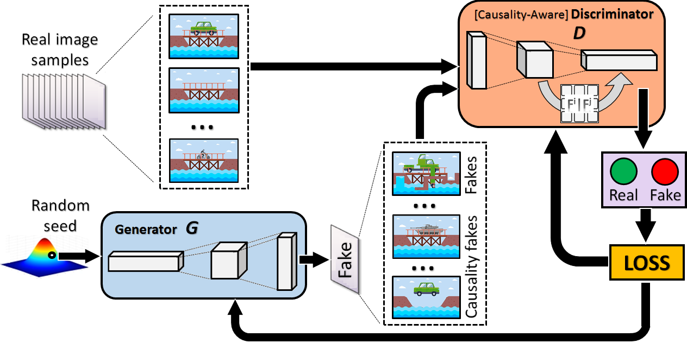
Causality-Aware Generative Adversarial Network (CA-GAN)
An architecture of
“Causality-Aware” Generative Adversarial Network (CA-GAN).
The major modification here (comparably to the traditional architecture) is a Causality-Aware Discriminator, which is based on CA-CNN architecture and includes a causality map component for learning causal feature relationships. This update makes the Discriminator to be capable of recognizing not only general fakes (not realistically looking inputs) but also “causal fakes”, i.e., images with realistically looking components but with inconsistent causal relationships among these components. Synchronously, the Generator learns to generate realistically-looking images with special respect to causalities within it.

Slide 14
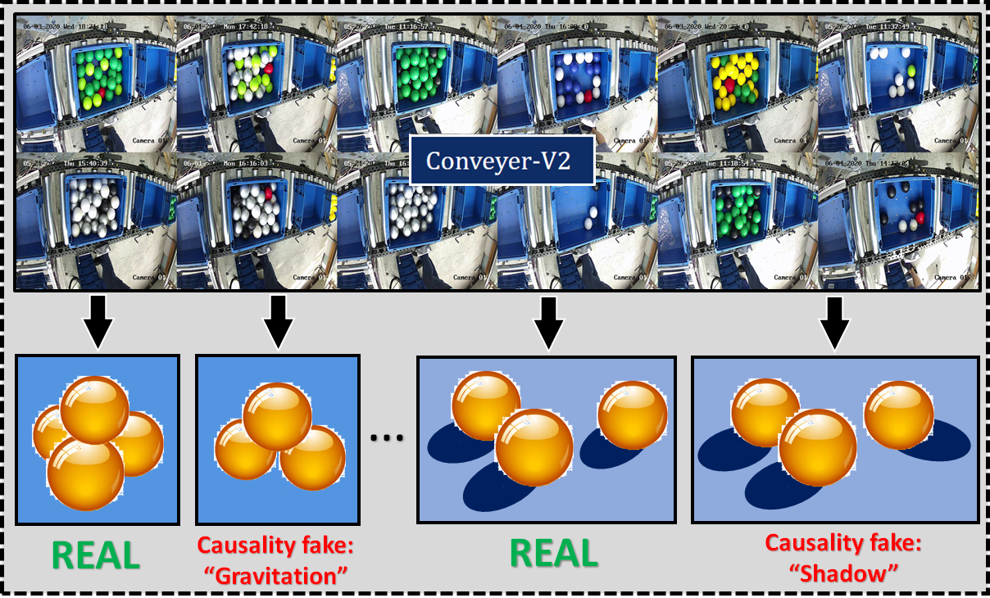
“Causality fakes” discovery in image generation experiments
An example of real-world simulations on a conveyor with a visual monitoring system. Collected observations have been used as an input to CA-GAN. During the training process, the Discriminator also acquired the capability to capture the causality-related fakes (examples are shown). After the training process, the Generator becomes capable of generating realistically-looking images (scenes) without causal inconsistencies.

Slide 15
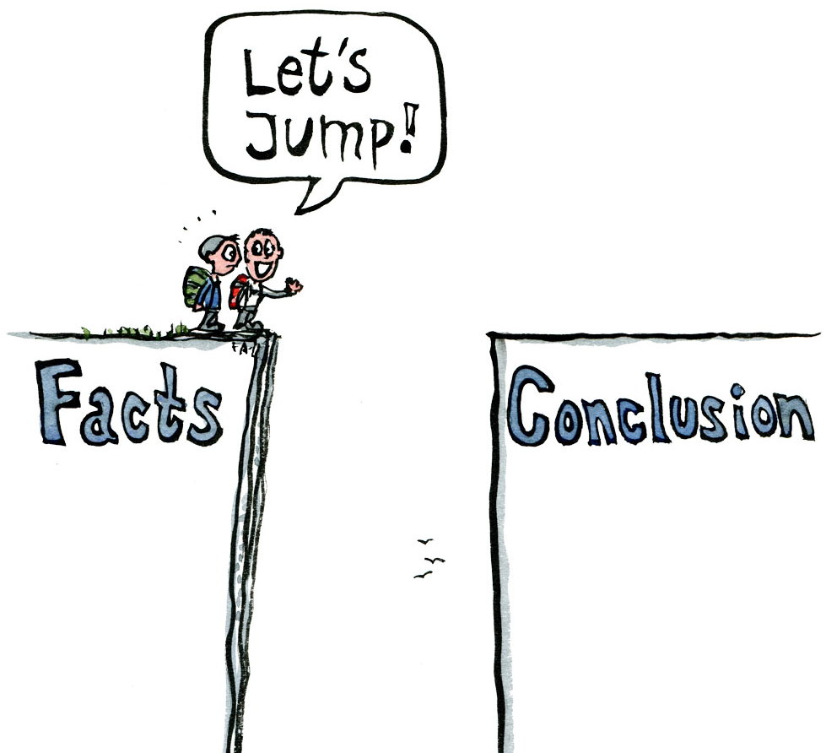
Conclusions:
We suggested an additional component (causality matrix as a group of special neurons) to update the traditional CNN architecture towards causality-awareness within the image classification process. The resulting CA-CNN architecture is capable of learning to distinguish between the classes of images, taking into account the causal relationships between the features from the images.
We considered CA-CNN as a possible architecture of a Discriminator within a typical GAN architecture. Such a causality-aware Discriminator (being more powerful due to additional skills) forces its counterpart – the Generator – to respect causalities when generating images. Corresponding causality-aware GANs or CA-GANs could be useful for both purposes: for the discovery of “causality fakes” (realistically-looking images but with inconsistent causal relationships between their components); and for generating realistically-looking images with respect to causalities.
Preliminary experiments and simulations with relatively small numbers of data samples provide certain optimism on the potential of the suggested causality-aware architectures. More experiments with big data from industrial processes are foreseen to discover the full potential of the proposed architectures. To get full benefit of our approach to Industry 4.0 needs, we will combine it in our future study with the self-attention mechanism in CNNs, which has proven its benefits for smart manufacturing applications.

Slide 16
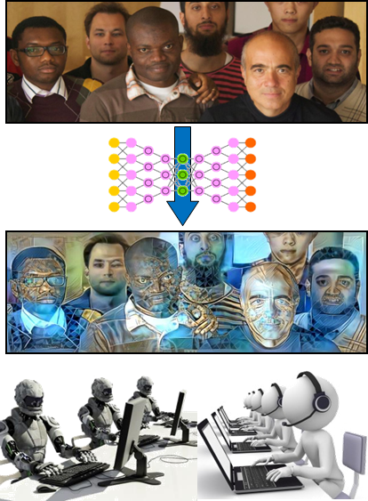
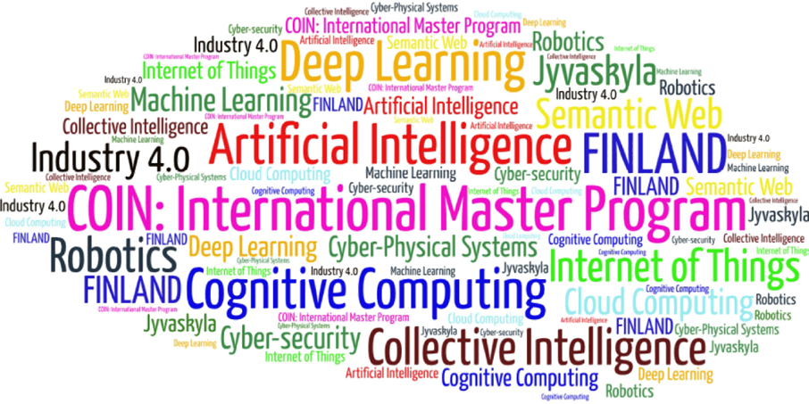
Come to study at our International Master Program
COIN: Cognitive Computing and Collective Intelligence …
… the first university program for collective intelligence, where humans learn together with their digital clones and autonomous digital assistants …
http://www.jyu.fi/ai
COIN

Slide 17
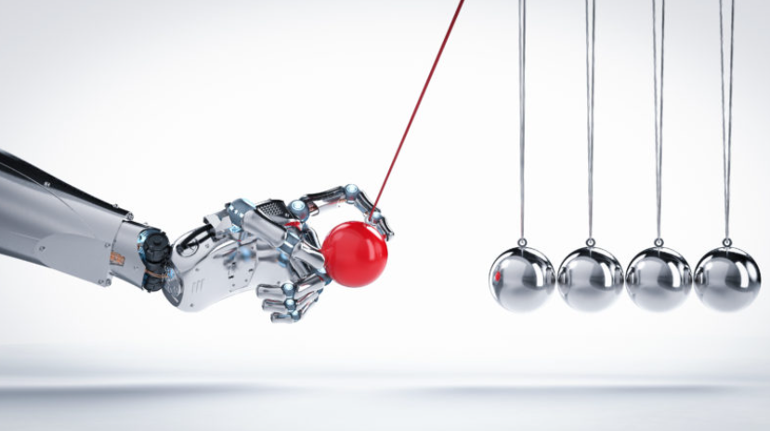
Link to the presentation: https://ai.it.jyu.fi/ISM-2022-Causality.pptx
Contact: vagan.terziyan@jyu.fi

Slide 18
4th International Conference on Industry 4.0 and Smart Manufacturing – ISM 2022
Upper Austria University of Applied Science – Hagenberg Campus – Linz, Austria
Blended Conference | 2-4 November 2022
Thank you!
“Causality-Aware Convolutional Neural Networks for Advanced Image Classification and Generation”
Vagan Terziyan ª, Oleksandra Vitko ^{b}
ª Faculty of Information Technology, University of Jyväskylä, Jyväskylä, Finland
^{b} Department of Artificial Intelligence, Kharkiv National University of Radio Electronics, Kharkiv, Ukraine
Contacts
ª vagan.terziyan@jyu.fi, ^{b} oleksandra.vitko@nure.ua
Link to complete slide-set:
https://ai.it.jyu.fi/ISM-2022-Causality.pptx
https://www.jyu.fi/en/
https://nure.ua/en/

