Slide 1
4th International Conference on Industry 4.0 and Smart Manufacturing – ISM 2022
Upper Austria University of Applied Science – Hagenberg Campus – Linz, Austria
Blended Conference | 2-4 November 2022
“Encryption and Generation of Images for Privacy-Preserving Machine Learning in Smart Manufacturing”
Vagan Terziyan ª, Diana Malyk ^{b}, Mariia Golovianko ^{c}, Vladyslav Branytskyi ^{d}
ª Faculty of Information Technology, University of Jyväskylä, Jyväskylä, Finland
^{b,c,d} Department of Artificial Intelligence, Kharkiv National University of Radio Electronics, Kharkiv, Ukraine
https://www.jyu.fi/en/
https://nure.ua/en/

Slide 2
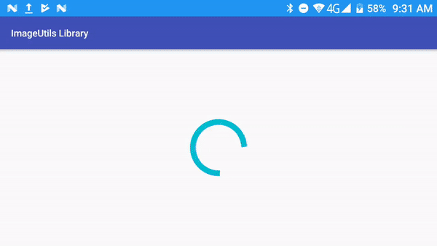
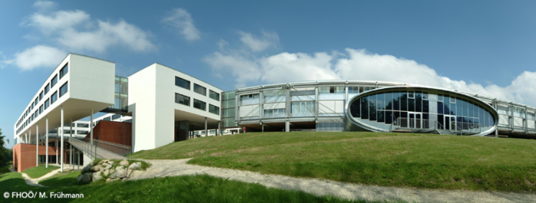
“Encryption and Generation of Images for Privacy-Preserving Machine Learning in Smart Manufacturing”
Paper # 8012
Vagan Terziyan, Diana Malyk, Mariia Golovianko & Vladyslav Branytskyi
University of Applied Science, Linz, Austria
4 November, 2022, 11:20 - 11:40
ISM 2022
International Conference on Industry 4.0
and Smart Manufacturing
Section/Room:
S 4.2 - SECURITY / Room: HS₅

Slide 3
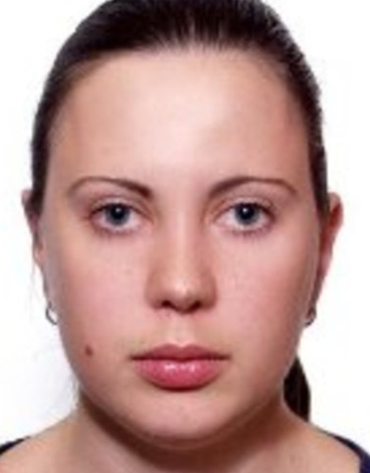
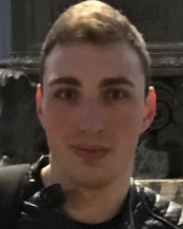
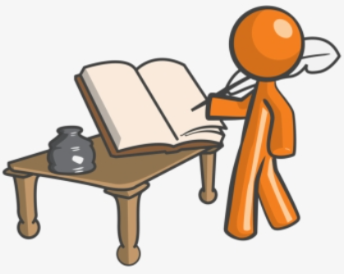
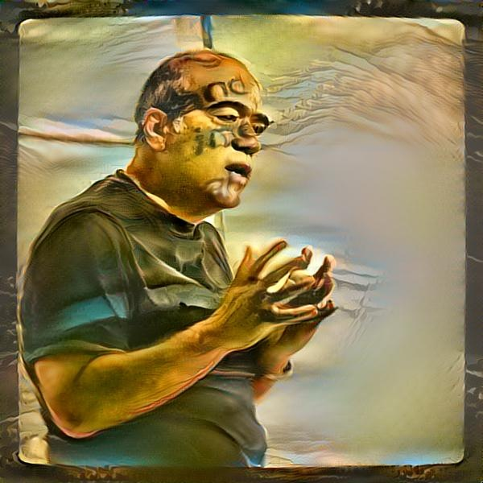
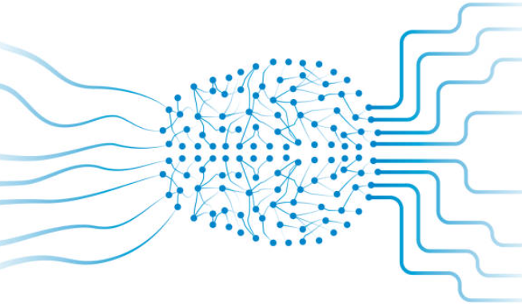
Authors
Diana Malyk
Mariia Golovianko
Vladyslav Branytskyi
“Encryption and Generation of Images for Privacy-Preserving Machine Learning in Smart Manufacturing”
Vagan Terziyan
vagan.terziyan@jyu.fi
https://nure.ua/en/
https://www.jyu.fi/en/

Slide 4
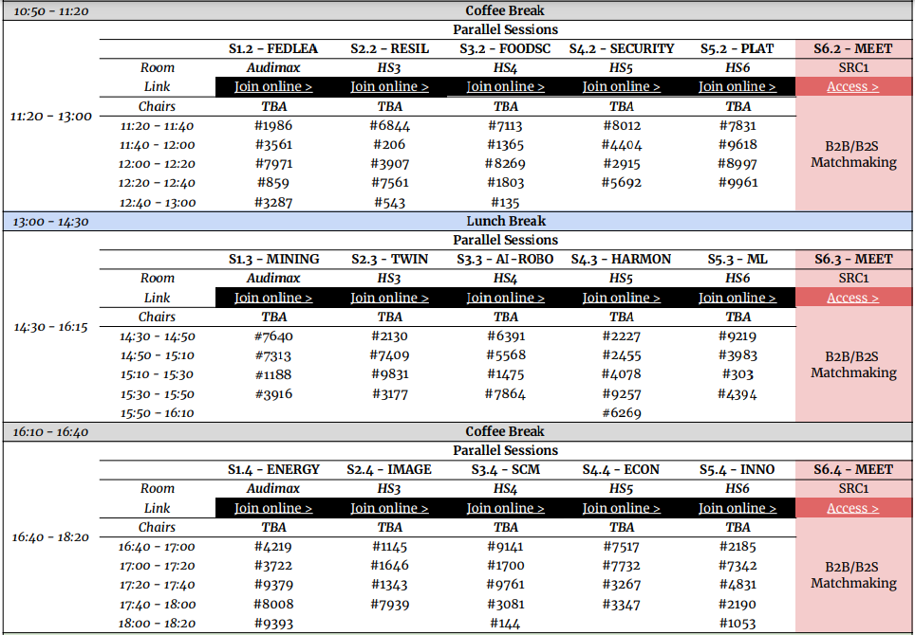
https://www.msc-les.org/conf/ism2022/ISM2022_ProgramAtAGlance.pdf
https://www.msc-les.org/ism2022/program-at-a-glance/
ISM-2022_8012_Image_Encryption
“Encryption and Generation of Images for Privacy-Preserving Machine Learning in Smart Manufacturing”
https://teams.microsoft.com/l/meetup-join/19%3a9b435349a7404e4998b14385638430bc%40thread.tacv2/1665005956970?context=%7b%22Tid%22%3a%227519d0cd-2106-47d9-adcb-320023abff57%22%2c%22Oid%22%3a%229f6efedb-1e10-4496-942f-92bdb2ba849d%22%7d
https://teams.microsoft.com/dl/launcher/launcher.html?url=%2F_%23%2Fl%2Fmeetup-join%2F19%3A9b435349a7404e4998b14385638430bc%40thread.tacv2%2F1665005956970%3Fcontext%3D%257b%2522Tid%2522%253a%25227519d0cd-2106-47d9-adcb-320023abff57%2522%252c%2522Oid%2522%253a%25229f6efedb-1e10-4496-942f-92bdb2ba849d%2522%257d%26anon%3Dtrue&type=meetup-join&deeplinkId=cb5c0b1b-1b92-4fb5-bd65-91d3319ccc26&directDl=true&msLaunch=true&enableMobilePage=true&suppressPrompt=true
https://teams.microsoft.com/dl/launcher/launcher.html?url=%2F_%23%2Fl%2Fmeetup-join%2F19%3A9b435349a7404e4998b14385638430bc%40thread.tacv2%2F1665005956970%3Fcontext%3D%257b%2522Tid%2522%253a%25227519d0cd-2106-47d9-adcb-320023abff57%2522%252c%2522Oid%2522%253a%25229f6efedb-1e10-4496-942f-92bdb2ba849d%2522%257d%26anon%3Dtrue&type=meetup-join&deeplinkId=1079cbb9-19b4-4066-a4ff-6ec049511121&directDl=true&msLaunch=true&enableMobilePage=true&suppressPrompt=true

Slide 6
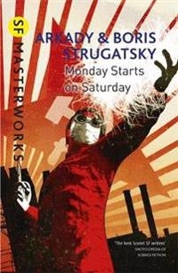
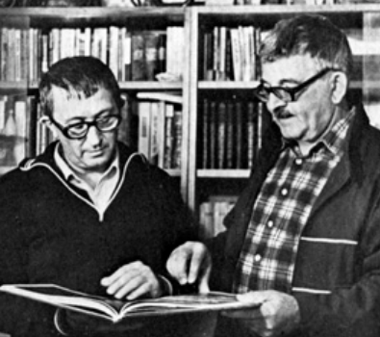
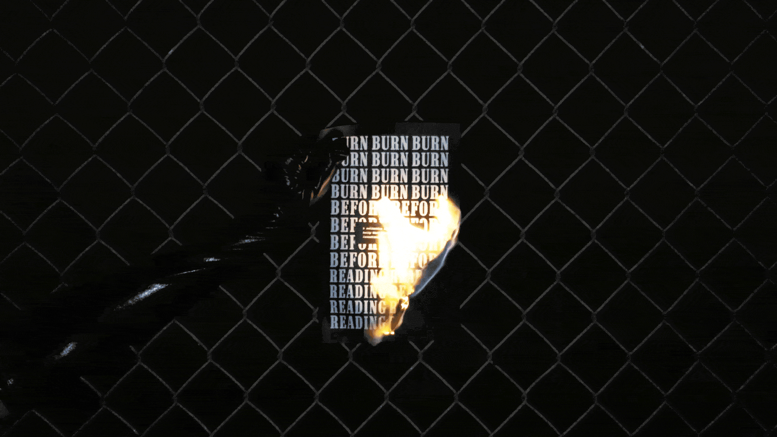
“Privacy notice” as an epigraph (motto) to this study …
“Top Secret. Burn before reading!”
Boris & Arkady Strugatsky (1965).
“Monday Begins on Saturday”
en.wikipedia.org/wiki/Monday_Begins_on_Saturday
“Privacy is the state of being free from public attention”
(Oxford Dictionary)

Slide 7
Machine Learning helps companies to get value from data

Slide 8
Data collected by corporate customers may contain sensitive private information

Slide 9
The best machine learning algorithms (capable to turn data into decision model) may be located at unsafe third party remote locations (clouds)

Slide 10
Decisions made by the trained model
After getting the model back from the remote cloud, the company can use it as an intelligent component of their systems. However, it is important that not only the private data but also the model is not stolen by the third party

Slide 11
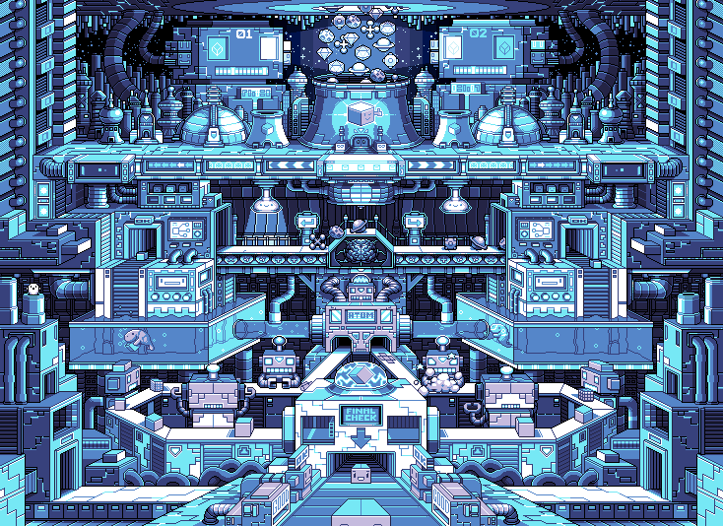
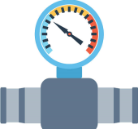
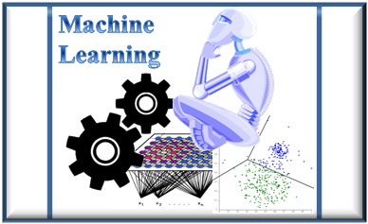
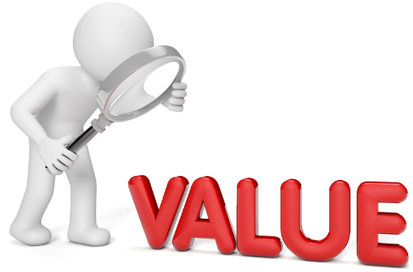
Data privacy challenge for Industry 4.0
Private (!)
DATA
Intelligence-as-a-Service
How to capture hidden value out of the data but (while doing it) preserve the data privacy?
The technical challenge would be enabling correct and efficient analysis of the large amounts of data produced by Industry 4.0 and its large sensor networks.
Machine Learning (ML) as a technology has progressed a lot during the last few years, however, the legal aspects of the collection and processing data (such as privacy concern regarding personal data) has been neglected. Nowadays the potential of the ML models is essentially limited by the strict privacy regulations.

Slide 12
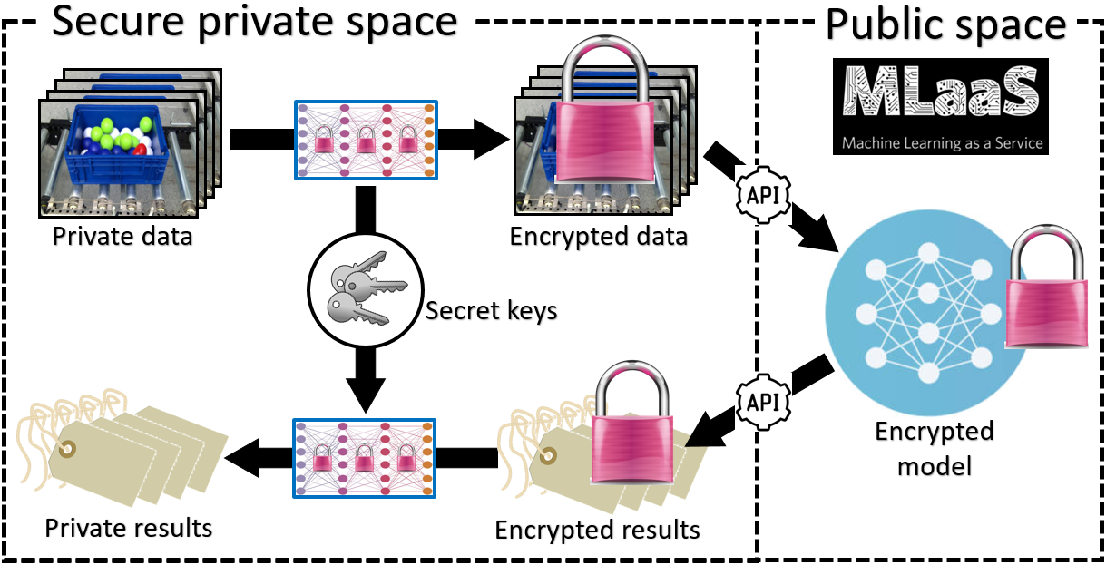
There is a huge need for Privacy-Preserving Machine Learning (PPML)

Slide 13
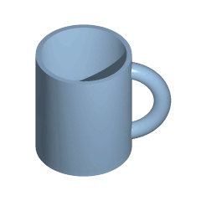
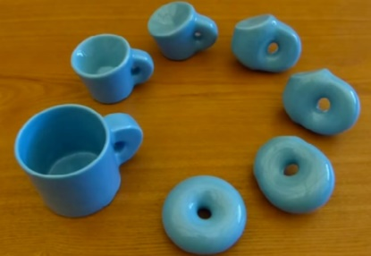
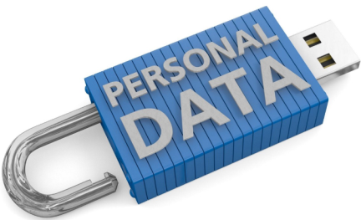
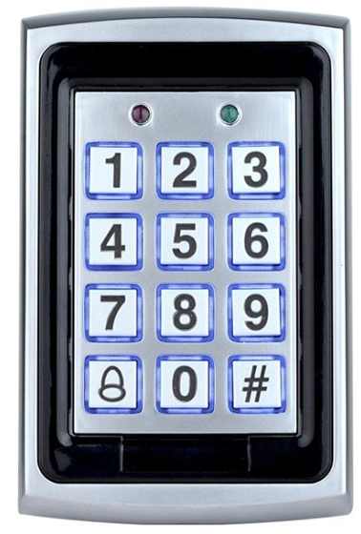
Our approach: topological (homeomorphic) encryption
In the mathematical field of topology, a homeomorphism or topological isomorphism is a continuous function between topological spaces that has a continuous inverse function. Homeomorphisms are the mappings that preserve all the topological properties of a given space. Two spaces with a homeomorphism between them are called homeomorphic, and from a topological viewpoint they are the same.
[Wikipedia]
Preserves decision boundaries
homomorphic encryption $≠$ homeomorphic encryption
Preserves algebra

Slide 14
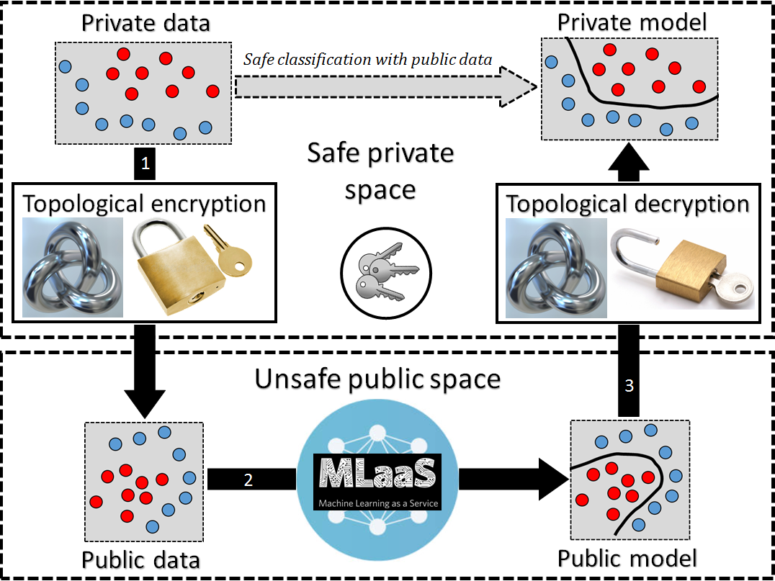
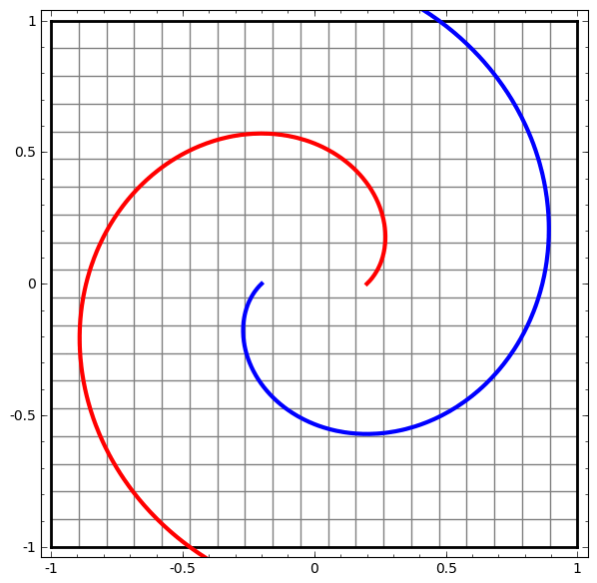
Generic schema of supervised PPML based on homeomorphic (topology-preserving) encryption

Slide 15
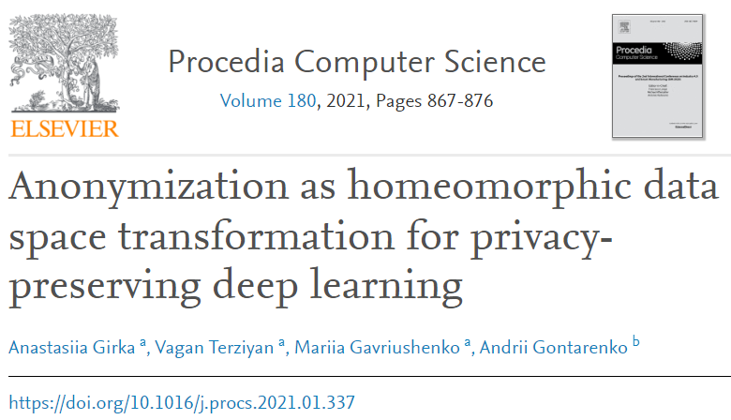
Input for this study
In Girka et al. (2021), we suggested a homeomorphic encryption as a homeomorphic transformation of labelled data with the secret transformation parameters as encryption keys. The intended objective was the possibility to use such encrypted data for PPML and particularly for safe supervised learning at third party servers (clouds). We performed a topology-preserving transformation of the original data as a kind of anonymization technique, which uses deep feedforward neural network (aka perceptron) to hide (by topology-preserving replacement) the coordinates (numeric attribute values) sensitive or private data samples but still enables potential classification model to be learned on the basis of the anonymized data. Such homeomorphic encryption applied on top of n-dimensional data manifold performed appropriate secret-key $n×n$ non-singular matrices (neural network weights) multiplication and invertible activation function at each layer. After several layers of such transformation, we will still keep the topologically equivalent (to the original one) data manifold, which hides private values of the data but preserves the labelling structure of the data needed to build the correct classification models.
Girka, A., Terziyan, V., Gavriushenko, M., & Gontarenko, A. (2021). Anonymization as Homeomorphic Data Space Transformation for Privacy-Preserving Deep Learning. Procedia Computer Science, 180, 867-876. Elsevier. https://doi.org/10.1016/j.procs.2021.01.337

Slide 16
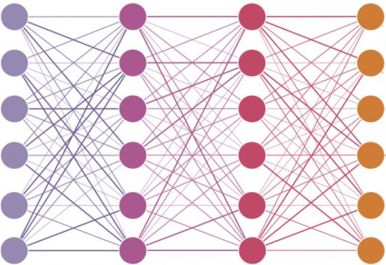
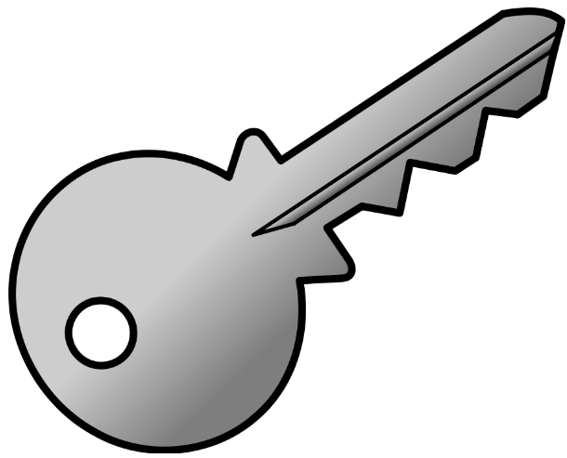
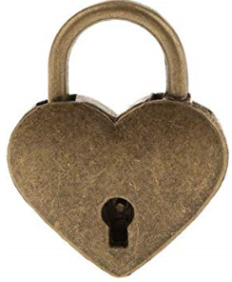
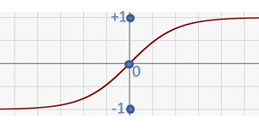
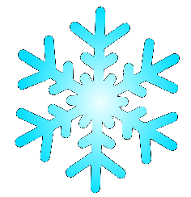
Anonymizer as a Deep Neural Network
with “frozen” secret parameters
Data
Data
Not safe for Machine Learning
Safe for Machine Learning
Several fully-connected anonymization layers aka deep neural network with frozen secret weights-and-biases-as-keys and non-linear invertible activation functions

Slide 17
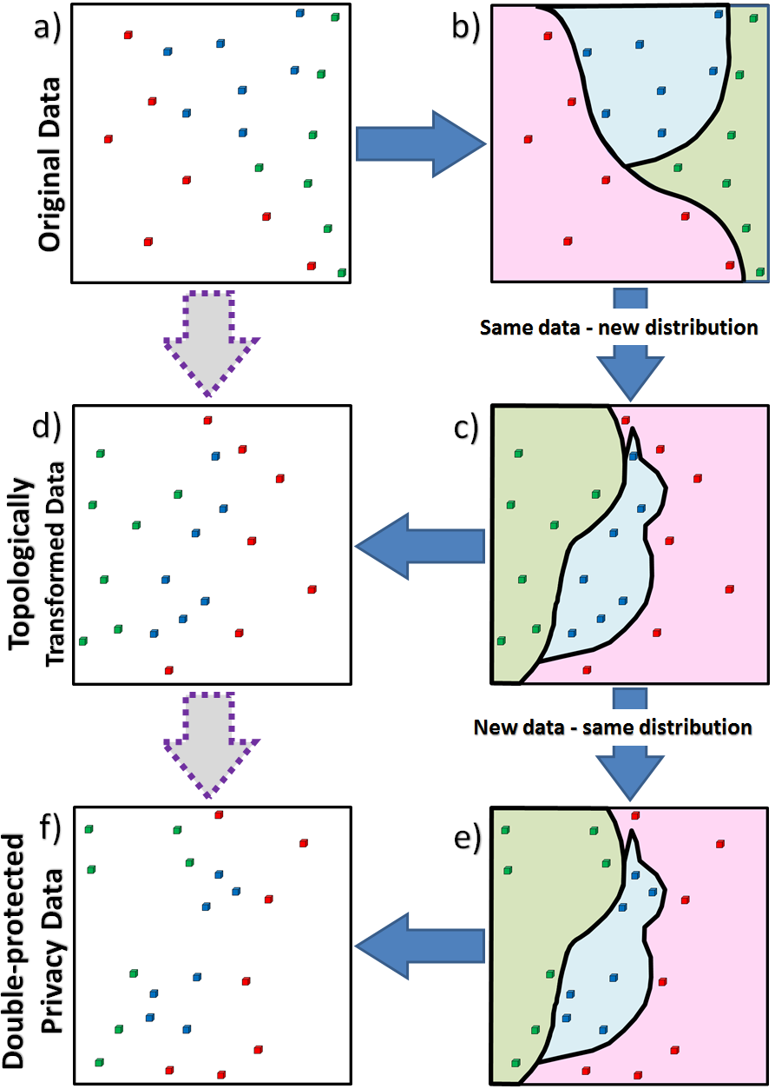
Homeomorphic encryption combined with synthetic data generation
Illustration of the homeomorphic data space transformation and synthetic data generation processes and their sequential use as a hybrid PPML process:
example of the original (private) data labelled into three classes (“green”, “blue” and “red”) in 2D space;
distribution of the original data is illustrated by the decision boundaries between the classes, which could be potentially learned by some ML algorithm;
the result of the homeomorphic data space transformation, which changes the distribution of the original data, relocates each data sample and corresponding decision boundaries;
shows the original data samples but relocated due to homeomorphic transformation for privacy reasons;
the synthetic data generation is illustrated, which preserves the distribution of data (i.e., creates new data samples for each class in new locations but not changing the decision boundaries);
the result of synthetic data generation is shown, which guarantees the double protection of the original private data (a) due to relocation of private samples and then replacing them with the arbitrary number of synthetic samples.

Slide 18
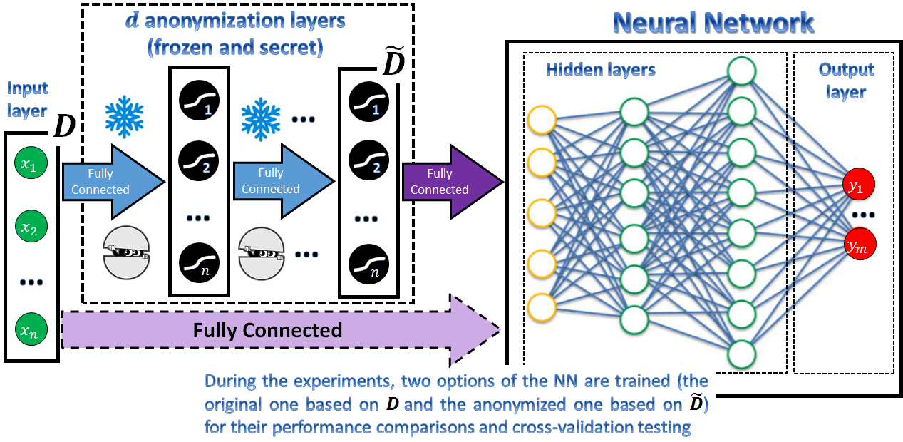
Topological (homeomorphic) encryption: schema of experimental evaluation

Slide 19
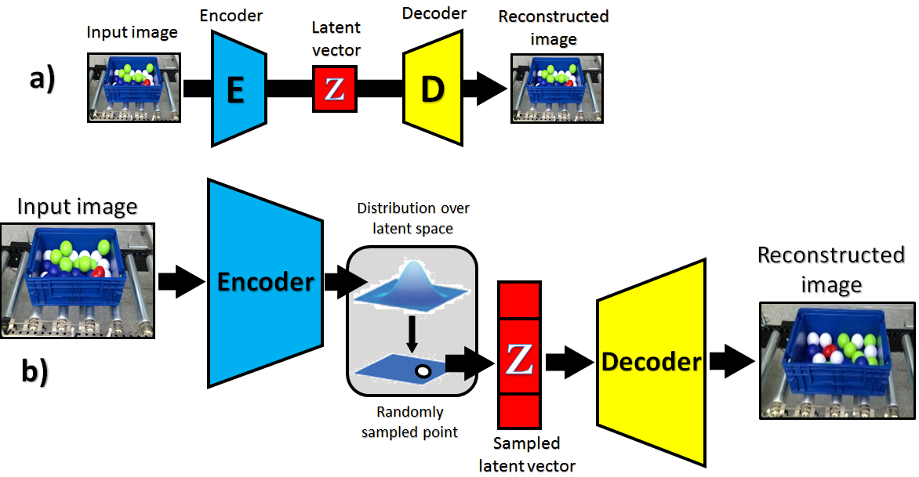
Can we apply homeomorphic encryption also to the images using, e.g., autoencoders?
An autoencoder is a type of deep learning network that is trained to replicate its input data. A basic or simple autoencoder consists of two networks: Encoder and Decoder (see (a)). The training process is organized so that the Encoder (having some image as an input) learns a set of hidden-within-image features, shown as a latent vector in (a). Simultaneously, the Decoder is trained to reconstruct the original image based on the latent vector. The more image-generation-specific option of an autoencoder (an alternative to popular Generative Adversarial Networks) is a variational autoencoder (b). It assumes the development of a low-dimensional latent vector space of representations (see (b)) where each point can be mapped to a realistically looking image. The role of such mapping (latent vector – grid of pixels for an image) is played by the Decoder.
Autoencoders:
the basic (e.g., convolutional) autoencoder;
[convolutional] variational autoencoder.

Slide 20
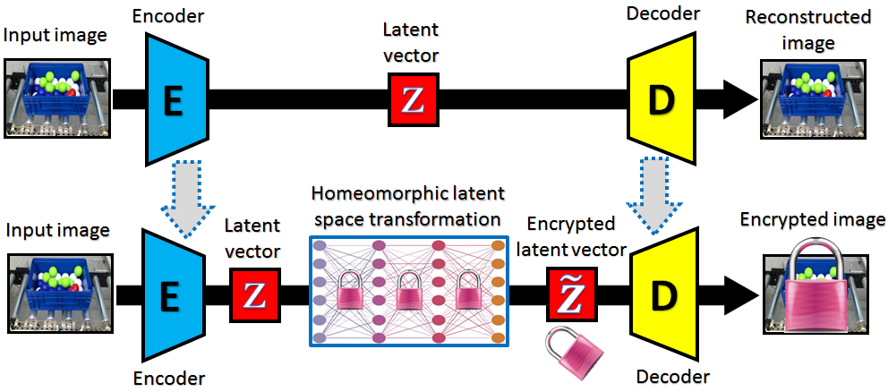
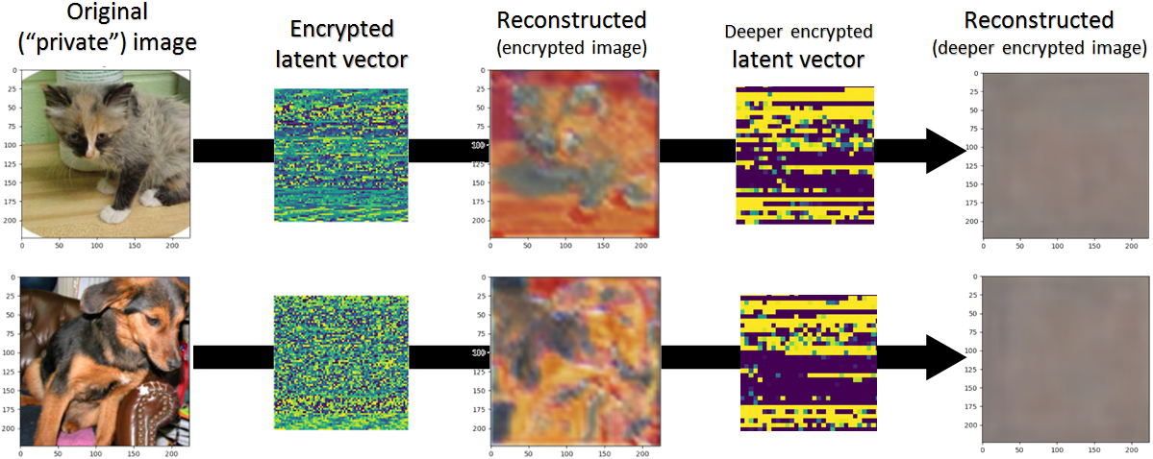
Topological (homeomorphic) encryption is doable also with private image data
The homeomorphic latent space transformation as a PPML approach to encrypt the images using a convolutional autoencoder.
Figure illustrates the result of applying the convolutional (driven by VGG-11 family of neural architectures) autoencoder for image encryption via homeomorphic transformation of the latent space. One can see that the private information from the original image can be safely hidden. Classification with the encrypted by this way images is possible yet gives slightly lower classification accuracy comparably to the pre-trained feature extractors.

Slide 21
Experimental evaluation
For the experiments with the much more powerful (than VGG-11) and pre-trained feature extractors, we have chosen the ResNet architecture [29] according to the configuration ResNet-18, see, e.g. [30], which has been pretrained for the Kaggle (www.kaggle.com/datasets/pytorch/resnet18). Extracted and encrypted feature vectors for Kaggle dataset have been used for image classification and show better classification accuracy comparably to the feature vectors extracted by the convolutional autoencoder, as can be seen from the table. One can see that there is almost no accuracy loss within the classification tasks in safe (three layers of deep encryption) dataset comparably to the original dataset. Therefore, if there is no need to visualize and show the encrypted images, then the feature extractors are the better choice to assist PPML with the homeomorphic transformation algorithm.
The source code and more details related to the Kaggle dataset encryption experiments together with the corresponding plots and figures can be found in https://github.com/Adversarial-Intelligence-Group/image-encryption .
[29] He, K., Zhang, X., Ren, S., and Sun, J. (2016). “Deep residual learning for image recognition”. In: Proceedings of the IEEE Conference on Computer Vision and Pattern Recognition (pp. 770-778).
[30] Wang, S., Xia, X., Ye, L., and Yang, B. (2021). “Automatic detection and classification of steel surface defect using deep convolutional neural networks”. Metals, 11(3), 388.

Slide 22
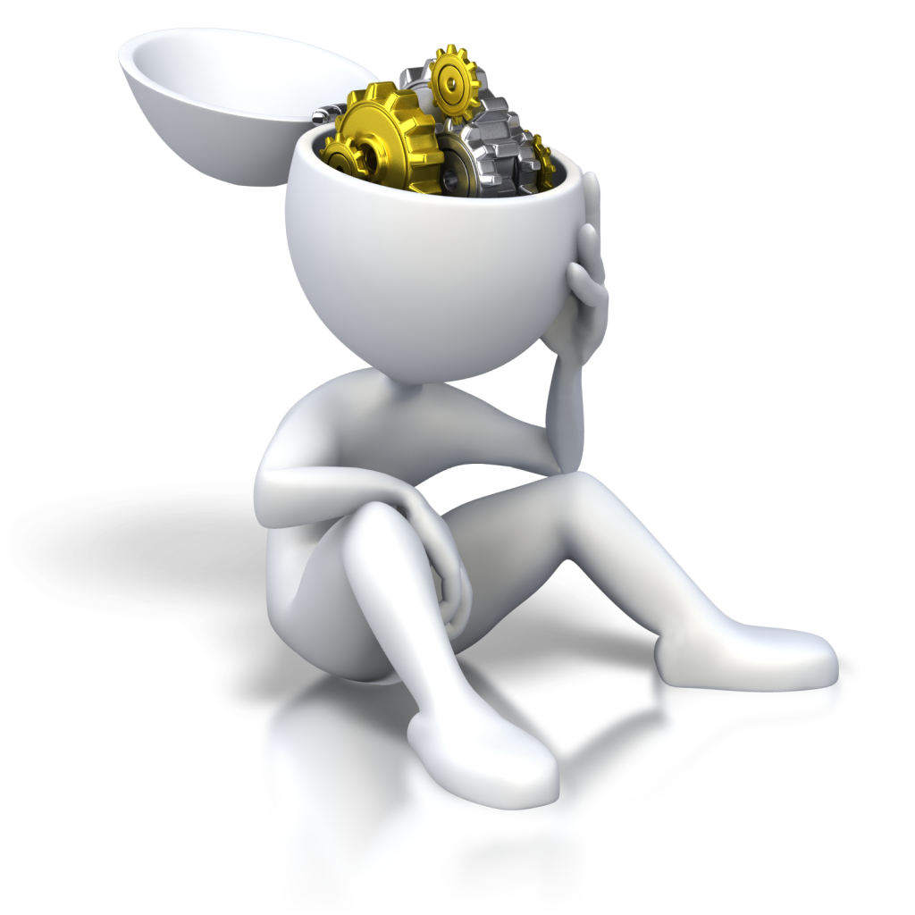
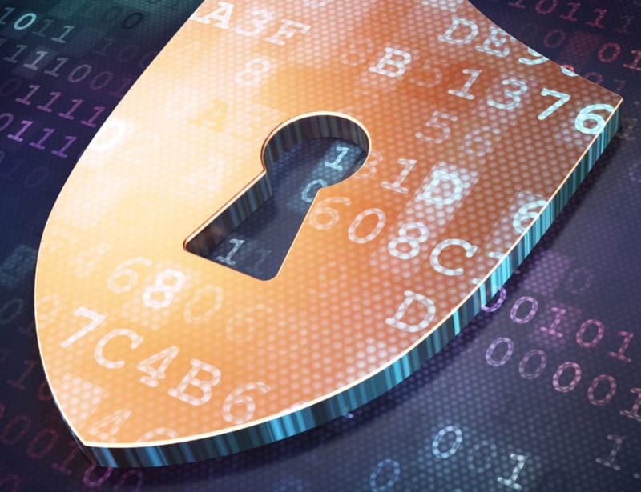
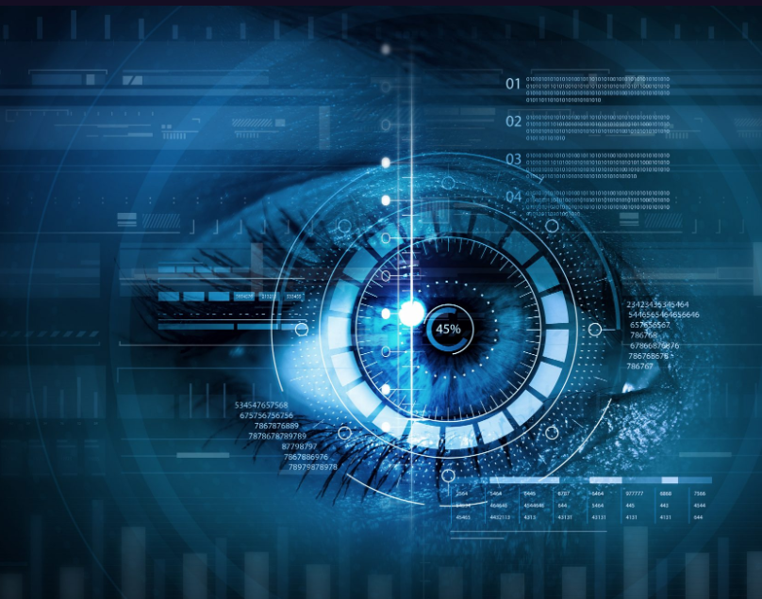
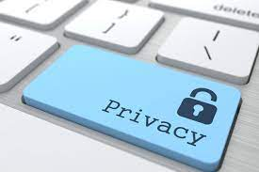
Conclusions
Image data (compared to the traditional tabular data) has certain specifics (features of images are hidden behind the pixels), which is the challenge for the mentioned PPML options. In this study, we have expanded the scope of the homeomorphic data space transformation algorithm to be also applied to image data. Privacy of an image is achieved by special encryption of the correspondent latent (feature) vector, obtained using convolutional autoencoders or more powerful pre-trained feature extractors. Such a PPML approach guarantees security of private data in the images and, at the same time, does not exclude the possibility to apply ML on top of the encrypted images;
In this paper, we also show that combining a homeomorphic data space (latent vector space for the images) transformation with a synthetic data generation (via convolutional variational autoencoders for the images) into one hybrid PPML process will essentially improve privacy. This is due to the fact that such a hybrid inherits the advantages of both components and eliminates most of the shortcomings of each one. For example, such a hybrid is capable of generating the well-protected synthetic images even on the basis of a relatively small number of the available original data samples, which is a problem if you apply the synthetic image generation alone without the encryption phase. Also, the leakage of the encryption keys, which is a problem with the encryption algorithm applied alone, will not be a problem for a hybrid due to the additional (synthetic image generation) PPML stage;
The source code and more additional illustrations for some of our image encryption experiments are available online at https://github.com/Adversarial-Intelligence-Group/image-encryption .

Slide 23
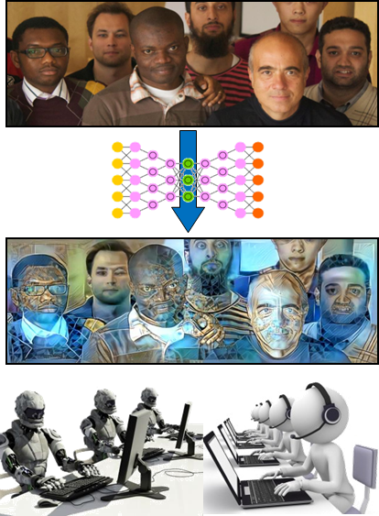
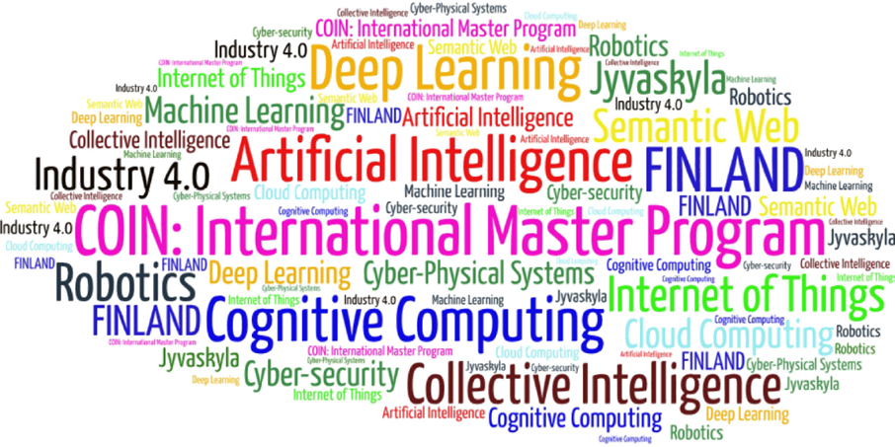
Come to study at our International Master Program
COIN: Cognitive Computing and Collective Intelligence …
… the first university program for collective intelligence, where humans learn together with their digital clones and autonomous digital assistants …
http://www.jyu.fi/ai
COIN

Slide 24
Link to the presentation: https://ai.it.jyu.fi/ISM-2022-Image_Encryption.pptx
See also: https://github.com/Adversarial-Intelligence-Group/image-encryption
Contact: vagan.terziyan@jyu.fi

Slide 25
4th International Conference on Industry 4.0 and Smart Manufacturing – ISM 2022
Upper Austria University of Applied Science – Hagenberg Campus – Linz, Austria
Blended Conference | 2-4 November 2022
Thank you!
“Encryption and Generation of Images for Privacy-Preserving Machine Learning in Smart Manufacturing”
Vagan Terziyan ª, Diana Malyk ^{b}, Mariia Golovianko ^{c} , Vladyslav Branytskyi ^{d}
ª Faculty of Information Technology, University of Jyväskylä, Jyväskylä, Finland
^{b,c,d} Department of Artificial Intelligence, Kharkiv National University of Radio Electronics, Kharkiv, Ukraine
Contacts
ª vagan.terziyan@jyu.fi , ^{b} diana.malyk@nure.ua , ^{c} mariia.golovianko@nure.ua , ^{d} vladyslav.branytskyi@nure.ua
Link to complete slide-set:
https://ai.it.jyu.fi/ISM-2022-Image_Encryption.pptx
https://www.jyu.fi/en/
https://nure.ua/en/

