Slide 1
4th International Conference on Industry 4.0 and Smart Manufacturing – ISM 2022
Upper Austria University of Applied Science – Hagenberg Campus – Linz, Austria
Blended Conference | 2-4 November 2022
“Industry 4.0 vs. Industry 5.0: Co-existence, Transition, or a Hybrid”
Mariia Golovianko ª , Vagan Terziyan ^{b}, Vladyslav Branytskyi ^{c}, Diana Malyk ^{d}
^{a,c,d} Department of Artificial Intelligence, Kharkiv National University of Radio Electronics, Kharkiv, Ukraine
^{b} Faculty of Information Technology, University of Jyväskylä, Jyväskylä, Finland
https://www.jyu.fi/en/
https://nure.ua/en/

Slide 2
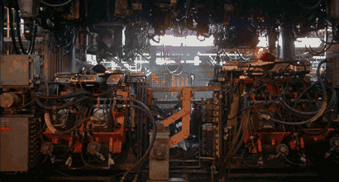
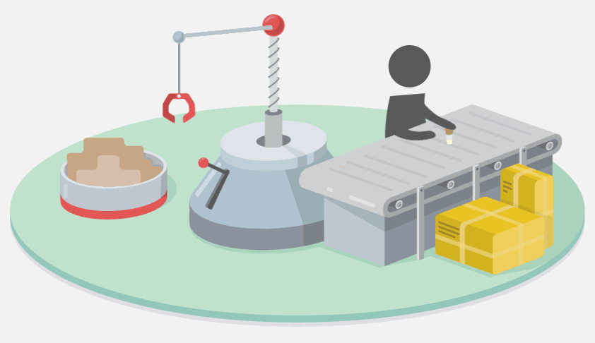
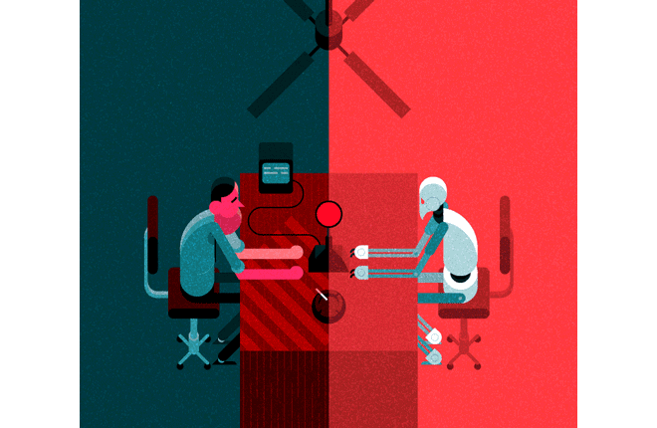
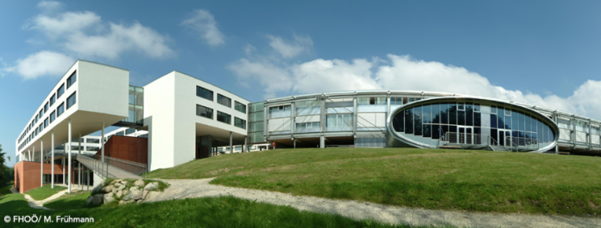
“Industry 4.0 vs. Industry 5.0:
Co-existence, Transition, or a Hybrid”
Paper # 6907
Mariia Golovianko, Vagan Terziyan, Vladyslav Branytskyi & Diana Malyk
University of Applied Science, Linz, Austria
2 November, 2022, 14:30 - 14:50
ISM 2022
International Conference on Industry 4.0
and Smart Manufacturing
Section/Room:
S 3.1 - HUMAN / Room: HS₄

Slide 3
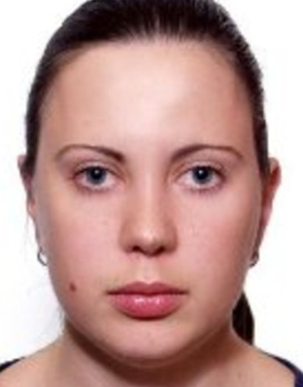
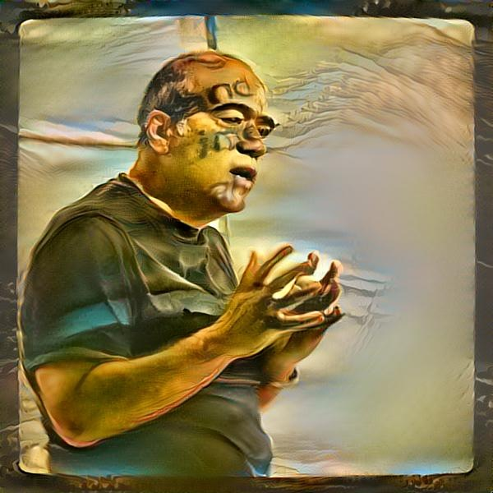
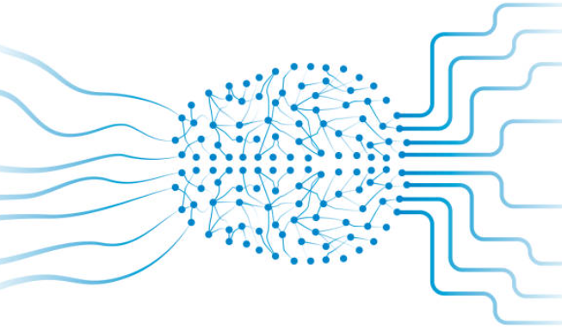
Authors
Mariia Golovianko
Vladyslav Branytskyi
Diana Malyk
“Industry 4.0 vs. Industry 5.0: Co-existence, Transition, or a Hybrid”
Vagan Terziyan
vagan.terziyan@jyu.fi
https://nure.ua/en/
https://www.jyu.fi/en/

Slide 4
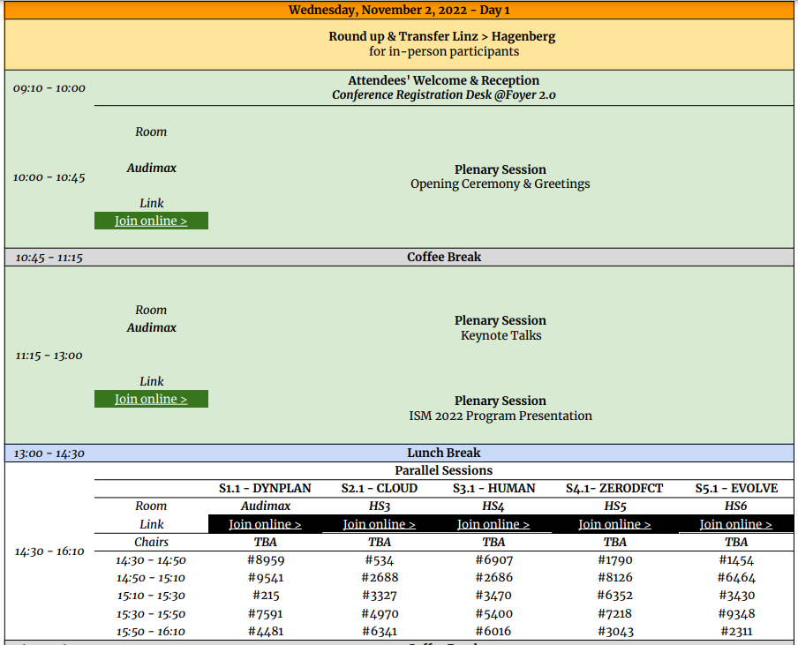
https://www.msc-les.org/conf/ism2022/ISM2022_ProgramAtAGlance.pdf
https://www.msc-les.org/ism2022/program-at-a-glance/
https://teams.microsoft.com/l/meetup-join/19%3a597406ead01b4145a81b4c3dde2052b5%40thread.tacv2/1664999995348?context=%7b%22Tid%22%3a%227519d0cd-2106-47d9-adcb-320023abff57%22%2c%22Oid%22%3a%229f6efedb-1e10-4496-942f-92bdb2ba849d%22%7d
https://teams.microsoft.com/dl/launcher/launcher.html?url=%2F_%23%2Fl%2Fmeetup-join%2F19%3A597406ead01b4145a81b4c3dde2052b5%40thread.tacv2%2F1664999995348%3Fcontext%3D%257b%2522Tid%2522%253a%25227519d0cd-2106-47d9-adcb-320023abff57%2522%252c%2522Oid%2522%253a%25229f6efedb-1e10-4496-942f-92bdb2ba849d%2522%257d%26anon%3Dtrue&type=meetup-join&deeplinkId=c0dfd816-d2b0-4b2e-bf4a-c9c532b50103&directDl=true&msLaunch=true&enableMobilePage=true&suppressPrompt=true
https://teams.microsoft.com/dl/launcher/launcher.html?url=%2F_%23%2Fl%2Fmeetup-join%2F19%3A597406ead01b4145a81b4c3dde2052b5%40thread.tacv2%2F1664999995348%3Fcontext%3D%257b%2522Tid%2522%253a%25227519d0cd-2106-47d9-adcb-320023abff57%2522%252c%2522Oid%2522%253a%25229f6efedb-1e10-4496-942f-92bdb2ba849d%2522%257d%26anon%3Dtrue&type=meetup-join&deeplinkId=26c0497b-23d1-4149-b3aa-07425e7d046f&directDl=true&msLaunch=true&enableMobilePage=true&suppressPrompt=true
“Industry 4.0 vs. Industry 5.0: Co-existence, Transition, or a Hybrid”
ISM-2022_6907_Industry_4_5

Slide 6
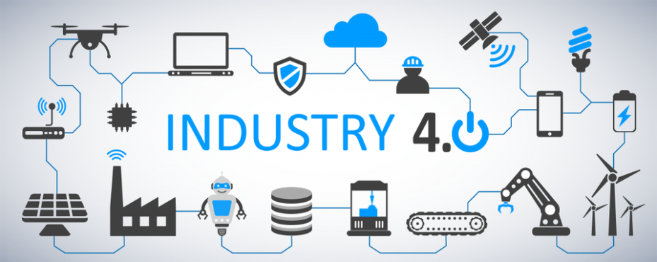
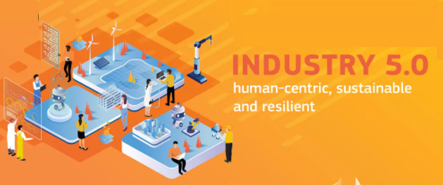
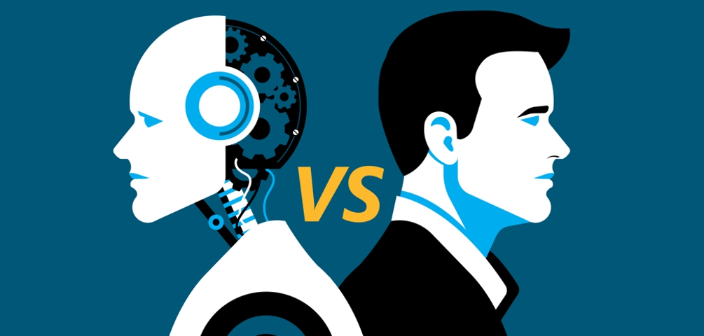
“Industry 4.0 vs. Industry 5.0” – is all about human role …
vs.
A popular view is that Industry 4.0 concept assumes a high share of automation in the decision-making processes and the Industry 5.0 concept assumes the recovery of the leading role of humans within the decision-making processes. Is these completely so? …

Slide 7
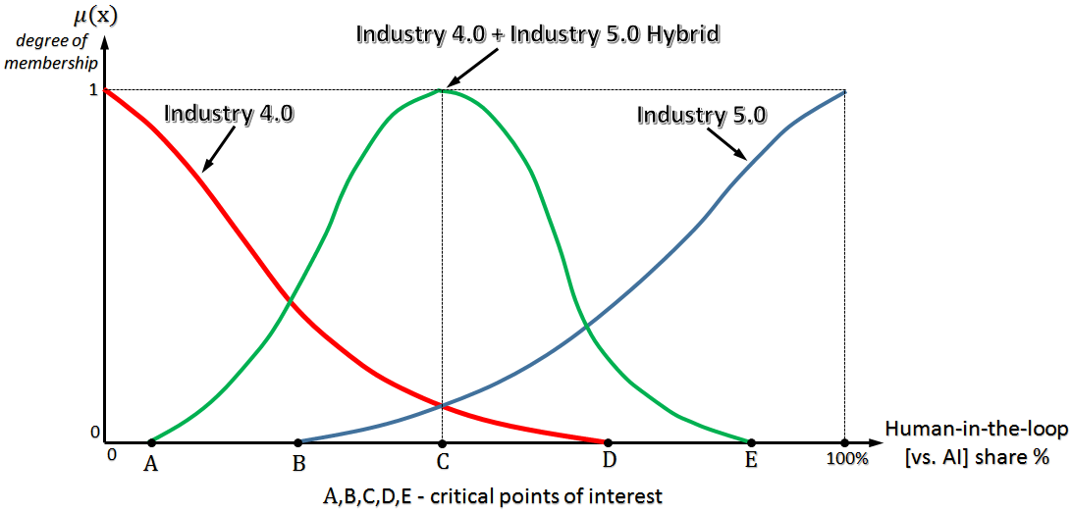
Concepts of Industry 4.0, Industry 5.0 and their potential hybrid visualized as fuzzy sets
Actually, the views and implementations of the Industry 4.0 are not completely supposed to have the “human-out-of-the-loop” slogan, and, similarly, the Industry 5.0 views and implementations are not implying the “human-back-into-the-loop” slogan completely. Both concepts are actually fuzzy and can be described by linguistic variables (according to fuzzy sets theory) …

Slide 8
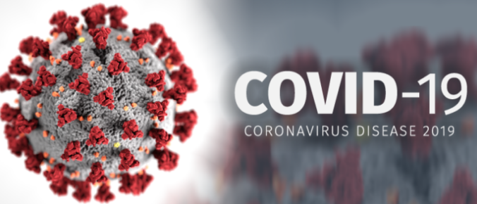
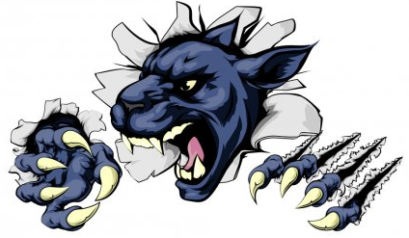
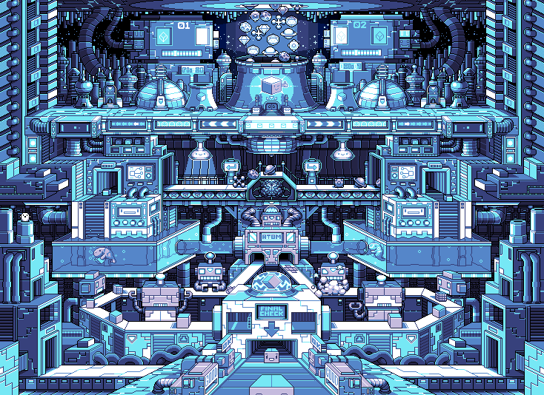
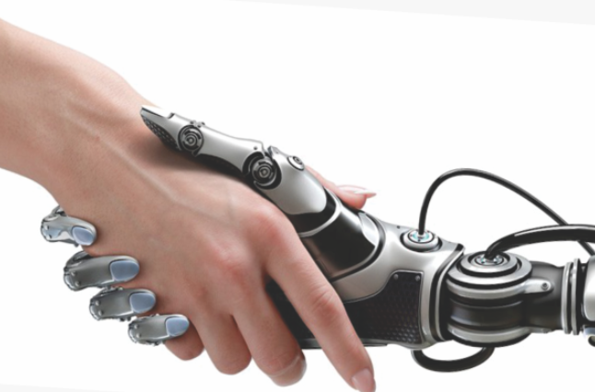
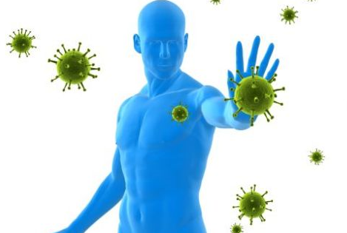
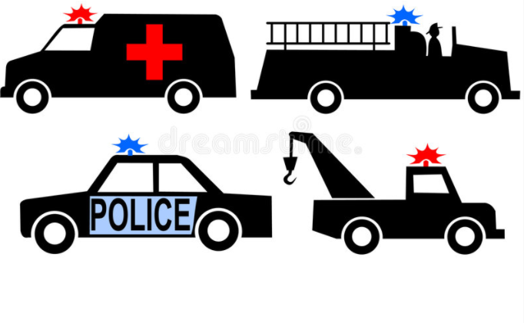
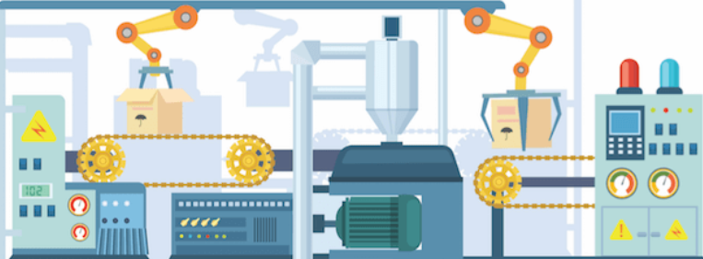
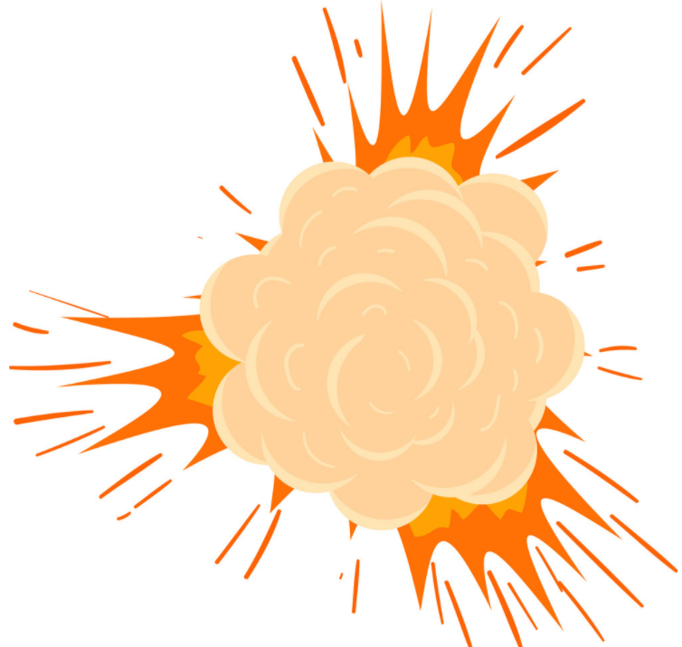
AI meets challenges …
Hybrid Threats
Artificial Intelligence as a digital recovery, sustainability and resilience enabler
I D U S T R Y
Cyberattacks
AI
Emergencies
Crashes

Slide 9
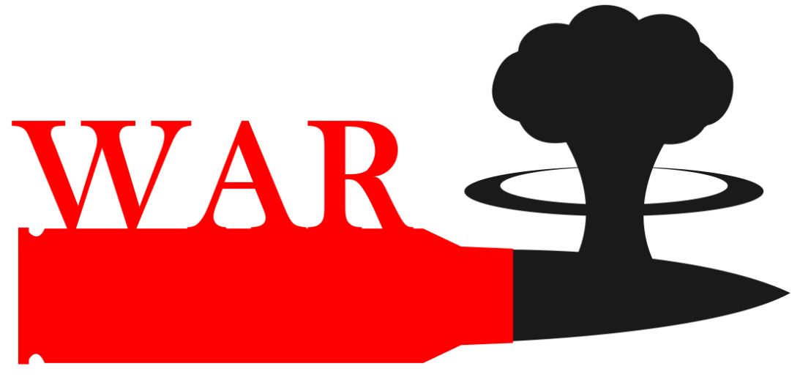
… these change Human + AI collaboration scenarios …
AI meets also the new challenges …
Artificial Intelligence as a digital recovery, sustainability and resilience enabler
I D U S T R Y
Refugee
AI
Crisis

Slide 10
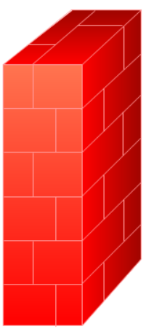
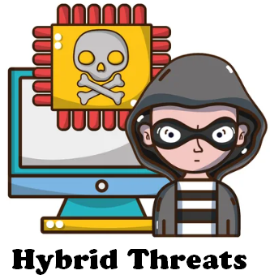
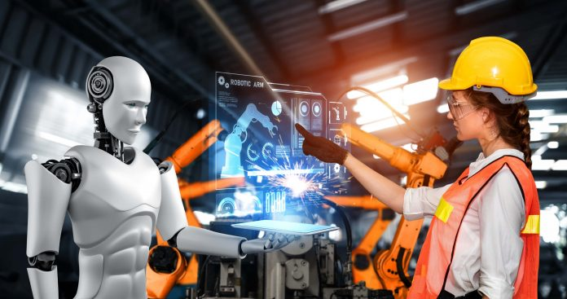
The need for resilience changes everything
AI vs. Human in Industry
Resilience
≈
AI strengths
Human vulnerabilities
Resilient Industry
≈
AI vulnerabilities
Human strengths

Slide 11
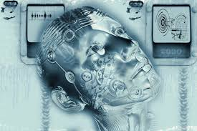
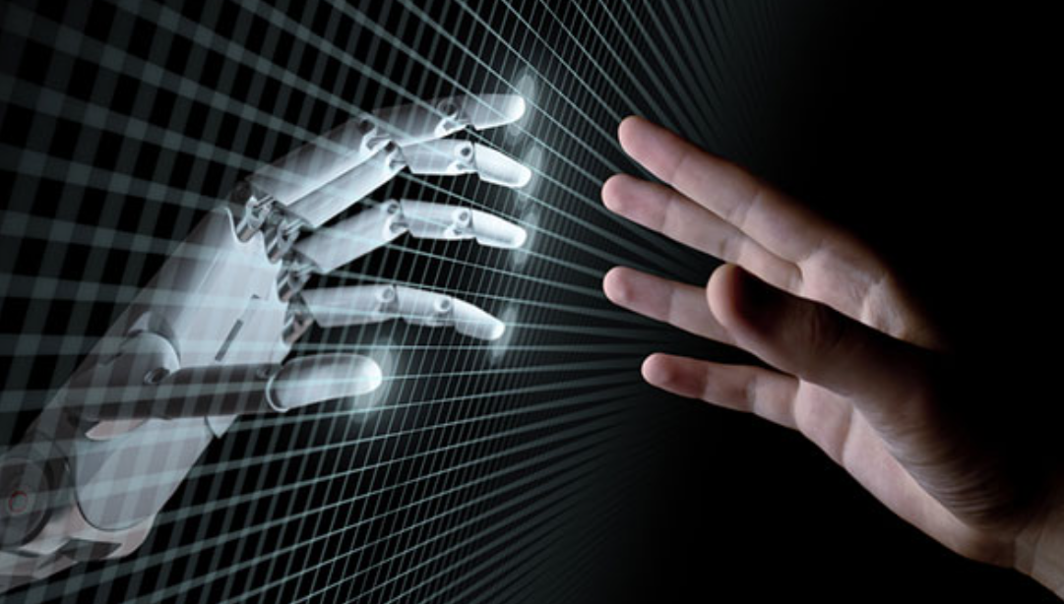
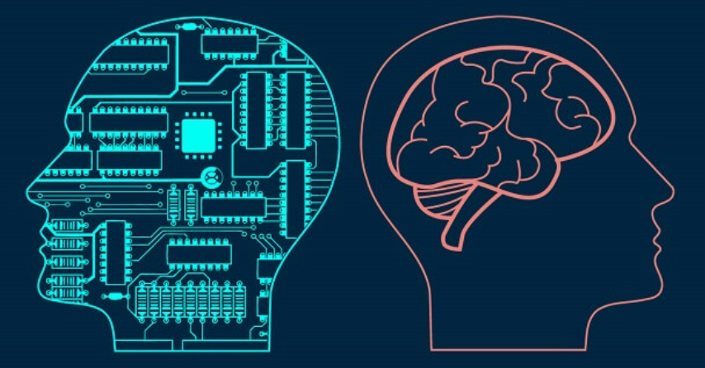
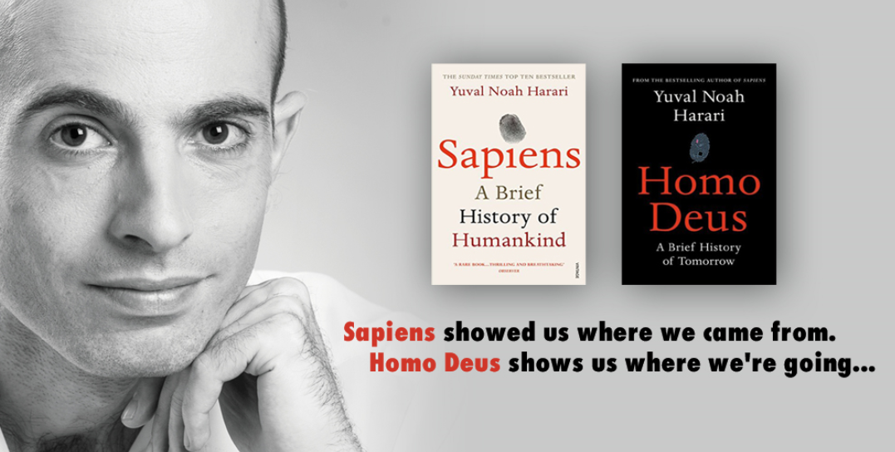
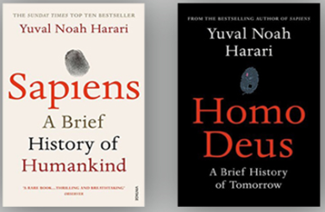
To enable resilient and efficient industry of the future we need a hybrid “Industry 4.0 + Industry 5.0” with the humans enhanced by autonomous AI technologies …
Resilient Industry
… and which will inherit the most valuable features of both - efficiency of the Industry 4.0 processes and sustainability of the Industry 5.0 decisions. Digital cognitive clones (i.e., twinning human decision-making behavior) could be an enabling technology for the future hybrid and as an accelerator (as well as resilience enabler) of the convergence of the digital and human worlds ...
21 Lessons shows us where we are today …

Slide 12
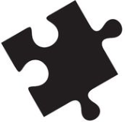
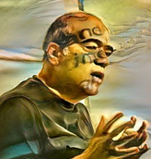
Enhancing human by ubiquitous access to the external capabilities via intelligent agents as proxy
SmartResource and UBIWARE as enablers:
http://www.cs.jyu.fi/ai/SmartResource_UBIWARE.html

Slide 13
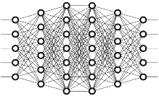
Enhancing human by smart, autonomous, personalized, trainable agent-driven capabilities
Gavriushenko, M., Kaikova, O., & Terziyan, V. (2020). Bridging Human and Machine Learning for the Needs of Collective Intelligence Development. Procedia Manufacturing, 42, 302-306. Elsevier. https://doi.org/10.1016/j.promfg.2020.02.092

Slide 14
Making human ubiquitous due to autonomous “clones”
Enhancing a human (or a system!) by making him/her ubiquitous and omniscient due to multiple autonomous clones capable to be present, self-develop and decide on human’s behalf synchronously within many processes
Terziyan, V., Gavriushenko, M., Girka, A., Gontarenko, A., & Kaikova, O. (2021). Cloning and Training Collective Intelligence with Generative Adversarial Networks. IET Collaborative Intelligent Manufacturing, 3(1), 64-74. John Wiley and Sons Ltd. https://doi.org/10.1049/cim2.12008

Slide 15
Enhancing humans by agent-driven, smart, autonomous cognitive immune system (aka personal security officer)
“poison”
Content from the environment
Terziyan, V., Golovianko, M., & Gryshko, S. (2018). Industry 4.0 Intelligence under Attack: From Cognitive Hack to Data Poisoning. In: K. Dimitrov (Ed.), Cyber Defence in Industry 4.0 Systems and Related Logistics and IT Infrastructure (NATO Science for Peace and Security Series D: Information and Communication Security, Vol. 51, pp. 110-125). IOS Press. https://doi.org/10.3233/978-1-61499-888-4-110
Enhancing a human or a system (process) by protecting it against inappropriate, adversarial, poisoned, etc., inputs and, therefore, protecting human’s or system’s knowledge, values and decision-making from “cognitive hacking”

Slide 16
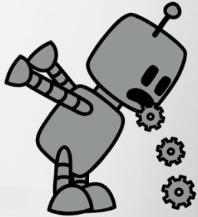
Enhancing disabled humans (systems) by autonomous, agent-driven, trainable complementary capabilities
Terziyan, V., & Kaikova, O. (2021). Neural Networks with Disabilities: An Introduction to Complementary Artificial Intelligence. Neural Computation, 34(1), 255-290. MIT Press Direct. https://doi.org/10.1162/neco_a_01449
Enhancing partially (temporarily) disabled human or a system (process) with specially trained, personalized, autonomous, smart complementary capabilities, which will compensate the lacking skills

Slide 17
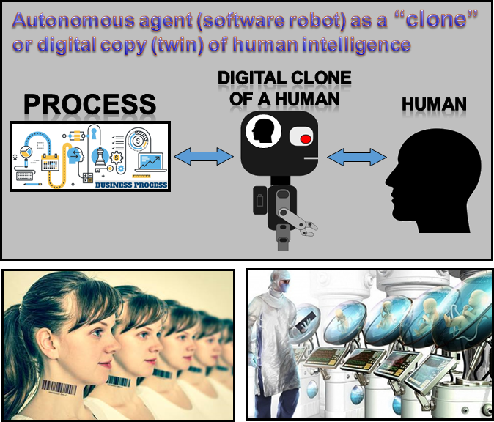
Patented Intelligence
(Pi-Mind)
Terziyan, V., Gryshko, S., & Golovianko, M. (2018). Patented Intelligence: Cloning Human Decision Models for Industry 4.0. Journal of Manufacturing Systems, 48 (Part C), 204-217. Elsevier. doi:10.1016/j.jmsy.2018.04.019
Cognitive cloning of humans
Golovianko, M., Gryshko, S., Terziyan, V., & Tuunanen, T. (2022). Responsible Cognitive Digital Clones as Decision Makers: A Design Science Research Study. European Journal of Information Systems.
https://doi.org/10.1080/0960085X.2022.2073278

Slide 18
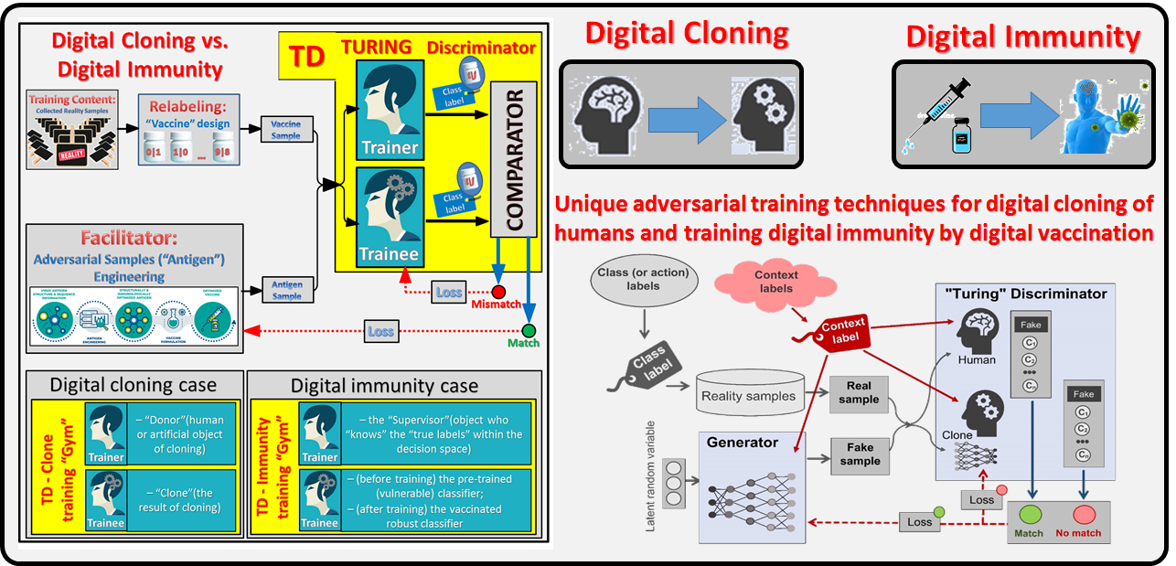
Adversarial training of a hybrid collective intelligence
Kaikova, O., Terziyan, V., Tiihonen, T., Golovianko, M., Gryshko, S., & Titova, L. (2022). Hybrid Threats against Industry 4.0: Adversarial Training of Resilience. E3S Web of Conferences, 353, 03004. https://doi.org/10.1051/e3sconf/202235303004
Branytskyi, V., Golovianko, M., Gryshko, S., Malyk, D., Terziyan, V., & Tuunanen, T. (2022). Digital Clones and Digital Immunity: Adversarial Training Handles Both. International Journal of Simulation and Process Modelling, 18(2), 124-139. https://doi.org/10.1504/IJSPM.2022.10048910

Slide 19
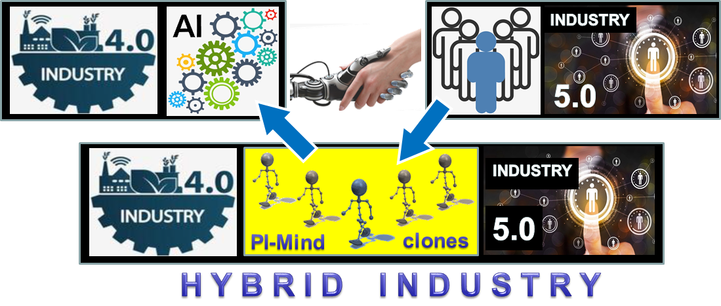
The concept of Industry 4.0 + Industry 5.0 hybrid (driven by Pi-Mind digital cognitive clones of humans)

Slide 20
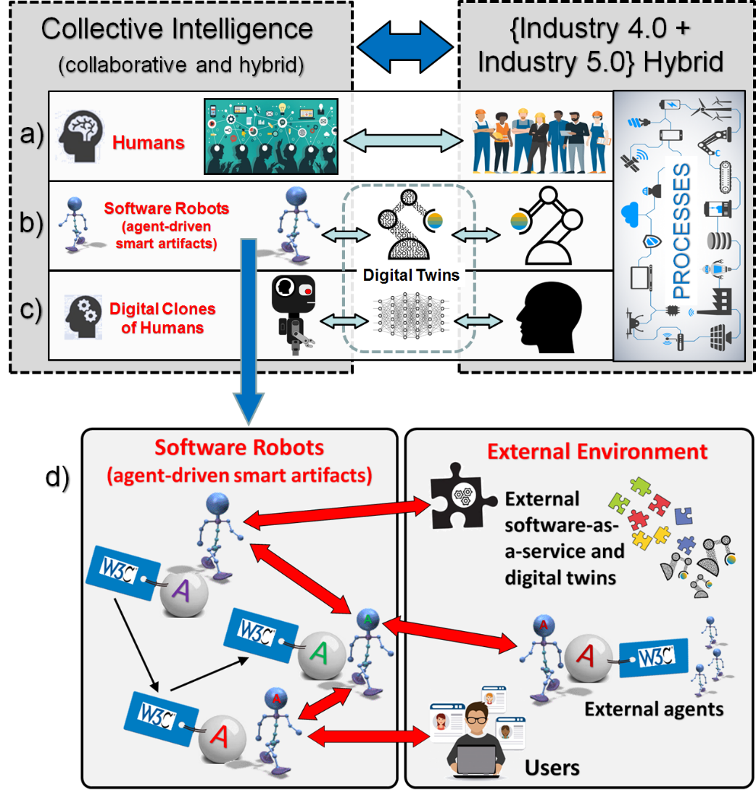
Generic schema of the collective intelligence components suitable for the Industry 4.0 – Industry 5.0 hybrid:
humans;
autonomous software robots as smart agent-driven artifacts (physical, digital, social or abstract);
digital (cognitive) clones of humans;
smart components from the external environment mediated by software robots.

Slide 21
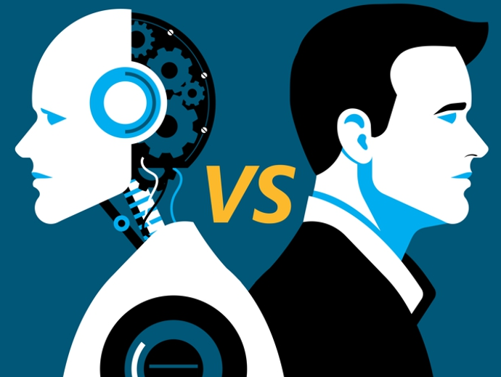
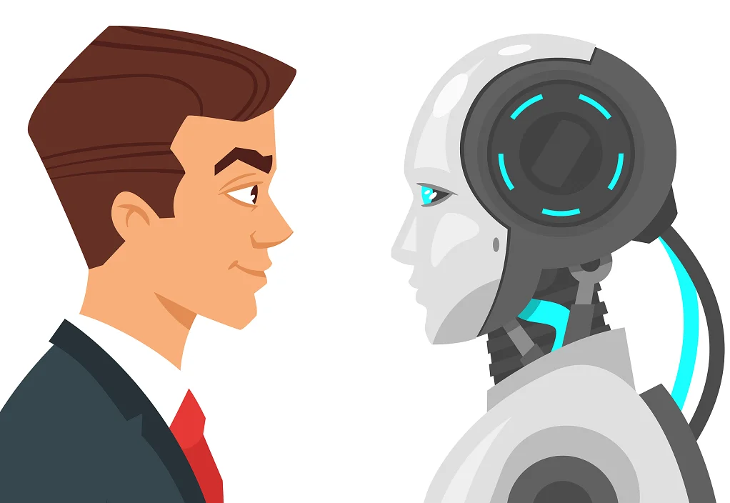
Conclusions
We recall an old and timeless “robots vs. humans” issue (particularly “efficiency and ubiquity vs. humanism and responsibility”) in the new “Industry 4.0 vs. Industry 5.0” context. On the one hand, current global challenges and crises require human-in-the-loop (supported by the Industry 5.0 concept) for responsible decision-making in new, challenging, complex and critical situations related to the secure control of smart manufacturing processes. On the other hand, the same challenges require efficient (fast and sustainable) control driven by ubiquitous autonomous automation (supported by the Industry 4.0 concept). Whether it is possible to create a sustainable hybrid integrating both concepts into one? Our answer is yes. This is possible due to the recently appeared digital artifacts, such as, cognitive clones (the core of the Industry 4.0 + Industry 5.0 hybrid ideology) and enabling technologies, such as, autonomous AI, cognitive cloning and adversarial learning;
A digital cognitive clone of a human decision-maker is an industrial compromise in the “robots vs. humans” dilemma, serving as a bridging concept to marry automation-centric Industry 4.0 and human-centric Industry 5.0. Cognitive clones, as smart bridging technological artifacts, keep particular humans (donors for the clones) within the loop of responsible decision-making processes and, at the same time, make such human involvement ubiquitous and, therefore, efficient;
Therefore, as a summary, we claim that: while the Industry 4.0 concept assumes a high share of automation in the decision-making and the Industry 5.0 concept assumes the leading role of humans in the decision-making, the Industry 4.0 + Industry 5.0 hybrid assumes collective (hybrid) intelligence to be the decision-making driver (efficient, ubiquitous, human-centric, responsible and resilient).

Slide 22
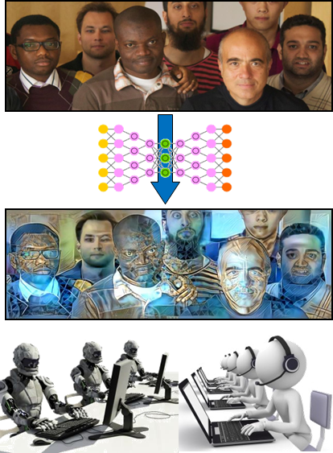
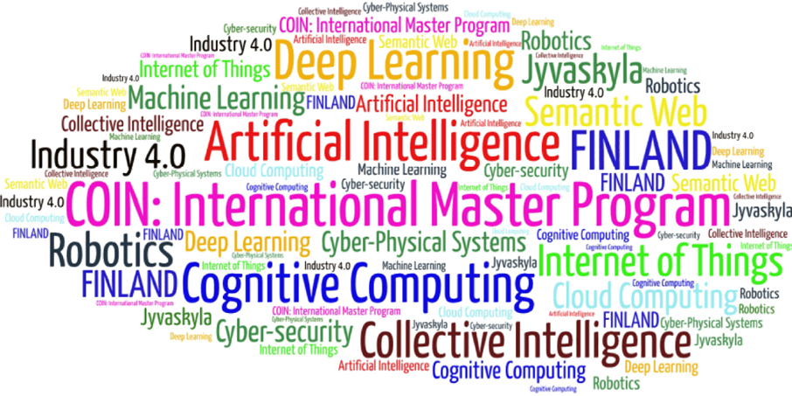
Come to study at our International Master Program
COIN: Cognitive Computing and Collective Intelligence …
… the first university program for collective intelligence, where humans learn together with their digital clones and autonomous digital assistants …
http://www.jyu.fi/ai
COIN

Slide 23
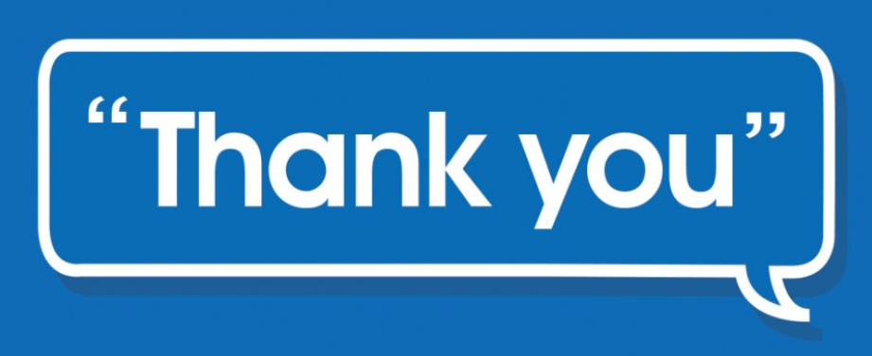
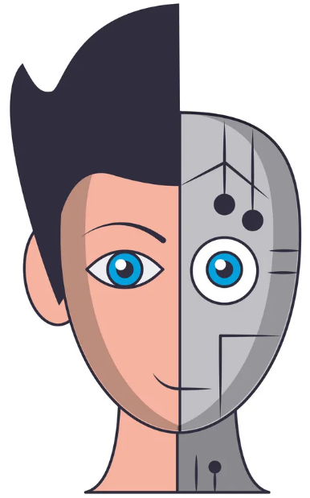
Link to the presentation: https://ai.it.jyu.fi/ISM-2022-Industry_4_5.pptx
Contact: mariia.golovianko@nure.ua ; vagan.terziyan@jyu.fi

Slide 24
4th International Conference on Industry 4.0 and Smart Manufacturing – ISM 2022
Upper Austria University of Applied Science – Hagenberg Campus – Linz, Austria
Blended Conference | 2-4 November 2022
Thank you!
“Industry 4.0 vs. Industry 5.0: Co-existence, Transition, or a Hybrid”
Mariia Golovianko ª , Vagan Terziyan ^{b}, Vladyslav Branytskyi ^{c}, Diana Malyk ^{d}
^{a,c,d} Department of Artificial Intelligence, Kharkiv National University of Radio Electronics, Kharkiv, Ukraine
^{b} Faculty of Information Technology, University of Jyväskylä, Jyväskylä, Finland
Contacts
ª mariia.golovianko@nure.ua, ^{b} vagan.terziyan@jyu.fi , ^{c} vladyslav.branytskyi@nure.ua , ^{d} diana.malyk@nure.ua
Link to complete slide-set:
https://ai.it.jyu.fi/ISM-2022-Industry_4_5.pptx
https://www.jyu.fi/en/
https://nure.ua/en/

