Slide 1
5th International Conference on Industry 4.0 and Smart Manufacturing – ISM 2023
Iscte - University Institute of Lisbon –Lisbon, Portugal | 22-24 November 2023
“Creative and Adversarial Cellular Automata for Simulating Resilience in Industry 5.0”
Vagan Terziyan ª, Artur Terziian ^{b}, Oleksandra Vitko ^{c}
ª Faculty of Information Technology, University of Jyväskylä, Jyväskylä, Finland
^{b} Private Lyceum “Professional”, Kharkiv, Ukraine
^{c} Department of Artificial Intelligence, Kharkiv National University of Radio Electronics, Kharkiv, Ukraine
https://www.jyu.fi/en/
http://lyceum-prof.at.ua/
https://nure.ua/en/

Slide 2
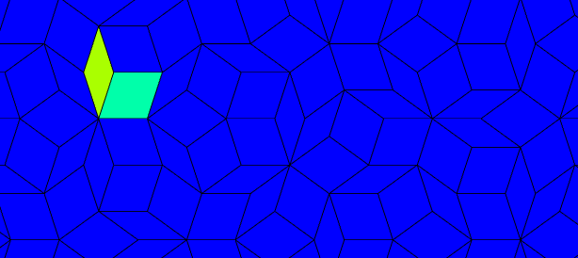
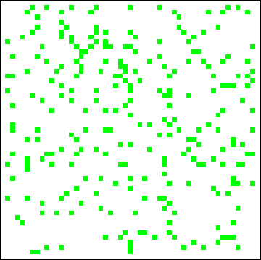
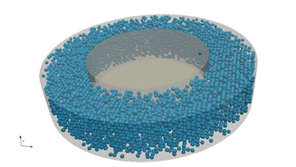
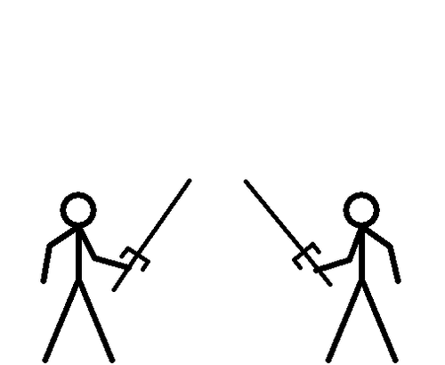
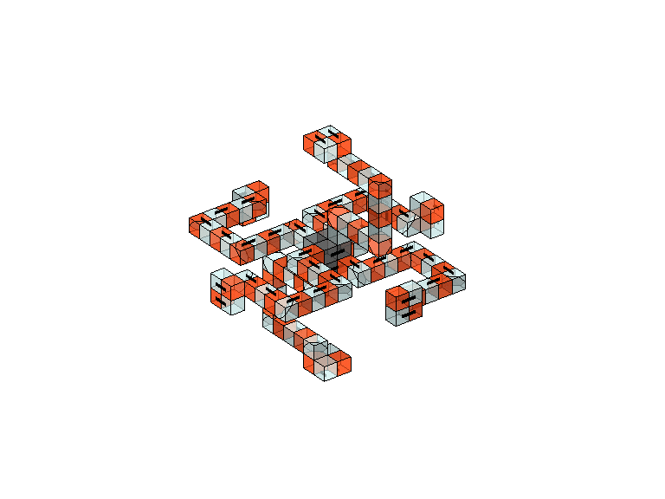
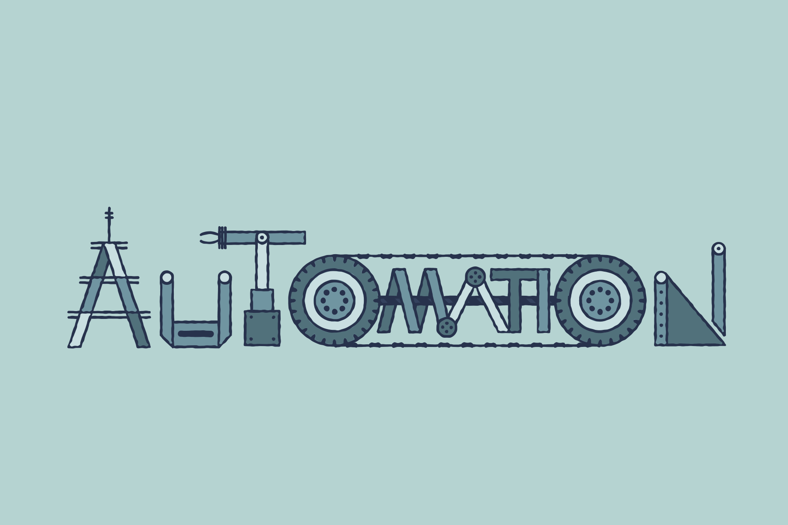
War and peace
Cellular
“Creative and Adversarial Cellular Automata for Simulating Resilience in Industry 5.0”
Paper # 4536
Vagan Terziyan, Artur Terziian & Oleksandra Vitko
Iscte - University Institute of Lisbon
24 November, 2023, 10:30 - 10:50
ISM 2023
International Conference on Industry 4.0
and Smart Manufacturing
Section/Room: S7.R4
S7 (RESILIENCE) / R4

Slide 3
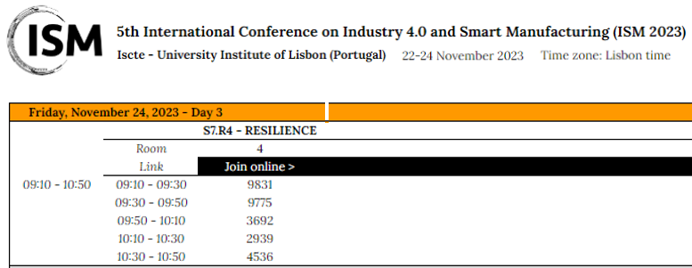

Slide 4
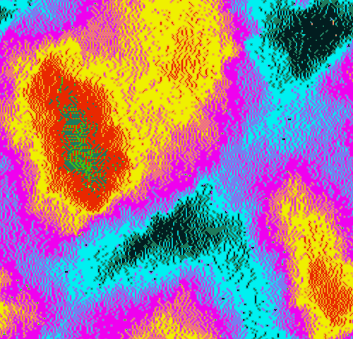
Vagan Terziyan
Authors
vagan.terziyan@jyu.fi
“Creative and Adversarial Cellular Automata for Simulating Resilience in Industry 5.0”
Artur Terziian
Oleksandra Vitko
http://lyceum-prof.at.ua/
https://www.jyu.fi/en/
https://nure.ua/en/

Slide 5
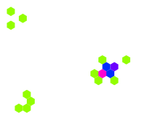
Cellular Automata? What is so special about it?
Cellular automata (CA) are computationally universal mathematical models (elementary, totalistic, stochastic, discrete or continuous, reversible or not, multidimensional, etc.) that consist of a grid of cells, each of which can be in one of a finite number of states. These cells are updated in discrete time steps based on a set of rules that define how the cells’ states evolve over time. The rules typically depend on the states of the cell’s neighboring cells. Therefore, CA are used to describe the behavior of a system made up of many interacting components, where each component is updated based on a set of rules that depend on its neighboring components. Cellular automata, depending on their type, can provide valuable insights into various complex systems, helping manufacturers and other organizations make better decisions and optimize their operations for maximum efficiency and profitability.
These specific properties, which make CA suitable for many industrial applications, are as follows:
local interactions (CA models are based on simple local interactions between individual cells, which can be easily programmed and simulated. These interactions can be described using simple rules and can be easily modified to model complex behaviors);
emergent behavior (the complex, emergent, and difficult to predict behavior of a CA system emerges from the local interactions of individual cells);
scalability (CA models can be scaled up or down depending on the complexity of the system being modeled); parallel processing (CA models can be efficiently simulated using parallel processing techniques. This makes them suitable for simulating large systems with many cells or agents);
modularity (CA models can be modularized, allowing different components of the system to be modeled separately and then integrated into a larger model); and …
flexibility (CA models can be easily modified and adapted to model different systems and scenarios. This makes them useful for simulating and testing different designs and scenarios before implementing them in the real world).

Slide 6
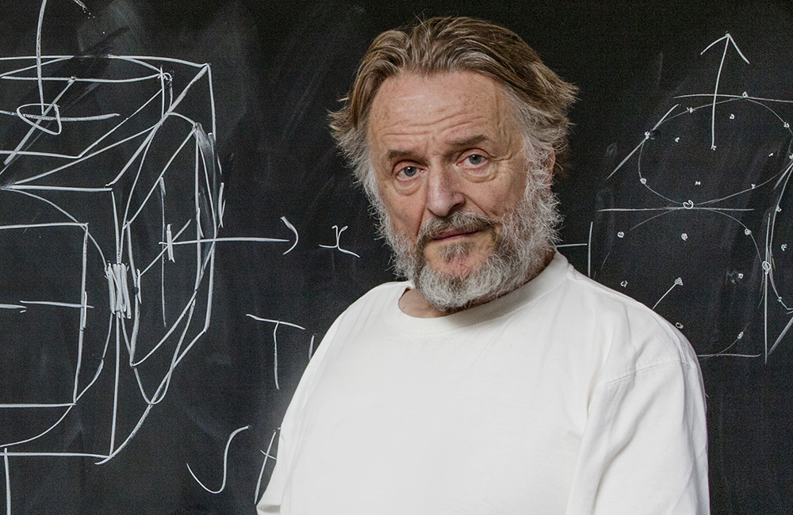
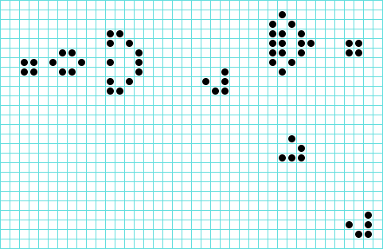
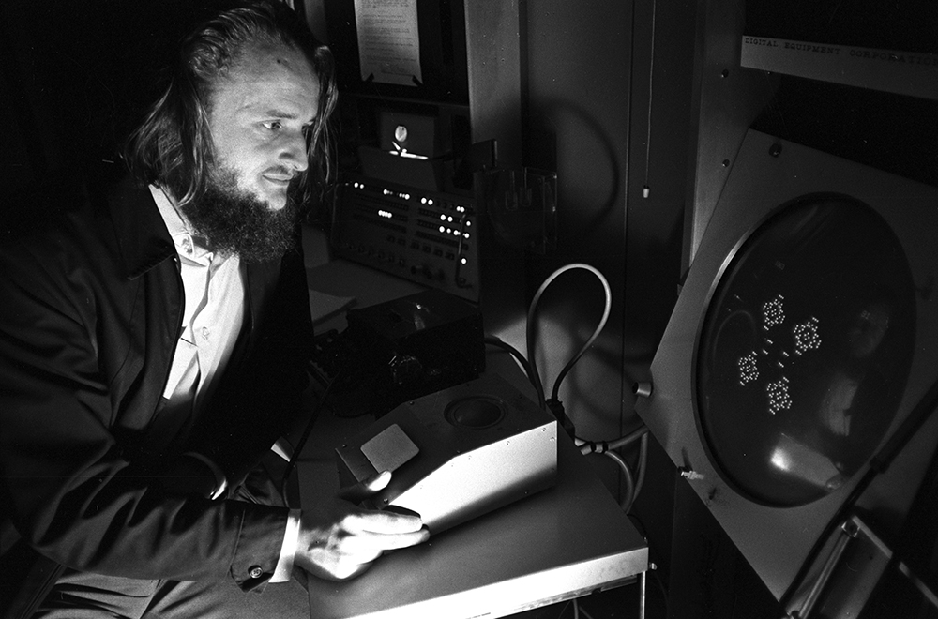
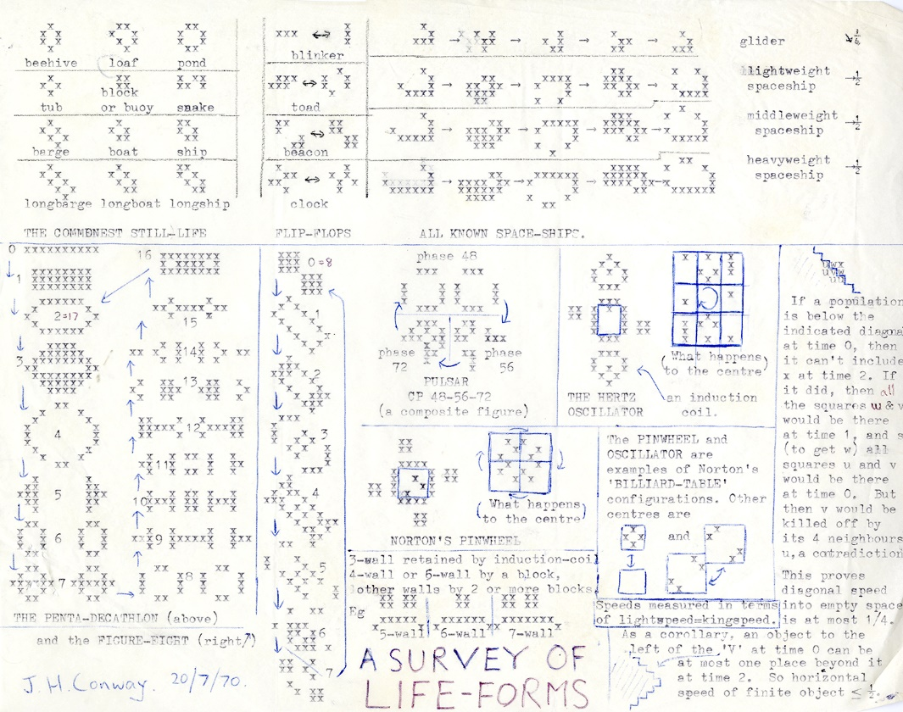
Conway’s Famous Invention “Game of Life”
John Horton Conway at Princeton University in 2009
John Conway playing the Game of Life in 1974
Survey of Life-forms, from a 1970 letter to Martin Gardner

Slide 7
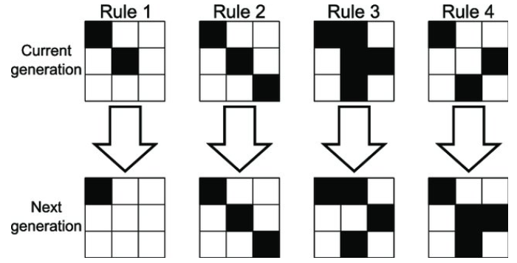
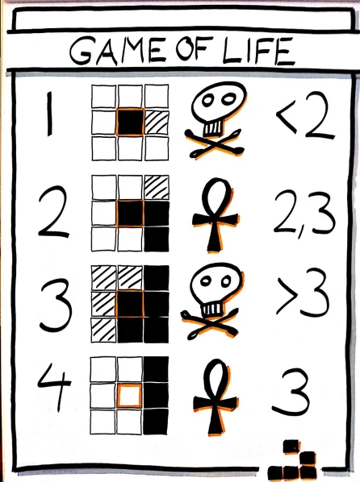
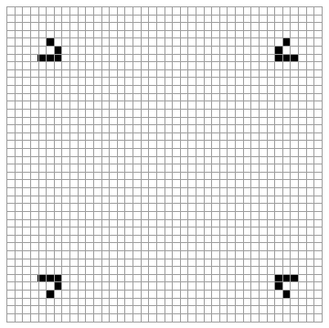
“Game of Life” rules
E x a m p l e s
Rule 1: Any live cell with fewer than two live neighbors dies (becomes empty), as if caused by underpopulation.
Rule 2: Any live cell with two or three live neighbors continue living in the next generation.
Rule 3: Any live cell with more than three live neighbors dies (becomes empty), as if by overpopulation.
Rule 4: Any dead (or empty) cell with exactly three live neighbors becomes a live cell, as if by reproduction.

Slide 8
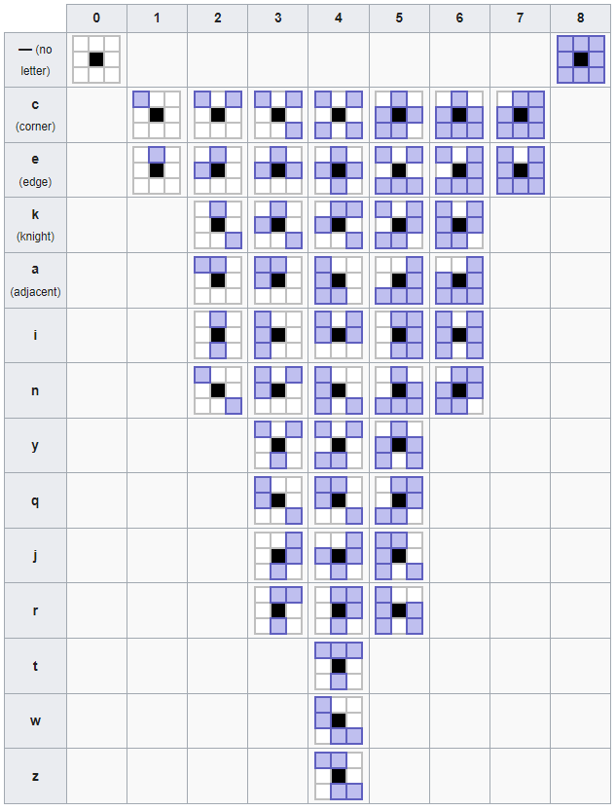
Cellular Automata Rules Generalization
The Moore neighborhood is the set of all cells that are orthogonally or diagonally-adjacent to the region of interest. For example, the Moore neighborhood of a single cell consists of the eight cells immediately surrounding it. The Moore neighborhood is the neighborhood of interest in Conway's Game of Life and all Life-like cellular automata.
The Moore neighborhood can be defined using Hensel notation, which represents the relative permutations of the cells using letters.
Consider, for example “Just Friends”, which is a two-state rule created by David Bell in 2000 as follows: “A cell stays alive only if it has 1 or 2 live neighbors (in any position). A cell is born only if it has exactly two live neighbors which are not adjacent vertically or horizontally.” Using Hensel notation, the Just Friends rule could be encoded as: B2-a/S12 , which means that a dead cell will be born (B) with 2 neighbors (2), except (-) when they are adjacent (a), and that a live cell will survive (S) with 1 or 2 neighbors (12) in any configuration.
With respect to possible rotations

Slide 9
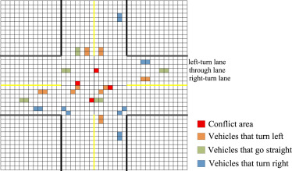
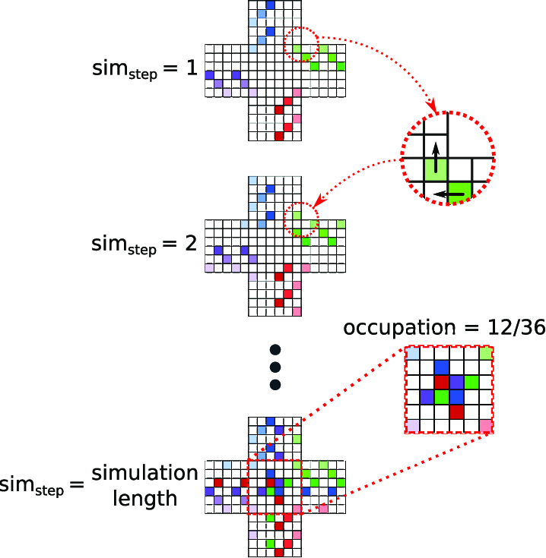
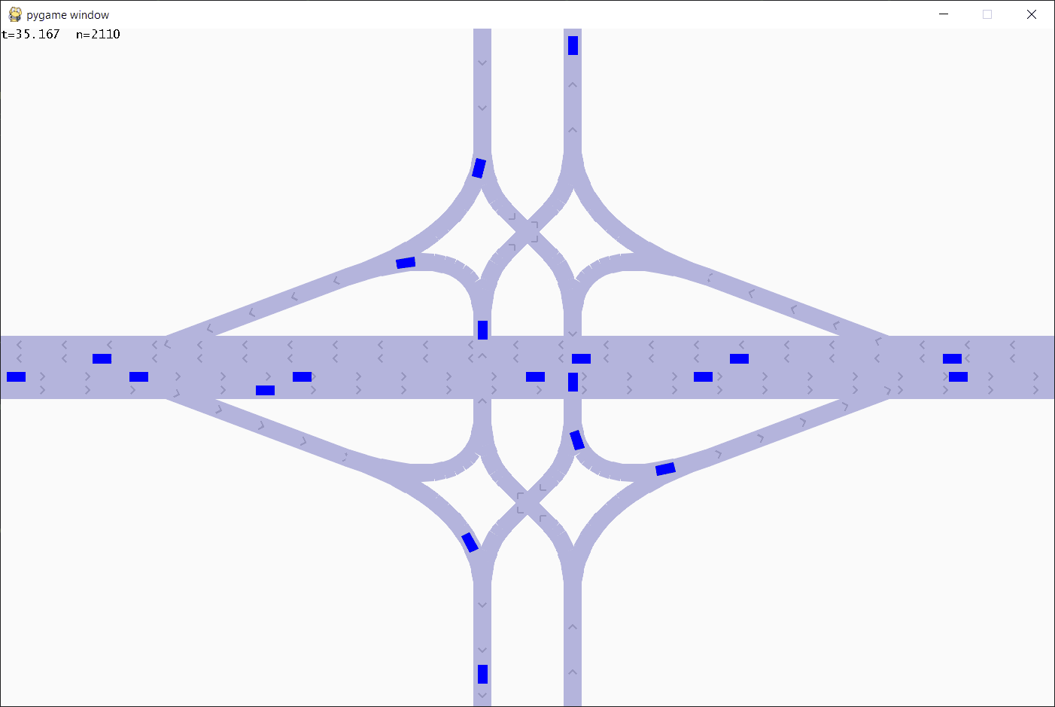
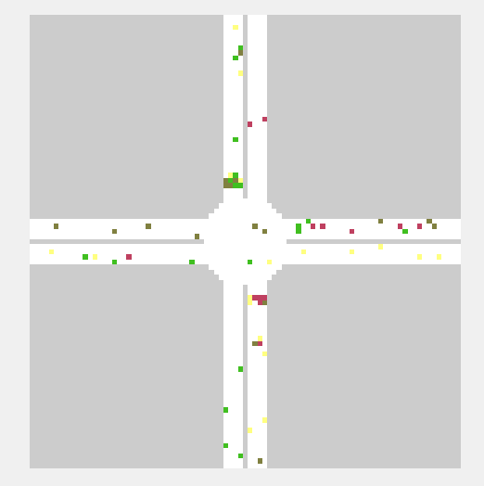
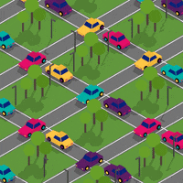
Simulating Traffic with Cellular Automata

Slide 10
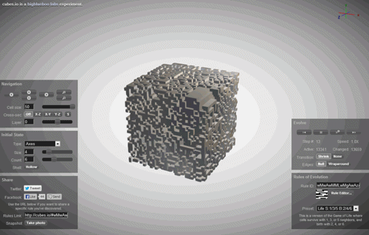
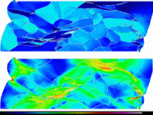
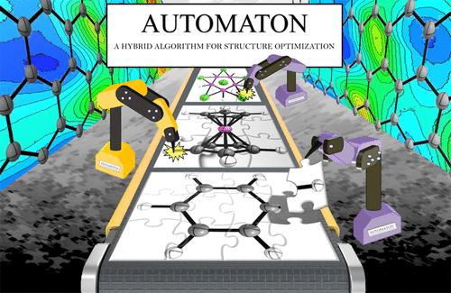
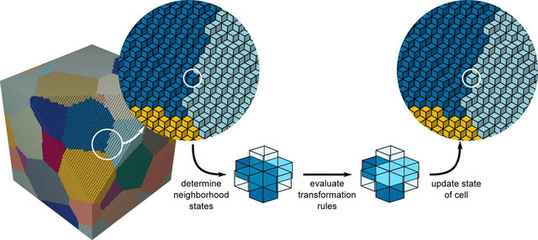
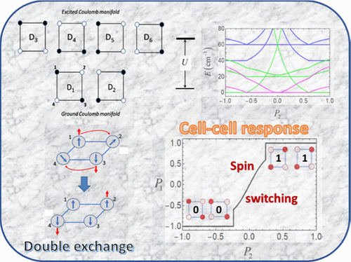
Simulating and Topology Optimization for Smart Structures and Materials with Cellular Automata

Slide 11
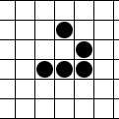
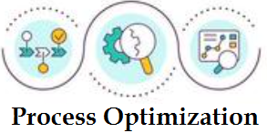
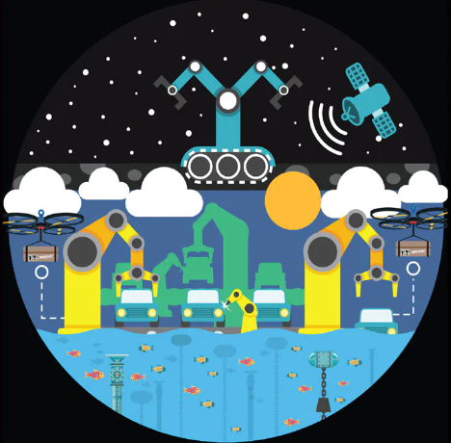
Potential Applications of Cellular Automata
Quality control: CA can be used to simulate the behavior and assess intended quality of materials and products under different conditions;
Supply chain optimization: By modeling the behavior of the supply chain using CA, it is possible to optimize the flow of materials and products between suppliers, manufacturers, and customers, helping to reduce costs, increase efficiency and improve customer satisfaction;
Process optimization: CA can be used to simulate the behavior of different manufacturing processes (e.g., assembly lines), helping to identify bottlenecks and inefficiencies and optimize the process for maximum production efficiency and product quality;
Autonomous systems: CA can be used to model and optimize autonomous systems’ (e.g., robots or drones) behavior, aiming to reduce the risk of accidents, improve performance, and increase safety;
Smart cities: CA simulations can provide valuable insights into the behavior of smart city systems, allowing city planners and engineers to optimize their operations for specific applications and environments, i.e., improve the performance of the city, reduce resource consumption, enhance the quality of life for citizens, among other potential benefits.
Supply chain
Autonomous systems

Slide 12
Industry 5.0, Resilience, and … Cellular Automata
Emergent Industry 5.0 as a kind of “human – smart industrial infrastructure” resilient ecosystem, is an emerging paradigm that emphasizes the integration of humans, smart machines and infrastructure into the resilient manufacturing process.
Resilience refers to the ability of a system to recover from disturbances or disruptions and maintain its functionality. In addition to human-centricity, resilience is an important concern in the Industry 4.0 – Industry 5.0 transformation process due to current global challenges.
Cellular Automata can also be used to model the resilience of complex systems. For that, the target complex system with emergent properties will be represented as a grid of cells, where each cell represents a component or unit of the system. The rules governing the behavior of the cells will simulate the interactions and dependencies between the different components. Resilience can be studied by simulating how a system responds to different types of disturbances or failures, such as the failure of a particular component or the disturbances within the connection logic between the components. By studying the system’s response to different types of disturbances, researchers can identify potential vulnerabilities and design strategies to improve the system’s resilience. The key advantage of using CA for resilience modeling in Industry 5.0 is that it enables modeling and optimizing the performance of complex, dynamic systems in a way that is both flexible and efficient.
Cellular Automata

Slide 13
OBJECTIVE: Upgrade Cellular Automata towards Resilience
We believe that capabilities of traditional CA for better resilience modelling and simulation could be upgraded if to enable different kind of cells and their interaction, particularly:
cells, which represent people, tools, and machines aka “productive forces”;
cells, which represent designed products, developed infrastructure, etc. aka “manufacturing results”;
cells, which represent “adversaries” like people and infrastructure capable to attack and disrupt/destroy other cells.
Rules in such “resilient” CA will represent some specific relationships, which are important in the resilience context, such as:
evolution and self-recovery of productive forces;
evolution and recovery of manufacturing results depending on productive forces dynamics;
attack and defence activity between adversarial cells representing different actors, etc.
OUR OBJECTIVE: In this study, we are going to introduce a couple of dimensions for further evolution of CA towards resilience, particularly:
the “creativity” dimension (to handle relationships between producers and products); and …
the “adversarial” dimension (to handle adversarial activity of cells).
As the basis to represent our CA upgrades (“Game of Life and Creation” to address the “creativity” dimension, “War and Peace” to address the “adversarial” dimension, and “War and Creation” to address both dimensions simultaneously) towards simulating resilience, we take the most famous ever CA, i.e., Conway’s “Game of Life”.

Slide 14
“Game of Life and Creation” (“rock creation” version) rules
(creation vs. reproduction)
Live cell
Rule 1: Any live cell with fewer than two live neighbors dies (becomes empty), as if caused by underpopulation.
Rule 2: Any live cell with two or three live neighbors continue living in the next generation.
Rule 3: Any live cell with more than three live neighbors dies (becomes empty), as if by overpopulation.
Rule 4: Any dead (or empty) cell with exactly three live neighbors becomes a live cell, as if by reproduction.
Rule 5: Any dead (or empty) cell with exactly two live neighbors becomes a rock cell, as if by creation (construction).
Rock cell
Empty (dead) cell
If applied, these rules are supposed to create at each iteration a new pattern of live, dead, and constructed rock cells. One may notice that the new Rule 5 not only specifies how rock cells appear but also impact CA by taking away free spaces that could be otherwise used for the live cells reproduction. Rock cells themselves never die nor take part as parents in reproduction.

Slide 15
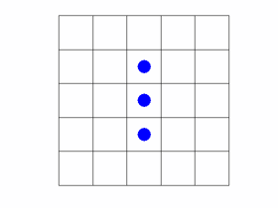
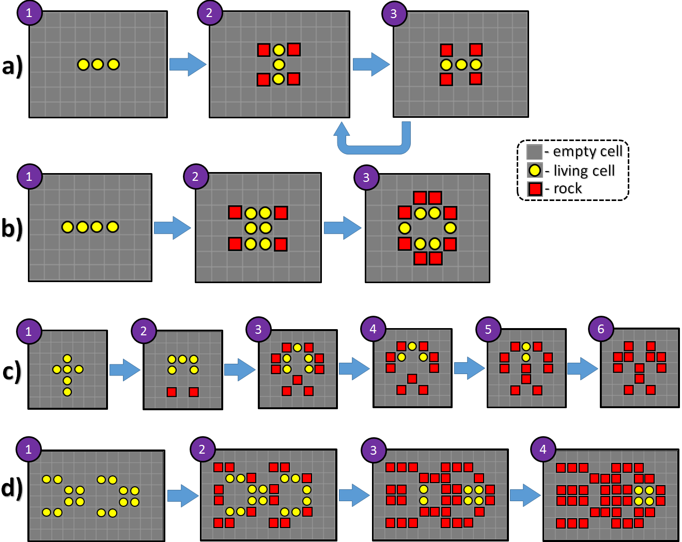
“Game of Life and Creation” example
(“rock creation” version)
Evolution within the “rock creation” version of the “Game of Life and Creation”:
“Blinker” – cycling with four rocks created;
Four living cells evolve into “Beehive” and create rocks around;
evolution and death of “Latin cross” but with remaining rocks;
Evolution of “Ants” into “Block” with many rocks created.
Note: (a) Blinker’s live cells in the “Game of Life and Creation” behave the same way as in the “Game of Life”; however, they created four rock cells during evolution. (b) shows the evolution of four living cells towards a stable position called a “beehive” with eight rocks constructed around. (c) shows the evolution of six living cells known as the “Latin cross”, where all the living cells die finally but 12 constructed rocks remain. (d) shows the evolution of two “ants” configurations, which end up in a “block” configuration of four living cells like in the original “Game of Life”. However, it produces 36 rocks during the evolution. All evolutionary chains (a-d) lead to a stable configuration.

Slide 16
“Game of Life and Creation” example of moving object
(“rock creation” version)
Some configurations of live cells in the Game of Life perform oscillations that recreate the same shape and move at the same time across the grid. Among those, the most famous one is "Glider". Figure below illustrates the evolution of "Glider" in the traditional Game of Life and in the Game of Life and Creation (“rock creation” version). In the former case, the trace of created rocks left by the glider takes away space needed for own recreation, and the glider dies.
Evolution (“continuous travel”) of the “Glider” in the Game of Life and evolution of it in the “Game of Life and Creation” (“rock creation” version) resulted to death and creation of 10 rocks.

Slide 17
“Game of Life and Creation” (“egg creation” version) rules
(creation as a delayed reproduction)
Rule 1: Any live cell with fewer than two live neighbors dies (becomes empty), as if caused by underpopulation.
Rule 2: Any live cell with two or three live neighbors continue living in the next generation.
Rule 3: Any live cell with more than three live neighbors dies (becomes empty), as if by overpopulation.
Rule 4: Any dead (or empty) cell with exactly three live neighbors becomes a live cell, as if by reproduction.
Rule 5: Any dead (or empty) cell with exactly two live neighbors becomes an “egg” cell with the “delay” parameter $t$ initialized as $t=T$.
Rule 6: Any “egg” cell at each iteration decrements its “delay” parameter by 1. If, as a result, $t$ reaches zero, then the “egg” cell is replaced by the live cell, as if by delayed reproduction.
Live cell
$t=T$ - delay
T
Egg cell
Empty (dead) cell
2
1
$$T=2$$

Slide 18
“Game of Life and Creation” (“egg creation” version) rules
(creation as a delayed reproduction)
Rule 1: Any live cell with fewer than two live neighbors dies (becomes empty), as if caused by underpopulation.
Rule 2: Any live cell with two or three live neighbors continue living in the next generation.
Rule 3: Any live cell with more than three live neighbors dies (becomes empty), as if by overpopulation.
Rule 4: Any dead (or empty) cell with exactly three live neighbors becomes a live cell, as if by reproduction.
Rule 5: Any dead (or empty) cell with exactly two live neighbors becomes an “egg” cell with the “delay” parameter $t$ initialized as $t=T$.
Rule 6: Any “egg” cell at each iteration decrements its “delay” parameter by 1. If, as a result, $t$ reaches zero, then the “egg” cell is replaced by the live cell, as if by delayed reproduction.
Live cell
$t=T$ - delay
T
Egg cell
Empty (dead) cell
These rules are supposed to create at each iteration a new pattern of live, dead, and laid egg cells. Here we have two types of reproduction, the immediate one with three “parents” specified by Rule 4 and the delayed one with two “parents” (Rule 5 and Rule 6). Rule 5 not only specifies how egg cells appear but also impacts CA by taking away free space that could be otherwise used for immediate live cell reproduction. Egg cells themselves never die until a newborn appears, according to Rule 6. The choice of the delay time $T$ can be used to control the game dynamics. If $T→∞$, then the “egg creation” version of the game will behave exactly as the “rock creation” version, which means that the latter version can be considered as a special case of the former one.

Slide 19
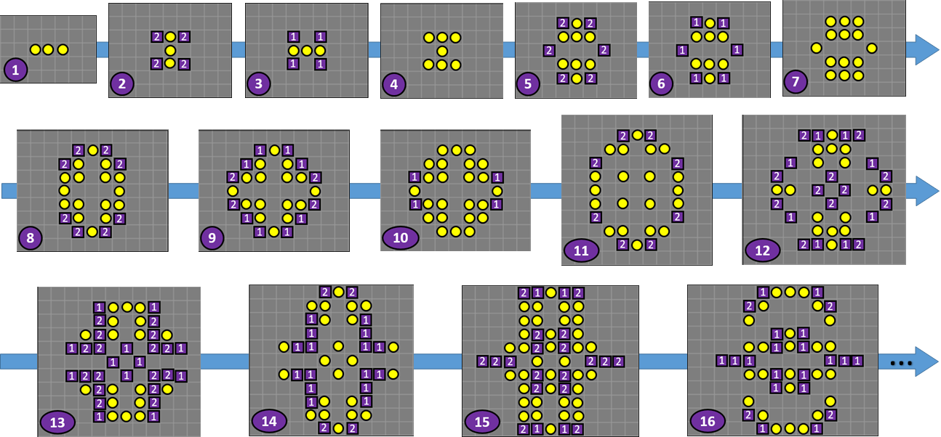
“Game of Life and Creation” example (“egg creation” version)
“Blinker”
Example in the Figure illustrates the evolution of “Blinker” in the “Game of Life and Creation” (“egg creation” version) with parameter $T=2$. One may see that the live population in this game with such settings grows and spreads faster than in the original “Game of Life”. Bigger number for $T$ will slow down the evolution. “Egg” cells in the figure are marked with the violet squares with current value of the delay parameter indicated.

Slide 20
“War and Peace” (two teams) rules (forced death and destruction)
Rule 1: Any live cell from either team with fewer than two live teammate neighbors dies (becomes empty), as if caused by underpopulation.
Rule 2a: Any live cell from either team with two or three live teammate neighbors will continue living in the next generation if the number of adversary neighbors is not more than the number of teammate neighbors.
Rule 2b: Any live cell from either team with two or three live teammate neighbors dies (becomes empty) if the number of its adversary neighbors is more than the number of teammate neighbors, as if by “killing”.
Rule 3: Any live cell from either team with more than three live teammate neighbors dies (becomes empty), as if by overpopulation.
Rule 4: Any dead (or empty) cell with exactly three live neighbors (“parents”) from either team becomes a live cell and a teammate of its parents, as if by reproduction. If both teams pretend to get a “child” within the same cell, the advantage is given to team, which belongs to the same “country” as the empty cell (defined by the border).
Live cell (Team 1)
Live cell (Team 2)
Empty (dead) cell
Rule 2b
Rule 4
?
Any configuration of cells will evolve according to the “Game of Life” rules in the case of “peace” (absence of adversaries around). In the situation of teams’ collisions (“war”), rules 2 (a, b) and 4 resolve the conflicts.

Slide 21
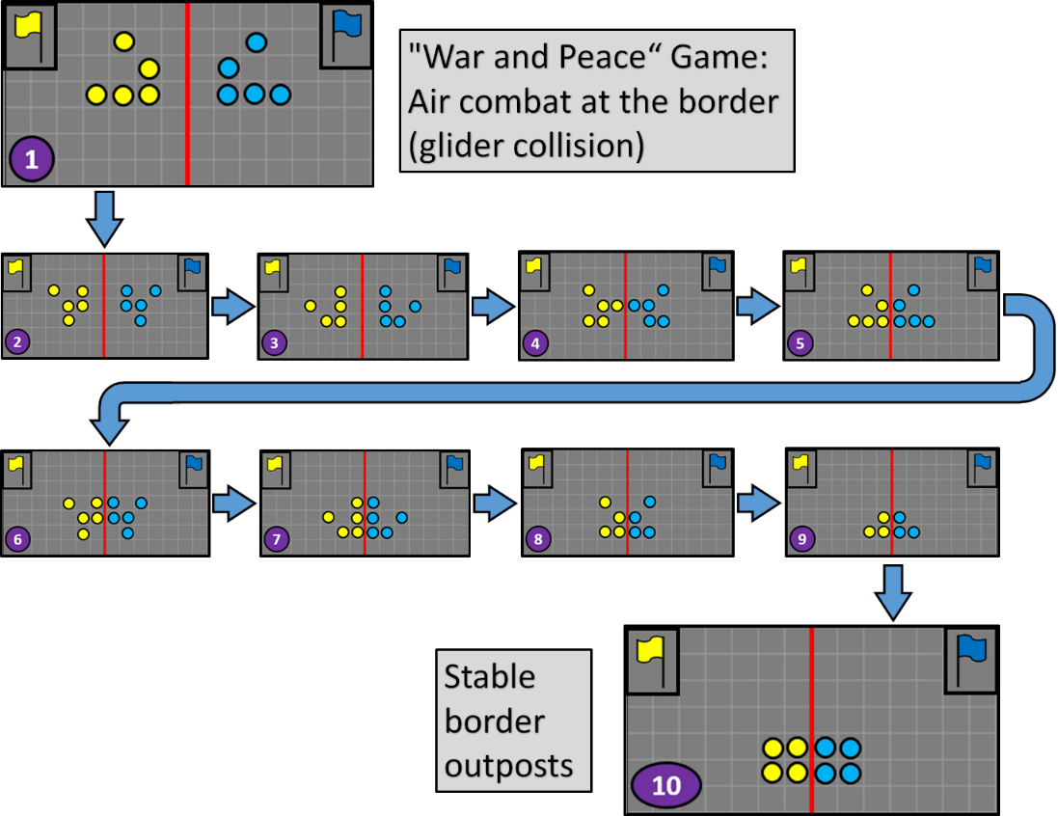
“War and Peace” CA example
(gliders’ collision)
The collision between two mutually adversarial gliders (one from “Yellow” team and another from “Blue” team) just on the border between the corresponding countries. The collision ends up in a stable configuration: two adversarial “Blocks” (aka border posts) on the opposite sides of the border.

Slide 22
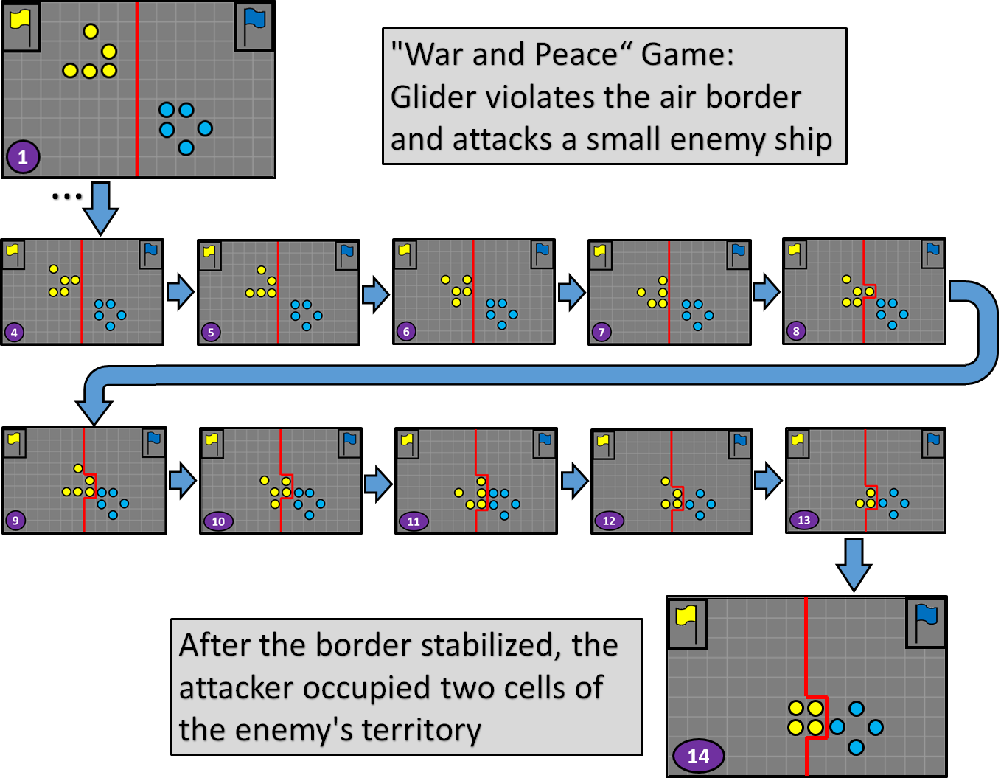
“War and Peace” CA example
(glider vs boat collision)
The collision between the yellow “Glider” and the blue ship (“Boat”), which happened after the glider violated the border and appeared on the territory of blue team in the “War and Peace” CA. After the “fight”, the yellow “Glider”, which finally takes the “Block” configuration, occupied two cells of foreign territory destroying the blue “Boat” into the form of “Tub”.

Slide 23
“War and Creation” (two teams) rules (“rock creation” option)
Rule 1: Any live cell from either team with fewer than two live teammate neighbors dies (becomes empty), as if caused by underpopulation.
Rule 2a: Any live cell from either team with two or three live teammate neighbors will continue living in the next generation if the number of adversary neighbors is not more than the number of teammate neighbors.
Rule 2b: Any live cell from either team with two or three live teammate neighbors dies (becomes empty) if the number of its adversary neighbors is more than the number of teammate neighbors, as if by “killing”.
Rule 3: Any live cell from either team with more than three live teammate neighbors dies (becomes empty), as if by overpopulation.
Rule 4: Any dead (or empty) cell with exactly three live neighbors (“parents”) from either team becomes a live cell and a teammate of its parents, as if by reproduction. If both teams pretend to get a “child” within the same cell, the advantage is given to team, which belongs to the same “country” as the empty cell (defined by the border).
Rule 5: Any dead (or empty) cell with exactly two live neighbors (“creators”) from either team becomes a “rock” cell and inherits the color from its parents’ team, as if by creation. If both teams pretend to create their “rock” within the same cell, the advantage is given to team, which belongs to the same “country” as the empty cell (defined by the border).
Live cell (Team 1)
Live cell (Team 2)
Empty (dead) cell
Rock cell (Team 1)
Rock cell (Team 2)
Rule 5
?

Slide 24
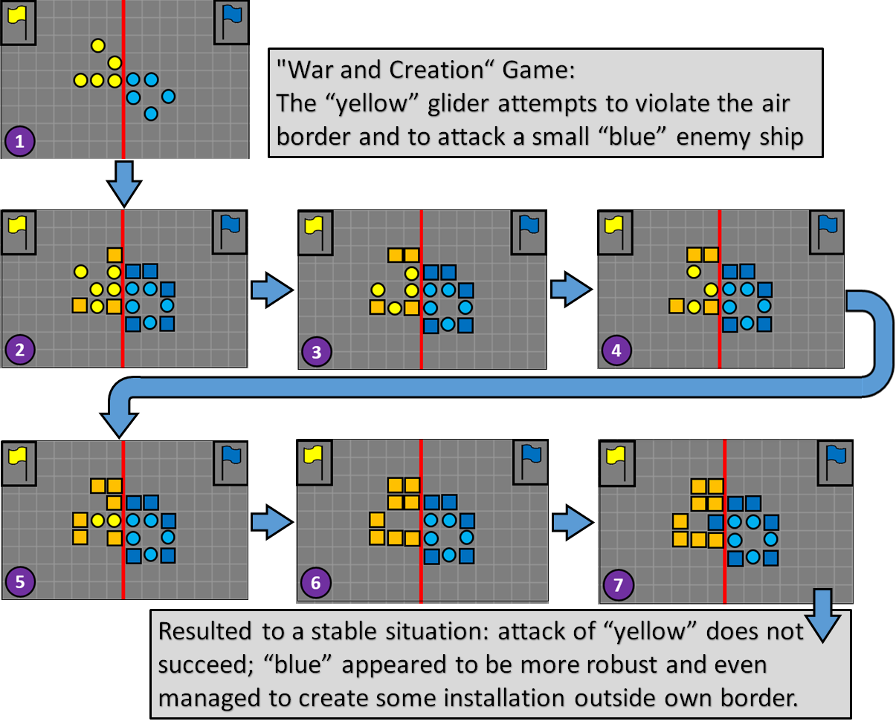
“War and Creation” CA example
(“rock creation” version)
The collision between the yellow “Glider” and the blue ship (“Boat”), which happened after the glider attempted to cross the border in the “War and Creation” (“rock creation” version) CA. After the “fight”, the yellow live team failed (only rocks remain). The blue team not only preserved its configuration but also created some installations on the yellow’s territory.

Slide 25
“War and Creation” (two teams) rules (“egg creation” option)
Rule 1: Any live cell from either team with fewer than two live teammate neighbors dies (becomes empty), as if caused by underpopulation.
Rule 2a: Any live cell from either team with two or three live teammate neighbors will continue living in the next generation if the number of adversary neighbors is not more than the number of teammate neighbors.
Rule 2b: Any live cell from either team with two or three live teammate neighbors dies (becomes empty) if the number of its adversary neighbors is more than the number of teammate neighbors, as if by “killing”.
Rule 3: Any live cell from either team with more than three live teammate neighbors dies (becomes empty), as if by overpopulation.
Rule 4: Any dead (or empty) cell with exactly three live neighbors (“parents”) from either team becomes a live cell and a teammate of its parents, as if by reproduction. If both teams pretend to get a “child” within the same cell, the advantage is given to team, which belongs to the same “country” as the empty cell (defined by the border).
Rule 5: Any dead (or empty) cell with exactly two live neighbors (“delayed parents”) from either team becomes an “egg” cell (of the same color as its parents’ team) with the “delay” parameter $t$ initialized as $t=T$. If both teams pretend to create their “egg” within the same cell, the advantage is given to team, which belongs to the same “country” as the empty cell (defined by the border).
Rule 6: Any “egg” cell at each iteration decrements its “delay” parameter by 1. If, as a result, $t$ reaches zero, then the “egg” cell is replaced by the live cell (preserving its color or team affiliation), as if by delayed reproduction.
Live cell (Team 1)
Live cell (Team 2)
Empty (dead) cell
T
Egg cell (Team 1)
$t=T$ - delay
T
Egg cell (Team 2)
Rule 5
$$T=2$$
?
2
Rule 6
?
1

Slide 26
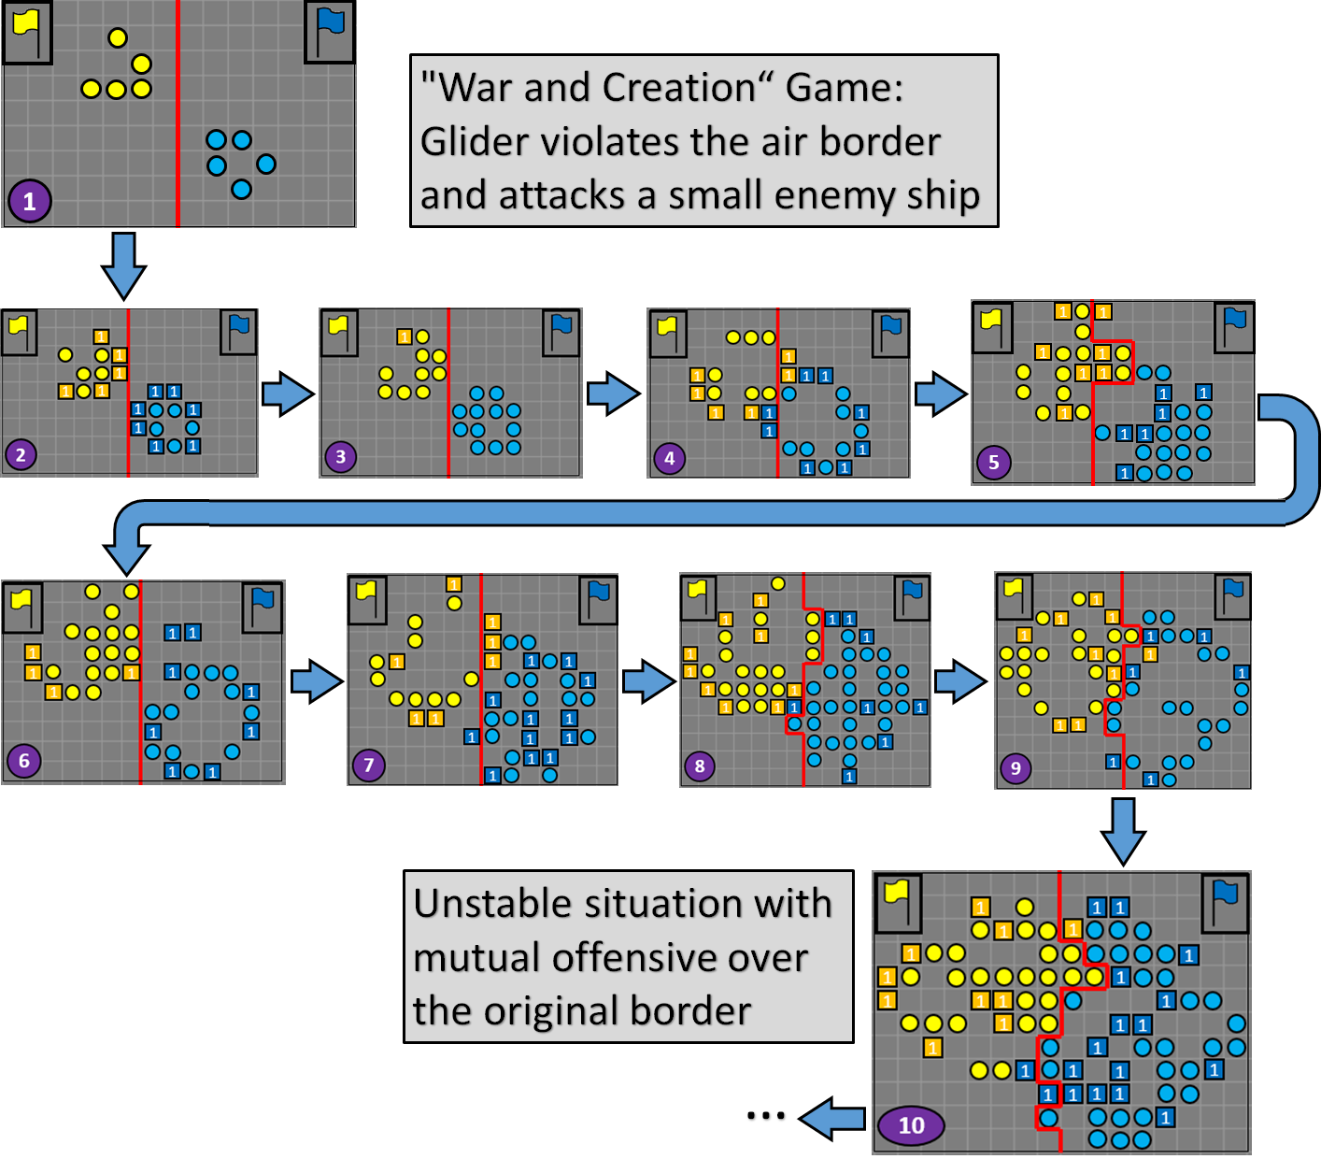
“War and Creation” CA example
(“egg creation” version)
The collision between the yellow “Glider” and the blue ship (“Boat”), which happened after the glider attempted to cross the border in the “War and Creation” (“egg creation” version) CA. The choice for a small delay parameter (T = 1) improved survivability of the life cells and provided additional dynamics to the CA evolution. The situation after ten iterations remains unstable and both teams seem to have certain progress in occupying the enemy’s territory and good chances to continue their mutual offensive.

Slide 27
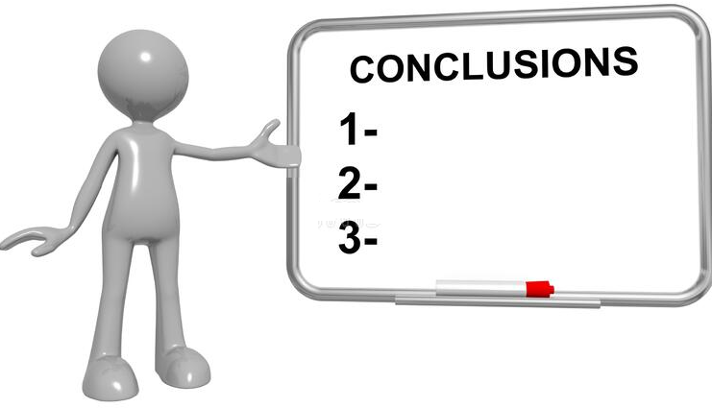
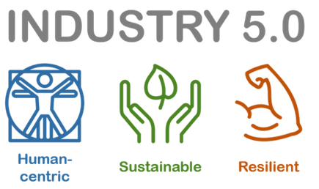
The concept of resilience is becoming increasingly important in the context of Industry 5.0;
Creative CA (such as the suggested “Life and Creation” CA among other potentially possible ones) can be used to model secure and resilient interactions and relationships between people, technology and products within the organization;
Adversarial CA (such as the suggested “War and Peace”) can be used to simulate and optimize systems that are capable of detecting and responding to various forms of attacks and deliberate disruptions, as well as to recover quickly from them;
Hybrid CA for overall resilience (such as suggested “War and Creation” among other potentially possible), which involves both creativity and adversarial interactions between cells, can be used to model a wide range of systems that involve creative collaborative production, competition, conflict, destruction and recovery activity among the actors.
1

Slide 28
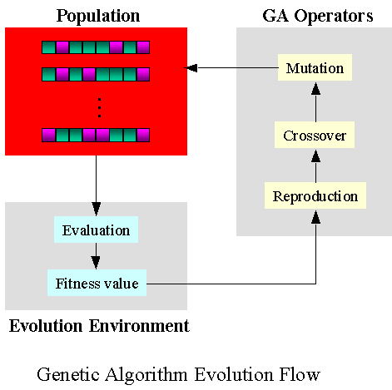
Yes, it is true that CA as a simulation tool and its modifications are a very high-level abstraction and applying it to real-life problems, particularly in industry, requires a certain effort;
Various CA population/configuration creativity, survivability and resilience capabilities largely depend on the rules and their parameters (e.g., number of “parents” for the “newborn child” or the “delayed born” parameter among many others);
Manual control over the rules during the simulation process is quite a complicated and time-consuming task;
The best way would be automatic adaptation of CA (particularly the rules behind CA) to the desired behavior. One possible approach is the use of genetic algorithms for this purpose. CA rules can be found as an outcome of genetic evolution so that these rules can enforce a desired behavior for the CA;
Our preliminary experiments show that the efficiency impact of genetic algorithms used for adaptive (self-learning) options of our “Life and Creation”, “War and Peace”, and “War and Creation”, i.e., CA with a greater simulation scope, is greater than in the case of traditional CA;
Despite the challenges, the combination of CA advantages, such as simplicity, emergent behavior, nonlinear dynamics, parallelism, and adaptability, makes CA a powerful simulation instrument that can be used to model a wide range of complex Industry 5.0 systems that involve humans with different roles, smart infrastructure, their complex interaction and logistics, safety, and resilience.
2
CA Rules

Slide 29
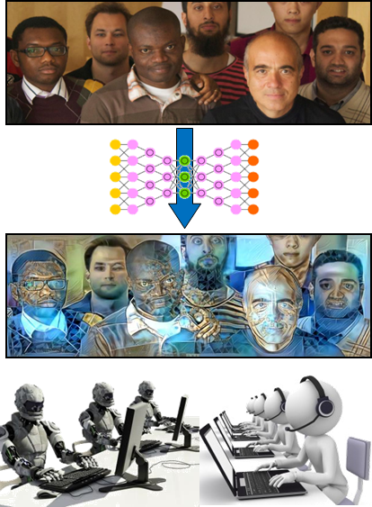
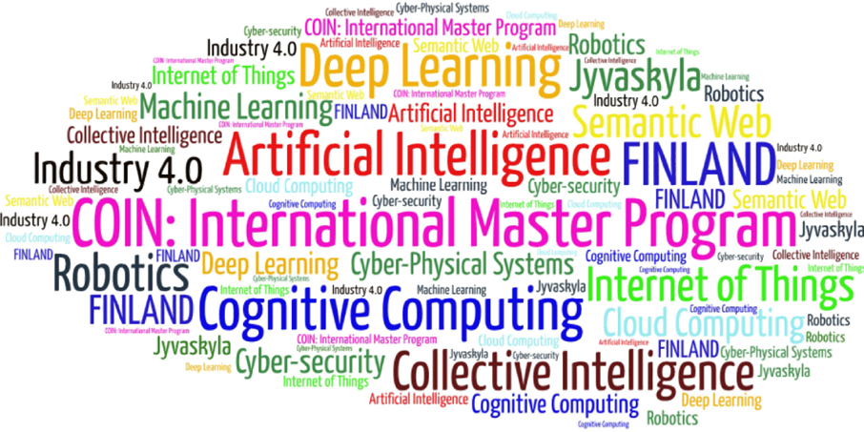
Come to study at our International Master Program
AI: Artificial Intelligence
(former Cognitive Computing and Collective Intelligence) …
… the first university program for collective intelligence, where humans learn together with their digital clones and autonomous digital assistants …
http://www.jyu.fi/ai
AI

Slide 30
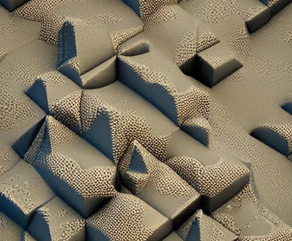
Link to the presentation: https://ai.it.jyu.fi/ISM-2023-Cellular_Automata.pptx
Contact: vagan.terziyan@jyu.fi

Slide 31
5th International Conference on Industry 4.0 and Smart Manufacturing – ISM 2023
Iscte - University Institute of Lisbon –Lisbon, Portugal | 22-24 November 2023
Thank you!
“Creative and Adversarial Cellular Automata for Simulating Resilience in Industry 5.0”
Vagan Terziyan ª, Artur Terziian ^{b}, Oleksandra Vitko ^{c}
ª Faculty of Information Technology, University of Jyväskylä, Jyväskylä, Finland
^{b} Private Lyceum “Professional”, Kharkiv, Ukraine
^{c} Department of Artificial Intelligence, Kharkiv National University of Radio Electronics, Kharkiv, Ukraine
Contacts
ª vagan.terziyan@jyu.fi , ^{b} terziyan@yahoo.com , ^{c} oleksandra.vitko@nure.ua
Link to complete slide-set:
https://ai.it.jyu.fi/ISM-2023-Cellular_Automata.pptx
https://www.jyu.fi/en/
http://lyceum-prof.at.ua/
https://nure.ua/en/

