Slide 1
5th International Conference on Industry 4.0 and Smart Manufacturing – ISM 2023
Iscte - University Institute of Lisbon –Lisbon, Portugal | 22-24 November 2023
“Using Cloning-GAN Architecture to Unlock the Secrets of Smart Manufacturing: Replication of Cognitive Models”
Vagan Terziyan ª, Timo Tiihonen ^{b}
^{a,b} Faculty of Information Technology, University of Jyväskylä, Jyväskylä, Finland
https://www.jyu.fi/en/

Slide 2
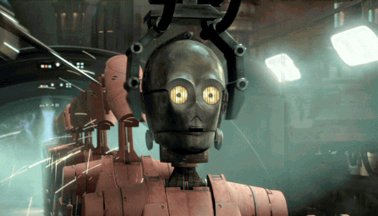
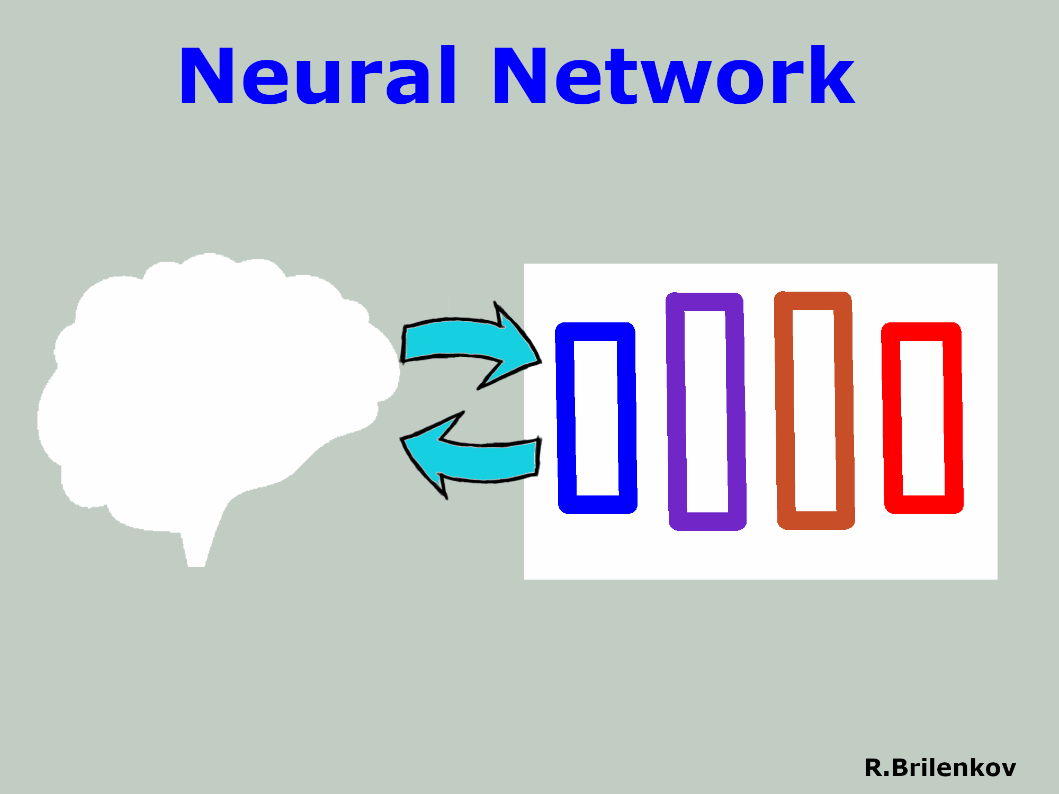
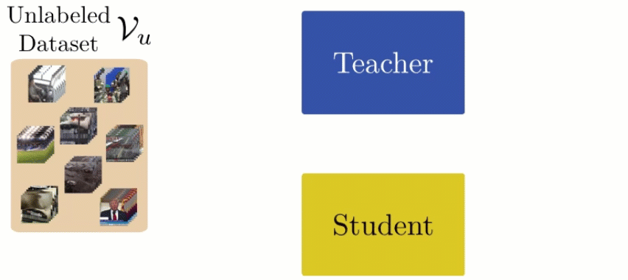
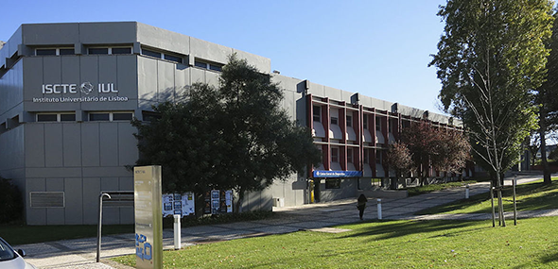
Knowledge transfer
C L O N I N G
Knowledge distillation
“Using Cloning-GAN Architecture to Unlock the Secrets of Smart Manufacturing:
Replication of Cognitive Models”
Paper # 2637
Vagan Terziyan & Timo Tiihonen
Iscte - University Institute of Lisbon
23 November, 2023, 12:40 - 13:00
ISM 2023
International Conference on Industry 4.0
and Smart Manufacturing
Section/Room: S4.R2
S4 (HUMANCENTR) / R2

Slide 3
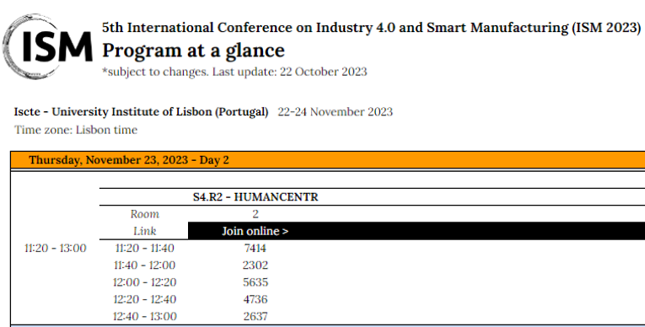

Slide 4
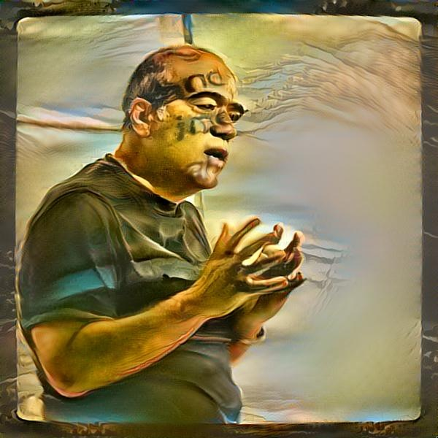
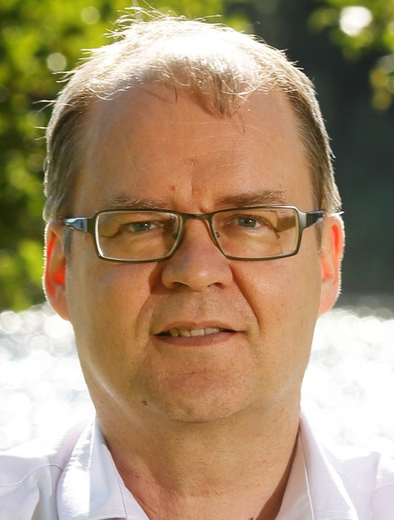
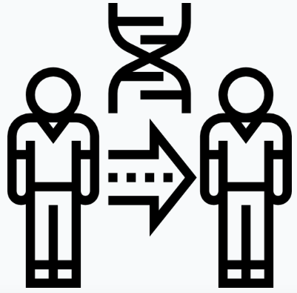
Vagan Terziyan
Authors
vagan.terziyan@jyu.fi
“Using Cloning-GAN Architecture to Unlock the Secrets of Smart Manufacturing: Replication of Cognitive Models”
Timo Tiihonen
https://www.jyu.fi/en/

Slide 5
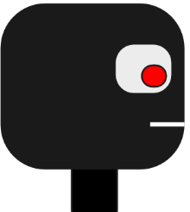
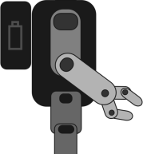
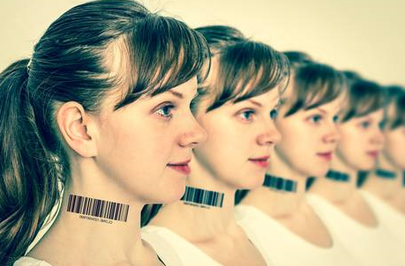
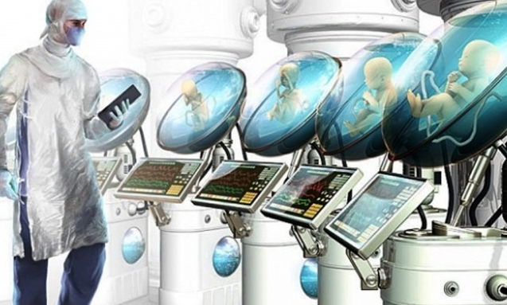
Autonomous agent (software robot) as a “clone”
or digital copy (twin) of human intelligence
Patented Intelligence
(Pi-Mind)
Digital clone
Of a human
Process
human
$π$-Mind (Pi-Mind) – “Patented Intelligence” technology is capable to capture, formalize, license, share, reuse, and integrate personal cognitive models and corresponding personal value- and decision-driven behavior (of a human or other smart entity) within autonomous cyber-physical-social systems and various business processes.
Terziyan, V., Gryshko, S., & Golovianko, M. (2018). Patented Intelligence: Cloning Human Decision Models for Industry 4.0. Journal of Manufacturing Systems, 48 (Part C), 204-217. Elsevier. https://doi.org/10.1016/j.jmsy.2018.04.019

Slide 6
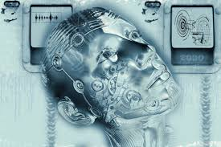
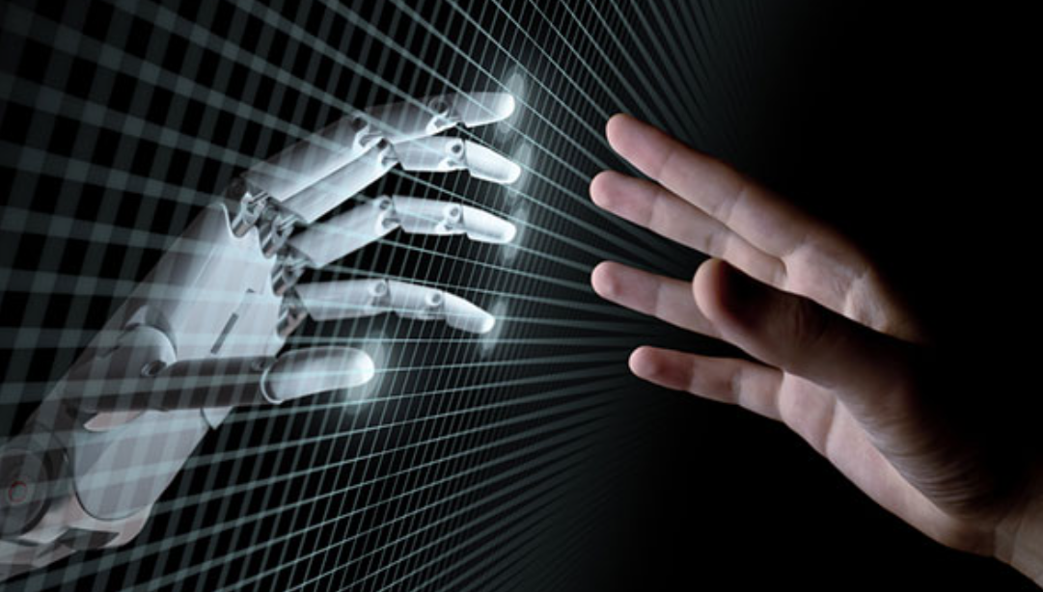
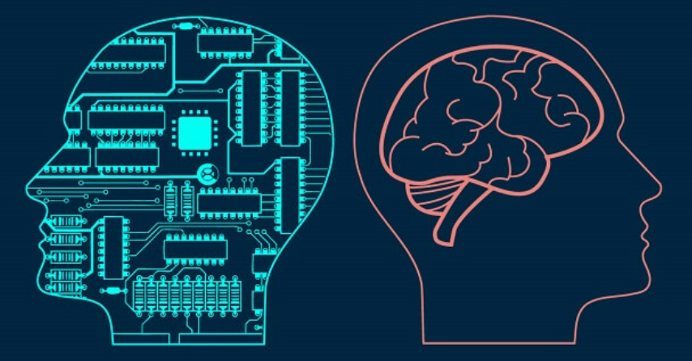
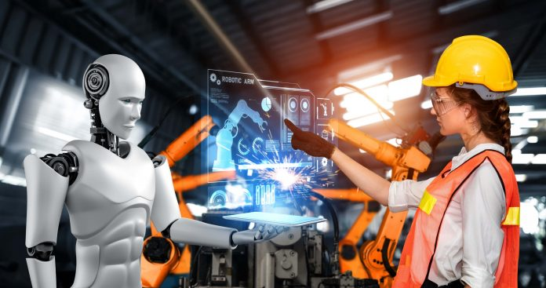
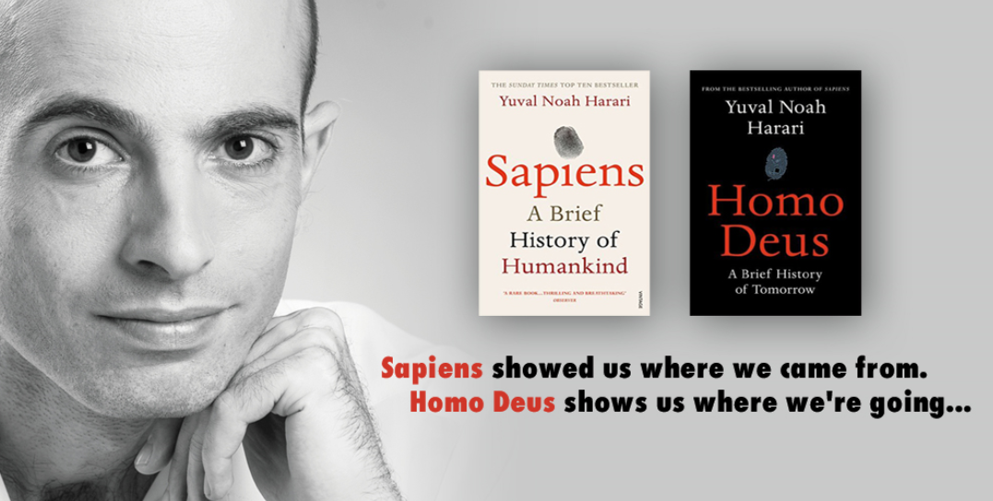
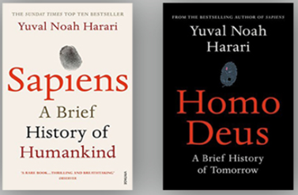
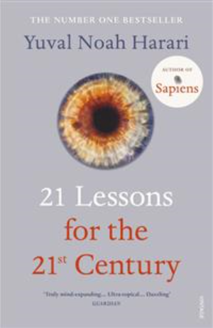
To enable resilient and efficient industry of the future we need a hybrid “Industry 4.0 + Industry 5.0” with:
humans enhanced by autonomous AI;
autonomous AI “with human face” …
Resilient Industry
… and which will inherit the most valuable features of both - efficiency of the Industry 4.0 processes and sustainability of the Industry 5.0 decisions. Digital cognitive clones (i.e., twinning human decision-making behavior) could be an enabling technology for the future hybrid and as an accelerator (as well as resilience enabler) of the convergence of the digital and human worlds ...
Golovianko, M., Terziyan, V., Branytskyi, V., & Malyk, D., (2023). Industry 4.0 vs. Industry 5.0: Co-existence, Transition, or a Hybrid. Procedia Computer Science, 217, 102-113. Elsevier. https://doi.org/10.1016/j.procs.2022.12.206.
21 Lessons shows us where we are today …

Slide 7
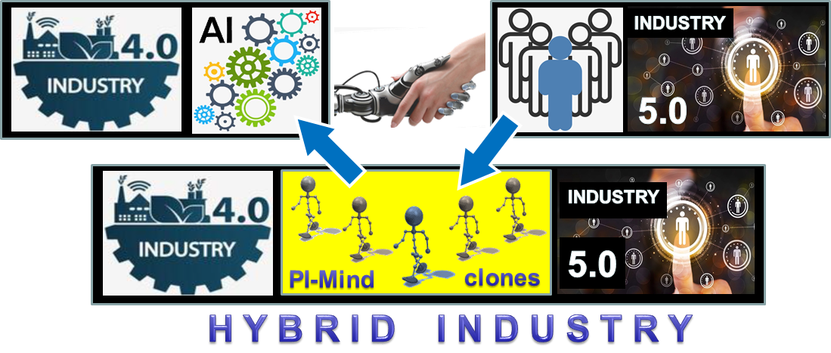
The concept of Industry 4.0 + Industry 5.0 hybrid (driven by Pi-Mind digital cognitive clones of humans)
Golovianko, M., Terziyan, V., Branytskyi, V., & Malyk, D., (2023). Industry 4.0 vs. Industry 5.0: Co-existence, Transition, or a Hybrid. Procedia Computer Science, 217, 102-113. Elsevier. https://doi.org/10.1016/j.procs.2022.12.206.

Slide 8
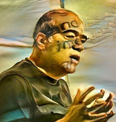
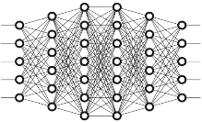
Agents as autonomous “clones” of human capabilities
Enhancing a human (or a system!) by making him or her ubiquitous and omniscient due to multiple autonomous clones capable to be present, self-develop and decide on human’s behalf synchronously within many processes…
A digital cognitive clone of a human decision-maker is an industrial compromise in the “robots vs. humans” dilemma, serving as a bridging concept to marry automation-centric Industry 4.0 and human-centric Industry 5.0. Cognitive clones, as smart bridging technological artifacts, keep particular humans (donors for the clones) within the loop of responsible decision-making processes and, at the same time, make such human involvement ubiquitous and, therefore, efficient

Slide 9
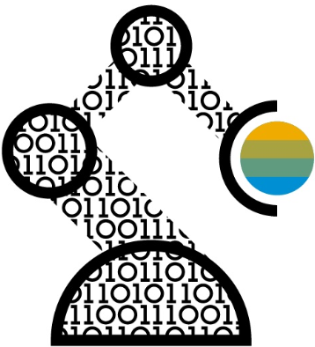
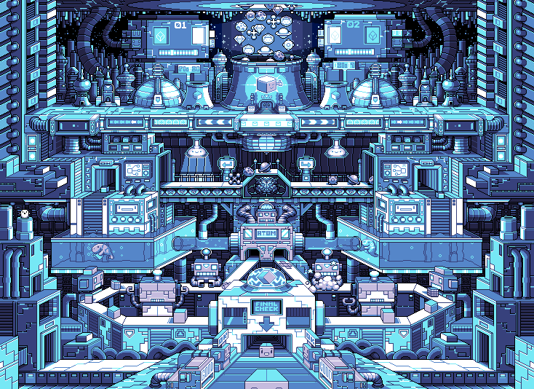
Digital Clones vs. Digital Twins
Workers (managers / operators)
Digital experiments
with customer
experience
Digital
clones
Customers
Digital clones
Product /
Service
Digital
Twin
COLD platform
Industry 4.0 – 5.0

Slide 10
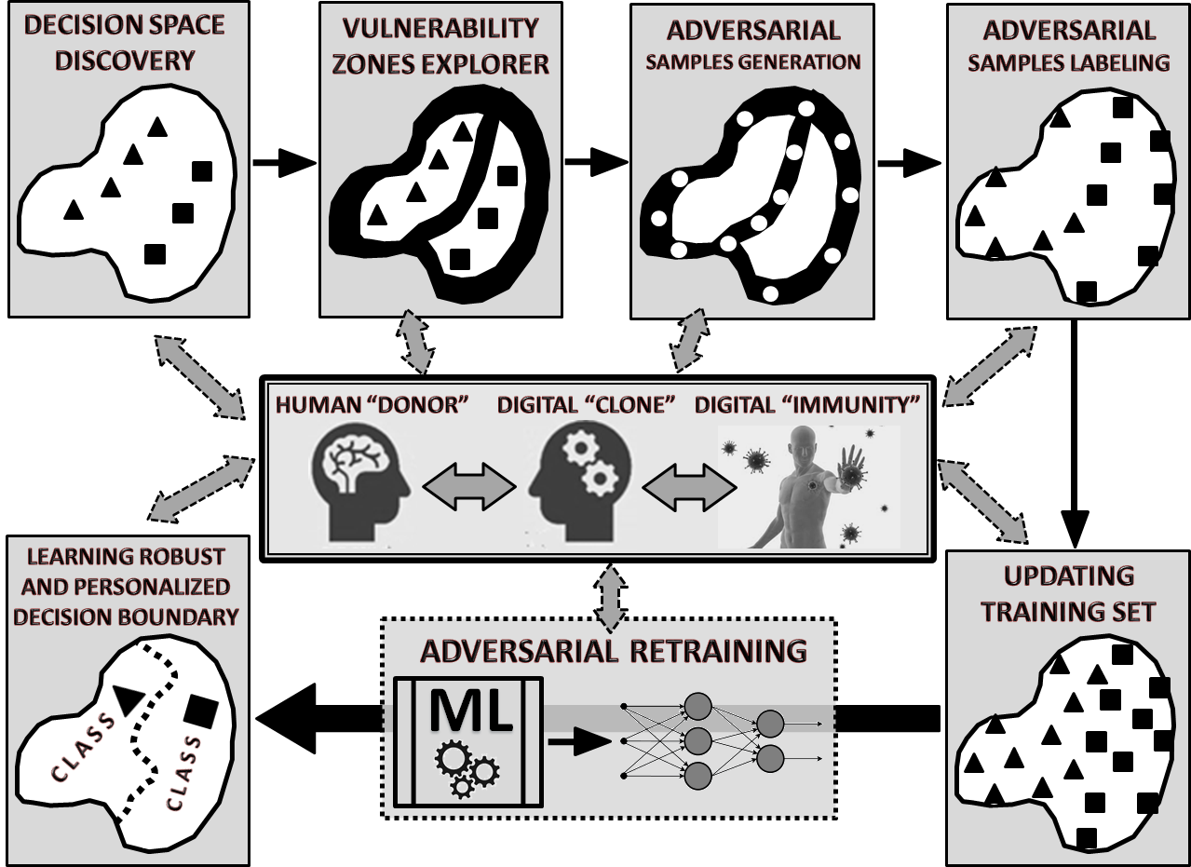
Adversarial Training as a major instrument for cloning
Branytskyi, V., Golovianko, M., Gryshko, S., Malyk, D., Terziyan, V., & Tuunanen, T. (2022). Digital Clones and Digital Immunity: Adversarial Training Handles Both. International Journal of Simulation and Process Modelling, 18(2), 124-139. Inderscience Publishers. https://doi.org/10.1504/IJSPM.2022.10048910
Kaikova, O., Terziyan, V., Tiihonen, T., Golovianko, M., Gryshko, S., & Titova, L. (2022). Hybrid Threats against Industry 4.0: Adversarial Training of Resilience. E3S Web of Conferences, 353, 03004.
https://doi.org/10.1051/e3sconf/202235303004

Slide 11
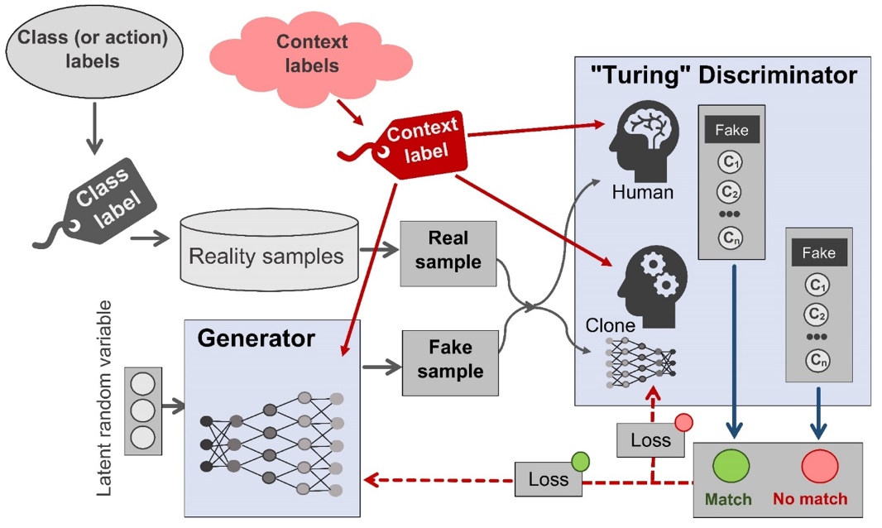
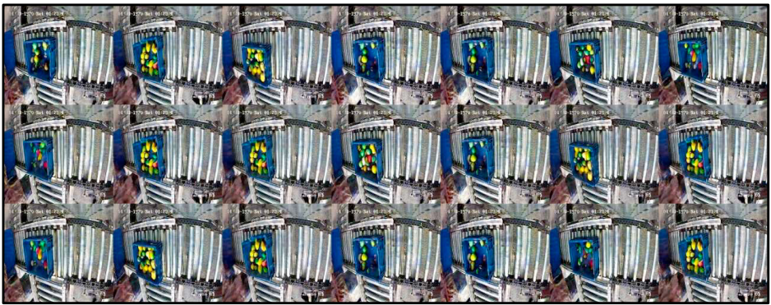
Cloning (adversarial training) Process General Architecture
based on special type of conditional Generative Adversarial Network (T|C-GAN) with “Turing” Discriminator
(including use-cases and experiments)
Golovianko, M., Gryshko, S., Terziyan, V., & Tuunanen, T. (2022). Responsible Cognitive Digital Clones as Decision Makers: A Design Science Research Study. European Journal of Information Systems. https://doi.org/10.1080/0960085X.2022.2073278
Pi-Mind technology-based T|C-SGAN adversarial architecture for transferring decision-making skills from a human to a digital clone
Golovianko, M., Gryshko, S., Terziyan, V., & Tuunanen, T. (2021). Towards Digital Cognitive Clones for the Decision-Makers: Adversarial Training Experiments. Procedia Computer Science, 180, 180-189. Elsevier. https://doi.org/10.1016/j.procs.2021.01.155

Slide 12
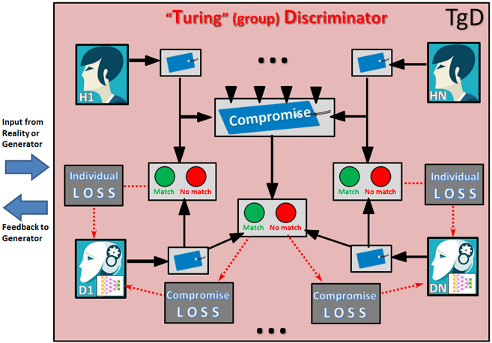
Cloning collective Intelligence
Using special GAN architecture with “Turing (group) Discriminator”
Terziyan, V., Gavriushenko, M., Girka, A., Gontarenko, A., & Kaikova, O. (2021). Cloning and Training Collective Intelligence with Generative Adversarial Networks. IET Collaborative Intelligent Manufacturing, 3(1), 64-74. John Wiley and Sons Ltd. https://doi.org/10.1049/cim2.12008
We provided an adversarial training framework for the collective intelligence. We show how cognitive capabilities can be copied (“cloned”) from humans and trained as a (responsible) collective intelligence. We made some modifications to the Generative Adversarial Networks architectures and adapted them for the cloning and training tasks. We modified the Discriminator component to a so‐called “Turing (group) Discriminator”, which includes one or several human and artificial discriminators working together.

Slide 13
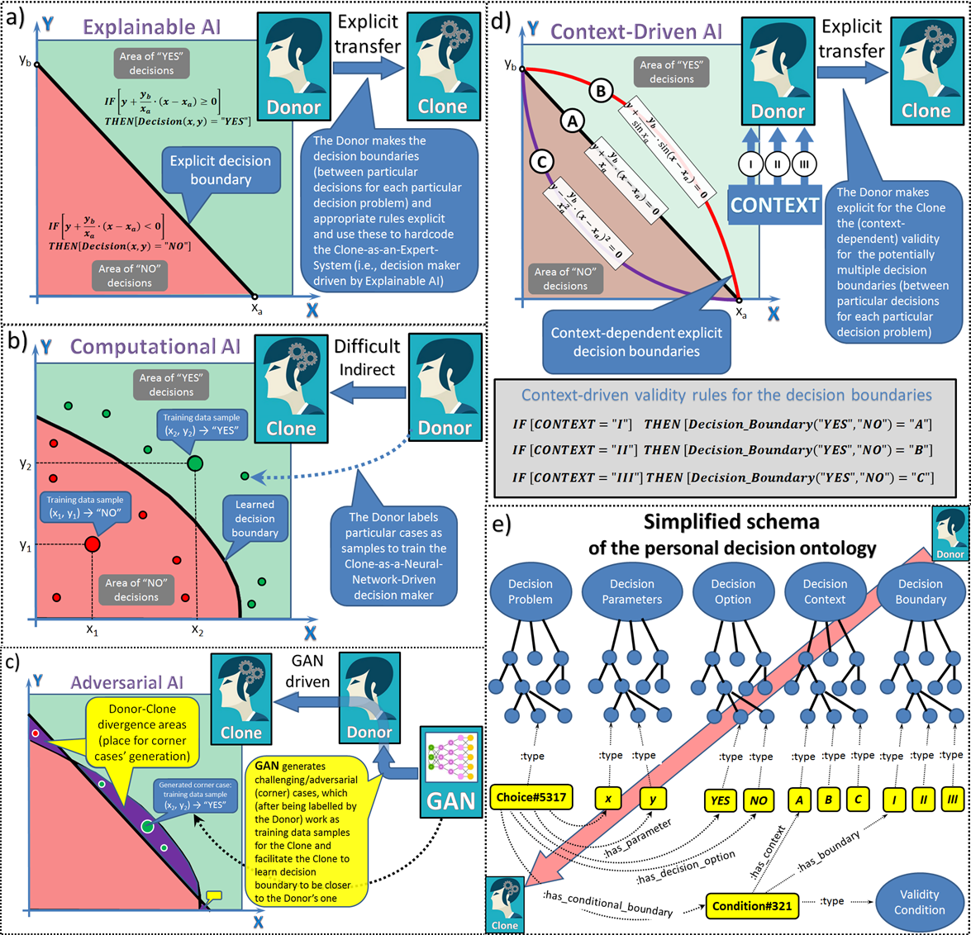
Challenges of Cognitive Cloning
explicit (donor to clone) knowledge transfer (e.g., as a set of decision rules);
machine learning-driven training of the clone (donor labels the particular decision contexts, and the clone learns the boundaries between different decision options by discovering the hidden decision rules of the donor);
adversarial learning (driven by GANs) helps facilitate the training process in b) by discovering the corner cases for challenging decisions, hence making the clone’s decision boundaries and rules closer to the donor’s;
discovering and making explicit the contexts that influence the donor’s decision boundaries and rules and training the clone specifically for all such contexts;
integrating both explicit and learned decision knowledge into different decision tasks and decision contexts under the umbrella of personal decision ontology, which will be used by the Pi-Mind agent when acting as a clone of a particular human donor.
Golovianko, M., Gryshko, S., Terziyan, V., & Tuunanen, T. (2022). Responsible Cognitive Digital Clones as Decision Makers: A Design Science Research Study. European Journal of Information Systems. https://doi.org/10.1080/0960085X.2022.2073278

Slide 14
Related Work
Behavioral cloning. (See also learning by imitation or building a model of human behavior when performing a complex skill). It is a method by which human sub-cognitive skills can be captured and reproduced in a computer program. As the human subject performs the skill, his or her actions are recorded along with the situation that gave rise to the action. A log of these records is used as input to a learning program, which outputs a set of rules (or policies) that reproduce the skilled behavior.
Knowledge transfer. Cloning can be seen as some kind of knowledge transfer between DONOR and CLONE. In machine learning, it is the process of transferring knowledge learned from one machine learning model, called “teacher model” (aka DONOR), to another (smaller) model, called “student model” (aka CLONE), with the goal of improving the performance of the student model. This is often done by leveraging the pre-existing knowledge of the teacher model to guide and enhance the learning of the student model, resulting in a more accurate and efficient model.
Knowledge distillation. Knowledge distillation is a specific technique for knowledge transfer that involves training a smaller model to mimic the behavior and predictions of a larger, more complex model. We may say that knowledge distillation approaches the problem of creating a functional copy of some classifier in a way that it has the same biases as the target classifier. A set of input-output pairs from the target classifier is collected that represent the confusing cases and biases to be replicated. Then these pairs will be used to train the student model using knowledge distillation. Our interest is particularly in data-free knowledge distillation, which means that distillation is made with no access to the data used for training teacher’s model (i.e., DONOR), and special techniques are used to generate synthetic data that the student model can learn from.
Adversarial distillation. In our study we want to teach the student model (CLONE) to copy not only correct answers but also the mistakes and biases of the teacher’s model (DONOR). Adversarial distillation supposes the use of an adversarial network (e.g., GAN) to generate samples, which are difficult ones for the student’s model to predict correctly, while still representing the underlying distribution of the data. In traditional distillation, the soft targets are generated by the teacher model itself, while, in adversarial distillation, these challenging examples are generated by an adversarial network that is specifically trained to do it.

Slide 15
Objectives of this study
Our overall objective is not related to optimizing the effectiveness and efficiency of classification models or addressing the data privacy issues like in traditional knowledge distillation, but rather getting a functional copy (aka digital cognitive “clone”) of some hidden phenomena or cognitive behavior (like human decision-making), including its strengths and weaknesses, perfectness and imperfectness, biases and ignorance, etc., without taking care about its performance. Therefore, we use the term (digital, cognitive) “cloning” instead of “distillation” in our research.
In this paper, we introduce an adversarial cloning architecture (“Cloning-GAN”) capable of making digital replicas of hidden cognitive assets with respect to their individual biases. The architecture is supposed to be a kind of adversarial distillation driven by a generative adversarial network with a special configuration and objectives regarding the generator and discriminator networks. It facilitates supervised machine learning of the clone model due to a smart way to generate challenging inputs for the donor (the target smart and black-box asset for the clone), who is supposed to act as a supervisor in such an adversarial learning process. The multicriteria-driven generator (adversarial facilitator) is the key cloning enabler and the major innovation in the suggested architecture.
In our Cloning-GAN architecture, the work on generating training samples for the CLONE is divided between the GENERATOR, who finds the coordinates for potentially challenging samples, and the DONOR, who labels it. This enables reaching adversarial distillation objectives without the use of a specific discriminator network component. However, the DONOR-CLONE pair in our architecture can be considered as a kind of complex discriminator, which we named as “Turing” discriminator in our former studies.

Slide 16
Distillation vs. Cloning: Objectives of this study
Related Work
Learning by imitation;
Knowledge transfer;
Knowledge distillation;
Adversarial distillation.
Overall objective is related to optimizing the effectiveness, efficiency, and/or privacy of classification models
$$≠$$
Cloning GAN
Overall objective is related to making digital replicas of hidden cognitive assets with respect to their individual biases. Intended cloning architecture facilitates supervised machine learning of the clone model due to a smart way to generate challenging inputs for the donor as a supervisor. The multicriteria-driven generator (adversarial facilitator) is the key cloning enabler and the major innovation in the suggested architecture.
A kind of adversarial distillation driven by a generative adversarial network with a special configuration and objectives regarding the generator and discriminator networks

Slide 17
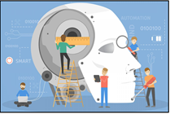
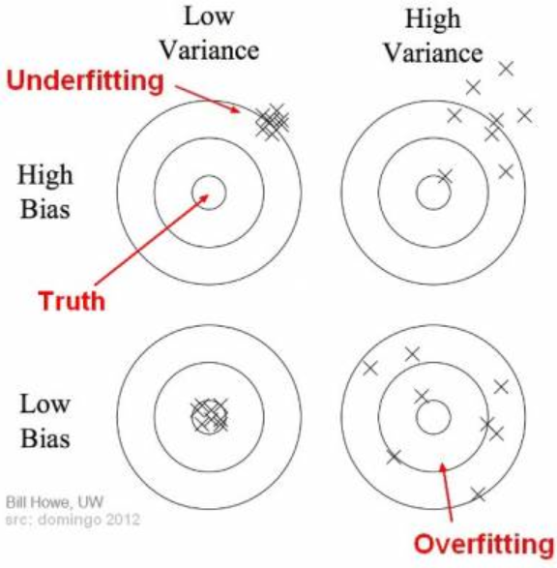
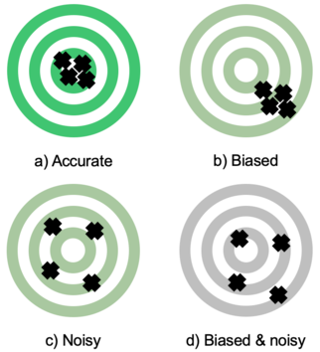
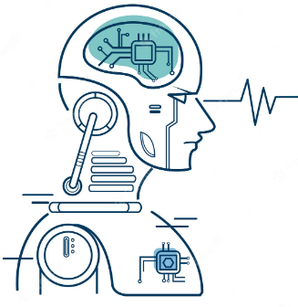
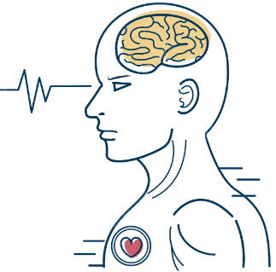
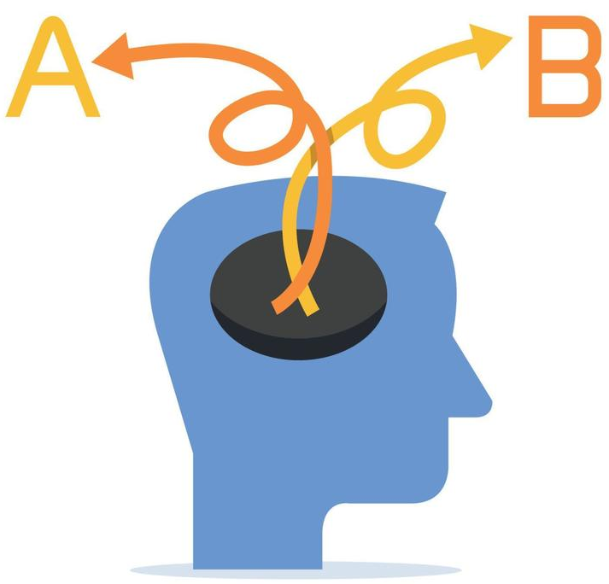
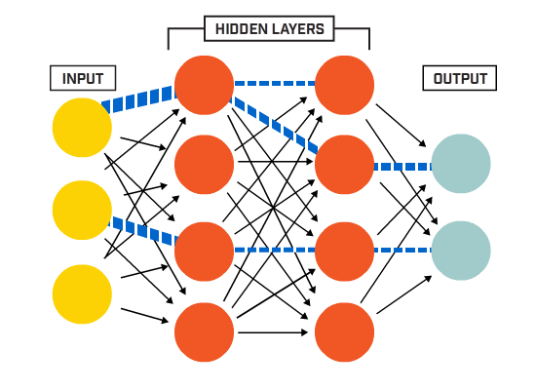
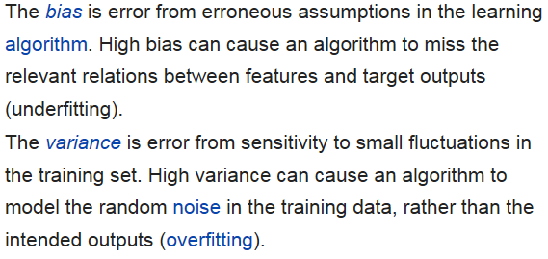
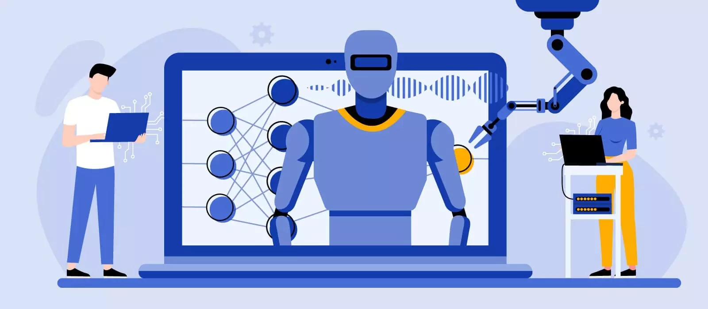
Major challenge of Cognitive Cloning: Noise and bias are not obstacles but objectives, which require adversarial-training-content generation for cloning with respect to personal cognitive biases
Clone vs Donor
Underfitting vs. Overfitting
Cognitive bias
Noise in human judgment arises because of factors such as cognitive biases, mood, and emotions.
Cognitive bias is a significant factor giving rise to both statistical bias and noise.
Goldberg, L. R. (1970). Man versus model of man: A rationale, plus some evidence, for a method of improving on clinical inferences. Psychological bulletin, 73(6), 422-432.
https://doi.org/10.1037/h0029230

Slide 18
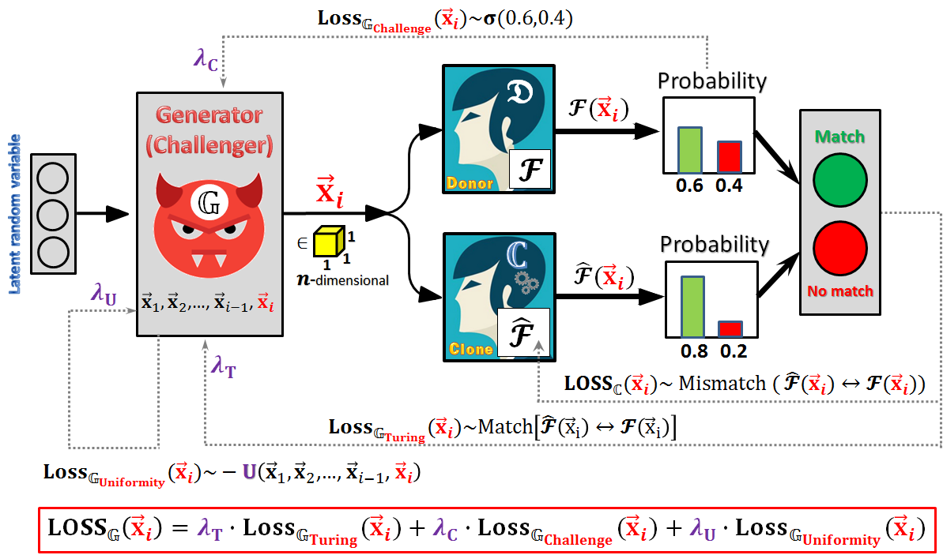
Suggested Cloning-GAN architecture

Slide 19
Cloning-GAN formal terminology
Assume we have the DONOR represented by a “labelling function” $𝓕:{[0,1]}^{n}⟼∆^{c}$ defined as follows:
(a) The domain of $𝓕$ is defined by the Euclidean space $ℝ^{n}$ bounded by a $n$-dimensional unit hypercube: ${[0,1]}^{n}$, each $i$-th point of which is an $n$-dimensional vector ${\vec{x}}_{i}$ of rational values, aka coordinates of some object of potential labelling: ${[0,1]}^{n}=\left\{∀{\vec{x}}_{i}:\left(x_{1},x_{2},…,x_{n}\right)∈ℝ^{n} | x_{1}∈\left[0,1\right],x_{2}∈\left[0,1\right],…,x_{n}∈[0,1]\right\}$;
(b) The range of $𝓕$ is defined by the unit $c$-simplex $∆^{c}$ (i.e., the $c$-dimensional probability simplex), each $i$-th point of which is a $c$-dimensional vector ${\vec{p}}_{i}$ of probabilities [regarding each of $c$ possible class labels from the set $𝕃=\left\{l_{1},l_{2},…,l_{c}\right\}$ assigned to the corresponding object represented by point ${\vec{x}}_{i}$ within the domain space]:
$∆^{c}=\left\{∀{\vec{p}}_{i}:\left(p_{1},p_{2},…,p_{c}\right)∈{\left[0,1\right]}^{c} | \sum_{k=1}^{c}{p_{k}}=1\right\}$;
(c) $∀{\vec{x}}_{i}:\left(x_{1},x_{2},…,x_{n}\right)∈{\left[0,1\right]}^{n},∃!{\vec{p}}_{i}:{\left(p_{1},p_{2},…,p_{c}\right)}_{i}∈∆^{c}, {\vec{p}}_{i}=𝓕\left({\vec{x}}_{i}\right).$
The DONOR performs as a labelling (classification) function (like a neural network), which takes a vector of numeric values (normalized to [0,1]) of some target object features as an input and outputs the probability distribution of that object having particular label (belonging to particular class) among several possible ones.

Slide 20
CLONE LOSS
Loss of the CLONE on each sample ${\vec{x}}_{i}$ (denoted as ${LOSS}_{ℂ}({\vec{x}}_{i})$) is a normalized measure (${LOSS}_{ℂ}({\vec{x}}_{i})∈[0,1]$) of the two probability distribution vectors’ mismatch (aka “Turing” mismatch): how CLONE addresses some newly generated sample ${\vec{x}}_{i}$ (i.e., $\hat{𝓕}\left({\vec{x}}_{i}\right)$) vs. how DONOR addresses the same sample ${\vec{x}}_{i}$ (i.e., $𝓕\left({\vec{x}}_{i}\right)$).
$$𝓕({\vec{x}}_{i}):(p_{1},p_{2},…,p_{c})$$
$$\hat{𝓕}\left({\vec{x}}_{i}\right):({\hat{p}}_{1},{\hat{p}}_{2},…,{\hat{p}}_{c})$$
$${LOSS}_{ℂ}({\vec{x}}_{i})=\text{Mismatch}\left[\hat{𝓕}\left({\vec{x}}_{i}\right)↔𝓕\left({\vec{x}}_{i}\right)\right]=\frac{1}{\sqrt{2}}∙d\left(\hat{𝓕}\left({\vec{x}}_{i}\right),𝓕({\vec{x}}_{i})\right)=\sqrt{\frac{{\left(p_{1}−{\hat{p}}_{1}\right)}^{2}+{\left(p_{2}−{\hat{p}}_{2}\right)}^{2}+…+{\left(p_{c}−{\hat{p}}_{c}\right)}^{2}}{2}}$$
(where $d$ – Euclidian distance).
GENERATOR LOSS (“Turing” component)
Loss of the GENERATOR on each generated sample ${\vec{x}}_{i}$ (${LOSS}_{𝔾}({\vec{x}}_{i})$) is constructed from three loss components:
$${LOSS}_{𝔾}\left({\vec{x}}_{i}\right)=λ_{T}∙Loss_{𝔾_{Turing}}({\vec{x}}_{i})+λ_{C}∙Loss_{𝔾_{Challenge}}({\vec{x}}_{i})+λ_{U}∙Loss_{𝔾_{Uniformity}}({\vec{x}}_{i})$$
“Turing” component of the GENERATOR’s loss on each generated sample ${\vec{x}}_{i}$ (denoted as $Loss_{𝔾_{Turing}}({\vec{x}}_{i})$) is a normalized measure ($∈[0,1]$) of the two probability distribution vectors’ match (aka “Turing” match): how CLONE addresses ${\vec{x}}_{i}$ (i.e., $\hat{𝓕}\left({\vec{x}}_{i}\right)$) vs. how DONOR addresses ${\vec{x}}_{i}$ (i.e., $𝓕\left({\vec{x}}_{i}\right)$):
$$Loss_{𝔾_{Turing}}({\vec{x}}_{i})=\text{Match}\left[\hat{𝓕}\left({\vec{x}}_{i}\right)↔𝓕\left({\vec{x}}_{i}\right)\right]=1−{Loss}_{ℂ}({\vec{x}}_{i})=1−\sqrt{\frac{{\left(p_{1}−{\hat{p}}_{1}\right)}^{2}+{\left(p_{2}−{\hat{p}}_{2}\right)}^{2}+…+{\left(p_{c}−{\hat{p}}_{c}\right)}^{2}}{2}}$$
“Turing” component of the GENERATOR’s loss on each sample ${\vec{x}}_{i}$ is opposite to the loss of the CLONE on the same sample because one of the GENERATOR’s objectives is to generate such samples, which would be the most difficult ones for the CLONE in predicting the DONOR’s outcomes.

Slide 21
GENERATOR LOSS (“Challenge” component)
“Challenge” component of the GENERATOR’s loss on each generated sample ${\vec{x}}_{i}$ (denoted as $Loss_{𝔾_{Challenge}}({\vec{x}}_{i})$) is a normalized measure ($∈[0,1]$) of how easy would be for the DONOR to confidently label the generated sample or, therefore, how far is the sample from being “adversarial” one and being able to confuse the DONOR (i.e., how far is the labelling probability distribution provided by DONOR on sample ${\vec{x}}_{i}$ from the uniform one):
${Loss}_{𝔾_{Challenge}}\left({\vec{x}}_{i}\right)=\frac{c}{\sqrt{c−1}}∙σ\left(p_{1},p_{2},…,p_{c}\right)=\sqrt{\frac{c∙\left(p_{1}^{2}+p_{2}^{2}+…+p_{c}^{2}\right)−1}{c−1}}$,
“Challenge” component of the GENERATOR’s loss ensures appearance of challenging-and-adversarial (close to decision boundaries and corner cases) samples helping the CLONE to faster learn the individual biases of the DONOR.
(where $σ$ – standard deviation).
More details on the “Challenge” component
$$σ\left(p_{1},p_{2},…,p_{c}\right)=\sqrt{\frac{{\left(p_{1}−\frac{1}{c}\right)}^{2}+{\left(p_{2}−\frac{1}{c}\right)}^{2}+…+{\left(p_{c}−\frac{1}{c}\right)}^{2}}{c}}=…=\frac{\sqrt{c∙\left(p_{1}^{2}+p_{2}^{2}+…+p_{c}^{2}\right)−1}}{c}$$
The more standard deviation $σ$ – the less confusion for the DONOR – the more loss for the GENERATOR
$$MAX\left[σ\left(p_{1},p_{2},…,p_{c}\right)\right]=σ\left(0, …,1,…,0\right)=\frac{\sqrt{c∙\left(0+…+1+…+0\right)−1}}{c}=\frac{\sqrt{c−1}}{c}$$
$$Loss_{𝔾_{Challenge}}\left({\vec{x}}_{i}\right)=\frac{σ\left(p_{1},p_{2},…,p_{c}\right)}{MAX\left[σ\left(p_{1},p_{2},…,p_{c}\right)\right]}=\frac{c}{\sqrt{c−1}}∙σ\left(p_{1},p_{2},…,p_{c}\right)=…=\sqrt{\frac{c∙\left(p_{1}^{2}+p_{2}^{2}+…+p_{c}^{2}\right)−1}{c−1}}$$
Therefore, $Loss_{𝔾_{Challenge}}({\vec{x}}_{i})∈\left[0,1\right]$ - aka normalized standard deviation $σ$

Slide 22
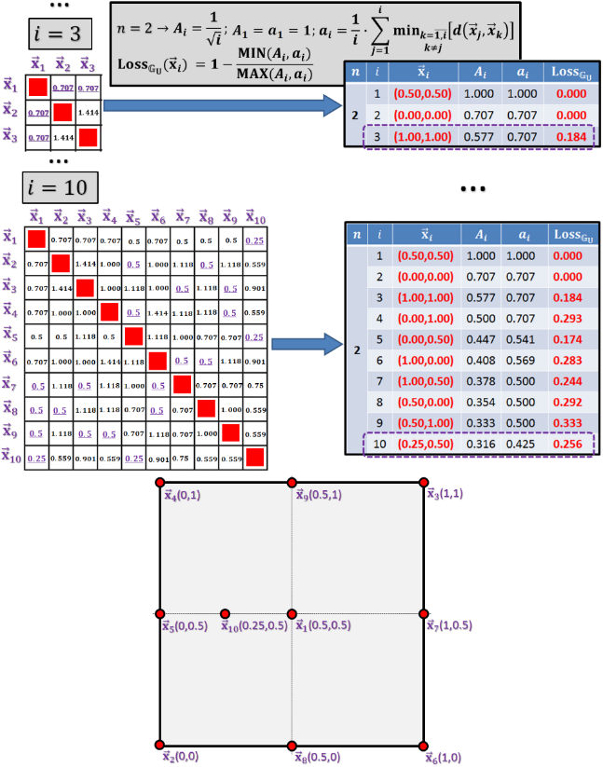
GENERATOR LOSS (“Uniformity” component)
One of the GENERATOR’s objectives is to generate adversarial samples “everywhere” (close to uniform distribution) within the decision space bounded by the unit hypercube. “Uniformity” component of the GENERATOR’s loss on each sample ${\vec{x}}_{i}$ ($Loss_{𝔾_{Uniformity}}({\vec{x}}_{i})$) is a normalized measure ($∈[0,1]$) of how far is the distribution of previously generated samples including the new one (${\vec{x}}_{1},{\vec{x}}_{2}$,…, ${\vec{x}}_{i−1}$, ${\vec{x}}_{i}$) from the uniform distribution. We compare the estimated average-nearest-neighbour-distance ($A_{i}$) for $i$ samples uniformly distributed within an $n$-dimensional unit hypercube with the actual average-nearest-neighbour-distance ($a_{i}$) for ${\vec{x}}_{1},{\vec{x}}_{2}$,…, ${\vec{x}}_{i−1}$, ${\vec{x}}_{i}$ generated samples:
$Loss_{𝔾_{Uniformity}}\left({\vec{x}}_{i}\right)=1−\frac{MIN(A_{i},a_{i})}{MAX(A_{i},a_{i})}$ (after $i$_{th} generated sample ${\vec{x}}_{i}$ in $n$-dimensional unit hypercube),
where $A_{i}=i^{−\frac{1}{n}}$ is a good heuristic approximation for the intended average nearest
neighbor distance taken from Bhattacharyya & Chakrabarti (2008);
$a_{1}=1; a_{i}=\frac{1}{i}∙\sum_{j=1}^{i}{\min_{k=\overline{1,i};k≠j}\left[d\left({\vec{x}}_{j},{\vec{x}}_{k}\right)\right]}$ ($d$ – Euclidian distance).
Bhattacharyya, P., & Chakrabarti, B. K. (2008). The Mean Distance to the nth Neighbour in a Uniform Distribution of Random Points: An Application of Probability Theory. European Journal of Physics, 29(3), 639-645. https://doi.org/10.1088/0143-0807/29/3/023
One may see that this calculation regarding each generated sample takes into account information on previously generated samples. However, it does not consume much memory for it. For each previously generated sample, the process keeps in its memory only the distance to its nearest neighbor (i.e., collecting the minimal distances needed to calculate $a_{i}$) and refines it when a new sample arrives.
Example illustrating “Uniformity” component of Cloning-GAN (based on iterative computing regarding 10 generated samples)

Slide 23
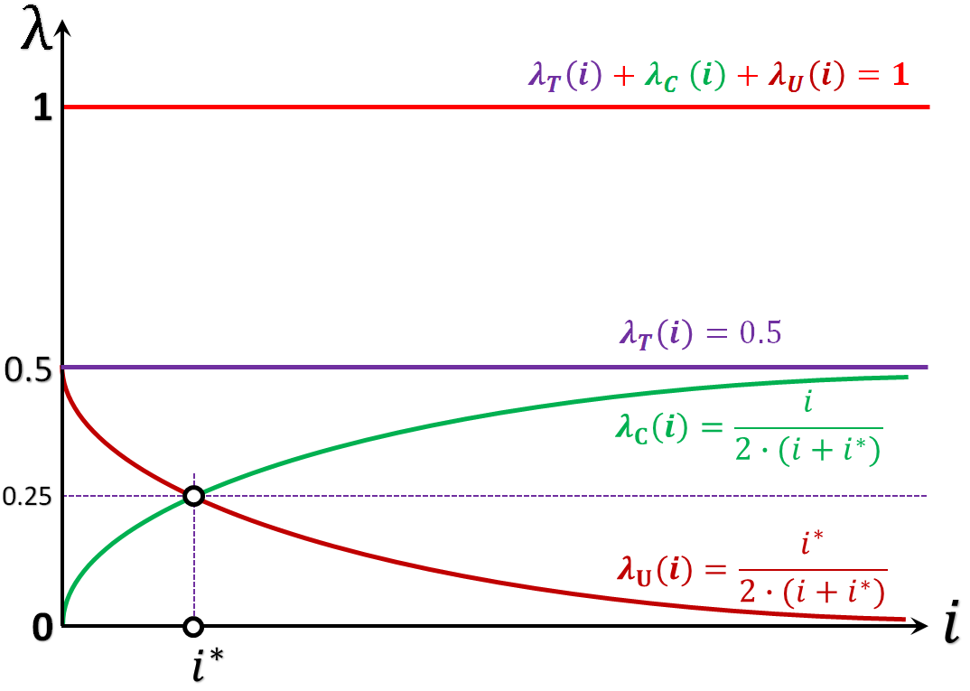
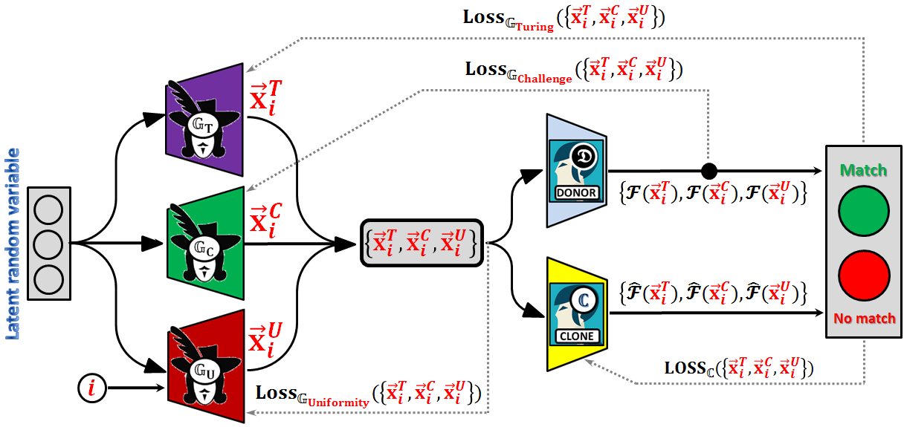
Trade-off options among the GENERATOR’s loss components
(1) The Basic Cloning-GAN (B-C-GAN) architecture supposes manual initialization and control of weights $λ_{T},λ_{C}, λ_{U}$ (assuming that $λ_{T}+λ_{C}+λ_{U}=1$), which will be considered as constants until changed manually if needed.
(2) The Dynamic Cloning-GAN (D-C-GAN) architecture assumes the dependence of the weights, which correspond to different components of the GENERATOR’s loss, on the current learning iteration (epoch) $i$.
(3) The “Three Musketeers” (“All for one and one for all”) Cloning-GAN (3M-C-GAN) architecture supposes splitting the GENERATOR to three (“Turing” or $𝔾_{T}$, “Challenge” or $𝔾_{C}$, and “Uniformity” or $𝔾_{U}$), one responsible for each loss component. The architecture assumes that, at $i$-th iteration, each of three GENERATORs independently generates one sample each and, therefore, resulting in a minibatch of three samples. Each of the GENERATORs will be punished for the loss created by all the minibatch (i.e., will be responsible for “colleagues’” performance also).
GENERATOR, like a kind of “young journalist”, in the beginning, learns to ask “different” questions and, when mature with this skill, switches to training his own capability of asking “difficult” questions also.
Plots show a trade-off among the importance of the GENERATOR’s loss function components during training

Slide 24
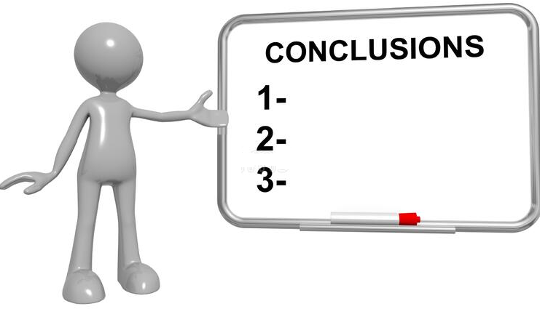
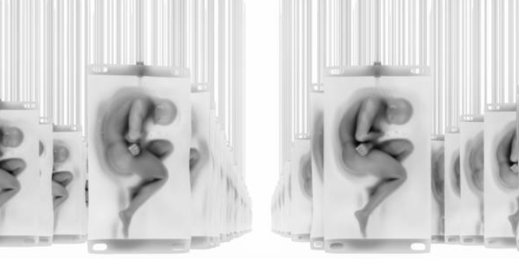
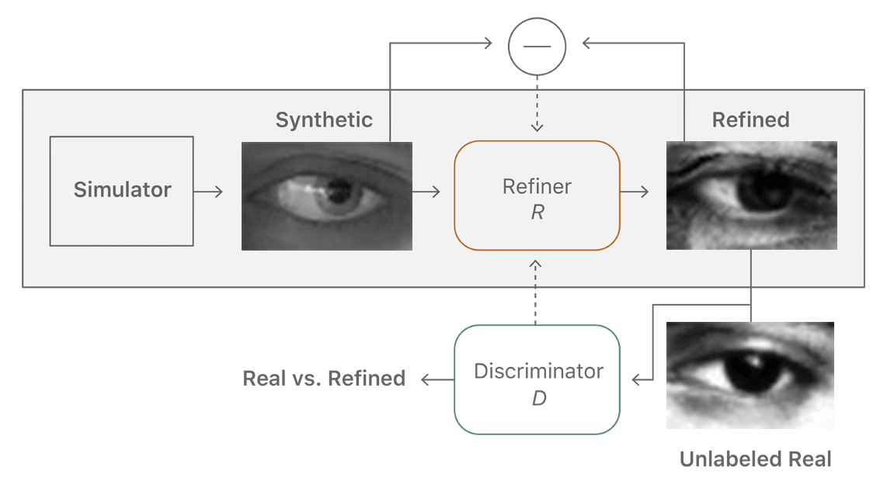
A highly automated and human-centric future of smart manufacturing requires process modeling, simulation, and control based on digital replicas of physical objects and smart entities, including humans. We modify traditional GAN to be used for cognitive cloning of hidden decision-making capability of a human or another smart model;
The suggested Cloning-GAN architecture is based on new philosophy. We do not have a target distribution to capture (like in traditional GAN) because the “reality” in this case is represented not by some set of data but by some hidden function (i.e., DONOR) to be learned and copied like in data-free knowledge distillation tasks. We just need to trade-off between the diversity and challenge of the generated data to get as good as possible training data for the CLONE;
Cloning-GAN inherits (from GAN) the process of incremental synchronous training of two adversaries. The capable data GENERATOR and the desirable CLONE are co-evolving towards perfectness during training. Comparably to the traditional GAN, the Cloning-GAN architecture is biased more towards the cloning rather than the generation objective;
Suggested architecture is a kind of adversarial knowledge distillation enabler facilitated by advanced multicriteria GENERATOR (B-C-GAN or D-C-GAN architectures) or by multi-GENERATOR (3M-C-GAN architecture). Our overall objective is not related to optimizing the effectiveness and efficiency of classification models or addressing the data privacy issues like in traditional knowledge distillation, but rather getting a functional copy (aka digital “clone”) of some hidden phenomena or cognitive behavior (like human decision-making), including its strengths and weaknesses, perfectness and imperfectness, biases and ignorance, etc., without taking care about its performance.
C L O N I N G

Slide 25
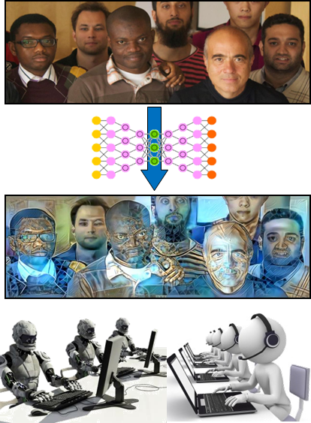
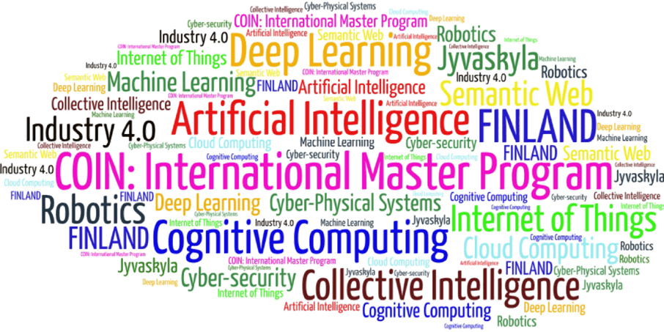
Come to study at our International Master Program
AI: Artificial Intelligence
(former Cognitive Computing and Collective Intelligence) …
… the first university program for collective intelligence, where humans learn together with their digital clones and autonomous digital assistants …
http://www.jyu.fi/ai
AI

Slide 26
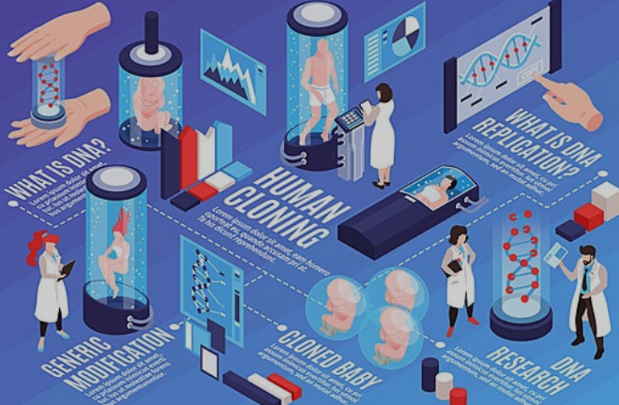
Link to the presentation: https://ai.it.jyu.fi/ISM-2023-Cloning_GAN.pptx
Contact: vagan.terziyan@jyu.fi

Slide 27
5th International Conference on Industry 4.0 and Smart Manufacturing – ISM 2023
Iscte - University Institute of Lisbon –Lisbon, Portugal | 22-24 November 2023
Thank you!
“Using Cloning-GAN Architecture to Unlock the Secrets of Smart Manufacturing: Replication of Cognitive Models”
Vagan Terziyan ª, Timo Tiihonen ^{b}
^{a,b} Faculty of Information Technology, University of Jyväskylä, Jyväskylä, Finland
Contacts
ª vagan.terziyan@jyu.fi, ^{b} timo.tiihonen@jyu.fi
Link to complete slide-set:
https://ai.it.jyu.fi/ISM-2023-Cloning_GAN.pptx
https://www.jyu.fi/en/

