Slide 1
5th International Conference on Industry 4.0 and Smart Manufacturing – ISM 2023
Iscte - University Institute of Lisbon –Lisbon, Portugal | 22-24 November 2023
“Deep Homeomorphic Data Encryption for Privacy Preserving Machine Learning”
Vagan Terziyan ª, Bohdan Bilokon ^{b}, Mariia Gavriushenko ^{c}
^{a, c} Faculty of Information Technology, University of Jyväskylä, Jyväskylä, Finland
^{b} Department of Artificial Intelligence, Kharkiv National University of Radio Electronics, Kharkiv, Ukraine
https://www.jyu.fi/en/
https://nure.ua/en/

Slide 2
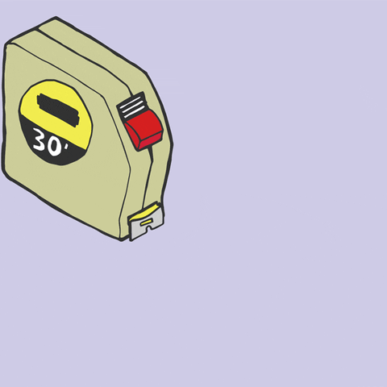
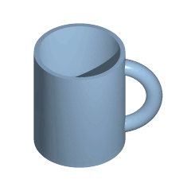
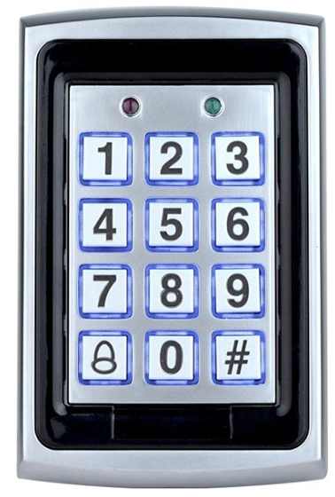
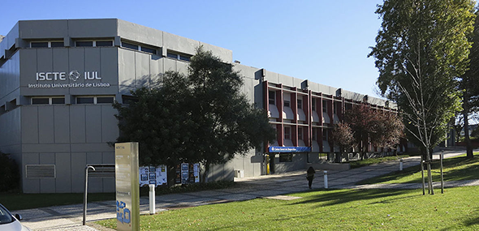
Q u a l i t y
“Deep Homeomorphic Data Encryption for Privacy Preserving Machine Learning”
Paper # 6778
Vagan Terziyan, Bohdan Bilokon & Mariia Gavriushenko
Iscte - University Institute of Lisbon
24 November, 2023, 11:40 - 12:00
ISM 2023
International Conference on Industry 4.0
and Smart Manufacturing
Section/Room: S8.R3
S8 (CYBERSECURITY) / R3

Slide 3
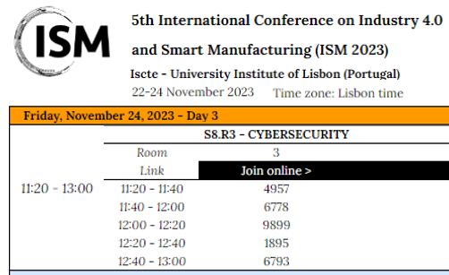

Slide 4
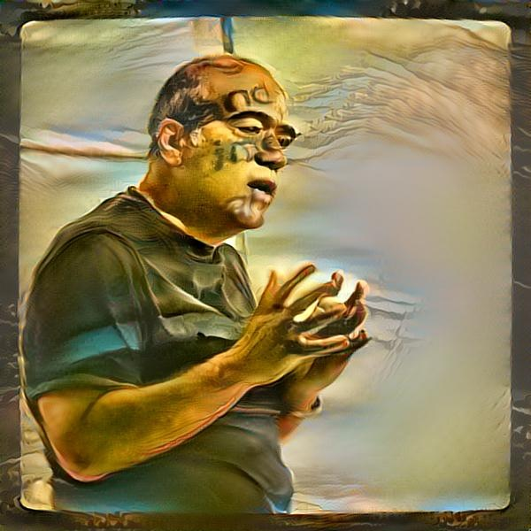
Vagan Terziyan
Mariia Gavriushenko
Authors
vagan.terziyan@jyu.fi
“Deep Homeomorphic Data Encryption
for Privacy Preserving Machine Learning”
Bohdan Bilokon
https://www.jyu.fi/en/
https://nure.ua/en/

Slide 5
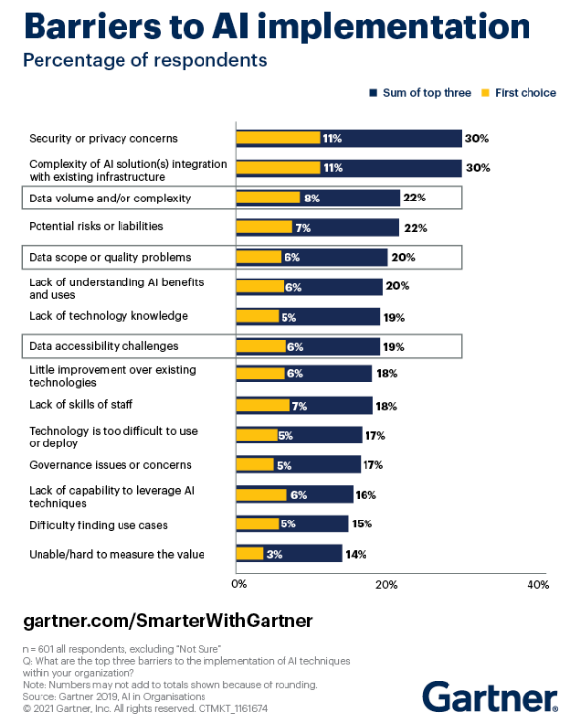
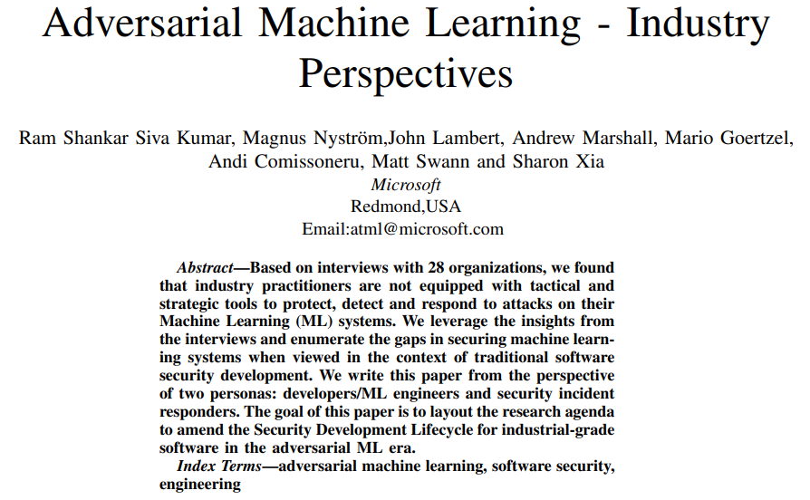
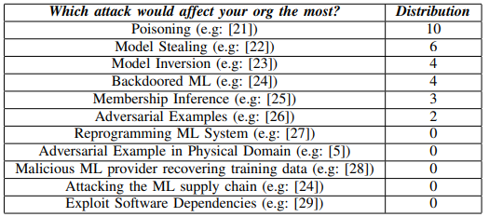
New Gartner survey: Only half of AI models make it into production
The survey reported that, on average, only 54% of AI models move from pilot to production.

Slide 6
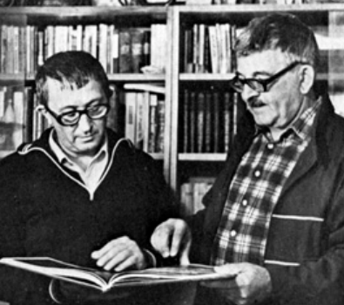
“Privacy notice” as an epigraph (motto) to this study …
“Top Secret. Burn before reading!”
Boris & Arkady Strugatsky (1965).
“Monday Begins on Saturday”
en.wikipedia.org/wiki/Monday_Begins_on_Saturday
“Privacy is the state of being free from public attention”
(Oxford Dictionary)
GDPR
You have the right to have your data erased …, if your personal data are no longer necessary in relation to the purpose for which it was collected ...

Slide 7
Machine Learning helps companies to get value from data

Slide 8
Data collected by corporate customers may contain sensitive private information

Slide 9
The best machine learning algorithms (capable to turn data into decision model) may be located at unsafe third party remote locations (clouds)

Slide 10
Decisions made by the trained model
After getting the model back from the remote cloud, the company can use it as an intelligent component of their systems. However, it is important that not only the private data but also the model is not stolen by the third party

Slide 11
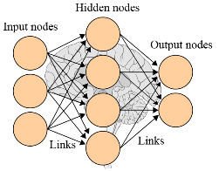
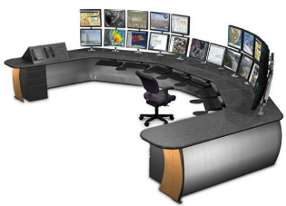
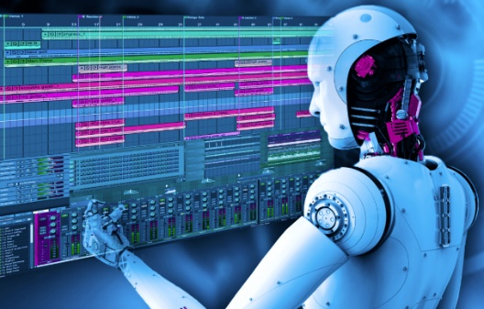
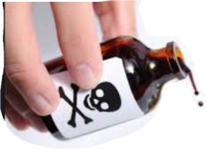
Data, Human and AI (training & testing) components of Machine Learning process are the targets for adversarial attacks
Labelled data
Human experts
Training data
Test data
Training
Industrial process
Trained model
Testing
Process data
Executable model
Attacks

Slide 12
Personal data privacy is under threat in the context of Machine Learning
Data (information) theft (stealing) is an illegal transfer or storage of personal, confidential, or financial information. This could include passwords, software code or algorithms, and proprietary processes or technologies with potentially severe consequences for individuals and organizations.
In inference attack, attackers cause a target machine learning model to leak information about its training data (including sensitive one).
In extraction attack, the adversary obtains a copy of your AI model by just observing what inputs cause what outputs. "You query the model, see the reaction, and, If you are allowed to do this enough times, you will teach your own model to behave the same way.

Slide 13
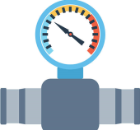
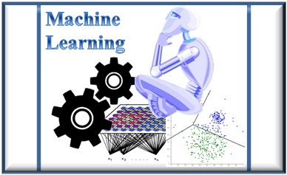
Data privacy challenge for Industry 4.0
Private (!)
DATA
Intelligence-as-a-Service
How to capture hidden value out of the data but (while doing it) preserve the data privacy?
The technical challenge would be enabling correct and efficient analysis of the large amounts of data produced by Industry 4.0 and its large sensor networks. Machine Learning (ML) as a technology has progressed a lot during the last few years, however, the legal aspects of the collection and processing data (such as privacy concern regarding personal data) has been neglected. Nowadays the potential of the ML models is essentially limited by the strict privacy regulations.

Slide 14
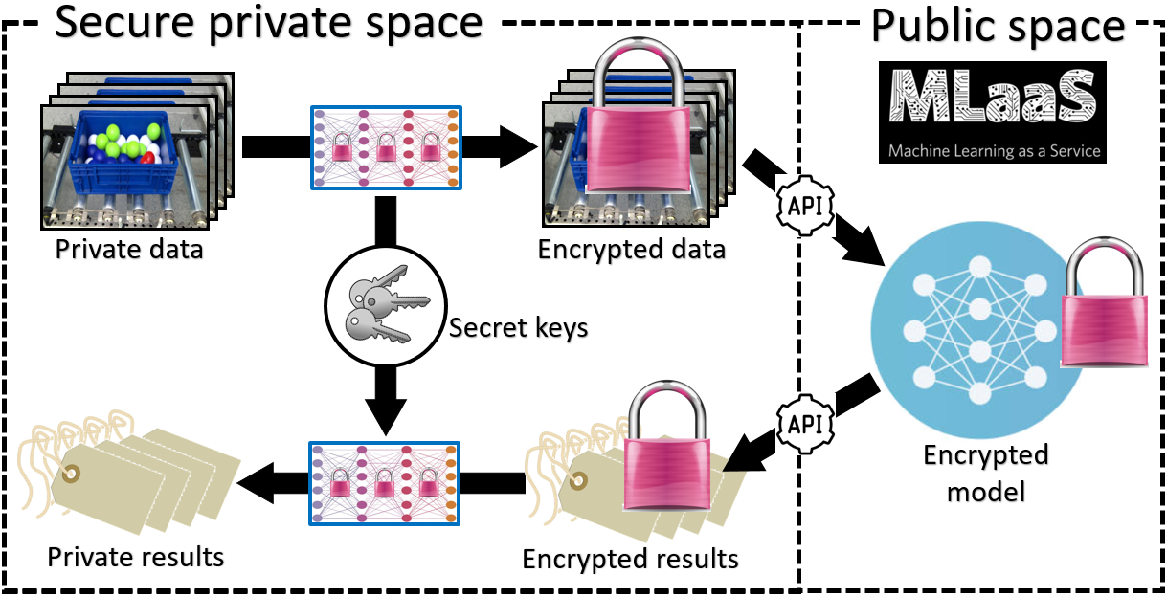
There is a huge need for Privacy-Preserving Machine Learning (PPML)

Slide 15
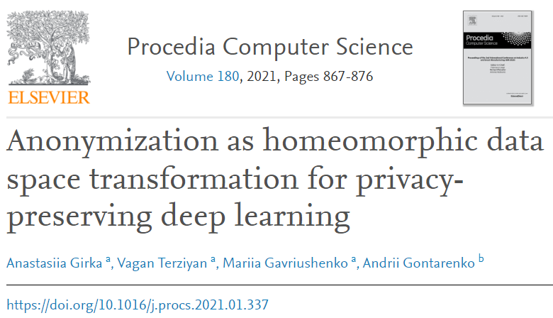
Input for this study - I
In Girka et al. (2021), we suggested a homeomorphic encryption as a homeomorphic transformation of labelled data with the secret transformation parameters as encryption keys. The intended objective was the possibility to use such encrypted data for PPML and particularly for safe supervised learning at third party servers (clouds). We performed a topology-preserving transformation of the original data as a kind of anonymization technique, which uses deep feedforward neural network (aka perceptron) to hide (by topology-preserving replacement) the coordinates (numeric attribute values) sensitive or private data samples but still enables potential classification model to be learned on the basis of the anonymized data. Such homeomorphic encryption applied on top of n-dimensional data manifold performed appropriate secret-key $n×n$ non-singular matrices (neural network weights) multiplication and invertible activation function at each layer. After several layers of such transformation, we will still keep the topologically equivalent (to the original one) data manifold, which hides private values of the data but preserves the labelling structure of the data needed to build the correct classification models.
Girka, A., Terziyan, V., Gavriushenko, M., & Gontarenko, A. (2021). Anonymization as Homeomorphic Data Space Transformation for Privacy-Preserving Deep Learning. Procedia Computer Science, 180, 867-876. Elsevier. https://doi.org/10.1016/j.procs.2021.01.337

Slide 16
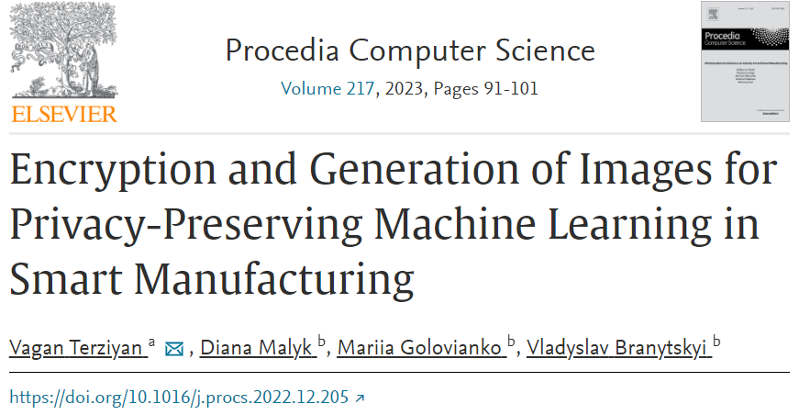
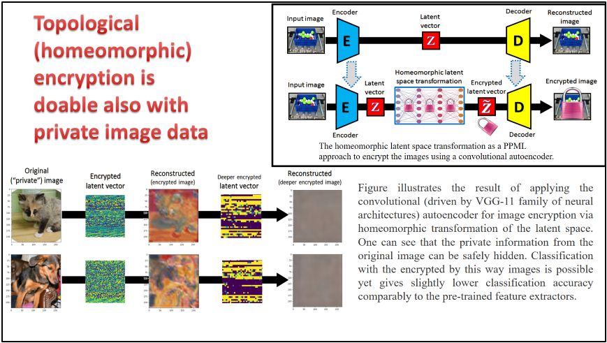
Input for this study - II
In Terziyan, Malyk, Golovianko & Branytskyi (2023), we extend our previous study on data anonymization for privacy-preserving machine learning also to image data. We show that our homeomorphic encryption algorithm can be applied on the feature level of image representation and enables both: hiding the private information and achieving a good classification performance on the encrypted data.
Terziyan, V., Malyk, D., Golovianko, M., & Branytskyi, V. (2023). Encryption and Generation of Images for Privacy-Preserving Machine Learning in Smart Manufacturing. Procedia Computer Science, 217, 91-101. Elsevier. https://doi.org/10.1016/j.procs.2022.12.205.

Slide 17
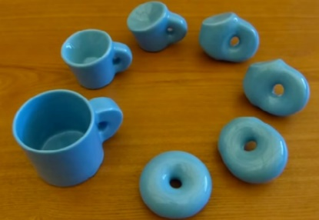
Our approach: topological (homeomorphic) encryption
In the mathematical field of topology, a homeomorphism or topological isomorphism is a continuous function between topological spaces that has a continuous inverse function. Homeomorphisms are the mappings that preserve all the topological properties of a given space. Two spaces with a homeomorphism between them are called homeomorphic, and from a topological viewpoint they are the same.
[Wikipedia]
Preserves decision boundaries
homomorphic encryption $≠$ homeomorphic encryption
Preserves algebra

Slide 18
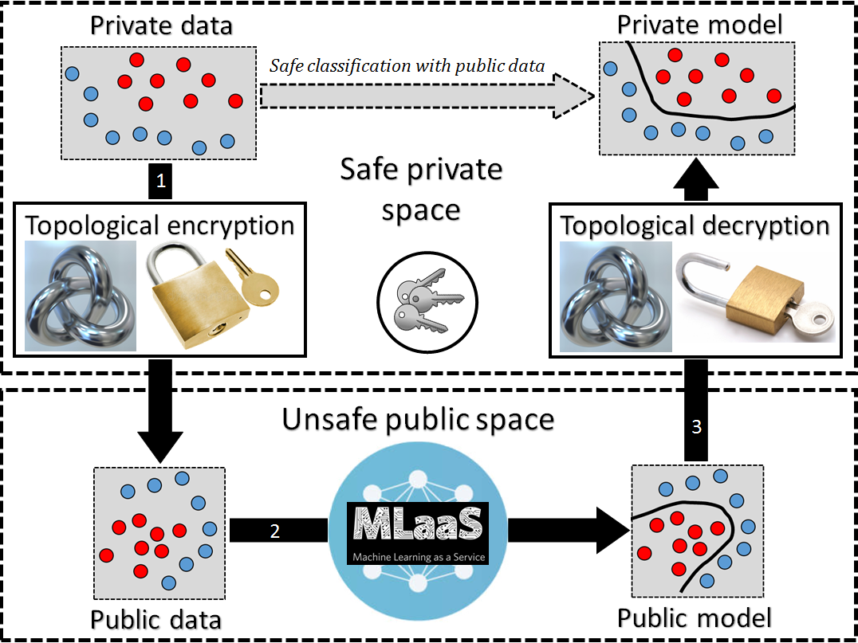
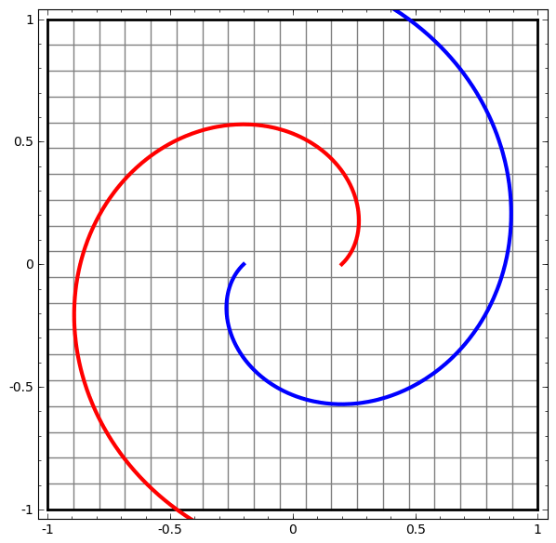
Generic schema of supervised PPML based on homeomorphic (topology-preserving) encryption

Slide 19
Our objective: multicriteria quality metric to assess homeomorphic encryption in PPML
(Algebra-preserving) homomorphic encryption is usually a complex procedure, which is applied to potentially different and unknown during the encryption phase purposes and use cases involving protected private data. In contrast, the (topology preserving) homeomorphic encryption (a quite simple and efficient procedure) can be used when we know that the main and sole purpose of the collected private data is a supervised ML (e.g., classification model building).
However, in both cases, the concerns for the PPML are similar:
We need a high level of protection (Security) provided by encryption.
We want to have the as small as possible (if any) loss of classification accuracy (ML Tolerance) of the model built from the encrypted data comparably to the one built from the original data.
We want to have as small as possible complexity increase (and, therefore, appropriate processing time) of the model built from the encrypted data (Efficiency) comparably to the one built from the original data.
Our objective is a quality metric (and its experimental testing) capable of using these mutually conflicting criteria to assess the quality of encryption regarding the particular data and intended model.

Slide 20
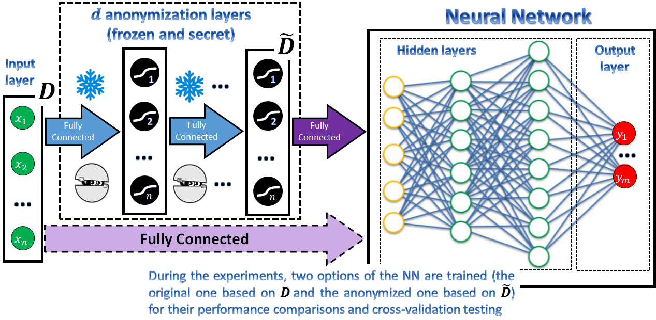
Topological (homeomorphic) encryption: schema of experimental evaluation

Slide 21
Key inputs for quality assessment (obtained experimentally)
Assume we have a dataset $D$ for supervised ML, particularly classification, containing $k$ samples that have $n$ attributes and labelled into $m$ different class categories.
Firstly, we configured and trained the neural network architecture, which will provide the best classification accuracy on top of the testing subset of the original data after learning. Let us assume that the architecture of the best preforming (on the original data) feedforward NN (perceptron) has the following total number of neurons: $n+m+H_{before}$, where: $H_{before}$ is the number of hidden neurons within the best NN architecture used with the original data (before anonymization).
Secondly, we anonymized the original dataset (which had been named $D$ before and became $\tilde{D}$ after the anonymization) using different anonymization depths $d$ (natural numbers from 1 to ∞). Therefore, the anonymizer here is another deep feedforward NN (aka perceptron), whose parameters (weights and biases are chosen as secret keys and frozen). After the frozen anonymization layers, another NN architecture will be configured and trained, which will provide the best classification accuracy on top of the testing subset of the anonymized data after learning. Let us assume that the architecture of the best preforming (on the anonymized data) feedforward NN (perceptron) has the following total number of neurons: $n+m+H_{after}$, where: $H_{after}$ is the number of hidden neurons within the best NN architecture used with the anonymized data (i.e., after the original data has been anonymized).

Slide 22
Key inputs for quality assessment (obtained experimentally)
Assume that the training experiments with both NNs give us the following measurements as the outcomes:
$A_{D|D}$ – testing accuracy for the case when the classifier is both trained and tested on the original “clean” data (i.e., a certain subset of the original data is used for training and the rest for testing);
$A_{\tilde{D}|\tilde{D}}$ – testing accuracy for the case when the classifier is both trained and tested on the modified “anonymized” data (i.e., a certain subset of the anonymized data is used for training and the rest for testing);
$A_{D|\tilde{D}}$ – testing accuracy for some kind of “cross-validation”, or the case when the classifier is trained on the original “clean” data but tested on the corresponding modified “anonymized” data (i.e., all the original data is used for training and all the anonymized data is used for testing);
$A_{\tilde{D}|D}$ – testing accuracy for another kind of “cross-validation”, or the case when the classifier is trained on the modified “anonymized” data and tested on the corresponding original “clean” data (i.e., all the anonymized data is used for training and all the original “clean” data is used for testing).
$d$ (depth of anonymization) – quality indicator, which value is supposed to be the more the better for the anonymization quality; The depth of anonymization (aka indicator for the data being “protected”) contributes to the security component of the anonymization quality. Each additional layer of the anonymization network adds at least $n^{2}$ (more precisely $n∙\left(n+1\right)$ if to take secret biases into account) secret keys (weights of the anonymization neural network), making potential hacking of the original data much more complicated.

Slide 23
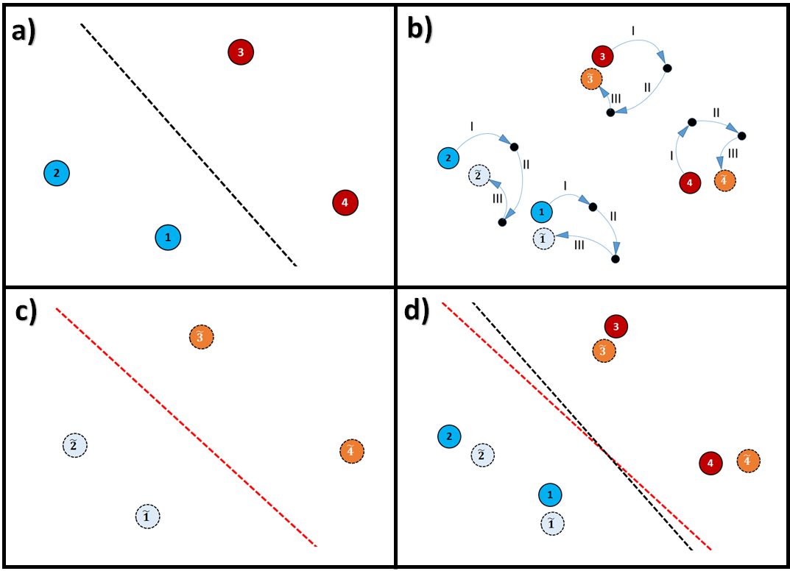
Computing preliminary quality indicators
$a=\left|A_{D|D}−A_{D|\tilde{D}}\right|$ (the greater value the better for the anonymization quality);
$b=\left|A_{\tilde{D}|\tilde{D}}−A_{\tilde{D}|D}\right|$ (the greater value the better for the anonymization quality);
NOTE: Indicators $a$ and $b$ are based on cross-validation and assesses how much replacement of the original data has been made by the anonymization procedure.
$γ=\frac{2∙a∙b}{a+b}$ – a harmonic mean (i.e., biased to the worth case scenario average) of $a$ and $b$ indicators;
NOTE: if $a=b=0$, then $γ=0$.
NOTE: $γ$ is a kind of indicator of how the data has been “replaced” (important for security component of all the anonymization quality functions), which estimates how well the original data samples are replaced (hidden) from their original places;
The need for a cross-validation to indicate weak homeomorphic encryption is visualized:
the original data samples and corresponding decision boundary between two classes;
replaced (with three layers of homeomorphic encryption) data samples occasionally appear close to their original places;
new decision boundary, which separates classes of the encrypted samples appears …
… to be close to the decision boundary for the original data, which indicates weak encryption.

Slide 24
SECURITY Component of Anonymization Quality
The “SECURITY” (a major importance) component of the Anonymization Quality (which indicates how strongly the privacy of the original data is protected by the anonymization) benefits from both: the depth of anonymization $d$ and the Harmonic Mean of both “cross-validation”-related quality indicators $a$ and $b$ as follows:
$Q_{Security}=1−e^{−γ∙d}=1−e^{−\frac{2∙a∙b∙d}{a+b}}$ .
NOTE: a more advanced option for the above equation would be the following one, which takes into account the number of instances $k$ and the number of attributes $n$ in the dataset:
$Q_{Security}^{∗}=1−e^{−γ∙d∙\frac{\ln{n^{2}}}{\ln{k}}}=1−e^{−\frac{2∙a∙b}{a+b}∙d∙\frac{2∙ln{n}}{\ln{k}}}$ .
Find detailed explanation in the article
NOTE: another advanced option for the equation above also takes into account the number of instances $k$ and the number of attributes $n$ in the dataset. It uses a negative power function instead of a logarithm to smooth the “attack opportunity” (driven by $k$ and restricted by $d$) as follows:
$Q_{Security}^{∗∗}=\sqrt{\frac{2∙a∙b}{a+b}∙\frac{d∙n∙\left(n+1\right)}{d∙n∙\left(n+1\right)+k^{d^{−1}}}}$ .
Find detailed explanation in the article
$${\overline{Q}}_{Security}=\frac{Q_{Security}+Q_{Security}^{∗}+Q_{Security}^{∗∗}}{3}$$
Average of the three options above

Slide 25
ML TOLERANCE Component of Anonymization Quality
The “ML TOLERANCE” (a moderate importance) component of the Anonymization Quality (which measures to what extent the accuracy is preserved after anonymization) is simply:
$Q_{ML Tolerance}=c$,
where $c=1−\left|A_{D|D}−A_{\tilde{D}|\tilde{D}}\right|$ (the greater value the better for the anonymization quality.

Slide 26
Efficiency Component of Anonymization Quality
The “EFFICIENCY” (a minor importance) component of the Anonymization Quality (which measures an additional resource (neurons) needed to deal with the anonymized data comparably to the original one) is as follows:
$Q_{Efficiency}=min (1,δ)$,
where $δ=\frac{n+m+H_{before}}{n+m+H_{after}}$(the greater value the better for the anonymization quality.

Slide 27
Final integrated Anonymization Quality Measure
The final Anonymization Quality measure (which value belongs to $[0,1]$ interval, or [0-100%] interval) for the $D→\tilde{D}$ anonymization can be computed as a “Golden Ratio”-driven [$φ$ is a “Golden Ratio” constant ($φ=\frac{1+\sqrt{5}}{2}≈1.618$)] compromise between the three quality components as follows:
$Q\left(D→\tilde{D}\right)=\frac{1}{φ^{2}+φ+1}∙\left(φ^{2}∙Q_{Security}+φ∙Q_{ML Tolerance}+Q_{Efficiency}\right)$.
$Q\left(D→\tilde{D}\right)≈0.5∙Q_{Security}+0.3∙Q_{ML Tolerance}+0.2∙Q_{Efficiency}$. (weighted Arithmetic mean option)
$$Q_{Security}^{∗}$$
$$Q_{Security}^{∗∗}$$
$\tilde{Q}\left(D→\tilde{D}\right)≈{\left(Q_{Security}\right)}^{0.5}∙{\left(Q_{ML Tolerance}\right)}^{0.3}∙{\left(Q_{Efficiency}\right)}^{0.2}$. (weighted Geometric mean option)
${\tilde{Q}}^{∗}\left(D→\tilde{D}\right)≈{\left(Q_{Security}^{∗}\right)}^{0.5}∙{\left(Q_{ML Tolerance}\right)}^{0.3}∙{\left(Q_{Efficiency}\right)}^{0.2}$.
${\tilde{Q}}^{∗∗}\left(D→\tilde{D}\right)≈{\left(Q_{Security}^{∗∗}\right)}^{0.5}∙{\left(Q_{ML Tolerance}\right)}^{0.3}∙{\left(Q_{Efficiency}\right)}^{0.2}$.
$\overline{\tilde{Q}}\left(D→\tilde{D}\right)≈{\left({\overline{Q}}_{Security}\right)}^{0.5}∙{\left(Q_{ML Tolerance}\right)}^{0.3}∙{\left(Q_{Efficiency}\right)}^{0.2}$.

Slide 28
Anonymization Quality Assessment Example
Anonymization (Homeomorphic Encryption) quality evaluation sheet.
“Letter Recognition” Dataset (https://archive.ics.uci.edu/ml/datasets/letter+recognition)
$$k$$ | 20000
$$n$$ | 16
$$m$$ | 26
$$train/test$$ | 70/30 |  |  | 50/50 |  |  | 30/70
$$d$$ | 1 | 2 | 3 | 1 | 2 | 3 | 1 | 2 | 3
$$H_{before}$$ | 185 |  |  | 220 |  |  | 193
$$H_{after}$$ | 214 | 245 | 275 | 260 | 295 | 336 | 210 | 228 | 250
$$A_{D|D}$$ | 0.970 |  |  | 0.965 |  |  | 0.946
$$A_{\tilde{D}|\tilde{D}}$$ | 0.945 | 0.920 | 0.895 | 0.935 | 0.905 | 0.875 | 0.911 | 0.876 | 0.841
$$A_{D|\tilde{D}}$$ | 0.050 | 0.040 | 0.030 | 0.040 | 0.040 | 0.020 | 0.050 | 0.040 | 0.030
$$A_{\tilde{D}|D}$$ | 0.060 | 0.040 | 0.030 | 0.060 | 0.050 | 0.020 | 0.050 | 0.030 | 0.030
$$a$$ | 0.920 | 0.930 | 0.940 | 0.925 | 0.925 | 0.945 | 0.896 | 0.906 | 0.916
$$b$$ | 0.885 | 0.880 | 0.865 | 0.875 | 0.855 | 0.855 | 0.861 | 0.846 | 0.811
$$c$$ | 0.975 | 0.950 | 0.925 | 0.970 | 0.940 | 0.910 | 0.965 | 0.930 | 0.895
$$δ$$ | 0.887 | 0.791 | 0.716 | 0.868 | 0.777 | 0.693 | 0.933 | 0.870 | 0.805
$$Q_{Security}$$ | 0.594 | 0.836 | 0.933 | 0.593 | 0.831 | 0.932 | 0.584 | 0.826 | 0.924
$$Q_{Security}^{∗}$$ | 0.397 | 0.637 | 0.780 | 0.396 | 0.630 | 0.779 | 0.388 | 0.625 | 0.764
$$Q_{Security}^{∗∗}$$ | 0.110 | 0.847 | 0.934 | 0.110 | 0.840 | 0.932 | 0.109 | 0.833 | 0.912
$${\overline{Q}}_{Security}$$ | 0.367 | 0.773 | 0.882 | 0.366 | 0.767 | 0.881 | 0.360 | 0.761 | 0.867
$$Q_{ML Tolerance}$$ | 0.975 | 0.950 | 0.925 | 0.970 | 0.940 | 0.910 | 0.965 | 0.930 | 0.895
$$Q_{Efficiency}$$ | 0.887 | 0.791 | 0.716 | 0.868 | 0.777 | 0.693 | 0.933 | 0.870 | 0.805
$$Q\left(D→\tilde{D}\right)$$ $$Q^{∗}\left(D→\tilde{D}\right)$$ $$Q^{∗∗}\left(D→\tilde{D}\right)$$ $$\overline{Q}\left(D→\tilde{D}\right)$$ | 0.767 0.668 0.525 0.653 | 0.861 0.762 0.867 0.830 | 0.887 0.811 0.888 0.862 | 0.761 0.663 0.520 0.648 | 0.853 0.752 0.857 0.821 | 0.878 0.801 0.878 0.852 | 0.768 0.670 0.531 0.656 | 0.866 0.766 0.870 0.834 | 0.892 0.812 0.886 0.863
$$\tilde{Q}\left(D→\tilde{D}\right)$$ $${\tilde{Q}}^{∗}\left(D→\tilde{D}\right)$$ $${\tilde{Q}}^{∗∗}\left(D→\tilde{D}\right)$$ $$\overline{\tilde{Q}}\left(D→\tilde{D}\right)$$ | 0.747 0.610 0.321 0.587 | 0.859 0.750 0.865 0.826 | 0.883 0.807 0.883 0.858 | 0.742 0.606 0.319 0.583 | 0.851 0.741 0.855 0.817 | 0.872 0.797 0.872 0.848 | 0.746 0.608 0.322 0.585 | 0.865 0.752 0.869 0.830 | 0.890 0.810 0.885 0.862
$$\overset{̿}{ℚ}\left(D→\tilde{D}\right)$$ | 0.780 { 0.652 ($d=1$); 0.828 ($d=2$); 0.859 ($d=3$) }
$$\overset{̿}{\tilde{ℚ}}\left(D→\tilde{D}\right)$$ | 0.755 { 0.585 ($d=1$); 0.824 ($d=2$); 0.856 ($d=3$) }
The quality estimations for the homeomorphic encryption are:
(a) $\overset{̿}{\tilde{ℚ}}\left(D→\tilde{D}\right)=0.585$for the case $d=1$;
(b) $\overset{̿}{\tilde{ℚ}}\left(D→\tilde{D}\right)=0.824$for the case $d=2$;
(c) $\overset{̿}{\tilde{ℚ}}\left(D→\tilde{D}\right)=0.856$for the case $d=3$; and
(d) $\overset{̿}{\tilde{ℚ}}\left(D→\tilde{D}\right)=0.755$($75.5\%$) as a summary across all the experiments.
The depth $d=3$ would be the best option to achieve the optimal quality ($0.856$) as a trade-off over the conflicting quality criteria.
Summary of experiments is demonstrated by finding the best performing NN configuration before and after encryption (separately for each depth). The experiments and plots are grouped for different ratios of training and test data used. An observation shows that encryption decreases slightly the classification accuracy over the encrypted data and demands more neurons for the best performing classifier configuration.

Slide 29
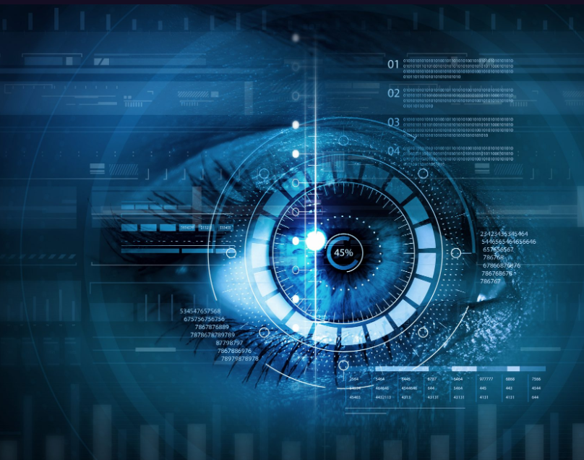
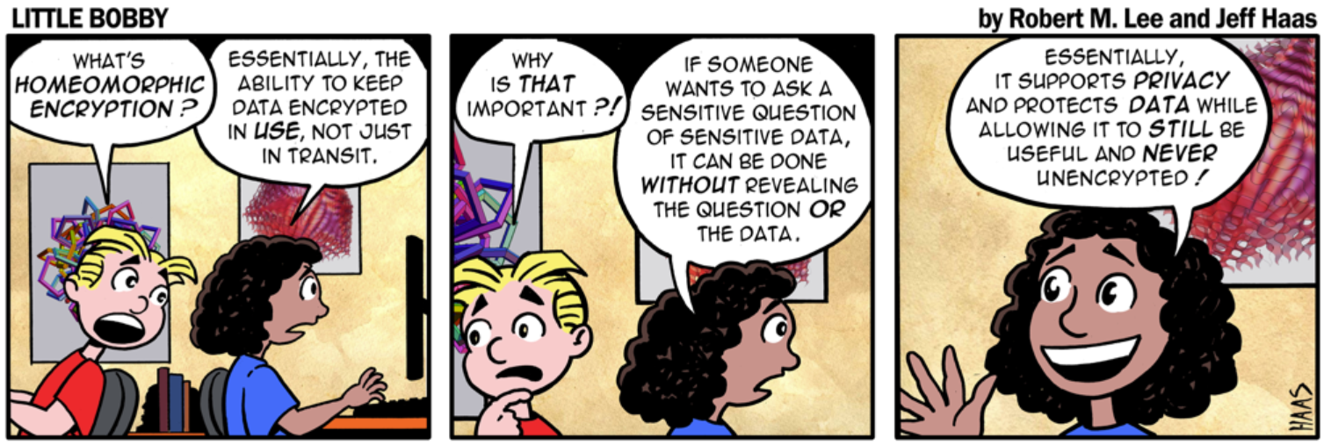
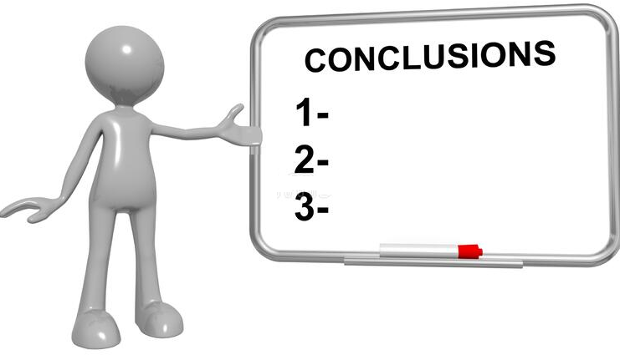
Conclusions
- Homeomorphic encryption algorithms pretend to be simple yet efficient tools for the PPML tasks compared to, e.g., more complex homomorphic encryption. We studied the quality of the homeomorphic encryption technique against three mutually conflicting criteria (security, ML tolerance and efficiency). For that purpose, we have developed the quality evaluation metric, which can be used as a quality judge for homeomorphic encryption as well as for other similar encryption and anonymization techniques (algorithms).
- We have tested both the quality metric and the homeomorphic encryption (with different depths) with several different datasets. We noticed that such a metric is a good guide for choosing the optimal encryption parameters. Due to several experiments, we have also noticed that the homeomorphic encryption guarantees a good overall quality regarding the conflicting criteria and can be used as a relatively simple alternative to the traditional homomorphic (and related) encryption in the context of PPML objectives.

Slide 30
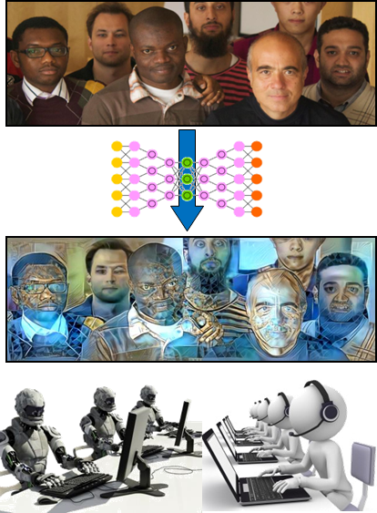
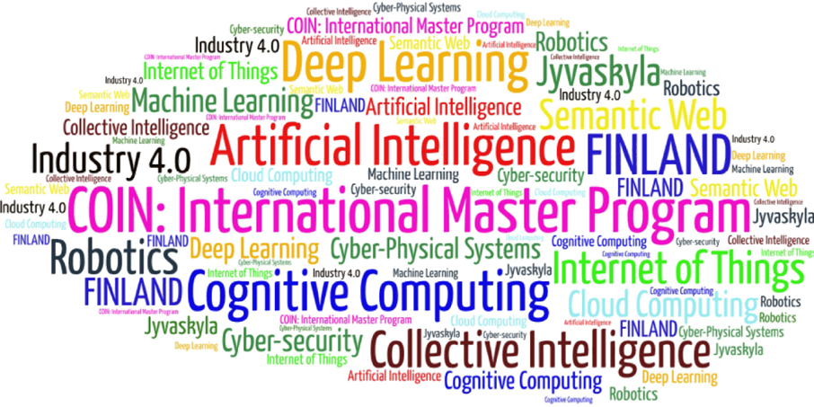
Come to study at our International Master Program
AI: Artificial Intelligence
(former Cognitive Computing and Collective Intelligence) …
… the first university program for collective intelligence, where humans learn together with their digital clones and autonomous digital assistants …
http://www.jyu.fi/ai
AI

Slide 31
Link to the presentation: https://ai.it.jyu.fi/ISM-2023-Encryption_Metric.pptx
Contact: vagan.terziyan@jyu.fi

Slide 32
5th International Conference on Industry 4.0 and Smart Manufacturing – ISM 2023
Iscte - University Institute of Lisbon –Lisbon, Portugal | 22-24 November 2023
Thank you!
“Deep Homeomorphic Data Encryption for Privacy Preserving Machine Learning”
Vagan Terziyan ª, Bohdan Bilokon ^{b}, Mariia Gavriushenko ^{c}
^{a,c} Faculty of Information Technology, University of Jyväskylä, Jyväskylä, Finland
^{b} Department of Artificial Intelligence, Kharkiv National University of Radio Electronics, Kharkiv, Ukraine
Contacts
ª vagan.terziyan@jyu.fi , ^{b} bohdan.bilokon@nure.ua , ^{c} gavrushik@gmail.com
Link to complete slide-set:
https://ai.it.jyu.fi/ISM-2023-Encryption_Metric.pptx
https://www.jyu.fi/en/
https://nure.ua/en/

