Slide 1
5th International Conference on Industry 4.0 and Smart Manufacturing – ISM 2023
Iscte - University Institute of Lisbon –Lisbon, Portugal | 22-24 November 2023
“Deep Neural Networks, Cellular Automata and Petri Nets: Useful Hybrids for Smart Manufacturing”
Olena Kaikova ª, Vagan Terziyan ^{b}
^{a,b} Faculty of Information Technology, University of Jyväskylä, Jyväskylä, Finland
https://www.jyu.fi/en/

Slide 2
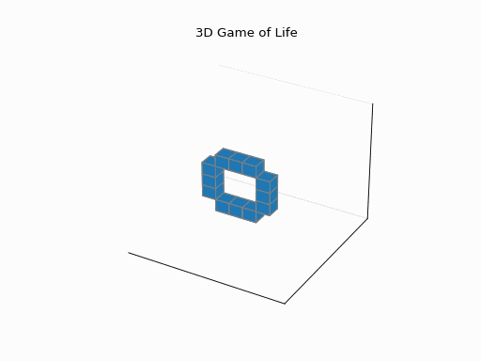
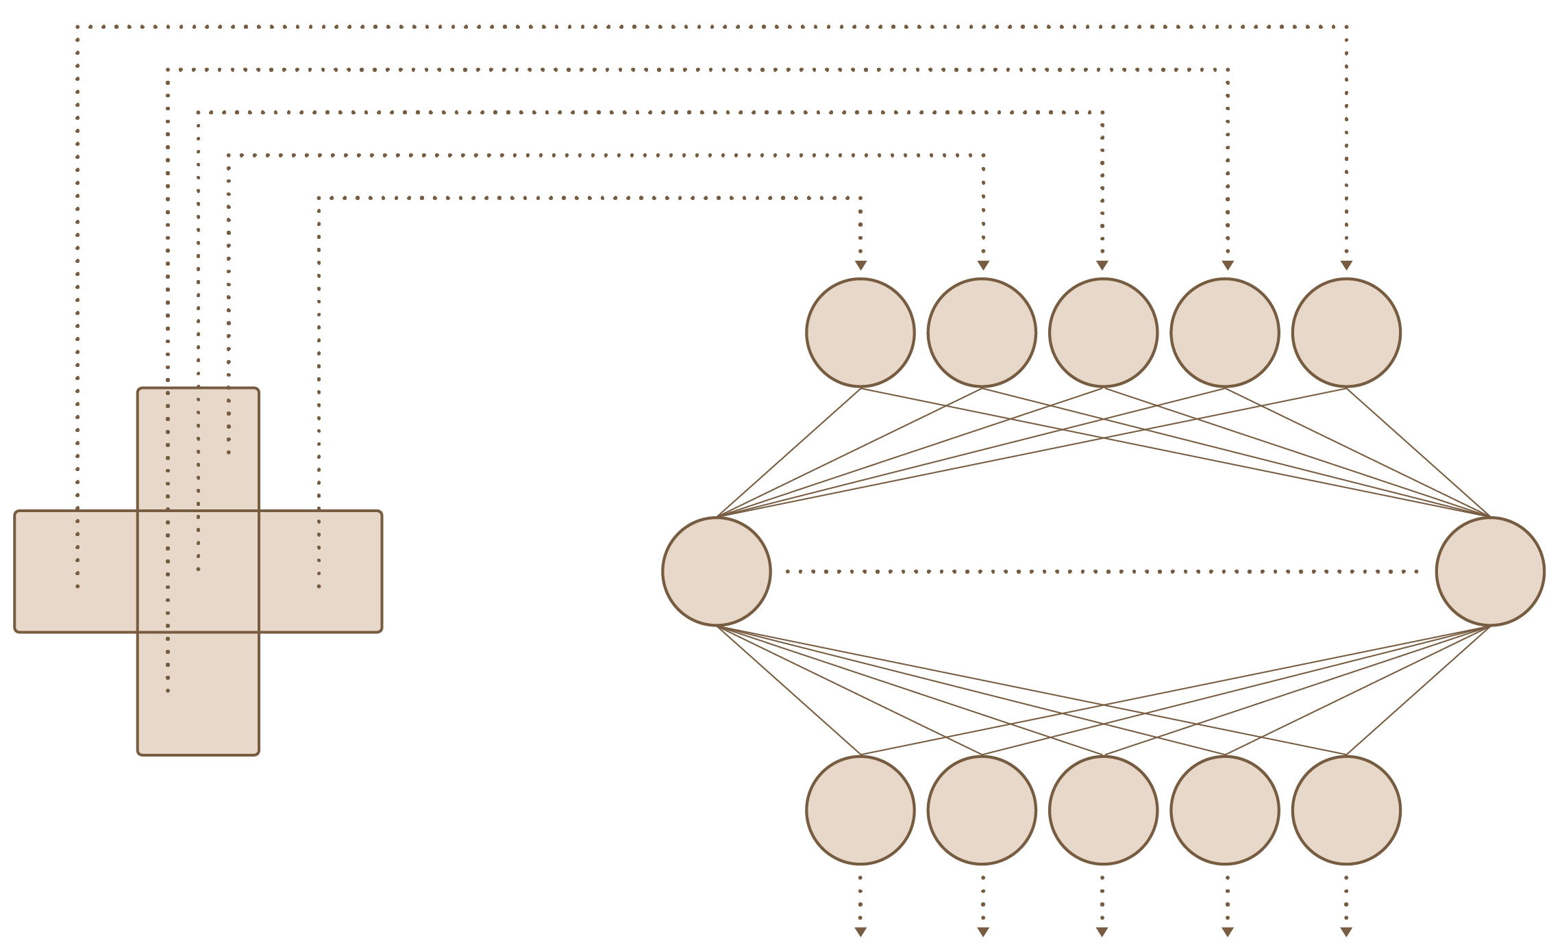
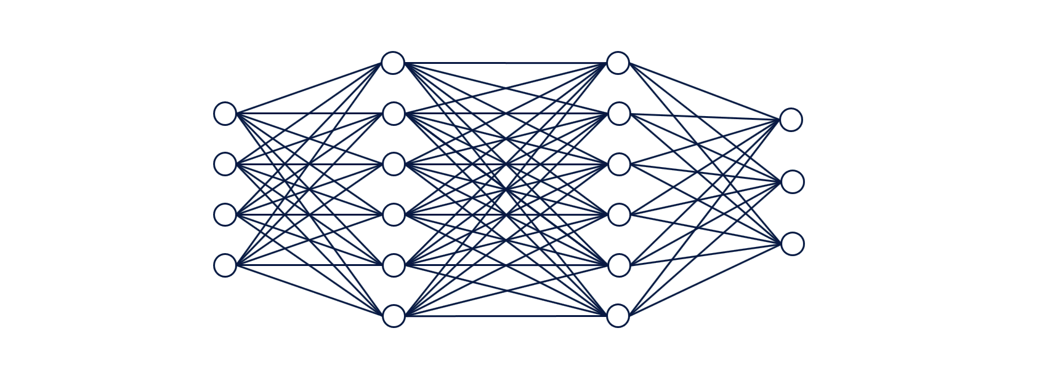
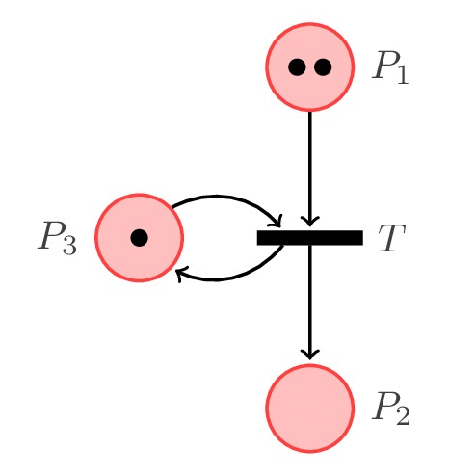
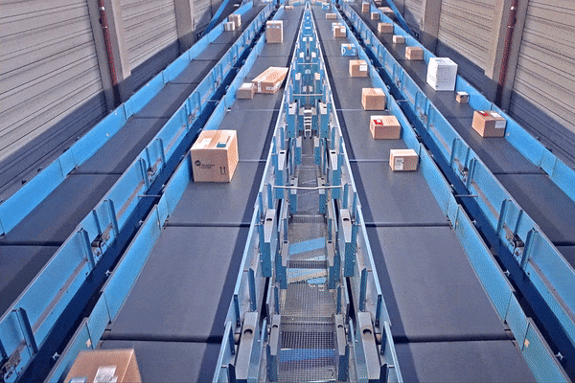
h y b r i d s
“Deep Neural Networks, Cellular Automata and Petri Nets: Useful Hybrids for Smart Manufacturing”
Paper # 7259
Olena Kaikova & Vagan Terziyan
Iscte - University Institute of Lisbon
23 November, 2023, 15:50 - 16:10
ISM 2023
International Conference on Industry 4.0
and Smart Manufacturing
Section/Room: S5.R1
S5 (EXPLAINABLEAI) / R1

Slide 3
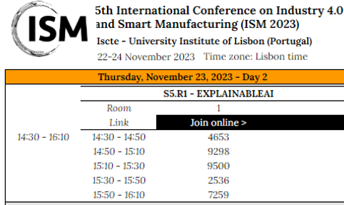

Slide 4
Authors
Olena Kaikova
“Deep Neural Networks, Cellular Automata and Petri Nets: Useful Hybrids for Smart Manufacturing”
Vagan Terziyan
vagan.terziyan@jyu.fi
https://www.jyu.fi/en/

Slide 5
Why hybrids?
Hybrid models enable different modelling techniques that can capture different aspects of the system being modeled, and the combination of these techniques can create a more comprehensive understanding of the system helping to simulate complex systems more accurately, which can lead to better decision-making particularly in Industry 4.0 and 5.0 applications.
Reliable process models for design, control, operation and troubleshooting purposes are a key for efficient Industry 4.0 and smart manufacturing. Taking into account the emerging “Industry 4.0 to Industry 5.0 transformation” challenge with human centricity and resilience in the focus, the traditional process modelling approaches, such as discrete-event modelling, must be enhanced with more sophisticated ones, including human behavior modelling techniques. Therefore, the required models will be hybrid in their mathematical nature and will combine discrete and continuous modelling components.

Slide 6
Options for Hybrid Models
A hybrid is a result of merging two or more components of different categories to generate something new that combines their characteristics into something more useful.
Two (or more) independent models A and B of different categories could be combined as a hybrid in one of these ways:
(a) Sequential: [Output (Model A) → Input (Model B)] $⟹$ [Output (Hybrid) = Output (Model B)];
(b) Interactive: {[Output (Model A) → Input (Model B)] AND [Output (Model B) → Input (Model A)]}$⟹$
$⟹${Output (Hybrid) = [Output (Model A) OR Output (Model B)};
(c) Mixed: {Context I $⟹$ [Output (Hybrid) = Output (Model A)]}; {Context II $⟹$
$⟹$[Output (Hybrid) = Output (Model B)]}; {Context III $⟹$
$⟹$[Output (Hybrid) = Output (Model A) $⊕$ Output (Model B)]}.
We added one important type of missing hybrid as follows:
(d) Managed: {[Output (Model A) → Configuration (Model B)]$⟹$
$⟹$[Output (Hybrid) = Output (Model B)]} OR {[Output (Model B) → Configuration (Model A)]$⟹$
$⟹$[Output (Hybrid) = Output (Model A)]}.
Hybrid of type (d) means that Model B is actually “does the job” while Model A controls the configuration (structure, hyperparameters, etc.) of Model B, or vice versa.

Slide 7
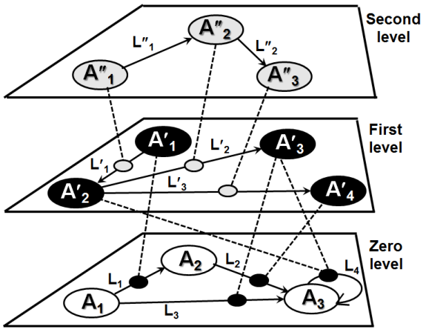
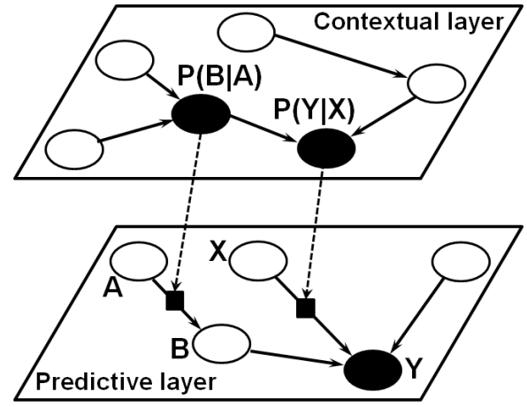
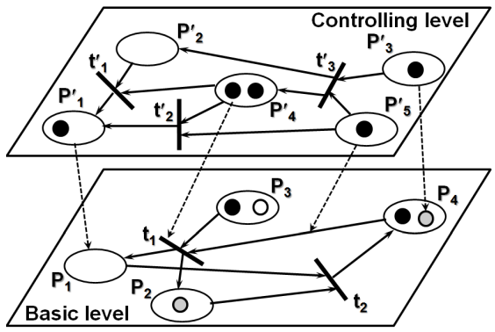
Objectives of this study
Our former studies (on “Semantic Metanetworks”, “Bayesian Metanetworks”, and “Metapetrinets” [see References in the paper]) considered models of type (d) as “meta-models” (i.e., “homogeneous hybrids”) when models A and B are of the same category.
In this paper, we are looking for “heterogeneous hybrids” of type (d). We consider A vs. B in the hybrids to be types of different modeling paradigms, either continuous vs. discrete modelling or vice versa. Our particular interest in this study focuses on hybrids, where Petri Nets or Cellular Automata represent the discrete modelling component within the hybrid and (Deep) Neural Networks represent the continuous modelling component in it.
Homogeneous Hybrid
Semantic Metanetwork
Bayesian Metanetwork
MetaPetriNet

Slide 8
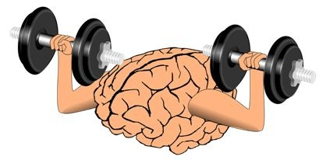
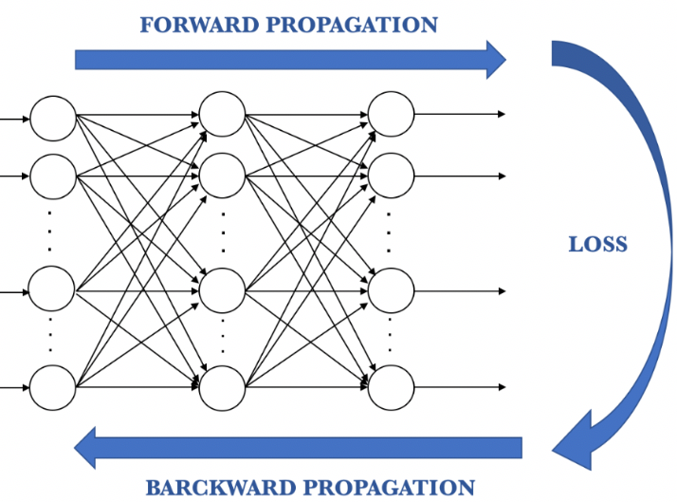
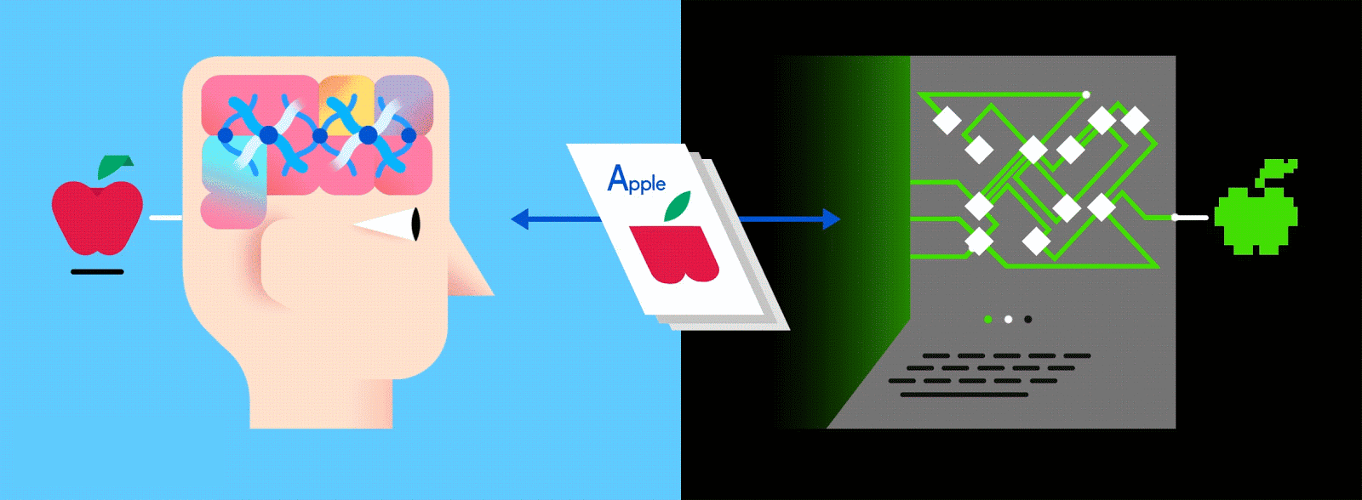
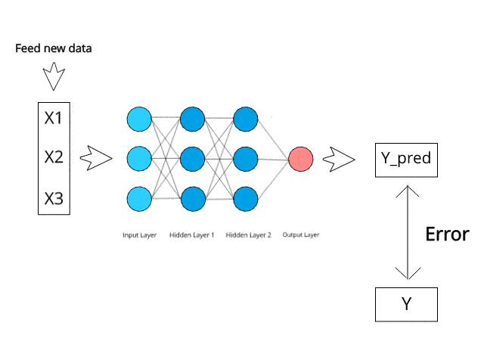
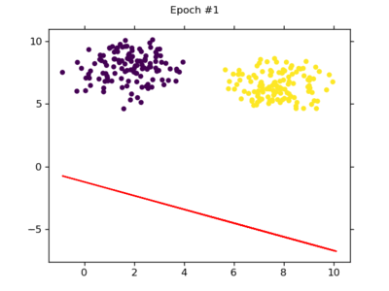
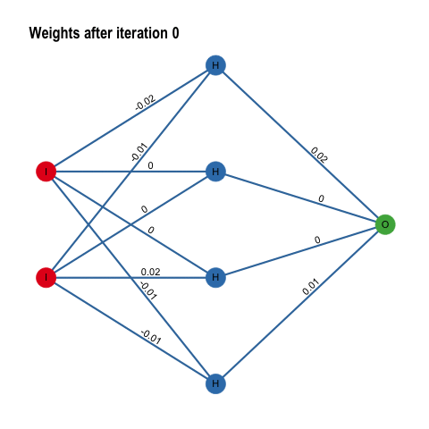
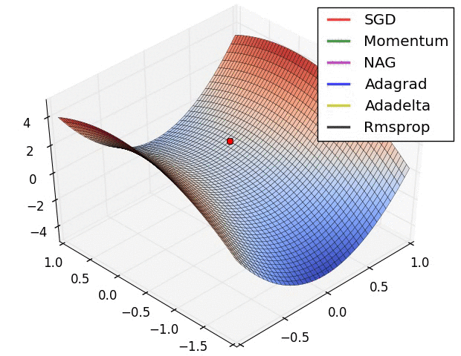
Neural Networks and Their training
Training NNs
(gradient descent variations)
Incremental learning
Batch learning
Minibatch learning

Slide 9
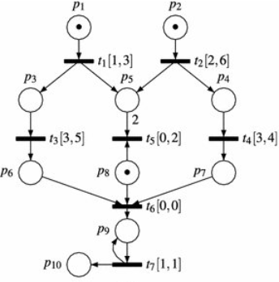
Petri Nets (… a useful mathematical tool for simulations …)
Petri Nets are a mathematical tool used for modeling and analyzing complex systems. They consist of a set of places, transitions, and directed arcs that connect them. Places are represented by circles, transitions by bars, and arcs by arrows. Places can hold tokens, which represent the state of the system, while transitions can fire and change the state of the system. The basic firing rule in Petri nets states that a transition is enabled (can fire) if all of its input places have at least one token. When a transition fires, it consumes one token from each of its input places and produces one token in each of its output places.
In Colored Petri Nets, tokens have additional attributes called colors, which can be used to model additional information about the system. The basic firing rule is modified in colored Petri nets to take into account these additional attributes: a transition can fire only if there are tokens in all of its input places that match the color(s) specified by the transition. When a transition fires, it consumes tokens with matching colors from its input places and produces tokens with matching colors in its output places.
A Time Petri Net (TPN) is a type of Petri net that incorporates time into the modeling process. In a TPN, each place and transition is associated with a time interval or duration, which specifies the amount of time required for the corresponding event to occur. The firing rule in a TPN is based on the notion of time intervals. A transition can fire only if all of its input places have at least one token, and if the time intervals associated with those input places have elapsed.
Petri nets are useful for studying the behavior of systems that involve concurrent processes (including logistics), resource sharing, and synchronization. They can help identify potential issues and bottlenecks in a system and suggest ways to improve its performance. To use Petri nets to model a system, you first identify the places, transitions, and arcs that represent the components of the system. Then you define the transitions’ firing rules that govern the system's behavior.

Slide 10
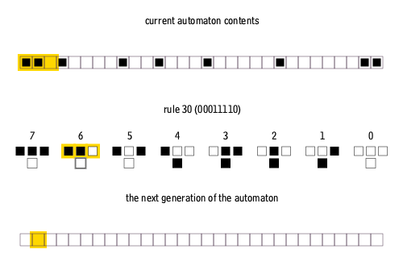
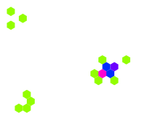
Cellular Automata (computationally universal tool for discrete simulations)
Cellular Automata (such as e.g., Conway’s “Game of Life”) are dynamical systems that are local, parallel, synchronous, space and time uniform. Cellular automata are used to model phenomena where the space can be regularly partitioned and where the same rules are used everywhere. Each cell has a state chosen inside a finite set. The dynamics is given by replacing the state of each cell according to its neighborhood and following the defined rules. In practice, cellular automata are often used for specific tasks, such as simulation and modeling of complex systems, pattern formation, and cryptography, among others.
https://playgameoflife.com/
1-D cellular automata
Gosper's Glider Gun creating "gliders" in the cellular automata Conway's Game of Life
Cellular automata based on hexagonal cells instead of squares
“Game of Life” rules

Slide 11
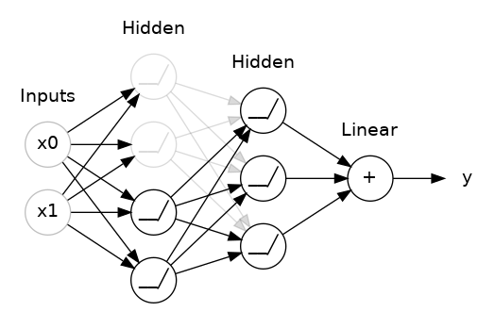
PN→NN
“towards improved manageability and explainability of the black-box decision models”
H y b r i d #1: Petri-Net-driven Neural Network
The hybrid PN→NN are designed to support general decision-making objectives and the NN component guarantees that. PN adds certain interpretable (explainable) control option to manage the way NN is being trained. Such a hybrid provides a control option for human experts (i.e., industrial domain experts rather than data scientists) to manage high-performing but “black-box” decision models in smart manufacturing.

Slide 12
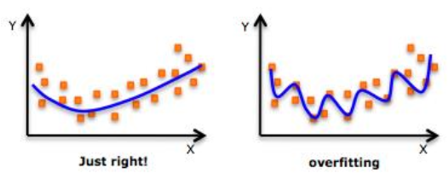
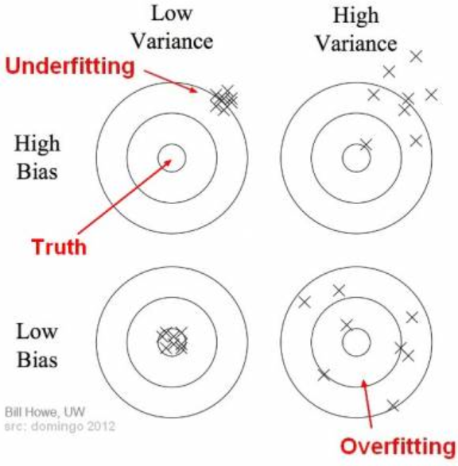
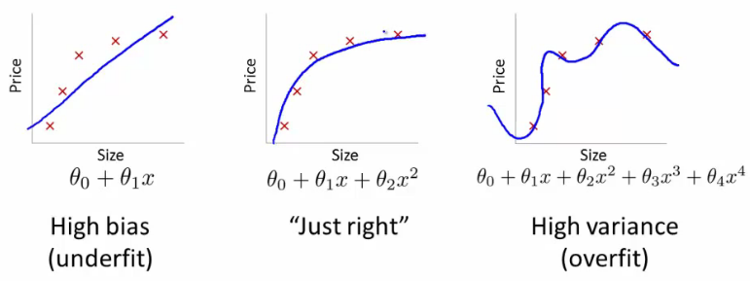
Overfitting:
A challenge for machine learning in general and for Neural networks in particular
Overfitting occurs when a neural network becomes too complex and starts to memorize the training data instead of learning to generalize from it. This means that the network may perform very well on the training data, but will perform poorly on new, unseen data. A simple analogy for overfitting can be compared to a student who memorizes answers to specific questions for a test, but does not fully understand the underlying concepts. If the test contains questions that are slightly different or ask for a deeper understanding of the material, the student may struggle to perform well.
BIAS VS. Variance

Slide 13
Dropout:
A popular instrument to combat overfitting
Dropout is a regularization technique used in deep neural networks to prevent overfitting. It involves randomly dropping out (i.e., making temporarily frozen) some of the neurons (together with input and output edges) in a neural network during training. The probability of a neuron being dropped out is usually set to a value between 0.1 and 0.5. The choice of nodes (neurons) to be deleted at the next training iteration (i.e., regarding the next minibatch of training data) is random.
Each neuron can be removed (or become inactive with “frozen” weights) at the next training iteration with probability, e.g., $p=0.25$

Slide 14
During each training iteration, a dropout layer removes a proportion of randomly selected neurons, forcing the remaining neurons to take on more responsibility for the representation. When a neuron is removed its corresponding input and output edges are also removed. This means that the neurons on either side of the removed neuron will no longer be connected directly to each other. As a result, the network must learn to make do without this connection, which helps prevent overfitting. During testing, the full network is used without any dropout, but the weights are scaled to account for the dropout during training. This reduces the risk of overfitting because the network cannot rely too heavily on any one feature, and so it learns more robust features that are useful across many inputs. Dropout makes the neural network more generalizable, which is essential for its ability to perform well on unseen data.
Dropout:
How?

Slide 15
How to combat Overfitting? Dropout !
Pick a mini-batch
$$θ^{t}←θ^{t−1}−η∇C\left(θ^{t−1}\right)$$
Training:
Each time before computing the gradients
Each neuron has some probability $p$ to be dropped out

Slide 16
Dropout is a kind of ensemble
minibatch
1
minibatch
2
minibatch
3
minibatch
4
Training of Dropout
M neurons
……
2^{M} possible networks
Using one mini-batch to train one network
Some parameters in the network are shared

Slide 17
Dropout is a kind of ensemble
Testing of Dropout
testing data x
All the weights multiply $(1−p)$
……
y₁
y₂
y₃
average
≈
y

Slide 18
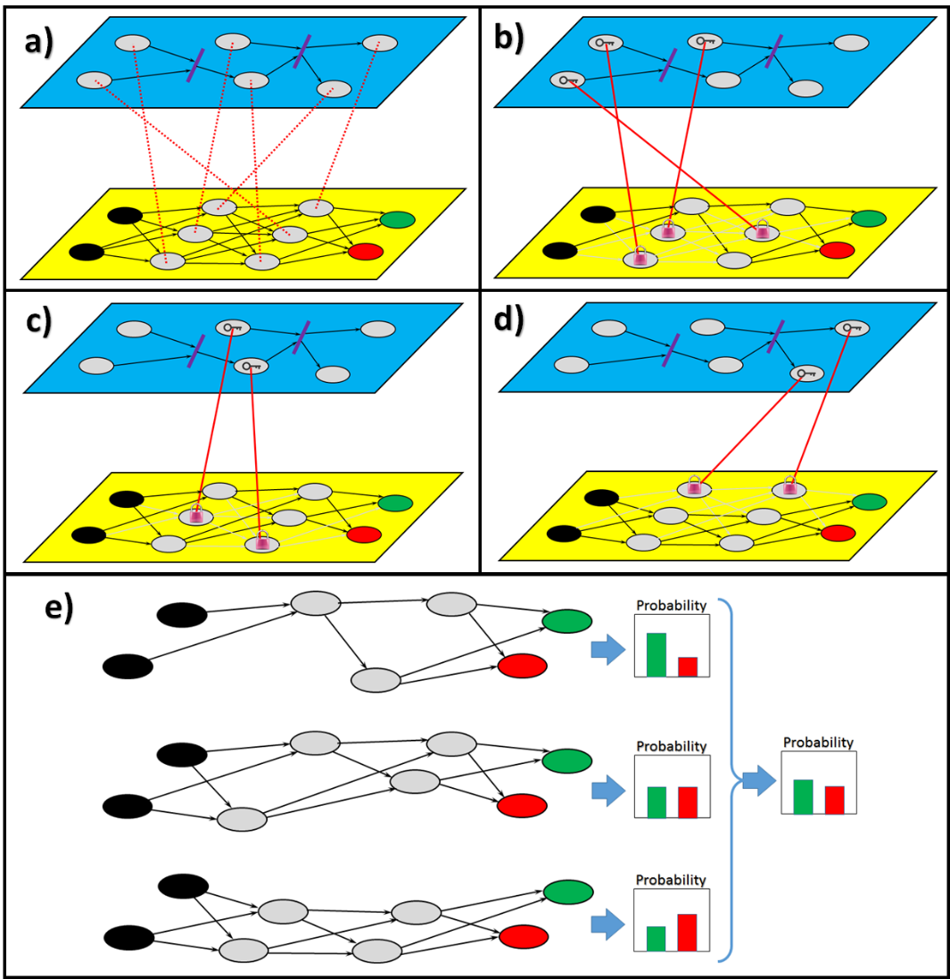
PN controls drop-out in deep NN learning
The initial PN marking with the tokens (“keys”) unlocks the corresponding neurons from the lower layer NN (i.e., these with corresponding keys will be “unlocked” and become active for training while others will be removed from current NN configuration)
Places of the PN from the upper layer correspond to the hidden neurons of the NN from the lower layer
PN generates its new marking due to fired transitions and, therefore, new neurons will be unlocked by the tokens (keys) while others locked (removed)
The last cycle of PN marking and corresponding NN configuration
Such a hybrid enables training process, which, instead of a random choice of the dropped-out neurons for each configuration, behaves as a controllable (by PN) dropout process.
All three configurations contribute to decision-making and their outputs makes an impact into the final probability distribution among the classes behind the output neurons

Slide 19
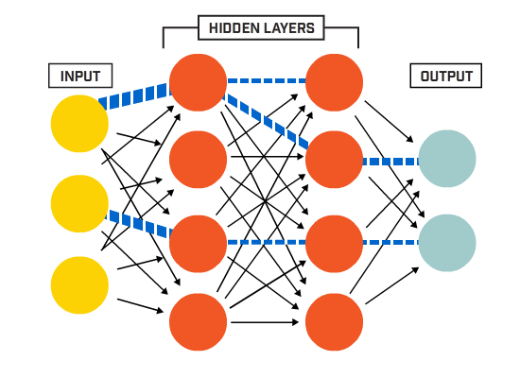
NN→PN
“bringing more intelligence and learnability into the discrete simulation models”
H y b r i d #2: Neural-Network-driven Petri Net
The hybrid NN→PN is designed for modelling, simulation and decision-support objectives and the PN component guarantees that. However, the NN component on top embeds some learnable intelligence into the basic models. These hybrids enable “smarter” self-configurable PNs based on the decisions automatically made by NN. This means that additional intelligence (learnable from data as a NN) may enhance the decision points within industrial processes previously managed by humans or hardcoded by the fixed rules. In this way, the decision-making power of PNs will grow due to the known high decision performance of NNs.

Slide 20
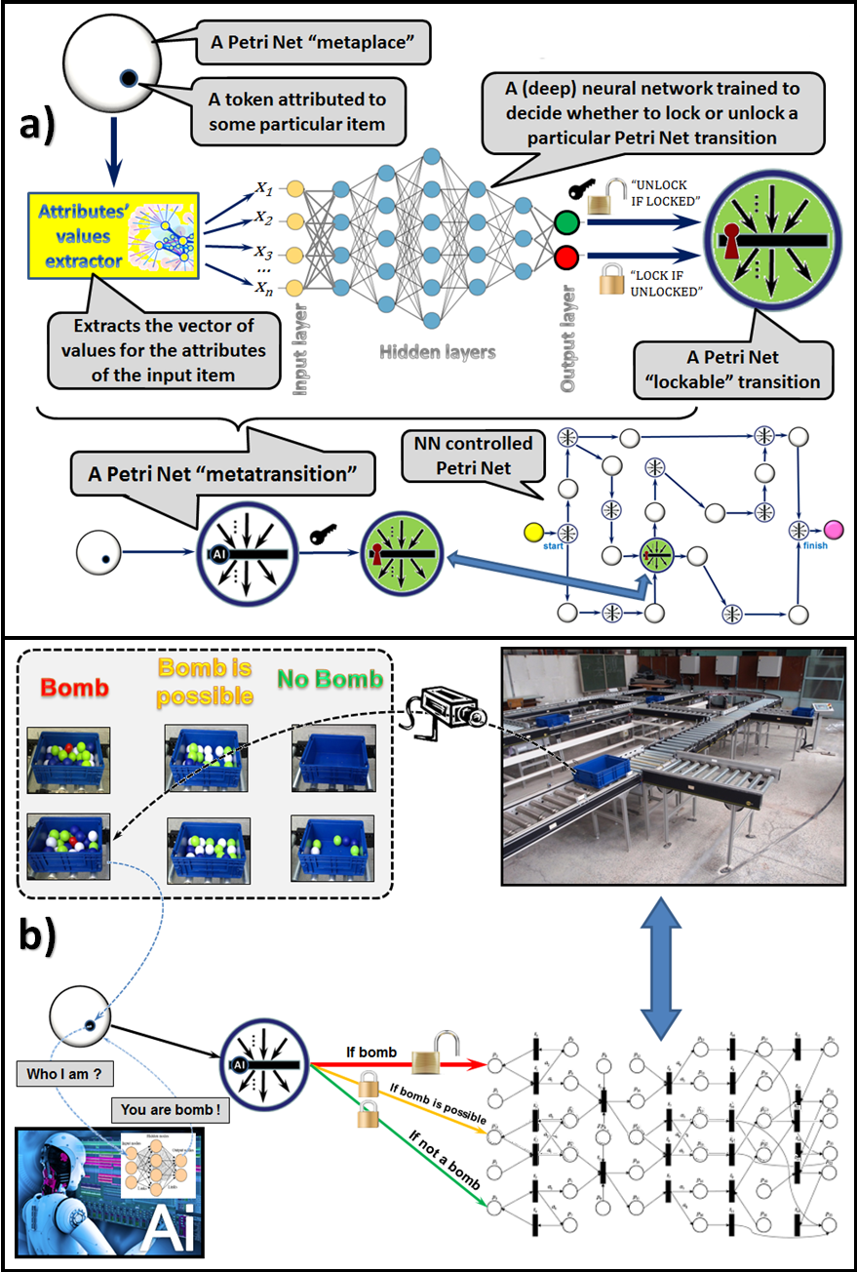
NN controls PN configuration (status of PN transitions)
Neural-Network-driven Petri Net process control illustrated:
some PN tokens can be attributed to particular physical items described by a vector of measurable attributes. Some PN transitions can be locked (dropped-out) or unlocked (dropped-back). Decisions on the transition status for lockable transitions are made by NN after processing such tokens’ attributes;
example scenario where the camera observes each item and NN decides on further logistics to be applied to handle the item (i.e., some parts of PN architecture, which simulates the logistics, will be locked).

Slide 21
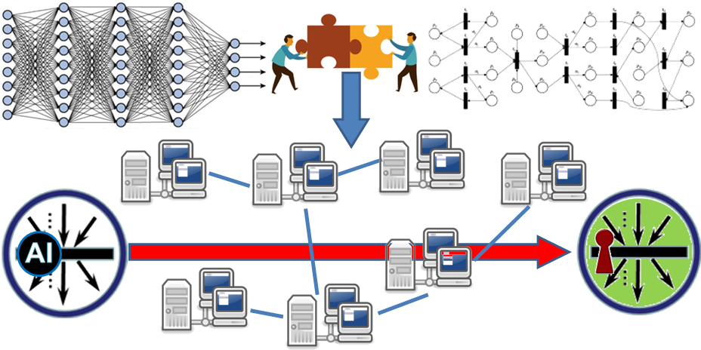
NN $→$ PN hybrid controls telecommunication network
Generic schema of potential application of the NN →PN hybrids to management of telecommunication networks (e.g., rooting, resource allocation, optimization, etc.). Activity in such networks could be simulated with the PN-driven modelling component, while a suitable configuration depending on changing context could be automatically decided and controlled by the NN-driven component.
[Project: DIOR: Deep Intelligent Optical and Radio Communication Networks; https://cordis.europa.eu/project/id/101008280]

Slide 22
CA→NN
“towards improved manageability and explainability of the black-box decision models”
H y b r i d #3: Cellular-Automata-driven Neural Network
The hybrid CA→NN are designed to support general decision-making objectives and the NN component guarantees that. CA adds certain interpretable (explainable) control option to manage the way NN is being trained. Such a hybrid (similarly as PN→NN) provides a control option for human experts (i.e., industrial domain experts rather than data scientists) to manage high-performing but “black-box” decision models in smart manufacturing.

Slide 23
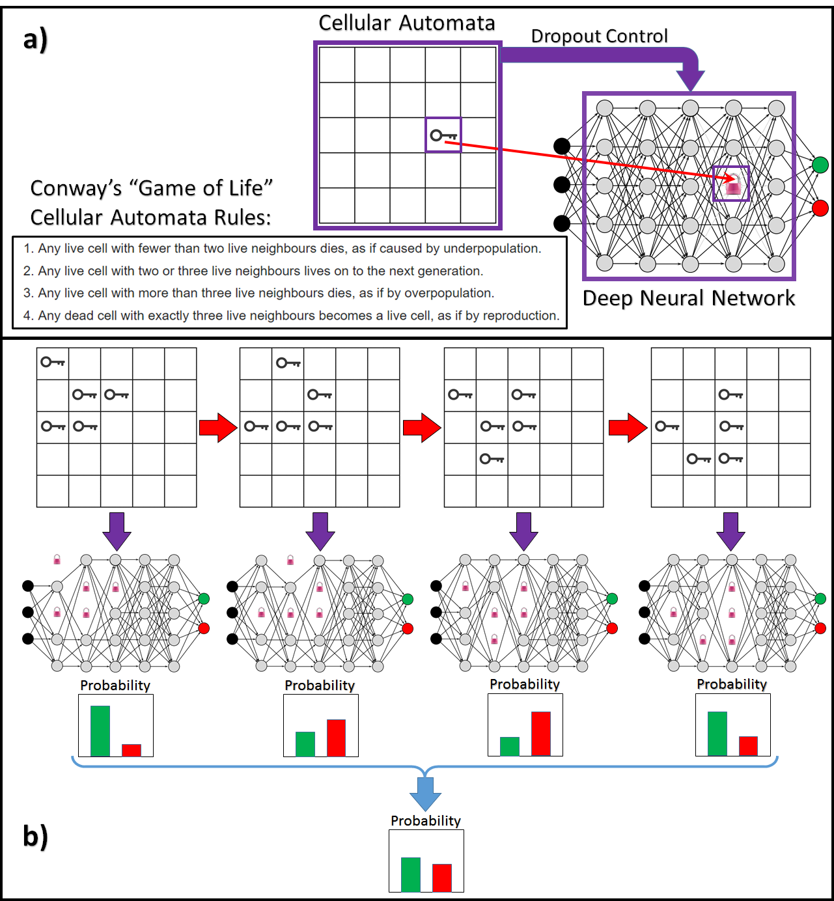
Cellular Automata controls drop-out in deep NN learning
cells in CA are attributed to the neurons in NN so that the status “alive” for each cell (marked with the “key”) means status “locked” (dropped-out) for the corresponding neuron;
example of CA evolution (with respect to the rules) and corresponding changes enforced in the NN structure. This in fact controls the dropout process, making the regularization (for better NN generalization performance) benefit from conscious control instead of randomness.

Slide 24
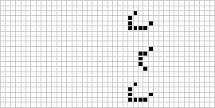
NN→CA
“bringing more intelligence and learnability into the discrete simulation models”
H y b r i d #4: Neural-Network-driven Cellular Automata
The hybrid NN→CA is designed for modelling, simulation and decision-support objectives and the CA component guarantees that. However, the NN component on top embeds some learnable intelligence into the basic models. These hybrids enable “smarter” self-configurable-rules-driven CAs based on the decisions automatically made by NN. This means that additional intelligence (learnable from data as a NN) may enhance the decision points within industrial processes previously managed by humans or hardcoded by the fixed rules. In this way, the simulation power of CAs will grow due to the known high decision performance of NNs.

Slide 25
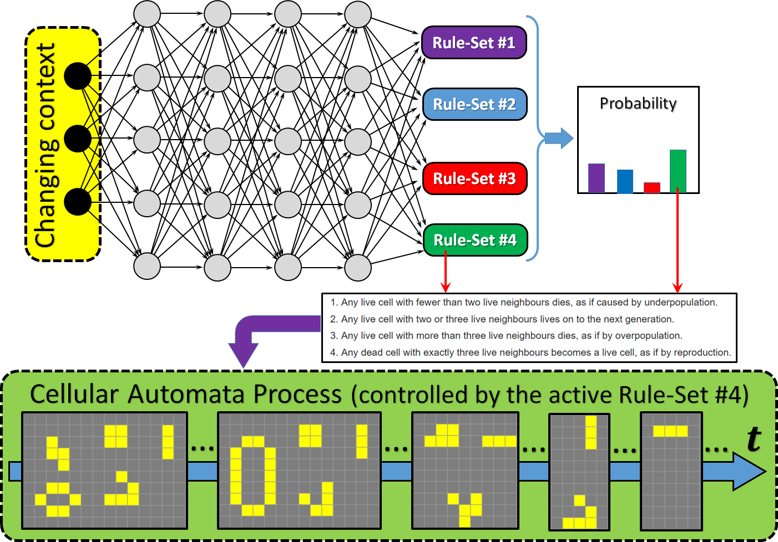
NN controls Cellular Automata behavior (rules)
One may see that CA-driven process simulation is generated and evolving according to the set of rules chosen by the NN on top of it. In the figure, the currently active set of rules (#4) is the one from Conway’s “Game of Life”. However, if context changes and the NN gives advantage to another set of rules, then the process dynamics will change in the run-time accordingly

Slide 26
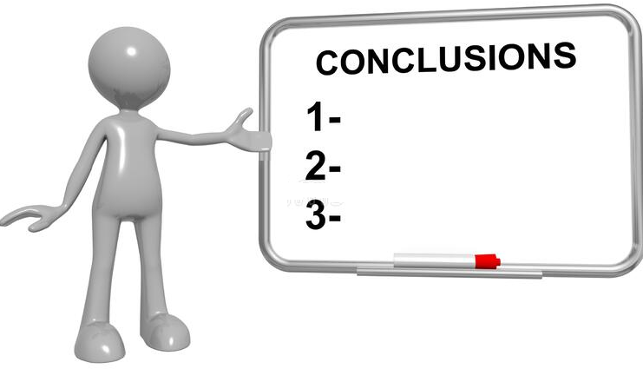
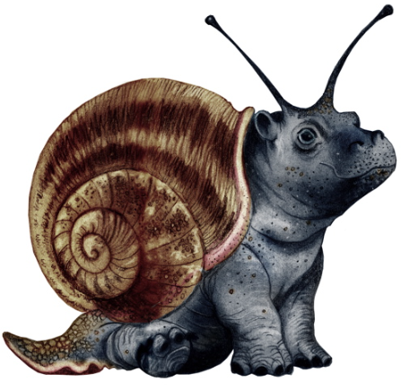
We considered hybrid approaches, which aim to (a) either intellectualize traditional discrete simulation models; or (b) make intelligent (deep learning) models explainable.
Suggested hybrid architectures are layered, assuming that the modelling component from the lower layer simulates a particular real-life process and the modelling component from the upper layer controls configuration and evolution dynamics of the lower layer.
We study four types of hybrids: (a) PN→NN; (b) NN→PN; (c) CA→NN; and (d) NN→CA. Hybrids (a) and (c) apply discrete control over the configuration of NN to add some explainability to the NN (i.e., consciously finding optimal configuration of the NN for better generalization performance). Hybrids (b) and (d) aim to intellectualize discrete simulation models, such as PN or CA. These hybrids apply NN decision-making to reconfigure automatically and in run-time either PN (change operational structure) or CA (change operational rules) depending on the context.
We tested these hybrids within , NATO SPS project IMMUNE: “Cyber-Defence for Intelligent Systems” (http://recode.bg/natog5511). Various scenarios have been simulated within the special laboratory (aka cyber-physical environment), which enables combining digital simulations with a real physical environment, including complex item storage and logistics. Preliminary experiments show that explainable control over NN or embedded (into PN or CA) NN intelligence provide additional performance and simulation flexibility to the modelling components of the hybrids.
Considered hybrid architectures are the classes of many potential hybrids. The modelling components (PNs, CA, and NNs) may have very different categories themselves, e.g.: PNs can be deterministic, stochastic, colored, high-level, fuzzy, temporal, etc.; CA can be deterministic, probabilistic, non-uniform, reversible, higher-order, totalistic, partitioned, etc.; NNs can be feedforward, recurrent, residual, convolutional, autoencoder, adversarial, etc. Each combination of these options gives a valid and specific hybrid, which can be used for specific industrial simulations.
h y b r i d s

Slide 27
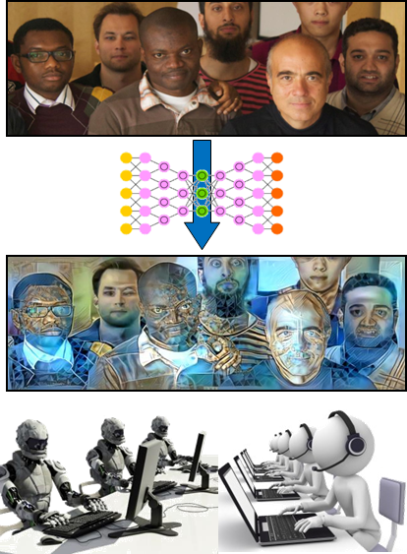
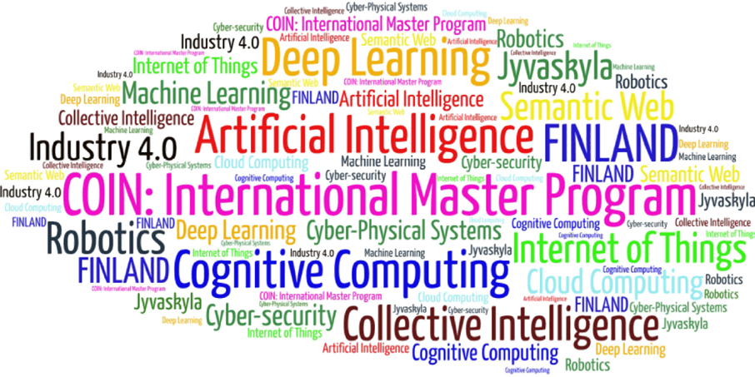
Come to study at our International Master Program
AI: Artificial Intelligence
(former Cognitive Computing and Collective Intelligence) …
… the first university program for collective intelligence, where humans learn together with their digital clones and autonomous digital assistants …
http://www.jyu.fi/ai
AI

Slide 28
Link to the presentation: https://ai.it.jyu.fi/ISM-2023-Hybrids.pptx
Contact: vagan.terziyan@jyu.fi

Slide 29
5th International Conference on Industry 4.0 and Smart Manufacturing – ISM 2023
Iscte - University Institute of Lisbon –Lisbon, Portugal | 22-24 November 2023
Thank you!
“Deep Neural Networks, Cellular Automata and Petri Nets: Useful Hybrids for Smart Manufacturing”
Olena Kaikova ª, Vagan Terziyan ^{b}
^{a,b} Faculty of Information Technology, University of Jyväskylä, Jyväskylä, Finland
Contacts
ª olena.o.kaikova@jyu.fi, ^{b} vagan.terziyan@jyu.fi
Link to complete slide-set:
https://ai.it.jyu.fi/ISM-2023-Hybrids.pptx
https://www.jyu.fi/en/

