Slide 1
5th International Conference on Industry 4.0 and Smart Manufacturing – ISM 2023
Iscte - University Institute of Lisbon –Lisbon, Portugal | 22-24 November 2023
“Taxonomy-Informed Neural Networks for Smart Manufacturing”
Vagan Terziyan ª, Oleksandra Vitko ^{b}
ª Faculty of Information Technology, University of Jyväskylä, Jyväskylä, Finland
^{b} Department of Artificial Intelligence, Kharkiv National University of Radio Electronics, Kharkiv, Ukraine
https://www.jyu.fi/en/
https://nure.ua/en/

Slide 2
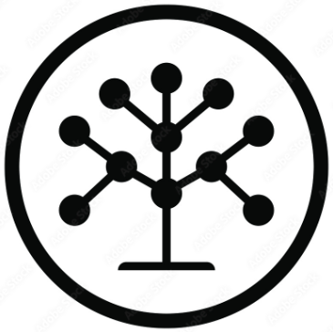
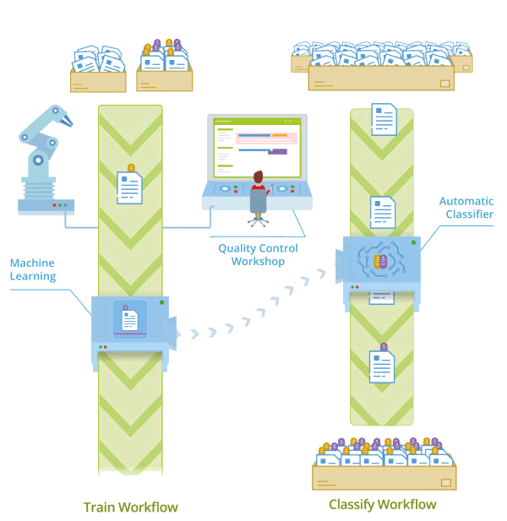
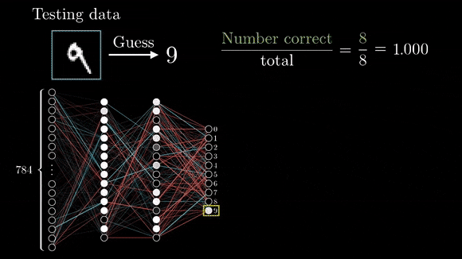
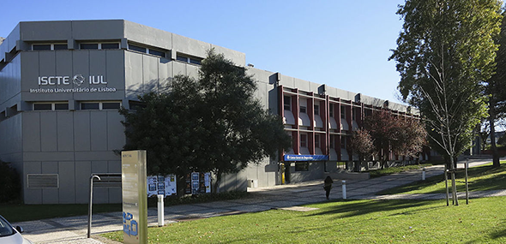
“Taxonomy-Informed Neural Networks for Smart Manufacturing”
Paper # 4250
Vagan Terziyan & Oleksandra Vitko
Iscte - University Institute of Lisbon
24 November, 2023, 12:20 - 12:40
ISM 2023
International Conference on Industry 4.0
and Smart Manufacturing
Section/Room: S8.R4
S8 (ONTOLOGIES) / R4

Slide 3
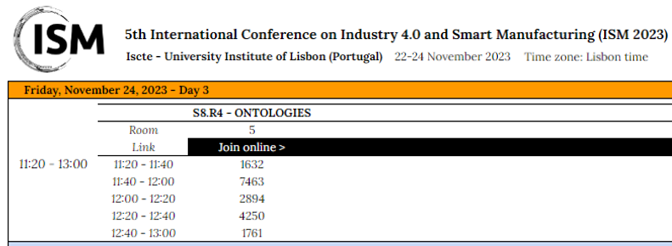

Slide 4
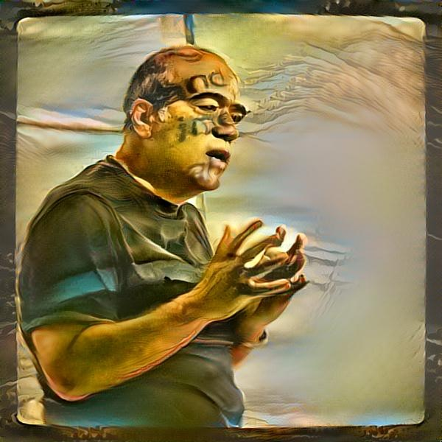
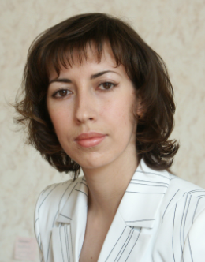
Authors
Vagan Terziyan
vagan.terziyan@jyu.fi
“Taxonomy-Informed Neural Networks for Smart Manufacturing”
Oleksandra Vitko
https://www.jyu.fi/en/
https://nure.ua/en/

Slide 5
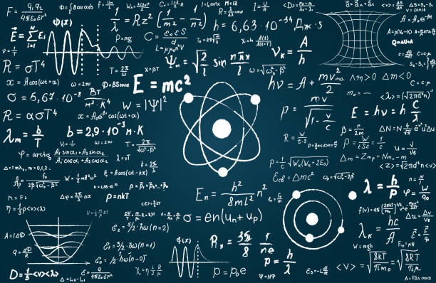
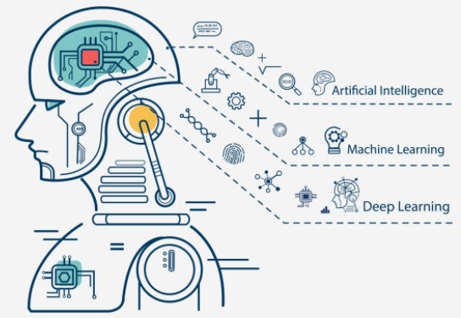
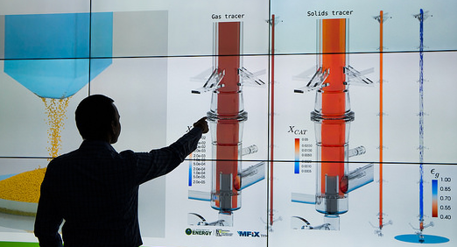
Current trend: from purely data-driven to knowledge-enhanced machine learning (ML) models (to better fit industrial needs)
There are clear indicators that the focus of innovations in AI in general and particularly in ML is shifting from purely data-driven models towards knowledge-enhanced “Informed ML” models, for example, from Computational Science …
Computational Science
AI & ML
Data Science

Slide 6
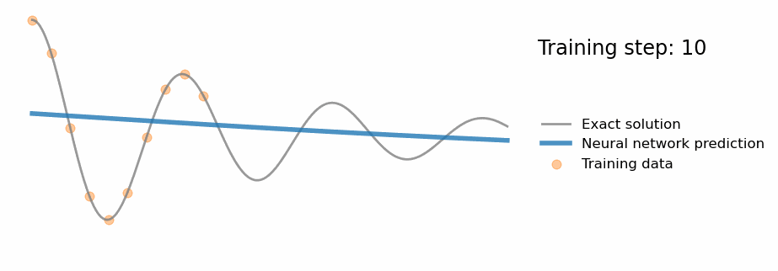
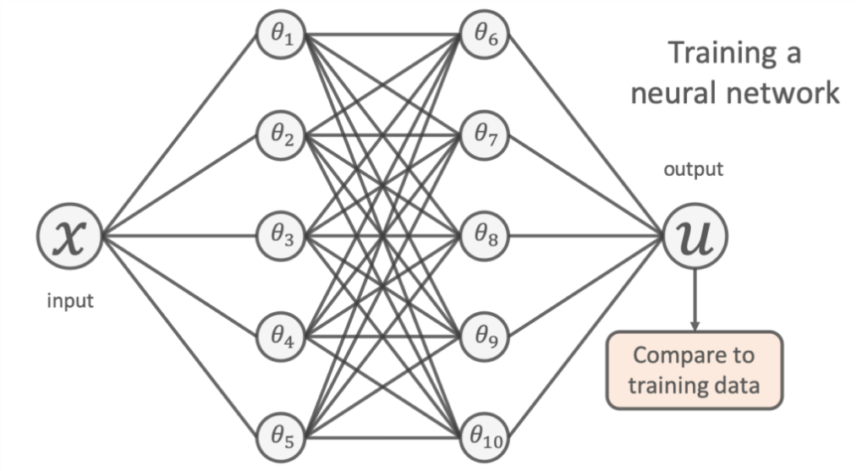
Traditional neural network (NN) model training objective: Fit training data
https://benmoseley.blog/my-research/so-what-is-a-physics-informed-neural-network/
To learn a model by traditional backpropagation, we try to tune the network’s free parameters (denoted by θs in the figure) so that the network’s predictions closely match the available experimental data. This is usually done by minimizing the mean-squared-error between its predictions and the training points:
Data Loss →
You can see that whilst the neural network accurately models the physical process within the vicinity of the experimental data, it fails to generalize away from this training data. By only relying on the data, one could argue it hasn’t truly “understood” the scientific problem.

Slide 7
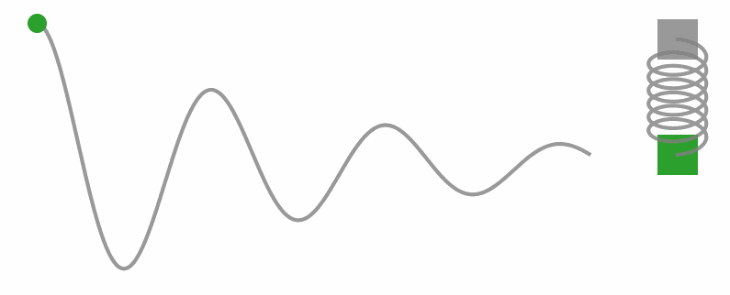
Additional knowledge about the physics of the process
https://benmoseley.blog/my-research/so-what-is-a-physics-informed-neural-network/
Assume that we already knew something about the physics of this process? Specifically, that the data points are actually measurements of the position of a damped harmonic oscillator. This is a classic physics problem, and we know that the underlying physics can be described by the following differential equation:
… where $m$ is the mass of the oscillator, $μ$ is the coefficient of friction and $k$ is the spring constant.
Physics-Informed Neural Network (PINN) objective would be to find the way to configure and train the NN model based on available data but, in addition, with respect to available knowledge on actual physical process behind the data …

Slide 8
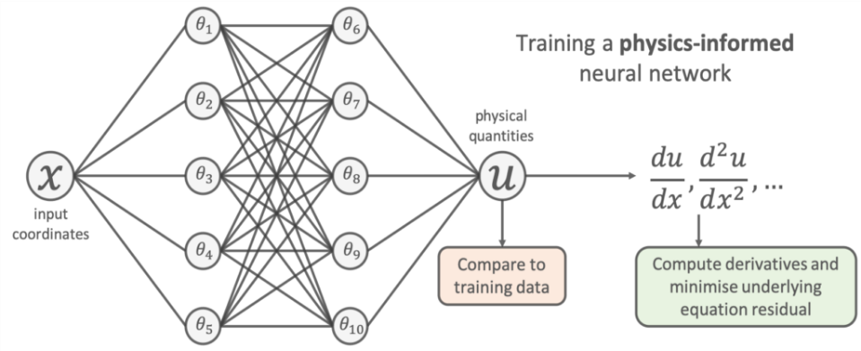
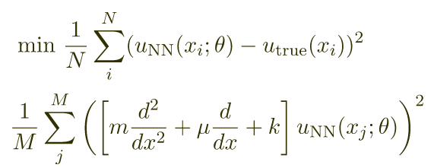
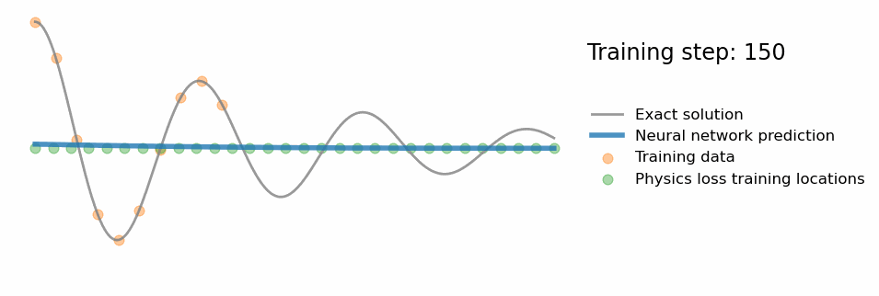
Loss function in PINN
https://benmoseley.blog/my-research/so-what-is-a-physics-informed-neural-network/
We get derivatives by sampling a set of input training locations $\{x_{j}\}$ and passing them through the network. Gradients of the network’s output with respect to its input are computed at these locations (using automatic differentiation. Finally, the residual of the underlying differential equation is computed using these gradients, and added as an extra term (Knowledge Loss) in the loss function (see below).
By incorporating existing physical principles into machine learning we are able to create more powerful models that learn from data and build upon our existing scientific knowledge.
Data Loss →
Loss →
+
Knowledge Loss →
We can see that the additional “Knowledge Loss” in the loss function tries to ensure that the solution learned by the network is consistent with the known physics.

Slide 9
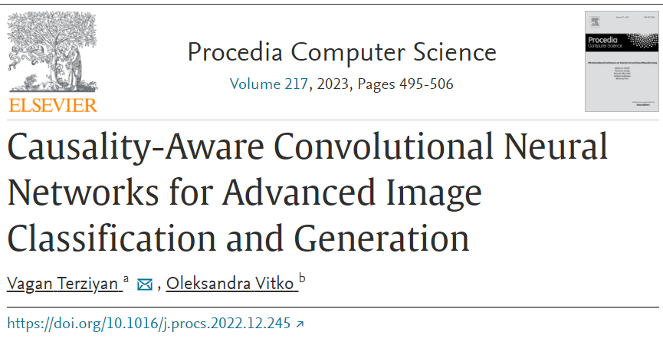
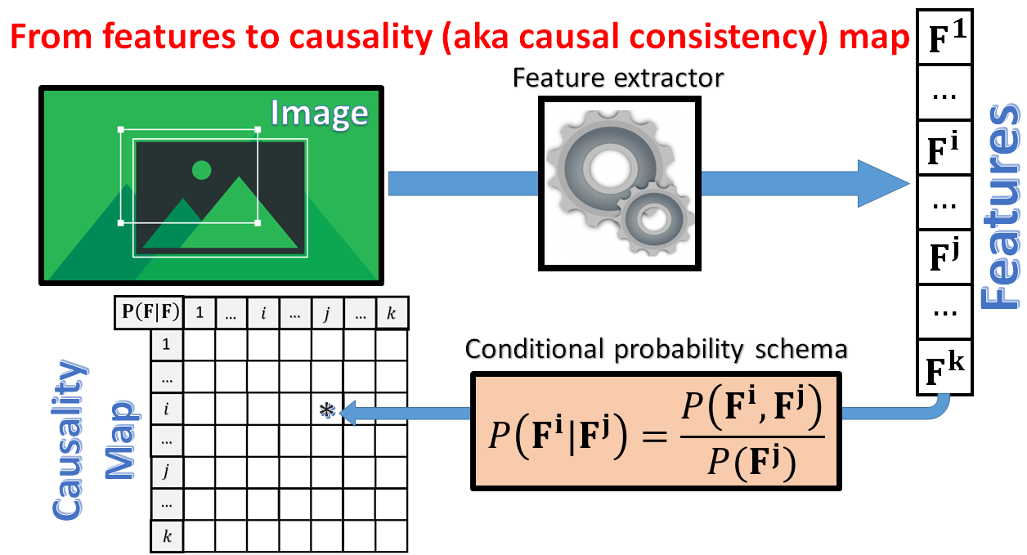
“Causality-Informed” NNs (our former study)
In Terziyan & Vitko (2023), we have suggested the way to discover (and take into account in image classification and generation) hidden causal relationships among image features as additional knowledge to improve neural networks’ training. We introduced an architecture for causality-aware convolutional neural network, which is enhanced by a causality map (as a special type of self-attention mechanism). Such architecture if applied with generative adversarial networks can generate images, which are realistically looking also from the causality point of view.
Terziyan, V., & Vitko, O., (2023). Causality-Aware Convolutional Neural Networks for Advanced Image Classification and Generation. Procedia Computer Science, 217, 495-506. Elsevier. https://doi.org/10.1016/j.procs.2022.12.245.

Slide 10
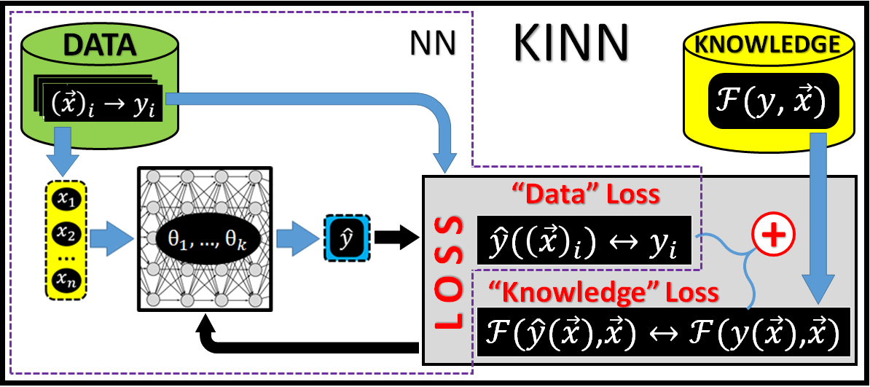
Knowledge-Informed Neural Network (KINN)
Different variations of “informed NNs” use available prior knowledge of the target model in addition to training data. Such NNs can be integrated into one broad category under the common umbrella term “Knowledge-Informed NN” (KINN). See the Figure. Let us assume that we have some prior knowledge of the target function in the form of some constraint $ℱ(y,\vec{x})$ from which it is impossible (or unfeasible) to directly derive the target function (model) $y=f\left(\vec{x}\right)$. The objective of KINN training will be still discovering the target function from available data in the form $y=f\left(\vec{x},\vec{θ}\right)$, however, with respect to the prior knowledge constraint $ℱ(y,\vec{x})$. This can be achieved by making a complex loss function in backpropagation training, which sums up (with defined coefficients of importance) the loss related to the training data fitness to the target model (“Data” loss) and the loss related to the prior knowledge (“Knowledge” loss).
Illustrating a generic NN schema (the part within the dashed line) and its extension towards KINN. KINN adds an extra summand to the NN’s loss function, which, in addition to the traditional “Data” Loss, takes into account the “Knowledge” Loss related to fitness of the current NN’s predictions regarding the target function with the available knowledge on this function.
Beyond PINNs: “Informed Machine Learning”
https://ieeexplore.ieee.org/stamp/stamp.jsp?tp=&arnumber=9429985

Slide 11
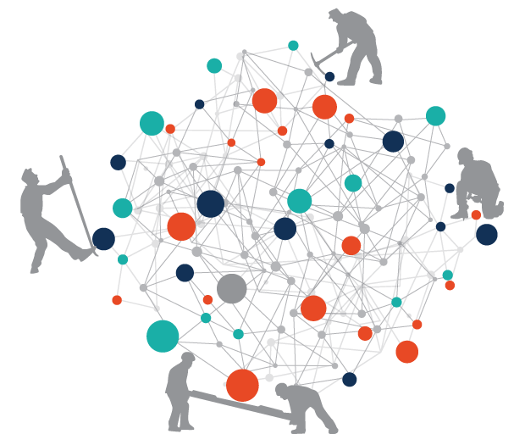
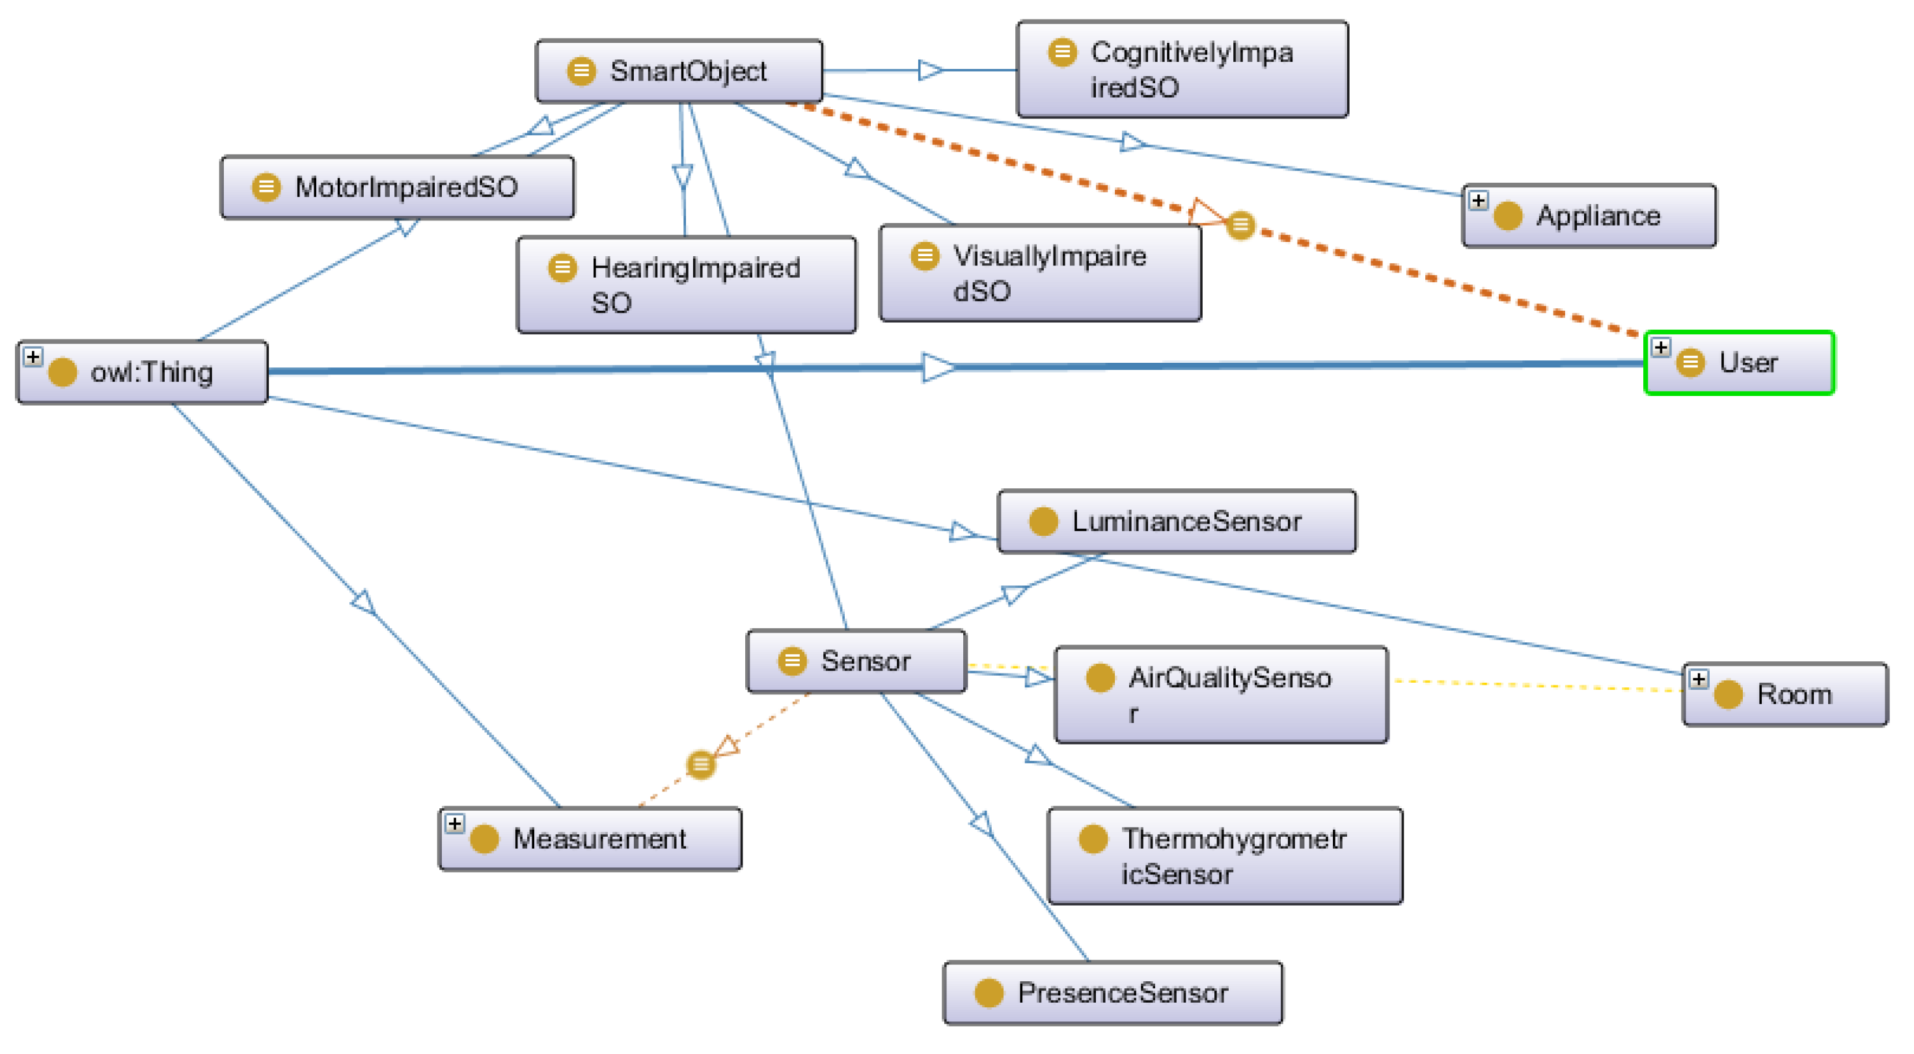
Adding awareness from conceptual modelling: Objectives of our study
The success of current KINNs implementations shows that additional knowledge constraints from computational modelling analytics may improve traditional data-driven modelling by NNs (e.g., in PINNs). However, …
… Would similar effects take place if we use constraints from conceptual modelling frameworks (e.g., ontology engineering)?
… Can we augment ML in general and NNs in particular by conceptual models and get benefits from the explainability of these models?
… Could knowledge from ontologies (taxonomies) be used to guide and improve NNs’ training from data?
… Would potential taxonomy-informed NNs (TINNs) become a reasonable concept and architecture for the informed ML?
… How can TINNs be potentially useful for Industry 4.0 and smart manufacturing?

Slide 12
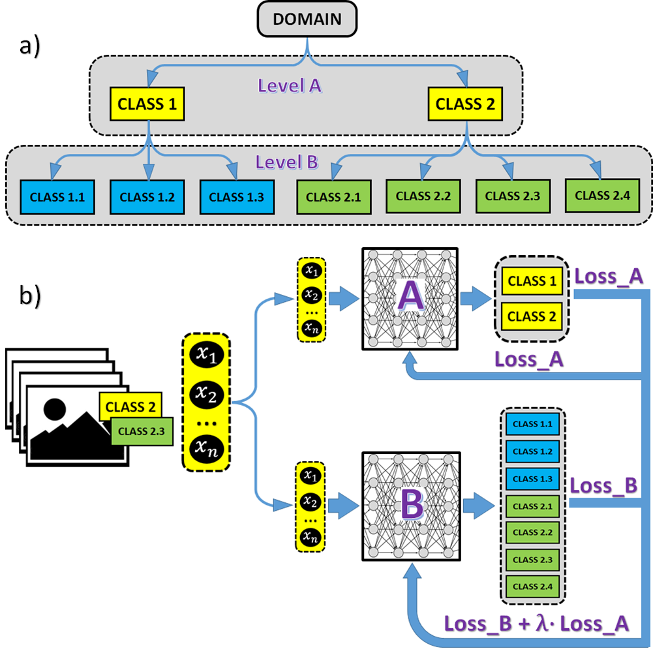
Adding Awareness of Class-Subclass Hierarchies to Neural Networks
Assume that we have a simple taxonomy, which can be defined using conceptual modelling terms from RDF/RDFS (N3 notation; https://www.w3.org/TeamSubmission/n3/) language as follows:
@prefix rdfs: <http://www.w3.org/2000/01/rdf-schema#> .
:DOMAIN a rdfs:Class .
:CLASS1 a rdfs:Class ; rdfs:subClassOf :DOMAIN .
:CLASS2 a rdfs:Class ; rdfs:subClassOf :DOMAIN .
:CLASS1.1 a rdfs:Class ; rdfs:subClassOf :CLASS1 . :CLASS1.2 a rdfs:Class ; rdfs:subClassOf :CLASS1 .
:CLASS1.3 a rdfs:Class ; rdfs:subClassOf :CLASS1 .
:CLASS2.1 a rdfs:Class ; rdfs:subClassOf :CLASS2 . :CLASS2.2 a rdfs:Class ; rdfs:subClassOf :CLASS2 .
:CLASS2.3 a rdfs:Class ; rdfs:subClassOf :CLASS2 .
:CLASS2.4 a rdfs:Class ; rdfs:subClassOf :CLASS2 . …
The training schema of TINN originated from simple taxonomy awareness is illustrated: (a) example of a taxonomy (class-subclass hierarchy of classes in the taxonomy); (b) the NN classifier B, which is currently being trained to label samples into 7 classes (lower level of the taxonomy) benefits from the NN classifier B trained to label the same instances into 2 classes of the upper level of the taxonomy. Classifier A contributes to the performance of classifier B by sharing part of its loss regarding the same input sample (e.g., some input training sample with two true labels, CLASS2 and CLASS2.3).

Slide 13
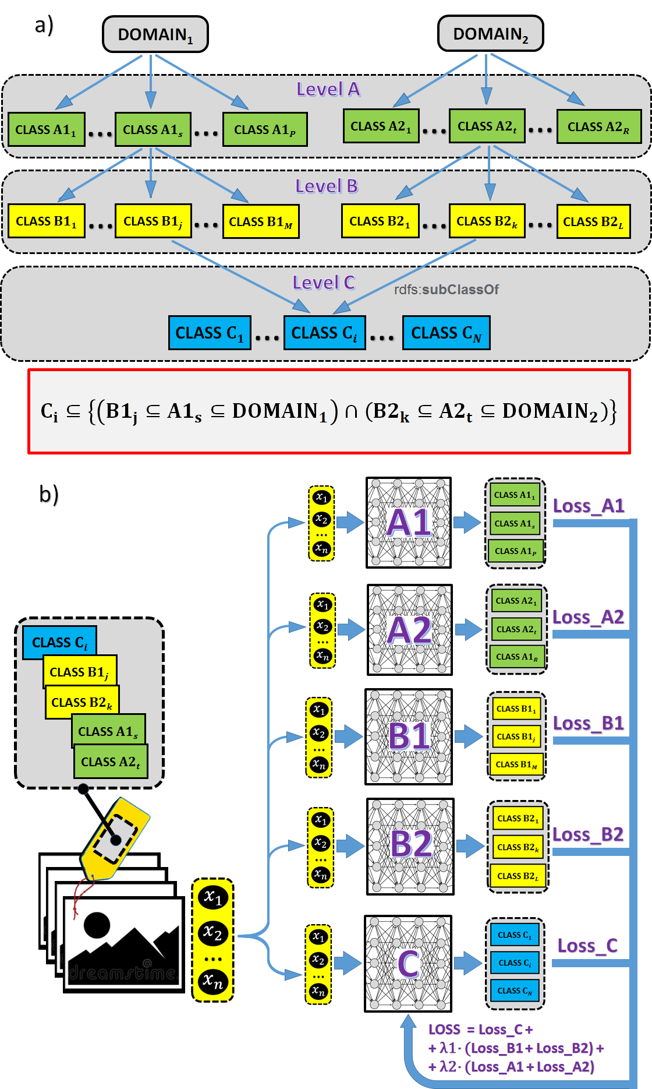
Awareness of more complex taxonomy with multiple inheritance to Neural Networks
…
:CLASS_C_{i} rdfs:subClassOf :CLASS_B1_{j} ; rdfs:subClassOf :CLASS_B2_{k} .
:CLASS_B1_{j} rdfs:subClassOf :CLASS_A1_{s} .
:CLASS_B2_{k} rdfs:subClassOf :CLASS_A2_{t} .
:CLASS_A1_{s} rdfs:subClassOf :DOMAIN₁ .
:CLASS_A2_{t} rdfs:subClassOf :DOMAIN₂ .
…
The training schema of the TINN originated from taxonomy (with multiple inheritance) awareness is illustrated:
example of a taxonomy (class-subclass hierarchy of classes in the taxonomy);
the NN classifier C, which is currently being trained to label data samples into 3 classes (lower level of the taxonomy) benefits from the NN classifiers B1 and B2 trained to label the same instances into two different groups of 3 classes each of the upper level of the taxonomy. In addition, the classifiers A1 and A2 from the higher level contribute indirectly to classifier C. The construction of overall loss (LOSS) for C is illustrated.

Slide 14
PINN LOSS computing for more complex taxonomy with multiple inheritance
$LOSS=Loss_{C}+λ1∙(Loss_{B1}+Loss_{B2})+λ2∙(Loss_{A1}+Loss_{A2})$.
Why?
$$LOSS=Loss_{C}+λ_{B}∙Loss_{B1}+λ_{B}∙Loss_{B2}=Loss_{C}+λ_{B}∙\left(Loss_{B1}+Loss_{B2}\right)=$$
$$=Loss_{C}+λ_{B}∙\left[\left(Loss_{B1}+λ_{A}∙Loss_{A1}\right)+\left(Loss_{B2}+λ_{A}∙Loss_{A2}\right)\right]==Loss_{C}+λ_{B}∙\left[\left(Loss_{B1}+Loss_{B2})+λ_{A}∙(Loss_{A1}+Loss_{A2}\right)\right]=$$
$=Loss_{C}+λ_{B}∙(Loss_{B1}+Loss_{B2})+λ_{B}∙λ_{A}∙(Loss_{A1}+Loss_{A2})$,
… which after substitutes $λ1←λ_{B}$ and $λ2←λ_{B}∙λ_{A}$ gives us the intended formula for LOSS.

Slide 15
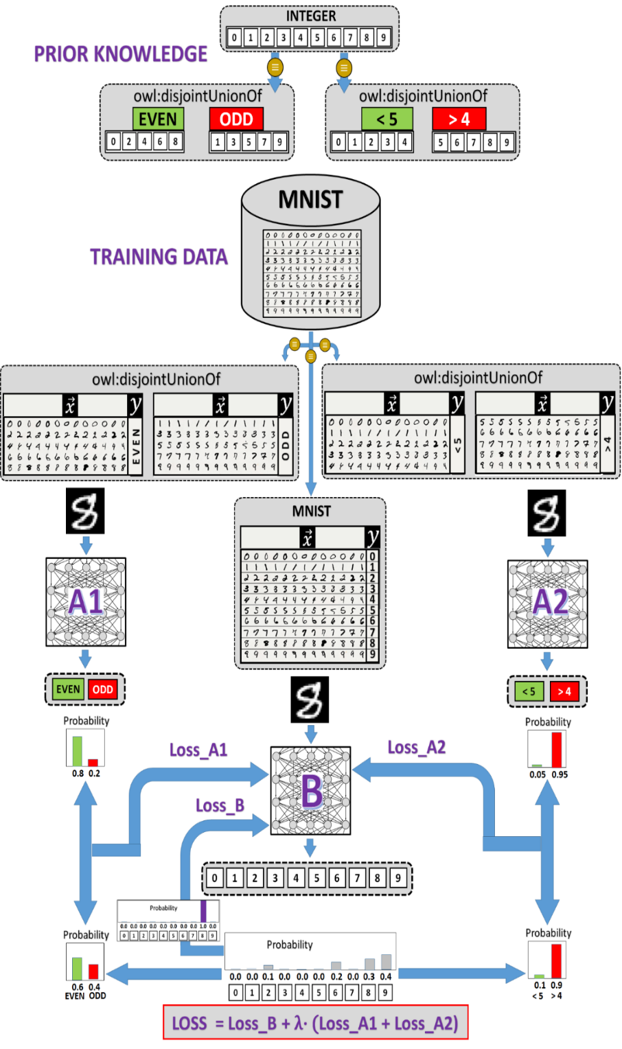
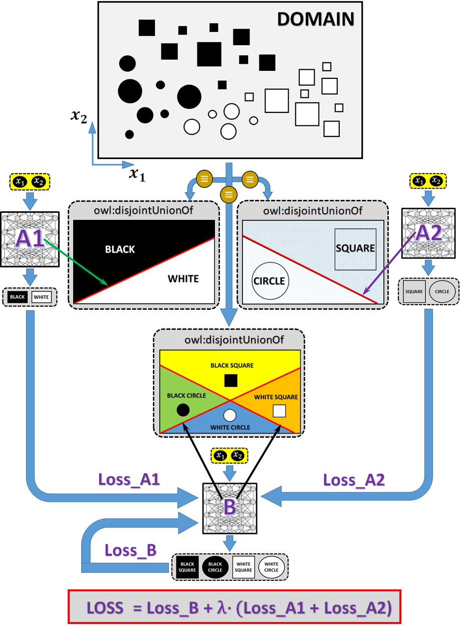
A Couple of Motivating Examples
2
1
The experiment of building NN classifier “B” for the DOMAIN, which is a disjoint union of four classes {BLACK_SQUARE; BLACK_CIRCLE; WHITE_SQUARE; WHITE_CIRCLE}.
Additional knowledge, that DOMAN is also a disjoint union of BLACK and WHITE samples and a disjoint union of SQUARE and CIRCLE samples, makes it possible to use TINN architecture for the target classifier “B”. The loss of “B” during training is updated with the loss coming from two other synchronously trained classifiers, “A1” (BLACK vs. WHITE) and “A2” (SQUARE vs. CIRCLE), which improves the performance of “B” to correctly classify the DOMAIN samples into four classes.
The unusual taxonomy awareness effect is explored on top of the MNIST dataset. The target convolutional NN classifier “B” is trained synchronously with the two other ones: “A1”, which distinguishes between odd and even digits, and “A2”, which distinguishes between “<5” and “>4” digits. For each portion of input training samples, the loss of “B” during backpropagation training is updated also with the corresponding losses from “A1” and “A2”, and such a TINN trick has surprisingly improved the performance of “B”.

Slide 16
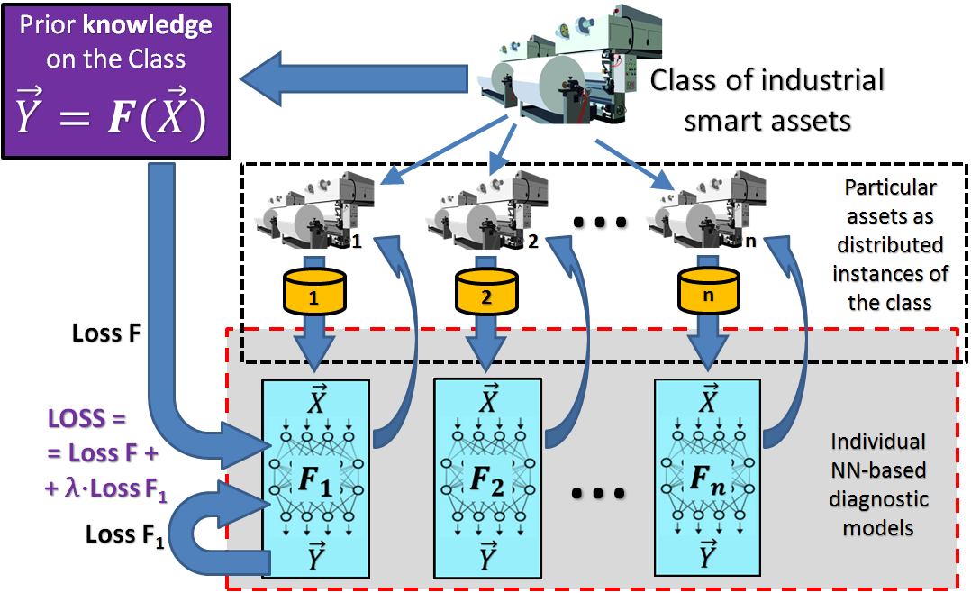
Instance-Class Relationship Awareness and its (Knowledge-Based & Federated) Effect
Consider a typical example of industrial assets’ diagnostics. Assume that a batch (aka class) of identical complex and smart (with self-monitoring infrastructure) industrial machines has been produced. These assets are sold and used in different processes, environments, places and other contexts. Assume that, according to the design features of this class of assets, the state (vector $\vec{Y}$) of some particular machine can be derived as some function over the measurable (by embedded sensors) vector of parameters $\vec{X}$. If the function is known or can be learned by ML, then the state diagnostics for each asset can be done automatically.
Consider scenario in the Figure. Here we assume that the (general for the class) function $\vec{Y}=F\left(\vec{X}\right)$ is known just after design and pilot testing and it is supposed to be applied to all the instances of the assets within the class during their operation within particular industrial processes. However, each machine may have some small individual constructive specifics before use and, definitely, more individual features may be acquired during operation due to different operational environments. Therefore, the histories of $\vec{X}$ and $\vec{Y}$ are collected as training data separately for each $i$-th machine and the individual diagnostic functions $\vec{Y}=F_{i}\left(\vec{X}\right)$ can be learned using ML (particularly NNs).
Naturally, the data collected independently regarding each asset may not be big enough for constructing a reliable diagnostic model. Therefore, combining it with the diagnostic knowledge on the class of identical assets will make each individual model more trustful. This can be done by applying TINNs’ logic and updating the loss value calculation for each individual NN ($F_{i}$) training by the loss related to the known and common-for-the-class function $F$. Taxonomy-awareness here is simply the known fact that $i$-th asset (with target diagnostic model $F_{i}$) is an instance of a class of similar assets with a general diagnostic model $F$.
The scenario is shown when each individual asset diagnostics model (NN) is trained based on the data collected from the particular asset history including awareness of the model constructed for the whole class of assets. Like in TINNs, we can update the loss function of each individual model during its backpropagation training with the loss regarding the overall class model.

Slide 17
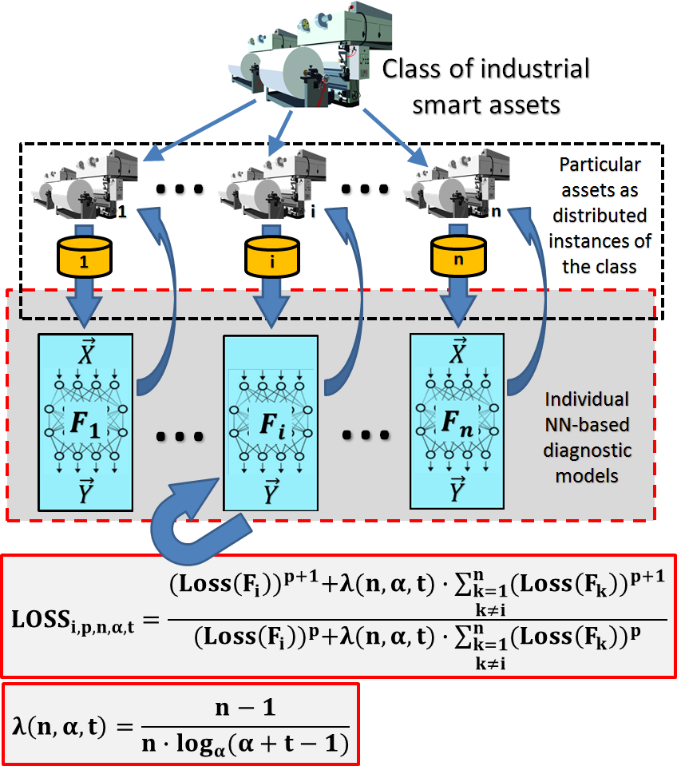
Instance-Class Relationship Awareness and its (Knowledge-Based & Federated) Effect
This scenario is an attempt to combine the TINN approach with federated learning. Here we do not have any prior knowledge of the common-for-the-class diagnostic function $F$. We suppose that each individual asset will collect its own history as training data, learn individual diagnostic models from the data and, in addition, they will benefit from the similar (same class) assets’ model construction experiences. Following the TINNs’ logic, we need such a loss function for backpropagation training of each individual model that takes into account the loss associated with its own asset as well as the losses associated with other assets. For each $i$-th NN model during its backpropagation training, we suggest constructing the loss by applying the weighted Lehmer mean ($LM$) function over the individual losses from other “partner” models according to the general schema:
${LOSS}_{i}=LM\left[Loss\left(F_{i}\right), λ∙Loss\left(F_{1}\right), …,λ∙Loss\left(F_{i−1}\right),λ∙Loss\left(F_{i+1}\right),…,λ∙Loss\left(F_{n}\right)\right]$.
The federated learning scenario with TINNs is in the Figure. Several individual NN diagnostic models (one for each smart asset) are trained simultaneously, each on its own training data. Each particular batch of training samples from the i-th NN goes through all the NNs, then a joint loss is computed from the individual losses as shown, and finally backpropagated only through the i-th network. This process repeats for each network. In this way, each network updates its weights with the awareness of the reaction of other networks to the same training samples. In LOSS formula: $i$ indicates a particular model ($F_{i}$) being trained; $n$ – the number of simultaneously trained models (i.e., the number of assets in the class); parameter $t$ is the current training epoch number (i.e., the influence of other “partner” models on the target model will decrease during the training process, and parameter $α$ can be used to control the decrease function); parameter $p$ controls the Lehmer mean itself, i.e., the biases related to the distribution of averaged losses.
We experimented with such scenarios for condition monitoring, diagnostics and predictive maintenance of industrial assets. For that, we embedded the schemas as additional features into our UBIWARE platform, which is a semantic (taxonomy-aware) middleware for smart industrial assets. Experiments show that “informed” TINNs as diagnostic models outperform the ignorant NNs, giving some updates on the accuracy from 0.9% to 5.8% (depending on the type of assets and other settings).

Slide 18
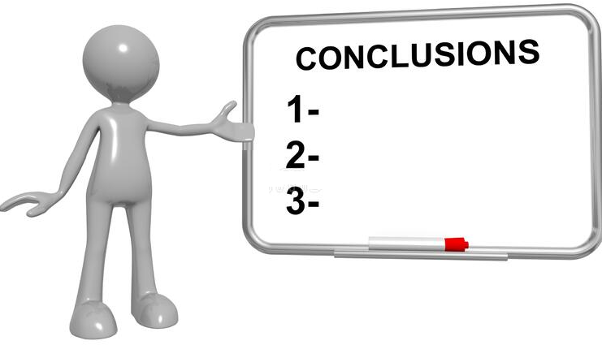
In this paper, we explored the possibility to adapt the modern “informed ML” approach and emerging informed NNs architectures to deal with conceptual models (ontologies/taxonomies). We show that taxonomy awareness during NNs’ training could be as useful as analytical constraints in PINNs. What has been taken from the PINNs’ experience is the structure of the loss function, which includes traditional fitness-to-training-data loss and some portion of the loss related to taxonomy awareness. We recommended and made preliminary exploration of TINNs as a new subclass of informed NN architectures, which can be used in many domains including smart manufacturing.
We limited our study to the basic taxonomic relationships: (hierarchical) “class-subclass” regarding the structure of training data and “instance-class” regarding physical objects from which the training data has been collected. Knowledge of complex taxonomies, i.e., with deep class hierarchies and multiple inheritance can be mapped to an appropriate structure of loss function applied during backpropagation training of TINNs.
During experiments we noticed that TINNs improve performance comparably to traditional NNs and this performance difference is more visible when dealing with noisy data.
Quite a lot of experimentation is still needed to explore the full potential of TINNs. In addition, other complex ontological constraints (regarding taxonomy classes) must be studied to explore other possible options for TINN architecture.

Slide 19
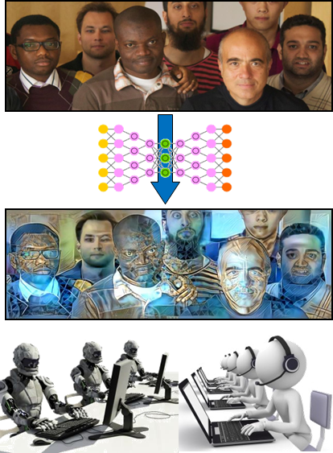
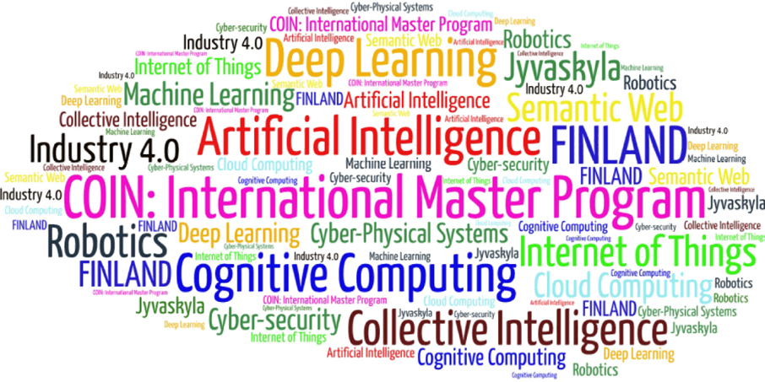
Come to study at our International Master Program
AI: Artificial Intelligence
(former Cognitive Computing and Collective Intelligence) …
… the first university program for collective intelligence, where humans learn together with their digital clones and autonomous digital assistants …
http://www.jyu.fi/ai
AI

Slide 20
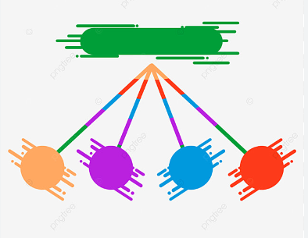
Link to the presentation: https://ai.it.jyu.fi/ISM-2023-TINN.pptx
Contact: vagan.terziyan@jyu.fi

Slide 21
5th International Conference on Industry 4.0 and Smart Manufacturing – ISM 2023
Iscte - University Institute of Lisbon –Lisbon, Portugal | 22-24 November 2023
Thank you!
“Taxonomy-Informed Neural Networks for Smart Manufacturing”
Vagan Terziyan ª, Oleksandra Vitko ^{b}
ª Faculty of Information Technology, University of Jyväskylä, Jyväskylä, Finland
^{b} Department of Artificial Intelligence, Kharkiv National University of Radio Electronics, Kharkiv, Ukraine
Contacts
ª vagan.terziyan@jyu.fi , ^{b} oleksandra.vitko@nure.ua
Link to complete slide-set:
https://ai.it.jyu.fi/ISM-2023-TINN.pptx
https://www.jyu.fi/en/
https://nure.ua/en/

