Slide 1


7th International Conference on Industry of the Future and Smart Manufacturing – ISM 2025
University of Malta - Malta | 12-14 November 2025
“Semantic AI for Future Industries: Bridging Explainability and Integration in Black Box Models”
Vagan Terziyan ª, Oleksandra Vitko ^{b}, Oleksandr Terziyan ^{b}
ª Faculty of Information Technology, University of Jyväskylä, Jyväskylä, Finland
^{b} Department of Artificial Intelligence, Kharkiv National University of Radio Electronics, Kharkiv, Ukraine
https://www.jyu.fi/en/
https://nure.ua/en/

Slide 2
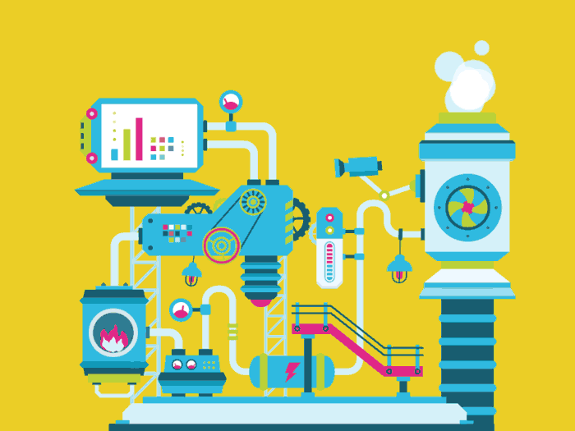
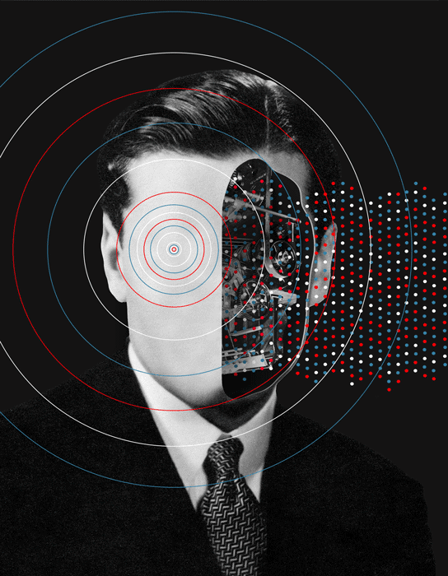
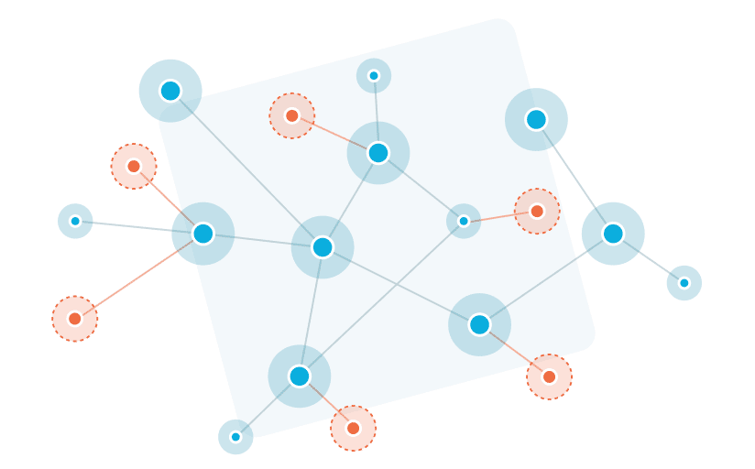
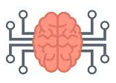
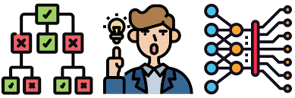
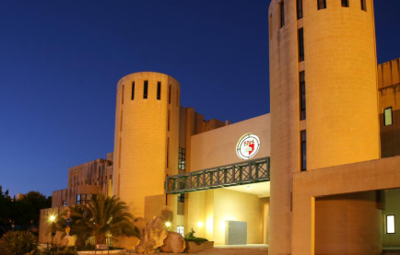


“Semantic AI for Future Industries:
Bridging Explainability and Integration in Black Box Models”
Paper # 5677
Vagan Terziyan, Oleksandra Vitko & Oleksandr Terziyan
Thursday, November 13, 2025, 12:30 ‒ 13:00 (6th of 6)
ISM 2025
7th International Conference on Industry of the Future and Smart Manufacturing
Section/Room: AI-FUTURE-1 / VR1
“Artificial Intelligence in the Industry of the Future – Part 1” (11:15 – 13:00)

Slide 3
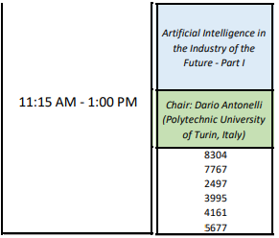

Slide 4
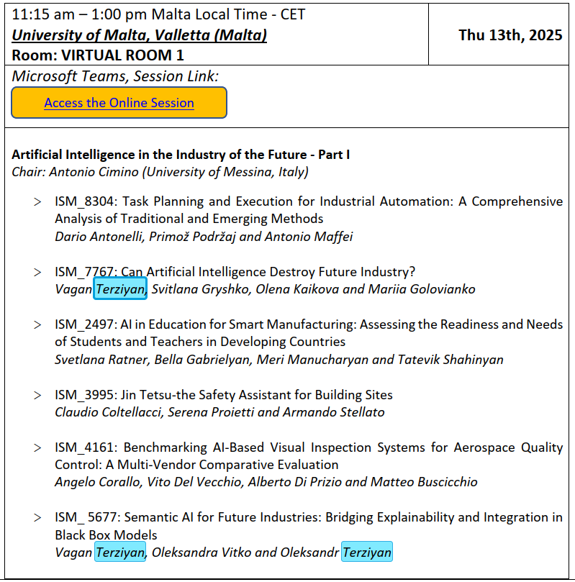
https://teams.microsoft.com/l/meetup-join/19%3ameeting_OTAzOGJmMGEtZTAyYS00MGE1LWFjOTktMjIxMGZjZjg0NzE3%40thread.v2/0?context=%7b%22Tid%22%3a%227519d0cd-2106-47d9-adcb-320023abff57%22%2c%22Oid%22%3a%22398dc36a-f564-4885-982b-579ed3a4a54b%22%7d
https://universityofmalta.zoom.us/j/99756180432

Slide 5
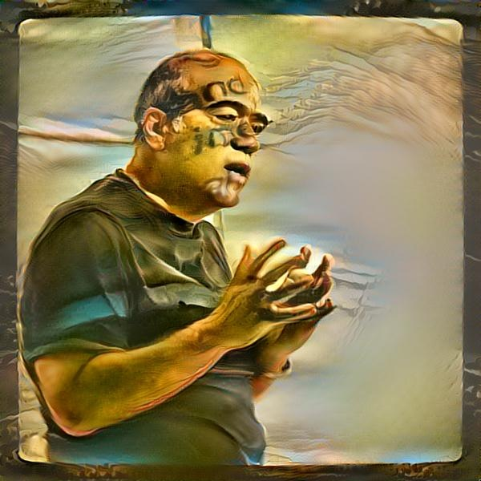

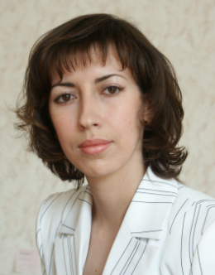
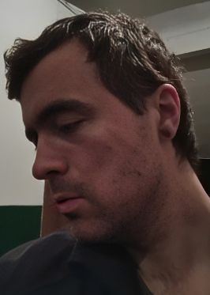

Vagan Terziyan
Authors
vagan.terziyan@jyu.fi
“Semantic AI for Future Industries: Bridging Explainability and Integration in Black Box Models”
Oleksandra Vitko
Oleksandr Terziyan
https://www.jyu.fi/en/
https://nure.ua/en/

Slide 6
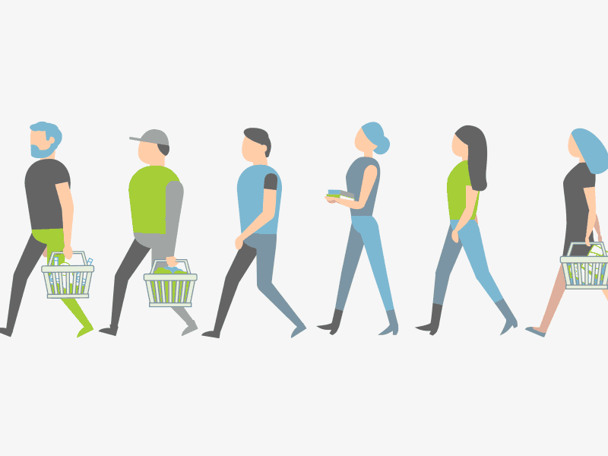





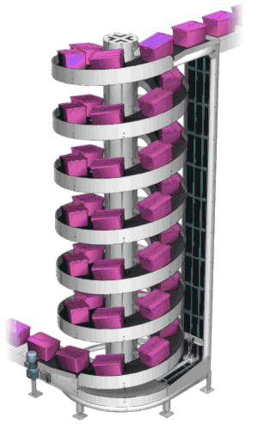


Modern industry requires transparent and interoperable AI
I
N
D
U
S
T
R
Y
5.0
Smart
Operator
XAI
OWL
Digital Twin
(as a black-box model)

Slide 7





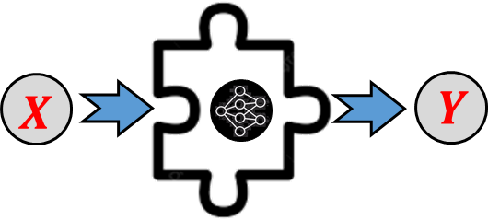


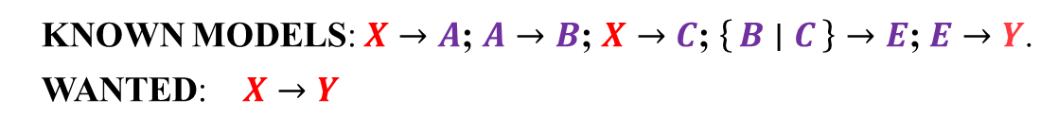
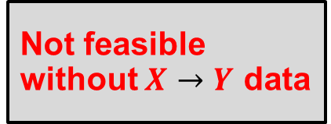

Black-box integration and interoperability challenge example
$$X$$
$$C$$
KNOWN MODELS: $X→A$; $A→B$; $X→C$; $\left\{B ∣ C\right\}→E$; $E→Y$.
WANTED: $X→Y$
$$E$$
$$Y$$
Not feasible without $X→Y$ data
$$A$$
$$B$$

Slide 8


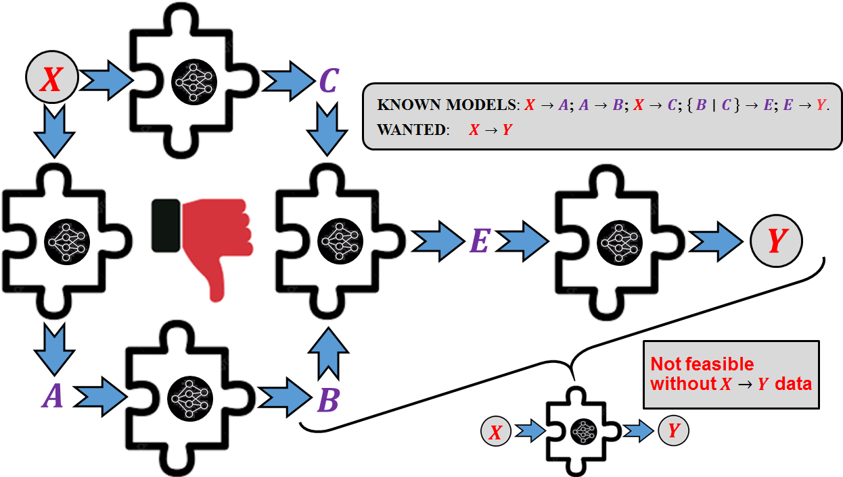
Black-box integration and interoperability challenge
(not just abstract but real)
Integration challenge (industry reality)
Consider an industrial predictive maintenance system in a smart factory. Different ML models may be developed independently to monitor different aspects of equipment health:
Vibration analysis model: Uses sensor data to predict early-stage mechanical failures (Sensor Data → Vibration Anomalies).
Thermal diagnostics model: Monitors heat signatures to detect overheating components (Sensor Data → Thermal Anomalies).
Load analysis model: Tracks operational stress and workload fluctuations to predict potential failures (Operational Data → Load Stress Indicators).
Failure risk estimation model: Takes combined indicators (vibration, thermal, and load anomalies) and estimates the probability of a critical failure ({Vibration | Thermal | Load} → Failure Risk).
Downtime prediction model: Determines the impact of predicted failures on production output and recommends preventive actions (Failure Risk → Production Downtime).
Each of these models was likely developed separately, trained on different datasets, and optimized for its specific domain. However, to achieve true predictive intelligence and explainability, the factory must reason holistically about how these models interact and contribute to final decision-making.
Integration challenge (abstract)

Slide 9

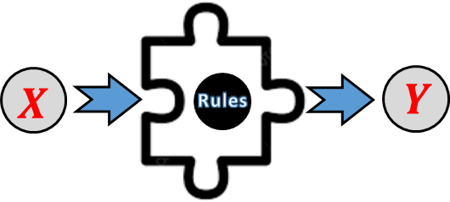


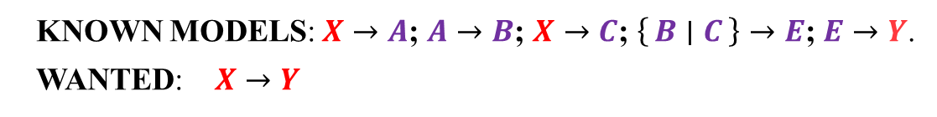

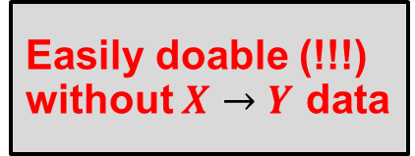



Semantic integration and interoperability example
$$X$$
$$C$$
Rules
KNOWN MODELS: $X→A$; $A→B$; $X→C$; $\left\{B ∣ C\right\}→E$; $E→Y$.
WANTED: $X→Y$
$$E$$
$$Y$$
Rules
Rules
Rules
Easily doable (!!!) without $X→Y$ data
$$A$$
$$B$$
Rules

Slide 10


Semantics-driven XAI: Not just explainability but also interoperability and integration
A major challenge in modern AI systems is ensuring both explainability and interoperability, especially when dealing with independently developed black box models. Traditional ML approaches often treat models as isolated entities, each trained on separate datasets with no inherent connection to others. This fragmentation limits interpretability and prevents seamless knowledge integration.
Explainable
Rules
SWRL
SPARQL
Interoperable
OWL
Our approach in this study, based on semantic ontology-driven representation, provides a solution to this problem by transforming disparate models into an interconnected, explainable reasoning system.

Slide 11
Why semantic rules? Core principles of semantic reasoning
What makes the black-box-to-semantic-rules transformation powerful is that, once within the same semantic framework, these rules act like interlocking puzzle pieces—naturally forming a logical chain that allows the reasoner to infer new knowledge. Unlike traditional AI models that operate in isolation, semantic reasoning provides mechanisms to seamlessly merge, compose, and extend knowledge representations while ensuring consistency and coherence. This is enabled by core principles of semantic reasoning:
Monotonic reasoning ensures that once a fact is inferred, it remains valid unless explicitly revised. As new rule sets are integrated, they contribute additional knowledge rather than overriding or contradicting existing inferences, making our system robust and reliable in dynamic environments.
Open World Assumption allows for incremental integration of models, even when complete information is unavailable. Unlike traditional databases, which assume that missing information is false (Closed World Assumption), semantic reasoning acknowledges potential unknowns, enabling flexible and adaptive inference.
Declarative and compositional nature of SWRL (Semantic Web Rule Language) ensures that extracted rule sets remain modular and naturally composable, allowing the reasoner to infer new facts without explicit reprogramming. This characteristic enables effortless expansion of the system with additional models.
Ontology-based conflict resolution systematically handles inconsistencies when integrating independently developed models. By aligning all rule sets under a common ontology, the reasoning framework prevents contradictions while ensuring interoperability between diverse AI components.

Slide 12


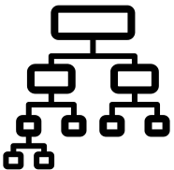

Our objective:
Neuro-Symbolic eXplanation pipeline
(NSX-pipeline)
NSX
Rules
As NNs become prevalent in industrial AI applications, their lack of interpretability remains a major challenge. Industry 4.0 and its evolution into Industry 5.0 demand not only high-performing AI models but also transparent, explainable, and interoperable systems that can integrate with existing semantic knowledge frameworks.
In this article, we introduce and experimentally study the Neuro-Symbolic eXplanation pipeline (NSX-pipeline)—a structured approach for transforming black box NNs into explainable, semantically structured models.
The NSX-pipeline, can be written as:
NN (black box) → Synthetic Data Generation → Decision Tree → SWRL → ChatGPT API → Explanation

Slide 13


Schema of experiments over the NSX-pipeline
The choice of the Iris dataset to demonstrate our experimental study on the NSX-pipeline is motivated by practical considerations that align with the objectives of Industry 4.0 and smart manufacturing. While Iris is traditionally associated with biological classification, its use here serves as a neutral, well-understood example that allows us to clearly demonstrate our methodology in a structured and reproducible manner. Our approach—converting a black box NN into an explainable ontology with SWRL rules—is highly domain-agnostic.
NSX
Rules
IRIS
Our experimental NSX-pipeline’s testing begins with the selection of several well-known public datasets. The goal is to get several trained NNs and use them further as black boxes to test the pipeline.
Experimental results, the code, and further details are available in: [https://ai.it.jyu.fi/experiments/NSX-pipeline/].
In the Figure, the whole process is shown originated with the popular Iris dataset [https://archive.ics.uci.edu/dataset/53/iris].

Slide 14
NSX
Synthetic data generation
Rules
Instead of using the original dataset, we treat the trained NN as an oracle to generate labeled synthetic data. We explored two approaches:
In the first, more optimistic scenario, we assumed access to class proportions and attribute value ranges, generating random samples until the class distributions matched those of the original dataset.
In the second, more realistic scenario, we only had information about attribute ranges and generated data until all classes had at least a minimum number of samples, allowing natural class proportions to emerge.
In both cases, random feature values were assigned labels based on the NN’s highest predicted probability.
To validate the quality of the synthetic data, we trained a decision tree on it and tested its performance against the original dataset, achieving an accuracy between 86% and 90%. This result suggests that the synthetic dataset effectively captures decision boundaries, enabling generalization to real data.

Slide 15
NSX
Decision tree induction from synthetic data
Rules
With the synthetic dataset in place, the next step involves training a decision tree that learns the classification patterns encoded by the NN. Decision trees provide an intuitive and interpretable model structure where classification is based on a sequence of attribute-value comparisons. The key considerations in this phase include:
Tree depth constraint: To maintain readability and generalization, we limit the depth of the decision tree to a predefined value (e.g., 3). This introduces controlled ambiguity in classification but ensures that rules remain manageable and human-comprehensible;
Rule consistency and completeness: While learning from data, we ensure that the decision tree rules are neither inconsistent (contradictory decisions for similar instances) nor redundant (overlapping rules leading to the same outcome);
Overfitting prevention: The decision tree is trained with pruning strategies to avoid capturing noise from the synthetic dataset while retaining the key classification patterns.
Once the decision tree is fully trained, each decision path represents a classification rule that maps a combination of attribute constraints to a specific class.

Slide 16
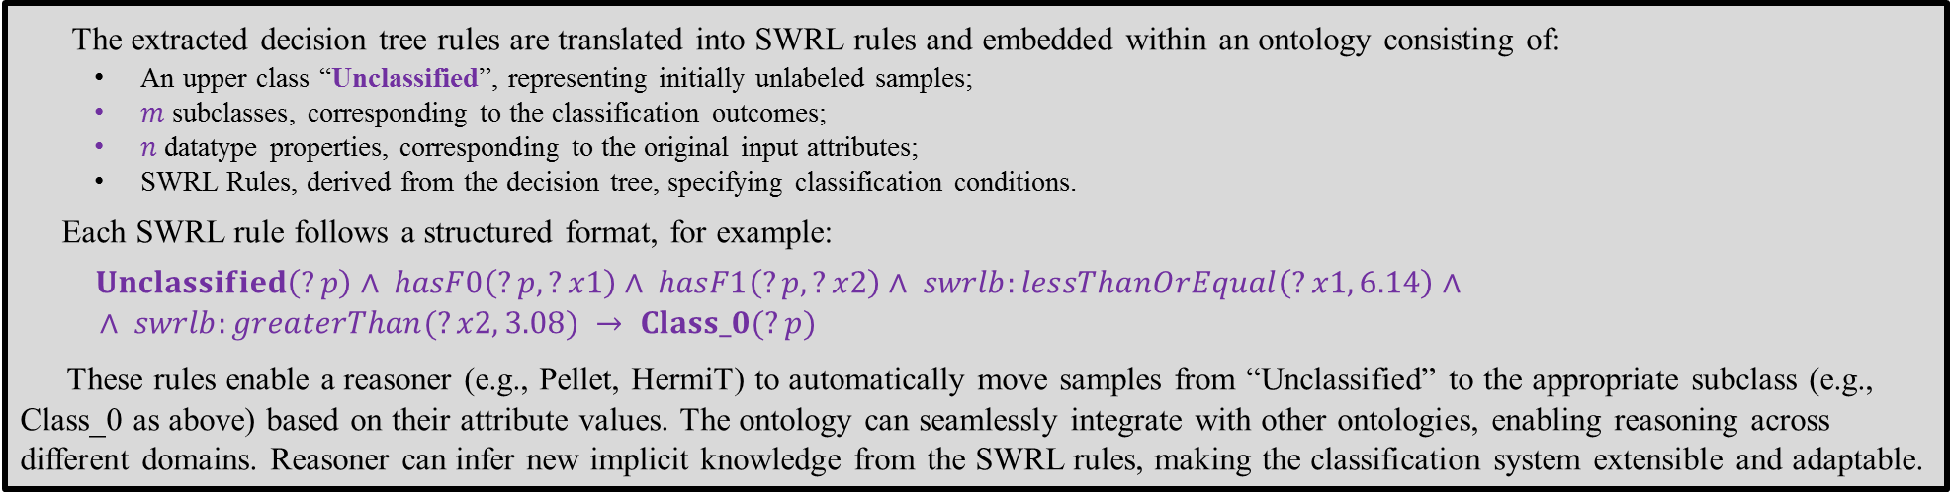
NSX
Ontology construction with SWRL rule embedding
Rules
The extracted decision tree rules are translated into SWRL rules and embedded within an ontology consisting of:
An upper class “Unclassified”, representing initially unlabeled samples;
$m$ subclasses, corresponding to the classification outcomes;
$n$ datatype properties, corresponding to the original input attributes;
SWRL Rules, derived from the decision tree, specifying classification conditions.
Each SWRL rule follows a structured format, for example:
$Unclassified\left(?p\right)∧ hasF0\left(?p, ?x1\right)∧ hasF1\left(?p, ?x2\right)∧ swrlb:lessThanOrEqual\left(?x1, 6.14\right)∧$
$$∧ swrlb:greaterThan(?x2, 3.08) → Class_0(?p)$$
These rules enable a reasoner (e.g., Pellet, HermiT) to automatically move samples from “Unclassified” to the appropriate subclass (e.g., Class_0 as above) based on their attribute values. The ontology can seamlessly integrate with other ontologies, enabling reasoning across different domains. Reasoner can infer new implicit knowledge from the SWRL rules, making the classification system extensible and adaptable.

Slide 17
NSX
Explainability via natural language rule interpretation
Rules
A novel feature of our pipeline is the ability to generate human-readable explanations for classification decisions. By querying an LLM (e.g., ChatGPT via API), the SWRL rules and classification results can be translated into natural language descriptions. This enhances the system’s transparency by providing:
Rule explanations: Each SWRL rule is converted into a readable form, explaining its classification logic;
Sample classification justifications: For any given test sample, the system provides an explicit explanation of why a specific class was assigned;
Unclassified case handling: If a test sample remains in “Unclassified”, the system identifies why no existing rule applies, highlighting potential areas for rule refinement.

Slide 18
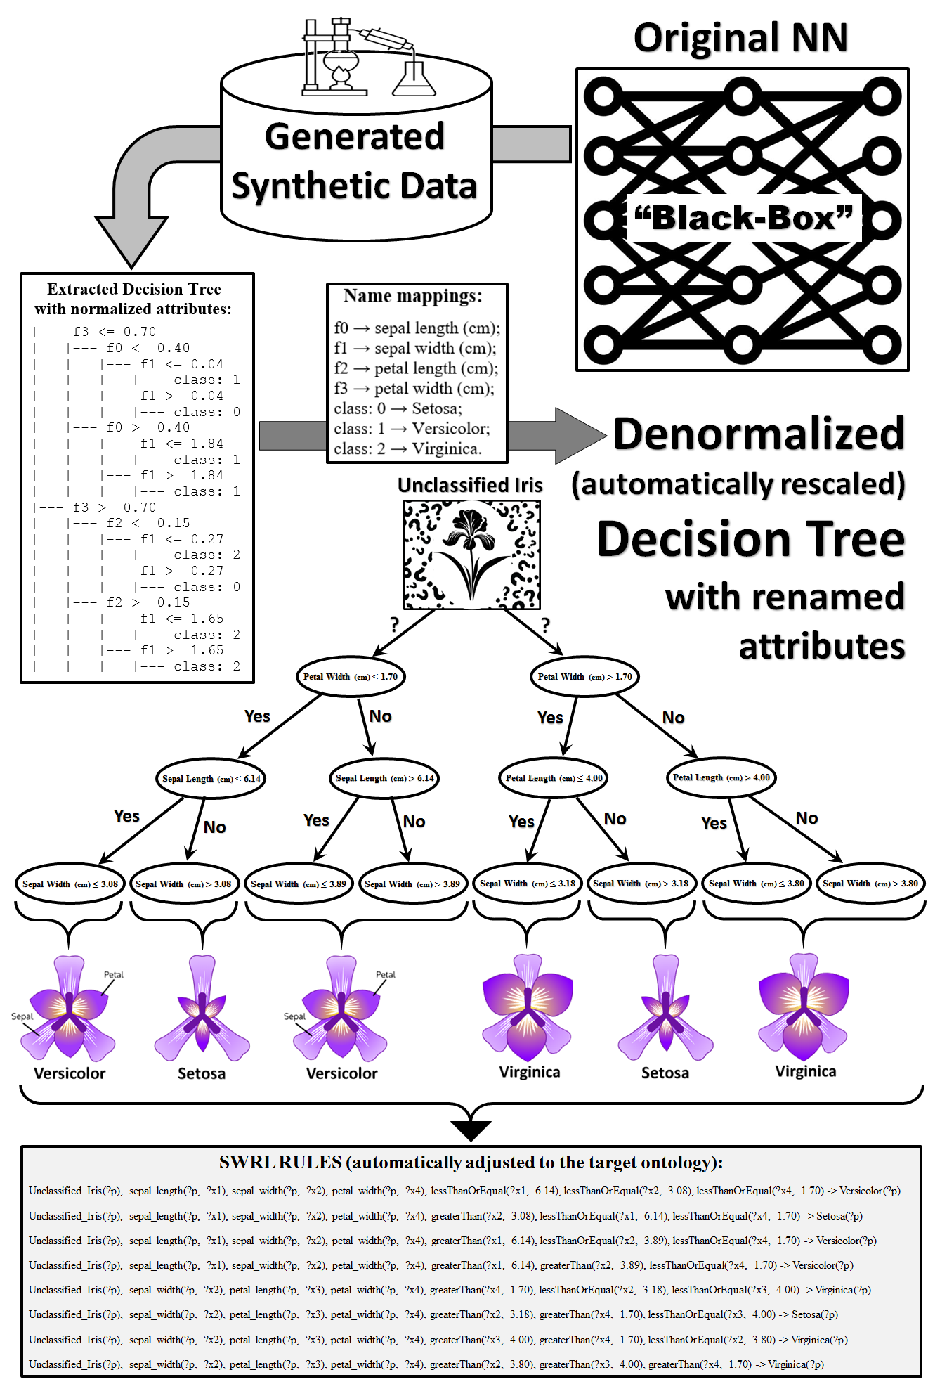
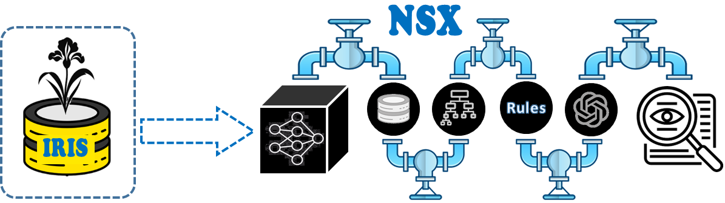
Visualizing IRIS experiments
(depth of decision tree is limited to 3)
Resulting ontology online:
http://ai.it.jyu.fi/vagan/ontologies/2024/SWRL.owl

Slide 19
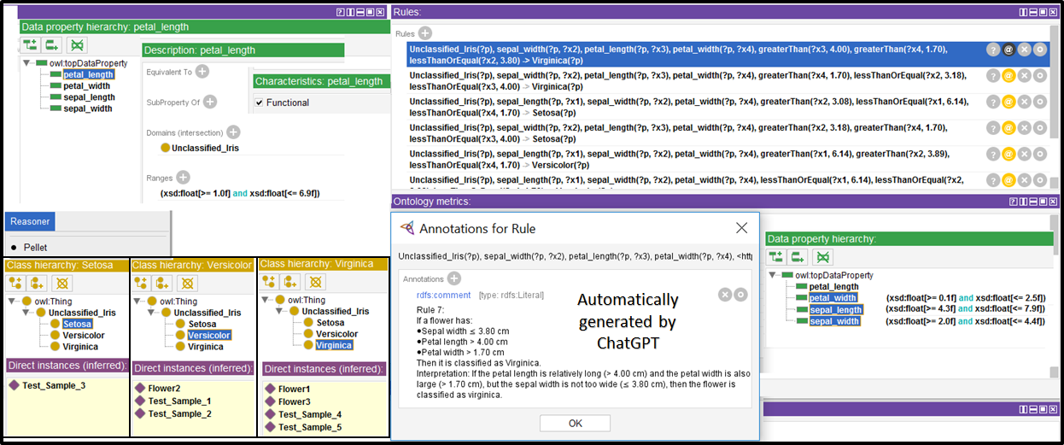
Visualizing IRIS experiments
(Protégé ontology screenshot: http://ai.it.jyu.fi/vagan/ontologies/2024/SWRL.owl)

Slide 20
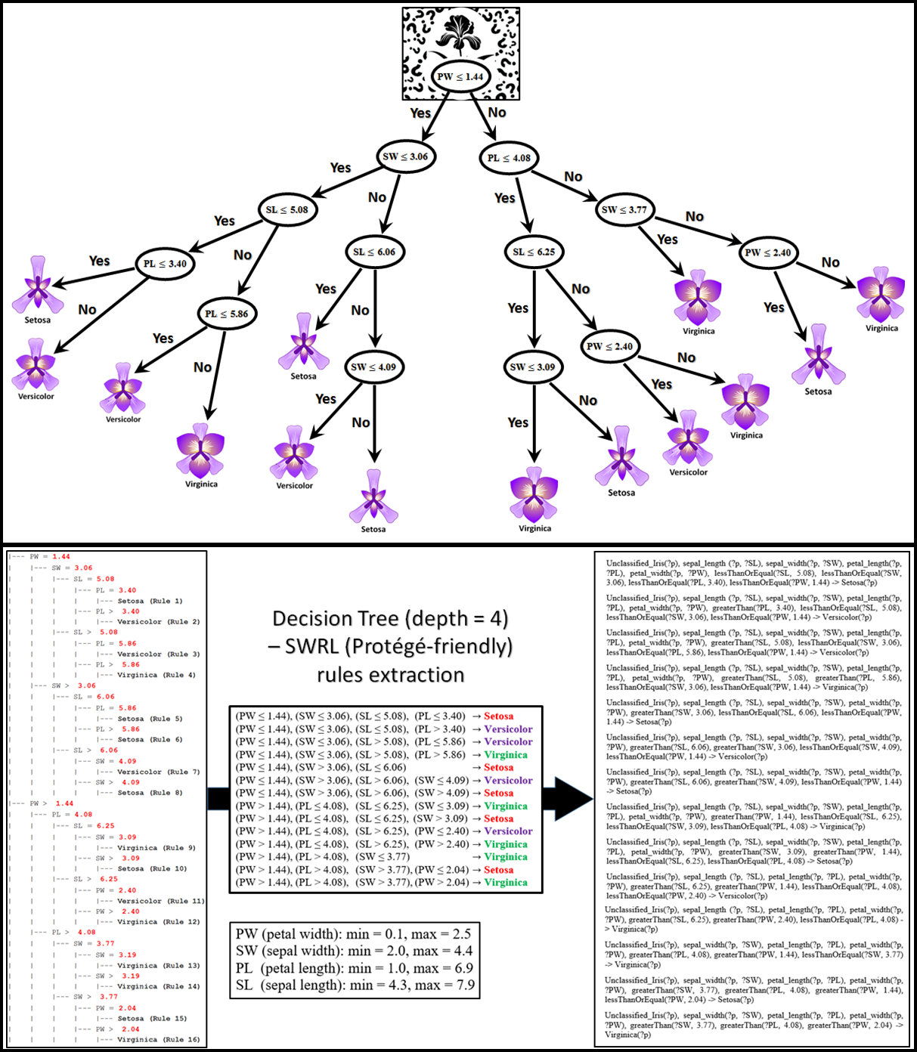
Visualizing IRIS experiments
(depth of decision tree is limited to 4)
Resulting ontology online:
http://ai.it.jyu.fi/vagan/ontologies/2024/SWRL_4.owl

Slide 21
Transforming SWRL rule sets into SPARQL queries via ChatGPT
OWL
Why and When is this Transformation Needed?
SWRL (Semantic Web Rule Language) is a powerful
rule-based reasoning framework used in ontology-driven
applications. However, in some cases, transforming
SWRL rules into SPARQL queries may be beneficial:
Interoperability: Not all ontology systems or triple stores support SWRL reasoning, whereas SPARQL is widely supported.
Alternative querying mechanism: If a system does not support real-time rule-based reasoning, SWRL rules can be translated into SPARQL to allow explicit querying instead.
Optimized execution: SWRL rules require an inference engine (e.g., Pellet), whereas SPARQL queries can retrieve results directly from an RDF store without full reasoning overhead.
Integration with other systems: Some knowledge graph applications, such as enterprise semantic search, prefer SPARQL over SWRL for efficient data access.
We applied ChatGPT as an external service to automatically convert SWRL rules into equivalent SPARQL queries. The transformation follows these steps:
SWRL rule set: The input consists of SWRL rules that express logical conditions and implications.
ChatGPT prompting: We construct a structured prompt that provides the SWRL rule and requests an equivalent SPARQL representation.
Generated SPARQL query: ChatGPT returns corresponding SPARQL SELECT or ASK query that retrieves instances satisfying the rule.
SWRL
SPARQL

Slide 22
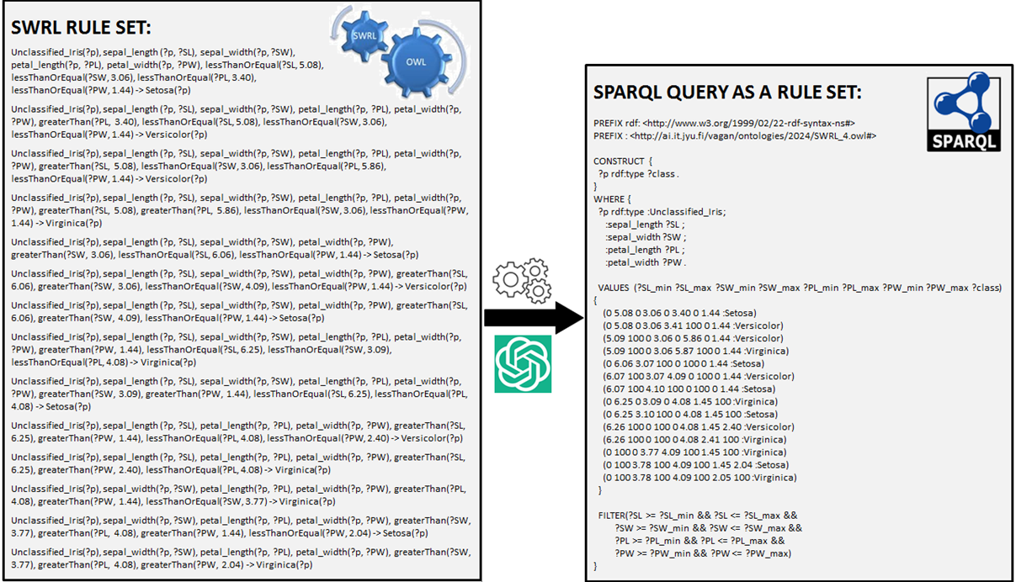
SWRL-to-SPARQL transformation example

Slide 23

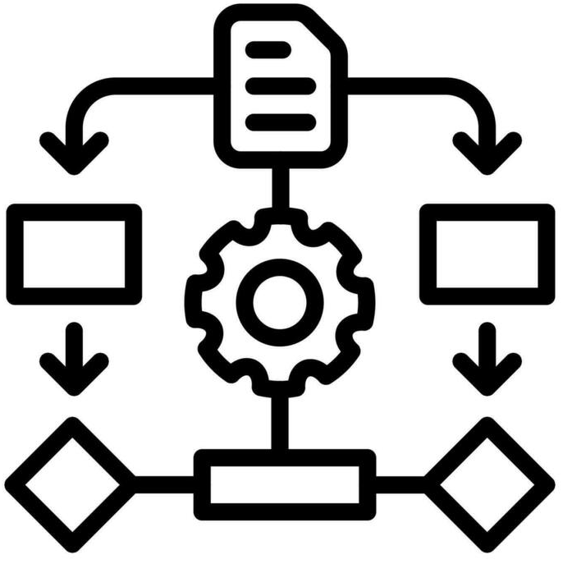



Samples of related work and industry concerns:
Semantic interoperability and integration: When semantic web technologies start gaining popularity, first evident industrial application areas were integration and interoperability. Enablers for these were semantic technologies, which are valuable not only in open Web environments, but also in closed industrial systems. Later Industry 4.0 emerged and once again emphasized the need for intelligent data driven seamless integration of various industrial components and processes, and, therefore, semantic interoperability became a critical requirement.
Our research contributes towards these objectives, related works, principles of semantic computing and interoperability by transforming black box NNs into explainable, interoperable, and semantically structured models using decision trees, SWRL rules, and ChatGPT-generated explanations, thus enabling machine-readable and reusable knowledge representations that align with Semantic Web ontologies for enhanced industrial AI transparency and integration.
Explainable AI and semantics (OntoXAI): Two parallel trends, i.e., recovery of human role (Industry 4.0 – Industry 5.0 transformation) and sophistication of highly accurate deep NN-based ML models unlock another emergent need – explainability. Corresponding need for interpreting “black box” models becomes a dominating concern in modern industry and evolves as XAI domain. XAI research has many various approaches but also it create a new interesting dimension of using semantic technologies in industry. OntoXAI is presented as a SWRL-based XAI approach to generate user-comprehensible natural language explanations through Open AI API in the context of dengue disease classification.
Our approach and experiments go beyond; and the key difference is that OntoXAI manually designs models with SWRL rules, whereas our approach automatically extracts SWRL rules from independently trained black box NNs. Therefore, we can process and integrate multiple pre-trained models without manual rule writing; and, instead of designing rules for a specific domain (like disease classification), we transform any black box NN into an explainable, ontology-driven reasoning system. Our approach is more data-driven, automated, and suited for large-scale AI integration.

Slide 24

Samples of related work:
Targeting black-box models with explanations: A growing body of research focuses on transforming black box NN models into more explainable and interoperable representations, facilitating their integration with semantic knowledge frameworks. One of the most common strategies is to approximate NNs with decision trees or rule-based systems. These methods extract human-interpretable decision boundaries from trained networks, making their reasoning explicit.
See, for example, TREPAN, which is a widely known approach (later enhanced with ontologies) that trains a decision tree using synthetic data labeled by NN.
Notable also DeepRED, which is an extension of decision tree generator that iteratively extracts rules from deep networks.
Beyond decision trees, researchers have sought to distill NNs into symbolic representations, enabling interoperability with semantic frameworks such as ontologies and rule-based systems. The intention is to converts trained models into logical rules, allowing integration with formal reasoning systems (e.g., neuro-symbolic AI paradigms or interpretable neuro-symbolic models). A more recent trend integrates deep learning models with structured semantic knowledge representations, such as neural-symbolic learning with knowledge graphs, which embeds structured knowledge within neural models and enables reasoning by aligning learned representations with ontologies.
Our approach aligns closely with decision tree-based rule extraction but extends it further by mapping distilled rules into SWRL, enhancing their interoperability with semantic frameworks. Unlike traditional rule-extraction methods that stop at explainability, our method aims for full integration into ontology-driven reasoning systems, bridging the gap between black box AI and symbolic knowledge representation. Such transformation preserves meaningful decision boundaries, reinforcing the potential of semantic rules as a faithful representation of NN knowledge.

Slide 25
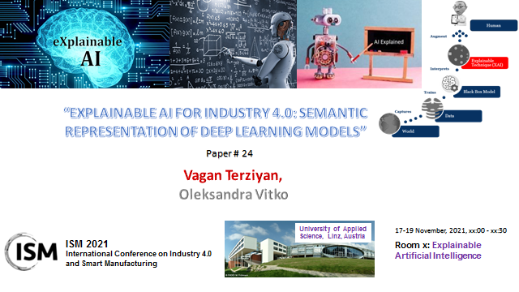
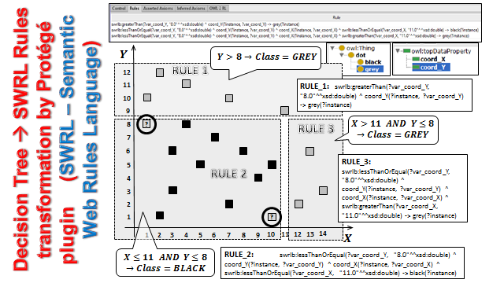
Connection to our former study:
In our former study, we proposed a simple transformation pipeline: Data → Decision Tree → SWRL. We trained a decision tree directly on available data and extracted SWRL rules for explainability and semantic integration. Our new approach in this study starts with one or several previously trained NNs as black boxes, without access to their original training data. The updated NSX-pipeline is: NN (black box) → Synthetic Data Generation → Decision Tree → SWRL → ChatGPT API → Explanation. The key difference is that we no longer rely on the original training data. Instead, we query the NN and generate synthetic data that captures its decision boundaries. This data is then used to train a decision tree, which serves as an interpretable model for extracting SWRL rules. Finally, we used ChatGPT API to generate natural language explanations, translating both symbolic rules and reasoning results into human-readable justifications. By recovering decision boundaries from black box NNs, our new method enables explainability and semantic reasoning without requiring access to the original dataset—a crucial advancement over our former approach.
Terziyan, V., and Vitko, O. (2022) “Explainable AI for Industry 4.0: Semantic representation of deep learning models.” Procedia Computer Science, 200: 216–226. Elsevier. https://doi.org/10.1016/j.procs.2022.01.220

Slide 26

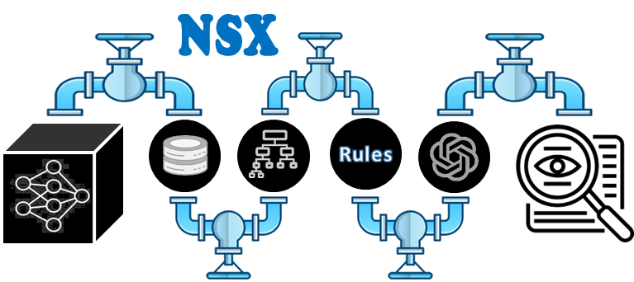
1
In this paper, we introduced the NSX-pipeline, a neuro-symbolic approach designed to enhance explainability and interoperability in AI-driven decision-making for Industry 4.0 and smart manufacturing. We motivated the need for such a pipeline by highlighting challenges in modern industrial AI systems, particularly the opacity of NNs and the difficulty of integrating black box ML models with symbolic ontology-driven reasoning frameworks.

Slide 27
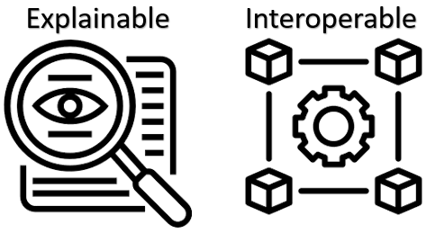
2
The proposed pipeline combines NN-based synthetic data generation, decision tree extraction, and SWRL rule induction to bridge the gap between black box learning and human-understandable explanations. Through experimental studies, we demonstrated the feasibility of this approach, showcasing how extracted rules align with learned decision boundaries and contribute to a more interpretable decision-making process.

Slide 28

3
Additionally, we provided access to supplementary materials, including code and generated ontologies, to facilitate further exploration.
As future work, we plan to extend our experiments to real-world industrial models and evaluate the scalability of the NSX-pipeline across multiple domains.
https://ai.it.jyu.fi/experiments/NSX-pipeline/
http://ai.it.jyu.fi/vagan/ontologies/2024/SWRL.owl
http://ai.it.jyu.fi/vagan/ontologies/2024/SWRL_4.owl

Slide 29
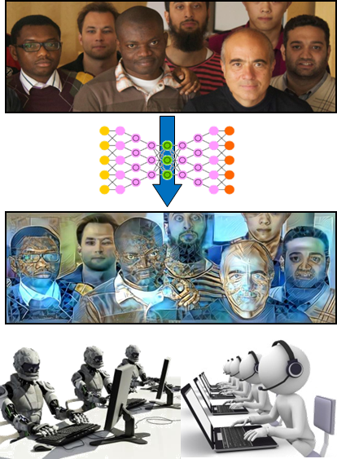
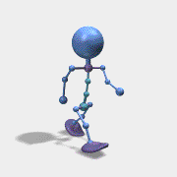

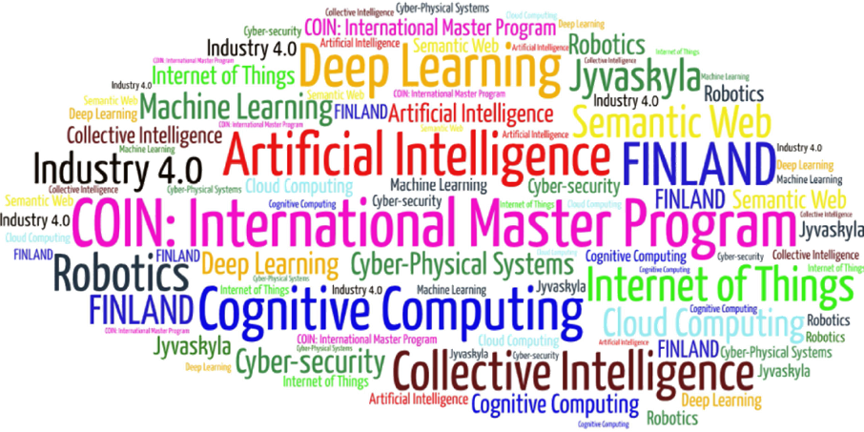
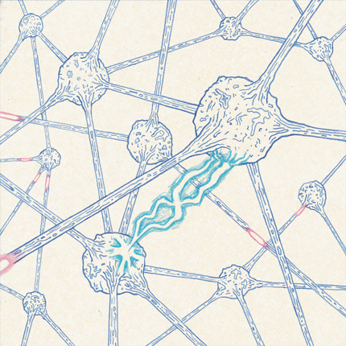
Come to study at our International Master Program
AI: Artificial Intelligence
(former Cognitive Computing and Collective Intelligence) …
… the first university program for collective intelligence, where humans learn together with their digital clones and autonomous digital assistants …
http://www.jyu.fi/ai
AI

Slide 30

Link to the presentation: https://ai.it.jyu.fi/ISM-2025-NN-SWRL.pptx
Link to Google’s NotebookLM / “Deep Dive” podcast:
https://ai.it.jyu.fi/ISM-2025-NN-SWRL.wav
Contact: vagan.terziyan@jyu.fi

Slide 31
7th International Conference on Industry of the Future and Smart Manufacturing – ISM 2025
University of Malta - Malta | 12-14 November 2025
Thank you!
“Semantic AI for Future Industries:
Bridging Explainability and Integration in Black Box Models”
Vagan Terziyan ª, Oleksandra Vitko ^{b}, Oleksandr Terziyan ^{b}
ª Faculty of Information Technology, University of Jyväskylä, Jyväskylä, Finland
^{b} Department of Artificial Intelligence, Kharkiv National University of Radio Electronics, Kharkiv, Ukraine
Contacts
vagan.terziyan@jyu.fi
Link to complete slide-set:
https://ai.it.jyu.fi/ISM-2025-NN-SWRL.pptx
https://www.jyu.fi/en/
https://nure.ua/en/

