Slide 1


7th International Conference on Industry of the Future and Smart Manufacturing – ISM 2025
University of Malta - Malta | 12-14 November 2025
“Beyond Backpropagation: Smarter Neural Networks for Smart Manufacturing”
Vagan Terziyan ª, Oleksandra Vitko ^{b}, Oleksandr Terziyan ^{b}
ª Faculty of Information Technology, University of Jyväskylä, Jyväskylä, Finland
^{b} Department of Artificial Intelligence, Kharkiv National University of Radio Electronics, Kharkiv, Ukraine
https://www.jyu.fi/en/
https://nure.ua/en/

Slide 2


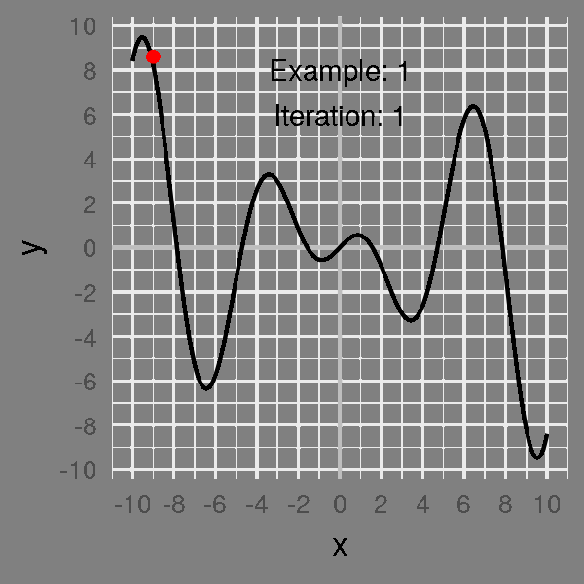


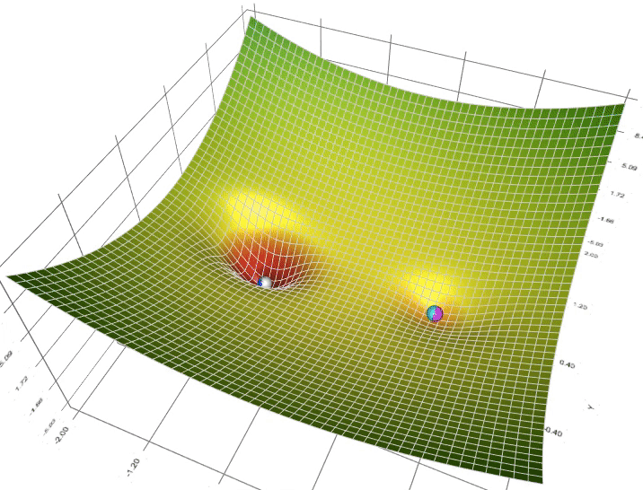



Exploitation
vs.
Exploration
“Beyond Backpropagation: Smarter Neural Networks for Smart Manufacturing”
Paper # 4274
Vagan Terziyan, Oleksandra Vitko & Oleksandr Terziyan
Thursday, November 13, 2025, 09:45 ‒ 10:05 (4th of 5)
ISM 2025
7th International Conference on Industry of the Future and Smart Manufacturing
Section/Room: TECH / VR1
“Cutting-Edge Technologies for Innovative Solutions” (9:00 – 10:45)

Slide 3

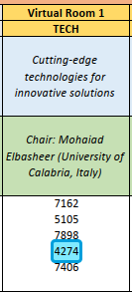

Slide 4
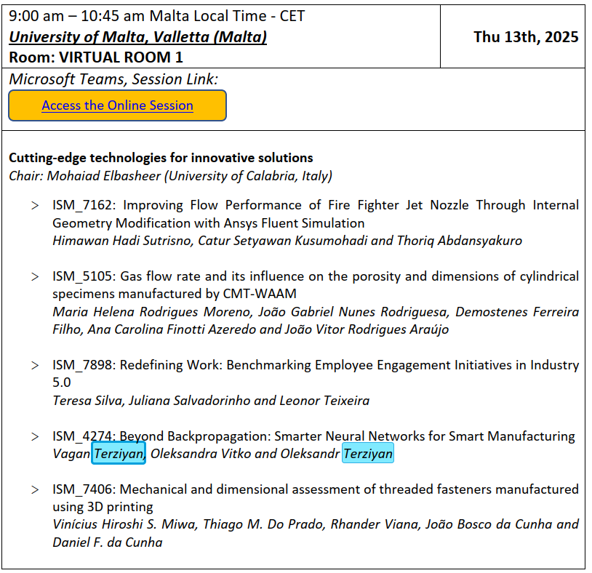
https://teams.microsoft.com/l/meetup-join/19%3ameeting_OTAzOGJmMGEtZTAyYS00MGE1LWFjOTktMjIxMGZjZjg0NzE3%40thread.v2/0?context=%7b%22Tid%22%3a%227519d0cd-2106-47d9-adcb-320023abff57%22%2c%22Oid%22%3a%22398dc36a-f564-4885-982b-579ed3a4a54b%22%7d
https://universityofmalta.zoom.us/j/99756180432

Slide 5


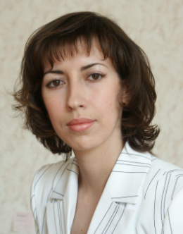


Vagan Terziyan
Authors
vagan.terziyan@jyu.fi
“Beyond Backpropagation: Smarter Neural Networks for Smart Manufacturing”
Oleksandra Vitko
Oleksandr Terziyan
https://www.jyu.fi/en/
https://nure.ua/en/

Slide 6

Modern and future industries require effective, efficient, robust, and resilient AI/ML-driven models, particularly well-trained neural networks

Slide 7
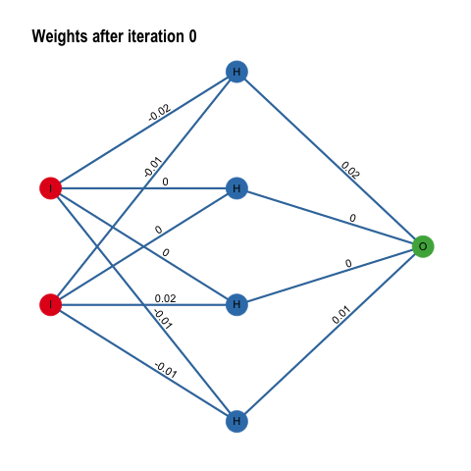
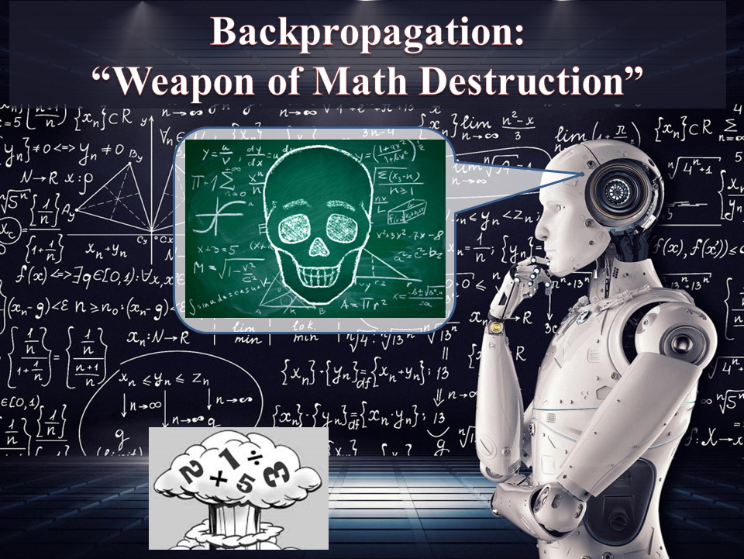
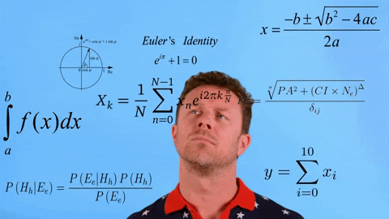
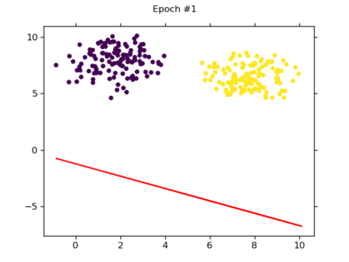
How neural nets are being trained? Backpropagation!

Slide 8
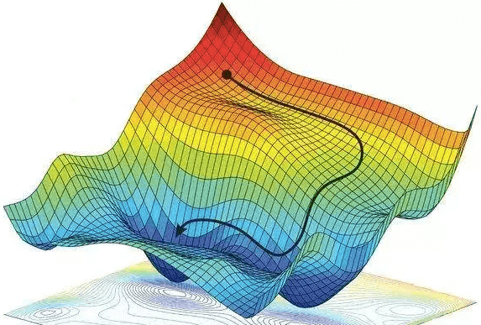






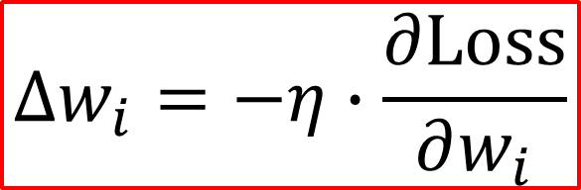

Backpropagation and gradient descent
$$θ$$
Backpropagation is simply an algorithm to compute the gradient:
$$w_{i}$$
$$θ←θ−η∙∇_{θ}Loss$$
$θ$ - vector of NN’s trainable parameters
$$\frac{∂Loss}{∂w_{i}}$$
Update for each parameter at each training iteration:
$$∆w_{i}=−η∙\frac{∂Loss}{∂w_{i}}$$
Why minus? Because we are moving following the gradient’s descending direction.

Slide 9
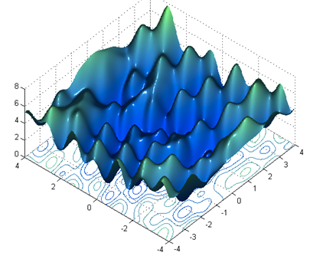
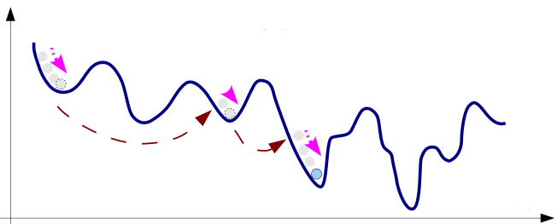
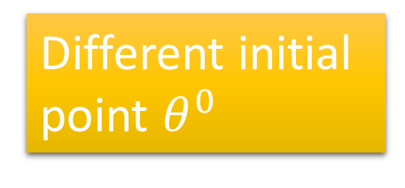





Minimizing Loss Function with Gradient Descent
$$Loss$$
Gradient descent never guarantees global minima
Different initial point $θ^{0}$
$$w$$
$$Loss$$
The major problem of training Neural Network is almost all about the “art” of optimizing (minimizing) the loss (cost or error) function to discover (close to) optimal configuration parameters (weights, biases ) for the model.
Reach different minima, so different results
$$w_{1}$$
$$w_{2}$$

Slide 10
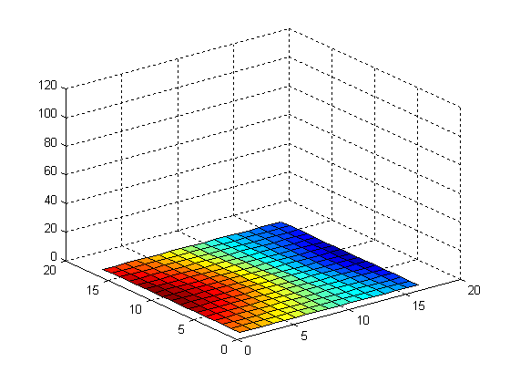
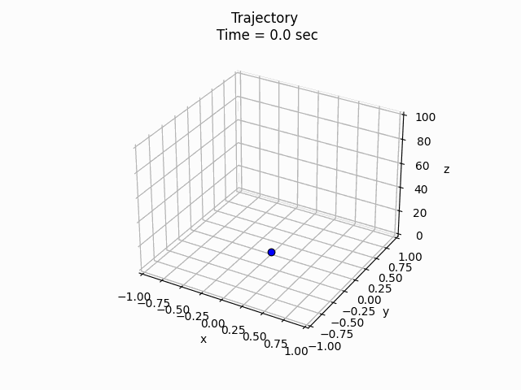











Trajectory of NN model evolution during training …
Model
$$θ$$
$$θ$$
Model
$$θ^{2}$$
$$θ$$
… do we care about it at all, or, actually, our concern is just minimizing the loss?
$$θ^{1}$$
…
$$θ_{0}$$
$$θ_{1}$$
$$θ_{t}$$

Slide 11

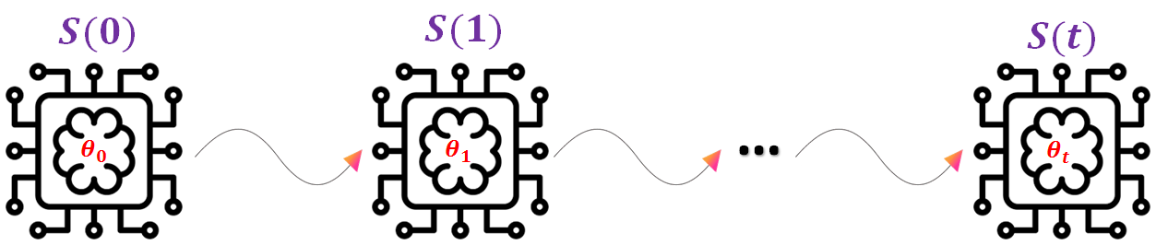



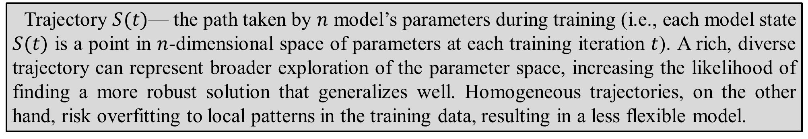



Why trajectory matters?
Model
$$θ$$
$$θ$$
“Homogeneity”
vs.
“Variability”
Model
$$θ^{2}$$
$$θ$$
$$θ^{1}$$
Trajectory $S(t)$— the path taken by $n$ model’s parameters during training (i.e., each model state $S(t)$ is a point in $n$-dimensional space of parameters at each training iteration $t$). A rich, diverse trajectory can represent broader exploration of the parameter space, increasing the likelihood of finding a more robust solution that generalizes well. Homogeneous trajectories, on the other hand, risk overfitting to local patterns in the training data, resulting in a less flexible model.

Slide 12

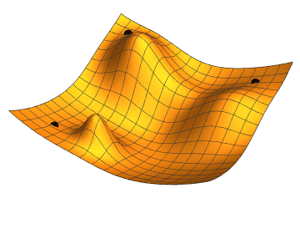

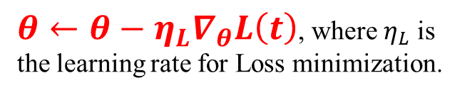
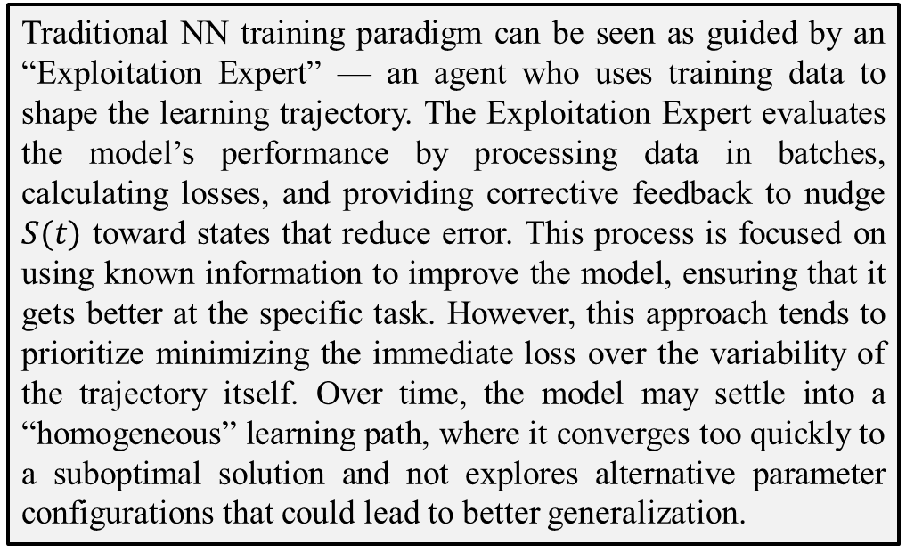
A “Tale of Two Trainers”: Balancing Exploration and Exploitation in Model Training
1. The “Exploitation Expert”: following the known path
L
Traditional NN training paradigm can be seen as guided by an “Exploitation Expert” — an agent who uses training data to shape the learning trajectory. The Exploitation Expert evaluates the model’s performance by processing data in batches, calculating losses, and providing corrective feedback to nudge $S(t)$ toward states that reduce error. This process is focused on using known information to improve the model, ensuring that it gets better at the specific task. However, this approach tends to prioritize minimizing the immediate loss over the variability of the trajectory itself. Over time, the model may settle into a “homogeneous” learning path, where it converges too quickly to a suboptimal solution and not explores alternative parameter configurations that could lead to better generalization.
Loss
$θ←θ−η_{L}∇_{θ}L\left(t\right)$, where $η_{L}$ is the learning rate for Loss minimization.

Slide 13


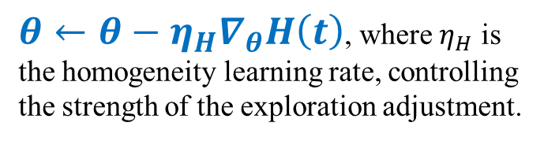



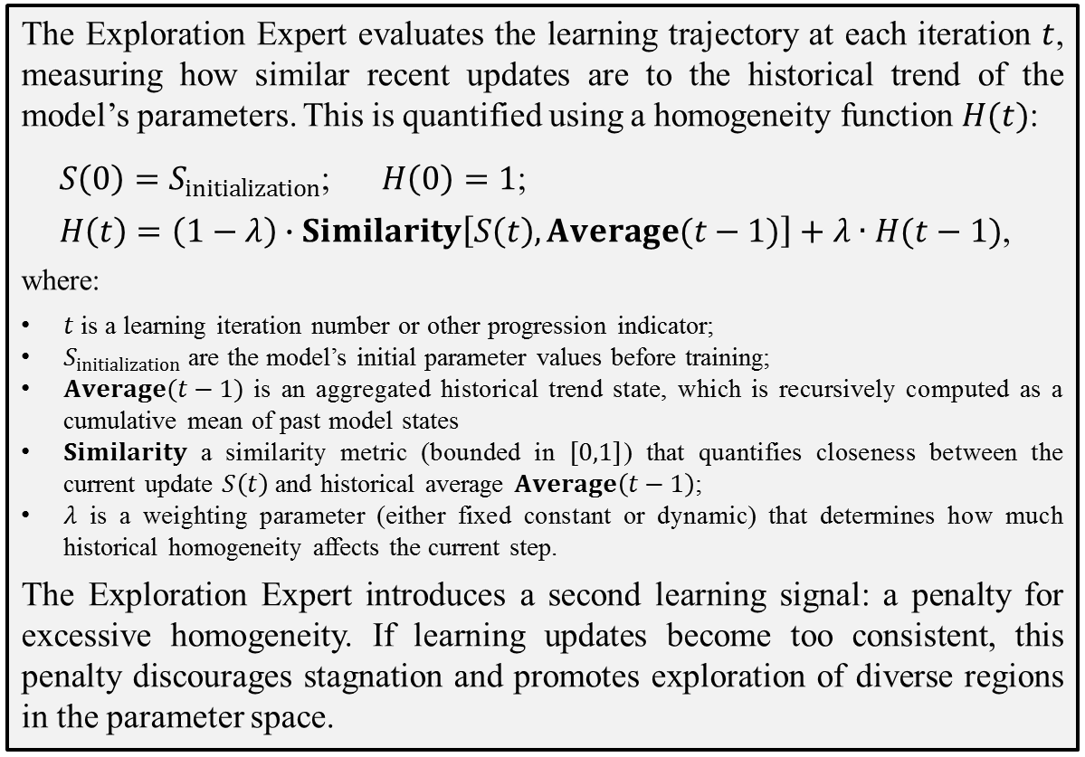
A “Tale of Two Trainers”: Balancing Exploration and Exploitation in Model Training
2. The “Exploration Expert”: enforcing trajectory variability
H
The Exploration Expert evaluates the learning trajectory at each iteration $t$, measuring how similar recent updates are to the historical trend of the model’s parameters. This is quantified using a homogeneity function $H(t)$:
$S\left(0\right)=S_{initialization}$; $H\left(0\right)=1$;
$H\left(t\right)=\left(1−λ\right)∙Similarity\left[S\left(t\right),Average(t−1)\right]+λ∙H(t−1)$,
where:
$t$ is a learning iteration number or other progression indicator;
$S_{initialization}$ are the model’s initial parameter values before training;
$Average(t−1)$ is an aggregated historical trend state, which is recursively computed as a cumulative mean of past model states
$Similarity$ a similarity metric (bounded in $[0,1]$) that quantifies closeness between the current update $S\left(t\right)$ and historical average $Average\left(t−1\right)$;
$λ$ is a weighting parameter (either fixed constant or dynamic) that determines how much historical homogeneity affects the current step.
The Exploration Expert introduces a second learning signal: a penalty for excessive homogeneity. If learning updates become too consistent, this penalty discourages stagnation and promotes exploration of diverse regions in the parameter space.
Model
$$θ$$
$$θ^{2}$$
$$θ^{1}$$
$θ←θ−η_{H}∇_{θ}H\left(t\right)$, where $η_{H}$ is the homogeneity learning rate, controlling the strength of the exploration adjustment.

Slide 14



Two independent objectives for NN training
H
L
Model
$$θ$$
Loss
$$θ$$
$θ←θ−η_{H}∇_{θ}H\left(t\right)$, where $η_{H}$ is the homogeneity learning rate, controlling the strength of the exploration adjustment.
$θ←θ−η_{L}∇_{θ}L\left(t\right)$, where $η_{L}$ is the learning rate for Loss minimization.

Slide 15
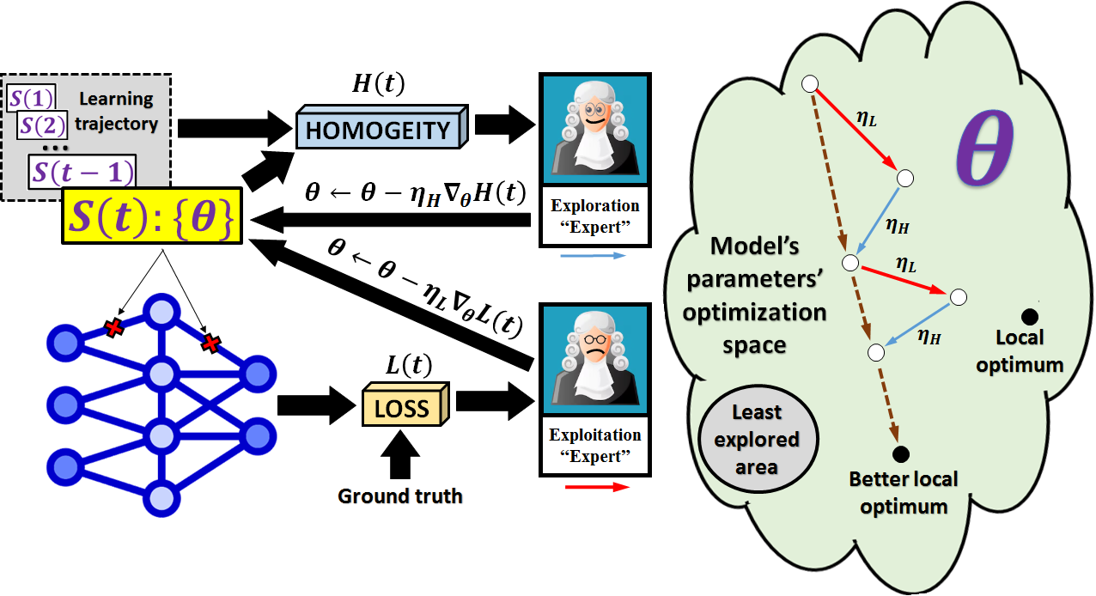

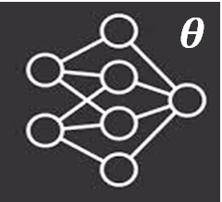
Balancing exploration and exploitation during NN training
Visualization of the neural network training process, where each iteration consists of two sequential weight update stages. The first stage is the traditional backpropagation of loss, driving the model to better fit the training data (exploitation stage). The second stage aims to minimize homogeneity, encouraging the model to explore new parameter settings (exploration stage) and avoid well-explored regions of the parameter space. This dual-objective training process may help the model escape local minima and potentially discover better parameter configurations.

Slide 16


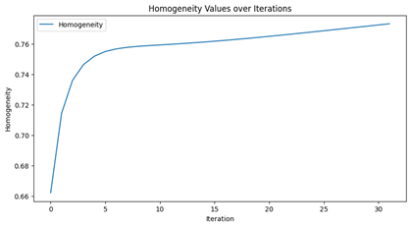
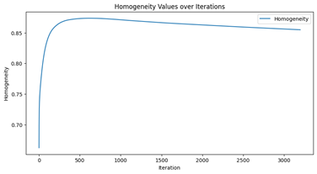
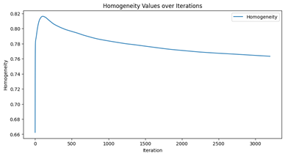
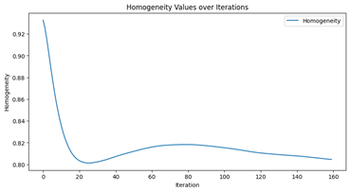
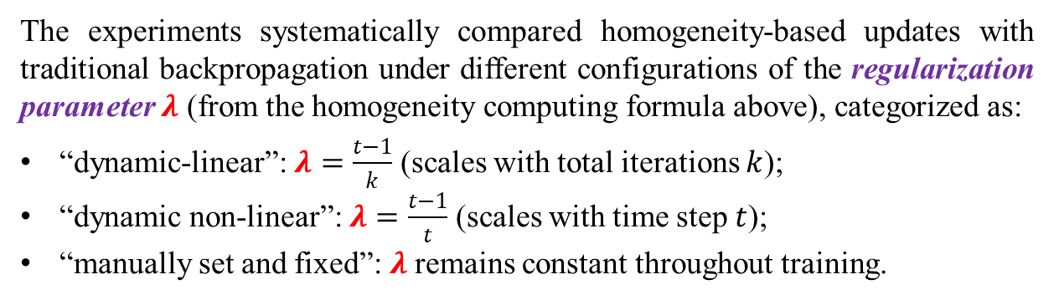
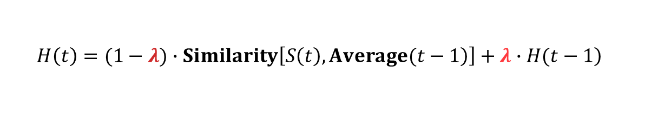
Experimental study settings
Implementation, source code, detailed outcomes from the experiments, additional results, and plots are available online [https://ai.it.jyu.fi/experiments/homogeneity/].
The experiments were conducted on two well-established datasets from UCI ML repository: MNIST and IRIS. These datasets serve as a solid foundation for an initial exploration of the proposed homogeneity-based training approach:
MNIST, with its complex 28×28 grayscale images and 42,000 samples, allows testing under high-dimensional input conditions, while …
IRIS, a simpler dataset with only 4 numerical features and 150 samples, provides insight into the method’s behavior in a lower-dimensional setting.
This combination ensures a balanced evaluation before extending the approach to real-world industrial datasets.
$$\left.H\left(t\right)=(1−λ)∙Similarity\left[\left.S\left(t\right),Average(t−1\right)\right]+λ∙H(t−1\right)$$
The experiments systematically compared homogeneity-based updates with traditional backpropagation under different configurations of the regularization parameter $λ$ (from the homogeneity computing formula above), categorized as:
“dynamic-linear”: $λ=\frac{t−1}{k}$ (scales with total iterations $k$);
“dynamic non-linear”: $λ=\frac{t−1}{t}$ (scales with time step $t$);
“manually set and fixed”: $λ$ remains constant throughout training.

Slide 17
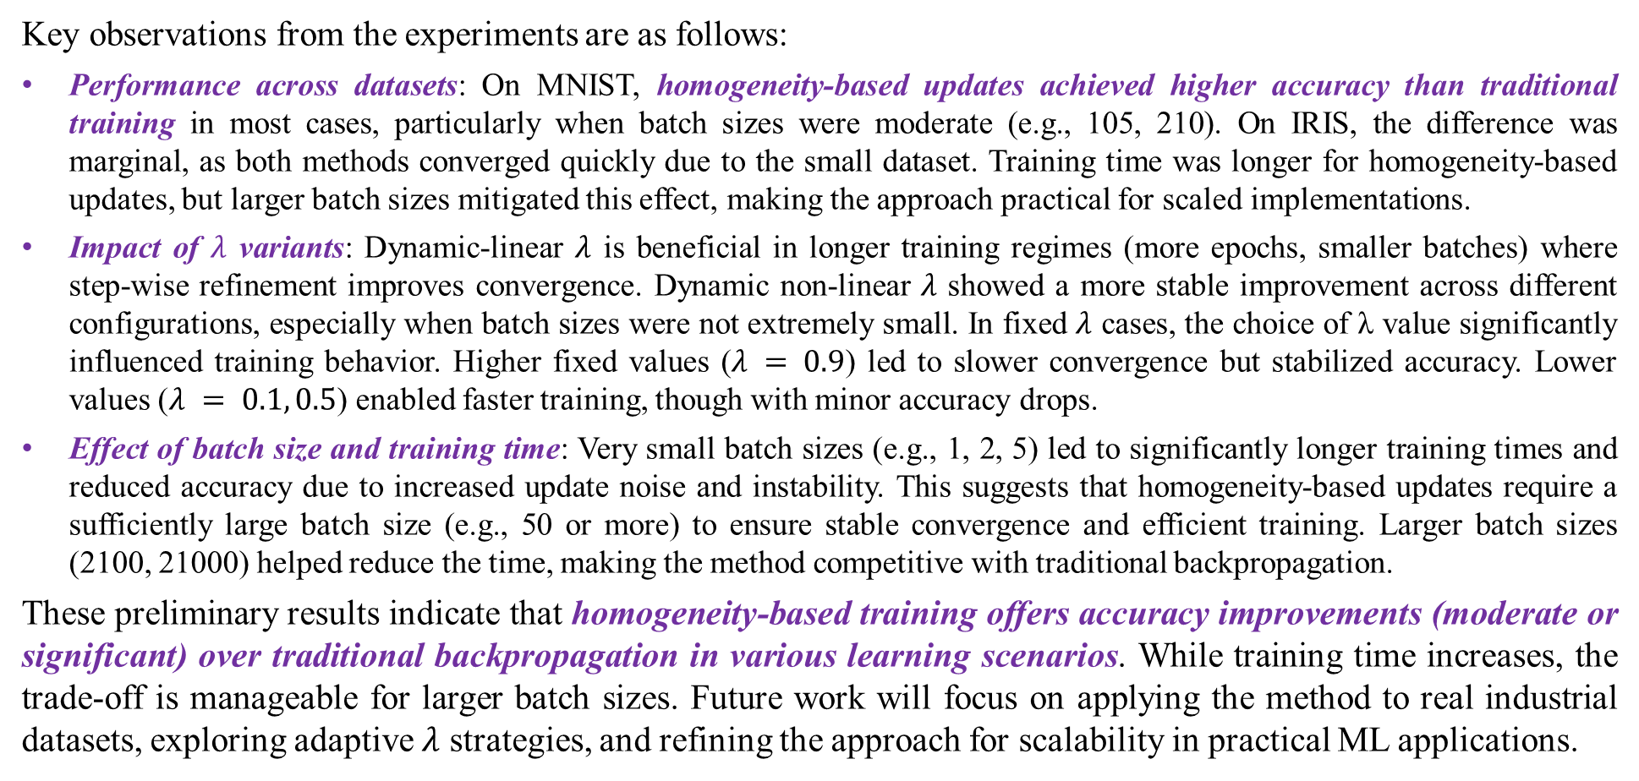
General summary of experimental results:
Key observations from the experiments are as follows:
Performance across datasets: On MNIST, homogeneity-based updates achieved higher accuracy than traditional training in most cases, particularly when batch sizes were moderate (e.g., 105, 210). On IRIS, the difference was marginal, as both methods converged quickly due to the small dataset. Training time was longer for homogeneity-based updates, but larger batch sizes mitigated this effect, making the approach practical for scaled implementations.
Impact of $λ$ variants: Dynamic-linear $λ$ is beneficial in longer training regimes (more epochs, smaller batches) where step-wise refinement improves convergence. Dynamic non-linear $λ$ showed a more stable improvement across different configurations, especially when batch sizes were not extremely small. In fixed $λ$ cases, the choice of λ value significantly influenced training behavior. Higher fixed values ($λ = 0.9$) led to slower convergence but stabilized accuracy. Lower values ($λ = 0.1, 0.5$) enabled faster training, though with minor accuracy drops.
Effect of batch size and training time: Very small batch sizes (e.g., 1, 2, 5) led to significantly longer training times and reduced accuracy due to increased update noise and instability. This suggests that homogeneity-based updates require a sufficiently large batch size (e.g., 50 or more) to ensure stable convergence and efficient training. Larger batch sizes (2100, 21000) helped reduce the time, making the method competitive with traditional backpropagation.
These preliminary results indicate that homogeneity-based training offers accuracy improvements (moderate or significant) over traditional backpropagation in various learning scenarios. While training time increases, the trade-off is manageable for larger batch sizes. Future work will focus on applying the method to real industrial datasets, exploring adaptive $λ$ strategies, and refining the approach for scalability in practical ML applications.

Slide 18



Samples of related work:
Entropy-regularized optimization (e.g., Soft Actor-Critic) is widely used in reinforcement and supervised learning to promote exploration and prevent premature convergence; it incorporates entropy into the loss function, ensuring that the model maintains a diverse set of possible outputs rather than converging quickly to a suboptimal solution.
Simulated annealing is a classical optimization technique that introduces stochastic perturbations to escape local minima and improve global search efficiency. Inspired by the annealing process in metallurgy, the technique probabilistically accepts worse solutions early in optimization, gradually reducing randomness as the temperature parameter decreases.
Momentum-based and adaptive gradient methods, such as Momentum SGD, RMSProp, and Adam, enhance optimization by smoothing gradient updates and adapting learning rates based on past gradients. These techniques indirectly encourage exploration by preventing erratic updates and allowing for more stable convergence, helping the model escape sharp or suboptimal minima.
Adversarial training enhances model robustness and generalization by introducing perturbations in the input space that challenge the model during training. Methods like the Fast Gradient Sign Method, Projected Gradient Descent, and TRADES create adversarial examples that force the model to learn more stable and generalizable representations.
Trust-region methods are widely used to balance exploration and exploitation by constraining parameter updates within a dynamically adjusted neighborhood. Classical methods like Trust-Region Newton Methods and Trust-Region Conjugate Gradient define a trust region around the current solution and restrict updates to prevent excessive changes that could destabilize convergence.
Meta-learning, or “learning to learn”, aims to optimize models such that they can quickly adapt to new tasks with minimal data. Prominent methods like Model-Agnostic Meta-Learning and Reptile learn parameter initializations that facilitate rapid adaptation across tasks. These approaches implicitly explore the parameter space by searching for representations that generalize well across different learning scenarios.
Stochastic Gradient Langevin Dynamics extends stochastic gradient descent by adding Gaussian noise to gradient updates. This prevents convergence to sharp minima, encouraging exploration of the parameter space and improving generalization.
Our homogeneity-based learning framework shares conceptual similarities with described methods, especially with trust-region methods, which regulate parameter updates, and with entropy-regularized optimization, which promotes exploration. However, it extends beyond these approaches by introducing a recursive homogeneity metric that dynamically guides exploration in the parameter space. Unlike stochastic noise injection or fixed step-size constraints, our method ensures structured and interpretable adaptation based on the network’s internal state, offering a fresh perspective on balancing exploration and exploitation and providing a clear metric directly tied to optimization dynamics and a systematic exploration mechanism that moves beyond probabilistic perturbations.

Slide 19

Potential Applications in Smart Manufacturing
The homogeneity-based learning framework introduces a structured way to balance exploration and exploitation, making it particularly suitable for Industry 4.0 and Smart Manufacturing applications, where adaptability, robustness, and real-time decision-making are critical. In dynamic industrial environments, NNs must operate under changing conditions, manage uncertainties, and optimize processes efficiently. Below, we outline few key use cases where our approach could enhance maintenance, process optimization, quality control, and autonomous decision-making.
Predictive maintenance and anomaly detection: It relies on AI models to anticipate equipment failures before they occur. Traditional models may overfit to normal operating conditions, leading to poor generalization when detecting novel faults. Our framework introduces structured exploration, preventing excessive reliance on past patterns and enhancing sensitivity to emerging anomalies.
Process optimization in smart factories: AI dynamically adjusts production parameters for resource efficiency. Traditional methods may converge to locally optimal settings, missing better configurations. Homogeneity-based learning prevents from settling into suboptimal parameters, allowing continuous fine-tuning as external factors change.
Quality control and defect detection: Automated visual inspection systems use deep learning to identify defects in manufactured products. Standard training may lead to overfitting to known defect patterns. Our approach enhances the model’s ability to discover previously unseen irregularities by maintaining controlled variability during training.
Autonomous industrial agents and robotics: Autonomous robots and agents in manufacturing make decisions under uncertainty adapting to dynamic environments. Traditional models often lack the flexibility to adapt to new operational constraints without retraining. Our framework enables intrinsic adaptation, allowing AI systems to evolve incrementally.
Resilience to adversarial attacks and cyber-physical security: Adversarial robustness is crucial for ensuring secure operations. Standard NNs are vulnerable to malicious perturbations, which exploit learned weaknesses. Our approach, by promoting diverse parameter exploration and smoother decision boundaries, makes models more resistant to such attacks.
Industry 5.0 envisions a human-centric, AI-augmented industrial landscape, where AI systems work alongside human operators to enhance efficiency, safety, and adaptability. Our framework aligns with this vision by ensuring NNs remain flexible, transparent, and interpretable in real-world applications. Unlike traditional deep learning models, which require periodic retraining to accommodate new conditions, homogeneity-based learning enables continuous adaptation without full retraining, reducing downtime and computational costs. By integrating this approach into real-time decision-making systems, predictive maintenance solutions, autonomous robotics, and cyber-physical security frameworks, manufacturers can enhance AI reliability, reduce operational risks, and improve overall efficiency.

Slide 20
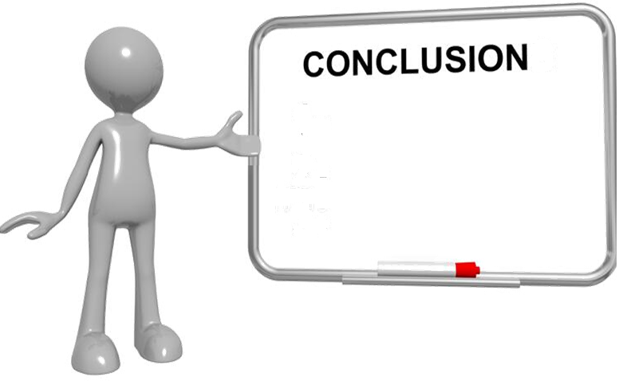

1
The increasing complexity of industrial AI models demands robust, well-optimized NNs capable of handling high-dimensional data and dynamic human factors. Traditional NN training, while effective, often suffers from homogeneity bias—an undesirable tendency toward locally homogeneous weight updates that can lead to suboptimal convergence. We introduced a homogeneity-based learning approach that quantifies and minimizes this bias by incorporating controlled variability during training.

Slide 21
2
Our experiments, conducted on some public datasets, explored the impact of different homogeneity refinement strategies under various training conditions. Results demonstrated that dynamic, non-linear refinement schemes effectively balance exploration and exploitation, improving network generalization while mitigating premature convergence. Importantly, our findings highlight the trade-offs between batch size, homogeneity reduction, and training stability, emphasizing the need for adaptive mechanisms to regulate variability.
.

Slide 22

3
Our preliminary results provide a promising foundation for further research. Future work will focus on validating the approach with real industrial datasets to assess its practical applicability in smart manufacturing and other AI-driven industries. Additionally, extending the method to more complex architectures such as Convolutional NNs, Recurrent NNs, and Generative Adversarial Networks will be crucial for broader applicability.

Slide 23
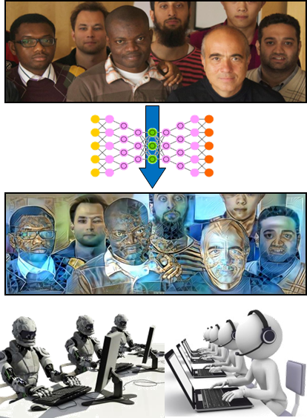
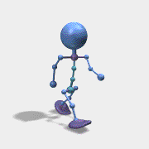

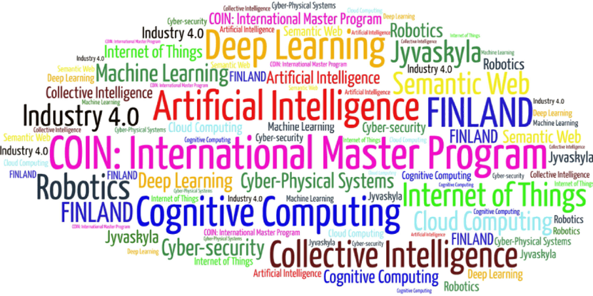
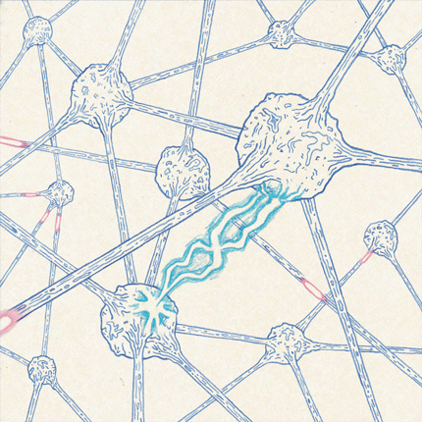
Come to study at our International Master Program
AI: Artificial Intelligence
(former Cognitive Computing and Collective Intelligence) …
… the first university program for collective intelligence, where humans learn together with their digital clones and autonomous digital assistants …
http://www.jyu.fi/ai
AI

Slide 24

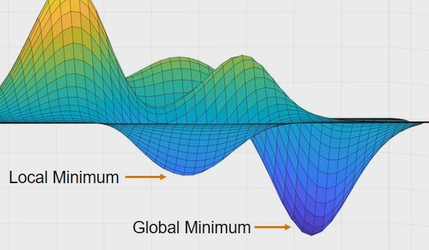
Link to the presentation: https://ai.it.jyu.fi/ISM-2025-Variability.pptx
Contact: vagan.terziyan@jyu.fi

Slide 25
7th International Conference on Industry of the Future and Smart Manufacturing – ISM 2025
University of Malta - Malta | 12-14 November 2025
Thank you!
“Beyond Backpropagation: Smarter Neural Networks for Smart Manufacturing”
Vagan Terziyan ª, Oleksandra Vitko ^{b}, Oleksandr Terziyan ^{b}
ª Faculty of Information Technology, University of Jyväskylä, Jyväskylä, Finland
^{b} Department of Artificial Intelligence, Kharkiv National University of Radio Electronics, Kharkiv, Ukraine
Contacts
vagan.terziyan@jyu.fi
Link to complete slide-set:
https://ai.it.jyu.fi/ISM-2025-Variability.pptx
https://www.jyu.fi/en/
https://nure.ua/en/

