Slide 1
Bridging human and machine learning for the needs of collective intelligence development
THE INTERNATIONAL CONFERENCE ON INDUSTRY 4.0 AND SMART MANUFACTURING
Mariia Gavriushenko
Notes:
Good afternoon ladies and gentleman, my name is doctor Mariia Gavriushenko and I'm representing our research group from the northern end of this continent - Finland, a town called Jyväskylä. Today I'll be talking about the need of bridging the gap between human and machine learning and current state of our research in this field.

Slide 2
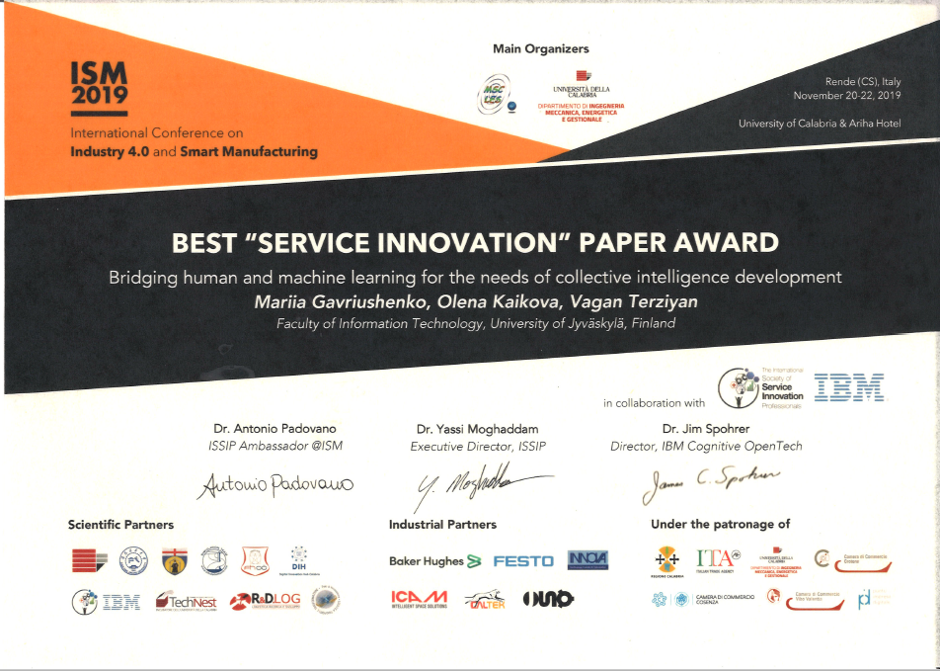

Slide 3
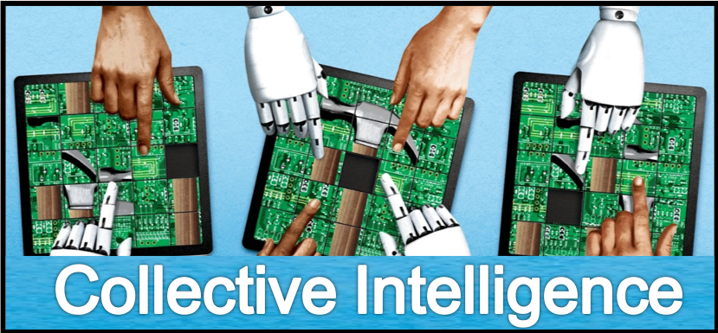
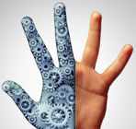
Artificial and human intelligence enhance and complement each other
They are stronger together as a team of Collective Intelligence
Both require training for personal development and high performance
Approaches to training (human vs. machine learning) are traditionally very different
Notes:
There are no doubts that artificial and human intelligence enhance and complement each other. They are stronger together as a team of Collective (or Collaborative) Intelligence. Both require training for personal development and high performance. However, the approaches to training (meaning human vs. (versus) machine learning) are traditionally very different.

Slide 4
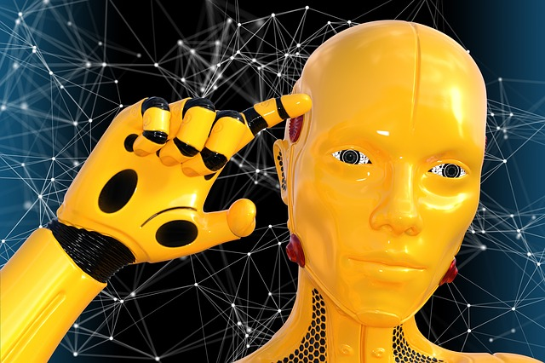
Current major AI need: training
Humans get education at schools, universities, etc.
AI gets education via deep learning, reinforcement learning, etc.
AI learning: dynamic, evolutionary process, similar to human education, but with new challenges and features.
It facilitates comprehensive acquisition of different skills at all the major cognitive levels, leveraging on collaboration in creative, dynamically changing ecosystems, similar to those built around universities.
Notes:
Training is the major need of the Artificial Intelligence, which humans can provide at the current stage of its evolution. In the human world, this need is addressed by education. Schools and universities serve as centers for intellectual capácity building, verified information sharing and exchange.
Likewise, a modern AI system must be well-trained. We argue that learning for a machine is a dynamic, evolutionary process, very similar to a traditional higher education, however, with new challenges and features.
It facilitates comprehensive acquisition of different skills at all the major cognitive levels, leveraging on collaboration in creative, dynamically changing ecosystems, similar to those built around universities.

Slide 5
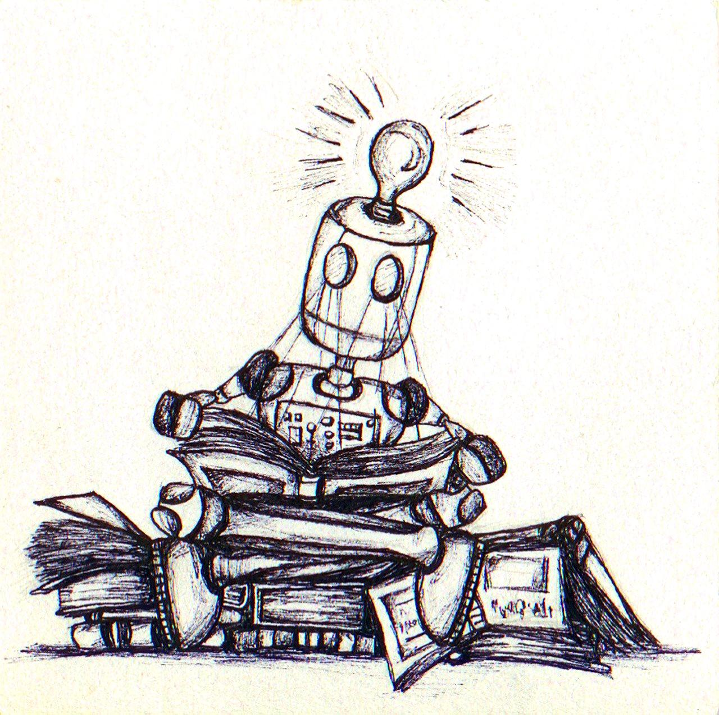
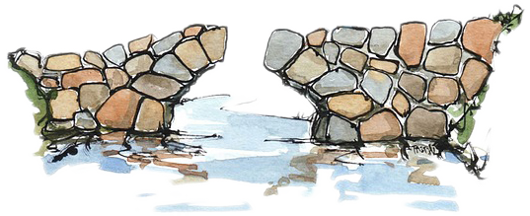
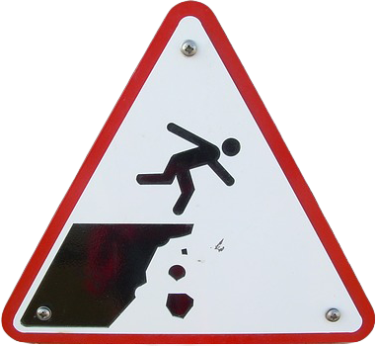
The Need
Notes:
By this article we want to point out the need for bridging the gap between the human and machine learning, so that some approaches used in machine learning will be useful for humans and vice-versa, some knowledge from human pedagogy can be useful also for training the artificial intelligence.

Slide 6
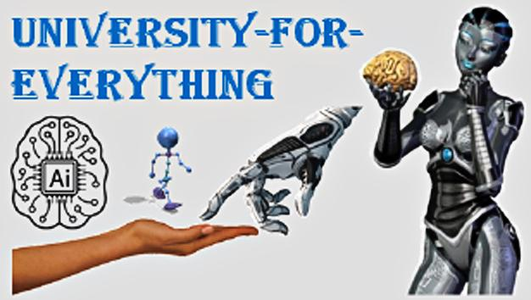
University for Everything a.k.a. “Deep university”
Our concept which can be launched as creative, evolving and collaborative training environment for AI and hybrid (Human + AI) cognitive systems.
Will provide its “students” with information resources and training methods for increasing self-awareness and autonomy by deep-learning-driven self-development of capabilities to be curious, ask questions intelligently and creatively, find answers and make decisions.
Most powerful weapon in IT business today: alliance between AI (analytical skills) and Human Intellect of great leaders (imaginative skills).
Together they make Collective Intelligence – major business model of the future.
Notes:
Recently we introduced a concept of the University for Everything or “deep university”, which can be launched as a creative, evolving and collaborative training environment. Students of such university would be both AI and hybrid (meaning Human + AI that is Collective Intelligence) cognitive systems.
Such university will provide a student with the information resources and training methods for increasing self-awareness and autonomy by deep-learning-driven self-development of capabilities to be curious, to ask questions, formulate queries intelligently and creatively, find answers and make decisions.
The most powerful weapon in the IT business today is the alliance between the AI, or analytical skills of self-learning machines, and the imaginative Human Intellect of great leaders. Together they make the Collective Intelligence, which is the major business model of the future.

Slide 7
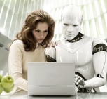
Collective Intelligence
Hybrid of human intelligence collaborating with several types of personal digital assistants:
intelligent agents
advisors
clones
twins
etc.
Notes:
We consider Collective Intelligence as a hybrid of human intelligence collaborating with several types of personal digital assistants like intelligent agents, advisors, clones, twins, etc.

Slide 8
Collective Intelligence: Roles
Notes:
So far we studied six different roles, which someone or something can play within a collective intelligence team. These roles include: (a) a human with own capabilities; (b) smart digital proxy between a human and available-as-a-service external capabilities; (c) smart and self-evolving digital capability providers; (d) cognitive agent-driven clones of a human; (e) agent as a personalized digital agent-driven immune system; (f) agent with complementary intelligence.

Slide 9
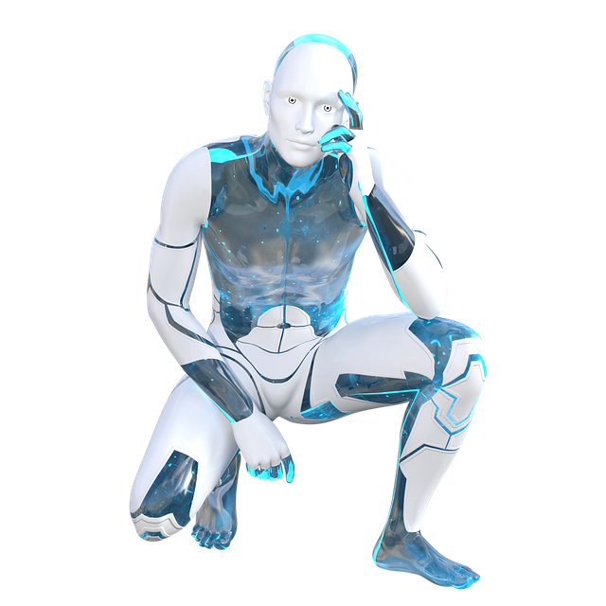
Digital clone
Concept introduced in 2003
Mostly used in production equipment maintenance and optimization, rather than product itself and its lifecycle after production.
Widely applied in cyber-physical integration on the way to smart manufacturing.
Idea of making digital twins of a manufacturing process enhanced with AI technologies aimed at integrating the digital twin of the product itself and a twin of the product’s development process.
We focus on creating a digital twin of a human being rather than product or equipment.
Notes:
Speaking of digital clones. The concept of Digital Twins or Clones was first introduced in over 15 years back in 2003.
It appears that currently digital clones are mostly utilized in terms of production equipment maintenance and optimization, rather than product itself and its lifecycle after production.
Digital twins are widely applied in cyber-physical integration on the way to smart manufacturing.
Such application of digital twins would help to shift the current 3.0 digitized factory to 4.0 smart factory.
A group of people from Brazilian and Germany's universities joined efforts to create a smart DT of a manufacturing process enhanced with AI technologies aimed at integrating the digital twin of the product itself and a twin of the product’s development process.
Here we focus on creating a digital twin of a human being rather than product or equipment.

Slide 10
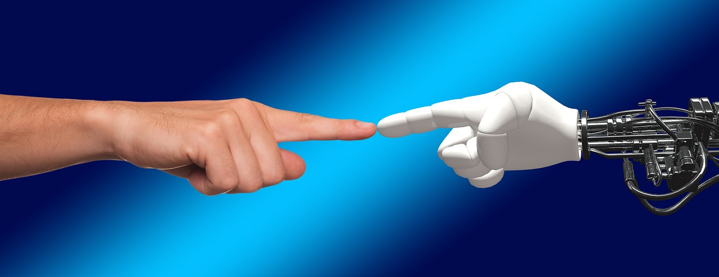
Training material order
SizeOrder matters!
How to prove?
Studying ontology- and deep-learning-driven metrics capable of ordering samples
Assessing results of training deep neural networks and human groups while altering training order
Using temporal interval semantics to specify uncertain temporal sequences of training events
Simulating collective intelligence groups by combining neural networks with autonomous “clones” of particular humans according to our “patented intelligence” (PI-Mind) technology
Using generator network for prototype ordering and simulating process of how a learner adapts to most problematic order of training samples.
Notes:
As I've already mentioned, our generic goal is to bridge the gap between human and machine learning for their mutual benefits and coevolution.
We aim to prove both theoretically and experimentally the hypothesis that the order of training material matters both for human and AI learners in a similar way.
To do that, we are studying a variety [və-ˈrī-ə-tē] of ontology-driven and deep-learning-driven metrics capable of ranking samples as well as groups of samples for learning towards optimal efficiency of the training process.
Furthermore, we are making synchronous tests by training deep neural networks (which are ensembles with different configuration and pre-training) and human groups and assessing the performance of training depending on the order of the inputs.
We have started using temporal interval semantics to specify uncertain temporal sequences of training events; simulating the collective intelligence groups by combining the neural networks with the autonomous “clones” of the particular humans according to our “patented intelligence” (or how we call it PI-Mind) technology; using the generator network for the prototype ordering and simulating the process of how a learner (that is discriminator) adapts to the most problematic order of the training samples.

Slide 11
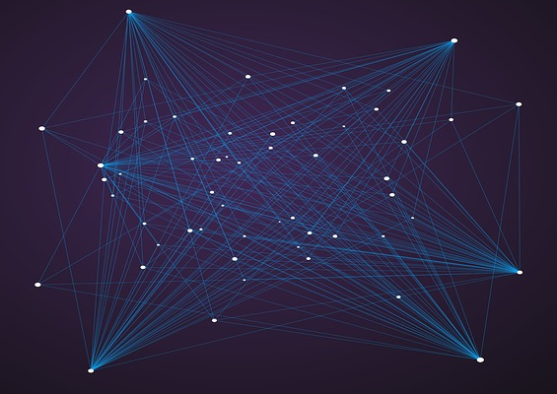
More steps towards optimal training process
Experimenting with the Adversarial Learning settings (nowadays popular deep learning algorithm)
Notes:
In addition to previously mentioned actions, we are going to perform similar experiments with the Adversarial Learning settings.
Such learning in general have recently become a popular type of deep learning algorithms. It has achieved great success in producing realistically looking images and in making predictions. Unlike the discriminative models, where the high-dimensional input data is usually mapped to a class label, the adversarial networks offer a different approach where the generative model is pitted against the discriminative one

Slide 12
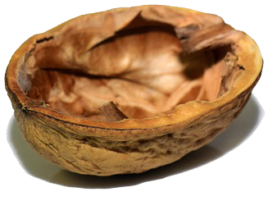
Adversarial learning in a nutshell
Adversarial method works as a system of two neural networks:
“generator” produces fake prototypes of intended class
“discriminator” tries to uncover fake by evaluating how well prototype fits the distribution of real prototypes of given class.
During training process, both networks are co-evolving up to perfectness in performing their conflicting objectives.
Generator
Fake prototype
Real
prototype
Discriminator
Real prototype
Fake
prototype
Notes:
Let me explain what adversarial learning is.
The adversarial method works as a system of two neural networks, where one of them, called a generator, produces fake prototypes of the intended class (for example, generating a human portrait) and the other one, called the discriminator, tries to uncover the fake by evaluating how well the prototype fits the distribution of real prototypes of this class.
During the training process, both networks are co-evolving up to the perfectness in performing their conflicting objectives.

Slide 13
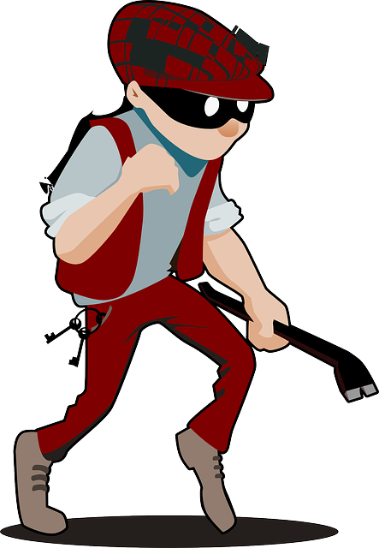
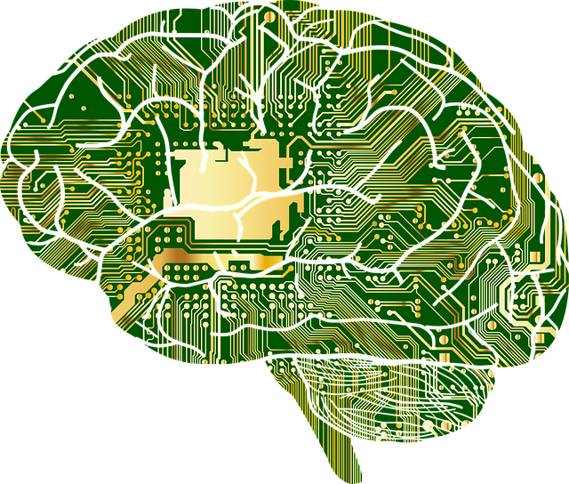
Threats for the AI
Attacks on training process:
Data poisoning
Data evasion
Next steps:
measure and learn estimating negative impact of data poisoning when target is not data itself but how it is selected and ordered
Notes:
One important issue to be addressed is how to protect the training process from data poisoning and data evasion attacks, which are the major threats for the AI today. We are going to measure and learn to estimate the negative impact of the data poisoning when the target is not the data itself but rather the way it is selected and ordered.

Slide 14
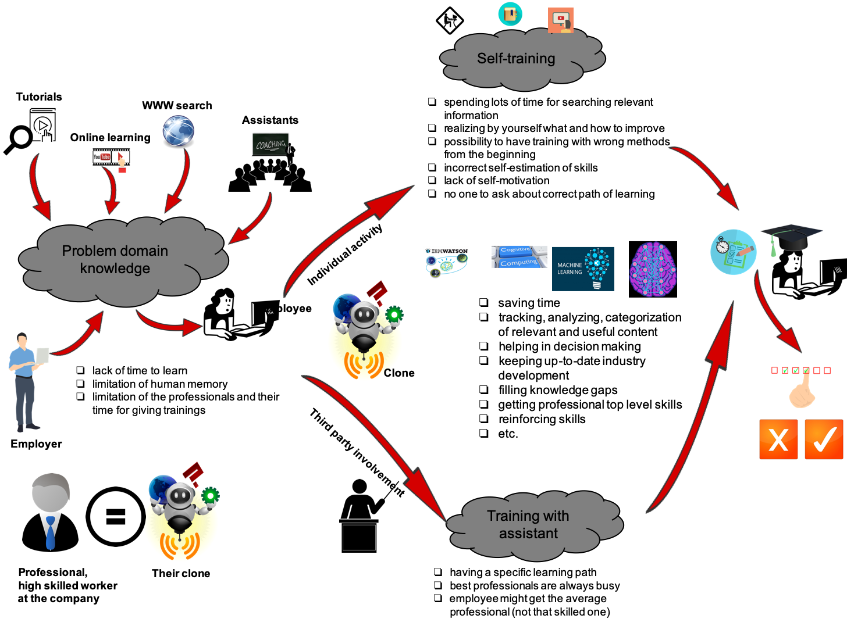
Digital Learning Assistant
Notes:
Technologies are developing very rapidly nowadays. The companies should be aware that in order to stay in the lead of the market, they should learn on the fly, use modern technologies and innovations which are useful for the business processes. Taking that into account, people inside the companies need training and retraining. We live in the age where employees always have to be on top of their skills.
As a particular example of a trained AI-student we have developed the concept of a digital learning assistant. It begins its lifecycle as a digital clone of a given human and develops on its own the required cognitive skill, that the human desires but does not possess. On the screen you can see an example use-case for such digital assistant.

Slide 15
Summary
Better knowledge of human teaching methods
AI
new optimal models for education process
development of learning process and intelligence of human and AI
Development of the AI
Fast development of humans
Notes:
To sum up, having better knowledge about suitable and relevant methods for teaching humans in sense of reducing the time of learning and better knowledge about human ability to learn, AI could build new optimal models for the education process. This will lead to the development of the learning process and intelligence of both human and the AI.
We believe that development of the AI will also lead in this case to the fast development of humans as a synchronous process.

Slide 16
Questions?
Thank you for your attention!
For all written questions and collaboration:
prof. Vagan Terziyan
vagan.terziyan@jyu.fi
Notes:
Thank you very much for your attention, if you have any questions, I'd be happy to answer now.
If you have any further or more detailed questions, want to know more or collaborate with us, please contact professor Vagan Terziyan at the email you can see behind (или где будет стоять экран относительно тебя) me. Thank you.

