Slide 1


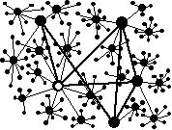

Knowledge Extraction from Web:
“Web-based knowledge mining methods” (“Методи видобування знань із веб-простору”)
‒ examples of knowledge graph construction
Vagan Terziyan
Kharkiv National University of Radioelectronics // University of Jyväskylä

Slide 2
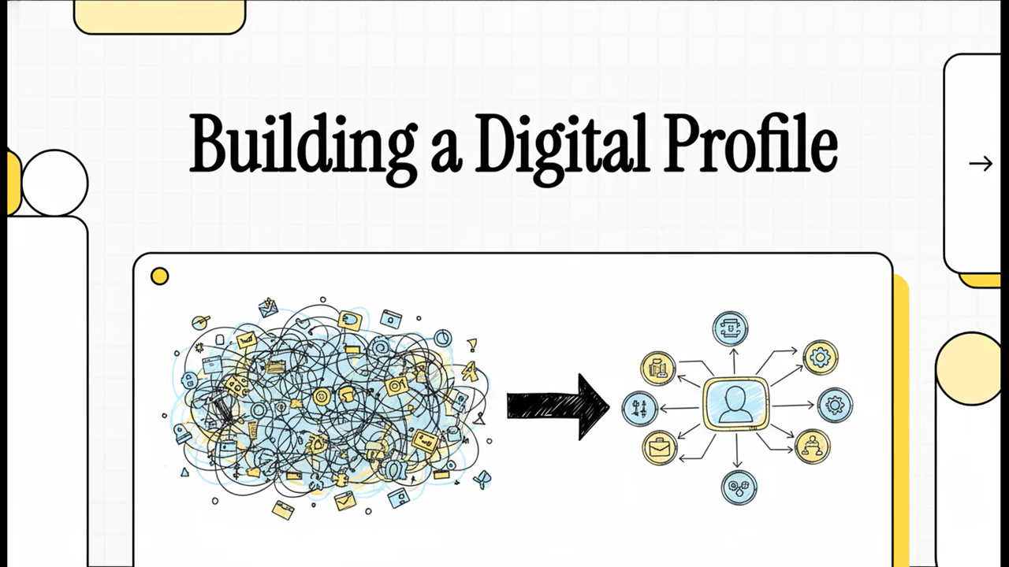
Just for fun: Let us first watch a short (AI-designed) video about this presentation

Slide 3
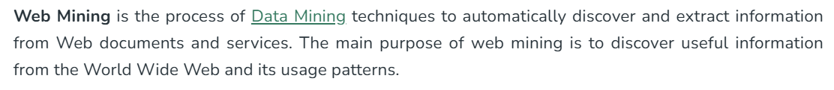
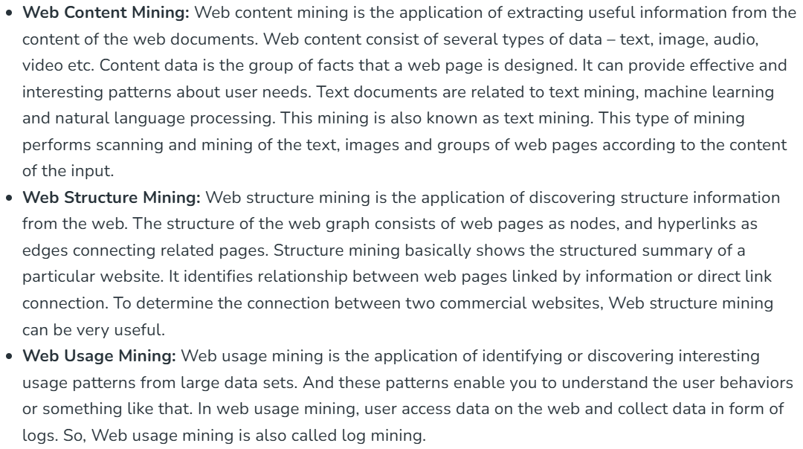
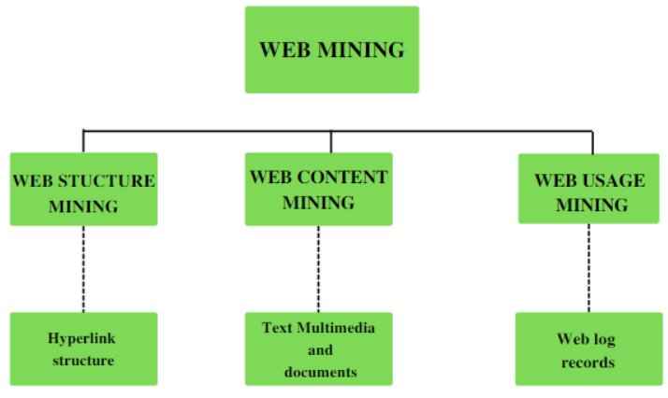
Our objective is NOT Web Mining!

Slide 4
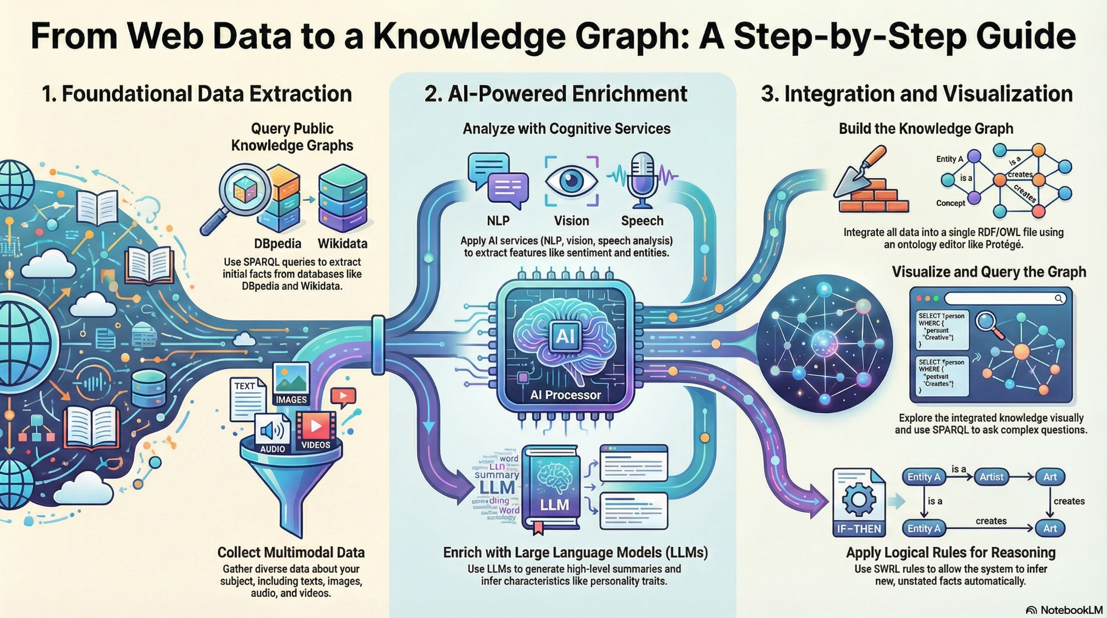
What is this course actually about?

Slide 5


Our objective is to learn how to extract structured information about target object (or a person) as a knowledge graph

Slide 6
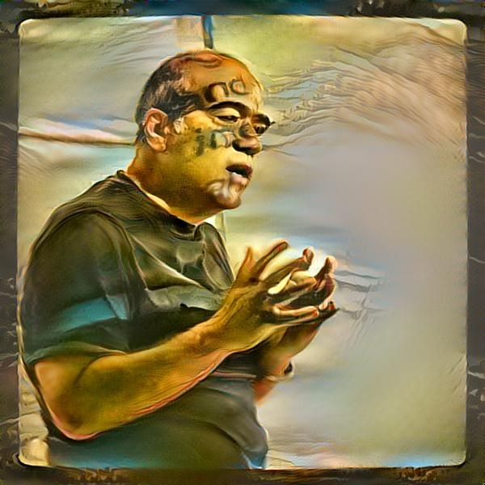

Lecturer
Vagan Terziyan
Professor: Artificial Intelligence (AI) (AI Department, Kharkiv National University of Radioelectronics, UA);
Professor: AI and Distributed Systems (Faculty of Information Technology, University of Jyväskylä, FI);
Head of Collective Intelligence research group;
Head of Master Programs:
IDSS: “Intelligent Decision-Support Systems”;
WISE: “Web Intelligence and Service Engineering”;
COIN: “Cognitive Computing and Collective Intelligence”;
AI: “Artificial Intelligence”;
Background: Applied Mathematics; Artificial Intelligence (AI) // (45 years of experience in AI);
Interest: Artificial Intelligence, Machine Learning, Cybersecurity, Industry 4.0 (5.0) …;
Click to see best scientific achievements represented by short videos;
Click to see academic genealogy
Vagan Terziyan

Slide 7
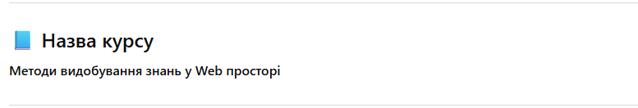
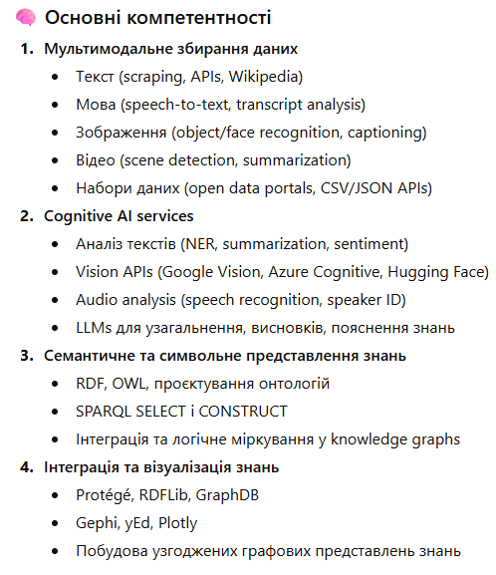
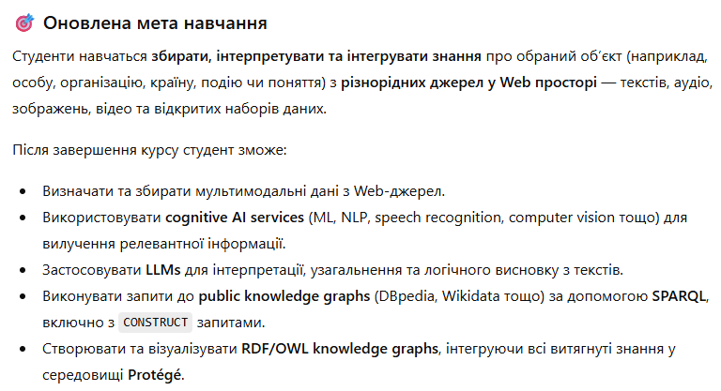
Basics about this course (UKR)

Slide 8
Course Assignment (page 1):
Web-Based Knowledge Extraction and Knowledge Graph Construction Assignment Objective (EN)
The objective of this assignment is to demonstrate the ability to collect, interpret, and integrate knowledge about a selected public individual using heterogeneous Web data sources, AI-based cognitive services, public knowledge graphs, and semantic web technologies.
Task Description (EN)
Each student shall select one well-known public person (e.g., a politician, scientist, entrepreneur, artist) as the target object of study.
The assignment consists of the following mandatory stages:
Knowledge Acquisition from Public Knowledge Graphs
Use SPARQL queries over DBpedia to:
  Identify the target person as a resource.
  Extract factual information using SELECT queries.
  Construct an initial ontology and knowledge graph using SPARQL CONSTRUCT queries (find examples in this presentation).
The resulting RDF graph must include both object properties (e.g., affiliations, positions, relations, etc.) and datatype properties (e.g., dates, numerical attributes, textual descriptions).

Slide 9
Course Assignment (page 2):
Web-Based Knowledge Extraction and Knowledge Graph Construction Assignment Objective (EN)
2. LLM-Based Knowledge Enrichment
Use Large Language Models (LLMs) to obtain additional interpreted knowledge about the target person.
Typical queries include (but are not limited to):
  Personality traits or communication style.
  Thematic focus of public speeches or writings.
  High-level summaries or inferred characteristics.
Extract structured attributes from LLM responses and represent them explicitly in RDF/OWL.
3. Multimodal Data Processing via Cognitive Services
Collect multimodal data related to the target person, such as:
  Texts (articles, speeches, interviews),
  Audio (speeches, interviews),
  Images (photos, public appearances),
  Videos (talks, public events).
Apply appropriate cognitive AI services (e.g., NLP, speech-to-text, sentiment analysis, image recognition, video analysis) to extract relevant features and signals.
Encode extracted results as datatype or object properties in the knowledge graph.

Slide 10
Course Assignment (page 3):
Web-Based Knowledge Extraction and Knowledge Graph Construction Assignment Objective (EN)
4. Ontology enhancement and rule design
Extend the ontology by:
  Defining new classes and properties where necessary.
  Designing logical rules (SWRL) or constraints (e.g., OWL axioms, class restrictions).
  Optionally deriving rules from external datasets or analytical observations.
Ensure semantic consistency and reuse of existing vocabularies when appropriate (e.g., DBpedia Ontology).
5. Knowledge graph Integration and visualization
Integrate all extracted and inferred knowledge into a single RDF/OWL file.
Load and visualize the complete ontology and knowledge graph in Protégé.
Verify correctness of classes, properties, individuals, and reasoning results.
Deliverable
A single .owl file containing:
  The ontology schema enhanced with rules.
  The complete knowledge graph describing the target person.
The file must be accessible via a public link (e.g., GitHub, institutional repository).
No written report is required beyond the ontology file itself.

Slide 11
Курсове завдання: (page 1):
Видобування знань з Web та побудова графів знань (UA)
Метою цього завдання є демонстрація здатності збирати, інтерпретувати та інтегрувати знання про обрану публічну особу з різнорідних Web-джерел із використанням AI-сервісів, публічних графів знань та семантичних технологій.
Опис завдання (UA)
Кожен студент повинен обрати одну відому публічну особу (наприклад, політика, науковця, підприємця, митця) як об’єкт дослідження.
Завдання складається з таких обов’язкових етапів:
1. Отримання знань з публічних графів знань
Використати SPARQL-запити до DBpedia (за бажанням також Wikidata) для:
  ідентифікації ресурсу, що відповідає обраній особі;
  вилучення фактів за допомогою SELECT-запитів;
  побудови початкової онтології та графа знань за допомогою SPARQL CONSTRUCT.
Отриманий RDF-граф повинен містити об’єктні властивості та дататипні властивості.

Slide 12
Курсове завдання: (page 2):
Видобування знань з Web та побудова графів знань (UA)
2. Збагачення знань за допомогою LLMs
Використати великі мовні моделі (LLMs) для отримання інтерпретованих знань про обрану особу.
  Типові запити включають:
  характеристики стилю мовлення або особистості;
  тематику публічних виступів чи текстів;
  узагальнення або логічні висновки.
Отримані результати мають бути формалізовані у вигляді RDF/OWL-властивостей.
3. Обробка мультимодальних даних через cognitive AI services
Зібрати мультимодальні дані про особу:
  тексти,
  аудіо,
  зображення,
  відео.
Застосувати відповідні cognitive AI-сервіси (NLP, розпізнавання мовлення, аналіз зображень і відео тощо).
Закодувати результати аналізу у графі знань.

Slide 13
Курсове завдання: (page 3):
Видобування знань з Web та побудова графів знань (UA)
4. Розширення онтології та проєктування правил
Розширити онтологію шляхом:
  введення нових класів і властивостей;
  проєктування логічних правил (SWRL) або обмежень (OWL-аксіоми);
  за можливості — автоматичного вилучення правил з даних.
Забезпечити семантичну узгодженість та повторне використання стандартних словників.
5. Інтеграція та візуалізація графа знань
Інтегрувати всі отримані знання в єдиний RDF/OWL-файл.
Відкрити та візуалізувати онтологію і граф знань у Protégé.
Перевірити коректність структури та логічних висновків.
Результат виконання (to be sent to the teacher for evaluation)
Один файл .owl, що містить:
  онтологію;
  повний граф знань про обрану публічну особу.
Файл має бути доступний за публічним посиланням.
Окремий письмовий звіт не вимагається.

Slide 14
Contents of this presentation
Introduction to knowledge graphs (semantic web, metadata, ontologies, semantic queries, rules)
SPARQL and DBPedia-driven ontology and knowledge graphs construction
Enhancing knowledge graphs by querying Large Language Models
Enhancing knowledge graphs by querying online AI (cognitive) services and by making useful ontology imports
Designing datasets for machine learning purposes using SPARQL and DBPedia to infer hidden information from the web
Explainable AI and automatic SWRL rules construction from the trained neural networks
Querying the designed knowledge graph

Slide 15
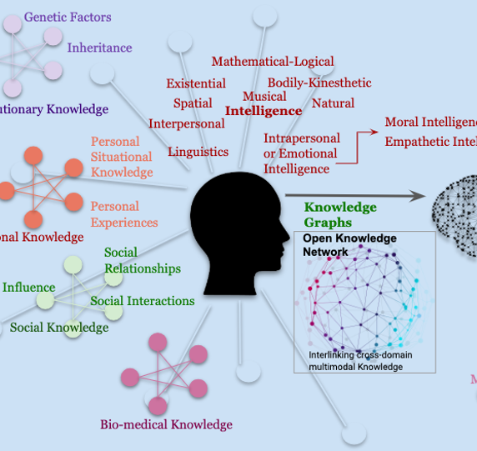

Brief introduction of knowledge graphs in the context of linked data, metadata, Semantic Web and ontologies

Slide 16
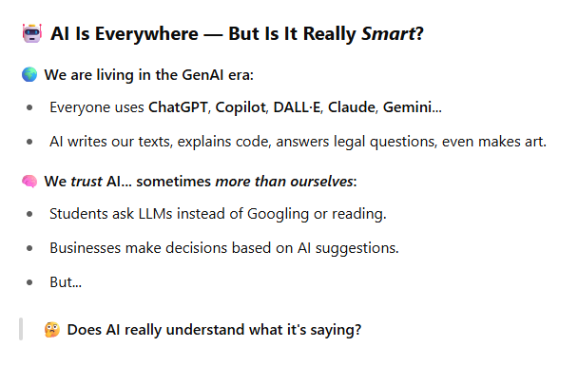
Why all these is important???

Slide 17
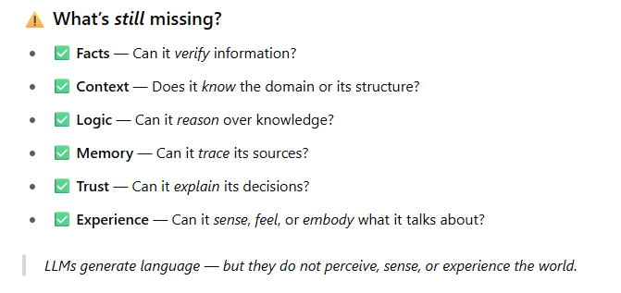
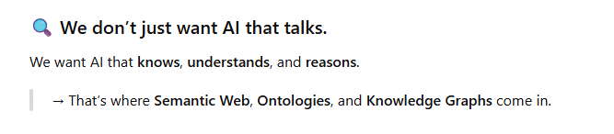
… Because! …

Slide 18






“We are happy with the large language models like ChatGPT! They seem to be very powerful!! We are sure that we can do everything by using them!!! Why the hell do we need all this complexity around Semantic Web, Ontologies, Linked Data, Knowledge Graphs, etc.?!!”
“Oh sure, let us just trust the statistical AI magic trick to handle all our data with zero logic, transparency, or guarantees — who needs structured knowledge or actual reasoning when we can just cross our fingers and hope the machine learned it all perfectly, right? Because obviously, we should be fine getting medical advice from a machine that guesses rather than one that integrates real knowledge.”

Slide 19

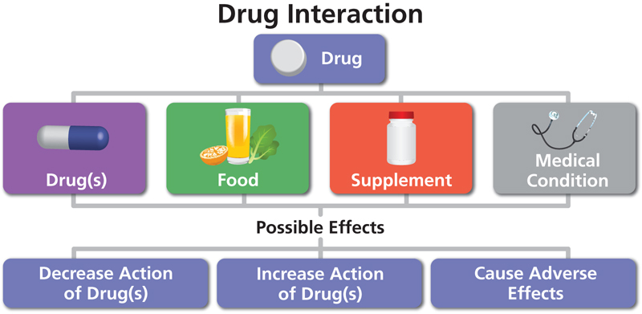
Consider scenario:
Clinical Drug Interaction Checking
Context: Imagine a medical application that helps doctors check for dangerous drug interactions when prescribing medications. The Semantic Web-based system uses a formal ontology (e.g., Drug Ontology, Medical Ontology) with specific rules and relationships about drug interactions, dosages, patient conditions, and known side effects. Another option for the doctors would be simply using some Large Language Model (LLM), for example ChatGPT, as an advisor.
Example Task:
A doctor inputs the following query:
“The patient is taking Warfarin and Ibuprofen. Are there any dangerous interactions?”

Slide 20

Query: “The patient is taking Warfarin and Ibuprofen. Are there any dangerous interactions?”
1. Semantic Web Approach
In this approach, we use ontologies that define drug properties and SWRL rules to infer interactions.
Ontologies: The system has an ontology with detailed information about drugs, such as their chemical properties, potential side effects, interactions, and contraindications.
Rules: Predefined SWRL rules govern drug interactions.
For example: Rule: “If DrugA has a blood-thinning effect and DrugB causes gastrointestinal bleeding, then their interaction leads to a dangerous condition.”
The system will:
Recognize that Warfarin is a blood thinner.
Recognize that Ibuprofen increases the risk of gastrointestinal bleeding.
Apply a formal rule in its ontology that defines a dangerous interaction when these two drugs are taken together.
Outcome:
The Semantic Web system provides a precise, deterministic answer (this result is guaranteed to be correct and consistent because it is based on explicitly defined medical knowledge encoded in the ontology and deterministic rules):
“Warfarin and Ibuprofen together increase the risk of serious gastrointestinal bleeding due to their interaction. This is a contraindicated combination.”

Slide 21
Query: “The patient is taking Warfarin and Ibuprofen. Are there any dangerous interactions?”
2. LLM (ChatGPT) approach
If the same question is posed to ChatGPT:
Prompt: “The patient is taking Warfarin and Ibuprofen. Are there any dangerous interactions?”
ChatGPT response:
ChatGPT will likely provide an answer based on its trained knowledge (since Warfarin and Ibuprofen are well-known). It may say:
“Yes, combining Warfarin, a blood thinner, with Ibuprofen can increase the risk of bleeding, especially gastrointestinal bleeding.”
Limitations:
Potential variability: The response might not be identical every time. ChatGPT could rephrase or add new information, but it may not provide the same consistent and exact response every time.
Probabilistic nature: ChatGPT’s answer is based on likelihood from its training data, not formal logic. It does not “know” in the deterministic sense that Warfarin and Ibuprofen are contraindicated. It produces an answer based on patterns it has learned.
No rule guarantee: The LLM may not apply explicit rules, especially if the question involves rare or obscure drugs or conditions. For new or less common interactions, it might fail to provide an accurate or sufficient response.

Slide 22
Query: “The patient is taking Warfarin and Ibuprofen. Are there any dangerous interactions?”
“Warfarin and Ibuprofen together increase the risk of serious gastrointestinal bleeding due to their interaction. This is a contraindicated combination.”
“Yes, combining Warfarin, a blood thinner, with Ibuprofen can increase the risk of bleeding, especially gastrointestinal bleeding.”
Why the Semantic Web performed better:
Deterministic output: The Semantic Web system will consistently give the same, accurate output every time, as it applies predefined medical rules and ontologies. This is critical in medical settings, where even slight variations can have serious consequences.
Complex reasoning: A Semantic Web system can handle complex drug interactions, even across multiple conditions, by chaining rules together and understanding hierarchies in the ontology. For example, it might recognize that the interaction is more dangerous for patients with a history of ulcers or liver disease, which ChatGPT might miss or not reason out.
Explainability and traceability: The Semantic Web system can explain exactly why Warfarin and Ibuprofen are a dangerous combination by tracing the applied rules and referencing the medical knowledge encoded in the ontology. ChatGPT cannot provide the same degree of transparent, rule-based reasoning.
Updates and real-time knowledge: The ontology can be updated in real-time with new drug interactions, as they become known. Semantic reasoners will automatically apply the new knowledge. ChatGPT’s training data is static and requires retraining to update, meaning it may not know about the latest drug interaction risks.
Conclusion:
In this example, the Semantic Web approach performs better due to its ability to:
Apply precise, deterministic rules for critical reasoning tasks.
Ensure consistency and reliability across different queries.
Provide explainable, traceable decisions based on formal ontologies.
While ChatGPT can give useful insights, especially for general queries, it cannot guarantee the same level of precision, safety, or formal reasoning in complex tasks like drug interaction checking.

Slide 23
Conclusion: Why Semantic Web based systems are still needed in the era of LLMs?
While LLMs like ChatGPT are powerful and flexible tools for processing and generating language, they do not replace the need for semantic systems in many critical applications. Semantic systems provide deterministic reasoning, transparency, consistency, compliance, and the ability to integrate and scale domain-specific knowledge in ways that LLMs currently cannot match. Even when an LLM is provided with explicit rules within a prompt, there are several reasons why semantic systems are still necessary:
Deterministic and consistent reasoning: Semantic systems provide guaranteed consistency and correctness in rule application, which is critical in many high-stakes domains.
Transparency and explainability: Semantic systems offer full transparency in their reasoning processes, which is essential for trust, auditing, and compliance.
Handling complexity: Semantic systems excel in applying complex, interconnected rules and performing multi-step reasoning, ensuring logical soundness.
Error handling: Semantic systems make it easier to diagnose, trace, and fix errors, providing a robust framework for maintaining accuracy over time.
Scalability and maintenance: Semantic systems allow for modular updates and maintenance of rules and knowledge, ensuring that the system evolves with changing knowledge without losing consistency.
Interoperability: Semantic systems are better suited for integrating and reasoning over structured data sources, making them essential for complex, multi-source AI systems.
The two approaches are not mutually exclusive; in fact, they can be complementary. LLMs can handle complex, unstructured queries and generate hypotheses, while semantic systems can validate, refine, and ensure that these hypotheses adhere to established rules and knowledge. In other words, semantic systems provide the precision and reliability that are often required in high-stakes environments, making them indispensable even in the era of advanced LLMs.

Slide 24


ChatGPT for Semantic Technologies
Semantic understanding: Transformers and large language models (like ChatGPT) excel at understanding and generating natural language text. They can extract and process semantic information from unstructured text, enabling them to derive meaning and context. This can greatly enhance the capabilities of semantic technologies by providing advanced natural language processing (NLP) capabilities.
Knowledge extraction: Transformers and large language models can be used to extract information and knowledge from vast amounts of text data. By applying techniques such as named entity recognition, relation extraction, and sentiment analysis, they can automatically extract structured data and populate knowledge graphs or ontologies. This can accelerate the process of building knowledge graphs and enriching semantic resources.
Entity linking: Transformers can assist in entity linking, which is the process of connecting mentions of entities in text to specific entities in knowledge graphs or linked data. By leveraging contextual information and embeddings, transformers can improve the accuracy and efficiency of entity linking algorithms, enhancing the semantic understanding of text.
Textual inference: Transformers can contribute to semantic technologies by providing powerful tools for textual inference. They can determine semantic relationships between text fragments, perform question-answering tasks, and support natural language understanding in various applications. This can be beneficial for ontology engineering, where reasoning and inference play a crucial role.
Pre-training and knowledge transfer: Pre-trained transformers and large language models can be utilized to bootstrap semantic technologies. By leveraging the knowledge and representations learned from vast amounts of text data, these models can be fine-tuned or used as feature extractors for downstream tasks such as semantic annotation, ontology alignment, or data integration.

Slide 25
Semantic Technologies for ChatGPT
Structured knowledge: Semantic technologies provide a structured and formal representation of knowledge through ontologies, knowledge graphs, and linked data. This structured knowledge can help enhance the understanding and reasoning capabilities of transformers, providing a solid foundation for more precise and accurate language understanding.
Data integration: Semantic technologies excel in integrating heterogeneous data from various sources by aligning schemas, linking entities, and resolving semantic inconsistencies. This integrated data can be used to train and fine-tune transformers, enabling them to learn from diverse and unified knowledge sources, leading to more comprehensive language models.
Domain-specific knowledge: Semantic technologies allow for the representation and incorporation of domain-specific knowledge into ontologies and knowledge graphs. This knowledge can be leveraged to enhance the performance of transformers in specific domains by providing domain-specific context and guiding the learning process.
Explainability and interpretability: Semantic technologies often provide transparent and interpretable representations of knowledge. This can be valuable for understanding the internal workings of transformers and large language models, which are typically regarded as black boxes. Semantic technologies can help bridge the gap between the opaque representations of language models and human-understandable knowledge.
SUMMARY: Transformers and large language models can leverage semantic technologies to enhance their understanding, knowledge extraction, and reasoning capabilities. Conversely, semantic technologies can benefit from the advanced natural language processing and learning capabilities of transformers, enabling them to handle unstructured text, improve inference, and integrate with large-scale language models. The combination of these approaches holds promise for advancing the field of AI-driven language understanding and knowledge representation.

Slide 26
What is more important for AI: Semantic Technologies or ChatGPT?
vs
Semantic technologies (in AI) focus on knowledge representation, data integration, semantic search, and knowledge graphs, enabling structured and meaningful understanding of data. Transformers-based large language models (in AI) excel at natural language understanding, language generation, contextual understanding, and leveraging pre-trained representations. Both play critical roles in AI, with semantic technologies providing a structured and semantic foundation for knowledge, and transformers-based models enabling advanced language processing and understanding. Integrating the two can enhance the overall capabilities of AI systems by combining structured knowledge with powerful language understanding and generation capabilities.

Slide 27
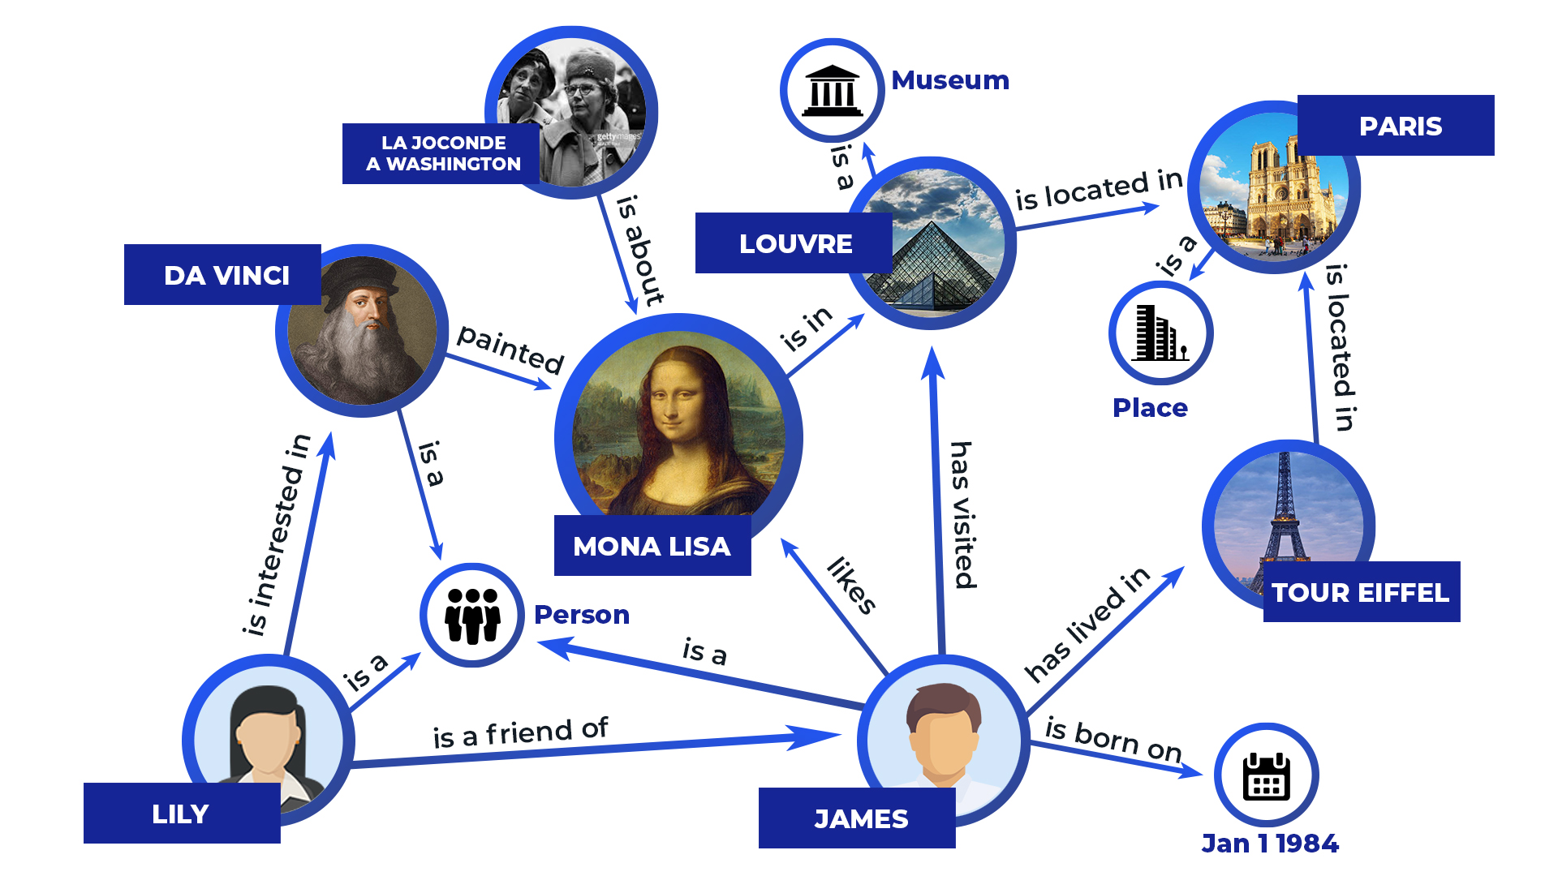
Beyond Semantic Web and Linked Data:
Knowledge Graphs
https://thetechbrook.com/inside-the-black-box-of-ai/

Slide 28
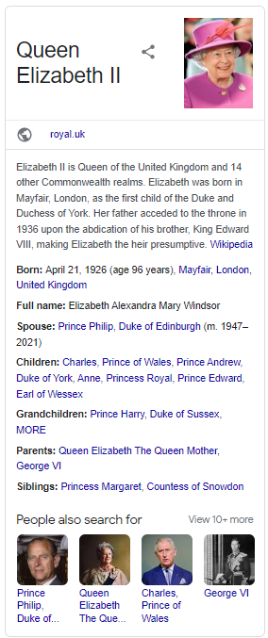
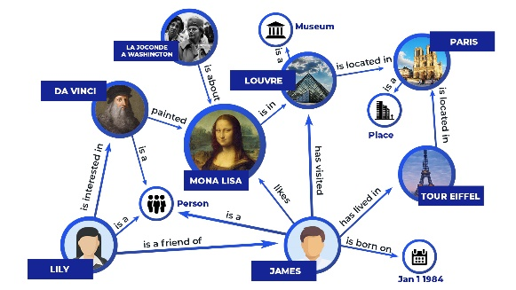
Beyond Semantic Web and Linked Data: Knowledge Graphs
Since the conception of computer science, the value in organizing information semantically has been looked at extensively. Organizing information semantically, by which we mean connecting things by what they “mean”, connections in data can be made much easier and more humanly readable. One way of doing this is a knowledge graph.
https://thetechbrook.com/inside-the-black-box-of-ai/
Knowledge graphs have been used since the beginning of AI. A knowledge graph refers to a graph like structure that connects real world “things” (such as places, people, events, objects, concepts) and illustrates the relationship between them. They’re used to store interlinked descriptions of concepts, for example that a cat and a dog are connected by the fact they are both considered “pets.”
Google uses this knowledge graph to generate the knowledge panels that appear in very common google search queries. For example, when searching “Queen Elizabeth” through the Google Search Engine, Google returns a list of web links most relevant to her. However, since 2012, Google also returns a small “knowledge panel” next to the links summarizing some of the key facts about her.

Slide 29
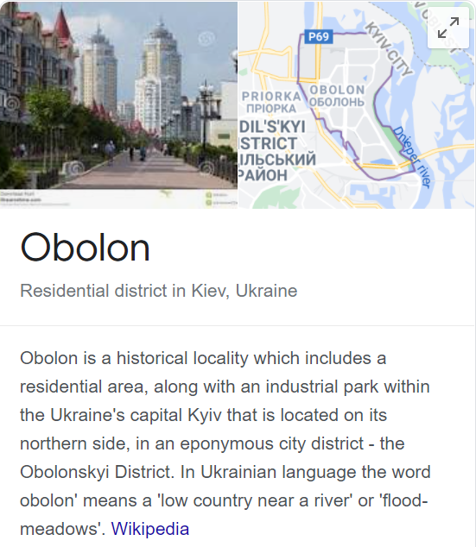
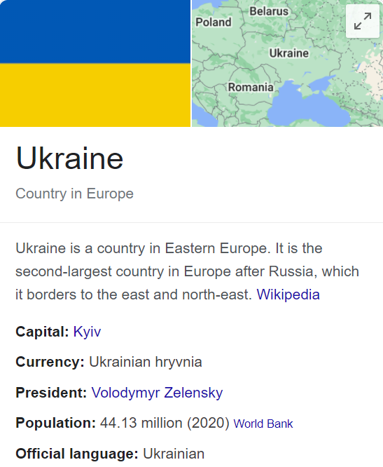
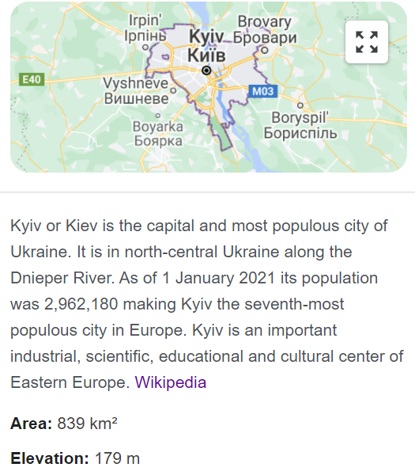
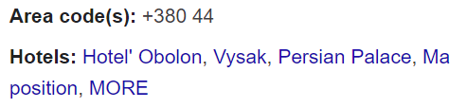
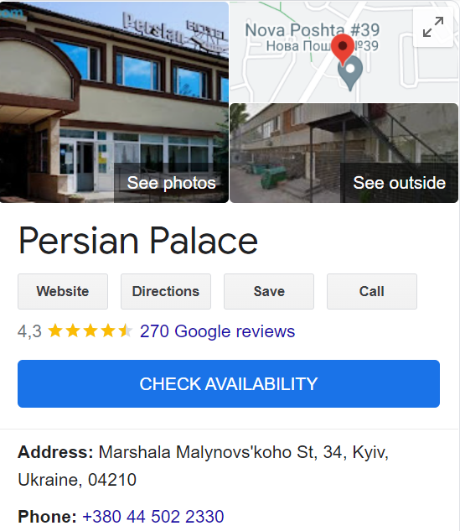
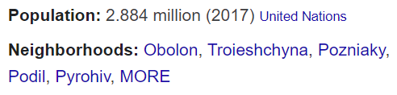
Beyond Semantic Web and Linked Data:
Knowledge Graphs
See also: EU Knowledge Graph
Google Knowledge Graph
hasCapital
Kyiv
hasNeighborhood
hasHotel
Read this: Noy, N., Gao, Y., Jain, A., Narayanan, A., Patterson, A., & Taylor, J. (2019). Industry-Scale Knowledge Graphs: Lessons and Challenges. Communications of the ACM, 62(8), 36-43.

Slide 30
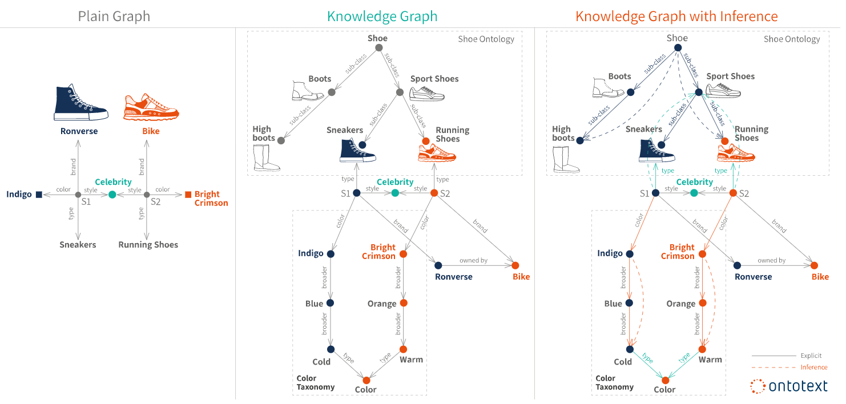
Knowledge graphs, represented in RDF, provide the best framework for data integration, unification, linking and reuse, because they combine:
Expressivity: The standards in the Semantic Web stack – RDF(S) and OWL – allow for a fluent representation of various types of data and content: data schema, taxonomies and vocabularies, all sorts of metadata, reference and master data. The RDF* extension makes it easy to model provenance and other structured metadata.
Performance: All the specifications have been thought out, and proven in practice, to allow for efficient management of graphs of billions of facts and properties.
Interoperability: There is a range of specifications for data serialization, access (SPARQL Protocol for end-points), management (SPARQL Graph Store) and federation. The use of globally unique identifiers facilitates data integration and publishing.
Standardization: All the above is standardized through the W3C community process, to make sure that the requirements of different actors are satisfied – all the way from logicians to enterprise data management professionals and system operations teams.
Knowledge graphs combine characteristics of several data management paradigms:
Database, because the data can be explored via structured queries;
Graph, because they can be analyzed as any other network data structure;
Knowledge base, because they bear formal semantics, which can be used to interpret the data and infer new facts.

Slide 31
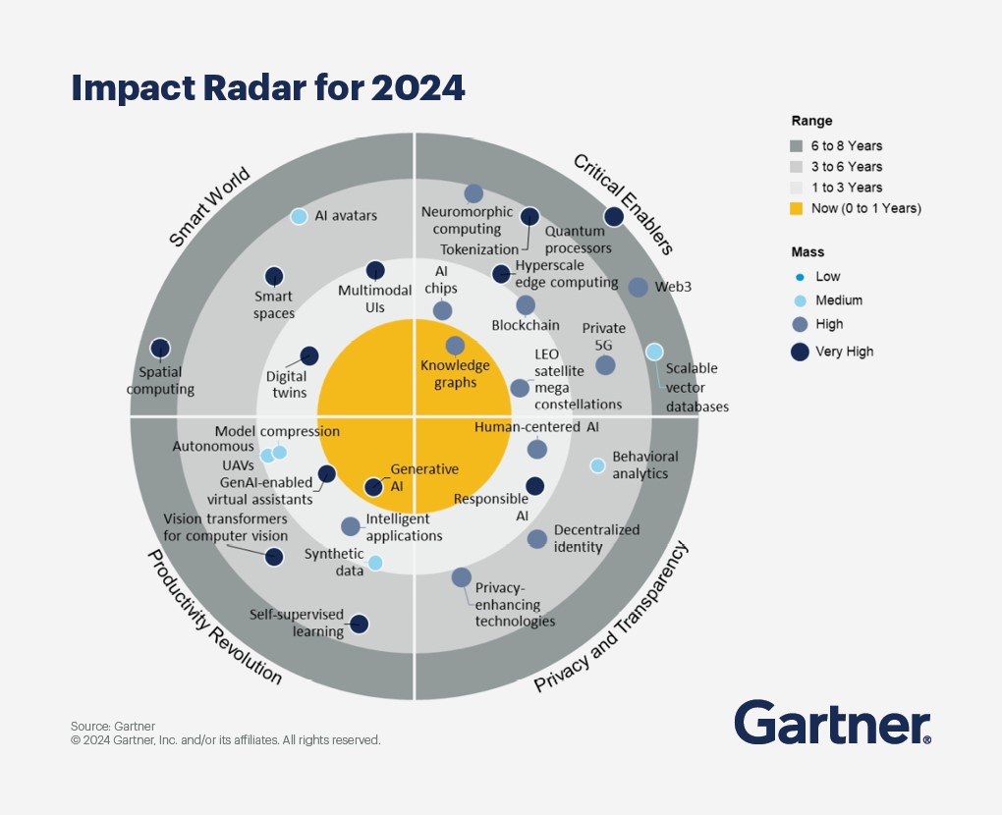
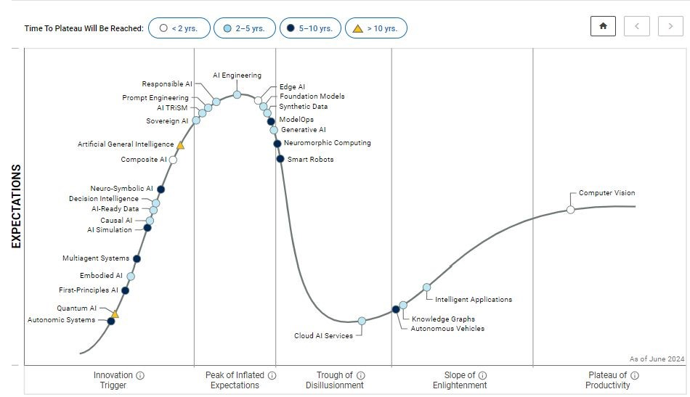
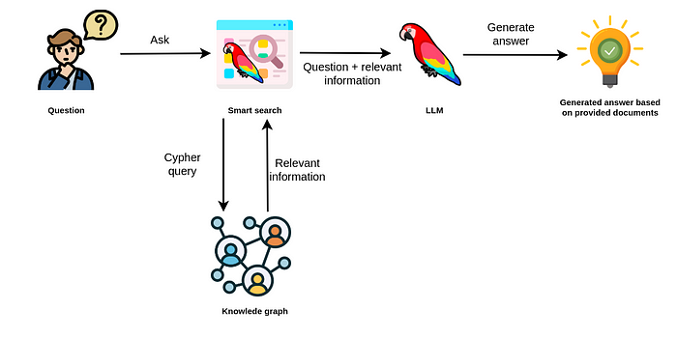
Knowledge Graphs and Generative AI
https://folderit.net/knowledge-graphs-and-generative-ai/
Gartner – Impact Radar for 2024
Svetlana Sicular, Research VP, AI at Gartner Linkedin Post
Text2Cypher
(it could be also Text2SPARQL) transformation
https://neo4j.com/labs/neodash/2.4/user-guide/extensions/natural-language-queries/
Knowledge graphs have reached the «Slope of Enlightenment» phase in the 2024 Gartner Hype Cycle for Artificial Intelligence. This phase indicates that the technology is becoming more widely understood and adopted, with real-world benefits and implementations becoming clearer. As knowledge graphs mature, they offer practical applications that drive significant value for businesses.
Cypher is Neo4j’s graph query language that lets you retrieve data from the graph. It is like SQL for graphs and was inspired by SQL, so it lets you focus on what data you want out of the graph (not how to get it). It is the easiest graph language to learn by far because of its similarity to other languages and intuitiveness.
SPARQL is the query language for accessing data in the Resource Description Framework (RDF). Cypher is the corresponding language for the data represented in property graphs.

Slide 32
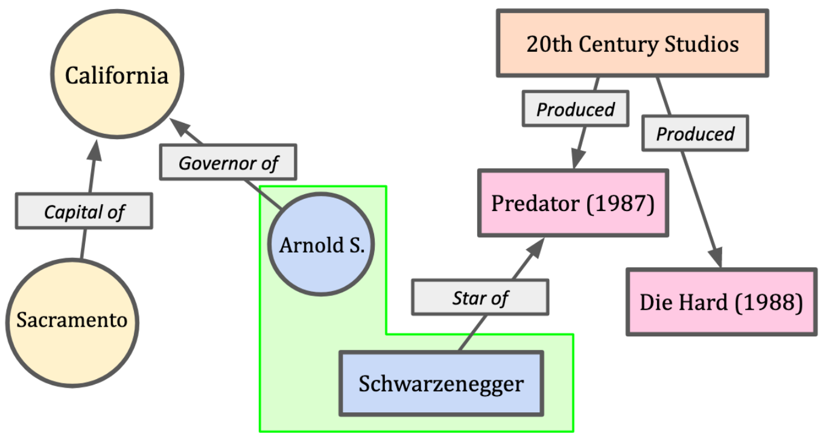
Coreference – the key challenge for knowledge graphs;
Entity alignment – the solution
Coreference problem: In natural language and structured data, the same person, object, or concept might be referred to by different names, pronouns, or phrases (e.g., “Arnold S.” vs. “Schwarzenegger” (see figure)). This makes it difficult to connect information correctly within or across knowledge graphs.
Entity alignment as the solution: Entity alignment is the process of matching and merging entities that represent the same real-world concept but appear in different datasets or parts of a knowledge graph.
Two hypothetical knowledge graphs representing disparate topics contain a node that corresponds to the same entity in the real world. Entity alignment is the process of identifying such nodes across multiple graphs.

Slide 33


Now, let us start from the roots:
Origin of the Semantic Web Approach
“The Semantic Web is a vision: the idea of having data on the Web defined and linked in a way that it can be used by machines not just for display purposes,
but for automation, integration and reuse
of data across various applications”
http://www.w3.org/sw/
The Semantic Web is an initiative with the goal of extending the current Web and facilitating Web automation, universally accessible web resources, and the 'Web of Trust', providing a universally accessible platform that allows data to be shared and processed by automated tools as well as by people.

Slide 34
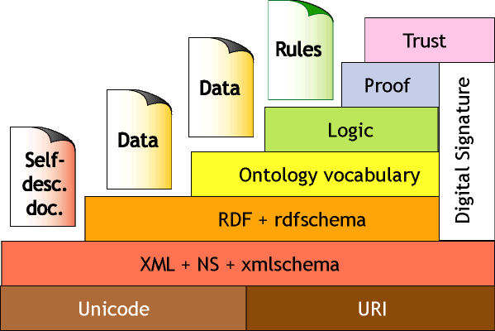
Tim Berners-Lee's Vision of Semantic Web (IJCAI-01)

Slide 35
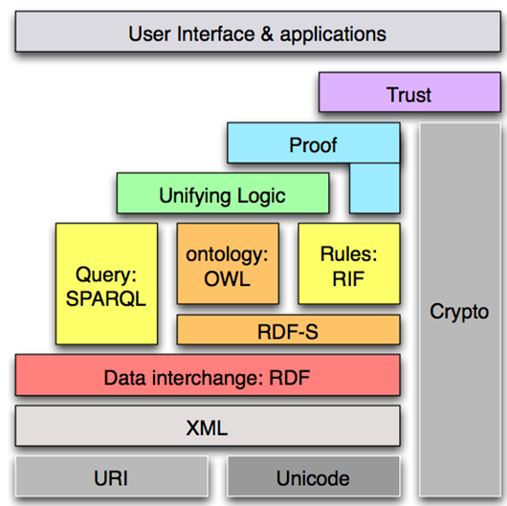
Semantic Web Stack
(updated, W3C, 2006)

Slide 36
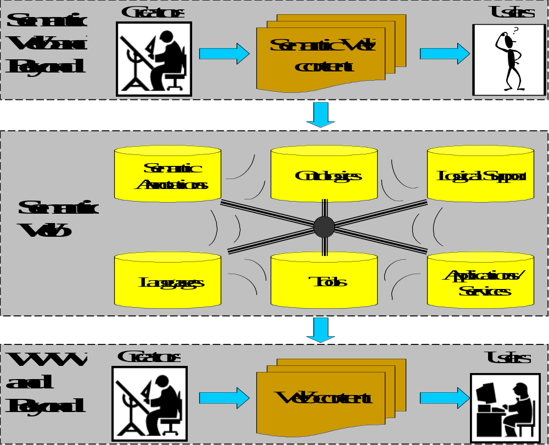
Semantic Web: New “Users”
applications
agents

Slide 37
Semantic Web: Annotations
applications
agents
Semantic annotations are specific sort of metadata, which provides information about particular domain objects, values of their properties and relationships, in a machine-processable, formal and standardized way.

Slide 38
Semantic Web: Ontologies
applications
agents
Ontologies make metadata interoperable and ready for efficient sharing and reuse. It provides shared and common understanding of a domain, that can be used both by people and machines. Ontologies are used as a form of agreement-based knowledge representation about the world or some part of it and generally describe: domain individuals, classes, attributes, relations and events.

Slide 39
Semantic Web: Rules
applications
agents
Logical support in form of rules is needed to infer implicit content, metadata and ontologies from the explicit ones. Rules are considered to be a major issue in the further development of the semantic web. On one hand, they can be used in ontology languages, in conjunction with or as an alternative to description logics. And on the other hand, they will act as a means to draw inferences, to configure systems, to express constraints, to specify policies, to react to events/changes, to transform data, to specify behavior of agents, etc.

Slide 40
Semantic Web: Languages
applications
agents
Languages are needed for machine-processable formal descriptions of: metadata (annotations) like e.g. RDF; ontologies like e.g. OWL.; rules like e.g. RuleML. The challenge is to provide a framework for specifying the syntax (e.g. XML) and semantics of all of these languages in a uniform and coherent way. The strategy is to translate the various languages into a common 'base' language (e.g. CL or Lbase) providing them with a single coherent model theory.

Slide 41
Semantic Web: Tools
applications
agents
User-friendly tools are needed for metadata manual creation (annotating content) or automated generation, for ontology engineering and validation, for knowledge acquisition (rules), for languages parsing and processing, etc.

Slide 42
Semantic Web: Applications and Services
applications
agents
Utilization of Semantic Web metadata, ontologies, rules, languages and tools enables to provide scalable Web applications and Web services for consumers and enterprises" making the web 'smarter' for people and machines.

Slide 43

Semantic Web basics
RDF:
  is a W3C standard and a tool:
    to describe Web resources
    to enable interoperability between applications that exchange machine-understandable information
RDF Schema:
  is a W3C standard which defines vocabulary for RDF
  organizes this vocabulary in a typed hierarchy
  capable to explicitly declare semantic relations between vocabulary terms

Slide 44




RDF – Semantic Web over Web Resources
John
has_job
has_homepage
Director
Ontology
to_be_in_love_with
has_job
has_homepage
Secretary
Mary

Slide 45
Resources (a popular term used in Semantic Web domain)
All things being described by RDF expressions are called resources:
  entire Web page;
  part of Web page (e.g., a specific XML element);
  group of Web pages (e.g., Web site);
  an object (physical, abstract, real or imaginable) that does not belong to the Web and is not directly accessible via the Web.

Slide 46
RDF Statement (two types)
Property_k
Resource_i
Value_n
OR
Property_r
Resource_i
Resource_ j

Slide 47
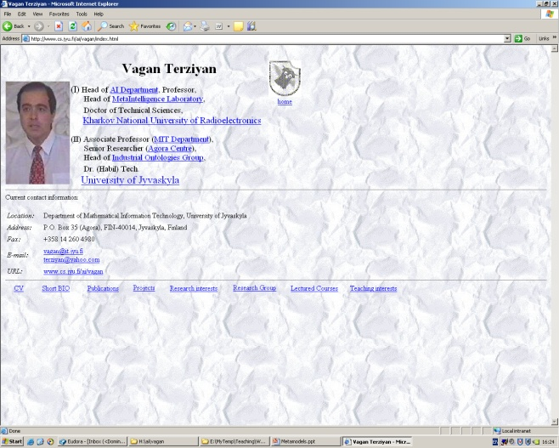

Semantic Relation as RDF statement
(so called “object property”)
L_{k}
A_{j}
Relation
A_{i}
Resource
Resource
Relation (i ≠ j)
Subject
Predicate
object
Personal web page of Terziyan V.
Web page of Agora Center
http://ai.it.jyu.fi/vagan/index.html
http://www.jyu.fi/agora-center/indexEng.html
refers_to
Dereferenceable URI
URI of Terziyan V.
employed_by
URI of Agora Center
http://ai.it.jyu.fi/vagan/#vagan
http://www.jyu.fi/agora-center/#AC
Non-dereferenceable URI

Slide 48
Semantic Property as RDF statement
(so called “datatype property”)
A_{i}
Property
Resource
Literal
Property (i = j)
L_{k}
Subject
Predicate
object
Personal web page of Terziyan V.
http://ai.it.jyu.fi/vagan/index.html
Literal
has_birthday
15.02.2000
“Birthday” of the web-page
Birthday of Terziyan V.
has_birthday
1958-XX-YY
URI of Terziyan V.
http://ai.it.jyu.fi/vagan/#vagan

Slide 49
Semantic Network of Web Resources
15.02.2000
Personal web page of Terziyan V.
has_birthday
Web page of Agora Center
http://ai.it.jyu.fi/vagan/index.html
http://www.jyu.fi/agora-center/indexEng.html
refers_to
isWebPageOf
1958-XX-YY
isWebPageOf
hasWebPage
has_birthday
hasWebPage
URI of Terziyan V.
employed_by
URI of Agora Center
http://ai.it.jyu.fi/vagan/#vagan
http://www.jyu.fi/agora-center/#AC

Slide 50
Resources and URIs
A resource can be anything that has identity
Uniform Resource Identifiers (URI)* provide a simple and extensible means for identifying a resource;
Not all resources are network "retrievable"; e.g., human beings, corporations, and books in a library can also be considered resources;
Read about “Hash vs Slash” debate
* The term "Uniform Resource Locator" (URL) refers to the subset of URI that identify resources via a representation of their primary access mechanism (e.g., their network "location"), rather than identifying the resource by name or by some other attribute(s) of that resource.

Slide 51
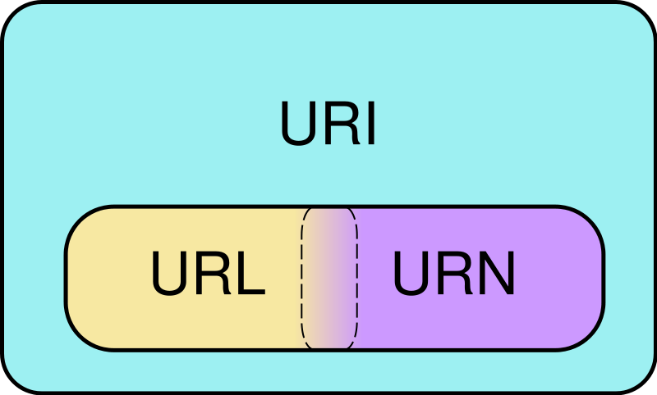
URI vs. URL vs. URN
A URI represents a single concept or thing, but many URIs can represent the same thing.
All URLs are URIs. Not all URIs are URLs.
URI identifies something uniquely.
URN identifies something by name.
URL identifies something by address.
Read here the simple explanation:
http://webpro.ninja/url-vs-uri-vs-urn/
Venn diagram of Uniform Resource Identifier (URI) scheme categories. Schemes in the URL (locator) and URN (name) categories both function as resource IDs, so URL and URN are subsets of URI. They are also, generally, disjoint sets. However, many schemes can't be categorized as strictly one or the other, because all URIs can be treated as names, and some schemes embody aspects of both categories – or neither.

Slide 52

URI “aliases” and Introduction to Linked Data
Berlin
Lets take city of Berlin as an example …

Slide 53

URI “aliases” and Introduction to Linked Data
Berlin
In the DBPedia the city of Berlin is identified by the following URI: http://dbpedia.org/resource/Berlin
URI: http://dbpedia.org/resource/Berlin
http://dbpedia.org/

Slide 54

URI “aliases” and Introduction to Linked Data
Berlin
… however in the GeoNames database the city of Berlin is identified by another URI: http://sws.geonames.org/2950159/
URI: http://dbpedia.org/resource/Berlin
URI: http://sws.geonames.org/2950159/
http://dbpedia.org/
http://www.geonames.org/

Slide 55

URI “aliases” and Introduction to Linked Data
For any software application these two URIs (URI aliases) look now like they refer to totally different objects …
URI: http://dbpedia.org/resource/Berlin
URI: http://sws.geonames.org/2950159/
http://dbpedia.org/
http://www.geonames.org/

Slide 56
URI “aliases” and Introduction to Linked Data
… now we have two isolated “islands” of data …
Here you can answer queries like, e.g., “Which city is a headquarter of GIGA Television?”
Here you can answer queries, like e.g., “Which city is a capital of Germany?”
:GIGA_Television
:Germany
:isHeadquarterOf
:isCapitalOf
URI: http://dbpedia.org/resource/Berlin
URI: http://sws.geonames.org/2950159/
http://dbpedia.org/
http://www.geonames.org/

Slide 57

URI “aliases” and Introduction to Linked Data
“Break the wall!” Make the connection between distinct URIs explicit ! You will obtain a Linked Data …
:GIGA_Television
:Germany
:isHeadquarterOf
:isCapitalOf
owl:sameAs
URI: http://dbpedia.org/resource/Berlin
URI: http://sws.geonames.org/2950159/
http://dbpedia.org/
http://www.geonames.org/

Slide 58
URI “aliases” and Introduction to Linked Data
… now you are able to make queries over the Linked Data (distributed database) like, e.g.: “Which companies have headquarters in the capital of Germany?”
:GIGA_Television
:Germany
:isHeadquarterOf
:isCapitalOf
owl:sameAs
URI: http://dbpedia.org/resource/Berlin
URI: http://sws.geonames.org/2950159/
http://dbpedia.org/
http://www.geonames.org/

Slide 59
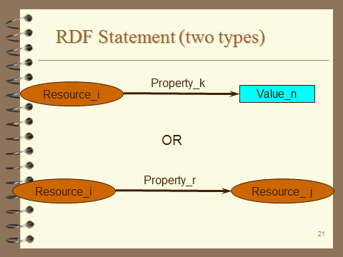
RDF Statement (two simplest basic structures)
subject
predicate
object
Subject of an RDF statement is a resource defined by URI
Predicate of an RDF statement is a property of a resource defined by URI
Object of an RDF statement is the value of a property of a resource (either defined by data value or by another resource URI depending on the type of RDF statement)

Slide 60

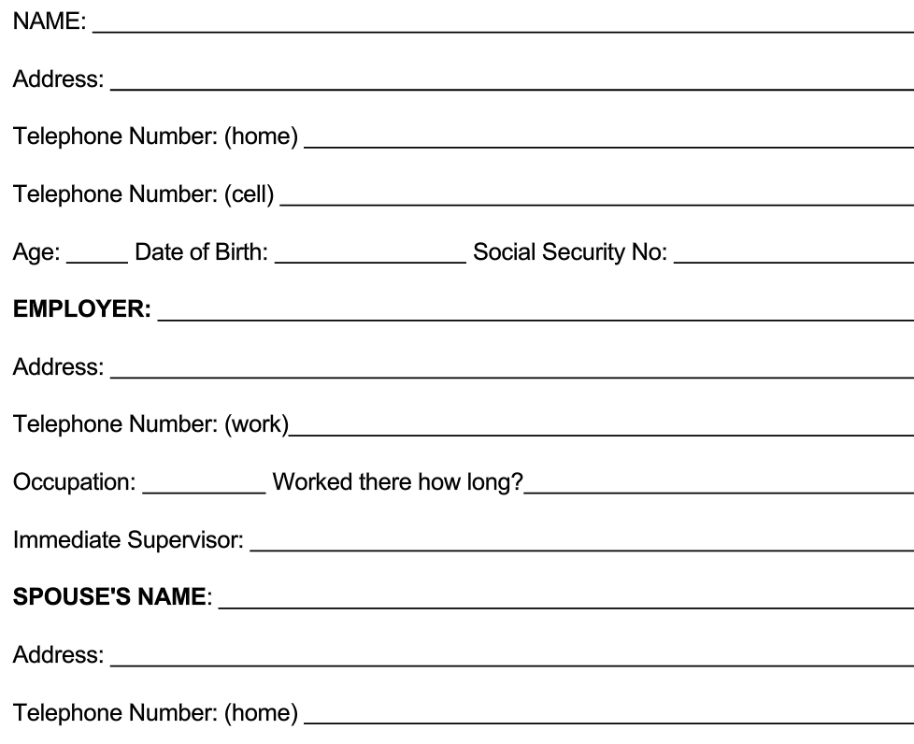
Making RDF Statements is like filling a questionnaire form
Vagan Terziyan
http://www.bla-bla.fi/#VaganTerziyan
Subject
Predicate
Object

Slide 61
Making RDF Statements is like filling a questionnaire form
http://www.bla-bla.fi/#VaganTerziyan
33
Subject
Predicate
Object

Slide 62
Making RDF Statements is like filling a questionnaire form
http://www.bla-bla.fi/#VaganTerziyan
Subject
http://dbpedia.org/page/University_of_Jyvaskyla
Predicate
Object

Slide 63
Making RDF Statements is like filling a questionnaire form
http://www.bla-bla.fi/#VaganTerziyan
Subject
Predicate
http://www.bla-bla.fi/#PekkaNeittaanmaki
Object

Slide 64

Concepts vs. URIs
“John loves Mary”

Slide 65

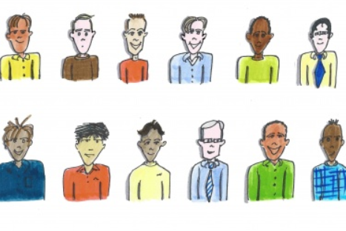
Concepts vs. URIs
“John loves Mary”
?
John
John
John
John
John
John
John
John
John
John
John
John

Slide 66
Concepts vs. URIs
<http://bla.com/#John-4> loves Mary
John-1
John-2
John-3
John-4
John-5
John-6
John-7
John-8
John-9
John-10
John-11
John-12

Slide 67

Concepts vs. URIs
<http://bla.com/#John-4> loves Mary
?
Mary
Mary
Mary
Mary
Mary

Slide 68
Concepts vs. URIs
<http://bla.com/#John-4> loves <http://bla.com/#Mary-5>
Mary-1
Mary-2
Mary-3
Mary-4
Mary-5

Slide 69
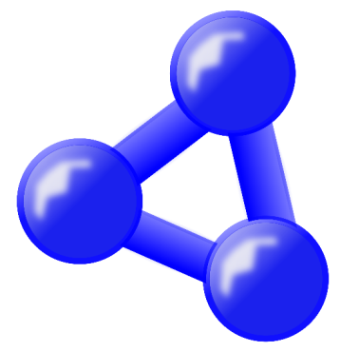
Concepts vs. URIs
<http://bla.com/#John-4> loves <http://bla.com/#Mary-5>
?
loves
loves
loves
Ontology-1
Ontology-2
Ontology-3

Slide 70

Concepts vs. URIs
“John loves Mary”
<http://bla.com/#John-4> <http://x.com/ontology-2/#loves> <http://bla.com/#Mary-5>
Now I got it !
loves
loves
loves
Ontology-1
Ontology-2
Ontology-3

Slide 71
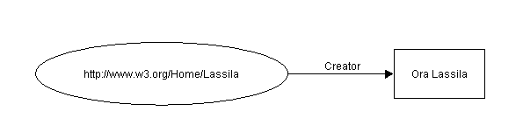
Example of RDF Statement
Ora Lassila is the creator of the resource http://www.w3.org/Home/Lassila.
Subject (resource)
http://www.w3.org/Home/Lassila
Predicate (property)
Creator
Object (xsd:literal)
“Ora Lassila”
xsd:literal refers to the datatype representing literal values. It is part of the XML Schema Datatypes (XSD) specification, which provides a set of built-in datatypes for representing data in XML documents. xsd:literal represents plain literal values in RDF, such as strings
Lets represent the above statement in RDF/XML in accordance with the “serialization” and the “abbreviated” syntax (see next slides):

Slide 72
RDF statement example in RDF/XML serialization syntax
Ora Lassila is the creator of the resource http://www.w3.org/Home/Lassila .
RDF/XML in accordance with the “serialization” syntax
<rdf:RDF>
<rdf:Description rdf:about=
"http://www.w3.org/Home/Lassila">
<s:Creator>Ora Lassila</s:Creator>
</rdf:Description>
</rdf:RDF>

Slide 73
RDF Example in serialization syntax (subject of statement)
Ora Lassila is the creator of the resource http://www.w3.org/Home/Lassila.
Subject
<rdf:RDF>
<rdf:Description rdf:about=
"http://www.w3.org/Home/Lassila">
<s:Creator>Ora Lassila</s:Creator>
</rdf:Description>
</rdf:RDF>

Slide 74
RDF Example in serialization syntax (predicate of statement)
Ora Lassila is the creator of the resource http://www.w3.org/Home/Lassila.
<rdf:RDF>
<rdf:Description rdf:about=
"http://www.w3.org/Home/Lassila">
<s:Creator>Ora Lassila</s:Creator>
</rdf:Description>
</rdf:RDF>
Predicate

Slide 75
RDF Example in serialization syntax (object of statement)
Ora Lassila is the creator of the resource http://www.w3.org/Home/Lassila.
<rdf:RDF>
<rdf:Description rdf:about=
"http://www.w3.org/Home/Lassila">
<s:Creator>Ora Lassila</s:Creator>
</rdf:Description>
</rdf:RDF>
Object

Slide 76
RDF Example in serialization syntax (reference to ontology)
Ora Lassila is the creator of the resource http://www.w3.org/Home/Lassila.
<rdf:RDF>
<rdf:Description rdf:about=
"http://www.w3.org/Home/Lassila">
<s:Creator>Ora Lassila</s:Creator>
</rdf:Description>
</rdf:RDF>
a specific namespace prefix as reference to ontology where predicates are defined, e.g. xmlns: s="http://description.org/schema/"

Slide 77
Same RDF statement in RDF/XML Abbreviated Syntax
Ora Lassila is the creator of the resource http://www.w3.org/Home/Lassila .
RDF/XML in accordance with the “abbreviated” syntax
<rdf:Description rdf:about="http://www.w3.org/Home/Lassila"
s:Creator="Ora Lassila" />

Slide 78
Abbreviated Syntax Example (1)
Ora Lassila is the creator of the resource http://www.w3.org/Home/Lassila.
<rdf:RDF>
<rdf:Description rdf:about="http://www.w3.org/Home/Lassila"
s:Creator="Ora Lassila" />
</rdf:RDF>
<?xml version="1.0"?>
<rdf:RDF
  xmlns:rdf="http://www.w3.org/1999/02/22-rdf-syntax-ns#"
  xmlns:s="http://description.org/schema/">
  <rdf:Description
  rdf:about="http://www.w3.org/Home/Lassila"
  s:Creator="Ora Lassila"/>
</rdf:RDF>

Slide 79
Abbreviated Syntax Example (2)
Ora Lassila is the creator of the resource http://www.w3.org/Home/Lassila.
Subject
<rdf:Description rdf:about="http://www.w3.org/Home/Lassila"
s:Creator="Ora Lassila" />

Slide 80
Abbreviated Syntax Example (3)
Ora Lassila is the creator of the resource http://www.w3.org/Home/Lassila.
<rdf:Description rdf:about="http://www.w3.org/Home/Lassila"
s:Creator ="Ora Lassila" />
Predicate

Slide 81
Abbreviated Syntax Example (4)
Ora Lassila is the creator of the resource http://www.w3.org/Home/Lassila.
<rdf:Description rdf:about="http://www.w3.org/Home/Lassila"
s:Creator="Ora Lassila" />
Object

Slide 82
Template/frame for RDF statement
Predicate
Subject
Value
<?xml version="1.0"?>
<rdf:RDF
xmlns:rdf="http://www.w3.org/1999/02/22-rdf-syntax-ns#"
xmlns: = " " >
<rdf:Description rdf:about= " “ "
: = " " />
</rdf:RDF>
prefix
Ontology (URI)
Subject (URI)
prefix
Predicate
Value

Slide 83

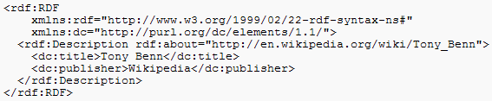

RDF N3 syntax
http://www.w3.org/TeamSubmission/n3/
Notation3, or N3 as it is more commonly known, is a shorthand non-XML serialization of RDF models, designed with human-readability in mind: N3 is much more compact and readable than XML RDF notation. The format is being developed by Tim Berners-Lee and others from the Semantic Web community.
RDF sample in XML notation
RDF sample in N3 notation

Slide 84

RDF N3 syntax
Some fast hints:
All URIs are quoted with angle brackets ( “<“ and “>” ). Whitespace within the < > is to be ignored.
All values are within quotation marks " " .
Each statement ends with the dot “.”
@pref is used to define the namespace prefix.
Square brackets [ ] are used for the “blank nodes”.
Check all in : http://www.w3.org/TeamSubmission/n3/
Example:
@PREFIX dc: <http://purl.org/dc/elements/1.1/> .
<http://en.wikipedia.org/wiki/Tony_Benn>
dc:publisher
"Wikipedia" .
Shorthand:
Square brackets for blank nodes:
[ pl ] means x, where there exists some x such that x has properties in the property list pl. For example:
[ :firstname "Ora" ] dc:wrote [ dc:title "Moby Dick" ] .
… is a statement which would be means in math:
exists x, y . firstname(x, "Ora") & dc:wrote(x,y) & dc:title (y, "Moby Dick")
… or in English "Some person who has a first name Ora wrote a book entitled "Moby Dick". Note not "the book" or "the person".

Slide 85
Template/frame for RDF statement (N3)
Predicate
Subject
Object
OR
Predicate
Subject
Value
<
>
<
>
<
>
.
Subject (URI)
Predicate (URI)
Object (URI)
OR
<
>
<
>
"
"
.
Subject (URI)
Predicate (URI)
Value
OR
@prefix Onto :
<
>
.
Onto
Ontology (URI)
:
:
:
.
Onto
Subject
Onto
Predicate
Onto
Object
:
:
"
"
.
Onto
Subject
Onto
Predicate
Value

Slide 86
Template/frame for RDF statement (N3)
.
<
>
<
>
<
>
http://www.jyu.fi/Onto.owl#John
http://www.jyu.fi/Onto.owl#Loves
http://www.jyu.fi/Onto.owl#Mary
OR
.
<
>
<
>
"
"
http://www.jyu.fi/Onto.owl#John
http://www.jyu.fi/Onto.owl#hasAge
25
OR
@prefix Onto :
>
.
P1
<
http://www.jyu.fi/Onto.owl#
:
:
:
.
P1
John
P1
Loves
P1
Mary
:
:
"
"
.
P1
John
P1
hasAge
25
Or(finally):
Or(even simpler):
@prefix P1: <http://www.jyu.fi/Onto.owl#> .
P1:John P1:Loves P1:Mary .
P1:John P1:hasAge "25" .
@prefix : <http://www.jyu.fi/Onto.owl#> .
:John :Loves :Mary .
:John :hasAge "25" .

Slide 87


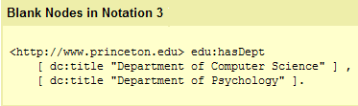
Some N3 syntax specifics
http://www.w3.org/TeamSubmission/n3/
Ontological statements in N3
@prefix rdfs: <http://www.w3.org/2000/01/rdf-schema#> .
:Professor a rdfs:Class .
<http://ai.it.jyu.fi/vagan> a :Professor .

Slide 88
Some N3 syntax specifics
http://www.w3.org/TeamSubmission/n3/
A B C , D , E , …, Z .
A B C .
@prefix : <http://www.jyu.fi/Onto.owl#> .
:John :Loves :Mary .
:John :Loves :Jane .
A B D .
…
@prefix : <http://www.jyu.fi/Onto.owl#> .
:John :Loves :Mary , :Jane .
A B Z .

Slide 89
Some N3 syntax specifics
http://www.w3.org/TeamSubmission/n3/
A B C ; D E ; … ; Y Z .
A B C .
@prefix : <http://www.jyu.fi/Onto.owl#> .
:John :Loves :Mary .
:John :hasAge "25" .
A D E .
…
@prefix : <http://www.jyu.fi/Onto.owl#> .
:John :Loves :Mary ; :hasAge "25" .
A Y Z .

Slide 90
Some N3 syntax specifics
http://www.w3.org/TeamSubmission/n3/
One N3 “sentence” – many triples
A B C , D ; E F ; G H , I , J .
Subject
“John loves Mary. John loves Jane. John is 25 years old.”
Predicate
A B C .
Object
@prefix : <http://www.jyu.fi/Onto.owl#> .
:John :Loves :Mary .
:John :Loves :Jane .
:John :hasAge "25" .
A B D .
A E F .
A G H .
A G I .
@prefix : <http://www.jyu.fi/Onto.owl#> .
:John :Loves :Mary , :Jane ; :hasAge "25" .
A G J .
“25 years old John loves Mary and Jane.”

Slide 91
Some N3 syntax specifics
http://www.w3.org/TeamSubmission/n3/
Subject
Predicate
A B [ C D ] .
Object
Blank node
means
“John loves someone who is 29 years old.”
@prefix : <http://www.jyu.fi/Onto.owl#> .
:John :Loves [ :hasAge "29" ] .
A B ?x? .
?x? C D .
“John loves someone who loves him back.”
@prefix : <http://www.jyu.fi/Onto.owl#> .
:John :Loves [ :Loves :John ] .
Something, someone, etc.

Slide 92
Some N3 syntax specifics
http://www.w3.org/TeamSubmission/n3/
One N3 “sentence” – many triples
A B C , D ; E F ; G [ H , I ] , J .
Subject
Predicate
A B C .
Object
A B D .
Blank node
A E F .
A G ?x? .
@prefix : <http://www.jyu.fi/Onto.owl#> .
:John :Loves :Mary , :Jane , [ :Loves :John ] ; :hasAge "25" .
?x? H I .
“25 years old John loves Mary, Jane and also someone else who loves him back.”
A G J .

Slide 93
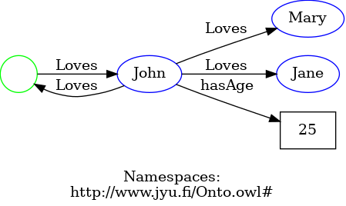
Visualize code as a graph
http://www.w3.org/TeamSubmission/n3/
@prefix : <http://www.jyu.fi/Onto.owl#> .
:John :Loves :Mary , :Jane , [ :Loves :John ] ; :hasAge "25" .
https://www.ldf.fi/service/rdf-grapher

Slide 94
RDF N3 examples
The story
4 RDF (N3) statements
Gender of Vagan Terziyan is male.
2. His mother is Svetlana Terziyan.
3. He is fun of fishing.
4. He is fun of Nordic walking.
<http://ai.it.jyu.fi/vagan/ontologies/university.owl#VaganTerziyan> <http://ai.it.jyu.fi/vagan/ontologies/university.owl#hasGender >
"male" .
1
<http://ai.it.jyu.fi/vagan/ontologies/university.owl#VaganTerziyan> <http://ai.it.jyu.fi/vagan/ontologies/university.owl#hasMother>
<http://ai.it.jyu.fi/vagan/ontologies/university.owl#SvetlanaTerziyan> .
2
<http://ai.it.jyu.fi/vagan/ontologies/university.owl#VaganTerziyan> <http://ai.it.jyu.fi/vagan/ontologies/LifeInFinland.owl#isFunOf>
"Fishing" .
3
<http://ai.it.jyu.fi/vagan/ontologies/university.owl#VaganTerziyan> <http://ai.it.jyu.fi/vagan/ontologies/LifeInFinland.owl#isFunOf>
"NordicWalking" .
4

Slide 95
RDF N3 examples
Gender of Vagan Terziyan is male.
2. His mother is Svetlana Terziyan.
3. He is fun of fishing.
4. He is fun of Nordic walking.
<http://ai.it.jyu.fi/vagan/ontologies/university.owl#VaganTerziyan> <http://ai.it.jyu.fi/vagan/ontologies/university.owl#hasGender >
"male" .
1
<http://ai.it.jyu.fi/vagan/ontologies/university.owl#VaganTerziyan> <http://ai.it.jyu.fi/vagan/ontologies/university.owl#hasMother>
<http://ai.it.jyu.fi/vagan/ontologies/university.owl#SvetlanaTerziyan> .
2
<http://ai.it.jyu.fi/vagan/ontologies/university.owl#VaganTerziyan> <http://ai.it.jyu.fi/vagan/ontologies/LifeInFinland.owl#isFunOf>
"Fishing" .
3
<http://ai.it.jyu.fi/vagan/ontologies/university.owl#VaganTerziyan> <http://ai.it.jyu.fi/vagan/ontologies/LifeInFinland.owl#isFunOf>
"NordicWalking" .
4
Reader-friendly version
@prefix On1: <http://ai.it.jyu.fi/vagan/ontologies/university.owl#> .
@prefix On2: <http://ai.it.jyu.fi/vagan/ontologies/LifeInFinland.owl#> .
On1:VaganTerziyan On1:hasGender "male" .
On1:VaganTerziyan On1:hasMother On1:SvetlanaTerziyan .
On1:VaganTerziyan On2:isFunOf "Fishing" .
On1:VaganTerziyan On2:isFunOf "NordicWalking" .

Slide 96
RDF N3 examples
Gender of Vagan Terziyan is male.
2. His mother is Svetlana Terziyan.
3. He is fun of fishing.
4. He is fun of Nordic walking.
<http://ai.it.jyu.fi/vagan/ontologies/university.owl#VaganTerziyan> <http://ai.it.jyu.fi/vagan/ontologies/university.owl#hasGender >
"male" .
1
<http://ai.it.jyu.fi/vagan/ontologies/university.owl#VaganTerziyan> <http://ai.it.jyu.fi/vagan/ontologies/university.owl#hasMother>
<http://ai.it.jyu.fi/vagan/ontologies/university.owl#SvetlanaTerziyan> .
2
<http://ai.it.jyu.fi/vagan/ontologies/university.owl#VaganTerziyan> <http://ai.it.jyu.fi/vagan/ontologies/LifeInFinland.owl#isFunOf>
"Fishing" .
3
<http://ai.it.jyu.fi/vagan/ontologies/university.owl#VaganTerziyan> <http://ai.it.jyu.fi/vagan/ontologies/LifeInFinland.owl#isFunOf>
"NordicWalking" .
4
Compact version
@prefix On1: <http://ai.it.jyu.fi/vagan/ontologies/university.owl#> .
@prefix On2: <http://ai.it.jyu.fi/vagan/ontologies/LifeInFinland.owl#> .
On1:VaganTerziyan On1:hasGender "male" ; On1:hasMother On1:SvetlanaTerziyan ; On2:isFunOf "Fishing" , "NordicWalking" .

Slide 97
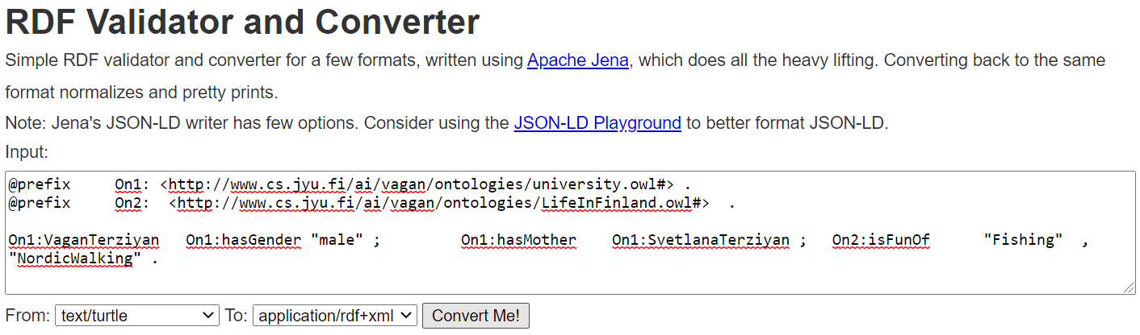
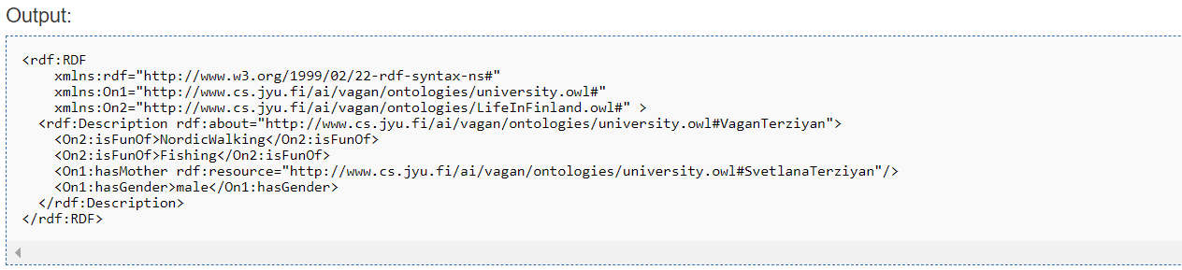
Online RDF translator
Try (also for the examples from the following slides) …
https://issemantic.net/rdf-converter
… instead of …
http://rdf-translator.appspot.com/

Slide 98
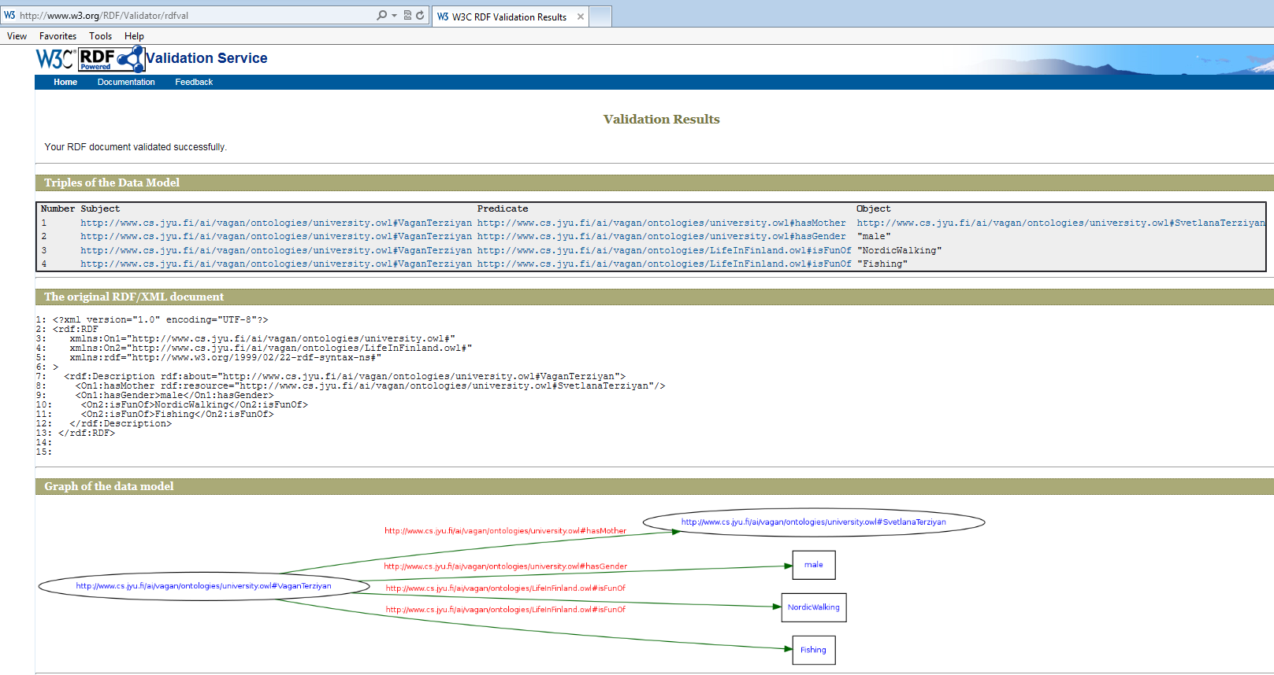
… lets validate the translation
http://www.w3.org/RDF/Validator/

Slide 99
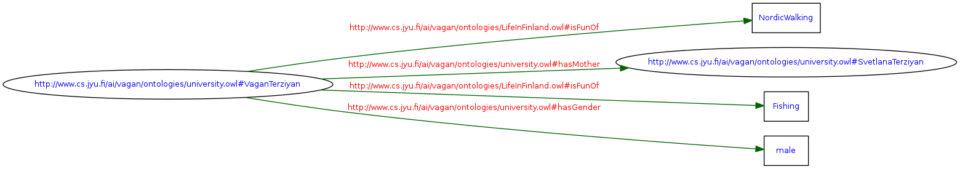
… and see the semantic graph
http://www.w3.org/RDF/Validator/

Slide 100


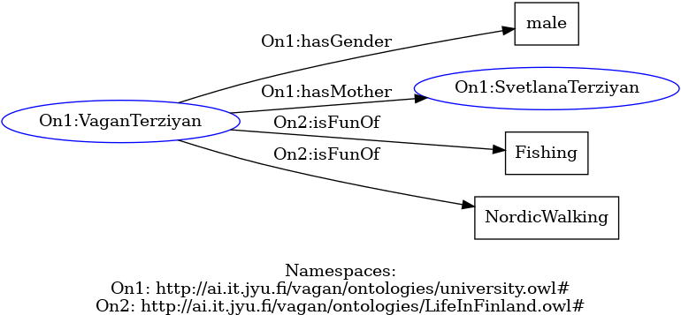
Try this nice visualization service !!!
https://www.ldf.fi/service/rdf-grapher

Slide 101
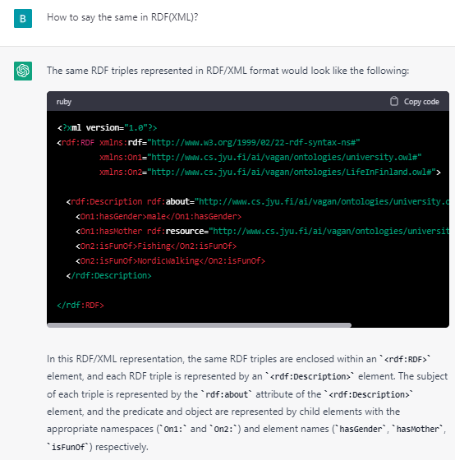
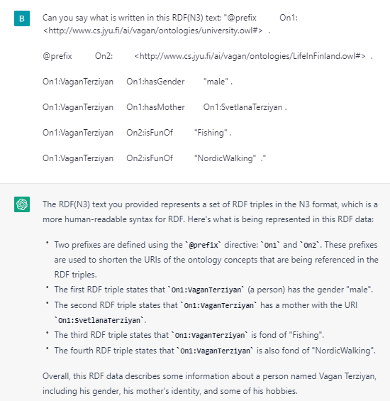
Just for fun … lets ask ChatGPT
https://chat.openai.com/chat
<?xml version="1.0"?>
<rdf:RDF xmlns:rdf="http://www.w3.org/1999/02/22-rdf-syntax-ns#"
xmlns:On1="http://ai.it.jyu.fi/vagan/ontologies/university.owl#"
xmlns:On2="http://ai.it.jyu.fi/vagan/ontologies/LifeInFinland.owl#">
<rdf:Description rdf:about="http://ai.it.jyu.fi/vagan/ontologies/university.owl#VaganTerziyan">
<On1:hasGender>male</On1:hasGender>
<On1:hasMother rdf:resource="http://ai.it.jyu.fi/vagan/ontologies/university.owl#SvetlanaTerziyan"/>
<On2:isFunOf>Fishing</On2:isFunOf>
<On2:isFunOf>NordicWalking</On2:isFunOf>
</rdf:Description>
</rdf:RDF>

Slide 102
RDF/N3 example (blank node with [ ])
Gender of Vagan Terziyan is male.
2. His mother is Svetlana Terziyan.
3. He is fun of fishing.
4. He is fun of Nordic walking.
5. He is fun of mother’s hobby.
<http://ai.it.jyu.fi/vagan/ontologies/university.owl#VaganTerziyan> <http://ai.it.jyu.fi/vagan/ontologies/university.owl#hasGender >
"male" .
1
<http://ai.it.jyu.fi/vagan/ontologies/university.owl#VaganTerziyan> <http://ai.it.jyu.fi/vagan/ontologies/university.owl#hasMother>
<http://ai.it.jyu.fi/vagan/ontologies/university.owl#SvetlanaTerziyan> .
2
<http://ai.it.jyu.fi/vagan/ontologies/university.owl#VaganTerziyan> <http://ai.it.jyu.fi/vagan/ontologies/LifeInFinland.owl#isFunOf>
"Fishing" .
3
<http://ai.it.jyu.fi/vagan/ontologies/university.owl#VaganTerziyan> <http://ai.it.jyu.fi/vagan/ontologies/LifeInFinland.owl#isFunOf>
"NordicWalking" .
4
<http://ai.it.jyu.fi/vagan/ontologies/university.owl#VaganTerziyan> <http://ai.it.jyu.fi/vagan/ontologies/LifeInFinland.owl#isFunOf>
[<http://ai.it.jyu.fi/vagan/ontologies/LifeInFinland.owl#isHobbyOf> <http://ai.it.jyu.fi/vagan/ontologies/university.owl#SvetlanaTerziyan>].
5
Compact version
@prefix On1: <http://ai.it.jyu.fi/vagan/ontologies/university.owl#> .
@prefix On2: <http://ai.it.jyu.fi/vagan/ontologies/LifeInFinland.owl#> .
On1:VaganTerziyan On1:hasGender "male" ; On1:hasMother On1:SvetlanaTerziyan ; On2:isFunOf "Fishing" , "NordicWalking" , [On2:isHobbyOf On1:SvetlanaTerziyan ] .

Slide 103
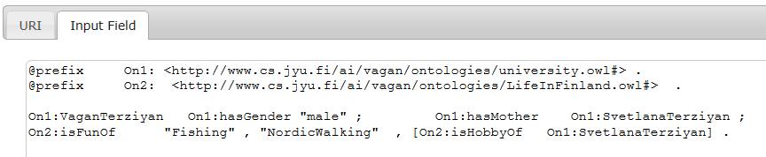


… lets translate it to RDF/XML …
https://issemantic.net/rdf-converter
http://rdf-translator.appspot.com/

Slide 104

… and check with RDF/XML validator
http://www.w3.org/RDF/Validator/

Slide 105

… and see the semantic graph
http://www.w3.org/RDF/Validator/

Slide 106
RDF/N3 example (nested blank nodes)
Gender of Vagan Terziyan is male.
2. His mother is Svetlana Terziyan.
3. He is fun of fishing.
4. He is fun of Nordic walking.
5*. He is fun of mother’s friend hobby.
<http://ai.it.jyu.fi/vagan/ontologies/university.owl#VaganTerziyan> <http://ai.it.jyu.fi/vagan/ontologies/university.owl#hasGender >
"male" .
1
<http://ai.it.jyu.fi/vagan/ontologies/university.owl#VaganTerziyan> <http://ai.it.jyu.fi/vagan/ontologies/university.owl#hasMother>
<http://ai.it.jyu.fi/vagan/ontologies/university.owl#SvetlanaTerziyan> .
2
<http://ai.it.jyu.fi/vagan/ontologies/university.owl#VaganTerziyan> <http://ai.it.jyu.fi/vagan/ontologies/LifeInFinland.owl#isFunOf>
"Fishing" .
3
<http://ai.it.jyu.fi/vagan/ontologies/university.owl#VaganTerziyan> <http://ai.it.jyu.fi/vagan/ontologies/LifeInFinland.owl#isFunOf>
"NordicWalking" .
4
<http://ai.it.jyu.fi/vagan/ontologies/university.owl#VaganTerziyan> <http://ai.it.jyu.fi/vagan/ontologies/LifeInFinland.owl#isFunOf>
[<http://ai.it.jyu.fi/vagan/ontologies/LifeInFinland.owl#isHobbyOf> [http://ai.it.jyu.fi/vagan/ontologies/LifeInFinland.owl#isFriendOf <http://ai.it.jyu.fi/vagan/ontologies/university.owl#SvetlanaTerziyan> ] ].
5*
Compact version
@prefix On1: <http://ai.it.jyu.fi/vagan/ontologies/university.owl#> .
@prefix On2: <http://ai.it.jyu.fi/vagan/ontologies/LifeInFinland.owl#> .
On1:VaganTerziyan On1:hasGender "male" ; On1:hasMother On1:SvetlanaTerziyan ; On2:isFunOf "Fishing" , "NordicWalking" , [On2:isHobbyOf [On2:isFriendOf On1:SvetlanaTerziyan ]] .

Slide 107




@prefix On1: <http://ai.it.jyu.fi/vagan/ontologies/university.owl#> .
@prefix On2: <http://ai.it.jyu.fi/vagan/ontologies/LifeInFinland.owl#> .
On1:VaganTerziyan On1:hasGender "male" ; On1:hasMother On1:SvetlanaTerziyan ; On2:isFunOf "Fishing" , "NordicWalking" , [On2:isHobbyOf [On2:isFriendOf On1:SvetlanaTerziyan ]] .
https://issemantic.net/rdf-converter
https://issemantic.net/rdf-visualizer
https://www.w3.org/RDF/Validator/rdfval

Slide 108

… nicer visualization
https://www.ldf.fi/service/rdf-grapher

Slide 109

N3 vs. TURTLE
Notation3, or N3 as it is more commonly known, is a shorthand non-XML serialization of Resource Description Framework models, designed with human-readability in mind: N3 is much more compact and readable than XML RDF notation. The format is being developed by Tim Berners-Lee and others from the Semantic Web community. A formalization of the logic underlying N3 was published by Berners-Lee and others in 2008.
N3 has several features that go beyond a serialization for RDF models, such as support for RDF-based rules. Turtle is a simplified, RDF-only subset of N3.
https://www.researchgate.net/publication/247484786_Semantic_Web_Tutorial_Using_N3

Slide 110
What is an ontology?
Studer(98): Formal, explicit specification of a shared conceptualization
Machine
readable
Consensual
knowledge
Concepts, properties,
functions, axioms
are explicitly defined
Abstract model of
some domain

Slide 111
Simplest possible interpretation:
ontology is just an empty
questionnaire form

Slide 112

What is an Ontology?
From: Ian Horrocks “OWL 2: The Next Generation”
A model of (some aspect of) the world
Introduces vocabulary
relevant to domain, e.g.:
  Anatomy

Slide 113

What is an Ontology?
From: Ian Horrocks “OWL 2: The Next Generation”
A model of (some aspect of) the world
Introduces vocabulary
relevant to domain
Specifies meaning of terms
  Heart is a muscular organ that
  is part of the circulatory system

Slide 114

What is an Ontology?
From: Ian Horrocks “OWL 2: The Next Generation”
A model of (some aspect of) the world
Introduces vocabulary
relevant to domain
Specifies meaning of terms
  Heart is a muscular organ that
  is part of the circulatory system
Formalised using suitable logic
Notes:
¥begin{array}{r@{¥,}c@{¥,}l} ¥forall x.[¥textsf{¥color{blue} Heart}(x) & {¥color{red}¥rightarrow} & ¥textsf{¥color{blue} MuscularOrgan}(x) ¥,¥wedge¥, ¥¥ & & ¥exists y.[¥textsf{¥color{magenta} isPartOf}(x,y) ¥,¥wedge¥, ¥¥&&¥textsf{¥color{blue} CirculatorySystem}(y)]] ¥end{array}

Slide 115
Ontology Elements
Concepts(classes) + their hierarchy
Concept properties (slots/attributes) + their hierarchy
Property restrictions (type, cardinality, domain …)
Relations between concepts (disjoint, equality …)
Instances

Slide 116
Description Logic Semantics
From: Ian Horrocks “OWL: A Description Logic Based Ontology Language”
Semantics given by standard First-Order Model Theory:
See also: https://en.wikipedia.org/wiki/First-order_logic
John
Mary
Lawyer
Doctor
Vehicle
hasChild
owns
Individual Resources
Classes of Resources
Properties of Resources
(Lawyer and Doctor)

Slide 117



Tbox vs. Abox in an Ontology
There are 2 different types of statements within an ontology:
  Tbox – statement(s) about some concepts (therefore it is the terminology component of a domain model. It defines the vocabulary of the domain);
  Abox – statement(s) about some individuals (therefore it is the assertion component of a domain model. It collects together specific facts about the domain).
Tbox component
Abox component

Slide 118
RDF Schema (language for simple ontologies)
RDF schema is a semantic extension of RDF used for simple ontologies’ design. The RDF schema language is used for declaring basic class and types when describing the terms used in RDF and are used to determine characteristics of other resources, such as the domains and ranges of properties.
rdf:type is an instance of rdf:Property that is used to state that a resource is an instance of a class
http://www.w3.org/TR/rdf-schema/
RDF Schema provides a data-modelling vocabulary for RDF data.
rdf:Property is the class of RDF properties
rdfs:Resource
rdfs:Class
rdfs:domain
rdfs:range
rdfs:subClassOf
rdfs:subPropertyOf
…
The namespaces are identified by:
@prefix rdf: <http://www.w3.org/1999/02/22-rdf-syntax-ns#> .
@prefix rdfs: <http://www.w3.org/2000/01/rdf-schema#> .
The RDF Schema class and property system is similar to the type systems of object-oriented programming languages such as Java. RDF Schema differs from many such systems in that instead of defining a class in terms of the properties its instances may have, RDF Schema describes properties in terms of the classes of resources to which they apply.

Slide 119

RDFS example
That’s the only we know from the RDF statement:
…
:Mary :hasHusband :John .
…

Slide 120

RDFS example
Now the question is, can we tell more about RDF statement components (subject, predicate, object) with the RDFS ?

Slide 121

RDFS example
First, we say explicitly that :Mary is a :Woman and :Woman is a Class

Slide 122

RDFS example
Then we say explicitly that :John is a :Man and :Man is a rdfs:Class

Slide 123

RDFS example
After that, we say explicitly that :hasHusband is a rdf:property

Slide 124

RDFS example
Then we say that class :Woman is the domain for the:hasHusband property

Slide 125

RDFS example
Then we say that class :Man is the range for the:hasHusband property

Slide 126

RDFS example
We can also add that both classes :Woman and :Man are subclasses of the class :Person

Slide 127

RDFS example
We can also introduce new (more general one) property :hasSpooth, which domain and range both belong to class :Person

Slide 128
RDFS example
We can also introduce new (more general one) property :hasSpooth, which domain and range both belong to class :Person
Notice the typo here and after. Actual meaning is :hasSpouse

Slide 129

RDFS example
… and we can specify that the :hasHusband property is a subproperty of the :hasSpooth property

Slide 130

RDFS example
All the RDF and RDFS statements can be easily written within one “story” using RDF (N3) notation:
@prefix rdf: <http://www.w3.org/1999/02/22-rdf-syntax-ns#> .
@prefix rdfs: <http://www.w3.org/2000/01/rdf-schema#> .
@prefix : <http://ai.it.jyu.fi/vagan/ontologies/LifeInFinland.owl#> .
:Person a rdfs:Class .
:Woman a rdfs:Class .
:Man a rdfs:Class .
:Woman rdfs:subClassOf :Person .
:Man rdfs:subClassOf :Person .
:hasHusband a rdf:Property .
:hasSpooth a rdf:Property .
:hasHusband rdfs:subPropertyOf :hasSpooth .
:hasSpooth rdfs:domain :Person .
:hasSpooth rdfs:range :Person .
:hasHusband rdfs:domain :Woman .
:hasHusband rdfs:range :Man .
:John a :Man .
:Mary a :Woman .
:Mary :hasHusband :John .

Slide 131



RDFS example (translate to RDF/XML)
http://rdf-translator.appspot.com/
https://issemantic.net/rdf-converter
… and the more complicated RDF/XML representation can be obtained automatically from RDF (N3) by using the RDF translation tool

Slide 132

… and validate RDF/XML
http://www.w3.org/RDF/Validator/

Slide 133
RDFS example (continue)
OWL
Adding some “cosmetics” from OWL (Web Ontology Language):
owl:ObjectProperty
rdf:type
rdf:type
@base <http://ai.it.jyu.fi/vagan/LifeInFinland.owl> .
@prefix rdf: <http://www.w3.org/1999/02/22-rdf-syntax-ns#> .
@prefix rdfs: <http://www.w3.org/2000/01/rdf-schema#> .
@prefix owl: <http://www.w3.org/2002/07/owl#> .
@prefix : <http://ai.it.jyu.fi/vagan/LifeInFinland.owl#> .
:Person a rdfs:Class .
:Woman a rdfs:Class .
:Man a rdfs:Class .
:Woman rdfs:subClassOf :Person .
:Man rdfs:subClassOf :Person .
:hasSpooth a owl:ObjectProperty .
:hasHusband a owl:ObjectProperty .
:hasHusband rdfs:subPropertyOf :hasSpooth .
:hasSpooth rdfs:domain :Person .
:hasSpooth rdfs:range :Person .
:hasHusband rdfs:domain :Woman .
:hasHusband rdfs:range :Man .
:John a :Man .
:Mary a :Woman .
:Mary :hasHusband :John .
Try to visualize this code:
https://issemantic.net/rdf-visualizer

Slide 134


… then we got translation to RDF/XML
https://issemantic.net/rdf-converter
https://www.w3.org/RDF/Validator/

Slide 135


… validating RDF/XML
http://www.w3.org/RDF/Validator/

Slide 136
… and see the semantic graph
http://www.w3.org/RDF/Validator/

Slide 137

… see nicer visualization
https://www.ldf.fi/service/rdf-grapher

Slide 138


… then we publish RDF/XML as OWL file to the right place in the Web

Slide 139

Opening file in Protégé (Screenshot 1)

Slide 140

Opening file in Protégé (Screenshot 2)

Slide 141


Try this online ontology visualization service:
https://service.tib.eu/webvowl/
https://service.tib.eu/webvowl/#iri=http://ai.it.jyu.fi/vagan/LifeInFinland.owl

Slide 142




Dublin Core
A set of fifteen basic properties for describing generalised Web resources;
ISO Standard
The Dublin Core Metadata Initiative is an open forum engaged in the development of interoperable online metadata standards that support a broad range of purposes and business models.
http://dublincore.org/
Namespace:
@prefix dc: http://purl.org/dc/elements/1.1/

Slide 143

Dublin Core (15 basic properties):

Slide 144
Dublin Core (15 basic properties):
See updates here: https://www.dublincore.org/specifications/dublin-core/dcmi-terms/

Slide 145


Dublin Core as of 2021
(15 basic properties and their typical datatypes):

Slide 146


Dublin Core Example (RDF/N3)

Slide 147
RDF (as a Linked Data) Illustrated
Properties (predicate)
RDF triples
HUMAN
#Vagan | Vagan | Terziyan | xx/yy/zz | #JyU
#John
#Aino
…
:#Vagan a HUMAN
C
:#Vagan :hasName “Vagan”
hasName
hasSurname
hasBirthday
isEmployedBy
:#Vagan :hasSurname “Terziyan”
:#Vagan :hasBirthday “xx/yy/zz”
:#Vagan :isEmployedBy :#JyU
Each cell is an RDF triple
Each cell is an RDF triple
Resources (subject)
UNIVERSITY
#MIT
#JyU | University of Jyvaskyla | Finland | 204 | #Aino
#NURE
…
!
C
hasTitle
hasLocation
hasWorldRank
hasRector
RDF triples (continue)
:#JyU a UNIVERSITY
:#JyU :hasTitle “University of Jyvaskyla”
:#JyU :hasLocation “Finland”
:#JyU :hasWorldRank “204”
:#JyU :hasRector :#Aino
:#Aino a HUMAN
… … …

Slide 148

Tutorial: Designing Ontologies with Protégé
Protégé is an ontology editor and a knowledge-base editor (download from: http://protege.stanford.edu ).
Protégé is also an open-source, Java tool that provides an extensible architecture for the creation of customized knowledge-based applications.
Protégé's OWL Plug-in now provides support for editing Semantic Web ontologies.
PLEASE !!!
Download version:
Protégé 5.5.0 or later
These will help to enjoy Protégé:
http://ai.it.jyu.fi/vagan/Ontologies.ppt
http://ai.it.jyu.fi/vagan/ProtegeOWL_1.ppt
http://ai.it.jyu.fi/vagan/ProtegeOWL_2.ppt

Slide 149



Download Protégé 5.5.0 or later
1
http://protege.stanford.edu/
2

Slide 150





DBpedia
http://dbpedia.org/
DBpedia (DataBasePedia) is a project aiming to extract structured content from the information created as part of the Wikipedia project and making it available in the Web. DBpedia allows querying relationships and properties associated with Wikipedia resources, including links to other related datasets. Therefore DBpedia is one of the more famous parts of the decentralized Linked Data effort.
The DBpedia data set uses a large multi-domain ontology which has been derived from Wikipedia. The English version of the DBpedia 2014 data set currently describes 4.58 million “things” with 583 million “facts” (find new numbers here). In addition, localized versions of DBpedia available in 125 languages. All these versions together describe 38.3 million things, out of which 23.8 million overlap (interlinked) with concepts from the English DBpedia.

Slide 151





Concepts in DBpedia
DBpedia Ontology (2014)
The DBpedia Ontology is a shallow, cross-domain ontology, which has been manually created based on the most commonly used infoboxes within Wikipedia. The ontology currently covers 685 classes which form a subsumption hierarchy and are described by 2,795 different properties.
RDF/N3

Slide 152






Naming “things” in DBpedia
http://wiki.dbpedia.org/Datasets
Each thing in the DBpedia data set is denoted by a de-referenceable URI-based reference of the form:
http://dbpedia.org/page/Name ,
where Name is derived from the URL of the source Wikipedia article, which has the form:
http://en.wikipedia.org/wiki/Name .
Thus, each DBpedia entity is tied directly to a Wikipedia article. Every DBpedia entity name resolves to a description-oriented Web document (or Web resource). Read more in: http://wiki.dbpedia.org/Datasets
Kharkiv city in Wikipedia and DBpedia
http://en.wikipedia.org/wiki/Kharkiv
http://dbpedia.org/page/Kharkiv
http://www.snee.com/bobdc.blog/2011/03/from-a-wikipedia-page-to-the-c.html

Slide 153







Building personal graph as Linked Data
@base <http://ai.it.jyu.fi/vagan/ontologies/university.owl#> .
@prefix db: <http://dbpedia.org/page/> .
@prefix gs: <http://scholar.google.com/citations?user=> .
gs:4U8ydfgAAAAJ
db:Kharkiv_National_University_of_Radioelectronics
:hasPublicationRecord
:hasPhDFrom
db:Ukraine
:hasPlaceOf Birth
:isCitizenOf
db:Kharkiv
:isEmployedBy
:isResidentOf
:VaganTerziyan
db:Finland
db:University_of_Jyvaskyla

Slide 154



Slide 155

OWL on one Slide
Symmetric: if P(x, y) then P(y, x)
Transitive: if P(x,y) and P(y,z) then P(x, z)
Functional: if P(x,y) and P(x,z) then y=z
InverseOf: if P1(x,y) then P2(y,x)
InverseFunctional: if P(y,x) and P(z,x) then y=z
allValuesFrom: P(x,y) and y=allValuesFrom(C)
someValuesFrom: P(x,y) and y=someValuesFrom(C)
hasValue: P(x,y) and y=hasValue(v)
cardinality: cardinality(P) = N
minCardinality: minCardinality(P) = N
maxCardinality: maxCardinality(P) = N
equivalentProperty: P1 = P2
intersectionOf: C = intersectionOf(C1, C2, …)
unionOf: C = unionOf(C1, C2, …)
complementOf: C = complementOf(C1)
oneOf: C = one of(v1, v2, …)
equivalentClass: C1 = C2
disjointWith: C1 != C2
sameIndividualAs: I1 = I2
differentFrom: I1 != I2
AllDifferent: I1 != I2, I1 != I3, I2 != I3, …
Thing: I1, I2, …
Legend:
Properties are indicated by: P, P1, P2, etc
Specific classes are indicated by: x, y, z
Generic classes are indicated by: C, C1, C2
Values are indicated by: v, v1, v2
Instance documents are indicated by: I1, I2, I3, etc.
A number is indicated by: N
P(x,y) is read as: “property P relates x to y”
Notes:
<owl:ObjectProperty rdf:ID="producesWine">
<owl:inverseOf rdf:resource="#hasMaker" />
</owl:ObjectProperty>

Slide 156
An Example
Woman ≡ Person ⊓ Female
Man ≡ Person ⊓ ¬Woman
Mother ≡ Woman ⊓ ∃hasChild.Person
Father ≡ Man ⊓ ∃hasChild.Person
Parent ≡ Father ⊔ Mother
Grandmother ≡ Mother ⊓ ∃hasChild.Parent
We can further infer (though not explicitly stated):
→ Grandmother ⊑ Person
Grandmother ⊑ Man ⊔ Woman
etc.

Slide 157
"Red wine is a subclass of all things that have a red color."
@prefix rdfs: <http://www.w3.org/2000/01/rdf-schema#> .
@prefix owl: <http://www.w3.org/2002/07/owl#> .
@prefix xsd: <http://www.w3.org/2001/XMLSchema#> .
@prefix : <http://ai.it.jyu.fi/vagan/LifeInFinland.owl#> .
:RedWine a owl:Class ;
rdfs:subClassOf
[ a owl:Restriction ;
owl:onProperty :hasColor ;
owl:hasValue "red"^^xsd:string
] .

Slide 158

Multiple Inheritance illustrated
Class i:
Round-Shaped_2D_Object
Class j:
Green_Object
rdfs:subClassOf
rdfs:subClassOf
Class k:
Green_Round-Shaped_2D_Object
Other way to define:
Green_Round-Shaped_2D_Object ≡ Round-Shaped_2D_Object ⊓ Green_Object

Slide 159



RDF2HTML
http://rhizomik.net/html/redefer/rdf2html-form/
http://ai.it.jyu.fi/vagan/ontologies/2014/demo-record.owl
http://rhizomik.net/html/redefer/rdf2html-form/
http://ai.it.jyu.fi/vagan/ontologies/2016/Cars.owl
Check also the Online SPARQL Query Demonstrator on top of some ontology: http://librdf.org/query

Slide 160

Semantic Query Language (SPARQL):
SPARQL is an RDF query language (semantic query language) for databases, able to retrieve and manipulate data stored in Resource Description Framework (RDF) format. It was made a standard by the RDF Data Access Working Group (DAWG) of the World Wide Web Consortium, and is recognized as one of the key technologies of the Semantic Web. On 15 January 2008, SPARQL 1.0 became an official W3C Recommendation, and SPARQL 1.1 in March, 2013.
There exist tools that allow one to connect and semi-automatically construct a SPARQL query for a SPARQL endpoint, for example ViziQuer (http://viziquer.lumii.lv/ ). In addition, there exist tools that translate SPARQL queries to other query languages, for example to SQL and to XQuery.
Link (Wikipedia): https://en.wikipedia.org/wiki/SPARQL

Slide 161






Where to try your own SPARQL query?
SPARQL is an RDF query language (i.e., a semantic query language) for databases, able to retrieve and manipulate data stored in RDF format.
On 15 January 2008, SPARQL 1.0 became an official W3C Recommendation and SPARQL 1.1 in March, 2013
(http://www.w3.org/TR/sparql11-query/ )
The example below demonstrates a simple query that leverages the ontology definition "foaf", often called the "friend-of-a-friend" ontology. Specifically, the following query returns names and emails of every person in the dataset:
http://sparql.org/sparql.html
SPARQL quick tutorial

Slide 162
Sparql query Example
Query:
“Select full names of all employees working for Nokia and provide information about period of their employment.”
Take data from:
http://ai.it.jyu.fi/vagan/ontologies/2016/Cars.owl (version 7.10.2016)
Use SPARQL endpoint:
http://librdf.org/query ... or, if it does not work, try: http://sparql.org/sparql.html

Slide 163
“Select full names of all employees working for Nokia and provide information about period of their employment.”
PREFIX rdf: <http://www.w3.org/1999/02/22-rdf-syntax-ns#>
PREFIX onto: <http://ai.it.jyu.fi/vagan/ontologies/2016/Cars.owl#>
PREFIX db: <http://dbpedia.org/page/>
SELECT DISTINCT ?name ?familyname ?begins ?ends
WHERE {
?x rdf:type onto:Employee .
?x onto:hasFirstName ?name .
?x onto:hasFamilyName ?familyname .
?x onto:hasJobRecord ?record .
?record onto:hasReferenceToEmployer db:Nokia .
?record onto:hasValidityInterval ?interval .
?interval onto:hasStartingTime ?begins .
?interval onto:hasFinishingTime ?ends .
}
ORDER BY ?name
Query:

Slide 164

SPARQL endpoint
(Redland Rasqal RDF Query Demonstration):
http://librdf.org/query

Slide 165

SPARQL query result

Slide 166

SPARQL query result (XML)

Slide 167

SPARQL query result (JSON)

Slide 168


Execute SPARQL
query directly
from Protégé 3.5

Slide 169



Execute SPARQL
query directly
from Protégé 5.5

Slide 170
“Select full names of all scholars studying in University of Jyvaskyla and provide information about period of their study.”
PREFIX rdf: <http://www.w3.org/1999/02/22-rdf-syntax-ns#>
PREFIX onto: <http://ai.it.jyu.fi/vagan/ontologies/2016/Cars.owl#>
PREFIX db: <http://dbpedia.org/page/>
SELECT DISTINCT ?name ?familyname ?begins ?ends
WHERE {
?x rdf:type onto:Scholar .
?x onto:hasFirstName ?name .
?x onto:hasFamilyName ?familyname .
?x onto:hasStudyRecord ?record .
?record onto:hasReferenceToSchool db:University_of_Jyvaskyla .
?record onto:hasValidityInterval ?interval .
?interval onto:hasStartingTime ?begins .
?interval onto:hasFinishingTime ?ends .
}
ORDER BY ?name
Query:

Slide 171

SPARQL query result

Slide 172
“Select full name, birthday, city and county of residence with its capital of a person who owns pet Tom”
PREFIX tutorial: <http://ai.it.jyu.fi/vagan/ontologies/2019/tutorial.owl#>
SELECT DISTINCT ?firstname ?familyname ?birthday ?country ?city ?capital
WHERE {
?someone tutorial:hasPet tutorial:Tom .
?someone tutorial:hasFirstName ?firstname .
?someone tutorial:hasFamilyName ?familyname .
?someone tutorial:hasBirthday ?birthday .
?someone tutorial:hasCityOfResidence ?city .
?city tutorial:isCityOf ?country .
?country tutorial:hasCapital ?capital
}
Query:

Slide 173


SPARQL query result

Slide 174
SPARQL queries from our 2024 class
PREFIX : <http://ai.it.jyu.fi/vagan/ontologies/2024/OurClass.owl#>
PREFIX rdf: <http://www.w3.org/1999/02/22-rdf-syntax-ns#>
PREFIX owl: <http://www.w3.org/2002/07/owl#>
PREFIX rdfs: <http://www.w3.org/2000/01/rdf-schema#>
PREFIX xsd: <http://www.w3.org/2001/XMLSchema#>
SELECT ?person ?firstName ?familyName ?birthday
WHERE {
?person a :Person ; :hasFirstName ?firstName ; :hasFamilyName ?familyName ; :hasBirthday ?birthday
}
PREFIX : <http://ai.it.jyu.fi/vagan/ontologies/2024/OurClass.owl#>
PREFIX rdf: <http://www.w3.org/1999/02/22-rdf-syntax-ns#>
PREFIX owl: <http://www.w3.org/2002/07/owl#>
PREFIX rdfs: <http://www.w3.org/2000/01/rdf-schema#>
PREFIX xsd: <http://www.w3.org/2001/XMLSchema#>
SELECT ?firstName ?familyName ?child ?mother
WHERE {
?child a :Person ; :hasFirstName ?firstName ; :hasFamilyName ?familyName ; :hasMother ?mother
}

Slide 175
Sparql query Example
Using “CONSTRUCT” to make query aka rule
PREFIX onto: <http://ai.it.jyu.fi/vagan/ontologies/2016/Cars.owl#>
PREFIX owl: <http://www.w3.org/2002/07/owl#>
CONSTRUCT { ?x onto:isPotentialFriendOf ?z .}
WHERE {
?x onto:isFriendOf ?y .
?y onto:isFriendOf ?z .
?x owl:differentFrom ?z .
}

Slide 176


SPARQL query result

Slide 177


SPARQL query result (XML)

Slide 178



Construct the missing values for the inverse property pair: hasPet - isPetOf
Query
PREFIX tutorial: <http://ai.it.jyu.fi/vagan/ontologies/2019/tutorial.owl#>
CONSTRUCT { ?pet tutorial:isPetOf ?owner }
WHERE { ?owner tutorial:hasPet ?pet }
Result
http://librdf.org/query
Redland Rasqal RDF Query Demonstration

Slide 179


“Find the birth place of William Shakespeare in DBPedia”.
http://dbpedia.org/sparql
PREFIX dbo: <http://dbpedia.org/ontology/>
PREFIX dbr: <http://dbpedia.org/resource/>
SELECT DISTINCT ?place
WHERE {
dbr:William_Shakespeare dbo:birthPlace ?place .
}
Try also: http://dbpedia.org/snorql/

Slide 180
Constructing complete ontology and cut a part of DBPedia graph to populate the ontology using SPARQL CONSTRUCT query
FROM: http://dbpedia.org
USING: http://dbpedia.org/sparql
PREFIX owl: <http://www.w3.org/2002/07/owl#>
PREFIX xsd: <http://www.w3.org/2001/XMLSchema#>
PREFIX rdfs: <http://www.w3.org/2000/01/rdf-schema#>
PREFIX rdf: <http://www.w3.org/1999/02/22-rdf-syntax-ns#>
PREFIX db: <http://dbpedia.org/page/>
PREFIX dbpedia: <http://dbpedia.org/>
PREFIX dbo: <http://dbpedia.org/ontology/>
PREFIX : <http://ai.it.jyu.fi/vagan/ontologies/2019/import.owl#>
CONSTRUCT {dbo:height a owl:DatatypeProperty . dbo:height a owl:FunctionalProperty. dbo:height rdfs:domain dbo:Person . dbo:height rdfs:range xsd:double . dbo:Person a owl:Class .
?hero dbo:height ?height . ?hero rdf:type dbo:Person
} WHERE {
?hero rdf:type dbo:Person . ?hero dbo:height ?height .
}

Slide 181
Constructing complete ontology and cut a part of DBPedia graph to populate the ontology using SPARQL CONSTRUCT query (almost similar)
FROM: http://dbpedia.org
USING: http://dbpedia.org/sparql
PREFIX owl: <http://www.w3.org/2002/07/owl#>
PREFIX xsd: <http://www.w3.org/2001/XMLSchema#>
PREFIX rdfs: <http://www.w3.org/2000/01/rdf-schema#>
PREFIX rdf: <http://www.w3.org/1999/02/22-rdf-syntax-ns#>
PREFIX db: <http://dbpedia.org/page/>
PREFIX dbpedia: <http://dbpedia.org/>
PREFIX dbo: <http://dbpedia.org/ontology/>
PREFIX : <http://ai.it.jyu.fi/vagan/ontologies/2019/WEIGHT.owl#>
CONSTRUCT {dbo:weight a owl:DatatypeProperty . dbo:weight a owl:FunctionalProperty. dbo:weight rdfs:domain dbo:Person . dbo:weight rdfs:range xsd:double . dbo:Person a owl:Class .
?hero dbo:weight ?weight . ?hero rdf:type dbo:Person
} WHERE {
?hero rdf:type dbo:Person . ?hero dbo:weight ?weight .
}

Slide 182
Constructing complete ontology and cut a part of DBPedia graph to populate the ontology using SPARQL CONSTRUCT query (both together)
PREFIX owl: <http://www.w3.org/2002/07/owl#>
PREFIX xsd: <http://www.w3.org/2001/XMLSchema#>
PREFIX rdfs: <http://www.w3.org/2000/01/rdf-schema#>
PREFIX rdf: <http://www.w3.org/1999/02/22-rdf-syntax-ns#>
PREFIX db: <http://dbpedia.org/page/>
PREFIX dbpedia: <http://dbpedia.org/>
PREFIX dbo: <http://dbpedia.org/ontology/>
PREFIX foaf: <http://xmlns.com/foaf/0.1/>
PREFIX : <http://ai.it.jyu.fi/vagan/ontologies/2020/PARAMETERS.owl#>
CONSTRUCT {
dbo:Person a owl:Class . ?hero rdf:type dbo:Person .
dbo:weight a owl:DatatypeProperty . dbo:weight a owl:FunctionalProperty. dbo:weight rdfs:domain dbo:Person . dbo:weight rdfs:range xsd:double .
dbo:height a owl:DatatypeProperty . dbo:height a owl:FunctionalProperty. dbo:height rdfs:domain dbo:Person . dbo:height rdfs:range xsd:double .
?hero dbo:weight ?weight . ?hero dbo:height ?height }
WHERE {
?hero rdf:type dbo:Person . ?hero dbo:height ?height . ?hero dbo:weight ?weight }
FROM: http://dbpedia.org
USING: http://dbpedia.org/sparql

Slide 183
OpenLink Virtuoso SPARQL Query Editor (dbpedia.org)
Test in 2024 classwork
PREFIX owl: <http://www.w3.org/2002/07/owl#>
PREFIX xsd: <http://www.w3.org/2001/XMLSchema#>
PREFIX rdfs: <http://www.w3.org/2000/01/rdf-schema#>
PREFIX rdf: <http://www.w3.org/1999/02/22-rdf-syntax-ns#>
PREFIX db: <http://dbpedia.org/page/>
PREFIX dbpedia: <http://dbpedia.org/>
PREFIX dbo: <http://dbpedia.org/ontology/>
PREFIX foaf: <http://xmlns.com/foaf/0.1/>
PREFIX : <http://ai.it.jyu.fi/vagan/ontologies/2024/OurClass.owl#>
CONSTRUCT {
?hero rdf:type :Person .
dbo:weight a owl:DatatypeProperty . dbo:weight a owl:FunctionalProperty. dbo:weight rdfs:domain :Person . dbo:weight rdfs:range xsd:double .
dbo:height a owl:DatatypeProperty . dbo:height a owl:FunctionalProperty. dbo:height rdfs:domain :Person . dbo:height rdfs:range xsd:double .
?hero dbo:weight ?weight . ?hero dbo:height ?height }
WHERE {
?hero rdf:type dbo:Person . ?hero dbo:height ?height . ?hero dbo:weight ?weight }
LIMIT 1000

Slide 184
Rules in 2024 classwork
Person(?x), dbo:height(?x, ?y), greaterThan(?y, 2) -> TallPerson(?x)
Person(?x), Person(?y), Person(?z), hasMother(?x, ?y), hasFather(?y, ?z), DifferentFrom (?x, ?y), DifferentFrom (?x, ?z), DifferentFrom (?y, ?z) -> hasGrandfather(?x, ?z), isGrandfatherOf(?z, ?x)
Person(?x), Person(?y), Person(?z), hasFather(?x, ?y), hasFather(?y, ?z), DifferentFrom (?x, ?y), DifferentFrom (?x, ?z), DifferentFrom (?y, ?z) -> hasGrandfather(?x, ?z), isGrandfatherOf(?z, ?x)
http://ai.it.jyu.fi/vagan/ontologies/2024/Import2.owl
http://ai.it.jyu.fi/vagan/ontologies/2022/family_A.owl

Slide 185
Constructing complete ontology and cut a part of DBPedia graph to populate the ontology using SPARQL CONSTRUCT query
FROM: http://dbpedia.org
USING: http://dbpedia.org/sparql
PREFIX owl: <http://www.w3.org/2002/07/owl#>
PREFIX xsd: <http://www.w3.org/2001/XMLSchema#>
PREFIX rdfs: <http://www.w3.org/2000/01/rdf-schema#>
PREFIX rdf: <http://www.w3.org/1999/02/22-rdf-syntax-ns#>
PREFIX db: <http://dbpedia.org/page/>
PREFIX dbpedia: <http://dbpedia.org/>
PREFIX dbo: <http://dbpedia.org/ontology/>
PREFIX import: <http://ai.it.jyu.fi/vagan/ontologies/2019/CX.owl#>
PREFIX : <http://ai.it.jyu.fi/vagan/ontologies/2019/import3.owl#>
CONSTRUCT {import:Business a owl:Class . import:Product a owl:Class .
?product rdf:type import:Product . ?company rdf:type import:Business . import:hasProducer a owl:ObjectProperty . import:isProducerOf a owl:ObjectProperty .
import:hasProducer rdfs:domain import:Product . import:hasProducer rdfs:range import:Business . ?product import:hasProducer ?company . ?company import:isProducerOf ?product .
import:isProducerOf rdfs:range import:Product . import:isProducerOf rdfs:domain import:Business . import:isProducerOf owl:inverseOf import:hasProducer
} WHERE {
?company dbo:product ?product .
}

Slide 186
Constructing complete ontology and cut a part of DBPedia graph to populate the ontology using SPARQL CONSTRUCT query
FROM: http://dbpedia.org
USING: http://dbpedia.org/sparql
PREFIX owl: <http://www.w3.org/2002/07/owl#>
PREFIX xsd: <http://www.w3.org/2001/XMLSchema#>
PREFIX rdfs: <http://www.w3.org/2000/01/rdf-schema#>
PREFIX rdf: <http://www.w3.org/1999/02/22-rdf-syntax-ns#>
PREFIX db: <http://dbpedia.org/page/>
PREFIX dbpedia: <http://dbpedia.org/>
PREFIX dbo: <http://dbpedia.org/ontology/>
PREFIX import: <http://ai.it.jyu.fi/vagan/ontologies/2019/CX.owl#>
PREFIX : <http://ai.it.jyu.fi/vagan/ontologies/2019/import6.owl#>
CONSTRUCT {import:Business a owl:Class . import:Service a owl:Class .
?service rdf:type import:Service . ?company rdf:type import:Business . import:hasProvider a owl:ObjectProperty . import:isProviderOf a owl:ObjectProperty .
import:hasProvider rdfs:domain import:Service . import:hasProvider rdfs:range import:Business . ?service import:hasProvider ?company . ?company import:isProviderOf ?service .
import:isProviderOf rdfs:range import:Service . import:isProviderOf rdfs:domain import:Business . import:isProviderOf owl:inverseOf import:hasProvider
} WHERE {
?company dbo:service ?service .
}

Slide 187
Constructing complete ontology and cut a part of DBPedia graph to populate the ontology using SPARQL CONSTRUCT query
FROM: http://dbpedia.org
USING: http://dbpedia.org/sparql
PREFIX owl: <http://www.w3.org/2002/07/owl#>
PREFIX xsd: <http://www.w3.org/2001/XMLSchema#>
PREFIX rdfs: <http://www.w3.org/2000/01/rdf-schema#>
PREFIX rdf: <http://www.w3.org/1999/02/22-rdf-syntax-ns#>
PREFIX db: <http://dbpedia.org/page/>
PREFIX dbpedia: <http://dbpedia.org/>
PREFIX dbo: <http://dbpedia.org/ontology/>
PREFIX CX: <http://ai.it.jyu.fi/vagan/ontologies/2019/CX.owl#>
PREFIX : <http://ai.it.jyu.fi/vagan/ontologies/2019/import5.owl#>
CONSTRUCT {
dbo:Person a owl:Class . CX:City a owl:Class . CX:Country a owl:Class . CX:Business a owl:Class .
?organization rdf:type CX:Business . ?city rdf:type CX:City . ?country rdf:type CX:Country .
CX:hasCity a owl:ObjectProperty ; rdfs:domain CX:Country ; rdfs:range CX:City .
CX:isCityOf a owl:ObjectProperty ; rdfs:domain CX:City ; rdfs:range CX:Country .
CX:isCityOf owl:inverseOf CX:hasCity .
CX:hasLocation a owl:ObjectProperty ; rdfs:domain [ a owl:Class ; owl:unionOf (CX:Business dbo:Person) ] ;
rdfs:range CX:City . CX:isLocationFor a owl:ObjectProperty ;
rdfs:range [ a owl:Class ; owl:unionOf (CX:Business dbo:Person) ] ; rdfs:domain CX:City .
CX:isLocationFor owl:inverseOf CX:hasLocation . ?organization CX:hasLocation ?city . ?city CX:isLocationFor ?organization .
?city CX:isCityOf ?country . ?country CX:hasCity ?city .
} WHERE {
?organization rdf:type dbo:Organisation . ?organization dbo:locationCity ?city . ?city dbo:country ?country .
}

Slide 188
Constructing complete ontology and cut a part of DBPedia graph to populate the ontology using SPARQL CONSTRUCT query
FROM: http://dbpedia.org
USING: http://dbpedia.org/sparql
PREFIX owl: <http://www.w3.org/2002/07/owl#>
PREFIX xsd: <http://www.w3.org/2001/XMLSchema#>
PREFIX rdfs: <http://www.w3.org/2000/01/rdf-schema#>
PREFIX rdf: <http://www.w3.org/1999/02/22-rdf-syntax-ns#>
PREFIX db: <http://dbpedia.org/page/>
PREFIX dbpedia: <http://dbpedia.org/>
PREFIX dbo: <http://dbpedia.org/ontology/>
PREFIX dc: <http://purl.org/dc/terms/>
PREFIX : <http://ai.it.jyu.fi/vagan/ontologies/2019/import8.owl#>
PREFIX import: <http://ai.it.jyu.fi/vagan/ontologies/2019/CX.owl#>
PREFIX yago: <http://dbpedia.org/class/yago/>
CONSTRUCT {import:AdvertisingCampaign a owl:Class . ?x a import:AdvertisingCampaign }
WHERE {?x a yago:AdvertisingCampaign100798959}

Slide 189
Constructing import containing cities and countries from DBPedia and their relationships using SPARQL CONSTRUCT query
PREFIX owl: <http://www.w3.org/2002/07/owl#>
PREFIX xsd: <http://www.w3.org/2001/XMLSchema#>
PREFIX rdfs: <http://www.w3.org/2000/01/rdf-schema#>
PREFIX rdf: <http://www.w3.org/1999/02/22-rdf-syntax-ns#>
PREFIX db: <http://dbpedia.org/page/>
PREFIX dbpedia: <http://dbpedia.org/>
PREFIX dbo: <http://dbpedia.org/ontology/>
PREFIX dbr: <http://dbpedia.org/resource/>
PREFIX : <http://ai.it.jyu.fi/vagan/ontologies/2020/country-city.owl#>
CONSTRUCT
{
:City a owl:Class .
:Country a owl:Class .
?x a :Country .
?y a :City .
:isCityOf a owl:ObjectProperty .
:hasCity a owl:ObjectProperty .
?y :isCityOf ?x .
?x :hasCity ?y
}
WHERE {?x a dbo:Country . ?y a dbo:City . ?y dbo:country ?x }

Slide 190
Constructing import containing cities and countries from DBPedia and their relationships using SPARQL CONSTRUCT query
Generating import for a particular ontology (… Kate.owl)
PREFIX owl: <http://www.w3.org/2002/07/owl#>
PREFIX xsd: <http://www.w3.org/2001/XMLSchema#>
PREFIX rdfs: <http://www.w3.org/2000/01/rdf-schema#>
PREFIX rdf: <http://www.w3.org/1999/02/22-rdf-syntax-ns#>
PREFIX db: <http://dbpedia.org/page/>
PREFIX dbpedia: <http://dbpedia.org/>
PREFIX dbo: <http://dbpedia.org/ontology/>
PREFIX dbr: <http://dbpedia.org/resource/>
PREFIX : <http://ai.it.jyu.fi/vagan/ontologies/2022/Kate.owl#>
CONSTRUCT
{
:Country a owl:Class .
?x a :Country .
?y a :City .
:isCityOf a owl:ObjectProperty ; rdfs:domain :City ; rdfs:range :Country .
:hasCity a owl:ObjectProperty ; rdfs:domain :Country ; rdfs:range :City ; owl:inverseOf :isCityOf .
?y :isCityOf ?x .
?x :hasCity ?y
}
WHERE {?x a dbo:Country . ?y a dbo:City . ?y dbo:country ?x }

Slide 191


Querying Kate ontology using http://sparql.org/sparql.html
PREFIX rdf: <http://www.w3.org/1999/02/22-rdf-syntax-ns#>
PREFIX owl: <http://www.w3.org/2002/07/owl#>
PREFIX dbr: <http://dbpedia.org/resource/>
PREFIX dbo: <http://dbpedia.org/ontology/>
PREFIX foaf: <http://xmlns.com/foaf/0.1/>
PREFIX xsd: <http://www.w3.org/2001/XMLSchema#>
PREFIX : <http://ai.it.jyu.fi/vagan/ontologies/2022/Kate.owl#>
SELECT DISTINCT ?y ?z
FROM <http://ai.it.jyu.fi/vagan/ontologies/2022/Kate.owl>
WHERE { :KateBeautiful ?y ?z }
ORDER BY ?y
What do you know about “KateBeautiful” ?

Slide 192


Querying Kate ontology using http://sparql.org/sparql.html
PREFIX rdf: <http://www.w3.org/1999/02/22-rdf-syntax-ns#>
PREFIX owl: <http://www.w3.org/2002/07/owl#>
PREFIX dbr: <http://dbpedia.org/resource/>
PREFIX dbo: <http://dbpedia.org/ontology/>
PREFIX : <http://ai.it.jyu.fi/vagan/ontologies/2022/Kate.owl#>
SELECT DISTINCT ?x
FROM <http://ai.it.jyu.fi/vagan/ontologies/2022/Kate.owl>
WHERE { :Alex ?x :KateBeautiful }
What is the relation(s) between “Alex” and “KateBeautiful” ?

Slide 193
Sparql Distributed query Example
Query:
“Select full names of all researchers born in Berlin”
Take data from 2 places:
http://ai.it.jyu.fi/vagan/ontologies/2016/Cars.owl
http://ai.it.jyu.fi/vagan/ontologies/2016/SWRL_Example.owl (version 13.10.2016)
Use SPARQL endpoint:
http://sparql.org/sparql.html

Slide 194
“Select full names of all researchers born in Berlin”.
PREFIX rdf: <http://www.w3.org/1999/02/22-rdf-syntax-ns#>
PREFIX onto: <http://ai.it.jyu.fi/vagan/ontologies/2016/Cars.owl#>
PREFIX onto2: <http://ai.it.jyu.fi/vagan/ontologies/2016/SWRL_Example.owl#>
PREFIX db: <http://dbpedia.org/page/>
SELECT DISTINCT ?name ?familyname
FROM <http://ai.it.jyu.fi/vagan/ontologies/2016/Cars.owl>
FROM <http://ai.it.jyu.fi/vagan/ontologies/2016/SWRL_Example.owl>
WHERE {
?x rdf:type onto:Person .
?x onto:hasCityofBirth db:Berlin .
?x onto:hasFirstName ?name .
?x onto:hasFamilyName ?familyname .
?x rdf:type onto2:Researcher .
}
ORDER BY ?name
Query:
notice: “FROM”

Slide 195

SPARQL endpoint
(SPARQLer – General purpose processor):
http://sparql.org/sparql.html

Slide 196



SPARQL query result

Slide 197
“Select the main industry of the county where pet Tom lives”
PREFIX tutorial: <http://ai.it.jyu.fi/vagan/ontologies/2019/tutorial.owl#>
PREFIX industry: <http://ai.it.jyu.fi/vagan/ontologies/2019/industry.owl#>
PREFIX db: <http://dbpedia.org/page/>
SELECT DISTINCT ?industry
FROM <http://ai.it.jyu.fi/vagan/ontologies/2019/tutorial.owl>
FROM <http://ai.it.jyu.fi/vagan/ontologies/2019/industry.owl>
WHERE {
?someone tutorial:hasPet tutorial:Tom .
?someone tutorial:hasCityOfResidence ?city .
?city tutorial:isCityOf ?country .
?country industry:hasMainIndustry ?industry
}
Query:
http://sparql.org/sparql.html

Slide 198


SPARQL query result

Slide 199
Sparql query Example*
Query:
“Provide information about the employment period of Nokia workers from Jyvaskyla whose favorite fish is RuslkaNo1.”
Take data from:
http://ai.it.jyu.fi/vagan/ontologies/2017/MyFirstOntology.owl (version 9.10.2017)
Use SPARQL endpoint:
http://librdf.org/query

Slide 200
“Provide information about the employment period of Nokia workers from Jyvaskyla whose favorite fish is RuslkaNo1.”
PREFIX rdf: <http://www.w3.org/1999/02/22-rdf-syntax-ns#>
PREFIX onto: <http://ai.it.jyu.fi/vagan/ontologies/2017/MyFirstOntology.owl#>
PREFIX db: <http://dbpedia.org/page/>
SELECT DISTINCT ?begins ?ends
WHERE {
?x onto:isLivingIn db:Jyvaskyla .
?x onto:hasFavouriteFish onto:RuslkaNo1 .
?x onto:hasJobRecord ?record .
?record onto:hasCompany onto:Nokia .
?record onto:hasStartingDate ?begins .
?record onto:hasFinishingDate ?ends .
}
ORDER BY ?record
Query:

Slide 201

SPARQL endpoint
(Redland Rasqal RDF Query Demonstration):
http://librdf.org/query

Slide 202



SPARQL query result

Slide 203
Sparql query Example*
Query:
“Provide information about the salaries of the University of Jyvaskyla employees”
Take data from:
http://ai.it.jyu.fi/vagan/ontologies/2018/dynamics.owl (version 2.10.2018)
Use SPARQL endpoint:
http://librdf.org/query

Slide 204
“Provide information about the salaries of the University of Jyvaskyla employees”
PREFIX rdf: <http://www.w3.org/1999/02/22-rdf-syntax-ns#>
PREFIX onto: <http://ai.it.jyu.fi/vagan/ontologies/2018/dynamics.owl#>
SELECT DISTINCT ?record ?salary
WHERE {
?x rdf:type onto:Employee .
?record rdf:type onto:JobRecord .
?x onto:isEmployeeIn ?record .
?record onto:hasEmployer onto:UniversityOfJyvaskyla .
?record onto:hasSalaryEuro ?salary .
}
ORDER BY ?record
Query:

Slide 205

SPARQL endpoint
(Redland Rasqal RDF Query Demonstration):
http://librdf.org/query

Slide 206


SPARQL query result

Slide 207



Check an excellent summary of the 20 years of Semantic Web history and current status:
Hitzler, P. (2021). A review of the semantic web field. Communications of the ACM, 64(2), 76-83.
https://dl.acm.org/doi/pdf/10.1145/3397512
And watch the video about it here: https://dl.acm.org/doi/abs/10.1145/3397512
https://www.youtube.com/watch?v=1FmzOlsGAG8

Slide 208
Beyond Semantic Web and Linked Data:
Knowledge Graphs
See also: EU Knowledge Graph
Google Knowledge Graph
hasCapital
Kyiv
hasNeighborhood
hasHotel
Read this: Noy, N., Gao, Y., Jain, A., Narayanan, A., Patterson, A., & Taylor, J. (2019). Industry-Scale Knowledge Graphs: Lessons and Challenges. Communications of the ACM, 62(8), 36-43.

Slide 209



Beyond Semantic Web and Linked Data:
Wikidata
WIKIDATA is a crowdsourced knowledge graph, like Wikipedia is a crowdsourced encyclopedia.
READ THIS: Vrandečić, D., & Krötzsch, M. (2014). Wikidata: a Free Collaborative Knowledgebase. Communications of the ACM, 57(10), 78-85.
Wikidata: SPARQL tutorial

Slide 210





WIKIDATA
31.07.2015
http://www.wikidata.org/

Slide 211

Wikidata Example
https://tools.wmflabs.org/reasonator/?q=Q42

Slide 212


VS
DBpedia and Wikidata are two related and similar, but still very different, Linked Data projects, both built around Wikipedia.
DBpedia’s focus is on generating Linked Open Data from Wikipedia documents.
Wikidata’s focus is on creating Linked Open (meta)Data to supplement Wikipedia documents.
Both projects provide access to their respective Linked Open Data via SPARQL Query Service endpoints. [source]
DBpedia and Wikidata are two online projects focused on offering structured data from Wikipedia in order to ease its exploitation on the Linked Data Web. A fundamental differences between both projects is that Wikidata has an open centralized nature, whereas DBpedia is more popular in the Semantic Web and the Linked Open Data communities and depends on the different linguistic editions of Wikipedia. [source]

Slide 213



… understanding the Semantic Web reasoning !
Rules and Reasoning
What can make me even better?..

Slide 214
Restrictions of Monotonic Logic
Semantic Web / Ontologies / OWL are based on the Open World Assumption: “everything is allowed if not explicitly prohibited”
Databases / SQL / Prologue are based on the Closed World Assumption: “everything is prohibited if not explicitly allowed”
Example:
Example:
Non-Monotonic Logic driven by the “negation as failure” rule is used for reasoning. For example “belief revision” can be applied as the process of changing beliefs to accommodate a new belief that might be inconsistent with the old ones. In the assumption that the new belief is correct, some of the old ones have to be retracted in order to maintain consistency.
John
loves
Mary
John
loves
Mary
Q: John loves Mary?
A: yes
Q: Mary loves John?
A: I do not know …
Q: John loves Mary?
A: yes
Q: Mary loves John?
A: no
Monotonic Logic assumes that adding a formula to a theory never produces a reduction of its set of consequences, i.e., learning a new piece of knowledge cannot reduce the set of what is known. Therefore monotonic logic cannot handle various reasoning tasks such as: reasoning by default (consequences may be derived only because of lack of evidence of the contrary); abductive reasoning (consequences are only deduced as most likely explanations); belief revision (when new knowledge may contradict old beliefs), etc.

Slide 215






CWA – “Change-Driven Inference”
Non-monotonic reasoning

Slide 216

OWA – “Discovery-Driven Inference”
monotonic reasoning
?
21.11.2013
Training at Madeira
R. Federer

Slide 217
OWA – “Discovery-Driven Inference”
21.11.2013
Training at Madeira
R. Federer

Slide 218
OWA – “Discovery-Driven Inference”
21.11.2013
Training at Madeira
R. Federer

Slide 219
OWA – “Discovery-Driven Inference”
21.11.2013
Training at Madeira
R. Federer

Slide 220
OWA – “Discovery-Driven Inference”
21.11.2013
Training at Madeira
R. Federer

Slide 221
OWA – “Discovery-Driven Inference”
21.11.2013
Training at Madeira
R. Federer

Slide 222
OWA – “Discovery-Driven Inference”
21.11.2013
Training at Madeira
R. Federer

Slide 223
OWA – “Discovery-Driven Inference”
21.11.2013
Training at Madeira
R. Federer

Slide 224
OWA – “Discovery-Driven Inference”
21.11.2013
Training at Madeira
R. Federer

Slide 225


Monotonic Reasoning on top of ontologies
or
Semantic Web Rule Language (SWRL)
OWL-DL “friend”
http://www.w3.org/Submission/SWRL/

Slide 226

Semantic Rules in SWRL

Slide 227
SWRL Rule structure
Contains an antecedent part (body), and a consequent (head).
The body and head consist of positive conjunctions of atoms:
Atom ∧ Atom … → Atom ∧ Atom …
(In modern Protégé syntax: Atom , Atom … -> Atom , Atom …)
SWRL provides seven types of atoms:
- Class Atoms owl:Class e.g., Person (?x), …, Person (John)
- Individual Property atoms owl:ObjectProperty e.g., loves (?x, ?y), …, loves (John, Mary)
- Data Valued Property atoms owl:DatatypeProperty e.g., hasAge(?x, 19), …, hasAge(Mary, 19)
- Different Individuals atoms e.g., differentFrom(?x, ?y), …,
- Same Individual atoms e.g., sameAs(?x, ?y), …, sameAs(John, ?y)
- Built-in atoms (next slide)
Person(?x) ∧ hasSibling(?x,?y) ∧ Man(?y) → hasBrother(?x,?y)
antecedent consequent
Person(?x) , hasSibling(?x,?y) , Man(?y) -> hasBrother(?x,?y)
antecedent consequent

Slide 228
SWRL built-ins
Some mathematical operations
Comparison of two datatypes
swrlb:add (satisfied iff the first argument is equal to the arithmetic sum of the second argument and the third argument)
swrlb:subtract
swrlb:multiply
swrlb:divide
swrlb:pow (satisfied iff the first argument is equal to the result of the second argument raised to the third argument power)
swrlb:abs (satisfied iff the first argument is the absolute value of the second argument)
swrlb:round (satisfied iff the first argument is equal to the nearest number to the second argument with no fractional part)
swrlb:booleanNot (satisfied iff the first argument is true and the second argument is false, or vice versa.
swrlb:equal
swrlb:notEqual
swrlb:lessThan
swrlb:lessThanOrEqual
swrlb:greaterThan
swrlb:greaterThanOrEqual
swrlb:stringEqualIgnoreCase (satisfied iff the first argument (string) is the same as the second argument (upper/lower case ignored))
Read more in: http://www.w3.org/Submission/SWRL/

Slide 229
When reading the SWRL rules examples in the following slides, notice that current version of Protégé uses “,” instead of “∧” in SWRL rules. Also, in new version, you are not supposed to write “swrlb:” prefix in the rules. Use also “->” instead of “→”.

Slide 230
Examples of SWRL Rules (1)
Rules compute age of a person from the current year and the date of birth and decide whether person alive or dead
( http://ai.it.jyu.fi/vagan/ontologies/2016/SWRL_Example.owl ):
Person(?x) ∧ hasLifetimeInterval(?x, ?y) ∧ hasStartingPoint(?y, ?start) ∧ hasFinishingPoint(?y, TODAY) ∧ hasYear(?start, ?startyear) ∧ hasYear(TODAY, ?todayyear) ∧ swrlb:subtract(?age, ?todayyear, ?startyear) → LivingPerson(?x) ∧ hasAge(?x, ?age)
Person(?x) ∧ hasLifetimeInterval(?x, ?y) ∧ hasStartingPoint(?y, ?birthday) ∧ hasFinishingPoint(?y, ?deathday) ∧ hasYear(?birthday, ?startyear) ∧ hasYear(?deathday, ?finishyear) ∧ hasYear(TODAY, ?todayyear) ∧ swrlb:lessThan(?finishyear, ?todayyear) ∧ swrlb:subtract(?age, ?finishyear, ?startyear) → AlreadyDeadPerson(?x) ∧ hasAge(?x, ?age)

Slide 231
Examples of SWRL Rules
A researcher, which Hirsch-index (citation index) is more than age (years) minus 40 is a good researcher:
(http://ai.it.jyu.fi/vagan/ontologies/2016/SWRL_Example.owl ):
Researcher(?x) ∧ hasAge(?x, ?age) ∧ swrlb:greaterThan(?age, 40) ∧ swrlb:subtract(?activeyears, ?age, 40) ∧ hasHirschIndexOfCitations(?x, ?hirschindex) ∧ swrlb:greaterThan(?hirschindex, ?activeyears) → GoodResearcher(?x)

Slide 232
Examples of SWRL Rules
A person of age between 29-89 would have an extra weight equal to positive difference between his/her weight in kilos and his/her height in centimeters (minus 100):
(http://ai.it.jyu.fi/vagan/ontologies/2016/SWRL_Example.owl ):
Person(?x) ∧ hasAge(?x,?age) ∧ swrlb:greaterThan(?age, 28) ∧ swrlb:lessThan(?age, 90) ∧ hasWeightKg(?x, ?weight) ∧ hasLengthSm(?x, ?length) ∧ swrlb:subtract(?ideal, ?length, 100) ∧ swrlb:subtract(?extra, ?weight, ?ideal) ∧ swrlb:greaterThan(?extra, 0) → hasExtraWeightKg(?x, ?extra)
!!!
Same rule written using Protégé 5+ -friendly syntax:
Person(?x), hasAge(?x,?age), greaterThan(?age, 28), lessThan(?age, 90), hasWeightKg(?x, ?weight), hasLengthSm(?x, ?length), subtract(?ideal, ?length, 100), subtract(?extra, ?weight, ?ideal), greaterThan(?extra, 0) -> hasExtraWeightKg(?x, ?extra)

Slide 233
Examples of SWRL Rules
A person of age between 29-89 would have a lacking weight equal to positive difference between his/her height in centimeters (minus 100) and his/her weight in kilos:
(http://ai.it.jyu.fi/vagan/ontologies/2016/SWRL_Example.owl ):
Person(?x) ∧ hasAge(?x,?age) ∧ swrlb:greaterThan(?age, 28) ∧ swrlb:lessThan(?age, 90) ∧ hasWeightKg(?x, ?weight) ∧ hasLengthSm(?x, ?length) ∧ swrlb:subtract(?ideal, ?length, 100) ∧ swrlb:subtract(?lacking, ?ideal, ?weight) ∧ swrlb:greaterThan(?lacking, 0) → hasLackingWeightKg(?x, ?lacking)

Slide 234
Examples of SWRL Rules
A person is a Happy person if he/she is still alive, has Hirsch index more than 15 and has less than 30 kg of extra weight :
(http://ai.it.jyu.fi/vagan/ontologies/2016/SWRL_Example.owl ):
LivingPerson(?x) ∧ hasHirschIndexOfCitations(?x, ?y) ∧ swrlb:greaterThan(?y, 15) ∧ hasExtraWeightKg(?x, ?z) ∧
swrlb:lessThan(?z, 30) → HappyPerson(?x)

Slide 235







See also: rule-based ontology of time
Terziyan V., Kaikova O., Ontology for Temporal Reasoning based on Extended Allen’s Interval Algebra, International Journal of Metadata, Semantics and Ontologies, Vol. 11, No. 2, 2016, pp. 93-109.
(doi: 10.1504/IJMSO.2016.080348).
The ontology is here: http://ai.it.jyu.fi/vagan/ontologies/2014/temporal.owl
It has 169 SWRL rules.
You can open it from Protégé 5.0.0. or later and use, e.g., the SWRL tab for inference, as well as to import it to other ontologies

Slide 236



See also: Ontology with embedded decision tree
Decision tree learned by ML algorithm
Training set
Ontology with training set and the decision tree is here:
http://ai.it.jyu.fi/vagan/ontologies/2016/DecisionTrees.owl
http://ai.it.jyu.fi/vagan/ontologies/2016/DecisionTrees.pprj (if to use Protégé 3.5).
You can see how the decision tree is formalized (by special definition of ontology classes) and you can see how Pellet reasoner can execute the decision tree to make implicit decisions

Slide 237


ONTOLOGY AND SEMANTIC GRAPH CONSTRUCTION
(around some “Target”)
USING SPARQL AND DBPedia
FROM: http://dbpedia.org
USING: http://dbpedia.org/sparql

Slide 238

PREFIX owl: <http://www.w3.org/2002/07/owl#>
PREFIX xsd: <http://www.w3.org/2001/XMLSchema#>
PREFIX rdfs: <http://www.w3.org/2000/01/rdf-schema#>
PREFIX rdf: <http://www.w3.org/1999/02/22-rdf-syntax-ns#>
PREFIX db: <http://dbpedia.org/page/>
PREFIX dbr: <http://dbpedia.org/resource/>
PREFIX dbp: <http://dbpedia.org/property/>
PREFIX dbpedia: <http://dbpedia.org/>
PREFIX dbo: <http://dbpedia.org/ontology/>
PREFIX : <http://ai.it.jyu.fi/vagan/ontologies/2025/Donald_Trump.owl#>
PREFIX myonto: <http://ai.it.jyu.fi/vagan/ontologies/2025/Donald_Trump.owl#>
CONSTRUCT
{ myonto: a owl:Ontology ; owl:versionInfo "1.0".
dbr:Donald_Trump a ?ctarget . ?ctarget a owl:Class.
dbr:Donald_Trump ?y ?x. ?y a owl:DatatypeProperty . ?y rdfs:domain ?ctarget .
dbr:Donald_Trump ?z ?t . ?t a ?ct. ?ct a owl:Class. ?z a owl:ObjectProperty . ?z rdfs:domain ?ctarget . ?z rdfs:range ?ct .
?p ?r dbr:Donald_Trump . ?p a ?cp. ?cp a owl:Class . ?r a owl:ObjectProperty . ?r rdfs:domain ?cp . ?z rdfs:range ?ctarget . }
WHERE
{ dbr:Donald_Trump a ?ctarget . ?ctarget a owl:Class.
dbr:Donald_Trump ?y ?x . ?y a owl:DatatypeProperty .
dbr:Donald_Trump ?z ?t . ?t a ?ct. ?ct a owl:Class .?z a owl:ObjectProperty .
?p ?r dbr:Donald_Trump . ?p a ?cp. ?cp a owl:Class . ?r a owl:ObjectProperty .
FILTER (?z != dbo:wikiPageWikiLink). FILTER (?r != dbo:wikiPageWikiLink).
FILTER (?z != dbp:wikiPageUsesTemplate). FILTER (?r != dbp:wikiPageUsesTemplate).
FILTER (?y != dbo:description) }
LIMIT 10000
USE (copy-paste) THIS SIMPLE Sample of construction query for https://dbpedia.org/sparql
(you can change target “Donald_Trump” in this example query to any other target of your own)
Save RDF/XML output file as OWL file and open in Protégé
USE your own web directory for storing ontology, instead of http://ai.it.jyu.fi/vagan/ontologies/2025/, which is used in this example
Filters are optional here; you can add more or delete them depending on your need

Slide 239
PREFIX owl: <http://www.w3.org/2002/07/owl#>
PREFIX xsd: <http://www.w3.org/2001/XMLSchema#>
PREFIX rdfs: <http://www.w3.org/2000/01/rdf-schema#>
PREFIX rdf: <http://www.w3.org/1999/02/22-rdf-syntax-ns#>
PREFIX db: <http://dbpedia.org/page/>
PREFIX dbr: <http://dbpedia.org/resource/>
PREFIX dbp: <http://dbpedia.org/property/>
PREFIX dbpedia: <http://dbpedia.org/>
PREFIX dbo: <http://dbpedia.org/ontology/>
PREFIX : <http://ai.it.jyu.fi/vagan/ontologies/2025/Donald_Trump.owl#>
CONSTRUCT
{
dbr:Donald_Trump a ?ctarget .
?ctarget a owl:Class.
?ctarget rdfs:subClassOf ?cupper .
?cupper a owl:Class .
}
WHERE
{
dbr:Donald_Trump a ?ctarget .
?ctarget a owl:Class.
?ctarget rdfs:subClassOf ?cupper .
?cupper a owl:Class .
}
LIMIT 10000
USEFUL IMPORT 1
Save RDF/XML output file as OWL file, e.g., Donald_Trump_Import_1.owl. Publish it into your web directory. Then open the main Donald_Trump.owl file in Protégé and add Donald_Trump_Import_1.owl as an imported ontology using its complete URI

Slide 240
PREFIX owl: <http://www.w3.org/2002/07/owl#>
PREFIX xsd: <http://www.w3.org/2001/XMLSchema#>
PREFIX rdfs: <http://www.w3.org/2000/01/rdf-schema#>
PREFIX rdf: <http://www.w3.org/1999/02/22-rdf-syntax-ns#>
PREFIX db: <http://dbpedia.org/page/>
PREFIX dbr: <http://dbpedia.org/resource/>
PREFIX dbp: <http://dbpedia.org/property/>
PREFIX dbpedia: <http://dbpedia.org/>
PREFIX dbo: <http://dbpedia.org/ontology/>
PREFIX : <http://ai.it.jyu.fi/vagan/ontologies/2025/Donald_Trump.owl#>
CONSTRUCT
{
?ct rdfs:subClassOf ?ctupper .
?ctupper a owl:Class .
}
WHERE
{
dbr:Donald_Trump ?z ?t .
?t a ?ct.
?ct a owl:Class .
?ct rdfs:subClassOf ?ctupper .
?ctupper a owl:Class .
}
LIMIT 10000
USEFUL IMPORT 2
Save RDF/XML output file as OWL file, e.g., Donald_Trump_Import_2.owl. Publish it into your web directory. Then open the main Donald_Trump.owl file in Protégé and add Donald_Trump_Import_2.owl as an imported ontology using its complete URI

Slide 241
PREFIX owl: <http://www.w3.org/2002/07/owl#>
PREFIX xsd: <http://www.w3.org/2001/XMLSchema#>
PREFIX rdfs: <http://www.w3.org/2000/01/rdf-schema#>
PREFIX rdf: <http://www.w3.org/1999/02/22-rdf-syntax-ns#>
PREFIX db: <http://dbpedia.org/page/>
PREFIX dbr: <http://dbpedia.org/resource/>
PREFIX dbp: <http://dbpedia.org/property/>
PREFIX dbpedia: <http://dbpedia.org/>
PREFIX dbo: <http://dbpedia.org/ontology/>
PREFIX : <http://ai.it.jyu.fi/vagan/ontologies/2025/Donald_Trump.owl#>
CONSTRUCT
{
?ct rdfs:subClassOf ?ctupper .
?ctupper a owl:Class .
}
WHERE
{
?t ?z dbr:Donald_Trump .
?t a ?ct.
?ct a owl:Class .
?ct rdfs:subClassOf ?ctupper .
?ctupper a owl:Class .
}
LIMIT 10000
USEFUL IMPORT 3
Save RDF/XML output file as OWL file, e.g., Donald_Trump_Import_3.owl. Publish it into your web directory. Then open the main Donald_Trump.owl file in Protégé and add Donald_Trump_Import_3.owl as an imported ontology using its complete URI

Slide 242
PREFIX owl: <http://www.w3.org/2002/07/owl#>
PREFIX xsd: <http://www.w3.org/2001/XMLSchema#>
PREFIX rdfs: <http://www.w3.org/2000/01/rdf-schema#>
PREFIX rdf: <http://www.w3.org/1999/02/22-rdf-syntax-ns#>
PREFIX db: <http://dbpedia.org/page/>
PREFIX dbr: <http://dbpedia.org/resource/>
PREFIX dbp: <http://dbpedia.org/property/>
PREFIX dbpedia: <http://dbpedia.org/>
PREFIX dbo: <http://dbpedia.org/ontology/>
PREFIX : <http://ai.it.jyu.fi/vagan/ontologies/2025/Donald_Trump.owl#>
CONSTRUCT
{
?y a owl:DatatypeProperty .
?y rdfs:range ?datarange
}
WHERE
{
dbr:Donald_Trump ?y ?x .
?y a owl:DatatypeProperty .
?y rdfs:range ?datarange
}
LIMIT 10000
USEFUL IMPORT 4
Save RDF/XML output file as OWL file, e.g., Donald_Trump_Import_4.owl. Publish it into your web directory. Then open the main Donald_Trump.owl file in Protégé and add Donald_Trump_Import_4.owl as an imported ontology using its complete URI

Slide 243
PREFIX owl: <http://www.w3.org/2002/07/owl#>
PREFIX xsd: <http://www.w3.org/2001/XMLSchema#>
PREFIX rdfs: <http://www.w3.org/2000/01/rdf-schema#>
PREFIX rdf: <http://www.w3.org/1999/02/22-rdf-syntax-ns#>
PREFIX db: <http://dbpedia.org/page/>
PREFIX dbr: <http://dbpedia.org/resource/>
PREFIX dbp: <http://dbpedia.org/property/>
PREFIX dbpedia: <http://dbpedia.org/>
PREFIX dbo: <http://dbpedia.org/ontology/>
PREFIX : <http://ai.it.jyu.fi/vagan/ontologies/2025/Donald_Trump.owl#>
CONSTRUCT
{
?y a ?ctarget
}
WHERE
{
dbr:Donald_Trump a ?ctarget .
?ctarget a owl:Class .
?y a ?ctarget
}
LIMIT 10000
USEFUL IMPORT 5:
POPULATE THE ONTOLOGY WITH CLASS INDIVIDUALS!
Save RDF/XML output file as OWL file, e.g., Donald_Trump_Import_5.owl. Publish it into your web directory. Then open the main Donald_Trump.owl file in Protégé and add Donald_Trump_Import_5.owl as an imported ontology using its complete URI
After adding all the five imports to the target file Donald_Trump.owl you will get the intended and populated ontology and knowledge graph, which can be further cleaned from unnecessary content, edited manually in Protégé or extended with the new imports.

Slide 244


Enhance your knowledge graph by prompting LLMs (e.g., ChatGPT)

Slide 245
@base <http://ai.it.jyu.fi/vagan/ontologies/2025/TargetPerson.owl> .
@prefix rdf: <http://www.w3.org/1999/02/22-rdf-syntax-ns#> .
@prefix rdfs: <http://www.w3.org/2000/01/rdf-schema#> .
@prefix owl: <http://www.w3.org/2002/07/owl#> .
@prefix xsd: <http://www.w3.org/2001/XMLSchema#> .
@prefix dbr: <http://dbpedia.org/resource/> .
@prefix dbo: <http://dbpedia.org/ontology/> .
@prefix : <http://ai.it.jyu.fi/vagan/ontologies/2025/TargetPerson.owl#> .
dbo:Person a rdfs:Class . :Text a rdfs:Class .
:isAuthorOf a owl:ObjectProperty ; rdfs:domain dbo:Person ; rdfs:range :Text .
:hasAuthor a owl:ObjectProperty ; owl:inverseOf :isAuthorOf ; rdfs:domain :Text ; rdfs:range dbo:Person .
:TargetText a :Text ; :hasAuthor dbr:TargetPerson .
dbr:TargetPerson a dbo:Person ; :isAuthorOf :TargetText .
:hasContent a owl:DatatypeProperty ; rdfs:domain :Text ; rdfs:range xsd:string .
:sentimentScore a owl:DatatypeProperty ; rdfs:domain :Text ; rdfs:range xsd:integer .
:formalityLevel a owl:DatatypeProperty ; rdfs:domain :Text ; rdfs:range xsd:integer .
:analyticalThinking a owl:DatatypeProperty ; rdfs:domain :Text ; rdfs:range xsd:integer .
:TargetText :hasContent "ActualContentOfTargetText"^^xsd:string .
:TargetText :sentimentScore "ActualSentimentScoreFrom0To10"^^xsd:integer .
:TargetText :formalityLevel "ActualFormalityLevelFrom0To10"^^xsd:integer .
:TargetText :analyticalThinking "ActualNumberForAnalyticalThinkingFrom0To10"^^xsd:integer .
USE THIS FORM TO QUERY ChatGPT AND GET VERY COOL IMPORT 6:
Add some values discovered by AI !
USE the prompt to ChatGPT (see next slide) and put there your own constants (red text)

Slide 246
I want you to construct an ontology based on your analysis of the resource identified generally as TargetText (actual identifier of TargetText I will provide below) written or said by TargetPerson (actual identifier of TargetPerson I will provide below).
Content (the text) of TargetText is identified in my request below as ActualContentOfTargetText.
First, you are supposed to analyze the given ActualContentOfTargetText and quantify the following three properties (datatype, xsd:integer, interval[0,10]): :sentimentScore , :formalityLevel , :analyticalThinking .
After that you fill the ontology form below (N3/Turtle) with the actual values, and provides the codes as an outcome: ontology in N3/Turtle format.
The form to be filled is as follows:
"
C O P Y - P A S T E T H E C O D E F R O M P R E V I O U S S L I D E A S S U C H H E R E !
"
NOW IS THE PARTICULAR REQUEST:
REPLACE TargetPerson everywhere in the form with Donald_Trump (Notice that you must make the required replacements everywhere in the text of the form, including URLs, URIs, etc.)
REPLACE TargetText everywhere in the form with CongressSpeechMarch2025
REPLACE "ActualContentOfTargetText" with "Tonight, as we mark the conclusion of our celebration of Black History Month, we are reminded of our Nation’s path toward civil rights and the work that still remains. Recent threats targeting Jewish Community Centers and vandalism of Jewish cemeteries, as well as last week’s shooting in Kansas City, remind us that while we may be a Nation divided on policies, we are a country that stands united in condemning hate and evil in all its forms."
ANALYSE the text of ActualContentOfTargetText, quantify :sentimentScore , :formalityLevel , :analyticalThinking and replace ActualSentimentScoreFrom0To10 , ActualFormalityLevelFrom0To10 , ActualNumberForAnalyticalThinkingFrom0To10 in the form by concrete integers within [0,10].
OUTPUT resulting filled form in N3/Turtle format.
You are not supposed to justify the values (for :sentimentScore , :formalityLevel , :analyticalThinking), just ouput the code as requested.

Slide 247
@base <http://ai.it.jyu.fi/vagan/ontologies/2025/Donald_Trump.owl> .
@prefix rdf: <http://www.w3.org/1999/02/22-rdf-syntax-ns#> .
@prefix rdfs: <http://www.w3.org/2000/01/rdf-schema#> .
@prefix owl: <http://www.w3.org/2002/07/owl#> .
@prefix xsd: <http://www.w3.org/2001/XMLSchema#> .
@prefix dbr: <http://dbpedia.org/resource/> .
@prefix dbo: <http://dbpedia.org/ontology/> .
@prefix : <http://ai.it.jyu.fi/vagan/ontologies/2025/Donald_Trump.owl#> .
dbo:Person a rdfs:Class . :Text a rdfs:Class .
:isAuthorOf a owl:ObjectProperty ;
rdfs:domain dbo:Person ;
rdfs:range :Text .
:hasAuthor a owl:ObjectProperty ;
owl:inverseOf :isAuthorOf ;
rdfs:domain :Text ;
rdfs:range dbo:Person .
:CongressSpeechMarch2025 a :Text ; :hasAuthor dbr:Donald_Trump .
dbr:Donald_Trump a dbo:Person ; :isAuthorOf :CongressSpeechMarch2025 .
:hasContent a owl:DatatypeProperty ;
rdfs:domain :Text ;
rdfs:range xsd:string .
:sentimentScore a owl:DatatypeProperty ;
rdfs:domain :Text ;
rdfs:range xsd:integer .
:formalityLevel a owl:DatatypeProperty ;
rdfs:domain :Text ;
rdfs:range xsd:integer .
:analyticalThinking a owl:DatatypeProperty ;
rdfs:domain :Text ;
rdfs:range xsd:integer .
:CongressSpeechMarch2025
:hasContent "Tonight, as we mark the conclusion of our celebration of Black History Month, we are reminded of our Nation’s path toward civil rights and the work that still remains. Recent threats targeting Jewish Community Centers and vandalism of Jewish cemeteries, as well as last week’s shooting in Kansas City, remind us that while we may be a Nation divided on policies, we are a country that stands united in condemning hate and evil in all its forms."^^xsd:string ;
:sentimentScore "6"^^xsd:integer ;
:formalityLevel "9"^^xsd:integer ;
:analyticalThinking "6"^^xsd:integer .
This is what ChatGPT outputs for my prompt above. After that I saved this output as owl file and used as additional import to the target Donald_Trump.owl.
I guess you understand that, if needed, you can request ChatGPT to discover and quantify many other properties from the texts, in addition to those used in this example (:sentimentScore, :formalityLevel, and :analyticalThinking). For that you modify the form used in the prompt accordingly

Slide 248
Asking ChatGPT to provide values for datatype properties regarding your target object. PROMPT example (part 1):
Assume that I provide identifiers of one or several Targets (persons, places, events, organizations, or any other entities).
Target identifiers are provided below, separated by commas.
A Target class identifier (common class for all Targets) is also provided.
Your task is to collect and integrate everything you know already (as well as what you can additionally find from the web) about these Targets from multiple sources (not only DBpedia), focusing exclusively on datatype properties (literal-valued attributes such as strings, numbers, dates, measurements, scores, etc.).
Do NOT use object properties or links to other entities.
Produce the result in RDF/N3 (Turtle) format only.
Step 1 — Namespace declarations
Start by declaring exactly the following namespaces:
@prefix owl: <http://www.w3.org/2002/07/owl#> .
@prefix xsd: <http://www.w3.org/2001/XMLSchema#> .
@prefix rdfs: <http://www.w3.org/2000/01/rdf-schema#> .
@prefix rdf: <http://www.w3.org/1999/02/22-rdf-syntax-ns#> .
@prefix db: <http://dbpedia.org/page/> .
@prefix dbr: <http://dbpedia.org/resource/> .
@prefix dbp: <http://dbpedia.org/property/> .
@prefix dbpedia: <http://dbpedia.org/> .
@prefix dbo: <http://dbpedia.org/ontology/> .
@prefix myonto: <http://ai.it.jyu.fi/vagan/ontologies/2025/Donald_Trump.owl#> .
This prompt after being executed via ChatGPT will result to the file, which you can use as an import to your ontology (in this example Donald_Trump.owl), and which provides needed values for Datatype properties of chosen targets
… Continued in the next slide …

Slide 249
Asking ChatGPT to provide values for datatype properties regarding your target object. PROMPT example (part 2):
Step 2 — Class declaration
Declare the provided Target class directly as an OWL class.
Example: dbo:Person a owl:Class .
Do NOT create any artificial classes such as TargetPerson.
Step 3 — Datatype property definitions
In the myonto: namespace:
For every datatype property you intend to use:
Explicitly declare it as owl:DatatypeProperty
Set:
rdfs:domain = Target class (e.g., dbo:Person)
rdfs:range = appropriate xsd datatype
Examples:
myonto:birthDate a owl:DatatypeProperty ;
rdfs:domain dbo:Person ;
rdfs:range xsd:date .
Use only datatype properties.
No object properties.
… Continued in the next slide …

Slide 250
Asking ChatGPT to provide values for datatype properties regarding your target object. PROMPT example (part 3):
Step 4 — Target instantiation
For each Target identifier:
- Assert it as instance of the Target class, for example: dbr:Donald_Trump a dbo:Person .
- Assign values to all defined datatype properties using literals only, for example: dbr:Donald_Trump myonto:birthDate "1946-06-14"^^xsd:date .
No links to other resources. Only literals.
Step 5 — Final output
Return a single self-contained Turtle file containing: Namespace declarations; Target class declaration; Datatype property definitions; All datatype assertions for all Targets.
Do NOT include: explanations, comments, object properties, extra text.
Output RDF/N3 only.
Targets: dbr:Donald_Trump , dbr:Melania_Trump , dbr:Eric_Trump , dbr:Ivana_Trump , dbr:Fred_Trump
Target class: dbo:Person

Slide 251
@prefix owl: <http://www.w3.org/2002/07/owl#> .
@prefix xsd: <http://www.w3.org/2001/XMLSchema#> .
@prefix rdfs: <http://www.w3.org/2000/01/rdf-schema#> .
@prefix rdf: <http://www.w3.org/1999/02/22-rdf-syntax-ns#> .
@prefix db: <http://dbpedia.org/page/> .
@prefix dbr: <http://dbpedia.org/resource/> .
@prefix dbp: <http://dbpedia.org/property/> .
@prefix dbpedia: <http://dbpedia.org/> .
@prefix dbo: <http://dbpedia.org/ontology/> .
@prefix myonto: <http://ai.it.jyu.fi/vagan/ontologies/2025/Donald_Trump.owl#> .
####################################################
# Class
####################################################
dbo:Person a owl:Class .
####################################################
# Datatype Properties (domain = dbo:Person)
####################################################
myonto:birthName a owl:DatatypeProperty ;
rdfs:domain dbo:Person ;
rdfs:range xsd:string .
myonto:birthDate a owl:DatatypeProperty ;
rdfs:domain dbo:Person ;
rdfs:range xsd:date .
myonto:birthPlaceName a owl:DatatypeProperty ;
rdfs:domain dbo:Person ;
rdfs:range xsd:string .
myonto:deathDate a owl:DatatypeProperty ;
rdfs:domain dbo:Person ;
rdfs:range xsd:date .
myonto:heightCm a owl:DatatypeProperty ;
rdfs:domain dbo:Person ;
rdfs:range xsd:decimal .
myonto:netWorthUSD a owl:DatatypeProperty ;
rdfs:domain dbo:Person ;
rdfs:range xsd:decimal .
Asking ChatGPT to provide values for datatype properties regarding your target object. PROMPT execution result:
####################################################
# Individuals + Datatype Assertions
####################################################
dbr:Donald_Trump a dbo:Person ;
myonto:birthName "Donald John Trump"^^xsd:string ;
myonto:birthDate "1946-06-14"^^xsd:date ;
myonto:birthPlaceName "Queens, New York City, U.S."^^xsd:string ;
myonto:heightCm "191"^^xsd:decimal ;
myonto:netWorthUSD "5000000000"^^xsd:decimal .
dbr:Melania_Trump a dbo:Person ;
myonto:birthName "Melanija Knavs"^^xsd:string ;
myonto:birthDate "1970-04-26"^^xsd:date ;
myonto:birthPlaceName "Novo Mesto, Slovenia (then Yugoslavia)"^^xsd:string ;
myonto:heightCm "180.34"^^xsd:decimal .
dbr:Eric_Trump a dbo:Person ;
myonto:birthName "Eric Frederick Trump"^^xsd:string ;
myonto:birthDate "1984-01-06"^^xsd:date ;
myonto:birthPlaceName "Manhattan, New York City, U.S."^^xsd:string .
dbr:Ivana_Trump a dbo:Person ;
myonto:birthName "Ivana Marie Zelníčková"^^xsd:string ;
myonto:birthDate "1949-02-20"^^xsd:date ;
myonto:birthPlaceName "Zlín, Czechoslovakia"^^xsd:string ;
myonto:deathDate "2022-07-14"^^xsd:date .
dbr:Fred_Trump a dbo:Person ;
myonto:birthName "Frederick Christ Trump"^^xsd:string ;
myonto:birthDate "1905-10-11"^^xsd:date ;
myonto:birthPlaceName "New York City, U.S."^^xsd:string ;
myonto:deathDate "1999-06-25"^^xsd:date .

Slide 252



Use cognitive services online to get analysis (additional features) of the data related to your target (text, audio, image, video, etc.) and to enhance your knowledge graph accordingly
Find many examples in: https://ai.it.jyu.fi/vagan/DL4CC_Part-1.pptx (see couple of examples in the next slides)
See list of services: https://ai.it.jyu.fi/vagan/DL4CC_Assignment.htm

Slide 253








Use of specialized services for content analysis and semantic graph enhancement
https://text2data.com/Demo
Find more in:
https://ai.it.jyu.fi/vagan/DL4CC_Part-1.pptx
One can add either manually or via API these results (or outcomes from similar services) to the constructed knowledge graph

Slide 254


One can extract structural data for enhancing knowledge graph using online services, which can process images (voice, video, etc.) of the target
https://cloud.google.com/vision

Slide 255
By smartly using SPARQL queries to DBPedia and prompts to ChatGPT you can produce imports, which can extend your target ontology as a rich knowledge graph. In this way you can study the target (person or anything else) by finding and linking data available in the web and by the analysis provided by the web-based intelligence-as-a-service.
You can also import other ontologies, rules, and content to your knowledge graph, for example ontology, which computes hidden family relationships:
You can import and use this rules-shell ontology for your own knowledge http://ai.it.jyu.fi/vagan/ontologies/2025/family.owl. For that after import you will need to distribute persons from your knowledge graph (e.g., family members of Donald Trump in my example) to :Man and :Woman classes

Slide 256

Samples of other targets on the next slides

Slide 257
PREFIX owl: <http://www.w3.org/2002/07/owl#>
PREFIX xsd: <http://www.w3.org/2001/XMLSchema#>
PREFIX rdfs: <http://www.w3.org/2000/01/rdf-schema#>
PREFIX rdf: <http://www.w3.org/1999/02/22-rdf-syntax-ns#>
PREFIX db: <http://dbpedia.org/page/>
PREFIX dbr: <http://dbpedia.org/resource/>
PREFIX dbp: <http://dbpedia.org/property/>
PREFIX dbpedia: <http://dbpedia.org/>
PREFIX dbo: <http://dbpedia.org/ontology/>
PREFIX : <http://ai.it.jyu.fi/vagan/ontologies/2025/Volodymyr_Zelenskyy.owl#>
PREFIX myonto: <http://ai.it.jyu.fi/vagan/ontologies/2025/Volodymyr_Zelenskyy.owl#>
CONSTRUCT
{ myonto: a owl:Ontology ; owl:versionInfo "1.0".
dbr:Volodymyr_Zelenskyy a ?ctarget . ?ctarget a owl:Class.
dbr:Volodymyr_Zelenskyy ?y ?x. ?y a owl:DatatypeProperty . ?y rdfs:domain ?ctarget .
dbr:Volodymyr_Zelenskyy ?z ?t . ?t a ?ct. ?ct a owl:Class. ?z a owl:ObjectProperty . ?z rdfs:domain ?ctarget . ?z rdfs:range ?ct .
?p ?r dbr:Volodymyr_Zelenskyy . ?p a ?cp. ?cp a owl:Class . ?r a owl:ObjectProperty . ?r rdfs:domain ?cp . ?z rdfs:range ?ctarget . }
WHERE
{ dbr:Volodymyr_Zelenskyy a ?ctarget . ?ctarget a owl:Class.
dbr:Volodymyr_Zelenskyy ?y ?x . ?y a owl:DatatypeProperty .
dbr:Volodymyr_Zelenskyy ?z ?t . ?t a ?ct. ?ct a owl:Class .?z a owl:ObjectProperty .
?p ?r dbr:Volodymyr_Zelenskyy . ?p a ?cp. ?cp a owl:Class . ?r a owl:ObjectProperty .
FILTER (?z != dbo:wikiPageWikiLink). FILTER (?r != dbo:wikiPageWikiLink).
FILTER (?z != dbp:wikiPageUsesTemplate). FILTER (?r != dbp:wikiPageUsesTemplate).
FILTER (?y != dbo:description) }
LIMIT 10000
USE (copy-paste) THIS SIMPLE Sample of construction query for https://dbpedia.org/sparql
(you can change target “Volodymyr_Zelenskyy” in this example query to any other target of your own)
Save RDF/XML output file as OWL file and open in Protégé
USE your own web directory for storing ontology, instead of http://ai.it.jyu.fi/vagan/ontologies/2025/, which is used in this example
Filters are optional here; you can add more or delete them depending on your need

Slide 258
PREFIX owl: <http://www.w3.org/2002/07/owl#>
PREFIX xsd: <http://www.w3.org/2001/XMLSchema#>
PREFIX rdfs: <http://www.w3.org/2000/01/rdf-schema#>
PREFIX rdf: <http://www.w3.org/1999/02/22-rdf-syntax-ns#>
PREFIX db: <http://dbpedia.org/page/>
PREFIX dbr: <http://dbpedia.org/resource/>
PREFIX dbpedia: <http://dbpedia.org/>
PREFIX dbo: <http://dbpedia.org/ontology/>
PREFIX : <http://ai.it.jyu.fi/vagan/ontologies/2025/Arthur_Conan_Doyle.owl#>
PREFIX myonto: <http://ai.it.jyu.fi/vagan/ontologies/2025/Arthur_Conan_Doyle.owl#>
CONSTRUCT
{
myonto: a owl:Ontology ; owl:versionInfo "1.0".
dbr:Arthur_Conan_Doyle a ?ctarget . ?ctarget a owl:Class.
dbr:Arthur_Conan_Doyle ?y ?x. ?y a owl:DatatypeProperty . ?y rdfs:domain ?ctarget .
dbr:Arthur_Conan_Doyle ?z ?t . ?t a ?ct. ?ct a owl:Class. ?z a owl:ObjectProperty . ?z rdfs:domain ?ctarget . ?z rdfs:range ?ct .
?p ?r dbr:Arthur_Conan_Doyle . ?p a ?cp. ?cp a owl:Class . ?r a owl:ObjectProperty . ?r rdfs:domain ?cp . ?z rdfs:range ?ctarget .
}
WHERE
{
dbr:Arthur_Conan_Doyle a ?ctarget . ?ctarget a owl:Class.
dbr:Arthur_Conan_Doyle ?y ?x . ?y a owl:DatatypeProperty .
dbr:Arthur_Conan_Doyle ?z ?t . ?t a ?ct. ?ct a owl:Class .?z a owl:ObjectProperty .
?p ?r dbr:Arthur_Conan_Doyle . ?p a ?cp. ?cp a owl:Class . ?r a owl:ObjectProperty .
}
LIMIT 2000
Playing with another target
… you can continue yourself now similar as with Trump …

Slide 259
PREFIX owl: <http://www.w3.org/2002/07/owl#>
PREFIX xsd: <http://www.w3.org/2001/XMLSchema#>
PREFIX rdfs: <http://www.w3.org/2000/01/rdf-schema#>
PREFIX rdf: <http://www.w3.org/1999/02/22-rdf-syntax-ns#>
PREFIX db: <http://dbpedia.org/page/>
PREFIX dbr: <http://dbpedia.org/resource/>
PREFIX dbpedia: <http://dbpedia.org/>
PREFIX dbo: <http://dbpedia.org/ontology/>
PREFIX : <http://ai.it.jyu.fi/vagan/ontologies/2025/Andriy_Shevchenko.owl#>
PREFIX myonto: <http://ai.it.jyu.fi/vagan/ontologies/2025/Andriy_Shevchenko.owl#>
CONSTRUCT
{
myonto: a owl:Ontology ; owl:versionInfo "1.0".
dbr:Andriy_Shevchenko a ?ctarget . ?ctarget a owl:Class.
dbr:Andriy_Shevchenko ?y ?x. ?y a owl:DatatypeProperty . ?y rdfs:domain ?ctarget .
dbr:Andriy_Shevchenko ?z ?t . ?t a ?ct. ?ct a owl:Class. ?z a owl:ObjectProperty . ?z rdfs:domain ?ctarget . ?z rdfs:range ?ct .
?p ?r dbr:Andriy_Shevchenko . ?p a ?cp. ?cp a owl:Class . ?r a owl:ObjectProperty . ?r rdfs:domain ?cp . ?z rdfs:range ?ctarget .
}
WHERE
{
dbr:Andriy_Shevchenko a ?ctarget . ?ctarget a owl:Class.
dbr:Andriy_Shevchenko ?y ?x . ?y a owl:DatatypeProperty .
dbr:Andriy_Shevchenko ?z ?t . ?t a ?ct. ?ct a owl:Class .?z a owl:ObjectProperty .
?p ?r dbr:Andriy_Shevchenko . ?p a ?cp. ?cp a owl:Class . ?r a owl:ObjectProperty .
}
LIMIT 5000
Playing with another target
… you can continue yourself now similar as with Trump …

Slide 260
PREFIX owl: <http://www.w3.org/2002/07/owl#>
PREFIX xsd: <http://www.w3.org/2001/XMLSchema#>
PREFIX rdfs: <http://www.w3.org/2000/01/rdf-schema#>
PREFIX rdf: <http://www.w3.org/1999/02/22-rdf-syntax-ns#>
PREFIX db: <http://dbpedia.org/page/>
PREFIX dbr: <http://dbpedia.org/resource/>
PREFIX dbpedia: <http://dbpedia.org/>
PREFIX dbo: <http://dbpedia.org/ontology/>
PREFIX : <http://ai.it.jyu.fi/vagan/ontologies/2025/Harry_Potter.owl#>
PREFIX myonto: <http://ai.it.jyu.fi/vagan/ontologies/2025/Harry_Potter.owl#>
CONSTRUCT
{
myonto: a owl:Ontology ; owl:versionInfo "1.0".
dbr:Harry_Potter a ?ctarget . ?ctarget a owl:Class.
dbr:Harry_Potter ?y ?x. ?y a owl:DatatypeProperty . ?y rdfs:domain ?ctarget .
dbr:Harry_Potter ?z ?t . ?t a ?ct. ?ct a owl:Class. ?z a owl:ObjectProperty . ?z rdfs:domain ?ctarget . ?z rdfs:range ?ct .
?p ?r dbr:Harry_Potter . ?p a ?cp. ?cp a owl:Class . ?r a owl:ObjectProperty . ?r rdfs:domain ?cp . ?z rdfs:range ?ctarget .
}
WHERE
{
dbr:Harry_Potter a ?ctarget . ?ctarget a owl:Class.
dbr:Harry_Potter ?y ?x . ?y a owl:DatatypeProperty .
dbr:Harry_Potter ?z ?t . ?t a ?ct. ?ct a owl:Class .?z a owl:ObjectProperty .
?p ?r dbr:Harry_Potter . ?p a ?cp. ?cp a owl:Class . ?r a owl:ObjectProperty .
}
LIMIT 2000
Playing with another target
… you can continue yourself now similar as with Trump …

Slide 261
EXAMPLE: Constructing and populating ontology using SPARQL and DBPedia
http://ai.it.jyu.fi/vagan/ontologies/2019/royalty.owl
ALL THE REALTIONS WITHIN ROYAL FAMILIES
Designed November 9, 2019 by Vagan Terziyan ( http://ai.it.jyu.fi/vagan )
This ontology contains explicit metadata on the family relationships for the monarchs and other royal persons. All the persons and their data are extracted from DBPedia using SPARQL CONSTRUCT queries. Inferred implicit relationships are made explicit using the rules and these new values are saved in this file as the explicit ones. The ontology contains also the rules used for the reasoning (Pellet reasoner has been used). As all the reasoning results are included, therefore, one do not need to try additional inference. However if you want to try the reasoning, then make it sure that you have enough memory for that (quite a lot is needed!). In this case also mark in advance all the individuals as different individuals to each other. If you do not have essential CPU and memory resource, then switch off the reasoners when use the ontology (case of Protege 5.x).

Slide 262



Useful for import ontology of family relationships
http://ai.it.jyu.fi/vagan/ontologies/2025/family.owl
Names of classes and properties can be used in SPARQL queries. Try, e.g., this general purpose SPARQL endpoint outside DBPedia: http://sparql.org/sparql.html
You can use this shell ontology, which includes a lot of SWRL rules for inference: http://ai.it.jyu.fi/vagan/ontologies/2025/family.owl ... for your own data extracted from DBPedia regarding your target

Slide 263
EXAMPLE: How to import data from DBPedia to Family ontology regarding the target
PREFIX : <http://ai.it.jyu.fi/vagan/ontologies/2025/family.owl>
PREFIX dbr: <http://dbpedia.org/resource/>
PREFIX dbo: <http://dbpedia.org/ontology/>
CONSTRUCT
{
dbr:Donald_Trump a :Person. dbr:Donald_Trump a :Man.
dbr:Donald_Trump dbo:spouse ?x . ?x a :Person. ?x a :Woman
}
WHERE {dbr:Donald_Trump dbo:spouse ?x }
SPARQL QUERY FOR IMPORT_A
Use: https://dbpedia.org/sparql
PREFIX : <http://ai.it.jyu.fi/vagan/ontologies/2025/family.owl>
PREFIX dbr: <http://dbpedia.org/resource/>
PREFIX dbo: <http://dbpedia.org/ontology/>
CONSTRUCT
{
dbr:Donald_Trump a :Person. dbr:Donald_Trump a :Man.
?x a :Person. dbr:Donald_Trump dbo:parent ?x
}
WHERE {dbr:Donald_Trump dbo:parent ?x }
SPARQL QUERY FOR IMPORT_B

Slide 264
EXAMPLE: How to import data from DBPedia to Family ontology regarding the target
PREFIX : <http://ai.it.jyu.fi/vagan/ontologies/2025/family.owl>
PREFIX dbr: <http://dbpedia.org/resource/>
PREFIX dbo: <http://dbpedia.org/ontology/>
CONSTRUCT
{
dbr:Donald_Trump a :Person. dbr:Donald_Trump a :Man.
dbr:Donald_Trump dbo:child ?x . ?x a :Person
}
WHERE {dbr:Donald_Trump dbo:child ?x }
SPARQL QUERY FOR IMPORT_C
Use: https://dbpedia.org/sparql
Notice that DBPedia contain small if any information about gender of the persons, therefore, you are supposed to manually assign the extracted persons (parents or children of the target person) to one of the classes :Man or :Woman in the Family ontology after you add there your imports.

Slide 265
PREFIX : <http://ai.it.jyu.fi/vagan/ontologies/2025/family.owl>
PREFIX dbr: <http://dbpedia.org/resource/>
PREFIX dbo: <http://dbpedia.org/ontology/>
PREFIX owl: <http://www.w3.org/2002/07/owl#>
PREFIX rdfs: <http://www.w3.org/2000/01/rdf-schema#>
CONSTRUCT { :Person a owl:Class . :Man a owl:Class . :Woman a owl:Class . :Man rdfs:subClassOf :Person. :Woman rdfs:subClassOf :Person. ?x a :Man . ?x a :Person. ?y a :Person . ?y a :Woman. ?x dbo:spouse ?y . dbo:spouse a owl:ObjectProperty . dbo:spouse rdfs:domain :Person . dbo:spouse rdfs:range :Person }
WHERE {?x dbo:gender dbr:Male . ?y dbo:gender dbr:Female . ?x dbo:spouse ?y}

Slide 266

HOW TO EXTRACT/DESIGN A DATASET for Machine Learning USING SPARQL AND DBPedia
FROM: http://dbpedia.org
USING: http://dbpedia.org/sparql

Slide 267
Constructing dataset for regression (option 1)
PREFIX rdf: <http://www.w3.org/1999/02/22-rdf-syntax-ns#>
PREFIX dbo: <http://dbpedia.org/ontology/>
PREFIX dbp: <http://dbpedia.org/property/>
PREFIX xsd: <http://www.w3.org/2001/XMLSchema#>
SELECT DISTINCT ?person ?yearOfBirth ?lifeSpanOfParentOne ?lifeSpanOfParentTwo ?lifeSpanOfPerson
WHERE {
?person rdf:type dbo:Person .
?person dbo:birthDate ?birthDate .
?person dbo:deathDate ?deathDate .
?person dbo:parent ?parent1 .
?parent1 dbo:deathDate ?parent1DeathDate .
?parent1 dbo:birthDate ?parent1BirthDate .
?person dbo:parent ?parent2 .
?parent2 dbo:deathDate ?parent2DeathDate .
?parent2 dbo:birthDate ?parent2BirthDate .
FILTER (?parent1 != ?parent2) # Exclude the first parent
BIND(YEAR(xsd:dateTime(?parent1DeathDate)) - YEAR(xsd:dateTime(?parent1BirthDate)) AS ?lifeSpanOfParentOne) # Compute lifespan in YEARs
BIND(YEAR(xsd:dateTime(?parent2DeathDate)) - YEAR(xsd:dateTime(?parent2BirthDate)) AS ?lifeSpanOfParentTwo) # Compute lifespan in YEARs
BIND(YEAR(xsd:dateTime(?deathDate)) - YEAR(xsd:dateTime(?birthDate)) AS ?lifeSpanOfPerson) # Compute lifespan in YEARs
BIND(YEAR(xsd:dateTime(?birthDate)) AS ?yearOfBirth) # Extract birth YEAR from complete birth date
}
ORDER BY ?yearOfBirth
LIMIT 1000
Resulting dataset is here:
http://ai.it.jyu.fi/vagan/ontologies/2023/LifeSpanWithoutGender.csv
This dataset could be used to build a regression model capable to predict the life span of a person given his/her year of birth, and lifespan of both parents

Slide 268
Building regression (option 1)
Dataset for regression is here:
http://ai.it.jyu.fi/vagan/ontologies/2023/LifeSpanWithoutGender.csv
This dataset is used to build a regression model capable to predict the life span of a person given his/her year of birth, and lifespan of both parents
SERVISE USED: https://stats.blue/Stats_Suite/multiple_linear_regression_calculator.html
RESULTING MODEL:
$$lifeSpanOfPerson= = −17.8687 + 0.0361⋅YearOfBirth + 0.1283⋅ lifeSpanOfParentOne + 0.1273⋅ lifeSpanOfParentTwo$$
TEST PREDICTION:
$$lifeSpanOfVagan= −17.8687 + 0.0361⋅1958 + 0.1283⋅90.6 + 0.1273⋅85.5=75 years and 4 months$$

Slide 269




Recommended by ChatGPT
$$PersonPredicted≈MAX(10;0.06∙YearOfBirth−53)$$
$$VaganPredicted=0.06∙1958−53=64.5$$
$$FatherPredicted=0.06∙1930−53=62.8$$
$$FatherActual=90.6$$
$$FatherExtra=27.8$$
$$MotherPredicted=0.06∙1933−53=63.0$$
$$MotherActual=85.5$$
$$MotherExtra=22.5$$
$$AverageFatherMotherExtra=25.2$$
$$ContraHarmonicAverageFatherMotherExtra=25.43$$
$$VaganEstimated=VaganPredicted+AverageFatherMotherExtra=64.5+25.2=89.7≈90$$
$$VaganEstimated=VaganPredicted+CHAverageFatherMotherExtra=64.5+25.4=89.9≈90$$

Slide 270









SERVISE USED:
https://www.statskingdom.com/linear-regression-calculator.html
$$PersonPredicted≈MAX(10; 0.05∙YearOfBirth−25)$$
$$VaganPredicted=72.5$$
$$FatherPredicted=71.1$$
$$FatherActual=90.6$$
$$FatherExtra=19.5$$
$$MotherPredicted=71.3$$
$$MotherActual=85.5$$
$$MotherExtra=14.2$$
$$AverageFatherMotherExtra=16.9$$
$$ContraHarmonicAverageFatherMotherExtra=17.3$$
$$VaganEstimated=VaganPredicted+AverageFatherMotherExtra=72.5+16.9=89.4≈89$$
$$VaganEstimated=VaganPredicted+CHAverageFatherMotherExtra=72.5+17.3=89.8≈90$$

Slide 271





SERVICE USED: https://planetcalc.com/5992/
Data for training is here: http://ai.it.jyu.fi/vagan/ontologies/2023/X.docx
http://ai.it.jyu.fi/vagan/ontologies/2023/Y.docx
$$PersonPredicted=12.9404∙{1.0009}^{YearOfBirth}$$
$$VaganPredicted=12.9404∙{1.0009}^{1958}=75.32$$
$$FatherPredicted=12.9404∙{1.0009}^{1930}=73.45$$
$$FatherActual=90.6$$
$$FatherExtra=17.15$$
$$MotherPredicted=12.9404∙{1.0009}^{1933}=73.65$$
$$MotherActual=85.5$$
$$MotherExtra=11.85$$
$$ContraharmonicAverageExtraFatherMother=14.98$$
$$VaganEstimated=75.32+14.98=90.3$$

Slide 272

More details:
SERVICE USED: https://planetcalc.com/5992/
Data for training is here: http://ai.it.jyu.fi/vagan/ontologies/2023/X.docx
http://ai.it.jyu.fi/vagan/ontologies/2023/Y.docx

Slide 273


More details:
SERVICE USED: https://planetcalc.com/5992/
Data for training is here: http://ai.it.jyu.fi/vagan/ontologies/2023/X.docx
http://ai.it.jyu.fi/vagan/ontologies/2023/Y.docx

Slide 274
PREFIX rdf: <http://www.w3.org/1999/02/22-rdf-syntax-ns#>
PREFIX dbo: <http://dbpedia.org/ontology/>
PREFIX dbp: <http://dbpedia.org/property/>
PREFIX owl: <http://www.w3.org/2002/07/owl#>
PREFIX xsd: <http://www.w3.org/2001/XMLSchema#>
PREFIX rdfs: <http://www.w3.org/2000/01/rdf-schema#>
PREFIX db: <http://dbpedia.org/page/>
PREFIX dbr: <http://dbpedia.org/resource/>
PREFIX dbpedia: <http://dbpedia.org/>
PREFIX : <http://ai.it.jyu.fi/vagan/ontologies/2023/lifespan.owl#>
CONSTRUCT
{
dbo:Person a owl:Class . ?person rdf:type dbo:Person .
dbo:parent a owl:ObjectProperty . dbo:parent rdfs:domain dbo:Person . dbo:parent rdfs:range dbo:Person .
dbo:birthDate a owl:DatatypeProperty . dbo:birthDate rdfs:domain dbo:Person . dbo:birthDate rdfs:range xsd:date .
dbo:deathDate a owl:DatatypeProperty . dbo:deathDate rdfs:domain dbo:Person . dbo:deathDate rdfs:range xsd:date .
?person dbo:birthDate ?birthDate . ?person dbo:deathDate ?deathDate .
?person dbo:parent ?parent1 . ?parent1 rdf:type dbo:Person . ?parent1 dbo:deathDate ?parent1DeathDate . ?parent1 dbo:birthDate ?parent1BirthDate .
?person dbo:parent ?parent2 . ?parent2 rdf:type dbo:Person . ?parent2 dbo:deathDate ?parent2DeathDate . ?parent2 dbo:birthDate ?parent2BirthDate .
?parent1 owl:differentFrom ?parent2 . ?parent1 owl:differentFrom ?person . ?parent2 owl:differentFrom ?person .
:parent1Life a owl:DatatypeProperty . :parent1Life rdfs:domain dbo:Person . :parent1Life rdfs:range xsd:integer .
:parent2Life a owl:DatatypeProperty . :parent2Life rdfs:domain dbo:Person . :parent2Life rdfs:range xsd:integer .
:ownLife a owl:DatatypeProperty . :ownLife rdfs:domain dbo:Person . :ownLife rdfs:range xsd:integer .
:ownYearOfBirth a owl:DatatypeProperty . :ownYearOfBirth rdfs:domain dbo:Person . :ownYearOfBirth rdfs:range xsd:integer .
?person :parent1Life ?lifeSpanOfParentOne . ?person :parent2Life ?lifeSpanOfParentTwo .
?person :ownLife ?lifeSpanOfPerson . ?person :ownYearOfBirth ?yearOfBirth .
}
WHERE {
?person rdf:type dbo:Person . ?person dbo:birthDate ?birthDate . ?person dbo:deathDate ?deathDate .
?parent1 rdf:type dbo:Person . ?parent2 rdf:type dbo:Person .
FILTER (?parent1 != ?parent2)
FILTER (?parent2 != ?parent1) # Exclude the first parent
FILTER (?parent2 != ?person)
FILTER (?parent1 != ?person)
?person dbo:parent ?parent1 . ?parent1 dbo:deathDate ?parent1DeathDate . ?parent1 dbo:birthDate ?parent1BirthDate .
?person dbo:parent ?parent2 . ?parent2 dbo:deathDate ?parent2DeathDate . ?parent2 dbo:birthDate ?parent2BirthDate .
BIND(YEAR(xsd:date(?parent1DeathDate)) - YEAR(xsd:date(?parent1BirthDate)) AS ?lifeSpanOfParentOne) # Compute lifespan in YEARs
BIND(YEAR(xsd:date(?parent2DeathDate)) - YEAR(xsd:date(?parent2BirthDate)) AS ?lifeSpanOfParentTwo) # Compute lifespan in YEARs
BIND(YEAR(xsd:date(?deathDate)) - YEAR(xsd:date(?birthDate)) AS ?lifeSpanOfPerson) # Compute lifespan in YEARs
BIND(YEAR(xsd:date(?birthDate)) AS ?yearOfBirth) # Extract birth YEAR from complete birth date
}
ORDER BY ?yearOfBirth
LIMIT 1000
Constructing corresponding ontology
http://ai.it.jyu.fi/vagan/ontologies/2023/lifespan.owl

Slide 275
PREFIX rdf: <http://www.w3.org/1999/02/22-rdf-syntax-ns#>
PREFIX dbo: <http://dbpedia.org/ontology/>
PREFIX dbp: <http://dbpedia.org/property/>
PREFIX owl: <http://www.w3.org/2002/07/owl#>
PREFIX xsd: <http://www.w3.org/2001/XMLSchema#>
PREFIX rdfs: <http://www.w3.org/2000/01/rdf-schema#>
PREFIX db: <http://dbpedia.org/page/>
PREFIX dbr: <http://dbpedia.org/resource/>
PREFIX dbpedia: <http://dbpedia.org/>
PREFIX : <http://ai.it.jyu.fi/vagan/ontologies/2023/lifespanM.owl#>
CONSTRUCT
{
dbo:Person a owl:Class . ?person rdf:type dbo:Person .
dbo:parent a owl:ObjectProperty . dbo:parent rdfs:domain dbo:Person . dbo:parent rdfs:range dbo:Person .
dbo:father a owl:ObjectProperty . dbo:father rdfs:domain dbo:Person . dbo:father rdfs:range dbo:Person .
dbo:mother a owl:ObjectProperty . dbo:mother rdfs:domain dbo:Person . dbo:mother rdfs:range dbo:Person .
dbo:birthDate a owl:DatatypeProperty . dbo:birthDate rdfs:domain dbo:Person . dbo:birthDate rdfs:range xsd:date .
dbo:deathDate a owl:DatatypeProperty . dbo:deathDate rdfs:domain dbo:Person . dbo:deathDate rdfs:range xsd:date .
?person dbo:birthDate ?birthDate . ?person dbo:deathDate ?deathDate .
?parent1 dbo:father ?person . ?parent1 rdf:type dbo:Person . ?parent1 dbo:deathDate ?parent1DeathDate . ?parent1 dbo:birthDate ?parent1BirthDate .
?parent2 dbo:mother ?person . ?parent2 rdf:type dbo:Person . ?parent2 dbo:deathDate ?parent2DeathDate . ?parent2 dbo:birthDate ?parent2BirthDate .
?parent1 owl:differentFrom ?parent2 . ?parent1 owl:differentFrom ?person . ?parent2 owl:differentFrom ?person .
:parent1Life a owl:DatatypeProperty . :parent1Life rdfs:domain dbo:Person . :parent1Life rdfs:range xsd:integer .
:parent2Life a owl:DatatypeProperty . :parent2Life rdfs:domain dbo:Person . :parent2Life rdfs:range xsd:integer .
:ownLife a owl:DatatypeProperty . :ownLife rdfs:domain dbo:Person . :ownLife rdfs:range xsd:integer .
:ownYearOfBirth a owl:DatatypeProperty . :ownYearOfBirth rdfs:domain dbo:Person . :ownYearOfBirth rdfs:range xsd:integer .
?person :parent1Life ?lifeSpanOfParentOne . ?person :parent2Life ?lifeSpanOfParentTwo .
?person :ownLife ?lifeSpanOfPerson . ?person :ownYearOfBirth ?yearOfBirth .
}
WHERE {
?person rdf:type dbo:Person . ?person dbo:birthDate ?birthDate . ?person dbo:deathDate ?deathDate .
?parent1 rdf:type dbo:Person . ?parent2 rdf:type dbo:Person .
FILTER (?parent1 != ?parent2)
FILTER (?parent2 != ?parent1) # Exclude the first parent
FILTER (?parent2 != ?person)
FILTER (?parent1 != ?person)
?parent1 dbo:father ?person . ?parent1 dbo:deathDate ?parent1DeathDate . ?parent1 dbo:birthDate ?parent1BirthDate .
?parent2 dbo:mother ?person . ?parent2 dbo:deathDate ?parent2DeathDate . ?parent2 dbo:birthDate ?parent2BirthDate .
BIND(YEAR(xsd:date(?parent1DeathDate)) - YEAR(xsd:date(?parent1BirthDate)) AS ?lifeSpanOfParentOne) # Compute lifespan in YEARs
BIND(YEAR(xsd:date(?parent2DeathDate)) - YEAR(xsd:date(?parent2BirthDate)) AS ?lifeSpanOfParentTwo) # Compute lifespan in YEARs
BIND(YEAR(xsd:date(?deathDate)) - YEAR(xsd:date(?birthDate)) AS ?lifeSpanOfPerson) # Compute lifespan in YEARs
BIND(YEAR(xsd:date(?birthDate)) AS ?yearOfBirth) # Extract birth YEAR from complete birth date
}
ORDER BY ?yearOfBirth
LIMIT 1000
Constructing corresponding ontology (M)
http://ai.it.jyu.fi/vagan/ontologies/2023/lifespanM.owl

Slide 276
PREFIX rdf: <http://www.w3.org/1999/02/22-rdf-syntax-ns#>
PREFIX dbo: <http://dbpedia.org/ontology/>
PREFIX dbp: <http://dbpedia.org/property/>
PREFIX owl: <http://www.w3.org/2002/07/owl#>
PREFIX xsd: <http://www.w3.org/2001/XMLSchema#>
PREFIX rdfs: <http://www.w3.org/2000/01/rdf-schema#>
PREFIX db: <http://dbpedia.org/page/>
PREFIX dbr: <http://dbpedia.org/resource/>
PREFIX dbpedia: <http://dbpedia.org/>
PREFIX : <http://ai.it.jyu.fi/vagan/ontologies/2023/lifespanMM.owl#>
CONSTRUCT
{
dbo:Person a owl:Class . ?person rdf:type dbo:Person .
dbo:parent a owl:ObjectProperty . dbo:parent rdfs:domain dbo:Person . dbo:parent rdfs:range dbo:Person .
dbo:father a owl:ObjectProperty . dbo:father rdfs:domain dbo:Person . dbo:father rdfs:range dbo:Person .
dbo:mother a owl:ObjectProperty . dbo:mother rdfs:domain dbo:Person . dbo:mother rdfs:range dbo:Person .
dbo:birthDate a owl:DatatypeProperty . dbo:birthDate rdfs:domain dbo:Person . dbo:birthDate rdfs:range xsd:date .
dbo:deathDate a owl:DatatypeProperty . dbo:deathDate rdfs:domain dbo:Person . dbo:deathDate rdfs:range xsd:date .
?person dbo:birthDate ?birthDate . ?person dbo:deathDate ?deathDate .
?parent1 dbo:father ?person . ?parent1 rdf:type dbo:Person . ?parent1 dbo:deathDate ?parent1DeathDate . ?parent1 dbo:birthDate ?parent1BirthDate .
?parent2 dbo:mother ?person . ?parent2 rdf:type dbo:Person . ?parent2 dbo:deathDate ?parent2DeathDate . ?parent2 dbo:birthDate ?parent2BirthDate .
?parent1 owl:differentFrom ?parent2 . ?parent1 owl:differentFrom ?person . ?parent2 owl:differentFrom ?person .
:parent1Life a owl:DatatypeProperty . :parent1Life rdfs:domain dbo:Person . :parent1Life rdfs:range xsd:integer .
:parent2Life a owl:DatatypeProperty . :parent2Life rdfs:domain dbo:Person . :parent2Life rdfs:range xsd:integer .
:ownLife a owl:DatatypeProperty . :ownLife rdfs:domain dbo:Person . :ownLife rdfs:range xsd:integer .
:ownYearOfBirth a owl:DatatypeProperty . :ownYearOfBirth rdfs:domain dbo:Person . :ownYearOfBirth rdfs:range xsd:integer .
?person :parent1Life ?lifeSpanOfParentOne . ?person :parent2Life ?lifeSpanOfParentTwo .
?person :ownLife ?lifeSpanOfPerson . ?person :ownYearOfBirth ?yearOfBirth .
}
WHERE {
?person rdf:type dbo:Person . ?person dbo:birthDate ?birthDate . ?person dbo:deathDate ?deathDate .
?parent1 rdf:type dbo:Man . ?parent2 rdf:type dbo:Woman .
FILTER (?parent1 != ?parent2)
?person dbo:parent ?parent1 . ?parent1 dbo:deathDate ?parent1DeathDate . ?parent1 dbo:birthDate ?parent1BirthDate .
?person dbo:parent ?parent2 . ?parent2 dbo:deathDate ?parent2DeathDate . ?parent2 dbo:birthDate ?parent2BirthDate .
BIND(YEAR(xsd:date(?parent1DeathDate)) - YEAR(xsd:date(?parent1BirthDate)) AS ?lifeSpanOfParentOne) # Compute lifespan in YEARs
BIND(YEAR(xsd:date(?parent2DeathDate)) - YEAR(xsd:date(?parent2BirthDate)) AS ?lifeSpanOfParentTwo) # Compute lifespan in YEARs
BIND(YEAR(xsd:date(?deathDate)) - YEAR(xsd:date(?birthDate)) AS ?lifeSpanOfPerson) # Compute lifespan in YEARs
BIND(YEAR(xsd:date(?birthDate)) AS ?yearOfBirth) # Extract birth YEAR from complete birth date
}
ORDER BY ?yearOfBirth
LIMIT 1000
Constructing corresponding ontology (MM)
http://ai.it.jyu.fi/vagan/ontologies/2023/lifespanMM.owl

Slide 277
PREFIX rdf: <http://www.w3.org/1999/02/22-rdf-syntax-ns#>
PREFIX dbo: <http://dbpedia.org/ontology/>
PREFIX dbp: <http://dbpedia.org/property/>
PREFIX owl: <http://www.w3.org/2002/07/owl#>
PREFIX xsd: <http://www.w3.org/2001/XMLSchema#>
PREFIX rdfs: <http://www.w3.org/2000/01/rdf-schema#>
PREFIX db: <http://dbpedia.org/page/>
PREFIX dbr: <http://dbpedia.org/resource/>
PREFIX dbpedia: <http://dbpedia.org/>
PREFIX : <http://ai.it.jyu.fi/vagan/ontologies/2023/lifespanMMM.owl#>
CONSTRUCT
{
dbo:Person a owl:Class .
:hasParent a owl:ObjectProperty . :hasParent rdfs:domain dbo:Person . :hasParent rdfs:range dbo:Person .
?person rdf:type dbo:Person . ?parent1 rdf:type dbo:Person . ?parent2 rdf:type dbo:Person .
?person :hasParent ?parent1 . ?person :hasParent ?parent2 .
}
WHERE {
?person rdf:type dbo:Person . ?parent1 rdf:type dbo:Person . ?parent2 rdf:type dbo:Person .
FILTER (?person != ?parent1)
FILTER (?person != ?parent2)
FILTER (?parent1 != ?parent2)
?person dbo:parent ?parent1 .
?person dbo:parent ?parent2 .
}
LIMIT 1000
Constructing corresponding ontology (MMM)
http://ai.it.jyu.fi/vagan/ontologies/2023/lifespanMMM.owl

Slide 278
PREFIX rdf: <http://www.w3.org/1999/02/22-rdf-syntax-ns#>
PREFIX dbo: <http://dbpedia.org/ontology/>
PREFIX dbp: <http://dbpedia.org/property/>
PREFIX owl: <http://www.w3.org/2002/07/owl#>
PREFIX xsd: <http://www.w3.org/2001/XMLSchema#>
PREFIX rdfs: <http://www.w3.org/2000/01/rdf-schema#>
PREFIX db: <http://dbpedia.org/page/>
PREFIX dbr: <http://dbpedia.org/resource/>
PREFIX dbpedia: <http://dbpedia.org/>
PREFIX : <http://ai.it.jyu.fi/vagan/ontologies/2023/lifespanMMM1.owl#>
CONSTRUCT
{
dbo:Person a owl:Class .
:hasParent a owl:ObjectProperty . :hasParent rdfs:domain dbo:Person . :hasParent rdfs:range dbo:Person .
?person rdf:type dbo:Person . ?parent1 rdf:type dbo:Person . ?parent2 rdf:type dbo:Person .
?person :hasParent ?parent1 . ?person :hasParent ?parent2 .
dbo:birthDate a owl:DatatypeProperty . dbo:birthDate rdfs:domain dbo:Person . dbo:birthDate rdfs:range xsd:date .
dbo:deathDate a owl:DatatypeProperty . dbo:deathDate rdfs:domain dbo:Person . dbo:deathDate rdfs:range xsd:date .
?person dbo:birthDate ?birthDate . ?person dbo:deathDate ?deathDate .
?parent1 dbo:deathDate ?parent1DeathDate . ?parent1 dbo:birthDate ?parent1BirthDate .
?parent2 dbo:deathDate ?parent2DeathDate . ?parent2 dbo:birthDate ?parent2BirthDate .
}
WHERE {
?person rdf:type dbo:Person .
?person dbo:birthDate ?birthDate . ?person dbo:deathDate ?deathDate .
?parent1 rdf:type dbo:Person . ?parent2 rdf:type dbo:Person .
FILTER (?person != ?parent1)
FILTER (?person != ?parent2)
FILTER (?parent1 != ?parent2)
?person dbo:parent ?parent1 .
?person dbo:parent ?parent2 .
?parent1 dbo:deathDate ?parent1DeathDate . ?parent1 dbo:birthDate ?parent1BirthDate .
?parent2 dbo:deathDate ?parent2DeathDate . ?parent2 dbo:birthDate ?parent2BirthDate .
}
LIMIT 1000
Constructing corresponding ontology (MMM1)
http://ai.it.jyu.fi/vagan/ontologies/2023/lifespanMMM1.owl

Slide 279
PREFIX rdf: <http://www.w3.org/1999/02/22-rdf-syntax-ns#>
PREFIX dbo: <http://dbpedia.org/ontology/>
PREFIX dbp: <http://dbpedia.org/property/>
PREFIX owl: <http://www.w3.org/2002/07/owl#>
PREFIX xsd: <http://www.w3.org/2001/XMLSchema#>
PREFIX rdfs: <http://www.w3.org/2000/01/rdf-schema#>
PREFIX db: <http://dbpedia.org/page/>
PREFIX dbr: <http://dbpedia.org/resource/>
PREFIX dbpedia: <http://dbpedia.org/>
PREFIX : <http://ai.it.jyu.fi/vagan/ontologies/2023/lifespanMMM2.owl#>
CONSTRUCT
{
dbo:Person a owl:Class .
:hasParent a owl:ObjectProperty . :hasParent rdfs:domain dbo:Person . :hasParent rdfs:range dbo:Person .
?person rdf:type dbo:Person . ?parent1 rdf:type dbo:Person . ?parent2 rdf:type dbo:Person .
?person :hasParent ?parent1 . ?person :hasParent ?parent2 .
dbo:birthDate a owl:DatatypeProperty . dbo:birthDate rdfs:domain dbo:Person . dbo:birthDate rdfs:range xsd:date .
dbo:deathDate a owl:DatatypeProperty . dbo:deathDate rdfs:domain dbo:Person . dbo:deathDate rdfs:range xsd:date .
?person dbo:birthDate ?birthDate . ?person dbo:deathDate ?deathDate .
?parent1 dbo:deathDate ?parent1DeathDate . ?parent1 dbo:birthDate ?parent1BirthDate .
?parent2 dbo:deathDate ?parent2DeathDate . ?parent2 dbo:birthDate ?parent2BirthDate .
:yearOfBirth a owl:DatatypeProperty . :yearOfBirth rdfs:domain dbo:Person . :yearOfBirth rdfs:range xsd:integer .
:yearOfDeath a owl:DatatypeProperty . :yearOfDeath rdfs:domain dbo:Person . :yearOfDeath rdfs:range xsd:integer .
?person :yearOfBirth ?yearOfBirth . ?person :yearOfDeath ?yearOfDeath .
?parent1 :yearOfBirth ?parent1YearOfBirth . ?parent1 :yearOfDeath ?parent1YearOfDeath .
?parent2 :yearOfBirth ?parent2YearOfBirth . ?parent2 :yearOfDeath ?parent2YearOfDeath .
}
WHERE {
?person rdf:type dbo:Person .
?person dbo:birthDate ?birthDate . ?person dbo:deathDate ?deathDate .
?parent1 rdf:type dbo:Person . ?parent2 rdf:type dbo:Person .
FILTER (?person != ?parent1)
FILTER (?person != ?parent2)
FILTER (?parent1 != ?parent2)
?person dbo:parent ?parent1 .
?person dbo:parent ?parent2 .
?parent1 dbo:deathDate ?parent1DeathDate . ?parent1 dbo:birthDate ?parent1BirthDate .
?parent2 dbo:deathDate ?parent2DeathDate . ?parent2 dbo:birthDate ?parent2BirthDate .
BIND(YEAR(xsd:date(?birthDate)) AS ?yearOfBirth)
BIND(YEAR(xsd:date(?deathDate)) AS ?yearOfDeath)
BIND(YEAR(xsd:date(?parent1BirthDate)) AS ?parent1YearOfBirth)
BIND(YEAR(xsd:date(?parent2BirthDate)) AS ?parent2YearOfBirth)
BIND(YEAR(xsd:date(?parent1DeathDate)) AS ?parent1YearOfDeath)
BIND(YEAR(xsd:date(?parent2DeathDate)) AS ?parent2YearOfDeath)
}
LIMIT 1000
Constructing corresponding ontology (MMM2)
http://ai.it.jyu.fi/vagan/ontologies/2023/lifespanMMM2.owl

Slide 280
PREFIX rdf: <http://www.w3.org/1999/02/22-rdf-syntax-ns#>
PREFIX dbo: <http://dbpedia.org/ontology/>
PREFIX dbp: <http://dbpedia.org/property/>
PREFIX owl: <http://www.w3.org/2002/07/owl#>
PREFIX xsd: <http://www.w3.org/2001/XMLSchema#>
PREFIX rdfs: <http://www.w3.org/2000/01/rdf-schema#>
PREFIX db: <http://dbpedia.org/page/>
PREFIX dbr: <http://dbpedia.org/resource/>
PREFIX dbpedia: <http://dbpedia.org/>
PREFIX : <http://ai.it.jyu.fi/vagan/ontologies/2023/lifespanMMM3.owl#>
CONSTRUCT
{
dbo:Person a owl:Class .
:hasParent a owl:ObjectProperty . :hasParent rdfs:domain dbo:Person . :hasParent rdfs:range dbo:Person .
?person rdf:type dbo:Person . ?parent1 rdf:type dbo:Person . ?parent2 rdf:type dbo:Person .
?person :hasParent ?parent1 . ?person :hasParent ?parent2 . ?parent1 owl:differentFrom ?parent2 . ?parent1 owl:differentFrom ?person . ?parent2 owl:differentFrom ?person .
dbo:birthDate a owl:DatatypeProperty . dbo:birthDate rdfs:domain dbo:Person . dbo:birthDate rdfs:range xsd:date .
dbo:deathDate a owl:DatatypeProperty . dbo:deathDate rdfs:domain dbo:Person . dbo:deathDate rdfs:range xsd:date .
?person dbo:birthDate ?birthDate . ?person dbo:deathDate ?deathDate .
?parent1 dbo:deathDate ?parent1DeathDate . ?parent1 dbo:birthDate ?parent1BirthDate .
?parent2 dbo:deathDate ?parent2DeathDate . ?parent2 dbo:birthDate ?parent2BirthDate .
:yearOfBirth a owl:DatatypeProperty . :yearOfBirth rdfs:domain dbo:Person . :yearOfBirth rdfs:range xsd:integer .
:yearOfDeath a owl:DatatypeProperty . :yearOfDeath rdfs:domain dbo:Person . :yearOfDeath rdfs:range xsd:integer .
?person :yearOfBirth ?yearOfBirth . ?person :yearOfDeath ?yearOfDeath .
?parent1 :yearOfBirth ?parent1YearOfBirth . ?parent1 :yearOfDeath ?parent1YearOfDeath .
?parent2 :yearOfBirth ?parent2YearOfBirth . ?parent2 :yearOfDeath ?parent2YearOfDeath .
:hasLifespan a owl:DatatypeProperty . :hasLifespan rdfs:domain dbo:Person . :hasLifespan rdfs:range xsd:integer .
?person :hasLifespan ?lifeSpanOfPerson .
?parent1 :hasLifespan ?lifeSpanOfParentOne.
?parent2 :hasLifespan ?lifeSpanOfParentTwo .
}
WHERE {
?person rdf:type dbo:Person .
?person dbo:birthDate ?birthDate . ?person dbo:deathDate ?deathDate .
?parent1 rdf:type dbo:Person . ?parent2 rdf:type dbo:Person .
FILTER (?person != ?parent1)
FILTER (?person != ?parent2)
FILTER (?parent1 != ?parent2)
?person dbo:parent ?parent1 .
?person dbo:parent ?parent2 .
?parent1 dbo:deathDate ?parent1DeathDate . ?parent1 dbo:birthDate ?parent1BirthDate .
?parent2 dbo:deathDate ?parent2DeathDate . ?parent2 dbo:birthDate ?parent2BirthDate .
BIND(YEAR(xsd:date(?birthDate)) AS ?yearOfBirth)
BIND(YEAR(xsd:date(?deathDate)) AS ?yearOfDeath)
BIND(YEAR(xsd:date(?parent1BirthDate)) AS ?parent1YearOfBirth)
BIND(YEAR(xsd:date(?parent2BirthDate)) AS ?parent2YearOfBirth)
BIND(YEAR(xsd:date(?parent1DeathDate)) AS ?parent1YearOfDeath)
BIND(YEAR(xsd:date(?parent2DeathDate)) AS ?parent2YearOfDeath)
BIND(xsd:integer(?yearOfDeath) - xsd:integer(?yearOfBirth) AS ?lifeSpanOfPerson)
BIND(xsd:integer(?parent1YearOfDeath) - xsd:integer(?parent1YearOfBirth) AS ?lifeSpanOfParentOne)
BIND(xsd:integer(?parent2YearOfDeath) - xsd:integer(?parent2YearOfBirth) AS ?lifeSpanOfParentTwo)
}
LIMIT 1000
Constructing corresponding ontology (MMM3)
http://ai.it.jyu.fi/vagan/ontologies/2023/lifespanMMM3.owl

Slide 281
Summarizing all these as a completely automated example of ontology construction (based on DBPedia query), populating ontology with data, Colab-friendly code (designed by ChatGPT) for learning regression model based on data and automatic SWRL rule construction (see following slides)
https://dbpedia.org/sparql/
https://chatgpt.com/
https://colab.research.google.com/
Protégé
http://ai.it.jyu.fi/vagan/ontologies/2026/lifespan.owl

Slide 282
PREFIX rdf: <http://www.w3.org/1999/02/22-rdf-syntax-ns#>
PREFIX dbo: <http://dbpedia.org/ontology/>
PREFIX dbp: <http://dbpedia.org/property/>
PREFIX owl: <http://www.w3.org/2002/07/owl#>
PREFIX xsd: <http://www.w3.org/2001/XMLSchema#>
PREFIX rdfs: <http://www.w3.org/2000/01/rdf-schema#>
PREFIX db: <http://dbpedia.org/page/>
PREFIX dbr: <http://dbpedia.org/resource/>
PREFIX dbpedia: <http://dbpedia.org/>
PREFIX : <http://ai.it.jyu.fi/vagan/ontologies/2026/lifespan.owl#>
CONSTRUCT
{
: a owl:Ontology ; owl:versionInfo "1.0".
dbo:Person a owl:Class .
:hasParent a owl:ObjectProperty . :hasParent rdfs:domain dbo:Person . :hasParent rdfs:range dbo:Person .
?person rdf:type dbo:Person . ?parent1 rdf:type dbo:Person . ?parent2 rdf:type dbo:Person .
?person :hasParent ?parent1 . ?person :hasParent ?parent2 . ?parent1 owl:differentFrom ?parent2 . ?parent1 owl:differentFrom ?person . ?parent2 owl:differentFrom ?person .
dbo:birthDate a owl:DatatypeProperty . dbo:birthDate rdfs:domain dbo:Person . dbo:birthDate rdfs:range xsd:date .
dbo:deathDate a owl:DatatypeProperty . dbo:deathDate rdfs:domain dbo:Person . dbo:deathDate rdfs:range xsd:date .
?person dbo:birthDate ?birthDate . ?person dbo:deathDate ?deathDate .
?parent1 dbo:deathDate ?parent1DeathDate . ?parent1 dbo:birthDate ?parent1BirthDate .
?parent2 dbo:deathDate ?parent2DeathDate . ?parent2 dbo:birthDate ?parent2BirthDate .
:yearOfBirth a owl:DatatypeProperty . :yearOfBirth rdfs:domain dbo:Person . :yearOfBirth rdfs:range xsd:decimal .
:yearOfDeath a owl:DatatypeProperty . :yearOfDeath rdfs:domain dbo:Person . :yearOfDeath rdfs:range xsd:decimal .
?person :yearOfBirth ?yearOfBirth . ?person :yearOfDeath ?yearOfDeath .
?parent1 :yearOfBirth ?parent1YearOfBirth . ?parent1 :yearOfDeath ?parent1YearOfDeath .
?parent2 :yearOfBirth ?parent2YearOfBirth . ?parent2 :yearOfDeath ?parent2YearOfDeath .
:hasLifespan a owl:DatatypeProperty . :hasLifespan rdfs:domain dbo:Person . :hasLifespan rdfs:range xsd:decimal .
?person :hasLifespan ?lifeSpanOfPerson .
?parent1 :hasLifespan ?lifeSpanOfParentOne.
?parent2 :hasLifespan ?lifeSpanOfParentTwo .
}
WHERE {
?person rdf:type dbo:Person .
?person dbo:birthDate ?birthDate . ?person dbo:deathDate ?deathDate .
?parent1 rdf:type dbo:Person . ?parent2 rdf:type dbo:Person .
FILTER (?person != ?parent1)
FILTER (?person != ?parent2)
FILTER (?parent1 != ?parent2)
?person dbo:parent ?parent1 .
?person dbo:parent ?parent2 .
?parent1 dbo:deathDate ?parent1DeathDate . ?parent1 dbo:birthDate ?parent1BirthDate .
?parent2 dbo:deathDate ?parent2DeathDate . ?parent2 dbo:birthDate ?parent2BirthDate .
BIND(YEAR(xsd:date(?birthDate)) AS ?yearOfBirth)
BIND(YEAR(xsd:date(?deathDate)) AS ?yearOfDeath)
BIND(YEAR(xsd:date(?parent1BirthDate)) AS ?parent1YearOfBirth)
BIND(YEAR(xsd:date(?parent2BirthDate)) AS ?parent2YearOfBirth)
BIND(YEAR(xsd:date(?parent1DeathDate)) AS ?parent1YearOfDeath)
BIND(YEAR(xsd:date(?parent2DeathDate)) AS ?parent2YearOfDeath)
BIND(xsd:decimal(?yearOfDeath) - xsd:decimal(?yearOfBirth) AS ?lifeSpanOfPerson)
BIND(xsd:decimal(?parent1YearOfDeath) - xsd:decimal(?parent1YearOfBirth) AS ?lifeSpanOfParentOne)
BIND(xsd:decimal(?parent2YearOfDeath) - xsd:decimal(?parent2YearOfBirth) AS ?lifeSpanOfParentTwo)
}
LIMIT 5000
Constructing (and populating by instances of persons) ontology for the example (2026)
Resulting ontology is here:
http://ai.it.jyu.fi/vagan/ontologies/2026/lifespan.owl
The ontology will be constructed and populated automatically by executing this query in https://dbpedia.org/sparql/ (choose result format RDF/XML).
(You can use your own namespace in the query instead of: http://ai.it.jyu.fi/vagan/ontologies/2026/lifespan.owl for your own similar ontology)

Slide 283
# ============================================
# Neuro-Symbolic Pipeline: DBpedia → PyTorch → SWRL
# ============================================
!pip install SPARQLWrapper pandas torch
from SPARQLWrapper import SPARQLWrapper, JSON
import pandas as pd
import torch
# --------------------------------------------
# 1. SPARQL QUERY
# --------------------------------------------
sparql = SPARQLWrapper("https://dbpedia.org/sparql")
query = """
PREFIX rdf: <http://www.w3.org/1999/02/22-rdf-syntax-ns#>
PREFIX dbo: <http://dbpedia.org/ontology/>
PREFIX xsd: <http://www.w3.org/2001/XMLSchema#>
SELECT DISTINCT ?yearOfBirth ?lifeSpanOfParentOne ?lifeSpanOfParentTwo ?lifeSpanOfPerson
WHERE {
?person rdf:type dbo:Person .
?person dbo:birthDate ?birthDate .
?person dbo:deathDate ?deathDate .
?person dbo:parent ?parent1 .
?parent1 dbo:deathDate ?p1d .
?parent1 dbo:birthDate ?p1b .
?person dbo:parent ?parent2 .
?parent2 dbo:deathDate ?p2d .
?parent2 dbo:birthDate ?p2b .
FILTER (?parent1 != ?parent2)
BIND(YEAR(xsd:dateTime(?p1d)) - YEAR(xsd:dateTime(?p1b)) AS ?lifeSpanOfParentOne)
BIND(YEAR(xsd:dateTime(?p2d)) - YEAR(xsd:dateTime(?p2b)) AS ?lifeSpanOfParentTwo)
BIND(YEAR(xsd:dateTime(?deathDate)) - YEAR(xsd:dateTime(?birthDate)) AS ?lifeSpanOfPerson)
BIND(YEAR(xsd:dateTime(?birthDate)) AS ?yearOfBirth)
}
LIMIT 10000
"""
sparql.setQuery(query)
sparql.setReturnFormat(JSON)
print("Querying DBpedia...")
results = sparql.query().convert()
rows = []
for r in results["results"]["bindings"]:
rows.append([
float(r["yearOfBirth"]["value"]),
float(r["lifeSpanOfParentOne"]["value"]),
float(r["lifeSpanOfParentTwo"]["value"]),
float(r["lifeSpanOfPerson"]["value"])
])
df = pd.DataFrame(rows, columns=["birthYear","p1","p2","lifespan"])
print("Raw samples:", len(df))
# --------------------------------------------
# 2. CLEAN DATA
# --------------------------------------------
df = df[(df["lifespan"]>20) & (df["lifespan"]<120)]
df = df[(df["p1"]>20) & (df["p2"]>20)]
df = df.dropna()
print("Clean samples:", len(df))
# --------------------------------------------
# 3. PYTORCH REGRESSION
# --------------------------------------------
X = torch.tensor(df[["birthYear","p1","p2"]].values, dtype=torch.float32)
y = torch.tensor(df["lifespan"].values, dtype=torch.float32).view(-1,1)
model = torch.nn.Linear(3,1)
optimizer = torch.optim.Adam(model.parameters(), lr=0.01)
loss_fn = torch.nn.MSELoss()
print("Training model...")
for epoch in range(5000):
optimizer.zero_grad()
pred = model(X)
loss = loss_fn(pred,y)
loss.backward()
optimizer.step()
W = model.weight.detach().numpy()[0]
b = model.bias.item()
print("\n=== Learned Regression Coefficients ===")
print("Intercept:", b)
print("β_birthYear:", W[0])
print("β_parent1:", W[1])
print("β_parent2:", W[2])
# --------------------------------------------
# 4. AUTO-GENERATE SWRL RULE
# --------------------------------------------
print("\n=== Generated SWRL Rule ===\n")
print(f"""
dbo:Person(?p) ,
yearOfBirth(?p, ?y) ,
hasParent (?p, ?p1) ,
hasParent (?p, ?p2) ,
DifferentFrom (?p1, ?p2),
hasLifespan (?p1, ?l1) ,
hasLifespan (?p2, ?l2) ,
multiply(?t1, {W[0]:.6f}, ?y) ,
multiply(?t2, {W[1]:.6f}, ?l1) ,
multiply(?t3, {W[2]:.6f}, ?l2) ,
add(?t4, ?t1, ?t2) ,
add(?t5, ?t4, ?t3) ,
add(?pred, ?t5, {b:.6f})
-> hasLifespan(?p, ?pred)
""")
print("Done.")
Run this code in Colab (https://colab.research.google.com/ )and you will get automatically generated rule (based on automatic DBPedia query, collecting data, constructing regression model based on data and automatic SWRL rule construction) for lifespan prediction suitable for our ontology constructed following the previous slide: http://ai.it.jyu.fi/vagan/ontologies/2026/lifespan.owl .

Slide 284
Result of running the code in Colab (https://colab.research.google.com/ ).
You will get a SWRL rule (like the one highlighted in the example), which you can copy-paste into your ontology opened in Protégé
Querying DBpedia...
Raw samples: 1923
Clean samples: 1901
Training model...
=== Learned Regression Coefficients ===
Intercept: -0.8481619358062744
β_birthYear: 0.030525856
β_parent1: 0.08905932
β_parent2: 0.089059286
=== Generated SWRL Rule ===
dbo:Person (?p) , yearOfBirth (?p, ?y) , hasParent (?p, ?p1) , hasParent (?p, ?p2) , DifferentFrom (?p1, ?p2), hasLifespan (?p1, ?l1) , hasLifespan (?p2, ?l2) , multiply (?t1, 0.030526, ?y) , multiply (?t2, 0.089059, ?l1) , multiply (?t3, 0.089059, ?l2) , add (?t4, ?t1, ?t2) , add (?t5, ?t4, ?t3) , add (?pred, ?t5, -0.848162) -> hasLifespan (?p, ?pred)
After that, by executing Pellet reasoner in Protégé you will see inferred values for lifespan of the persons
End of 2026 example

Slide 285

Additional SWRL rules for the ontology to implement regression and lifespan computations
http://ai.it.jyu.fi/vagan/ontologies/2023/lifespanMMM3.owl
dbo:Person(?person), yearOfBirth(?person, ?yearOfBirthInteger), hasLifespan(?person, ?lifeSpan), pow(?powerOperand, 1.0009, ?yearOfBirthInteger), multiply(?predicted, 12.9404, ?powerOperand), subtract(?extra, ?lifespan, ?predicted) -> hasPredictedLifespan(?person, ?predicted), hasExtraLifespan(?person, ?extra)
RULE 1:
dbo:Person(?person), dbo:Person(?parent1), dbo:Person(?parent2), hasParent(?person, ?parent1), hasParent(?person, ?parent2) , DifferentFrom(?parent1, ?parent2), hasExtraLifespan(?parent1, ?extra1), hasExtraLifespan(?parent2, ?extra2), add(?sumOfExtras, ?extra1, ?extra2), divide(?averageOfExtras, ?sumOfExtras, 2.0) -> hasEstimatedExtraYears(?person, ?averageOfExtras)
RULE 2:
dbo:Person(?person), hasPredictedLifespan(?person, ?predicted), hasEstimatedExtraYears(?person, ?averageOfExtras), add(?estimatedLifespan, ?predicted, ?averageOfExtras) -> hasEstimatedLifespan(?person, ?estimatedLifespan)
RULE 3:

Slide 286
PREFIX rdf: <http://www.w3.org/1999/02/22-rdf-syntax-ns#>
PREFIX dbo: <http://dbpedia.org/ontology/>
PREFIX dbp: <http://dbpedia.org/property/>
PREFIX owl: <http://www.w3.org/2002/07/owl#>
PREFIX xsd: <http://www.w3.org/2001/XMLSchema#>
PREFIX rdfs: <http://www.w3.org/2000/01/rdf-schema#>
PREFIX db: <http://dbpedia.org/page/>
PREFIX dbr: <http://dbpedia.org/resource/>
PREFIX dbpedia: <http://dbpedia.org/>
PREFIX : <http://ai.it.jyu.fi/vagan/ontologies/2023/lifespanMMM3.owl#>
CONSTRUCT
{
:hasName a owl:DatatypeProperty . :hasName rdfs:domain dbo:Person . :hasName rdfs:range xsd:string .
?person :hasName ?name .
?parent1 :hasName ?name1 .
?parent2 :hasName ?name2 .
}
WHERE {
?person rdf:type dbo:Person .
?person dbo:birthDate ?birthDate . ?person dbo:deathDate ?deathDate .
?parent1 rdf:type dbo:Person . ?parent2 rdf:type dbo:Person .
FILTER (?parent1 != ?parent2)
?person dbo:parent ?parent1 .
?person dbo:parent ?parent2 .
?parent1 dbo:deathDate ?parent1DeathDate . ?parent1 dbo:birthDate ?parent1BirthDate .
?parent2 dbo:deathDate ?parent2DeathDate . ?parent2 dbo:birthDate ?parent2BirthDate .
BIND(REPLACE(STR(?person), ".*\\/", "", "i") AS ?name)
BIND(REPLACE(STR(?parent1), ".*\\/", "", "i") AS ?name1)
BIND(REPLACE(STR(?parent2), ".*\\/", "", "i") AS ?name2)
}
LIMIT 1000
Constructing corresponding ontology (MMM3)*
http://ai.it.jyu.fi/vagan/ontologies/2023/lifespanMMM3.owl
dbo:Person(?x), hasName(?x, ?y), startsWith(?y, "Alexander") -> Male(?x)

Slide 287
Constructing dataset for regression (option 2)
PREFIX rdf: <http://www.w3.org/1999/02/22-rdf-syntax-ns#>
PREFIX dbo: <http://dbpedia.org/ontology/>
PREFIX dbp: <http://dbpedia.org/property/>
PREFIX xsd: <http://www.w3.org/2001/XMLSchema#>
SELECT DISTINCT ?name ?gender ?yearOfBirth ?lifeSpanOfParentOne ?lifeSpanOfParentTwo ?lifeSpanOfPerson
WHERE {
?person rdf:type dbo:Person . ?person dbo:birthDate ?birthDate . ?person dbo:deathDate ?deathDate .
?person dbo:parent ?parent1 . ?parent1 dbo:deathDate ?parent1DeathDate . ?parent1 dbo:birthDate ?parent1BirthDate .
?person dbo:parent ?parent2 . ?parent2 dbo:deathDate ?parent2DeathDate . ?parent2 dbo:birthDate ?parent2BirthDate .
FILTER (?parent1 != ?parent2) # Exclude the first parent
BIND(YEAR(xsd:dateTime(?parent1DeathDate)) - YEAR(xsd:dateTime(?parent1BirthDate)) AS ?lifeSpanOfParentOne)
BIND(YEAR(xsd:dateTime(?parent2DeathDate)) - YEAR(xsd:dateTime(?parent2BirthDate)) AS ?lifeSpanOfParentTwo)
BIND(YEAR(xsd:dateTime(?deathDate)) - YEAR(xsd:dateTime(?birthDate)) AS ?lifeSpanOfPerson)
BIND(YEAR(xsd:dateTime(?birthDate)) AS ?yearOfBirth)
BIND(REPLACE(STR(?person), ".*\\/", "", "i") AS ?name)
BIND(
IF(STRSTARTS(STR(?name), "John"), "male",
IF(STRSTARTS(STR(?name), "James"), "male",
IF(STRSTARTS(STR(?name), "Robert"), "male",
IF(STRSTARTS(STR(?name), "Michael"), "male",
IF(STRSTARTS(STR(?name), "David"), "male",
IF(STRSTARTS(STR(?name), "Mary"), "female",
IF(STRSTARTS(STR(?name), "Jennifer"), "female",
IF(STRSTARTS(STR(?name), "Elizabeth"), "female",
IF(STRSTARTS(STR(?name), "Barbara"), "female",
IF(STRSTARTS(STR(?name), "Margaret"), "female", "unknown"
)))))))))) AS ?gender)
FILTER(?gender != "unknown")
}
ORDER BY ?yearOfBirth
LIMIT 1000
Resulting dataset is here: http://ai.it.jyu.fi/vagan/ontologies/2023/LifeSpanWithGender.csv
This dataset could be used to build a regression model capable to predict the life span of a person given his/her year of birth, gender, lifespan of both parents

Slide 288
Just for fun: Try to guess, what kind of a classifier can be built with the help of this query:
PREFIX dbo: <http://dbpedia.org/ontology/>
PREFIX dbp: <http://dbpedia.org/property/>
PREFIX rdfs: <http://www.w3.org/2000/01/rdf-schema#>
SELECT ?city ?population ?area ?country ?cityClass
WHERE {
?city a dbo:City .
?city dbp:populationTotal ?population .
?city dbo:areaTotal ?areaLiteral . # Use a new variable for the area property
# Cast the area property to an integer
BIND(xsd:integer(?areaLiteral) AS ?area) .
?city dbo:country ?country .
BIND(
IF(
?population < 50000 && ?area < 2000000, "SmallCity",
IF(
?population > 500000 || ?area > 90000000, "LargeCity",
"MediumCity"
)
) AS ?cityClass)
}
LIMIT 10000
https://dbpedia.org/sparql
Try this or similar queries. This is cool!

Slide 289
XAI
YET ANOTHER EXOTIC TRICK from Explainable AI (XAI): AUTOMATIC SWRL RULES CONSTRUCTION FROM THE TRAINED NEURAL NETWORKS (aka black boxes).
(see special presentation at the following slides)

Slide 290

From black box to Explainable AI via semantics and Large Language Models:
Terziyan, V., Vitko, O., & Terziyan, O. (2025, to appear). Semantic AI for Future Industries: Bridging Explainability and Integration in Black Box Models. Procedia Computer Science. Elsevier.
Video presentation by NotebookLM: https://ai.it.jyu.fi/Semantic_AI.mp4

Slide 291








“Semantic AI for Future Industries:
Bridging Explainability and Integration in Black Box Models”
Vagan Terziyan, Oleksandra Vitko & Oleksandr Terziyan
ISM 2025
7th International Conference on Industry of the Future and Smart Manufacturing
Thursday, November 13, 2025

Slide 292









Modern industry requires transparent and interoperable AI
I
N
D
U
S
T
R
Y
5.0
Smart
Operator
XAI
OWL
Digital Twin
(as a black-box model)

Slide 293











Black-box integration and interoperability challenge example
$$X$$
$$C$$
KNOWN MODELS: $X→A$; $A→B$; $X→C$; $\left\{B ∣ C\right\}→E$; $E→Y$.
WANTED: $X→Y$
$$E$$
$$Y$$
Not feasible without $X→Y$ data
$$A$$
$$B$$

Slide 294



Integration challenge (industry reality)
Black-box integration and interoperability challenge
(not just abstract but real)
Consider an industrial predictive maintenance system in a smart factory. Different ML models may be developed independently to monitor different aspects of equipment health:
Vibration analysis model: Uses sensor data to predict early-stage mechanical failures (Sensor Data → Vibration Anomalies).
Thermal diagnostics model: Monitors heat signatures to detect overheating components (Sensor Data → Thermal Anomalies).
Load analysis model: Tracks operational stress and workload fluctuations to predict potential failures (Operational Data → Load Stress Indicators).
Failure risk estimation model: Takes combined indicators (vibration, thermal, and load anomalies) and estimates the probability of a critical failure ({Vibration | Thermal | Load} → Failure Risk).
Downtime prediction model: Determines the impact of predicted failures on production output and recommends preventive actions (Failure Risk → Production Downtime).
Each of these models was likely developed separately, trained on different datasets, and optimized for its specific domain. However, to achieve true predictive intelligence and explainability, the factory must reason holistically about how these models interact and contribute to final decision-making.
Integration challenge (abstract)

Slide 295










Semantic integration and interoperability example
$$X$$
$$C$$
Rules
KNOWN MODELS: $X→A$; $A→B$; $X→C$; $\left\{B ∣ C\right\}→E$; $E→Y$.
WANTED: $X→Y$
Rules
Rules
$$E$$
$$Y$$
Rules
Easily doable (!!!) without $X→Y$ data
$$A$$
$$B$$
Rules

Slide 296


Semantics-driven XAI: Not just explainability but also interoperability and integration
A major challenge in modern AI systems is ensuring both explainability and interoperability, especially when dealing with independently developed black box models. Traditional ML approaches often treat models as isolated entities; each trained on separate datasets with no inherent connection to others. This fragmentation limits interpretability and prevents seamless knowledge integration.
Explainable
Rules
SWRL
SPARQL
Interoperable
OWL
Our approach in this study, based on semantic ontology-driven representation, provides a solution to this problem by transforming disparate models into an interconnected, explainable reasoning system.

Slide 297
Why semantic rules? Core principles of semantic reasoning
What makes the black-box-to-semantic-rules transformation powerful is that, once within the same semantic framework, these rules act like interlocking puzzle pieces—naturally forming a logical chain that allows the reasoner to infer new knowledge. Unlike traditional AI models that operate in isolation, semantic reasoning provides mechanisms to seamlessly merge, compose, and extend knowledge representations while ensuring consistency and coherence. This is enabled by core principles of semantic reasoning:
Monotonic reasoning ensures that once a fact is inferred, it remains valid unless explicitly revised. As new rule sets are integrated, they contribute additional knowledge rather than overriding or contradicting existing inferences, making our system robust and reliable in dynamic environments.
Open World Assumption allows for incremental integration of models, even when complete information is unavailable. Unlike traditional databases, which assume that missing information is false (Closed World Assumption), semantic reasoning acknowledges potential unknowns, enabling flexible and adaptive inference.
Declarative and compositional nature of SWRL (Semantic Web Rule Language) ensures that extracted rule sets remain modular and naturally composable, allowing the reasoner to infer new facts without explicit reprogramming. This characteristic enables effortless expansion of the system with additional models.
Ontology-based conflict resolution systematically handles inconsistencies when integrating independently developed models. By aligning all rule sets under a common ontology, the reasoning framework prevents contradictions while ensuring interoperability between diverse AI components.

Slide 298




Our objective:
Neuro-Symbolic eXplanation pipeline
(NSX-pipeline)
NSX
Rules
As NNs become prevalent in industrial AI applications, their lack of interpretability remains a major challenge. Industry 4.0 and its evolution into Industry 5.0 demand not only high-performing AI models but also transparent, explainable, and interoperable systems that can integrate with existing semantic knowledge frameworks.
In this article, we introduce and experimentally study the Neuro-Symbolic eXplanation pipeline (NSX-pipeline)—a structured approach for transforming black box NNs into explainable, semantically structured models.
The NSX-pipeline, can be written as:
NN (black box) → Synthetic Data Generation → Decision Tree → → SWRL → ChatGPT API → Explanation

Slide 299


Schema of experiments over the NSX-pipeline
The choice of the Iris dataset to demonstrate our experimental study on the NSX-pipeline is motivated by practical considerations that align with the objectives of Industry 4.0 and smart manufacturing. While Iris is traditionally associated with biological classification, its use here serves as a neutral, well-understood example that allows us to clearly demonstrate our methodology in a structured and reproducible manner. Our approach—converting a black box NN into an explainable ontology with SWRL rules—is highly domain-agnostic.
NSX
Rules
IRIS
Our experimental NSX-pipeline’s testing begins with the selection of several well-known public datasets. The goal is to get several trained NNs and use them further as black boxes to test the pipeline.
Experimental results, the code, and further details are available in:
[https://ai.it.jyu.fi/experiments/NSX-pipeline/].
In the Figure, the whole process is shown originated with the popular Iris dataset [https://archive.ics.uci.edu/dataset/53/iris].

Slide 300
NSX
Synthetic data generation
Rules
Instead of using the original dataset, we treat the trained NN as an oracle to generate labeled synthetic data. We explored two approaches:
In the first, more optimistic scenario, we assumed access to class proportions and attribute value ranges, generating random samples until the class distributions matched those of the original dataset.
In the second, more realistic scenario, we only had information about attribute ranges and generated data until all classes had at least a minimum number of samples, allowing natural class proportions to emerge.
In both cases, random feature values were assigned labels based on the NN’s highest predicted probability.
To validate the quality of the synthetic data, we trained a decision tree on it and tested its performance against the original dataset, achieving an accuracy between 86% and 90%. This result suggests that the synthetic dataset effectively captures decision boundaries, enabling generalization to real data.

Slide 301
Decision tree induction from synthetic data
NSX
Rules
With the synthetic dataset in place, the next step involves training a decision tree that learns the classification patterns encoded by the NN. Decision trees provide an intuitive and interpretable model structure where classification is based on a sequence of attribute-value comparisons. The key considerations in this phase include:
Tree depth constraint: To maintain readability and generalization, we limit the depth of the decision tree to a predefined value (e.g., 3). This introduces controlled ambiguity in classification but ensures that rules remain manageable and human-comprehensible;
Rule consistency and completeness: While learning from data, we ensure that the decision tree rules are neither inconsistent (contradictory decisions for similar instances) nor redundant (overlapping rules leading to the same outcome);
Overfitting prevention: The decision tree is trained with pruning strategies to avoid capturing noise from the synthetic dataset while retaining the key classification patterns.
Once the decision tree is fully trained, each decision path represents a classification rule that maps a combination of attribute constraints to a specific class.

Slide 302

Ontology construction with SWRL rule embedding
NSX
Rules
The extracted decision tree rules are translated into SWRL rules and embedded within an ontology consisting of:
  An upper class “Unclassified”, representing initially unlabeled samples;
  $m$ subclasses, corresponding to the classification outcomes;
  $n$ datatype properties, corresponding to the original input attributes;
  SWRL Rules, derived from the decision tree, specifying classification conditions.
Each SWRL rule follows a structured format, for example:
$Unclassified\left(?p\right)∧ hasF0\left(?p, ?x1\right)∧ hasF1\left(?p, ?x2\right)∧ swrlb:lessThanOrEqual\left(?x1, 6.14\right)∧$
$$∧ swrlb:greaterThan(?x2, 3.08) → Class_0(?p)$$
These rules enable a reasoner (e.g., Pellet, HermiT) to automatically move samples from “Unclassified” to the appropriate subclass (e.g., Class_0 as above) based on their attribute values. The ontology can seamlessly integrate with other ontologies, enabling reasoning across different domains. Reasoner can infer new implicit knowledge from the SWRL rules, making the classification system extensible and adaptable.

Slide 303
Explainability via natural language rule interpretation
NSX
Rules
A novel feature of our pipeline is the ability to generate human-readable explanations for classification decisions. By querying an LLM (e.g., ChatGPT via API), the SWRL rules and classification results can be translated into natural language descriptions. This enhances the system’s transparency by providing:
Rule explanations: Each SWRL rule is converted into a readable form, explaining its classification logic;
Sample classification justifications: For any given test sample, the system provides an explicit explanation of why a specific class was assigned;
Unclassified case handling: If a test sample remains in “Unclassified”, the system identifies why no existing rule applies, highlighting potential areas for rule refinement.

Slide 304


Visualizing IRIS experiments
(depth of decision tree is limited to 3)
Resulting ontology online:
http://ai.it.jyu.fi/vagan/ontologies/2024/SWRL.owl

Slide 305

Visualizing IRIS experiments
(Protégé ontology screenshot: http://ai.it.jyu.fi/vagan/ontologies/2024/SWRL.owl)

Slide 306

Visualizing IRIS experiments
(depth of decision tree is limited to 4)
Resulting ontology online:
http://ai.it.jyu.fi/vagan/ontologies/2024/SWRL_4.owl

Slide 307
Transforming SWRL rule sets into SPARQL queries via ChatGPT
OWL
Why and When is this Transformation Needed?
SWRL (Semantic Web Rule Language) is a powerful
rule-based reasoning framework used in ontology-driven
applications. However, in some cases, transforming
SWRL rules into SPARQL queries may be beneficial:
  Interoperability: Not all ontology systems or triple stores support SWRL reasoning, whereas SPARQL is widely supported.
  Alternative querying mechanism: If a system does not support real-time rule-based reasoning, SWRL rules can be translated into SPARQL to allow explicit querying instead.
  Optimized execution: SWRL rules require an inference engine (e.g., Pellet), whereas SPARQL queries can retrieve results directly from an RDF store without full reasoning overhead.
  Integration with other systems: Some knowledge graph applications, such as enterprise semantic search, prefer SPARQL over SWRL for efficient data access.
We applied ChatGPT as an external service to automatically convert SWRL rules into equivalent SPARQL queries. The transformation follows these steps:
  SWRL rule set: The input consists of SWRL rules that express logical conditions and implications.
  ChatGPT prompting: We construct a structured prompt that provides the SWRL rule and requests an equivalent SPARQL representation.
  Generated SPARQL query: ChatGPT returns corresponding SPARQL SELECT or ASK query that retrieves instances satisfying the rule.
SWRL
SPARQL

Slide 308

SWRL-to-SPARQL transformation example

Slide 309





Samples of related work and industry concerns:
Semantic interoperability and integration: When semantic web technologies start gaining popularity, first evident industrial application areas were integration and interoperability. Enablers for these were semantic technologies, which are valuable not only in open Web environments, but also in closed industrial systems. Later Industry 4.0 emerged and once again emphasized the need for intelligent data driven seamless integration of various industrial components and processes, and, therefore, semantic interoperability became a critical requirement.
Our research contributes towards these objectives, related works, principles of semantic computing and interoperability by transforming black box NNs into explainable, interoperable, and semantically structured models using decision trees, SWRL rules, and ChatGPT-generated explanations, thus enabling machine-readable and reusable knowledge representations that align with Semantic Web ontologies for enhanced industrial AI transparency and integration.
Explainable AI and semantics (OntoXAI): Two parallel trends, i.e., recovery of human role (Industry 4.0 – Industry 5.0 transformation) and sophistication of highly accurate deep NN-based ML models unlock another emergent need – explainability. Corresponding need for interpreting “black box” models becomes a dominating concern in modern industry and evolves as XAI domain. XAI research has many various approaches but also it create a new interesting dimension of using semantic technologies in industry. OntoXAI is presented as a SWRL-based XAI approach to generate user-comprehensible natural language explanations through Open AI API in the context of dengue disease classification.
Our approach and experiments go beyond; and the key difference is that OntoXAI manually designs models with SWRL rules, whereas our approach automatically extracts SWRL rules from independently trained black box NNs. Therefore, we can process and integrate multiple pre-trained models without manual rule writing; and, instead of designing rules for a specific domain (like disease classification), we transform any black box NN into an explainable, ontology-driven reasoning system. Our approach is more data-driven, automated, and suited for large-scale AI integration.

Slide 310

Samples of related work:
Targeting black-box models with explanations: A growing body of research focuses on transforming black box NN models into more explainable and interoperable representations, facilitating their integration with semantic knowledge frameworks. One of the most common strategies is to approximate NNs with decision trees or rule-based systems. These methods extract human-interpretable decision boundaries from trained networks, making their reasoning explicit.
See, for example, TREPAN, which is a widely known approach (later enhanced with ontologies) that trains a decision tree using synthetic data labeled by NN.
Notable also DeepRED, which is an extension of decision tree generator that iteratively extracts rules from deep networks.
Beyond decision trees, researchers have sought to distill NNs into symbolic representations, enabling interoperability with semantic frameworks such as ontologies and rule-based systems. The intention is to converts trained models into logical rules, allowing integration with formal reasoning systems (e.g., neuro-symbolic AI paradigms or interpretable neuro-symbolic models). A more recent trend integrates deep learning models with structured semantic knowledge representations, such as neural-symbolic learning with knowledge graphs, which embeds structured knowledge within neural models and enables reasoning by aligning learned representations with ontologies.
Our approach aligns closely with decision tree-based rule extraction but extends it further by mapping distilled rules into SWRL, enhancing their interoperability with semantic frameworks. Unlike traditional rule-extraction methods that stop at explainability, our method aims for full integration into ontology-driven reasoning systems, bridging the gap between black box AI and symbolic knowledge representation. Such transformation preserves meaningful decision boundaries, reinforcing the potential of semantic rules as a faithful representation of NN knowledge.

Slide 311



Connection to our former study:
In our former study, we proposed a simple transformation pipeline: Data → Decision Tree → SWRL. We trained a decision tree directly on available data and extracted SWRL rules for explainability and semantic integration. Our new approach in this study starts with one or several previously trained NNs as black boxes, without access to their original training data. The updated NSX-pipeline is: NN (black box) → Synthetic Data Generation → Decision Tree → SWRL → ChatGPT API → Explanation. The key difference is that we no longer rely on the original training data. Instead, we query the NN and generate synthetic data that captures its decision boundaries. This data is then used to train a decision tree, which serves as an interpretable model for extracting SWRL rules. Finally, we used ChatGPT API to generate natural language explanations, translating both symbolic rules and reasoning results into human-readable justifications. By recovering decision boundaries from black box NNs, our new method enables explainability and semantic reasoning without requiring access to the original dataset—a crucial advancement over our former approach.
Terziyan, V., and Vitko, O. (2022) “Explainable AI for Industry 4.0: Semantic representation of deep learning models.” Procedia Computer Science, 200: 216–226. Elsevier. https://doi.org/10.1016/j.procs.2022.01.220

Slide 312


1
In this paper, we introduced the NSX-pipeline, a neuro-symbolic approach designed to enhance explainability and interoperability in AI-driven decision-making for Industry 4.0 and smart manufacturing. We motivated the need for such a pipeline by highlighting challenges in modern industrial AI systems, particularly the opacity of NNs and the difficulty of integrating black box ML models with symbolic ontology-driven reasoning frameworks.

Slide 313

2
The proposed pipeline combines NN-based synthetic data generation, decision tree extraction, and SWRL rule induction to bridge the gap between black box learning and human-understandable explanations. Through experimental studies, we demonstrated the feasibility of this approach, showcasing how extracted rules align with learned decision boundaries and contribute to a more interpretable decision-making process.

Slide 314

3
Additionally, we provided access to supplementary materials, including code and generated ontologies, to facilitate further exploration.
As future work, we plan to extend our experiments to real-world industrial models and evaluate the scalability of the NSX-pipeline across multiple domains.
https://ai.it.jyu.fi/experiments/NSX-pipeline/
http://ai.it.jyu.fi/vagan/ontologies/2024/SWRL.owl
http://ai.it.jyu.fi/vagan/ontologies/2024/SWRL_4.owl

Slide 315

Link to the presentation: https://ai.it.jyu.fi/ISM-2025-NN-SWRL.pptx
Link to Google’s NotebookLM / “Deep Dive” podcast:
https://ai.it.jyu.fi/ISM-2025-NN-SWRL.wav
Contact: vagan.terziyan@jyu.fi

Slide 316


You finished designing your knowledge graph for the chosen target! How to query it?

Slide 317
You can query the resulting knowledge graph about your target using:
http://sparql.org/sparql.html
PREFIX dbr: <http://dbpedia.org/resource/>
PREFIX : <http://ai.it.jyu.fi/vagan/ontologies/2025/Donald_Trump.owl#>
SELECT DISTINCT ?y ?z
FROM <http://ai.it.jyu.fi/vagan/ontologies/2025/Donald_Trump.owl>
WHERE { dbr:Donald_Trump ?y ?z }
ORDER BY ?y

Slide 318
Example:
http://sparql.org/sparql.html
PREFIX rdf: <http://www.w3.org/1999/02/22-rdf-syntax-ns#>
PREFIX owl: <http://www.w3.org/2002/07/owl#>
PREFIX dbr: <http://dbpedia.org/resource/>
PREFIX dbo: <http://dbpedia.org/ontology/>
PREFIX : <http://ai.it.jyu.fi/vagan/ontologies/2019/royalty.owl#>
SELECT DISTINCT ?y ?z
FROM <http://ai.it.jyu.fi/vagan/ontologies/2019/royalty.owl>
WHERE { dbr:Peter_the_Great ?y ?z }
ORDER BY ?y

Slide 319

Now I am free!
I have created “semantic story” about my target for the course assignment

