Slide 1
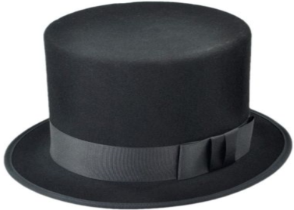
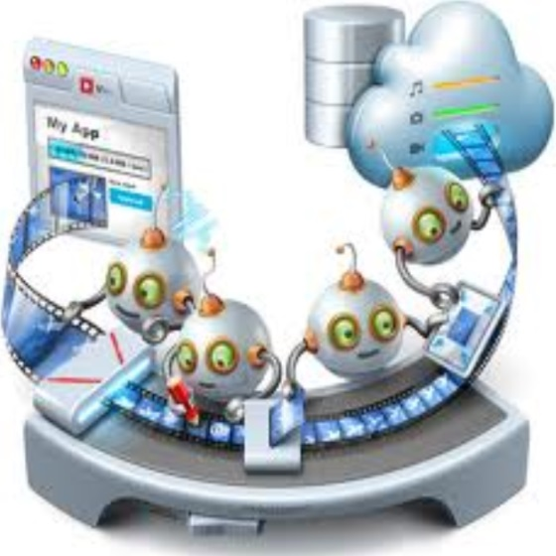
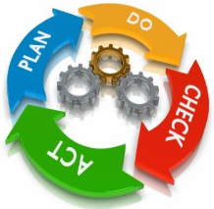
National Portal for Quality Assurance in Ukrainian Higher Education
QA
http://portal.dovira.eu
Vagan Terziyan
TRUST Project Conference
Kyiv, Ukraine
2-3.10.2014
Quality
assurance

Slide 2
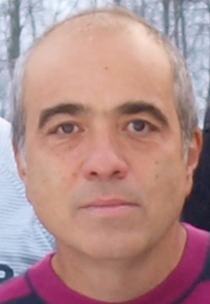
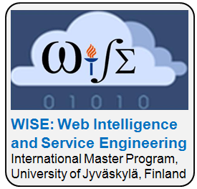
The Author and the Project
Vagan Terziyan ( e-mail: vagan@jyu.fi )
Initiator of the TRUST project activities; author of some conceptual solutions and architectures of the project;
Prof. («Distributed Systems») in University of Jyväskylä (Finland), Department of Mathematical Information Technology;
Invited Prof. in Kharkiv National University of Radioelectronics (Ukraine), Department of Artificial Intelligence;
Head of research group (Industrial Ontologies Group);
Head of International Master Program WISE: Web Intelligence and Service Engineering (http://www.mit.jyu.fi/ai/WISE_Letter.pdf) in University of Jyväskylä (Finland);
More here: http://www.mit.jyu.fi/ai/vagan
The project TRUST: “Towards Trust in Quality Assurance Systems” (funded by the EU Tempus Program) aimed at development of a unified transparent framework for the quality assurance of the Ukrainian higher education system which is in line with the common European academic culture and supports both the national reform of higher education and integration of Ukraine into the European Education Area.
http://dovira.eu

Slide 3
From The Author
Apologies for possible typos in the text. Also for the arrogant and rough style in some places (done intentionally to point out the importance of some issues and invite a solution together).
The author may not share opinions and political preferences of the cited sources of information. This presentation was not intended any political goals.
I am grateful to the anonymous photographers and artists, whose photos and pictures (or their fragments) posted on the Internet, I used in the presentation.
This project has been funded with support from the European Commission. This presentation reflects the views only of the author, and the Commission cannot be held responsible for any use which may be made of the information contained therein.

Slide 4
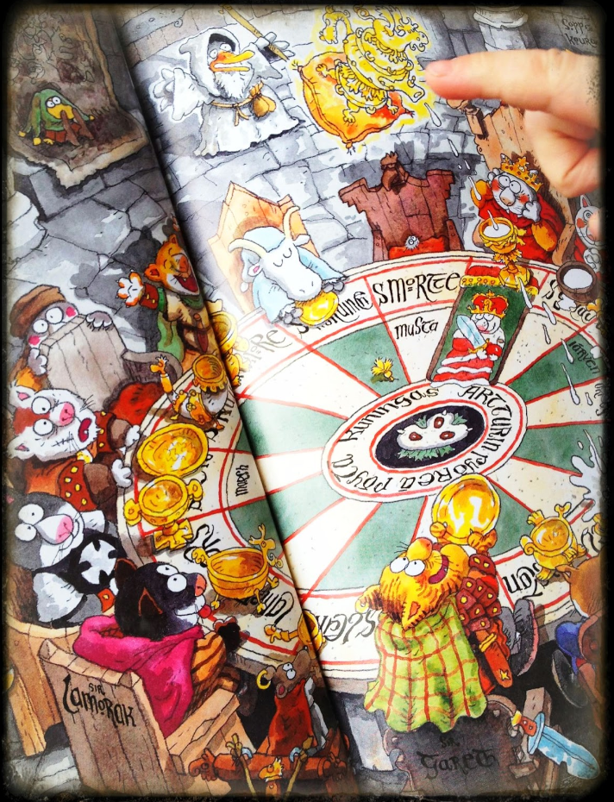
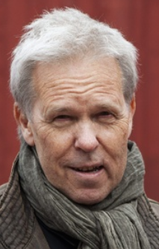
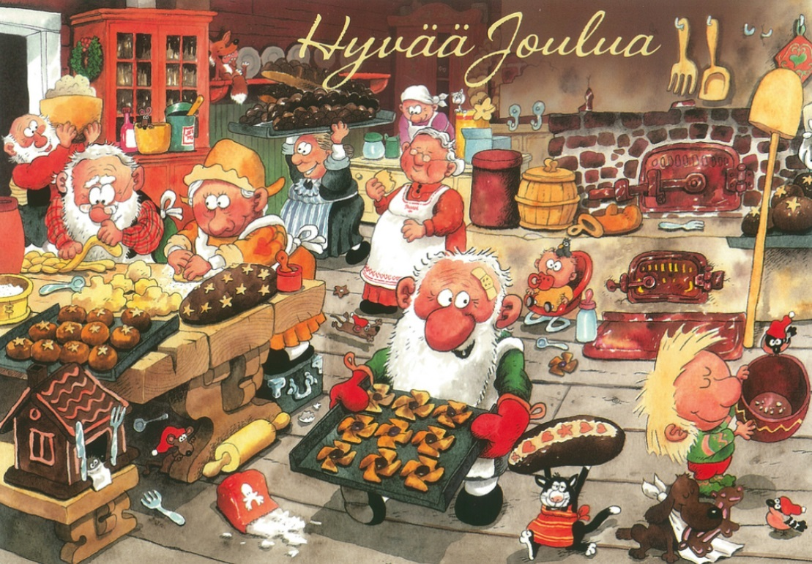
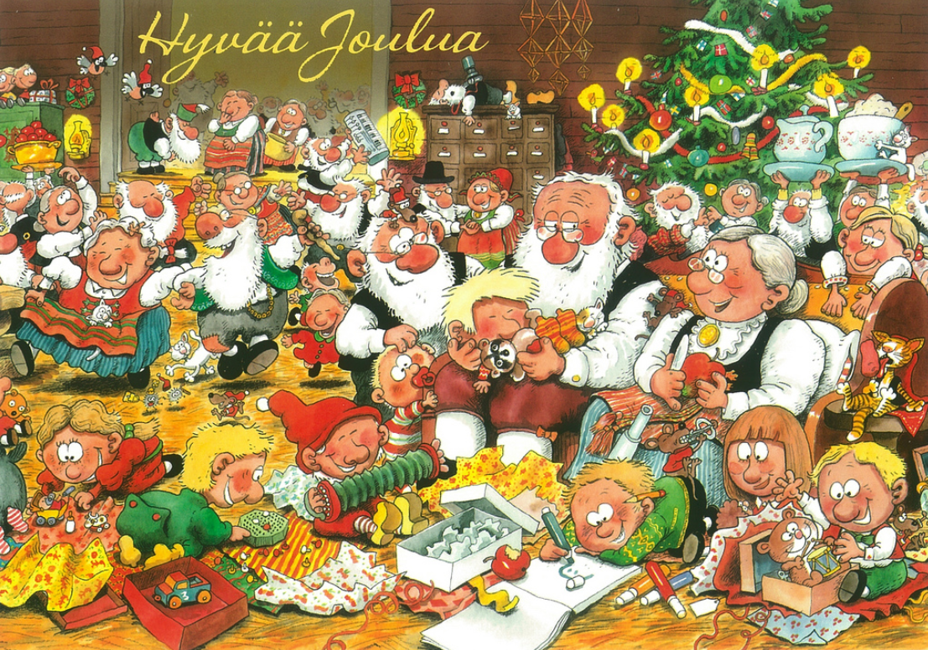
Warning, Pictures !
The presentation is oversaturated with graphics, which makes its real-time perception quite difficult. But here I've tried (as far as it is appropriate in the academic presentations) to use the approach of the famous Finnish artist Mauri Kunnas – talking pictures with the reader. Scanning the slides once again after the presentation will help to recover a comprehensive message from the senses encoded in graphics...

Slide 5
LINKS
This Presentation in PowerPoint: http://www.cs.jyu.fi/ai/Quality-3_en.pptx;
Video-version: http://www.cs.jyu.fi/ai/Quality/video;
More detailed analysis (in Russian) in the following presentations: http://www.cs.jyu.fi/ai/Quality.ppt, http://www.cs.jyu.fi/ai/Quality-2.ppt and http://www.cs.jyu.fi/ai/Quality-3.ppt (complete version of this presentation);
Web-site of the TRUST project: http://dovira.eu/ ;
Web site of the TRUST portal: http://portal.dovira.eu/
(English version under construction: http://portal.dovira.eu/en)

Slide 6
Content and Logical schema of the presentation
System of values ​​and the disruption in Ukrainian Higher Education
Transparency needed for the academic reports, evaluations, decisions and choices made, etc., and reasons behind them for the societal control
National Web-portal as a “weapon of truth"
Quality of Education and Academic Culture
Unique architecture of the portal and its potential users
Transparency can be supported by information systems but why those used by the state are not appropriate for that?
Who, how and why controls the higher education and who needs the quality?
“Highlight" of the Portal - personalized value systems
Quality Assurance vs. Endless Monitoring of the Universities
There is a need for a tool to support development of the society and formation of its academic culture and academic elite as a result of active participation within the Quality Assurance activities
What was planned, what was done, what is left for the future of the Portal
Vulnerable places in the Quality Assurance Processes of Ukrainian Higher Education
Instead of an epilogue: Portal as a "guarantor of freedom"

Slide 7
Content and Logical schema of the presentation (if to be short)
Diagnosis:
(of the Quality Assurance systems within Ukrainian higher education)
«Everything is terrible !»
Remedy:
«Transparency !!»
Rehabilitation
and
Prophylactics:
«Portal !!!»
Система ценностей и разруха в украинском высшем образовании
Нужна прозрачность отчетов, оценок, принятых решений в области образования и их причин для общественного контроля
Национальный Web-портал как "оружие правды"
Качество образования и академическая культура
Уникальная архитектура портала и потенциальные пользователи
Нужна поддержка информационными системами, но почему не подходят имеющиеся в распоряжении государства?
Кто, как и зачем контролирует образование и кому нужно его качество?
"Изюминка" Портала - персональные системы ценностей
Обеспечение качества vs. бесконечный мониторинг вузов
Нужен инструмент поддержки развития общества, его академической культуры и элиты в результате активного участия в процессах обеспечения качества
Что планировали, что реализовали и что в перспективе развития портала
Уязвимые места в процессах обеспечения качества украинского высшего образования
Вместо послесловия: портал как "гарант свободы"

Slide 8
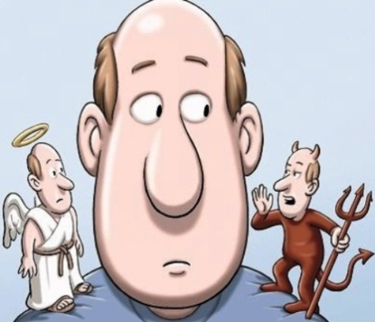
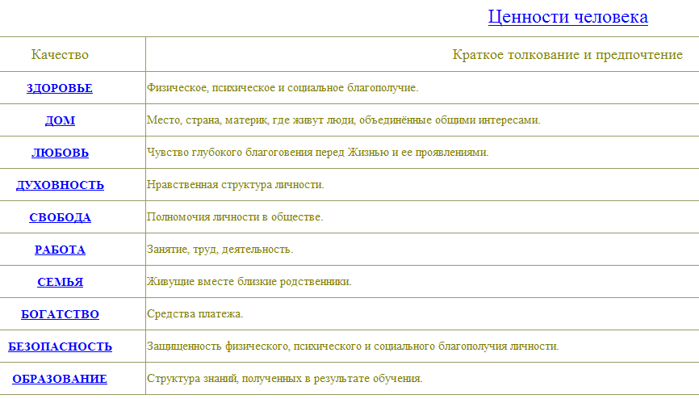
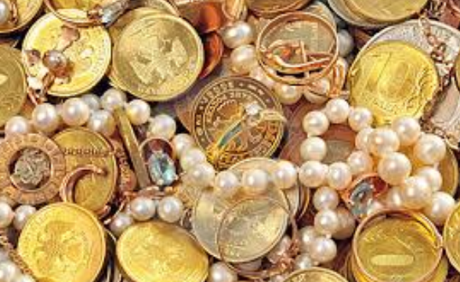
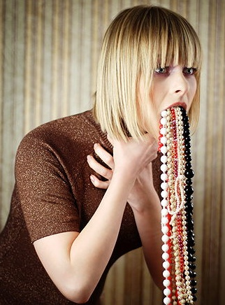
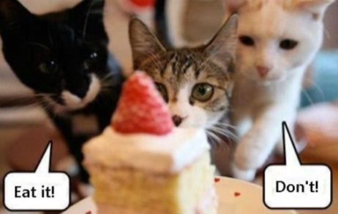
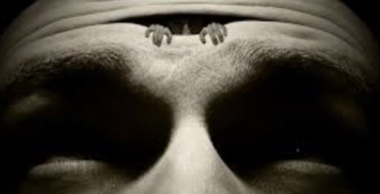
Strait to the «Value System» …
... because, before someone starts talking about the Quality Assurance it would be great, for the beginning, to ask for some clue on what actually is “good” and what is “bad” in education…

Slide 9
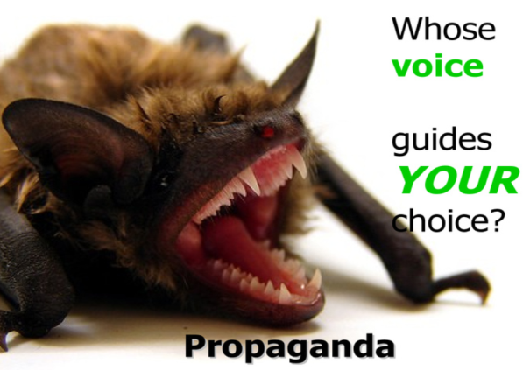
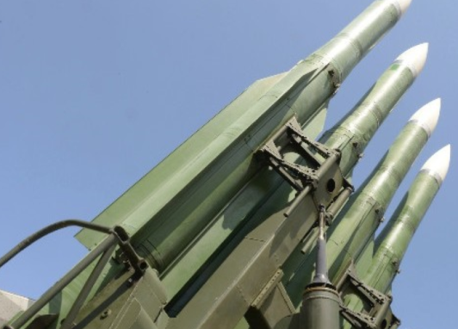
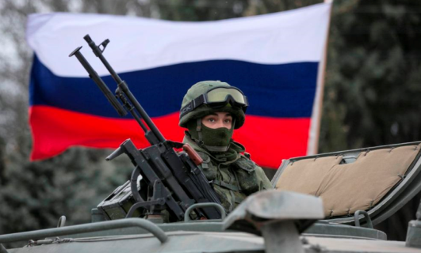
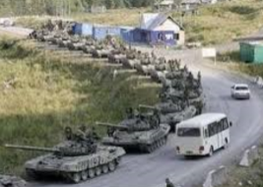
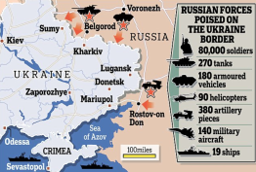
Value System and the «Information War»
A real war always begins with an information war; and the main target of the information war is the value system of a potential victim!
We demand peace!

Slide 10
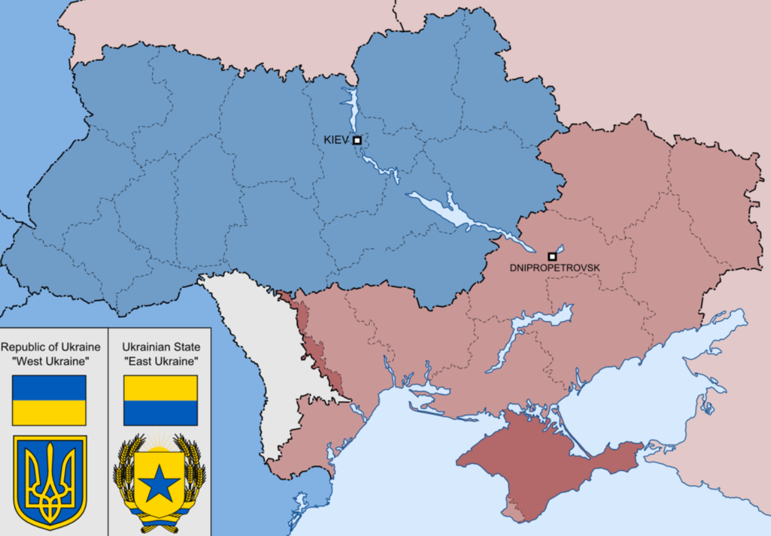
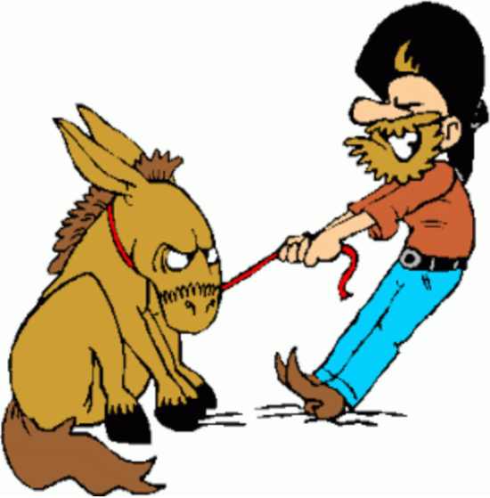
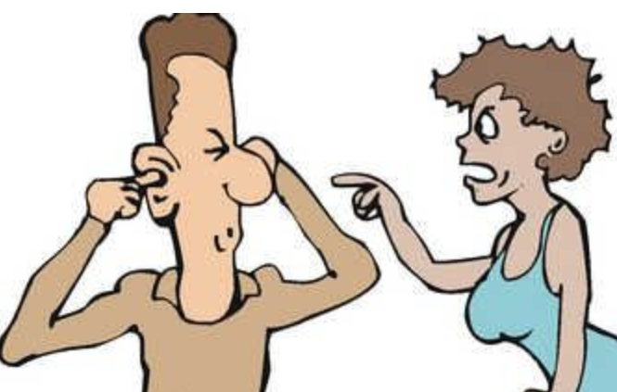
The trust «is broken»: horizontally ...

Slide 11
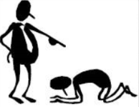
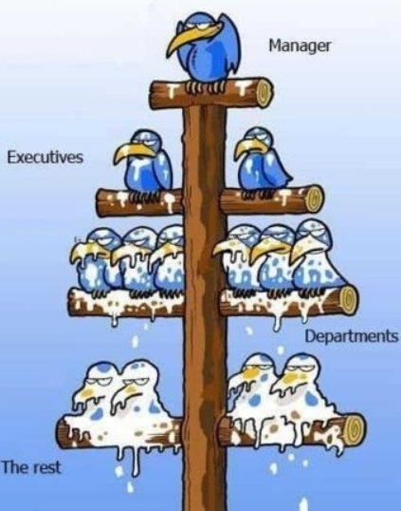
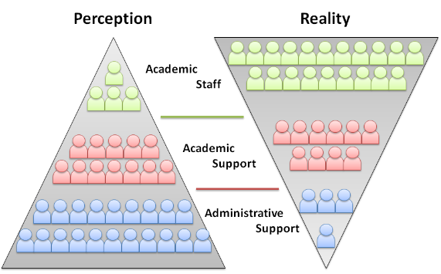
The trust «is broken»: … and vertically
Power pyramid vs service pyramid

Slide 12
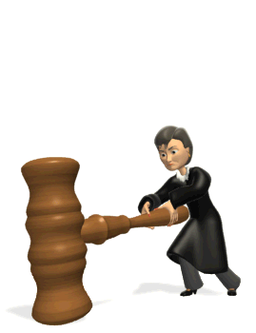
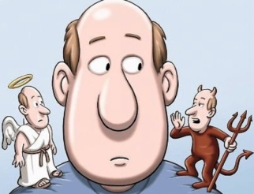
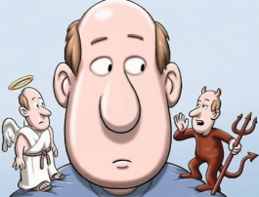
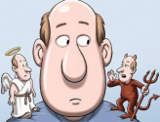
Obviously, the last few years, Ukrainian education and its system of values ​​were deliberately destroyed "from above" ...
Ukrainian
Higher
Education

Slide 13
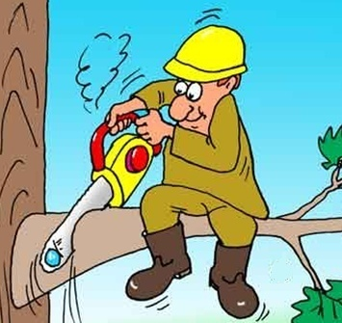
... however we also took an active part in that process!
Ukrainian
Higher
Education

Slide 14
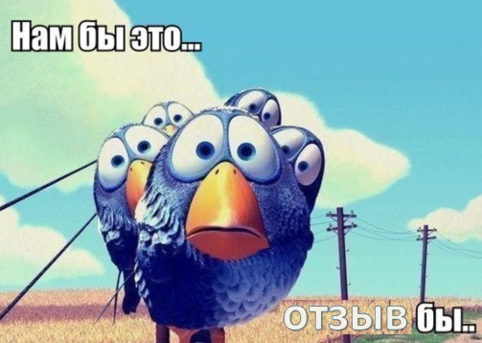
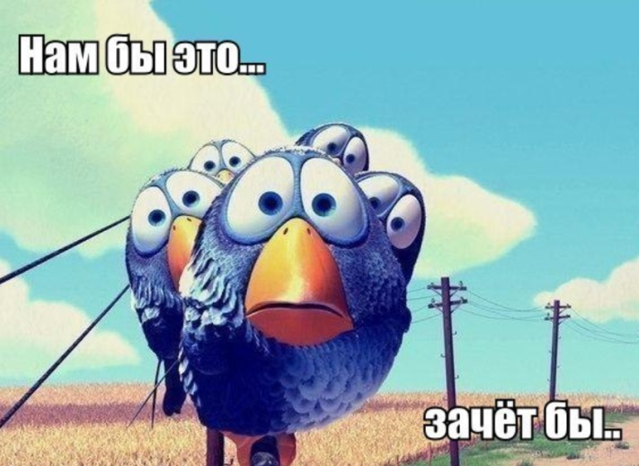
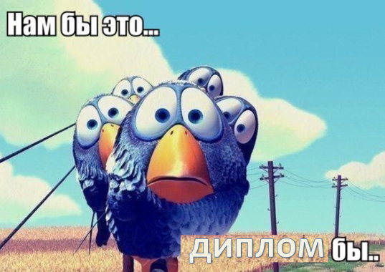
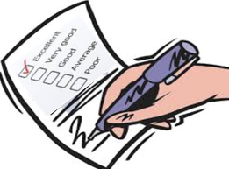
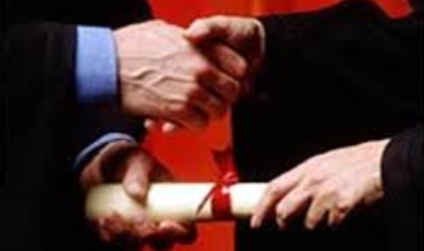
The “vicious circle”
… credits …
Give us …!
… grades …
… diploma …
... Everybody «happy», ... Are we ??!
… easy… Just sign and forget! Who cares?

Slide 15
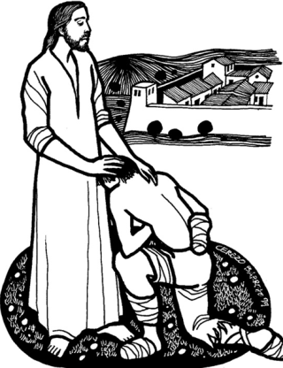
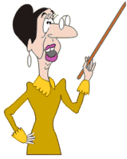
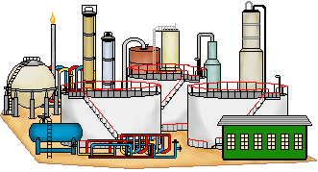
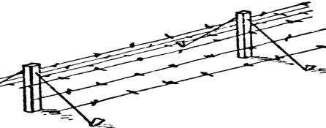
Who needs “quality” in such a system? Nobody !?!
State and officials
University administration
Academic staff
Industry
... What about us ?
Students
Society

Slide 16
So many interesting «resources» can be found as a capital of our educational system ! ...
Innovation
Scientific article
Professor
Lecture course
Project application
Student
Department
Supply
Curriculum
University

Slide 17
... each one with its unique content, essence and quality ...

Slide 18
"The worse - the better" (?), or “quality seekers" (?)
КРУ: The State
Financial Inspection
…But when these “smiling angels” come to us (usually with surprising regularity), is this (content, uniqueness, quality) they are interested in ?

Slide 19
... Looks like they are searching for something more important...
Here is their real target.
Everything has to be supplied with a lot of paper. And if the paper is absent, then it is supposed that nothing had happen, neither “the thing” itself (even if evident), nor its content, the uniqueness or the quality... But if the paper is in order, then it is no longer important if there was anything in reality and how it was... But, on the other hand, is not it our own invention, i.e., such an order, that a piece of paper in academic world matters more than content and impact? Do not we ourselves welcome such a culture as easier, clearer and more convenient one for us??
VS

Slide 20
What are expectations of our “bosses“? Is that quality ??
STATE
INSPECTORATE
Of UKRAINIAN
UNIVERSITIES
INSTITUTE OF INNOVATIVE TECHNOLOGIES
and EDUCATIONAL CONTENT
MINISTRY of
EDUCATION
and SCIENCE
of UKRAINE
VS
CAUTION,
STATISTICS !
Government agencies around the Ministry of Education and Science are more concerned about the statistics of the academic activities of the universities, and neither care much about the content nor about the quality (and impact) of the achievements...
Statistics vs. Reality
Behind a “beautiful dress” of the statistics it is convenient to hide the miserable actual content, because it is easy to fake statistics, and it is difficult to check it...

Slide 21
How the rest of the world measures quality ?
International academic community
suggests measuring the quality
of Universities’ activity not by the
“numerical statistics” of the
achievements but by their impact.
VS
CAUTION,
Statistics !
L O N G L I V E
IMPACT !
Impact is the reportable, quantifiable difference, or potential difference, that your academic achievement is making in real people’s lives. It reports payoffs and benefits to society. The focus is on public – not internal or personal – benefit.
http://www.extension.unl.edu/

Slide 22
No impact – No quality !
... First show me your Hirsch-index !

Slide 23
What is Quality Assurance ? (Consider a simple analogy)
Is not Quality Assurance !
Quality Assurance
- Lab. tests and questionnaires;
- Healthy lifestyle and prophylactics;
- Late diagnostics
(based on clear symptoms);
- Early (predictive and preventive)
diagnostics;
- Treatment (as elimination
of the consequences of
a decease);
- Treatment (as elimination of the
causes of a decease);
…
…

Slide 24
What is Quality Assurance ? (Consider a simple analogy)
Is not Quality Assurance !
Quality Assurance
… i.e., endless monitoring, reactive “manual” control, elimination of the consequences of the problems without a detailed analysis of the causes and without planning preventive measures for the future
… i.e., a regular activity aimed at guaranteeing that all the systems and processes in our body will always function as they "prescribed" by the God and the Nature ... and even better

Slide 25
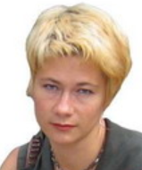
Do we have any Quality Assurance culture?
In her brilliant study (see deliverables of the project) of the official QA procedures (existing ones and standardized in Ukrainian higher education), our expert Svitlana Gryshko has concluded that the major problems are not related to the composition and structure of these procedures, but primarily with the culture of their execution by all the relevant players. Most vulnerable places in these procedures are recognized within the decision-making-points and acting in accordance with the decisions made.
“Even assuming that the autonomy of universities and other academic freedoms will be guaranteed in the new law on higher education, they earn the benefit and not harm the quality of education only if there will be a sufficient level of academic culture in Ukrainian society.” [QA Concept, Project TRUST]
Svitlana Gryshko

Slide 26
What is «Culture» ?
“Culture of an individual or a group is a systematic manner of the deliberate use of own freedom.”
Vagan Terziyan, 3 March, 2013

Slide 27
What is «Culture» and how to «compute» it ?
Culture of an individual or a group is
a systematic manner of the deliberate use of own freedom
The choice of action is done on the basis of the stable well-established system of values ​​(vector of weights of criteria for evaluating the alternatives) and its steady evolutionary dynamics (if any), and, therefore, can be predicted with the reasonable confidence and precision...
Either choice is made intentionally, with understanding the possible effects (impact) on the basis of previously accumulated (own and others') experience and knowledge, and not on the basis of instincts (as in the animal world) or random (chaotic) guessing...
We mean the freedom to choose the preferred alternative of an action from the list of possible ones in certain situations ...
3
2
1
Thus, the stable value system completely determines the culture of its host, and, because such a system can be easily formalized in mathematical terms, it allows to formalize, document, provide, upon request, visualize, analyze, compute (and so on) also the culture, as an object for possible use in the information systems and portals to support the quality assurance processes.
C U L T U R E
4

Slide 28
Let’s try to figure out where exactly are these “vulnerable places” (weak spots) in business processes (structured and formalized procedures) for quality assurance in Ukrainian higher education and how they relate to the culture.

Slide 29
Decision point within a business process
A
C
B

Slide 30
In education, as well as in other domains, all the decisions are being made as a result of some kind of «quality» assessment
Accreditation;
Licensing;
Ranking;
Monitoring;
Testing;
Student recruitment;
Attestation;
Staff recruitment;
Distribution of «portfolios», titles, budgets, grants, scholarships, prices, etc.;
Choosing objectives, methods, strategies, tactics …
…
«quality of alternatives’» assessment and decision making
Good selection and objective evaluation of alternatives is the basis of decision-making.

Slide 31
How a decision is being made ?
A
C
B

Slide 32
How a decision is being made ?
Laws, formal duties, regulations, rules, policies and instructions
Instrument
Knowledge, capabilities, experience
Personal interest, culture, value system and emotions
Input
Output
List of alternatives for the decision and relevant input data
Decision made / chosen alternative
A
C
B

Slide 33
How a decision is being made ?
Laws, formal duties, regulations, rules, policies and instructions
Comparably easy to change or reconfigure
Knowledge, capabilities, experience
Personal interest, culture, value system and emotions
List of alternatives for the decision and relevant input data
Decision made / chosen alternative
A
C
B

Slide 34
How a decision is being made ?
Laws, formal duties, regulations, rules, policies and instructions
More difficult to change as it demands staff training or replacement
Knowledge, capabilities, experience
Personal interest, culture, value system and emotions
List of alternatives for the decision and relevant input data
Decision made / chosen alternative
A
C
B

Slide 35
How a decision is being made ?
Laws, formal duties, regulations, rules, policies and instructions
Knowledge, capabilities, experience
Extremely difficult to capture, recognize, predict, influence and drive the change …
Personal interest, culture, value system and emotions
List of alternatives for the decision and relevant input data
Decision made / chosen alternative
A
C
B

Slide 36
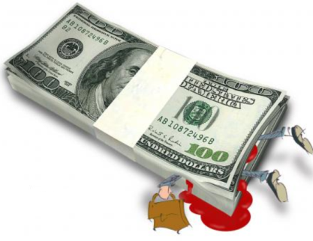
How a decision is being made?
Laws, formal duties, regulations, rules, policies and instructions
Knowledge, capabilities, experience
… and this is the most vulnerable place (week spot) for the corruption!
Personal interest, culture, value system and emotions
List of alternatives for the decision and relevant input data
Decision made / chosen alternative
A
C
B

Slide 37
How a decision is being made?
Laws, formal duties, regulations, rules, policies and instructions
Knowledge, capabilities, experience
Personal interest, culture, value system and emotions
List of alternatives for the decision and relevant input data
Decision made / chosen alternative
A
C
B

Slide 38
Who will win ? ...
We will destroy the corruption with the reforms!
We will destroy the reforms with the corruption!

Slide 39
Portal «TRUST» as a «Weapon of Truth»
TRUST Portal must become a "weapon of truth" or a tool for ensuring transparency (for the society) of assessments and decisions made by the authorities and officials in the field of higher education and the possibility of operational impact on them.
TRUTH
«TRUST»
Semantic Portal
TRUTH
TRUTH
TRUTH
http://portal.dovira.eu

Slide 40
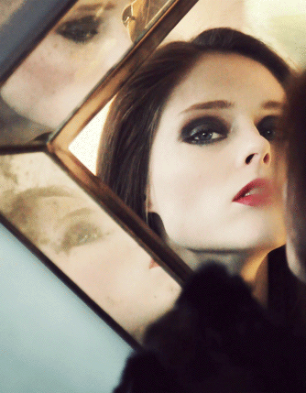
What does the TRUST Portal think about me?
Am I not the fairest of them all? ..

Slide 41
Who needs the truth ?
I swear to tell the truth, the whole truth, and nothing but the truth…

Slide 42
Who needs the truth?
… and who the …
needs your truth ?!! …
«Comfort Zone», «TruthPhobia», «Self-Deception» ?
Everyone prefers own truth...

Slide 43
Who needs the truth?
«… and you will know the truth, and the truth will make you free»
(Gospel of John 8:32)
Long live autonomy!
Long live federalization!..
... And plenty of money!
Possession of Rights and freedom do not imply the wish and the capability to use them!
Freedom … What is this?
… What for ??
… How is that ???

Slide 44
Human Development is about “expanding the choices people have, to lead lives that they value…”
[Streeten, P. (1994). "Human Development: Means and Ends". Human Development (84.2): 232–237]
Human Development is the process of widening the spectrum and the quality of possible own choices
Human
Development

Slide 45
Six Pillars of Human Development http://hdr.undp.org/en/humandev
HUMAN DEVELOPMENT
Productivity
full personal participation in the process of the common income generation
Empowerment
the freedom of the people to influence development and decisions that affect their lives
Cooperation
belonging to communities for mutual enrichment
Equity
Security
Sustainability

Slide 46
TRUST Portal as a tool for human development
Abstract: Education is recognized as a fundamental enabler of human development. The adoption of information and communications technologies (ICTs) by education (especially in developing countries) contributes to educational system reforms, in addition to the traditional advantages, such as social openness and accessibility. Yet the academic community has not studied sufficiently the challenging context in which ICTs are used as instruments for the reform of inefficient, and sometimes even corrupted, educational systems rather than just as means for smarter classrooms, remote access, or content management. The object of this study is Ukrainian higher education (HE) and its quality assurance (QA) system, which appears to be neither flexible nor transparent. We offer an ICT solution to provide the needed transparency. We show that such transparency is urgently needed for the structural reform of this system, in order to empower people and recover their trust and respect toward HE. The solution is based on ontology-driven portal as a digital ecosystem for national QA. We show how the content of the portal can be managed and verified based on users’ social activity and reputation management, and how the quality evaluations of different players can be made with personalized procedures and quality indicators.
Terziyan V., Golovianko M., Shevchenko O., Semantic Portal as a Tool for Structural Reform of the Ukrainian Educational System, In: P. Soja and P. Rupino da Cunha (Eds.), ICT in Transition Economies: Narrowing the Research Gap to Developed Countries, Special Issue in: Information Technology for Development, Taylor & Francis Group, 22 pp. (doi: 10.1080/02681102.2014.899955).
“… In this study we assumed that a reform of the HE system can be facilitated by a transparent bottom-up public-initiated and public-driven activity, which itself can be qualified as a human development process. We have shown that the quality assurance as a complex of activities enhancing effectiveness of an educational system is an important enabler of human empowerment. We pointed out that the greatest damage to the quality of higher education in … Ukraine, is due to the fact that … the governmental officials … seem to encourage the institutionally based culture of corruption in higher education and use QA practices primarily for control and punishment purposes. The main beneficiary of educational services quality – society – is left out of the quality monitoring and management. In our research we show that taking part in public QA activity would be a shortcut to participatory development by enhancing human autonomy and strengthening the conviction that an individual and the overall society can take responsibility for state decision-making...”

Slide 47
Intended Portal Architecture based on «Cloud Computing» and «Linked Data» technologies
Information
Information
Information
«Software robots» – intelligent agent-driven interfaces and Web-services
Metadata
!
Ontology-driven storage
«Cloud» of «personalized value systems»
“Object” under
evaluation
Result of evaluation according to chosen method («value system»)
Value System
User

Slide 48
ATTENTION! The main compromise: Trusted sources of impeccable (carefully verified) information, with subjective but transparent evaluation methods on top
Information
Information
Information
The area of
«strict requirements for trust»
Ontology-driven storage
The area of
«free and transparent
choice»
The “Cloud”
of personalized
«value systems»
Compromise principle: «subjective opinions and evaluations on the basis of objective data and facts».

Slide 49
Major components of a personal «value systems» in terms of «Business Intelligence»
Components of a Value System:
Quality indicators;
What is good and what is bad among quality indicators (“+” or “–” attached to weights in the formula);
Absolute Importance of an indicator (absolute values of weights normalized to [0,1]);
Harmony of Indicators (relative importance of the indicators or covariance matrix);
Choice-of-decision-function weights;
Trust-to-information-sources weights;
Meta-Indicators (weights of importance for imported value systems)
Business Intelligence – «The road from data to evaluations and decisions supported by analytics»

Slide 50
«What is good?» Creation of the personal «value system» (1)“price-list” based on taxonomy of achievements

Slide 51
«What is good?» Creation of the personal «value system» (2)“price-list” based on impact of achievements
impact
Amount of pages
Impact factor of the journal
Sales of copies (sum)
Amount of citations
Amount of downloads

Slide 52
«What is bad?» (negative quality indicators or “penalty-fee-list”)
anti-achievement (type1)
-
-
anti-achievement (type2)
-
-
anti-achievement (type3)
-
-
anti-achievement (type4)
-
-
anti-achievement (type5)
-
-
anti-achievement (type6)
-
-
anti-achievement (type7)
-
-
anti-achievement (type8)
-
-
Examples of «anti-achievements» (decreasing the overall quality score):
The fact of "rollback" in public procurement;
The illegal issue of the diploma;
The illegal enrollment in high school;
Teacher’s corruption fact;
Plagiarism in the Ms thesis work;
Plagiarism in the PhD thesis work;
The fact of deliberate distortion of reported data;
Fact of the of professional ethics violation;
…

Slide 53
Trust to the sources of information as a component of the value system
http://www.5.ua/
http://www.pravda.com.ua
http://grani.ru
http://izvestia.ru/
http://kp.ru
0 | 0 | 0.2 | 0.8 | 0.8 | 0.9
0.9 | 0.9 | 0.7 | 0.1 | 0 | 0.1
The difference in value systems - the basis of the intransigence of cultures

Slide 54
Value «Meta-Systems» (importing and composing from existing value systems)
Normalized “trust coefficient”
0.1
0.4
0.2
0.05
0.25

Slide 55
How to select the attributes correctly ?
Ontology
It would be unwise to create such attributes in the storage, which in their nature involve statistics, and therefore will require constant updating.
БД
“Сотрудники”
“People”
Vagan Terziyan
Bad !!!

Slide 56
How to select the attributes correctly ?
Ontology
“Statistical” attributes have to be automatically computed by the embedded software procedures instead of manual supply.
БД
“Сотрудники”
“People”
Σ
Instance
counter
Vagan Terziyan
Good !!!

Slide 57
All attributes are “statistical” (i.e., wrong for DBs)!
(existing structure of HEI’s obligatory report for the quality monitoring)
Кількість
Number of
Чисельність
?

Slide 58
Ideal architecture to organize the data: ontology-driven system of registers organized as LINKED DATA
“Publications”
Ontology
“People”
“Universities”

Slide 59
Collection and Verification vs. Processing and Presentation of the information …
State
register(s)
QA-Portal
… - “these are two big differences “ !
API
User

Slide 60
Problem!
Reference:
Originally the Portal was conceived only as an analytical add-on to the state academic registers, but in fact we had to create all the needed registers because of their absence (or API-unavailability) in the state institutions.
API
State
register(s)
QA-Portal
… They appeared to be either absent, or they were not capable to provide access via application programming interfaces (i.e., they were useless for the Portal objectives).
API
User
http://www.ugorod.kr.ua/news/2012-07-28-15064.html

Slide 61
… Therefore, to provide the Portal with the data, it was necessary to find (temporary?) replacement of such (as in this slide) architecture, where the state institutions collect, own and control the information …
Portal
User Interface
State Register
User

Slide 62
Social Register
… We had to create a system of "social" in fact registries to be filled and managed through Web-interfaces by personal representatives (volunteers) of the academic community. This made it possible to fill the registers (aka social networking activity) on a fully voluntary basis without the involvement of an administrative pressure…
WWW
WWW
WWW
User
Contributor’s Interface
… which means that the society have to take over also the duties of information verification and certification …

Slide 63
Web Portal
Abstract Architecture of the Portal
User Interface
User-Contributor
User-Observer

Slide 64
Web Portal
The architecture combined academic registers into an integrated system, controlled by the "Higher Education" domain ontology (in accordance with the SEMANTIC WEB technology standards), and provided a single WEB-interface to enter and retrieve the information. This information is presented within the portal as LINKED DATA (metadata) and stored along with the procedures (services) for its analytical processing in accordance with the CLOUD COMPUTING technology. This means that the user is able to use the portal’s computer infrastructure, software platforms, personal storage space and analytics, analytical software services, and so on ... remotely via the WEB-interface.
Abstract Architecture of the Portal
User Interface
User-Contributor
User-Observer

Slide 65
The main page of the portal looks like this now
http://portal.dovira.eu/en

Slide 66
… However it has been planned like this ...
It was assumed that this set of functions will be provided by the state registers
The portal should only provide this functionality (in the form of personalized analytics, driven by value-systems-based ranking of individuals and organizations), with the possibility to automatically query needed information from the remote state registers

Slide 67
... But in reality we have to do it so ...

Slide 68
... Moreover, in addition we have to develop also this !
Lacking “administrative resource”, and following the principles of the societal portal concept, it was necessary to find additional motivation for members of the academic community to enter their information into the registers of the portal (in fact to become our co-developers). Just for that we have to develop this package ("Personal Academic Web-Portfolio"), a convenient and useful service for everyone.

Slide 69
... As a result the portal offers today three service packages
20%
The approximate efforts’ ratio
55%
25%

Slide 70
Portal’s Development Team
They did it !
Designers-
analysts
Менеджер
Software Engineers
Менеджер
http://portal.dovira.eu

Slide 71
Portal’s Development Team
They did it !
Designers-
analysts
Менеджер
Overall evaluation of their work: «underoverdone»
… i.e., they have done much more than it has been planned And much more than were even possible with available resources (financial, constrained time and administrative support), ... But less than it has been dreamed and was conceptually feasible.
Software Engineers
Менеджер
http://portal.dovira.eu

Slide 72
What’s left for the future ? (1)
As the ЄДЕБО database (www.edbo.gov.ua) has recently reported launching a new module "Researchers and Teachers”, which is supposed to serve as the official register of the academic staff of universities with their achievements, we will keep in mind interesting opportunity to establish an automatic link between the Portal and the ЄДЕБО (when available) through the Web services over SOAP protocol and receive additional benefits from the interaction of the principles, capabilities and procedures of public and social repositories of academic information.

Slide 73
What’s left for the future? (2)
Modify the experimental prototype to full and ready for a large-scale operation version, adapting it to the infrastructure of the future owner ("host") (e.g., "an independent national quality assurance agency", if such will be established and will meet our Concept);
Share experiences and architecture of the portal to other domain areas (other than education), adopting appropriate business models;

Slide 74
What’s left for the future? (3)
Add the capability of the automatic formation of integrated value systems (and thus rankings) on the basis of personal ones;
Implement the “reputation management and social verification” subsystem;
Add the option of “off-line” participation in collaborative decision-making being represented by own value system;
Add the functions of capturing dynamics and making trend analysis for the value systems and for the interpenetration of the academic cultures for individuals, organizations and groups;

Slide 75
What’s left for the future? (4)
Significantly improve access-control features, data integrity, security and privacy;
Further development of the multi-lingual interface;
Adding services on user-driven ontology management with automatic generation of new registers and corresponding interfaces for their filling;
Special function on societal voting on various expert nominations;
…

Slide 76
Who has to be the Portal’s owner: state or society ?
If the Portal - a "weapon of truth", then it must be used either:
(1) by people and their academic elite to control the activities of the officials; or
(2) by the state and officials to gain control over the people and the academic elite.
Our preference is:
(3) the Portal evolving into a tool of trust and cooperation between all the parties!

Slide 77
President Poroshenko about Values and Dignity
“Ukraine’s war is the only war of the last decade that is purely about values… “Values come first” – this is the truth the West would remind Ukraine of over the last years. Now it is Ukraine’s turn to remind the West of this truth!”
“We called our revolution the Revolution of Dignity. Human dignity was the driving force that took people to the streets. This revolution must result in an education of dignity, an economy of dignity, and a society of dignity… Human dignity is the one thing we have to oppose to the barbarism of those attacking us.”
“Война в Украине - это единственная война за последнее десятилетие, которая является исключительно «войной ценностей» ... "Ценности превыше всего" - это правда, которую Запад напоминал Украине в течении последних лет. Теперь очередь Украины напомнить Западу эту истину!”
“Мы назвали нашу революцию «революцией достоинства». Достоинство было движущей силой, которая вывела людей на улицы. Эта революция должна привести к достоинству и в образовании, и в экономике и в общественной жизни… Достоинство это то, что мы должны противопоставить варварству тех, кто нападает на нас.”
Address by the President of Ukraine Petro Poroshenko to the Joint Session of the United States Congress, 18 September, 2014
Dignity armed by the truth always wins!
TRUTH
Propaganda
”Что есть достоинство без честности?”

Slide 78
We hope,
we TRUST,
We contribute!
Serhiy Kvit
(Minister of Education):
«Law «On Higher Education» must become an Instrument for improving the quality of Ukrainian education»
At 6 September, 2014, there was a Forum on the implementation of the new law «On Higher Education» - for the administrative staff of Ukrainian universities.
Liliya Grinevych
(Chair of the Parliamentary Committee for Science and Education):
«The only objective – real improvement of the quality of our higher education and the educational system to become globally competitive…»
Arseniy Yatsenyuk
(Prime-Minister):
«Ministry of Education has to develop only the state policies in education, and not controlling every University, neither appoint rectors, … nor decide to whom give the state order for the graduates and to whom not».
Smells like a freedom !.. But ...

Slide 79
Freedom can be different !
Freedom!
Freedom Independence Autonomy
A “sick” value system directs freedom into evil
Long live an autonomy of universities !
Long live a students’ self-governance !!
Long live an independent Quality Assurance agency !!!
... think 1000 times, before granting freedom (autonomy, independence, …) to somebody, why and to whom, whether they are worthy of freedom and they know what to do with it for the prosperity (not for the opposite) of the society.

Slide 80
Prove your right for the “freedom” straight at the Portal !
(… for example, the right to be an expert of an independent QA agency and to freely judge others)
Here it is Portfolio of my achievements (so I know how to work)!
My rank at the Portal appeared to be the highest among all the experts in this domain ! So I am getting the mandate of public confidence in my right to judge others!
Here it is my Value System (I will make my decisions accordingly) !
“Don’t give that which is holy to the dogs, neither throw your pearls before the pigs, lest perhaps they trample them under their feet, and turn and tear you to pieces”
(Gospel of Matthew 7:6)
Who are the judges?!

Slide 81
I am free now!
I have created my portfolio at the TRUST-Portal

Slide 82
All Conclusions in one «formula»
Impact - is a Quality
Quality assurance - is a Transparency
Transparency - is a Portal
Portal - is a weapon of Truth
Truth - is a Freedom
Freedom – is a new impact

Slide 83
Thank you !
http://dovira.eu/
http://portal.dovira.eu/
Impact
Freedom
Quality
Truth
Transparency
Portal
http://www.cs.jyu.fi/ai/Quality-3_en.pptx
http://www.cs.jyu.fi/ai/Quality/video

Slide 84
You will overcome someday !..
“Struggle – you will overcome, God helps you! The truth, the glory and the holy will are on your side!”
T.G. Shevchenko, 1845
Glory to Ukraine !
Glory
to Heroes !
“…and on the recovered land there will not be any enemy. There will be son, there will be mother there will be people on the land”
(T.G. Shevchenko, 1860)
I Ukraine

