Slide 1
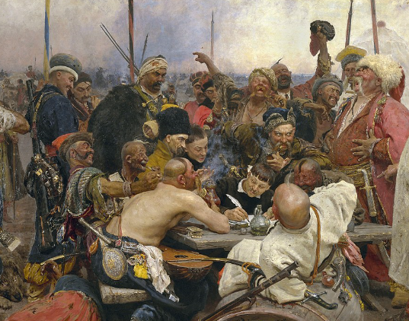
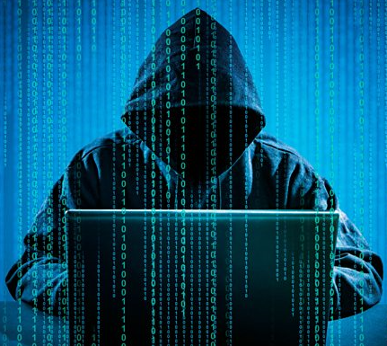
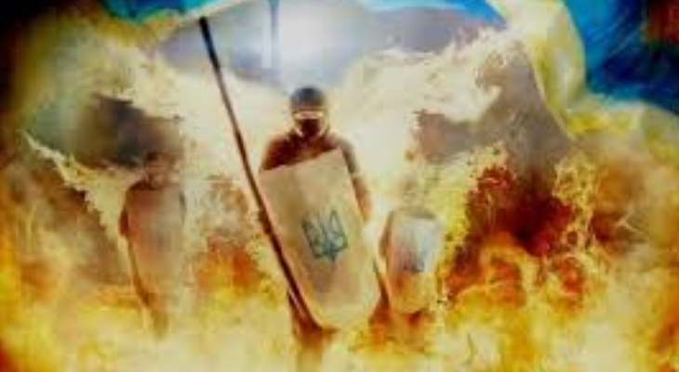
Academic Response to Hybrid Threats:
Adversarial Learning Against Cognitive Hacking
Vagan Terziyan
University of Jyväskylä,
FINLAND

Slide 2
“Russian” has been chosen as a language for this speech as well as for being a backup language for “English” in some slides of this presentation … After few slides you will understand why …

Slide 3
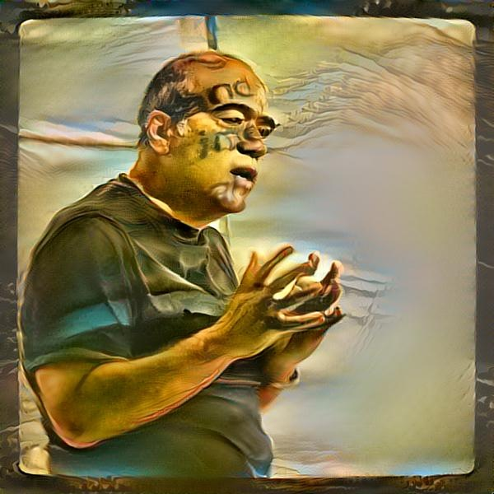
The lecturer
Vagan Terziyan
Professor: Distributed Systems (University of Jyväskylä);
Visiting Professor: Artificial Intelligence (Kharkiv National University of Radioelectronics);
Head of Master Programs:
WISE: “Web Intelligence and Service Engineering”
COIN: “Cognitive Computing and Collective Intelligence”
Background: Applied Mathematics; Artificial Intelligence (40+ years of experience)
Interest: Artificial Intelligence …

Slide 4
I am grateful to the anonymous photographers and artists, whose photos and pictures (or their fragments) posted on the Internet, have been used in the presentation.

Slide 5
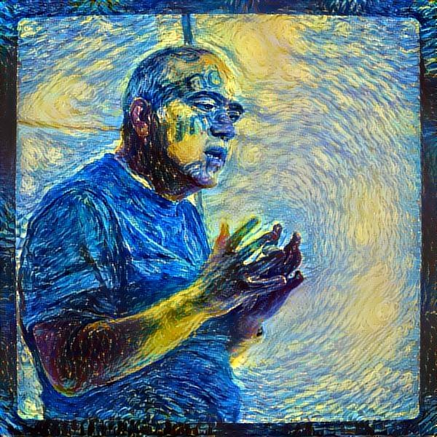
Instead of
the foreword
"Совесть - это устойчивая эмоция, пропорциональная абсолютной величине разности между собственной (задекларированной для самого себя) системой ценностей и той, которая в реальности лежит в основе твоих поступков.” Ваган Терзиян (4 декабря, 2019)
“Conscience is a sustainable emotion proportional to an absolute value of the difference between your own (declared for yourself) value system and the one that in reality underlies your actions.” Vagan Terziyan (4 December, 2019)
Do not confuse conscience (совесть) with consciousness (сознание)
(вместо
предисловия)
"Научись любить и защищать свою совесть - сбережешь и самого себя, и свою страну” Ваган Терзиян (27 февраля, 2020)
“Learn to love and protect your conscience - you will save both yourself and your country” Vagan Terziyan (27 February, 2020)

Slide 6
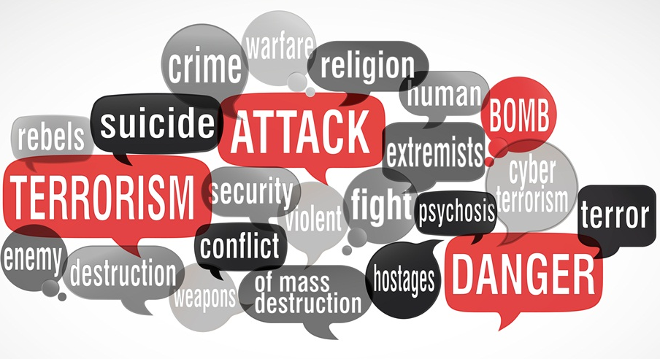
We will be talking about Hybrid Threats (HT). What is the key aspect of HT and WARN team concern?

Slide 7
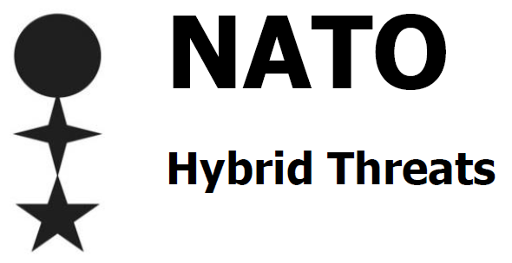
Terminology
War and Warfare: conventional vs. irregular vs. hybrid
The term “Hybrid War” refers to a conflict where both/all sides involved use “Hybrid Warfare” that combines conventional (regular), irregular and other approaches to combat.
Conventional (regular) warfare is, according to NATO’s definition, warfare where regular opponents, officially enlisted by state, are engaged and regular tactics and activities are used, while respecting international treaties, conventions and laws.
Irregular warfare is according to available NATO’s definitions a warfare that denotes a form of conflict, where one or more protagonists adopt irregular methods and favors indirect and asymmetric approaches, e.g., irregular troops or any combatants not formally enlisted in the armed forces of a nation-state or other legally constituted entity. These are likely to rely on local support, fight in the target place and they are often hard to distinguish from local civilians. The irregular opponents’ tactic will often include undermining and eroding target’s will and determination. The tactic also includes avoiding regular decisive deployment of national forces, and if necessary, then preferably under the terms and circumstances chosen by the irregular opponents.
Hybrid warfare in NATO’s view is a violent conflict applying combination and simultaneous use of conventional and irregular warfare, involving both state and non-state actors, used adaptively in pursuit of their objectives and not limited to physical battlefield or territory. Each attack contains its own combinations and mutations of the two and targets further aspects of state and society to undermine it and reach its goals. Hybrid warfare can be employed in conflicts not only by states and armed forces but also by a variety of actors beyond the authority of states (such as separatists, terrorist, extremist or other criminal groups). Even though the phenomenon is hardly new, what is new and surprising is the “scale of use and exploitation of old tools in new ways.”

Slide 8
Terminology
War and Warfare: conventional vs. irregular vs. hybrid
The term “Hybrid War” refers to a conflict where both/all sides involved use “Hybrid Warfare” that combines conventional (regular), irregular and other approaches to combat.
Conventional (regular) warfare is, according to NATO’s definition, warfare where regular opponents, officially enlisted by state, are engaged and regular tactics and activities are used, while respecting international treaties, conventions and laws.
Irregular warfare is according to available NATO’s definitions a warfare that denotes a form of conflict, where one or more protagonists adopt irregular methods and favors indirect and asymmetric approaches, e.g., irregular troops or any combatants not formally enlisted in the armed forces of a nation-state or other legally constituted entity. These are likely to rely on local support, fight in the target place and they are often hard to distinguish from local civilians. The irregular opponents’ tactic will often include undermining and eroding target’s will and determination. The tactic also includes avoiding regular decisive deployment of national forces, and if necessary, then preferably under the terms and circumstances chosen by the irregular opponents.
Hybrid warfare in NATO’s view is a violent conflict applying combination and simultaneous use of conventional and irregular warfare, involving both state and non-state actors, used adaptively in pursuit of their objectives and not limited to physical battlefield or territory. Each attack contains its own combinations and mutations of the two and targets further aspects of state and society to reach its goals. Hybrid warfare can be employed in conflicts not only by states and armed forces but also by a variety of actors beyond the authority of states (such as separatists, terrorist, extremist or other criminal groups). Even though the phenomenon is hardly new, what is new and surprising is the “scale of use and exploitation of old tools in new ways.”
Attacker and its tactics are officially recognized
Attacker and its tactics are hidden
from being exposed officially
Attacker and its tactics are combination of officially recognized and hidden ones

Slide 9
Гибридная Война

Slide 10
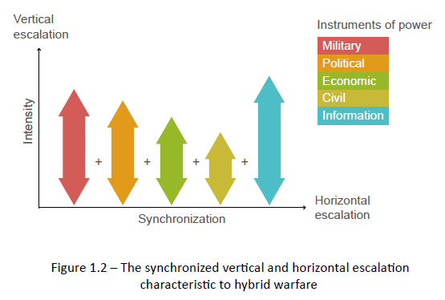
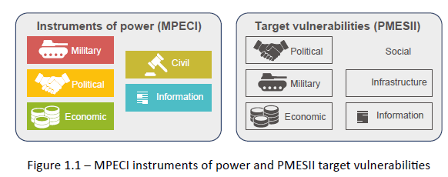
Vertical and Horizontal Dimensions of Hybrid Warfare
In: https://assets.publishing.service.gov.uk/government/uploads/system/uploads/attachment_data/file/784299/concepts_mcdc_countering_hybrid_warfare.pdf a conceptual model was developed for understanding hybrid warfare. The model was agnostic to the type of aggressor (for example, state or non-state actor) but focused on state-actors as the target. It was based on the following key characteristics:
The combined use of multiple instruments of power to achieve asymmetry through targeting an expanded range of vulnerabilities.
A synchronized attack package that exploits both horizontal and vertical axes of escalation.
An emphasis on creativity and ambiguity to achieve synergistic effects (including in the cognitive domain).
The model describes how an actor engaging in hybrid warfare may use a wide range of military, political, economic, civilian and informational (MPECI) instruments of power aimed at the political, military, economic, social, informational and infrastructure (PMESII) vulnerabilities of a target system, to escalate in ‘vertical’ and ‘horizontal’ terms to achieve the desired goals while avoiding or complicating decisive counteraction. The instruments of power and vulnerabilities are shown in Figure 1.1, while the concept of synchronizing the instruments of power is visualized in Figure 1.2.

Slide 11
Vertical and Horizontal Dimensions of Hybrid Warfare
In: https://assets.publishing.service.gov.uk/government/uploads/system/uploads/attachment_data/file/784299/concepts_mcdc_countering_hybrid_warfare.pdf a conceptual model was developed for understanding hybrid warfare. The model was agnostic to the type of aggressor (for example, state or non-state actor) but focused on state-actors as the target. It was based on the following key characteristics:
The combined use of multiple instruments of power to achieve asymmetry through targeting an expanded range of vulnerabilities.
A synchronized attack package that exploits both horizontal and vertical axes of escalation.
An emphasis on creativity and ambiguity to achieve synergistic effects (including in the cognitive domain).
The model describes how an actor engaging in hybrid warfare may use a wide range of military, political, economic, civilian and informational (MPECI) instruments of power aimed at the political, military, economic, social, informational and infrastructure (PMESII) vulnerabilities of a target system, to escalate in ‘vertical’ and ‘horizontal’ terms to achieve the desired goals while avoiding or complicating decisive counteraction. The instruments of power and vulnerabilities are shown in Figure 1.1, while the concept of synchronizing the instruments of power is visualized in Figure 1.2.
Attacker (state or non-state actor) uses synchronously a variety of instruments against a variety of vulnerabilities of a target (state actor)

Slide 12
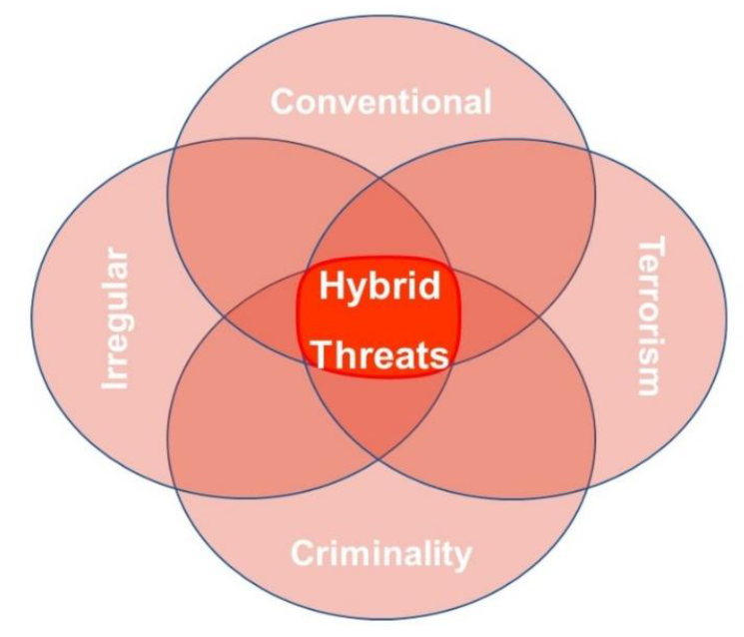
We live in an era of hybrid threats. The range of methods and activities around hybrid threats is wide, including: influencing information; logistical weaknesses like energy supply pipelines; economic and trade-related blackmail; undermining international institutions by rendering rules ineffective; terrorism or increasing insecurity. Hybrid threats are methods and activities that are targeted towards vulnerabilities of the opponent. Vulnerabilities can be created by many things, including historical memory, legislation, old practices, geostrategic factors, strong polarization of society, technological disadvantages or ideological differences. If the interests and goals of the user of hybrid methods and activity are not achieved, the situation can escalate into hybrid warfare where the role of military and violence will increase significantly.
Hybrid Threat is a coordinated and synchronized activity, that deliberately targets democratic states’ and institutions systemic vulnerabilities, through a wide range of means. The aim of the activity is to influence different forms of decision making at the local (regional), state, or institutional level to favor and/or gain the agent’s strategic goals while undermining and/or hurting the target.
NATO has identified several actions as hybrid threats. Among them are: multimodal, low intensity, kinetic and non-kinetic threats to international peace and security including cyber war, low intensity asymmetric conflict scenarios, global terrorism, piracy, transnational organized crime, demographic challenges, resources security, retrenchment from globalization and the proliferation of weapons of mass destruction.
Hybrid Threat
https://www.hybridcoe.fi/hybrid-threats/
Гибридная угроза - это скоординированная и синхронизированная деятельность, которая преднамеренно нацелена на системные уязвимости демократических государств и институтов с помощью широкого спектра средств. Целью этой деятельности является влияние на различные формы принятия решений на местном (региональном), государственном или институциональном уровне для поддержки и / или достижения стратегических целей агента, одновременно подрывая и / или нанося ущерб цели.

Slide 13
We live in an era of hybrid threats. The range of methods and activities around hybrid threats is wide, including: influencing information; logistical weaknesses like energy supply pipelines; economic and trade-related blackmail; undermining international institutions by rendering rules ineffective; terrorism or increasing insecurity. Hybrid threats are methods and activities that are targeted towards vulnerabilities of the opponent. Vulnerabilities can be created by many things, including historical memory, legislation, old practices, geostrategic factors, strong polarization of society, technological disadvantages or ideological differences. If the interests and goals of the user of hybrid methods and activity are not achieved, the situation can escalate into hybrid warfare where the role of military and violence will increase significantly.
Hybrid Threat is a coordinated and synchronized activity, that deliberately targets democratic states’ and institutions systemic vulnerabilities, through a wide range of means. The aim of the activity is to influence different forms of decision making at the local (regional), state, or institutional level to favor and/or gain the agent’s strategic goals while undermining and/or hurting the target.
NATO has identified several actions as hybrid threats. Among them are: multimodal, low intensity, kinetic and non-kinetic threats to international peace and security including cyber war, low intensity asymmetric conflict scenarios, global terrorism, piracy, transnational organized crime, demographic challenges, resources security, retrenchment from globalization and the proliferation of weapons of mass destruction.
Hybrid Threat (“between the lines”)
Гибридная угроза - это скоординированная и синхронизированная деятельность, которая преднамеренно нацелена на системные уязвимости демократических государств и институтов с помощью широкого спектра средств. целью этой деятельности является влияния на различные формы принятия решений на местном (региональном), государственном или институциональном уровне для поддержки и / или достижения стратегических целей агента, одновременно подрывая и / или нанося ущерб цели.
https://www.hybridcoe.fi/hybrid-threats/

Slide 14
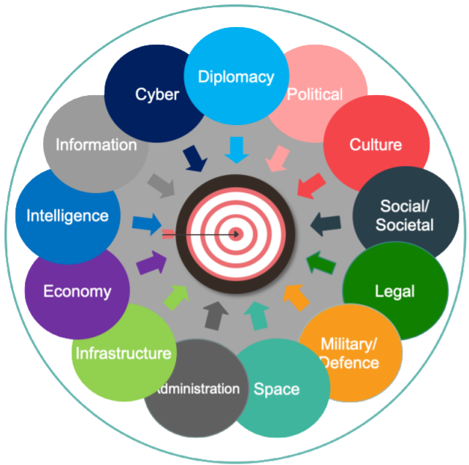
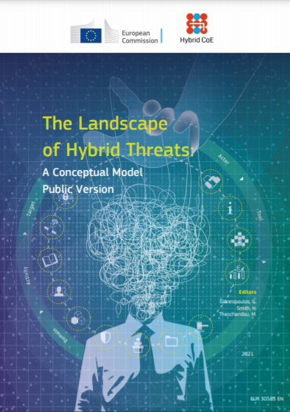
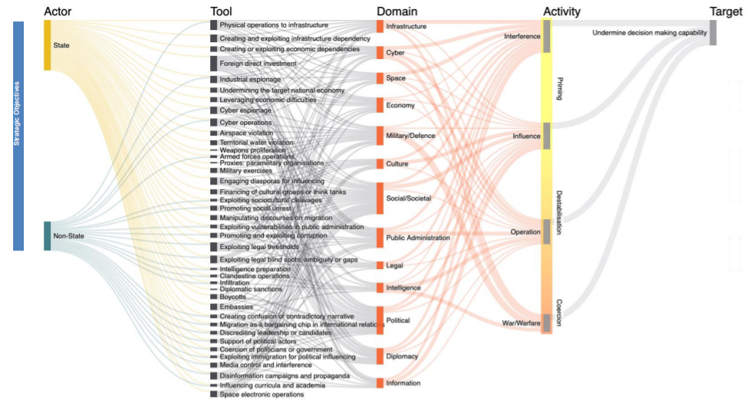
Hybrid Threats:
Conceptual Model
https://www.hybridcoe.fi/wp-content/uploads/2021/02/conceptual_framework-reference-version-shortened-good_cover_-_publication_office.pdf

Slide 15
Challenge for the academic world
Hybrid War is about confusing war and peace as it is unclear when the actual war starts and ends, whether during information and cyber attacks or during military operations...
The aspects of defense then include: national and governmental defense, international activities, critical infrastructure, financial market, media, science and education and civil society.
Leadership education is an important contributor to preparedness. The Finnish model of national defense courses for not only government officials, but also business leaders, custodians of national infrastructure, and key decision-makers may be difficult or impossible for some other nations to replicate; but engagement must be sought where it can. The key message is that in the new environment of whole of society threats, nobody is too unimportant to be a target; and that consequently, nobody is too unimportant to be involved in defense.
“… Нет никого в современном обществе, кто был бы не слишком важен, чтобы стать мишенью; и, следовательно, нет никого в современном обществе, кто был бы не слишком важен, чтобы участвовать в защите …”

Slide 16
Russia and hybrid threats
"Россия - это страна с непредсказуемой историей“ …
..., покопавшись в "официально разрешенной к применению версии" которой, всегда можно наковырять достаточно оправданий ее (России) сегодняшним претензиям и связанным с ними гибридным угрозам ...
жизненная философия: “Ресентимент — это ненависть раба ко всему, где ему чудится свобода” (Яков Кротов; http://krotov.info/yakov/2_life/2_svoystva/resentiment.htm )
"Russia is a country with an unpredictable history" (Medvedev, 2017) ; ... having delved into the "officially approved version" of which, you can always pick up enough justifications for its (Russia) today's pretensions and the hybrid threats associated with them ...
… Philosophy of life: “Ressentiment is the hatred of a slave for everything where freedom seems to him” (Yakov Krotov)

Slide 17
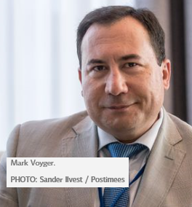
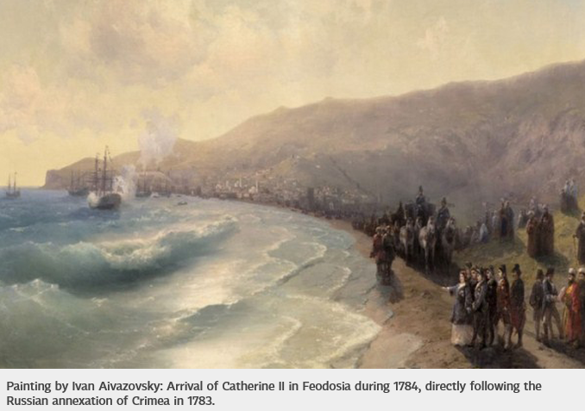
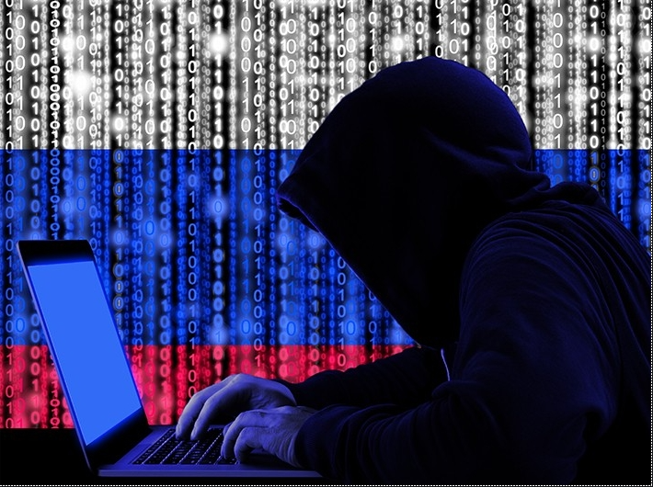
19 April 2021 –
238 years anniversary of Russian hybrid warfare … since its birthday:
19 April 1783
Correspondent (question): “… is hybrid warfare really a new type of military strategy …?”
Mark Voyger (answer): “… hybrid warfare Russian-style is as old, if not older than the United States of America, as your Eastern neighbor has been using methods that can be described as 'hybrid' since at least the 18th century. … What is interesting, it can be traced back exactly to the first annexation of Crimea by the Russian Empire under Empress Catherine the Great. … In her Manifest of 19 April 1783 she used the same justification and … the same range of tools used to annex the peninsula – political, diplomatic, legal, cultural, economic and intelligence – that were used by President Putin in March of 2014. In a way, that date can be considered the birthday of Russian hybrid warfare.”
Mark Voyger - Former Commanding General of US Army Europe

Slide 18
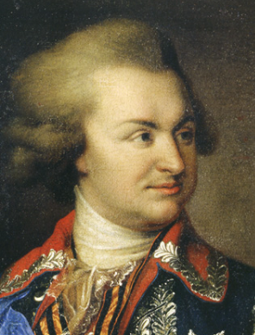
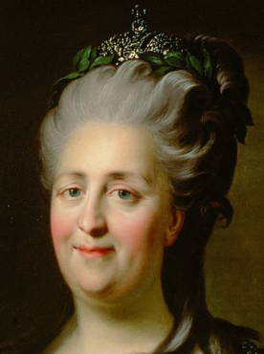
In March 1783, Prince Potemkin made a rhetorical push to encourage Empress Catherine II to annex Crimea. Having just returned from Crimea, he told her that many “Crimeans would happily submit to Russian rule” (“крымчане будут счастливы подчиняться российской власти”). Encouraged by this news, Empress Catherine issued a formal proclamation of annexation on 19 April 1783.
19 April 1783 –
the birthday of Russian hybrid warfare

Slide 19
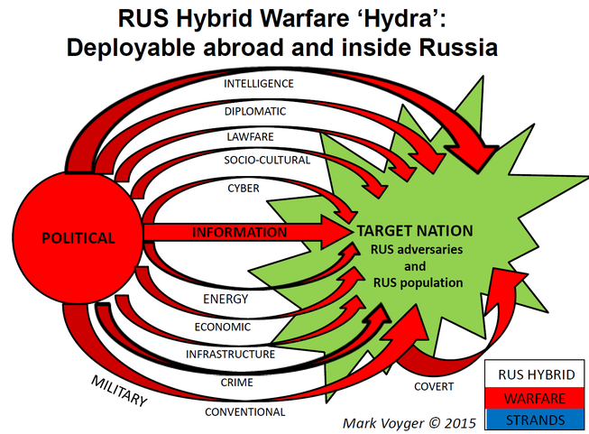
“Russian hybrid warfare can be compared to a “hydra”, an ancient mythological monster – it has a political 'head' and multiple tentacles. As early as the 1920s Soviet military strategists, such as [Alexander] Svechin and others elaborated on the concept of political warfare, as the centerpiece of modern warfare. Russian hybrid warfare ‘hydra’ uses also legal, diplomatic, intelligence, socio-cultural, economic, financial, energy and infrastructure tools, as well as organized crime, and conventional and covert military actions, to target both adversary nations or the Russian population, domestically and abroad. ”
Covert operations aim to secretly fulfill their mission objectives without anyone knowing who sponsored or carried out the operation, or in some cases, without anyone knowing that the operation has even occurred.
Source:
https://news.postimees.ee/4505726/mark-voyger-russian-hybrid-warfare-can-still-bring-surprises-in-the-future
Mark Voyger, former special advisor to retired Lieutenant-General Ben Hodges, former Commanding General of US Army Europe, says in an interview that calling hybrid warfare a completely new type of war would be incorrect. “We are dealing with the same devil, which we have already seen in the past, only this time it is using new high-tech tools and methods.”

Slide 20
Key hybrid threat: Provoking self-destruction by information
Information attacks aim to “awaken” hidden internal forces that may lead a nation to self-destruction
INFORMATION
Информационные атаки направлены на «пробуждение» скрытых внутренних сил, которые могут привести нацию к самоуничтожению.
COVERT

Slide 21
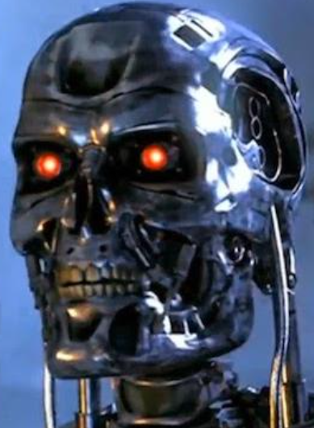
Artificial Intelligence (AI) and Hybrid Threats (HT):
- AI as source of HT;
- AI as target of HT;
- AI as instrument of HT;
- AI as defence from HT
Artificial Intelligence may be used and is used to enhance hybrid threats

Slide 22
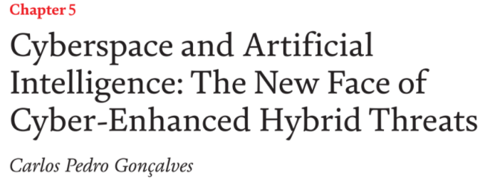
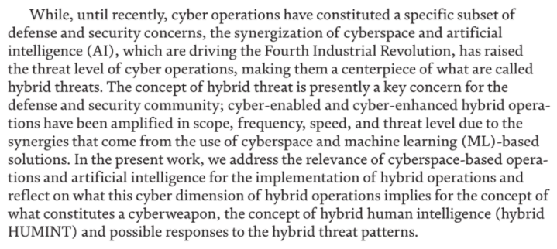
AI and Hybrid Threats
Gonçalves, C. P. (2019). Cyberspace and Artificial Intelligence: The New Face of Cyber-Enhanced Hybrid Threats. In Cyberspace. IntechOpen. doi:10.5772/intechopen.88648

Slide 23
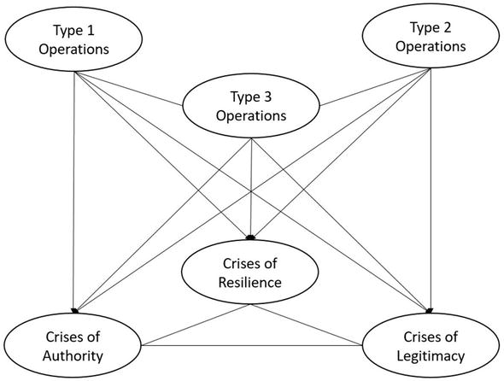
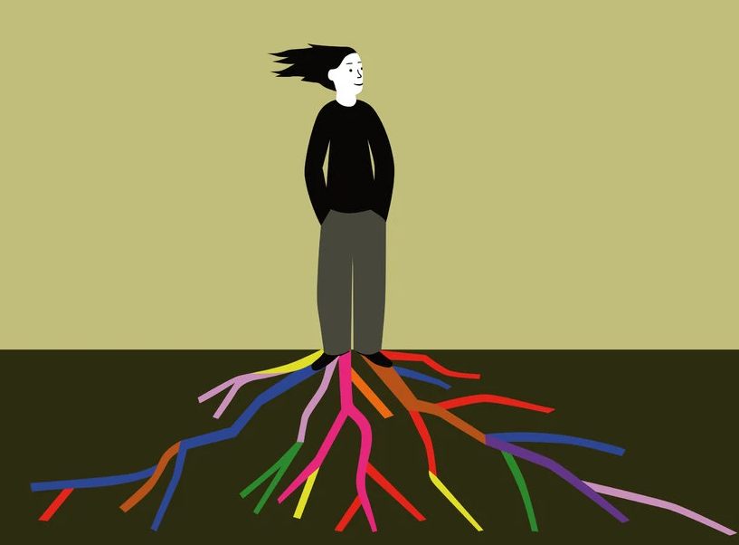
AI and Hybrid Threats
Gonçalves, C. P. (2019). Cyberspace and Artificial Intelligence: The New Face of Cyber-Enhanced Hybrid Threats. In Cyberspace. IntechOpen. doi:10.5772/intechopen.88648
Media, platforms, … social networks, the manipulation of contents, and the use of AI, ML, and data science to manipulate people’s behavior, online and offline, are a major component in hybrid campaigns. The three types of operations can all target the three weaknesses, authority, resilience, and legitimacy, amplifying state instability and leading a country into a crisis situation that may, in the limit, produce the fall of a government …
Behavioral hacking is a major hybrid threat and can take advantage of the impact of fake contents, propaganda, disinformation, as well as strategic leaks of critical data, in order to affect people’s behaviors ...
There is an urgent need for … hybrid resilience, of which cyber resilience is just an aspect. The concept of hybrid resilience as the ability to resist and recover from hybrid campaigns ...

Slide 24
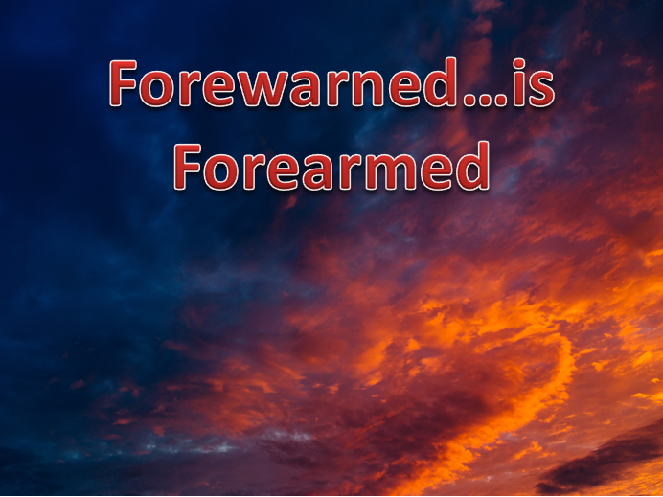
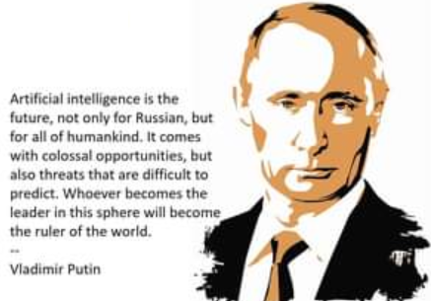
Putin says: the nation that leads in AI “will become the ruler of the world”

Slide 25
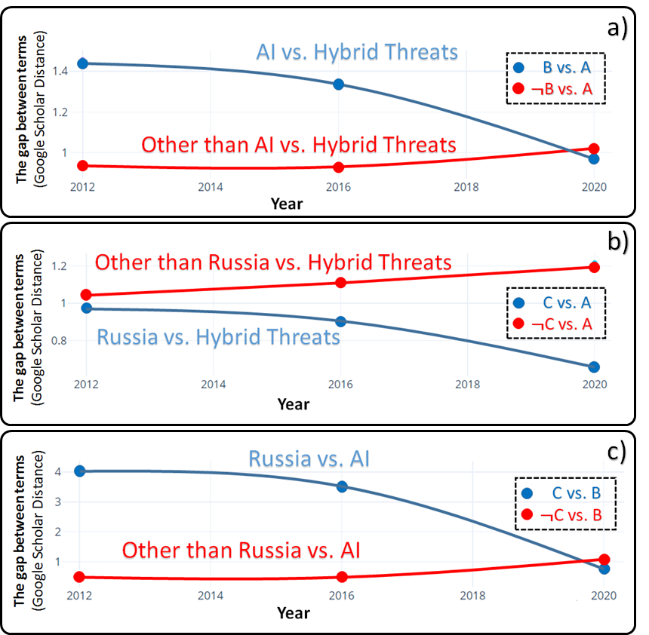
“Russia”, “Artificial Intelligence” vs. “Hybrid Threats”:
Google Scholar Gap Analysis
“Artificial Intelligence” and “Hybrid Threats” concepts are more and more often appear together in published studies
“Hybrid Threats” concept is more and more associated with “Russia” in published studies
“Artificial Intelligence” concept is more and more associated with “Russia” in published studies

Slide 26
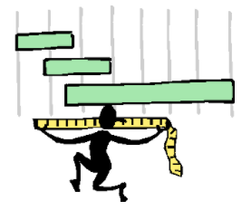
Google Scholar Gap Analysis? How?

Slide 27
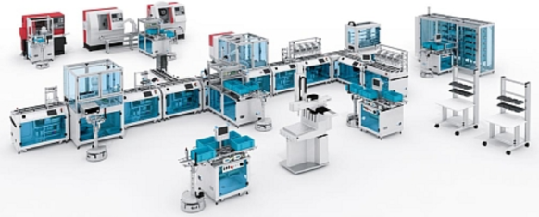
Cyber-Physical-Social Systems
Collective Intelligence
Critical Infrastructure is about Cyber-Physical-Social Systems populated and controlled by the Collective Intelligence that are essential for the functioning of a society and economy
Critical Infrastructure
Humans and artificial decision makers
Flexible infrastructure of heterogeneous systems, facilities, assets, technologies, networks and processes
https://bt3gl.github.io/index.html

Slide 28
Cyber-Physical-Social Systems
Collective Intelligence
Which of these is more vulnerable for a hacker attack: infrastructure or intelligence?
Critical Infrastructure
“Only amateurs attack machines…”
[B. Schneier (2000). Semantic Attacks…]
“… professionals target people”
[B. Schneier (2000). Semantic Attacks…]

Slide 29
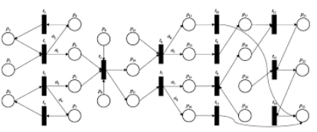
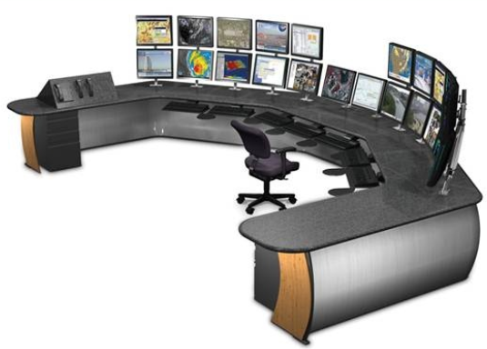
Simple scenario: human observes context change
and updates the control model accordingly

Slide 30
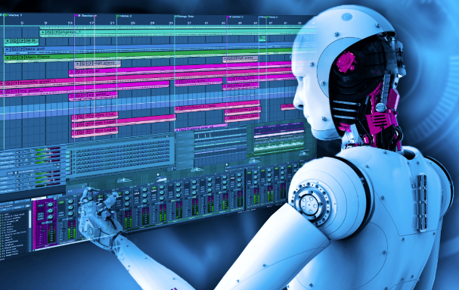
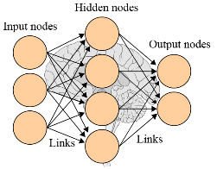
… assume the control is automated

Slide 31
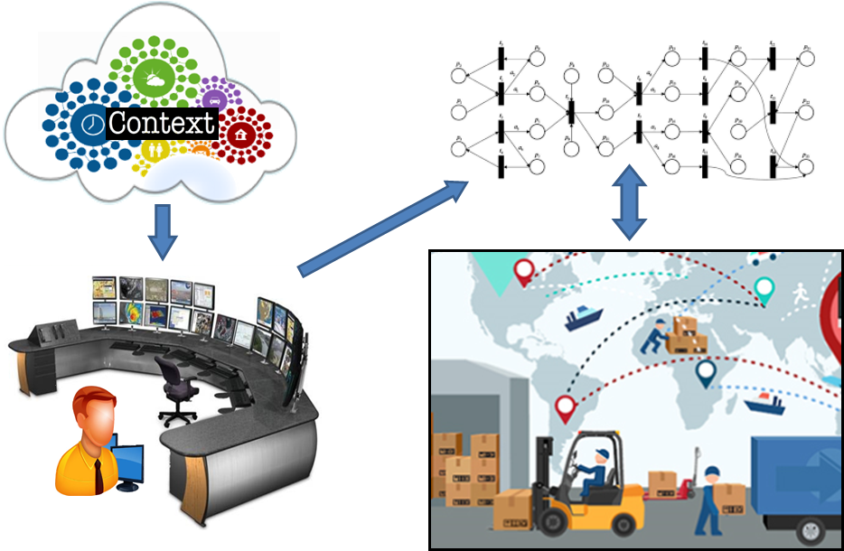
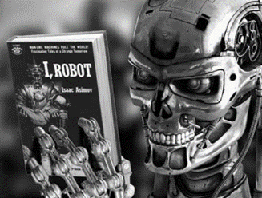
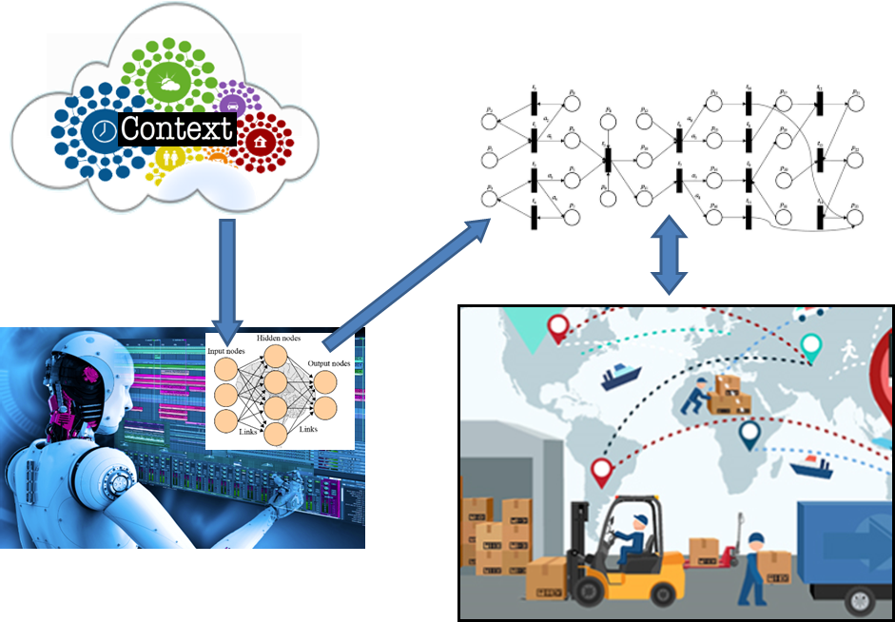
Source 1
Source 2
…
Source n
Intelligent component
(i.e., Neural Network)
of the control model
requires training and
testing (Machine
Learning). Training data
is needed. Do we trust
the sources of it?
Data
Training set
Test set
Training and testing
of the control model
Trained model

Slide 32
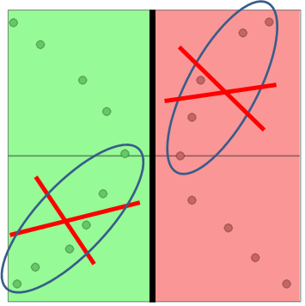
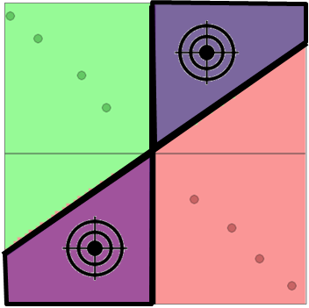
All intelligent models are vulnerable to sophisticated data evasion and data poisoning attacks
Remember?
How to protect the intelligence (both artificial and human) against new attacks?

Slide 33
An example of simple 2D decision space
Y
Area of “YES” decisions
X, Y - attributes of a decision
(x₁, y₁), (x₂, y₂) – values of the attributes of the two samples of the decisions in the figure
Training data sample
(x₂, y₂) → “YES”
– a training sample of the “YES” decision
y₂
– a training sample of the “NO” decision
Training data sample
(x₁, y₁) → “NO”
Learned decision boundary
– decision boundary
y₁
Area of “NO” decisions
x₁
x₂
X

Slide 34
Example:
200
Height (sm)
Skinny
Hidden decision boundary (machine learning objective)
180
Overweight
160
60
80
Weight (kg)
100

Slide 35
Example: Training set for supervised learning
Weight (kg) | Height (sm) | Decision
67 | 175 | skinny
77 | 182 | skinny
82 | 198 | skinny
76 | 164 | overweight
91 | 167 | overweight
98 | 180 | overweight

Slide 36
Example:
200
“Training Samples” on top of the “Decision Space”
Height (sm)
“Training Samples” on top of the “Decision Space”
180
160
60
80
Weight (kg)
100

Slide 37
Example:
200
Skinny
Area of relative certainty: for any point (a new test person) within this area we could be more or less certain that the person is “Skinny”
Height (sm)
180
160
60
80
Weight (kg)
100

Slide 38
Example:
200
Height (sm)
Another area of relative certainty: for any point (a new test person) within this area we could be more or less certain that the person is “Overweight”
180
160
60
80
Weight (kg)
100

Slide 39
Example:
200
Skinny
Height (sm)
“GREY ZONE”: Somewhere within this area we have the hidden “decision boundary” between the two options, which we are going to learn
180
“GREY” (IGNORANCE or CONFUSION) ZONE
Overweight
160
60
80
Weight (kg)
100

Slide 40
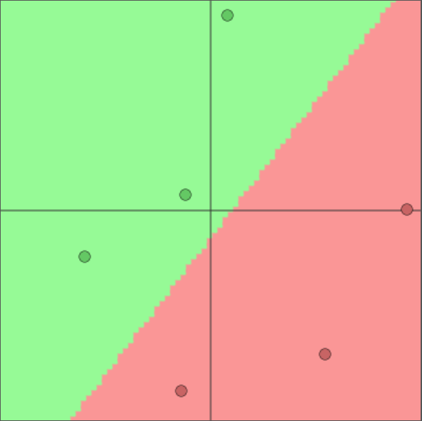
Example:
200
Skinny
Height (sm)
180
Learned decision boundary (from the training samples)
Machine Learning model
Overweight
160
60
80
Weight (kg)
100

Slide 41
Example:
200
Height (sm)
Hidden “correct” decision boundary (machine learning objective)
180
Actually learned decision boundary (machine learning outcome based on training samples)
160
60
80
Weight (kg)
100

Slide 42
Example:
200
Height (sm)
Hidden “correct” decision boundary (machine learning objective)
Vulnerability zone: area of potentially incorrect decisions by the target model and, at the same time, this is the space (“window of opportunity”) for the attackers aiming further “poisoning” the target decision model and, therefore, making the situation with the decision-making correctness even worth …
180
Actually learned decision boundary (machine learning outcome based on training samples)
Vulnerability zone
160
60
80
Weight (kg)
100

Slide 43
Example: Training set for supervised learning
DATA POISONING ATTACK
Weight (kg) | Height (sm) | Decision
67 | 175 | skinny
77 | 182 | skinny
82 | 198 | skinny
76 | 164 | overweight
91 | 167 | overweight
98 | 180 | overweight
Example: Poisoned samples
Weight (kg) | Height (sm) | Decision
96 | 199 | overweight
64 | 162 | skinny

Slide 44
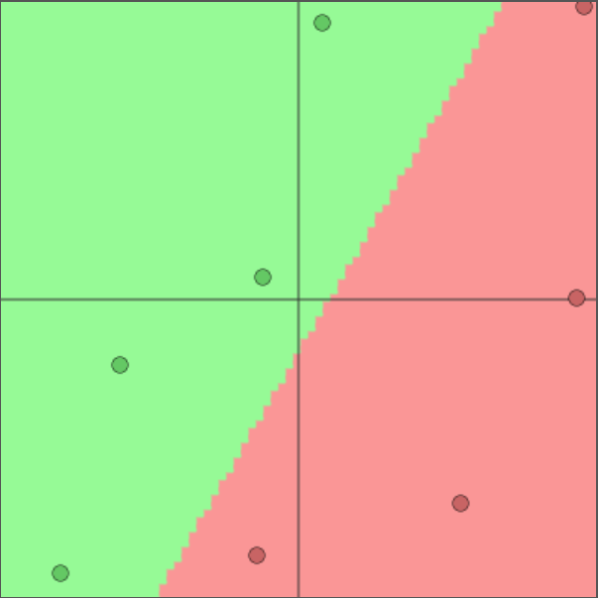
Example:
200
Poisoned sample
Height (sm)
Hidden “correct” decision boundary (machine learning objective)
180
Re-trained model: decision boundary (from training samples + new poisoned samples)
Vulnerability zone (expands)
Result of poisoning: larger vulnerability zone, which also means more opportunities for the attackers in further poisoning …
Poisoned sample
160
60
80
Weight (kg)
100

Slide 45
Example: impact of more poisoning
200
Poisoned sample
Poisoned samples
Height (sm)
Hidden “correct” decision boundary (machine learning objective)
Result of poisoning: larger vulnerability zone, which means incorrect decision-making in larger areas and which also means more opportunities for the attackers in further poisoning …
180
Re-trained model: decision boundary (from training samples + new poisoned samples)
Vulnerability zone (expands)
Poisoned samples
Poisoned samples
160
60
80
Weight (kg)
100

Slide 46
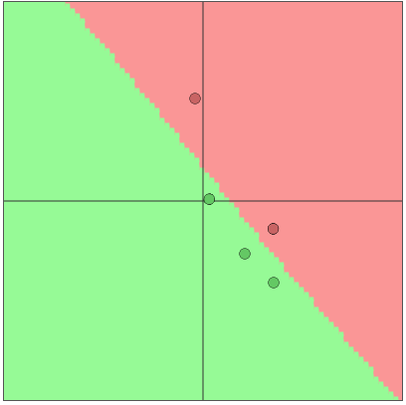
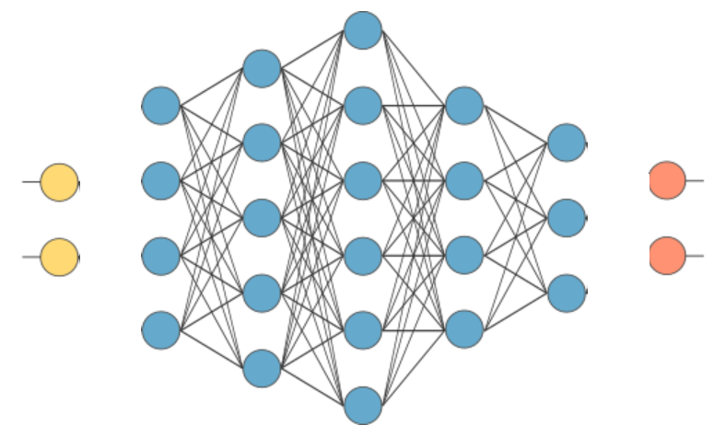
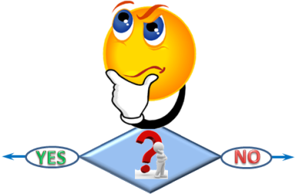
For a simple experiment and the visualizations, we used:
http://cs.stanford.edu/people/karpathy/convnetjs/demo/classify2d.html
Deep Neural Network
x_{i}
“YES”
y_{i}
“NO”
Input layer
Output layer
Hidden layers
This decision boundary has been computed on the basis of 5 training samples of the decisions by the Deep Neural Network with the following architecture:
Artificial
decision-
maker
This Neural Network has 2 hidden layers with 4 neurons each

Slide 47
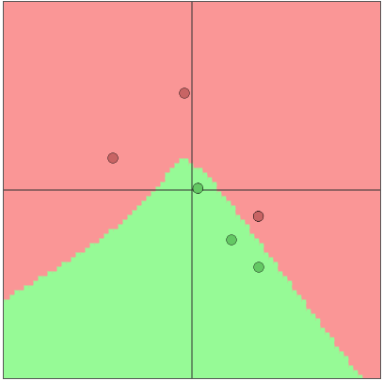
Let us “poison” the data by adding one extra “NO” point
Before poisoning
After poisoning

Slide 48
“Poisoned” training data – “Poisoned Decisions”
Target of the attacker: “poisoned ” areas of the decision space (i.e. the area of potentially wrong decisions made by the artificial decision-maker )
Artificial
decision-
maker
Before poisoning
After poisoning

Slide 49
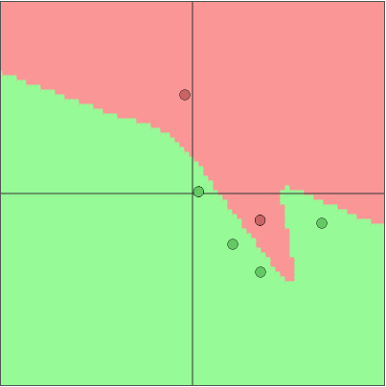
Let us “poison” the data by adding one extra “YES” point
Before poisoning
After poisoning

Slide 50
“Poisoned” training data – “Poisoned Decisions”
Target of the attacker: “poisoned ” areas of the decision space (i.e. the area of potentially wrong decisions made by the artificial decision-maker )
Artificial
decision-
maker
Before poisoning
After poisoning

Slide 51
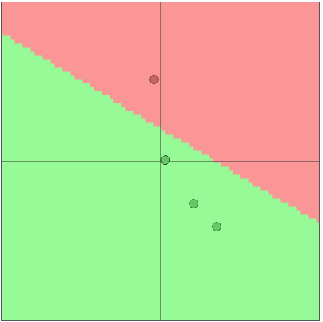
Let us “poison” the data by removing one “NO” point
Before poisoning
After poisoning

Slide 52
“Poisoned” training data – “Poisoned Decisions”
Target of the attacker: “poisoned ” areas of the decision space (i.e. the area of potentially wrong decisions made by the artificial decision-maker )
Artificial
decision-
maker
Before poisoning
After poisoning

Slide 53
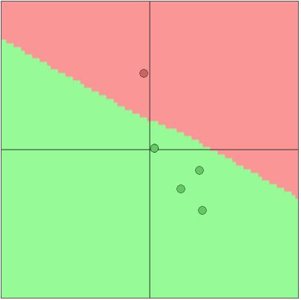
Let us “poison” the data by “recoloring” one point from “NO” to “YES”
Before poisoning
After poisoning

Slide 54
“Poisoned” training data – “Poisoned Decisions”
Target of the attacker: “poisoned ” areas of the decision space (i.e. the area of potentially wrong decisions made by the artificial decision-maker )
Artificial
decision-
maker
Before poisoning
After poisoning

Slide 55
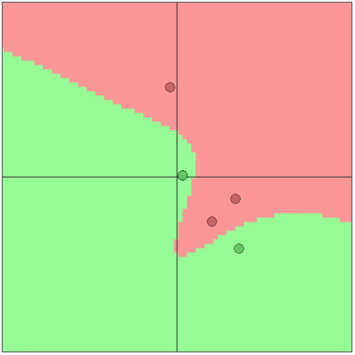
Let us “poison” the data by “recoloring” one point from “YES” to “NO”
Before poisoning
After poisoning

Slide 56
“Poisoned” training data – “Poisoned Decisions”
Target of the attacker: “poisoned ” areas of the decision space (i.e. the area of potentially wrong decisions made by the artificial decision-maker )
Artificial
decision-
maker
Before poisoning
After poisoning

Slide 57
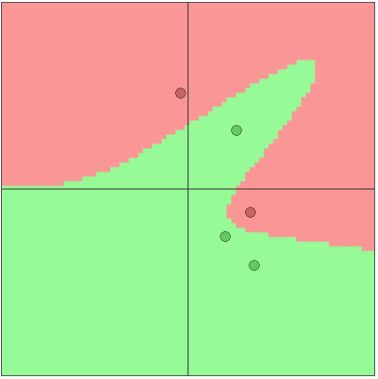
Let us “poison” the data by “changing location” of one “YES” point
Before poisoning
After poisoning

Slide 58
“Poisoned” training data – “Poisoned Decisions”
Target of the attacker: “poisoned ” areas of the decision space (i.e. the area of potentially wrong decisions made by the artificial decision-maker )
Artificial
decision-
maker
Before poisoning
After poisoning

Slide 59
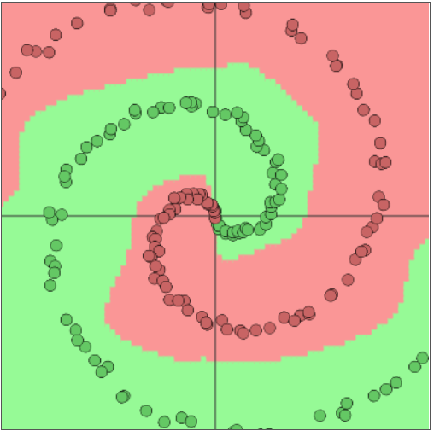
Let us consider a more complex decision problem addressed by two different decision-makers
Artificial
decision-
maker
Deep (5 hidden layers) Neural Network
Artificial
decision-
maker
Shallow (1 hidden layer) Neural Network
Before poisoning
Before poisoning

Slide 60
Let us “poison” the data by adding three “NO” points: Intended impact – “broken” decision boundary
Artificial
decision-
maker
Shallow (1 hidden layer) Neural Network
Before poisoning
After poisoning

Slide 61
Let us “poison” the data by adding three “NO” points: Intended impact – “broken” decision boundary
Artificial
decision-
maker
Deep (5 hidden layers) Neural Network
Before poisoning
After poisoning

Slide 62
Let us “poison” the data by unbalanced prototype selection for learning the decision boundary
Artificial
decision-
maker
Shallow (1 hidden layer) Neural Network
Before poisoning
Poisoning (wrong prototype selection)

Slide 63
Let us “poison” the data by unbalanced prototype selection for learning the decision boundary
Artificial
decision-
maker
Target of the attacker: “poisoned ” areas of the decision space (i.e. the area of potentially wrong decisions made by the artificial decision-maker )
Target of the attacker: “poisoned ” areas of the decision space (i.e. the area of potentially wrong decisions made by the artificial decision-maker )
Correct “balanced ” decision boundary
Incorrect “biased ” decision boundary
Poisoning (wrong prototype selection)
After poisoning

Slide 64
AI vs. AI: DEEPFAKE –
the most harmful adversarial learning technique

Slide 65
The dark
side of AI
Deepfake …
“… - is a technology that makes individuals believe as if anyone has said or done anything when they are not”
https://mc.ai/deepfakes-real-or-fake/

Slide 66
Let me show a simple deepfake with artificial “toonified me” (right picture).
First step: “toonify” myself …
https://deepai.org/machine-learning-model/toonify

Slide 67
… Now the “deepfake”:
https://toonify.photos/original
Toonify first:
https://talkingheads.rosebud.ai/tokkingheads/
https://talkingheads.rosebud.ai/tokkingheads/

Slide 68
Deepfake: easy effort
with sufficient impact
This is easy: Anybody who has a computer and access to the internet can technically produce a “deepfake” video, says John Villasenor, professor of electrical engineering at the University of California, Los Angeles. To create DeepFake videos, it encompasses deep learning models to train the huge amount of dataset to let the model understand. It uses Generative Adversarial Networks which allow two models to understand themselves. One model is being trained on the dataset and generate results while the other model check for faults and the first model again train on data to minimize the errors. This process goes on until the faults become zero. The bigger the data set is the better the results are generated and appear more realistic.
https://deepfakedetectionchallenge.ai/
… and dangerous: The potential security threat of realistic fake videos of people doing and saying things they never did is cause for concern as it can be a component of the hybrid threat against target person or a group.
Blackmail

Slide 69
Deepfake Queen: 2020 Alternative Christmas Message
Read about it:
(BBC) https://www.bbc.com/news/technology-55424730 ;
(CNN) https://edition.cnn.com/2020/12/25/uk/deepfake-queen-speech-christmas-intl-gbr/index.html
Watch it: https://www.youtube.com/watch?v=IvY-Abd2FfM
The Alternative Christmas Message has been shown on Channel 4 at 15:25 GMT on 25 December.

Slide 70
Not Only Image: Deepfake Speech Synthesis
Read about it: https://www.scip.ch/en/?labs.20210318
https://www.youtube.com/watch?v=LEzIAixNkFI

Slide 71
Deepfakes are dangerous
https://www.insightsforprofessionals.com/en-us/it/security/deepfake-technology-explained

Slide 72
Deepfakes are dangerous
https://www.insightsforprofessionals.com/en-us/it/security/deepfake-technology-explained

Slide 73
Deepfakes are dangerous
https://www.insightsforprofessionals.com/en-us/it/security/deepfake-technology-explained

Slide 74
Deepfakes are dangerous
https://www.insightsforprofessionals.com/en-us/it/security/deepfake-technology-explained

Slide 75
Deepfakes are dangerous
https://www.insightsforprofessionals.com/en-us/it/security/deepfake-technology-explained
Businesses across the globe have already lost money, reputational power and successful brand images due to the misuse of deepfakes, and it’s not expected to slow down anytime soon. For example, the cost of a deepfake scam exceeds $250 million in 2020 alone.
While deepfake technology is still in its early stages, the threat it poses to businesses has already begun. Organizations should take their security protocols seriously and ensure they have a holistic defense strategy that touches all endpoints of a workforce to combat this threat.

Slide 76
Be vigilant as you yourself will always be a coauthor of all potential deepfakes created against you

Slide 77
We are different but we have similar vulnerabilities
At certain level of abstraction we may assume that human vulnerabilities regarding Cognitive Hacking are similar to the vulnerabilities of Artificial Intelligence regarding Data Evasion, Data Poisoning, etc. attacks …

Slide 78
Decision-making as a main target of attacks
Information (evidence) channels (inputs)
Decisions/responses (outputs)
$$x_{1}$$
Decision-making model
$$y_{1}$$
$$x_{2}$$
$$y_{2}$$
W O R L D
…
…
$$x_{n}$$
$$y_{m}$$
W O R L D
Learning inputs
Attacks
…
Attacks
$$t_{1}$$
$$t_{2}$$
$$t_{r}$$
$$l_{1}$$
$$l_{2}$$
$$l_{k}$$
[MACHINE] LEARNING
OUTCOMES
Learning
(or machine learning)

Slide 79
Related Work
https://www.mdpi.com/2073-8994/13/4/597/htm
Steingartner, W., Galinec, D., & Kozina, A. (2021). Threat Defense: Cyber Deception Approach and Education for Resilience in Hybrid Threats Model. Symmetry, 13(4), 597.
ABSTRACT: This paper aims to explore the cyber-deception-based approach and to design a novel conceptual model of hybrid threats that includes deception methods. Security programs primarily focus on prevention-based strategies aimed at stopping attackers from getting into the network. These programs attempt to use hardened perimeters and endpoint defenses by recognizing and blocking malicious activities to detect and stop attackers before they can get in. Most organizations implement such a strategy by fortifying their networks with defense-in-depth through layered prevention controls. Detection controls are usually placed to augment prevention at the perimeter, and not as consistently deployed for in-network threat detection. This architecture leaves detection gaps that are difficult to fill with existing security controls not specifically designed for that role. Rather than using prevention alone, a strategy that attackers have consistently succeeded against, defenders are adopting a more balanced strategy that includes detection and response. Most organizations deploy an intrusion detection system (IDS) or next-generation firewall that picks up known attacks or attempts to pattern match for identification. Other detection tools use monitoring, traffic, or behavioral analysis. These reactive defenses are designed to detect once they are attacked yet often fail. They also have some limitations because they are not designed to catch credential harvesting or attacks based on what appears as authorized access. They are also often seen as complex and prone to false positives, adding to analyst alert fatigue. The security industry has focused recent innovation on finding more accurate ways to recognize malicious activity with technologies such as user and entity behavioral analytics (UEBA), big data, artificial intelligence (AI), and deception.

Slide 80
Cognitive Hack

Slide 81
“Only amateurs attack machines; professionals target people”
[B. Schneier (2000). Semantic Attacks…]
Cognitive hacking is a cyberattack that seeks to manipulate the perception of people by exploiting their psychological vulnerabilities. The purpose of the attack is changes in behavior, usually resulting from exposure to misinformation. As such, cognitive hacking is a form of social engineering although it may target a broad audience rather than specific individuals.
Cognitive hacking may be overt or covert, can take various forms and may be launched through a variety of attack vectors. The attack is usually information-based and non-technical, however. In most cases, cognitive hacking does not involve corruption of hardware or software or even unauthorized access to systems or data.
The most common tool used in a cognitive hack is weaponized information: messages or content that is designed to affect the user's perceptions and beliefs in a way that will harm a target. The active "attack" is carried out by the people affected by those messages. For example, disinformation about a political candidate might go viral and convince large numbers of people to vote for someone else.
https://whatis.techtarget.com/definition/cognitive-hacking

Slide 82
Human Values/Beliefs System and Cognitive Hack
BELIEFS
A real war always begins with an information war, which weapon is cognitive hack and the main target is the mind (i.e., beliefs and values) of a potential victim!
We demand peace!

Slide 83
https://euvsdisinfo.eu/propaganda-must-be-opposed-by-the-language-of-values/
Andrei Arkhangelsky is a Russian journalist, columnist, author and the cultural editor of the weekly magazine Ogonyok. He is also one of the most active commentators in Russia on the topic of disinformation and propaganda.
To blur the line between good and evil
Q. What purpose or purposes does the disinformation serve, in your opinion?
A. Its global goal is to destroy any existing values in the world, especially the liberal ones. Its task is to install the idea that there are no values at all, only gross instincts and habits. That a person cannot change for the better. That there is no difference between democracy and authoritarianism, that “everyone behaves equally badly.” Ultimately, the goal is to blur the line between good and evil … When no one believes in anything, obviously, it is more convenient to solve tactical political tasks. … This “freedom from culture,” as Freud said, gives people pleasure…
Opposing propaganda with values and facts
Q. … what can be a threat to misinformation? … What methods and approaches have been used in such cases?
A. … The propaganda insists that liberalism is a lack of values. It must be shown that this is not so. It is necessary to translate democracy into the language of values, into the language of universal ethics. … it is necessary to explain again where the border between good and evil is today. That is, the propaganda must also be opposed at the level of values, and not just facts.
Values
Facts
Values
Values vs. Facts $≡$
$≡$Top-down vs. Bottom-up AI

Slide 84
Media “zombie”

Slide 85
Attempt to hack our “VALUES” – is the major hybrid threat today
Methods are changed

Slide 86
(Hybrid) cognitive hack of a critical infrastructure: Poisoning minds of the decision-makers

Slide 87
(Hybrid) cognitive hack of a critical infrastructure: Poisoned minds poison the whole system
Critical
Infrastructure

Slide 88
(Hybrid) cognitive hack is capable of switching the “inhabitants” of a critical infrastructure from the process of Co-Creation to the process of Co-Destruction
Co-creation (also collaborative innovation) within the critical infrastructure is the collaborative development of new critical value for the society (concepts, solutions, critically important products and services) together with all the collective intelligence actors: consumers, experts, stakeholders, state officers, etc. Co-creation through positive engagement behavior may occur when collective intelligence actors are: delighted; feel valued experience reciprocity; receive incentives from their organization and from the state as whole; are solicited for feedback, can count on services’ and processes’ improvement efforts and they are confident that they interact with helpful, empathetic, polite and responsive managers and state officers.
Co-destruction is the process (initiated by internal or external factors), through which the collective intelligence co-destroys the value being previously co-created. Co-destruction through negative engagement behaviors emerges from rude persons’ behaviors, indifference, confrontation with organizational or state management, technological failure, the lack of complaint outlets and persons’ desire for revenge.
See also: https://www.emerald.com/insight/content/doi/10.1108/JSM-01-2017-0027/full/html

Slide 89
Do we know our core values ?

Slide 90
Adversarial learning and adversarial testing
of our values …

Slide 91
«Culture» and the Freedom of Choice in Decision-Making

Slide 92
What is «Culture» and how to «compute» it ?
Culture of an individual or a group is
a systematic manner of the deliberate use of own freedom
The choice of action is done on the basis of the stable well-established system of values ​​(vector of weights of criteria for evaluating the alternatives) and its steady evolutionary dynamics (if any), and, therefore, can be predicted with the reasonable confidence and precision...
Either choice is made intentionally, with understanding the possible effects (impact) on the basis of previously accumulated (own and others') experience and knowledge, and not on the basis of instincts (as in the animal world) or random (chaotic) guessing...
We mean the freedom to choose the preferred alternative of an action from the list of possible ones in certain situations ...
3
2
1
Thus, the stable value system completely determines the culture of its host, and, because such a system can be easily formalized in mathematical terms, it allows to formalize, document, provide, upon request, visualize, analyze, compute (and so on) also the culture, as an object for possible use in the information systems to support the decision-making processes.
C U L T U R E
4

Slide 93
Decision point within a business process
A
C
B

Slide 94
How a decision is being made?
Making predictive assessment of available choices aiming to maximize expected utility (positive impact and personal benefits from the choice) and in the same time to minimize cost (negative impact and personal losses from the choice) .
A
C
B

Slide 95
Decision-making is a core challenge for the processes within critical infrastructure
Decision point within
a business process
A
C
B

Slide 96
How a decision is being made ?
Ограничения и регуляторы
Organizational component: decision environment (laws, formal duties, regulations, rules, orders, instructions and policies
Instrument
Область свободного выбора
Personal component: mind (knowledge, beliefs, capabilities, skills, experience, interests, culture, values, and emotions)
Input
Output
List of alternatives for the decision and relevant input data
Decision made / chosen alternative
A
C
B

Slide 97
How a decision is being made ?
Ограничения и регуляторы
Organizational component: decision environment (laws, formal duties, regulations, rules, orders, instructions and policies
For the organization: Comparably easy to monitor, change or reconfigure if needed.
For a hacker:
a difficult target to influence
Область свободного выбора
Personal component: mind (knowledge, beliefs, capabilities, skills, experience, interests, culture, values, and emotions)
List of alternatives for the decision and relevant input data
Decision made / chosen alternative
A
C
B

Slide 98
How a decision is being made ?
For the organization: Extremely difficult to capture, recognize, predict, influence and drive the change …
For a hacker:
an excellent and relatively easy target
Ограничения и регуляторы
Organizational component: decision environment (laws, formal duties, regulations, rules, orders, instructions and policies
Область свободного выбора
Personal component: mind (knowledge, beliefs, capabilities, skills, experience, interests, culture, values, and emotions)
List of alternatives for the decision and relevant input data
Decision made / chosen alternative
A
C
B

Slide 99
How a decision is being made ?
Ограничения и регуляторы
Organizational component: decision environment (laws, formal duties, regulations, rules, orders, instructions and policies
… and this is the most vulnerable place (week spot) for the “corruption”, cognitive hackers and other hybrid attacks
Область свободного выбора
Personal component: mind (knowledge, beliefs, capabilities, skills, experience, interests, culture, values, and emotions)
List of alternatives for the decision and relevant input data
Decision made / chosen alternative
A
C
B

Slide 100
Two important observations:
Ограничения и регуляторы
Organizational component: decision environment (laws, formal duties, regulations, rules, orders, instructions and policies
Personal filters on restrictions from the organizational component: our personal culture to choose either to follow or not to follow particular regulations, restrictions or policies …
Область свободного выбора
Personal component: mind (knowledge, beliefs, capabilities, skills, experience, interests, culture, values, and emotions)
Hell of slavery
Organizational component: decision environment (laws, formal duties, regulations, rules, orders, instructions and policies
Ограничения и регуляторы
Heaven of balance
Область свободного выбора
Personal component: mind (knowledge, beliefs, capabilities, skills, experience, interests, culture, values, and emotions)
Hell of chaos

Slide 101
Main layers (folders) of the personal value system
Personal
importance
$$\sum_{1}^{all}{weight}=100$$
Я как гражданин / резидент / патриот .
I'm as a citizen / resident / patriot .
7
20
Я как созидатель / творец .
I'm as a maker / contributor / creator .
6
30
Я как друг / коллега / партнер .
I'm as a friend / colleague / partner .
5
5
Я как собственник / предприниматель / акционер .
I'm as an owner / entrepreneur / shareholder.
4
5
Я как наемный работник.
I'm as an employee.
3
10
Я как член семьи.
I'm as a family member.
2
10
Я как свободная, самостоятельная и самодостаточная личность.
I'm as a free, independent and self-sufficient person.
1
20

Slide 102
Self-Assess own value system at each layer
Confidence

Slide 103
For each layer of the value system:
(a) Figuring out the most vital issues/questions
I'm as a citizen / resident / patriot

Slide 104
(b) Answer each question and give your confidence value (%) for each answer
Confidence
$$Confidence\left(\text{"}\text{YES}\text{"}\right)+$$
$$+ Confidence\left("\text{NO}\text{"}\right)=100$$

Slide 105
(c) Evaluate each question from the relative importance (for you) point of view
$$\sum_{1}^{all}{weight}=100$$

Slide 106
Example (B)
Degree of confidence
Issue / question – component of the personal value system
Считаю ли я Россию основным виновником войны в Украине?
Do I consider Russia the main culprit of the war in Ukraine?
80
1
20
Давать ли воду в оккупированный Крым ?
Should we give water to the occupied Crimea?
20
2
80
Платить ли пенсии жителям оккупированного Донбасса ?
Should we pay pensions to residents of occupied Donbass?
50
3
50
Согласен ли я с правом частной собственности на Украинскую землю?
Do I agree with the right of private ownership of Ukrainian land?
5
4
95
Согласен ли я на достижение мира в Украине путем уступок врагу?
Do I agree to peace in Ukraine through concessions to the enemy?
1
5
99

Slide 107
Example (B)
Degree of confidence
Issue / question – component of the personal value system
Считаю ли я правильным выбор Украинского народа на последних выборах президента?
Do I consider the right choice of the Ukrainian people in the last presidential election?
15
6
75
Доверяю ли я Украинской армии?
Do I trust the Ukrainian army?
90
7
10
Согласен ли я с тем, что Революция Достоинства пошла на пользу Украине?
Do I agree that the Revolution of Dignity has benefited Ukraine?
95
8
5
Хотел ли бы я жить и работать за пределами Украины?
Would I like to live and work outside of Ukraine?
35
9
75
Должен ли украинский язык быть единственным государственным языком в Украине?
Should Ukrainian be the only state language in Ukraine?
66
10
34
…

Slide 108
Example (C)
Personal Importance of the issue
Issue / question – component of the personal value system
Считаю ли я Россию основным виновником войны в Украине?
Do I consider Russia the main culprit of the war in Ukraine?
1
10
Давать ли воду в оккупированный Крым ?
Should we give water to the occupied Crimea?
2
5
Платить ли пенсии жителям оккупированного Донбасса ?
Should we pay pensions to residents of occupied Donbass?
3
5
Согласен ли я с правом частной собственности на Украинскую землю?
Do I agree with the right of private ownership of Ukrainian land?
4
15
Согласен ли я на достижение мира в Украине путем уступок врагу?
Do I agree to peace in Ukraine through concessions to the enemy?
5
25

Slide 109
Example (C)
Personal Importance of the issue
Issue / question – component of the personal value system
Считаю ли я правильным выбор Украинского народа на последних выборах президента?
Do I consider the right choice of the Ukrainian people in the last presidential election?
6
10
Доверяю ли я Украинской армии?
Do I trust the Ukrainian army?
7
15
Согласен ли я с тем, что Революция Достоинства пошла на пользу Украине?
Do I agree that the Revolution of Dignity has benefited Ukraine?
8
10
Хотел ли бы я жить и работать за пределами Украины?
Would I like to live and work outside of Ukraine?
9
5
Должен ли украинский язык быть единственным государственным языком в Украине?
Should Ukrainian be the only state language in Ukraine?
10
0
…

Slide 110
Я как гражданин / резидент / патриот.
I'm as a citizen / resident / patriot .
20
…
Согласен ли я с тем, что Революция Достоинства пошла на пользу Украине?
Do I agree that the Revolution of Dignity has benefited Ukraine?
95
10
5
…
…
$$D=\left|0.2∙0.1∙0.95−0.1∙0.25∙0.1\right|=0.0165$$
Я как гражданин / резидент / патриот.
I'm as a citizen / resident / patriot .
10
…
Согласен ли я с тем, что Революция Достоинства пошла на пользу Украине?
Do I agree that the Revolution of Dignity has benefited Ukraine?
10
25
90
…
…

Slide 111
Why did we put
so huge effort
to win WARN
Project ?

Slide 112
Is this the key challenge of WARN project: to dance (“водить хороводы”) around Europe?

Slide 113
Is this the key challenge of WARN project: to dance (“водить хороводы”) around Europe?
I hope – NOT !

Slide 114
Or maybe the challenge is just a paperwork?
C U R R I C U L U M
WARN
Reports

Slide 115
Or maybe the challenge is just a paperwork?
I hope – NOT !
C U R R I C U L U M
WARN
Reports

Slide 116
The real challenge
is here …
?
C U R R I C U L U M

Slide 117
The real challenge
is here …
Как бы нам по привычке не создать еще несколько курсов, похожих на курсы из "горячо любимого" студентами списка: "Охрана труда", "Безопасность жизнедеятельности", "Гражданская оборона", "Основы Болонского процесса", и т.п. … Как сделать результаты проекта, изложенные в новых курсах, интересными и полезными одновременно и для студентов и для безопасности страны в целом?
As if by habit, we wouldn’t create a few more courses similar to those from the students' list of "beloved": “Occupational Safety", "Life Safety", "Civil Defense", "Fundamentals of the Bologna Process", etc. … How to make the project results presented in new courses interesting and useful both for students and for the security of the country as a whole?
?
C U R R I C U L U M

Slide 118
The real challenge
is here …
We need to change radically the way we present such courses for students. In this project, we promised to develop and apply “Adversarial Learning” as a teaching method for our new courses
?
C U R R I C U L U M

Slide 119
Adversarial Learning

Slide 120
Shocking News from AI (12.2017):
just 4 hours of competitive/adversarial learning (self-play) with a general reinforcement learning algorithm has been enough for the AlphaZero to become the World chess champion
Chess changed forever today. Artificial Intelligence also…, maybe the rest of the world did, too.
The Artificial Intelligence program AlphaZero has obliterated the highest-rated chess engine Stockfish, which for most top players is their go-to preparation tool, and which won the 2016 TCEC Championship and the 2017 Chess.com Computer Chess Championship. AlphaZero won the 100-game match with 28 wins, 72 draws, and zero losses.
It took AlphaZero only four hours to "learn" chess. Sorry humans, you had a good run.
That's right - the programmers of AlphaZero, housed within the DeepMind division of Google, had it use a type of "machine learning," specifically reinforcement learning. Put more plainly, AlphaZero was not "taught" the game in the traditional sense. That means no opening book, no endgame tables, and apparently no complicated algorithms dissecting minute differences between center pawns and side pawns.

Slide 121
Adversarial
Learning
Adversarial learning is a novel research field that lies at the intersection of machine learning and computer security. It aims at enabling the safe adoption of machine learning techniques in adversarial settings. The problem is motivated by the fact that machine learning techniques have not been originally designed to cope with intelligent and adaptive adversaries, and, thus, in principle, the whole system security may be compromised by exploiting specific vulnerabilities of learning algorithms through a careful manipulation of the input data. Accordingly, to improve the security of learning algorithms, the field of adversarial learning addresses the following main open issues:
identifying potential vulnerabilities of machine learning algorithms during learning and classification;
devising the corresponding attacks and evaluating their impact on the attacked system;
proposing countermeasures to improve the security of machine learning algorithms against the considered attacks.
Adversarial learning usually focuses on attacks staged either at training (poisoning) or test time (evasion), together with the proposal of suitable countermeasures.

Slide 122
Reactive vs. Proactive Security
Reactive
Proactive
Most of the currently discussed defense strategies follow the paradigm of proactive security: they attempt to prevent potential attacks, or mitigate their impact, before they occur, by incorporating knowledge of the attacker’s strategy in the designed algorithm or defense mechanism. In real-world applications, however, deployed systems still follow a reactive security approach: they are only updated when novel attacks are observed, by adding novel features (if required), and, more often, by retraining the system using newly-collected data. Both paradigms should be exploited complementarily, for thoroughly assessing security against carefully-targeted attacks, and of improving it security by design.
Biggio, B., Fumera, G., & Roli, F. (2014). Pattern Recognition Systems Under Attack: Design Issues and Research Challenges. International Journal of Pattern Recognition and Artificial Intelligence, 28(7).

Slide 123
Artificial Intelligence has already
many real threats, and more new
ones are foreseen in near future
AI
We cannot rely on a reactive
approach towards the threats.
We need an “Immunity” for AI !

Slide 124
Our approach: Artificial Immune System for Artificial Intelligence trained by “Smart Vaccination” and driven by Generative Adversarial Networks (GANs)
Artificial attacker
“Generator”
Artificial defender
“Discriminator”
VS
Artificial attacker “Generator” is trained to generate sophisticated, well-disguised and constantly improved attacks by creating fake data as an input to AI system
Artificial defender “Discriminator” is trained to distinguish between fake and real inputs coming to AI system and constantly improves the ability to repel the attacks

Slide 125
Humanity have already many
hybrid threats, and more new
ones are foreseen in near future
We cannot rely on a reactive
approach towards the threats. We need
to train an “Immunity” for our minds !

Slide 126
Poisoning vs. Vaccination:
just one “small” difference
Poisoning
Vaccination
In both cases we discover the vulnerability zone within the decision space and generate adversarial samples within it …
… then we either convert the adversarial samples into a POISON by assigning them the incorrect labels …
… or we convert the adversarial samples into a VACCINE by assigning them the correct labels .

Slide 127
Poisoning vs. Vaccination
digital vaccine
“GREY” (IGNORANCE or CONFUSION) ZONE
digital poison

Slide 128
Remember? Poisoning example
The vulnerability zone within the decision space is discovered and adversarial samples within it are generated…
… then the adversarial samples within the vulnerability zone are deliberately converted into a POISON by incorrect labelling.

Slide 129
Vaccine instead of poison …
The vulnerability zone within the decision space is discovered and adversarial samples within it are generated…
… then the adversarial samples are converted into a VACCINE by assigning them the correct labels .

Slide 130
Objective for WARN courses
Содержание наших курсов по сути должно выполнять функцию “профилактической вакцины”, способной укрепить иммунитет слушателей против гибридных атак (как внутренних так и внешних) на их сознание, совесть, ответственность, культуру и систему ценностей.
The content of our courses should essentially serve as a preventive vaccine that can strengthen the immunity of students against hybrid attacks (both internal and external) on their consciousness, conscience, responsibility, culture and value system.
Confidence

Slide 131
October 8, 2021
“The learning objective and related intended learning outcomes of the new WARN-related courses or/and programs is not an update of personal knowledge, skills, beliefs or values (traditional outcomes) but the robustness and resilience of the already available ones (WARN project discovery and innovation) … “

Slide 132
October 8, 2021
«Цель обучения и связанные с ней предполагаемые результаты изучения новых WARN курсов и/или программ - это не обновление личных знаний, навыков, убеждений или ценностей (традиционные результаты), а надежность и устойчивость уже имеющихся (открытие и инновация проекта WARN)… »

Slide 133
… just as simple as …

Slide 134
… by the way, I hope you remember:
… During our former Tempus project TRUST: “Towards Trust in Quality Assurance Systems” (2011-2014), we invented and promoted the concept of personal academic value system to assess the academic quality instead of forcing everyone to accept some “correct” value system …
… and we designed the Web environment (Portal ”TRUST” http://portal.dovira.eu/ ) to host such personal value systems and to make various academic analytical assessments on top of it …
Read more here: https://ai.it.jyu.fi/Quality/
Ваган Терзиян, "Портал как инструмент обеспечения качества и академической культуры в украинском высшем образовании" (полный комплект слайдов, PowerPoint-2010 файл, 47 Мб.);
Ваган Терзиян, "Портал как инструмент обеспечения качества и академической культуры в украинском высшем образовании" (видеозапись лекции с урезанным комплектом слайдов, 1 час);
Vagan Terziyan, "National Portal for Quality Assurance in Ukrainian Higher Education" (slides in English, PowerPoint-2010 file, 43 Мb.).

Slide 135
… TRUST Portal is not going to force you to change your academic values; it respects and protects the academic values of everyone
https://www.youtube.com/watch?v=FQ8r5MqDLs4

Slide 136
TRUST портал как инструмент развития человеческого потенциала
Abstract: Education is recognized as a fundamental enabler of human development. The adoption of information and communications technologies (ICTs) by education (especially in developing countries) contributes to educational system reforms, in addition to the traditional advantages, such as social openness and accessibility. Yet the academic community has not studied sufficiently the challenging context in which ICTs are used as instruments for the reform of inefficient, and sometimes even corrupted, educational systems rather than just as means for smarter classrooms, remote access, or content management. The object of this study is Ukrainian higher education (HE) and its quality assurance (QA) system, which appears to be neither flexible nor transparent. We offer an ICT solution to provide the needed transparency. We show that such transparency is urgently needed for the structural reform of this system, in order to empower people and recover their trust and respect toward HE. The solution is based on ontology-driven portal as a digital ecosystem for national QA. We show how the content of the portal can be managed and verified based on users’ social activity and reputation management, and how the quality evaluations of different players can be made with personalized procedures and quality indicators.
Terziyan V., Golovianko M., Shevchenko O., Semantic Portal as a Tool for Structural Reform of the Ukrainian Educational System, In: P. Soja and P. Rupino da Cunha (Eds.), ICT in Transition Economies: Narrowing the Research Gap to Developed Countries, Special Issue in: Information Technology for Development, Taylor & Francis Group, 22 pp. (doi: 10.1080/02681102.2014.899955).
“… In this study we assumed that a reform of the HE system can be facilitated by a transparent bottom-up public-initiated and public-driven activity, which itself can be qualified as a human development process. We have shown that the quality assurance as a complex of activities enhancing effectiveness of an educational system is an important enabler of human empowerment. We pointed out that the greatest damage to the quality of higher education in … Ukraine, is due to the fact that … the governmental officials … seem to encourage the institutionally based culture of corruption in higher education and use QA practices primarily for control and punishment purposes. The main beneficiary of educational services quality – society – is left out of the quality monitoring and management. In our research we show that taking part in public QA activity would be a shortcut to participatory development by enhancing human autonomy and strengthening the conviction that an individual and the overall society can take responsibility for state decision-making...”
"... В этом исследовании мы предположили, что реформа системы высшего образования может способствовать прозрачной, инициативной (снизу-вверх) общественной деятельности, которая сама по себе может квалифицироваться, как процесс развития человеческого потенциала. Мы показали, что обеспечение качества (QA) как комплекс мероприятий, повышающих эффективность системы образования, является важным фактором, работающим на благо человека. Мы отметили, что наибольший ущерб качеству высшего образования в Украине, наносится тем, что правительственные чиновники поощряют культуру коррупции в сфере высшего образования и используют практику QA в первую очередь для целей контроля и наказания. Основной бенефициарий качественных образовательных услуг - общество - остается вне контроля и управления качеством. В нашем исследовании мы показываем, что участие в деятельности общественной QA станет кратчайшим путем к совместному развитию за счет роста потенциала, автономии и убеждения, что человек и общество в целом могут взять на себя ответственность за участие в принятии государственных решений ... "

Slide 137
Архитектурное видение TRUST Портала на основе технологий «Cloud Computing» и «Linked Data»
Информация
Информация
Информация
«Программные роботы» – интеллектуальные агенты-интерфейсы и Web-сервисы
Метаданные
!
Онтологическое хранилище информации
«Облако» (“Cloud”)
персонализированных
«систем ценностей»
Объект оценивания
Результат
оценивания
в соответствии
с выбранным
методом («системой
ценностей»)
Система ценностей
Пользователь

Slide 138
ВНИМАНИЕ! Главный компромисс проекта TRUST: безупречные источники информации при субъективных методах оценивания
Информация
Информация
Информация
Область
«жестких
требований
к доверию»
Онтологический
портал
Область
«свободного
и прозрачного
выбора»
Принцип компромисса: «субъективные мнения и оценки на основе объективных данных и фактов».
«Облако» (“Cloud”)
персонализированных
«систем ценностей»

Slide 139
В наших свежих публикациях по теме портала мы показали как делать сложные аналитические оценки в академической среде, где соревнуются разные системы ценностей (и административной вертикали, и каждого сотрудника отдельно). Также мы доказали, что можно позитивно влиять на коллективное сознание, но при этом уважать и укреплять индивидуальные академические ценности каждого (какими бы они ни были).
In our recent publications on the topic of the portal, we have shown how to make complex analytical assessments in an academic environment where different value systems compete (both in the administrative vertical and each employee separately). We also proved that it is possible to positively influence the collective mindset, but at the same time respect and strengthen everyone's individual academic values (whatever they may be).
Semenets, V., Gryshko, S., Golovianko, M., Shevchenko, O., Titova, L., Kaikova, O., Terziyan, V., & Tiihonen, T. (2021). How the University Portal Inspired Changes in the Academic Assessment Culture. arXiv preprint arXiv:2105.14154.
Semenets, V., Terziyan, V., Gryshko, S., & Golovianko, M. (2021). Assessment and Decision-Making in Universities: Analytics of the Administration-Staff Compromises. arXiv preprint arXiv:2105.10560.

Slide 140
Assumption
Спор часто укрепляет участников в собственном мнении и в ценностях, которые лежат в его основе …
A dispute often strengthens participants in their own opinions and in the values that underlie it …

Slide 141
Generic model of adversarial training in the classroom
(Attacker vs. Defender | Arbiter)
Attacker
Defender
VS
“Immune
System”
“Vaccine”
Arbiter
“Facilitator”

Slide 142
The role of “Attacker”
Attacker
Attacker team invents a “Dilemma” query for the Defender. Dilemma requires a response (choice from two options) and has multi-aspect nature. The goal of an Attacker is actually not a wrong choice but rather a confusion and maximal (close to fifty-fifty) disagreement within the Defender team. I.e., the more disagreement, the better performance of the Attacker.
“Vaccine”
One may notice some similarities (and some evident differences) with the approaches used in the training platform from our Dutch partner …

Slide 143
The role of “Defender”
Defender
The Defender must address the “Dilemma” query with a clear choice (the team leader makes the choice taking into account the reasoned individual choices from the team members) with the value of confidence (depending on the voting outcome). Before that each team member (each responsible for a certain aspect of the problem) shares own reasons for the individual choice among the team. The goal of a Defender is to make a right choice (from the Arbiter point of view) with the high confidence I.e., the more confidence towards the right choice, the better performance of the Defender.
“Immune
System”

Slide 144
The role of “Arbiter”
Arbiter
The “Arbiter” is the most responsible role of providing (at each iteration of the process) a feedback (supplied by concrete arguments) to both teams (Attacker and Defender). The feedback includes numeric assessment of the quality of the query from the Attacker and the quality of the response from the Defender with the detailed comments. It is expected that this feedback will help to improve the performance of both competing teams at next iterations of the process. I.e., the Arbiter is actually a “facilitator” of the training process …
“Facilitator”
It is supposed that (during the training process) each student will be playing at least once in each of the three teams (“Attacker”, ”Defender” and “Arbiter”)

Slide 145
Model 1: Teacher vs. Teacher | Teacher
VS
WARN
WARN
T E A C H E R
T E A C H E R
WARN
T E A C H E R

Slide 146
Model 2: Students vs. Teacher | Teacher
VS
S t u d e n t s
WARN
T E A C H E R
WARN
T E A C H E R

Slide 147
Model 3: Teacher vs. Students | Teacher
VS
S t u d e n t s
WARN
T E A C H E R
WARN
T E A C H E R

Slide 148
Model 4: Teacher vs. Teacher | Students
VS
WARN
WARN
T E A C H E R
T E A C H E R
S t u d e n t s

Slide 149
Model 5: Students vs. Students | Teacher
VS
S t u d e n t s
S t u d e n t s
WARN
T E A C H E R

Slide 150
Model 6: Students vs. Teacher | Students
VS
S t u d e n t s
WARN
T E A C H E R
S t u d e n t s

Slide 151
Model 7: Teacher vs. Students | Students
VS
S t u d e n t s
WARN
T E A C H E R
S t u d e n t s

Slide 152
Model 8: Students vs. Students | Students
VS
S t u d e n t s
S t u d e n t s
S t u d e n t s

Slide 153
Regrouping, changing roles and subject
S t u d e n t s
S t u d e n t s
S t u d e n t s

Slide 154
What is our main risk factor, which may prevent all these to be done and work?
You would not believe, this is - …

Slide 155
… - … “Пофигизм” студентов …
deliberate indifference of the students

Slide 156
“Пофигизм” vs. “Resilience”
-- похожи как "близнецы", но с "разным знаком“ …
У проекта WARN сложная задача -- побороть пофигизм, …
… но при этом укрепить resilience.
“… бо в нас іншої нема!”
Мы должны разрушить одну “оболочку” и построить (укрепить) другую (и научить студентов делать так же как мы с другими) ...

Slide 157
By the way, “Пофигизм” has been also facilitated by the hybrid war …

Slide 158
Any idea, how to combat “Пофигизм” ?
И
Г
Ф
И
О
WARN
З
П
М

Slide 159
Stages of a hybrid threat (“Cognitive Hack”) execution
дезориентация
деморализация
дестабилизация
Disorientation
Demoralization
Destabilization
0
0
100
We are loosing confidence in our values
We do not care at all about our values (“пофигизм”)
We co-destruct our infrastructure in favor of an attacker because of wrong decisions

Slide 160
We need to find an “academic vaccine”
for our minds to wake-up our immunity against cognitive hack as hybrid threat:
“WARN VACCINE”
WARN

Slide 161
Important Proportion
C
A
v
Новая методика WARN-обучения так же будет отличаться от зомбирования студентов новым контентом …
a
c
WARN
c
i
n
a
t
i
o
$$≈$$
n
$$\frac{A}{B}=\frac{C}{D}$$
B
D
p
o
i
s
o
n
i
… как и процесс вакцинации отличается от процесса отравления ...
n
g

Slide 162
Кто он(a) –
“WARN TEACHER”?
WARN
Идеальный преподаватель WARN курсов по новой методике должен стать не столько двигателем или дирижером процесса состязательного обучения (или когнитивной вакцинации), сколько катализатором этого процесса. При этом желательно обладать такими тремя качествами как:
страсть (включая энтузиазм и вдохновение в одном флаконе);
импровизация (включая находчивость и креативность в одном флаконе; и
толерантнось (включая скромность и самокритичность в одном флаконе.

Slide 163
Who he/she is –
“A WARN TEACHER”?
WARN
The ideal teacher of new WARN courses should be not so much an engine or conductor of the adversarial learning process (or cognitive vaccination), but rather a catalyst of this process. At the same time, it is desirable to have such three qualities as:
passion (including enthusiasm and inspiration “in one bottle”);
improvisation (including resourcefulness and creativity “in one bottle”; and
tolerance (including modesty and self-criticism “in one bottle”).

Slide 164
Our academic portfolio: “From IMMUNE project to WARN project”
#G5511 “Cyber Defence for Intelligent Systems”
IMMUNE
WARN
See details at the next slide …

Slide 165
Terziyan, V., Gryshko, S., & Golovianko, M. (2018). Patented Intelligence: Cloning Human Decision Models for Industry 4.0. Journal of Manufacturing Systems, 48 (Part C), 204-217. Elsevier. doi:10.1016/j.jmsy.2018.04.019
Terziyan, V., Golovianko, M., & Gryshko, S. (2018). Industry 4.0 Intelligence under Attack: From Cognitive Hack to Data Poisoning. In: K. Dimitrov (Ed.), Cyber Defence in Industry 4.0 Systems and Related Logistics and IT Infrastructure (NATO Science for Peace and Security Series D: Information and Communication Security, Vol. 51, pp. 110-125). IOS Press. https://doi.org/10.3233/978-1-61499-888-4-110
Terziyan, V., & Nikulin, A. (2019). Ignorance-Aware Approaches and Algorithms for Prototype Selection in Machine Learning. arXiv:1905.06054.
Terziyan, V., & Nikulin, A. (2021). Semantics of Voids within Data: Ignorance-Aware Machine Learning. ISPRS International Journal of Geo-Information, 10(4), 246. https://doi.org/10.3390/ijgi10040246
Gavriushenko, M., Kaikova, O., & Terziyan, V. (2020). Bridging Human and Machine Learning for the Needs of Collective Intelligence Development. Procedia Manufacturing, 42, 302-306. Elsevier. https://doi.org/10.1016/j.promfg.2020.02.092
Terziyan, V., Gavriushenko, M., Girka, A., Gontarenko, A., & Kaikova, O. (2021). Cloning and Training Collective Intelligence with Generative Adversarial Networks. IET Collaborative Intelligent Manufacturing, 3(1), 64-74. John Wiley and Sons Ltd. https://doi.org/10.1049/cim2.12008
Girka, A., Terziyan, V., Gavriushenko, M., & Gontarenko, A. (2021). Anonymization as Homeomorphic data Space Transformation for Privacy-Preserving Deep Learning. Procedia Computer Science, 180, 867-876. Elsevier. https://doi.org/10.1016/j.procs.2021.01.337
Terziyan, V., Gryshko, S., & Golovianko, M. (2021). Taxonomy of Generative Adversarial Networks for Digital Immunity of Industry 4.0 Systems. Procedia Computer Science, 180, 676-685. Elsevier. https://doi.org/10.1016/j.procs.2021.01.290
Golovianko, M., Gryshko, S., Terziyan, V., & Tuunanen, T. (2021). Towards Digital Cognitive Clones for the Decision-Makers: Adversarial Training Experiments. Procedia Computer Science, 180, 180-189. Elsevier. https://doi.org/10.1016/j.procs.2021.01.155
Semenets, V., Terziyan, V., Gryshko, S., & Golovianko, M. (2021). Assessment and Decision-Making in Universities: Analytics of the Administration-Staff Compromises. arXiv preprint arXiv:2105.10560.
Semenets, V., Gryshko, S., Golovianko, M., Shevchenko, O., Titova, L., Kaikova, O., Terziyan, V., & Tiihonen, T. (2021). How the University Portal Inspired Changes in the Academic Assessment Culture. arXiv preprint arXiv:2105.14154
Terziyan, V., & Kaikova, O. (2021). Neural Networks with Disabilities: An Introduction to Complementary Artificial Intelligence. Neural Computation, 33, 1-36. MIT Press. https://doi.org/10.1162/neco_a_01449
Terziyan, V., Golovianko, M., Branytskyi, V., Malyk, D., & Gryshko, S. (2021). Implementing and Training the Immune System (Attack Detector). Technical Report (Annex 3, Deliverable 3, pp. 1-19). NATO SPS G511 Project IMMUNE: “Cyber-Defence for Intelligent Systems”. http://recode.bg/natog5511/wp-content/uploads/2021/05/ANNEX-3-Deliverable-3_NURE-and-JYU-G5511.pdf .
Branytskyi, V., Golovianko, M., Gryshko, S., Malyk, D., Terziyan, V., & Tuunanen, T. (2021). Digital Clones and Digital Immunity: Adversarial Training Handles Both. International Journal of Simulation and Process Modelling. (To appear).
Kumpulainen, S., & Terziyan, V. (2022). Artificial General Intelligence vs. Industry 4.0: Do They Need Each Other? Procedia Computer Science. Elsevier. (To appear).
Terziyan, V., & Vitko, O. (2022). Explainable AI for Industry 4.0: Semantic Representation of Deep Learning Models. Procedia Computer Science. Elsevier. (To appear).
Branytskyi, V., Golovianko, M., Malyk, D., & Terziyan, V. (2022). Generative Adversarial Networks with Bio-Inspired Primary Visual Cortex for Industry 4.0. Procedia Computer Science. Elsevier. (To appear).
Golovianko, M., Gryshko, S., Terziyan, V., & Tuunanen, T. (2022). Responsible Cognitive Digital Clones as Decision Makers: A Design Science Research Study. European Journal of Information Systems. Submitted (under review).
Puzzles of our
“From-IMMUNE-to-WARN” academic portfolio
(2018 - 2021)
IMMUNE
WARN

Slide 166
How can we do all these?
Now it is time to brainstorm together!
I am one among the best experts worldwide,…, I am working for WARN project !
All of us are Change Agents, which means “Warriors of Light & Warriors of Good”
(“воины света, воины добра”) !

Slide 167
Есть ценности, которые нельзя предавать никогда!
There are values that can never be betrayed!
W A R N

Slide 168
W A R N

