Slide 1
Industry 4.0 Intelligence under Attack: From Cognitive Hack to Data Poisoning NATO SPS Workshop "Cyber Defense in Industry 4.0 Systems and Related Logistics and IT Infrastructure"
Vagan Terziyan
Faculty of Information Technology, University of Jyväskylä
URL:http://www.mit.jyu.fi/ai/vagan
Jyväskylä, October 16-20, 2017

Slide 2
Photo from the Workshop

Slide 3
Lecturer today
Vagan Terziyan
Professor: Distributed Systems
Head of International Master Programs:
WISE: “Web Intelligence and Service Engineering”
COIN: “ Cognitive Computing and Collective Intelligence”
Background: Applied Mathematics; Artificial Intelligence
Interests: AI: semantic technologies, agent technologies, cyber-physical systems, smart everything, cognitive computing, machine learning, Industry 4.0, …

Slide 4
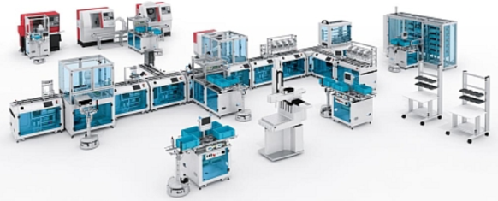
Cyber-Physical Systems
Collective Intelligence
Industry 4.0 is about Cyber-Physical Systems populated and controlled by the Collective Intelligence for the smart and autonomous manufacturing purposes
Industry 4.0
Flexible infrastructure
Human and artificial decision makers
https://bt3gl.github.io/index.html

Slide 5
Cyber-Physical Systems
Collective Intelligence
Which of these is more vulnerable for a hacker attack: infrastructure or intelligence?
Industry 4.0
Flexible infrastructure
Human and artificial decision makers
“Only amateurs attack machines…”
[B. Schneier (2000). Semantic Attacks…]
“… professionals target people”
[B. Schneier (2000). Semantic Attacks…]

Slide 6
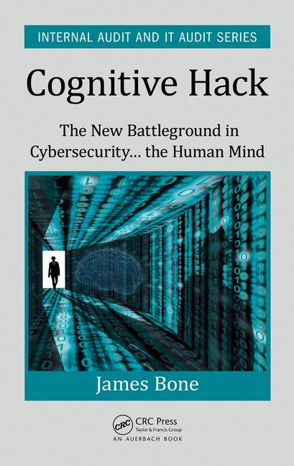
Intelligence, mind and cybersecurity
Is a decision-making process safe?
“Only amateurs attack machines; professionals target people”
[B. Schneier (2000). Semantic Attacks…]
Cybersecurity-related aspects of the Cognitive Computing, Deep Learning and Collective Intelligence
Emerging Cognitive Computing services attract huge amounts of users worldwide. Very recently the new vulnerabilities of Cognitive Computing and of its enabler Deep Learning have been discovered - the so called Cognitive Risks for Cybersecurity associated with the Cognitive Hack attacks. The cyber battleground has shifted recently from an attack on hard assets to a much softer target: the human mind as human behavior is the new and last “weakest link” in the cyber security armor. The cognitive hack takes place when a users’ behavior is influenced by misinformation. In his new book [J. Bone (2017). Cognitive Hack: The New Battleground in Cybersecurity ... the Human Mind, CRC Press], James Bone admits that “the human-machine interaction is the greatest threat in cyber space yet very few, if any, security professionals are well versed in strategies to close this gap”.

Slide 7
Decision-making is a core challenge for the self-managed processes of the Industry 4.0
Decision point within
a business process
A
C
B

Slide 8
How a decision is being made ?
Organizational component: decision environment (laws, formal duties, regulations, rules, orders, instructions and policies
Instrument
Personal component: mind (knowledge, beliefs, capabilities, skills, experience, interests, culture, values, and emotions)
Input
Output
List of alternatives for the decision and relevant input data
Decision made / chosen alternative
A
C
B

Slide 9
How a decision is being made ?
Organizational component: decision environment (laws, formal duties, regulations, rules, orders, instructions and policies
For the organization: Comparably easy to monitor, change or reconfigure if needed.
For a hacker:
a difficult target to influence
Personal component: mind (knowledge, beliefs, capabilities, skills, experience, interests, culture, values, and emotions)
List of alternatives for the decision and relevant input data
Decision made / chosen alternative
A
C
B

Slide 10
How a decision is being made ?
For the organization: Extremely difficult to capture, recognize, predict, influence and drive the change …
For a hacker:
an excellent and relatively easy target
Organizational component: decision environment (laws, formal duties, regulations, rules, orders, instructions and policies
Personal component: mind (knowledge, beliefs, capabilities, skills, experience, interests, culture, values, and emotions)
List of alternatives for the decision and relevant input data
Decision made / chosen alternative
A
C
B

Slide 11
How a decision is being made ?
Organizational component: decision environment (laws, formal duties, regulations, rules, orders, instructions and policies
… and this is the most vulnerable place (week spot) for the cognitive hack or other various kind of corruption!
Personal component: mind (knowledge, beliefs, capabilities, skills, experience, interests, culture, values, and emotions)
List of alternatives for the decision and relevant input data
Decision made / chosen alternative
A
C
B

Slide 12
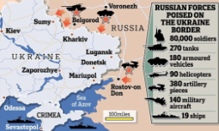
Value System and the «Information War»
A real war always begins with an information war, which weapon is cognitive hack and the main target is the mind (i.e., the value system) of a potential victim!
We demand peace!

Slide 13
Cognitive hack of an Industry 4.0 system: Poisoning minds of the decision-makers

Slide 14
Cognitive hack of an Industry 4.0 system: Poisoned minds poison the system

Slide 15
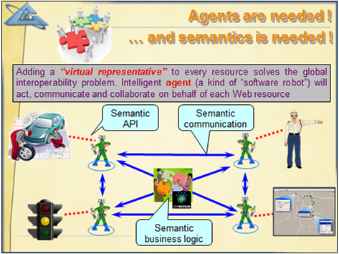
Collective Intelligence
“Army of decision-makers”
Cognitive Computing is the simulation of human thought processes in a computerized model. Cognitive computing involves self-learning systems that use data mining, pattern recognition and natural language processing to mimic the way the human brain works. The goal of cognitive computing is to automate decision-making and problem-solving.
Who they are?
Humans
Mind “clones” of humans
Machine-Learning (Cognitive Computing) - driven agents

Slide 16
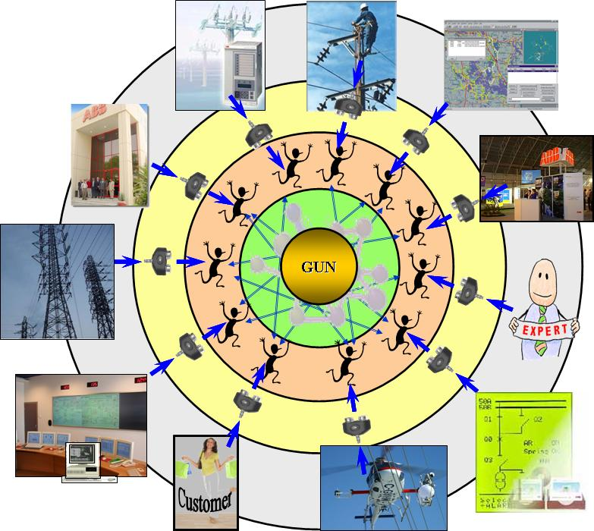
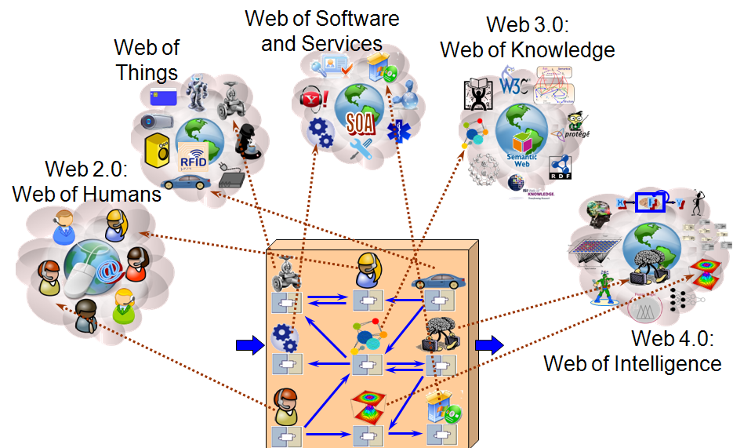
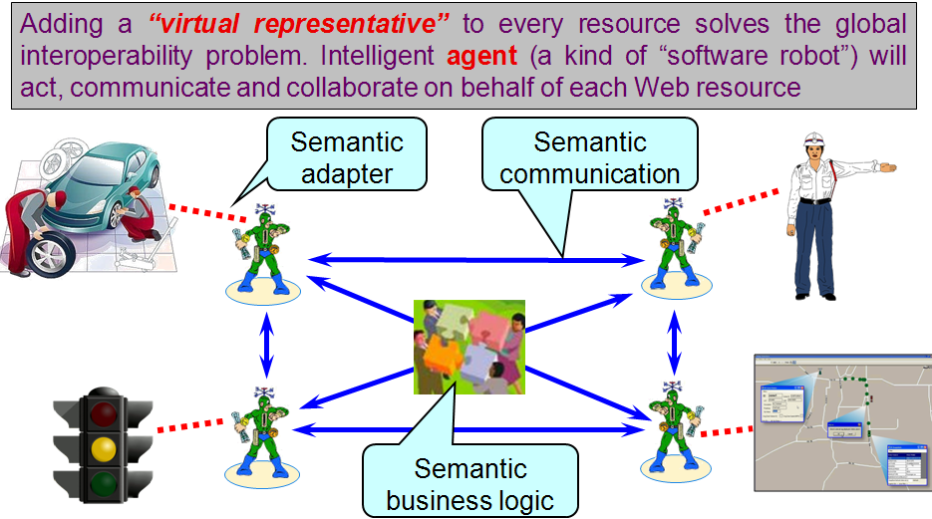
Global Understanding Environment (GUN) (Industrial Ontologies Group)
Predicting Industry 4.0 already in 2003 !
GUN is a kind of Ubiquitous Eco-System for Ubiquitous Society, which is such proactive, self-managed evolutionary Semantic Web of Things, People and Abstractions where all kinds of entities can understand, interact, serve, develop and learn from each other.
GUN = Global Environment + Global Understanding =
= Proactive Self-Managed Semantic Web of Everything
http://www.mit.jyu.fi/ai/OntoGroup/projects.htm
http://www.mit.jyu.fi/ai/Industrial_Ontologies_Group_booklet_print.doc

Slide 17
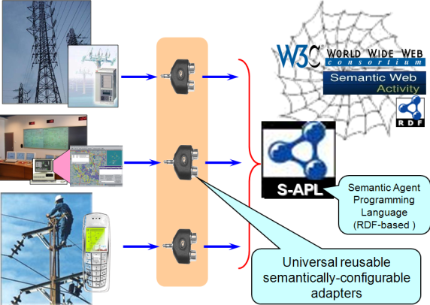
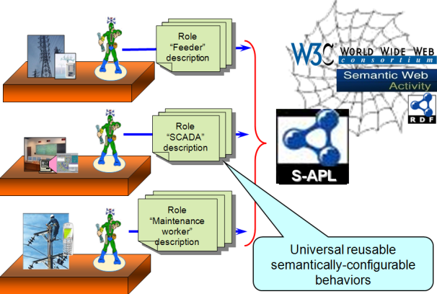
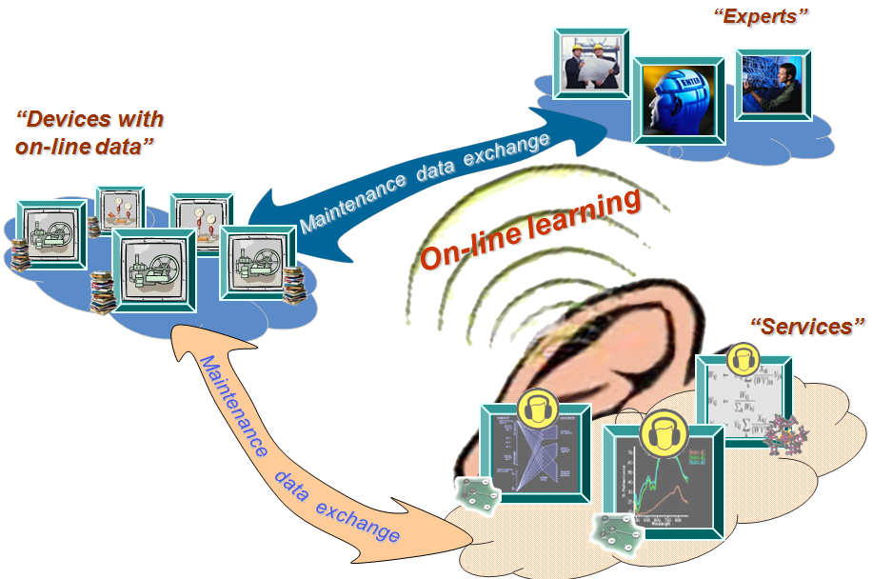
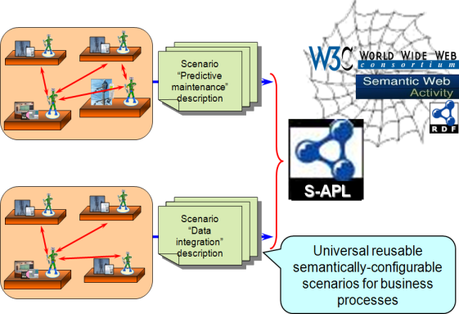
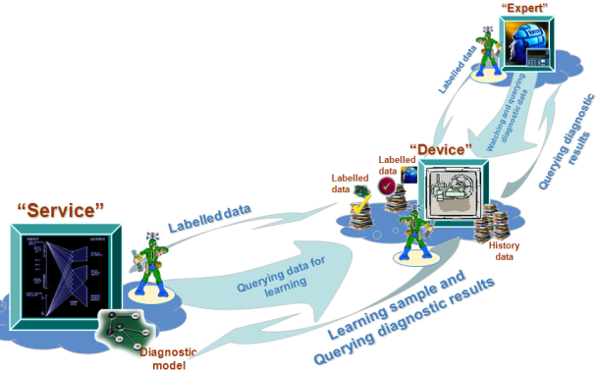
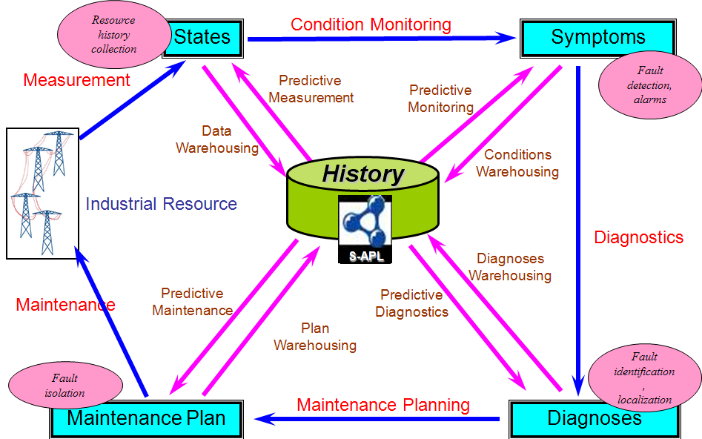
SmartResource project - our first step towards Collective Intelligence – driven Industry 4.0
S m a r t R e s o u r c e
Tekes Project (2004-2006)
SmartResource: “Proactive Self-Maintained Resources in Semantic Web” Tekes project (2004-2006) done by IOG.
Project site:
http://www.mit.jyu.fi/ai/OntoGroup/SmartResource.htm
One of the most essential results of the SmartResource project was creation of the “Smart Resource Technology” for designing complex software systems. The technology allows considering each traditional system component as a “smart resource”, i.e. proactive, agent-driven, self-managing. Such approach has shown certain advantages comparably to other software technologies, e.g. OOSE, SOA, Component-Based SE, Agent-Driven SE, Semantic SE, etc.

Slide 18
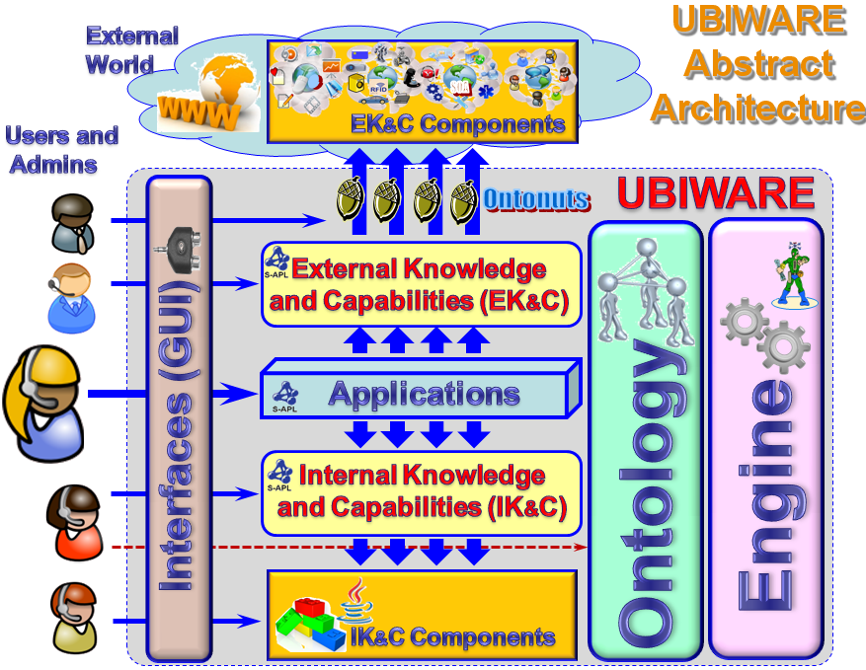
UBIWARE project (2007-2010) – designing a middleware for Industry 4.0

Slide 19
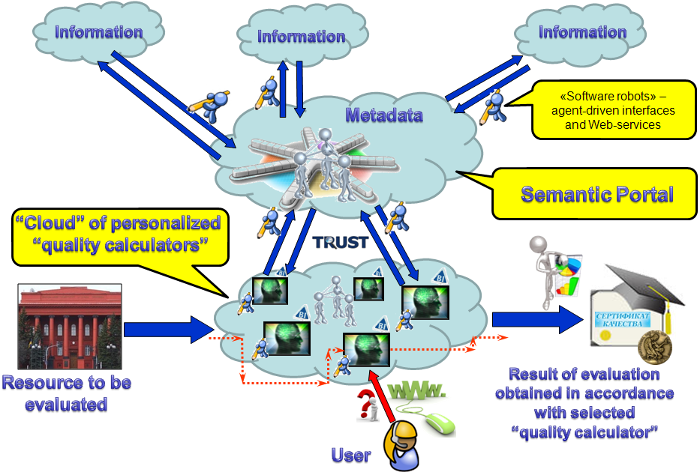
TRUST project (2011-2015) – designing a cloud of “transparent minds” for the trusted decision-making in education

Slide 20
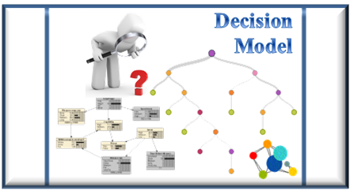
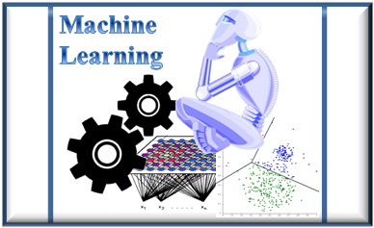
Machine Learning (systems, which skills you do not need to program; you just teach - they learn)
Generic
Machine-Learning
- based process
Environment
Actuators
Sensors
Machine learning refers to a variety of algorithms and methodologies that enable systems to improve their performance over time as they obtain more data. It is about recognizing trends from data or recognizing the categories that the data fit in, etc., so that when the system is presented with new data, it can make proper predictions, diagnoses, decisions, etc. This means learning by input-output examples rather than by coding.
[http://www.pcworld.idg.com.au/article/595254/five-things-need-know-about-ai-cognitive-neural-deep-oh-my/]

Slide 21
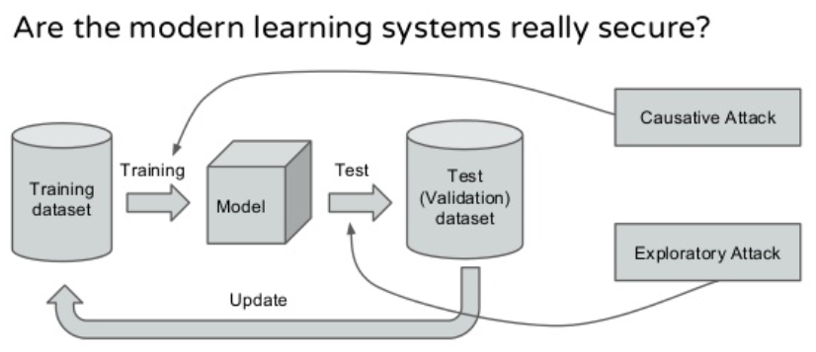
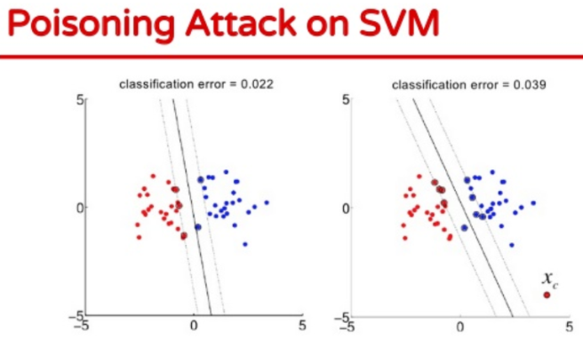
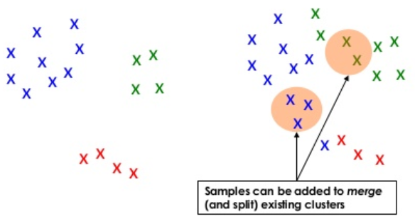
Cognitive Computing and Cybersecurity
Is Cognitive Computing safe?
Cybersecurity-related aspects of the Cognitive Computing, Deep Learning and Collective Intelligence
Cognitive Computing enhances creation of “artificial” decision-makers, agents, cognitive robots, etc. These entities are becoming users of various information systems and sources and automatically learn based on this usage experiences. Therefore they are also becoming a potential target for Cognitive Hacking. Recent articles related to security aspects of Cognitive Computing and Deep Learning noticed numerous potential risks of influencing outcomes of Machine Learning (decision models) by a variety of (training) data poisoning attacks. Therefore one interesting topic for the self-study would be on how to handle such risks (based on system's self-awareness and self-protection) for both human and artificial minds (i.e., risks of Cognitive Hacking of the Collective Intelligence) to make future smart systems secure.

Slide 22
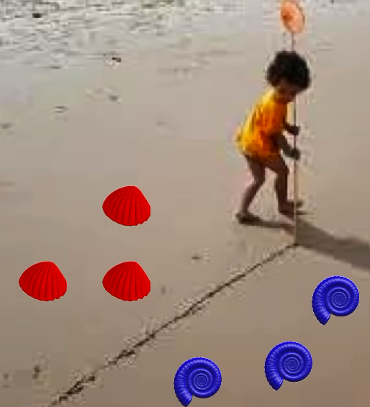
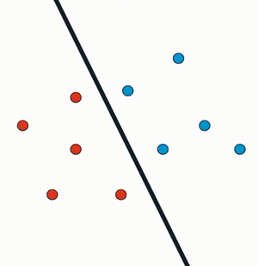
Child separating green and red shells? No! She is “drawing the decision boundary” …

Slide 23
An example of simple 2D decision space
Y
Area of “YES” decisions
X, Y - attributes of a decision
(x₁, y₁), (x₂, y₂) – values of the attributes of the two samples of the decisions in the figure
Training data sample
(x₂, y₂) → “YES”
– a training sample of the “YES” decision
y₂
– a training sample of the “NO” decision
Training data sample
(x₁, y₁) → “NO”
Learned decision boundary
– decision boundary
y₁
Area of “NO” decisions
x₁
x₂
X

Slide 24
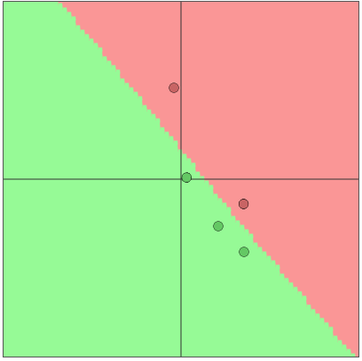
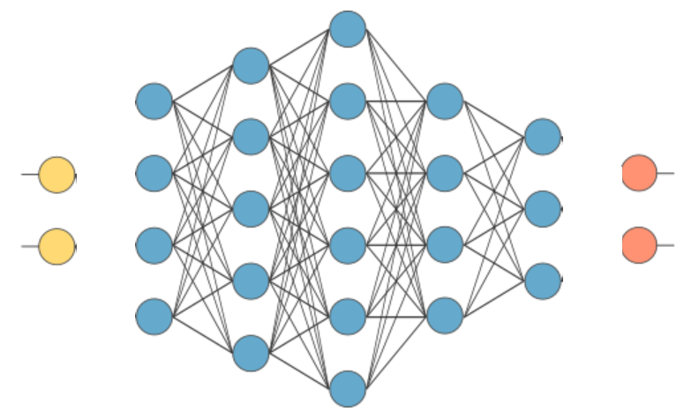
For a simple experiment and the visualizations, we used:
http://cs.stanford.edu/people/karpathy/convnetjs/demo/classify2d.html
Deep Neural Network
x_{i}
“YES”
y_{i}
“NO”
Input layer
Output layer
Hidden layers
This decision boundary has been computed on the basis of 5 training samples of the decisions by the Deep Neural Network with the following architecture:
Artificial
decision-
maker
This Neural Network has 2 hidden layers with 4 neurons each

Slide 25
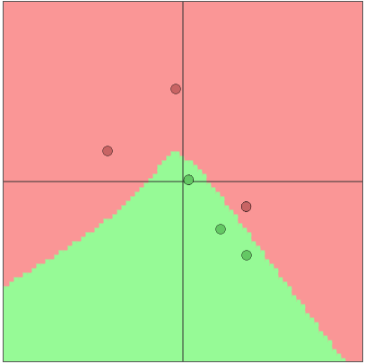
Let us “poison” the data by adding one extra “NO” point
Before poisoning
After poisoning

Slide 26
“Poisoned” training data – “Poisoned Decisions”
Target of the attacker: “poisoned ” areas of the decision space (i.e. the area of potentially wrong decisions made by the artificial decision-maker )
Artificial
decision-
maker
Before poisoning
After poisoning

Slide 27
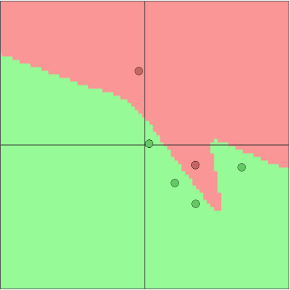
Let us “poison” the data by adding one extra “YES” point
Before poisoning
After poisoning

Slide 28
“Poisoned” training data – “Poisoned Decisions”
Target of the attacker: “poisoned ” areas of the decision space (i.e. the area of potentially wrong decisions made by the artificial decision-maker )
Artificial
decision-
maker
Before poisoning
After poisoning

Slide 29
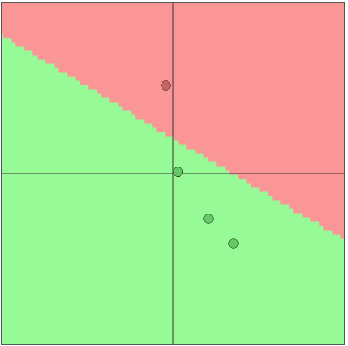
Let us “poison” the data by removing one “NO” point
Before poisoning
After poisoning

Slide 30
“Poisoned” training data – “Poisoned Decisions”
Target of the attacker: “poisoned ” areas of the decision space (i.e. the area of potentially wrong decisions made by the artificial decision-maker )
Artificial
decision-
maker
Before poisoning
After poisoning

Slide 31
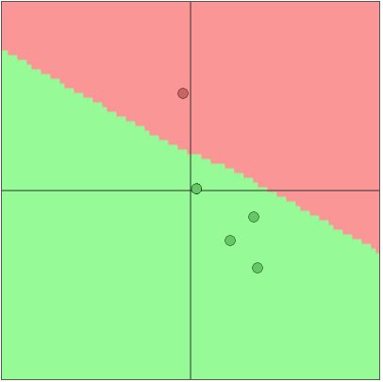
Let us “poison” the data by “recoloring” one point from “NO” to “YES”
Before poisoning
After poisoning

Slide 32
“Poisoned” training data – “Poisoned Decisions”
Target of the attacker: “poisoned ” areas of the decision space (i.e. the area of potentially wrong decisions made by the artificial decision-maker )
Artificial
decision-
maker
Before poisoning
After poisoning

Slide 33
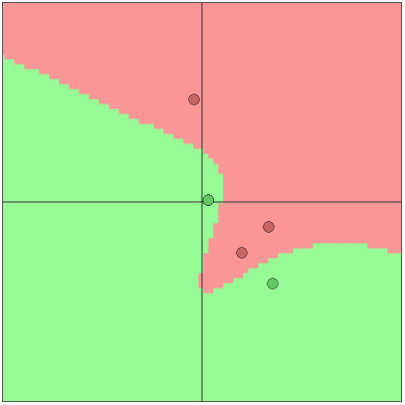
Let us “poison” the data by “recoloring” one point from “YES” to “NO”
Before poisoning
After poisoning

Slide 34
“Poisoned” training data – “Poisoned Decisions”
Target of the attacker: “poisoned ” areas of the decision space (i.e. the area of potentially wrong decisions made by the artificial decision-maker )
Artificial
decision-
maker
Before poisoning
After poisoning

Slide 35
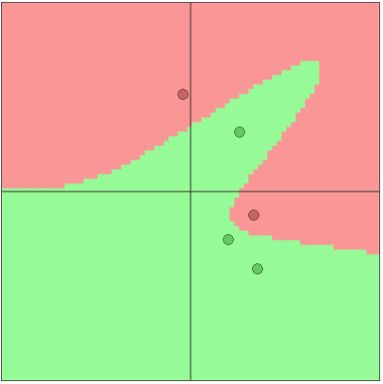
Let us “poison” the data by “changing location” of one “YES” point
Before poisoning
After poisoning

Slide 36
“Poisoned” training data – “Poisoned Decisions”
Target of the attacker: “poisoned ” areas of the decision space (i.e. the area of potentially wrong decisions made by the artificial decision-maker )
Artificial
decision-
maker
Before poisoning
After poisoning

Slide 37
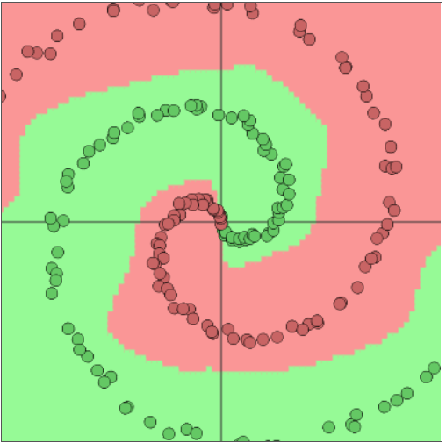
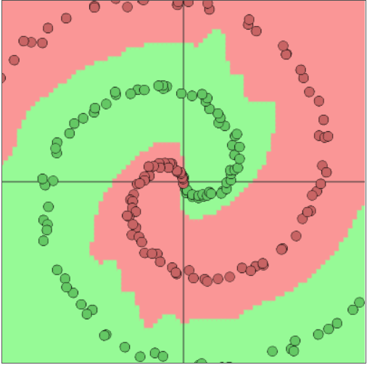
Let us consider a more complex decision problem addressed by two different decision-makers
Artificial
decision-
maker
Deep (5 hidden layers) Neural Network
Artificial
decision-
maker
Shallow (1 hidden layer) Neural Network
Before poisoning
Before poisoning

Slide 38
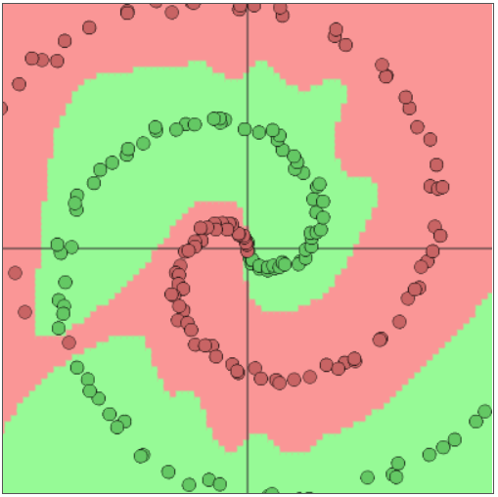
Let us “poison” the data by adding three “NO” points: Intended impact – “broken” decision boundary
Artificial
decision-
maker
Shallow (1 hidden layer) Neural Network
Before poisoning
After poisoning

Slide 39
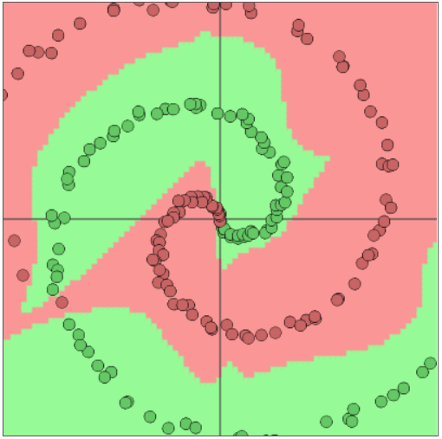
Let us “poison” the data by adding three “NO” points: Intended impact – “broken” decision boundary
Artificial
decision-
maker
Deep (5 hidden layers) Neural Network
Before poisoning
After poisoning

Slide 40
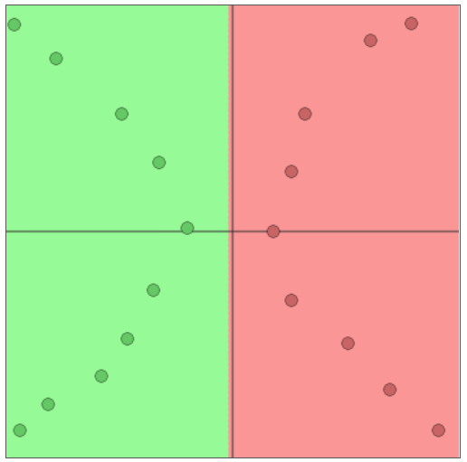
Let us “poison” the data by unbalanced prototype selection for learning the decision boundary
Artificial
decision-
maker
Shallow (1 hidden layer) Neural Network
Before poisoning
Poisoning (wrong prototype selection)

Slide 41
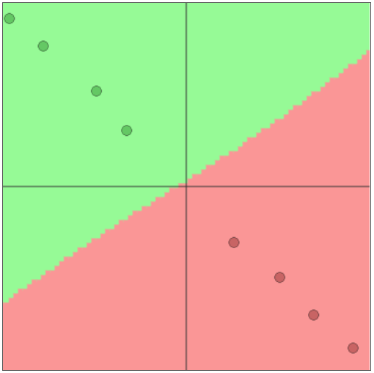
Let us “poison” the data by unbalanced prototype selection for learning the decision boundary
Artificial
decision-
maker
Target of the attacker: “poisoned ” areas of the decision space (i.e. the area of potentially wrong decisions made by the artificial decision-maker )
Target of the attacker: “poisoned ” areas of the decision space (i.e. the area of potentially wrong decisions made by the artificial decision-maker )
Correct “balanced ” decision boundary
Incorrect “biased ” decision boundary
Poisoning (wrong prototype selection)
After poisoning

Slide 42
Let us see how “poisoning” (adding just one extra point) compromises the result of clustering (unsupervised learning) the unlabeled data. Impact: 1 cluster (incorrect as intended by the attacker) instead of 2 (correct)
Before poisoning
After poisoning

Slide 43
Poisoned images may fool self-driving cars
Unfortunately, it’s not difficult to fool visual classification algorithms by merely altering the physical appearance of road signage slightly. E.g., adding a few stickers or spray paint to signs caused deep neural network-based classifiers to confuse them for other types of signs …
https://thenewstack.io/camouflaged-graffiti-road-signs-can-fool-machine-learning-models/

Slide 44
Poisoned images fool AI
C. Szegedy, W. Zaremba, I. Sutskever, J. Bruna, D. Erhan, I. Goodfellow, and R. Fergus. “Intriguing Properties of Neural Networks”. https://arxiv.org/pdf/1312.6199v4.pdf
Figure shows three images. On the left is an image that the AI system correctly classifies as a school bus. Image in center is a noise which when added to the left image creates an image shown on the right which still looks like a school bus to a human observer. But the AI system now classifies this image (right) as an ostrich.
“Clean” image
“Poison” or special noise
“Poisoned” image

Slide 45
Stealing machine learning models:
Model extraction attacks
https://pdfs.semanticscholar.org/8a95/423d0059f7c5b1422f0ef1aa60b9e26aab7e.pdf?_ga=2.108826690.1356588117.1507705151-256528290.1507099135
Machine learning (ML) models may be deemed confidential due to their sensitive training data, commercial value, or use in security applications. Increasingly often, confidential ML models are being deployed with publicly accessible query interfaces. ML-as-a-service (“predictive analytics”) systems are an example. In model extraction attacks, an adversary with black-box access, but no prior knowledge of an ML model’s parameters or training data, aims to duplicate the functionality of (i.e., “steal”) the model with near-perfect fidelity for popular model classes including logistic regression, neural networks, and decision trees.

Slide 46
Samples of current research related to Data Poisoning and Adversarial Machine Learning

Slide 47
Evasion Attacks
https://arxiv.org/pdf/1704.08996
To cope with the increasing variability and sophistication of modern attacks, machine learning has been widely adopted as a statistically-sound tool for malware detection. However, its security against well-crafted attacks has not only been recently questioned, but it has been shown that machine learning exhibits inherent vulnerabilities that can be exploited to evade detection at test time. In other words, machine learning itself can be the weakest link in a security system. In this paper, we rely upon a previously-proposed attack framework to categorize potential attack scenarios against learning-based malware detection tools, by modeling attackers with different skills and capabilities. We then define and implement a set of corresponding evasion attacks to thoroughly assess the security of Drebin, an Android malware detector. The main contribution of this work is the proposal of a simple and scalable secure-learning paradigm that mitigates the impact of evasion attacks, while only slightly worsening the detection rate in the absence of attack. We finally argue that our secure-learning approach can also be readily applied to other malware detection tasks.

Slide 48
Feature selection under attack
http://proceedings.mlr.press/v37/xiao15.pdf
Proceedings of the 32nd International Conference on Machine Learning, PMLR 37:1689-1698, 2015.
Learning in adversarial settings is becoming an important task for application domains where attackers may inject malicious data into the training set to subvert normal operation of data-driven technologies. Feature selection has been widely used in machine learning for security applications to improve generalization and computational efficiency, although it is not clear whether its use may be beneficial or even counterproductive when training data are poisoned by intelligent attackers. In this work, we shed light on this issue by providing a framework to investigate the robustness of popular feature selection methods, including LASSO, ridge regression and the elastic net. Our results on malware detection show that feature selection methods can be significantly compromised under attack (we can reduce LASSO to almost random choices of feature sets by careful insertion of less than 5% poisoned training samples), highlighting the need for specific countermeasures.
Poisoning (integrity) attacks. The attacker tampers with the training data to enforce selection of a feature subset that will facilitate classifier evasion at test time. For instance, an attacker may craft poisoning samples to enforce selection of a given subset of features, whose values are easily changed
with trivial manipulations to the malicious data at test time.
Poisoning (availability) attacks. Here the attacker aims to
inject well-crafted poisoning points into the training data
to maximally compromise the output of the feature selection algorithm, or directly of the learning algorithm

Slide 49
Support Vector Machine under attack
http://www.sciencedirect.com/science/article/pii/S0925231215001198
Neurocomputing, Vol. 160, 21 July 2015, pp. 53-62
Machine learning algorithms are increasingly being applied in security-related tasks such as spam and malware detection, although their security properties against deliberate attacks have not yet been widely understood. Intelligent and adaptive attackers may indeed exploit specific vulnerabilities exposed by machine learning techniques to violate system security. Being robust to adversarial data manipulation is thus an important, additional requirement for machine learning algorithms to successfully operate in adversarial settings. In this work, we evaluate the security of Support Vector Machines (SVMs) to well-crafted, adversarial label noise attacks. In particular, we consider an attacker that aims to maximize the SVM׳s classification error by flipping a number of labels in the training data. We formalize a corresponding optimal attack strategy, and solve it by means of heuristic approaches to keep the computational complexity tractable. We report an extensive experimental analysis on the effectiveness of the considered attacks against linear and non-linear SVMs, both on synthetic and real-world datasets. We finally argue that our approach can also provide useful insights for developing more secure SVM learning algorithms, and also novel techniques in a number of related research areas, such as semi-supervised and active learning.

Slide 50
https://www.sec.in.tum.de/assets/Uploads/HanXiao2.pdf
Classifiers under attack
Advances in Knowledge Discovery and Data Mining (2012): 207-218.
Machine learning has yield significant advances in decision-making for complex systems, but are they robust against adversarial attacks? We generalize the evasion attack problem to the multi-class linear classifiers, and present an efficient algorithm for approximating the optimal disguised instance. Experiments on real-world data demonstrate the effectiveness of our method.

Slide 51
Autoregressive models under attack
http://www.aaai.org/ocs/index.php/AAAI/AAAI16/paper/download/12049/11758
Forecasting models play a key role in money-making ventures in many different markets. Such models are often trained on data from various sources, some of which may be untrustworthy. An actor in a given market may be incentivised to drive predictions in a certain direction to their own benefit. Prior analyses of intelligent adversaries in a machine-learning context have focused on regression and classification. In this paper we address the non-iid setting of time series forecasting. We consider a forecaster, Bob, using a fixed, known model and a recursive forecasting method. An adversary, Alice, aims to pull Bob’s forecasts toward her desired target series, and may exercise limited influence on the initial values fed into Bob’s model. We consider the class of linear autoregressive models, and a flexible framework of encoding Alice’s desires and constraints. We describe a method of calculating Alice’s optimal attack that is computationally tractable, and empirically demonstrate its effectiveness compared to random and greedy baselines on synthetic and real-world time series data. We conclude by discussing defensive strategies in the face of Alice-like adversaries.
AAAI (pp. 1452-1458).

Slide 52
Collaborative Filtering under attack
http://papers.nips.cc/paper/6142-data-poisoning-attacks-on-factorization-based-collaborative-filtering.pdf
Recommendation and collaborative filtering systems are important in modern information and e-commerce applications. As these systems are becoming increasingly popular in the industry, their outputs could affect business decision making, introducing incentives for an adversarial party to compromise the availability or integrity of such systems. We introduce a data poisoning attack on collaborative filtering systems. We demonstrate how a powerful attacker with full knowledge of the learner can generate malicious data so as to maximize his/her malicious objectives, while at the same time mimicking normal user behavior to avoid being detected. While the complete knowledge assumption seems extreme, it enables a robust assessment of the vulnerability of collaborative filtering schemes to highly motivated attacks. We present efficient solutions for two popular factorization-based collaborative filtering algorithms: the alternative minimization formulation and the nuclear norm minimization method. Finally, we test the effectiveness of our proposed algorithms on real-world data and discuss potential defensive strategies.
One particular form of attacks is called data poisoning, in which a malicious party creates dummy (malicious) users in a recommendation system with carefully chosen item preferences (i.e., data) such that the effectiveness or credibility of the system is maximally degraded. For example, an attacker might attempt to make recommendations that are as different as possible from those that would otherwise be made by the recommendation system. In another, more subtle, example, the attacker is associated with the producer of a specific movie or product, who may wish to increase or decrease the popularity of a certain item. In both cases, the credibility of a recommendation system is harmed by the malicious activities, which could lead to significant economic loss.

Slide 53
We have seen just a few examples of the related research.
To read more fresh articles on Data Poisoning, click here:
http://scholar.google.fi/scholar?q=%22Data+Poisoning%22&btnG=&hl=en&as_sdt=1%2C5&as_ylo=2016&as_vis=1
Read also:
https://en.wikipedia.org/wiki/Adversarial_machine_learning

Slide 54
COIN Master Program –
A pilot of the “University-for-Collective-Intelligence”
New International Master Program: COIN: Cognitive Computing and Collective Intelligence
COIN
starts September 2018
On completion of the programme, the graduates will be able to use, design and train complex self-managed and continuously evolving public and private industrial systems, digital ecosystems, cyber-physical systems, systems-of-systems, platforms, services and applications; will be able to connect their designs with publicly available Deep Learning and Big Data analytics and Web-based Cognitive Computing capabilities as services; will be able to figure-out and approach various challenging aspects of wicked problems world-wide, which require collective intelligence and self-managing service-based architectures for their solutions; understand and professionally utilize for that purpose knowledge on enabling technologies and tools; … Students, who will graduate from the programme with a Master of Science in Natural Sciences from the Faculty of Information Technology, will think beyond the routine and will be able not just to adapt to a change but to help to create and control it. This means that our graduates will not be able only to “solve smart problems”, but in addition to it they will be able to “invent new and smart problems” and drive them by “designing artificial smart problem solvers”.

