Slide 2
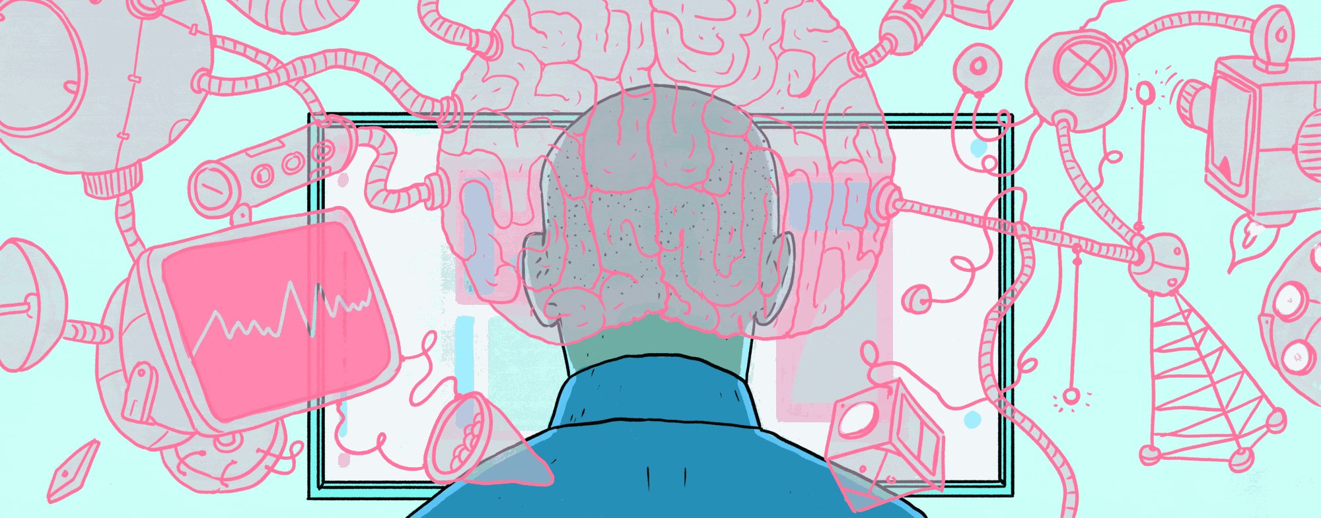
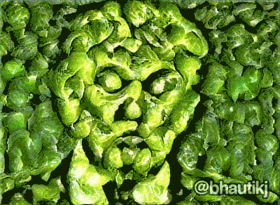
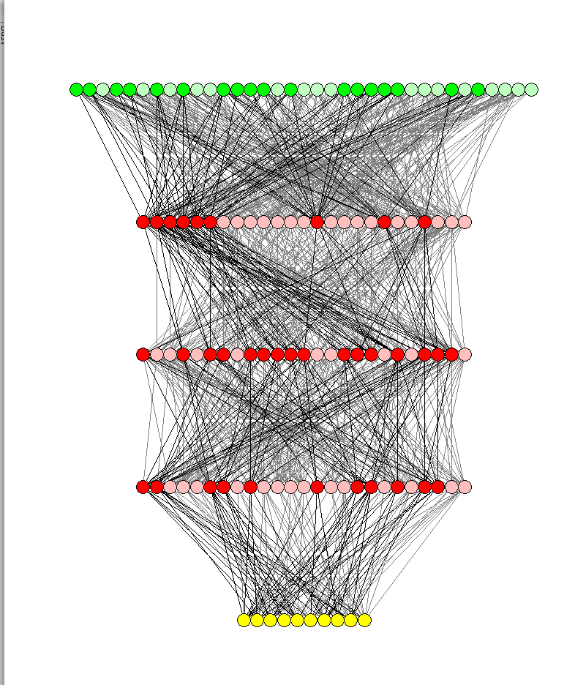
Part II: Introduction to Neural Networks and Deep Learning lectures from the course: TIES4910: Deep Learning for Cognitive Computing
Vagan Terziyan
Department of Mathematical Information Technology, University of Jyvaskyla
URL:https://ai.it.jyu.fi/vagan
Fall 2017

Slide 3
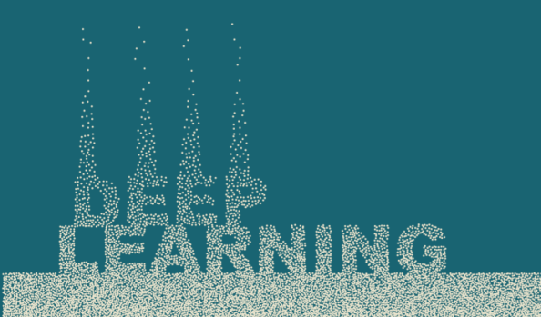
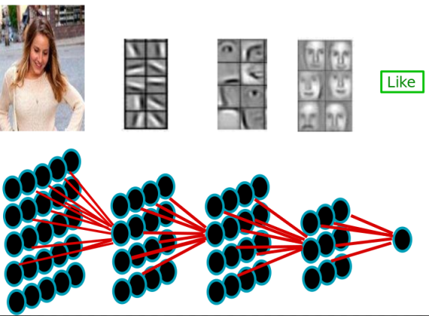
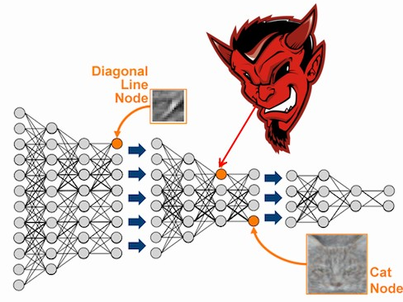
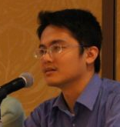
Concerns of the Part-II:
Deep Learning for beginners;
Neural nets basics;
Gradient descent and backpropagation;
Variations of deep learning approaches and architectures.
Content is provided mostly on the basis of slides from Hung-yi Lee courses with some additions from: Luis Serrano, Michael Nielsen, Brandon Rohrer and others, compiled and edited by Vagan Terziyan

Slide 4
I am grateful to the authors of the reused slides (see title page), as well as anonymous photographers and artists, whose photos and pictures (or their fragments) posted on the Internet, have been used in the presentation.
Beware on hidden slides!

Slide 5
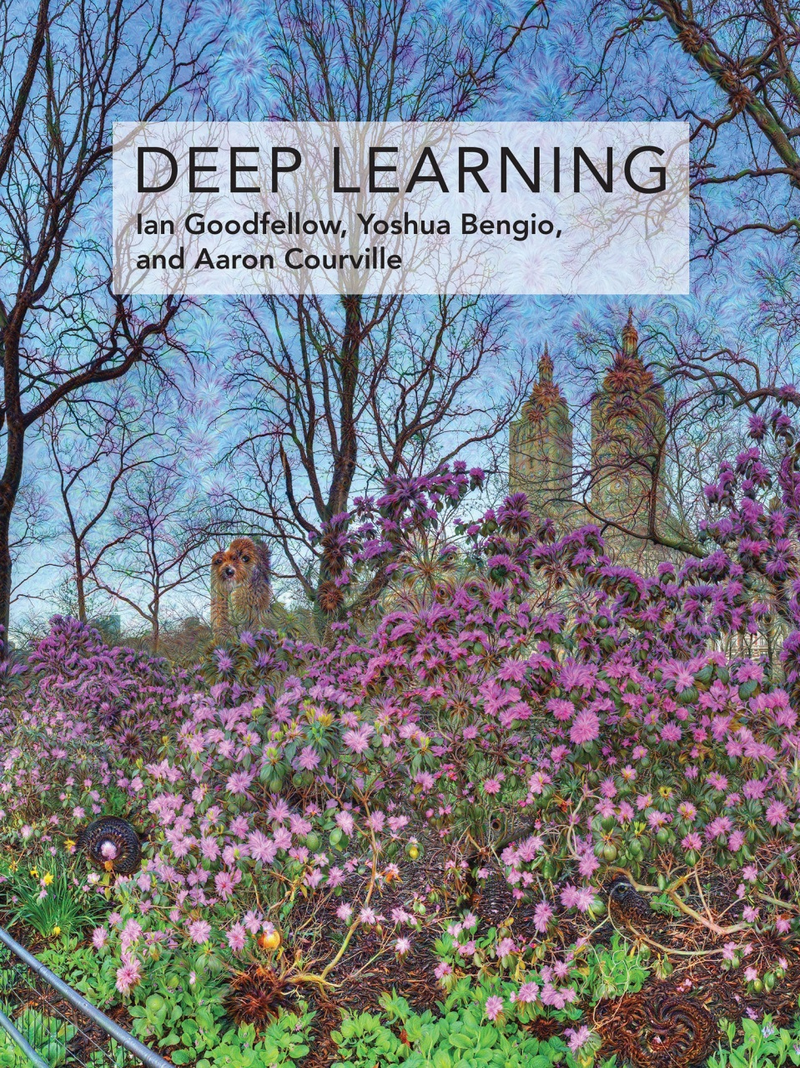
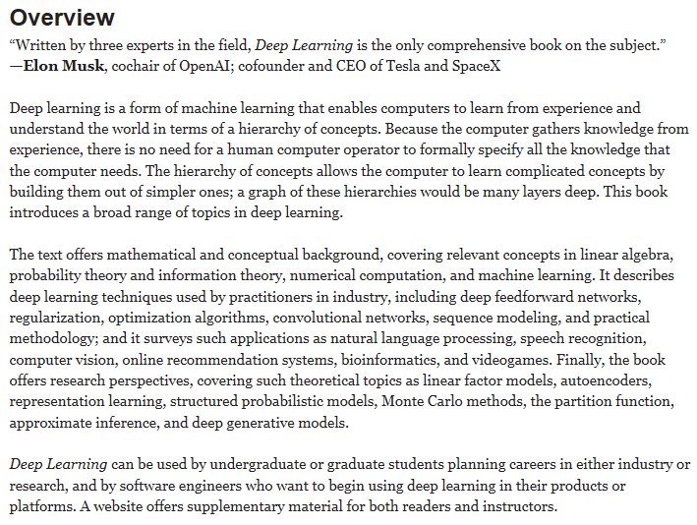
Recommended reading
Goodfellow, I., Bengio, Y., & Courville, A. (2016). Deep Learning, MIT Press, 787 pp.
http://www.deeplearningbook.org

Slide 6
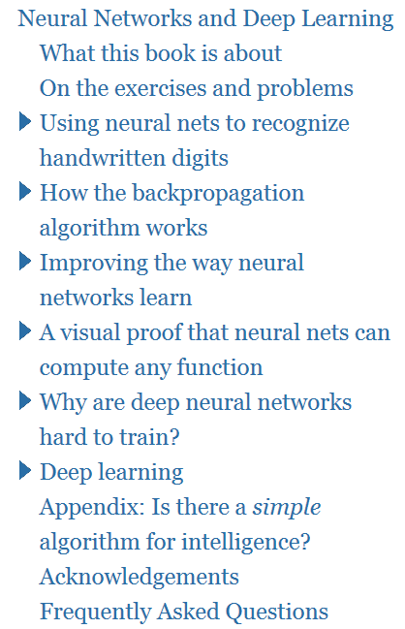
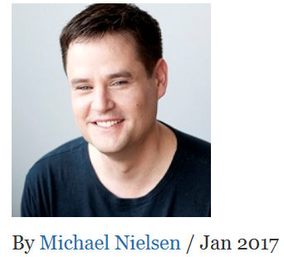
Recommended reading
“Neural Networks and Deep Learning”
written by Michael Nielsen
http://neuralnetworksanddeeplearning.com/

Slide 7
What we remember
from the Machine Learning?
Lets check together …

Slide 8
Cognitive computing, data mining and knowledge discovery, computational intelligence, soft computing, machine learning, deep learning, etc., are different but correlated facets of the same trend within the evolution of the Artificial Intelligence

Slide 9
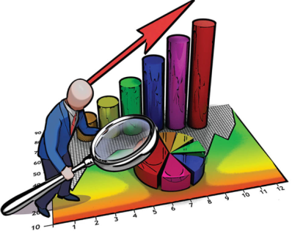
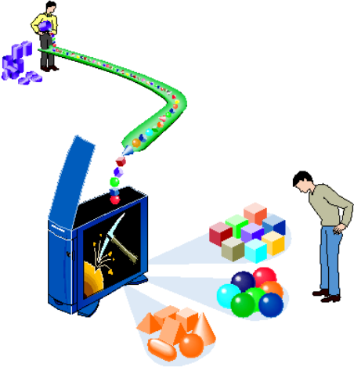
Tasks of Machine Learning vs. Database Querying
Database Querying examples
Machine Learning examples
Find all credit applicants with last name of Smith.
Identify customers who have purchased more than $10,000 in the last month.
Find all customers who have purchased milk
Find all credit applicants who are poor credit risks. (classification)
Identify customers with similar buying habits. (Clustering)
Find all items which are frequently purchased with milk. (association rules)

Slide 10
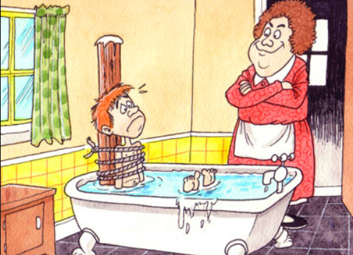

Slide 11
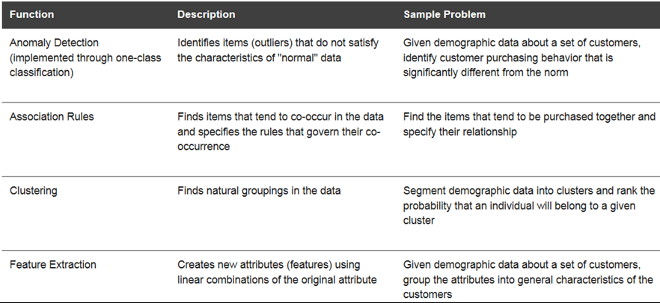

Slide 12
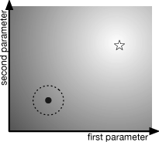
Reinforcement Learning
Used for agent and multi-agent learning, planning, simulation-based optimization, evolutionary computation, etc.

Slide 13
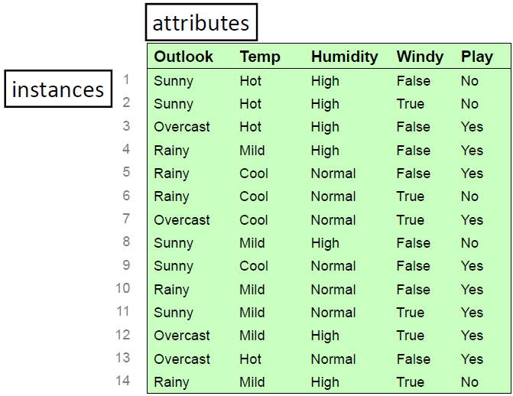
Sample of the data

Slide 14
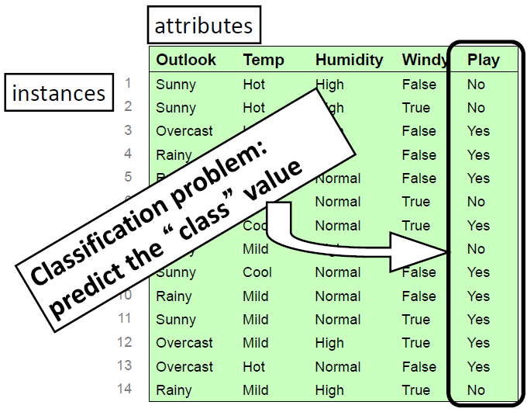
Classification

Slide 15
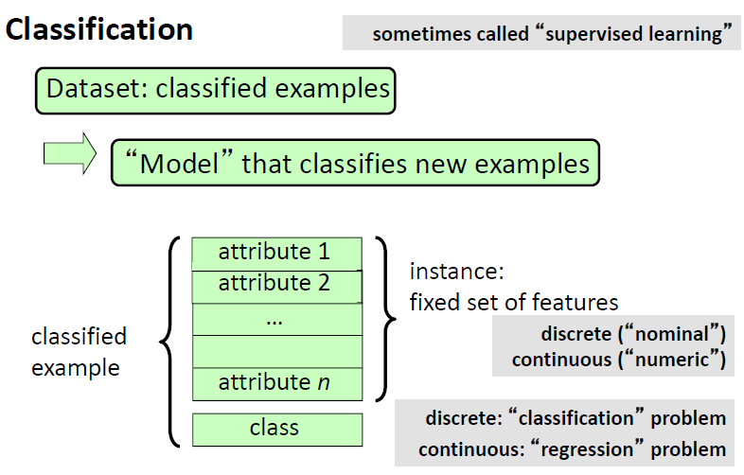

Slide 16
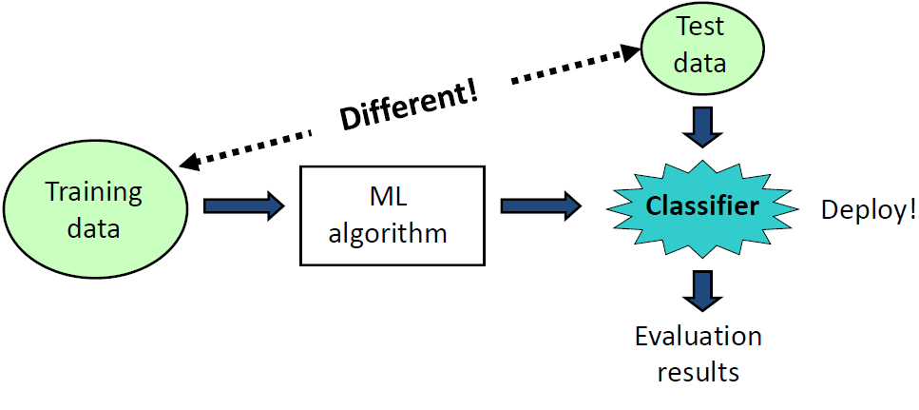
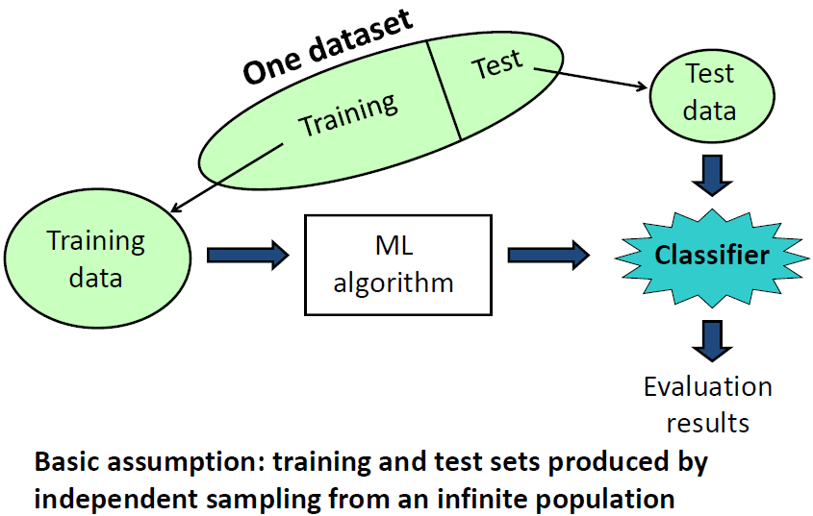
Training vs Testing

Slide 17
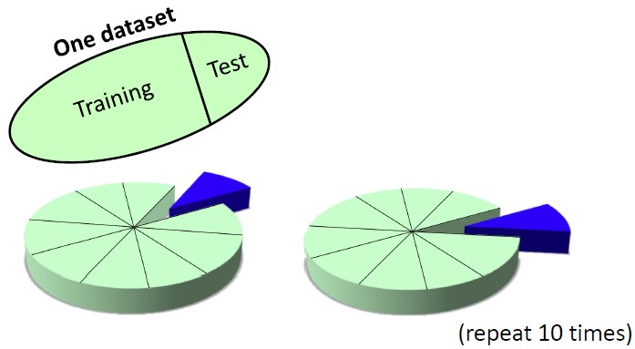
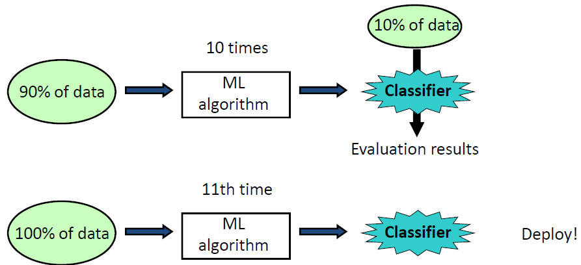

Slide 18
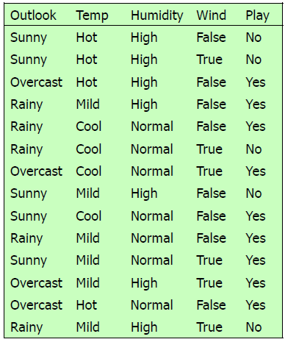
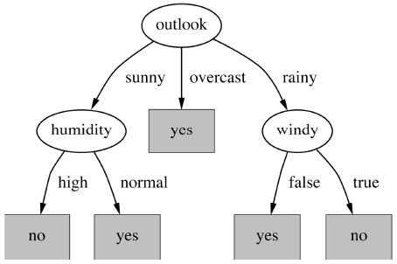

Slide 19
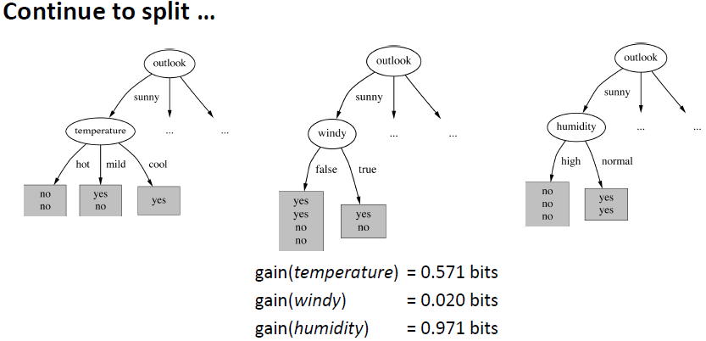

Slide 20
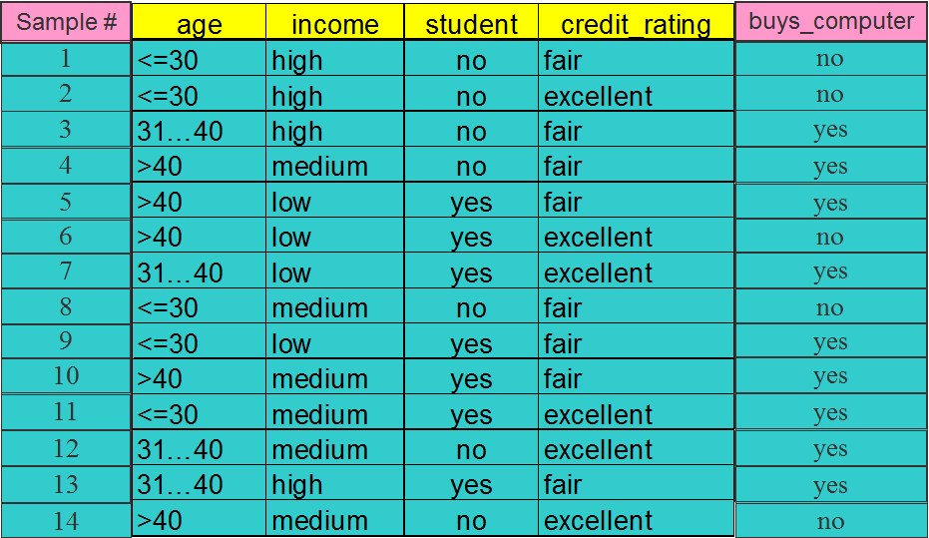
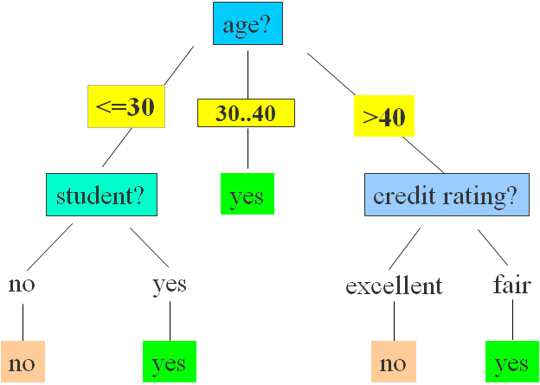
Rules

Slide 21
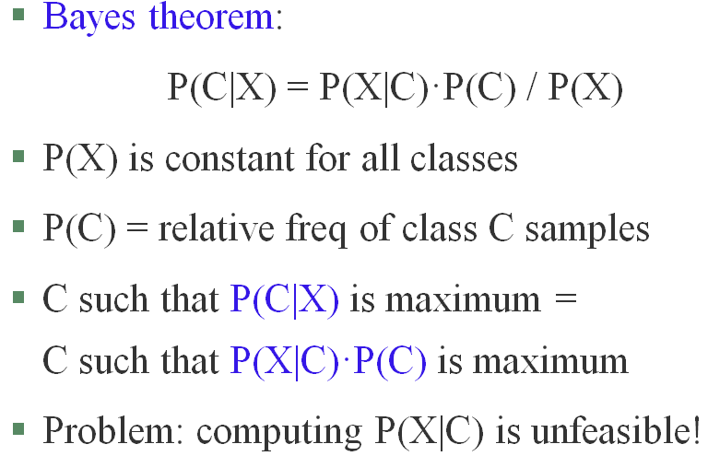
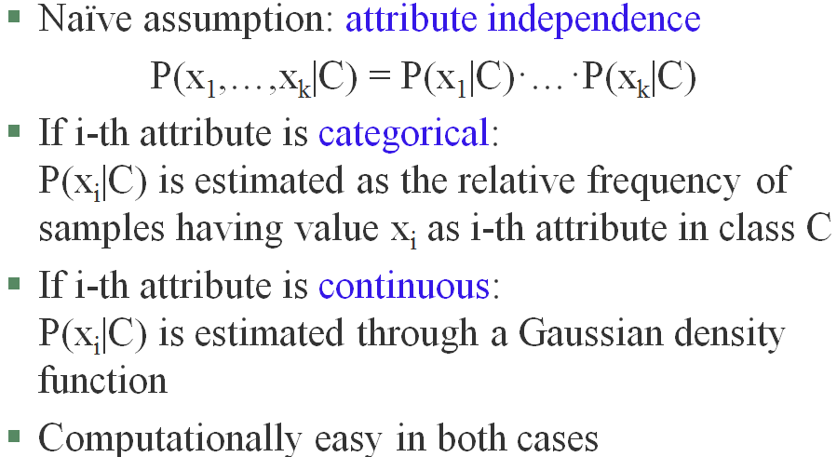
Naïve Bayesian Classification
P(P) = 9/14
P(N) = 5/14

Slide 22
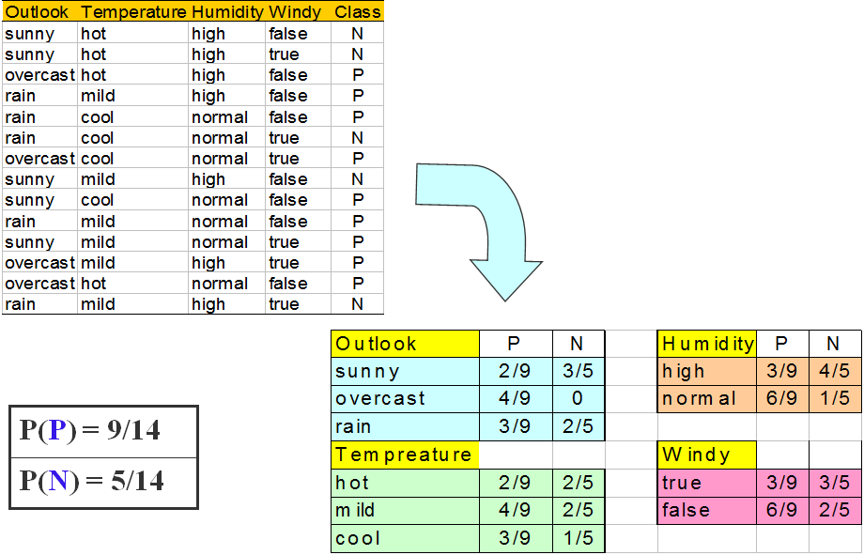
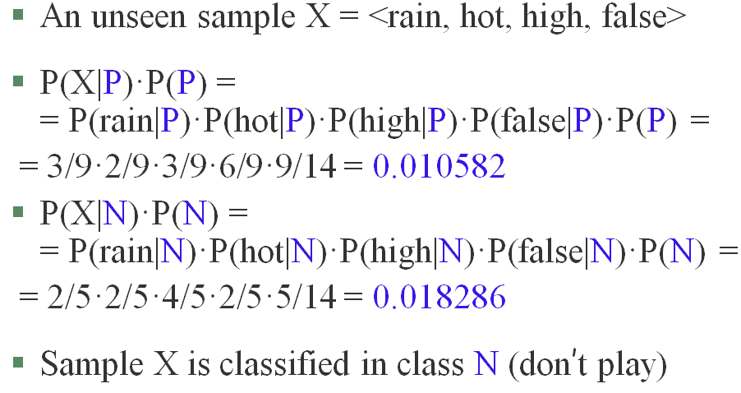
Naïve Bayesian Classification

Slide 23
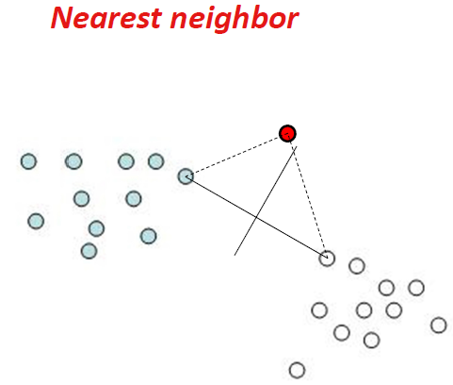
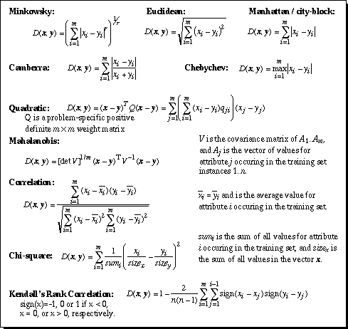
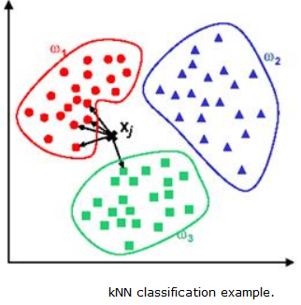

Slide 24
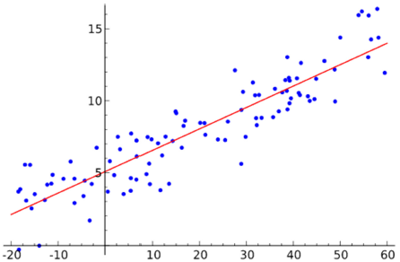
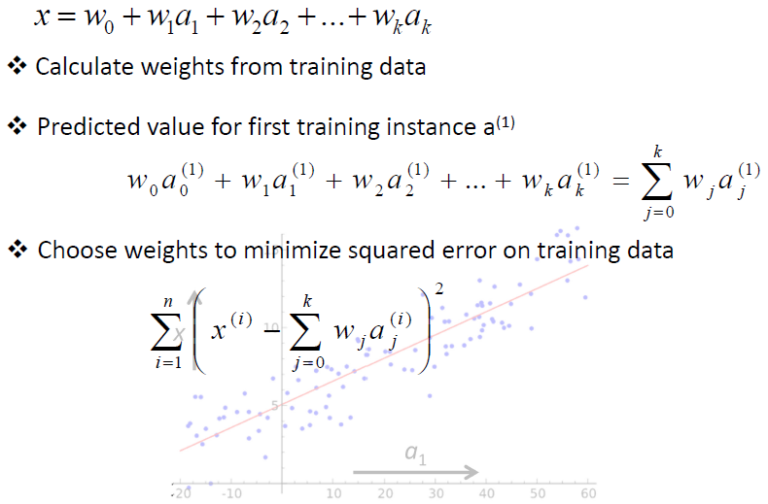
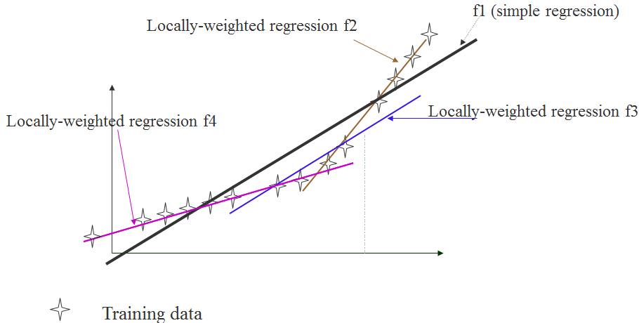
Non-Linear: e.g., Locally weighted regression

Slide 25
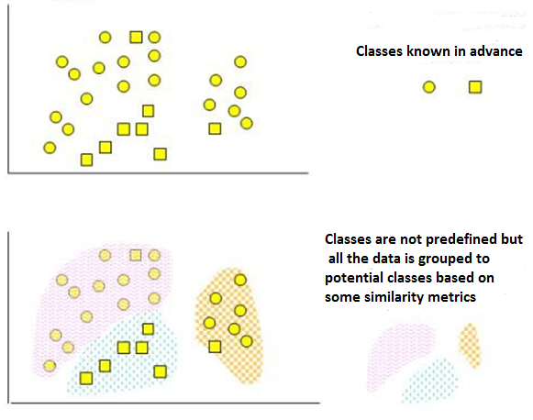
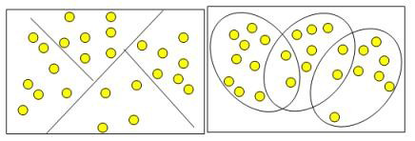
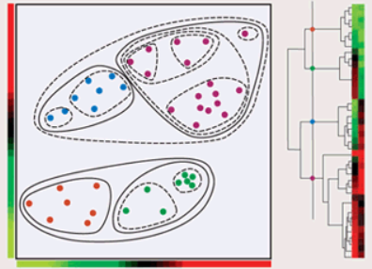
Clustering vs. Classification
k-means

Slide 26
OK, assume we remember at least something … Let us continue here: Fast and friendly (?) introduction
(complements to Luis Serrano)
https://chatbotslife.com/check-out-this-new-video-a-friendly-introduction-to-neural-networks-and-deep-learning-50a1375585fd#.lm3wyqeks

Slide 27
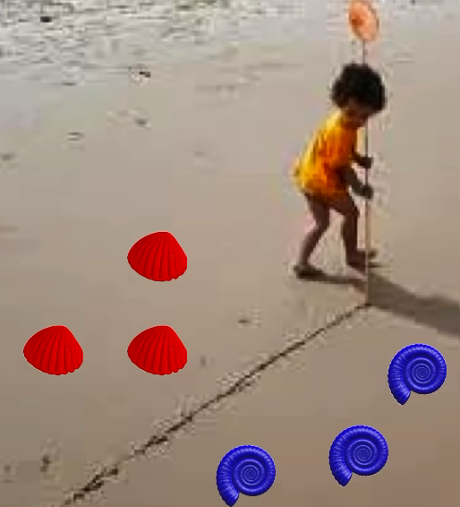
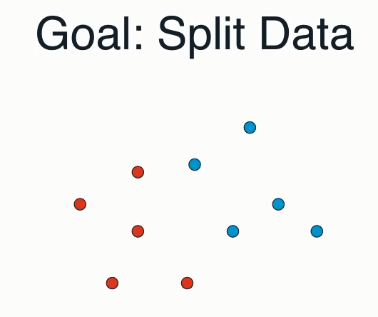
Child separating blue and red shells? No! She is “splitting the data” …

Slide 28
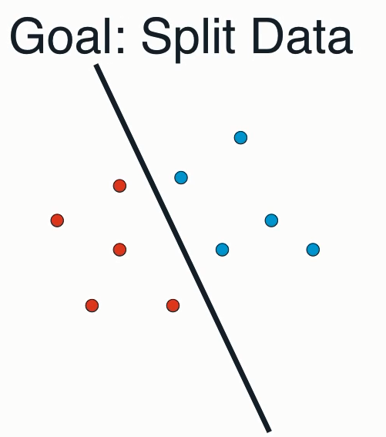
Child separating blue and red shells? No! She is “splitting the data” …

Slide 29
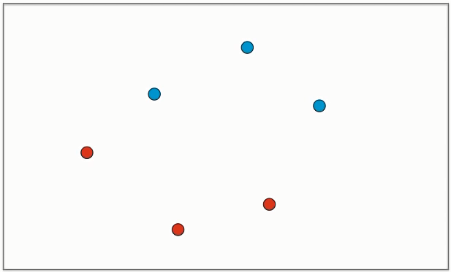
Assume we have such a task for splitting.

Slide 30
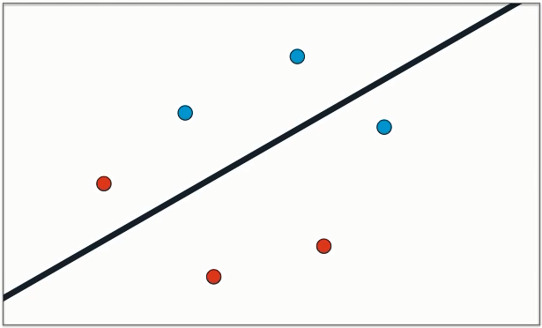
We start with some random decision …

Slide 31
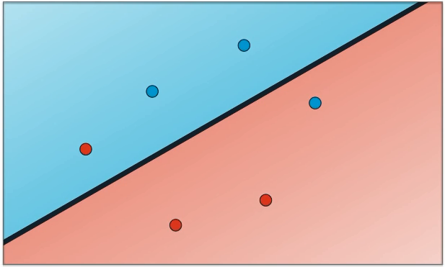
… assuming that …
Area of “blue points”
Area of “red points”

Slide 32
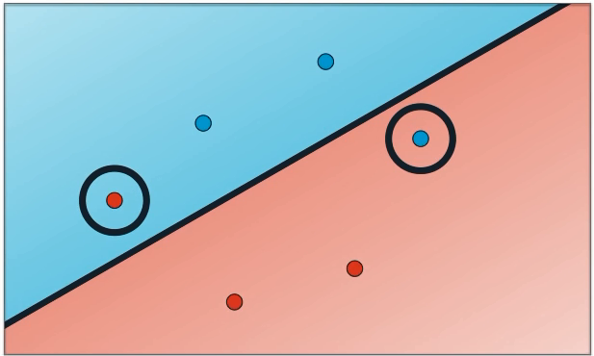
How good is that assumption?

Slide 33
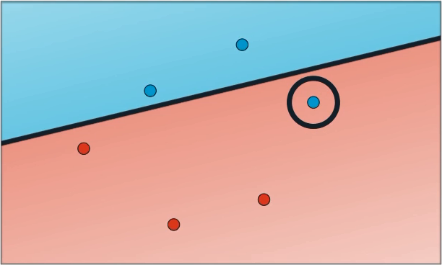
Smartly moving the line may decrease the error …

Slide 34
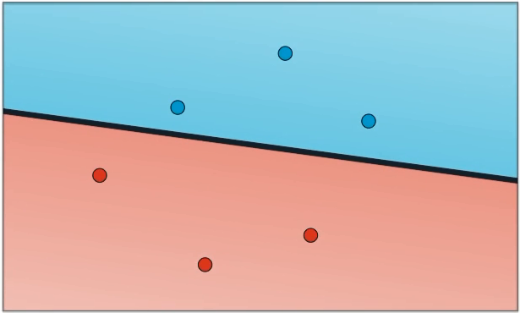
Continue improving …
No errors, but can we still improve? Yes, but then we have to get rid of a discrete error function (problematic to find a derivative for optimization) and suggest something better …

Slide 35
Logistic regression: “Penalizing” errors
- some continuous function

Slide 36
Now the task for minimizing error function using “gradient descent” is doable
Gradient descent: at every stage finding the “fastest way down”

Slide 37
Let us use the “philosophy” of a probability to define the error (loss) function
sigmoid
“Blueness” probability distribution
Activation
function

Slide 38
Compare two cases
Joint probability
(all 4 classified / colored correctly)
Joint probability
(all 4 classified / colored correctly)
This solution is more likely than the previous one above

Slide 39
From probabilities to error function
- Overall error
- Overall error
- Individual penalty
- Individual penalty
$$E\left(p_{1},p_{2},…,p_{n}\right)=−\sum_{i=1}^{n}{{log⁡(p}_{i})}$$

Slide 40
A neuron (a simplest linear separator)

Slide 41
More complex case (a linear separator may not be enough)
We need a curve,
but how to get it?
Merging 2 linear solutions. Not bad!
… but how to formulate “+” to get result like this?

Slide 42
Let us try to achieve a nonlinearity (consider same point transformations in two pictures)
… cannot be a probability as it > 1
+
Activation function

Slide 43
Let us try to achieve a nonlinearity (let us give different weights to the merged solutions and also some shift)
Looks like another “neuron”

Slide 44
Looks like now we have a network of neurons!
Finally we have
a neural network!

Slide 45
… and this network is capable to separate two areas as shown in the picture

Slide 46
Our Neural Network Architecture

Slide 47
More complex separation curves will require more neurons within the hidden layer

Slide 48
Adding extra dimension? No problem; the neurons will just become separation planes instead of separation lines …

Slide 49
Adding extra layers? This may resolve really complex classification tasks!

Slide 50
Playing GO example application
Self-driving car example application

Slide 51
Thank you, Luis, you have convinced us to go deeper to deep learning! Now we have a long trip ahead …
Check also full video from Luis Serrano for reminding yourself more basics of the Machine Learning :
https://www.youtube.com/watch?v=9dbNC1gmQHI

Slide 52
”Deeper” Introduction to Deep Learning
What people already knew in 1980s
Self-study reading: http://neuralnetworksanddeeplearning.com/chap1.html

Slide 53
Example Application
Handwriting Digit Recognition
Machine
“2”
MNIST dataset of digits’ images: http://yann.lecun.com/exdb/mnist/

Slide 54
Handwriting Digit Recognition
Input
Output
y₁
is 1
0.1
y₂
is 2
0.7
The image is “2”
……
……
……
y₁₀
0.2
is 0
16 x 16 = 256
Ink → 1
No ink → 0
Each dimension represents the confidence of a digit.

Slide 55
Example Application
Handwriting Digit Recognition
y₁
Machine
y₂
“2”
……
……
y₁₀
$$f:R^{256}→R^{10}$$
In deep learning, the function $f$ is represented by neural network

Slide 56
Element of Neural Network
Neuron
$$f:R^{K}→R$$
…
Activation function
weights
bias

Slide 57
Activation Function (Case of Perceptron)
bias
Inputs 0 1 and 1 0 produce output 1. Input 1 1 produces output 0 , since (−2)∗1+(−2)∗1+3=−1
is negative.
http://neuralnetworksanddeeplearning.com/chap1.html

Slide 58
What we want from a Neural Network
Suppose we have a network of neurons (aka perceptrons) that we'd like to use to learn to solve some problem (e.g., digit classification). And we'd like the network to learn weights and biases so that the output from the network correctly classifies the digit. To see how learning might work, suppose we make a small change in some weight (or bias) in the network. What we'd like is for this small change in weight to cause only a small corresponding change in the output from the network. This property will make learning possible.
For example, suppose the network was mistakenly classifying an image as an "8" when it should be a "9". We could figure out how to make a small change in the weights and biases so the network gets a little closer to classifying the image as a "9". And then we'd repeat this, changing the weights and biases over and over to produce better and better output. The network would be learning.
The problem is that this isn't what happens when our network contains perceptrons! Therefore we need a neuron with another activation function.
http://neuralnetworksanddeeplearning.com/chap1.html

Slide 59
Sigmoid Neuron with Sigmoid Activation Function
Just like a perceptron, the sigmoid neuron has inputs: x₁ , x₂ , … . But instead of being just 0 or 1, these inputs can also take on any values between 0 and 1. So, for instance, 0.638… is a valid input for a sigmoid neuron. Also just like a perceptron, the sigmoid neuron has weights for each input, w₁ , w₂ , … , and an overall bias b. But the output is not 0 or 1. Instead, it's σ(w⋅x+b) , where σ is called the sigmoid function defined as follows:
The smoothness of σ means that small changes Δw_{j} in the weights and Δb in the bias will produce a small change Δoutput in the output from the neuron. Calculus tells us that Δoutput is well approximated by:
http://neuralnetworksanddeeplearning.com/chap1.html

Slide 60
Other Possible Activation Functions
See more in: https://en.wikipedia.org/wiki/Activation_function

Slide 61
A Neural Network
neuron
Input
Layer 1
Layer 2
Layer L
Output
……
y₁
……
y₂
……
……
……
……
……
……
y_{M}
Input Layer
Output Layer
Hidden Layers
Deep means many (>1) hidden layers
The leftmost layer in this network is called the input layer, and the neurons within the layer are called input neurons. The rightmost or output layer contains the output neurons, or, as in this case, a single output neuron. The middle layer is called a hidden layer, since the neurons in this layer are neither inputs nor outputs.

Slide 62
Example of Neural Network
1
4
0.98
1
-2
1
-1
-2
0.12
-1
1
0
Sigmoid Function

Slide 63
Example of Neural Network
1
4
0.98
2
0.86
3
0.62
1
-2
-1
-1
1
0
-2
-1
-2
0.12
-2
0.11
-1
0.83
-1
1
-1
4
0
0
2
$$f\left(\left[\begin{matrix}1 \\ −1\end{matrix}\right]\right)=\left[\begin{matrix}0.62 \\ 0.83\end{matrix}\right]$$

Slide 64
Example of Neural Network
1
0.73
2
0.72
3
0.51
0
-2
-1
-1
1
0
-2
-1
0.5
-2
0.12
-1
0.85
0
1
-1
4
0
0
2
$$f:R^{2}→R^{2}$$
$$f\left(\left[\begin{matrix}0 \\ 0\end{matrix}\right]\right)=\left[\begin{matrix}0.51 \\ 0.85\end{matrix}\right]$$
Different parameters define different function

Slide 65
Matrix Operation
1
4
0.98
1
-2
1
-1
-2
0.12
-1
1
0
$$\left[\begin{matrix}1 & −2 \\ −1 & 1\end{matrix}\right]$$
$$\left[\begin{matrix}1 \\ −1\end{matrix}\right]$$
$$\left[\begin{matrix}1 \\ 0\end{matrix}\right]$$
$$=$$
$$\left[\begin{matrix}0.98 \\ 0.12\end{matrix}\right]$$
$$σ\left( \right)$$
$$+$$
$$\left[\begin{matrix}4 \\ −2\end{matrix}\right]$$
Notes:
See also: http://videolectures.net/deeplearning2015_coates_deep_learning/

Slide 66
Neural Network
……
y₁
W¹
W²
W^{L}
……
y₂
b¹
b²
b^{L}
……
……
……
……
……
x
a¹
a²
y
……
y_{M}
W¹
x
b¹
+
$$σ\left( \right)$$
a¹
b²
W²
+
$$σ\left( \right)$$
W^{L}
b^{L}
a^{L-1}
+
$$σ\left( \right)$$

Slide 67
Neural Network
……
y₁
W¹
W²
W^{L}
……
y₂
b¹
b²
b^{L}
……
……
……
……
……
x
a¹
a²
y
……
y_{M}
y
x
Using parallel computing techniques to speed up matrix operation
$$=f\left( \right)$$
W^{L}
…
W²
W¹
x
b¹
b²
…
b^{L}
+
+
+
$$σ\left( \right)$$
$$=σ\left( \right)$$
$$σ\left( \right)$$
x

Slide 68
Softmax
The softmax function is a function that "squashes" a K-dimensional vector z of arbitrary real values to a K-dimensional vector σ ( z ) of real values in the range (0, 1) that add up to 1. In probability theory, the output of the softmax function is used to represent a probability distribution over K different possible outcomes, i.e., predicted probability for the j'th class given a sample vector x and a weighting vector w.
Softmax layer as the output layer
Ordinary Layer
In general, the output of network can be any value.
May not be easy to interpret

Slide 69
Softmax
Probability:
$1>y_{i}>0$
$\sum_{i}{y_{i}=1}$
Softmax layer as the output layer
Softmax Layer
3
20
0.88
1
2.7
0.12
-3
0.05
≈0

Slide 70
How to set network parameters
$$θ=\left\{W^{1},b^{1},W^{2},b^{2},⋯W^{L},b^{L}\right\}$$
……
y₁
is 1
0.1
……
y₂
0.7
is 2
Softmax
……
……
……
……
y₁₀
is 0
0.2
16 x 16 = 256
Ink → 1
No ink → 0
Set the network parameters $θ$ such that ……
Input:
How to let the neural network achieve this
y₁ has the maximum value
Input:
y₂ has the maximum value

Slide 71
Training Data
Preparing training data: images and their labels
“5”
“0”
“4”
“1”
“9”
“2”
“1”
“3”
Using the training data to find the network parameters.

Slide 72
“Traditional” Neural Network for Digits Recognition
The input layer of the network contains neurons encoding the values of the input pixels. Assume our training data for the network will consist of many 16 by 16 pixel images of scanned handwritten digits, and so the input layer contains 256=16×16 neurons. The input pixels are greyscale, with a value of 0.0 representing white, a value of 1.0 representing black, and in between values representing gradually darkening shades of grey.
The second layer of the network is a hidden layer. We denote the number of neurons in this hidden layer by n, and the example illustrates a small hidden layer, containing just n=15 neurons.
The output layer of the network contains 10 neurons. If the first neuron fires, i.e., has an output ≈1 , then that will indicate that the network thinks the digit is a 0. If the second neuron fires then that will indicate that the network thinks the digit is a 1. And so on. A little more precisely, we number the output neurons from 0 through 9, and figure out which neuron has the highest activation value. If that neuron is, say, neuron number 6, then our network will guess that the input digit was a 6. And so on.
Input layer (256 neurons)
http://neuralnetworksanddeeplearning.com/chap1.html

Slide 73
Cost (or Loss) Function
Given a set of network parameters $θ$, each example has a cost value.
“1”
……
y₁
0.2
1
……
y₂
0
0.3
……
……
Cost
……
……
……
$$L\left(θ\right)=\sqrt{\sum_{i}{{\left({target}_{i}−y_{i}\right)}^{2}}}$$
……
y₁₀
0
0.5
target
Cost can be Euclidean distance or cross entropy of the network output and target

Slide 74
Total Cost
For all training data …
Total Cost:
NN
$$C\left(θ\right)=\sum_{r=1}^{R}{L^{r}\left(θ\right)}$$
x¹
y¹
$${\hat{y}}^{1}$$
$$L^{1}\left(θ\right)$$
x²
NN
y²
$${\hat{y}}^{2}$$
How bad the network parameters $θ$ is on this task
$$L^{2}\left(θ\right)$$
x³
NN
y³
$${\hat{y}}^{3}$$
$$L^{3}\left(θ\right)$$
……
……
……
……
Find the network parameters $θ^{∗}$ that minimize this value
x^{R}
NN
y^{R}
$${\hat{y}}^{R}$$
$$L^{R}\left(θ\right)$$
So the aim of our training algorithm will be to minimize the cost C($θ$) as a function of the weights and biases. In other words, we want to find a set of weights and biases which make the cost as small as possible. We can do that using an algorithm known as gradient descent.

Slide 75
What is Gradient?
Suppose we're trying to minimize some function, C(v). This could be any real-valued function of many variables, v = v₁ , v₂ ,… . Imagine C as a function of just two variables, which we'll call v₁ and v₂
Suppose (just to stimulate our imagination) that we'll be trying to write down Newton's equations of motion for the “ball”, considering the effects of friction and gravity, and so on. “If we were declared God for a day, and could make up our own laws of physics, dictating to the ball how it should roll, what law or laws of motion could we pick that would make it so the ball always rolled to the bottom of the valley?” To make this question more precise, let's think about what happens when we move the ball a small amount Δv₁ in the v₁ direction, and a small amount Δv₂ in the v₂ direction. Calculus tells us that C changes as follows:
If f(x₁, ..., x_{n}) is a differentiable, real-valued function of several variables, its gradient is the vector whose components are the n partial derivatives of f [Wikipedia]
We're going to find a way of choosing Δv₁ and Δv₂ so as to make ΔC negative; i.e., we'll choose them so the “ball” is “rolling” down into the “valley”. To figure out how to make such a choice it helps to define Δv to be the vector of changes in v , Δv ≡ (Δv₁ , Δv₂)^{T} , where T is the transpose operation, turning row vectors into column vectors. We'll also define the gradient of C to be the vector of partial derivatives. We denote the gradient vector by ∇C, i.e., for our 2-variables case, it is as follows:

Slide 76
Gradient Descent
Assume there are only two parameters w₁ and w₂ in a network.
Error Surface
$$θ=\left\{w_{1},w_{2}\right\}$$
The colors represent the value of C.
Randomly pick a starting point $θ^{0}$
Compute the negative gradient at $θ^{0}$
$$w_{2}$$
$$θ^{∗}$$
$$−η∇C\left(θ^{0}\right)$$
$$−∇C\left(θ^{0}\right)$$
$$−∇C\left(θ^{0}\right)$$
Times the learning rate $η$
$$∇C\left(θ^{0}\right)=\left[\begin{matrix}∂C\left(θ^{0}\right)/∂w_{1} \\ ∂C\left(θ^{0}\right)/∂w_{2}\end{matrix}\right]$$
$$θ^{0}$$
$$−η∇C\left(θ^{0}\right)$$
$$w_{1}$$

Slide 77
Gradient Descent
Eventually, we would reach a minima …..
Randomly pick a starting point $θ^{0}$
Compute the negative gradient at $θ^{0}$
$$θ^{2}$$
$$−η∇C\left(θ^{2}\right)$$
$$−η∇C\left(θ^{1}\right)$$
$$w_{2}$$
$$−∇C\left(θ^{2}\right)$$
$$−∇C\left(θ^{1}\right)$$
$$θ^{1}$$
$$−∇C\left(θ^{0}\right)$$
Times the learning rate $η$
$$θ^{0}$$
$$−η∇C\left(θ^{0}\right)$$
$$w_{1}$$

Slide 78
Local Minima
Gradient descent never guarantee global minima
Different initial point $θ^{0}$
Reach different minima, so different results
$$C$$
Who is Afraid of Non-Convex Loss Functions?
http://videolectures.net/eml07_lecun_wia/
$$w_{1}$$
$$w_{2}$$

Slide 79
Looks like:
If to summarize shortly, the major problem of learning Neural Networks in general and Deep Learning in particular is almost all about the “art” of optimizing (minimizing) the cost (loss) function to discover (close to) optimal configuration parameters for the network …

Slide 80
Besides local minima ……
cost
Very slow at the plateau
Stuck at saddle point
Stuck at local minima
$$∇C\left(θ\right)≈0$$
$$∇C\left(θ\right)=0$$
$$∇C\left(θ\right)=0$$
parameter space

Slide 81
In physical world …
In classical mechanics, momentum is the product of the mass and velocity of an object (p = m∙v), quantified in kilogram-meters per second. It is dimensionally equivalent to impulse, the product of force and time, quantified in newton-seconds. For example, a heavy truck moving rapidly has a large momentum, and it takes a large or prolonged force to get the truck up to this speed, and would take a similarly large or prolonged force to bring it to a stop. If the truck were lighter, or moving more slowly, then it would have less momentum and therefore require less impulse to start or stop. [Wikipedia]
Momentum
How about put this phenomenon in gradient descent?

Slide 82
Momentum
Still not guarantee reaching global minima, but give some hope ……
cost
Movement =
Negative of Gradient + Momentum
Negative of Gradient
Momentum
Real Movement
Gradient = 0

Slide 84
Many approaches exist in literature …

Slide 85
Mini-batch
Randomly initialize $θ^{0}$
x¹
NN
y¹
Pick the 1st batch
$${\hat{y}}^{1}$$
$$L^{1}$$
$$C=L^{1}+L^{31}+⋯$$
Mini-batch
NN
x³¹
y³¹
$${\hat{y}}^{31}$$
$$θ^{1}←θ^{0}−η∇C\left(θ^{0}\right)$$
$$L^{31}$$
Pick the 2nd batch
……
$$C=L^{2}+L^{16}+⋯$$
NN
$$θ^{2}←θ^{1}−η∇C\left(θ^{1}\right)$$
x²
y²
$${\hat{y}}^{2}$$
$$L^{2}$$
…
Mini-batch
C is different each time when we update parameters!
x¹⁶
NN
y¹⁶
$${\hat{y}}^{16}$$
$$L^{16}$$
……
Notes:
Shuffle data, and repeat above process

Slide 86
Mini-batch
Original Gradient Descent
With Mini-batch
unstable
The colors represent the total C on all training data.

Slide 87
Mini-batch
Faster
Better!
Randomly initialize $θ^{0}$
x¹
NN
y¹
Pick the 1st batch
$${\hat{y}}^{1}$$
$$C^{1}$$
$$C=C^{1}+C^{31}+⋯$$
Mini-batch
NN
x³¹
y³¹
$${\hat{y}}^{31}$$
$$θ^{1}←θ^{0}−η∇C\left(θ^{0}\right)$$
$$C^{31}$$
Pick the 2nd batch
……
$$C=C^{2}+C^{16}+⋯$$
NN
$$θ^{2}←θ^{1}−η∇C\left(θ^{1}\right)$$
x²
y²
$${\hat{y}}^{2}$$
$$C^{2}$$
…
Until all mini-batches have been picked
Mini-batch
x¹⁶
NN
y¹⁶
$${\hat{y}}^{16}$$
$$C^{16}$$
one epoch
……
Repeat the above process

Slide 88
Backpropagation An efficient way to compute the gradient
Self-Study reading: http://neuralnetworksanddeeplearning.com/chap2.html

Slide 89
Backpropagation
A network can have millions of parameters.
Backpropagation is the way to compute the gradients efficiently
Many toolkits can compute the gradients automatically

Slide 90
Let us explain the “philosophy” of a backpropagation trying to use the logic of Brandon Rohrer (from: Deep Learning Demystified ) with our own example
Brandon Rohrer

Slide 91
Backpropagation example
UA
PL
class
features

Slide 92
Training (how do we learn these weights?)
UA
PL
1
0
0
1
0
1
1
0

Slide 93
Initialize (start random)
UA
PL
.3
.8
.9
.9
.6
.2
.1
.4

Slide 94
Gather data for training (let us have just 2 samples for supervised learning)
features
class
I.
UA
Training set
II.
PL

Slide 95
Let us start with “stochastic gradient descent” (“feeding” network by training examples one-by-one)
Online Learning
Training set

Slide 96
Take first data sample
UA
PL
I.
UA
.3
.8
.9
.9
.6
.2
.1
.4

Slide 97
Activate corresponding neurons (a)
1 ∙ 0.3 + 0 ∙ 0.9 +
+ 0 ∙ 0.6 + 1 ∙ 0.1 =
= 0.4
UA
PL
Notice that for the simplicity in this example we are using simply “identity” activation
y = f(z) = z
a
I.
UA
weights
.3
.8
.9
.9
.6
.2
.1
.4
features
inputs
1
0
0
1

Slide 98
Activate corresponding neurons (b)
UA
PL
0.4
b
0.8 + 0.4 = 1.2
I.
UA
.3
.8
.9
.9
.6
.2
.1
.4

Slide 99
Using “softmax” to make $\sum_{i}{y_{i}=1}$
UA
PL
0.3
0.4
1.2
0.7
I.
UA
.3
.8
.9
.9
.6
.2
.1
.4

Slide 100
Now check our error
Calculate errors done by neurons. If errors are “bad”, the weights need a lot of work.
I.
UA
UA
PL
0.3
(must be 1)
0.7
(must be 0)
Error = |1 - 0.3| = 0.7
Error = |0 - 0.7| = 0.7
.3
.8
.9
.9
.6
.2
.1
.4
1
0
d = 0.7
0.3
0.7

Slide 101
Gradient descent
For each weight, adjust it up and down a bit and see how the error changes.
error
adjustment = error * gradient * delta
weight

Slide 102
Backpropagation: Adjust all the weights
adjustment = error * gradient * delta
I.
UA
UA
PL
0.3
(must be 1)
0.7
(must be 0)
.3
.8
.9
.9
.6
.2
.1
.4

Slide 103
Backpropagation: Adjust all the weights
adjustment = error * gradient * delta
I.
UA
Let adjustment is ≈ 0.2
UA
PL
0.3
(must be 1)
0.7
(must be 0)
.5
.8
.9
.9
.6
.2
.1
.4

Slide 104
Backpropagation: Adjust all the weights
adjustment = error * gradient * delta
I.
UA
Let adjustment is ≈ 0.2
UA
PL
0.3
(must be 1)
0.7
(must be 0)
.5
.6
.9
.9
.6
.2
.1
.4

Slide 105
Backpropagation: Adjust all the weights
adjustment = error * gradient * delta
I.
UA
Let adjustment is ≈ 0.2
UA
PL
0.3
(must be 1)
0.7
(must be 0)
.5
.6
.9
.9
.6
.2
.3
.4

Slide 106
Backpropagation: Adjust all the weights
adjustment = error * gradient * delta
I.
UA
Let adjustment is ≈ 0.2
UA
PL
0.3
(must be 1)
0.7
(must be 0)
.5
.6
.9
.9
.6
.2
.3
.2

Slide 107
Backpropagation: Update the outcomes
adjustment = error * gradient * delta
I.
UA
Let adjustment is ≈ 0.2
1 ∙ 0.5 + 1 ∙ 0.3 =
= 0.8 $\underset{→}{softmax}0.5$
UA
PL
0.2 + 0.6 = 0.8 $\underset{→}{softmax}0.5$
0.5
(must be 1)
0.5
(must be 0)
Error = |1 - 0.5| = 0.5
Error = |0 - 0.5| = 0.5
Error is lower now!
.5
.6
.9
.9
.6
.2
.3
.2
1
0
0
1
1
0
d = 0.5
0.5
0.5

Slide 108
Backpropagation: now take another sample
adjustment = error * gradient * delta
II.
PL
1 ∙ 0.9 + 1 ∙ 0.6 =
= 1.5 $\underset{→}{softmax}0.6$
UA
PL
0.9 + 0.2 = 1.1 $\underset{→}{softmax}0.4$
0.6
(must be 0)
0.4
(must be 1)
Error = |0 - 0.6| = 0.6
Error = |1 - 0.4| = 0.6
.5
.6
.9
.9
.6
.2
.3
.2
0
1
1
0
0
1
d = 0.6
0.6
0.4

Slide 109
Backpropagation: adjust the weights again
adjustment = error * gradient * delta
II.
PL
UA
PL
0.6
(must be 0)
0.4
(must be 1)
.5
.6
.9
.9
.6
.2
.3
.2
0
1
1
0

Slide 110
Backpropagation: adjust the weights again
adjustment = error * gradient * delta
II.
PL
Let adjustment is ≈ 0.2
UA
PL
0.6
(must be 0)
0.4
(must be 1)
.5
.6
.7
.9
.6
.2
.3
.2
0
1
1
0

Slide 111
Backpropagation: adjust the weights again
adjustment = error * gradient * delta
II.
PL
Let adjustment is ≈ 0.2
UA
PL
0.6
(must be 0)
0.4
(must be 1)
.5
.6
.7
.6
.2
.3
.2
1.1
0
1
1
0

Slide 112
Backpropagation: adjust the weights again
adjustment = error * gradient * delta
II.
PL
Let adjustment is ≈ 0.2
UA
PL
0.6
(must be 0)
0.4
(must be 1)
.5
.6
.7
.4
.2
.3
.2
1.1
0
1
1
0

Slide 113
Backpropagation: adjust the weights again
adjustment = error * gradient * delta
II.
PL
Let adjustment is ≈ 0.2
UA
PL
0.6
(must be 0)
0.4
(must be 1)
.5
.6
.7
.4
.4
.3
.2
1.1
0
1
1
0

Slide 114
Backpropagation: Update the outcomes
adjustment = error * gradient * delta
II.
PL
Let adjustment is ≈ 0.2
1 ∙ 0.7 + 1 ∙ 0.4 =
= 1.1 $\underset{→}{softmax}0.4$
UA
PL
1.1 + 0.4= 1.5 $\underset{→}{softmax}0.6$
0.4
(must be 0)
0.6
(must be 1)
Error = |0 - 0.4| = 0.4
Error = |1 - 0.6| = 0.4
Error is lower now!
.5
.6
.7
.4
.4
.3
.2
1.1
0
1
1
0
0
1
d = 0.4
0.4
0.6

Slide 115
Backpropagation: Repeat everything until success (error is close to 0)
… i.e., now back to sample I and repeat the iteration with weights update;
I.
UA
Remember? This was a stochastic gradient descent or “online learning”
After that make iteration with weights update for sample II.
II.
PL
And so on …

Slide 116
Back to the beginning and let us try a “(complete batch) gradient descent” (“feeding” network by all the examples simultaneously)
Batch Learning
Training set

Slide 117
Take both (all) our data samples
UA
PL
I.
UA
II.
PL
.3
.8
.9
.9
.6
.2
.1
.4

Slide 118
Error of the first sample
1 ∙ 0.3 + 1 ∙ 0.1 = = 0.4 $\underset{→}{softmax}0.3$
I.
UA
UA
PL
0.8 + 0.4 = 1.2 $\underset{→}{softmax}0.7$
0.3
(must be 1)
0.7
(must be 0)
Error = |1 - 0.3| = 0.7
Error = |0 - 0.7| = 0.7
.3
.8
.9
.9
.6
.2
.1
.4
Error₁ = 0.7

Slide 119
Error of the second sample
adjustment = error * gradient * delta
II.
PL
1 ∙ 0.9 + 1 ∙ 0.6 =
= 1.5 $\underset{→}{softmax}0.6$
UA
PL
0.9 + 0.2 = 1.1 $\underset{→}{softmax}0.4$
0.6
(must be 0)
0.4
(must be 1)
Error = |0 - 0.6| = 0.6
Error = |1 - 0.4| = 0.6
.3
.8
.9
.9
.6
.2
.1
.4
Error₂ = 0.6

Slide 120
Compute cumulative error for the whole batch (let us use simple mean)
Error₁ = 0.7
Error₂ = 0.6
$$Error=\frac{1}{R}∙\sum_{i=1}^{R}{{Error}_{i}}=0.65$$
Error = 0.65

Slide 121
Backpropagation: adjust the weights
adjustment = error * gradient * delta
Let adjustment is ≈ 0.2
UA
PL
0.3 | 0.6
0.7 | 0.4
.5
.6
.7
.4
.4
.3
.2
1.1

Slide 122
Backpropagation: update the outcomes and the errors
adjustment = error * gradient * delta
Let adjustment is ≈ 0.2
UA
PL
0.5 | 0.4
0.5 | 0.6
.5
.6
.7
.4
.4
.3
.2
1.1
Error is lower now!
Error₁ = 0.7
Error₂ = 0.5
Error = 0.6

Slide 123
Backpropagation: Repeat everything until success (cumulative error is close to 0)
… i.e., now back to the batch of both sample I and sample II and repeat the iteration with weights update …
I.
UA
Remember? This was a gradient descent or (complete) “batch learning”
II.
PL
And so on …

Slide 124
Notice that the our example has been chosen so that the outcomes of both online and batch learning at each iteration are identical, which of course in not so for a generic case …
Actually everything is a bit more complicated but consider this as an approximate and simplified schema of a backpropagation idea

Slide 125
Thank you, Brandon for interesting way of explaining a complicated thing; now let us go deeper to the backpropagation
Brandon Rohrer

Slide 126
Backpropagation explained
1

Slide 127
Fragment of 3 layers
within a neural Network
Backpropagation explained
2
-
-
the bias of the neuron
-

Slide 128
Backpropagation explained
3
The goal of training neural network is to minimize cost/loss function for the training set by finding optimal configuration (weights and biases) for the network. During training we iteratively update the weights of the network using the gradient descent algorithm and following the weights’ update rule as follows:
Why minus? Because we are moving following the gradient’s descending direction.
Backpropagation is simply an algorithm to compute the gradient:

Slide 129
In mathematics, a partial derivative of a function of several variables is its derivative with respect to one of those variables , with the others held constant (as opposed to the total derivative, in which all variables are allowed to vary).
$$→$$
gradient
$$∂$$
The gradient is the column representation of the vector with the following components:

Slide 130
Backpropagation explained
4
Univariate? Focused on one variable.
The chain rule is a formula for computing the derivative of the composition of two or more functions, e.g., , as follows:

Slide 131
Backpropagation explained
5
Multivariate? Focused on several variables.

Slide 132
Backpropagation explained
6

Slide 133
Backpropagation explained
7
Now we understand why we are using a particular
activation function
(to make our life easier when differentiating)

Slide 134
Backpropagation explained
8
Now we understand why we are using a particular
loss function
(to make our life easier when differentiating)
Squared error function
$$\frac{∂E_{total}}{∂{output}_{k} }={output}_{k}−{target}_{k}$$

Slide 135
Backpropagation in 1 slide:
http://neuralnetworksanddeeplearning.com/chap2.html
“At the heart of backpropagation is an expression for the partial derivative ∂C/∂w of the cost function C with respect to any weight w (or bias b) in the network. The expression tells us how quickly the cost changes when we change the weights and biases. And while the expression is somewhat complex, it also has a beauty to it, with each element having a natural, intuitive interpretation. And so backpropagation … actually gives us detailed insights into how changing the weights and biases changes the overall behavior of the network.”
Cost function:
σ – vectorization function

Slide 136
A Backpropagation schema for a simple network
https://web.archive.org/web/20150317210621/https://www4.rgu.ac.uk/files/chapter3%20-%20bp.pdf
Activation function: sigmoid

Slide 137
Now let us play the schema on a simple example
https://web.archive.org/web/20150317210621/https://www4.rgu.ac.uk/files/chapter3%20-%20bp.pdf
A
0.1
0.3
0.8
loss
y
0.5
0.4
0.9
B
output
target
0.6
Input
layer
Hidden
layer
Output
layer

Slide 138
Now let us play the schema on a simple example
https://web.archive.org/web/20150317210621/https://www4.rgu.ac.uk/files/chapter3%20-%20bp.pdf
Put inputs
0.35
0.1
0.3
0.8
loss
y
0.5
0.4
0.9
0.9
output
target
0.6
Input
layer
Hidden
layer
Output
layer

Slide 139
Now let us play the schema on a simple example
https://web.archive.org/web/20150317210621/https://www4.rgu.ac.uk/files/chapter3%20-%20bp.pdf
Perform a forward pass on the network
0.35 ∙ 0.1 + 0.9∙ 0.8 = 0.755
Sigmoid (0.755 ) = 0.68
0.755
0.68
0.35
0.1
0.3
0.8
loss
y
0.5
0.4
0.9
0.9
output
target
0.6
0.6637
Input
layer
0.68
Hidden
layer
Output
layer
0.35 ∙ 0.4 + 0.9∙ 0.6 = 0.68
Sigmoid (0.755 ) = 0.6637

Slide 140
Now let us play the schema on a simple example
https://web.archive.org/web/20150317210621/https://www4.rgu.ac.uk/files/chapter3%20-%20bp.pdf
Perform a forward pass on the network
0.68
0.35
0.1
0.3
0.8
loss
y
0.5
0.4
0.9
0.69
0.9
0.801
output
target
0.6
0.6637
Input
layer
Hidden
layer
Output
layer
Sigmoid (0.801 ) ≈ 0.69
0.68 ∙ 0.3 + 0.6637∙ 0.9 ≈ 0.801

Slide 141
Now let us play the schema on a simple example
https://web.archive.org/web/20150317210621/https://www4.rgu.ac.uk/files/chapter3%20-%20bp.pdf
Now we have an error (loss)
0.68
0.35
0.1
0.3
0.8
Loss = -0.19
0.69
0.69
0.5
0.4
0.9
0.9
output
target
0.6
0.6637
Input
layer
Hidden
layer
Output
layer

Slide 142
Now let us play the schema on a simple example
https://web.archive.org/web/20150317210621/https://www4.rgu.ac.uk/files/chapter3%20-%20bp.pdf
Perform a reverse pass:
Compute reversal for output error
δ = error ∙ (1 - output) ∙ output = (-0.19) ∙ 0.31 ∙ 0.69 ≈ -0.0406
0.68
0.35
0.1
0.3
0.8
-0.19
-0.0406
0.69
0.5
0.4
0.9
0.69
0.9
output
target
0.6
0.6637
Input
layer
Hidden
layer
Output
layer
Used property of sigmoid function:
$$σ\left(x\right)=\frac{1}{1+e^{−x}}$$
$$\frac{∂σ(x)}{∂x}=σ(x)∙(1−σ(x))$$

Slide 143
Now let us play the schema on a simple example
https://web.archive.org/web/20150317210621/https://www4.rgu.ac.uk/files/chapter3%20-%20bp.pdf
Perform a reverse pass:
Update weights of the output neuron
w_{new} = w_{old} + δ ∙ input
0.3 + (-0.0406 ∙ 0.68) = 0.2724
0.68
0.35
0.1
0.3
0.2724
-0.19
0.8
-0.0406
0.69
0.69
0.5
0.4
0.9
0.9
output
target
0.873
0.6
0.6637
Input
layer
Hidden
layer
Output
layer
0.9 + (-0.0406 ∙ 0.6637) = 0.873

Slide 144
Now let us play the schema on a simple example
https://web.archive.org/web/20150317210621/https://www4.rgu.ac.uk/files/chapter3%20-%20bp.pdf
Perform a reverse pass:
Compute errors for hidden layer
δ_{i} = δ ∙ W ∙ (1 - output) ∙ output
δ₁ = -0.0406 ∙ 0.2724 ∙ (1 – 0.68) ∙ 0.68 = -0.0024
0.68
0.1
-0.0024
0.35
0.2724
-0.19
0.8
-0.0406
0.69
0.69
0.5
0.4
0.9
0.873
output
target
0.6
-0.0079
0.6637
Input
layer
Hidden
layer
Output
layer
δ₂ = -0.0406 ∙ 0.873 ∙ (1 – 0.6637) ∙ 0.6637 = -0.0079

Slide 145
Now let us play the schema on a simple example
https://web.archive.org/web/20150317210621/https://www4.rgu.ac.uk/files/chapter3%20-%20bp.pdf
Perform a reverse pass:
Update weights for hidden layer
w_{new} = w_{old} + δ ∙ input
0.1 + (-0.0024 ∙ 0.35) = 0.099
0.8 + (-0.0024 ∙ 0.9) = 0.798
0.099
0.35
0.1
-0.0024
0.2724
0.798
0.8
-0.19
-0.0406
0.69
0.5
0.398
0.4
0.9
output
target
0.873
0.6
-0.0079
0.593
Input
layer
Hidden
layer
Output
layer
0.4 + (-0.0079 ∙ 0.35) = 0.398
0.6 + (-0.0079 ∙ 0.9) = 0.593

Slide 146
Now let us play the schema on a simple example
https://web.archive.org/web/20150317210621/https://www4.rgu.ac.uk/files/chapter3%20-%20bp.pdf
We got an updated network:
0.35
0.099
0.2724
0.798
y
0.5
0.398
output
0.9
0.873
target
0.593
Input
layer
Hidden
layer
Output
layer

Slide 147
Now let us play the schema on a simple example
https://web.archive.org/web/20150317210621/https://www4.rgu.ac.uk/files/chapter3%20-%20bp.pdf
After new forward pass
we will get an updated output:
Error is lower now
0.35
0.099
0.2724
0.798
Loss = -0.182
0.682
0.5
0.398
output
0.9
0.873
target
0.593
Input
layer
Hidden
layer
Output
layer
… and so on …

Slide 148
Once again: Notation
:output of a neuron
:output of a layer
……
……
: input of activation function
……
……
: input of activation function for a layer
Layer
Layer
nodes
nodes

Slide 149
Notation
: a weight
: the weights between layers
……
……
: a bias
……
……
: a bias for all neurons in a layer
Layer
Layer
nodes
nodes

Slide 150
Relations between Layer Outputs
……
……
……
……
Layer
Layer
nodes
nodes

Slide 151
Neural Network is a function
vector
x
vector
y
(to be learned from training examples)

Slide 152
Gradient Descent
Given R training examples:
Find a set of parameters θ* minimizing the error function C(θ)
We have to compute and

Slide 153
is the multiplication of two terms
Layer
Layer
…
…
…
…
Chain rule reminder:

Slide 154
is the multiplication of two terms
Layer
Layer
…
…
…
…

Slide 155
– First Term
Layer l-1
Layer l
If l > 1
…
…
…
…

Slide 156
– First Term
Input
Layer 1
If l > 1
…
…
If l = 1
…
…

Slide 157
– Second Term
is always the multiplication of two terms
Layer
Layer
…
…
…
…

Slide 158
– Second Term
Two Questions:
1. How to compute
2. The relation of and
Layer L
(output layer)
Layer l-1
Layer l
Layer l+1
……
……
…
…
…
…
……
…
…
…
…

Slide 159
– Second Term
Two Questions:
1. How to compute
2. The relation of and
Layer L
(output layer)
Depending on the definition of error function
…
…

Slide 160
– Second Term
Two Questions:
1. How to compute
2. The relation of and

Slide 161
– Second Term
Two Questions:
1. How to compute
2. The relation of and
Layer l
Layer l+1
…
…
…
…
…
…

Slide 162
– Second Term
…
Layer l
Layer l+1
…
…
…
…
…

Slide 163
– Second Term
Layer l
Layer l+1
new type of neuron
output
input
…
…
…
…
…
multiply a constant
…

Slide 164
– Second Term
Layer l
Layer l+1
…
…

Slide 165
– Second Term
Layer l
Layer l+1
Compare
Layer l
Layer l+1
…
…
…
…
…
…

Slide 166
Two Questions:
1. How to compute
2. The relation of and
Layer l
Layer l+1
Layer L-1
Layer L
……
……
…
…
…
…
……
…
…
…
…

Slide 167
Backpropagation
Layer
Layer
Forward Pass
Backward Pass
…
…
…
…

Slide 168
Summary (backpropagation cycle)
https://theclevermachine.wordpress.com/
Math. details: https://theclevermachine.wordpress.com/2014/09/06/derivation-error-backpropagation-gradient-descent-for-neural-networks/

Slide 169
Looks difficult? (lets follow the logic of the backpropagation idea from another angle …)
http://colah.github.io/posts/2015-08-Backprop/
Let us take a sample of a computational graph, which computes the expression: e = (a+b)∗(b+1)

Slide 170
Why Deep?

Slide 171
Deeper is Better?
Layer X Size | Word Error Rate (%) | Layer X Size | Word Error Rate (%)
1 X 2k | 24.2
2 X 2k | 20.4
3 X 2k | 18.4
4 X 2k | 17.8
5 X 2k | 17.2 | 1 X 3772 | 22.5
7 X 2k | 17.1 | 1 X 4634 | 22.6
 |  | 1 X 16k | 22.1
Not surprised, more parameters, better performance
Seide, Frank, Gang Li, and Dong Yu. "Conversational Speech Transcription Using Context-Dependent Deep Neural Networks." Interspeech. 2011.

Slide 172
Universality Theorem
Any continuous function f
Can be realized by a network with one hidden layer
(given enough hidden neurons)
Reference for the reason: http://neuralnetworksanddeeplearning.com/chap4.html
Why “Deep” neural network not “Fat” neural network?

Slide 173
Fat + Short v.s. Thin + Tall
The same number of parameters
Which one is better?
……
……
……
Shallow
Deep

Slide 174
Fat + Short vs. Thin + Tall
Layer X Size | Word Error Rate (%) | Layer X Size | Word Error Rate (%)
1 X 2k | 24.2
2 X 2k | 20.4
3 X 2k | 18.4
4 X 2k | 17.8
5 X 2k | 17.2 | 1 X 3772 | 22.5
7 X 2k | 17.1 | 1 X 4634 | 22.6
 |  | 1 X 16k | 22.1
Seide, Frank, Gang Li, and Dong Yu. "Conversational Speech Transcription Using Context-Dependent Deep Neural Networks." Interspeech. 2011.

Slide 175
Why Deep?
長髮女
長髮男
短髮女
短髮男
Deep → Modularization
Classifier 1
Girls with
long hair
長髮女
長髮女
長髮女
長髮女
Classifier 2
Boys with
long hair
長髮男
Image
weak
Little examples
Classifier 3
Girls with
short hair
短髮女
短髮女
短髮女
短髮女
Classifier 4
Boys with short hair
短髮男
短髮男
短髮男
短髮男

Slide 176
Why Deep?
Each basic classifier can have sufficient training examples.
Deep → Modularization
長髮女
長髮男
長髮女
Boy or Girl?
短髮女
長髮女
短髮女
長髮女
短髮女
v.s.
短髮男
短髮女
短髮男
Image
短髮男
短髮男
Basic
Classifier
長髮女
短髮女
Long or short?
長髮女
短髮女
長髮女
短髮女
長髮女
短髮女
v.s.
短髮男
長髮男
短髮男
Classifiers for the attributes
短髮男
短髮男

Slide 177
Why Deep?
can be trained by little data
Deep → Modularization
Classifier 1
Girls with
long hair
Boy or Girl?
Classifier 2
Boys with
long hair
Image
Basic
Classifier
fine
Little data
Classifier 3
Girls with
short hair
Long or short?
Classifier 4
Boys with short hair
Sharing by the following classifiers as module

Slide 178
Why Deep?
Deep Learning also works on small data set like TIMIT.
→ Less training data?
Deep → Modularization
……
The modularization is automatically learned from data.
……
……
……
……
……
……
The most basic classifiers
Use 1st layer as module to build classifiers
Use 2nd layer as module ……

Slide 179
Hand-crafted
kernel function
An SVM (Support Vector Machine) model is a representation of the examples as points in space, mapped so that the examples of the separate categories are divided by a clear gap that is as wide as possible. New examples are then mapped into that same space and predicted to belong to a category based on which side of the gap they fall. … In addition to performing linear classification, SVMs can efficiently perform a non-linear classification using what is called the kernel trick, implicitly mapping their inputs into high-dimensional feature spaces. [Wikipedia]
SVM
Apply simple classifier
Source of image: http://www.gipsa-lab.grenoble-inp.fr/transfert/seminaire/455_Kadri2013Gipsa-lab.pdf
Deep Learning
simple classifier
Learnable kernel
$$φ\left(x\right)$$
……
y₁
$$x$$
……
y₂
…
…
…
…
…
……
y_{M}

Slide 180
Hard to get the power of Deep …
Before 2006, deeper usually does not imply better.

Slide 181
Tips for Training DNN

Slide 183
Try to play with NN architectures yourself with this online demo from TensorFlow
http://playground.tensorflow.org/

Slide 184
Recipe for Learning
Don’t forget!
overfitting
Modify the Network
Preventing
Overfitting
Better optimization Strategy
http://www.gizmodo.com.au/2015/04/the-basic-recipe-for-machine-learning-explained-in-a-single-powerpoint-slide/

Slide 185
Recipe for Learning
Modify the Network
Better optimization Strategy
Prevent Overfitting
New activation functions, for example, ReLU or Maxout
Adaptive learning rates
Dropout
Only use this approach when you already obtained good results on the training data.

Slide 186
ReLU
Rectified Linear Unit (ReLU)
Reason:
$$a$$
$$σ\left(z\right)$$
1. Fast to compute
$$a=z$$
2. Biological reason
$$a=0$$
3. Infinite sigmoid with different biases
$$z$$
4. Vanishing gradient problem
[Xavier Glorot, AISTATS’11]
[Andrew L. Maas, ICML’13]
[Kaiming He, arXiv’15]

Slide 187
Vanishing Gradient Problem
A restricted Boltzmann machine (RBM) is a generative stochastic artificial neural network that can learn a probability distribution over its set of inputs.
……
y₁
In 2006, people used RBM pre-training.
In 2015, people use ReLU.
……
y₂
……
……
……
……
……
……
y_{M}
Smaller gradients
Larger gradients
Learn very slow
Learn very fast
Almost random
Already converge
based on random!?

Slide 188
Vanishing Gradient Problem
Smaller gradients
……
$$y_{1}$$
$${\hat{y}}_{1}$$
Small output
……
$$y_{2}$$
$${\hat{y}}_{2}$$
……
……
……
……
……
$$C$$
……
$$+∆C$$
……
$$y_{M}$$
$${\hat{y}}_{M}$$
Large input
$$+∆w$$
Intuitive way to compute the gradient …
$$\frac{∂C}{∂w}=?$$
$$\frac{∆C}{∆w}$$

Slide 189
ReLU
$$a$$
$$a=z$$
$$a=0$$
$$z$$
0
0
0
0

Slide 190
ReLU
$$a$$
$$a=z$$
A Thinner linear network
$$a=0$$
$$z$$
Do not have smaller gradients

Slide 191
Maxout
ReLU is a special cases of Maxout
Learnable activation function [Ian J. Goodfellow, ICML’13]
+
neuron
+
$$5$$
$$1$$
Input
Max
$$7$$
Max
$$2$$
+
$$7$$
+
$$2$$
+
$$−1$$
+
$$4$$
Max
$$1$$
Max
$$4$$
+
$$1$$
+
$$3$$
You can have more than 2 elements in a group.

Slide 192
Maxout
ReLU is a special cases of Maxout
Learnable activation function [Ian J. Goodfellow, ICML’13]
Activation function in maxout network can be any piecewise linear convex function
How many pieces depending on how many elements in a group
2 elements in a group
3 elements in a group

Slide 193
Learning Rate
Set the learning rate η carefully
$$−η∇C\left(θ^{0}\right)$$
If learning rate is too large
Cost may not decrease after each update
$$w_{2}$$
$$−∇C\left(θ^{0}\right)$$
$$θ^{0}$$
$$w_{1}$$

Slide 194
Adaptive Learning Rate
Can we give different parameters different learning rates?
Set the learning rate η carefully
If learning rate is too large
Cost may not decrease after each update
$$w_{2}$$
If learning rate is too small
$$−∇C\left(θ^{0}\right)$$
$$−η∇C\left(θ^{0}\right)$$
$$θ^{0}$$
Training would be too slow
$$w_{1}$$

Slide 195
Adagrad
Original Gradient Descent
$$θ^{t}←θ^{t−1}−η∇C\left(θ^{t−1}\right)$$
Each parameter w are considered separately
$$g^{t}=\frac{∂C\left(θ^{t}\right)}{∂w}$$
$$w^{t+1}←w^{t}−{\text{η}}_{w}g^{t}$$
Parameter dependent learning rate
constant
$${\text{η}}_{w}=\frac{η}{\sqrt{\sum_{i=0}^{t}{{\left(g^{i}\right)}^{2}}}}$$
Summation of the square of the previous derivatives

Slide 196
Adagrad
$${\text{η}}_{w}=\frac{η}{\sqrt{\sum_{i=0}^{t}{{\left(g^{i}\right)}^{2}}}}$$
http://courses.cs.washington.edu/courses/cse547/15sp/slides/adagrad.pdf
g⁰ | g¹ | ……
0.1 | 0.2 | ……
g⁰ | g¹ | ……
20.0 | 10.0 | ……
$$w_{1}$$
$$w_{2}$$
Learning rate:
Learning rate:
$$\frac{η}{\sqrt{{0.1}^{2}}}$$
$$=\frac{η}{0.1}$$
$$\frac{η}{\sqrt{{20}^{2}}}$$
$$=\frac{η}{20}$$
$$\frac{η}{\sqrt{{0.1}^{2}+{0.2}^{2}}}$$
$$=\frac{η}{0.22}$$
$$\frac{η}{\sqrt{{20}^{2}+{10}^{2}}}$$
$$=\frac{η}{22}$$
Observation:
1. Learning rate is smaller and smaller for all parameters
2. Smaller derivatives, larger learning rate, and vice versa
Why?

Slide 197
Larger derivatives
Smaller Learning Rate
Smaller Derivatives
Larger Learning Rate
2. Smaller derivatives, larger learning rate, and vice versa
Why?

Slide 198
Not the whole story ……
Adagrad [John Duchi, JMLR’11]
RMSprop
https://www.youtube.com/watch?v=O3sxAc4hxZU
Adadelta [Matthew D. Zeiler, arXiv’12]
Adam [Diederik P. Kingma, ICLR’15]
AdaSecant [Caglar Gulcehre, arXiv’14]
“No more pesky learning rates” [Tom Schaul, arXiv’12]

Slide 199
Dropout
Pick a mini-batch
$$θ^{t}←θ^{t−1}−η∇C\left(θ^{t−1}\right)$$
Training:
Each time before computing the gradients
Each neuron has p% to dropout

Slide 200
Dropout
Pick a mini-batch
$$θ^{t}←θ^{t−1}−η∇C\left(θ^{t−1}\right)$$
Training:
Thinner!
Each time before computing the gradients
Each neuron has p% to dropout
The structure of the network is changed.
Using the new network for training
For each mini-batch, we resample the dropout neurons

Slide 201
Dropout
Testing:
No dropout
If the dropout rate at training is p%, all the weights times (1-p)%
Assume that the dropout rate is 50%.
If a weight $w=1$ by training, set $w=0.5$ for testing.

Slide 202
Dropout - Intuitive Reason
If you want job to be done, do it yourself
When teams up, if everyone expect the partner will do the work, nothing will be done finally.
However, if you know your partner will dropout, you will do better.
When testing, no one dropout actually, so obtaining good results eventually.

Slide 203
Dropout - Intuitive Reason
Why the weights should multiply (1-p)% (dropout rate) when testing?
Training of Dropout
Testing of Dropout
Assume dropout rate is 50%
No dropout
Weights from training
$$w_{1}$$
$$0.5×$$
$$w_{1}$$
$$z^{′}≈2z$$
$$w_{2}$$
$$z$$
$$0.5×$$
$$w_{2}$$
$$z^{′}$$
$$w_{3}$$
$$0.5×$$
$$w_{3}$$
$$w_{4}$$
$$0.5×$$
$$w_{4}$$
Weights multiply (1-p)%
$$z^{′}≈z$$

Slide 204
Dropout is a kind of ensemble.
Training Set
Ensemble
Set 1
Set 2
Set 3
Set 4
Network
1
Network
2
Network
3
Network
4
Train a bunch of networks with different structures

Slide 205
Dropout is a kind of ensemble.
Ensemble
Testing data x
Network
1
Network
2
Network
3
Network
4
y₁
y₂
y₃
y₄
average

Slide 206
Dropout is a kind of ensemble.
minibatch
1
minibatch
2
minibatch
3
minibatch
4
Training of Dropout
M neurons
……
2^{M} possible networks
Using one mini-batch to train one network
Some parameters in the network are shared

Slide 207
Dropout is a kind of ensemble.
Testing of Dropout
testing data x
All the weights multiply (1-p)%
……
y₁
y₂
y₃
average
≈
y

Slide 208
More about dropout
More reference for dropout [Nitish Srivastava, JMLR’14] [Pierre Baldi, NIPS’13][Geoffrey E. Hinton, arXiv’12]
Dropout works better with Maxout [Ian J. Goodfellow, ICML’13]
Dropconnect [Li Wan, ICML’13]
Dropout delete neurons
Dropconnect deletes the connection between neurons
Annealed dropout [S.J. Rennie, SLT’14]
Dropout rate decreases by epochs
Standout [J. Ba, NISP’13]
Each neural has different dropout rate

Slide 209
http://ufldl.stanford.edu/tutorial/unsupervised/Autoencoders/
http://www.deeplearningbook.org/contents/autoencoders.html

Slide 210
Autoencoders
https://en.wikipedia.org/wiki/Autoencoder
NN with 7 hidden layers, 20 neurons per layer
http://cs.stanford.edu/people/karpathy/convnetjs/demo/image_regression.html

