Slide 1


Slide 2
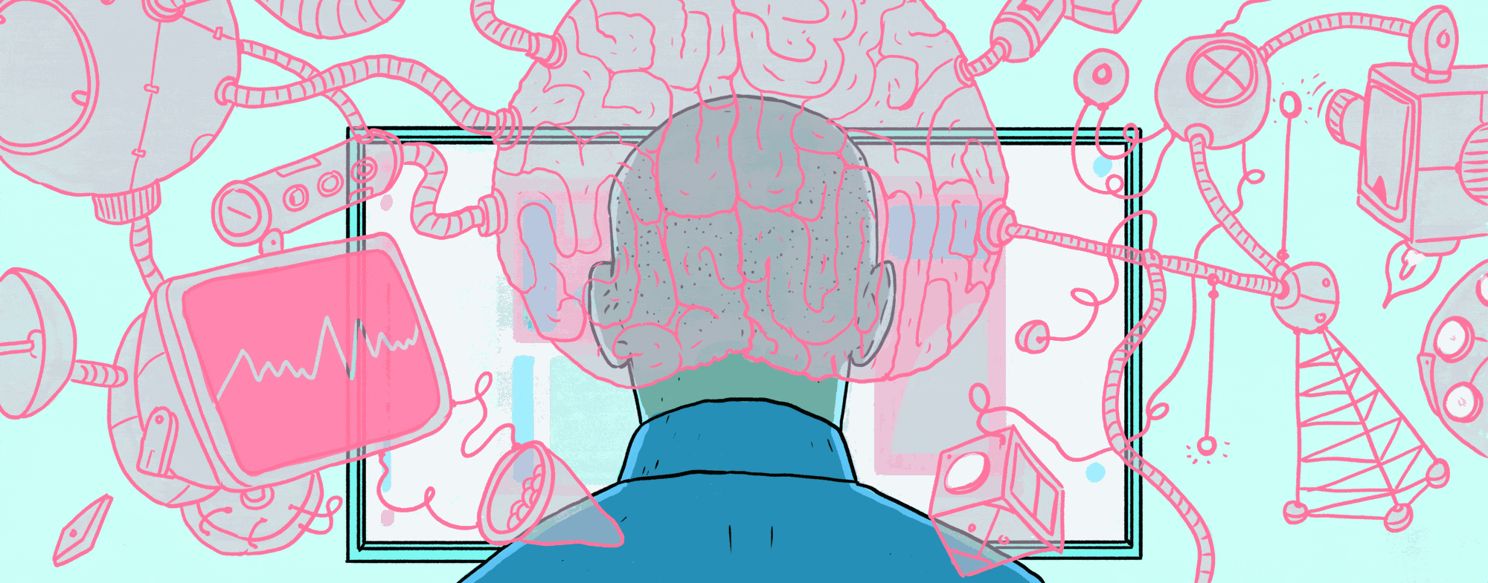
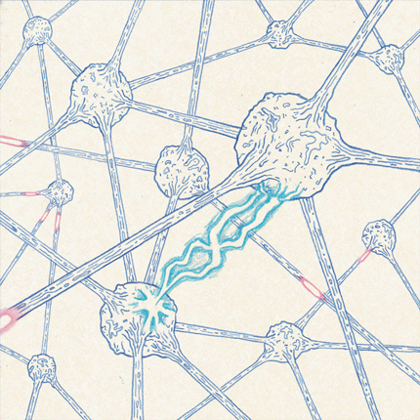
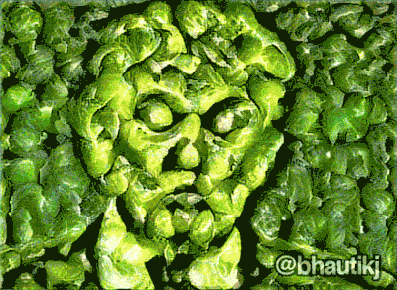
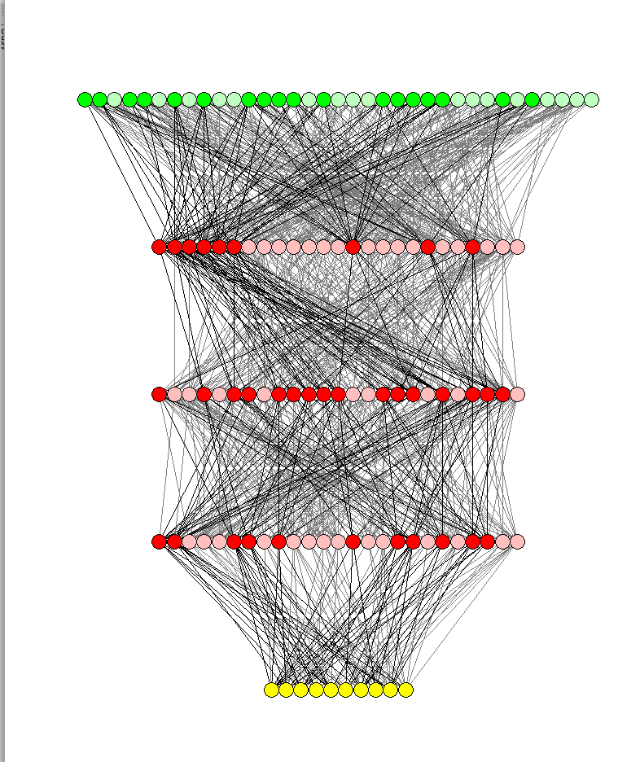

Part III: Convolutional Neural Networks for Image Processing lectures from the course:
TIES4910: Deep Learning for Cognitive Computing
Vagan Terziyan
Department of Mathematical Information Technology, University of Jyvaskyla
URL:https://ai.it.jyu.fi/vagan
Fall 2017

Slide 3
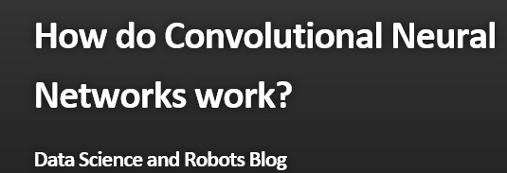

Concerns of the Part-III:
What is Convolutional Neural Network and how it works;
What kind of architecture has a Convolutional Neural Network;
How a Convolutional Neural Network processes images;
How to train a Convolutional Neural Network.
Content is provided mostly on the basis of slides and videos from Brandon Rohrer, compiled and edited by Vagan Terziyan
Brandon Rohrer

Slide 4
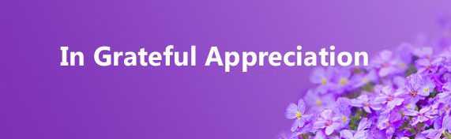

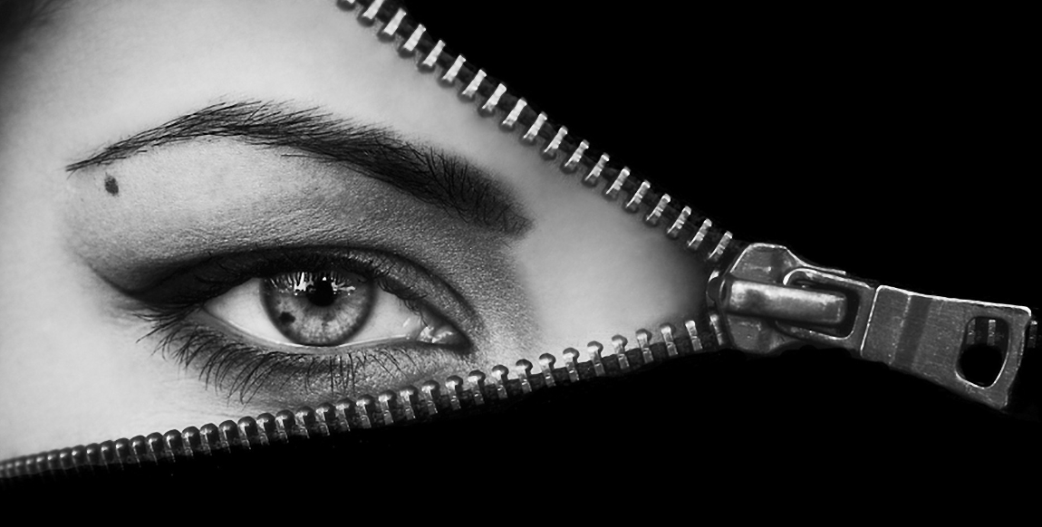
I am grateful to Brandon Rohrer (for his fantastic content and slides reproduced here), as well as to the anonymous photographers and artists, whose photos and pictures (or their fragments) posted on the Internet, have been used in the presentation.
Beware on hidden slides!

Slide 5

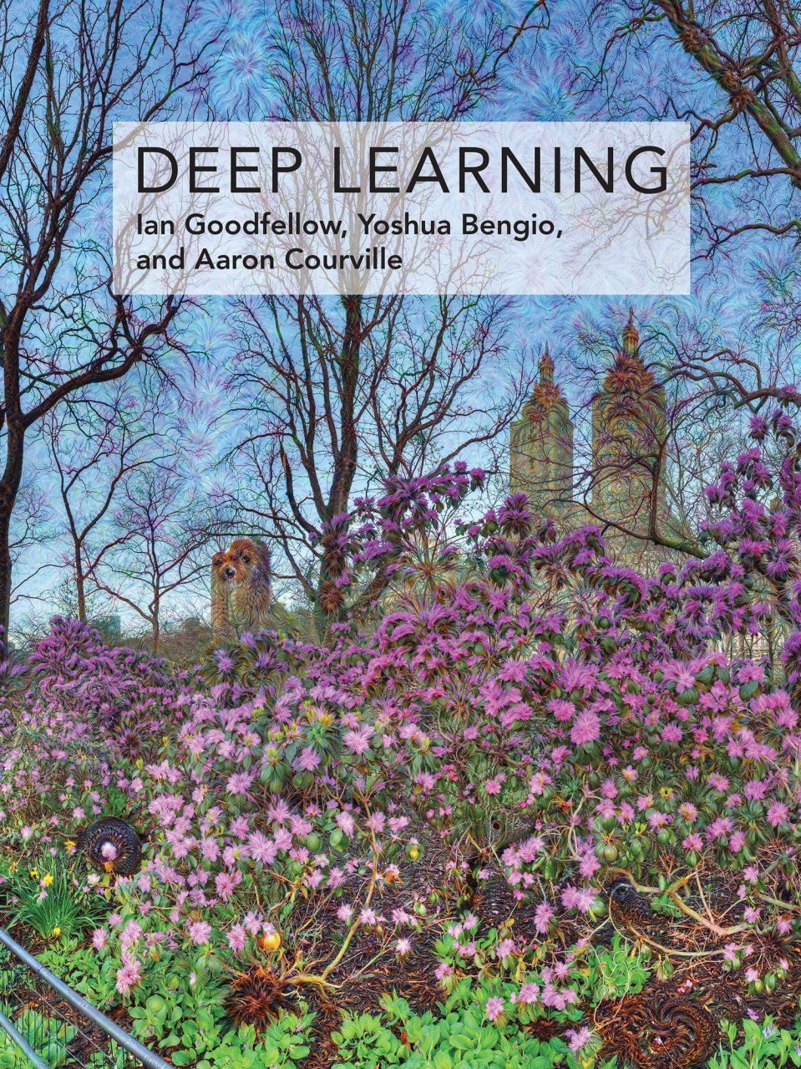
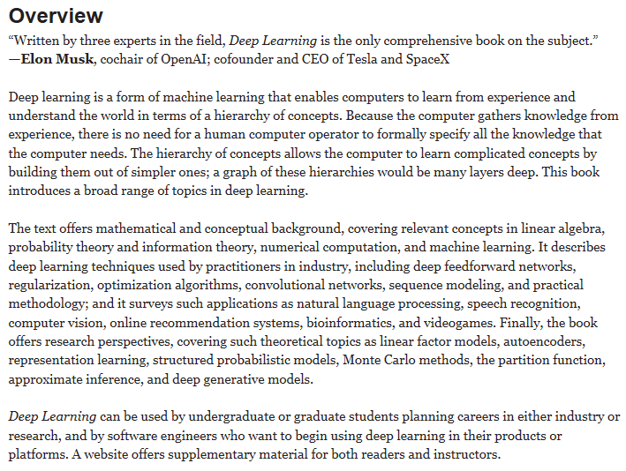
Recommended reading
Goodfellow, I., Bengio, Y., & Courville, A. (2016). Deep Learning, MIT Press, 787 pp.
http://www.deeplearningbook.org

Slide 6
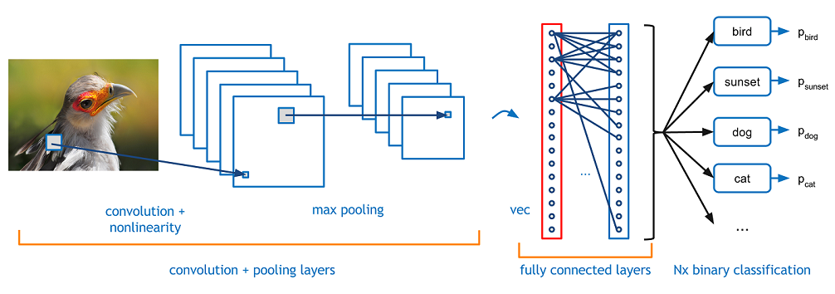
Convolutional Neural Net (CNN): what for?
https://adeshpande3.github.io/adeshpande3.github.io/A-Beginner's-Guide-To-Understanding-Convolutional-Neural-Networks/
Convolutional neural networks. Sounds like a weird combination of biology and math with a little CS sprinkled in, but these networks have been some of the most influential innovations in the field of computer vision. 2012 was the first year that neural nets grew to prominence as Alex Krizhevsky* used them to win that year’s ImageNet competition (basically, the annual Olympics of computer vision), dropping the classification error record from 26% to 15%, an astounding improvement at the time. Ever since then, a host of companies have been using deep learning at the core of their services. Facebook uses neural nets for their automatic tagging algorithms, Google for their photo search, Amazon for their product recommendations, Pinterest for their home feed personalization, and Instagram for their search infrastructure. However, the classic, and arguably most popular, use case of these networks is for image processing. Within image processing, let’s take a look at how to use these CNNs for image classification.
*Krizhevsky, Alex. "ImageNet Classification with Deep Convolutional Neural Networks”

Slide 7

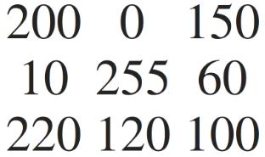
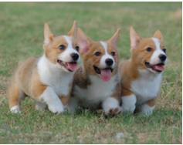
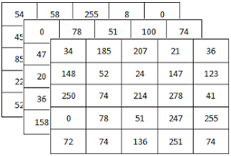
What we see
What computer sees
B
G
R
When a computer sees an image (takes an image as input), it will see an array of pixel values. Depending on the resolution and size of the image, it will see a X x X x 3 array of numbers (The 3 refers to RGB values). Just to drive home the point, let's say we have a color image in JPG form and its size is 480 x 480. The representative array will be 480 x 480 x 3. Each of these numbers is given a value from 0 to 255 which describes the pixel intensity at that point.

Slide 8
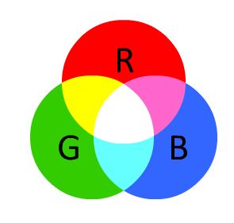
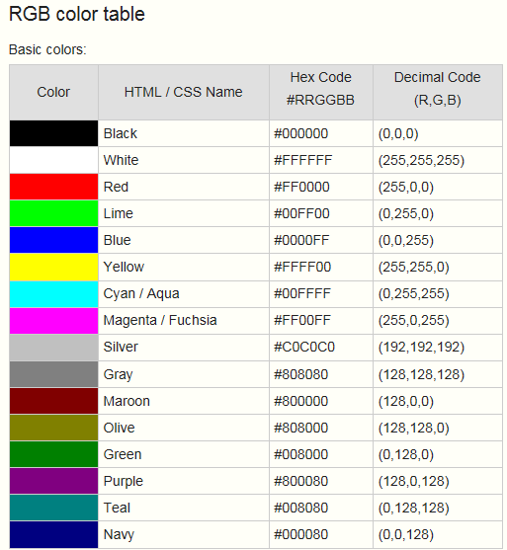
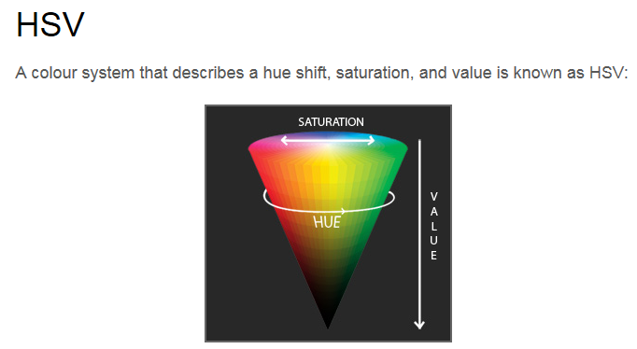
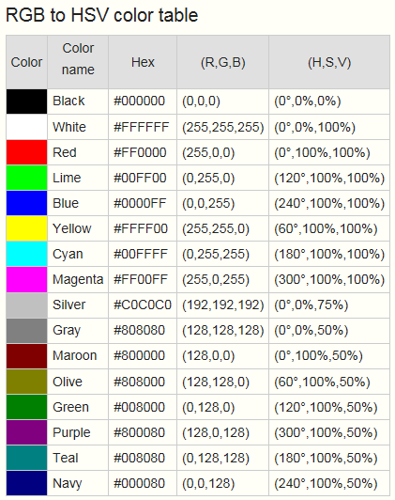
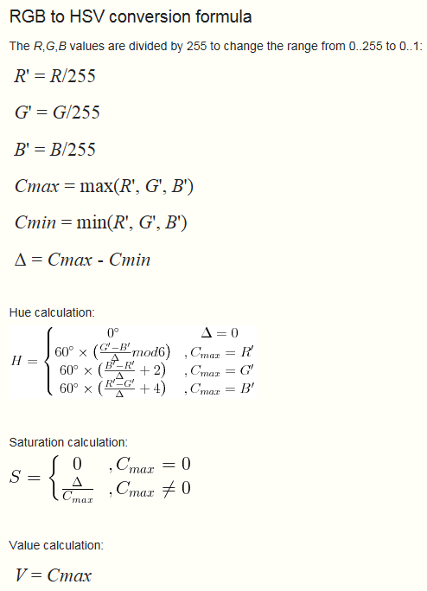
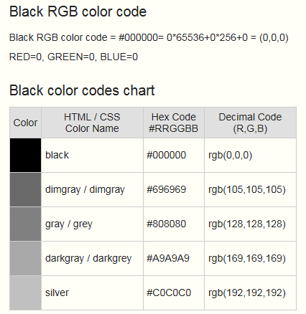
B
What are these numbers?
G
R
The RGB color model is an additive color model in which red, green and blue light are added together in various proportions (intensity) defined within the interval [0,255] to reproduce a broad array of colors. The name of the model comes from the initials of the three additive primary colors, red, green and blue. https://en.wikipedia.org/wiki/RGB_color_model
Other option

Slide 9
A toy Convolutional Neural Net (CNN): X’s and O’s
Says whether a picture is of an X or an O
A two-dimensional
array of pixels
CNN
X or O
We’ll stick with a very simplified example: determining whether an image is of an X or an O. This example is just rich enough to illustrate the principles behind CNNs, but still simple enough to avoid getting bogged down in non-essential details. Our CNN has one job. Each time we hand it a picture, it has to decide whether it has an X or an O. It assumes there is always one or the other.

Slide 10
For example
CNN
X
CNN
O

Slide 11
Trickier cases
CNN
X
translation
scaling
rotation
weight
CNN
O

Slide 12
Deciding is hard
?
=

Slide 13
What computers see
?
=
Here for the simplicity we used as an input strictly black (RGB: {0,0,0}) and white (RGB: {255,255,255}) image; therefore 3 RGB layers can be replaced by one. The only layer is normalized so that the min and max values of our pixels intensity are -1 for black and 1 for white respectively. (Normalization function: new_value = -1 + 2∙old_value/255 )

Slide 14
What computers see

Slide 15
Computers are literal
=
x
To a computer, an image looks like a two-dimensional array of pixels with a number in each position. In our example a pixel value of 1 is white, and -1 is black. When comparing two images, if any pixel values don’t match, then the images don’t match, at least to the computer. Ideally, we would like to be able to see X’s and O’s even if they’re shifted, shrunken, rotated or deformed. This is where CNNs come in.

Slide 16
Convolutional Nets match pieces of the image
=
=
CNNs compare images piece by piece. The pieces that it looks for are called features. By finding rough feature matches in roughly the same positions in two images, CNNs get a lot better at seeing similarity than whole-image matching schemes.
=

Slide 17
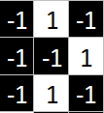
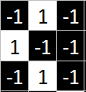
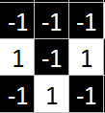
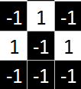
3 chosen 3x3 features, which match pieces of the image
Other 3x3 features
…

Slide 23
Filtering: Feature as a Filter
When presented with a new image, the CNN doesn’t know exactly where these features will match so it tries them everywhere, in every possible position. In calculating the match to a feature across the whole image, we make it a filter. The math we use to do this is called convolution, from which Convolutional Neural Networks take their name.

Slide 24
Filtering: The math behind the match (convolution)
Line up the feature and the image patch.
Multiply each image pixel by the corresponding feature pixel.
Add them up.
Divide by the total number of pixels in the feature.
The convolutional layer is the core building block of a CNN. The layer's parameters consist of a set of learnable filters (or kernels), which have a small receptive field, but extend through the full depth of the input volume. Each filter is convolved across the width and height of the input volume, computing the dot product between the entries of the filter and the input and producing a 2-dimensional activation map of that filter.

Slide 25
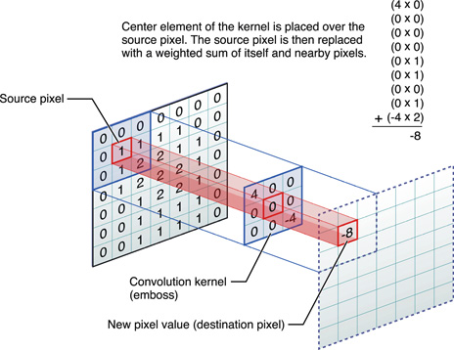
Filtering: The math behind the match (convolution)

Slide 26
Filtering: The math behind the match
1 x 1 = 1

Slide 27
Filtering: The math behind the match
1 x 1 = 1

Slide 28
Filtering: The math behind the match
-1 x -1 = 1

Slide 29
Filtering: The math behind the match
-1 x -1 = 1

Slide 30
Filtering: The math behind the match
-1 x -1 = 1

Slide 31
Filtering: The math behind the match
1 x 1 = 1

Slide 32
Filtering: The math behind the match
-1 x -1 = 1

Slide 33
Filtering: The math behind the match
-1 x -1 = 1

Slide 34
Filtering: The math behind the match
-1 x -1 = 1

Slide 35
Filtering: The math behind the match
1 x 1 = 1

Slide 36

Filtering: The math behind the match
$$\frac{1+1+1+1+1+1+1+1+1}{9}= 1$$

Slide 37
Filtering: The math behind the match
1 x 1 = 1

Slide 38
Filtering: The math behind the match
-1 x 1 = -1

Slide 39
Filtering: The math behind the match

Slide 40

Filtering: The math behind the match
$$\frac{1+1−1+1+1+1−1+1+1}{9}= .55$$
.55

Slide 41
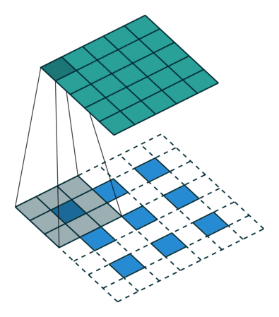
Convolution: Trying every possible match

Slide 42
Convolution: Trying every possible match
Activation map of the filter
=
feature
or filter
To complete our convolution, we repeat this process, lining up the feature with every possible image patch. We can take the answer from each convolution and make a new two-dimensional array from it, based on where in the image each patch is located. This map of matches is also a filtered version of our original image. It’s a map of where in the image the feature is found. Values close to 1 show strong matches, values close to -1 show strong matches for the photographic negative of our feature, and values near zero show no match of any sort.

Slide 43
=
=
=
The next step is to repeat the convolution process for each of the other features. The result is a set of filtered images, one for each of our filters. It’s convenient to think of this whole collection of convolution operations as a single processing step. In CNNs this is referred to as a convolution layer, hinting at the fact that it will soon have other layers added to it.

Slide 44
Convolution layer
One image becomes a stack of filtered images

Slide 45
Convolution layer
One image becomes a stack of filtered images

Slide 46
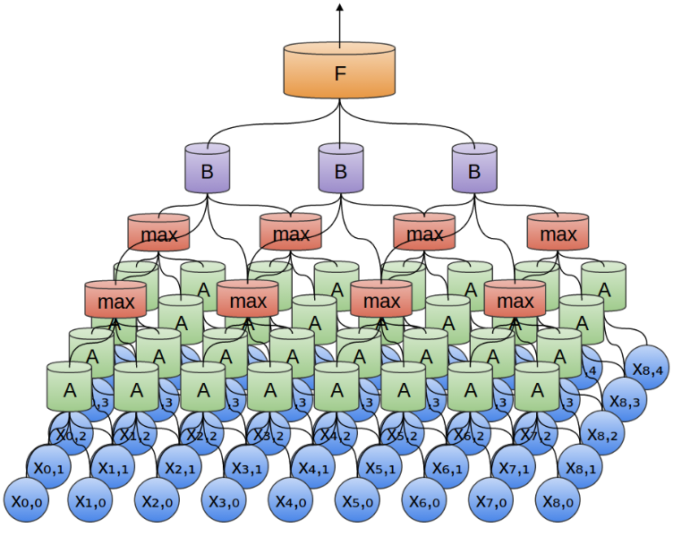
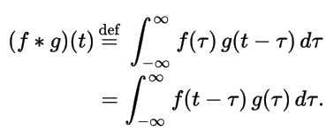
Convolution in math.
If you love mathematics you can enjoy the reading about the mathematical nature of a convolution and CNNs here:
http://colah.github.io/posts/2014-07-Understanding-Convolutions/
http://colah.github.io/posts/2014-07-Conv-Nets-Modular/

Slide 47
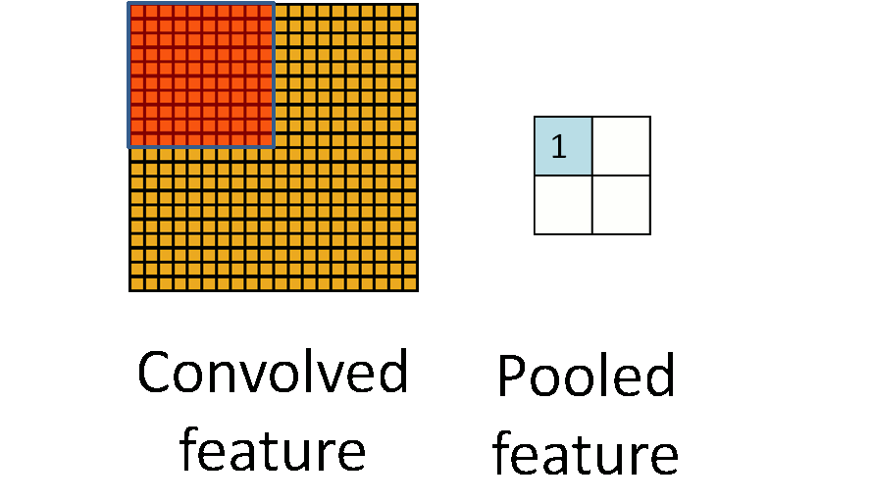
Pooling: Shrinking the image stack
Another power tool that CNNs use is called pooling. Pooling is a way to take large images and shrink them down while preserving the most important information in them. The math behind pooling is second-grade level at most. It consists of stepping a small window across an image and taking the maximum value from the window at each step. In practice, a window 2 or 3 pixels on a side and steps of 2 pixels work well.
Pick a window size (usually 2 or 3).
Pick a stride (usually 2).
Walk your window across your filtered images.
From each window, take the maximum value.

Slide 48
Pooling
maximum

Slide 49
Pooling
maximum

Slide 50
Pooling
maximum

Slide 51
Pooling
maximum

Slide 52
Pooling
maximum

Slide 53
Pooling
max pooling

Slide 54
After pooling, an image has about a quarter as many pixels as it started with. Because it keeps the maximum value from each window, it preserves the best fits of each feature within the window. This means that it doesn’t care so much exactly where the feature fit as long as it fit somewhere within the window. The result of this is that CNNs can find whether a feature is in an image without worrying about where it is. This helps solve the problem of computers being hyper-literal.

Slide 55
Pooling layer
A stack of images becomes a stack of smaller images.
A pooling layer is just the operation of performing pooling on an image or a collection of images. The output will have the same number of images, but they will each have fewer pixels. This is also helpful in managing the computational load. Taking an 8 megapixel image down to a 2 megapixel image makes life a lot easier for everything downstream.

Slide 56
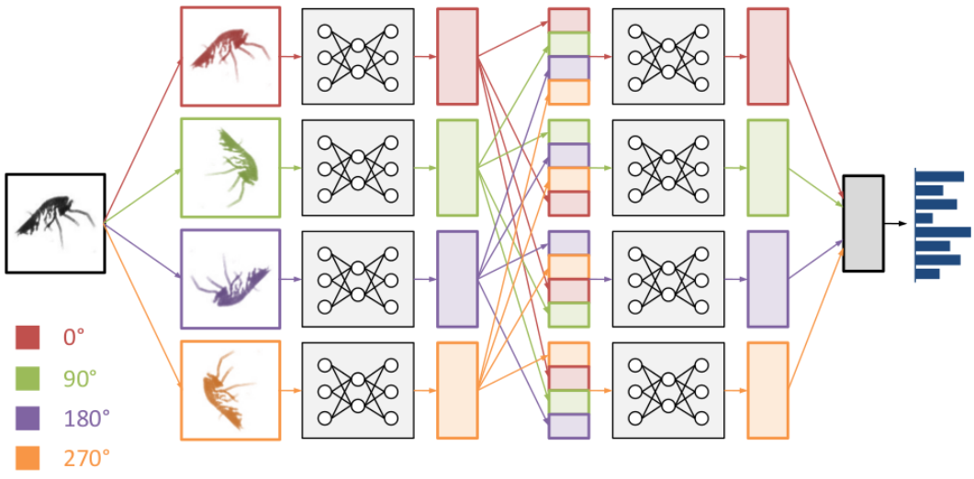
Read also on “cyclic pooling” by “rolling feature maps”
http://benanne.github.io/2015/03/17/plankton.html
A cyclic pooling enables to extract features from input images in four different orientations. An alternative interpretation is that its filters are applied to the input images in four different orientations. That means we can combine the stacks of feature maps from the different orientations into one big stack, and then learn the next layer of features on this combined input. As a result, the network then appears to have 4 times more filters than it actually has.

Slide 57

Normalization
Keep the math from breaking by tweaking each of the values just a bit. Change everything negative to zero.
A small but important player in this process is the Rectified Linear Unit or ReLU. It’s math is also very simple—wherever a negative number occurs, swap it out for a 0. This helps the CNN stay mathematically healthy by keeping learned values from getting stuck near 0 or blowing up toward infinity.
ReLU is a layer of neurons that applies the non-saturating activation function f (x) = max(0, x). It increases the nonlinear properties of the decision function and of the overall network without affecting the receptive fields of the convolution layer. Other functions are also used to increase nonlinearity, for example the saturating hyperbolic tangent f(x) = tanh⁡(x), f(x) = |tanh(x)| , and the sigmoid function f(x) = (1 + e^{− x} )⁻¹. Compared to other functions the usage of ReLU is preferable, because it results in the neural network training several times faster, without making a significant difference to the accuracy.

Slide 58
Rectified Linear Units (ReLUs)

Slide 59
Rectified Linear Units (ReLUs)

Slide 60
Rectified Linear Units (ReLUs)

Slide 61
Rectified Linear Units (ReLUs)

Slide 62
ReLU layer
A stack of images becomes a stack of images with no negative values.

Slide 63
Layers get stacked
The output of one becomes the input of the next.
Convolution
ReLU
Pooling
You’ve probably noticed that the input to each layer (two-dimensional arrays) looks a lot like the output (two-dimensional arrays). Because of this, we can stack them like Lego bricks. Raw images get filtered, rectified and pooled to create a set of shrunken, feature-filtered images.

Slide 64
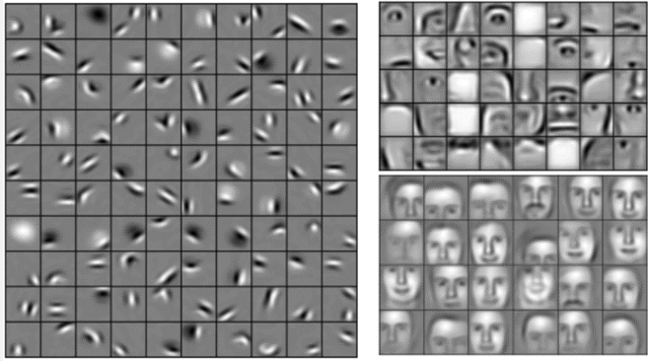
Deep stacking
Layers can be repeated several (or many) times.
Convolution
ReLU
Convolution
ReLU
Pooling
Convolution
ReLU
Pooling
Layers’ outcomes can be filtered and shrunken again and again. Each time, the features become larger and more complex, and the images become more compact. This lets lower layers represent simple aspects of the image, such as edges and bright spots. Higher layers can represent increasingly sophisticated aspects of the image, such as shapes and patterns. These tend to be readily recognizable. For instance, in a CNN trained on human faces, the highest layers represent patterns that are clearly face-like.

Slide 65
Fully connected layer
Every value gets a vote

Slide 66
Fully connected layer
… and the vote depends on how strongly a value predicts X or O
X
O

Slide 67
Fully connected layer
Vote depends on how strongly a value predicts X or O
(see the picture after feeding both X and O)
X
O

Slide 68
Fully connected layer
Lets have a new input (X or O ?):
X
O

Slide 69
Fully connected layer
Lets have a new input (X or O ?):
X
O

Slide 70
Fully connected layer
Lets have a new input (X or O ?):
X
0.92
O

Slide 71
Fully connected layer
Future values vote on X or O
X
0.92
O

Slide 72
Fully connected layer
Future values vote on X or O
X
0.92
O
0.51

Slide 73
Fully connected layer
Future values vote on X or O
X
0.92
O
0.51
Fully connected layers take the high-level filtered images and translate them into votes. In our case, we only have to decide between two categories, X and O. Fully connected layers are the primary building block of traditional neural networks. Instead of treating inputs as a two-dimensional array, they are treated as a single list and all treated identically. Every value gets its own vote on whether the current image is an X or and O. However, the process isn’t entirely democratic. Some values are much better than others at knowing when the image is an X, and some are particularly good at knowing when the image is an O. These get larger votes than the others. These votes are expressed as weights, or connection strengths, between each value and each category.

Slide 74
Fully connected layer
A list of feature values becomes a list of votes.
X
O
When a new image is presented to the CNN, it percolates through the lower layers until it reaches the fully connected layer at the end. Then an election is held. The answer with the most votes wins and is declared the category of the input.

Slide 75
Fully connected layers
These can also be stacked.
X
O

Slide 76
Putting it all together
A set of pixels becomes a set of votes.
0.92
X
Convolution
ReLU
Convolution
ReLU
Pooling
Convolution
ReLU
Pooling
Fully connected
Fully connected
O
0.51
Fully connected layers, like the rest, can be stacked because their outputs (a list of votes) look a whole lot like their inputs (a list of values). In practice, several fully connected layers are often stacked together, with each intermediate layer voting on phantom “hidden” categories. In effect, each additional layer lets the network learn (deep learning!) ever more sophisticated combinations of features that help it make better decisions.

Slide 77
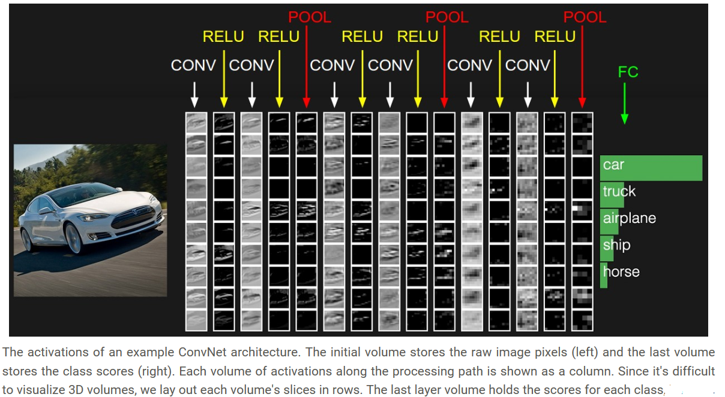
One more example and demo
See full web-based demo for the example

Slide 78
Learning (back to our X & O example)
Q: Where do all the magic numbers come from?
Features in convolutional layers
Voting weights in fully connected layers
A: Backpropagation
The backward propagation of errors or backpropagation, is a common method of training artificial neural networks and used in conjunction with an optimization method such as gradient descent. The algorithm repeats a two phase cycle, propagation and weight update. When an input vector is presented to the network, it is propagated forward through the network, layer by layer, until it reaches the output layer. The output of the network is then compared to the desired output, using a loss function, and an error value is calculated for each of the neurons in the output layer. The error values are then propagated backwards, starting from the output, until each neuron has an associated error value which roughly represents its contribution to the original output. [Wikipedia]

Slide 79
Backpropagation
Error = right answer – actual answer
0.92
X
Convolution
ReLU
Convolution
ReLU
Pooling
Convolution
ReLU
Pooling
Fully connected
Fully connected
O
0.51

Slide 80
Backpropagation
0.92
X
Convolution
ReLU
Convolution
ReLU
Pooling
Convolution
ReLU
Pooling
Fully connected
Fully connected
O
0.51

Slide 81
Backpropagation
0.92
X
Convolution
ReLU
Convolution
ReLU
Pooling
Convolution
ReLU
Pooling
Fully connected
Fully connected
O
0.51

Slide 82
Backpropagation
0.92
X
Convolution
ReLU
Convolution
ReLU
Pooling
Convolution
ReLU
Pooling
Fully connected
Fully connected
O
0.51

Slide 83
Backpropagation
0.92
X
Convolution
ReLU
Convolution
ReLU
Pooling
Convolution
ReLU
Pooling
Fully connected
Fully connected
O
0.51

Slide 84
Backpropagation
Loss (or cost)
0.92
X
Convolution
ReLU
Convolution
ReLU
Pooling
Convolution
ReLU
Pooling
Fully connected
Fully connected
O
0.51

Slide 85
Gradient descent
For each feature pixel and voting weight, adjust it up and down a bit and see how the error changes.
loss function
To make use of backpropagation, we need a collection of images that we already know the answer for. This means that some patient soul flipped through thousands of images and assigned them a label of X or O. We use these with an untrained CNN, which means that every pixel of every feature and every weight in every fully connected layer is set to a random value. Then we start feeding images through it, one after other. Each image the CNN processes results in a vote. The amount of wrongness in the vote, the error, tells us how good our features and weights are. The features and weights can then be adjusted to make the error less. Each value is adjusted a little higher and a little lower, and the new error computed each time. Whichever adjustment makes the error less is kept. After doing this for every feature pixel in every convolutional layer and every weight in every fully connected layer, the new weights give an answer that works slightly better for that image. This is then repeated with each subsequent image in the set of labeled images. Quirks that occur in a single image are quickly forgotten, but patterns that occur in lots of images get baked into the features and connection weights. If you have enough labeled images, these values stabilize to a set that works pretty well across a wide variety of cases.
error
weight

Slide 86
Gradient descent
For each feature pixel and voting weight, adjust it up and down a bit and see how the error changes.
error
weight

Slide 87
Hyperparameters (knobs)
Convolution
Number of features
Size of features
Pooling
Window size
Window stride
Fully Connected
Number of neurons
Our story is filling in nicely, but it still has a huge hole—Where do features come from? and How do we find the weights in our fully connected layers? If these all had to be chosen by hand, CNNs would be a good deal less popular than they are. Luckily, a bit of machine learning magic called backpropagation does this work for us.
Generally in machine learning hyperparameters (knobs):
  Define higher level concepts about the model such as complexity, or capacity to learn.
  Cannot be learned directly from the data in the standard model training process and need to be predefined.
  Can be decided by setting different values, training different models, and choosing the values that test better

Slide 88
Architecture of CNN
How many of each type of layer?
In what order?

Slide 89
Not just images
Any 2D (or 3D) data.
e.g., images
e.g., videos or medical scans
While our X and O example involves images, CNNs can be used to categorize other types of data too. The trick is, whatever data type you start with, to transform it to make it look like an image. For instance, audio signals can be chopped into short time chunks, and then each chunk broken up into bass, midrange, treble, or finer frequency bands. This can be represented as a two-dimensional array where each column is a time chunk and each row is a frequency band. “Pixels” in this fake picture that are close together are closely related. CNNs work well on this. Researchers have gotten quite creative. They have adapted text data for natural language processing and even chemical data for drug discovery.

Slide 90
Images
Columns of pixels
Rows of pixels

Slide 91
Sound
Time steps
Intensity in each
frequency band

Slide 92
Text
Position in
sentence
Words in
dictionary

Slide 93
Limitations
ConvNets only capture local “spatial” patterns in data.
If the data can’t be made to look like an image, ConvNets are less useful.

Slide 94
Customer data
Name, age,
address, email,
purchases,
browsing activity,…
Customers

Slide 95
Rule of thumb
If your data is just as useful after swapping any of your columns with each other, then you can’t use Convolutional Neural Networks.

Slide 96
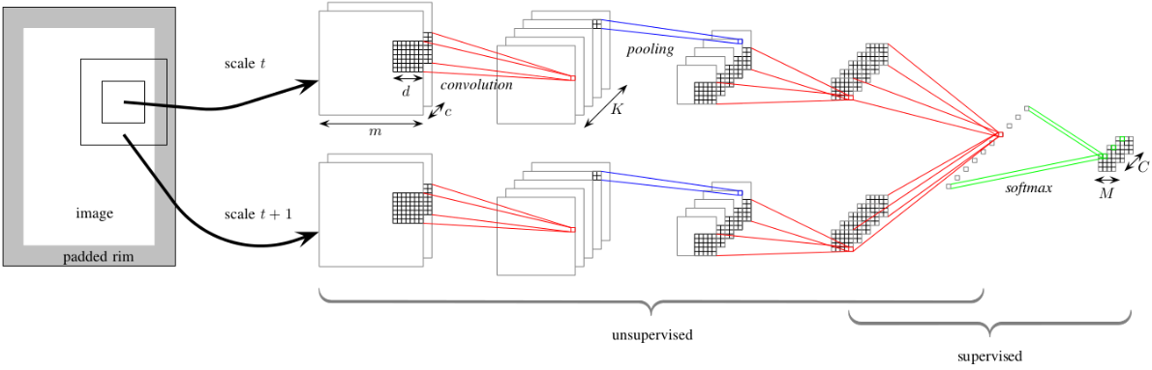
In a nutshell
ConvNets are great at finding patterns and using them to classify images.
Their architecture designed so that it can naturally combine and benefit from both: unsupervised and supervised learning.

Slide 97

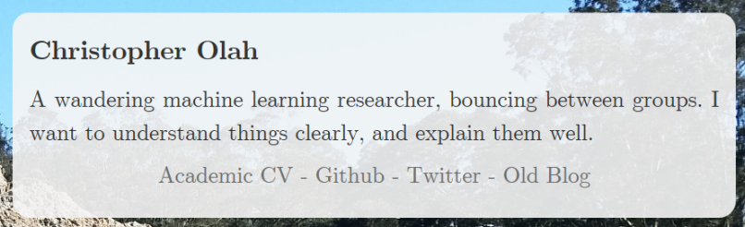
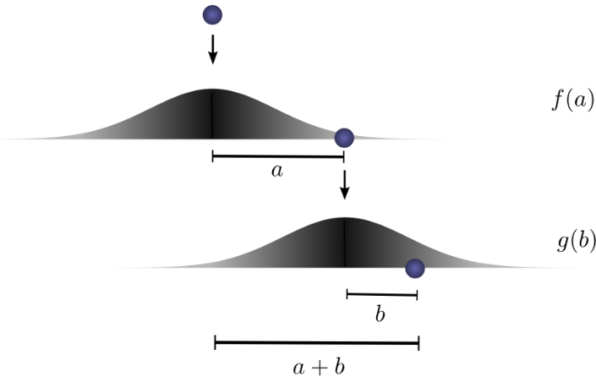

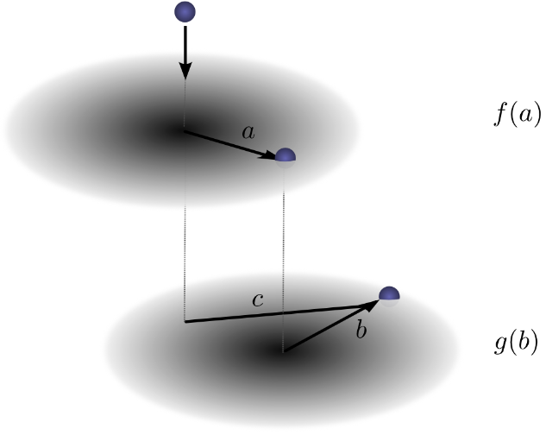

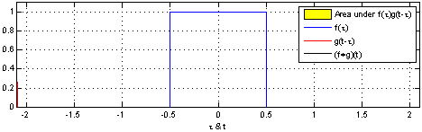

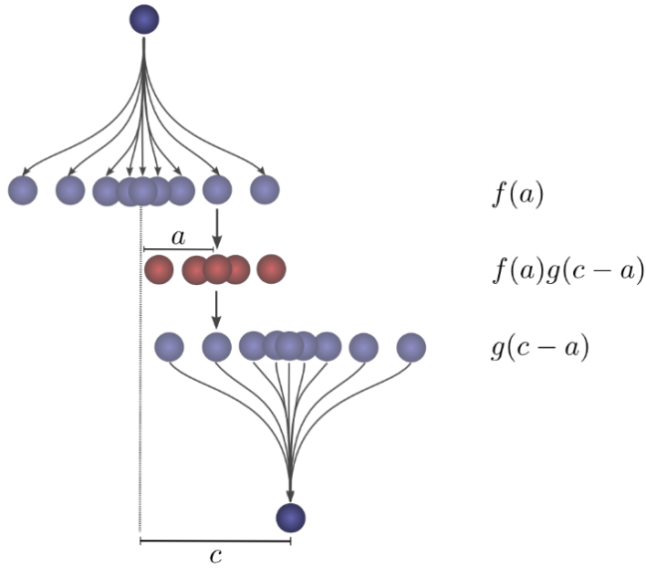
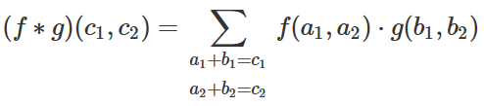
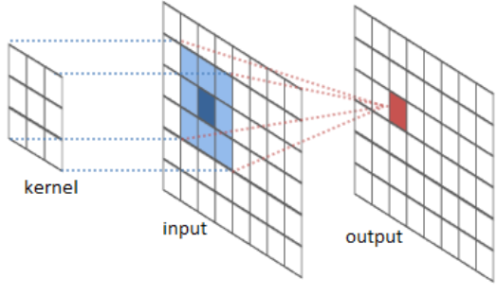
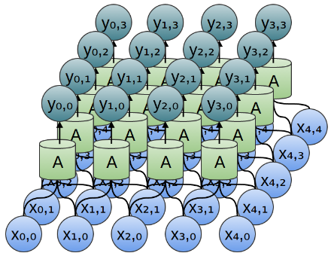
Explaining Convolutional Networks with a bit more of mathematics

Slide 98
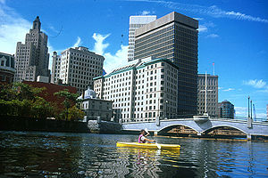
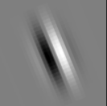
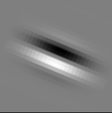
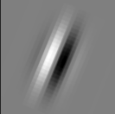
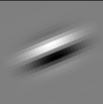
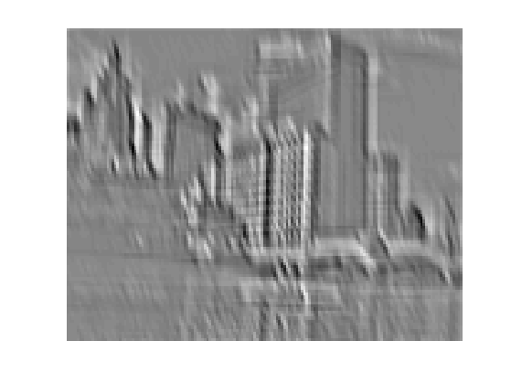
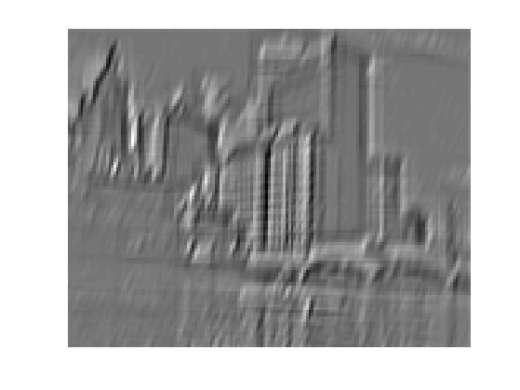
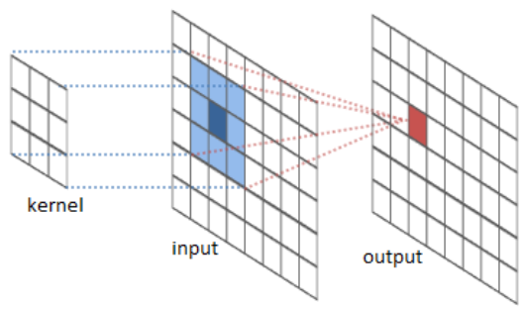
Filters
Input
Feature maps
http://cs.nyu.edu/~fergus/tutorials/deep_learning_cvpr12/

Slide 99
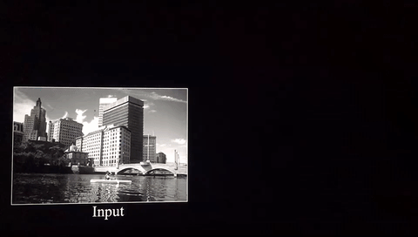
http://cs.nyu.edu/~fergus/tutorials/deep_learning_cvpr12/

Slide 100
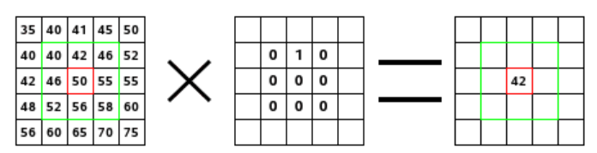



Convolution with this kernel just shifts all the target pixels one cell down
https://docs.gimp.org/en/plug-in-convmatrix.html

Slide 101


Convolution with this kernel just shifts all the target pixels one cell down-left
41
45
50
42
46
52
50
55
55

Slide 102


Applying different kernels
(filters) to the image
Original image

Slide 103


Applying different kernels
(filters) to the image
Original image

Slide 104

Applying different kernels
(filters) to the image
Original image

Slide 105

Applying different kernels
(filters) to the image
Original image

Slide 106

Applying different kernels
(filters) to the image
Original image

Slide 107


Applying different kernels
(filters) to the image
Original image

Slide 108

Applying different kernels
(filters) to the image
Original image

Slide 109

Applying different kernels
(filters) to the image
Original image

Slide 110

Applying different kernels
(filters) to the image
Original image

Slide 111


Applying different kernels
(filters) to the image
Original image
https://docs.gimp.org/en/plug-in-convmatrix.html

Slide 112

Applying different kernels
(filters) to the image
Original image
https://docs.gimp.org/en/plug-in-convmatrix.html

Slide 113

Applying different kernels
(filters) to the image
Original image
https://docs.gimp.org/en/plug-in-convmatrix.html

Slide 114

Applying different kernels
(filters) to the image
Original image
https://docs.gimp.org/en/plug-in-convmatrix.html

Slide 115

Applying different kernels
(filters) to the image
Original image
https://docs.gimp.org/en/plug-in-convmatrix.html

Slide 116


Online demo on applying
different kernels (filters)
to the image
http://setosa.io/ev/image-kernels/

Slide 117

Online demo on applying
different kernels (filters)
to the image
http://setosa.io/ev/image-kernels/

Slide 118



Online demo on applying different kernels (filters) to the image
http://setosa.io/ev/image-kernels/
Original
Sharpen

Slide 119


Online demo on applying different kernels (filters) to the image
http://setosa.io/ev/image-kernels/
Original
Emboss

Slide 120


Online demo on applying different kernels (filters) to the image
http://setosa.io/ev/image-kernels/
Original
Edge detect

Slide 121


Online demo on applying different kernels (filters) to the image
http://setosa.io/ev/image-kernels/
Original
Edge detect

Slide 122


http://setosa.io/ev/image-kernels/

Slide 123






Slide 124




Deconvolutional neural Networks
http://www.matthewzeiler.com/pubs/cvpr2010/cvpr2010.pdf
Convolutional networks are a bottom-up approach where the input signal is subjected to multiple layers of convolutions, non-linearities and sub-sampling. By contrast, each layer in a Deconvolutional Network is top-down; it seeks to generate the input signal by a sum over convolutions of the feature maps (as opposed to the input) with learned filters. Given an input and a set of filters, inferring the feature map activations requires solving a multi-component deconvolution problem that is computationally challenging.
https://www.quora.com/How-does-a-deconvolutional-neural-network-work

Slide 125



Generative Adversarial Networks

Slide 126

Generative Adversarial Networks are a relatively new type of neural network architecture which pits two sub-networks against each-other in order to learn very realistic generative models of high-dimensional data (mostly used for image synthesis, though extensions to sound, text, and other media have been constructed). When one generates something like an image, the pixels themselves are not individually so responsible for the realism of the image as the correlations and relatively arrangements of pixels, and so hand-crafted loss functions to measure reconstruction accuracy have a tendency towards blurriness or other perceptual artefacts. But when you allow two networks to compete with each-other: one to make a plausible fake, the other to distinguish forgeries from reality, then the networks (in principle) eliminate the noticeable differences from reality one-by-one. A blurry image can be detected, so it eliminates blurriness, and so on. The results of this approach are visually quite impressive, but because the two sub-networks are trained against different, opposed target functions, there is a wealth of new instabilities and problems that can crop up compared to training traditional neural networks which have a single unified loss function.
http://www.araya.org/archives/1183

Slide 127


Generator vs. Discriminator (possible “story”):
https://medium.com/@ageitgey/abusing-generative-adversarial-networks-to-make-8-bit-pixel-art-e45d9b96cee7#.3yphgmwnz
1
In our “story” to build a Deep Convolutional Generative Adversarial Network (DCGAN), we create two deep neural networks. Then we make them fight against each other, endlessly attempting to out-do one another. In the process, they both become stronger. Let’s pretend that the first deep neural network is a brand new police officer who is being trained to spot counterfeit money. Its job is to look at a picture and tell us if the picture contains real money. Since we are looking for objects in pictures, we can use a standard Convolutional Neural Network for this job. But the basic idea is that the neural network that takes in an image, processes it through several layers that recognize increasingly complex features in the image and then it outputs a single value—in this case, whether or not the image contains a picture of real money. This first neural network is called the Discriminator:
Now let’s pretend the second neural network is a brand new counterfeiter who is just learning how to create fake money. For this second neural network, we’ll reverse the layers in a normal Convolutional Neural Network so that everything runs backwards. So instead of taking in a picture and outputting a value, it takes in a list of values and outputs a picture. This second neural network is called the Generator:
So now we have a police officer (the Discriminator) looking for fake money and a counterfeiter (the Generator) that’s printing fake money. Let’s make them battle!

Slide 128



Generator vs. Discriminator (possible “story”):
https://medium.com/@ageitgey/abusing-generative-adversarial-networks-to-make-8-bit-pixel-art-e45d9b96cee7#.3yphgmwnz
2
In the first round, the Generator will create pathetic forgeries that barely resemble money at all because it knows absolutely nothing about what money is supposed to look like:
But right now the Discriminator is equally terrible at it’s job of recognizing money, so it won’t know the difference:
At this point, we step in and tell the Discriminator that this dollar bill is actually fake. Then we show it a real dollar bill and ask it how it looks different from the fake one. The Discriminator looks for a new detail to help it separate the real one from the fake one. For example, the Discriminator might notice that real money has a picture of a person on it and the fake money doesn’t. Using this knowledge, the Discriminator learns how to tell the fake from the real one. It gets a tiny bit better at its job:

Slide 129

Generator vs. Discriminator (possible “story”):
https://medium.com/@ageitgey/abusing-generative-adversarial-networks-to-make-8-bit-pixel-art-e45d9b96cee7#.3yphgmwnz
3
Now we start Round 2. We tell the Generator that it’s money images are suddenly getting rejected as fake so it needs to step up it’s game. We also tell it that the Discriminator is now looking for faces, so the best way to confuse the Discriminator is to put a face on the bill:
And the fake bills are being accepted as valid again! So now the Discriminator has to look again at the real dollar and find a new way to tell it apart from the fake one.
This back-and-forth game between the Generator and the Discriminator continues thousands of times until both networks are experts. Eventually the Generator is producing near-perfect counterfeits and the Discriminator has turned into a Master Detective looking for the slightest mistakes.
At the point when both networks are sufficiently trained so that humans are impressed by the fake images, we can use the fake images for whatever purpose we want.

Slide 130


https://github.com/Newmu/dcgan_code
Some “tricks” with GANs:
Arithmetic on faces
https://arxiv.org/pdf/1511.06434.pdf

Slide 131



Some “tricks” with GANs:
Rotations of faces and more
https://github.com/Newmu/dcgan_code
Rotations
https://arxiv.org/pdf/1511.06434.pdf

Slide 132

GAN-driven image recovery
http://www.kurzweilai.net/neural-networks-promise-sharpest-ever-images

Slide 133
Also check out
Deep Learning Demystified
The writings of Christopher Olah:
http://colah.github.io/posts/2014-07-Understanding-Convolutions/
http://colah.github.io/posts/2014-07-Conv-Nets-Modular/
http://colah.github.io/
See also:
http://cs231n.github.io/convolutional-networks/
https://adeshpande3.github.io/adeshpande3.github.io/A-Beginner's-Guide-To-Understanding-Convolutional-Neural-Networks/
https://en.wikipedia.org/wiki/Convolutional_neural_network
http://cs231n.github.io/neural-networks-2/

Slide 134
Some ConvNet/DNN toolkits
Caffe (Berkeley Vision and Learning Center)
CNTK (Microsoft)
Deeplearning4j (Skymind)
TensorFlow (Google)
Theano (University of Montreal + broad community)
Torch (Ronan Collobert)
Many others

