Slide 1


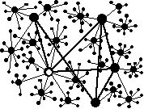

Semantic Web:
State of the Art and Opportunities
Industrial Ontologies Group
Vagan Terziyan
partly based on various online tutorials and presentations, with respect to their authors
“Industrial Ontologies” Group /
“Collective Intelligence” Group
https://www.jyu.fi/en/research-groups/collective-intelligence
University of Jyväskylä

Slide 2

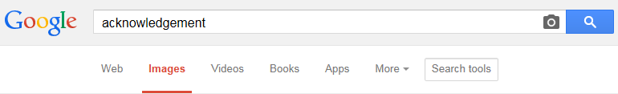
I am grateful to the anonymous photographers and artists, whose photos and pictures (or their fragments) posted on the Internet, have been used in the presentation.

Slide 3
NOTICE
If any content linked to by pages of this presentation has the prefix:
http://www.mit.jyu.fi/ai/ ...
… or the prefix:
http://www.cs.jyu.fi/ai/ ...
… and is not accessible, then use the new prefix:
https://ai.it.jyu.fi/ ...
… to access.
Sorry for the temporary inconvenience due to an unexpected server change.

Slide 4
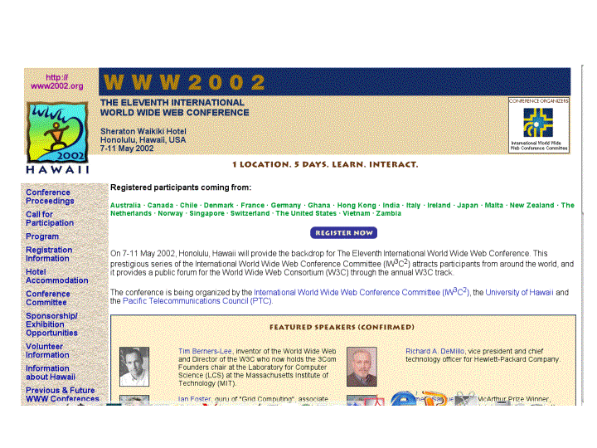
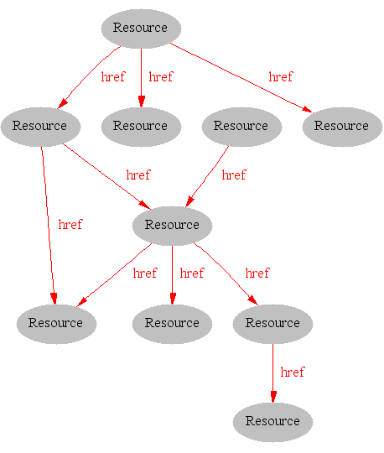
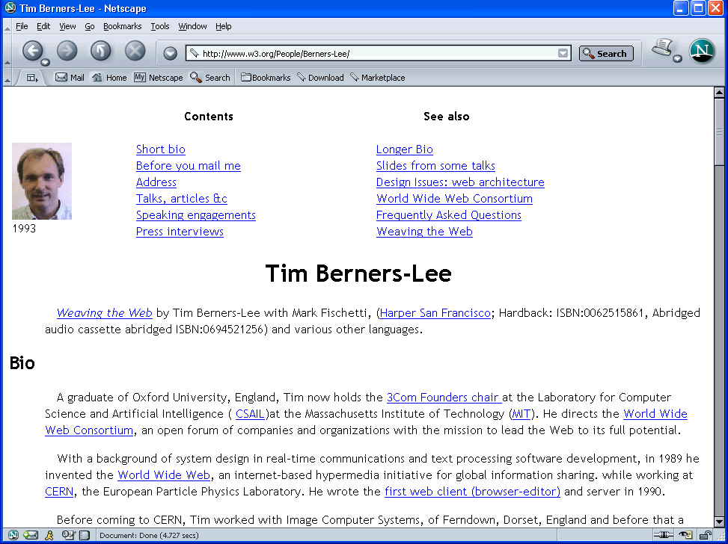
Where we were: the Syntactic Web
[Hendler & Miller 02]

Slide 5
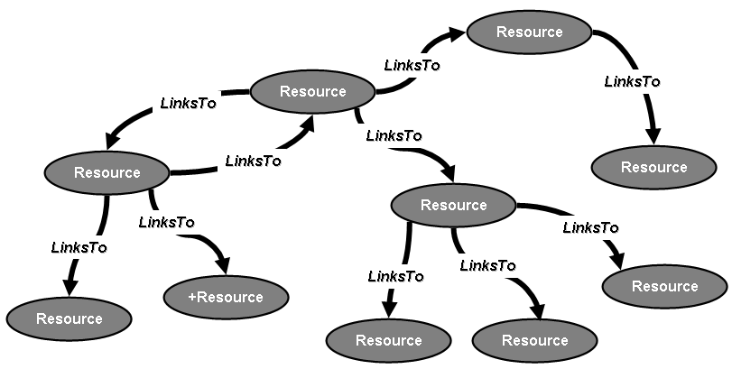
Where we were (dumb links)

Slide 6
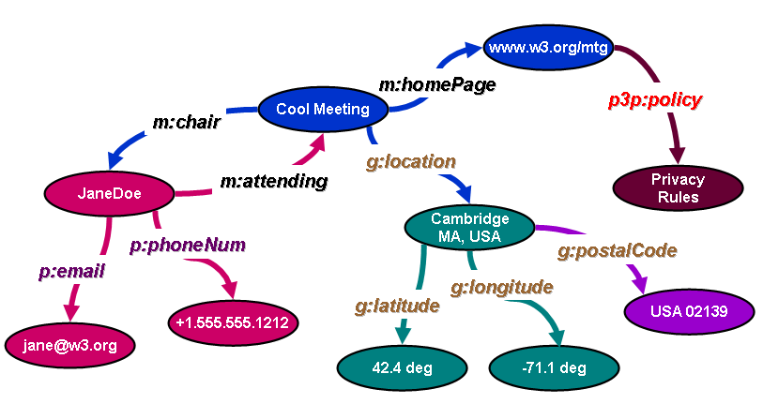
Semantic Web
(data connected by relationships)

Slide 7


Origin of the Semantic Web Approach
“The Semantic Web is a vision: the idea of having data on the Web defined and linked in a way that it can be used by machines not just for display purposes,
but for automation, integration and reuse
of data across various applications”
http://www.w3.org/sw/
The Semantic Web is an initiative with the goal of extending the current Web and facilitating Web automation, universally accessible web resources, and the 'Web of Trust', providing a universally accessible platform that allows data to be shared and processed by automated tools as well as by people.

Slide 8
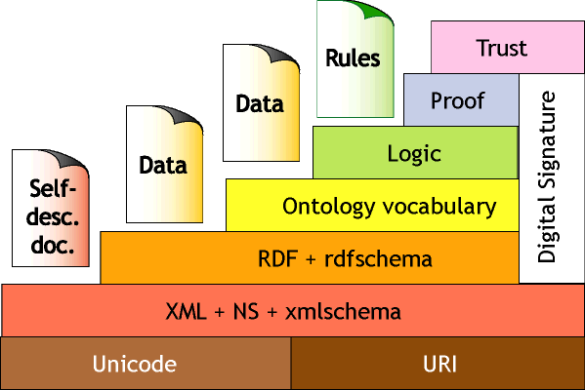
Tim Berners-Lee's Vision of Semantic Web (IJCAI-01)

Slide 9
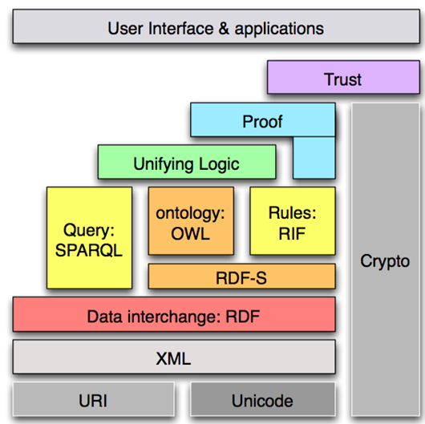
Semantic Web Stack
(updated, W3C, 2006)

Slide 10
Semantic Web: New “Users”
applications
agents

Slide 11
Semantic Web: Annotations
applications
agents
Semantic annotations are specific sort of metadata, which provides information about particular domain objects, values of their properties and relationships, in a machine-processable, formal and standardized way.

Slide 12
Semantic Web: Ontologies
applications
agents
Ontologies make metadata interoperable and ready for efficient sharing and reuse. It provides shared and common understanding of a domain, that can be used both by people and machines. Ontologies are used as a form of agreement-based knowledge representation about the world or some part of it and generally describe: domain individuals, classes, attributes, relations and events.

Slide 13
Semantic Web: Rules
applications
agents
Logical support in form of rules is needed to infer implicit content, metadata and ontologies from the explicit ones. Rules are considered to be a major issue in the further development of the semantic web. On one hand, they can be used in ontology languages, in conjunction with or as an alternative to description logics. And on the other hand, they will act as a means to draw inferences, to configure systems, to express constraints, to specify policies, to react to events/changes, to transform data, to specify behavior of agents, etc.

Slide 14
Semantic Web: Languages
applications
agents
Languages are needed for machine-processable formal descriptions of: metadata (annotations) like e.g. RDF; ontologies like e.g. OWL.; rules like e.g. RuleML. The challenge is to provide a framework for specifying the syntax (e.g. XML) and semantics of all of these languages in a uniform and coherent way. The strategy is to translate the various languages into a common 'base' language (e.g. CL or Lbase) providing them with a single coherent model theory.

Slide 15
Semantic Web: Tools
applications
agents
User-friendly tools are needed for metadata manual creation (annotating content) or automated generation, for ontology engineering and validation, for knowledge acquisition (rules), for languages parsing and processing, etc.

Slide 16
Semantic Web: Applications and Services
applications
agents
Utilization of Semantic Web metadata, ontologies, rules, languages and tools enables to provide scalable Web applications and Web services for consumers and enterprises" making the web 'smarter' for people and machines.

Slide 17
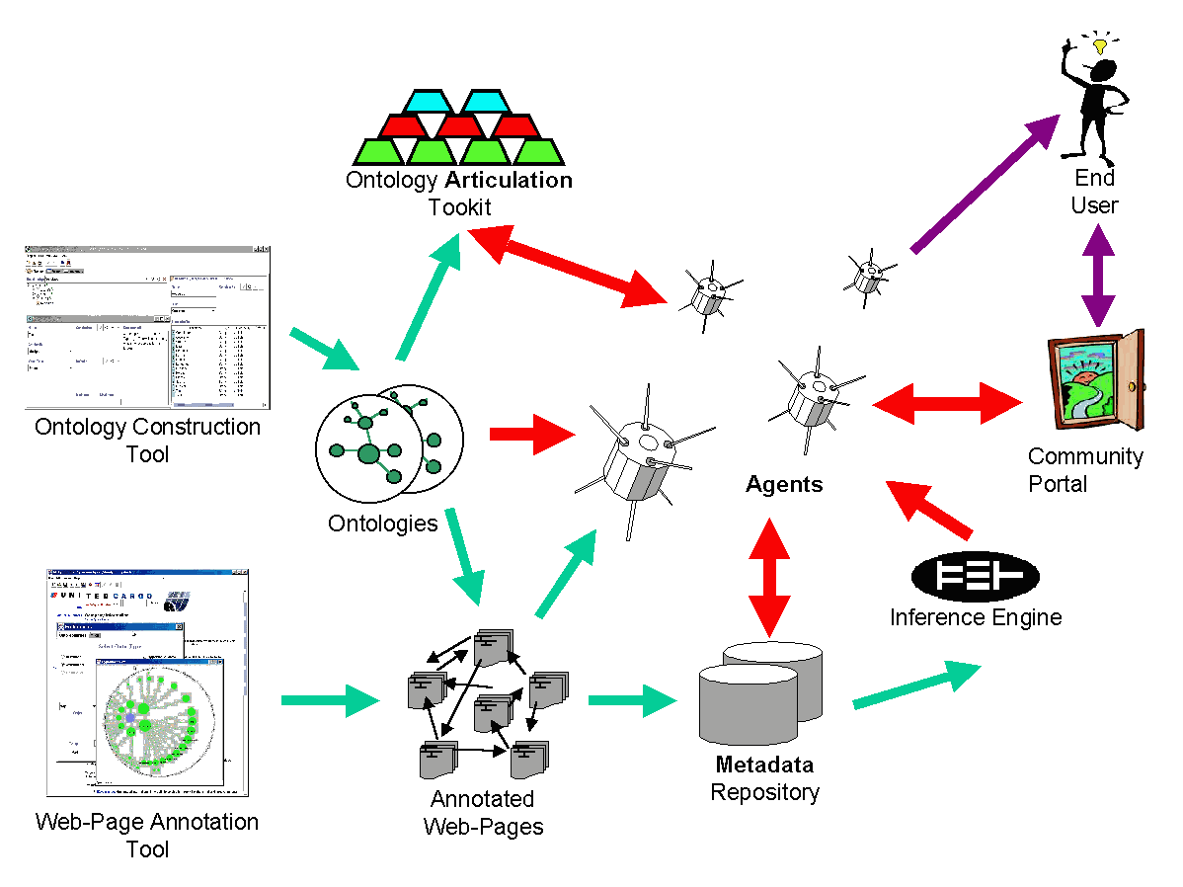
The Semantic Web
The Ontology Articulation Toolkit helps agents to understand unknown ontologies

Slide 18
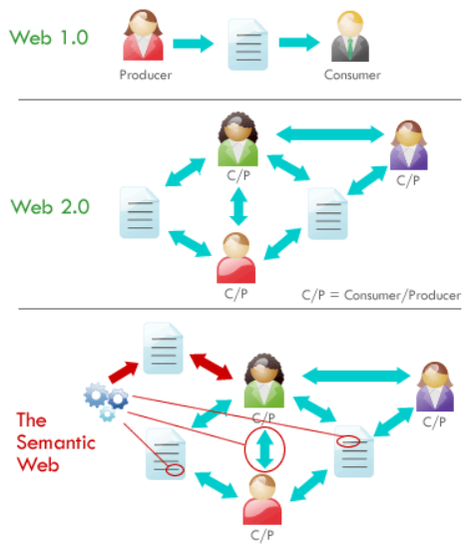
Semantic Web: Added Value
http://buhalis.blogspot.fi/2012/03/semantic-web-in-tourism-new-era.html

Slide 19

Semantic Web basics
RDF:
  is a W3C standard and a tool:
    to describe Web resources
    to enable interoperability between applications that exchange machine-understandable information
RDF Schema:
  is a W3C standard which defines vocabulary for RDF
  organizes this vocabulary in a typed hierarchy
  capable to explicitly declare semantic relations between vocabulary terms

Slide 20

RDF – Semantic Web over Web Resources
John
has_job
has_homepage
Director
Ontology
to_be_in_love_with
has_job
has_homepage
Secretary
Mary

Slide 21
Resources (a popular term used in Semantic Web domain)
All things being described by RDF expressions are called resources:
  entire Web page;
  part of Web page (e.g., a specific XML element);
  group of Web pages (e.g., Web site);
  an object (physical, abstract, real or imaginable) that does not belong to the Web and is not directly accessible via the Web.

Slide 22
RDF Statement (two types)
Property_k
Resource_i
Value_n
OR
Property_r
Resource_i
Resource_ j

Slide 23
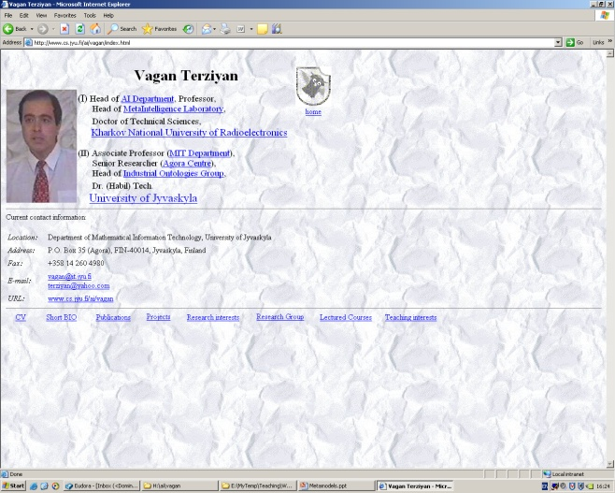
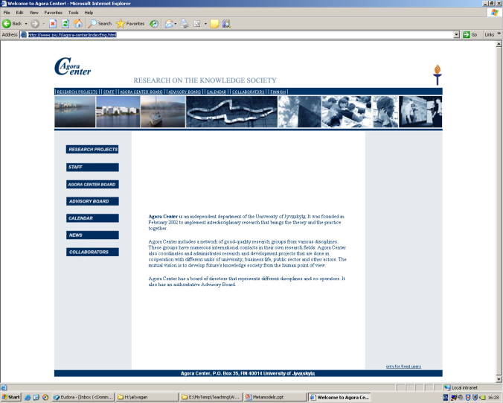
Semantic Relation as RDF statement
(so called “object property”)
L_{k}
A_{j}
Relation
A_{i}
Resource
Resource
Relation (i ≠ j)
Subject
Predicate
object
Personal web page of Terziyan V.
Web page of Agora Center
https://ai.it.jyu.fi/vagan/index.html
http://www.jyu.fi/agora-center/indexEng.html
refers_to
URI of Terziyan V.
employed_by
URI of Agora Center
https://ai.it.jyu.fi/vagan/#vagan
http://www.jyu.fi/agora-center/#AC

Slide 24
Semantic Property as RDF statement
(so called “datatype property”)
A_{i}
Property
Resource
Literal
Property (i = j)
L_{k}
Subject
Predicate
object
Personal web page of Terziyan V.
https://ai.it.jyu.fi/vagan/index.html
Literal
has_birthday
15.02.2000
“Birthday” of the web-page
Birthday of Terziyan V.
has_birthday
1958-XX-YY
URI of Terziyan V.
https://ai.it.jyu.fi/vagan/#vagan

Slide 25
Semantic Network of Web Resources
15.02.2000
Personal web page of Terziyan V.
has_birthday
Web page of Agora Center
https://ai.it.jyu.fi/vagan/index.html
http://www.jyu.fi/agora-center/indexEng.html
refers_to
isWebPageOf
1958-XX-YY
isWebPageOf
hasWebPage
has_birthday
hasWebPage
URI of Terziyan V.
employed_by
URI of Agora Center
https://ai.it.jyu.fi/vagan/#vagan
http://www.jyu.fi/agora-center/#AC

Slide 26
Resources and URIs
A resource can be anything that has identity
Uniform Resource Identifiers (URI)* provide a simple and extensible means for identifying a resource;
Not all resources are network "retrievable"; e.g., human beings, corporations, and books in a library can also be considered resources;
Read about “Hash vs Slash” debate
* The term "Uniform Resource Locator" (URL) refers to the subset of URI that identify resources via a representation of their primary access mechanism (e.g., their network "location"), rather than identifying the resource by name or by some other attribute(s) of that resource.

Slide 27
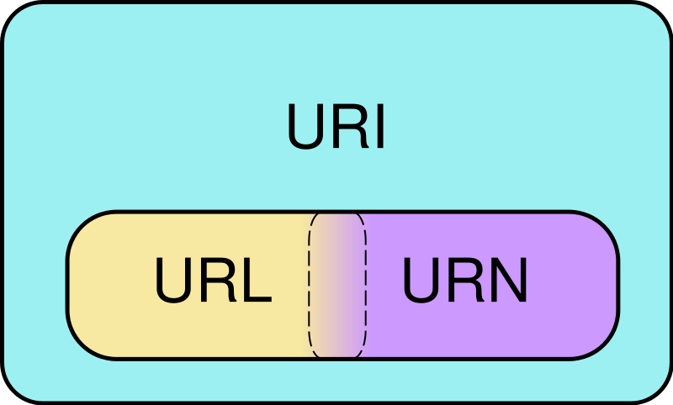
URI vs. URL vs. URN
A URI represents a single concept or thing, but many URIs can represent the same thing.
All URLs are URIs. Not all URIs are URLs.
URI identifies something uniquely.
URN identifies something by name.
URL identifies something by address.
Read here the simple explanation:
http://webpro.ninja/url-vs-uri-vs-urn/
Venn diagram of Uniform Resource Identifier (URI) scheme categories. Schemes in the URL (locator) and URN (name) categories both function as resource IDs, so URL and URN are subsets of URI. They are also, generally, disjoint sets. However, many schemes can't be categorized as strictly one or the other, because all URIs can be treated as names, and some schemes embody aspects of both categories – or neither.

Slide 28

URI “aliases” and Introduction to Linked Data
Berlin
Let us take city of Berlin as an example …

Slide 29

URI “aliases” and Introduction to Linked Data
Berlin
In the DBPedia the city of Berlin is identified by the following URI: http://dbpedia.org/resource/Berlin
URI: http://dbpedia.org/resource/Berlin
http://dbpedia.org/

Slide 30

URI “aliases” and Introduction to Linked Data
Berlin
… however in the GeoNames database the city of Berlin is identified by another URI: http://sws.geonames.org/2950159/
URI: http://dbpedia.org/resource/Berlin
URI: http://sws.geonames.org/2950159/
http://dbpedia.org/
http://www.geonames.org/

Slide 31

URI “aliases” and Introduction to Linked Data
For any software application these two URIs (URI aliases) look now like they refer to totally different objects …
URI: http://dbpedia.org/resource/Berlin
URI: http://sws.geonames.org/2950159/
http://dbpedia.org/
http://www.geonames.org/

Slide 32
URI “aliases” and Introduction to Linked Data
… now we have two isolated “islands” of data …
Here you can answer queries like, e.g., “Which city is a headquarter of GIGA Television?”
Here you can answer queries, like e.g., “Which city is a capital of Germany?”
:GIGA_Television
:Germany
:isHeadquarterOf
:isCapitalOf
URI: http://dbpedia.org/resource/Berlin
URI: http://sws.geonames.org/2950159/
http://dbpedia.org/
http://www.geonames.org/

Slide 33

URI “aliases” and Introduction to Linked Data
“Break the wall!” Make the connection between distinct URIs explicit ! You will obtain a Linked Data …
:GIGA_Television
:Germany
:isHeadquarterOf
:isCapitalOf
owl:sameAs
URI: http://dbpedia.org/resource/Berlin
URI: http://sws.geonames.org/2950159/
http://dbpedia.org/
http://www.geonames.org/

Slide 34
URI “aliases” and Introduction to Linked Data
… now you are able to make queries over the Linked Data (distributed database) like, e.g.: “Which companies have headquarters in the capital of Germany?”
:GIGA_Television
:Germany
:isHeadquarterOf
:isCapitalOf
owl:sameAs
URI: http://dbpedia.org/resource/Berlin
URI: http://sws.geonames.org/2950159/
http://dbpedia.org/
http://www.geonames.org/

Slide 35





Need for linked data (example)
Vagan Terziyan’s record in the Central Hospital Database
Vagan Terziyan’s record in Nordea Database
?
URI of Vagan Terziyan in Nordea Database:
http://www.NordeaDB.fi/#VaganTerziyan
URI of Vagan Terziyan in the Central Hospital Database:
http://www.JKL_Central_Hospital_DB.fi/#VaganTerziyan

Slide 36
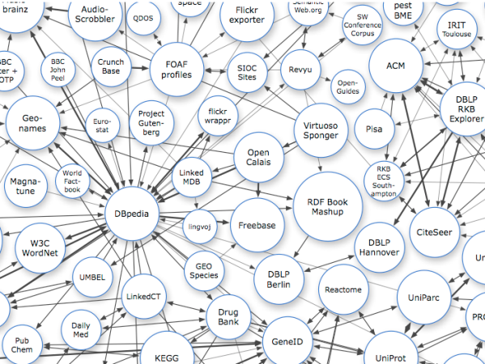
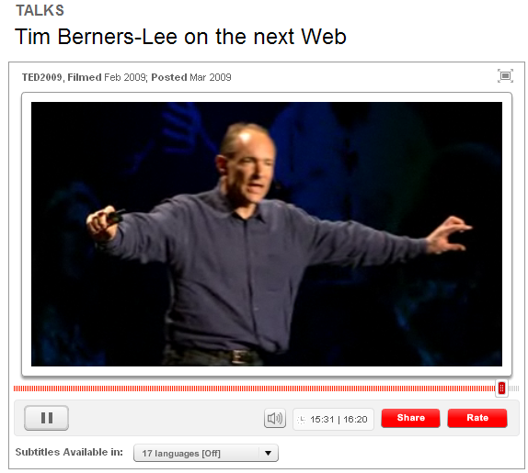
Dereferenceable URI
The term Linked Data is used to describe a method of exposing, sharing, and connecting data via dereferenceable* URIs on the Web.
Linked Data is about using the Web to connect related data that wasn’t previously linked or using the Web to lower the barriers to linking data currently linked using other methods. More specifically, Wikipedia defines Linked Data as a term used to describe a recommended best practice for exposing, sharing, and connecting pieces of data, information, and knowledge on the Semantic Web using URIs and RDF. Linked Data aims to extend the Web with a data commons by publishing various open datasets as RDF on the Web and by setting RDF links between data items from different data sources.
*A dereferenceable Uniform Resource Identifier or dereferenceable URI is a resource retrieval mechanism that uses any of the internet protocols (e.g. HTTP) to obtain a copy or representation of the resource it identifies. In the context of traditional HTML web pages, this is the normal and obvious way of working: A URI refers to the page, and when requested the web server returns a copy of it. In other non-dereferenceable contexts, such as XML Schema, the namespace identifier is still a URI, but this is simply an identifier (i.e. a namespace name). There is no intention that this can or should be dereferenced. There is even a separate attribute, schemaLocation, which may contain a dereferenceable URI that does point to a copy of the schema document. In the case of Linked Data, the representation takes the form of a document (typically HTML or XML) that describes the resource that the URI identifies. In either case, the mechanism makes it possible for a user (or software agent) to "follow your nose" to find out more information related to the identified resource.
http://www.ted.com/talks/tim_berners_lee_on_the_next_web.html

Slide 37
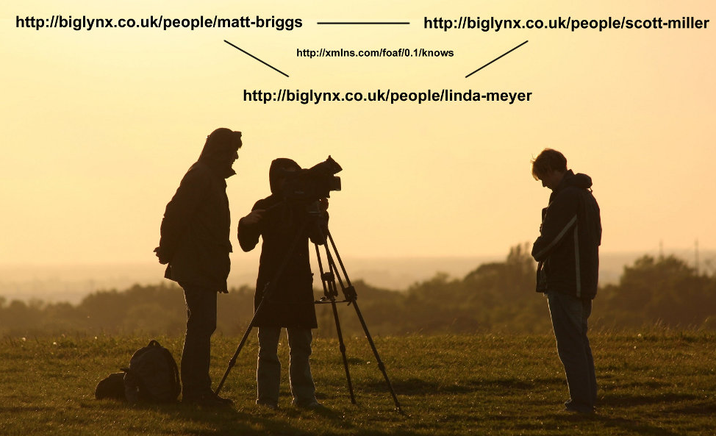
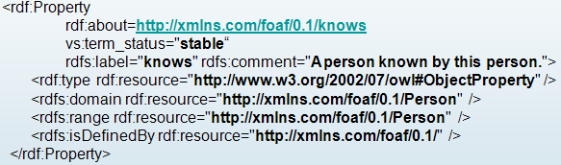
Relationships between URIs illustrated
The picture shows a Big Lynx film team at work. Within the picture, Big Lynx Lead Cameraman Matt Briggs as well as his two assistants, Linda Meyer and Scott Miller, are identified by HTTP URIs from the Big Lynx namespace. The relationship, that they know each other, is represented by connecting lines having the relationship type http://xmlns.com/foaf/0.1/knows.
[source: http://linkeddatabook.com/editions/1.0/ ]

Slide 38
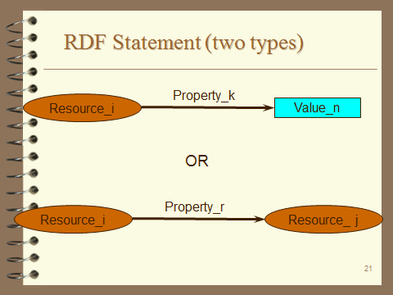
RDF Statement (two simplest basic structures)
subject
predicate
object
Subject of an RDF statement is a resource defined by URI
Predicate of an RDF statement is a property of a resource defined by URI
Object of an RDF statement is the value of a property of a resource (either defined by data value or by another resource URI depending on the type of RDF statement)

Slide 39
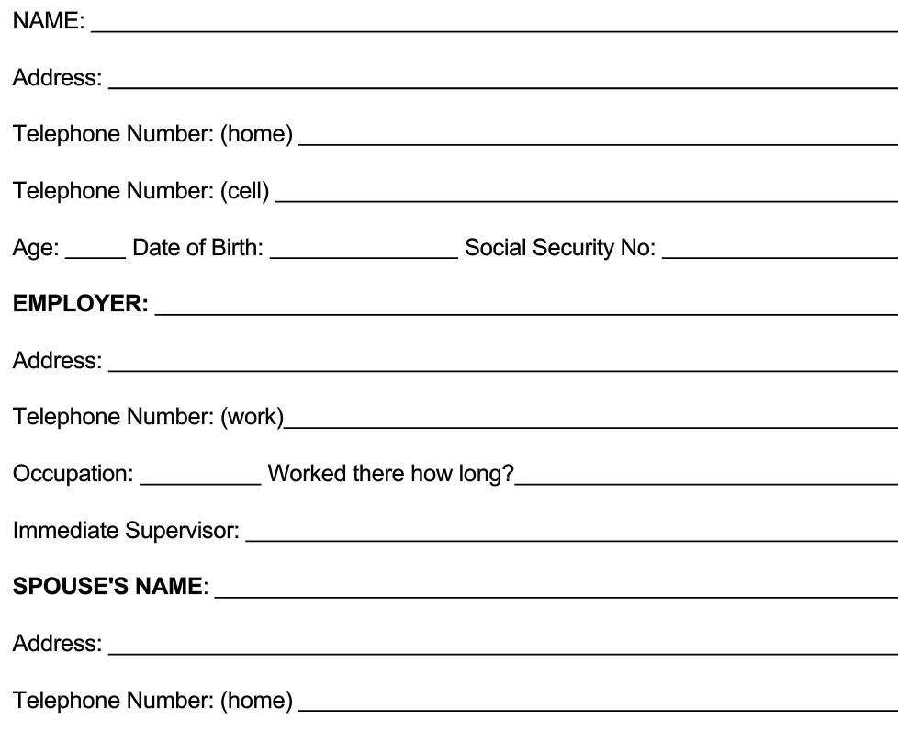
Making RDF Statements is like filling a questionnaire form
Vagan Terziyan
http://www.bla-bla.fi/#VaganTerziyan
Subject
Predicate
Object

Slide 40
Making RDF Statements is like filling a questionnaire form
http://www.bla-bla.fi/#VaganTerziyan
33
Subject
Predicate
Object

Slide 41
Making RDF Statements is like filling a questionnaire form
http://www.bla-bla.fi/#VaganTerziyan
Subject
http://dbpedia.org/page/University_of_Jyvaskyla
Predicate
Object

Slide 42
Making RDF Statements is like filling a questionnaire form
http://www.bla-bla.fi/#VaganTerziyan
Subject
Predicate
http://www.bla-bla.fi/#PekkaNeittaanmaki
Object

Slide 43

Concepts vs. URIs
“John loves Mary”

Slide 44

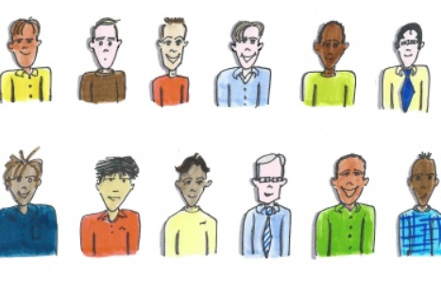
Concepts vs. URIs
“John loves Mary”
?
John
John
John
John
John
John
John
John
John
John
John
John

Slide 45
Concepts vs. URIs
<http://bla.com/#John-4> loves Mary
John-1
John-2
John-3
John-4
John-5
John-6
John-7
John-8
John-9
John-10
John-11
John-12

Slide 46

Concepts vs. URIs
<http://bla.com/#John-4> loves Mary
?
Mary
Mary
Mary
Mary
Mary

Slide 47
Concepts vs. URIs
<http://bla.com/#John-4> loves <http://bla.com/#Mary-5>
Mary-1
Mary-2
Mary-3
Mary-4
Mary-5

Slide 48
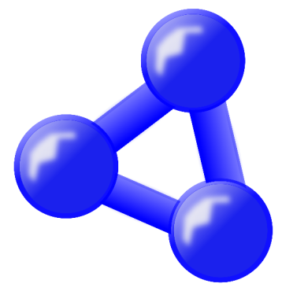
Concepts vs. URIs
<http://bla.com/#John-4> loves <http://bla.com/#Mary-5>
?
loves
loves
loves
Ontology-1
Ontology-2
Ontology-3

Slide 49

Concepts vs. URIs
“John loves Mary”
<http://bla.com/#John-4> <http://x.com/ontology-2/#loves> <http://bla.com/#Mary-5>
Now I got it !
loves
loves
loves
Ontology-1
Ontology-2
Ontology-3

Slide 50
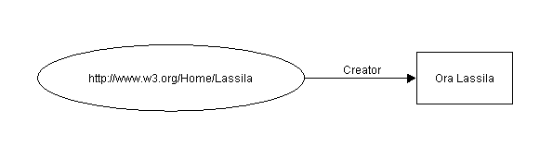
Example of RDF Statement
Ora Lassila is the creator of the resource http://www.w3.org/Home/Lassila.
Subject (resource)
http://www.w3.org/Home/Lassila
Predicate (property)
Creator
Object (xsd:literal)
“Ora Lassila”
xsd:literal refers to the datatype representing literal values. It is part of the XML Schema Datatypes (XSD) specification, which provides a set of built-in datatypes for representing data in XML documents. xsd:literal represents plain literal values in RDF, such as strings
Lets represent the above statement in RDF/XML in accordance with the “serialization” and the “abbreviated” syntax (see next slides):

Slide 51
RDF statement example in RDF/XML serialization syntax
Ora Lassila is the creator of the resource http://www.w3.org/Home/Lassila .
RDF/XML in accordance with the “serialization” syntax
<rdf:RDF>
<rdf:Description rdf:about=
"http://www.w3.org/Home/Lassila">
<s:Creator>Ora Lassila</s:Creator>
</rdf:Description>
</rdf:RDF>

Slide 52
RDF Example in serialization syntax (subject of statement)
Ora Lassila is the creator of the resource http://www.w3.org/Home/Lassila.
Subject
<rdf:RDF>
<rdf:Description rdf:about=
"http://www.w3.org/Home/Lassila">
<s:Creator>Ora Lassila</s:Creator>
</rdf:Description>
</rdf:RDF>

Slide 53
RDF Example in serialization syntax (predicate of statement)
Ora Lassila is the creator of the resource http://www.w3.org/Home/Lassila.
<rdf:RDF>
<rdf:Description rdf:about=
"http://www.w3.org/Home/Lassila">
<s:Creator>Ora Lassila</s:Creator>
</rdf:Description>
</rdf:RDF>
Predicate

Slide 54
RDF Example in serialization syntax (object of statement)
Ora Lassila is the creator of the resource http://www.w3.org/Home/Lassila.
<rdf:RDF>
<rdf:Description rdf:about=
"http://www.w3.org/Home/Lassila">
<s:Creator>Ora Lassila</s:Creator>
</rdf:Description>
</rdf:RDF>
Object

Slide 55
RDF Example in serialization syntax (reference to ontology)
Ora Lassila is the creator of the resource http://www.w3.org/Home/Lassila.
<rdf:RDF>
<rdf:Description rdf:about=
"http://www.w3.org/Home/Lassila">
<s:Creator>Ora Lassila</s:Creator>
</rdf:Description>
</rdf:RDF>
a specific namespace prefix as reference to ontology where predicates are defined, e.g. xmlns: s="http://description.org/schema/"

Slide 56
Same RDF statement in RDF/XML Abbreviated Syntax
Ora Lassila is the creator of the resource http://www.w3.org/Home/Lassila .
RDF/XML in accordance with the “abbreviated” syntax
<rdf:Description rdf:about="http://www.w3.org/Home/Lassila"
s:Creator="Ora Lassila" />

Slide 57
Abbreviated Syntax Example (1)
Ora Lassila is the creator of the resource http://www.w3.org/Home/Lassila.
<rdf:RDF>
<rdf:Description rdf:about="http://www.w3.org/Home/Lassila"
s:Creator="Ora Lassila" />
</rdf:RDF>
<?xml version="1.0"?>
<rdf:RDF
  xmlns:rdf="http://www.w3.org/1999/02/22-rdf-syntax-ns#"
  xmlns:s="http://description.org/schema/">
  <rdf:Description
  rdf:about="http://www.w3.org/Home/Lassila"
  s:Creator="Ora Lassila"/>
</rdf:RDF>

Slide 58
Abbreviated Syntax Example (2)
Ora Lassila is the creator of the resource http://www.w3.org/Home/Lassila.
Subject
<rdf:Description rdf:about="http://www.w3.org/Home/Lassila"
s:Creator="Ora Lassila" />

Slide 59
Abbreviated Syntax Example (3)
Ora Lassila is the creator of the resource http://www.w3.org/Home/Lassila.
<rdf:Description rdf:about="http://www.w3.org/Home/Lassila"
s:Creator ="Ora Lassila" />
Predicate

Slide 60
Abbreviated Syntax Example (4)
Ora Lassila is the creator of the resource http://www.w3.org/Home/Lassila.
<rdf:Description rdf:about="http://www.w3.org/Home/Lassila"
s:Creator="Ora Lassila" />
Object

Slide 61
Template/frame for RDF statement
Predicate
Subject
Value
<?xml version="1.0"?>
<rdf:RDF
xmlns:rdf="http://www.w3.org/1999/02/22-rdf-syntax-ns#"
xmlns: = " " >
<rdf:Description rdf:about= " “ "
: = " " />
</rdf:RDF>
prefix
Ontology (URI)
Subject (URI)
prefix
Predicate
Value

Slide 62

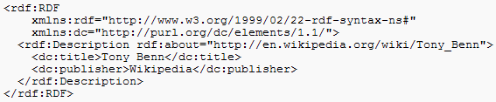

RDF N3 syntax
http://www.w3.org/TeamSubmission/n3/
Notation3, or N3 as it is more commonly known, is a shorthand non-XML serialization of RDF models, designed with human-readability in mind: N3 is much more compact and readable than XML RDF notation. The format is being developed by Tim Berners-Lee and others from the Semantic Web community.
RDF sample in XML notation
RDF sample in N3 notation

Slide 63

RDF N3 syntax
Some fast hints:
All URIs are quoted with angle brackets ( “<“ and “>” ). Whitespace within the < > is to be ignored.
All values are within quotation marks " " .
Each statement ends with the dot “.”
@pref is used to define the namespace prefix.
Square brackets [ ] are used for the “blank nodes”.
Check all in : http://www.w3.org/TeamSubmission/n3/
Example:
@PREFIX dc: <http://purl.org/dc/elements/1.1/> .
<http://en.wikipedia.org/wiki/Tony_Benn>
dc:publisher
"Wikipedia" .
Shorthand:
Square brackets for blank nodes:
[ pl ] means x, where there exists some x such that x has properties in the property list pl. For example:
[ :firstname "Ora" ] dc:wrote [ dc:title "Moby Dick" ] .
… is a statement which would be means in math:
exists x, y . firstname(x, "Ora") & dc:wrote(x,y) & dc:title (y, "Moby Dick")
… or in English "Some person who has a first name Ora wrote a book entitled "Moby Dick". Note not "the book" or "the person".

Slide 64
Template/frame for RDF statement (N3)
Predicate
Subject
Object
OR
Predicate
Subject
Value
<
>
<
>
<
>
.
Subject (URI)
Predicate (URI)
Object (URI)
OR
<
>
<
>
"
"
.
Subject (URI)
Predicate (URI)
Value
OR
@prefix Onto :
<
>
.
Onto
Ontology (URI)
:
:
:
.
Onto
Subject
Onto
Predicate
Onto
Object
:
:
"
"
.
Onto
Subject
Onto
Predicate
Value

Slide 65
Template/frame for RDF statement (N3)
.
<
>
<
>
<
>
http://www.jyu.fi/Onto.owl#John
http://www.jyu.fi/Onto.owl#Loves
http://www.jyu.fi/Onto.owl#Mary
OR
.
<
>
<
>
"
"
http://www.jyu.fi/Onto.owl#John
http://www.jyu.fi/Onto.owl#hasAge
25
OR
@prefix Onto :
>
.
P1
<
http://www.jyu.fi/Onto.owl#
:
:
:
.
P1
John
P1
Loves
P1
Mary
:
:
"
"
.
P1
John
P1
hasAge
25
Or(finally):
Or(even simpler):
@prefix P1: <http://www.jyu.fi/Onto.owl#> .
P1:John P1:Loves P1:Mary .
P1:John P1:hasAge "25" .
@prefix : <http://www.jyu.fi/Onto.owl#> .
:John :Loves :Mary .
:John :hasAge "25" .

Slide 66


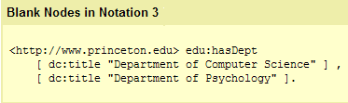
Some N3 syntax specifics
http://www.w3.org/TeamSubmission/n3/
Ontological statements in N3
@prefix rdfs: <http://www.w3.org/2000/01/rdf-schema#> .
:Professor a rdfs:Class .
<https://ai.it.jyu.fi/vagan> a :Professor .

Slide 67
Some N3 syntax specifics
http://www.w3.org/TeamSubmission/n3/
A B C , D , E , …, Z .
A B C .
@prefix : <http://www.jyu.fi/Onto.owl#> .
:John :Loves :Mary .
:John :Loves :Jane .
A B D .
…
@prefix : <http://www.jyu.fi/Onto.owl#> .
:John :Loves :Mary , :Jane .
A B Z .

Slide 68
Some N3 syntax specifics
http://www.w3.org/TeamSubmission/n3/
A B C ; D E ; … ; Y Z .
A B C .
@prefix : <http://www.jyu.fi/Onto.owl#> .
:John :Loves :Mary .
:John :hasAge "25" .
A D E .
…
@prefix : <http://www.jyu.fi/Onto.owl#> .
:John :Loves :Mary ; :hasAge "25" .
A Y Z .

Slide 69
Some N3 syntax specifics
http://www.w3.org/TeamSubmission/n3/
One N3 “sentence” – many triples
A B C , D ; E F ; G H , I , J .
Subject
“John loves Mary. John loves Jane. John is 25 years old.”
Predicate
A B C .
Object
@prefix : <http://www.jyu.fi/Onto.owl#> .
:John :Loves :Mary .
:John :Loves :Jane .
:John :hasAge "25" .
A B D .
A E F .
A G H .
A G I .
@prefix : <http://www.jyu.fi/Onto.owl#> .
:John :Loves :Mary , :Jane ; :hasAge "25" .
A G J .
“25 years old John loves Mary and Jane.”

Slide 70
Some N3 syntax specifics
http://www.w3.org/TeamSubmission/n3/
Subject
Predicate
A B [ C D ] .
Object
Blank node
means
“John loves someone who is 29 years old.”
@prefix : <http://www.jyu.fi/Onto.owl#> .
:John :Loves [ :hasAge "29" ] .
A B ?x? .
?x? C D .
“John loves someone who loves him back.”
@prefix : <http://www.jyu.fi/Onto.owl#> .
:John :Loves [ :Loves :John ] .
Something, someone, etc.

Slide 71
Some N3 syntax specifics
http://www.w3.org/TeamSubmission/n3/
One N3 “sentence” – many triples
A B C , D ; E F ; G [ H , I ] , J .
Subject
Predicate
A B C .
Object
A B D .
Blank node
A E F .
A G ?x? .
@prefix : <http://www.jyu.fi/Onto.owl#> .
:John :Loves :Mary , :Jane , [ :Loves :John ] ; :hasAge "25" .
?x? H I .
“25 years old John loves Mary, Jane and also someone else who loves him back.”
A G J .

Slide 72

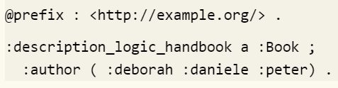





Some N3 syntax draft plans (collections)
https://w3c.github.io/N3/spec/
N3 may support "collections" to represent ordered collections of resources enclosed by parentheses ("( )"). The contained resources are called members.
Order matters
Order does not matter
$$≠$$
:description_logic_handbook a :Book ; :author :deborah , :daniele , :peter .
$$≠$$
:Fred :approved :resolution123 .
:Wilma :approved :resolution123 .
:Dino :approved :resolution123 .
:Fred :read :resolution1 .
:Fred :read :resolution2 .
:Fred :approved :resolution1 .
:Fred :approved :resolution2 .
:Wilma :read :resolution1 .
:Wilma :read :resolution2 .
:Wilma :approved :resolution1 .
:Wilma :approved :resolution2 .
$$≠$$

Slide 73
Some N3 syntax draft plans
(statements about statements)
https://w3c.github.io/N3/spec/
It is often useful to attach metadata to groups of triples — to give the additional context of the information, personal opinions on the matter, and so on. We can use graph terms to quote RDF graphs, and then describe the graph term using N3 statements.
@prefix : <http://www.jyu.fi/Onto.owl#> .
@prefix xsd: <http://www.w3.org/2001/XMLSchema#> .
{ :John :Loves :Mary } :validFrom “2023-01-01“^^xsd:date ; :validUntil “2023-05-31“^^xsd:date .
{ :John :Loves :Jane } :validFrom “2023-06-01“^^xsd:date ; :validUntil “2023-08-30“^^xsd:date .
“John loved Mary during January-May 2023, and he loved Jane during June-August 2023. ”
@prefix : <http://www.jyu.fi/Onto.owl#> .
:Mary :Believes { :John :Loves :Mary . :John a :Honest_Man } .
“Mary believes that John is an honest man and loves her.”

Slide 74
Some N3 syntax draft plans (rules)
https://w3c.github.io/N3/spec/
N3 may support declarative programming by allowing logical implications, or N3 rules, which can be loosely compared to If-Then statements.
@prefix : <http://www.jyu.fi/Onto.owl#> .
{ :John :Loves :Mary . :Mary :Loves :John } => { :Mary a :Happy_Person. :John a :Happy_Person}
@prefix : <http://www.jyu.fi/Onto.owl#> .
{ ?x :Loves ?y . ?y :Loves ?x } => { ?x a :Happy_Person. ?y a :Happy_Person}

Slide 75
SWRL rules in N3 syntax (as it is now)
"If a person has an age greater than or equal to 65 and satisfies other conditions, then the person is eligible for retirement."
@prefix xsd: <http://www.w3.org/2001/XMLSchema#> .
@prefix owl: <http://www.w3.org/2002/07/owl#> .
@prefix swrl: <http://www.w3.org/2003/11/swrl#> .
@prefix : <http://www.ontology.owl#> .
[ ] a swrl:Imp ; swrl:antecedent ( _:genid3 _:genid5 _:genid7 _:genid9 ) ;
swrl:consequent ( _:genid11 _:genid13 ) .
_:genid3 a swrl:ClassAtom ; swrl:argument1 :x ; swrl:classPredicate :Person .
_:genid5 a swrl:DatavaluedPropertyAtom ; swrl:argument1 :x ; swrl:argument2 :age ;
swrl:propertyPredicate :hasAge .
_:genid7 a swrl:DatavaluedPropertyAtom ; swrl:argument1 :x ; swrl:argument2 :gender ;
swrl:propertyPredicate :hasGender .
_:genid9 a swrl:DatavaluedPropertyAtom ; swrl:argument1 :age ; swrl:argument2 "65"^^xsd:int ;
swrl:propertyPredicate owl:greaterThanOrEqual .
_:genid11 a swrl:ClassAtom ; swrl:argument1 :x ; swrl:classPredicate :Person .
_:genid13 a swrl:DatavaluedPropertyAtom ; swrl:argument1 :x ; swrl:argument2 true ;
swrl:propertyPredicate :eligibleForRetirement .
… looks complicated.

Slide 76
RDF N3 examples
The story
4 RDF (N3) statements
Gender of Vagan Terziyan is male.
2. His mother is Svetlana Terziyan.
3. He is fun of fishing.
4. He is fun of Nordic walking.
<https://ai.it.jyu.fi/vagan/ontologies/university.owl#VaganTerziyan> <https://ai.it.jyu.fi/vagan/ontologies/university.owl#hasGender>
"male" .
1
<https://ai.it.jyu.fi/vagan/ontologies/university.owl#VaganTerziyan> <https://ai.it.jyu.fi/vagan/ontologies/university.owl#hasMother>
<https://ai.it.jyu.fi/vagan/ontologies/university.owl#SvetlanaTerziyan> .
2
<https://ai.it.jyu.fi/vagan/ontologies/university.owl#VaganTerziyan> <https://ai.it.jyu.fi/vagan/ontologies/LifeInFinland.owl#isFunOf>
"Fishing" .
3
<https://ai.it.jyu.fi/vagan/ontologies/university.owl#VaganTerziyan> <https://ai.it.jyu.fi/vagan/ontologies/LifeInFinland.owl#isFunOf>
"NordicWalking" .
4

Slide 77
RDF N3 examples
Gender of Vagan Terziyan is male.
2. His mother is Svetlana Terziyan.
3. He is fun of fishing.
4. He is fun of Nordic walking.
<https://ai.it.jyu.fi/vagan/ontologies/university.owl#VaganTerziyan> <https://ai.it.jyu.fi/vagan/ontologies/university.owl#hasGender >
"male" .
1
<https://ai.it.jyu.fi/vagan/ontologies/university.owl#VaganTerziyan> <https://ai.it.jyu.fi/vagan/ontologies/university.owl#hasMother>
<https://ai.it.jyu.fi/vagan/ontologies/university.owl#SvetlanaTerziyan> .
2
<https://ai.it.jyu.fi/vagan/ontologies/university.owl#VaganTerziyan> <https://ai.it.jyu.fi/vagan/ontologies/LifeInFinland.owl#isFunOf>
"Fishing" .
3
<https://ai.it.jyu.fi/vagan/ontologies/university.owl#VaganTerziyan> <https://ai.it.jyu.fi/vagan/ontologies/LifeInFinland.owl#isFunOf>
"NordicWalking" .
4
Reader-friendly version
@prefix On1: <https://ai.it.jyu.fi/vagan/ontologies/university.owl#> .
@prefix On2: <https://ai.it.jyu.fi/vagan/ontologies/LifeInFinland.owl#> .
On1:VaganTerziyan On1:hasGender "male" .
On1:VaganTerziyan On1:hasMother On1:SvetlanaTerziyan .
On1:VaganTerziyan On2:isFunOf "Fishing" .
On1:VaganTerziyan On2:isFunOf "NordicWalking" .

Slide 78
RDF N3 examples
Gender of Vagan Terziyan is male.
2. His mother is Svetlana Terziyan.
3. He is fun of fishing.
4. He is fun of Nordic walking.
<https://ai.it.jyu.fi/vagan/ontologies/university.owl#VaganTerziyan> <https://ai.it.jyu.fi/vagan/ontologies/university.owl#hasGender >
"male" .
1
<https://ai.it.jyu.fi/vagan/ontologies/university.owl#VaganTerziyan> <https://ai.it.jyu.fi/vagan/ontologies/university.owl#hasMother>
<https://ai.it.jyu.fi/vagan/ontologies/university.owl#SvetlanaTerziyan> .
2
<https://ai.it.jyu.fi/vagan/ontologies/university.owl#VaganTerziyan> <https://ai.it.jyu.fi/vagan/ontologies/LifeInFinland.owl#isFunOf>
"Fishing" .
3
<https://ai.it.jyu.fi/vagan/ontologies/university.owl#VaganTerziyan> <https://ai.it.jyu.fi/vagan/ontologies/LifeInFinland.owl#isFunOf>
"NordicWalking" .
4
Compact version
@prefix On1: <https://ai.it.jyu.fi/vagan/ontologies/university.owl#> .
@prefix On2: <https://ai.it.jyu.fi/vagan/ontologies/LifeInFinland.owl#> .
On1:VaganTerziyan On1:hasGender "male" ; On1:hasMother On1:SvetlanaTerziyan ; On2:isFunOf "Fishing" , "NordicWalking" .

Slide 79
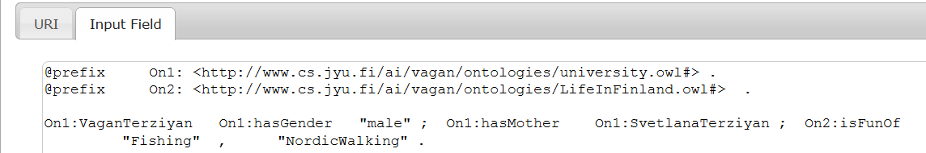
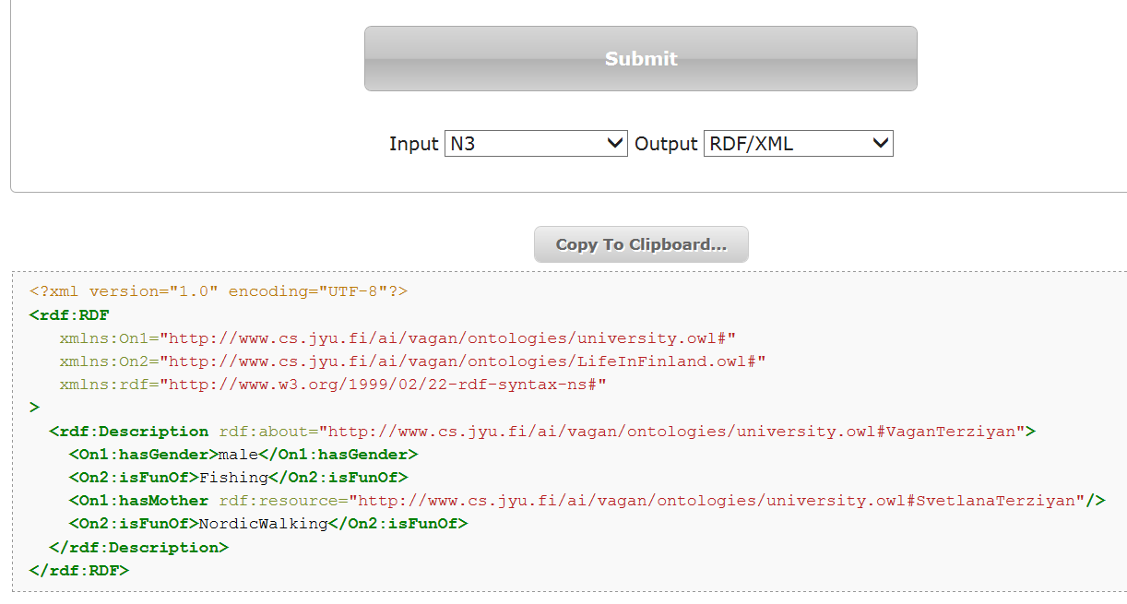
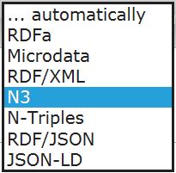
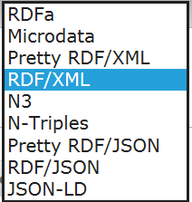
Online RDF translator
http://rdf-translator.appspot.com/ - may not work properly

Slide 80
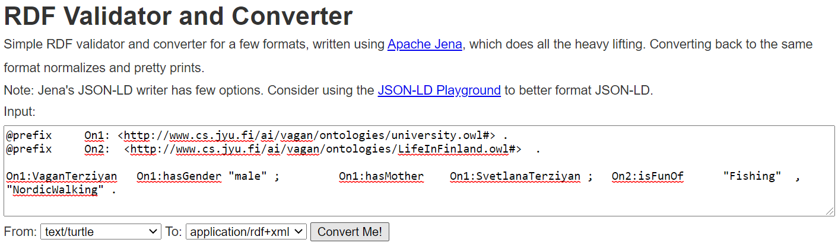
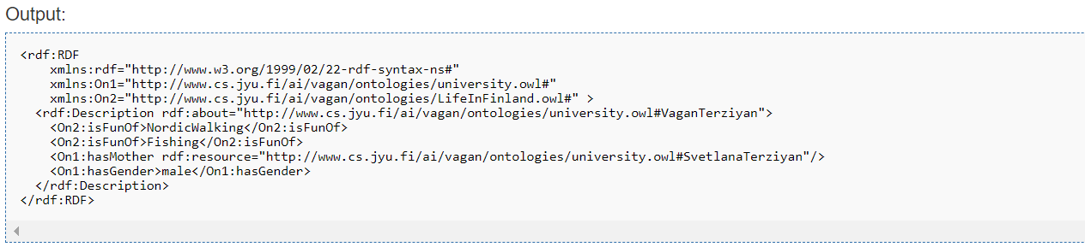
Online RDF translator (option 2)
Try (also for the examples from the following slides) …
https://issemantic.net/rdf-converter
… instead of …
http://rdf-translator.appspot.com/

Slide 81
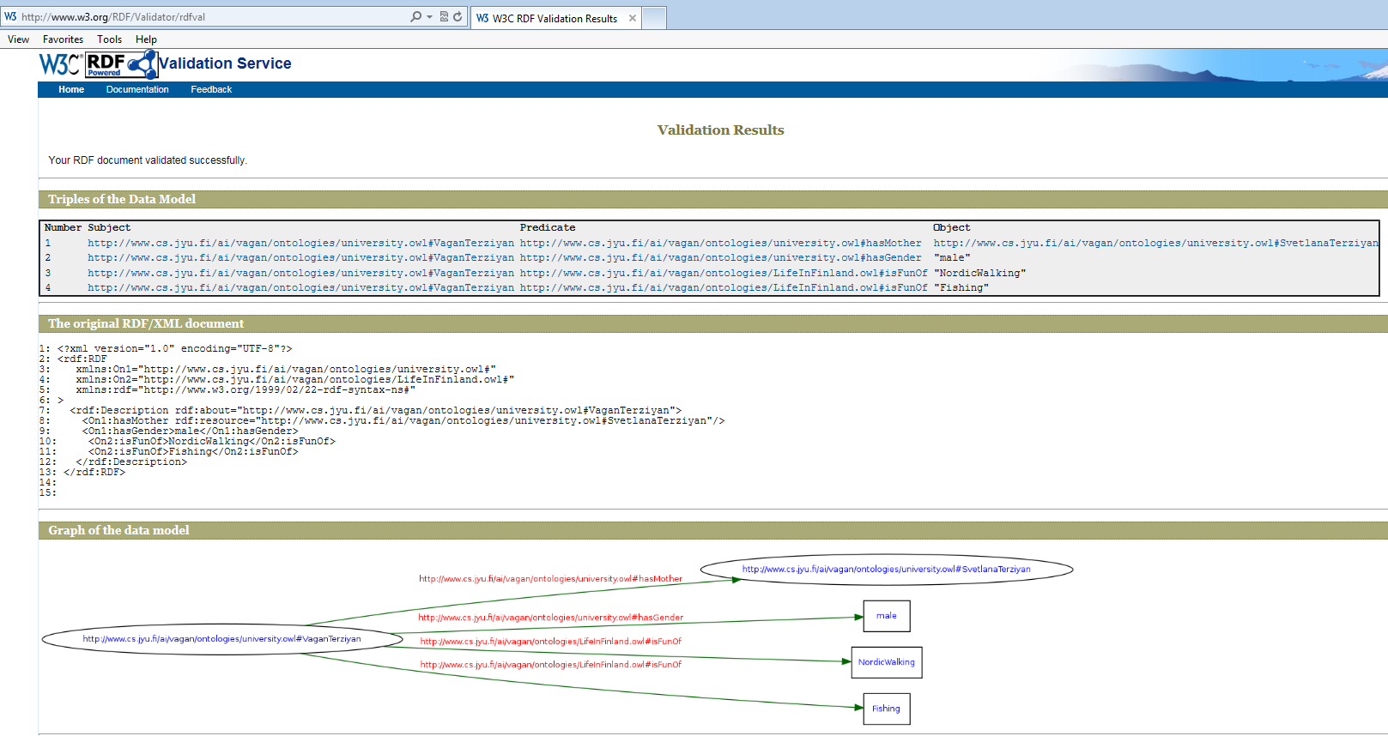
… lets validate the translation
http://www.w3.org/RDF/Validator/

Slide 82
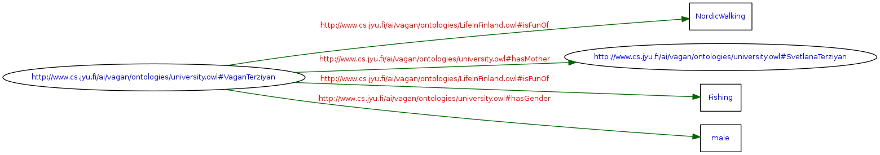
… and see the semantic graph
http://www.w3.org/RDF/Validator/

Slide 83
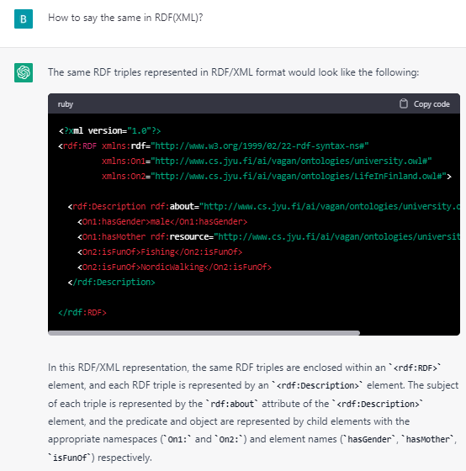
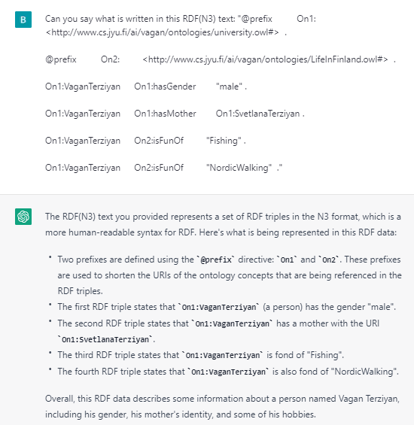
Just for fun … lets ask ChatGPT
https://chat.openai.com/chat
<?xml version="1.0"?>
<rdf:RDF xmlns:rdf="http://www.w3.org/1999/02/22-rdf-syntax-ns#"
xmlns:On1="https://ai.it.jyu.fi/vagan/ontologies/university.owl#"
xmlns:On2="https://ai.it.jyu.fi/vagan/ontologies/LifeInFinland.owl#">
<rdf:Description rdf:about="https://ai.it.jyu.fi/vagan/ontologies/university.owl#VaganTerziyan">
<On1:hasGender>male</On1:hasGender>
<On1:hasMother rdf:resource="https://ai.it.jyu.fi/vagan/ontologies/university.owl#SvetlanaTerziyan"/>
<On2:isFunOf>Fishing</On2:isFunOf>
<On2:isFunOf>NordicWalking</On2:isFunOf>
</rdf:Description>
</rdf:RDF>

Slide 84
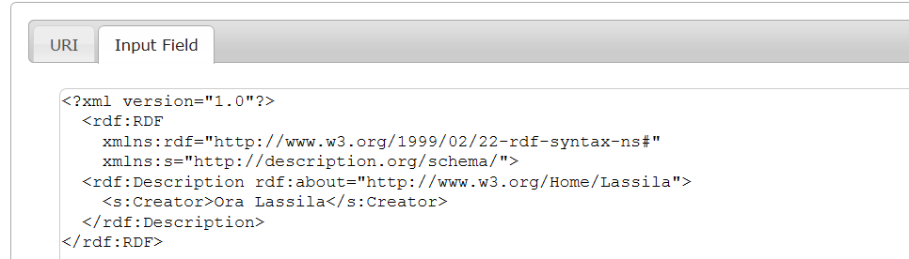
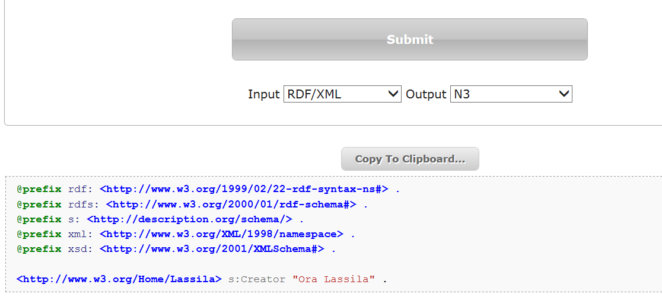
Online RDF translator (“Ora Lassila” example)
https://issemantic.net/rdf-converter
http://rdf-translator.appspot.com/

Slide 85
RDF/N3 example (blank node with [ ])
Gender of Vagan Terziyan is male.
2. His mother is Svetlana Terziyan.
3. He is fun of fishing.
4. He is fun of Nordic walking.
5. He is fun of mother’s hobby.
<https://ai.it.jyu.fi/vagan/ontologies/university.owl#VaganTerziyan> <https://ai.it.jyu.fi/vagan/ontologies/university.owl#hasGender >
"male" .
1
<https://ai.it.jyu.fi/vagan/ontologies/university.owl#VaganTerziyan> <https://ai.it.jyu.fi/vagan/ontologies/university.owl#hasMother>
<https://ai.it.jyu.fi/vagan/ontologies/university.owl#SvetlanaTerziyan> .
2
<https://ai.it.jyu.fi/vagan/ontologies/university.owl#VaganTerziyan> <https://ai.it.jyu.fi/vagan/ontologies/LifeInFinland.owl#isFunOf>
"Fishing" .
3
<https://ai.it.jyu.fi/vagan/ontologies/university.owl#VaganTerziyan> <https://ai.it.jyu.fi/vagan/ontologies/LifeInFinland.owl#isFunOf>
"NordicWalking" .
4
<https://ai.it.jyu.fi/vagan/ontologies/university.owl#VaganTerziyan> <https://ai.it.jyu.fi/vagan/ontologies/LifeInFinland.owl#isFunOf>
[<https://ai.it.jyu.fi/vagan/ontologies/LifeInFinland.owl#isHobbyOf> <https://ai.it.jyu.fi/vagan/ontologies/university.owl#SvetlanaTerziyan>].
5
Compact version
@prefix On1: <https://ai.it.jyu.fi/vagan/ontologies/university.owl#> .
@prefix On2: <https://ai.it.jyu.fi/vagan/ontologies/LifeInFinland.owl#> .
On1:VaganTerziyan On1:hasGender "male" ; On1:hasMother On1:SvetlanaTerziyan ; On2:isFunOf "Fishing" , "NordicWalking" , [On2:isHobbyOf On1:SvetlanaTerziyan ] .

Slide 86
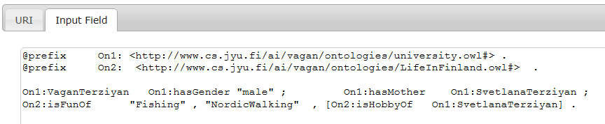
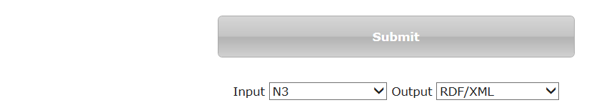
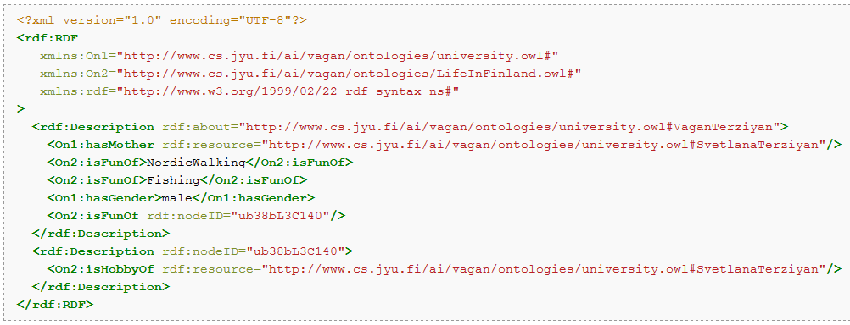
… lets translate it to RDF/XML …
https://issemantic.net/rdf-converter
http://rdf-translator.appspot.com/

Slide 87
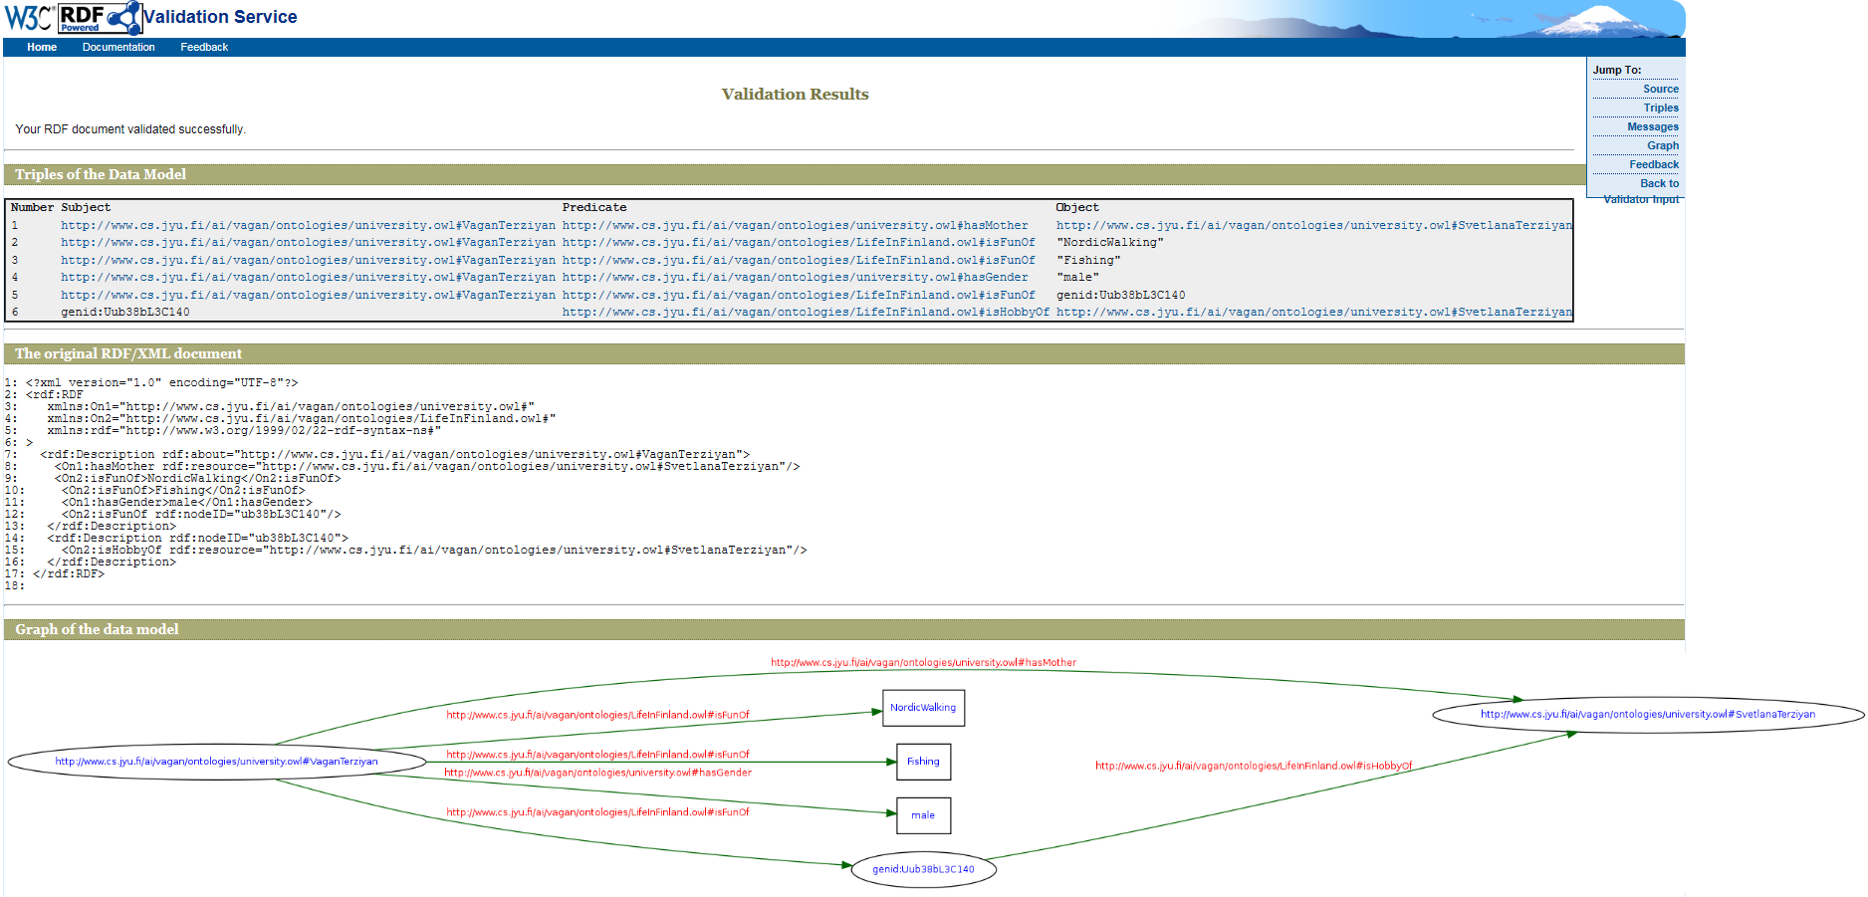
… and check with RDF/XML validator
http://www.w3.org/RDF/Validator/

Slide 88
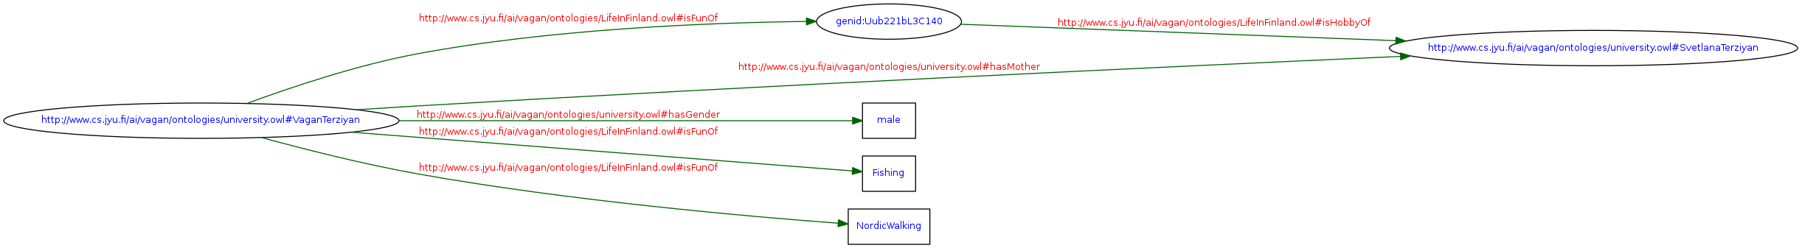
… and see the semantic graph
http://www.w3.org/RDF/Validator/

Slide 89
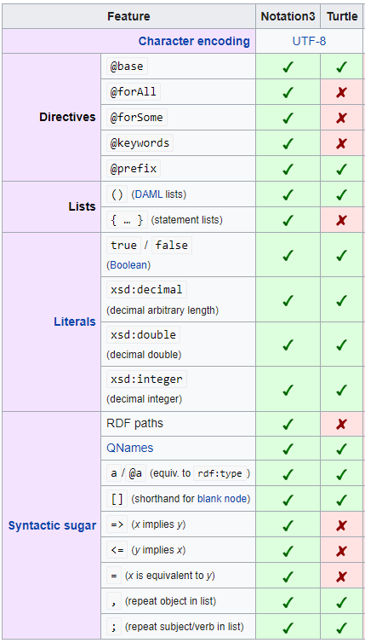
N3 vs. TURTLE
Notation3, or N3 as it is more commonly known, is a shorthand non-XML serialization of Resource Description Framework models, designed with human-readability in mind: N3 is much more compact and readable than XML RDF notation. The format is being developed by Tim Berners-Lee and others from the Semantic Web community. A formalization of the logic underlying N3 was published by Berners-Lee and others in 2008.
N3 has several features that go beyond a serialization for RDF models, such as support for RDF-based rules. Turtle is a simplified, RDF-only subset of N3.
https://www.researchgate.net/publication/247484786_Semantic_Web_Tutorial_Using_N3

Slide 90


Slide 91
What is an ontology?
Studer(98): Formal, explicit specification of a shared conceptualization
Machine
readable
Consensual
knowledge
Concepts, properties,
functions, axioms
are explicitly defined
Abstract model of
some domain

Slide 92
Simplest possible interpretation:
ontology is just an empty
questionnaire form

Slide 93
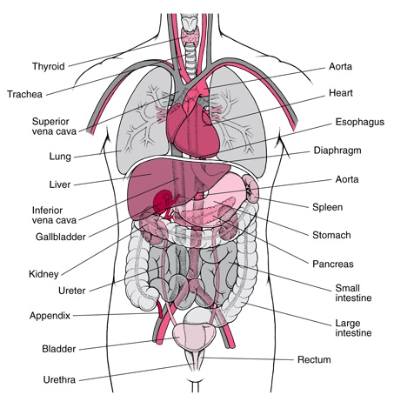
What is an Ontology?
From: Ian Horrocks “OWL 2: The Next Generation”
A model of (some aspect of) the world
Introduces vocabulary
relevant to domain, e.g.:
  Anatomy

Slide 94
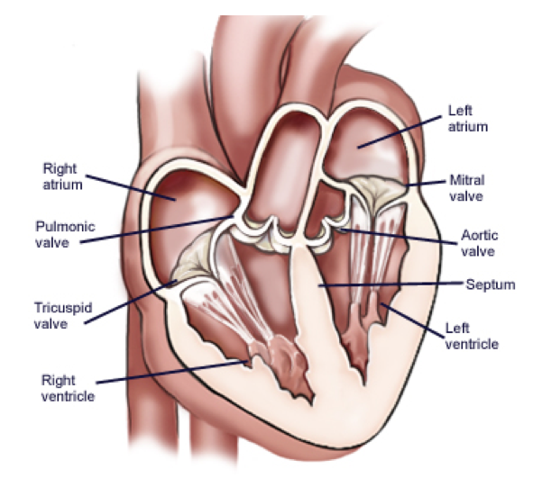
What is an Ontology?
From: Ian Horrocks “OWL 2: The Next Generation”
A model of (some aspect of) the world
Introduces vocabulary
relevant to domain
Specifies meaning of terms
  Heart is a muscular organ that
  is part of the circulatory system

Slide 95
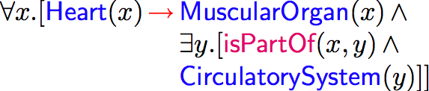
What is an Ontology?
From: Ian Horrocks “OWL 2: The Next Generation”
A model of (some aspect of) the world
Introduces vocabulary
relevant to domain
Specifies meaning of terms
  Heart is a muscular organ that
  is part of the circulatory system
Formalised using suitable logic
Notes:
¥begin{array}{r@{¥,}c@{¥,}l} ¥forall x.[¥textsf{¥color{blue} Heart}(x) & {¥color{red}¥rightarrow} & ¥textsf{¥color{blue} MuscularOrgan}(x) ¥,¥wedge¥, ¥¥ & & ¥exists y.[¥textsf{¥color{magenta} isPartOf}(x,y) ¥,¥wedge¥, ¥¥&&¥textsf{¥color{blue} CirculatorySystem}(y)]] ¥end{array}

Slide 96
Ontology Elements
Concepts(classes) + their hierarchy
Concept properties (slots/attributes) + their hierarchy
Property restrictions (type, cardinality, domain …)
Relations between concepts (disjoint, equality …)
Instances

Slide 97
Description Logic Semantics
From: Ian Horrocks “OWL: A Description Logic Based Ontology Language”
Semantics given by standard First-Order Model Theory:
See also: https://en.wikipedia.org/wiki/First-order_logic
John
Mary
Lawyer
Doctor
Vehicle
hasChild
owns
Individual Resources
Classes of Resources
Properties of Resources
(Lawyer and Doctor)

Slide 98
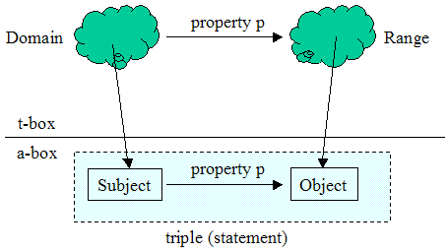
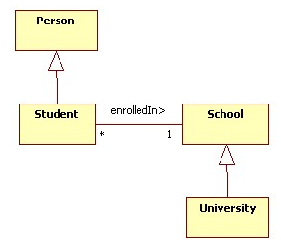
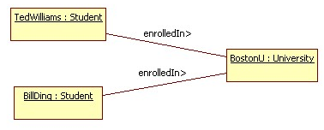
Tbox vs. Abox in an Ontology
There are 2 different types of statements within an ontology:
  Tbox – statement(s) about some concepts (therefore it is the terminology component of a domain model. It defines the vocabulary of the domain);
  Abox – statement(s) about some individuals (therefore it is the assertion component of a domain model. It collects together specific facts about the domain).
Tbox component
Abox component

Slide 99
RDF Schema (language for simple ontologies)
RDF schema is a semantic extension of RDF used for simple ontologies’ design. The RDF schema language is used for declaring basic class and types when describing the terms used in RDF and are used to determine characteristics of other resources, such as the domains and ranges of properties.
rdf:type is an instance of rdf:Property that is used to state that a resource is an instance of a class
http://www.w3.org/TR/rdf-schema/
RDF Schema provides a data-modelling vocabulary for RDF data.
rdf:Property is the class of RDF properties
rdfs:Resource
rdfs:Class
rdfs:domain
rdfs:range
rdfs:subClassOf
rdfs:subPropertyOf
…
The namespaces are identified by:
@prefix rdf: <http://www.w3.org/1999/02/22-rdf-syntax-ns#> .
@prefix rdfs: <http://www.w3.org/2000/01/rdf-schema#> .
The RDF Schema class and property system is similar to the type systems of object-oriented programming languages such as Java. RDF Schema differs from many such systems in that instead of defining a class in terms of the properties its instances may have, RDF Schema describes properties in terms of the classes of resources to which they apply.

Slide 100
RDFS example
That’s the only we know from the RDF statement:
…
:Mary :hasHusband :John .
…
RDFS
:Mary
:hasHusband
:John
RDF

Slide 101

RDFS example
That’s the only we know from the RDF statement:
…
:Mary :hasHusband :John .
…

Slide 102
RDFS example
Now the question is, can we tell more about RDF statement components (subject, predicate, object) with the RDFS ?
RDFS
RDFS
:hasHusband
:Mary
:Mary
:Mary
:hasHusband
:John
RDF
:John
RDF
:John

Slide 103

RDFS example
Now the question is, can we tell more about RDF statement components (subject, predicate, object) with the RDFS ?

Slide 104
RDFS example
First, we say explicitly that :Mary is a :Woman and :Woman is a Class
RDFS
RDFS
rdfs:Class
rdf:type
:hasHusband
:Woman
rdf:type
:Mary
:Mary
:Mary
:hasHusband
:hasHusband
:John
RDF
:John
RDF
:John

Slide 105

RDFS example
First, we say explicitly that :Mary is a :Woman and :Woman is a Class

Slide 106
RDFS example
Then we say explicitly that :John is a :Man and :Man is a rdfs:Class
RDFS
RDFS
rdfs:Class
rdf:type
rdf:type
:hasHusband
:Woman
rdf:type
:Mary
:Mary
:Mary
:hasHusband
:hasHusband
rdf:type
:John
:Man
RDF
:John
RDF
:John

Slide 107

RDFS example
Then we say explicitly that :John is a :Man and :Man is a rdfs:Class

Slide 108
RDFS example
After that, we say explicitly that :hasHusband is a rdf:property
RDFS
rdfs:Class
rdf:type
rdf:type
:hasHusband
:Woman
rdf:type
rdf:type
:Mary
:Mary
:hasHusband
rdf:property
rdf:type
:Man
:John
:John
RDF

Slide 109

RDFS example
After that, we say explicitly that :hasHusband is a rdf:property

Slide 110
RDFS example
Then we say that class :Woman is the domain for the:hasHusband property
RDFS
rdfs:Class
rdf:type
rdf:type
rdfs:Domain
:Woman
:hasHusband
rdf:type
rdf:type
:Mary
:Mary
:hasHusband
rdf:property
rdf:type
:Man
:John
:John
RDF

Slide 111

RDFS example
Then we say that class :Woman is the domain for the:hasHusband property

Slide 112
RDFS example
Then we say that class :Man is the range for the:hasHusband property
RDFS
rdfs:Class
rdf:type
rdf:type
rdfs:Domain
:Woman
:hasHusband
rdf:type
rdf:type
:Mary
rdfs:Range
:Mary
:hasHusband
rdf:property
rdf:type
:Man
:John
:John
RDF

Slide 113

RDFS example
Then we say that class :Man is the range for the:hasHusband property

Slide 114
RDFS example
We can also add that both classes :Woman and :Man are subclasses of the class :Person
RDFS
rdfs:Class
rdf:type
rdf:type
rdf:type
:Person
rdfs:subClassOf
rdfs:Domain
:Woman
:hasHusband
rdf:type
rdf:type
:Mary
rdfs:Range
rdfs:subClassOf
:Mary
rdf:property
:hasHusband
rdf:type
:John
:Man
RDF
:John

Slide 115

RDFS example
We can also add that both classes :Woman and :Man are subclasses of the class :Person

Slide 116
RDFS example
We can also introduce new (more general one) property :hasSpooth, which domain and range both belong to class :Person
RDFS
rdfs:Class
rdf:type
rdf:type
rdfs:Domain
rdf:type
:hasSpooth
rdfs:Range
:Person
rdf:type
rdfs:subClassOf
rdfs:Domain
:Woman
:hasHusband
rdf:type
rdf:type
:Mary
rdfs:Range
rdfs:subClassOf
:Mary
rdf:property
:hasHusband
rdf:type
:John
:Man
RDF
:John

Slide 117

RDFS example
We can also introduce new (more general one) property :hasSpooth, which domain and range both belong to class :Person

Slide 118
RDFS example
… and we can specify that the :hasHusband property is a subproperty of the :hasSpooth property
RDFS
rdfs:Class
rdf:type
rdf:type
rdfs:Domain
rdf:type
:hasSpooth
rdfs:Range
:Person
rdfs:subPropertyOf
rdf:type
rdfs:subClassOf
rdfs:Domain
:Woman
:hasHusband
rdf:type
rdf:type
:Mary
rdfs:Range
rdfs:subClassOf
:Mary
:hasHusband
rdf:property
rdf:type
:Man
:John
:John
RDF

Slide 119

RDFS example
… and we can specify that the :hasHusband property is a subproperty of the :hasSpooth property

Slide 120

RDFS example
All the RDF and RDFS statements can be easily written within one “story” using RDF (N3) notation:
@prefix rdf: <http://www.w3.org/1999/02/22-rdf-syntax-ns#> .
@prefix rdfs: <http://www.w3.org/2000/01/rdf-schema#> .
@prefix : <https://ai.it.jyu.fi/vagan/ontologies/LifeInFinland.owl#> .
:Person a rdfs:Class .
:Woman a rdfs:Class .
:Man a rdfs:Class .
:Woman rdfs:subClassOf :Person .
:Man rdfs:subClassOf :Person .
:hasHusband a rdf:Property .
:hasSpooth a rdf:Property .
:hasHusband rdfs:subPropertyOf :hasSpooth .
:hasSpooth rdfs:domain :Person .
:hasSpooth rdfs:range :Person .
:hasHusband rdfs:domain :Woman .
:hasHusband rdfs:range :Man .
:John a :Man .
:Mary a :Woman .
:Mary :hasHusband :John .

Slide 121



RDFS example (translate to RDF/XML)
http://rdf-translator.appspot.com/
https://issemantic.net/rdf-converter
… and the more complicated RDF/XML representation can be obtained automatically from RDF (N3) by using the RDF translation tool

Slide 122

… and validate RDF/XML
http://www.w3.org/RDF/Validator/

Slide 123
RDFS example (continue)
OWL
Adding some “cosmetics” from OWL (Web Ontology Language):
owl:ObjectProperty
rdf:type
rdf:type
@base <https://ai.it.jyu.fi/vagan/LifeInFinland.owl> .
@prefix rdf: <http://www.w3.org/1999/02/22-rdf-syntax-ns#> .
@prefix rdfs: <http://www.w3.org/2000/01/rdf-schema#> .
@prefix owl: <http://www.w3.org/2002/07/owl#> .
@prefix : <https://ai.it.jyu.fi/vagan/LifeInFinland.owl#> .
:Person a rdfs:Class .
:Woman a rdfs:Class .
:Man a rdfs:Class .
:Woman rdfs:subClassOf :Person .
:Man rdfs:subClassOf :Person .
:hasSpooth a owl:ObjectProperty .
:hasHusband a owl:ObjectProperty .
:hasHusband rdfs:subPropertyOf :hasSpooth .
:hasSpooth rdfs:domain :Person .
:hasSpooth rdfs:range :Person .
:hasHusband rdfs:domain :Woman .
:hasHusband rdfs:range :Man .
:John a :Man .
:Mary a :Woman .
:Mary :hasHusband :John .
Try to visualize this code:
https://issemantic.net/rdf-visualizer

Slide 124


… then we got translation to RDF/XML
https://issemantic.net/rdf-converter
https://www.w3.org/RDF/Validator/

Slide 125


… validating RDF/XML
http://www.w3.org/RDF/Validator/

Slide 126
… and see the semantic graph
http://www.w3.org/RDF/Validator/

Slide 127


… then we publish RDF/XML as OWL file to the right place in the Web

Slide 128

Opening file in Protégé (Screenshot 1)

Slide 129

Opening file in Protégé (Screenshot 2)

Slide 130


Try this online ontology visualization service:
https://service.tib.eu/webvowl/
https://service.tib.eu/webvowl/#iri=https://ai.it.jyu.fi/vagan/LifeInFinland.owl

Slide 131




Dublin Core
A set of fifteen basic properties for describing generalised Web resources;
ISO Standard
The Dublin Core Metadata Initiative is an open forum engaged in the development of interoperable online metadata standards that support a broad range of purposes and business models.
http://dublincore.org/
Namespace:
@prefix dc: http://purl.org/dc/elements/1.1/

Slide 132

Dublin Core (15 basic properties):

Slide 133
Dublin Core (15 basic properties):
See updates here: https://www.dublincore.org/specifications/dublin-core/dcmi-terms/

Slide 134


Dublin Core as of 2021
(15 basic properties and their typical datatypes):

Slide 135
Dublin Core Example (RDF/XML)
<?xml version="1.0"?>
<rdf:RDF xmlns:rdf="http://www.w3.org/1999/02/22-rdf-syntax-ns#"
xmlns:dc="http://purl.org/dc/elements/1.1/">
<rdf:Description rdf:about="http://www.ukoln.ac.uk/metadata/resources/dc/datamodel/WD-dc-rdf/">
<dc:title> Guidance on expressing the Dublin Core within the RDF </dc:title>
<dc:creator> Eric Miller </dc:creator>
<dc:creator> Paul Miller </dc:creator>
<dc:creator> Dan Brickley </dc:creator>
<dc:subject> Dublin Core; RDF; XML </dc:subject>
<dc:publisher> Dublin Core Metadata Initiative </dc:publisher>
<dc:contributor> Dublin Core Data Model Working Group </dc:contributor>
<dc:date> 1999-07-01 </dc:date>
<dc:format> text/html </dc:format>
<dc:language> en </dc:language>
</rdf:Description>
</rdf:RDF>

Slide 136



Dublin Core Example (RDF/N3)
Obtained with: http://rdf-translator.appspot.com/
Try also: https://issemantic.net/rdf-converter

Slide 137
RDF (as a Linked Data) Illustrated
Properties (predicate)
RDF triples
HUMAN
#Vagan | Vagan | Terziyan | 27/12/58 | #JyU
#John
#Aino
…
:#Vagan a HUMAN
C
:#Vagan :hasName “Vagan”
hasName
hasSurname
hasBirthday
isEmployedBy
:#Vagan :hasSurname “Terziyan”
:#Vagan :hasBirthday “1958-12-27”
:#Vagan :isEmployedBy :#JyU
Each cell is an RDF triple
Each cell is an RDF triple
Resources (subject)
UNIVERSITY
#MIT
#JyU | University of Jyvaskyla | Finland | 204 | #Aino
#KNURE
…
!
C
hasTitle
hasLocation
hasWorldRank
hasRector
RDF triples (continue)
:#JyU a UNIVERSITY
:#JyU :hasTitle “University of Jyvaskyla”
:#JyU :hasLocation “Finland”
:#JyU :hasWorldRank “204”
:#JyU :hasRector :#Aino
:#Aino a HUMAN
… … …

Slide 138
Traditional RDF Statement
Subject of an RDF statement is a resource
Predicate of an RDF statement is a property of a resource
Object of an RDF statement is the value of a property of a resource (either literal or resource)
Property_k
Resource_i
Literal
OR
Property_r
Resource_i
Resource_ j

Slide 139

New semantics of RDF Statement in S-APL (object - executable resource)
Property_m
Resource_i
exe: Resource_ j
Semantics of such statement means that the value of the Property_m of the Resource_i can be obtained as a result of execution of the procedure (query, service, function, etc.) represented as Resource_ j
executable property
Semantic Agent Programming Language (Designed by Industrial Ontologies Group)
S-APL

Slide 140









property
(datatype)
Resource_A
Literal
property
(object)
Resource_A
Resource_B
property
(executable)
Resource_A
exe:Resource_C
execution

Slide 141





RDFa: Resource Description Framework in Attributes
https://developers.google.com/structured-data/testing-tool/
Rich snippets is an example of how the Semantic Web is being adopted by large and powerful Internet companies, so it's encouraging to see that Google is pushing for rapid adoption.

Slide 142


RDFa: Combining human- and machine-readable information within the same document !
RDFa (or Resource Description Framework – in – attributes) is a W3C Recommendation that adds a set of attribute-level extensions to XHTML for embedding rich metadata within Web documents. RDFa provides a set of XHTML attributes to augment visual data with machine-readable hints and turns the existing human-visible text and links into machine-readable data without repeating content. The great thing about RDFa is the ability to weave meaning and rich data directly into a web page without having any impact on the front-end user experience.
XHTML
HTML5
Today's web is built predominantly for human readers. Even as machine-readable data begins to permeate the web, it is typically distributed in a separate file, with a separate format, and very limited correspondence between the human and machine versions. As a result, web browsers can provide only minimal assistance to humans in parsing and processing web pages: browsers only see presentation information. RDFa is intended to solve the problem of marking up machine-readable data in HTML documents. RDFa provides a set of HTML attributes to augment visual data with machine-readable hints. Using RDFa, authors may turn their existing human-visible text and links into machine-readable data without repeating content.

Slide 143



Slide 144


RDFa Example (1)
Example of HTML :
Browser screenshot:

Slide 145



RDFa Example (2)
Read first:
http://www.w3.org/TR/xhtml-rdfa-primer/
Use:
(http://rdfa.info/play/)
Update your HTML with some RDFa inside and check it:
Great ! Same view!

Slide 146

RDFa Example (3)
Original HTML :

Slide 147
RDFa Example (4)
Step-by-step markup the HTML with RDFa :

Slide 148
RDFa Example (5)
Step-by-step markup the HTML with RDFa :

Slide 149
RDFa Example (6)
Step-by-step markup the HTML with RDFa :

Slide 150
RDFa Example (7)
Step-by-step markup the HTML with RDFa :

Slide 151
RDFa Example (8)
Step-by-step markup the HTML with RDFa :

Slide 152
RDFa Example (9)
Step-by-step markup the HTML with RDFa :

Slide 153

RDFa Example (10)
Finally: HTML marked up with RDFa :

Slide 154




RDFa Example (“Happy end”)

Slide 155

Same Example with real ontology (me.owl)

Slide 156



Same Example with real ontology (me.owl)

Slide 157

Same Example with real ontology (me.owl)
https://ai.it.jyu.fi/vagan/ontologies/2016/me.owl

Slide 158

me.owl ontology in N3 format

Slide 159



Same Example with real ontology (me.owl)

Slide 160
<div
xmlns:v="https://ai.it.jyu.fi/vagan/ontologies/2016/me.owl#" typeof="v:Person">
My name is <span property="v:name">VaganTerziyan</span> but people call me <span property="v:nickname">Professor </span>because I am a <span property="v:title">professor</span> at <span property="v:affiliation">University of Jyvaskyla</span>.
Here is my home page:
<a href="https://ai.it.jyu.fi/vagan" rel="v:url"> http:www.cs.jyu.fi/ai/vagan </a>.
</div>

Slide 161

Same Example with real ontology (me.owl)
N3

Slide 162


Adding “resource” explicitly
<div xmlns: v="https://ai.it.jyu.fi/vagan/ontologies/2016/me.owl#"
xmlns: t="https://ai.it.jyu.fi/vagan/ontologies/university.owl#"
resource = "t:VaganTerziyan"
typeof="v:Person">
My name is
<span property="v:name">
Vagan Terziyan
</span>
but people call me
<span property="v:nickname">
Professor
</span>
because I am a
<span property="v:title">
professor
</span>
at
<span property="v:affiliation">
University of Jyvaskyla
</span>
. Here is my home page:
<a href="https://ai.it.jyu.fi/vagan" rel="v:url">
https://ai.it.jyu.fi/vagan
</a>
.
</div>
<div xmlns:v="https://ai.it.jyu.fi/vagan/ontologies/2016/me.owl#" xmlns:t="https://ai.it.jyu.fi/vagan/ontologies/university.owl#" resource = "t:VaganTerziyan" typeof = "v:Person">
My name is <span property="v:name">Vagan Terziyan</span> but people call me <span property="v:nickname">Professor</span> because I am a <span property="v:title">professor</span> at <span property="v:affiliation">University of Jyvaskyla</span> .
Here is my home page:
<a href="https://ai.it.jyu.fi/vagan" rel="v:url">https://ai.it.jyu.fi/vagan </a>.
</div>
<div xmlns:v="https://ai.it.jyu.fi/vagan/ontologies/2016/me.owl#" xmlns:t="https://ai.it.jyu.fi/vagan/ontologies/university.owl#" resource = "t:VaganTerziyan" typeof="v:Person">
My name is <span property="v:name">Vagan Terziyan</span> but people call me <span property="v:nickname">Professor</span> because I am a <span property="v:title">professor</span> at <span property="v:affiliation">University of Jyvaskyla</span> .
Here is my home page:
<a href="https://ai.it.jyu.fi/vagan" rel="v:url">https://ai.it.jyu.fi/vagan </a>.
</div>
RDFa
http://rdfa.info/play/
https://www.easyrdf.org/converter
N3

Slide 163


Want to go further ?..
... Download Protégé first !..

Slide 164

Tutorial: Designing Ontologies with Protégé
Protégé is an ontology editor and a knowledge-base editor (download from: http://protege.stanford.edu ).
Protégé is also an open-source, Java tool that provides an extensible architecture for the creation of customized knowledge-based applications.
Protégé's OWL Plug-in now provides support for editing Semantic Web ontologies.
PLEASE !!!
Download version:
Protégé 5.5.0 or later
These will help to enjoy Protégé:
https://ai.it.jyu.fi/vagan/Ontologies.ppt
https://ai.it.jyu.fi/vagan/ProtegeOWL_1.ppt
https://ai.it.jyu.fi/vagan/ProtegeOWL_2.ppt

Slide 165



Download Protégé 5.5.0 or later
1
http://protege.stanford.edu/
2

Slide 166




DBpedia
http://dbpedia.org/
DBpedia (DataBasePedia) is a project aiming to extract structured content from the information created as part of the Wikipedia project and making it available in the Web. DBpedia allows querying relationships and properties associated with Wikipedia resources, including links to other related datasets. Therefore DBpedia is one of the more famous parts of the decentralized Linked Data effort.
The DBpedia data set uses a large multi-domain ontology which has been derived from Wikipedia. The English version of the DBpedia 2014 data set currently describes 4.58 million “things” with 583 million “facts” (find new numbers here). In addition, localized versions of DBpedia available in 125 languages. All these versions together describe 38.3 million things, out of which 23.8 million overlap (interlinked) with concepts from the English DBpedia.

Slide 167





Concepts in DBpedia
DBpedia Ontology (2014)
The DBpedia Ontology is a shallow, cross-domain ontology, which has been manually created based on the most commonly used infoboxes within Wikipedia. The ontology currently covers 685 classes which form a subsumption hierarchy and are described by 2,795 different properties.
RDF/N3

Slide 168






Naming “things” in DBpedia
http://wiki.dbpedia.org/Datasets
Each thing in the DBpedia data set is denoted by a de-referenceable URI-based reference of the form:
http://dbpedia.org/page/Name ,
where Name is derived from the URL of the source Wikipedia article, which has the form:
http://en.wikipedia.org/wiki/Name .
Thus, each DBpedia entity is tied directly to a Wikipedia article. Every DBpedia entity name resolves to a description-oriented Web document (or Web resource). Read more in: http://wiki.dbpedia.org/Datasets
Kharkiv city in Wikipedia and DBpedia
http://en.wikipedia.org/wiki/Kharkiv
http://dbpedia.org/page/Kharkiv
http://www.snee.com/bobdc.blog/2011/03/from-a-wikipedia-page-to-the-c.html

Slide 169







Building personal graph as Linked Data
@base <https://ai.it.jyu.fi/vagan/ontologies/university.owl#> .
@prefix db: <http://dbpedia.org/page/> .
@prefix gs: <http://scholar.google.com/citations?user=> .
gs:4U8ydfgAAAAJ
db:Kharkiv_National_University_of_Radioelectronics
:hasPublicationRecord
:hasPhDFrom
db:Ukraine
:hasPlaceOf Birth
:isCitizenOf
db:Kharkiv
:isEmployedBy
:isResidentOf
:VaganTerziyan
db:Finland
db:University_of_Jyvaskyla

Slide 170

OWL: Web Ontology Language
The Web Ontology Language (OWL) is a family of knowledge representation languages or ontology languages for engineering ontologies or knowledge bases. The languages are characterized by formal semantics and RDF/XML-based serializations for the Semantic Web.
OWL DL (Description Logic) designed to provide the maximum expressiveness possible while retaining computational completeness (either φ or ¬φ belong), decidability (there is an effective procedure to determine whether φ is derivable or not), and the availability of practical reasoning algorithms. OWL DL includes all OWL language constructs, but they can be used only under certain restrictions
http://www.w3.org/TR/owl-ref/ OWL 2004
http://www.w3.org/TR/owl2-overview/ OWL-2 2009

Slide 171

http://sig.biostr.washington.edu/projects/ontviews/

Slide 172
Why OWL? Limitations of RDFS
RDFS is too weak in describing resources with sufficient details, e.g.:
  No localised range and domain constraints
    Cannot say that the range of isToughtBy is only professor when applied to professors and lecturer when applied to lecturers
  No cardinality constraints
    Cannot say that a course is taught by at least one professor, or persons have exactly 2 parents
  No transitive, inverse or symmetrical properties
    Cannot say that isPartOf is a transitive property, that hasSupervisor is the inverse of isSupervisorOf, and, that friendOf is symmetrical
  Disjoint classes
    Cannot say that Graduate and PhD. Students are two disjoint classes
  Boolean combinations of classes
    Sometimes we may need to build new classes by combining other classes using union, intersection, and complement (e.g. person is the disjoint union of the classes male and female)

Slide 173
OWL Class and OWL Properties
rdfs:Resource
rdfs:Class
rdf:Property
owl:ObjectProperty
owl:DatatypeProperty
owl:Class

Slide 174



Slide 175

OWL on one Slide
Symmetric: if P(x, y) then P(y, x)
Transitive: if P(x,y) and P(y,z) then P(x, z)
Functional: if P(x,y) and P(x,z) then y=z
InverseOf: if P1(x,y) then P2(y,x)
InverseFunctional: if P(y,x) and P(z,x) then y=z
allValuesFrom: P(x,y) and y=allValuesFrom(C)
someValuesFrom: P(x,y) and y=someValuesFrom(C)
hasValue: P(x,y) and y=hasValue(v)
cardinality: cardinality(P) = N
minCardinality: minCardinality(P) = N
maxCardinality: maxCardinality(P) = N
equivalentProperty: P1 = P2
intersectionOf: C = intersectionOf(C1, C2, …)
unionOf: C = unionOf(C1, C2, …)
complementOf: C = complementOf(C1)
oneOf: C = one of(v1, v2, …)
equivalentClass: C1 = C2
disjointWith: C1 != C2
sameIndividualAs: I1 = I2
differentFrom: I1 != I2
AllDifferent: I1 != I2, I1 != I3, I2 != I3, …
Thing: I1, I2, …
Legend:
Properties are indicated by: P, P1, P2, etc
Specific classes are indicated by: x, y, z
Generic classes are indicated by: C, C1, C2
Values are indicated by: v, v1, v2
Instance documents are indicated by: I1, I2, I3, etc.
A number is indicated by: N
P(x,y) is read as: “property P relates x to y”
Notes:
<owl:ObjectProperty rdf:ID="producesWine">
<owl:inverseOf rdf:resource="#hasMaker" />
</owl:ObjectProperty>

Slide 176
An Example
Woman ≡ Person ⊓ Female
Man ≡ Person ⊓ ¬Woman
Mother ≡ Woman ⊓ ∃hasChild.Person
Father ≡ Man ⊓ ∃hasChild.Person
Parent ≡ Father ⊔ Mother
Grandmother ≡ Mother ⊓ ∃hasChild.Parent
We can further infer (though not explicitly stated):
→ Grandmother ⊑ Person
Grandmother ⊑ Man ⊔ Woman
etc.

Slide 177
"Red wine is a subclass of all things that have a red color."
@prefix rdfs: <http://www.w3.org/2000/01/rdf-schema#> .
@prefix owl: <http://www.w3.org/2002/07/owl#> .
@prefix xsd: <http://www.w3.org/2001/XMLSchema#> .
@prefix : <https://ai.it.jyu.fi/vagan/LifeInFinland.owl#> .
:RedWine a owl:Class ;
rdfs:subClassOf
[ a owl:Restriction ;
owl:onProperty :hasColor ;
owl:hasValue "red"^^xsd:string
] .

Slide 178

Multiple Inheritance illustrated
Class i:
Round-Shaped_2D_Object
Class j:
Green_Object
rdfs:subClassOf
rdfs:subClassOf
Class k:
Green_Round-Shaped_2D_Object
Other way to define:
Green_Round-Shaped_2D_Object ≡ Round-Shaped_2D_Object ⊓ Green_Object

Slide 179






Flavors of a Partonomy
isPartOf
isIngradientOf
isComponentOf
isContainedIn
isMemberOf
isPieceOf

Slide 180
OWL-2 vs. OWL
OWL-2 adds new functionality with respect to OWL.:
  keys;
  disjoint union of classes
  property chains;
  richer datatypes, data ranges;
  qualified cardinality restrictions;
  asymmetric, reflexive, and disjoint properties;
  enhanced annotation capabilities .

Slide 181



RDF2HTML
http://rhizomik.net/html/redefer/rdf2html-form/
https://ai.it.jyu.fi/vagan/ontologies/2014/demo-record.owl
http://rhizomik.net/html/redefer/rdf2html-form/
https://ai.it.jyu.fi/vagan/ontologies/2016/Cars.owl
Check also the Online SPARQL Query Demonstrator on top of some ontology: http://librdf.org/query

Slide 182

Semantic Query Language (SPARQL):
SPARQL is an RDF query language (semantic query language) for databases, able to retrieve and manipulate data stored in Resource Description Framework (RDF) format. It was made a standard by the RDF Data Access Working Group (DAWG) of the World Wide Web Consortium, and is recognized as one of the key technologies of the Semantic Web. On 15 January 2008, SPARQL 1.0 became an official W3C Recommendation, and SPARQL 1.1 in March, 2013.
There exist tools that allow one to connect and semi-automatically construct a SPARQL query for a SPARQL endpoint, for example ViziQuer (http://viziquer.lumii.lv/ ). In addition, there exist tools that translate SPARQL queries to other query languages, for example to SQL and to XQuery.
Link (Wikipedia): https://en.wikipedia.org/wiki/SPARQL

Slide 183






Where to try your own SPARQL query?
SPARQL is an RDF query language (i.e., a semantic query language) for databases, able to retrieve and manipulate data stored in RDF format.
On 15 January 2008, SPARQL 1.0 became an official W3C Recommendation and SPARQL 1.1 in March, 2013
(http://www.w3.org/TR/sparql11-query/ )
The example below demonstrates a simple query that leverages the ontology definition "foaf", often called the "friend-of-a-friend" ontology. Specifically, the following query returns names and emails of every person in the dataset:
http://sparql.org/sparql.html
SPARQL quick tutorial

Slide 184
Sparql query Example
Query:
“Select full names of all employees working for Nokia and provide information about period of their employment.”
Take data from:
https://ai.it.jyu.fi/vagan/ontologies/2016/Cars.owl (version 7.10.2016)
Use SPARQL endpoint:
http://librdf.org/query

Slide 185
“Select full names of all employees working for Nokia and provide information about period of their employment.”
PREFIX rdf: <http://www.w3.org/1999/02/22-rdf-syntax-ns#>
PREFIX onto: <https://ai.it.jyu.fi/vagan/ontologies/2016/Cars.owl#>
PREFIX db: <http://dbpedia.org/page/>
SELECT DISTINCT ?name ?familyname ?begins ?ends
WHERE {
?x rdf:type onto:Employee .
?x onto:hasFirstName ?name .
?x onto:hasFamilyName ?familyname .
?x onto:hasJobRecord ?record .
?record onto:hasReferenceToEmployer db:Nokia .
?record onto:hasValidityInterval ?interval .
?interval onto:hasStartingTime ?begins .
?interval onto:hasFinishingTime ?ends .
}
ORDER BY ?name
Query:

Slide 186

SPARQL endpoint
(Redland Rasqal RDF Query Demonstration):
http://librdf.org/query

Slide 187

SPARQL query result

Slide 188

SPARQL query result (XML)

Slide 189

SPARQL query result (JSON)

Slide 190


Execute SPARQL
query directly
from Protégé 3.5

Slide 191



Execute SPARQL
query directly
from Protégé 5.5

Slide 192
“Select full names of all scholars studying in University of Jyvaskyla and provide information about period of their study.”
PREFIX rdf: <http://www.w3.org/1999/02/22-rdf-syntax-ns#>
PREFIX onto: <https://ai.it.jyu.fi/vagan/ontologies/2016/Cars.owl#>
PREFIX db: <http://dbpedia.org/page/>
SELECT DISTINCT ?name ?familyname ?begins ?ends
WHERE {
?x rdf:type onto:Scholar .
?x onto:hasFirstName ?name .
?x onto:hasFamilyName ?familyname .
?x onto:hasStudyRecord ?record .
?record onto:hasReferenceToSchool db:University_of_Jyvaskyla .
?record onto:hasValidityInterval ?interval .
?interval onto:hasStartingTime ?begins .
?interval onto:hasFinishingTime ?ends .
}
ORDER BY ?name
Query:

Slide 193

SPARQL query result

Slide 194
“Select full name, birthday, city and county of residence with its capital of a person who owns pet Tom”
PREFIX tutorial: <https://ai.it.jyu.fi/vagan/ontologies/2019/tutorial.owl#>
SELECT DISTINCT ?firstname ?familyname ?birthday ?country ?city ?capital
WHERE {
?someone tutorial:hasPet tutorial:Tom .
?someone tutorial:hasFirstName ?firstname .
?someone tutorial:hasFamilyName ?familyname .
?someone tutorial:hasBirthday ?birthday .
?someone tutorial:hasCityOfResidence ?city .
?city tutorial:isCityOf ?country .
?country tutorial:hasCapital ?capital
}
Query:

Slide 195


SPARQL query result

Slide 196
Sparql query Example
Using “CONSTRUCT” to make query aka rule
PREFIX onto: <https://ai.it.jyu.fi/vagan/ontologies/2016/Cars.owl#>
PREFIX owl: <http://www.w3.org/2002/07/owl#>
CONSTRUCT { ?x onto:isPotentialFriendOf ?z .}
WHERE {
?x onto:isFriendOf ?y .
?y onto:isFriendOf ?z .
?x owl:differentFrom ?z .
}

Slide 197


SPARQL query result

Slide 198


SPARQL query result (XML)

Slide 199



Construct the missing values for the inverse property pair: hasPet - isPetOf
Query
PREFIX tutorial: <https://ai.it.jyu.fi/vagan/ontologies/2019/tutorial.owl#>
CONSTRUCT { ?pet tutorial:isPetOf ?owner }
WHERE { ?owner tutorial:hasPet ?pet }
Result
http://librdf.org/query
Redland Rasqal RDF Query Demonstration

Slide 200


“Find the birth place of William Shakespeare in DBPedia”.
http://dbpedia.org/sparql
PREFIX dbo: <http://dbpedia.org/ontology/>
PREFIX dbr: <http://dbpedia.org/resource/>
SELECT DISTINCT ?place
WHERE {
dbr:William_Shakespeare dbo:birthPlace ?place .
}
Try also: http://dbpedia.org/snorql/

Slide 201
Constructing complete ontology and cut a part of DBPedia graph to populate the ontology using SPARQL CONSTRUCT query
FROM: http://dbpedia.org
USING: http://dbpedia.org/sparql
PREFIX owl: <http://www.w3.org/2002/07/owl#>
PREFIX xsd: <http://www.w3.org/2001/XMLSchema#>
PREFIX rdfs: <http://www.w3.org/2000/01/rdf-schema#>
PREFIX rdf: <http://www.w3.org/1999/02/22-rdf-syntax-ns#>
PREFIX db: <http://dbpedia.org/page/>
PREFIX dbpedia: <http://dbpedia.org/>
PREFIX dbo: <http://dbpedia.org/ontology/>
PREFIX : <https://ai.it.jyu.fi/vagan/ontologies/2019/import.owl#>
CONSTRUCT {dbo:height a owl:DatatypeProperty . dbo:height a owl:FunctionalProperty. dbo:height rdfs:domain dbo:Person . dbo:height rdfs:range xsd:double . dbo:Person a owl:Class .
?hero dbo:height ?height . ?hero rdf:type dbo:Person
} WHERE {
?hero rdf:type dbo:Person . ?hero dbo:height ?height .
}

Slide 202
Constructing complete ontology and cut a part of DBPedia graph to populate the ontology using SPARQL CONSTRUCT query (almost similar)
FROM: http://dbpedia.org
USING: http://dbpedia.org/sparql
PREFIX owl: <http://www.w3.org/2002/07/owl#>
PREFIX xsd: <http://www.w3.org/2001/XMLSchema#>
PREFIX rdfs: <http://www.w3.org/2000/01/rdf-schema#>
PREFIX rdf: <http://www.w3.org/1999/02/22-rdf-syntax-ns#>
PREFIX db: <http://dbpedia.org/page/>
PREFIX dbpedia: <http://dbpedia.org/>
PREFIX dbo: <http://dbpedia.org/ontology/>
PREFIX : <https://ai.it.jyu.fi/vagan/ontologies/2019/WEIGHT.owl#>
CONSTRUCT {dbo:weight a owl:DatatypeProperty . dbo:weight a owl:FunctionalProperty. dbo:weight rdfs:domain dbo:Person . dbo:weight rdfs:range xsd:double . dbo:Person a owl:Class .
?hero dbo:weight ?weight . ?hero rdf:type dbo:Person
} WHERE {
?hero rdf:type dbo:Person . ?hero dbo:weight ?weight .
}

Slide 203
Constructing complete ontology and cut a part of DBPedia graph to populate the ontology using SPARQL CONSTRUCT query (both together)
PREFIX owl: <http://www.w3.org/2002/07/owl#>
PREFIX xsd: <http://www.w3.org/2001/XMLSchema#>
PREFIX rdfs: <http://www.w3.org/2000/01/rdf-schema#>
PREFIX rdf: <http://www.w3.org/1999/02/22-rdf-syntax-ns#>
PREFIX db: <http://dbpedia.org/page/>
PREFIX dbpedia: <http://dbpedia.org/>
PREFIX dbo: <http://dbpedia.org/ontology/>
PREFIX foaf: <http://xmlns.com/foaf/0.1/>
PREFIX : <https://ai.it.jyu.fi/vagan/ontologies/2020/PARAMETERS.owl#>
CONSTRUCT {
dbo:Person a owl:Class . ?hero rdf:type dbo:Person .
dbo:weight a owl:DatatypeProperty . dbo:weight a owl:FunctionalProperty. dbo:weight rdfs:domain dbo:Person . dbo:weight rdfs:range xsd:double .
dbo:height a owl:DatatypeProperty . dbo:height a owl:FunctionalProperty. dbo:height rdfs:domain dbo:Person . dbo:height rdfs:range xsd:double .
?hero dbo:weight ?weight . ?hero dbo:height ?height }
WHERE {
?hero rdf:type dbo:Person . ?hero dbo:height ?height . ?hero dbo:weight ?weight }
FROM: http://dbpedia.org
USING: http://dbpedia.org/sparql

Slide 204
Constructing complete ontology and cut a part of DBPedia graph to populate the ontology using SPARQL CONSTRUCT query
FROM: http://dbpedia.org
USING: http://dbpedia.org/sparql
PREFIX owl: <http://www.w3.org/2002/07/owl#>
PREFIX xsd: <http://www.w3.org/2001/XMLSchema#>
PREFIX rdfs: <http://www.w3.org/2000/01/rdf-schema#>
PREFIX rdf: <http://www.w3.org/1999/02/22-rdf-syntax-ns#>
PREFIX db: <http://dbpedia.org/page/>
PREFIX dbpedia: <http://dbpedia.org/>
PREFIX dbo: <http://dbpedia.org/ontology/>
PREFIX import: <https://ai.it.jyu.fi/vagan/ontologies/2019/CX.owl#>
PREFIX : <https://ai.it.jyu.fi/vagan/ontologies/2019/import3.owl#>
CONSTRUCT {import:Business a owl:Class . import:Product a owl:Class .
?product rdf:type import:Product . ?company rdf:type import:Business . import:hasProducer a owl:ObjectProperty . import:isProducerOf a owl:ObjectProperty .
import:hasProducer rdfs:domain import:Product . import:hasProducer rdfs:range import:Business . ?product import:hasProducer ?company . ?company import:isProducerOf ?product .
import:isProducerOf rdfs:range import:Product . import:isProducerOf rdfs:domain import:Business . import:isProducerOf owl:inverseOf import:hasProducer
} WHERE {
?company dbo:product ?product .
}

Slide 205
Constructing complete ontology and cut a part of DBPedia graph to populate the ontology using SPARQL CONSTRUCT query
FROM: http://dbpedia.org
USING: http://dbpedia.org/sparql
PREFIX owl: <http://www.w3.org/2002/07/owl#>
PREFIX xsd: <http://www.w3.org/2001/XMLSchema#>
PREFIX rdfs: <http://www.w3.org/2000/01/rdf-schema#>
PREFIX rdf: <http://www.w3.org/1999/02/22-rdf-syntax-ns#>
PREFIX db: <http://dbpedia.org/page/>
PREFIX dbpedia: <http://dbpedia.org/>
PREFIX dbo: <http://dbpedia.org/ontology/>
PREFIX import: <https://ai.it.jyu.fi/vagan/ontologies/2019/CX.owl#>
PREFIX : <https://ai.it.jyu.fi/vagan/ontologies/2019/import6.owl#>
CONSTRUCT {import:Business a owl:Class . import:Service a owl:Class .
?service rdf:type import:Service . ?company rdf:type import:Business . import:hasProvider a owl:ObjectProperty . import:isProviderOf a owl:ObjectProperty .
import:hasProvider rdfs:domain import:Service . import:hasProvider rdfs:range import:Business . ?service import:hasProvider ?company . ?company import:isProviderOf ?service .
import:isProviderOf rdfs:range import:Service . import:isProviderOf rdfs:domain import:Business . import:isProviderOf owl:inverseOf import:hasProvider
} WHERE {
?company dbo:service ?service .
}

Slide 206
Constructing complete ontology and cut a part of DBPedia graph to populate the ontology using SPARQL CONSTRUCT query
FROM: http://dbpedia.org
USING: http://dbpedia.org/sparql
PREFIX owl: <http://www.w3.org/2002/07/owl#>
PREFIX xsd: <http://www.w3.org/2001/XMLSchema#>
PREFIX rdfs: <http://www.w3.org/2000/01/rdf-schema#>
PREFIX rdf: <http://www.w3.org/1999/02/22-rdf-syntax-ns#>
PREFIX db: <http://dbpedia.org/page/>
PREFIX dbpedia: <http://dbpedia.org/>
PREFIX dbo: <http://dbpedia.org/ontology/>
PREFIX CX: <https://ai.it.jyu.fi/vagan/ontologies/2019/CX.owl#>
PREFIX : <https://ai.it.jyu.fi/vagan/ontologies/2019/import5.owl#>
CONSTRUCT {
dbo:Person a owl:Class . CX:City a owl:Class . CX:Country a owl:Class . CX:Business a owl:Class .
?organization rdf:type CX:Business . ?city rdf:type CX:City . ?country rdf:type CX:Country .
CX:hasCity a owl:ObjectProperty ; rdfs:domain CX:Country ; rdfs:range CX:City .
CX:isCityOf a owl:ObjectProperty ; rdfs:domain CX:City ; rdfs:range CX:Country .
CX:isCityOf owl:inverseOf CX:hasCity .
CX:hasLocation a owl:ObjectProperty ; rdfs:domain [ a owl:Class ; owl:unionOf (CX:Business dbo:Person) ] ;
rdfs:range CX:City . CX:isLocationFor a owl:ObjectProperty ;
rdfs:range [ a owl:Class ; owl:unionOf (CX:Business dbo:Person) ] ; rdfs:domain CX:City .
CX:isLocationFor owl:inverseOf CX:hasLocation . ?organization CX:hasLocation ?city . ?city CX:isLocationFor ?organization .
?city CX:isCityOf ?country . ?country CX:hasCity ?city .
} WHERE {
?organization rdf:type dbo:Organisation . ?organization dbo:locationCity ?city . ?city dbo:country ?country .
}

Slide 207
Constructing complete ontology and cut a part of DBPedia graph to populate the ontology using SPARQL CONSTRUCT query
FROM: http://dbpedia.org
USING: http://dbpedia.org/sparql
PREFIX owl: <http://www.w3.org/2002/07/owl#>
PREFIX xsd: <http://www.w3.org/2001/XMLSchema#>
PREFIX rdfs: <http://www.w3.org/2000/01/rdf-schema#>
PREFIX rdf: <http://www.w3.org/1999/02/22-rdf-syntax-ns#>
PREFIX db: <http://dbpedia.org/page/>
PREFIX dbpedia: <http://dbpedia.org/>
PREFIX dbo: <http://dbpedia.org/ontology/>
PREFIX dc: <http://purl.org/dc/terms/>
PREFIX : <https://ai.it.jyu.fi/vagan/ontologies/2019/import8.owl#>
PREFIX import: <https://ai.it.jyu.fi/vagan/ontologies/2019/CX.owl#>
PREFIX yago: <http://dbpedia.org/class/yago/>
CONSTRUCT {import:AdvertisingCampaign a owl:Class . ?x a import:AdvertisingCampaign }
WHERE {?x a yago:AdvertisingCampaign100798959}

Slide 208
Constructing import containing cities and countries from DBPedia and their relationships using SPARQL CONSTRUCT query
PREFIX owl: <http://www.w3.org/2002/07/owl#>
PREFIX xsd: <http://www.w3.org/2001/XMLSchema#>
PREFIX rdfs: <http://www.w3.org/2000/01/rdf-schema#>
PREFIX rdf: <http://www.w3.org/1999/02/22-rdf-syntax-ns#>
PREFIX db: <http://dbpedia.org/page/>
PREFIX dbpedia: <http://dbpedia.org/>
PREFIX dbo: <http://dbpedia.org/ontology/>
PREFIX dbr: <http://dbpedia.org/resource/>
PREFIX : <https://ai.it.jyu.fi/vagan/ontologies/2020/country-city.owl#>
CONSTRUCT
{
:City a owl:Class .
:Country a owl:Class .
?x a :Country .
?y a :City .
:isCityOf a owl:ObjectProperty .
:hasCity a owl:ObjectProperty .
?y :isCityOf ?x .
?x :hasCity ?y
}
WHERE {?x a dbo:Country . ?y a dbo:City . ?y dbo:country ?x }

Slide 209
Constructing import containing cities and countries from DBPedia and their relationships using SPARQL CONSTRUCT query
Generating import for a particular ontology (… Kate.owl)
PREFIX owl: <http://www.w3.org/2002/07/owl#>
PREFIX xsd: <http://www.w3.org/2001/XMLSchema#>
PREFIX rdfs: <http://www.w3.org/2000/01/rdf-schema#>
PREFIX rdf: <http://www.w3.org/1999/02/22-rdf-syntax-ns#>
PREFIX db: <http://dbpedia.org/page/>
PREFIX dbpedia: <http://dbpedia.org/>
PREFIX dbo: <http://dbpedia.org/ontology/>
PREFIX dbr: <http://dbpedia.org/resource/>
PREFIX : <https://ai.it.jyu.fi/vagan/ontologies/2022/Kate.owl#>
CONSTRUCT
{
:Country a owl:Class .
?x a :Country .
?y a :City .
:isCityOf a owl:ObjectProperty ; rdfs:domain :City ; rdfs:range :Country .
:hasCity a owl:ObjectProperty ; rdfs:domain :Country ; rdfs:range :City ; owl:inverseOf :isCityOf .
?y :isCityOf ?x .
?x :hasCity ?y
}
WHERE {?x a dbo:Country . ?y a dbo:City . ?y dbo:country ?x }

Slide 210


Querying Kate ontology using http://sparql.org/sparql.html
PREFIX rdf: <http://www.w3.org/1999/02/22-rdf-syntax-ns#>
PREFIX owl: <http://www.w3.org/2002/07/owl#>
PREFIX dbr: <http://dbpedia.org/resource/>
PREFIX dbo: <http://dbpedia.org/ontology/>
PREFIX foaf: <http://xmlns.com/foaf/0.1/>
PREFIX xsd: <http://www.w3.org/2001/XMLSchema#>
PREFIX : <https://ai.it.jyu.fi/vagan/ontologies/2022/Kate.owl#>
SELECT DISTINCT ?y ?z
FROM <https://ai.it.jyu.fi/vagan/ontologies/2022/Kate.owl>
WHERE { :KateBeautiful ?y ?z }
ORDER BY ?y
What do you know about “KateBeautiful” ?

Slide 211


Querying Kate ontology using http://sparql.org/sparql.html
PREFIX rdf: <http://www.w3.org/1999/02/22-rdf-syntax-ns#>
PREFIX owl: <http://www.w3.org/2002/07/owl#>
PREFIX dbr: <http://dbpedia.org/resource/>
PREFIX dbo: <http://dbpedia.org/ontology/>
PREFIX : <https://ai.it.jyu.fi/vagan/ontologies/2022/Kate.owl#>
SELECT DISTINCT ?x
FROM <https://ai.it.jyu.fi/vagan/ontologies/2022/Kate.owl>
WHERE { :Alex ?x :KateBeautiful }
What is the relation(s) between “Alex” and “KateBeautiful” ?

Slide 212
Sparql Distributed query Example
Query:
“Select full names of all researchers born in Berlin”
Take data from 2 places:
https://ai.it.jyu.fi/vagan/ontologies/2016/Cars.owl
https://ai.it.jyu.fi/vagan/ontologies/2016/SWRL_Example.owl (version 13.10.2016)
Use SPARQL endpoint:
http://sparql.org/sparql.html

Slide 213
“Select full names of all researchers born in Berlin”.
PREFIX rdf: <http://www.w3.org/1999/02/22-rdf-syntax-ns#>
PREFIX onto: <https://ai.it.jyu.fi/vagan/ontologies/2016/Cars.owl#>
PREFIX onto2: <https://ai.it.jyu.fi/vagan/ontologies/2016/SWRL_Example.owl#>
PREFIX db: <http://dbpedia.org/page/>
SELECT DISTINCT ?name ?familyname
FROM <https://ai.it.jyu.fi/vagan/ontologies/2016/Cars.owl>
FROM <https://ai.it.jyu.fi/vagan/ontologies/2016/SWRL_Example.owl>
WHERE {
?x rdf:type onto:Person .
?x onto:hasCityofBirth db:Berlin .
?x onto:hasFirstName ?name .
?x onto:hasFamilyName ?familyname .
?x rdf:type onto2:Researcher .
}
ORDER BY ?name
Query:
notice: “FROM”

Slide 214

SPARQL endpoint
(SPARQLer – General purpose processor):
http://sparql.org/sparql.html

Slide 215



SPARQL query result

Slide 216
“Select the main industry of the county where pet Tom lives”
PREFIX tutorial: <https://ai.it.jyu.fi/vagan/ontologies/2019/tutorial.owl#>
PREFIX industry: <https://ai.it.jyu.fi/vagan/ontologies/2019/industry.owl#>
PREFIX db: <http://dbpedia.org/page/>
SELECT DISTINCT ?industry
FROM <https://ai.it.jyu.fi/vagan/ontologies/2019/tutorial.owl>
FROM <https://ai.it.jyu.fi/vagan/ontologies/2019/industry.owl>
WHERE {
?someone tutorial:hasPet tutorial:Tom .
?someone tutorial:hasCityOfResidence ?city .
?city tutorial:isCityOf ?country .
?country industry:hasMainIndustry ?industry
}
Query:
http://sparql.org/sparql.html

Slide 217


SPARQL query result

Slide 218
Sparql query Example*
Query:
“Provide information about the employment period of Nokia workers from Jyvaskyla whose favorite fish is RuslkaNo1.”
Take data from:
https://ai.it.jyu.fi/vagan/ontologies/2017/MyFirstOntology.owl (version 9.10.2017)
Use SPARQL endpoint:
http://librdf.org/query

Slide 219
“Provide information about the employment period of Nokia workers from Jyvaskyla whose favorite fish is RuslkaNo1.”
PREFIX rdf: <http://www.w3.org/1999/02/22-rdf-syntax-ns#>
PREFIX onto: <https://ai.it.jyu.fi/vagan/ontologies/2017/MyFirstOntology.owl#>
PREFIX db: <http://dbpedia.org/page/>
SELECT DISTINCT ?begins ?ends
WHERE {
?x onto:isLivingIn db:Jyvaskyla .
?x onto:hasFavouriteFish onto:RuslkaNo1 .
?x onto:hasJobRecord ?record .
?record onto:hasCompany onto:Nokia .
?record onto:hasStartingDate ?begins .
?record onto:hasFinishingDate ?ends .
}
ORDER BY ?record
Query:

Slide 220

SPARQL endpoint
(Redland Rasqal RDF Query Demonstration):
http://librdf.org/query

Slide 221



SPARQL query result

Slide 222
Sparql query Example*
Query:
“Provide information about the salaries of the University of Jyvaskyla employees”
Take data from:
https://ai.it.jyu.fi/vagan/ontologies/2018/dynamics.owl (version 2.10.2018)
Use SPARQL endpoint:
http://librdf.org/query

Slide 223
“Provide information about the salaries of the University of Jyvaskyla employees”
PREFIX rdf: <http://www.w3.org/1999/02/22-rdf-syntax-ns#>
PREFIX onto: <https://ai.it.jyu.fi/vagan/ontologies/2018/dynamics.owl#>
SELECT DISTINCT ?record ?salary
WHERE {
?x rdf:type onto:Employee .
?record rdf:type onto:JobRecord .
?x onto:isEmployeeIn ?record .
?record onto:hasEmployer onto:UniversityOfJyvaskyla .
?record onto:hasSalaryEuro ?salary .
}
ORDER BY ?record
Query:

Slide 224

SPARQL endpoint
(Redland Rasqal RDF Query Demonstration):
http://librdf.org/query

Slide 225


SPARQL query result

Slide 226
Where to look for details
RDF:
http://www.w3.org/RDF/
RDF Schema:
http://www.w3.org/TR/rdf-schema/
RDFa :
http://www.w3.org/TR/xhtml-rdfa-primer/
OWL:
  Guide: http://www.w3.org/TR/owl-guide/
  Reference: http://www.w3.org/TR/owl-ref/
  Semantics and Abstract Syntax:
  http://www.w3.org/TR/owl-semantics/

Slide 227









Make Semantic Web your profession with these books

Slide 228



Check an excellent summary of the 20 years of Semantic Web history and current status:
Hitzler, P. (2021). A review of the semantic web field. Communications of the ACM, 64(2), 76-83.
https://dl.acm.org/doi/pdf/10.1145/3397512
And watch the video about it here: https://dl.acm.org/doi/abs/10.1145/3397512
https://www.youtube.com/watch?v=1FmzOlsGAG8

Slide 229






Beyond Semantic Web and Linked Data:
Knowledge Graphs
See also: EU Knowledge Graph
Google Knowledge Graph
hasCapital
Kyiv
hasNeighborhood
hasHotel
Read this: Noy, N., Gao, Y., Jain, A., Narayanan, A., Patterson, A., & Taylor, J. (2019). Industry-Scale Knowledge Graphs: Lessons and Challenges. Communications of the ACM, 62(8), 36-43.

Slide 230



Fresh update for RDF and SPARQL:
https://w3c.github.io/rdf-star/cg-spec/editors_draft.html
https://graphdb.ontotext.com/documentation/9.2/free/devhub/rdf-sparql-star.html
https://arxiv.org/pdf/1406.3399.pdf
Check: https://issemantic.net/rdf-visualizer

Slide 231

Examples of what is cool in RDF*:

Slide 232



Beyond Semantic Web and Linked Data:
Wikidata
WIKIDATA is a crowdsourced knowledge graph, like Wikipedia is a crowdsourced encyclopedia.
READ THIS: Vrandečić, D., & Krötzsch, M. (2014). Wikidata: a Free Collaborative Knowledgebase. Communications of the ACM, 57(10), 78-85.
Wikidata: SPARQL tutorial

Slide 233





WIKIDATA
31.07.2015
http://www.wikidata.org/

Slide 234

Wikidata Example
https://tools.wmflabs.org/reasonator/?q=Q42

Slide 235


VS
DBpedia and Wikidata are two related and similar, but still very different, Linked Data projects, both built around Wikipedia.
DBpedia’s focus is on generating Linked Open Data from Wikipedia documents.
Wikidata’s focus is on creating Linked Open (meta)Data to supplement Wikipedia documents.
Both projects provide access to their respective Linked Open Data via SPARQL Query Service endpoints. [source]
DBpedia and Wikidata are two online projects focused on offering structured data from Wikipedia in order to ease its exploitation on the Linked Data Web. A fundamental differences between both projects is that Wikidata has an open centralized nature, whereas DBpedia is more popular in the Semantic Web and the Linked Open Data communities and depends on the different linguistic editions of Wikipedia. [source]

Slide 236






Read More on Current State of Data Science and Related Fields Here:
http://www.dataversity.net
http://www.dataversity.net/category/data-topics/smart-data-data-topics/
DATAVERSITY® is a provider of high quality educational resources for business and information technology professionals on the uses and management of data. Our worldwide community of practitioners, experts, and developers participate in, and benefit from hosted conferences, articles and blogs, as well as live webinars, certification, daily news reports, presentations, research, and training materials.
MISSION STATEMENT: The DATAVERSITY mission is to provide the single best source of education for anyone working with data in their professional life. If you need to learn how to implement and/or manage a data-driven business solution, we want you to be able to find the answers at DATAVERSITY.

Slide 237


… understanding the Semantic Web reasoning !
Rules and Reasoning
What can make me even better?..

Slide 238
Restrictions of Monotonic Logic
Semantic Web / Ontologies / OWL are based on the Open World Assumption: “everything is allowed if not explicitly prohibited”
Databases / SQL / Prologue are based on the Closed World Assumption: “everything is prohibited if not explicitly allowed”
Example:
Example:
Non-Monotonic Logic driven by the “negation as failure” rule is used for reasoning. For example “belief revision” can be applied as the process of changing beliefs to accommodate a new belief that might be inconsistent with the old ones. In the assumption that the new belief is correct, some of the old ones have to be retracted in order to maintain consistency.
John
loves
Mary
John
loves
Mary
Q: John loves Mary?
A: yes
Q: Mary loves John?
A: I do not know …
Q: John loves Mary?
A: yes
Q: Mary loves John?
A: no
Monotonic Logic assumes that adding a formula to a theory never produces a reduction of its set of consequences, i.e., learning a new piece of knowledge cannot reduce the set of what is known. Therefore monotonic logic cannot handle various reasoning tasks such as: reasoning by default (consequences may be derived only because of lack of evidence of the contrary); abductive reasoning (consequences are only deduced as most likely explanations); belief revision (when new knowledge may contradict old beliefs), etc.

Slide 239






CWA – “Change-Driven Inference”
Non-monotonic reasoning

Slide 240

OWA – “Discovery-Driven Inference”
monotonic reasoning
?
21.11.2013
Training at Madeira
R. Federer

Slide 241
OWA – “Discovery-Driven Inference”
21.11.2013
Training at Madeira
R. Federer

Slide 242
OWA – “Discovery-Driven Inference”
21.11.2013
Training at Madeira
R. Federer

Slide 243
OWA – “Discovery-Driven Inference”
21.11.2013
Training at Madeira
R. Federer

Slide 244
OWA – “Discovery-Driven Inference”
21.11.2013
Training at Madeira
R. Federer

Slide 245
OWA – “Discovery-Driven Inference”
21.11.2013
Training at Madeira
R. Federer

Slide 246
OWA – “Discovery-Driven Inference”
21.11.2013
Training at Madeira
R. Federer

Slide 247
OWA – “Discovery-Driven Inference”
21.11.2013
Training at Madeira
R. Federer

Slide 248
OWA – “Discovery-Driven Inference”
21.11.2013
Training at Madeira
R. Federer

Slide 249


Example of Non-Monotonic Reasoning
or
what the Semantic Web is not capable of (see next slides…)

Slide 250
Example (formalised rules)
Atomic predicates from the story:
Rules as the story:
P₁ = :John :loves :Mary .
P₂ = :Mary :loves :John .
P₃ = :Pete :hasFriend :Mary .
P₄ = :John :isAbusing :Pete .
P₅ = :John :hasBadMood ”true”.
1. Mary will love John if he loves her and if he is not abusing Pete.
2. Pete will consider Mary as his friend if she is not in love with John.
3. Pete will not consider Mary as his friend if she is in love with John who is abusing him.
4. John will stop loving Mary if she does not love him or she is a friend of Pete.
5. Mary will stop loving John if he is abusing Pete.
6. John being in bad mood will abuse Pete.
7. John gets rid of bad mood if Mary loves him or if she is not a friend of Pete.
8. John will fall in a bad mood if he loves Mary and she does not love him or vice versa.
9. John will stop abusing Pete if he (John) does not love Mary any more or if she is not a friend of Pete.
Let the initial state to be:
Formalized rules from the story:

Slide 251
Example (reasoning, 1-st step)
Hereinafter for the simplicity we will apply the rules synchronously !
loves
John
Mary
hasFriend
Pete

Slide 252
Example (reasoning, 2-nd step)
loves
John
Mary
hasFriend
hasBadMood
Pete

Slide 253
Example (reasoning, 3-rd step)
loves
John
Mary
isAbusing
hasFriend
Pete

Slide 254
Example (reasoning, 4-th step)
John
Mary
hasBadMood
Pete

Slide 255
Example (reasoning, 5-th step)
John
Mary
isAbusing
hasFriend
Pete

Slide 256
Example (reasoning, reaching terminal state)
John
Mary
hasFriend
Pete
terminal state

Slide 257
Example (final “terminal” state)
1. John does not love Mary.
2. Mary does not love John.
3. Mary is a friend of Pete.
4. John is not abusing Pete.
5. John is not in a bad mood.

Slide 258
Example (another initial and in the same time terminal state)
to love
1. John loves Mary.
2. Mary loves John.
3. Mary is not a friend of Pete.
4. John is not abusing Pete.
5. John is not in a bad mood.
John
Mary
to love
Pete
terminal state

Slide 259
Example (two possible terminal states of the “love triangle”)
to love
John
Mary
to love
Pete
John
Mary
to have a friend
Pete

Slide 260
Example (asynchronous reasoning tree)
R₁
R₈
R₄
R₁
R₄
R₄
R₆
R₄
R₆
R₄
R₈
R₉
R₆
R₅
R₈
R₉
R₇
R₃
R₉
R₃
R₅
R₅
R₉
R₇
R₈
R₉
R₂
R₇
R₉
R₆
R₅
R₇
R₉
R₈
R₆
R₂
R₉
R₂
R₇
R₂

Slide 261
Temporal Rules
Lifetime of a relation
Restoration time of a relation

Slide 262
Lifetime of a Relation
Lifetime of relation L_{k}, which means that since appearance in the network this relation is valid T units of time

Slide 263
Example (Initial state of the network)

Slide 264
Example (Network evolution)

Slide 265
Restoration Time of a Relation
Restoration (“relaxation”) time of relation L_{k}, which means that since removal from the network this relation will be restored and become valid again after T units of time
~

Slide 266
Example

Slide 267
Example (Network evolution)
t = t₀
t = t₀ + τ
t = t₀ + 2τ
t = t₀ + 3τ

Slide 268
Semantic Pendulum (Cyclic)

Slide 269
Cyclic Pendulum Example
t = t₀
t = t₀ + 2τ
t = t₀ + 5τ
t = t₀ + 7τ

Slide 270


Monotonic Reasoning on top of ontologies
or
Semantic Web Rule Language (SWRL)
OWL-DL “friend”
http://www.w3.org/Submission/SWRL/

Slide 271

Semantic Rules in SWRL

Slide 272
SWRL Rule structure
Contains an antecedent part (body), and a consequent (head).
The body and head consist of positive conjunctions of atoms:
Atom ∧ Atom … → Atom ∧ Atom …
SWRL provides seven types of atoms:
- Class Atoms owl:Class e.g., Person (?x), …, Person (John)
- Individual Property atoms owl:ObjectProperty e.g., loves (?x, ?y), …, loves (John, Mary)
- Data Valued Property atoms owl:DatatypeProperty e.g., hasAge(?x, 19), …, hasAge(Mary, 19)
- Different Individuals atoms e.g., differentFrom(?x, ?y), …,
- Same Individual atoms e.g., sameAs(?x, ?y), …, sameAs(John, ?y)
- Built-in atoms (next slide)
Person(?x) ∧ hasSibling(?x,?y) ∧ Man(?y) → hasBrother(?x,?y)
antecedent consequent

Slide 273
SWRL built-ins
Some mathematical operations
Comparison of two datatypes
swrlb:add (satisfied iff the first argument is equal to the arithmetic sum of the second argument and the third argument)
swrlb:subtract
swrlb:multiply
swrlb:divide
swrlb:pow (satisfied iff the first argument is equal to the result of the second argument raised to the third argument power)
swrlb:abs (satisfied iff the first argument is the absolute value of the second argument)
swrlb:round (satisfied iff the first argument is equal to the nearest number to the second argument with no fractional part)
swrlb:booleanNot (satisfied iff the first argument is true and the second argument is false, or vice versa.
swrlb:equal
swrlb:notEqual
swrlb:lessThan
swrlb:lessThanOrEqual
swrlb:greaterThan
swrlb:greaterThanOrEqual
swrlb:stringEqualIgnoreCase (satisfied iff the first argument (string) is the same as the second argument (upper/lower case ignored))
Read more in: http://www.w3.org/Submission/SWRL/

Slide 274
Examples of SWRL Rules (1)
Rules compute age of a person from the current year and the date of birth and decide whether person alive or dead
( https://ai.it.jyu.fi/vagan/ontologies/2016/SWRL_Example.owl ):
Person(?x) ∧ hasLifetimeInterval(?x, ?y) ∧ hasStartingPoint(?y, ?start) ∧ hasFinishingPoint(?y, TODAY) ∧ hasYear(?start, ?startyear) ∧ hasYear(TODAY, ?todayyear) ∧ swrlb:subtract(?age, ?todayyear, ?startyear) → LivingPerson(?x) ∧ hasAge(?x, ?age)
Person(?x) ∧ hasLifetimeInterval(?x, ?y) ∧ hasStartingPoint(?y, ?birthday) ∧ hasFinishingPoint(?y, ?deathday) ∧ hasYear(?birthday, ?startyear) ∧ hasYear(?deathday, ?finishyear) ∧ hasYear(TODAY, ?todayyear) ∧ swrlb:lessThan(?finishyear, ?todayyear) ∧ swrlb:subtract(?age, ?finishyear, ?startyear) → AlreadyDeadPerson(?x) ∧ hasAge(?x, ?age)

Slide 275
Examples of SWRL Rules
A researcher, which Hirsch-index (citation index) is more than age (years) minus 40 is a good researcher:
(https://ai.it.jyu.fi/vagan/ontologies/2016/SWRL_Example.owl ):
Researcher(?x) ∧ hasAge(?x, ?age) ∧ swrlb:greaterThan(?age, 40) ∧ swrlb:subtract(?activeyears, ?age, 40) ∧ hasHirschIndexOfCitations(?x, ?hirschindex) ∧ swrlb:greaterThan(?hirschindex, ?activeyears) → GoodResearcher(?x)

Slide 276
Examples of SWRL Rules
A person of age between 29-89 would have an extra weight equal to positive difference between his/her weight in kilos and his/her height in centimeters (minus 100):
(https://ai.it.jyu.fi/vagan/ontologies/2016/SWRL_Example.owl ):
Person(?x) ∧ hasAge(?x,?age) ∧ swrlb:greaterThan(?age, 28) ∧ swrlb:lessThan(?age, 90) ∧ hasWeightKg(?x, ?weight) ∧ hasLengthSm(?x, ?length) ∧ swrlb:subtract(?ideal, ?length, 100) ∧ swrlb:subtract(?extra, ?weight, ?ideal) ∧ swrlb:greaterThan(?extra, 0) → hasExtraWeightKg(?x, ?extra)

Slide 277
Examples of SWRL Rules
A person of age between 29-89 would have a lacking weight equal to positive difference between his/her height in centimeters (minus 100) and his/her weight in kilos:
(https://ai.it.jyu.fi/vagan/ontologies/2016/SWRL_Example.owl ):
Person(?x) ∧ hasAge(?x,?age) ∧ swrlb:greaterThan(?age, 28) ∧ swrlb:lessThan(?age, 90) ∧ hasWeightKg(?x, ?weight) ∧ hasLengthSm(?x, ?length) ∧ swrlb:subtract(?ideal, ?length, 100) ∧ swrlb:subtract(?lacking, ?ideal, ?weight) ∧ swrlb:greaterThan(?lacking, 0) → hasLackingWeightKg(?x, ?lacking)

Slide 278
Examples of SWRL Rules
A person is a Happy person if he/she is still alive, has Hirsch index more than 15 and has less than 30 kg of extra weight :
(https://ai.it.jyu.fi/vagan/ontologies/2016/SWRL_Example.owl ):
LivingPerson(?x) ∧ hasHirschIndexOfCitations(?x, ?y) ∧ swrlb:greaterThan(?y, 15) ∧ hasExtraWeightKg(?x, ?z) ∧
swrlb:lessThan(?z, 30) → HappyPerson(?x)

Slide 279







See also: rule-based ontology of time
Terziyan V., Kaikova O., Ontology for Temporal Reasoning based on Extended Allen’s Interval Algebra, International Journal of Metadata, Semantics and Ontologies, Vol. 11, No. 2, 2016, pp. 93-109.
(doi: 10.1504/IJMSO.2016.080348).
The ontology is here: https://ai.it.jyu.fi/vagan/ontologies/2014/temporal.owl
It has 169 SWRL rules.
You can open it from Protégé 5.0.0. or later and use, e.g., the SWRL tab for inference, as well as to import it to other ontologies

Slide 280



See also: Ontology with embedded decision tree
Decision tree learned by ML algorithm
Training set
Ontology with training set and the decision tree is here:
https://ai.it.jyu.fi/vagan/ontologies/2016/DecisionTrees.owl
https://ai.it.jyu.fi/vagan/ontologies/2016/DecisionTrees.pprj (if to use Protégé 3.5).
You can see how the decision tree is formalized (by special definition of ontology classes) and you can see how Pellet reasoner can execute the decision tree to make implicit decisions

Slide 281

ONTOLOGY CONSTRUCTION
USING SPARQL AND DBPedia
FROM: http://dbpedia.org
USING: http://dbpedia.org/sparql

Slide 282
PREFIX owl: <http://www.w3.org/2002/07/owl#>
PREFIX xsd: <http://www.w3.org/2001/XMLSchema#>
PREFIX rdfs: <http://www.w3.org/2000/01/rdf-schema#>
PREFIX rdf: <http://www.w3.org/1999/02/22-rdf-syntax-ns#>
PREFIX db: <http://dbpedia.org/page/>
PREFIX dbr: <http://dbpedia.org/resource/>
PREFIX dbpedia: <http://dbpedia.org/>
PREFIX dbo: <http://dbpedia.org/ontology/>
PREFIX : <http://Your_Personal_Web_Space/TARGET.owl#>
CONSTRUCT
{
?x ?y dbr:TARGET . ?x a ?cx . ?cx a owl:Class . ?y a owl:ObjectProperty . dbr:TARGET a ?ctarget . ?ctarget a owl:Class . ?z a ?cx . ?t a ?ctarget . ?y rdfs:domain ?cx . ?y rdfs:range ?ctarget .
}
WHERE
{
?x ?y dbr:TARGET . ?x a ?cx . ?cx a owl:Class . ?y a owl:ObjectProperty . dbr:TARGET a ?ctarget . ?ctarget a owl:Class . ?z a ?cx . ?t a ?ctarget
}
Sample of construction query
PREFIX owl: <http://www.w3.org/2002/07/owl#>
PREFIX xsd: <http://www.w3.org/2001/XMLSchema#>
PREFIX rdfs: <http://www.w3.org/2000/01/rdf-schema#>
PREFIX rdf: <http://www.w3.org/1999/02/22-rdf-syntax-ns#>
PREFIX db: <http://dbpedia.org/page/>
PREFIX dbr: <http://dbpedia.org/resource/>
PREFIX dbpedia: <http://dbpedia.org/>
PREFIX dbo: <http://dbpedia.org/ontology/>
PREFIX : <https://ai.it.jyu.fi/vagan/ontologies/2020/Finland.owl#>
CONSTRUCT
{
?x ?y dbr:Finland . ?x a ?cx . ?cx a owl:Class . ?y a owl:ObjectProperty . dbr:Finland a ?ctarget . ?ctarget a owl:Class . ?z a ?cx . ?t a ?ctarget . ?y rdfs:domain ?cx . ?y rdfs:range ?ctarget .
}
WHERE
{
?x ?y dbr:Finland . ?x a ?cx . ?cx a owl:Class . ?y a owl:ObjectProperty . dbr:Finland a ?ctarget . ?ctarget a owl:Class . ?z a ?cx . ?t a ?ctarget
}
Your_Personal_Web_Space = www.cs.jyu.fi/ai/vagan/ontologies/2020
TARGET = Finland

Slide 283
PREFIX owl: <http://www.w3.org/2002/07/owl#>
PREFIX xsd: <http://www.w3.org/2001/XMLSchema#>
PREFIX rdfs: <http://www.w3.org/2000/01/rdf-schema#>
PREFIX rdf: <http://www.w3.org/1999/02/22-rdf-syntax-ns#>
PREFIX db: <http://dbpedia.org/page/>
PREFIX dbr: <http://dbpedia.org/resource/>
PREFIX dbpedia: <http://dbpedia.org/>
PREFIX dbo: <http://dbpedia.org/ontology/>
PREFIX : <http://Your_Personal_Web_Space/TARGET.owl#>
CONSTRUCT
{
?x ?y dbr:TARGET . ?x a ?cx . ?cx a owl:Class . ?y a owl:ObjectProperty . dbr:TARGET a ?ctarget . ?ctarget a owl:Class . ?z a ?cx . ?t a ?ctarget . ?y rdfs:domain ?cx . ?y rdfs:range ?ctarget .
}
WHERE
{
?x ?y dbr:TARGET . ?x a ?cx . ?cx a owl:Class . ?y a owl:ObjectProperty . dbr:TARGET a ?ctarget . ?ctarget a owl:Class . ?z a ?cx . ?t a ?ctarget
}
PREFIX owl: <http://www.w3.org/2002/07/owl#>
PREFIX xsd: <http://www.w3.org/2001/XMLSchema#>
PREFIX rdfs: <http://www.w3.org/2000/01/rdf-schema#>
PREFIX rdf: <http://www.w3.org/1999/02/22-rdf-syntax-ns#>
PREFIX db: <http://dbpedia.org/page/>
PREFIX dbr: <http://dbpedia.org/resource/>
PREFIX dbpedia: <http://dbpedia.org/>
PREFIX dbo: <http://dbpedia.org/ontology/>
PREFIX : <https://ai.it.jyu.fi/vagan/ontologies/2020/Kharkiv.owl#>
CONSTRUCT
{
?x ?y dbr:Kharkiv . ?x a ?cx . ?cx a owl:Class . ?y a owl:ObjectProperty . dbr:Kharkiv a ?ctarget . ?ctarget a owl:Class . ?z a ?cx . ?t a ?ctarget . ?y rdfs:domain ?cx . ?y rdfs:range ?ctarget .
}
WHERE
{
?x ?y dbr:Kharkiv . ?x a ?cx . ?cx a owl:Class . ?y a owl:ObjectProperty . dbr:Kharkiv a ?ctarget . ?ctarget a owl:Class . ?z a ?cx . ?t a ?ctarget
}
Another target:
Your_Personal_Web_Space = www.cs.jyu.fi/ai/vagan/ontologies/2020
TARGET = Kharkiv

Slide 284
EXAMPLE: Constructing and populating ontology using SPARQL and DBPedia
https://ai.it.jyu.fi/vagan/ontologies/2019/royalty.owl
ALL THE REALTIONS WITHIN ROYAL FAMILIES
Designed November 9, 2019 by Vagan Terziyan ( https://ai.it.jyu.fi/vagan )
This ontology contains explicit metadata on the family relationships for the monarchs and other royal persons. All the persons and their data are extracted from DBPedia using SPARQL CONSTRUCT queries. Inferred implicit relationships are made explicit using the rules and these new values are saved in this file as the explicit ones. The ontology contains also the rules used for the reasoning (Pellet reasoner has been used). As all the reasoning results are included, therefore, one do not need to try additional inference. However if you want to try the reasoning, then make it sure that you have enough memory for that (quite a lot is needed!). In this case also mark in advance all the individuals as different individuals to each other. If you do not have essential CPU and memory resource, then switch off the reasoners when use the ontology (case of Protege 5.x).

Slide 285



First we prepare the shell for our royalty.owl ontology in Protege by specifying Classes, Object Properties and SWRL rules (see on next slides)
Names of classes and properties can be used in SPARQL queries. Try, e.g., this general purpose SPARQL endpoint: http://sparql.org/sparql.html
You can use the shell ontology https://ai.it.jyu.fi/vagan/ontologies/2022/family_A.owl for your own data (now it contains just few artificial instances for testing)

Slide 286
IMPORT_1
PREFIX : <https://ai.it.jyu.fi/vagan/ontologies/2022/family_A.owl>
PREFIX dbr: <http://dbpedia.org/resource/>
CONSTRUCT {dbr:Peter_the_Great a :Person. dbr:Peter_the_Great a :Man }
WHERE { dbr:Peter_the_Great ?x ?y }
IMPORT_2
PREFIX : <https://ai.it.jyu.fi/vagan/ontologies/2022/family_A.owl>
PREFIX dbr: <http://dbpedia.org/resource/>
PREFIX dbo: <http://dbpedia.org/ontology/>
CONSTRUCT {dbr:Peter_the_Great dbo:spouse ?x . ?x a :Person. ?x a :Woman }
WHERE { dbr:Peter_the_Great dbo:spouse ?x }
PREFIX : <https://ai.it.jyu.fi/vagan/ontologies/2022/family_A.owl>
PREFIX dbr: <http://dbpedia.org/resource/>
PREFIX dbo: <http://dbpedia.org/ontology/>
CONSTRUCT {dbr:Peter_the_Great dbo:parent ?x}
WHERE { dbr:Peter_the_Great dbo:parent ?x }
IMPORT_3

Slide 287
PREFIX : <https://ai.it.jyu.fi/vagan/ontologies/2022/family_A.owl>
PREFIX dbr: <http://dbpedia.org/resource/>
PREFIX dbo: <http://dbpedia.org/ontology/>
PREFIX owl: <http://www.w3.org/2002/07/owl#>
PREFIX rdfs: <http://www.w3.org/2000/01/rdf-schema#>
CONSTRUCT { :Person a owl:Class . :Man a owl:Class . :Woman a owl:Class . :Man rdfs:subClassOf :Person. :Woman rdfs:subClassOf :Person. x? a :Man . ?y . ?x a :Person. ?y a :Person . ?y a :Woman. ?x dbo:spouse ?y . dbo:spouse a owl:ObjectProperty . dbo:spouse rdfs:domain :Person . dbo:spouse rdfs:range :Person }
WHERE {?x dbo:gender dbr:Male . ?y dbo:gender dbr:Female . ?x dbo:spouse ?y}

Slide 288
PREFIX : <https://ai.it.jyu.fi/vagan/ontologies/2022/family_A.owl#>
PREFIX dbr: <http://dbpedia.org/resource/>
PREFIX dbo: <http://dbpedia.org/ontology/>
PREFIX owl: <http://www.w3.org/2002/07/owl#>
PREFIX rdfs: <http://www.w3.org/2000/01/rdf-schema#>
CONSTRUCT {
:Person a owl:Class .
:Man a owl:Class .
:Woman a owl:Class .
:Man rdfs:subClassOf :Person.
:Woman rdfs:subClassOf :Person.
?x a :Woman .
?x a :Person.
?y a :Person .
?y a :Man.
?x dbo:spouse ?y .
?y dbo:spouse ?x .
dbo:spouse a owl:ObjectProperty .
dbo:spouse rdfs:domain :Person .
dbo:spouse rdfs:range :Person
}
WHERE {?x dbo:gender dbr:Female .
?y dbo:gender dbr:Male .
?x dbo:spouse ?y}
PREFIX : <https://ai.it.jyu.fi/vagan/ontologies/2022/family_A.owl#>
PREFIX dbr: <http://dbpedia.org/resource/>
PREFIX dbo: <http://dbpedia.org/ontology/>
PREFIX owl: <http://www.w3.org/2002/07/owl#>
PREFIX rdfs: <http://www.w3.org/2000/01/rdf-schema#>
CONSTRUCT {
:Person a owl:Class .
:Man a owl:Class .
:Woman a owl:Class .
:Man rdfs:subClassOf :Person.
:Woman rdfs:subClassOf :Person.
?x a :Man .
?x a :Person.
?y a :Person .
?y a :Woman.
?x dbo:spouse ?y .
?y dbo:spouse ?x .
dbo:spouse a owl:ObjectProperty .
dbo:spouse rdfs:domain :Person .
dbo:spouse rdfs:range :Person
}
WHERE {?x dbo:gender dbr:Male .
?y dbo:gender dbr:Female .
?x dbo:spouse ?y}

Slide 289
Capturing male and female instances of class dbo:Monarch from DBPedia and filling appropriate classes :Man and :Woman into our constructed royalty.owl ontology together with the basic object properties of the instances: dbo:spouse and dbo:parent
PREFIX owl: <http://www.w3.org/2002/07/owl#>
PREFIX foaf: <http://xmlns.com/foaf/0.1/>
PREFIX : <https://ai.it.jyu.fi/vagan/ontologies/2019/royalty.owl#>
PREFIX dbo: <http://dbpedia.org/ontology/>
CONSTRUCT {
?x a :Man . ?x a :Person . ?y a :Person . ?z a :Person . ?x dbo:spouse ?y . ?x dbo:parent ?z .
dbo:spouse a owl:ObjectProperty . dbo:spouse rdfs:domain :Person . dbo:spouse rdfs:range :Person .
dbo:parent a owl:ObjectProperty . dbo:parent rdfs:domain :Person . dbo:parent rdfs:range :Person .
}
WHERE {
?x a dbo:Monarch . ?x dbo:spouse ?y . ?x dbo:parent ?z . ?x foaf:gender "male"@en
}
1
PREFIX owl: <http://www.w3.org/2002/07/owl#>
PREFIX foaf: <http://xmlns.com/foaf/0.1/>
PREFIX : <https://ai.it.jyu.fi/vagan/ontologies/2019/royalty.owl#>
PREFIX dbo: <http://dbpedia.org/ontology/>
CONSTRUCT {
?x a :Woman . ?x a :Person . ?y a :Person . ?z a :Person . ?x dbo:spouse ?y . ?x dbo:parent ?z .
dbo:spouse a owl:ObjectProperty . dbo:spouse rdfs:domain :Person . dbo:spouse rdfs:range :Person .
dbo:parent a owl:ObjectProperty . dbo:parent rdfs:domain :Person . dbo:parent rdfs:range :Person .
}
WHERE {
?x a dbo:Monarch . ?x dbo:spouse ?y . ?x dbo:parent ?z . ?x foaf:gender "female"@en
}
2

Slide 290
Capturing male and female instances of class dbo:Royalty from DBPedia and filling appropriate classes :Man and :Woman into our constructed royalty.owl ontology together with the basic object properties of the instances: dbo:spouse and dbo:parent
PREFIX owl: <http://www.w3.org/2002/07/owl#>
PREFIX foaf: <http://xmlns.com/foaf/0.1/>
PREFIX : <https://ai.it.jyu.fi/vagan/ontologies/2019/royalty.owl#>
PREFIX dbo: <http://dbpedia.org/ontology/>
CONSTRUCT {
?x a :Man . ?x a :Person . ?y a :Person . ?z a :Person . ?x dbo:spouse ?y . ?x dbo:parent ?z .
dbo:spouse a owl:ObjectProperty . dbo:spouse rdfs:domain :Person . dbo:spouse rdfs:range :Person .
dbo:parent a owl:ObjectProperty . dbo:parent rdfs:domain :Person . dbo:parent rdfs:range :Person .
}
WHERE {
?x a dbo:Royalty . ?x dbo:spouse ?y . ?x dbo:parent ?z . ?x foaf:gender "male"@en
}
3
PREFIX owl: <http://www.w3.org/2002/07/owl#>
PREFIX foaf: <http://xmlns.com/foaf/0.1/>
PREFIX : <https://ai.it.jyu.fi/vagan/ontologies/2019/royalty.owl#>
PREFIX dbo: <http://dbpedia.org/ontology/>
CONSTRUCT {
?x a :Woman . ?x a :Person . ?y a :Person . ?z a :Person . ?x dbo:spouse ?y . ?x dbo:parent ?z .
dbo:spouse a owl:ObjectProperty . dbo:spouse rdfs:domain :Person . dbo:spouse rdfs:range :Person .
dbo:parent a owl:ObjectProperty . dbo:parent rdfs:domain :Person . dbo:parent rdfs:range :Person .
}
WHERE {
?x a dbo:Royalty . ?x dbo:spouse ?y . ?x dbo:parent ?z . ?x foaf:gender "female"@en
}
4

Slide 291
Here we use Sparql query to work instead of SWRL rule No. 13 (see next slides), which is problematic for Pellet Reasoner (takes too much memory resources). By these queries we uncover implicit :hasSibling relations between instances of appropriate classes (dbo:Monarch and dbo:Royalty) from DBPedia and filling result into our constructed royalty.owl ontology
PREFIX owl: <http://www.w3.org/2002/07/owl#>
PREFIX foaf: <http://xmlns.com/foaf/0.1/>
PREFIX : <https://ai.it.jyu.fi/vagan/ontologies/2019/royalty.owl#>
PREFIX dbo: <http://dbpedia.org/ontology/>
CONSTRUCT {
?x a :Person . ?y a :Person . ?z a :Person . ?x dbo:parent ?z . ?y dbo:parent ?z . ?x :hasSibling ?y . ?y :hasSibling ?x .
dbo:parent a owl:ObjectProperty . dbo:parent rdfs:domain :Person . dbo:parent rdfs:range :Person .
}
WHERE {
?x a dbo:Monarch . ?x dbo:parent ?z . ?y a dbo:Monarch . ?y dbo:parent ?z . ?x foaf:gender ?xg . ?y foaf:gender ?yg . FILTER (?x != ?y) .
}
5
PREFIX owl: <http://www.w3.org/2002/07/owl#>
PREFIX foaf: <http://xmlns.com/foaf/0.1/>
PREFIX : <https://ai.it.jyu.fi/vagan/ontologies/2019/royalty.owl#>
PREFIX dbo: <http://dbpedia.org/ontology/>
CONSTRUCT {
?x a :Person . ?y a :Person . ?z a :Person . ?x dbo:parent ?z . ?y dbo:parent ?z . ?x :hasSibling ?y . ?y :hasSibling ?x .
dbo:parent a owl:ObjectProperty . dbo:parent rdfs:domain :Person . dbo:parent rdfs:range :Person .
}
WHERE {
?x a dbo:Monarch . ?x dbo:parent ?z . ?y a dbo:Royalty . ?y dbo:parent ?z . ?x foaf:gender ?xg . ?y foaf:gender ?yg . FILTER (?x != ?y) .
}
6

Slide 292
Here we use Sparql query to work instead of SWRL rule No. 13 (see next slides), which is problematic for Pellet Reasoner (takes too much memory resources). By these queries we uncover implicit :hasSibling relations between instances of appropriate classes (dbo:Monarch and dbo:Royalty) from DBPedia and filling result into our constructed royalty.owl ontology (continuation)
PREFIX owl: <http://www.w3.org/2002/07/owl#>
PREFIX foaf: <http://xmlns.com/foaf/0.1/>
PREFIX : <https://ai.it.jyu.fi/vagan/ontologies/2019/royalty.owl#>
PREFIX dbo: <http://dbpedia.org/ontology/>
CONSTRUCT {
?x a :Person . ?y a :Person . ?z a :Person . ?x dbo:parent ?z . ?y dbo:parent ?z . ?x :hasSibling ?y . ?y :hasSibling ?x .
dbo:parent a owl:ObjectProperty . dbo:parent rdfs:domain :Person . dbo:parent rdfs:range :Person .
}
WHERE {
?x a dbo:Royalty . ?x dbo:parent ?z . ?y a dbo:Royalty . ?y dbo:parent ?z . ?x foaf:gender ?xg . ?y foaf:gender ?yg . FILTER (?x != ?y) .
}
7

Slide 293
Similarly to previous case, here we use Sparql query to work instead of SWRL rule No. 25 (see next slides), which is also problematic for Pellet Reasoner (takes too much memory resources). By these queries we uncover implicit :hasSecondOrderSibling relations
PREFIX owl: <http://www.w3.org/2002/07/owl#>
PREFIX foaf: <http://xmlns.com/foaf/0.1/>
PREFIX : <https://ai.it.jyu.fi/vagan/ontologies/2019/royalty.owl#>
PREFIX dbo: <http://dbpedia.org/ontology/>
CONSTRUCT {
?x a :Person . ?y a :Person . ?z a :Person . ?k a :Person . ?r a :Person . ?x dbo:parent ?z . ?y dbo:parent ?k . ?z dbo:parent ?r .
?k dbo:parent ?r . dbo:parent a owl:ObjectProperty . :hasSecondOrderSibling a owl:ObjectProperty . ?x :hasSecondOrderSibling ?y .
?y :hasSecondOrderSibling ?x
}
WHERE {
?x a dbo:Monarch . ?y a dbo:Monarch . ?x dbo:parent ?z . ?y dbo:parent ?k . ?z dbo:parent ?r . ?k dbo:parent ?r . ?x foaf:gender ?xg .
?y foaf:gender ?yg . FILTER (?x != ?y) . FILTER (?z != ?k) .
}
8
PREFIX owl: <http://www.w3.org/2002/07/owl#>
PREFIX foaf: <http://xmlns.com/foaf/0.1/>
PREFIX : <https://ai.it.jyu.fi/vagan/ontologies/2019/royalty.owl#>
PREFIX dbo: <http://dbpedia.org/ontology/>
CONSTRUCT {
?x a :Person . ?y a :Person . ?z a :Person . ?k a :Person . ?r a :Person . ?x dbo:parent ?z . ?y dbo:parent ?k . ?z dbo:parent ?r .
?k dbo:parent ?r . dbo:parent a owl:ObjectProperty . :hasSecondOrderSibling a owl:ObjectProperty . ?x :hasSecondOrderSibling ?y .
?y :hasSecondOrderSibling ?x
}
WHERE {
?x a dbo:Monarch . ?y a dbo:Royalty . ?x dbo:parent ?z . ?y dbo:parent ?k . ?z dbo:parent ?r . ?k dbo:parent ?r . ?x foaf:gender ?xg .
?y foaf:gender ?yg . FILTER (?x != ?y) . FILTER (?z != ?k) .
}
9

Slide 294
Similarly to previous case, here we use Sparql query to work instead of SWRL rule No. 25 (see next slides), which is also problematic for Pellet Reasoner (takes too much memory resources). By these queries we uncover implicit :hasSecondOrderSibling relations
PREFIX owl: <http://www.w3.org/2002/07/owl#>
PREFIX foaf: <http://xmlns.com/foaf/0.1/>
PREFIX : <https://ai.it.jyu.fi/vagan/ontologies/2019/royalty.owl#>
PREFIX dbo: <http://dbpedia.org/ontology/>
CONSTRUCT {
?x a :Person . ?y a :Person . ?z a :Person . ?k a :Person . ?r a :Person . ?x dbo:parent ?z . ?y dbo:parent ?k . ?z dbo:parent ?r . ?k dbo:parent ?r . dbo:parent a owl:ObjectProperty . :hasSecondOrderSibling a owl:ObjectProperty .
?x :hasSecondOrderSibling ?y . ?y :hasSecondOrderSibling ?x
}
WHERE {
?x a dbo:Royalty . ?y a dbo:Royalty . ?x dbo:parent ?z . ?y dbo:parent ?k . ?z dbo:parent ?r . ?k dbo:parent ?r .
?x foaf:gender ?xg . ?y foaf:gender ?yg . FILTER (?x != ?y) . FILTER (?z != ?k) .
}
10

Slide 295
SWRL rules for “Royalty” Ontology
Person(?x) ^ Man(?y) ^ dbo:parent(?x, ?y) -> hasFather(?x, ?y)
Person(?x) ^ Woman(?y) ^ dbo:parent(?x, ?y) -> hasMother(?x, ?y)
Man(?x) ^ Person(?y) ^ dbo:parent(?x, ?y) -> isSonOf(?x, ?y)
Woman(?x) ^ Person(?y) ^ dbo:parent(?x, ?y) -> isDaughterOf(?x, ?y)
Man(?x) ^ Woman(?y) ^ dbo:spouse(?x, ?y) -> hasWife(?x, ?y) ^ hasHusband(?y, ?x)
Man(?x) ^ Man(?y) ^ dbo:spouse(?x, ?y) -> man-man(?x, ?y)
Woman(?x) ^ Woman(?y) ^ dbo:spouse(?x, ?y) -> woman-woman(?x, ?y)
Person(?x) ^ Person(?y) ^ Person(?z) ^ dbo:parent(?x, ?y) ^ dbo:parent(?y, ?z) -> hasGrandParent(?x, ?z)
Man(?x) ^ Person(?y) ^ Person(?z) ^ dbo:parent(?x, ?y) ^ dbo:parent(?y, ?z) -> isGrandSonOf(?x, ?z)
Woman(?x) ^ Person(?y) ^ Person(?z) ^ dbo:parent(?x, ?y) ^ dbo:parent(?y, ?z) -> isGrandDaughterOf(?x, ?z)
Person(?x) ^ Person(?y) ^ Woman(?z) ^ dbo:parent(?x, ?y) ^ dbo:parent(?y, ?z) -> hasGrandMother(?x, ?z)
Person(?x) ^ Person(?y) ^ Man(?z) ^ dbo:parent(?x, ?y) ^ dbo:parent(?y, ?z) -> hasGrandFather(?x, ?z)
Person(?x) ^ Person(?y) ^ differentFrom(?x, ?y) ^ Person(?z) ^ dbo:parent(?x, ?z) ^ dbo:parent(?y, ?z) -> hasSibling(?x, ?y)
Person(?x) ^ Man(?y) ^ differentFrom(?x, ?y) ^ Person(?z) ^ dbo:parent(?x, ?z) ^ dbo:parent(?y, ?z) -> hasBrother(?x, ?y)
Person(?x) ^ Woman(?y) ^ differentFrom(?x, ?y) ^ Person(?z) ^ dbo:parent(?x, ?z) ^ dbo:parent(?y, ?z) -> hasSister(?x, ?y)
Person(?x) ^ Person(?y) ^ dbo:parent(?x, ?y) ^ Man(?z) ^ differentFrom (?y,?z) ^ dbo:parent (?y,?k) ^ dbo:parent(?z,?k) -> hasUncle(?x, ?z)
Person(?x) ^ Person(?y) ^ dbo:parent(?x, ?y) ^ Woman(?z) ^ differentFrom(?y, ?z) ^ dbo:parent(?y, ?k) ^ dbo:parent(?z, ?k) -> hasAunt(?x, ?z)
Man(?x) ^ Person(?y) ^ Person(?z) ^ dbo:parent(?x, ?y) ^ differentFrom (?y, ?z)^dbo:parent (?y,?k) ^ dbo:parent(?z, ?k) -> isNephewOf(?x, ?z)
Woman(?x) ^ Person(?y) ^ Person(?z) ^ dbo:parent(?x, ?y) ^ differentFrom(?y, ?z) ^ dbo:parent(?y, ?k) ^ dbo:parent(?z, ?k) -> isNieceOf(?x, ?z)
Person(?x) ^ Person(?z) ^ dbo:spouse(?x, ?z)^ Man(?y) ^ dbo:parent(?z, ?y) -> hasFather-In-Law(?x, ?y)
Person(?x) ^ Person(?z) ^ dbo:spouse(?x, ?z)^ Woman(?y) ^ dbo:parent(?z, ?y) -> hasMother-In-Law (?x, ?y)
Man(?x) ^ Person(?z) ^ dbo:spouse(?x, ?z)^Person(?y) ^ dbo:parent(?z, ?y) -> isSon-In-LawOf(?x, ?y)
Woman(?x) ^ Person(?z) ^ dbo:spouse(?x, ?z) ^ Person(?y) ^ dbo:parent(?z, ?y) -> isDaughter-In-LawOf(?x, ?y)
Person(?x) ^ Person(?z) ^ dbo:spouse(?x, ?z)^ Person(?y) ^ dbo:parent(?z, ?y) -> hasParent-In-Law(?x, ?y)
Person(?x) ^ Person(?y) ^ differentFrom(?x, ?y) ^ Person(?z) ^ dbo:parent(?x, ?z) ^ Person(?k) ^ dbo:parent(?y, ?k) ^ differentFrom(?z, ?k) ^ Person (?r) ^ dbo:parent(?z, ?r) ^ dbo:parent(?k, ?r) -> hasSecondOrderSibling(?x, ?y)
Person(?x) ^ Man(?y) ^ differentFrom(?x, ?y) ^ Person(?z) ^ dbo:parent(?x, ?z) ^ Person(?k) ^ dbo:parent(?y, ?k) ^ differentFrom(?z, ?k) ^ Person(?r) ^ dbo:parent(?z, ?r) ^ dbo:parent(?k, ?r) -> hasCousin(?x, ?y)
Person(?x) ^ Woman(?y) ^ differentFrom(?x, ?y) ^ Person(?z) ^ dbo:parent(?x, ?z) ^ Person(?k) ^ dbo:parent(?y, ?k) ^ differentFrom(?z, ?k) ^ Person(?r) ^ dbo:parent(?z, ?r) ^ dbo:parent(?k, ?r) -> hasCousine(?x, ?y)
Person(?x) ^ Person(?y) ^ Person(?z) ^ Person(?k) ^ dbo:parent(?x, ?y) ^ dbo:parent(?y, ?z) ^ dbo:parent(?z ,?k) -> hasGreatGrandParent(?x, ?k)
Person(?x) ^ Person(?y) ^ Person(?z) ^ Man(?k) ^ dbo:parent(?x, ?y) ^ dbo:parent(?y, ?z) ^ dbo:parent(?z, ?k) -> hasGreatGrandFather(?x, ?k)
Person(?x) ^ Person(?y) ^ Person(?z) ^ Woman(?k) ^ dbo:parent(?x, ?y) ^ dbo:parent(?y, ?z) ^ dbo:parent(?z, ?k) -> hasGreatGrandMother(?x, ?k)
Man(?x) ^ Person(?y) ^ Person(?z) ^ Person(?k) ^ dbo:parent(?x, ?y) ^ dbo:parent(?y, ?z) ^ dbo:parent(?z ,?k) -> isGreatGrandSonOf(?x, ?k)
Woman(?x) ^ Person(?y) ^ Person(?z) ^ Person(?k) ^ dbo:parent(?x, ?y) ^ dbo:parent(?y, ?z) ^ dbo:parent(?z ,?k) -> isGreatGrandDaughterOf(?x, ?k)

Slide 296
More compact representation of the same rule set, but it requires more memory and time resources for Pellet reasoner (here the order of rules matters if you use them portion-by-portion for saving resources):
Person(?x) ^ Man(?y) ^ dbo:parent(?x, ?y) -> hasFather(?x, ?y)
Person(?x) ^ Woman(?y) ^ dbo:parent(?x, ?y) -> hasMother(?x, ?y)
Man(?x) ^ Person(?y) ^ dbo:parent(?x, ?y) -> isSonOf(?x, ?y)
Woman(?x) ^ Person(?y) ^ dbo:parent(?x, ?y) -> isDaughterOf(?x, ?y)
Man(?x) ^ Woman(?y) ^ dbo:spouse(?x, ?y) -> hasWife(?x, ?y) ^ hasHusband(?y, ?x)
Man(?x) ^ Man(?y) ^ dbo:spouse(?x, ?y) -> man-man(?x, ?y)
Woman(?x) ^ Woman(?y) ^ dbo:spouse(?x, ?y) -> woman-woman(?x, ?y)
Person(?x) ^ Person(?y) ^ Person(?z) ^ dbo:parent(?x, ?y) ^ dbo:parent(?y, ?z) -> hasGrandParent(?x, ?z)
Man(?x) ^ Person(?z) ^ hasGrandParent(?x, ?z) -> isGrandSonOf(?x, ?z)
Woman(?x) ^ Person(?z) ^ hasGrandParent(?x, ?z) -> isGrandDaughterOf(?x, ?z)
Person(?x) ^ Woman(?z) ^ hasGrandParent(?x, ?z) -> hasGrandMother(?x, ?z)
Person(?x) ^ Man(?z) ^ hasGrandParent(?x, ?z) -> hasGrandFather(?x, ?z)
Person(?x) ^ Person(?z) ^ dbo:spouse(?x, ?z) ^ Person(?y) ^ dbo:parent(?z, ?y) -> hasParent-In-Law(?x, ?y)
Person(?x) ^ Person(?z) ^ dbo:spouse(?x, ?z) ^ Man(?y) ^ dbo:parent(?z, ?y) -> hasFather-In-Law(?x, ?y)
Person(?x) ^ Person(?z) ^ dbo:spouse(?x, ?z) ^ Woman(?y) ^ dbo:parent(?z, ?y) -> hasMother-In-Law(?x, ?y)
Man(?x) ^ Person(?z) ^ dbo:spouse(?x, ?z) ^ Person(?y) ^ dbo:parent(?z, ?y) ->isSon-In-LawOf(?x, ?y)
Woman(?x) ^ Person(?z) ^ dbo:spouse(?x, ?z) ^ Person(?y) ^ dbo:parent(?z, ?y) -> hasDaughter-In-LawOf(?x, ?y)
Person(?x) ^ Person(?y) ^ Person(?z) ^ dbo:parent(?x, ?y) ^ hasGrandParent(?y, ?z) -> hasGreatGrandParent(?x, ?z)
Person(?x) ^ Man(?y) ^ hasGreatGrandParent(?x, ?y) -> hasGreatGrandFather(?x, ?y)
Person(?x) ^ Woman(?y) ^ hasGreatGrandParent(?x, ?y) -> hasGreatGrandMother(?x, ?y)
Man(?x) ^ Person(?y) ^ hasGreatGrandParent(?x, ?y) -> isGreatGrandSonOf(?x, ?y)
Woman(?x) ^ Person(?y) ^ hasGreatGrandParent(?x, ?y) -> isGreatGrandDaughterOf(?x, ?y)
Person(?x) ^ Person(?y) ^ differentFrom(?x, ?y) ^ Person(?z) ^ dbo:parent(?x, ?z) ^ dbo:parent(?y, ?z) -> hasSibling(?x, ?y) SPARQL
Person(?x) ^ Man(?y) ^ hasSibling(?x, ?y) -> hasBrother(?x, ?y)
Person(?x) ^ Woman(?y) ^ hasSibling(?x, ?y) -> hasSister(?x, ?y)
Person(?x) ^ Person(?y) ^ dbo:parent(?x, ?y) ^ Man(?z) ^ hasSibling(?y, ?z) -> hasUncle(?x, ?z)
Person(?x) ^ Person(?y) ^ dbo:parent(?x, ?y) ^ Woman(?z) ^ hasSibling(?y, ?z) -> hasAunt(?x, ?z)
Man(?x) ^ Person(?y) ^ dbo:parent(?x, ?y) ^ Person(?z) ^ hasSibling(?y, ?z) -> isNephewOf(?x, ?z)
Woman(?x) ^ Person(?y) ^ dbo:parent(?x, ?y) ^ Person(?z) ^ hasSibling(?y, ?z) -> isNieceOf(?x, ?z)
Person(?x) ^ Person(?y)^ Person(?z) ^ Person(?k) ^ dbo:parent(?x, ?z) ^ dbo:parent(?y, ?k) ^ hasSibling(?z, ?k) -> hasSecondOrderSibling(?x, ?y) SPARQL
Person(?x) ^ Man(?y) ^ hasSecondOrderSibling(?x, ?y) -> hasCousin(?x, ?y)
Person(?x) ^ Woman(?y) ^ hasSecondOrderSibling(?x, ?y) -> hasCousine(?x, ?y)

Slide 297
You can query the resulting ontology:
http://sparql.org/sparql.html
PREFIX rdf: <http://www.w3.org/1999/02/22-rdf-syntax-ns#>
PREFIX owl: <http://www.w3.org/2002/07/owl#>
PREFIX dbr: <http://dbpedia.org/resource/>
PREFIX dbo: <http://dbpedia.org/ontology/>
PREFIX : <https://ai.it.jyu.fi/vagan/ontologies/2019/royalty.owl#>
SELECT DISTINCT ?y ?z
FROM <https://ai.it.jyu.fi/vagan/ontologies/2019/royalty.owl>
WHERE { dbr:Target_Resource ?y ?z }
ORDER BY ?y

Slide 298
Example:
http://sparql.org/sparql.html
PREFIX rdf: <http://www.w3.org/1999/02/22-rdf-syntax-ns#>
PREFIX owl: <http://www.w3.org/2002/07/owl#>
PREFIX dbr: <http://dbpedia.org/resource/>
PREFIX dbo: <http://dbpedia.org/ontology/>
PREFIX : <https://ai.it.jyu.fi/vagan/ontologies/2019/royalty.owl#>
SELECT DISTINCT ?y ?z
FROM <https://ai.it.jyu.fi/vagan/ontologies/2019/royalty.owl>
WHERE { dbr:Peter_the_Great ?y ?z }
ORDER BY ?y

Slide 299
SEE MORE EXAMPLES:
Constructing and populating ontology using SPARQL and DBPedia
https://ai.it.jyu.fi/vagan/ontologies/2019/kharkiv.owl
This is ontology focused around city Kharkiv. It is constructed and populated as cuts from DBPedia using Sparql CONSTRUCT queries
https://ai.it.jyu.fi/vagan/ontologies/2019/Artificial_intelligence.owl
This is ontology around the Artificial Intelligence concept. It is constructed and populated using Sparql CONSTRUCT queries to DBPedia.

Slide 300

Try also to download (for, e.g., importing to your ontology) some .rdf files from the http://dbpedia.org/data/ …, for example:
http://dbpedia.org/data/Finland.rdf
http://dbpedia.org/data/University_of_Jyvaskyla.rdf
http://dbpedia.org/data/Football.rdf
… and many others …

Slide 301

DATASET for Machine Learning CONSTRUCTION
USING SPARQL AND DBPedia
FROM: http://dbpedia.org
USING: http://dbpedia.org/sparql

Slide 302
Constructing dataset for regression (option 1)
PREFIX rdf: <http://www.w3.org/1999/02/22-rdf-syntax-ns#>
PREFIX dbo: <http://dbpedia.org/ontology/>
PREFIX dbp: <http://dbpedia.org/property/>
PREFIX xsd: <http://www.w3.org/2001/XMLSchema#>
SELECT DISTINCT ?person ?yearOfBirth ?lifeSpanOfParentOne ?lifeSpanOfParentTwo ?lifeSpanOfPerson
WHERE {
?person rdf:type dbo:Person .
?person dbo:birthDate ?birthDate .
?person dbo:deathDate ?deathDate .
?person dbo:parent ?parent1 .
?parent1 dbo:deathDate ?parent1DeathDate .
?parent1 dbo:birthDate ?parent1BirthDate .
?person dbo:parent ?parent2 .
?parent2 dbo:deathDate ?parent2DeathDate .
?parent2 dbo:birthDate ?parent2BirthDate .
FILTER (?parent1 != ?parent2) # Exclude the first parent
BIND(YEAR(xsd:dateTime(?parent1DeathDate)) - YEAR(xsd:dateTime(?parent1BirthDate)) AS ?lifeSpanOfParentOne) # Compute lifespan in YEARs
BIND(YEAR(xsd:dateTime(?parent2DeathDate)) - YEAR(xsd:dateTime(?parent2BirthDate)) AS ?lifeSpanOfParentTwo) # Compute lifespan in YEARs
BIND(YEAR(xsd:dateTime(?deathDate)) - YEAR(xsd:dateTime(?birthDate)) AS ?lifeSpanOfPerson) # Compute lifespan in YEARs
BIND(YEAR(xsd:dateTime(?birthDate)) AS ?yearOfBirth) # Extract birth YEAR from complete birth date
}
ORDER BY ?yearOfBirth
LIMIT 1000
Resulting dataset is here:
https://ai.it.jyu.fi/vagan/ontologies/2023/LifeSpanWithoutGender.csv
This dataset could be used to build a regression model capable to predict the life span of a person given his/her year of birth, and lifespan of both parents

Slide 303
Building regression (option 1)
Dataset for regression is here:
https://ai.it.jyu.fi/vagan/ontologies/2023/LifeSpanWithoutGender.csv
This dataset is used to build a regression model capable to predict the life span of a person given his/her year of birth, and lifespan of both parents
SERVISE USED: https://stats.blue/Stats_Suite/multiple_linear_regression_calculator.html
RESULTING MODEL:
$$lifeSpanOfPerson= = −17.8687 + 0.0361⋅YearOfBirth + 0.1283⋅ lifeSpanOfParentOne + 0.1273⋅ lifeSpanOfParentTwo$$
TEST PREDICTION:
$$lifeSpanOfVagan= −17.8687 + 0.0361⋅1958 + 0.1283⋅90.6 + 0.1273⋅85.5=75 years and 4 months$$

Slide 304




Recommended by ChatGPT
$$PersonPredicted≈MAX(10;0.06∙YearOfBirth−53)$$
$$VaganPredicted=0.06∙1958−53=64.5$$
$$FatherPredicted=0.06∙1930−53=62.8$$
$$FatherActual=90.6$$
$$FatherExtra=27.8$$
$$MotherPredicted=0.06∙1933−53=63.0$$
$$MotherActual=85.5$$
$$MotherExtra=22.5$$
$$AverageFatherMotherExtra=25.2$$
$$ContraHarmonicAverageFatherMotherExtra=25.43$$
$$VaganEstimated=VaganPredicted+AverageFatherMotherExtra=64.5+25.2=89.7≈90$$
$$VaganEstimated=VaganPredicted+CHAverageFatherMotherExtra=64.5+25.4=89.9≈90$$

Slide 305









SERVISE USED:
https://www.statskingdom.com/linear-regression-calculator.html
$$PersonPredicted≈MAX(10; 0.05∙YearOfBirth−25)$$
$$VaganPredicted=72.5$$
$$FatherPredicted=71.1$$
$$FatherActual=90.6$$
$$FatherExtra=19.5$$
$$MotherPredicted=71.3$$
$$MotherActual=85.5$$
$$MotherExtra=14.2$$
$$AverageFatherMotherExtra=16.9$$
$$ContraHarmonicAverageFatherMotherExtra=17.3$$
$$VaganEstimated=VaganPredicted+AverageFatherMotherExtra=72.5+16.9=89.4≈89$$
$$VaganEstimated=VaganPredicted+CHAverageFatherMotherExtra=72.5+17.3=89.8≈90$$

Slide 306





SERVICE USED: https://planetcalc.com/5992/
Data for training is here: https://ai.it.jyu.fi/vagan/ontologies/2023/X.docx
https://ai.it.jyu.fi/vagan/ontologies/2023/Y.docx
$$PersonPredicted=12.9404∙{1.0009}^{YearOfBirth}$$
$$VaganPredicted=12.9404∙{1.0009}^{1958}=75.32$$
$$FatherPredicted=12.9404∙{1.0009}^{1930}=73.45$$
$$FatherActual=90.6$$
$$FatherExtra=17.15$$
$$MotherPredicted=12.9404∙{1.0009}^{1933}=73.65$$
$$MotherActual=85.5$$
$$MotherExtra=11.85$$
$$ContraharmonicAverageExtraFatherMother=14.98$$
$$VaganEstimated=75.32+14.98=90.3$$

Slide 307

More details:
SERVICE USED: https://planetcalc.com/5992/
Data for training is here: https://ai.it.jyu.fi/vagan/ontologies/2023/X.docx
https://ai.it.jyu.fi/vagan/ontologies/2023/Y.docx

Slide 308


More details:
SERVICE USED: https://planetcalc.com/5992/
Data for training is here: https://ai.it.jyu.fi/vagan/ontologies/2023/X.docx
https://ai.it.jyu.fi/vagan/ontologies/2023/Y.docx

Slide 309
PREFIX rdf: <http://www.w3.org/1999/02/22-rdf-syntax-ns#>
PREFIX dbo: <http://dbpedia.org/ontology/>
PREFIX dbp: <http://dbpedia.org/property/>
PREFIX owl: <http://www.w3.org/2002/07/owl#>
PREFIX xsd: <http://www.w3.org/2001/XMLSchema#>
PREFIX rdfs: <http://www.w3.org/2000/01/rdf-schema#>
PREFIX db: <http://dbpedia.org/page/>
PREFIX dbr: <http://dbpedia.org/resource/>
PREFIX dbpedia: <http://dbpedia.org/>
PREFIX : <https://ai.it.jyu.fi/vagan/ontologies/2023/lifespan.owl#>
CONSTRUCT
{
dbo:Person a owl:Class . ?person rdf:type dbo:Person .
dbo:parent a owl:ObjectProperty . dbo:parent rdfs:domain dbo:Person . dbo:parent rdfs:range dbo:Person .
dbo:birthDate a owl:DatatypeProperty . dbo:birthDate rdfs:domain dbo:Person . dbo:birthDate rdfs:range xsd:date .
dbo:deathDate a owl:DatatypeProperty . dbo:deathDate rdfs:domain dbo:Person . dbo:deathDate rdfs:range xsd:date .
?person dbo:birthDate ?birthDate . ?person dbo:deathDate ?deathDate .
?person dbo:parent ?parent1 . ?parent1 rdf:type dbo:Person . ?parent1 dbo:deathDate ?parent1DeathDate . ?parent1 dbo:birthDate ?parent1BirthDate .
?person dbo:parent ?parent2 . ?parent2 rdf:type dbo:Person . ?parent2 dbo:deathDate ?parent2DeathDate . ?parent2 dbo:birthDate ?parent2BirthDate .
?parent1 owl:differentFrom ?parent2 . ?parent1 owl:differentFrom ?person . ?parent2 owl:differentFrom ?person .
:parent1Life a owl:DatatypeProperty . :parent1Life rdfs:domain dbo:Person . :parent1Life rdfs:range xsd:integer .
:parent2Life a owl:DatatypeProperty . :parent2Life rdfs:domain dbo:Person . :parent2Life rdfs:range xsd:integer .
:ownLife a owl:DatatypeProperty . :ownLife rdfs:domain dbo:Person . :ownLife rdfs:range xsd:integer .
:ownYearOfBirth a owl:DatatypeProperty . :ownYearOfBirth rdfs:domain dbo:Person . :ownYearOfBirth rdfs:range xsd:integer .
?person :parent1Life ?lifeSpanOfParentOne . ?person :parent2Life ?lifeSpanOfParentTwo .
?person :ownLife ?lifeSpanOfPerson . ?person :ownYearOfBirth ?yearOfBirth .
}
WHERE {
?person rdf:type dbo:Person . ?person dbo:birthDate ?birthDate . ?person dbo:deathDate ?deathDate .
?parent1 rdf:type dbo:Person . ?parent2 rdf:type dbo:Person .
FILTER (?parent1 != ?parent2)
FILTER (?parent2 != ?parent1) # Exclude the first parent
FILTER (?parent2 != ?person)
FILTER (?parent1 != ?person)
?person dbo:parent ?parent1 . ?parent1 dbo:deathDate ?parent1DeathDate . ?parent1 dbo:birthDate ?parent1BirthDate .
?person dbo:parent ?parent2 . ?parent2 dbo:deathDate ?parent2DeathDate . ?parent2 dbo:birthDate ?parent2BirthDate .
BIND(YEAR(xsd:date(?parent1DeathDate)) - YEAR(xsd:date(?parent1BirthDate)) AS ?lifeSpanOfParentOne) # Compute lifespan in YEARs
BIND(YEAR(xsd:date(?parent2DeathDate)) - YEAR(xsd:date(?parent2BirthDate)) AS ?lifeSpanOfParentTwo) # Compute lifespan in YEARs
BIND(YEAR(xsd:date(?deathDate)) - YEAR(xsd:date(?birthDate)) AS ?lifeSpanOfPerson) # Compute lifespan in YEARs
BIND(YEAR(xsd:date(?birthDate)) AS ?yearOfBirth) # Extract birth YEAR from complete birth date
}
ORDER BY ?yearOfBirth
LIMIT 1000
Constructing corresponding ontology
https://ai.it.jyu.fi/vagan/ontologies/2023/lifespan.owl

Slide 310
PREFIX rdf: <http://www.w3.org/1999/02/22-rdf-syntax-ns#>
PREFIX dbo: <http://dbpedia.org/ontology/>
PREFIX dbp: <http://dbpedia.org/property/>
PREFIX owl: <http://www.w3.org/2002/07/owl#>
PREFIX xsd: <http://www.w3.org/2001/XMLSchema#>
PREFIX rdfs: <http://www.w3.org/2000/01/rdf-schema#>
PREFIX db: <http://dbpedia.org/page/>
PREFIX dbr: <http://dbpedia.org/resource/>
PREFIX dbpedia: <http://dbpedia.org/>
PREFIX : <https://ai.it.jyu.fi/vagan/ontologies/2023/lifespanM.owl#>
CONSTRUCT
{
dbo:Person a owl:Class . ?person rdf:type dbo:Person .
dbo:parent a owl:ObjectProperty . dbo:parent rdfs:domain dbo:Person . dbo:parent rdfs:range dbo:Person .
dbo:father a owl:ObjectProperty . dbo:father rdfs:domain dbo:Person . dbo:father rdfs:range dbo:Person .
dbo:mother a owl:ObjectProperty . dbo:mother rdfs:domain dbo:Person . dbo:mother rdfs:range dbo:Person .
dbo:birthDate a owl:DatatypeProperty . dbo:birthDate rdfs:domain dbo:Person . dbo:birthDate rdfs:range xsd:date .
dbo:deathDate a owl:DatatypeProperty . dbo:deathDate rdfs:domain dbo:Person . dbo:deathDate rdfs:range xsd:date .
?person dbo:birthDate ?birthDate . ?person dbo:deathDate ?deathDate .
?parent1 dbo:father ?person . ?parent1 rdf:type dbo:Person . ?parent1 dbo:deathDate ?parent1DeathDate . ?parent1 dbo:birthDate ?parent1BirthDate .
?parent2 dbo:mother ?person . ?parent2 rdf:type dbo:Person . ?parent2 dbo:deathDate ?parent2DeathDate . ?parent2 dbo:birthDate ?parent2BirthDate .
?parent1 owl:differentFrom ?parent2 . ?parent1 owl:differentFrom ?person . ?parent2 owl:differentFrom ?person .
:parent1Life a owl:DatatypeProperty . :parent1Life rdfs:domain dbo:Person . :parent1Life rdfs:range xsd:integer .
:parent2Life a owl:DatatypeProperty . :parent2Life rdfs:domain dbo:Person . :parent2Life rdfs:range xsd:integer .
:ownLife a owl:DatatypeProperty . :ownLife rdfs:domain dbo:Person . :ownLife rdfs:range xsd:integer .
:ownYearOfBirth a owl:DatatypeProperty . :ownYearOfBirth rdfs:domain dbo:Person . :ownYearOfBirth rdfs:range xsd:integer .
?person :parent1Life ?lifeSpanOfParentOne . ?person :parent2Life ?lifeSpanOfParentTwo .
?person :ownLife ?lifeSpanOfPerson . ?person :ownYearOfBirth ?yearOfBirth .
}
WHERE {
?person rdf:type dbo:Person . ?person dbo:birthDate ?birthDate . ?person dbo:deathDate ?deathDate .
?parent1 rdf:type dbo:Person . ?parent2 rdf:type dbo:Person .
FILTER (?parent1 != ?parent2)
FILTER (?parent2 != ?parent1) # Exclude the first parent
FILTER (?parent2 != ?person)
FILTER (?parent1 != ?person)
?parent1 dbo:father ?person . ?parent1 dbo:deathDate ?parent1DeathDate . ?parent1 dbo:birthDate ?parent1BirthDate .
?parent2 dbo:mother ?person . ?parent2 dbo:deathDate ?parent2DeathDate . ?parent2 dbo:birthDate ?parent2BirthDate .
BIND(YEAR(xsd:date(?parent1DeathDate)) - YEAR(xsd:date(?parent1BirthDate)) AS ?lifeSpanOfParentOne) # Compute lifespan in YEARs
BIND(YEAR(xsd:date(?parent2DeathDate)) - YEAR(xsd:date(?parent2BirthDate)) AS ?lifeSpanOfParentTwo) # Compute lifespan in YEARs
BIND(YEAR(xsd:date(?deathDate)) - YEAR(xsd:date(?birthDate)) AS ?lifeSpanOfPerson) # Compute lifespan in YEARs
BIND(YEAR(xsd:date(?birthDate)) AS ?yearOfBirth) # Extract birth YEAR from complete birth date
}
ORDER BY ?yearOfBirth
LIMIT 1000
Constructing corresponding ontology (M)
https://ai.it.jyu.fi/vagan/ontologies/2023/lifespanM.owl

Slide 311
PREFIX rdf: <http://www.w3.org/1999/02/22-rdf-syntax-ns#>
PREFIX dbo: <http://dbpedia.org/ontology/>
PREFIX dbp: <http://dbpedia.org/property/>
PREFIX owl: <http://www.w3.org/2002/07/owl#>
PREFIX xsd: <http://www.w3.org/2001/XMLSchema#>
PREFIX rdfs: <http://www.w3.org/2000/01/rdf-schema#>
PREFIX db: <http://dbpedia.org/page/>
PREFIX dbr: <http://dbpedia.org/resource/>
PREFIX dbpedia: <http://dbpedia.org/>
PREFIX : <https://ai.it.jyu.fi/vagan/ontologies/2023/lifespanMM.owl#>
CONSTRUCT
{
dbo:Person a owl:Class . ?person rdf:type dbo:Person .
dbo:parent a owl:ObjectProperty . dbo:parent rdfs:domain dbo:Person . dbo:parent rdfs:range dbo:Person .
dbo:father a owl:ObjectProperty . dbo:father rdfs:domain dbo:Person . dbo:father rdfs:range dbo:Person .
dbo:mother a owl:ObjectProperty . dbo:mother rdfs:domain dbo:Person . dbo:mother rdfs:range dbo:Person .
dbo:birthDate a owl:DatatypeProperty . dbo:birthDate rdfs:domain dbo:Person . dbo:birthDate rdfs:range xsd:date .
dbo:deathDate a owl:DatatypeProperty . dbo:deathDate rdfs:domain dbo:Person . dbo:deathDate rdfs:range xsd:date .
?person dbo:birthDate ?birthDate . ?person dbo:deathDate ?deathDate .
?parent1 dbo:father ?person . ?parent1 rdf:type dbo:Person . ?parent1 dbo:deathDate ?parent1DeathDate . ?parent1 dbo:birthDate ?parent1BirthDate .
?parent2 dbo:mother ?person . ?parent2 rdf:type dbo:Person . ?parent2 dbo:deathDate ?parent2DeathDate . ?parent2 dbo:birthDate ?parent2BirthDate .
?parent1 owl:differentFrom ?parent2 . ?parent1 owl:differentFrom ?person . ?parent2 owl:differentFrom ?person .
:parent1Life a owl:DatatypeProperty . :parent1Life rdfs:domain dbo:Person . :parent1Life rdfs:range xsd:integer .
:parent2Life a owl:DatatypeProperty . :parent2Life rdfs:domain dbo:Person . :parent2Life rdfs:range xsd:integer .
:ownLife a owl:DatatypeProperty . :ownLife rdfs:domain dbo:Person . :ownLife rdfs:range xsd:integer .
:ownYearOfBirth a owl:DatatypeProperty . :ownYearOfBirth rdfs:domain dbo:Person . :ownYearOfBirth rdfs:range xsd:integer .
?person :parent1Life ?lifeSpanOfParentOne . ?person :parent2Life ?lifeSpanOfParentTwo .
?person :ownLife ?lifeSpanOfPerson . ?person :ownYearOfBirth ?yearOfBirth .
}
WHERE {
?person rdf:type dbo:Person . ?person dbo:birthDate ?birthDate . ?person dbo:deathDate ?deathDate .
?parent1 rdf:type dbo:Man . ?parent2 rdf:type dbo:Woman .
FILTER (?parent1 != ?parent2)
?person dbo:parent ?parent1 . ?parent1 dbo:deathDate ?parent1DeathDate . ?parent1 dbo:birthDate ?parent1BirthDate .
?person dbo:parent ?parent2 . ?parent2 dbo:deathDate ?parent2DeathDate . ?parent2 dbo:birthDate ?parent2BirthDate .
BIND(YEAR(xsd:date(?parent1DeathDate)) - YEAR(xsd:date(?parent1BirthDate)) AS ?lifeSpanOfParentOne) # Compute lifespan in YEARs
BIND(YEAR(xsd:date(?parent2DeathDate)) - YEAR(xsd:date(?parent2BirthDate)) AS ?lifeSpanOfParentTwo) # Compute lifespan in YEARs
BIND(YEAR(xsd:date(?deathDate)) - YEAR(xsd:date(?birthDate)) AS ?lifeSpanOfPerson) # Compute lifespan in YEARs
BIND(YEAR(xsd:date(?birthDate)) AS ?yearOfBirth) # Extract birth YEAR from complete birth date
}
ORDER BY ?yearOfBirth
LIMIT 1000
Constructing corresponding ontology (MM)
https://ai.it.jyu.fi/vagan/ontologies/2023/lifespanMM.owl

Slide 312
PREFIX rdf: <http://www.w3.org/1999/02/22-rdf-syntax-ns#>
PREFIX dbo: <http://dbpedia.org/ontology/>
PREFIX dbp: <http://dbpedia.org/property/>
PREFIX owl: <http://www.w3.org/2002/07/owl#>
PREFIX xsd: <http://www.w3.org/2001/XMLSchema#>
PREFIX rdfs: <http://www.w3.org/2000/01/rdf-schema#>
PREFIX db: <http://dbpedia.org/page/>
PREFIX dbr: <http://dbpedia.org/resource/>
PREFIX dbpedia: <http://dbpedia.org/>
PREFIX : <https://ai.it.jyu.fi/vagan/ontologies/2023/lifespanMMM.owl#>
CONSTRUCT
{
dbo:Person a owl:Class .
:hasParent a owl:ObjectProperty . :hasParent rdfs:domain dbo:Person . :hasParent rdfs:range dbo:Person .
?person rdf:type dbo:Person . ?parent1 rdf:type dbo:Person . ?parent2 rdf:type dbo:Person .
?person :hasParent ?parent1 . ?person :hasParent ?parent2 .
}
WHERE {
?person rdf:type dbo:Person . ?parent1 rdf:type dbo:Person . ?parent2 rdf:type dbo:Person .
FILTER (?person != ?parent1)
FILTER (?person != ?parent2)
FILTER (?parent1 != ?parent2)
?person dbo:parent ?parent1 .
?person dbo:parent ?parent2 .
}
LIMIT 1000
Constructing corresponding ontology (MMM)
https://ai.it.jyu.fi/vagan/ontologies/2023/lifespanMMM.owl

Slide 313
PREFIX rdf: <http://www.w3.org/1999/02/22-rdf-syntax-ns#>
PREFIX dbo: <http://dbpedia.org/ontology/>
PREFIX dbp: <http://dbpedia.org/property/>
PREFIX owl: <http://www.w3.org/2002/07/owl#>
PREFIX xsd: <http://www.w3.org/2001/XMLSchema#>
PREFIX rdfs: <http://www.w3.org/2000/01/rdf-schema#>
PREFIX db: <http://dbpedia.org/page/>
PREFIX dbr: <http://dbpedia.org/resource/>
PREFIX dbpedia: <http://dbpedia.org/>
PREFIX : <https://ai.it.jyu.fi/vagan/ontologies/2023/lifespanMMM1.owl#>
CONSTRUCT
{
dbo:Person a owl:Class .
:hasParent a owl:ObjectProperty . :hasParent rdfs:domain dbo:Person . :hasParent rdfs:range dbo:Person .
?person rdf:type dbo:Person . ?parent1 rdf:type dbo:Person . ?parent2 rdf:type dbo:Person .
?person :hasParent ?parent1 . ?person :hasParent ?parent2 .
dbo:birthDate a owl:DatatypeProperty . dbo:birthDate rdfs:domain dbo:Person . dbo:birthDate rdfs:range xsd:date .
dbo:deathDate a owl:DatatypeProperty . dbo:deathDate rdfs:domain dbo:Person . dbo:deathDate rdfs:range xsd:date .
?person dbo:birthDate ?birthDate . ?person dbo:deathDate ?deathDate .
?parent1 dbo:deathDate ?parent1DeathDate . ?parent1 dbo:birthDate ?parent1BirthDate .
?parent2 dbo:deathDate ?parent2DeathDate . ?parent2 dbo:birthDate ?parent2BirthDate .
}
WHERE {
?person rdf:type dbo:Person .
?person dbo:birthDate ?birthDate . ?person dbo:deathDate ?deathDate .
?parent1 rdf:type dbo:Person . ?parent2 rdf:type dbo:Person .
FILTER (?person != ?parent1)
FILTER (?person != ?parent2)
FILTER (?parent1 != ?parent2)
?person dbo:parent ?parent1 .
?person dbo:parent ?parent2 .
?parent1 dbo:deathDate ?parent1DeathDate . ?parent1 dbo:birthDate ?parent1BirthDate .
?parent2 dbo:deathDate ?parent2DeathDate . ?parent2 dbo:birthDate ?parent2BirthDate .
}
LIMIT 1000
Constructing corresponding ontology (MMM1)
https://ai.it.jyu.fi/vagan/ontologies/2023/lifespanMMM1.owl

Slide 314
PREFIX rdf: <http://www.w3.org/1999/02/22-rdf-syntax-ns#>
PREFIX dbo: <http://dbpedia.org/ontology/>
PREFIX dbp: <http://dbpedia.org/property/>
PREFIX owl: <http://www.w3.org/2002/07/owl#>
PREFIX xsd: <http://www.w3.org/2001/XMLSchema#>
PREFIX rdfs: <http://www.w3.org/2000/01/rdf-schema#>
PREFIX db: <http://dbpedia.org/page/>
PREFIX dbr: <http://dbpedia.org/resource/>
PREFIX dbpedia: <http://dbpedia.org/>
PREFIX : <https://ai.it.jyu.fi/vagan/ontologies/2023/lifespanMMM2.owl#>
CONSTRUCT
{
dbo:Person a owl:Class .
:hasParent a owl:ObjectProperty . :hasParent rdfs:domain dbo:Person . :hasParent rdfs:range dbo:Person .
?person rdf:type dbo:Person . ?parent1 rdf:type dbo:Person . ?parent2 rdf:type dbo:Person .
?person :hasParent ?parent1 . ?person :hasParent ?parent2 .
dbo:birthDate a owl:DatatypeProperty . dbo:birthDate rdfs:domain dbo:Person . dbo:birthDate rdfs:range xsd:date .
dbo:deathDate a owl:DatatypeProperty . dbo:deathDate rdfs:domain dbo:Person . dbo:deathDate rdfs:range xsd:date .
?person dbo:birthDate ?birthDate . ?person dbo:deathDate ?deathDate .
?parent1 dbo:deathDate ?parent1DeathDate . ?parent1 dbo:birthDate ?parent1BirthDate .
?parent2 dbo:deathDate ?parent2DeathDate . ?parent2 dbo:birthDate ?parent2BirthDate .
:yearOfBirth a owl:DatatypeProperty . :yearOfBirth rdfs:domain dbo:Person . :yearOfBirth rdfs:range xsd:integer .
:yearOfDeath a owl:DatatypeProperty . :yearOfDeath rdfs:domain dbo:Person . :yearOfDeath rdfs:range xsd:integer .
?person :yearOfBirth ?yearOfBirth . ?person :yearOfDeath ?yearOfDeath .
?parent1 :yearOfBirth ?parent1YearOfBirth . ?parent1 :yearOfDeath ?parent1YearOfDeath .
?parent2 :yearOfBirth ?parent2YearOfBirth . ?parent2 :yearOfDeath ?parent2YearOfDeath .
}
WHERE {
?person rdf:type dbo:Person .
?person dbo:birthDate ?birthDate . ?person dbo:deathDate ?deathDate .
?parent1 rdf:type dbo:Person . ?parent2 rdf:type dbo:Person .
FILTER (?person != ?parent1)
FILTER (?person != ?parent2)
FILTER (?parent1 != ?parent2)
?person dbo:parent ?parent1 .
?person dbo:parent ?parent2 .
?parent1 dbo:deathDate ?parent1DeathDate . ?parent1 dbo:birthDate ?parent1BirthDate .
?parent2 dbo:deathDate ?parent2DeathDate . ?parent2 dbo:birthDate ?parent2BirthDate .
BIND(YEAR(xsd:date(?birthDate)) AS ?yearOfBirth)
BIND(YEAR(xsd:date(?deathDate)) AS ?yearOfDeath)
BIND(YEAR(xsd:date(?parent1BirthDate)) AS ?parent1YearOfBirth)
BIND(YEAR(xsd:date(?parent2BirthDate)) AS ?parent2YearOfBirth)
BIND(YEAR(xsd:date(?parent1DeathDate)) AS ?parent1YearOfDeath)
BIND(YEAR(xsd:date(?parent2DeathDate)) AS ?parent2YearOfDeath)
}
LIMIT 1000
Constructing corresponding ontology (MMM2)
https://ai.it.jyu.fi/vagan/ontologies/2023/lifespanMMM2.owl

Slide 315
PREFIX rdf: <http://www.w3.org/1999/02/22-rdf-syntax-ns#>
PREFIX dbo: <http://dbpedia.org/ontology/>
PREFIX dbp: <http://dbpedia.org/property/>
PREFIX owl: <http://www.w3.org/2002/07/owl#>
PREFIX xsd: <http://www.w3.org/2001/XMLSchema#>
PREFIX rdfs: <http://www.w3.org/2000/01/rdf-schema#>
PREFIX db: <http://dbpedia.org/page/>
PREFIX dbr: <http://dbpedia.org/resource/>
PREFIX dbpedia: <http://dbpedia.org/>
PREFIX : <https://ai.it.jyu.fi/vagan/ontologies/2023/lifespanMMM3.owl#>
CONSTRUCT
{
dbo:Person a owl:Class .
:hasParent a owl:ObjectProperty . :hasParent rdfs:domain dbo:Person . :hasParent rdfs:range dbo:Person .
?person rdf:type dbo:Person . ?parent1 rdf:type dbo:Person . ?parent2 rdf:type dbo:Person .
?person :hasParent ?parent1 . ?person :hasParent ?parent2 . ?parent1 owl:differentFrom ?parent2 . ?parent1 owl:differentFrom ?person . ?parent2 owl:differentFrom ?person .
dbo:birthDate a owl:DatatypeProperty . dbo:birthDate rdfs:domain dbo:Person . dbo:birthDate rdfs:range xsd:date .
dbo:deathDate a owl:DatatypeProperty . dbo:deathDate rdfs:domain dbo:Person . dbo:deathDate rdfs:range xsd:date .
?person dbo:birthDate ?birthDate . ?person dbo:deathDate ?deathDate .
?parent1 dbo:deathDate ?parent1DeathDate . ?parent1 dbo:birthDate ?parent1BirthDate .
?parent2 dbo:deathDate ?parent2DeathDate . ?parent2 dbo:birthDate ?parent2BirthDate .
:yearOfBirth a owl:DatatypeProperty . :yearOfBirth rdfs:domain dbo:Person . :yearOfBirth rdfs:range xsd:integer .
:yearOfDeath a owl:DatatypeProperty . :yearOfDeath rdfs:domain dbo:Person . :yearOfDeath rdfs:range xsd:integer .
?person :yearOfBirth ?yearOfBirth . ?person :yearOfDeath ?yearOfDeath .
?parent1 :yearOfBirth ?parent1YearOfBirth . ?parent1 :yearOfDeath ?parent1YearOfDeath .
?parent2 :yearOfBirth ?parent2YearOfBirth . ?parent2 :yearOfDeath ?parent2YearOfDeath .
:hasLifespan a owl:DatatypeProperty . :hasLifespan rdfs:domain dbo:Person . :hasLifespan rdfs:range xsd:integer .
?person :hasLifespan ?lifeSpanOfPerson .
?parent1 :hasLifespan ?lifeSpanOfParentOne.
?parent2 :hasLifespan ?lifeSpanOfParentTwo .
}
WHERE {
?person rdf:type dbo:Person .
?person dbo:birthDate ?birthDate . ?person dbo:deathDate ?deathDate .
?parent1 rdf:type dbo:Person . ?parent2 rdf:type dbo:Person .
FILTER (?person != ?parent1)
FILTER (?person != ?parent2)
FILTER (?parent1 != ?parent2)
?person dbo:parent ?parent1 .
?person dbo:parent ?parent2 .
?parent1 dbo:deathDate ?parent1DeathDate . ?parent1 dbo:birthDate ?parent1BirthDate .
?parent2 dbo:deathDate ?parent2DeathDate . ?parent2 dbo:birthDate ?parent2BirthDate .
BIND(YEAR(xsd:date(?birthDate)) AS ?yearOfBirth)
BIND(YEAR(xsd:date(?deathDate)) AS ?yearOfDeath)
BIND(YEAR(xsd:date(?parent1BirthDate)) AS ?parent1YearOfBirth)
BIND(YEAR(xsd:date(?parent2BirthDate)) AS ?parent2YearOfBirth)
BIND(YEAR(xsd:date(?parent1DeathDate)) AS ?parent1YearOfDeath)
BIND(YEAR(xsd:date(?parent2DeathDate)) AS ?parent2YearOfDeath)
BIND(xsd:integer(?yearOfDeath) - xsd:integer(?yearOfBirth) AS ?lifeSpanOfPerson)
BIND(xsd:integer(?parent1YearOfDeath) - xsd:integer(?parent1YearOfBirth) AS ?lifeSpanOfParentOne)
BIND(xsd:integer(?parent2YearOfDeath) - xsd:integer(?parent2YearOfBirth) AS ?lifeSpanOfParentTwo)
}
LIMIT 1000
Constructing corresponding ontology (MMM3)
https://ai.it.jyu.fi/vagan/ontologies/2023/lifespanMMM3.owl

Slide 316

Additional SWRL rules for the ontology to implement regression and lifespan computations
https://ai.it.jyu.fi/vagan/ontologies/2023/lifespanMMM3.owl
dbo:Person(?person), yearOfBirth(?person, ?yearOfBirthInteger), hasLifespan(?person, ?lifeSpan), pow(?powerOperand, 1.0009, ?yearOfBirthInteger), multiply(?predicted, 12.9404, ?powerOperand), subtract(?extra, ?lifespan, ?predicted) -> hasPredictedLifespan(?person, ?predicted), hasExtraLifespan(?person, ?extra)
RULE 1:
dbo:Person(?person), dbo:Person(?parent1), dbo:Person(?parent2), hasParent(?person, ?parent1), hasParent(?person, ?parent2) , DifferentFrom(?parent1, ?parent2), hasExtraLifespan(?parent1, ?extra1), hasExtraLifespan(?parent2, ?extra2), add(?sumOfExtras, ?extra1, ?extra2), divide(?averageOfExtras, ?sumOfExtras, 2.0) -> hasEstimatedExtraYears(?person, ?averageOfExtras)
RULE 2:
dbo:Person(?person), hasPredictedLifespan(?person, ?predicted), hasEstimatedExtraYears(?person, ?averageOfExtras), add(?estimatedLifespan, ?predicted, ?averageOfExtras) -> hasEstimatedLifespan(?person, ?estimatedLifespan)
RULE 3:

Slide 317
PREFIX rdf: <http://www.w3.org/1999/02/22-rdf-syntax-ns#>
PREFIX dbo: <http://dbpedia.org/ontology/>
PREFIX dbp: <http://dbpedia.org/property/>
PREFIX owl: <http://www.w3.org/2002/07/owl#>
PREFIX xsd: <http://www.w3.org/2001/XMLSchema#>
PREFIX rdfs: <http://www.w3.org/2000/01/rdf-schema#>
PREFIX db: <http://dbpedia.org/page/>
PREFIX dbr: <http://dbpedia.org/resource/>
PREFIX dbpedia: <http://dbpedia.org/>
PREFIX : <https://ai.it.jyu.fi/vagan/ontologies/2023/lifespanMMM3.owl#>
CONSTRUCT
{
:hasName a owl:DatatypeProperty . :hasName rdfs:domain dbo:Person . :hasName rdfs:range xsd:string .
?person :hasName ?name .
?parent1 :hasName ?name1 .
?parent2 :hasName ?name2 .
}
WHERE {
?person rdf:type dbo:Person .
?person dbo:birthDate ?birthDate . ?person dbo:deathDate ?deathDate .
?parent1 rdf:type dbo:Person . ?parent2 rdf:type dbo:Person .
FILTER (?parent1 != ?parent2)
?person dbo:parent ?parent1 .
?person dbo:parent ?parent2 .
?parent1 dbo:deathDate ?parent1DeathDate . ?parent1 dbo:birthDate ?parent1BirthDate .
?parent2 dbo:deathDate ?parent2DeathDate . ?parent2 dbo:birthDate ?parent2BirthDate .
BIND(REPLACE(STR(?person), ".*\\/", "", "i") AS ?name)
BIND(REPLACE(STR(?parent1), ".*\\/", "", "i") AS ?name1)
BIND(REPLACE(STR(?parent2), ".*\\/", "", "i") AS ?name2)
}
LIMIT 1000
Constructing corresponding ontology (MMM3)*
https://ai.it.jyu.fi/vagan/ontologies/2023/lifespanMMM3.owl
dbo:Person(?x), hasName(?x, ?y), startsWith(?y, "Alexander") -> Male(?x)

Slide 318
Constructing dataset for regression (option 2)
PREFIX rdf: <http://www.w3.org/1999/02/22-rdf-syntax-ns#>
PREFIX dbo: <http://dbpedia.org/ontology/>
PREFIX dbp: <http://dbpedia.org/property/>
PREFIX xsd: <http://www.w3.org/2001/XMLSchema#>
SELECT DISTINCT ?name ?gender ?yearOfBirth ?lifeSpanOfParentOne ?lifeSpanOfParentTwo ?lifeSpanOfPerson
WHERE {
?person rdf:type dbo:Person . ?person dbo:birthDate ?birthDate . ?person dbo:deathDate ?deathDate .
?person dbo:parent ?parent1 . ?parent1 dbo:deathDate ?parent1DeathDate . ?parent1 dbo:birthDate ?parent1BirthDate .
?person dbo:parent ?parent2 . ?parent2 dbo:deathDate ?parent2DeathDate . ?parent2 dbo:birthDate ?parent2BirthDate .
FILTER (?parent1 != ?parent2) # Exclude the first parent
BIND(YEAR(xsd:dateTime(?parent1DeathDate)) - YEAR(xsd:dateTime(?parent1BirthDate)) AS ?lifeSpanOfParentOne)
BIND(YEAR(xsd:dateTime(?parent2DeathDate)) - YEAR(xsd:dateTime(?parent2BirthDate)) AS ?lifeSpanOfParentTwo)
BIND(YEAR(xsd:dateTime(?deathDate)) - YEAR(xsd:dateTime(?birthDate)) AS ?lifeSpanOfPerson)
BIND(YEAR(xsd:dateTime(?birthDate)) AS ?yearOfBirth)
BIND(REPLACE(STR(?person), ".*\\/", "", "i") AS ?name)
BIND(
IF(STRSTARTS(STR(?name), "John"), "male",
IF(STRSTARTS(STR(?name), "James"), "male",
IF(STRSTARTS(STR(?name), "Robert"), "male",
IF(STRSTARTS(STR(?name), "Michael"), "male",
IF(STRSTARTS(STR(?name), "David"), "male",
IF(STRSTARTS(STR(?name), "Mary"), "female",
IF(STRSTARTS(STR(?name), "Jennifer"), "female",
IF(STRSTARTS(STR(?name), "Elizabeth"), "female",
IF(STRSTARTS(STR(?name), "Barbara"), "female",
IF(STRSTARTS(STR(?name), "Margaret"), "female", "unknown"
)))))))))) AS ?gender)
FILTER(?gender != "unknown")
}
ORDER BY ?yearOfBirth
LIMIT 1000
Resulting dataset is here: https://ai.it.jyu.fi/vagan/ontologies/2023/LifeSpanWithGender.csv
This dataset could be used to build a regression model capable to predict the life span of a person given his/her year of birth, gender, lifespan of both parents

Slide 319





Semantic Application/Service Architecture
(a typical example, see next slides)
See also: good reading for the Semantic Web applications’ developers:

Slide 320

























API
RDF
API
API
A generic Semantic Web application/service architecture “Personal Semantic Space Manager”
User

Slide 321
Application Programming Interface
External online system/service 1
API
RDF
API
API
User

Slide 322
External online system/service 1
API
RDF
External online system/service 2
API
API
External online system/service 3
User

Slide 323

External online system/service 1
API
Metadata Storage
“Personal Portfolio”
External online system/service 2
API
API
External online system/service 3
User

Slide 324
External online system/service 1
API
Metadata Storage
“Personal Portfolio”
Service Functionality
(BI Analytics)
External online system/service 2
API
API
External online system/service 3
User

Slide 325

External online system/service 1
API
Metadata Storage
“Personal Portfolio”
Service Functionality
(BI Analytics)
External online system/service 2
API
API
WUI
External online system/service 3
Web User Interface
User

Slide 326
External online system/service 1
API
Metadata Storage
“Personal Portfolio”
Service Functionality
(BI Analytics)
External online system/service 2
API
API
API for exporting services
API
WUI
External online system/service 3
External systems/services, which query our functionality
User

Slide 327
Service Platform
External online system/service 1
API
Metadata Storage
“Personal Portfolio”
Service Functionality
(BI Analytics)
External online system/service 2
API
API
API
WUI
External online system/service 3
External systems/services, which query our functionality
User

Slide 328

PERSONAL SEMANTIC SPACE MANAGEMENT
Architecture with Manual Information Warehouse

Slide 329

















RDF
User

Slide 330


Service Platform
Metadata Storage
“Personal Portfolio”
Service Functionality
(BI Analytics)
API
WUI
External systems/services, which query our functionality
User

Slide 331

PERSONAL SEMANTIC SPACE MANAGEMENT
Mixed Generic Architecture

Slide 332




API
API
RDF
External
SEMANTIC
API
Cloud
Architecture
RDF
Other
applications
User

Slide 333


Service Platform
Metadata Storage
“Personal Portfolio”
Service Functionality
(BI Analytics)
API
WUI
External systems/services, which query our functionality
User

Slide 334










Example of Semantic Web Application:
Semantic Portal for Quality Assurance in Higher Education “TRUST”
Terziyan V., Golovianko M., Shevchenko O., Semantic Portal as a Tool for Structural Reform of the Ukrainian Educational System, In: P. Soja and P. Rupino da Cunha (Eds.), ICT in Transition Economies: Narrowing the Research Gap to Developed Countries, Special Issue in: Information Technology for Development, Taylor & Francis Group, 22 pp. (doi: 10.1080/02681102.2014.899955).
http://www.tandfonline.com/doi/abs/10.1080/02681102.2014.899955#.VSe1QE0cSfA
http://portal.dovira.eu/
See also the presentation here: https://ai.it.jyu.fi/Quality-3_en.pptx

Slide 335

Why Semantic Technologies ?
From http://www.mkbergman.com/1015/the-rationale-for-semantic-technologies/ :
  Unlike conventional IT systems with their closed-world approach, semantic technologies that adhere to these guidelines can be deployed incrementally at lower cost and with lower risk. Further, we have seen that semantic technologies offer an excellent integration approach, with no need to re-do schema because of changed circumstances. The approach further leverages existing information assets and brings the responsibility for the knowledge function more directly to its users and consumers.
  Semantic technologies are thus well-suited for knowledge applications. With their graph structures and the ability to capture semantic differences and meanings, these technologies can also accommodate multiple viewpoints and stakeholders. There are also excellent capabilities to relate all available information – from documents and images and metadata to tables and databases – into a common footing.
  These advantages will immediately accrue through better integration and interoperability of diverse information assets. But, for early adopters, perhaps the most immediate benefit will come from visible leadership in embracing these enabling technologies in advance of what will surely become the preferred approach to knowledge problems.
Conventional IT Systems are Poorly Suited to Knowledge Applications
Frequently customers ask me why semantic technologies should be used instead of conventional information technologies. In the areas of knowledge representation (KR) and knowledge management (KM), there are compelling reasons and benefits for selecting semantic technologies over conventional approaches. This article attempts to summarize these rationales from a layperson perspective.
It is important to recognize that semantic technologies are orthogonal to the buzz around some other current technologies, including cloud computing and big data. Semantic technologies are also not limited to open data: they are equivalently useful to private or proprietary data. It is also important to note that semantic technologies do not imply some grand, shared schema for organizing all information. Semantic technologies are not “one ring to rule them all,” but rather a way to capture the world views of particular domains and groups of stakeholders. Lastly, semantic technologies done properly are not a replacement for existing information technologies, but rather an added layer that can leverage those assets for interoperability and to overcome the semantic barriers between existing information silos. [Mike Bergman, July 2012]

Slide 336



Download Jess Reasoner for SWRL Rules
http://www.jessrules.com/
Use Jess 7.1 p2 version
(you can use it 1 month for free)

Slide 337
Metasemantic Networks

Slide 338
A Metasemantic Network
Metasemantic Network (Semantic Metanetwork) is considered formally as the set of semantic networks, which are put on each other in such a way that links of every previous semantic network are in the same time nodes of the next network

Slide 339
An Example of a Semantic Metanetwork

Slide 340
How it Works
In a Semantic Metanetwork every higher level controls semantic structure of the lower level.
Simple controlling rules might be, for example, in which contexts certain link of a semantic structure can exist and in which context it should be deleted from the semantic structure.
Such multilevel network can be used in an adaptive control system which structure is automatically changed following changes in a context of the environment.
The algebra for reasoning with a semantic metanetwork is also developed.

Slide 341
Published and Further Developed in
Terziyan V., Multilevel Models for Knowledge Bases Control and Their Applications to Automated Information Systems, Doctor of Technical Sciences Degree Thesis, Kharkov State Technical University of Radioelectronics, 1993.
Terziyan V., Puuronen S., Reasoning with Multilevel Contexts in Semantic Metanetworks, In: P. Bonzon, M. Cavalcanti, R. Nossun (Eds.), Formal Aspects in Context, Kluwer Academic Publishers, 2000, pp. 107-126.

Slide 342
Metasemantic Algebra of Contexts

Slide 343
Metasemantic Algebra: A Semantic Predicate
Semantic predicate describes a piece of knowledge (relation or property) by the expression:
if there is knowledge that a relation with name L_{k} holds between objects A_{i} and A_{j}

Slide 344
Example of Knowledge

Slide 345
Semantic Operations: Inversion

Slide 346
Semantic Operations: Negation
P(<Mary>, <to_love>, <Tom>) = false,
it is the same as:
P(<Mary>, <not_to_love>, <Tom>) = true.

Slide 347
Semantic Operations: Composition
If it is true: P(<Mary>, <has_husband>, <Tom>) and
P(<Tom>, <has_mother>, <Diana>),
then it is also true that:
P(<Mary>, <has_mother-in-law>, <Diana>).

Slide 348



Composition in Semantic Web
has_husband
has_mother
has_mother-in-law
If it is true: P(<Mary>, <has_husband>, <Tom>) and
P(<Tom>, <has_mother>, <Diana>),
then it is also true that:
P(<Mary>, <has_mother-in-law>, <Diana>).

Slide 349
Semantic Operations: Integration
<to_give_birth_to> + <to_take_care_of> = <to_be_mother_of>.

Slide 350
Semantic Operations: Interpretation

Slide 351




Interpretation in Semantic Web
(RDF Reification)
Source: “Ukrayinska Pravda”
agrees
has_polytical_opponent
has_coalition_partner
agrees
V. Yuschenko
V. Yanukovich
Source: “Obozrevatel”

Slide 352





Interpreting Knowledge in a Context (multiple reification)
…

Slide 353
Example of Interpretation
The interpreted knowledge about the relation between A₁ and A₃ taking all contexts and metacontexts into account is as follows:

Slide 354
Interpretation (Decontextualization)
Suppose that your colleague, whose context you know well, has described you a situation. You use knowledge about context of this person to interpret the “real” situation. Example is more complicated if several persons describe you the same situation. In this case, the context of the situation is the semantic sum over all personal contexts.

Slide 355
Content Forecasting
Suppose that you observe some situation and know exactly what happened. Than you can guess by which way this situation will be described to you by other persons whose context you know well.

Slide 356
Context Recognition
Suppose that someone sends you a message describing the situation that you know well. You compare your own knowledge with the knowledge you received. Usually you can derive your opinion about the sender of this letter. Knowledge about the source of the message, you derived, can be considered as certain context in which real situation has been interpreted and this can help you to recognize a source or at least his motivation to change the reality.

Slide 357
Lifting (Relative Decontextualization)
This means deriving knowledge interpreted in some context if it is known how this knowledge was interpreted in another context.

Slide 358
Published and Further Developed in
Terziyan V., Multilevel Models for Knowledge Bases Control and Their Applications to Automated Information Systems, Doctor of Technical Sciences Degree Thesis, Kharkov State Technical University of Radioelectronics, 1993.
Terziyan V., Puuronen S., Reasoning with Multilevel Contexts in Semantic Metanetworks, In: P. Bonzon, M. Cavalcanti, R. Nossun (Eds.), Formal Aspects in Context, Kluwer Academic Publishers, 2000, pp. 107-126.

Slide 359
Summary
The semantic web is based on machine-processable semantics of data.
Its backbone technology are Ontologies.
It is based on web languages such as XML, RDF, and OWL, and tools that make use of these languages.

Slide 360
Conclusion
Semantic Web is not only a technology as many used to name it;
Semantic Web is not only an environment as many naming it now;
Semantic Web it is a new context within which one should rethink and re-interpret his existing businesses, resources, services, technologies, processes, environments, products etc. to raise them to totally new level of performance…

Slide 361
“Ask not what the Semantic Web Can do for you, ask what you can do for the Semantic Web”
Hans-Georg Stork, European Union
http://lsdis.cs.uga.edu/SemNSF

Slide 362

Now I am free!
I have created “semantic story” about myself for the course assignment

Slide 363




Choose Cognitive Computing, Semantic or/and Agent Technologies as a topic for M.Sc. Thesis (or PhD) !
Various topics related to Cognitive Computing, Semantic and Agent Technologies, corresponding issues, applications and numerous challenges can be an excellent topic for Master Thesis or Doctoral Thesis. If you want to suggest/discuss possible topic, please contact course instructor as a potential supervisor ( vagan.terziyan@jyu.fi ).
Agent
technologies
Cognitive
Computing

Slide 364


