Slide 1






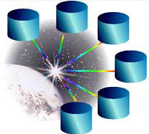



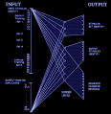
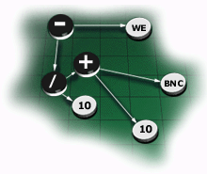







UBIWARE Project
2007-2010
“Smart Semantic Middleware for Ubiquitous Computing”
Deliverable 3.4 and Final Report
Resource Agent
“Expert”
“Device”
Resource Agent
Resource Agent
“Service”
Industrial Ontologies Group
University of Jyväskylä

Slide 2


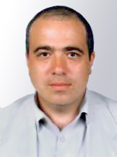
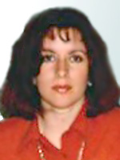

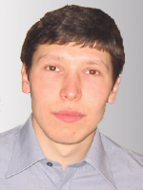
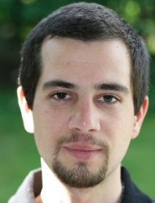
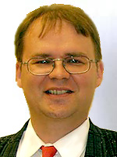





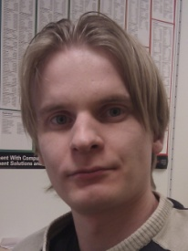




Industrial Ontologies Group
IOG Team Kernel
University of Jyväskylä
Researchers
  Vagan Terziyan (Head)
  Olena Kaykova
  Oleksiy Khriyenko
  Sergiy Nikitin
  Michal Nagy
Contact Person:
Timo Tiihonen
  e-mails:
    timo.tiihonen@jyu.fi
    vagan.terziyan@jyu.fi
  phone: +358 14 260 2741
  Michael Cochez
  Joonas Kesäniemi
  Viljo Pilli-Sihvola
  Jose Luis Garduno
URL: https://ai.it.jyu.fi/OntoGroup

Slide 3
What is UBIWARE (in short)
UBIWARE is a tool to support:
  design and installation of…,
  autonomic operation of… and
  interoperability among…
… complex, heterogeneous, open, dynamic and self-configurable distributed industrial systems;…
… and to provide following services for system components:
  adaptation;
  automation;
  centralized or P2P organization;
  coordination, collaboration, interoperability and negotiation;
  self-awareness, communication and observation;
  data and process integration;
  (semantic) discovery, sharing and reuse.

Slide 4





Current UBIWARE Agent Architecture
Behavior Engine
Beliefs storage
Data
Rules
RAB
RAB
RAB
RAB
Blackboard
RAB: Reusable Atomic Behaviors
c
Pool of Atomic Behaviours
S-APL Repository
S-APL
S-APL – Semantic Agent Programming Language (RDF-based)
S-APL – is a hybrid of semantics (metadata / ontologies/ rules) specification languages, semantic reasoners, and agent programming languages. It integrates the semantic description of domain resources with the semantic prescription of the agents' behaviors
Ontology
http://users.jyu.fi/~akataso/sapl.html

Slide 5



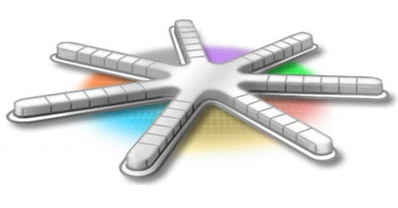



Why do you need UBIWARE ?
University of Jyväskylä
Industrial Ontologies Group

Slide 6




What the companies usually want to get from us?
They want to see technology applied to their problems, allegorically they want a ready-to-use product, let us say, coffee,
but…

Slide 7

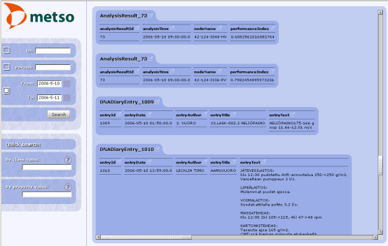

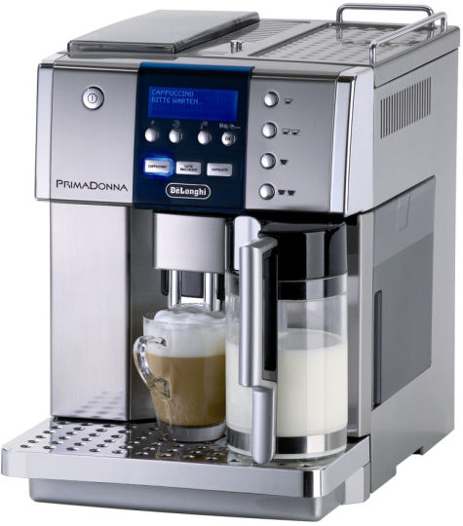
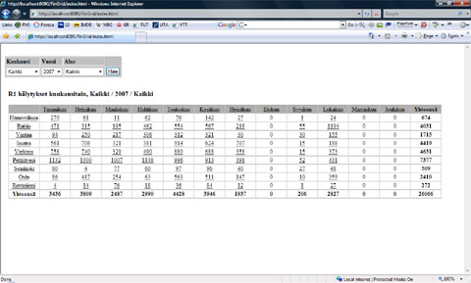




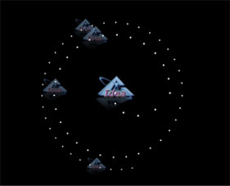
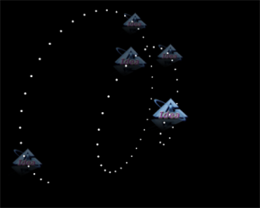
UBIWARE allegoric view
S-APL script
UBIWARE
IOG
But we are providing much more than just a coffee, we are providing a coffee maker !

Slide 8

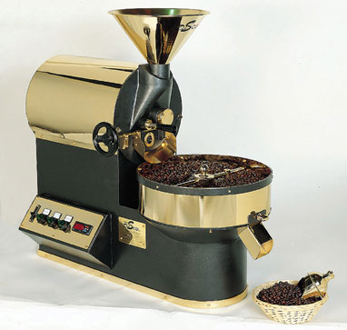


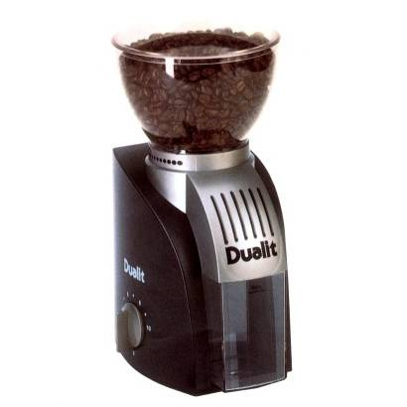

UBIWARE allegoric view (2)
Coffee
Roaster
Unroasted beans
1.
2.
Roasted beans
S-APL script
UBIWARE
IOG
Roasted beans
3.
Coffee
Grinder
4.
Ground coffee
UBIWARE is also about orchestrating external resources to achieve a goal!

Slide 9



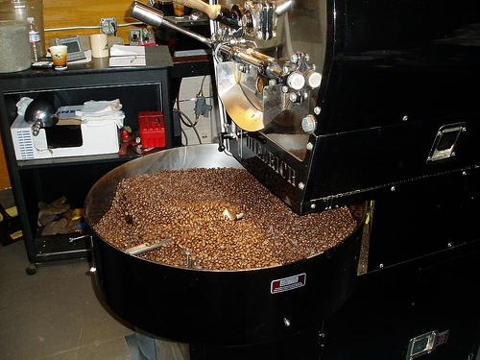
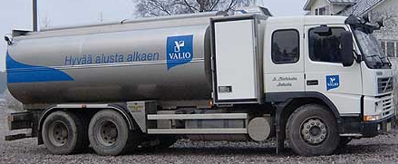
Outsourced external resources can be both: information and service providers
S-APL script
UBIWARE
IOG

Slide 10



You may say however: “I still want my coffee, not a coffee maker !”
Coffee-Making-as-a-Service
Order
and instructions
S-APL script
UBIWARE
IOG
UBIWARE-Driven Cloud:
PRIME / GERI
Coffee
You may still get your coffee made by our coffee maker, hosted “within the cloud”, and even have possibility to take part in making your coffee every time you need it and every way you like it!

Slide 11
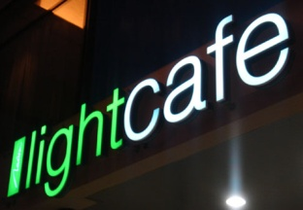









You may serve the coffee made by our “Cloud-Coffee-Maker” to others
Coffee-Making-as-a-Service
for service providers
Order
and instructions
S-APL script
UBIWARE
IOG
UBIWARE-Driven Cloud:
PRIME / GERI
Coffee

Slide 12
Message to the UBIWARE partners
Do not loose the opportunity, save your resources – select UBIWARE (“make coffee yourself (using your or our kitchen infrastructure) easily and cheaper whenever you need it and not buy it every time”);
Help us to develop the basis of UBIWARE first of all, then you will be able to manage you future (even more sophisticated) cases by yourself.

Slide 13
UBIWARE
Deliverable 3.4

Slide 14
Outline
Introduction
New agent classification
New agent platform architecture
New tools for developers

Slide 15
Introduction
The UBIWARE project:
  New generation middleware platform that allows creation of self-managed complex industrial systems consisting of different components:
Component nature:
  Smart machines and devices
  Sensors and actuators
  RFIDs
  Web-services, software
  components and applications
  Humans
Component properties:
  Distributed
  Heterogeneous
  Shared
  Reusable
Technologies:
  Software Agents
    management of complex systems
  Semantic Web
    interoperability, including dynamic discovery
    data integration
    inter-agent behavioral coordination

Slide 16

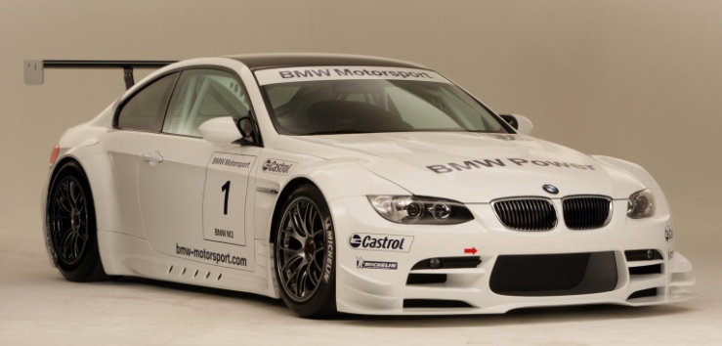
Introduction
Ubiware 3.0
Ubiware 3.1
One agent type
Skeleton of new infrastructure
No persistency
Simple desktop environment
Not yet cloud-ready
New agent classification
Fully implemented new infrastructure
New persistency subsystem
Advanced desktop
environment
Cloud-ready

Slide 17
Introduction
select apps.
use apps.
Application user
manage users
manage applications
create UBIWARE applications
Application developer
Platform administrator

Slide 18
New agent classification
Ubiware 3.0
Ubiware 3.1
Just one agent type
The developer builds the whole infrastructure himself/herself
No policies
There is a predefined hierarchy of agents
Some types have more rights than others
Easier policy management

Slide 19
Platform infrastructure agent
Functions
  provide generic platform-related services to other agents
  exactly 7 agents of this type
  available all the time (from platform startup till platform shutdown)

Slide 20
Application infrastructure agent
Functions
  works for a particular application running on top of Ubiware
  works for every user of the application
  one application can have several AIAs
  available from application deployment till undeployment
Example
  an application related to flower delivery might have one agent who is responsible for delivery scheduling for every user

Slide 21
Personal user agent (PUA)
Functions
  representative of the user in the platform
  every user of the platform has exactly one personal user agent
  can have several “helper agents” who are called personal user workers (shortly “workers”)

Slide 22
Personal worker agent
Functions
  PUA's “helpers”
  creates a connection between the user and an application that the user wishes to utilize
  number of PUAs:

Slide 23
Personal worker agent
User A
User B

Slide 24
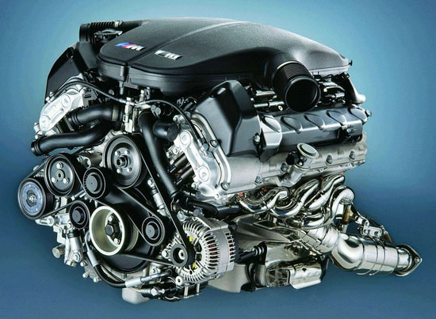
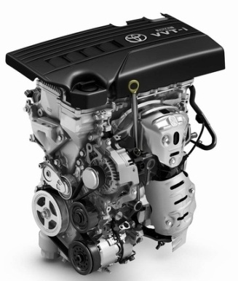
3. Platform infrastructure architecture
Ubiware 3.0
Ubiware 3.1
The developer has to create all agents himself/herself
No platform infrastructure agents, just generic agents
Difficult policy management
Agents with platform functions provided in the distribution
7 platform infrastructure agents
Easy policy management

Slide 25
Architecture overview

Slide 26
Ubiware directory facilitator

Slide 27
Ubiware directory facilitator
Ubiware 3.0
Ubiware 3.1
Simple Yellow Pages
Every agent provides a service
Service is just a string
String is not semantic
(it has no “meaning”)
More sophisticated service registry
Every agent can register handlers
Services are defined by handlers
Both services and handlers are resources (they can be annotated)

Slide 28
Policy agent

Slide 29
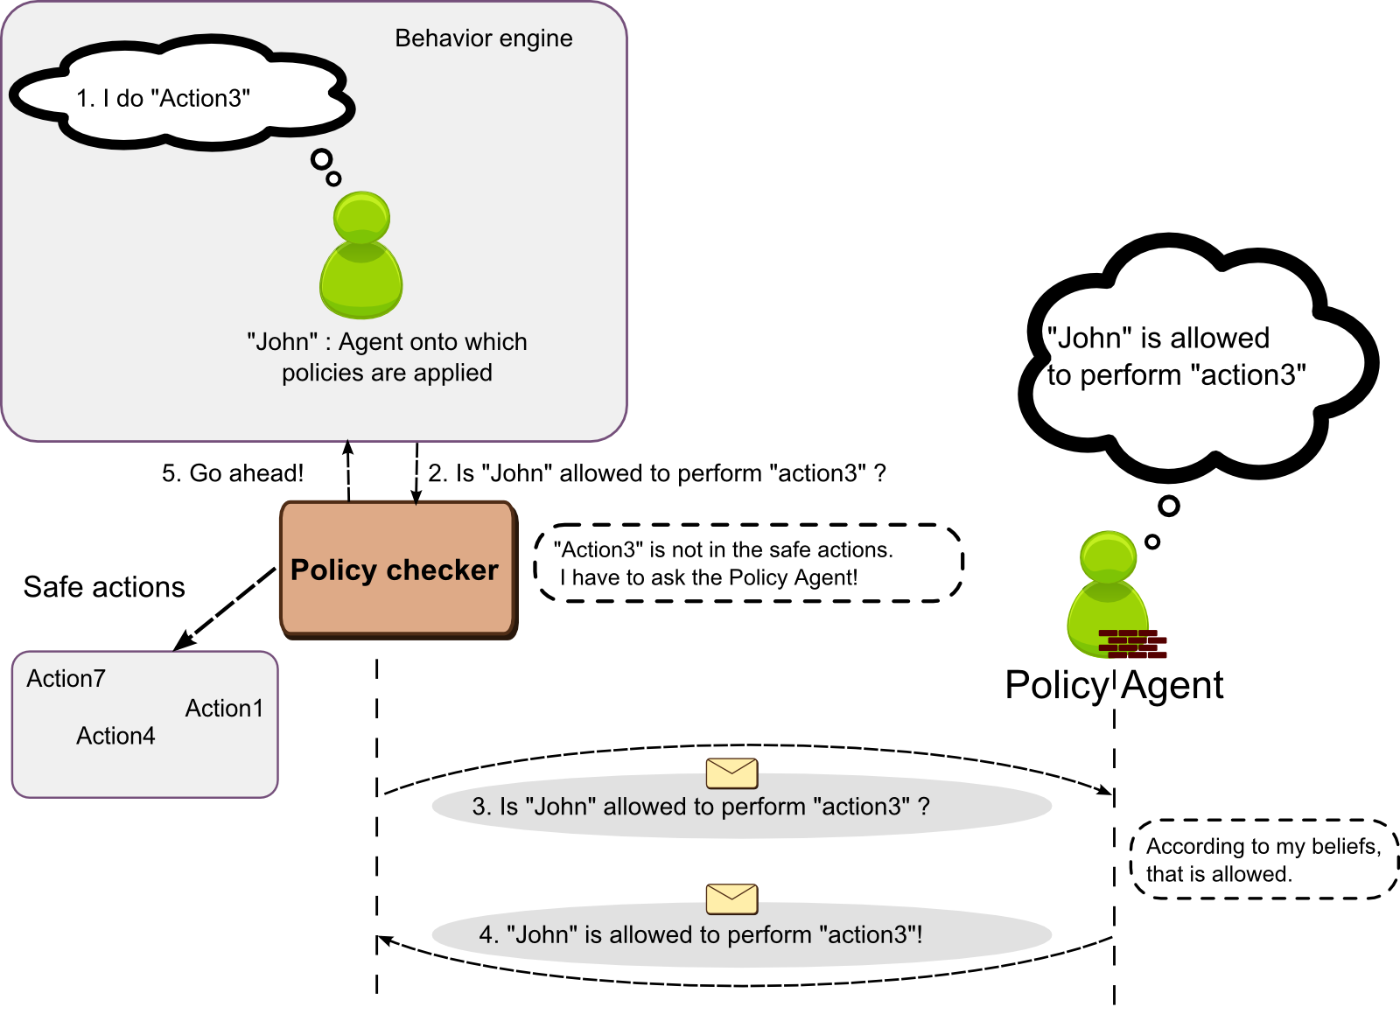
Policy agent

Slide 30
Ontology agent

Slide 31
Ontology agent

Slide 32
Web interface agent

Slide 33
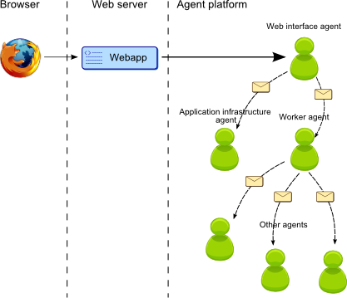
Web interface agent

Slide 34
Application manager agent

Slide 35
Application manager agent
I want App1
Select App1
Worker A-AMA
User A
Start worker
I can use App1
Application manager agent
Worker A-A1
I can use App2
Worker A-A2
Tasks:
  Register applications
  Starts workers

Slide 36
User manager agent

Slide 37
User manager agent

Slide 38
Package manager agent

Slide 39
Package manager agent
policy
policy
service
policy
policy
policy
policy
policy
role

Slide 40
Package manager agent
Register policies
Register
Deploy WAR
Start AIA
Role upload
Register handlers and services

Slide 41
4. New tools for developers
Persistency subsystem
SAPL builder
@prefix per: <http://www.ubiware.jyu.fi/persistency#> .
:myPersistenContainer rdf:type per:PersistentContainer
; per:hasID "myContainer123"
; per:hasState per:clean
; per:hasContent {
:p1 rdf:type fam:Person
; fam:hasFirstName "John"
; fam:hasFirstSurname "Doe"
; fam:hasAge "25" .
:p2 rdf:type fam:Person
; fam:hasFirstName "Peter"
; fam:hasFirstSurname "Smith"
; fam:hasAge "33" .
:p3 rdf:type fam:Person
; fam:hasFirstName "Mary"
; fam:hasFirstSurname "Hemingway"
; fam:hasAge "32" .
}
IDGenerator idGen = new IDGenerator("pmaUBIPackage");
SaplDocument sd = new SaplDocument();
sd.addStatement(actionID, rdf.type, pma.UBIDeploymentAction);
sd.addStatement(actionID, pma.pathToUBIFile, new
Literal("someString"));
sd.addStatement(actionID, pma.deploymentStatus, pma.UBIIdentified);
String saplString = sd.generateSapl();

Slide 42
Persistency subsystem
Before:
  In the beginning the agent loads a script
  After several iterations the beliefs will naturally change as the agent is performing its task
  After agent’s termination beliefs are lost
Now:
  You can declare all the beliefs or a subset of beliefs as persistent
  If agent dies unexpectedly, they are still available and will be loaded upon the next startup

Slide 43
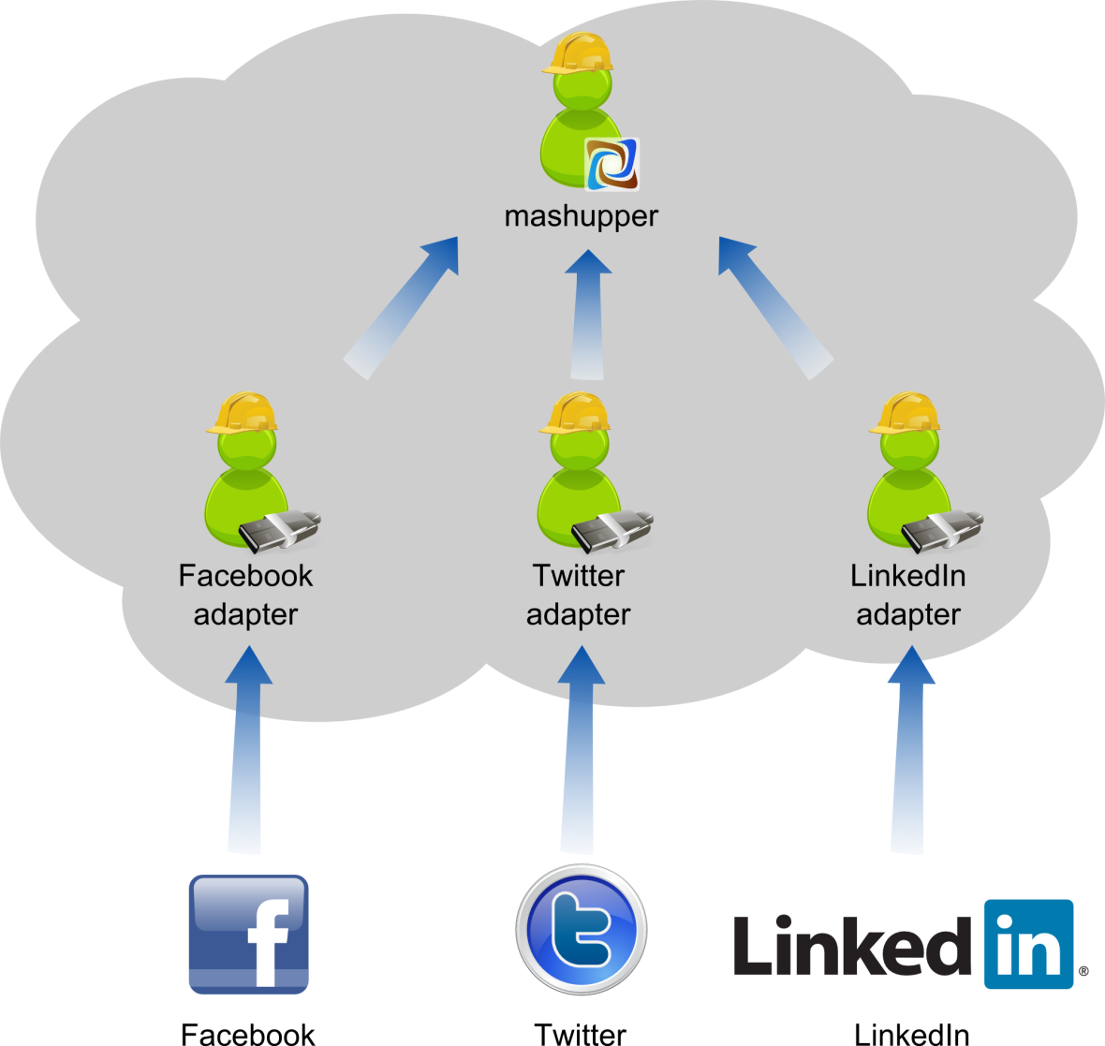
Mashupper demo

Slide 44

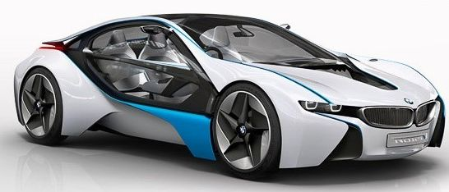
The future: Ubiware 4.0
Ubiware 3.0
Ubiware 3.1
Ubiware 4.0
One agent type
Skeleton of new infrastructure
No persistency
Simple desktop environment
Not yet cloud-ready
New agent classification
Fully implemented new infrastructure
New persistency subsystem
Advanced desktop
environment
Cloud-ready
Work continues in 2011
Automated payment system
Voice and SMS interface
Orchestration engine
Orchestration editor

Slide 45
UBIWARE
Final Project Report

Slide 46
S-APL and SOA
The Service Oriented Architecture (SOA) is an approach to integrating available enterprise applications in a flexible and loosely coupled manner to enable more sophisticated, complex and distributed applications. SOA is built on the notion of services (external capabilities, which are realizations of self-contained business functions).
SOA is based on choreography and orchestration of services.
Choreography is concerned with describing the external visible behavior of services, as a set of message exchanges, from the functionality consumer point of view.
Orchestration deals with describing how a number of services, two or more, cooperate and communicate with the aim of achieving a common goal.
S-APL is a language capable to describe both choreography and orchestration (through ontonuts) of external capabilities (data or functional services) and internal atomic capabilities (Reusable Atomic Behaviors) needed for designing and executing a complex business process.

Slide 47
S-APL and Semantics
What has been achieved in UBIWARE project is that our approach and S-APL enable not just traditional choreography and orchestration but much more powerful ones: configurable and semantic choreography and orchestration. This makes qualitative difference between S-APL and e.g. BPEL (Business Process Execution Language – very popular industrial standard).
With S-APL one may describe logic of a configurable process (structure and components of the process are not explicitly prescribed but described in terms of intended properties and can be changed even during the process execution).
In the same time with S-APL one may describe logic of semantic integration of data taken from external sources and reasoning logic on top of the data.
Due to ontonuts technology and based on the Open World Assumption (alternatively to BPEL with the Closed World Assumption), S-APL engine is able to discover and automatically utilize (in a runtime) new services (capabilities) that have just appeared in semantic service registry.

Slide 48



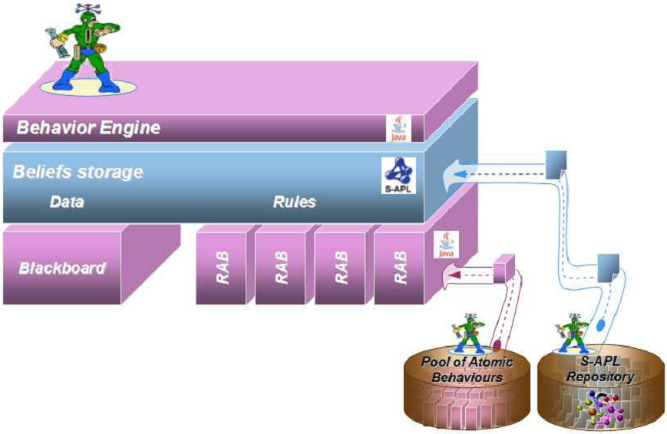

Key Components of UBIWARE Scientific Impact
S-APL Engine
Business Process Choreography
3. Language
2. Engine
4. Ontonuts
External Capabilities Orchestration
Ontonuts
1. UBIWARE: Approach and Architecture

Slide 49
Project Results
Theoretical achievements:
  new paradigm in software engineering and approach towards creation of semantically enhanced agent-based integration middleware that makes heterogeneous resources proactive, goal-driven and able to interoperate with each other in collaborative environment;
  Semantic Agent Programming Language (S-APL) is integrating features of several kinds of tools: agent programming languages, semantic reasoners, querying languages and agent communication content languages;
  Ontonut technology to tackle the problem of distributed querying in UBIWARE-based multi-agent systems;
  SURPAS (Smart Ubiquitous Resource Privacy and Security) and organizational policies;
  4I (FOR EYE) technology - a next step towards new generation of context-aware service-oriented collaborative user interfaces.

Slide 50
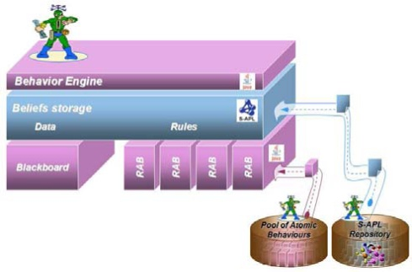
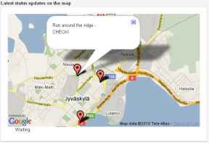
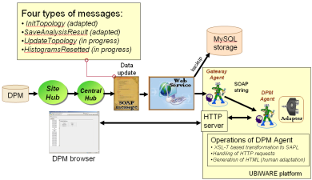
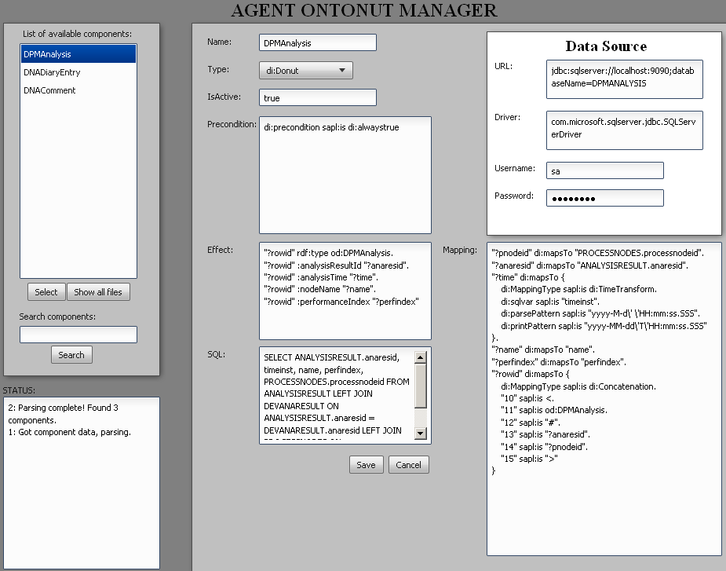
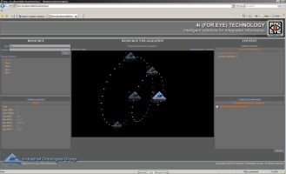
Project Results
UBIWARE Platform:
  The UBIWARE Platform is a development framework for creating multi-agent systems;
  UBIWARE engine;
  Ontonuts engine;
  Application-independent user oriented runtime environment;
  Platform architecture follows cloud computing paradigm.
Case Studies:
  Industrial prototypes (for Fingrid, Metso Automation, Inno-W and ABB Companies);
  IOG case: Mashupper – Agent-enabled Social Web;
4I (FOR EYE) Browser

Slide 51
Utilization of Project Results
Used in industry and other projects:
  Fingrid Company;
  SCOPE project;
  Cloud Software project (TIVIT Program).
Courses:
  Design of Agent-based Systems;
  Semantic Web and Ontology Engineering;
  Service-oriented Architectures and Cloud Computing for Developers.

Slide 52
Dissemination of the Results
Internationalization:
Project has an international impact in a sense that project had a very international team. Researchers from 9 countries have been involved into research and development process during the project years.
IOG team has got an award as the most international team (Agora Center, University of Jyväskylä).
New academic degrees:
Environment of the project was very assistive for the students that took part in the project research and development. As a result of it, project gave as outcome 3 Ph.D. and 2 M.Sc. academic degrees.
Specialists for industry:
One more outcome of the project is five specialists that have been taught and have got correspondent skills from the UBIWARE project and now are working for industry in different local and international companies.
52 of 56

Slide 53
Project Related Publications
UBIWARE
B
International Book Chapters
6
J
International Journal Papers
2
C
International Conference Papers
23
T
5
PhD and MSc Theses

Slide 54
UBIWARE publications up to 31.12.2010 (1)
Terziyan V., Katasonov A., Cardoso J., Hauswirth M., Majumdar A., PRIME: Proactive Inter-Middleware for Global Enterprise Resource Integration, In: E. Õunapuu (ed.), Agile and Self-Organizing Enterprise Information Systems: Developing a Cloud Platform, IGI Global, 2011, 22 pp. (book chapter submitted).
Terziyan V., Kaykova O., Zhovtobryukh D., UbiRoad: Semantic Middleware for Cooperative Traffic Systems and Services, In: International Journal on Advances in Intelligent Systems, Vol. 3, No 34, 2010, 14 pp. (to appear).
Kesäniemi J., Resources-Oriented Infrastructure for MAS Environment, Multi-Agent Systems, IN-TECH Publishing, Vienna, Austria, ISBN 978-953-7619-X-X (to be submitted).
Nikitin S., Dynamic Aspects of Industrial Middleware Architectures, In: Jyvaskyla Studies in Computing, PhD Thesis, Jyvaskyla University Printing House, January 2011.
Pilli-Sihvola V., Intelligence as a Service, MSc Thesis, Department of Mathematical Information Technology, University of Jyväskylä, December 2010.
Nagy M., Katasonov A., Khriyenko O. Nikitin S., Szydlowski M., Terziyan V., Challenges of Middleware for the Internet of Things, In: A. Rodić (ed.), Automation and Control – Theory and Practice, IN-TECH Publishing, Vienna, Austria, December 2009, ISBN 978-953-307-039-1, pp. 247-270 (Chapter XIV).
Katasonov A., Terziyan V., Using Semantic Technology to Enable Behavioural Coordination of Heterogeneous Systems, In: Gang Wu (ed.), Semantic Web, IN-TECH Publishing, Vienna, Austria, January 2010, ISBN 978-953-7619-54-1, pp. 135-156 (Chapter VIII).
B
J
B
T
T
B
B

Slide 55
UBIWARE publications up to 31.12.2010 (2)
C
Terziyan V., Kaykova O., Zhovtobryukh D., UbiRoad: Semantic Middleware for Context-Aware Smart Road Environments, In: G.O. Bellot, H. Sasaki, M. Ehmann and C. Dini (Eds.), Proceedings of the Fifth International Conference on Internet and Web Applications and Services (ICIW-2010), May 9-15, 2010, Barcelona, Spain, IEEE CS Press, pp. 295-302. (best paper award!).
Khriyenko O., Nikitin S., Terziyan V., Context-Policy-Configuration: Paradigm of Intelligent Autonomous System Creation, In: J. Filipe and J. Cordeiro (Eds.), Proceedings of the 12th International Conference on Enterprise Information Systems (ICEIS-2010), Vol. 2, Funchal, Madeira, Portugal, 8-12 June, 2010, pp. 198-205.
Nikitin S., Terziyan V., Nagy M., Mastering Intelligent Clouds: Engineering Intelligent Data Processing Services in the Cloud, In: J. Gilipe, J. Andrade, and J.-L. Ferrier (Eds.), Proceedings of the 7th International Conference on Informatics in Control, Automation and Robotics (ICINCO-2010), Vol.1, Funchal, Madeira, Portugal, 15-18 June, 2010, pp. 174-181.
Nikitin S., Terziyan V., Lappalainen M., SOFIA: Agent Scenario for Forest Industry, In: J. Filipe and J. Cordeiro (Eds.), Proceedings of the 12th International Conference on Enterprise Information Systems (ICEIS-2010), Vol. 1, Funchal, Madeira, Portugal, 8-12 June, 2010, pp. 15-22.
Khriyenko O., Terziyan V., Similarity/Closeness-Based Resource Browser, In: J.J. Zhang (Ed.), Proceedings of the Ninth IASTED International Conference on Visualization, Imaging and Image Processing (VIIP-2009), July 13-15, 2009, Cambridge, UK, ACTA Press, ISBN: 978-0-88986-800-7, pp. 184-191.
C
C
C
C

Slide 56
UBIWARE publications up to 31.12.2010 (3)
C
Kesäniemi J., Katasonov A., Terziyan V., An Observation Framework for Multi-Agent Systems, In: Proceedings of the Fifth International Conference on Autonomic and Autonomous Systems (ICAS 2009), April 21-25, 2009, Valencia, Spain, IEEE CS Press, pp. 336-341.
Katasonov A., Terziyan V., Semantic Approach to Dynamic Coordination in Autonomous Systems, In: Proceedings of the Fifth International Conference on Autonomic and Autonomous Systems (ICAS 2009), April 21-25, 2009, Valencia, Spain, IEEE CS Press, pp. 321-329. (best paper award!) .
Terziyan V., Zhovtobryukh D., Katasonov A., Proactive Future Internet: Smart Semantic Middleware for Overlay Architecture, In: Proceedings of the Fifth International Conference on Networking and Services (ICNS-2009), April 21-25, 2009, Valencia, Spain, IEEE CS Press pp. 149-154.
Nikitin S., Katasonov A., Terziyan V., Ontonuts: Reusable Semantic Components for Multi-Agent Systems, In: Proceedings of the Fifth International Conference on Autonomic and Autonomous Systems (ICAS 2009), April 21-25, 2009, Valencia, Spain, IEEE CS Press, pp. 200-207.
Khriyenko O., Adaptive Semantic Web based Environment for Web Resources, In: Jyvaskyla Studies in Computing, PhD Thesis, Volume 97, Jyvaskyla University Printing House, 192 pp., December 13, 2008.
Bleier A., A Framework for Market-Based Coordination in Multi-Agent Systems, MSc Thesis, University of Osnabrück, September 30, 2008.
C
C
C
T
T

Slide 57
UBIWARE publications up to 31.12.2010 (4)
Terziyan V., Semantic Web Services for Smart Devices Based on Mobile Agents, In: D. Taniar (Ed.), Mobile Computing: Concepts, Methodologies, Tools, and Applications (6 volumes), IGI Global, November 2008, ISBN: 978-1-60566-054-7, Vol. II, Chapter 2.22, pp. 630-641.
Terziyan V. and Katasonov A. (2008) Global Understanding Environment: Applying Semantic and Agent Technologies to Industrial Automation, In: Lytras, M. and Ordonez De Pablos, P. (eds) Emerging Topics and Technologies in Information Systems, IGI Global , 2009, ISBN: 978-1-60566-222-0, pp. 55-87 (Chapter III).
Katasonov A. and Terziyan V. (2008) Semantic Agent Programming Language (S-APL): A Middleware Platform for the Semantic Web, In: Proc. 2nd IEEE Conference on Semantic Computing, August 4-7, 2008, Santa Clara, CA, USA, pp.504-511.
Khriyenko O., Context-sensitive Visual Resource Browser, In: Proceedings of the IADIS International Conference on Computer Graphics and Visualization (CGV-2008), Amsterdam, The Netherlands, 24-26 July 2008.
Katasonov A., Kaykova O., Khriyenko O., Nikitin S., Terziyan V., Smart Semantic Middleware for the Internet of Things, In: Proceedings of the 5-th International Conference on Informatics in Control, Automation and Robotics, 11-15 May, 2008, Funchal, Madeira, Portugal, ISBN: 978-989-8111-30-2, Volume ICSO, pp. 169-178.
Terziyan V., SmartResource - Proactive Self-Maintained Resources in Semantic Web: Lessons learned, In: International Journal of Smart Home, Special Issue on Future Generation Smart Space, Vol.2, No. 2, April 2008, SERSC Publisher, ISSN: 1975-4094, pp. 33-57.
B
B
C
C
C
J

Slide 58
UBIWARE publications up to 31.12.2010 (5)
C
Katasonov A. and Terziyan V. (2007) SmartResource Platform and Semantic Agent Programming Language (S-APL), In: Proceedings of the 5th Conference on Multi-Agent Technologies (MATES’07), September 24-26, 2007, Leipzig, Germany, LNAI 4687, pp.25-36.
Terziyan V., Predictive and Contextual Feature Separation for Bayesian Metanetworks, In: B. Apolloni et al. (Eds.), Proceedings of KES-2007 / WIRN-2007, Vietri sul Mare, Italy, September 12-14, Vol. III, Springer, LNAI 4694, 2007, pp. 634–644.
Khriyenko O., Context-sensitive Multidimensional Resource Visualization, In: Proceedings of the 7th IASTED International Conference on Visualization, Imaging, and Image Processing (VIIP 2007), Palma de Mallorca, Spain, 29-31 August 2007.
Khriyenko O., 4I (FOR EYE) Multimedia: Intelligent semantically enhanced and context-aware multimedia browsing, In: Proceedings of the International Conference on Signal Processing and Multimedia Applications (SIGMAP-2007), Barcelona, Spain, 28-31 July 2007.
Khriyenko O., 4I (FOR EYE) Technology: Intelligent Interface for Integrated Information, In: Proceedings of the 9th International Conference on Enterprise Information Systems (ICEIS-2007), Funchal, Madeira – Portugal, 12-16 June 2007.
Salmenjoki K., Tsaruk Y., Terziyan V., Viitala M., Agent-Based Approach for Electricity Distribution Systems, In: Proceedings of the 9-th International Conference on Enterprise Information Systems, 12-16, June 2007, Funchal, Madeira, Portugal, ISBN: 978-972-8865-89-4, pp. 382-389.
C
C
C
C
C

Slide 59
UBIWARE publications up to 31.12.2010 (6)
Nikitin S., Terziyan V., Pyotsia J., Data Integration Solution for Paper Industry - A Semantic Storing, Browsing and Annotation Mechanism for Online Fault Data, In: Proceedings of the 4th International Conference on Informatics in Control, Automation and Robotics (ICINCO), May 9-12, 2007, Angers, France, INSTICC Press, ISBN: 978-972-8865-87-0, pp. 191-194.
Naumenko, A., Srirama, S., Secure Communication and Access Control for Mobile Web Service Provisioning, In: Proceedings of International Conference on Security of Information and Networks (SIN2007), 8-10th May, 2007.
Naumenko A., Semantics-Based Access Control in Business Networks, In: Jyvaskyla Studies in Computing, PhD Thesis, Volume 78, Jyvaskyla University Printing House, 215 pp., June 28, 2007.
Naumenko A., Katasonov A., Terziyan V., A Security Framework for Smart Ubiquitous Industrial Resources, In: R. Gonzalves, J.P. Muller, K. Mertins and M. Zelm (Eds.), In: Enterprise Interoperability II: New challenges and Approaches, Proceedings of the 3rd International Conference on Interoperability for Enterprise Software and Applications (IESA-07), March 28-30, 2007, Madeira Island, Portugal, Springer, pp. 183-194.
Naumenko A., SEMANTICS-BASED ACCESS CONTROL - Ontologies and Feasibility Study of Policy Enforcement Function, In: Proceedings of the 3rd International Conference on Web Information Systems and Technologies (WEBIST-07), Barcelona, Spain - March 3-6, 2007, Volume Internet Technologies, INSTICC Press, pp. 150-155.
Khriyenko O., Coordination of the Distributed Proactive Smart Resource, In: Proceedings of the IASTED International Conference on Parallel and Distributed Computing and Networks (PDCN 2007) as part of the 25th IASTED International Multi-Conference on APPLIED INFORMATICS, Innsbruck, Austria, 13-15 February, 2007, 7 pp.
C
C
T
C
C
C

Slide 60
Project Budget
Total
Expenses*
Planed
Budget
2007
2008
2009
2010
Salary & Overheads:
160 258
390 992
248 662
218 291
1 018 203
1 135 532
Travels:
9 163
10 292
7 958
9 033
36 446
37 833
Equipment &
Consumables:
5 611
5 635
4 162
1 345
104
0
TOTAL (Euro):
173 583
402 629
256 724
227 324
1 060 260
1 179 000
Funding from companies & TEKES:
20 000
20 000
20 000
60 000
60 000
10 000
20 000
20 000
10 000
60 000
60 000
Inno-W:
500
1 000
12 000
2 500
16 000
16 000
Hansa Ecuras:
own work
own work
own work
own work
own work
own work
10 000
10 000
20 000
20 000
20 000
20 000
20 000
3 000
3 000
3 000
TEKES:
138 693
321 700
217 702
0**
678 095**
1 000 000
TOTAL (Euro):
182 193
372 700
289 702
12 500**
857 095**
1 179 000
* expenses for the period: 01.05.2007 - 31.10.2010
* * the final payment from Tekes will be received after the final report

Slide 61
Perspectives for Results Utilization
Future plans of use:
  SCOPE project continuation;
  Cloud Software project (also in cooperation with TECHILA Company);
  PRIME-II EU project (FP7/ICT: in cooperation with IBM-Ireland, TELECOM SudParis, National Univ. of Ireland, VTT, University of Coimbra, Inno-W, Sapienza SL, T.I.M.E. SRL and Menta Networks);
  cCloud: Collaborative clouds (Academy of Finland, in cooperation with University of Helsinki and Tampere University of Technology);
  i-Cloud, EU project (in cooperation with partners from Switzerland, Germany and Finland);
  SOFIA project proposal (TEKES);
  Projects within SERTE and D2I TIVIT Programs.

Slide 62
Next step
UBIWARE 4.0:
  Payment system;
  Scenario editor;
  User-as-developer interface;
  Open for updates,
  xxx;
Commercialization:
  Future support of the Fingrid case
  xxx;
New project needed:
  New TIVIT Programs (SERTE and D2I)
  xxx;

Slide 63
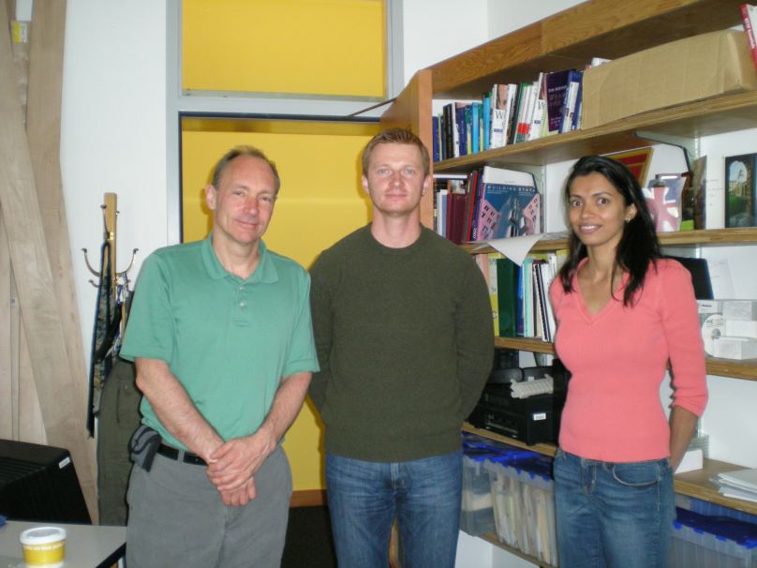
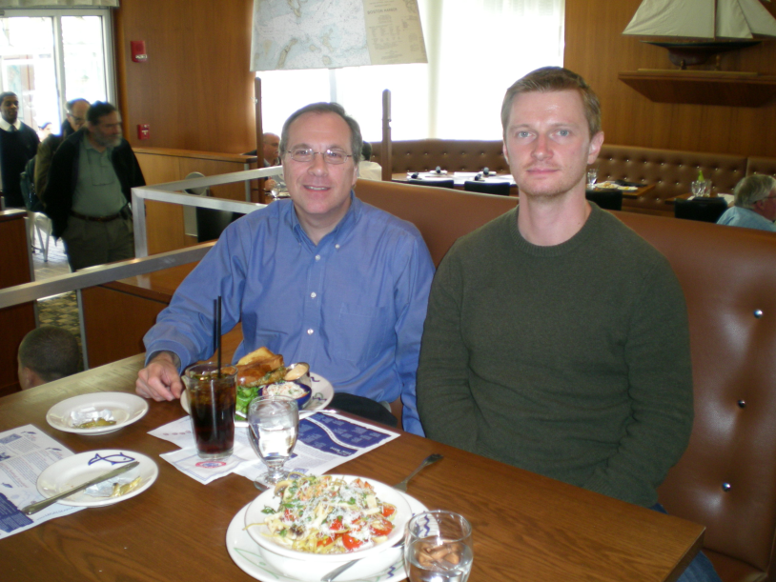
Events during the project years
2007-2008
  Anton Naumenko has been awarded the degree of DOCTOR OF PHILOSOPHY;
  Artem Katasonov has been visiting USA with a purpose to disseminate results of the project and continue cooperation with research groups from MIT. Artem had meetings with Tim Berners-Lee and Lalana Kagal (CS and AI laboratory) and with Edmund Shuster (Data Center - a part of Laboratory for Manufacturing and Productivity);
TOTAL (Euro):

Slide 64

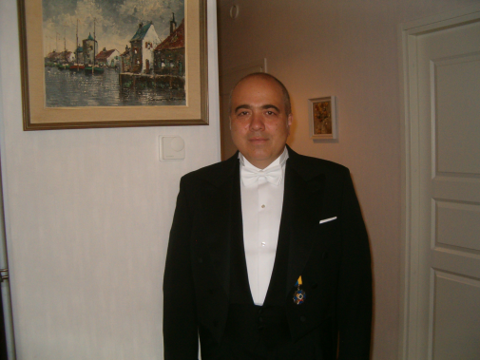
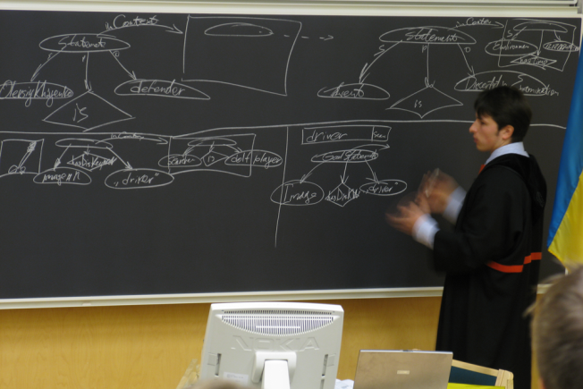
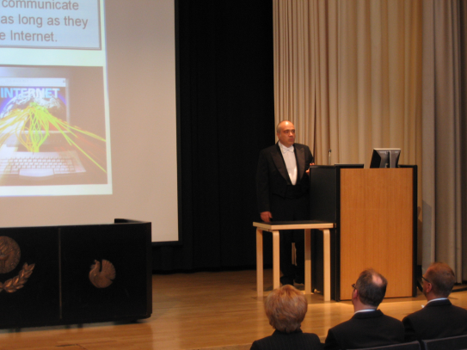
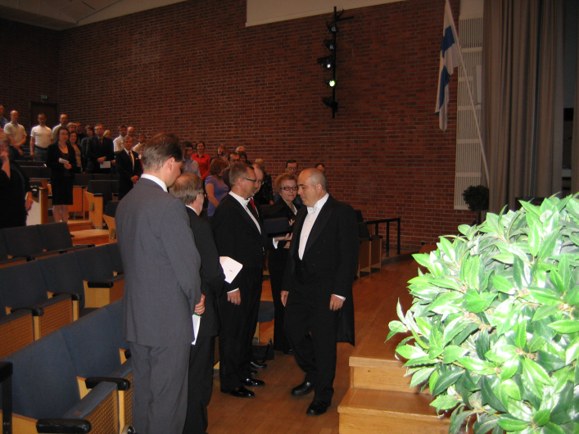

Events during the project years
2009
  The team leader of the IOG, Vagan Terziyan has been awarded the FULL PROFESSOR POSITION in University of Jyväskylä. Also he has celebrated their 50th anniversary;
  Oleksiy Khriyenko has been awarded the degree of DOCTOR OF PHILOSOPHY;

Slide 65
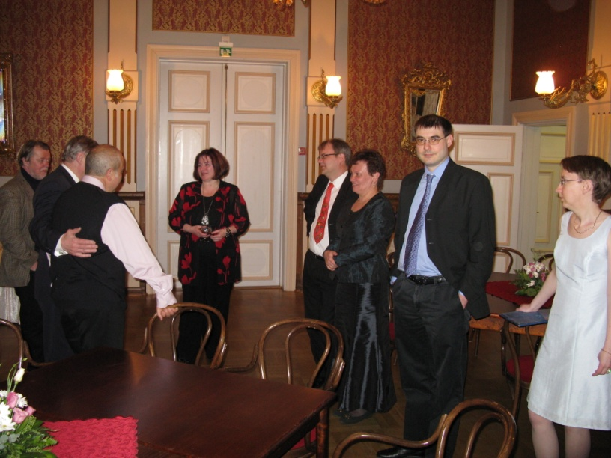
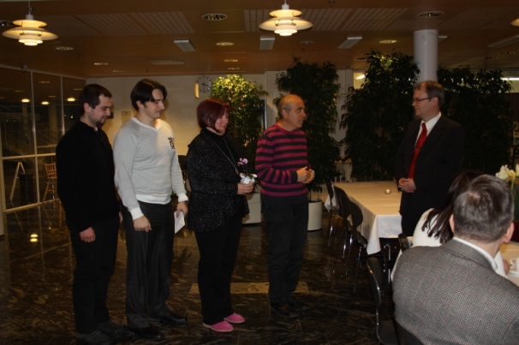
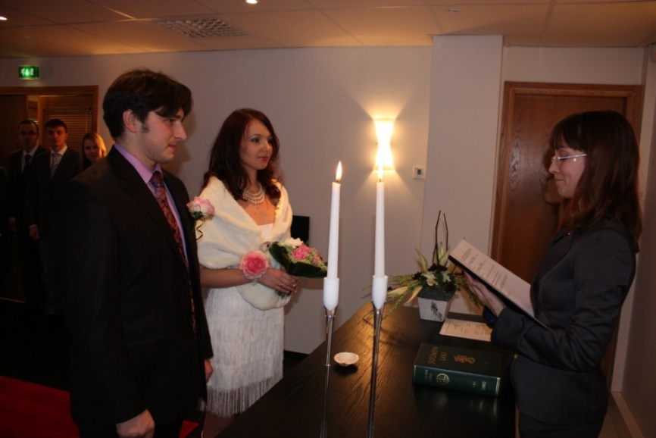
Events during the project years
2010
  Olena Kaykova and Timo Tiihonen have celebrated their 50th anniversaries;
  Khriyenko Oleksiy has got married;

Slide 66
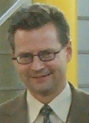
Obtain More Information about UBIWARE from:
Head of UBIWARE Industrial Consortium (Steering Committee Head) Dr. Jouni Pyötsiä, Metso Automation Oy.
Jouni.Pyotsia@metso.com , Tel.: 040-548-3544
UBIWARE Contact Person Prof. Timo Tiihonen, Vice-Rector, University of Jyväskylä
tiihonen@cc.jyu.fi , Tel.: 014-260-2741
UBIWARE Project Leader Prof. Vagan Terziyan, Agora Center, University of Jyväskylä
vagan@cc.jyu.fi , Tel.: 014-260-4618

